Slide 1
Embedded Artificial Intelligence (AI) into the Curriculum Structure of Higher Education Academic Programs
Kamal Bin Yusoh
Assistant Vice Chancellor (Academic Development) UMPSA

Slide 2
01
AI in Education
Embedded AI vs New Curriculum
02
Curriculum integration strategies
Highlight
03
04
Challenges in AI Integration
Future directions and
opportunities
05

Slide 3
“Ensuring quality higher education is one of the most important things we can do for future generations”
~ Ron Lewis~

Slide 4
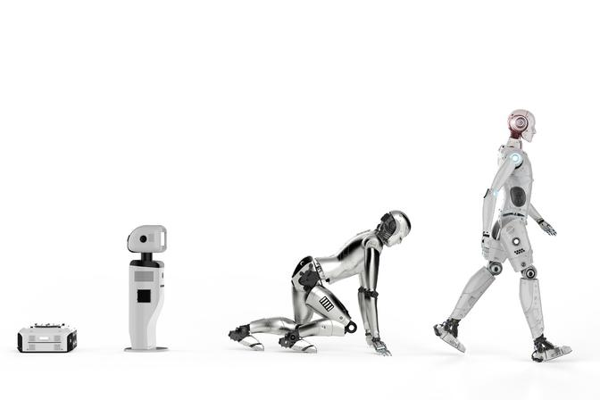
https://www.timeshighereducation.com/campus/four-steps-integrating-generative-ai-learning-and-teaching

Slide 5
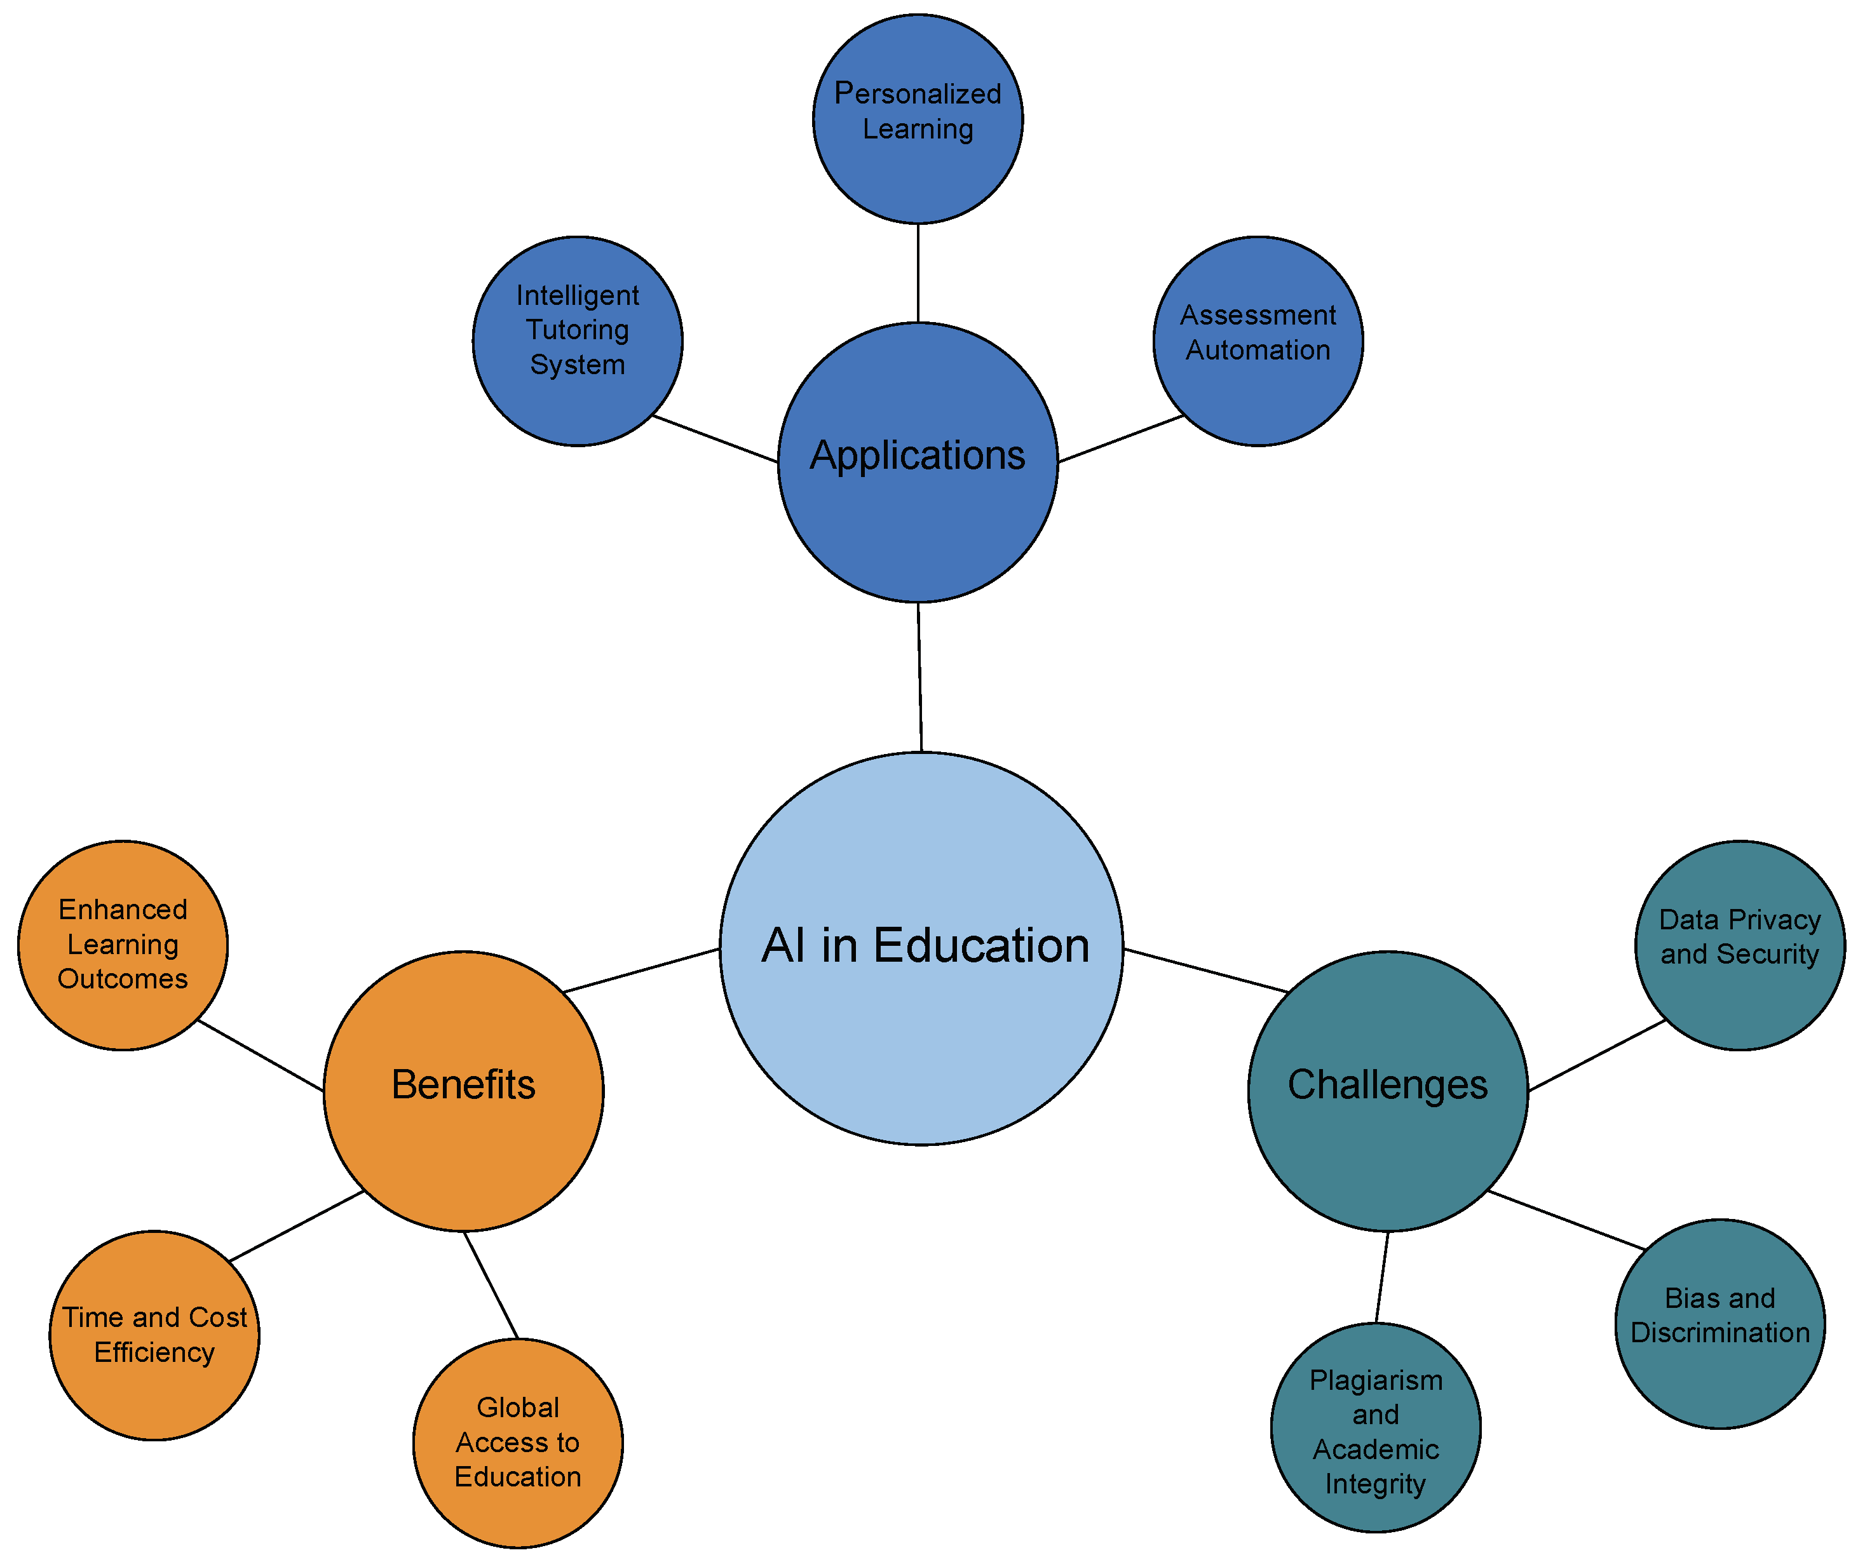
Sustainability 2023, 15(16), 12451; https://doi.org/10.3390/su151612451

Slide 6
AI in Teaching & Learning
Generative AI can assist in curriculum design by suggesting course structures, prerequisites, and sequencing based on educational goals and industry trends
AI-powered tools can generate course materials, lecture notes, interactive models and even textbooks. This can save educators time and resources while ensuring that course content is up-to-date and relevant.
AI-driven assessment tools for assessments and feedback can reduce faculty workload.
Adaptive learning platforms can adjust content based on individual progress, thereby personalizing learning experiences
AI can recommend supplementary learning resources, articles, and videos to enhance students' understanding of course topics

Slide 7
AI in Teaching & Learning
Chatbots and virtual advisors can provide 24/7 support for student enquiries, course registration and academic advising
AI-driven tools can reduce the manual workload of administrative tasks such as admissions, enrolment management and financial aid processingTingkah laku beretika

Slide 8
Embedded AI subject in existing curricula
Vs
Develop a new AI academic program

Slide 9
AI as a Subject in Existing Curriculum
Integrating AI into existing subjects (like computer science, data science, or ethics) allows students to see its application in various fields
Broader Context
Encourages connections between AI and other disciplines (e.g., AI in healthcare, business, or environmental science).
Interdisciplinary Learning
Resource Optimization
Utilizes existing faculty and resources rather than needing new programs or courses
Students can gradually build their understanding of AI concepts alongside core discipline principles, leading to a more cohesive educational experience
Integrated Exposure
Industry-Relevant Skills
Graduates equipped with AI knowledge in their engineering discipline are more attractive to employers seeking tech-savvy engineers

Slide 10
AI as a Subject in Existing Curriculum
Depth vs. Breadth: Might limit the depth of AI education if it’s just an add-on rather than a focus.
Variable Exposure: Students may not get a comprehensive understanding of AI if it’s taught in a fragmented way.
Dispersed Focus: AI content may be scattered across various courses, making it harder for students to grasp comprehensive AI principles and their interconnections
Content Saturation: Integrating AI could overload existing curricula, potentially diminishing focus on foundational discipline topics
Slow Adaptation: Existing curricula may not adapt quickly enough to keep pace with the fast-evolving AI landscape, leaving students with outdated knowledge

Slide 11
AI as a New Standalone Program
Focused
Curriculum
Allows for a dedicated, in-depth study of AI concepts, technologies, and applications.
Prepares students for specific careers in AI, data science,
and machine learning.
Specialized Skills
Attracts
Interest
A standalone program can draw students who are specifically interested in AI and related technologies
Students have a well-defined learning path, with courses sequenced to build on each other, facilitating better mastery of complex topics
Clear Progression
Stronger Connections
A dedicated AI curriculum can facilitate partnerships with industry leaders, providing students with internship opportunities and real-world projects
11

Slide 12
AI as a New Standalone Program
Resource Intensive: Requires investment in new faculty, infrastructure, and course materials.
Potential Isolation: May lead to a siloed understanding of AI, separating it from other relevant disciplines.
Niche Interest: A standalone program might attract fewer students compared to integrated offerings, potentially impacting program viability.
Narrow Focus: Students may become overly specialized in AI, which could hinder their adaptability in a job market that values diverse skill sets
Slow to Evolve: A standalone program may struggle to keep pace with the fast-changing AI landscape, leading to outdated content and skills

Slide 13
Curriculum Integration Strategies
AI modules in existing course
Embed AI topics into existing courses to ensure that students encounter AI concepts throughout their education
Cross-Disciplinary Approach
Integrating AI concepts into existing courses (i.e. data science, ethics, engineering).
Project-Based Learning
Hands-on projects that incorporate AI technologies.
Hackathons and Competitions
Organize and challenge students to develop AI solutions, fostering innovation and teamwork
Collaboration with Industry
Partnering with tech companies for real-world applications and internships.

Slide 14
Examples Courses and Modules
Core AI courses
Introduction of AI
Machine Learning Fundamentals
Ethics in AI
Integration in existing courses
AI in robotic engineering
Data Analysis with AI tools (for business).

Slide 15
Case Studies
Successful program
Institutions that have effectively integrated AI (e.g., MIT, UC Berkeley, Oxford)
MIT has integrated AI across various disciplines, offering courses such as "Machine Learning for Healthcare" and "AI and the Future of Work.“
UC Berkeley integrates AI into various courses, including computer science, economics, and public policy
Oxford has developed programs that integrate AI with scientific research and engineering applications

Slide 16
Challenges in AI Integration
Resource constraints
Need for faculty training and updated materials.
Curriculum Overload
Balancing AI with foundational subject matter.
Equity in Access
Ensuring all students have access to AI tools and resources
Overused
extensive use of AI could diminish critical thinking, creative problem-solving and other essential skills.

Slide 17
Future Directions & Opportunities
AI Literacy and Ethics
possess a foundational understanding of AI principles, techniques, and potential applications becomes increasingly crucial as part of academic curriculum
Emerging Trends
Continuous evolution of AI technologies and their implications for education.
Need for Flexibility
Adapting curriculum to stay relevant with rapid advancements in AI.
Personalized Learning Experiences
AI-driven tools will enable more personalized educational pathways, adapting to individual learning styles and paces
Augmented and virtual reality

Slide 18
Conclusion
Key Takeaways
Embedding AI into curricula is crucial for modern education.
Applications of AI in Education
It enhances skills, prepares students for diverse careers, and fosters innovation
Future directions of AI

Slide 19
Thank you

