Slide 1


Content Delivery Instructions for Third-Party Content Providers
第三方内容提供方数据传输指南
Last Revised: May, 2025
Content and Data Sourcing Team
上次修订：2025年5月
内容数据收录团队

Slide 2
Topics covered 目录
Content Delivery Overview 数据传输概览
Tips for smooth content transfer顺利传输数据的几点建议
Internet workflows (including our IP ranges, for whitelisting) 网页获取数据流程（含需要开白名单IP段）
sFTP upload workflow sFTP传输数据流程
Other options 其他传输数据选择
Content samples 数据样例
* You will be asked to choose your content delivery method via a Web Form.
签署授权书时，您需要通过网页选择数据传输方式。

Slide 3
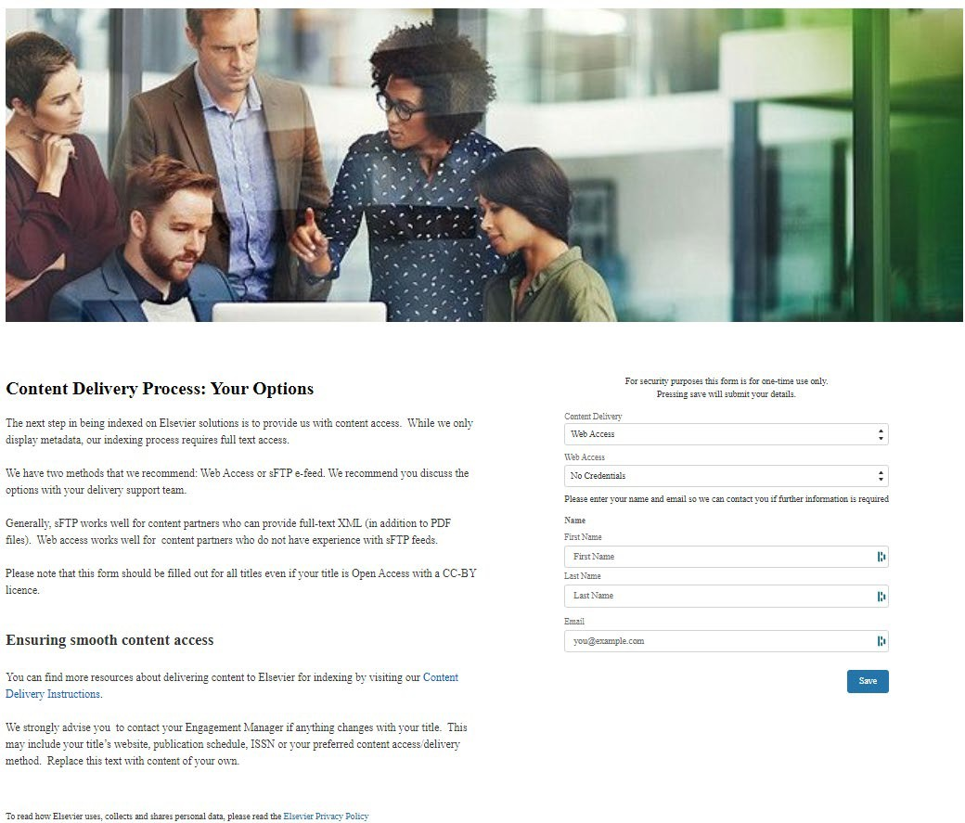
Content Delivery Overview 数据传输概览
Screen shot of the web form 网页截图
We have introduced a Content Delivery workflow for our Content Partners.
We will send you a unique web form where you can choose your content delivery method. This form can be shared with your technical team to fill out.
数据传输采用以下流程。
我们将向您发送专门的网页，请您选择适用的数据传输方式。您可将该网页转发给技术团队，选择具体方式。
This will be sent to you by your Publishing Relations Manager
出版关系经理将为您发送该网页

Slide 4
Tips for smooth content deliver 顺利传输数据几点建议
The biggest tip is to inform your Publishing Relations Manager about any changes
最重要的建议：期刊任何变化都要通知您的出版关系经理
This may include changes to:
包括下述变动：
The journal website or URL期刊网站或网址
The journal title 刊名
The publication schedule 出版计划
Content delivery methods 数据传输方式
Your contact details 联系人信息
The ISSN (If you are updating the ISSN number, please ensure you update ISSN Portal as well. We use this to verify ISSN changes. )
ISSN号（如果您的ISSN号变更，请及时在ISSN Portal网站上维护您的刊物信息。我们会据此确认ISSN变更）
If the title ceases production or is transferred to another publisher, please notify your Publishing Relations Manager.
如果期刊停刊或转至其他出版商，请通知您的出版关系经理。
Please ensure our web access does not expire.
请确保我们的网络访问不会过期。
If there is a change in format, for example a DTD version update, please notify your Publishing Relations Manager or write to cds-sc@elsevier.com.
如果您的期刊格式上有任何变动，例如DTD版本更新，请通知您的出版关系经理或致函 cds-sc@elsevier.com。
If you have questions, you can check our content provider FAQs or reach out to your Publishing Relations Manager directly.
如有疑问，请您查阅《内容提供方常见问题答疑》或直接向您的出版联关系经理咨询。

Slide 5
Internet Workflows
网络获取数据流程

Slide 6
Internet workflows 网络获取数据流程
Web Access content delivery options 通过网站访问传输内容
Credentials Required (User Name/Password) Access to your title: This is the most common method. 使用用户名/密码访问贵刊网站：目前最常用方式。 | Whitelisting our IP Ranges: This means that our crawlers are allowed to access your content. 将我们的IP地址列入白名单： 允许我们爬取贵刊网站获取数据。 | For Open Access Titles: If your website allows access to HTML & PDFs without restrictions, you may not have to do anything. OA期刊：如果贵刊期刊网站不限制HTML和PDF数据获取，不需要做任何事情。
Minimum requirements: Your table of contents (TOC) and PDFs of all your articles must be available on your website. The TOC can be in HTML only.
传输最低标准：所有文章的题录信息（TOC）和PDF都可以通过贵刊网站获取。
题录可以仅为HTML网页格式。

Slide 7
Credentials (User Name/Password) Delivery
账密数据传输流程
How to do it 如何设置：
Please choose “Web Access” as your Content Delivery choice. 请选择“网站访问” 作为数据传输方式。
Choose “Credentials Required” in the Web Access field. Your Publishing Relations Manager will reach out about a week after we receive the form with next steps to get the credentials. 在网站访问选项中勾选“需要账密 Credentials Required”。收到回复一周内， 您的出版关系经理将会与您联络，获取登录密码。
Create user credentials for your title for Elsevier to use. Please use cds-sc@elsevier.com for the credentials 为爱思唯尔创建账户，将cds-sc@elsevier.com 用作账户名称。
Update your Publishing Relations Manager or write to cds-sc@elsevier.com if anything changes such as URL, publication title or ISSN. 贵刊任何变更，包括网址URL、刊名或ISSN等变更，请与您的出版关系经理联系或致函cds-sc@elsevier.com 。
*This is the most common delivery method*
*该选项为最常用的数据传输方式*

Slide 8
IP recognition IP地址识别数据传输
How to do it 如何设置：
Please choose “Web Access” as your Content Delivery choice.选择“网站访问-Web Access”作为数据传输方式。
Chose “IP Recognition” on the Content Delivery webform.在网络访问中请选择“IP识别 IP Recognition”。
Let your webmaster or technical contact know you need to whitelist the following IP ranges of our processing teams. 请通知您的网管或技术人员，将我们数据收集所用的下述IP地址列入白名单。
Confirm with your Publishing Relations Manager when this has been done 将IP列入白名单后，请与您的出版关系经理确认。
Update your Publishing Relations Manager if anything changes such as URL, publication title or ISSN. 贵刊任何变更，包括网址URL、刊名或ISSN等变更，请与您的出版关系经理联系。
You can find our current
list of IP ranges here.
您可以通过下述链接查询我们现用IP地址 IP Range

Slide 9
Open Access titles 开放获取期刊
With Open Access Titles, you may not have to do anything 开放获取期刊，不需要做任何事情。
How to do it 如何设置：
Please choose “Web Access” as your Content Delivery choice.选择“网站访问-Web Access”作为数据传输方式。
Choose “No Credentials” in the Web Access field.在网站访问中请选择“无需账密- No Credentials”。
To ensure delivery runs smoothly, you may want to check with your IT department to see if you have download restrictions on your website. If you do, please whitelist our IP ranges. 为确保数据传输顺利，请您与IT部门确认：贵刊网站是否有下载限制。如果有，请将我们的IP地址列入白名单。
Update your Publishing Relations Manager if anything changes such as URL, publication title or ISSN. 贵刊任何变更，包括网址URL、刊名或ISSN等变更，请与您的出版关系经理联系。
You can find our current
list of IP ranges here.
您可以通过下述链接查询我们现用IP地址.

Slide 10
sFTP e-feed Workflow sFTP数据传输流程

Slide 11
sFTP e-feed workflow sFTP传输数据流程
Requirements: Your content should be available as full text XML and PDFs. We recommend XML is JATS format, but we can process other formats of XML. If you are not sure if you meet this requirement, please check with your technical delivery person.
传输条件：期刊必须有XML和PDF格式全文文档。JATS格式的XML文档为最优选，其他格式的XML文档我们也可以处理。请与贵刊技术传输负责人确认是否满足上述要求。
How to do it 如何设置 :
Ensure you meet the requirements 确保您满足上述条件。
Choose “sFTP upload” in the Content Delivery form. 在数据传输中选择“sFTP上传”。
Your Publishing Relations Manager will be in touch after you have filled out the content delivery webform. 在您提交数据传输方式选择表单后，您的出版关系经理会与您联系。

Slide 12
Ensuring your sFTP e-feed runs smoothly
确保sFTP数据传输顺利
With an sFTP/e-feed, there are a few simple things you can do to ensure your content is easy
process.以下几点简单操作，确保sFTP数据传输顺利：
Use a directory structure that clearly indicates to which article any meta data or supplementary files belong.
使用目录结构来清晰地列出每篇文章的元数据或补充文件的归属。
If you have a journal that publishes on an article-by-article basis, please share your content as soon as it is published and if applicable, include the issue number.
如果期刊以文章为单位进行出版，内容一旦出版请立刻传输。如果出版文章已有所属期次，请附上对应期次信息。
For peer-reviewed content, we always need the version of record of the article (the final, published version). You may also include Articles in Press (sometimes called eFirst/Ahead of Print), as long as these are uploaded to a dedicated folder within your e-feed.
同行评审的内容，我们需要最终版本文章（ “version of record“最终出版版本）。优先出版的文章（Articles in Press，也叫 eFirst或Ahead of Print)，您可以通过FTP传输到指定文件夹。

Slide 13
Other Content Delivery Methods
其他数据传输方式

Slide 14
Other options 其他方式
If you do not have full-text PDFs on your website and you cannot provide full text XML, please reach out to your Publishing Relations Manager to discuss the best options for you.
如果贵刊网站不展示全文PDF文件，并且您也不能提供XML全文文件，请联系出版关
系经理讨论最佳数据传输方式

Slide 15
Other options 其他方式
If you do not have full-text PDFs on your website and you cannot provide full text XML, please reach out to your Publishing Relations Manager to discuss the best options for you.
如果贵刊网站不展示全文PDF文件，并且您也不能提供XML全文文件，请联系出版关
系经理讨论最佳数据传输方式

Slide 16
Other Resources 其他资源
Do you have questions not answered here? Please reach out to your Publishing Relations Manager at cds-sc@elsevier.com.
如有其他疑问，请致函cds-sc@elsevier.com联系您的出版关系经理。
You can also check our Scopus Content Partner FAQs.
您也可以查阅《内容提供方常见问题答疑》 Content Provider FAQs

Slide 17
Content Samples 数据样例
For some types of content delivery, your Publishing Relations Manager will ask for content samples so we can ensure we can process them. This is completely separate from the samples you may have been asked for in the evaluation process.
部分数据内容传输方式，出版关系经理会要求您提供数据样例，我们会测试能否处理该格式的内容。这些数据样例，完全不同于您在期刊遴选阶段提交的文章样本文档。
In this case, we are concerned with technical specifications of your file. These sample files will not affect your indexing status.
此类数据样例，我们更关注数据文档的技术细节。样例文件，不会影响正常数据收录。

Slide 18
Thank you
感谢您的支持

