Slide 1
CLIMATE ACTION PLANS
Notes:
This presentation has been designed to introduce climate action areas and the key areas to target to sustainability leads, senior leadership teams, governors and/or teachers. Please adapt the presentation to suit the needs of the education setting you are presenting to.
A shorter version of this presentation is also available.

Slide 2
Climate Action Plans
A climate action plan is a detailed plan to enable your education setting, or trust, to progress or commence sustainability initiatives.
Structured and strategic
Looks different for each setting!
Notes:
A climate action plan is a detailed plan to enable your education setting, or trust, to progress or commence sustainability initiatives.
Allows you to take a structured and strategic route toward ensuring your setting or trust is acting toward, and educating about, sustainability.
Plan can sit within an individual setting, or across a trust, or both.
A whole setting approach- important that the whole education setting, or trust, is engaged so that planning becomes action.
It is recognised that different settings are at different stages of this journey. This approach is not designed to duplicate planning and action that has already taken place.
Further support provided is designed to ensure that settings are supported with further and complimentary information, regardless of where they are currently at in their journey.

Slide 3
What is an action plan? It’s not a to-do list!
An action plan lists specific steps that are needed to achieve a common goal.
They need:
Goal: Outline the clear goal and purpose. Where to?
Actions: The activities that’ll lead to achieving your goal. What route?
Items: The ‘Steps’ broken up into specific, small tasks. How?
Timeline: From start to finish, schedule every step and task. When?
Resources: Anything you need: staff time, funding, expertise. With what?
Reporting: To track progress and ensure the Plan becomes a reality. How are we?
Notes:
Firstly, an action plan is not a to-do list! A to-do list is typically used to write down single tasks that need to be completed but don’t necessarily lead to one common goal. They can change daily depending on circumstances. They are actions but they don’t have a vision they’re moving towards and are much less organized than action plans.
So what is an action plan?
An action plan will follow specific steps and include tasks that all lead to the completion of a common goal.
They need a GAITRR. Not an alligator but these six key components that make up what they need:
A Goal: What are we aiming for? We need clear aspirations to achieve this, for example, reducing emissions by 75% or embedding sustainability into all subjects. We need these common goals to ensure we know where we’re going.
Actions: They’re the activities that’ll lead to achieving your goal. Actions detail what will happen, and the more detail, the better.
Items: The items break the actions into specific, small tasks that are more achievable. They’re the steps we take to get to the next checkpoint.
Timeline: An action plan timeline is the whole action plan laid out from start to finish. It shows the full duration of the action plan and every step and task is also plotted on this timeline, including their start and end dates.
Resources: Resources are anything needed to execute the action plan including staff time, funding, equipment, expertise, etc. You’ll want to identify the resources you’ll need for the action plan and attach them to the tasks to which they’ll be applied.
Reporting: A Plan is great, but how do we make sure we keep on track? Setting up our reporting requirements means that once westart to execute the action plan, we ensure your actual progress matches your planned progress.

Slide 4
Climate action plans can help you to…
Be more resilient to the effects of climate change.
Meet emission reduction targets.
Maximise biodiversity value of education estates.
Be the catalyst for change across communities.
Enable and empower young people.
Notes:
Be more resilient to the effects of climate change- all education settings face significant operational risks from climate change.
Meet emission reduction targets- education settings are a significant source of greenhouse gas emissions within the public sector.
Maximise biodiversity value of education estates- the green and grey space that education settings occupy can be managed in ways that provide a significant boost to nature and biodiversity and provide a space for engagement with the natural world.
Be the catalyst for change across communities- education settings serve as critical hubs for joining people together in the fight against climate change and biodiversity loss.
Enable and empower young people- through a better understanding of climate change, a greater connection to nature and opportunities to participate in sustainability activities we can enable young people to translate knowledge into positive action.
​

Slide 5
Key areas of a climate action plan
A climate action plan (CAP) should typically cover the following 4 areas, to align with DfE’s sustainability and climate change strategy:
Notes:
The Key areas to target within a Climate Action plan are:
Decarbonisation- Reduce emissions and support students to be part of the transition to net zero.
Biodiversity- Enhance biodiversity, improve air quality and increase access to, and connection with, nature.
Adaptation and Resilience- Adapt our buildings and systems to prepare for the effects of climate change.
Climate education and green careers- Prepare students for a world impacted by climate change through education & practice.
You will now work through each of these areas.

Slide 6
Sustainability Support for Education
A key source of information on developing and delivering your CAP is Sustainability Support for Education:​
A free, online service which aims to inspire and equip all education settings in England with their next steps on sustainability​
It includes the ability to input information about your setting to get more tailored support
It helps you to set your priorities, to include in your CAP ​
It directs you to quality assured resources to help you implement those priorities
Notes:
Encourage all education settings to sign up to the free service to assist them on the journey to create and deliver CAPs.
Aims to inspire and equip all education settings in England, providing easily accessible guidance and information to Sustainability Leads and their wider education setting to help facilitate the creation, implementation and delivery of Climate Action Plans.
Recognises there is a huge amount of information out there, so it can be hard to know what to do and where to start.
Includes a self-assessment tool to gauge individual sustainability capability.
Provides a quality-assured directory of suitable environmental sustainability courses.
Also includes a directory of quality-assured organisations that are well-placed to provide support in developing and delivering Climate Action Plans.

Slide 7
Decarbonisation
Aim to reduce emissions and support students to be part of the transition to net zero.
Notes:
Decarbonisation-

Slide 8
The main greenhouse gases
Carbon dioxide
Transport
Deforestation
Burning fossil fuels
(coal, oil, gas)
Burning fossil fuels
(coal, oil, gas)
Methane
Agriculture
(especially cows & sheep)
Agriculture
(especially cows & sheep)
Natural gas systems
Landfills
Nitrous oxide
Cars
Manufacturing
Cars
Manufacturing
Fertilisers
F-gases
Refrigeration
Aluminium smelting
Notes:
The main driver of climate change is the greenhouse effect. Some gases in the Earth's atmosphere act a bit like the glass in a greenhouse, trapping the sun's heat and stopping it from leaking back into space and causing global warming.
Many of these greenhouse gases occur naturally, but human activities are increasing the concentrations of some of them in the atmosphere, in particular:
carbon dioxide (CO2)
methane
nitrous oxide
fluorinated gases
CO2 produced by human activities is the largest contributor to global warming. Other greenhouse gases are emitted by human activities in smaller quantities.
Causes for rising emissions:
Burning coal, oil and gas produces carbon dioxide and nitrous oxide.
Cutting down forests (deforestation). Trees help to regulate the climate by absorbing CO2 from the atmosphere. When they are cut down, that beneficial effect is lost and the carbon stored in the trees is released into the atmosphere, adding to the greenhouse effect.
Increasing livestock farming. Cows and sheep produce large amounts of methane when they digest their food.
Fertilisers containing nitrogen produce nitrous oxide emissions.
Fluorinated gases are emitted from equipment and products that use these gases. Such emissions have a very strong warming effect, up to 23 000 times greater than CO2.
Further information- Causes of climate change - European Commission (europa.eu)

Slide 9
Where do greenhouse gas emissions come from in an education setting?
Notes:
Ask question to your audience.

Slide 10
On site
Upstream
Downstream
Scope 1
Direct, in control
Scope 2
Indirect, in control
Scope 3
Indirect, not controlled
Investments including pensions
Student & staff travel (inc. commuting)
School facilities
Purchased electricity, heating & cooling
Use & processing of sold products
Purchased goods & services inc. food & stationery
Owned vehicles
Data storage & digital servers
Capital goods
Waste
Multi-academy trusts (MATs) are expected to include emissions from these scopes within ESG reporting.
Notes:
More information on the definitions of scope 1, 2 and 3- What are scope 1, 2 and 3 emissions? | Deloitte UK
Scope 3 emissions contain 15 categories, to cover specific upstream and downstream value-chain activities. There are resources available to the education sector.

Slide 11
Net zero emissions
“Cutting greenhouse gas emissions to as close to zero as possible, with any remaining emissions re-absorbed from the atmosphere.”
United Nations
Notes:
Net Zero further information- Net Zero Coalition | United Nations
Every year in England, schools emit more than 10 million tonnes of carbon.
Net zero is the most commonly used wording but you may have also heard of carbon neutral for example. Understanding what each of these mean is really important.
Firstly, neither represent zero emissions, whereby we release no GHGs to the atmosphere. Given GHGs are the leading cause of climate change, zero emissions would be ideal, but there are likely going to be difficult to remove emissions remaining from all but the most ambitious action.
Then we go into the idea of reducing but not removing all.
Carbon neutral means removing the equivalent amount of CO2 to what’s emitted through activities across their supply chains, by investing in ‘carbon sinks’ that absorb CO2. Carbon sinks, like the ocean or forests, absorb more carbon from the atmosphere than they emit. Most businesses who are carbon neutral also try to reduce their emissions but this isn’t measured in the definition. So if you have a carbon neutral organization, they’ve not necessarily reduced emissions, but they have offset an equivalent.
Net zero is expanded in scale, going beyond the removal of just carbon emissions to include all GHGs such as methane and nitrous oxide. It means cutting greenhouse gas emissions to as close to zero as possible, with any remaining emissions re-absorbed from the atmosphere, according to the UN. They still offset, but there is an equal, if not greater emphasis, on following an ambitious emissions reduction trajectory.

Slide 12
Cut emissions
in half by
2030
Cut in half again by
2040
And again by
2050
New
carbon budget
Notes:
Click through the slide for each box to appear.
Recognise the urgency
Well, say this orange slide is our current greenhouse gas emissions. The experts say that to reach our goals of 1.5’c we need to *click* cut our emissions in half by 2030, *click* cut our emissions in half again by 2040, and *click* one more time by 2050. That means we need to reduce emissions by 87.5%, be left with one eighth of current emissions to keep on target.
So if you see net zero, ask first: what are your emission reduction plans?

Slide 13
How could you reduce your emissions?
Notes:
Ask question to your audience.

Slide 14
Key actions for each area
Energy & Utilities
Transport
Purchasing
Food
Insulate buildings
Go renewable
Turn heating down & close windows
Be energy-efficient
Unplug
Walking & wheeling
Public transport
Lift sharing
Single driving
Know what you buy
Encourage second-hand & foster reuse
Work with climate-minded suppliers
Ask for third-party certifications
Introduce plant-based
Reduce red meat & dairy
Consider seasonal & local produce
Educate on the journey of food
Incentivise sustainable options
Foster community
Upskill
Notes:
A few example actions to help decarbonise.

Slide 15
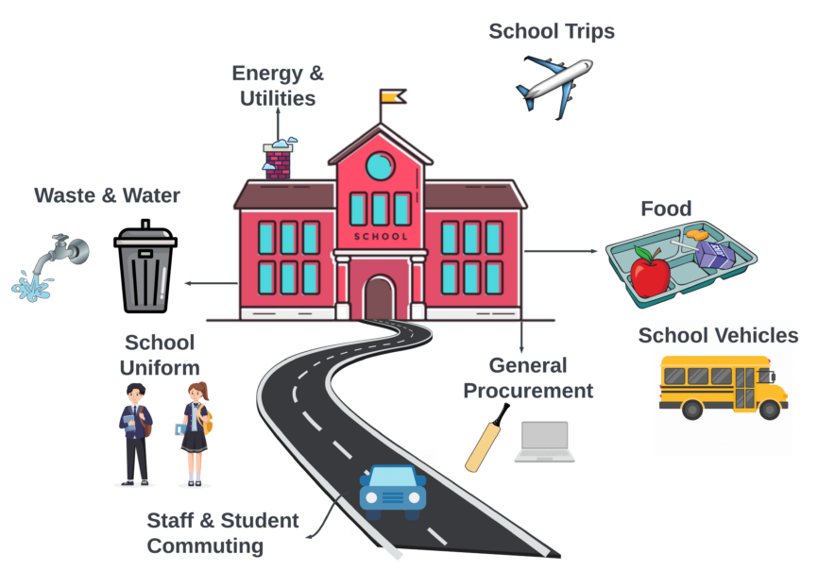
Count Your Carbon
Generate a bespoke carbon footprint for your education setting.
Emissions split into 4 categories:
Energy
Transport
Food
Purchases
Notes:
Count Your Carbon is the nation’s first free, full scope carbon emissions tool built for – and in collaboration with – nurseries, schools and colleges. Whether you’re at the very start of your sustainability journey, or you’re a passionate environmentalist looking to effect change, join us on our mission to reduce carbon emissions in educational settings by 50% by 2030.
Count Your Carbon is based on the world’s most widely used greenhouse gas accounting standards: the GHG Protocol, and has been tailored to educational settings. The tool was built by Eco-Schools England in partnership with Let’s Go Zero and carbon experts Arete Zero Carbon, and is made possible thanks to players of People’s Postcode Lottery. Development was informed by months of in-depth research with those working in educational settings (including teachers, catering staff, bursars and caretakers) and within local authorities

Slide 16
Adaptation and Resilience
Aim to adapt our buildings and systems to prepare for the effects of climate change.

Slide 17
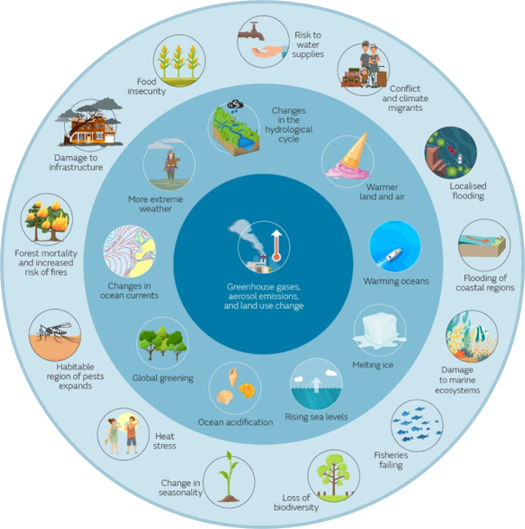
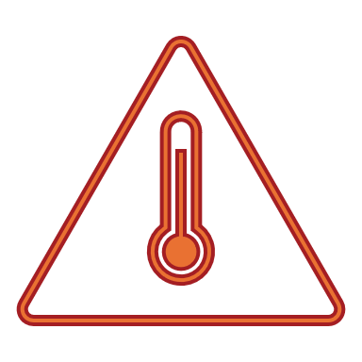
Climate change impacts
Most relevant impacts for schools
Heat stress
Water scarcity
Air quality
Flooding
Food safety & security
Extreme weather
Met Office- www.metoffice.gov.uk/weather/climate-change/effects-of-climate-change
Notes:
Image- Effects of climate change - Met Office:
Inner circle (dark blue)= drivers of climate change
Middle circle (blue)= changes to the climate system
Outer circle (light blue)= impacts
There are a whole host of impacts on the environment, the species we share the planet with and our own survival and lifestyles.​
Global warming exceeded 1.5C across the 12-month period between February 2023 and January 2024
2023 was declared the warmest year on record
In 2023, Global temperatures in every month between June and December set new monthly records with July and August being the two hottest months on record (WMO),
We also see increases in extreme weather of all types. In 2020, 26 all time low temperature records were broken. In 2021, that rose to 176 records. ​
The outer edge of this circle shows some of the impacts we’ll face: fires, flooding, gross damage to ecosystems, the expansion of this 6th mass extinction we’re facing.
Climate change has many critical socio-economic impacts. Because it will cause increase in disease, it threatens our water supply, it causes food insecurity as pests increase and yields decrease, and as more of the earth will become uninhabitable or inflicted by natural disasters, forecasts from international thinktank the IEP predicting that 1.2 billion people could be displaced globally by 2050 due to climate change and natural disasters.
Climate change has been called the greatest humanitarian crisis we face and it should be treated as such. ​
School specific risks- Chapter 5: Health, Communities and the Built Environment - UK Climate Risk (5.14.1.1.1 Current risk: Education sector):
10,150 schools in England are assessed as being exposed to a significant probability of flood
Severe damage to buildings entail significant costs, and alternative venues need to be found to ensure continuity of education.
2007 floods resulted in school closures across England with a total of 400,000 pupil school days lost. which was estimated to have an economic cost of £12 million, not including damage to property
Children are more vulnerable to heat risks, especially young children and those with special needs, and are reliant on teachers and other adults for support, knowledge and guidance, particularly at early school age
Higher temperatures are likely to increase heat risks in the future, especially in the south of England, with London experiencing the highest levels of overheating
​
Climate change is the defining crisis of our generation, and it will be the lived reality for generations to come. Many people still do not understand the issue or feel able to respond to it adequately, including the very young people whose future will be most affected.

Slide 18
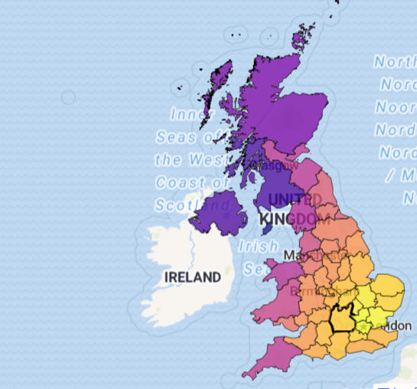
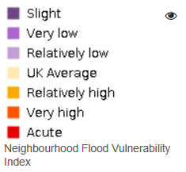
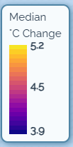
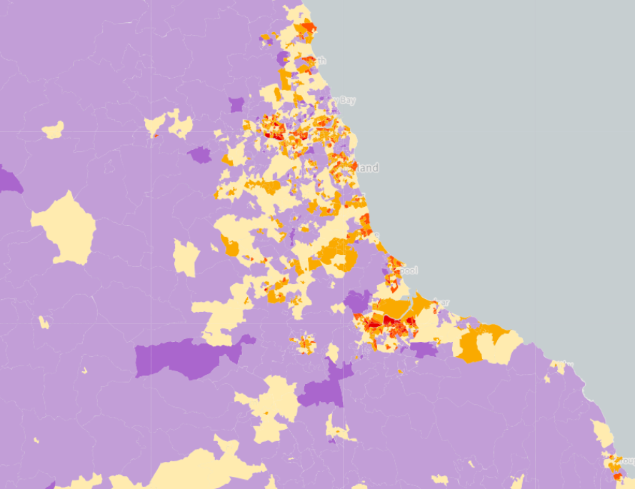
Understanding local impacts
Climate Risk Indicators
https://uk-cri.org/
Climate Just Map Tool
www.climatejust.org.uk/map
Notes:
Visit the following sites and input maps from your local area:
Climate Risk Indicators (uk-cri.org)
www.climatejust.org.uk/map

Slide 19
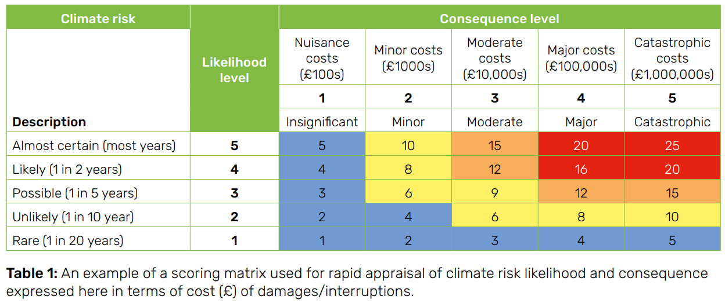
Assessing risk
Notes:
Example scoring matrix for climate risk likelihood and consequence.
Could consider other factors not just cost and damages/interruptions.

Slide 20
How can you adapt and prepare for the effects of climate change?
Notes:
Ask question to your audience.

Slide 21
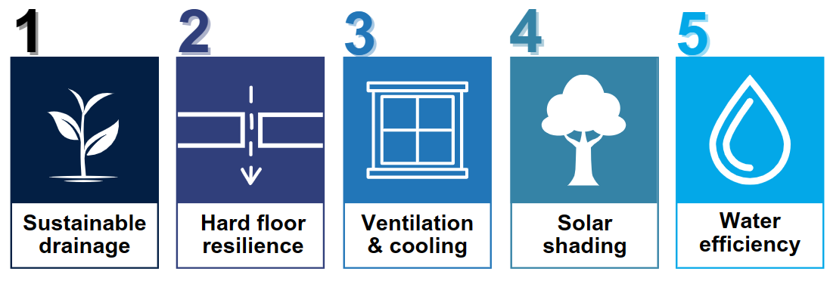
Areas of Action: 5 steps to be a Climate Resilient Education Setting
By the Greater London Authority
Notes:
This is taken from the Greater London Authority guidance for London schools on the measures they can take to adapt to climate change. Please note not all measures will be relevant for every education setting. Further information here- Climate change guidance for London schools and early years settings - Arup
Further examples of steps education settings can take to be climate resilient:
Install sails/ pergolas on your grounds to provide shade during warmer weather.
Replace hard surfaces with green spaces to reduce flooding, provide shade and reduce air pollution.
Add solar control film to windows that receive the most sunlight.
Install sustainable drainage system (SuDS) planters to reduce the risk of flooding.
Add green roofs or walls to help soak up rainwater and keep buildings cool.
Improve water efficiency in your buildings.
Install water butts to collect rainwater.

Slide 22
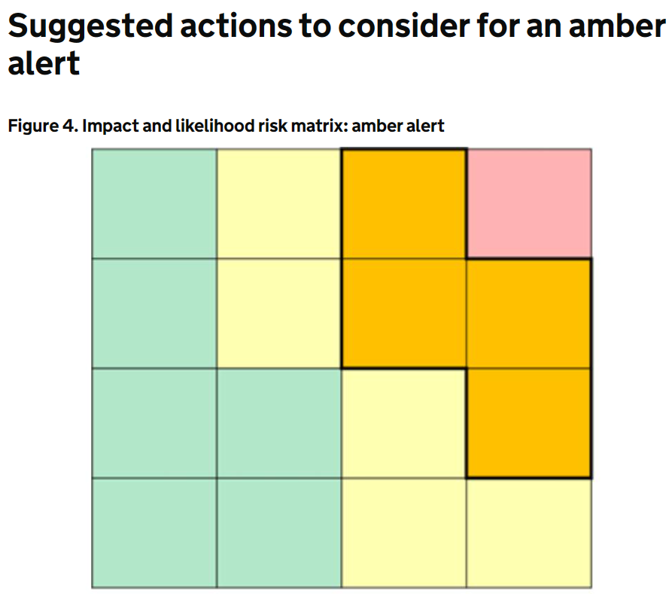
Areas of Action: Hot weather & health action cards
Have response plans in place
Identify those most at risk
Have workplace champions
Train staff
Measure to take:
Have shade
Designated cool rooms
Weather monitoring
Heat-Health Alert action card for the voluntary and community sector - GOV.UK (www.gov.uk)
Notes:
Heat and Health alert action cards have been designed for the voluntary and community sector, but much of the information is transferable to education settings- Heat-Health Alert action card for the voluntary and community sector - GOV.UK (www.gov.uk)
This Heat-Health Alert (HHA) action card summarises the suggested actions that the voluntary and community sector should consider to prepare for and respond to each HHA alert type. The action cards cover the core elements of heat-health action plans recommended by the World Health Organization (WHO):
longer-term development and planning
preparation before the summer
prevention during the summer
specific responses to hot weather
monitoring and evaluation
In line with other weather warning systems in operation within England (and the UK) warnings will be issued when the weather conditions have the potential to impact the health and wellbeing of the population. The alerts will be given a colour (yellow, amber or red) based on the combination of the impact the weather conditions could have, and the likelihood of those impacts being realised. These assessments are made in conjunction with the Met Office when adverse weather conditions are indicated within the forecast.

Slide 23
Biodiversity
Aim to enhance biodiversity, improve air quality and increase access to, and connection with, nature.

Slide 24
Biodiversity Stripes from WWF Living Planet Index
Species are going extinct 1000 – 10,000 times faster than background levels
How many species are we losing? | WWF (panda.org)
Notes:
How many species are we losing? | WWF (panda.org)

Slide 25
What is biodiversity?
The number of organisms living on Earth across land and other aquatic ecosystems.
A
The variability among living organisms within ecosystems
and the ecosystems of which they are part.
B
C
The area of natural habitats untouched by humans across Earth.

Slide 26
What is biodiversity?
The number of organisms living on Earth across land and other aquatic ecosystems.
A
The variability among living organisms within ecosystems
and the ecosystems of which they are part.
B
C
The area of natural habitats untouched by humans across Earth.

Slide 27
The main threats to biodiversity
1
2
3
4
5
Habitat Loss & Degradation
Overexploitation of Natural Resources
Climate Change
Pollution
Invasive Species
Notes:
More information available here- 5 key drivers of the nature crisis (unep.org)

Slide 28
How can you enhance biodiversity, improve air quality and increase access to, and connection with, nature?
Notes:
Ask question to your audience.

Slide 29
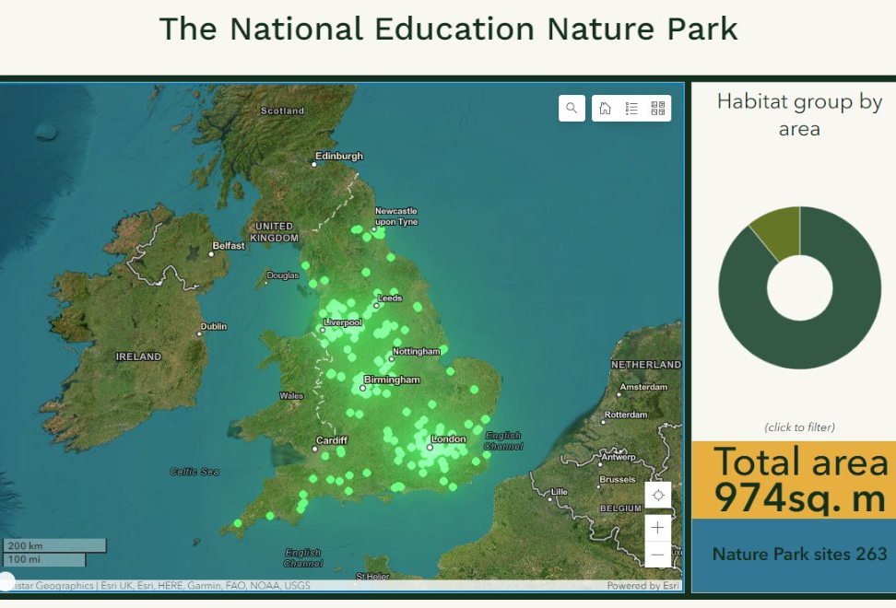
National Education Nature Park
A free programme helping to put nature at the heart of education.
The programme brings nurseries, schools and colleges together to create one vast nature park.
Pupils map their school’s site, record data on a national online map and create a plan to improve their setting for nature.
Put plans into action and celebrate successes!
Sign up here- www.educationnaturepark.org.uk
Notes:
Encourage all education settings to sign up to the National Education Nature Park- Home | Education Nature Park
A free programme providing educators with the resources, support and guidance needed to put nature at the heart of education.
The programme brings nurseries, schools and colleges together to create one vast nature park, tracking biodiversity improvement across an area that is more than twice the size of Birmingham.
Pupils map their school’s site by surveying what is living and growing there, record their data on a national online map and then create a plan to improve their school, college or nursery for nature.
Put plans into action, record your changes and celebrate your successes!
Embedding nature across everyday teaching and learning will give every child and young person in England the opportunity to develop a meaningful connection to nature, contribute to nature recovery across the country and build resilience for a changing world.
Developed by a partnership led by the Natural History Museum with the Royal Horticultural Society, Royal Society and other partners, commissioned by the DfE.

Slide 30
Areas of Action
1
2
3
4
5
Habitat Loss & Degradation
Overexploitation of Natural Resources
Climate Change
Pollution
Invasive Species
Preserve green spaces & corridors
Consider catering
Use less resources
Connect to the full life cycle
Grow our own
Decarbonise
Nurture green skills
Understand it
Reduce litter
Reduce & reuse
Less light & noise
Plant native species
Consider resilience
Notes:
Example action areas.

Slide 31
Climate Education and Green Careers
Prepare students for a world impacted by climate change through education & practice.​

Slide 32
What is climate education?
Supports students to understand:
Local & global environmental challenges
How to take individual & collective action to address them.
Causes of, the impacts of and the solutions to climate change.
How environmental challenges intersect with society through a holistic view of sustainability
People
Planet
Prosperity
Notes:
Quality, fit for purpose education that supports students and young people to understand local and global environmental challenges and how to take individual and collective action to address them. Quality Climate Education has a holistic view of sustainability that encompasses how environmental challenges intersect with society. It covers the causes of, the impacts of and the solutions to climate change.

Slide 33
The benefits of climate education
Acquire knowledge of the climate system and the human role in shaping it
Gain key life skills and insights into global citizenship
Be active participants in sustainability solutions
Be prepared to thrive in the green transition
Notes:
Climate Education comes with unique and exciting opportunities. It provides not just the opportunity to acquire the broad knowledge that underpins our understanding of the climate system and the human role in shaping it but also key life skills and insights into global citizenship since climate change is and will remain an interconnected global challenge

Slide 34
How can we deliver climate education?
1.
Feature in existing curriculum
Opportunities exist for all subjects
2.
Enhance with small changes
‘Curriculum for a Changing Climate’ (Teach the Future)
3.
Imagine substantive changes
Cross-curricular & holistic education
Notes:
In almost all the curriculum areas where studies have been conducted, it has been found that opportunities exist for demonstrating that what students are already learning is linked to their understanding of climate change. The courses that most specifically reference climate change are secondary geography, chemistry, Design Technology and Food Studies with some optional GCSE subjects offer students the specific competencies needed to take appropriate climate action (both adaptive and mitigative) in their future careers and personal lives. But opportunities are implicit throughout all other subjects’ content at all levels. It may be easier for teachers to imagine, plan and implement some of these opportunities at EYFS and primary key stages, where cross-disciplinary and interdisciplinary teaching is more often found.
There are a multitude of opportunities to enhance current curriculum specifications to better include Climate Education topics and the skills needed for the future green economy. The ‘Curriculum for a Changing Climate’ project commissioned by student-led Teach the Future England shows how the existing curriculum can be amended to equip students with the knowledge and skills necessary to understand, and take action on, the climate crisis. The Tracked Changes project has been led by academics, with input from teachers, educators and education experts.
Wales, Scotland, Italy and New Zealand are some of the countries that have conducted a substantive review of curriculum in relation to Climate Education as part of a wider curriculum reimagining (in Wales through the Curriculum for Wales and in Scotland in the Learning for Sustainability Action Plan as part of Scotland’s Curriculum both of which thread broader sustainability concerns throughout the curriculum). Though not yet happening at a national level, individual settings and academy trusts could be considering how to go beyond individual subject content to create rich, interdisciplinary, cross-subject and holistic education opportunities.

Slide 35
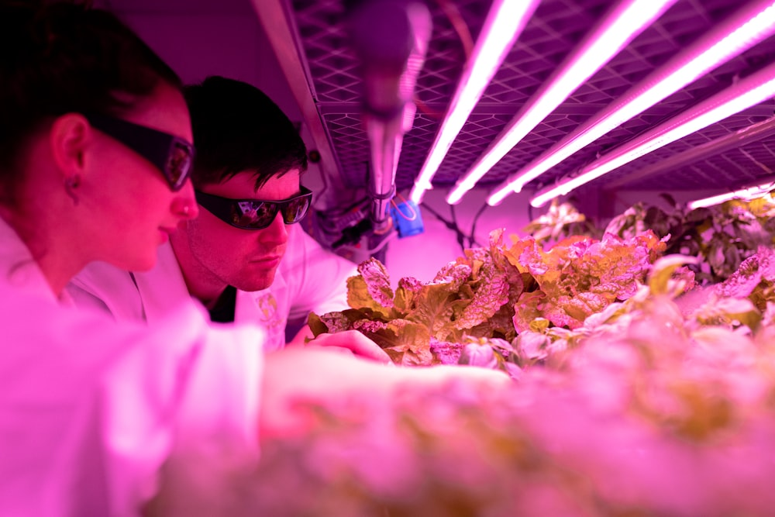
What is a green job?
“Employment in an activity that contributes to protecting or restoring the environment, including those that mitigate or adapt to climate change”​
The Office for National Statistics, 2023
Notes:
Definition- “Green jobs” update, current and upcoming work - Office for National Statistics (ons.gov.uk)

Slide 36
What jobs are in the green sector?
Power
Renewables
Energy storage
Natural resources
Nature restoration
Agriculture & waste
Homes & buildings
New efficient homes
Retrofitting inc. heat pumps & networks
Transport
Low/no emissions vehicles
Cycling & walking
Climate adaptation
Engineering
Nature-based solutions
Business & industry
Hydrogen
Carbon Capture (CCUS)
Enabling decarbonisation
Science & innovation
Green finance
Notes:
In 2020, the government set out its Ten Point Plan for a Green Industrial Revolution. This plan will support up to 250,000 green jobs in 2030, by seeking to develop long-term advantage for the UK in new low carbon sectors. Investments in these sectors are expected to drive funding and jobs across the UK, from electric vehicle manufacture in the midlands, to construction and installation of offshore wind farms around the coast and the retrofitting of homes across the country. However, the UK can go much further. The government has set an ambition for two million green jobs in the UK by 2030
Green Jobs Taskforce report (publishing.service.gov.uk)

Slide 37
“Green jobs will not be niche.​ We anticipate that sustainability and climate change will touch every career.”​
Department for Education, 2022

Slide 38
How to support students into green careers?
Understand topic
Climate education
Experience
Work experience
Impacts & solutions
Networking
Gain skills
Technical & transferrable skills
Values
See opportunities
Targeted career guidance
Industry connections
Notes:
If we break that down a bit more, that’d look like:
Helping students understand the various industries and sectors that fall under the umbrella of green careers. Researching and providing information on areas such as renewable energy, sustainable agriculture, environmental conservation etc.
Assisting students in mapping their skills and their career paths to try and create action plan for achieving their goals
Using networking events, guest speakers to connect students to the industry. Using alumni networking can give insights, opportunities and jobs leads.
Offering workshops, seminars and training programs to help students develop the skills we discussed earlier
Providing resources and guidance to support students in their search got green careers such as cover letter/CV clinics and interview prep
Finally collaborate with the sustainability team to create a supportive environment for students interested in green careers
https://wedocs.unep.org/bitstream/handle/20.500.11822/35070/GGEGJ.pdf

Slide 39
What skills do we need for the green transition?

Slide 40
A new green learning agenda: Approaches to quality education for climate action, Kwuak & Casey (2021)
Skills for green jobs
Green life skills
Skills for a green transformation
Cross-cutting capabilities to respond to and
tackle environmental challenges
Adaptive capabilities that can transform unjust structures into more sustainable & equitable alternatives
Specific capabilities that fulfil the needs of transitioning to a low-carbon & resilient society
Notes:
A new green learning agenda: Approaches to quality education for climate action | Brookings

Slide 41
A new green learning agenda: Approaches to quality education for climate action, Kwuak & Casey (2021)
Skills for green jobs
Green life skills
Skills for a green transformation
Adaptability
Emotional intelligence
Creativity
Critical thinking
Empathy
Growth mindset
Intercultural competence
Open-mindedness
Participatory skills
Anticipatory thinking
Coalition building
Disruptive thinking
Environmental stewardship
Inclusive mindset
Perspective skills
Political agency
Systems thinking
Valuing indigenous knowledge
Data analysis
Engineering
Entrepreneurship
Environmental & ecosystem management
Finance skills
ICT skills
Project management
Research skills
Cross-cutting capabilities to respond to and
tackle environmental challenges
Adaptive capabilities that can transform unjust structures into more sustainable & equitable alternatives
Specific capabilities that fulfil the needs of transitioning to a low-carbon economy
Instrumental
Transformative
Notes:
What kind of skills do you think would fulfil each element?
A new green learning agenda: Approaches to quality education for climate action | Brookings

Slide 42
Developing your plan
What do we want to improve? | What information do we need and how will we get it? | What changes will we make? | Who will deliver the changes? | What will be the progress by Sep 2024? | What will be the progress by Sep 2025? | How are we doing? [To be updated at regular review points]
Notes:
Example of how individuals could develop their climate action plan.
Encourage a separate table for each of the four key action areas.
Could offer an example.

Slide 43
THANK YOU FOR LISTENING
Any questions?

