Slide 1
Climate Action Planning
Turning climate ambition into climate action in education​.
Notes:
This presentation has been designed to introduce the idea of climate action planning to sustainability leads, senior leadership teams, governors and/or teachers. Please adapt the presentation to suit the needs of the education setting you are presenting to.
If you would like to do so, please add the logo of the company or organisation to the 'master' slide so it will show up on each slide.

Slide 2
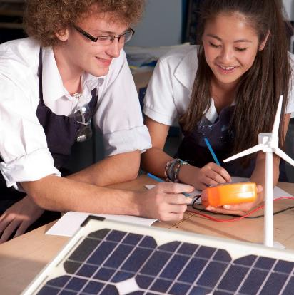
Climate Ambassadors Objective
To provide education settings within England access to expert support from volunteer Climate Ambassadors, who will help them develop and deliver impactful Climate Action Plans.
Notes:
The Climate Ambassador scheme provides education settings with free access to a diverse network of trained volunteers from across relevant private, public, charity and education sectors to provide tailored guidance and support to progress their Climate Action Plans. The ambition is to support settings, wherever they are on their journey, to:
1. Decarbonise by becoming more efficient across their operations, to save money and reducing emissions.
2. Adapt and build resilience against the risks of climate change, such as overheating or flooding.
3. Increase biodiversity across the estate and improving access to green space.
4. Weave climate education and green careers across teaching and student facing activities.
By education settings we mean all publicly funded nurseries, pre-schools, primary and secondary schools, multi academy trusts and colleges. This work is funded by the Department for Education and delivered by the University of Reading and EAUC. It directly supports the delivery of the department’s climate change and sustainability strategy.

Slide 3
UK Government Vision
The UK has world-leading education in sustainability and climate change by 2030.
To deliver the UN Sustainable Development Goals and UNESCO’s ‘Education for Sustainable Development for 2030’.
To meet net zero emissions by 2050.
UK Government Policy​
Notes:
1- Sustainability and climate change: a strategy for the education and children’s services systems - GOV.UK (www.gov.uk)
2- THE 17 GOALS | Sustainable Development (un.org) and Education for sustainable development | UNESCO
3- Net Zero Strategy: Build Back Greener - GOV.UK (www.gov.uk)

Slide 4
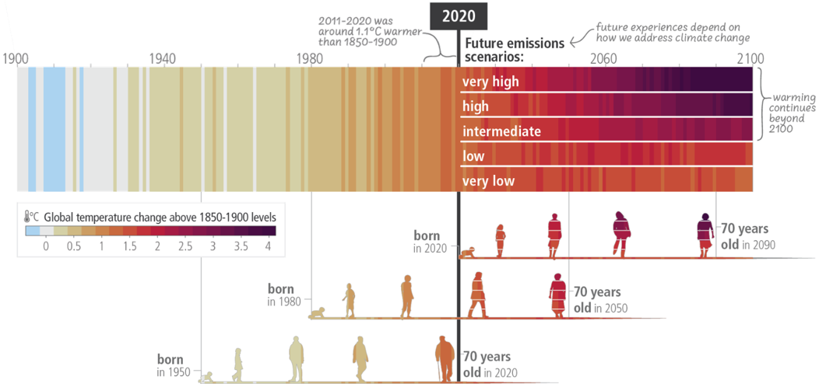
Climate change is…
“The long-term shift in the average temperature and weather patterns across the world.” (Met Office)
IPCC, 2023: Summary for Policymakers. In: Climate Change 2023: Synthesis Report. Contribution of Working Groups I, II and III to the Sixth Assessment Report of the Intergovernmental Panel on Climate Change [Core Writing Team, H. Lee and J. Romero (eds.)]. IPCC, Geneva, Switzerland, pp. 1-34, doi: 10.59327/IPCC/AR6-9789291691647.001
Notes:
Climate Change definition- What is climate change? - Met Office
The Intergovernmental Panel on Climate Change (IPCC)- The IPCC was set up in 1988 by the World Meteorological Organization (WMO) and United Nations Environment Programme (UNEP) to provide policymakers with regular assessments of the scientific basis of climate change, its impacts and future risks, and options for adaptation and mitigation.
IPCC 2023 Sixth Assessment Report (AR6) Synthesis Report- IPCC_AR6_SYR_SPM.pdf Figure from slide can be found on page 7.
More information on the IPCC assessment reports available here- The IPCC Sixth Assessment Report (AR6) - Met Office
Description of figure on slide:
The IPCC say that the extent to which current and future generations will experience a hotter and different world depends on choices now and in the near term. The chart (image on slide) from the same report shows the increasing global average temperatures over the past, and five potential scenarios for heating in the future.​​
The best-case scenario at the bottom of the figure shows a significantly hotter than scenario than our past and requires that we halve global emissions by 50% by 2030 to have a 50% chance of capping heating at this level.​

Slide 5
Sustainability is…
“meeting our own needs without compromising the ability of future generations to meet their own needs.”
(WCED, 1987)
People
Planet
Prosperity
Notes:
In 1987, the United Nations Brundtland Commission defined sustainability as “meeting the needs of the present without compromising the ability of future generations to meet their own needs.”
Sustainable Development Goals- | Sustainable Development (un.org)

Slide 6
Net zero emissions
“Cutting greenhouse gas emissions to as close to zero as possible, with any remaining emissions re-absorbed from the atmosphere.”
United Nations
Notes:
Net Zero further information- Net Zero Coalition | United Nations
Every year in England, schools emit more than 10 million tonnes of carbon.
Net zero is the most commonly used wording but you may have also heard of carbon neutral for example. Understanding what each of these mean is really important.
Firstly, neither represent zero emissions, whereby we release no GHGs to the atmosphere. Given GHGs are the leading cause of climate change, zero emissions would be ideal, but there are likely going to be difficult to remove emissions remaining from all but the most ambitious action.
Then we go into the idea of reducing but not removing all.
Carbon neutral means removing the equivalent amount of CO2 to what’s emitted through activities across their supply chains, by investing in ‘carbon sinks’ that absorb CO2. Carbon sinks, like the ocean or forests, absorb more carbon from the atmosphere than they emit. Most businesses who are carbon neutral also try to reduce their emissions but this isn’t measured in the definition. So if you have a carbon neutral organization, they’ve not necessarily reduced emissions, but they have offset an equivalent.
Net zero is expanded in scale, going beyond the removal of just carbon emissions to include all GHGs such as methane and nitrous oxide. It means cutting greenhouse gas emissions to as close to zero as possible, with any remaining emissions re-absorbed from the atmosphere, according to the UN. They still offset, but there is an equal, if not greater emphasis, on following an ambitious emissions reduction trajectory.

Slide 7
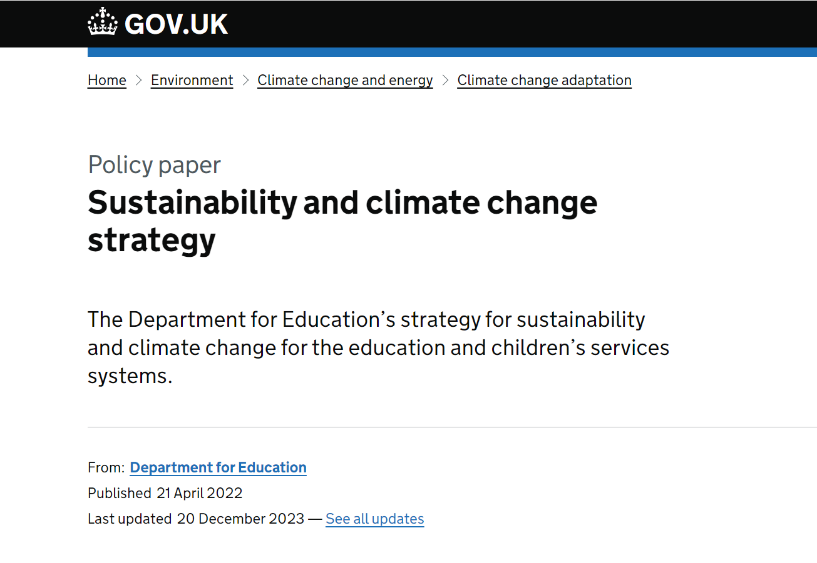
DfE Sustainability and Climate Change Strategy
All education settings should have a sustainability lead and a climate action plan by 2025.
Notes:
In April 2022, DfE published a Sustainability and Climate Change Strategy
Whole-system strategy development​.
The target is for all education settings to have a sustainability lead and a climate action plan in place by 2025, to help embed sustainability in all they do.
Sustainability leadership could be a group of people or an individual responsible for the development and implementation of a climate action plan.
There are many organisations working to improve sustainability and mitigate against climate change. DfE will work with those who share their objectives, extending and amplifying good practice and initiatives.

Slide 8
The role of education settings…
Community leadership
Enabling and empowering young people
National emission reductions
Protect and enhance biodiversity across occupied sites
Adapt to climate risks
Notes:
Nurseries, schools and colleges are the cornerstone of every community in England. They intersect with the causes of, risks from and solutions to climate change and nature loss in four ways:
Community leadership- education settings serve as critical hubs for joining people together in the fight against climate change and biodiversity loss through education and fostering behaviour change, engaging communities, preparing the future workforce, and advancing equity and social justice. There are school-aged children in 42% of all UK households. Education settings can be the catalyst for change across communities.
Enabling and empowering young people- through a better understanding of climate change, a greater connection to nature and opportunities to participate in activities tackling the climate emergency, we can enable young people to translate knowledge into positive action to improve their local communities, their country and the planet. We can also harness young people’s passion and interest in climate change and sustainability, enabling them to have the knowledge and skills required for green jobs.
National emission reductions- Education is the public sector’s largest emitter of carbon from buildings: 37% of public sector emissions, comprising 13% from state primary schools, 11% from state secondary schools and 13% from universities- Environmental sustainability overview (nao.org.uk). Reaching net zero targets requires these emissions to be significantly reduced.
Protect and enhance biodiversity across occupied sites- The green and grey space that education settings occupy can be managed in ways that provide a significant boost to nature and biodiversity and provide a space for engagement with the natural world for young people and the broader community.
Adapt to climate risks- All education settings face significant operational risks from the climate change that has already occurred and that which is still to come. Good management of our education system requires anticipation of these risks and adaptation to them to avoid significant educational losses.

Slide 9
Sustainability Leadership
It is up to each individual education setting to decide the structure of their sustainability leadership team.
Best practice shows that change is delivered when driven by a diverse team of passionate individuals.
Notes:
It is up to each individual setting to decide the structure of their sustainability leadership team- an individual setting/ setting up across a Multi Academy Trust (MAT)/ both.
Best practice shows that change is delivered when driven by a diverse team of passionate individuals.
It is important that the whole education setting, or trust, is engaged so that planning becomes action.
It is important that both educational (e.g. teaching staff) and operational (e.g. estates management) expertise is brought to this team.

Slide 10
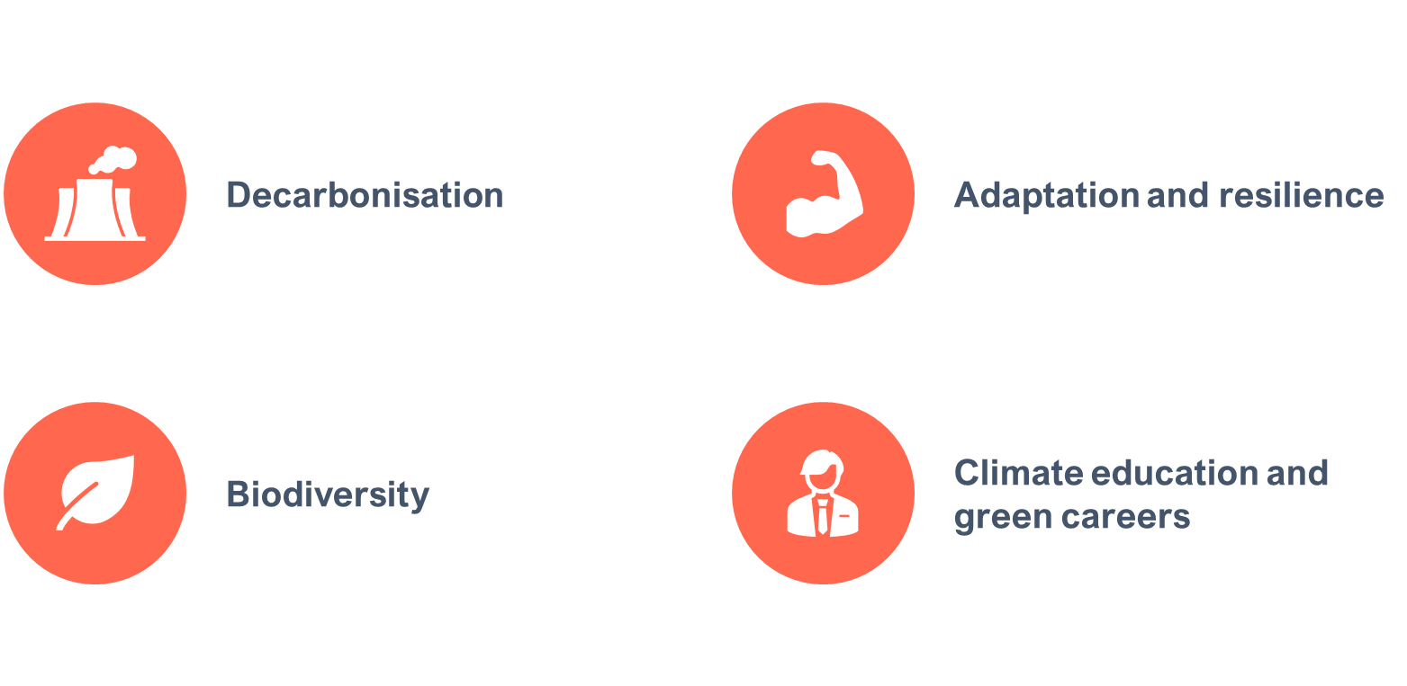
What is a Climate Action Plan?
A climate action plan is a detailed plan to enable your education setting, or trust, to progress or commence sustainability initiatives.
Structured and strategic
4 key action areas
Looks different for each setting!
Notes:
A climate action plan is a detailed plan to enable your education setting, or trust, to progress or commence sustainability initiatives.
Allows you to take a structured and strategic route toward ensuring your setting or trust is acting toward, and educating about, sustainability.
Plan can sit within an individual setting, or across a MAT, or both.
A whole setting approach- important that the whole education setting, or trust, is engaged so that planning becomes action.
It is recognised that different settings are at different stages of this journey. This approach is not designed to duplicate planning and action that has already taken place.
Further support provided is designed to ensure that settings are supported with further and complimentary information, regardless of where they are currently at in their journey.
The Key areas to target within a Climate Action plan are:
Decarbonisation- Reduce emissions and support students to be part of the transition to net zero.
Biodiversity- Enhance biodiversity, improve air quality and increase access to, and connection with, nature.
Adaptation and Resilience- Adapt our buildings and systems to prepare for the effects of climate change.
Climate education and green careers- Prepare students for a world impacted by climate change through education & practice.

Slide 11
Climate Action Plans can help you to…
Be more resilient to the effects of climate change.
Meet emission reduction targets.
Maximise biodiversity value of education estates.
Be the catalyst for change across communities.
Enable and empower young people.
Notes:
Be more resilient to the effects of climate change- all education settings face significant operational risks from climate change.
Meet emission reduction targets- education settings are a significant source of greenhouse gas emissions within the public sector.
Maximise biodiversity value of education estates- the green and grey space that education settings occupy can be managed in ways that provide a significant boost to nature and biodiversity and provide a space for engagement with the natural world.
Be the catalyst for change across communities- education settings serve as critical hubs for joining people together in the fight against climate change and biodiversity loss.
Enable and empower young people- through a better understanding of climate change, a greater connection to nature and opportunities to participate in sustainability activities we can enable young people to translate knowledge into positive action.
​

Slide 12
Where are you as a education setting?
We have a sustainability leadership team
We have started our climate action plan
We know our carbon footprint
We have assessed our climate risk
We have mapped ‘green spaces’ on our site
We have delivered training to our staff on climate change and sustainability
Notes:
Possible places to start on a climate action journey. Discuss these points with your audience.

Slide 13
Resources and Support
Notes:
Climate Ambassadors: Turning Climate Ambition into Climate Action in Education | Climate Ambassadors
Home | Education Nature Park
UK Climate Change • Let's Go Zero (letsgozero.org)
Call to Action Page - Count Your Carbon
CPD for school and college staff (reading.ac.uk)
Sustainability Support for Education- will be available from June 2024

Slide 14
THANK YOU FOR LISTENING
Any questions?

