Slide 1

Guide to Retail Pricing in Louisiana
July 2024

Slide 2
Applicable Requirements
Louisiana Weights and Measures Law and Regulations require that accurate prices be posted for items that are for sale or offered or exposed for sale. The price of all items recorded using machine-readable code shall be posted for the consumer.
This pictorial guide has been developed to visually demonstrate examples of pricing strategies that comply with or violate Louisiana rules and statues. If you have questions regarding price posting, contact the Division of Weights and Measures at 225-925-3780.
Special thanks to the Arizona Department of Agriculture for sharing the base of this presentation with us.
Applicable Statutes and Rules:
LA RSs 4617.A. and 4624
LAC 7:XXXV:117

Slide 3
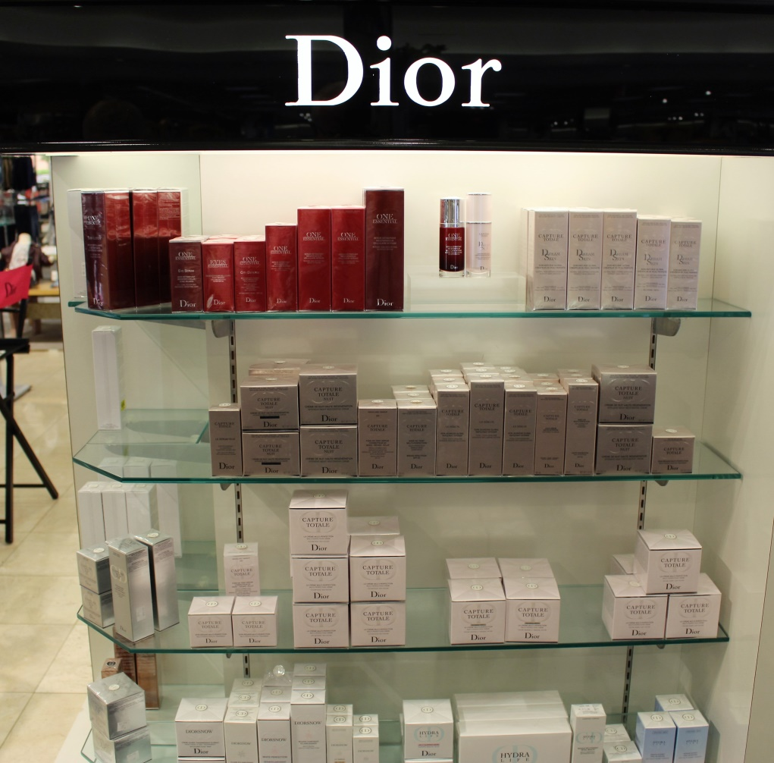

A price tag may be placed on individual items for sale as in this example.
In this example the store has chosen to place prices on individual items rather than on the shelving.

Slide 4
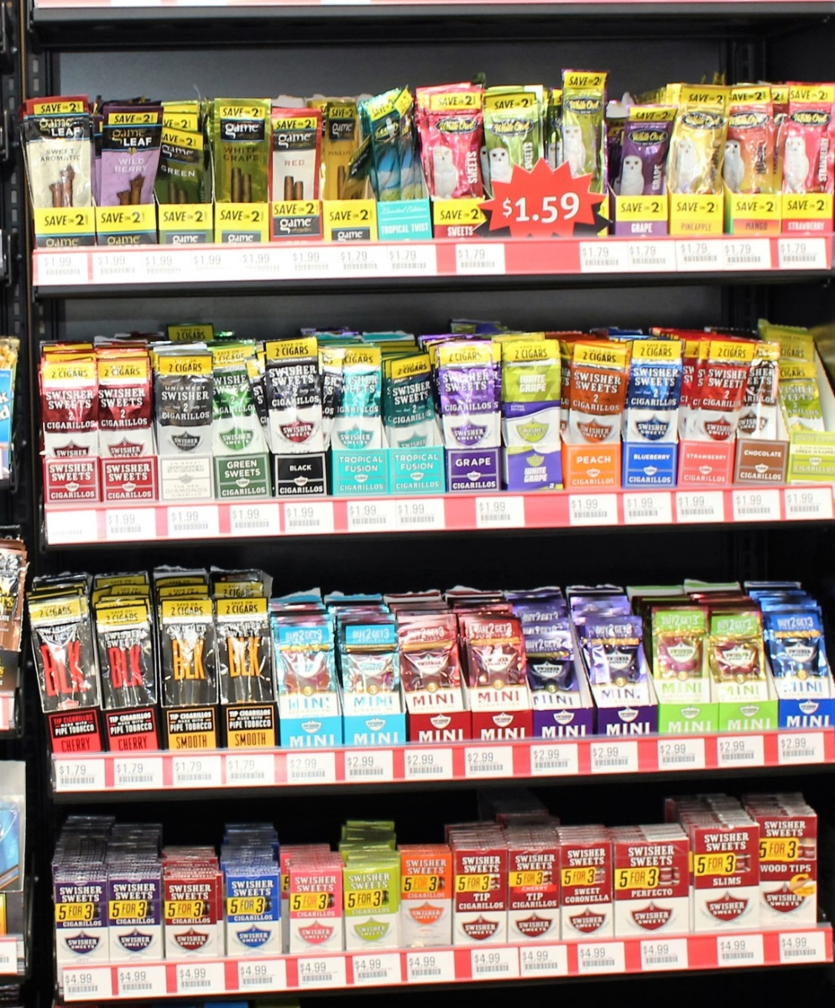
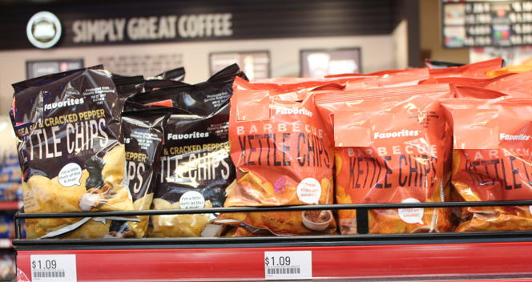
Instead of pricing each individual item separately, items may be priced on the shelf where the item is displayed.
Price displayed for each item on the shelf below the item.

Slide 5
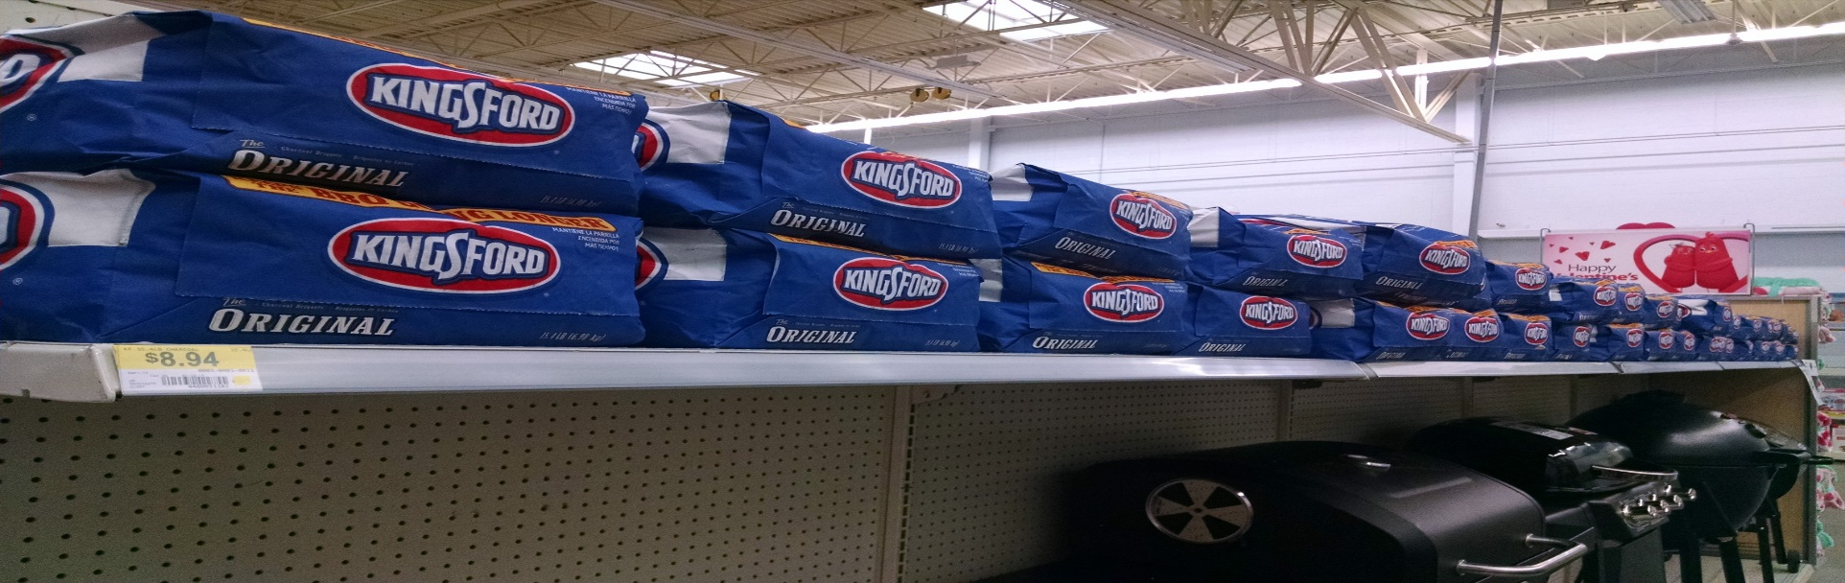


Items on a shelf with the same pricing code.
or
The price may be posted at each end of the isle or more often for items with the same pricing code.

Slide 6
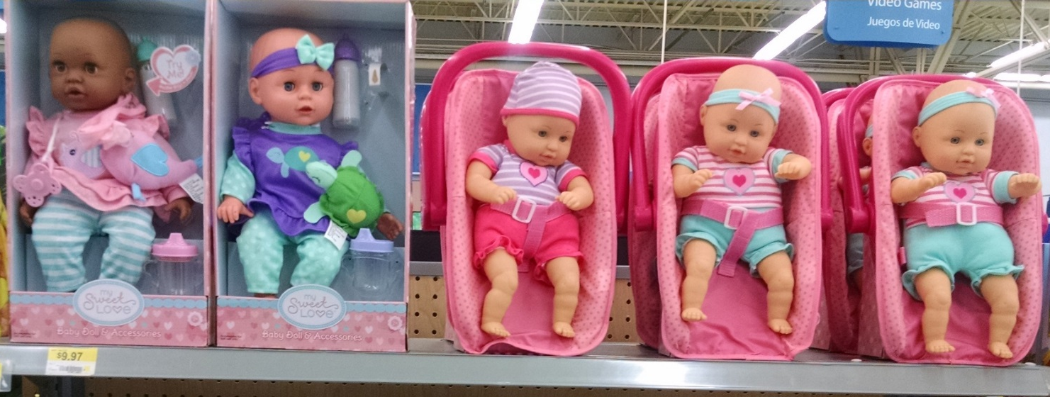
Items that are the same price with differing pricing codes may be posted at each end of the shelf if there is a generic price without specific product information.
These items are correctly priced if all the products on the shelf are the same price and the price tag posted does not have specific product information.
Price should be posted where the red circles are located if the items are not the same price.

Slide 7
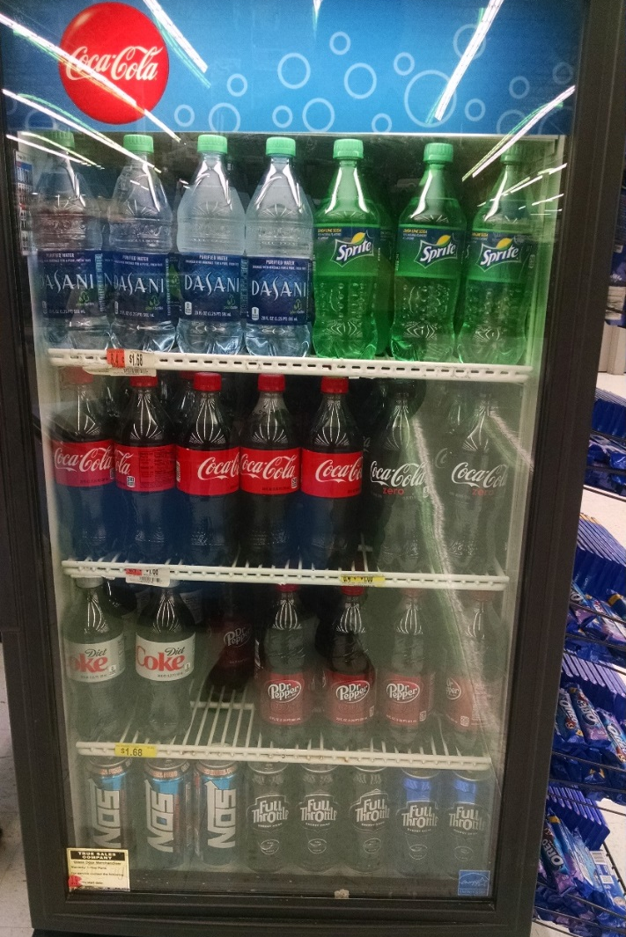
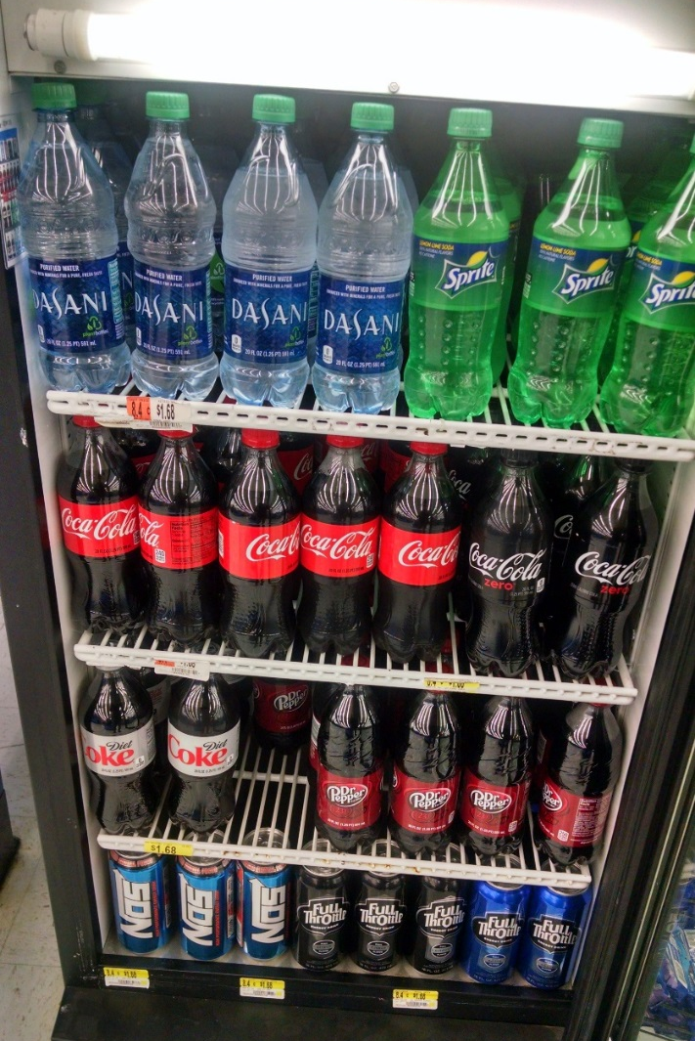
Instead of pricing each individual item separately, items may be priced on the shelf where the item is displayed.
If the price tag specifies “Dasani Water,” the Sprite would not be considered to have a posted priced in this picture. If the price tag is generic with only a price and no product specified, then the Sprite would be the same price as the water.
Prices may be on the inside or outside of refrigerator doors. The prices for the bottom shelf were not visible when the door was closed but are visible when the door is opened.

Slide 8
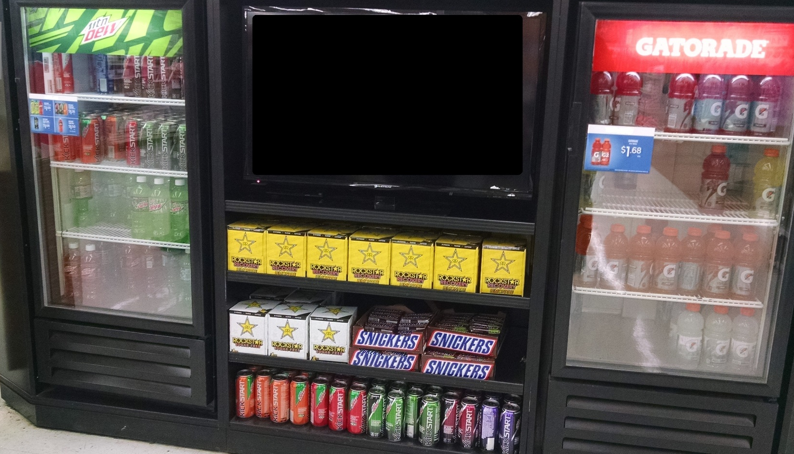
Menu style pricing
The prices may be posted in a menu style. The sign on the door states the price for all items in the refrigerator.
The products on the shelves under the television are in violation. They do not have the price posted.

Slide 9
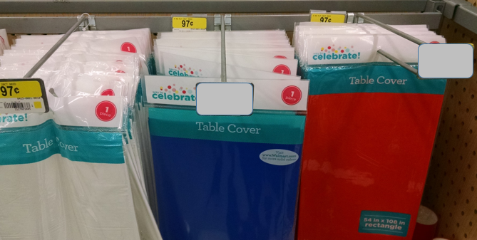
Hanging items
The prices may be posted in front of the item or behind the item, but the price must be visible.

Slide 10
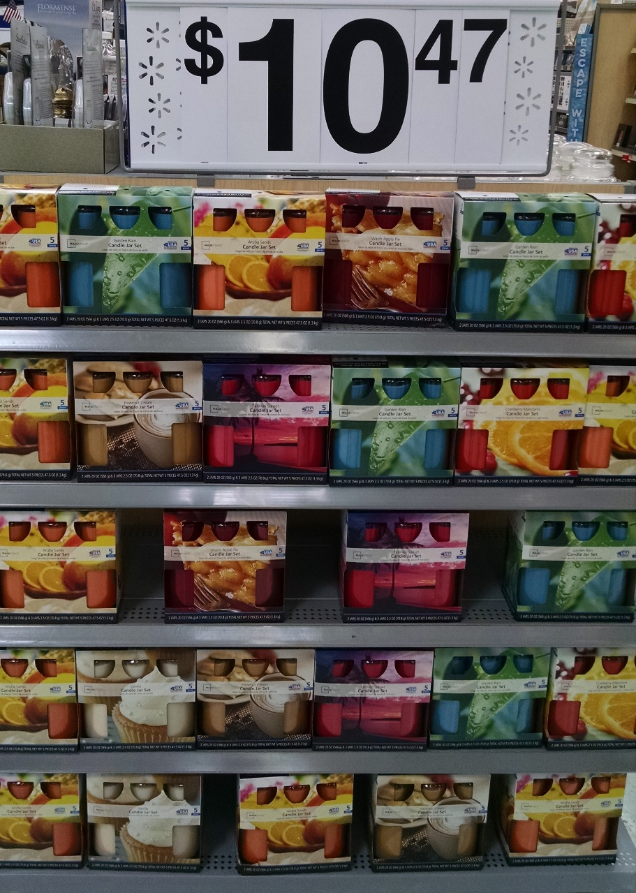
End caps/vertical displays
The large sign on top is considered the price for all items in this display since no shelf tags are posted.

Slide 11
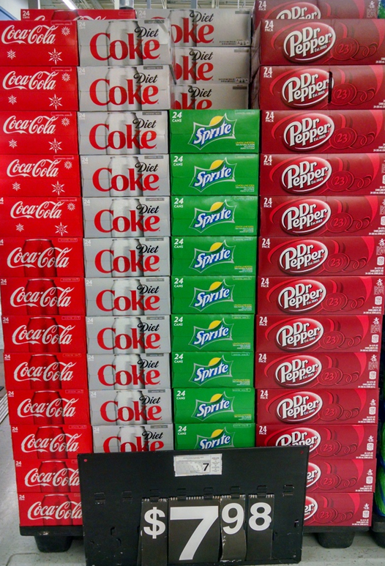
End caps/vertical displays
The price for vertical displays may be located on top, middle, or bottom as long as it is readily visible to the consumer.
Note: Since this display has two prices posted that appear to be for the entire display, if the posted prices are different, the lowest price posted is considered the price.

Slide 12
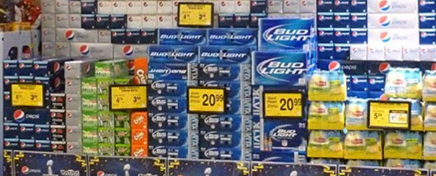
Multi-price display
If the items in a display have differing prices, they must be clearly posted.

Slide 13
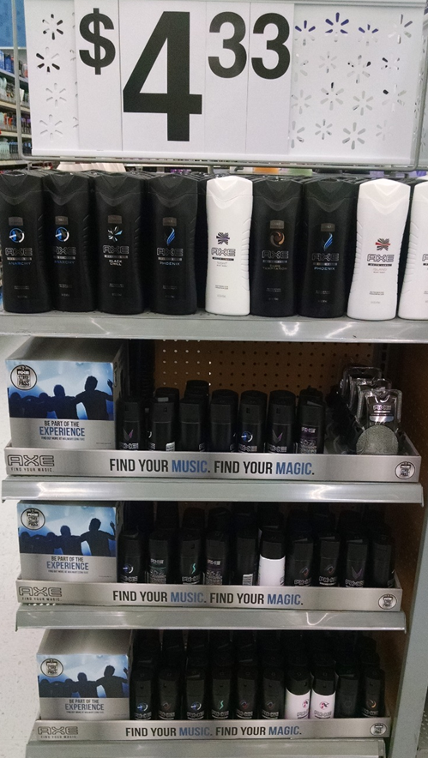
Multi-price display
In this display, the large sign is the price for the items on the top shelf only.
The second shelf has a lower price and should have its own tag.
  The second shelf would be considered as an undercharge.
The bottom two shelves have a higher price and should also have its own tag.
  The bottom two shelves are in violation for overcharging since this display has one generic price with no product specific identification.

Slide 14

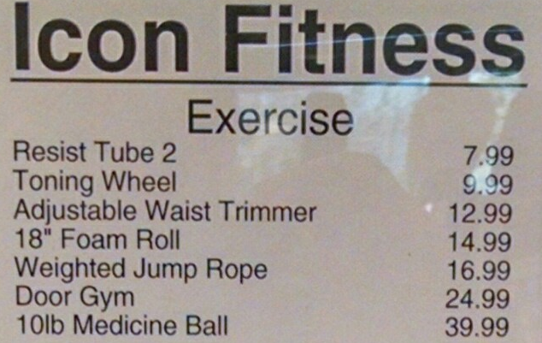
Multi-price display with menu style pricing
In this display, all items offered for sale are listed on a menu style sign. The price and description must be legible to the consumer.

Slide 15
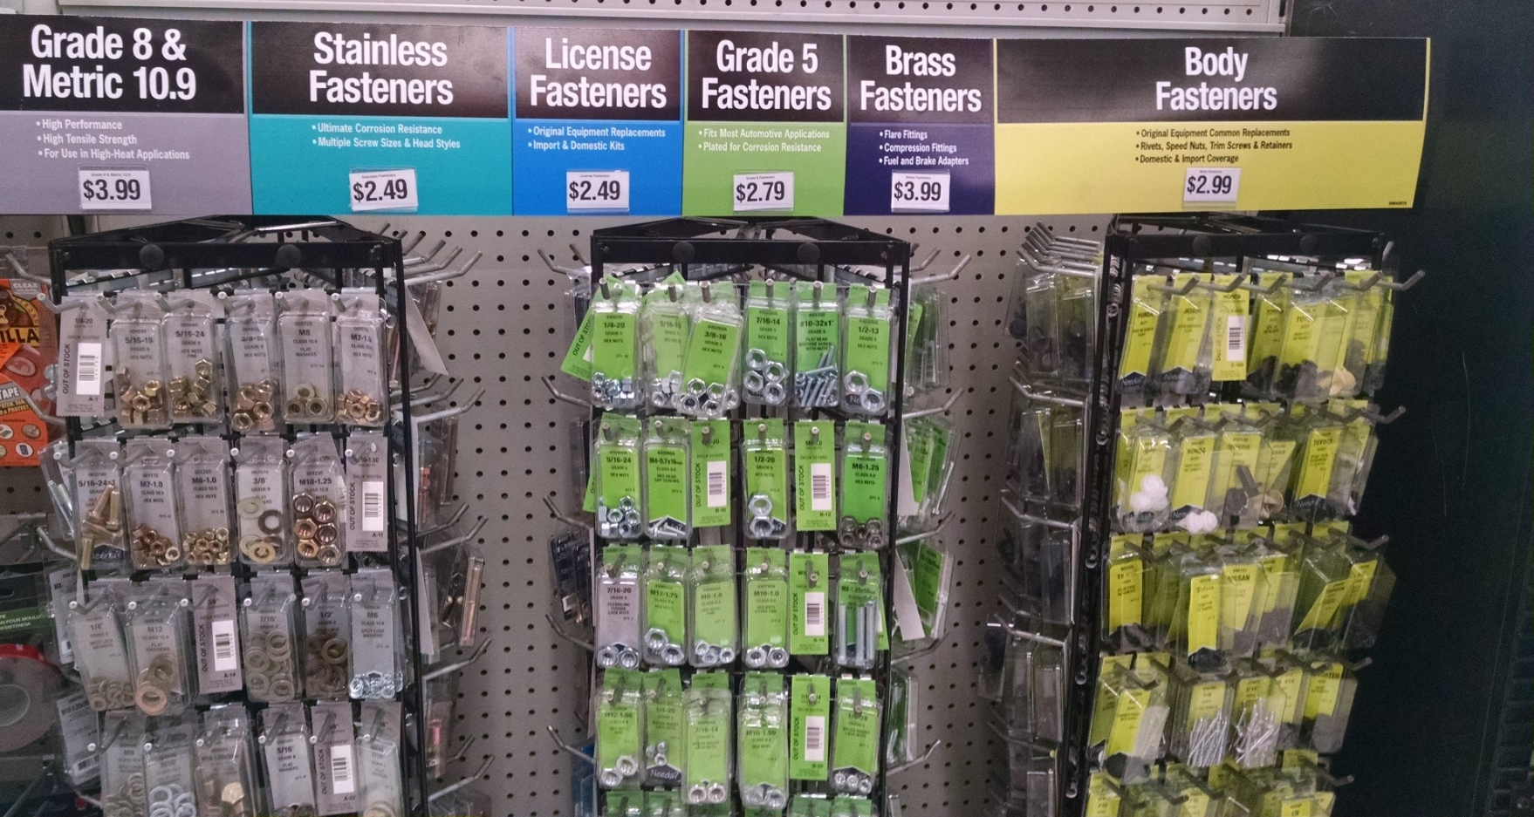
Multi-price display with color coded menu style pricing
Color codes may be used in menu style pricing.

Slide 16
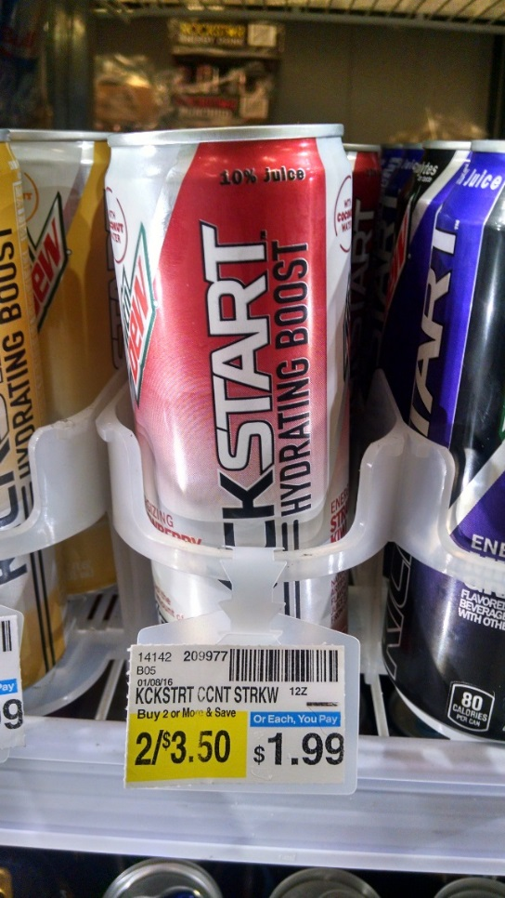
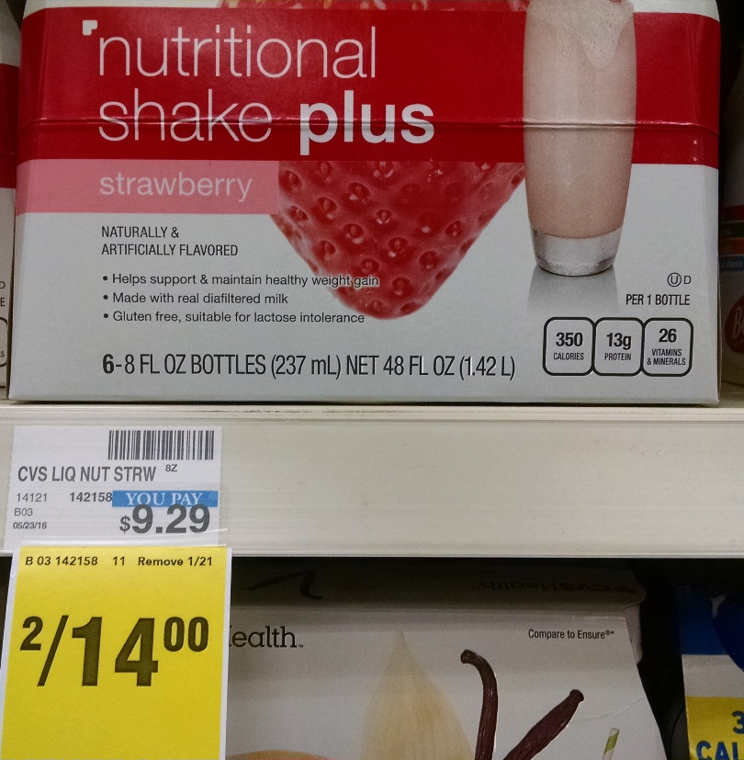
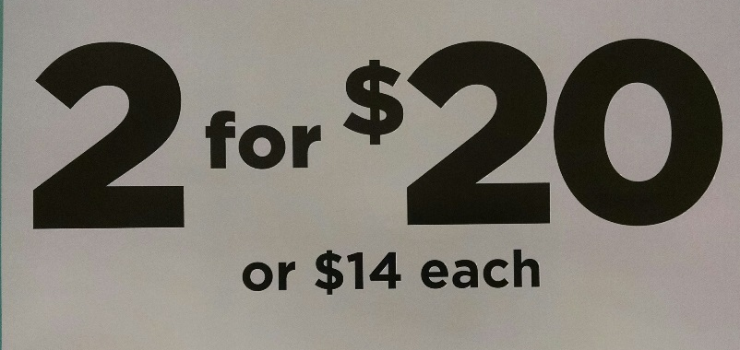
Multi-unit discount pricing
When a discount is offered for multi-unit purchases, the single purchase price must also be posted.

Slide 17
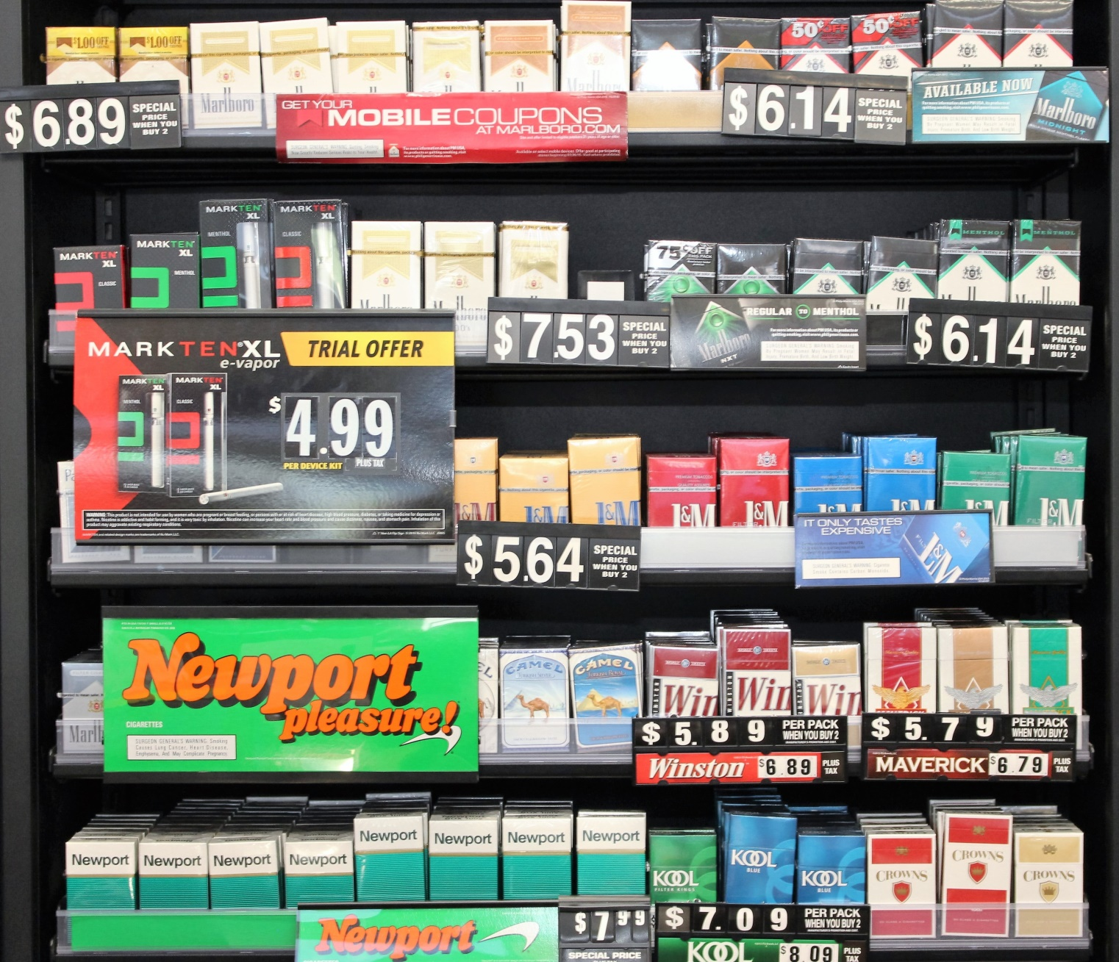
Multi-unit discount pricing
When a discount is offered for multi-unit purchases, the single purchase price must also be posted.
This would be considered a price posting violation because it only advertises the price per pack when multiple packs are purchased.
These clearly show the price per pack when you buy one or multiples.

Slide 18
Multi-unit discount pricing
When a discount is offered for multi-unit purchases, the single purchase price must also be posted.
The single pack price is advertised in a menu style while the multi-pack price is posted on the shelf. This is acceptable if the menu style listing is near the products.

Slide 19
For More Information:
Call: 225-925-3780
Visit: Device registration and inspections | Louisiana Department of Agriculture and Forestry (la.gov)

