Slide 1



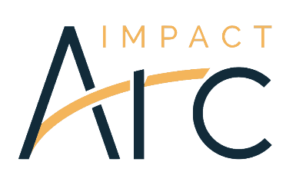
Sustainable Indigenous Finance:
Navigating the Energy Transition
COVERING:
Investor Guide Launch
PRESENTED BY:
Olivia Lieberthal, Maria Lettini, Rebecca Adamson, Daisy Nicholls, and Jon Borchardt
DATE:
October 28, 2025
Investor Guide Launch
Olivia Lieberthal, Maria Lettini, Rebecca Adamson, Daisy Nicholls, and Jon Borchardt
October 28, 2025

Slide 2


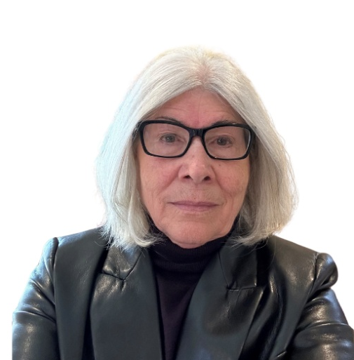


Speakers
Olivia Lieberthal
Maria Lettini
Rebecca Adamson
Daisy Nicholls
Jon Borchardt
Senior Manager
US SIF
CEO
US SIF
Founder & President
First Nations Development & First Peoples Worldwide
Senior Analyst
Impact ARC
Senior Analyst
BMO Wealth Management

Slide 3
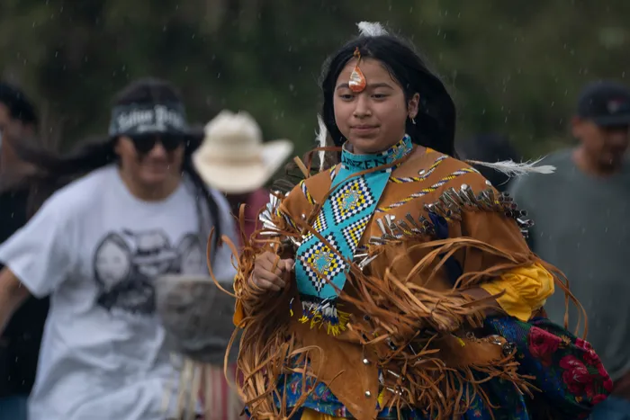

Fireside Chat
Rebecca Adamson
Founder and President, First Nations Development and First Peoples Worldwide

Slide 4
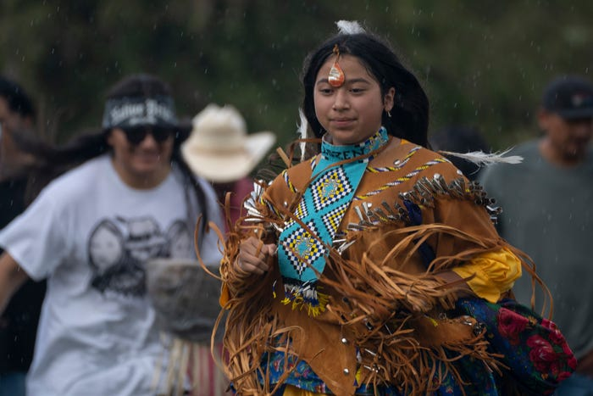

Slide 5
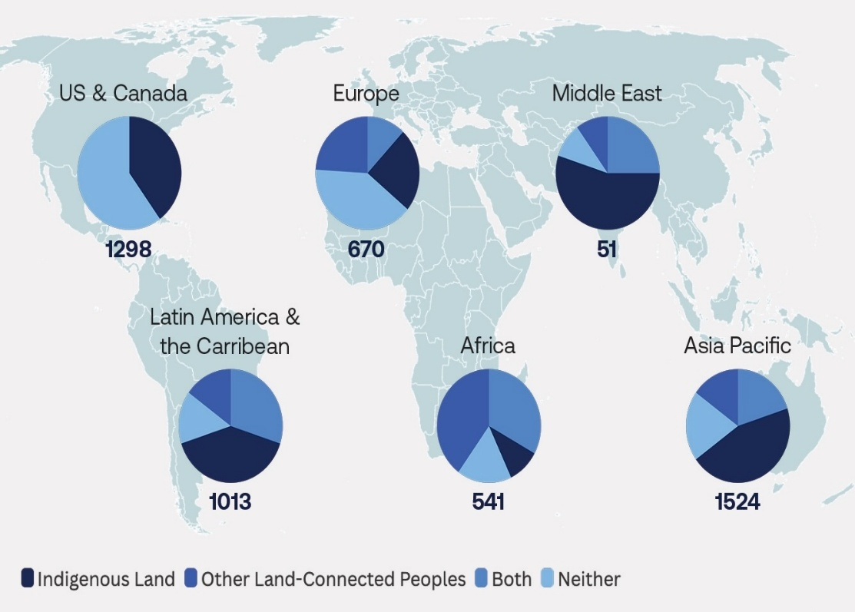
Key Statistics
Indigenous Peoples and local communities steward an estimated 50% of the world’s land.¹
Projects located within 31 miles of Indigenous territories are associated with approximately 10 more conflict events per year than otherwise similar projects.³
54% of global energy transition mineral and mining projects are located on Indigenous lands.²
For projects within 6.2 miles of an Indigenous land claim, the annual incidence of material events increases by as much as 500%.⁴
85% of lithium and 75% of manganese reserves and resources are located on or near Indigenous Peoples’ land.²
1 World Resources Institute, “Protecting Biodiversity Hinges on Securing Indigenous and Community Land Rights” (2024)
2 J. R. Owen, D. Kamp, A. M. Lechner, J. Harris, R. Zhang, and É. Lèbre, “Energy transition minerals and their intersection with land-connected peoples” (2022)
3 R. Adamson and W. Henisz, “Development of Critical Minerals for the Energy Transition Poses Interdependent Material Social and Environmental Risks”(2024 – Unpublished)
4 W. J. Henisz and J. McGlinch, “ESG, Material Credit Events, and Credit Risk” (2019)

Slide 6
Overview of the Investor Guide
Daisy Nicholls
Senior Analyst, ImpactARC

Slide 7

Methodology
Extensive research drawing on:
Case studies
Academic reports
Existing frameworks and tools
Legal cases
Corporate findings
40+ direct interviews with:
Investors
Indigenous experts
Rating agencies
Data providers
Legal professionals
Academics
Review of the guide by:
Indigenous Advisory Council
Indigenous experts
Project Stakeholders

Slide 8
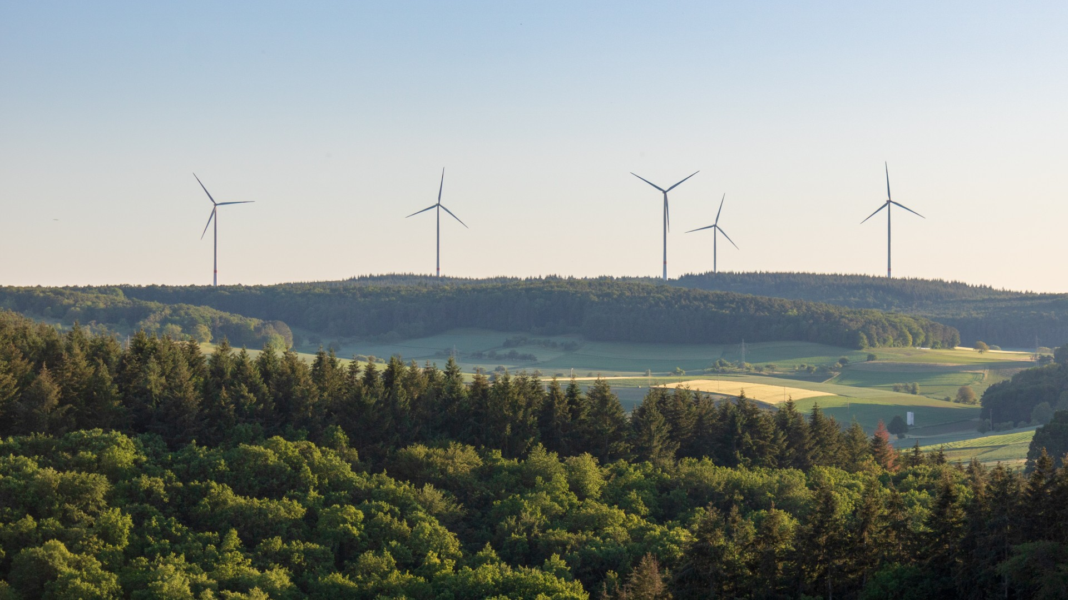
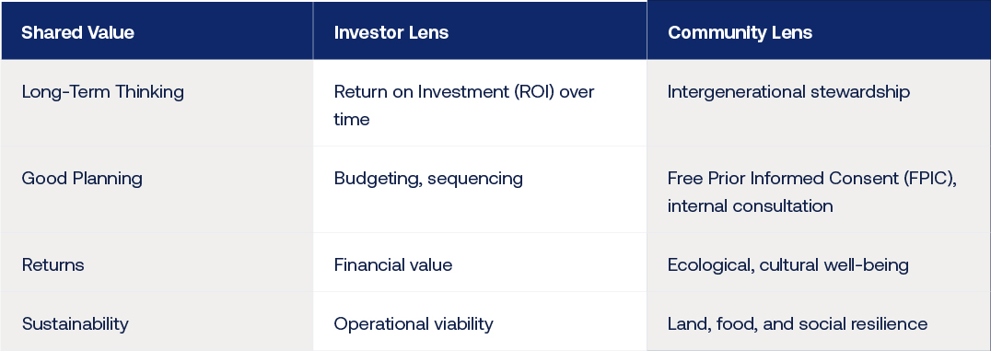
Purpose of the Guide
Designed to help investors:
Understand the material risks and opportunities related to intersections with Indigenous Peoples
Adopt a practical framework to identify, assess, and mitigate these risks
Strengthen due diligence and align investment practices with Indigenous priorities and principles
Unlock opportunities for shared prosperity, resilience, and long-term value creation

Slide 9
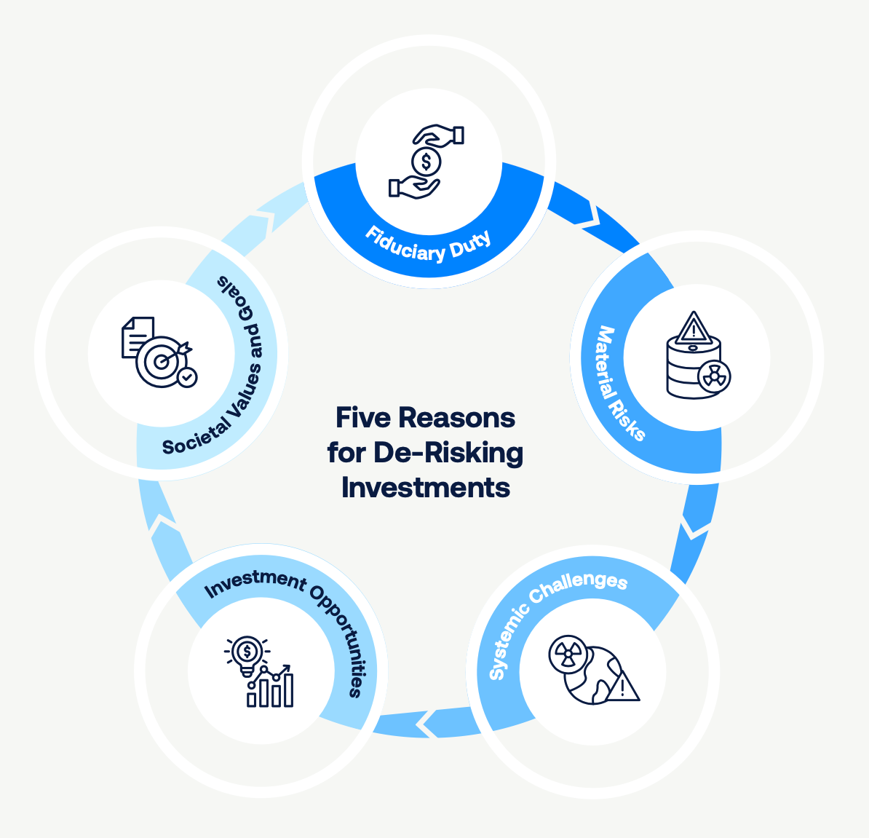
Part A: Understanding the Context
Why should investors consider Indigenous Peoples in their investment decision-making?

Slide 10
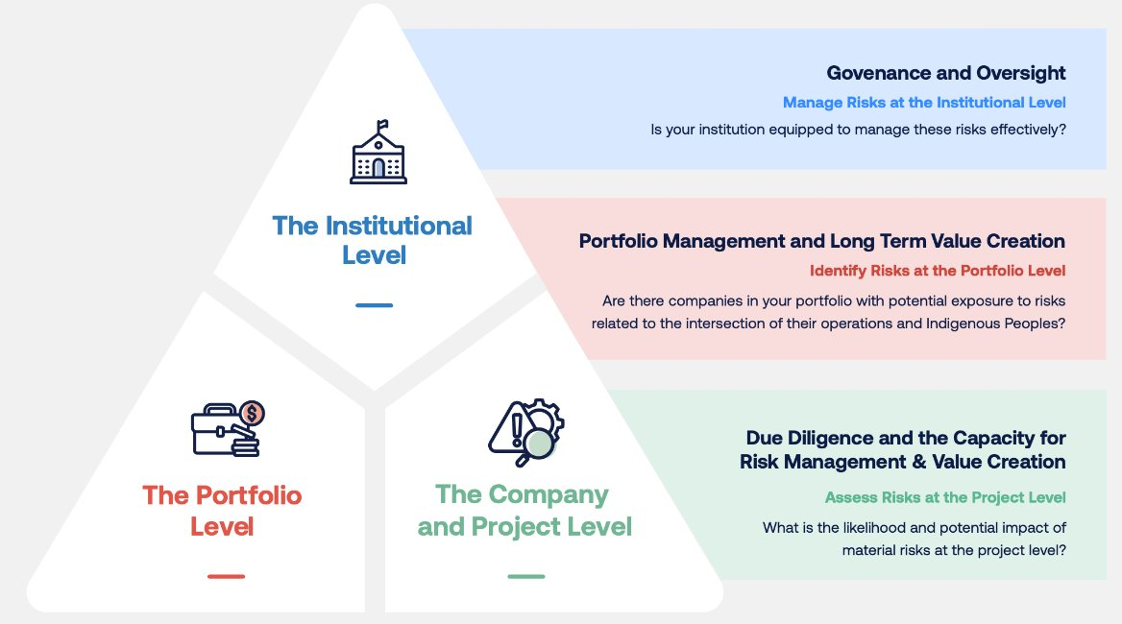
Part B: Framework for De-Risking Investments
How can investors take action to identify, assess, and mitigate these risks?
Also includes a list of recommended resources, data sources, and emerging tools.

Slide 11
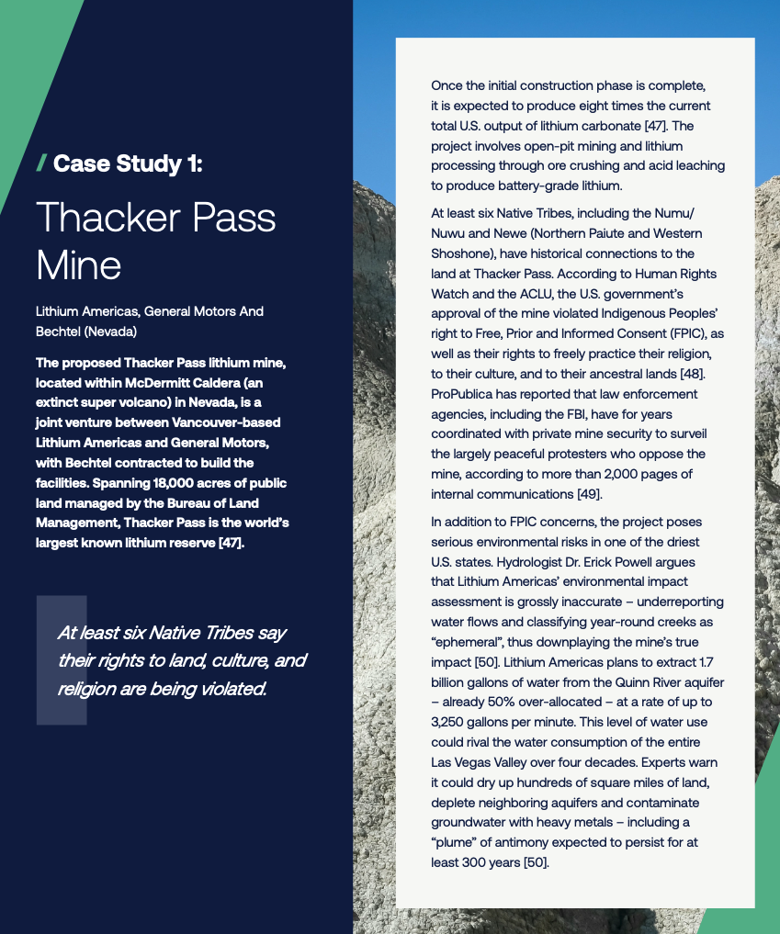
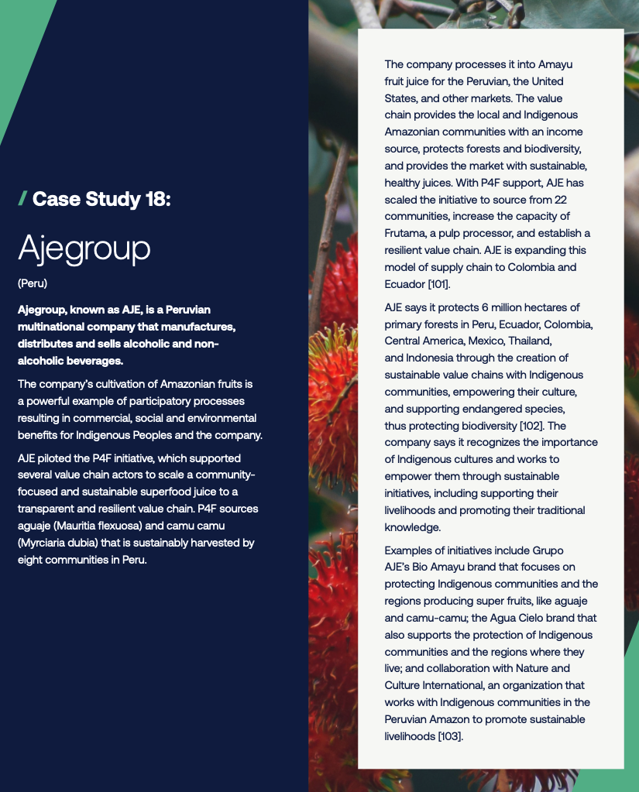
Part C: Examples and Case Studies
Examples of Negative Impacts (Risks) and Positive Impacts (Opportunities)

Slide 12

Investor Discussion
Jon Borchardt
Senior Analyst, Energy, Materials & Industrials
BMO Wealth Management

Slide 13
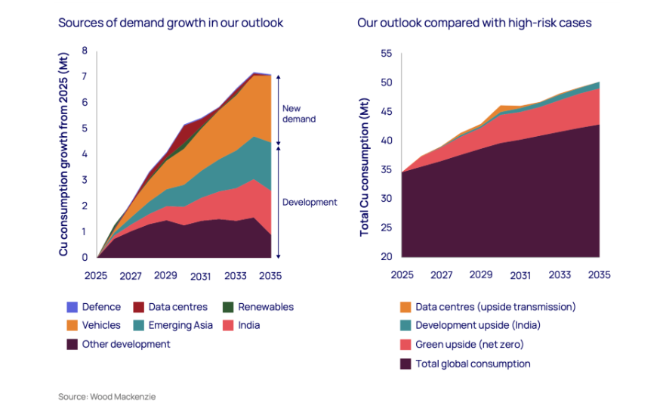
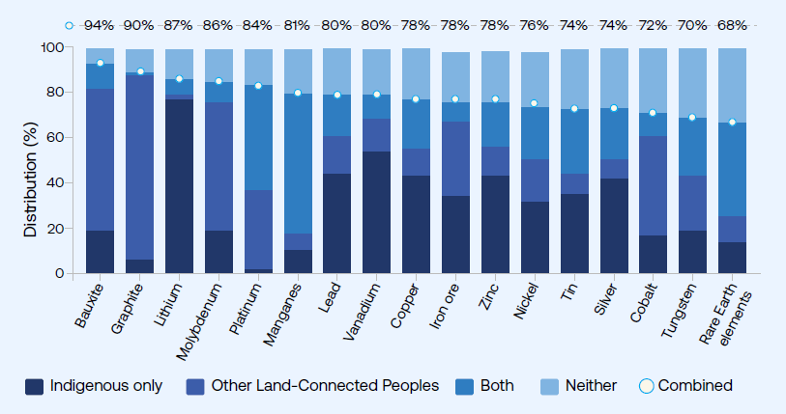
Commodities, Transition & Indigenous Peoples
Sources for copper demand growth
Distribution of reserves & resources for 17 key minerals globally
Source: US SIF, Nat Sustain
Source: Wood Mackenzie
Notes:
Wood Mackenzie forecasts that global copper demand will surge by 24% by 2035, reaching 42.7 million tons annually.
Wood Mackenzie warns that current investment in supply is insufficient to meet the projected demand, creating a substantial supply-demand gap by 2035. Meeting this demand requires significant new mine capacity and increased secondary scrap use.
It is estimated 89% of US copper reserves and over 75% of lithium, copper, and nickel resources are located within 35 miles of Native American reservations. Accessing these areas is crucial for domestic supply goals.
So, you haven’t see the mining sector be the hot interest sector in ages– you have been looking at this sector for a long time now-- what different do you currently see and what’s changed and where is the opportunity?
Rare earth thing….trump made deals…gvmt support huge change.
Percentages at the top of the graph reflect the combined total for
Indigenous and other land-connected peoples overlap
Jon has extensive experience in the commodities, metals, mining and energy sector. He has been a partner at a clean tech hedge fund, a PM on a commodity fund and really is my go-to for understanding these sectors and this space.

Slide 14
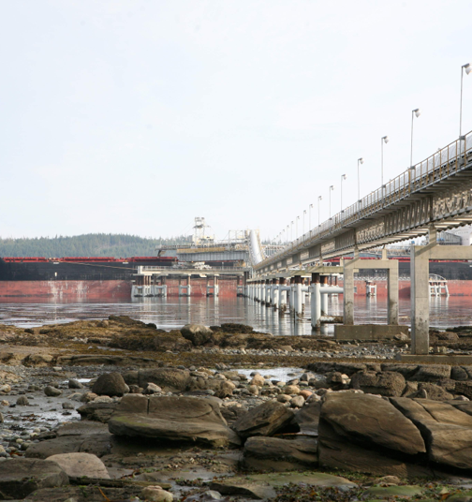


Investing in Commodities vs. Resource Extraction & Energy Transition
Management Quality & Asset Specific Risk
Upside Potential
Downside Risks
Notes:
Upside potential:
Resource discovery
Project delivery/rising output
increased return of capital
Improved balance sheet.
Downside risks:
Higher than expected project cost
Project delays
Geopolitical
Geologic
NGO, local & indigenous community resistance

Slide 15
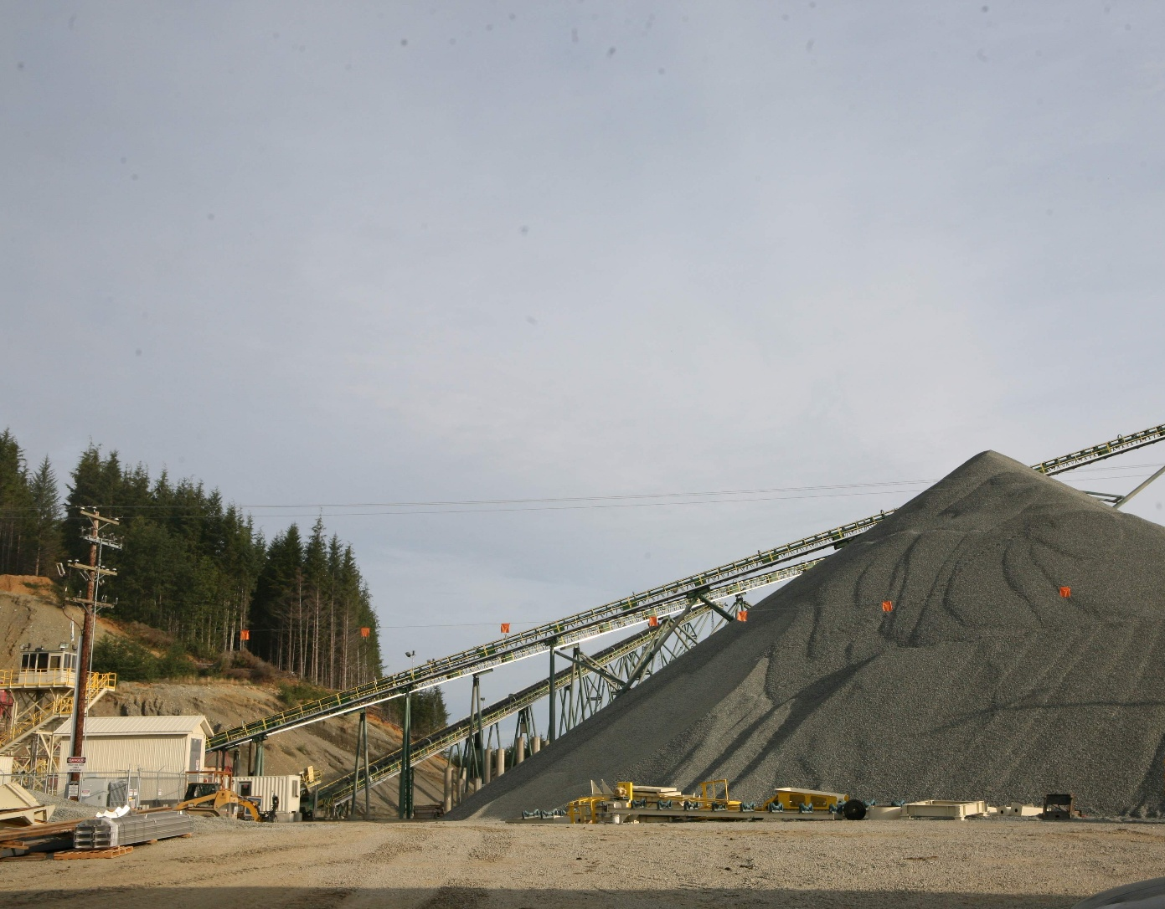
Earning a Social License Reduces Downside Project Risk
Early & consistent communication/ engagement with Indigenous communities
Improves the odds of a smooth progression through regulatory process
Reduced legal risk
Reduces NGOs ability to magnify issues and reputational risk
Collaboration yields mutual benefits: workforce development, infrastructure, stability
Project delays erode shareholder value : Time = Net Present Value (NPV) killer
Partnerships protect shareholder value while providing benefits to local/indigenous communities

Slide 16

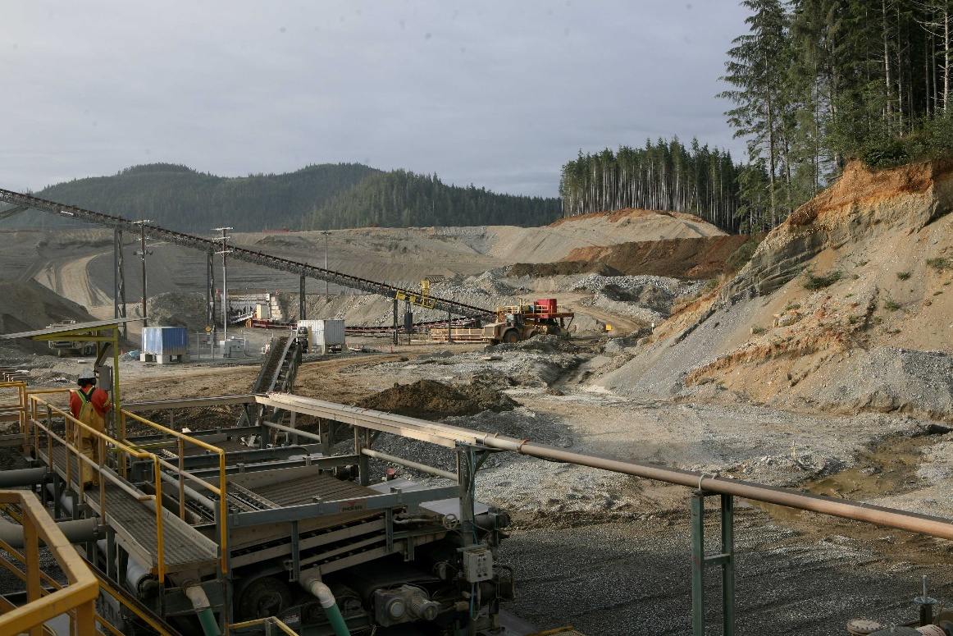
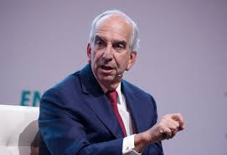
Management Commitment & History: Do they walk the walk?
When you train local people, and give them opportunities, they become your most powerful ally.
Investing in the community is not charity…
Mark Bristow, Former CEO,
Barrick Gold
Being a good corporate citizen is in our DNA
We look to give back in the communities where we operate, build schools, train, power/services
John Hess, CEO
Hess Corporation
Adapted from meeting notes, J.Borchardt

Slide 17
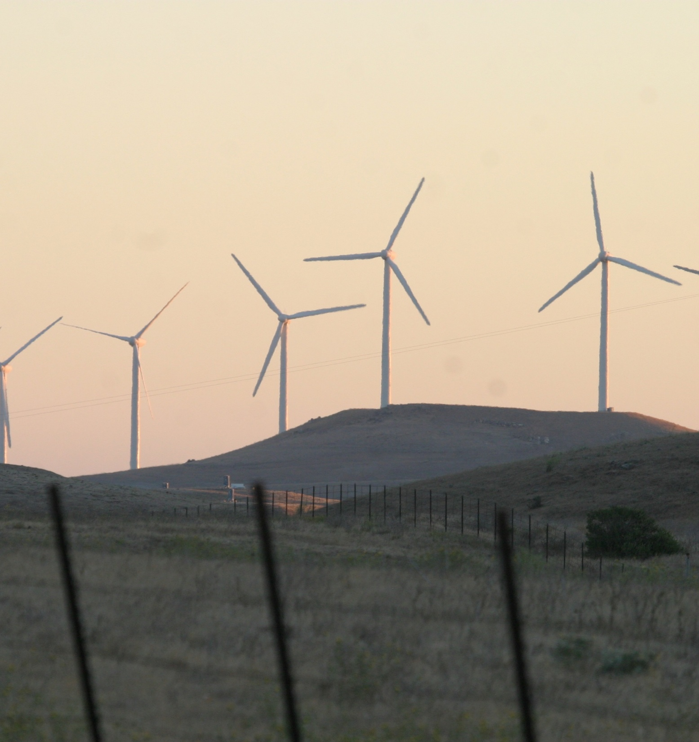
Osage Wind Project: Enel Green Power vs. The Osage Nation
Osage Wind Project in Oklahoma: 84 turbines, ~$250M cost
The Osage Nation owned the sub-surface mineral rights
The Osage Nation called on the operator to get a mining permit and halt construction activity
Federal regulators instructed Enel to get a mining permit
Developer and Enel disregarded the requests
Operator excavated & crushed rock during construction
A Federal judge found this work constituted mineral extraction
Enel was ordered to remove all 84 turbines, restore the land & pay legal fees and penalties.
Enel claim it will cost $259M to remove the turbines.
“It is apparent that this decision was the product of a desire to maximize financial gains by Defendants’ representatives, while recklessly disregarding the risks of infringing upon the mineral rights of the Osage Nation.”
– U.S. District Court Judge, Jennifer Choe-Groves

Slide 18
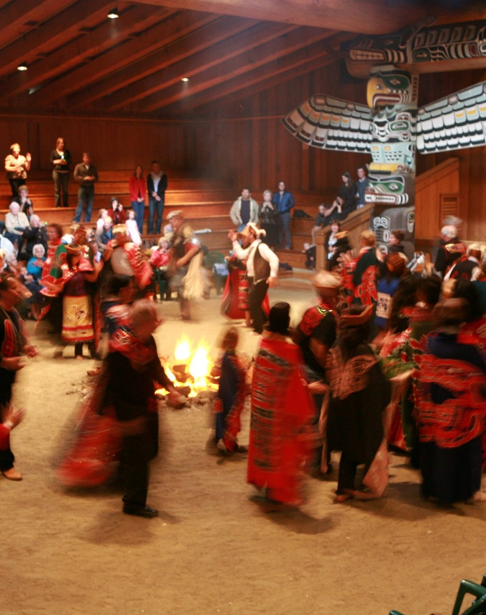
Red Dog Mine - Teck & Northwest Arctic Native Association
Through early consultation and demonstrated environmental responsibility trust was earned
Agreement forged – Teck brought know-how; NANA retained title & received royalties that steps up with output
NANA members receive preferred employment and contracting status; salaries above state average
NANA shares royalties with 11 other regional Native corporations
Mining taxes funded the creation and continued operation of a local government and services.
Both Teck and NANA have worked together on permitting and legal issues
“With the Company having established itself as an environmentally responsible developer in the exploration phase of Red Dog Mine, initial opposition to mining was reduced and the Landowner was more receptive to considering a mining venture.” – U.S. Bureau of Mines
“The partnership between the Landowner and the Company represents a melding of environmental, social, culture and economic interest.” – U.S. Bureau of Mines

Slide 19
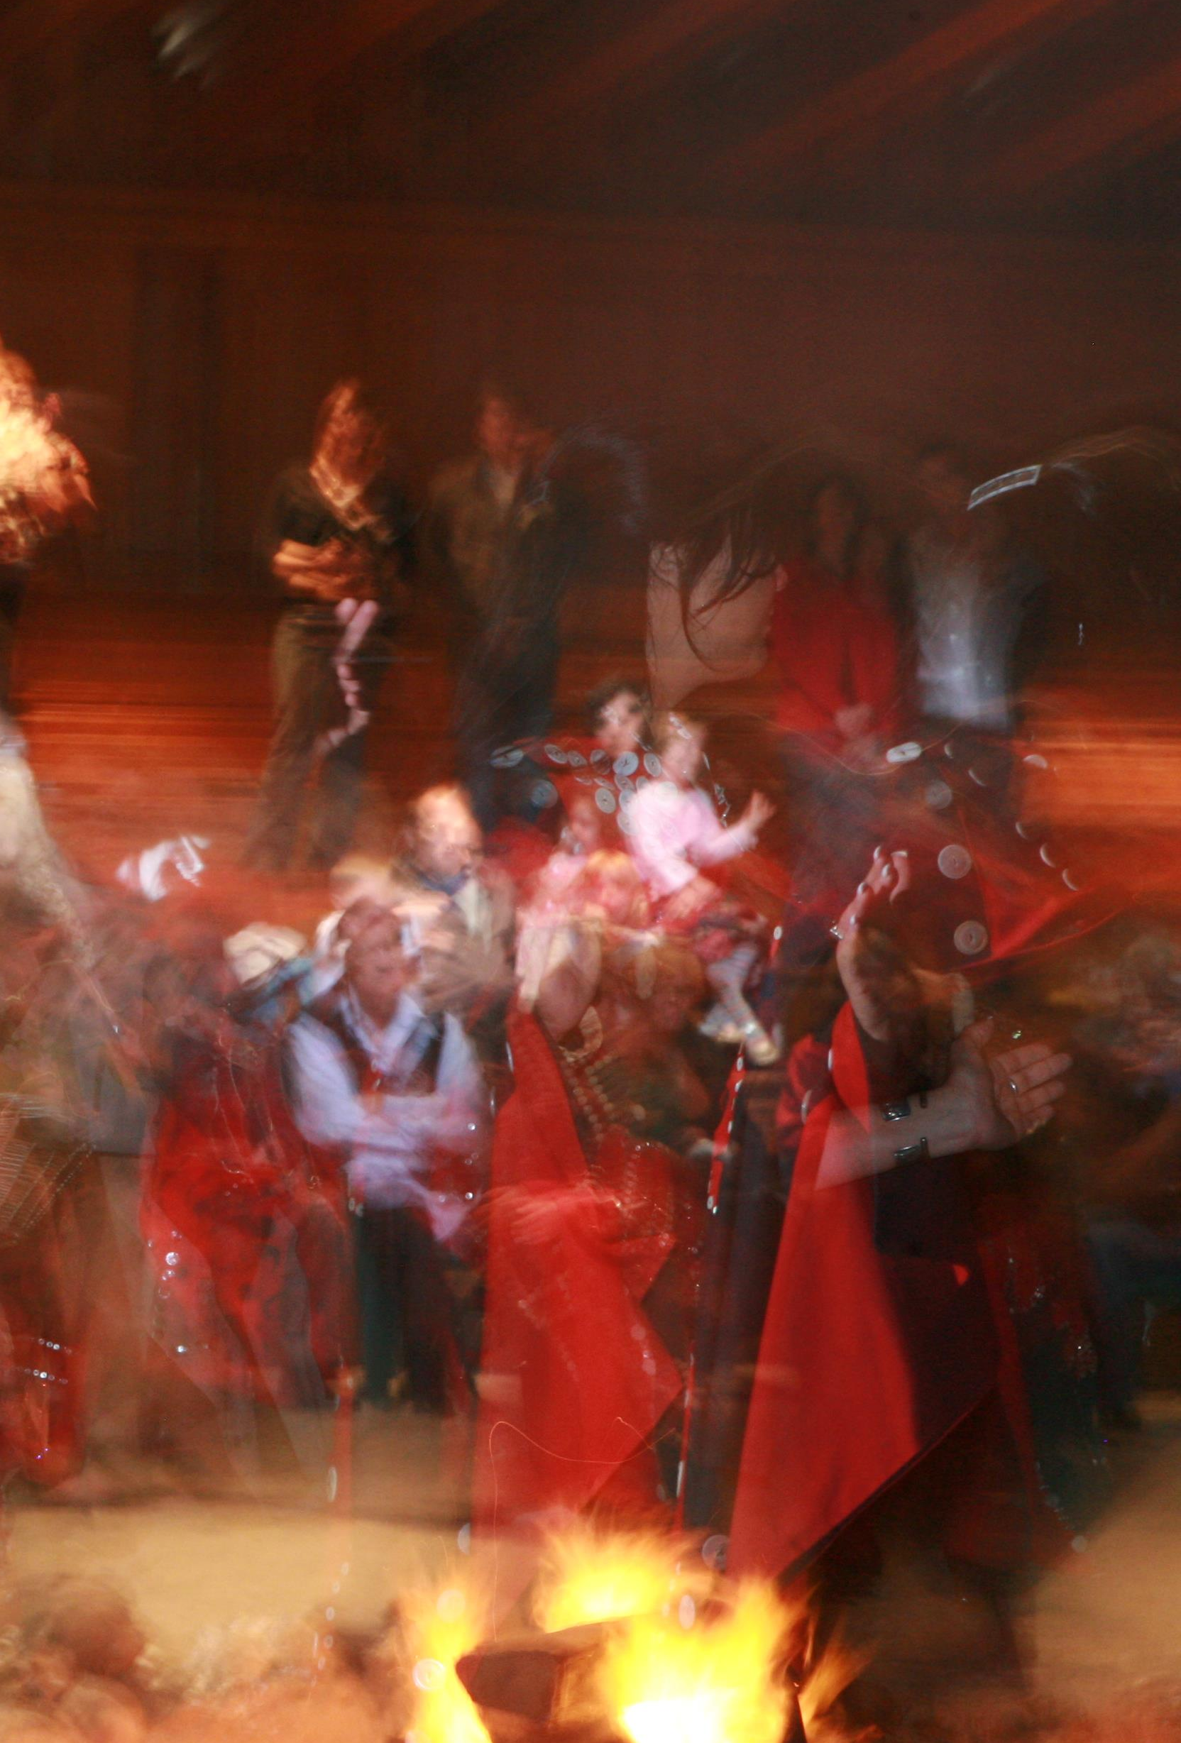
DeLamar Gold– Integra Resources + Shoshone-Paiute Tribe
Integra worked in advance with the Tribe on infrastructure siting and environmental safeguards
Integra negotiated a Lower-48 first-of-kind negotiated partnership
Tribe member to be involved in all aspects of mine management through project life
Planning & development addresses cultural and environmental considerations
Economic participation: includes benefit sharing & ownership
Collaborative effort to dvp Mine Plan of Operation
The Bureau of Land Management accepted the MPOP starting NEPA EIS process
Early partnership with the Tribe lowers permitting risk and supports timely NEPA advancement
“This Agreement asserts our right to a seat at the table to help direct how things happen in our territory. It supports the Shoshone-Paiute to be a driver of responsible economic development in the region, providing for our people and our neighbors, and protecting our values, interests, and culture”
– Brian Mason, Chairman of the Shoshone-Paiute Tribes

Slide 20
Q&A Session
Sustainable Indigenous Finance: Navigating the Energy Transition

Slide 21

US SIF Indigenous Advisory Council

Slide 22
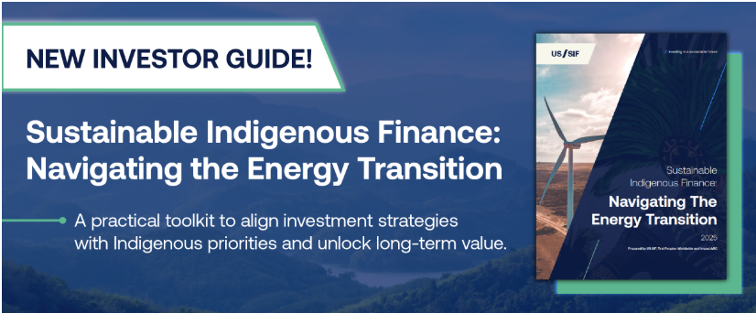

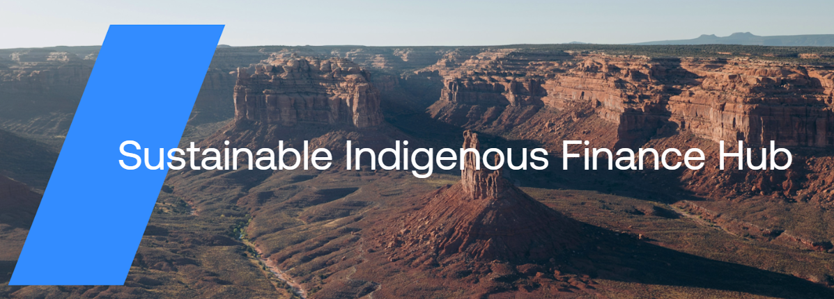
Stay Involved
Sustainable Indigenous Finance Guide
A practical, evidence-based, first-of-its-kind resource designed to help investors implement Indigenous inclusion, engagement and priorities into investment processes.
To download the report, please use the QR code to be directed to our website:
Sustainable Indigenous Finance Hub
A dynamic resource and knowledge hub designed to elevate the voices and work of practitioners and Indigenous Peoples, while serving as a collaborative to share resources, best practices, and innovative approaches.
If you’re interested in partnership opportunities or contributing content, please reach out to Olivia at olieberthal@ussif.org

Slide 23

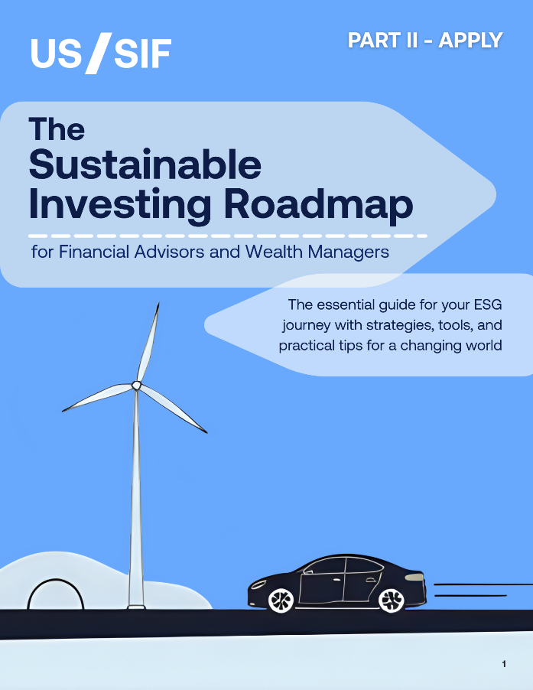
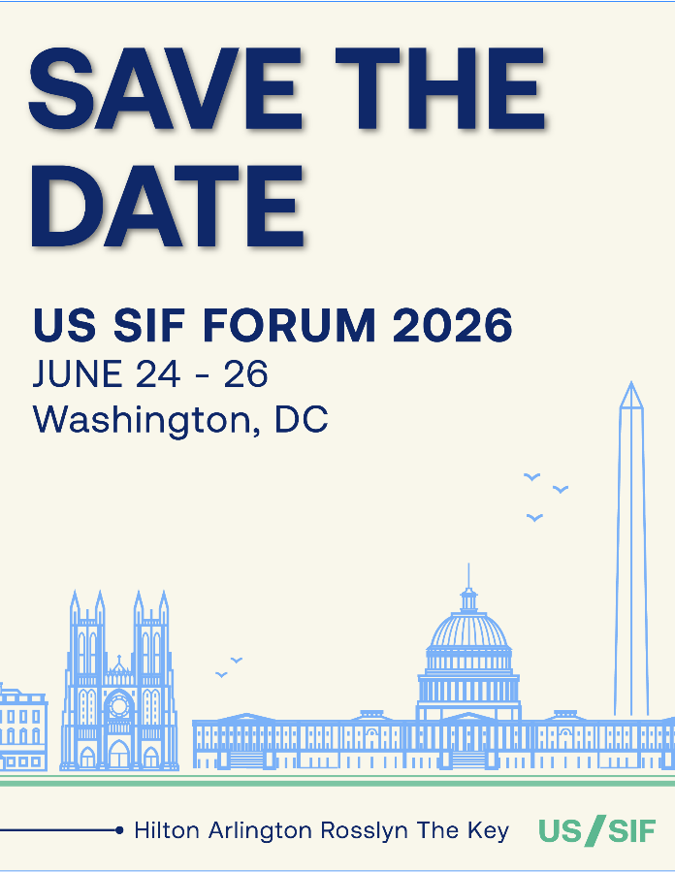
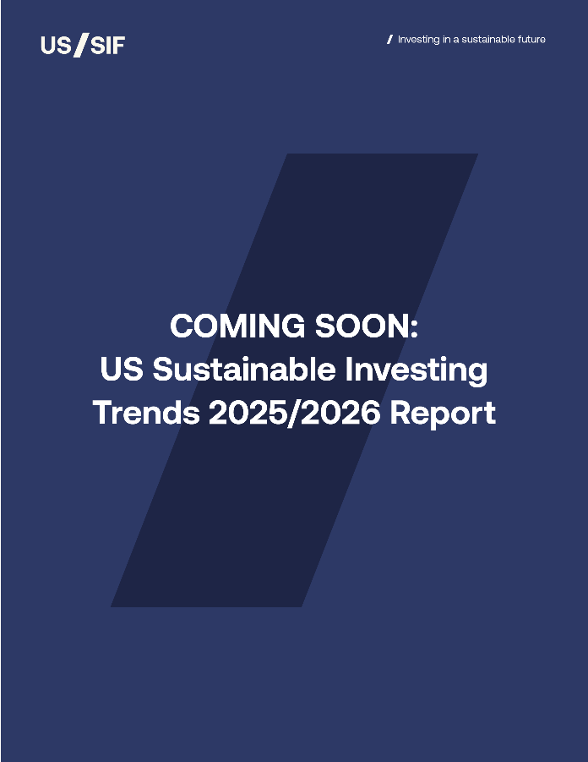
Coming Up Next
Scan to View US SIF Events Calendar!
Financial Advisor Roadmap Series: Part II
November 2025
Save the Date - US SIF FORUM 2026
June 24 -26, 2026
US SIF 2025/2026 Trends Report
December 2025

Slide 24
Disclaimer
This presentation was prepared for informational purposes only and should not be interpreted as financial, investment, or trading advice, nor as a recommendation regarding any specific investment, security, or course of action.
The lists, case studies, and examples of companies, investment managers, and vehicles referenced are provided solely for educational purposes. They do not constitute endorsements, investment solicitations, or marketing materials, nor should they be construed as offers to invest.
This guide is for educational purposes only and does not create any fiduciary or legal obligations beyond those imposed by applicable law. The investment risk analysis tools mentioned in this guide are just some (of many) examples of relevant tools for analyzing investment risk in relation to projects involving Indigenous communities.
The information and views shared by presenters are their own perspectives and are not necessarily attributable to any affiliated organizations or companies.
Thank you!

Slide 25
Thank you for joining us!
olieberthal@ussif.org
https://www.ussif.org

