Slide 1
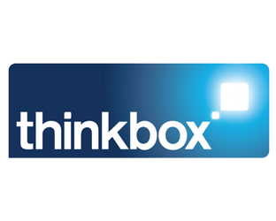
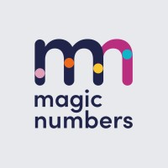
The TV playbook for online businesses

Slide 2
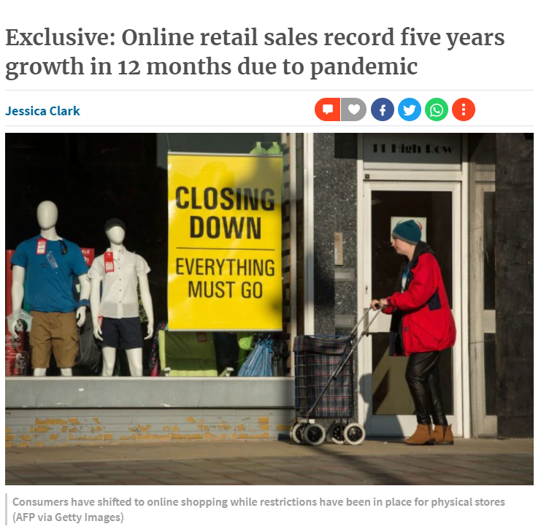
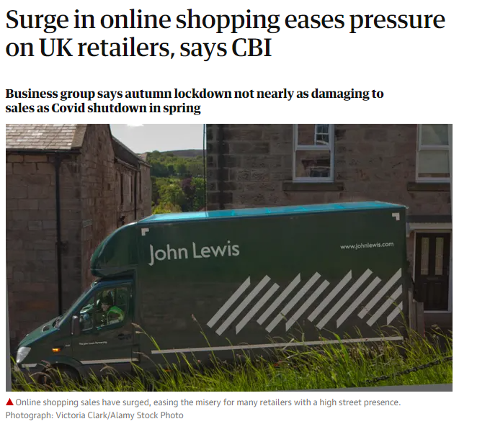
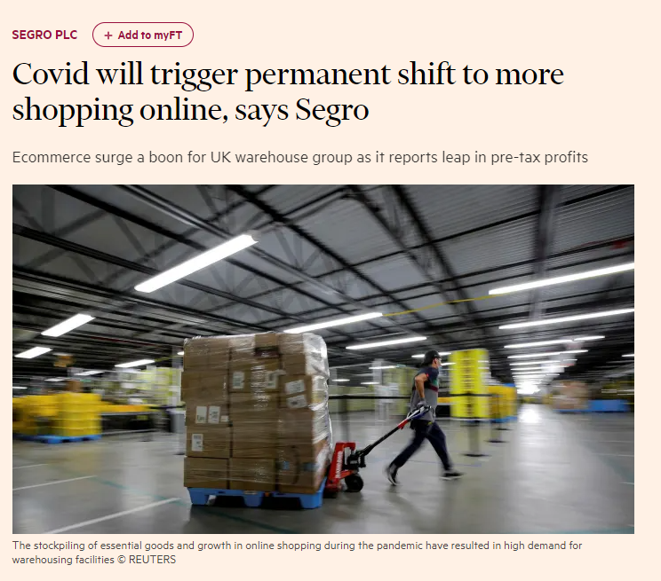
Increased ecommerce is arguably the biggest Covid behavioural shift
Notes:
Out of all the lasting business effects resulting from the pandemic - Increased ecommerce is arguably the biggest behavioural shift
5 years growth in 12 months
This isn’t a flash in the pan impact – light or never online shoppers have had a taste and have enjoyed the convenience this offers
Existing bricks and mortar businesses have been forced to up their game in this area and are now better positioned than ever before to take advantage of this growing opportunity
With this behavioural shift it was clear that advertising was going to be a vital means for these types of business to capitalise on this opportunity as without any physical presence, building brand awareness and top of mind status within a given category is vital for success.

Slide 3
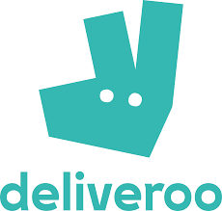
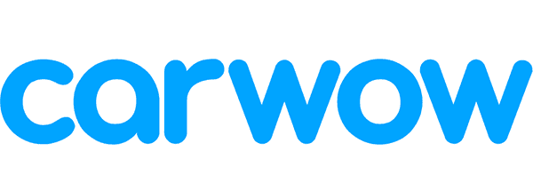
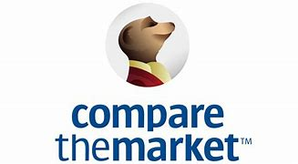
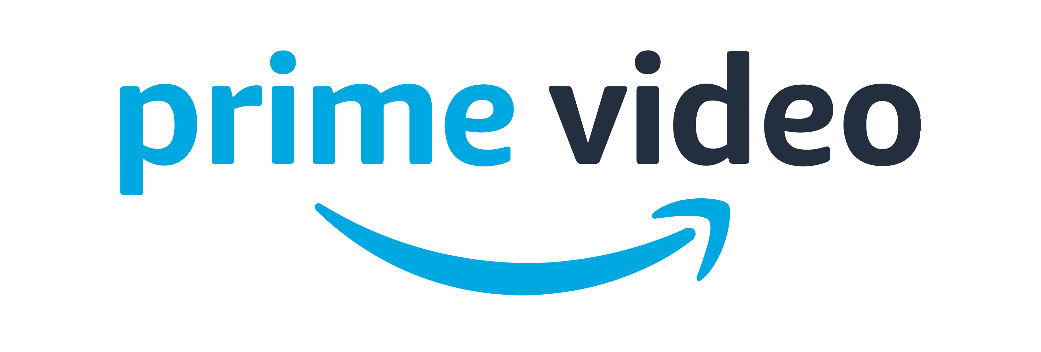
TV is experiencing a surge in spend from ‘online-born’ businesses
194%
+£43m
Increase in linear TV expenditure, Jan to Jul 2021 vs. Jan to Jul 2019
103%
+£32m
235%
+£25m
137%
+£19m
26%
+£16m
72%
∞%
+£12m
+£11m
279%
+£9m
209%
25%
+£8m
+£6m
Jan to Jul 2021 total spend
£65m | £63m | £36m | £32m | £80m | £28m | £11m | £12m | £12m | £32m
Source: Nielsen, Thinkbox-created category of online-born businesses. Brands shown are not the exhaustive list, but account for the majority of spend
Notes:
As we moved into 2021, it became clear that many emerging online brands saw this behavioural shift as their key opportunity to make a land grab. Some established sectors such as price comparison websites significantly increased, but we also saw a whole array of businesses from emerging sectors significantly ramp up their spend – Food delivery/subscription, Online market places, used cars, exercise equipment many seeing triple digit increase in investment.
But this is likely the tip of the iceberg, and with these emerging online businesses having grown up in the world of search and social advertising with return path data, they’re used to being able to directly track the traffic their advertising is generating and so the shift to an advertising channel that can’t join up the dots in the same way can be a daunting step to take .

Slide 4
Our Brief
The
Solution
What role does TV advertising play for online businesses and when?
How does TV advertising work alongside search advertising?
How does the role for TV advertising vary by life-stage or product type?
Business economists Magic Numbers were commissioned to conduct the analysis.
The study used a combination of qualitative interviews and econometric analysis on 10 online businesses that have successfully used TV advertising to drive growth.
Notes:
And it was this challenge that was in our mind when we sent out our brief for this study at the beginning of the year
There were three specific areas we were interested in covering:
What role does TV advertising play for online businesses and when?
How does TV advertising work alongside search advertising? We were particularly interested to learn if the reliance on search for traffic changed as brands moved onto TV or if there were any efficiencies to be gained through increased brand familiarity.
How does the role for TV advertising vary by life-stage or product type?

Slide 5
Conducted qualitative interviews with senior client-side marketers and media specialists
8 hours of insight from marketers working on online brands week in week out
Xabi Izaguirre,
Parcelmonkey
Tom Beardmore,
Chamber
Simon Wilden, Goodstuff
Cheryl Calverley, Eve Sleep
Chris Seigal,
Harry’s
Abba Newberry, Habito
Lucas Bergmans, Cazoo
Source: Magic Numbers, The TV playbook for online businesses (2021)
Notes:
Magic Numbers conducted qualitative interviews with marketers that work on online brands week in and week out as part of the first stage of this study. This included five senior client side marketers; Xabi Izaguirre (Parcelmonkey), Cheryl Calverley (Eve Sleep), Chris Seigal (Harry’s), Abba Newberry (Habito) and Lucas Bergmans (Cazoo). Media specialists Tom Beardmore (Chamber) and Simon Wilden (Goodstuff) were also interviewed. Drawing on their knowledge, these experts were asked about their experience scaling ecommerce businesses, their decision to use broad reach media including TV, and the effects of going live on TV. Search also played a role in the discussions addressing how they use it, how it works and how it works alongside TV advertising.

Slide 6
Comprehensive econometric analysis of 10 brands that have seen success through TV advertising
Over
120m
website visits
£106m
of spending on TV
30 years
of advertising experience
Source: Magic Numbers, The TV playbook for online businesses (2021)
Notes:
With the research grounded in econometrics, the modelling occurred in two stages. The first addressed the source of web visits where multiple factors contributed to visits. Analysis looked at the contributions by external non media factors (including the economy, weather, the impact of COVID and competitor activity), TV ads (peak, non-peak and on demand), paid brand search, paid generic search as well as other media utilised by these advertisers.
The second phase of modelling establishes how TV and other elements drive different types of online journeys. This stage specifically explored website visits that were ‘assisted by’ paid search to investigate what prompts people to click on a brand or generic paid search ad. Evaluating the type of online journey TV prompts was important as journeys that involve paid brand search are cheaper than journeys that involve paid generic search, which are the most expensive of all.

Slide 7
Multiple considerations were taken into account to understand the impact of TV and other media
Mobility
Mobility
Mobility
A range of online born business models, specifically brands that have seen success through TV advertising
Analysis conducted using data that was available to buy or access through open data sources
Limitations with platforms such as Facebook and YouTube to determine cost per response
Analysis excludes BVOD as unable to attain a three year set of data that would be required for this specific model
Data sources: Similarweb, BARB, Nielsen AdIntel, Google mobility, ONS, Google trends, CASS, SMMT, Investopedia, news articles
Notes:
All modelling was conducted using data that was available to buy or access through open data sources; Similarweb was used for the estimates of web traffic and paid for search activity, Nielsen AdIntel was used to model investment into linear TV, Radio and Out of Home. The other data sources used in the modelling were BARB, Google mobility, ONS, Google trends, CASS, SMMT, Investopedia, news articles.
Due to the limited data available from walled gardens such as Facebook and YouTube, although it was possible to determine what traffic was derived from a social platform, it wasn’t possible to model a cost per response. Magic Numbers also looked to investigate the role of BVOD, but were unable to attain a three year set of data that would be required for this specific model.

Slide 8
Findings
3 signs it’s time for TV
The effects of TV on your business
TV drives cost-effective search
A 2-step approach that works
Source: Magic Numbers, The TV playbook for online businesses (2021)

Slide 9
3 signs it’s time for TV
“Good Finds” – Gumtree

Slide 10
01: A clever new product “Unless you land two or three points that explain our product you're not really going to get people to come to the website with the right level of intent in the first place. And it's hard to deliver those three messages outside of TV.”
Lucas Bergmans, Group Brand Director at Cazoo
“Sofa” – Cazoo
Notes:
TV is the perfect medium for brands to educate consumers and drive website visits simultaneously - especially if the product is clever, new, or difficult to understand. This subsequently has a positive impact on conversion rate by bringing prospective customers to the site that understand the proposition.

Slide 11
This brand offers a home gym product + online community
They reached 200k visits per week at a cost 300 times lower than their hero product’s price
Source: Magic Numbers, The TV playbook for online businesses (2021)
Notes:
This is true for a home gym equipment business who used TV to communicate the value of having an online community alongside with their equipment. Analysis showed that this brand reached 200k visits per week at a cost per visit 300 times lower than their hero product’s price through their TV campaign.

Slide 12
This furniture brand saw website conversion improve with TV advertising
TV brings people that understand the proposition and more likely to buy
Source: Advertiser own econometric data
Notes:
TV brings people with the right ‘level of intent’ to the site, who have already understood the proposition and are ready to buy. A method to measure the ‘level of intent’ is to analyse the website conversion rate (the proportion of all visitors that purchased). The below chart shows the conversion rate as well as TV impacts for a furniture brand. On average, in weeks when more TV ads were watched, the website conversion rate is higher. This highlights that TV brings consumers who are more likely to complete the purchase journey. This brand can be seen increasing their volume of traffic through a larger TV presence to drive awareness and consideration and ultimately increase their conversion rate.

Slide 13
02: Need to scale fast “At HelloFresh we were spending a significant amount of our marketing budget on TV every month because the category was early stage and we had well-funded competitors.
Chris Seigal, Senior Director, Direct to Consumer at Harry's Inc previously Director of Growth, HelloFresh US
“Family Meal” – Hello Fresh
Notes:
The boom of online businesses has seen incredible growth from brands who are battling to stay at the top of their category. These brands are often driving the digital disruption of a category and find that they need to scale quickly so they can dominate against their competitors – a strategy seen in meal kit brands, price comparison websites and more recently selling cars online.

Slide 14
This brand is currently driving the digital disruption of 2nd hand cars
They reached 0.5m visits per week after scaling up TV spend
Scale up phase
Experimentation phase
Source: Magic Numbers, The TV playbook for online businesses (2021)
Notes:
Of the brands analysed, a second-hand online car dealership (driving the digital disruption within their category) reached 0.5m visits per week after scaling up TV investment.

Slide 15
03: Run out of efficient online buys “Your CPC goes up significantly, so your cost per engagement goes up significantly. And you’re getting over what your target CPA is. Everything's become inefficient. And often, that’s the point where the business acknowledges, you need to start doing offline advertising.”
Tom Beardmore, Director, Chamber
“You Make Us” – Monzo
Notes:
The third sign that you are ready for TV is when your normal marketing mix (typically performance marketing) no longer seems to be working – key signs include a loss of efficiency in offline channels or slow / no growth. Therefore, the usual media mix must be reviewed and replaced with an alternative strategy to continue to unlock growth.

Slide 16
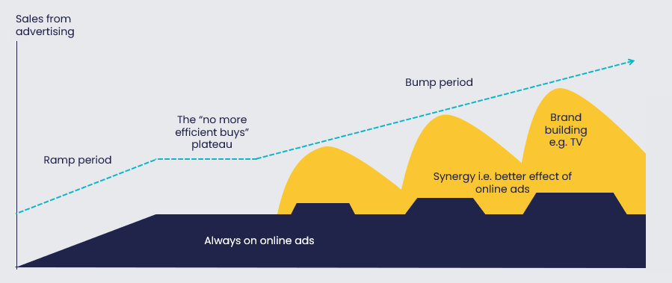
A typical stage in the life of an online born business
It’s a consequence of success, when you’ve already reached everyone that’s easy to convert
Source: Grace Kite and Tom Roach
Notes:
As seen below, the typical life cycle of an online born business begins with initial growth, ramping up through short lived activation ads online and sustaining performance activity to communicate to consumers that are in market, especially those who are not loyal elsewhere. After a period, this growth becomes stagnant, and brands need to reach outside the immediately available pool of customers to grow. Eventually, they are able to break through the plateau during the ‘bump period’, utilising brand building and attention holding media such as TV. Whilst the brands benefit from the direct effect of launching on TV, there is also a synergy between media as there is an increase in the effectiveness of their performance marketing channels (that they would have previously relied on.)

Slide 17
This dieting brand broke through the plateau
By investing into TV they unlocked growth directly and through better response to paid search
Bump period
The “no more efficient buys” plateau
Ramp period
Source: Magic Numbers, The TV playbook for online businesses (2021)
Notes:
This pattern was seen in the brands analysed. TV modelling revealed that a dieting brand had a peak weekly web traffic of 111,000 visitors and an average of 23,300 prior to trialing TV. Following their TV launch, the peak rose to 378,000 visitors and the average increased to 99,000 visitors.

Slide 18
Summary – 3 signs it’s time for TV
You have a clever new product – you need to educate and drive visits at the same time
Need to scale fast - you & competitors are driving digital disruption of the category
You’ve run out of efficient performance marketing buys and need to look elsewhere
“Save Christmas” – eBay
Source: Magic Numbers, The TV playbook for online businesses (2021)
Notes:
3 signs it’s time for TV
A clever new product - when understanding your proposition makes people more likely to buy
TV is a useful medium to educate consumers at scale, directing engaged consumers who understand the product and are more likely to purchase.
A home gym equipment business, with a novel proposition, reached 200k visits per week at a cost per visit 300 times lower than their hero product’s price through their TV campaign.
When you need to scale fast
A second-hand online car dealership reached 0.5m visits per week after scaling up TV investment.
When you run out of efficient online buys
Growth for these brands tended to come to a halt when additional spend in their usual marketing mix no longer delivered as much incremental returns and so need to review their media mix to continue to unlock growth.
Modelling revealed that a dieting brand had a peak weekly web traffic of 111,000 visitors and an average of 23,300 prior to trialing TV. Following their TV launch, the peak rose to 378,000 visitors and the average increased to 99,000 visitors.

Slide 19
The effects of TV on your business
“Low Prices on Gifts” – Amazon

Slide 20
“We have an amazing video of the founder shooting his web analytics platform the night that they ran their first TV spot. And he's with his family looking at the counter on GA and saying ‘Yeah! This many people on site!’ And you can hear him and his family, they’re cheering.”
“I’ve got a video somewhere of where we're all geeking-out because of having the TV on. Watching the Google Analytics and just going nuts”
“As the spot ran we saw a huge surge in traffic and conversions. Seeing visits shoot up, flow through our site and convert remains as exciting as the day we launched. The excitement doesn't and shouldn’t go away”
Source: Magic Numbers, The TV playbook for online businesses (2021)

Slide 21
TV drives immediate impact
R^{2=0.90}
Source: BARB/Google Trends, Jan 2019 – Jul 2021

Slide 22
This is seen in an increase in search volume aligned with TV activity
R^{2=0.91}
Source: BARB/Google Trends, Jan 2019 – Jul 2021

Slide 23
Seasonal factors also impact search volume
R^{2=0.69}
Source: BARB/Google Trends, Jan 2019 – Jul 2021

Slide 24
Across the 10 brands modelled, TV was the biggest single source of traffic
Contributing 42% of all visits, around 50m in all
Breakdown of web visits by driver
Source: Magic Numbers, The TV playbook for online businesses (2021)
Notes:
One of the benefits of TV is the immediate effect it can deliver, in this case a surge in website visits. Analysis across the brands consistently showed a clear relationship between TV activity and web traffic. The uplift in website visits is visible regardless of the level of investment or the size of the launch and is likely impacted by the ease and convenience of searching immediately via a mobile device.
Naturally, these brands are dependent on marketing, with c.80% of visits driven by marketing comms. Across the 10 brands modelled, 120m visits were generated, with TV driving 42% of all visits (equivalent to 50 million in total.)

Slide 25
Cost per visit was £1.90-£2.50 for 6 of our 10 brands
This is a pretty good benchmark to use in planning
£1.90-£2.50 is a good benchmark
But there is variation
Complex financial product
Simple D2C highly optimised
Compares favourably to generic search cost
e.g. gift delivery £1-3
e.g. financial services £5-11
6 of the 10 brands we modelled had a TV cost per visit between £1.90 and £2.50
Source: Magic Numbers, The TV playbook for online businesses (2021), Google Ads, FS – Financial Services
Notes:
Across the 10 brands analysed, TV drove 50 million visits at an average cost per visit of £2.11. A range of costs per visits were seen across the brands. A gift delivery brand delivered the cheapest cost per visit at £0.40 – this is a direct-to-consumer brand with a simple proposition who have optimised their TV plan over the years to target low cost visits. At the other end of the scale, a financial service brand delivered a cost per visit of £27.30, this brand sells mortgages which is a high-ticket product with a long purchase cycle, which can justify this higher CPV, but their TV strategy is more focussed on driving longer term credibility and trust in their brand, rather than visits. Despite this variance, the majority (6 of the 10 brands modelled) had a TV cost per visit between £1.90 and £2.50. In comparison to generic search where costs are hugely variable where a typical cost per click (visit) in gift delivery is £1-3 and in financial services £5-11.

Slide 26
Additionally TV provides scale in a way that other offline channels can’t
It’s because TV has higher reach – 68% of adults watch ads on live TV every day
Ideal for an offline channel is to drive lots of visits at a low cost per visit
Source: Magic Numbers, The TV playbook for online businesses (2021)
Notes:
The analysis found that TV is more cost efficient in comparison to Out of Home and Radio (the other offline channels used by the 10 brands). Despite the larger investment in TV (vs. Out of Home and Radio), the number of web visits driven showed that TV provided good value visits at scale.

Slide 27
TV has the longest-lasting effects
Brand TV has effects lasting up to 2 years after airing
Source: Magic Numbers, The TV playbook for online businesses (2021)
Notes:
Brand TV and Out of Home advertising delivers lasting effects, with 50% of sales seen in the first 14 weeks following activity and the other 50% seen in the remaining two years after airing. This is in sharp contrast to Search and Social which have an immediate impact but short-lived effects.

Slide 28
“The only way we're going to get out of this trap of having to keep pushing money in, of 60% of our sales being driven by marketing, is by generating underlying brand awareness, underlying brand strength. The long-term strategic play, that base sales layer to fall back on”
Cheryl Calverley, CEO, Eve Sleep
“Cuddly Toy” – Eve Sleep
Notes:
TV is particularly potent for brands as this long-term strategy provides a safety net of base sales (i.e. sales that you generate without the need for marketing activity) in the event that marketing activity has to stop.

Slide 29
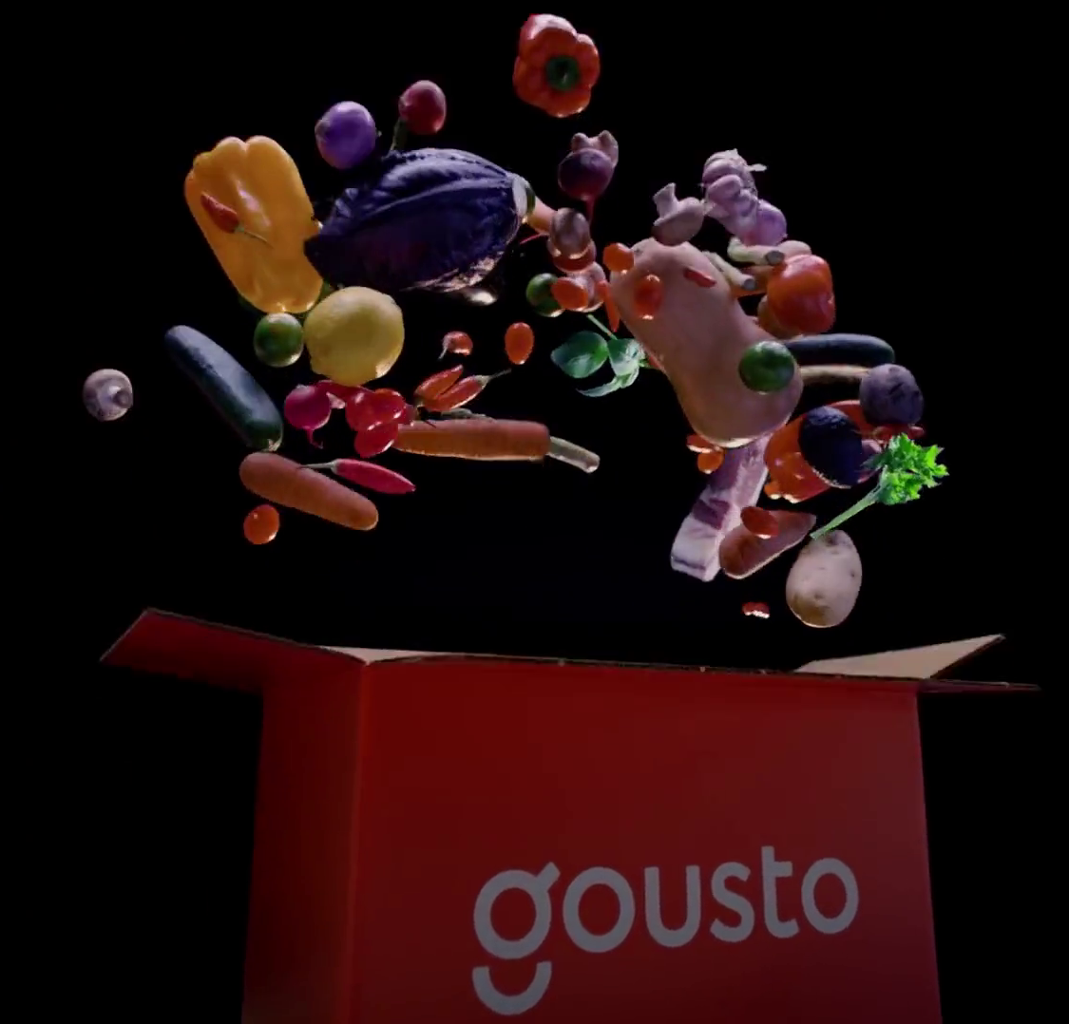
Summary – The effects of TV on your business
An immediate response visible in your dashboards
A big effect at a cost per visit comparable to that of search advertising
Lasting ad effects that grow base sales
“Give It Some” – Gousto
Source: Magic Numbers, The TV playbook for online businesses (2021)
Notes:
The effects of TV on your business
An immediate response visible in your dashboards
Individual brand data consistently shows a clear relationship between TV activity and web traffic. Across the 10 brands modelled, TV drove 42% of all visits, 50 million in total.
A big effect at a cost per visit comparable to that of search advertising
Across the 10 brands analysed, TV drove 50 million visits at an average cost per visit of £2.11.
6 of the 10 brands we modelled had a TV cost per visit between £1.90 and £2.50. In comparison to generic search where the costs are hugely variable but a typical cost per click (visit) in gift delivery is £1-3, and in financial services £5-11.
Lasting ad effects that grow base sales
TV is also effective at brand building. Brand focused TV advertising alongside Out of Home advertising was shown through the modelling to have the longest-lasting effects, delivering 50% of sales in the first 14 weeks following activity and the other 50% in the remaining two years after airing.

Slide 30
TV drives cost-effective search
“Did Somebody Say Just Eat” – Just Eat

Slide 31
Most online journeys prompted by TV involve your brand name early
Which means more cost effective search performance
Breakdown of web visits by driver
The journeys initiated by ATL channel
Source: Magic Numbers, The TV playbook for online businesses (2021)
Notes:
Within search advertising, direct, organic and paid brand search visits are highly desired as these are the cheaper and, in some cases, free visits. TV and search have always been strongly linked. Brands can capitalise on these searches as analysis showed that most online journeys prompted by TV involve your brand name early which means lower spend in the search environment. TV (in comparison to Radio and Out of Home) lands the brand name better than the other offline channels as it encourages people to search the brand and not the category.
Of the journeys initiated by TV, 66% were direct/URL or organic search visits (which carry zero additional cost), 20% were paid for brand search clicks (which carry a small search cost), and 14% were for paid generic searches (that carry a high search cost).

Slide 32
Click through rates are important
Directly, and because the Google algorithms respond
Direct traffic
Organic traffic
Paid traffic
Time to long click and so ranking
Online adspend
Quality score and cost per click
Organic search click through rate
Paid search click through rate
Sales
TV
TV
Source: Magic Numbers, The TV playbook for online businesses (2021)

Slide 33
Brand paid search environment is not a level playing field
It’s much harder to be a smaller, less well known brand
“New e-commerce brands haven't been bought by people, or their families, or their friends.
People see them on telly, but if, when they go to Google that brand name, they see a name they recognise more they’ll choose that instead.
Why would you choose Bloom and Wild if M&S or Interflora is there?”
Cheryl Calverley, CEO, Eve Sleep
You are small, competitor is big
Competitor gets a good CTR on your brand name
They can buy ads for your brand cheaply
You always have to buy your own brand terms
Source: Magic Numbers, The TV playbook for online businesses (2021)

Slide 34
The situation is even worse in generic search
Being small is even harder here
“The big guns come in and competitor x does a campaign
And then you're talking about millions of pounds coming into the PPC market that we can't keep up with.”
CMO, ecommerce brand
You are small, competitor is big
Competitor gets better CTR on generic ads
They can buy category terms cheaply
They have a bigger budget & get better value
Source: Magic Numbers, The TV playbook for online businesses (2021)

Slide 35
Summary – TV drives cost-effective search
TV drives cost effective web visits because it prompts people to look for your brand not the category
“Big Sis” – Bloom & Wild
Source: Magic Numbers, The TV playbook for online businesses (2021)
Notes:
TV drives cost-effective search
TV drives cost effective web visits because it prompts people to look for your brand not the category
Of the web visits initiated by TV, 66% were direct/URL or organic search visits (which carry zero additional cost), 20% were paid for brand search clicks (which carry a small search cost), and 14% were for paid generic searches (that carry a high search cost).

Slide 36
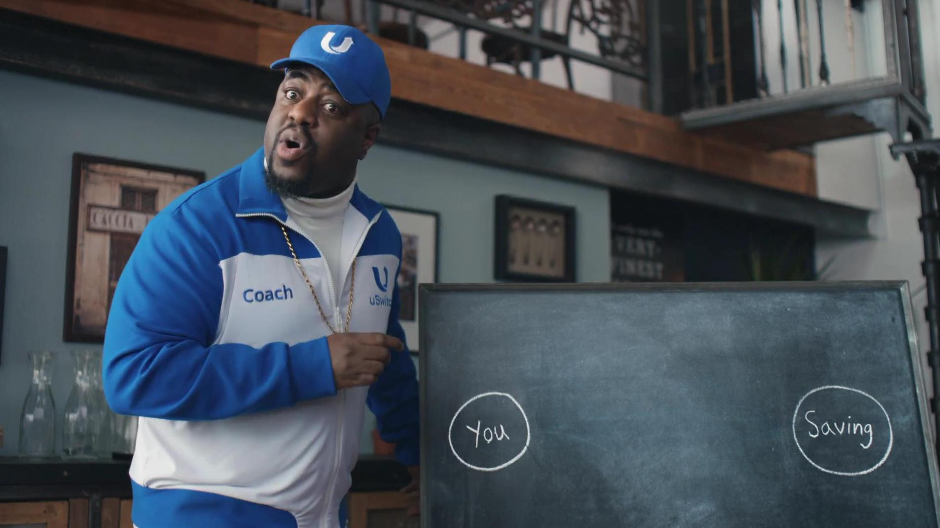
A 2-step approach to TV that works
“Step by Step” –Uswitch

Slide 37
Start with TV that allows test and learn
“Calm Bull” – moneysupermarket.com
Notes:
This advice has been developed through the qualitative research with the industry experts who have successfully used TV advertising to grow online businesses, alongside the strategies employed by the 10 brands modelled in the econometric analysis.

Slide 38
Start by targeting low cost visits with an activation film
Brand focused film
Minimise cost of visits
by use of lower rating TV programming and dayparts
Maximize reach
of buyers by use of higher rating dayparts
Test & learn with a activation strategy
Response focused film
Source: Magic Numbers, The TV playbook for online businesses (2021)
Notes:
When delving into the world of TV advertising, acquisition or response focused TV provides an initial starting point for a brand to test and learn the best approach for their business.
This type of TV advertising is often referred to as DRTV (Direct Response TV).
DRTV can be mistakenly thought of as daytime and weekday only airtime, as it’s a legacy term from the days of call centres – you’d plan your response focused campaigns to play out at a time when someone was there to pick up the phone.
But with response now, in the main, occurring via the internet, there are no boundaries for when someone responds to an ad they’ve just seen.
It does though, still refer to lower cost airtime, which generally means, no prime time (8-11pm) on the larger channels. DRTV should be thought of as TV advertising that conforms to the following parameters:
Targets an immediate response (call to action focussed creative, airtime targeting the audience most likely to buy)
Lower priced airtime (no peak on larger rating channels)
The next stage of growth will likely require a move away from an efficiency-based strategy

Slide 39
Take advantage of seasonal peaks & cheaper TV periods
JAN
FEB
MAR
APR
MAY
JUN
JUL
AUG
SEP
OCT
NOV
DEC
Retail
SALES & TV COST INDEX
FMCG
SALES & TV COST INDEX
Finance
SALES & TV COST INDEX
Source: ‘Supercharge: TV for small businesses’, May 2019, Data2Decisions/Work/Thinkbox. Data2Decisions database of smaller brands
Notes:
Best time for TV based on two key factors:
Seasonality of your sales
The cost of TV
TV campaigns at low budgets should follow these guidelines

Slide 40
Start with low budget bursts & build up presence
Optimal laydown for different investment levels - FMCG
JAN
FEB
MAR
APR
MAY
JUN
JUL
AUG
SEP
OCT
NOV
DEC
Source: ‘Supercharge: TV for small businesses’, May 2019, Data2Decisions/Work/Thinkbox. Data2Decisions optimisations based on database of smaller FMCG brands
Notes:
At lower budgets a ‘burst’ strategy is optimal as priority weeks to be on air with a TV campaign should be based on seasonal peaks and lower TV costs
However, as the budget increases it is better to move towards a continuity strategy adding in more weeks of TV – this is to avoid diminishing returns

Slide 41
Shorter TV ads can deliver greater ROI for small advertisers
Source: ‘Supercharge: TV for small businesses’, May 2019, Data2Decisions/Work/Thinkbox. Data2Decisions database of smaller brands. Base = 30s
Notes:
For smaller brands, shorter length TV ads are most effective. In particular, 20” ads which provide enough time to build awareness. Shorter 10” cut downs can be effective as sustaining effects or delivering a very simple message.

Slide 42
Awareness helps activation work harder for new to TV advertisers
Based on an average small retail brand with annual brand TV spend of £0.5m and tactical TV spend of £200k
Activation message
Awareness message
The primary role of TV (Especially for newer or smaller businesses) should be to drive brand awareness.
Once a brand becomes familiar to people, activation messages that deliver a call to action or highlight offers or promotions, become more effective too.
The research found that there’s +14% increase in effectiveness if activation messages follow branding campaigns.
Weeks
+14% sales response on activation activity
Weeks
Source: ‘Supercharge: TV for small businesses’, May 2019, Data2Decisions/Work/Thinkbox. Data2Decisions database of smaller brands.
Notes:
The primary role of TV should be to drive brand awareness. This doesn’t mean that it shouldn’t also deliver a call to action, but for newer or smaller advertisers, the focus should always be getting the brand out there and making it known.
Once a brand becomes familiar to people, activation messages that deliver a call to action or highlight offers or promotions, become more effective too. The research found that there’s +14% increase in effectiveness if activation messages follow branding campaigns. The benefits don’t stop there. Non-TV activation channels (such as search/affiliates/DM etc) will also see an increase as brands becomes more familiar and people feel more confident in purchasing them.

Slide 43
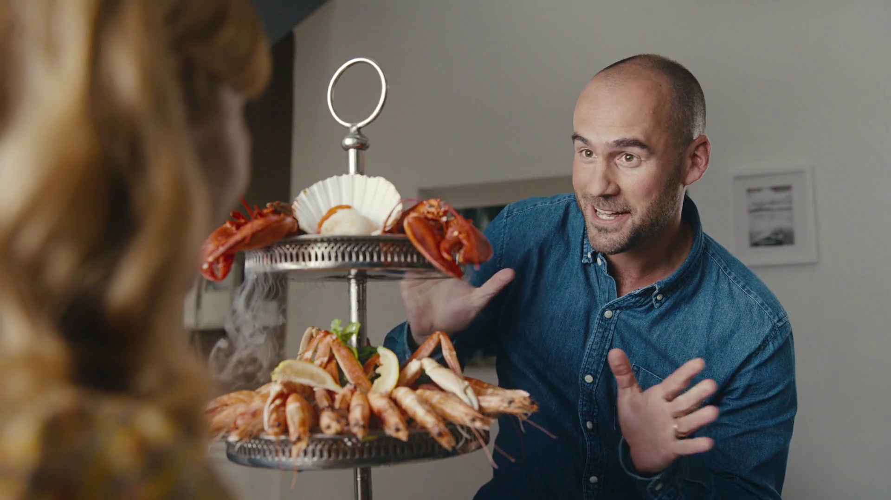
There is a right way to shift into brand focussed advertising
“Meal” – Cinch
Notes:
Depending on your brands circumstances, there is a right way to shift into brand focussed advertising which is working with agencies and using a different strategic approach:
A move away from test and learn into professional media planning
And a move away from the kind of creative content that works online to higher quality and more expensive films, made by an advertising agency
There are already a number of very good agencies that are specialised in working with online born brands:
They’ve done this before and can offer the right advice
And they can negotiate good deals on TV spots because they are always buying space from the big TV media owners and have the right relationships

Slide 44
The right strategy depends on your circumstances
This insight was provided by media agencies Goodstuff and Chamber
Brand focused film
Be here if:
Competition is fierce
High ticket price
Long purchase cycle
Mature product/category
Minimise cost of visits
by use of lower rating TV programming and dayparts
Maximize reach
of buyers by use of higher rating dayparts
Be here if:
Test & learn phase
Clear proposition
Low ticket price
Short purchase cycle
No/little competition
Be here if:
Disrupting the category
Need to explain your product
Need to scale fast
Response focused film
Source: Magic Numbers, The TV playbook for online businesses (2021)
Notes:
As described in the first step - you’ll likely start in the bottom left on this chart, targeting low-cost visits with a response focussed film and you may well never need to move from that quadrant if your circumstances continue to suit this strategy: that is when the sell is not a particularly hard sell; you’ve got a product that’s easy to understand and not too expensive; and the competition isn’t too fierce.
But when you hit the ceiling, i.e. increasing spend through this strategy no longer drives incremental web traffic, you’ll likely need to move out of that quadrant and start to either pay a bit more per visit, but reach more people and get a larger scale response - or invest in a richer creative that is capable of generating a longer lasting impact – or both - and if you go for both you’re going to be moving towards the red corner on this chart, which is where brand building advertising is necessary.
The blue corner is one that’s not typically talked about for established TV advertisers. But this is an important option for many online brands and particularly those that are disrupting their category, doing something very different, or need to scale fast. This is where you try to reach as many potential category buyers as possible, but the ad itself doesn’t have to be focussed on delivering an emotional connection – the new way of doing things is better, right? The job for the ad is to introduce that new way and explain it.

Slide 45
Our successful TV-using brands generally mixed activation and brand TV
With the mix in line with the approach we just saw
Complex
D2C
High ticket price
Need to scale fast
Source: Magic Numbers, The TV playbook for online businesses (2021), FS – Financial Services
Notes:
The most likely solution will be a blend of brand and activation, but many advertisers in this study, who have all successfully seen growth through TV followed this suggested approach:
The brands that have a complex product, need to scale first and fast, or had a high-ticket price – tended to go for a mix that had a lot of high-reach dayparts.
Those that had a relatively simple proposition, a clear thing they are selling that can just be sent straight away tended to stick more with the cheaper, lower rating dayparts.

Slide 46
Summary – A 2-step approach to TV that works
Start with acquisition/response focused TV that allows test and learn.
Depending on your brands circumstances, there is a right way to shift into brand and reach focussed advertising, which will likely involve working with agencies and using a different strategic approach.
“Midas Touvch” – Purple Bricks
Source: Magic Numbers, The TV playbook for online businesses (2021)
Notes:
A 2-step approach to TV that works
The following guidance is based on the findings from the expert interviews and the approach to TV used by the 10 brands in the study.
Start with acquisition/response focused TV that allows test and learn
Most online businesses should first establish the business case for TV advertising through an acquisition/response focused campaign:
Target an immediate response (call to action focussed creative, airtime targeting the audience most likely to buy).
Lower priced airtime (no peak on larger rating channels).
The next stage of growth will likely require a move away from an efficiency-based strategy.
Depending on your brands circumstances, there is a right way to shift into brand focussed advertising.
Working with both a media and creative agency will benefit businesses looking for the next stage of growth.

Slide 47
In summary
3 signs it’s time for TV
The effects of TV on your business
TV drives cost-effective search
A 2-step approach that works
Source: Magic Numbers, The TV playbook for online businesses (2021)
Notes:
3 signs it’s time for TV:
You have a clever new product – you need to educate and drive visits at the same time.
Need to scale fast - you and competitors are driving digital disruption of the category.
You’ve run out of efficient performance marketing buys and need to look elsewhere.
The effects of TV on your business:
An immediate response visible in your dashboards.
A big effect at a low cost per visit expect £1.90 – £2.50.
A layer of base sales to rely on if you ever need to switch off advertising.
TV drives cost-effective search:
TV drives cheaper journeys because it prompts people to look for your brand, not the category.
A 2-step approach that works:
Start with TV that allows test and learn, and is keenly priced, i.e. lower rating channels and dayparts.
Depending on your brands circumstances, there is a right way to shift into brand and reach focussed advertising, which will likely involve working with agencies and using a different strategic approach.

Slide 48
Appendix

Slide 49
Analysis included ten brands that have seen success through TV advertising
Covering a range of business models, categories, and TV investment
Source: Magic Numbers, The TV playbook for online businesses (2021), FS – Financial Services

Slide 50
3 years of web visits for each brand - analysed to see the effect of TV
Econometrics is the gold standard - it untangles TV from other things that drive visits
Non-media
TV ads
All web site visits
Paid brand search
Other ads
Paid generic search
Weather
Covid
Economy
Market
Series A
Series B
Series C
Competitor visits and Launches
Live TV peak
Live TV non-peak
TV on demand (BVOD)
Visits
Visits
Social
Radio
OOH
Cinema
Press
Source: Magic Numbers, The TV playbook for online businesses (2021). Data sources in the public domain: Similarweb, DDS, Addynamix, Google mobility, ONS, Google trends, CASS, SMMT, Investopedia, news articles

Slide 51
Additional models to identify TV visits that were “assisted by” paid search
These show what prompts people to click on a brand or generic paid search ad
Non-media
TV ads
Brand paid search visits
Other ads
Generic paid search visits
More expensive online journeys
Source: Magic Numbers, The TV playbook for online businesses (2021)

Slide 52
And it’s clear, visits do respond rapidly and noticeably to TV
In this example it’s a big spending unknown brand at launch
Total TV spend £20m
Source: Magic Numbers, The TV playbook for online businesses (2021)

Slide 53
And TV visits were good value for money vs other offline channels
Lower cost per visit than Out of Home and Radio
These brands spent a lot on TV
So we expect a lot of visits
Spend ÷ visits reveals value
Source: Magic Numbers, The TV playbook for online businesses (2021)

