Slide 1
A Matter of Time
Notes:
Exploring the impact of time-length in TV advertising

Slide 2
TV’s questions of time
What is the impact of different time lengths?
Do I need long and short ads?
How do I use different time lengths most effectively?
Can a story be told in 10 seconds or less?
Notes:
What’s the impact of time length in TV advertising? Do you need a mix of short and long ads? Can you tell a story in less than 10 seconds?
These are some of the most common questions about TV advertising – and for good reason.
We’ve long known the power of story-telling in advertising. The ability to connect emotionally with viewers is one of the fundamental drivers of TV’s effectiveness for brands.
But as video has become ubiquitous across platforms, we need to broaden our understanding of AV to understand if conventional copy-length wisdom still applies.
The research agency Work undertook a small-scale study that explored the role of time in TV advertising and importantly, its relationship with storytelling. Given the study’s size, we can’t claim it’s representative of how all ads of varying length work, but we believe it to be a good indication.

Slide 3
TV advertising consists of two things..
Storytelling
&
Memory
Notes:
The best TV advertising does two things. Firstly, it tells us compelling stories. Secondly, it stimulates our emotions which in turn drives our long-term memory.

Slide 4
The challenge…
Incredibly difficult to extrapolate the impact of previous brand experience from exposure and creative
Used existing creative treatments and brands that were unfamiliar to the UK market but for categories that were highly familiar
Notes:
Although the question of time-length is one that’s enduring within media research, there is relatively little research out there. Why? Because the impact of previous brand experience and past exposure cannot be underestimated. It’s virtually impossible to extrapolate those elements from the creative effects unless you start with an entirely new brand.
Creating a new, fake brand, however, is hard to do convincingly without a ‘proper’ proposition and some serious cash for the creative.
Partnering with Walnut, Work Research devised a research framework that managed to jump the biggest hurdles of this kind of research.
Firstly, they selected four existing creative treatments (three emotional and one rational) for brands that were unknown in the UK but sat within categories that were very familiar. These were retail, insurance, broadband and washing detergent.

Slide 5
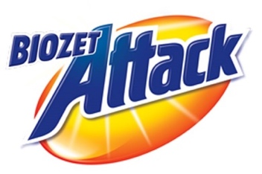
Four unknown brands
Long
60 seconds
Explicit brand perceptions…
“I think”
Medium
30 seconds
Implicit brand perceptions…
Short
10/6/5 seconds
“I feel”
Notes:
A team of real-life ad agency creatives tweaked the brands, giving them new identities. This way, we could be sure that none of the respondents had any previous brand history that could muddy the results.
Next, the team of creatives formed a set of cut-downs for each using exactly the same processes they would for any of their clients. These cut-downs were then vetted by several different teams to ensure that creatively, they made sense and were fair representations of the original ads. Time-lengths were categorised as follows:
Long – 60”
Medium – 30”
Short – 10”, 6” or 5”
Finally, each of the ads were taken into an online test where each iteration was shown, in amongst a reel of other ad ‘clutter’, to 200 people each.

Slide 6
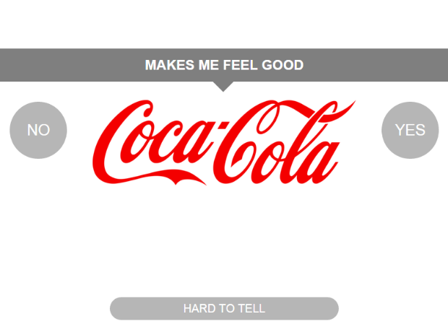
Reaction time test
Trustworthy
‘Yes’
+ Reaction time is FAST
Says it and TRULY believes it
‘Yes’
+ Reaction time is SLOW
Says it but does NOT truly believe it
Notes:
They were tested against two factors:
Explicit perception statements (to see what people thought and consciously remembered about the brands)
Implicit brand perceptions tests (to understand what people felt about them or thought they just knew for themselves)
The latter was tested via ‘IRT’ (Implicit Reaction Testing). If someone truly believes or disbelieves something, their initial reaction tends to be strong and automatic. The more doubt they have the slower the reaction time as the brain must consciously consider what is being processed and this slows the response down.
Around half of the respondents were tested again several days later. Some saw the ad repeated (either full length or cut-down) again whilst others didn’t which gave an indication of the decay rate for the measured effects.

Slide 7
Four findings
Longer ads have benefits over shorter executions
Longer ads act as memory ‘anchors’
Longer ads enhance image memory
Brand awareness decays faster than brand perception
Notes:
Key Findings:
Longer ads have benefits over shorter executions
Longer ads act as memory ‘anchors’
Longer ads enhance image memory
Brand awareness decays faster than brand perception

Slide 8
1) Longer ads have benefits over shorter executions
Notes:
Longer ads have benefits over shorter ones
Longer ads delivered a 42% uplift to explicit brand statements over short ones and were therefore, unsurprisingly, better at delivering a greater volume of information.

Slide 9
Longer ads deliver more explicit brand information
Explicit agreement to brand statements
91%
64%
Source: A Matter of Time, 2019, Work/Walnut/Thinkbox. Based on 3 brands (3 x short ad; 3 x long ad)
Notes:
Longer ads delivered a 42% uplift to explicit brand statements over short ones and were therefore, unsurprisingly, better at delivering a greater volume of information.

Slide 10
Longer ads work even harder at an implicit level
Implicit agreement to brand statements
64%
36%
Source: A Matter of Time, 2019, Work/Walnut/Thinkbox. Based on 3 brands (3 x short ad; 3 x long ad)
Notes:
Longer ads worked much harder at an implicit level, however, where they almost doubled the implicit effects over short ads. The longer ads were evidently shifting brand feeling and sentiment more effectively, which is especially poignant when you consider that these brands were totally unknown to the respondents.

Slide 11
Longer ads act as memory ‘anchors’
Notes:
Longer ads work as memory ‘anchors’

Slide 12
Our brains seek out stories
If there are gaps we fill ‘blind spots’ with made-up information
This is called ‘reconstructive memory’ (Bartlett)
Notes:
Our brains are programmed to seek out, respond to and remember stories. Storytelling has helped us learn, educate and evolve since the dawn of humanity. Stories engage more of the brain and create universal patterns that transcend culture and language. But how does this relate to copy-length?
Our brains like order - and if there is no order they try to create it. If there are gaps in information, our brains fill them in. That is why two people can have very different recollections of the same event. We rely on ‘reconstructive memory’ to fill in the blanks and make sense of what we’ve experienced.

Slide 13
What does this mean for advertising?
Longer, more comprehensive stories = fewer gaps to fill
With shorter ads the brain defaults to ‘reconstructive memory’
Notes:
In advertising terms, this means that the longer ads often have a stronger sense of narrative and are therefore more comprehensive. There are fewer gaps for our brains to fill in and advertisers have more control over how their brand is perceived.
Behavioural science shows us that product experience is inherently tied to brand memory (see our study From Brand to Bland). An enhanced brand memory is likely to result in a positive brand experience.
Longer ads therefore act as ‘anchors’ for our memory, providing the basis for positive brand memory and reducing the need for reconstructive memory to kick in.

Slide 14
Longer ads enhance memory effects
=
+28%
Improvement in explicit brand perception
3-5 days
=
Improvement in explicit perception
+9%*
3-5 days
=
Improvement in explicit perception
+51%
Source: A Matter of Time, 2019, Work/Walnut/Thinkbox. Based on 3 brands (3 x short ad; 3 x long ad) * Based on one test cell for one 10 second ad
Notes:
When a short ad is seen after a long ad, there’s a 51% uplift in explicit memory effects versus just 9% for seeing a short ad in isolation. This is including a gap of several days between viewing the ads and testing.

Slide 15
Longer ads enhance image memory
Notes:
Longer ads enhance image memory

Slide 16
Our brains don’t work like video cameras…
We evoke memories by story still snapshots
This is why imagery is so important in building effective brands
Context and narrative are key drivers of brand memory
Notes:
Our brains don’t work like video cameras. We evoke memories by storing still snapshots of events. This is why iconic imagery is so crucial to TV advertising and building effective brands. Both context and narrative are key drivers of brand memory and these inherently come from strong brand stories.

Slide 17
Same imagery, similar duration, different levels of recall
Recall of imagery
71%
52%
Source: A Matter of Time, 2019, Work/Walnut/Thinkbox. Based on 3 brands (3 x short ad; 3 x long ad)
Notes:
In our experiment, the same imagery was included in both the long and shorter ads, for a similar duration of time in each instance. However, the memory of key scenes in the longer ads is 37% higher (based on the average indices of all ads where same scenes are in both long and short versions) than it is for the shorter ads.
However, the memory of key scenes in the longer ads was 37% higher (based on the average indices of all ads where same scenes are in both long and short versions) than it is for the shorter ads.
This shows that the narrative context is hugely influential in driving the recall of iconic imagery and the narrative context is enhanced through longer ads.

Slide 18
Brand awareness decays faster than brand perception

Slide 19
Awareness decays faster than perception
Explicit perception
Implicit perception
Implicit scene memory
Prompted brand awareness
Spontaneous brand awareness
-18%
-20%
-60%
-83%
-87%
Source: A Matter of Time, 2019, Work/Walnut/Thinkbox. Based on 4 brands. Delay was 3-5 days post-exposure.
Notes:
We also discovered that the metrics most commonly tracked as indicators of brand health – spontaneous and prompted brand awareness – decay much faster than the implicit and explicit brand perception measures.
There was 87% and 83% decay respectively for spontaneous and prompted brand awareness several days after the first exposure versus 20% decay for implicit perceptions and 18% for explicit.
Implicit memory of scenes from ads also decayed more slowly at around twice the rate that brand perceptions did. In other words, people remember the key messages and feelings towards a brand and the visuals of the ad over the brand’s name.

Slide 20
People remember stories
Notes:
All of this highlights the importance of emotion in advertising and also supports Heath’s theory of LIP – that even when we are paying relatively little attention to ads, we’re still forming a set of associations and feelings around brands that endure beyond exposure even if we can’t consciously recall the brand name.
Given that this study was looking at just one or two exposure of a previously unfamiliar brand, it demonstrates the narrative power of advertising in shaping brand associations and the importance of harnessing the power of storytelling to drive those associations in the most positive manner. It also supports what Thinkbox has found in a previous study which is that branding works best when interwoven into the narrative of an ad rather than relying solely on branding in an end frame.

Slide 21
In summary
Longer ads have benefits over shorter executions
Longer ads act as memory ‘anchors’
Longer ads enhance image memory
Brand awareness decays faster than brand perception
Notes:
Summary:
Longer ads have benefits over shorter executions
Longer ads act as memory ‘anchors’
Longer ads enhance image memory
Brand awareness decays faster than brand perception

