Slide 1
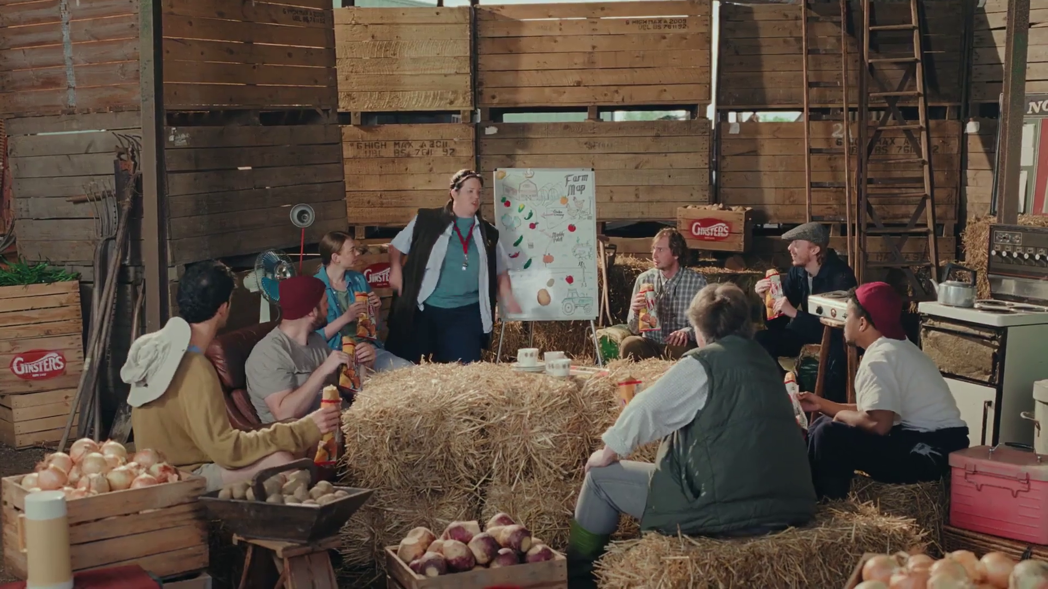

VOD Viewing
Ginsters – Taste the Effort

Slide 2
Total TV accounted for 70% of total video viewing in 2025
4 hrs 54 mins
Source: 2025, Barb / IPA TouchPoints 2025 / Pornhub / UK Cinema Association / Ipsos Iris
Total TV = Broadcaster TV, SVODs & AVODs
Notes:
Methodology
The quantitative analysis of total video consumption in the UK was undertaken by Thinkbox. It combined 2025 data from Barb, the IPA’s TouchPoints, Pornhub, UK Cinema Association, and Ipsos Iris.
Barb data shows how much time is spent viewing broadcaster content, live or time-shifted (including BVOD) on all devices as well as Blu-Ray/DVD viewing. This chart also utilises Barb’s expanding audience reporting capabilities to provide a view of time spent viewing content on YouTube, TikTok, other video sharing services (such as Twitch) as well as SVOD/AVOD platforms. Whilst Barb reports on in-home consumption, a combination of Ipsos Iris and IPA TouchPoints data was used to determine the remaining out-of-home consumption.
The combination of these sources creates a solid estimate as it utilises the robustness of Barb data (11,500 panel members, representative of the UK TV population, metered actual consumption data, analysis across a whole year) alongside Ipsos Iris and IPA TouchPoints data to capture any out-of-home consumption.
Time spent viewing video at cinemas was based on total admissions data from the UK Cinema Association profiled for each audience using data from DCM.
Source: Ipsos iris Online Audience Measurement Service, 12-month average Jan – Dec 2025. Internet users aged 15+, using PC/laptop, smartphone or tablet device.
Technical note: [Broadcaster] data for YouTube includes content owner data for the BBC, Channel 4, CNBC, ITV, NBC and Sky. [Commercial broadcaster] data for YouTube includes content owner data for Channel 4, CNBC, ITV, NBC and Sky. TikTok data is both website and app.
Ipsos iris is the UKOM endorsed service for the measurement of audiences of online content. We passively track the online behaviour of a single-source panel of over 10,000 UK adults, who install software across their devices (a combination of smartphones, tablets, PCs and laptops). The panel is recruited to be representative of the internet population demographically, geographically and by device type. This passive data is fused with anonymous, device-level data derived from site-centric tags on hundreds of the biggest sites and apps to create a synthetic panel of around 1 million synthetic panellists. More detail on the methodology can be found here.

Slide 3




Viewing to TV content is mainly on the larger screen
 | Total TV | YouTube | TikTok | All other online video | % of all video time
 | 95.8% | 44.7% | 0.6% | 6.6% | 84.3%
 | 1.4% | 16.4% | 1.3% | 58.0% | 3.8%
 | 1.4% | 8.1% | 4.6% | 5.5% | 2.5%
 | 1.4% | 30.8% | 93.4% | 29.9% | 9.4%
Source: Barb 2025, Total TV = Broadcaster TV, Total SVOD/AVOD. Adults.

Slide 4
SVOD & video-sharing seasonal viewing consistent across 25
Adults – All devices
Source: Barb, 2025, Online Multiple Screens Network, Adults 16+, All devices
Notes:
Broadcaster viewing across 2025 highlights the impact of seasonal viewing, whilst viewing to SVOD platforms and video sharing services was broadly consistent.

Slide 5
For adults, broadcaster viewing has the largest share
Adults – All devices
Source: Barb, 2025. Adults 16+. Online Multiple Screens Network
Notes:
This chart looks at Barb’s audience reporting capabilities. The focal meter data provides further insight into SVOD and video-sharing platforms to provide a view on ‘total identified viewing’ which includes:
Total broadcaster viewing – represents the time spent watching linear broadcast channels and broadcaster-owned VOD services (BVOD). This includes live viewing, as well as pre- and post broadcast viewing, and viewing to archive box-sets on a BVOD service. We capture and report this viewing across four screens — TV sets, tablets, PCs and smartphones. For tagged services, this includes any streaming regardless of whether it was through the home WiFi network.
Total SVOD/AVOD viewing - includes 19 VOD services — notably Amazon Prime Video, Disney+ and Netflix. Viewing is reported on all four screens, although this only includes viewing through a home’s WiFi network.
Total video-sharing– includes viewing — again on all four screens — to platforms such as TikTok, Twitch and YouTube. Our audience reporting for video-sharing platforms only includes viewing through a home WiFi network.

Slide 6
For 16-34s, viewing remains consistent across the year
16-34 – All devices
Source: Barb, 2025. 16-34. Online Multiple Screens Network
Notes:
This chart looks at Barb’s audience reporting capabilities. The focal meter data provides further insight into SVOD and video-sharing platforms to provide a view on ‘total identified viewing’ which includes:
Total broadcaster viewing – represents the time spent watching linear broadcast channels and broadcaster-owned VOD services (BVOD). This includes live viewing, as well as pre- and post broadcast viewing, and viewing to archive box-sets on a BVOD service. We capture and report this viewing across four screens — TV sets, tablets, PCs and smartphones. For tagged services, this includes any streaming regardless of whether it was through the home WiFi network.
Total SVOD/AVOD viewing - includes 19 VOD services — notably Amazon Prime Video, Disney+ and Netflix. Viewing is reported on all four screens, although this only includes viewing through a home’s WiFi network.
Total video-sharing– includes viewing — again on all four screens — to platforms such as TikTok, Twitch and YouTube. Our audience reporting for video-sharing platforms only includes viewing through a home WiFi network.

Slide 7
Commercial broadcasters are unrivalled for scale
Adults – All devices
Bubble area represents total volume of daily viewing
AVERAGE DAILY REACH (000s)
Other
SVOD
Other AVOD
Twitch
AVE TIME VIEWED PER VIEWER PER DAY
Source: Barb / Adults, all devices – 2025
Notes:
This chart breaks down viewing to the various platforms in terms of the average number of people watching per day (for at least 3 minutes) compared with the average time spent watching per viewer (i.e. only counting those who watched on that day).
Analysis across 2025 shows that the commercial broadcasters (linear and on demand) collectively reach over 26 million viewers every day, with each of those viewers watching for an average of 3hrs, 40 mins a day. The combined portfolio of BBC channels (linear and on demand) attracts the second largest volume of viewing, with 22 million daily reach and an average view time of 2 hours, 12 mins a day. YouTube is next, with a daily reach of 18 million and a view time of 1hr 53 mins (Barb only measure in-home viewing, we estimate that YouTube would be larger in viewing time if out of home viewing was included).
SVOD services such as Netflix has a daily reach of 12 million people and a view time of 1hr 52 mins.

Slide 8
Highest reach & most viewing is delivered by Commercial TV
Adults – TV Set
Bubble area represents total volume of daily viewing
AVERAGE DAILY REACH (000s)
Other AVOD
Other SVOD
TikTok
Twitch
AVE TIME VIEWED PER VIEWER PER DAY
Source: Barb / All adults, TV sets – 2025
Notes:
This chart breaks down viewing to the various platforms in terms of the average number of adults watching per day (for at least 3 minutes) on a TV set compared with the average time spent watching per viewer (i.e. only counting those who watched on that day).
Analysis across 2025 shows that the commercial broadcasters (linear and on demand) collectively reach 26 million adult viewers every day, with each of those viewers watching for an average of 3hrs, 40 mins a day. The combined portfolio of BBC channels (linear and on demand) has a daily reach of 21 million and an average view time of 2hr 12 mins. YouTube has a daily reach of 7 million adults and a view time of 2hr 13 mins.
SVOD services such as Netflix has a daily reach of 10 million people and a view time of 1hr 51 mins.

Slide 9
Three ways to watch Total TV
Adults
16-34
3 hrs 26 mins
1 hr 47 mins
Source: 2025, Barb, VOD includes Broadcaster VOD, SVOD and AVOD
Notes:
Breaking down Total TV into the different ways reveals the increasingly important role of Live and VOD viewing.
This data uses both Barb data and includes an estimate of any unknown viewing that is thought to fall into Playback and Live viewing.

Slide 10
VOD enabling us to watch more entertainment, drama & films
Adults – TV set
MINUTES PER PERSON PER DAY
Source: Barb - TV set only, Adults, 2025
Notes:
This data highlights how both the content people watch and the way they watch it are changing.
Last year, audiences spent more time watching Entertainment, Drama, and Film, and video on demand was a key driver. VOD offers the choice and control that viewers seek for this type of content.

Slide 11
VOD enabling 16-34s to watch more entertainment, drama & films
16-34 – TV set
MINUTES PER PERSON PER DAY
Source: Barb - TV set only, 16-34s, 2025
Notes:
This data highlights how both the content 16-34s watch and the way they watch it are changing.
Last year, 16-34s spent more time watching Entertainment, Drama, and Film, and video on demand was a key driver. VOD offers the choice and control that viewers seek for this type of content.
However, Sport, News, Hobbies, and Current Affairs are still predominantly consumed through linear TV.

Slide 12

Primetime drama has high levels of on-demand viewing
1.49m
37% Live
viewing (any device)
4.03 million adult viewers
2.54m
63% On-demand viewing (any device)
Source: Barb, 2025, Adults, Live +3min. Murder Before Evensong, S1 Ep1, 7th Oct, Channel 5, All Devices.
Notes:
Prime time drama has high levels of on-demand viewing because it’s not time sensitive so people choose to watch it at a time that suits them.
In this example, the launch episode of Murder Before Evensong on Channel 5 had 37% live viewing and 63% on-demand.
37% live
63% on-demand

Slide 13

Content released as a boxset can receive high pre-broadcast viewing
3.42m
47% Pre-broadcast viewing (any device)
7.41 million total viewers
2.16m
29% Time-shifted viewing (any device) within 28 days of broadcast
1.74m
24% Live TV set viewing
Source: Barb, 2025, Adults, Live +3min. Protection (PKA Witness Protection), ITV1, 31st Mar, Online Multiple Screens, All Devices.
Notes:
Content that’s released as a boxset before being shown live on broadcaster TV often attracts high levels of pre-broadcast viewing.
In this example, this episode of Protection (PKA Witness Protection) on ITV1, received 47% of the total audience to the pre-broadcast on-demand release.
47% pre-broadcast
24% live on a TV set
29% time shifted

Slide 14

Weight of viewing is a key factor in incremental reach
4
12
25
47
75
115
169
244
360
734
Average mins per day of linear TV
Lightest tier 0-19%
Middle tier 20-49%
Heaviest tier 50-100%
Source: PwC UK, Barb, all viewers split into tenths based upon their weight of linear TV viewing
Notes:
Detailed analysis by PwC (as reported in ‘BVOD Almighty: Reach and Return’) has identified a segment that are important drivers of why BVOD is delivering incremental reach.
This chart shows the viewing population split into ten equal groups (deciles) based upon amount of liner TV viewing per week.
The lightest decile averages 4-mins of linear viewing per day. Up to the heaviest decile who view for 734-minutes (12-hours 14-minutes) per day.
The deciles have been split into three groups:
Lightest tier. These are very hard to reach on TV (linear or BVOD) and are most likely to be targeted via platforms such as YouTube
Middle tier.
Heaviest tier. These are quite east to reach via linear TV and, as a result, BVOD probably has little role to play.

Slide 15
‘Middle tier’ of viewers are key to BVOD’s incremental reach
All viewers split into tenths based on their weight of linear TV viewing
Linear
0-19%
Lightest tier
Middle tier 20-49%
Heaviest tier 50-100%
BVOD
% contribution to viewing
Source: PwC UK, Barb, all viewers split into tenths based upon their weight of linear TV viewing
Notes:
This chart shows for each of the three tiers (and the deciles within them) what proportion of linear and BVOD consumption they account for.
Key to note is that the middle tier (green) proportionally watch a lot of BVOD. Whilst they account for 7% of linear TV viewing, they make up 28% of BVOD consumption.
This makes them the key audience for extending campaign via the use of BVOD – relatively they are easier to reach via BVOD then linear TV.

Slide 16
BVOD provides good odds of reaching an attractive audience
Lightest tier
0-19%
Middle tier
20-49%
Heaviest tier
50-100%
Hard to reach via TV
TV reach extenders
Easily reachable via linear TV
Average odds of reaching segment per exposure
Linear: 1 in 185
Linear: 1 in 14
Linear: 1 in 1.1
BVOD: 1 in 12
BVOD: 1 in 4
BVOD: 1 in 2
Average linear TV viewing per day
8 minutes
49 minutes
5 hours and 24 minutes
skews towards:
ABC1 adults (71%) and 16-34 adults (42%)
Source: PwC UK, Barb, all viewers split into tenths based upon their weight of linear TV viewing
Notes:
… or to put it another way, for every 14 impressions you buy on linear one person falls into the middle tier group (assuming natural delivery)
But on BVOD, it only takes four impressions to, on average, reach somebody in the middle tier. As such, on average, using BVOD is three and a half more efficient than linear at reaching the middle tier of viewers.
The middle tier are very attractive audiences for many advertisers (proportionally younger and upscale) and BVOD enables them to be reached in an efficient way.

Slide 17
A blend of linear and addressable builds cost effective reach
Audience: ABC1 Adults
Source: Barb BVOD Planner (2025, 6 weeks 9-14) / natural delivery / station average prices. Addressable includes BVOD & SVOD Ad Tiers (Netflix, Disney+, and Prime Video).

Slide 18
A blend of linear and addressable builds cost effective reach
Audience: 16-34
Source: Barb BVOD Planner (2025, 6 weeks 9-14) / natural delivery / station average prices. Addressable includes BVOD & SVOD Ad Tiers (Netflix, Disney+, and Prime Video).

Slide 19
A blend of linear and addressable builds cost effective reach
Audience: HP+CH
Source: Barb BVOD Planner (2025, 6 weeks 9-14) / natural delivery / station average prices. Addressable includes BVOD & SVOD Ad Tiers (Netflix, Disney+, and Prime Video).

Slide 20










Top commercial BVOD programmes 2025 (All Devices)
Playing Nice
ITV, 5 Jan
4,230,966
Protection
ITV, 16 Mar
3,958,390
Unforgotten
ITV, 9 Feb
3,561,793
Trigger Point
ITV, 22 Oct
3,080,297
The Great British Bake Off
Channel 4, 9 Sep
2,736,614
Code of Silence
ITV, 18 May
2,538,340
I’m a Celebrity… Get Me Out of Here!
ITV, 17 Nov
2,490,548
Patience
Channel 4, 8 Jan
2,344,424
Karen Pirie
ITV, 20 Jul
2,334,404
Out There
ITV, 19 Jan
2,296,152
Source: Barb, 2025, Adults. Average audience achieved during the first 28 days of their availability. All devices. Commercial BVOD. Top performing episode only.
Notes:
Top commercial BVOD programme 2025 (All devices).

Slide 21
Three quarters of individuals have access to an SVOD service
Source: Barb Establishment Survey, % of population
* = Due to the COVID-19 pandemic and the suspension of face-to-face interviewing, quarterly BARB Establishment Survey data were not produced for Q4 2020, as a result, 2020 Q3 data is used
Notes:
Three quarters of individuals have access to an SVOD service (Amazon Prime Video, Apple TV +, Britbox, Disney +, Hayu, NowTV, Paramount+, Discovery and Netflix.)

Slide 22
SVOD subscriptions returned to growth
Source: Barb Establishment Survey
* = Due to the COVID-19 pandemic and the suspension of face-to-face interviewing, quarterly Barb Establishment Survey data were not produced for Q4 2020, as a result, 2020 Q3 data is used

Slide 23




SVOD ad tier growth increasing high quality TV inventory
Source: Barb Establishment Survey, subscription to ad-tier service

Slide 24










Top Netflix programmes 2025 (TV Set)
Adolescence
13 Mar
12,691,496
The Thursday Murder Club
28 Aug
9,661,971
Harlen Coben's Missing You
1 Jan
6,897,047
Wake Up Dead Man: A Knives Out Mystery
12 Dec
6,825,783
Happy Gilmore 2
25 Jul
5,912,767
Wednesday
6 Aug
5,882,202
Stranger Things
27 Nov
5,795,558
Dept. Q
29 May
5,781,102
Hostage
21 Aug
5,732,640
Monster: The Ed Gein Story
3 Oct
5,181,064
Source: Barb, 2025, Adults. Average audience achieved during the first 28 days of their availability. Only includes TV set viewing. Top performing episode only.
Notes:
Top Netflix programme 2025 (TV set).
Adolescence was the most watched Netflix programme of 2025, pulling an average audience of 12.7 million viewers within 28 days.

Slide 25

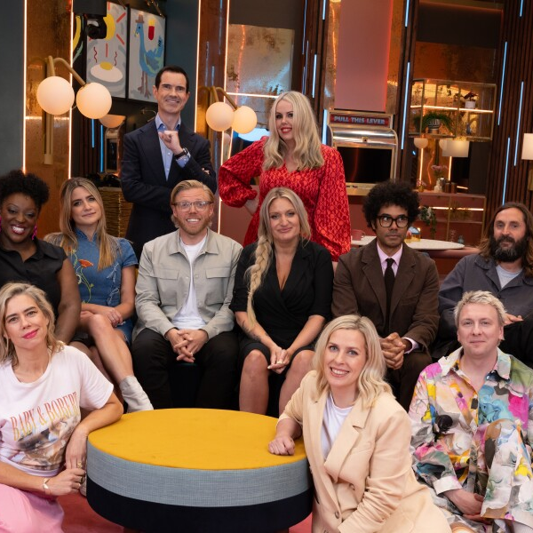








Top Amazon Prime Video programmes 2025 (TV Set)
Clarkson’s Farm
23 May
7,259,234
LOL: Last One Laughing UK
20 Mar
6,008,952
Reacher
20 Feb
4,033,557
Heads Of State
2 Jul
3,103,777
The Assassin
25 Jul
2,938,317
The Accountant 2
5 Jun
2,714,648
A Working Man
15 May
2,431,251
Playdate
12 Nov
2,405,642
The Girlfriend
10 Sep
2,257,737
Fallout
17 Dec
2,153,202
Source: Barb, 2025, Adults. Average audience achieved during the first 28 days of their availability. Only includes TV set viewing. Top performing episode only.
Notes:
Top Amazon Prime Video programme 2025 (TV set).
Clarkson’s Farm was the most watched Amazon Prime Video programme of 2025, pulling an average audience of 7.3 million viewers within 28 days.

Slide 26










Top Disney+ programmes 2025 (TV Set)
Moana 2
12 Mar
3,593,422
Thunderbolts
27 Aug
2,183,865
Alien: Earth
13 Aug
2,005,840
Lilo & Stitch
3 Sep
1,891,505
The Fantastic Four: First Steps
5 Nov
1,782,008
The Stolen Girl
16 Apr
1,755,028
Captain America: Brave New World
28 May
1,746,603
A Thousand Blows
21 Feb
1,576,368
Star Wars: Andor
23 Apr
1,508,662
High Potential
1 Oct
1,375,090
Source: Barb, 2025, Adults. Average audience achieved during the first 28 days of their availability. Only includes TV set viewing. Top performing episode only.
Notes:
Top Disney+ programme 2025 (TV set).
Moana 2 was the most watched Disney+ programme of 2025, pulling an average audience of 3.6 million viewers within 28 days.

Slide 27
SVOD viewing broadly consistent across 2025
Adults – All devices
Source: Barb, 2025, Online Multiple Screens Network, Adults, All devices
Notes:
Broadcaster viewing across 2025 highlights the impact of seasonal viewing, whilst viewing to SVOD platforms was broadly consistent.

