Slide 1
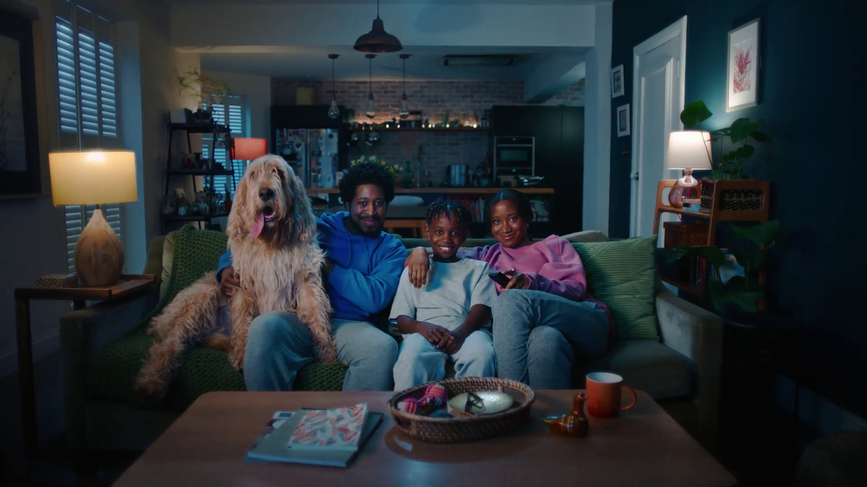
Power of shared viewing
Freely, “Everyone TV”

Slide 2
‘Other people’ is 1 of 6 in-home factors that influence ad recall
DEVICE
OTHER PEOPLE
CONTENT
MOOD
SATISFACTION
LOCATION
Source: Context Effects, Map The Territory & Tapestry Research, 2024
Notes:
There are 6 in-home factors that influence ad recall ‘Other people’ is 1 of the key factors.

Slide 3
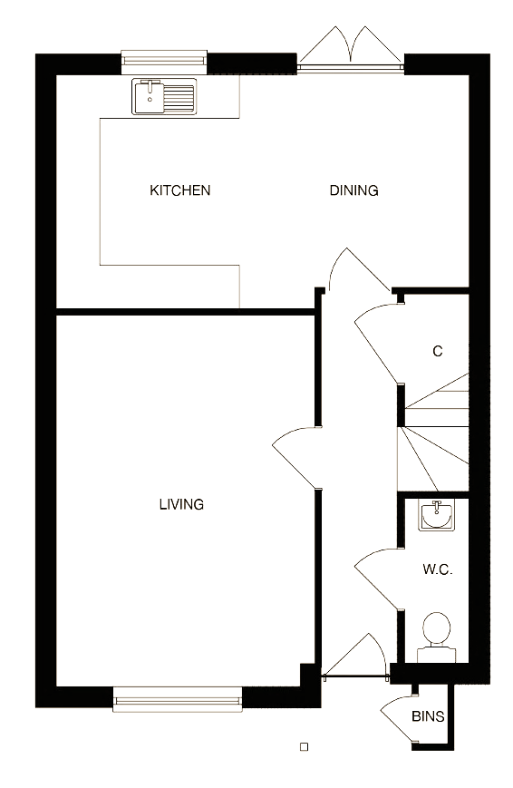
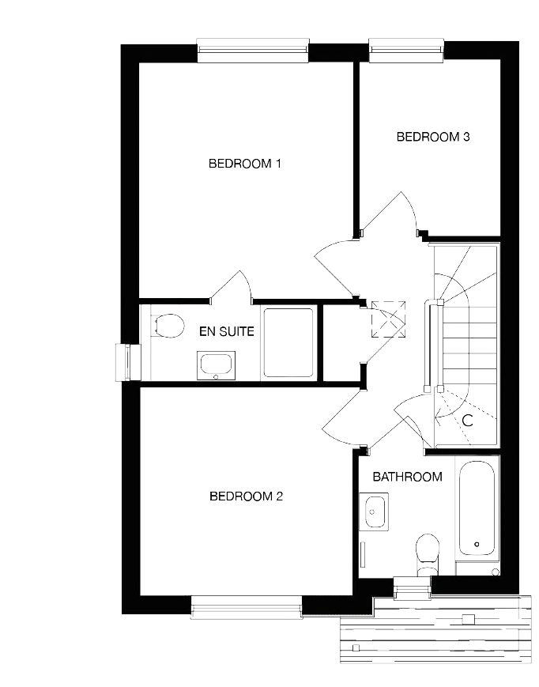
The living room is the location with the highest ad recall
176%
higher vs. the kitchen
10%
higher than in the bedroom
22%
higher than all other rooms in the home
Source: Context Effects, Map The Territory & Tapestry Research, 2024
Notes:
In the home, the living room is the location with the highest ad recall.
A18. Do you remember seeing any advertising when you watched [OCCASION]?
A5. Where were you when you watched [OCCASION]?
Base: 4,005 viewing occasions with ads answered by 2,017 online respondents aged 18-75 who watched any type of video content via any source the previous day. Sample matched to Barb.

Slide 4
In the living room we are more likely to be with others … and in a more democratic way Ad recall increases by 23% when watching with others vs. alone 2x more likely to repeat / mimic the ads (increasing to 3.2x when watching with kids)
Source: Context Effects, Map The Territory & Tapestry Research, 2024
Notes:
When in the living room, we are more likely to be with others. Ad recall increases by 23% when watching with others compared to watching alone. Additionally, viewers are twice as likely to repeat or mimic the ads, with this likelihood increasing to 3.2 times as likely when watching with children.

Slide 5
89% of all shared viewing occurs in the living room
 | Living Room | Kitchen | Bedroom | Other room
Live | 107 | 55 | 79 | 100
Delayed | 105 | 52 | 83 | 95
BVOD | 104 | 66 | 91 | 89
Broadcaster TV | 106 | 55 | 77 | 97
SVOD | 106 | 65 | 102 | 79
Likelihood of co-viewing by set location
High
Mid
Low
Source: Barb / TRP / 2023 / TV Set / Individuals / Index vs All set locations / Broadcaster TV = Live + Delayed + BVOD
Notes:
Up to 89% of all shared viewing occurs in the living room, with the kitchen being the least likely room for shared viewing to occur.

Slide 6
Importance of shared viewing for younger audiences
Tails.com, “Never Average”

Slide 7
Higher likelihood of shared broadcaster viewing amongst 16-34s
Source: Barb / TRP / 2023 / TV Set / All set locations
Notes:
There is a higher likelihood of shared broadcaster viewing amongst 16-34s, particularly high percentage (17%) of group viewing (3+ people).

Slide 8
16-34s are more likely to watch Broadcaster TV in groups
Source: Barb / TRP / 2023 / TV Set / All set locations / Total Broadcaster
Notes:
16-34s are more likely to watch Broadcaster TV in groups than older audiences.

Slide 9
Most likely to find 16-34s group viewing in live & delayed
Source: Barb / TRP / 2023 / TV Set / All set locations / 16-34
Notes:
Most likely to find 16-34s group viewing in live & delayed TV content.

Slide 10
Importance of broadcaster viewing
Hotels.com, “Big Sampson”

Slide 11
Broadcaster TV has the highest volume of co-viewing minutes
Source: Barb / TRP / 2023 / TV Set / All set locations
Notes:
Broadcaster TV accounts for the highest volume of co-viewing minutes.

Slide 12
Live TV is a crucial shared viewing occasion
Source: Barb / TRP / 2023 / TV Set / All set locations / Individuals
Notes:
Live TV is a crucial shared viewing occasion, where the most co-viewing minutes occur.

