Slide 1


TV advertising’s ultimate nickable charts
What every marketer should know
UPDATED May 2026
Notes:
Hello. Welcome to ‘TV advertising’s ultimate nickable charts’. This deck brings together the ultimate evidence which explains how and why TV is the most effective form of advertising – and is, in fact, becoming more effective.
If you have any questions about this deck – or would like more information on any topic – please contact us via info@thinkbox.tv.

Slide 2




















1. Who is Thinkbox?
Thinkbox champions TV and helps advertisers get the best out of it.
Main shareholders
Associates & supporters
Member of

Slide 3
Why nick these?
You probably already have plenty of charts in your life, so why do you need these?
Well, if you work in marketing, these are essential.
Whether you’re working on a pitch, looking for facts to share with colleagues, want to know what TV can now do, or just really enjoy charts, this deck is for you.
It’s packed with insight and evidence, from the facts about our transforming TV viewing to the latest on how and why TV advertising works.
It covers lots of ground but with a single purpose: to give you the proof of why TV advertising is so valuable and vital to businesses of all shapes and sizes – more so now than perhaps ever.
If you want to nick even more charts or have any questions, please get in touch with us at research@thinkbox.tv
Notes:
If you want to nick even more charts or have any questions, please get in touch with us at research@thinkbox.tv

Slide 4
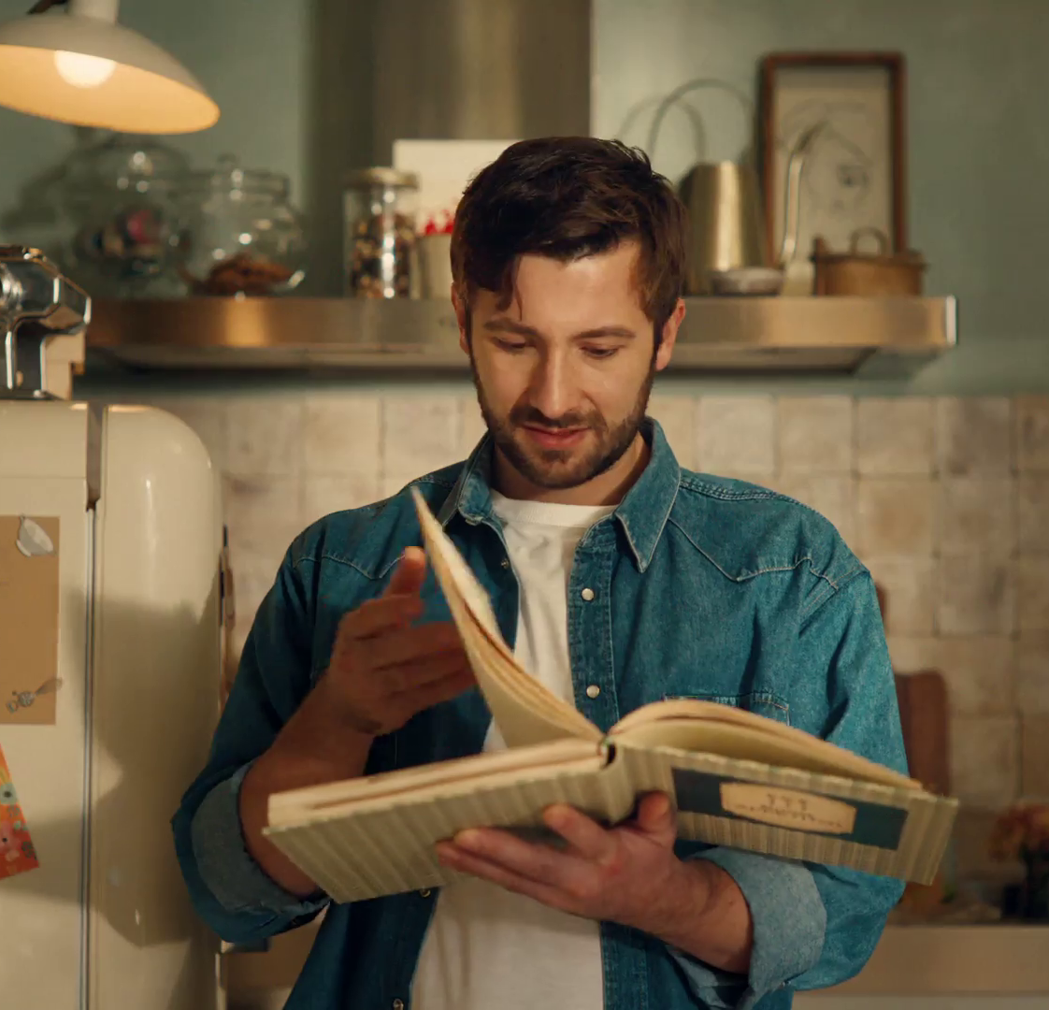
In this deck…
TV VIEWING: THE FACTS | 01
TV IS A TRUSTED & SAFE ENVIRONMENT FOR BRANDS | 02
TV: THE MOST EFFECTIVE ADVERTISING | 03
TV HAS UNBEATABLE SCALE AND REACH | 04
TV IS THE EMOTIONAL MEDIUM AND BUILDS BRAND FAME | 05
TV IS GREAT VALUE | 06
La Famiglia Rana - Grazie, Sofia

Slide 5
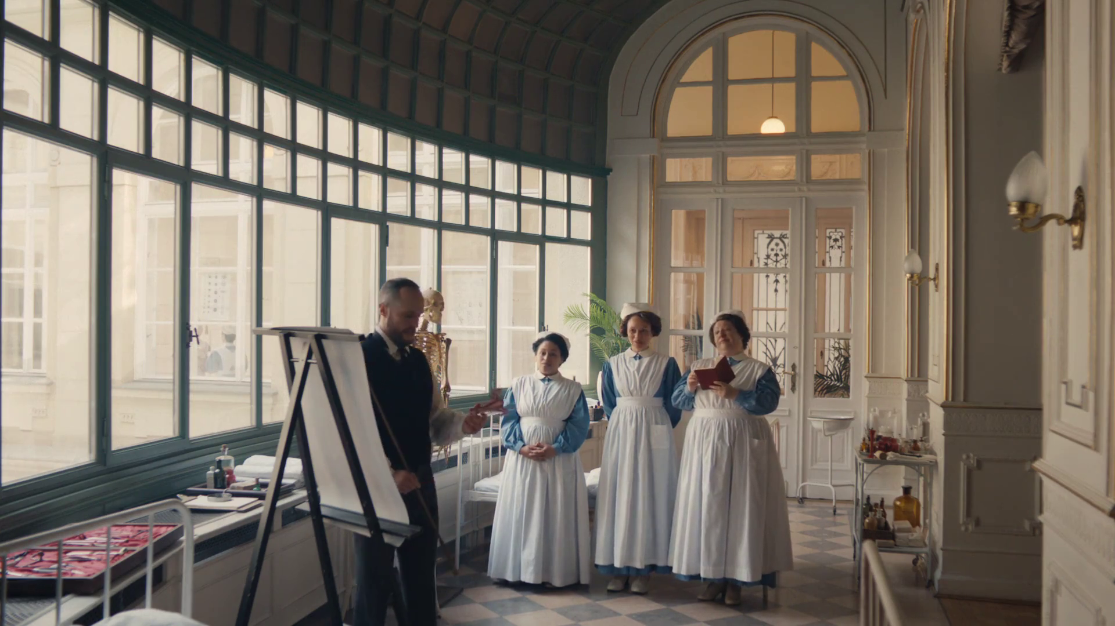
TV viewing: the facts
SECTION ONE
Maltesers - Look On The Light Side

Slide 6

Summary –
TV Viewing: the facts
In 2025, we watched 3h 26m of Total TV each day.
VOD represents 23% of total TV viewing for 16-34s
TV advertising accounted for 85% of the video advertising we saw each day in 2025, and 53% for 16-34s.
ITV - There's No Place Like ITV
Sources: please see notes
Notes:
Source: 2025, Barb / IPA TouchPoints 2025 / Pornhub / UK Cinema Association / Ipsos Iris. Total TV = Broadcaster TV, SVODs & AVODs
Source: 2025, Barb, VOD includes Broadcaster VOD, SVOD and AVOD
Source: 2025, Barb / Broadcaster stream data / UK Cinema Association / Ipsos Iris
**YouTube ad time modelled at 3.33% of content time (Enders Analysis, 23rd October 2024) and excludes those estimated to be on the YouTube Premium tier. *TikTok ad time modelled at 3.4% of content time using agency and broadcaster estimates. **Other online modelled at 3.33% of content time.

Slide 7
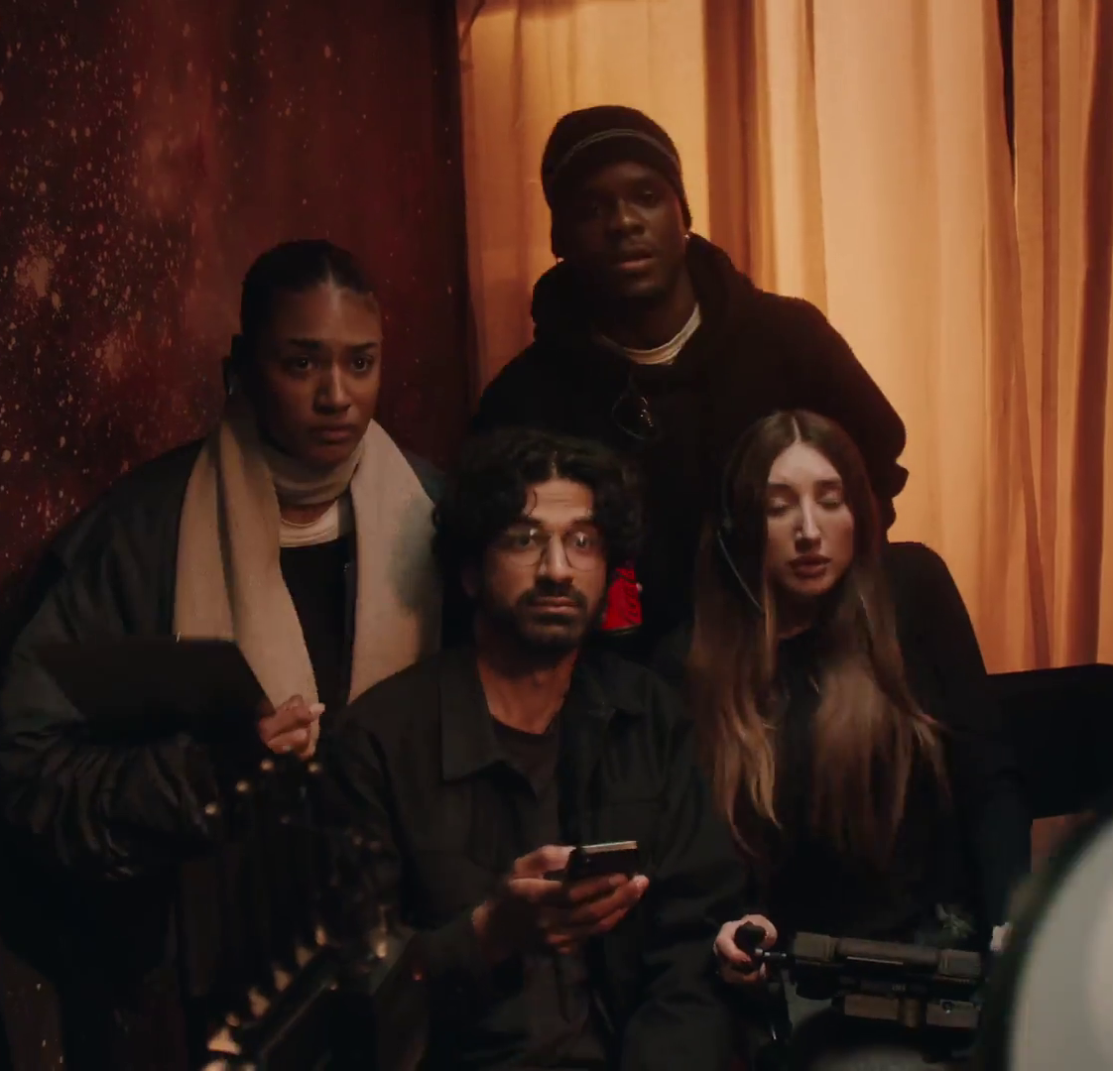
TV viewers have never had it better
78% of main TV screens 40” or bigger
88% have access to broadcaster VOD on TV set
Lenovo - A World Gone Football
Source: Barb / Barb Establishment Survey
Notes:
TV technology and content quality have improved dramatically in the past decade.

Slide 8
Total TV accounted for 70% of total video viewing in 2025
4 hrs 54 mins
Source: 2025, Barb / IPA TouchPoints 2025 / Pornhub / UK Cinema Association / Ipsos Iris
Total TV = Broadcaster TV, SVODs & AVODs
Notes:
Total TV accounted for 70% of total video viewing in 2025
Methodology
The quantitative analysis of total video consumption in the UK was undertaken by Thinkbox. It combined 2025 data from Barb, the IPA’s TouchPoints, Pornhub, UK Cinema Association, and Ipsos Iris.
Barb data shows how much time is spent viewing broadcaster content, live or time-shifted (including BVOD) on all devices as well as Blu-Ray/DVD viewing. This chart also utilises Barb’s expanding audience reporting capabilities to provide a view of time spent viewing content on YouTube, TikTok, other video sharing services (such as Twitch) as well as SVOD/AVOD platforms. Whilst Barb reports on in-home consumption, a combination of Ipsos Iris and IPA TouchPoints data was used to determine the remaining out-of-home consumption.
The combination of these sources creates a solid estimate as it utilises the robustness of Barb data (11,500 panel members, representative of the UK TV population, metered actual consumption data, analysis across a whole year) alongside Ipsos Iris and IPA TouchPoints data to capture any out-of-home consumption.
Time spent viewing video at cinemas was based on total admissions data from the UK Cinema Association profiled for each audience using data from DCM.
Source: Ipsos iris Online Audience Measurement Service, 12-month average Jan – Dec 2025. Internet users aged 15+, using PC/laptop, smartphone or tablet device.
Technical note: [Broadcaster] data for YouTube includes content owner data for the BBC, Channel 4, CNBC, ITV, NBC and Sky. [Commercial broadcaster] data for YouTube includes content owner data for Channel 4, CNBC, ITV, NBC and Sky. TikTok data is both website and app.
Ipsos iris is the UKOM endorsed service for the measurement of audiences of online content. We passively track the online behaviour of a single-source panel of over 10,000 UK adults, who install software across their devices (a combination of smartphones, tablets, PCs and laptops). The panel is recruited to be representative of the internet population demographically, geographically and by device type. This passive data is fused with anonymous, device-level data derived from site-centric tags on hundreds of the biggest sites and apps to create a synthetic panel of around 1 million synthetic panellists. More detail on the methodology can be found here.

Slide 9
Total TV accounts for 85% of all AV advertising time
12%
Individuals
Ad time per day: 16:38
85%
Source: 2025, Barb / Broadcaster stream data / UK Cinema Association / Ipsos Iris
**YouTube ad time modelled at 3.33% of content time (Enders Analysis, 23rd October 2024) and excludes those estimated to be on the YouTube Premium tier. *TikTok ad time modelled at 3.4% of content time using agency and broadcaster estimates. **Other online modelled at 3.33% of content time.
Notes:
Without a single source data provider on time-spent watching AV advertising, this analysis takes a jigsaw approach, using a variety of data sources to build the most accurate picture of AV viewing time possible.
The data approach used to build the estimate for each platform:
Total TV: Barb data for Total TV (broadcaster and SVOD/AVOD services) and the broadcasters’ own census data for BVOD advertising viewing time.
Cinema: The UK Cinema Association provides total box office seats sold. We’ve estimated 15 minutes of advertising per seat.
YouTube: Ad time modelled at 3.33% of content time (Enders Analysis, 23rd October 2024) and excludes those estimated to be on the YouTube Premium tier.
TikTok: Ad time modelled at 3.4% of content time using agency and broadcaster estimates.
Other online video: ad time modelled at 3.33% of content time.

Slide 10
16-34s spend more time with TV advertising than YouTube and TikTok combined
14%
48%
16-34s
Ad time per day: 8:58
33%
Source: 2025, Barb / Broadcaster stream data / UK Cinema Association / Ipsos Iris
**YouTube ad time modelled at 3.33% of content time (Enders Analysis, 23rd October 2024) and excludes those estimated to be on the YouTube Premium tier. *TikTok ad time modelled at 3.4% of content time using agency and broadcaster estimates. **Other online modelled at 3.33% of content time.
Notes:
Without a single source data provider on time-spent watching AV advertising, this analysis takes a jigsaw approach, using a variety of data sources to build the most accurate picture of AV viewing time possible.
The data approach used to build the estimate for each platform:
Total TV: Barb data for Total TV (broadcaster and SVOD/AVOD services) and the broadcasters’ own census data for BVOD advertising viewing time.
Cinema: The UK Cinema Association provides total box office seats sold. We’ve estimated 15 minutes of advertising per seat.
YouTube: Ad time modelled at 3.33% of content time (Enders Analysis, 23rd October 2024) and excludes those estimated to be on the YouTube Premium tier.
TikTok: Ad time modelled at 3.4% of content time using agency and broadcaster estimates.
Other online video: ad time modelled at 3.33% of content time.

Slide 11
Three ways to watch Total TV
Adults
16-34
3 hrs 26 mins
1 hr 47 mins
Source: 2025, Barb, VOD includes Broadcaster VOD, SVOD and AVOD
Notes:
Breaking down Total TV into the different ways reveals the increasingly important role of Live and VOD viewing.
This data uses both Barb data and includes an estimate of any unknown viewing that is thought to fall into Playback and Live viewing.

Slide 12








There are 8 need states which drive video viewing
content
7% ESCAPE
10% EXPERIENCE
9% INDULGE
12% IN TOUCH
2% DO
16% COMFORT
personal
social
18% DISTRACT
26% UNWIND
context
Source: The Age of Television, 2018, MTM/Thinkbox.
Notes:
The Age of Television study, conducted by MTM, on behalf of Thinkbox, observed there are eight need states which define our video viewing habits:
Escape (7% viewing time) - The need to lose yourself in another world and become fully immersed in highly involving and engaging content .
Experience (10% viewing time) - The need to feel part of a shared viewing experience, either by watching live or being able to participate in a wider social conversation.
In Touch (12% viewing time) - The need to feel aware of what’s happening in the world, by being informed about political, social and cultural events.
Comfort (16% viewing time) - The need for shared family / couple time, which tends to be served by familiar programmes and viewing routines.
Unwind (26% viewing time) - The need to relax and de-stress from the pressures of the day, through familiar and undemanding content.
Distract (18% viewing time) - The need for instant gratification to fill time, counter boredom or provide a short break from other tasks.
Do (2% viewing time) - The need to find useful information that can be practically applied to any area of life.
Indulge (9% viewing time) - The need to pursue personal interests, hobbies and fulfil guilty pleasures.
The study sized these eight need states in terms of the time audiences spend meeting each one with video content.
We found that the largest proportion of time spent watching videos is to satisfy the need to unwind, the need for a distraction and the need for comfort.
The role of content and context differ across each need state, with content is particularly important for escape and experience.
In contrast, the need to unwind is far more likely to be driven by context – such as the need to wind down after work.
The need states also differ in terms of being personally or socially driven. For example, the need for comfort is driven by a desire to spend time with others, while the need for a distraction is more personal.
For more information on this study please see:
https://www.thinkbox.tv/Research/Thinkbox-research/The-Age-of-Television-the-needs-that-drive-us

Slide 13
British content, new and known, still attracts huge audiences
Rank | Channel Group | Programme Title | Average Audience (m) | Series | Origin
1 | Netflix | Adolescence | 15.2 | 1 | UK
2 | BBC | The Celebrity Traitors | 13.9 | 1 | UK
3 | BBC | The Traitors | 9.9 | 3 | UK
4 | Amazon | Clarkson's Farm | 9.1 | 4 | UK
5 | ITV | I'm a Celebrity... Get Me Out of Here! | 9.1 | 25 | UK
6 | Netflix | Harlen Coben's Missing You | 9.0 | 1 | UK
7 | Netflix | Dept. Q | 8.8 | 1 | UK
8 | Channel 4 | The Great British Bake Off | 8.6 | 16 | UK
9 | ITV | Vera | 8.5 | 14 | UK
10 | ITV | Unforgotten | 8.4 | 6 | UK
Rank | Channel Group | Programme Title | Average Audience (m) | Series | Origin
11 | ITV | The 1% Club | 8.4 | 4 | UK
12 | BBC | Call the Midwife | 8.2 | 14 | UK
13 | BBC | Race Across the World | 8.2 | 5 | UK
14 | BBC | Strictly Come Dancing | 7.9 | 23 | UK
15 | BBC | Silent Witness | 7.9 | 28 | UK
16 | BBC | Death in Paradise | 7.9 | 14 | UK
17 | ITV | Playing Nice | 7.8 | 1 | UK
18 | Netflix | Wednesday | 7.8 | 2 | US
19 | BBC | Celebrity Race Across the World | 7.5 | 3 | UK
20 | Amazon | LOL: Last One Laughing UK | 7.5 | 1 | UK
Source: Barb, 2025, Adults. TV set viewing. Top performing episode (excludes one-offs, kids, films and sports).
Notes:
British content, new and know still attract huge audiences.

Slide 14
TV set remains the home for viewing to high-quality content
Smartphones
Tablets
PCs
TV Sets
Source: Barb, 2025. Adults 16+. Online Multiple Screens Network
Notes:
Analysis from Barb shows that the majority of total identified was spent watching broadcaster channels and VOD services.
In terms of devices, the TV set is the most popular screen for broadcaster viewing and SVOD/AVOD viewing. For video-sharing services like YouTube, TV set viewing accounts for a smaller proportion.
* Total identified viewing includes:
Total broadcaster viewing – this represents the time spent watching linear broadcast TV channels and broadcaster-owned VOD services (BVOD). This includes live viewing, as well as pre- and post-broadcast viewing, and viewing to archive box-sets on a BVOD service. This is reported across four screens — TV sets, tablets, PCs, and smartphones — by gathering information about what is streamed through the home Wi-Fi network. For tagged services that share their own census level data with Barb, this includes any streaming regardless of whether it was through the home Wi-Fi network or not.
Total SVOD/AVOD viewing – this covers 19 VOD services, notably Amazon Prime Video, Disney+, and Netflix. Viewing is reported on all four screens, although this only includes viewing through a home’s Wi-Fi network as these services are not tagged.
Total video-sharing – this covers the use of platforms such as TikTok, Twitch, and YouTube. As with SVOD/AVOD viewing, reporting for video-sharing platforms only includes viewing through a home Wi-Fi network on all four screens.

Slide 15

TV is a trusted & safe environment for brands
SECTION TWO
Sky Mobile - Keep Rollin
Notes:
TV in the UK is full of wonderful, high-quality content which broadcasters invest in heavily. This, alongside the tight regulation which governs TV content and advertising, makes it a safe environment for viewers and brands.
In addition, TV has a robust, metred measurement system, Barb, which provides a joint industry currency for TV advertising trading based on completed ads, watched full screen (and by humans).

Slide 16

Summary –
TV is a trusted & safe environment for brands
TV’s hidden value includes high value exchange, strong costly signals and high attention levels.
TV ads were most trusted by the UK public (35%)
Staysure - Where the Sun Don't Shine
Sources: please see notes
Notes:
Source: Adnormal Behaviour, 2022, Ipsos / Thinkbox. Q.TN3: In which, if any, of the following places are you most likely to find advertising that...you trust

Slide 17
TV’s hidden value
High value exchange
Shared viewing
Strong costly signals
Trusted
Not perceived to be targeted
Big screen
High attention levels
High completion rates
Bot free
Regulated / Ad clearance
Notes:
TV in the UK is full of wonderful, high quality content which broadcasters invest in heavily. This, alongside the tight regulation which governs TV content and advertising, makes it a safe environment for viewers and brands.
In addition, TV has a robust, metred measurement system, Barb, which provides a joint industry currency for TV advertising trading based on completed ads, watched full screen (and by humans).

Slide 18



TV advertising is seen as most trustworthy
Newspapers
Radio
Magazines
Search
Cinema
TV
Social Media
Outdoor
Direct Mail
YouTube
Websites
Source: Adnormal Behaviour, 2022, Ipsos / Thinkbox. Q.TN3: In which, if any, of the following places are you most likely to find advertising that...you trust
Base: ‘normal’ people (1,158)
Notes:
Thinkbox’s ‘Adnormal Behaviour’ work showed that TV ads were see as the most trusted form of advertising.
For more information on this study, see the full write up on the Thinkbox website:
https://www.thinkbox.tv/research/thinkbox-research/adnormal-behaviour/

Slide 19
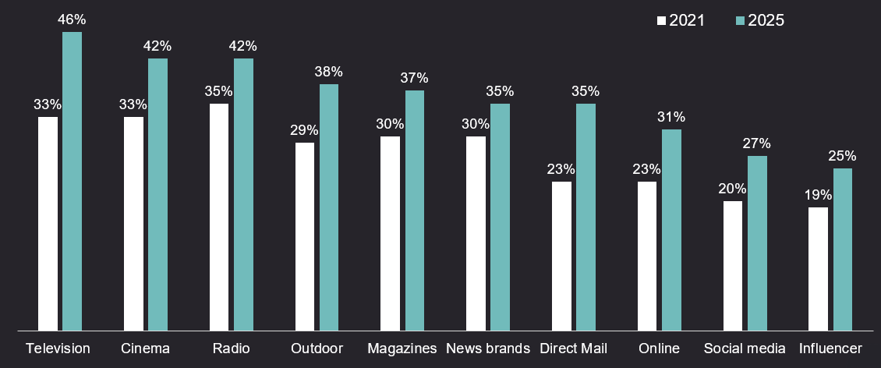
TV advertising is the most trusted medium
Source: Credos Trust Tracker (Advertising Association).
Q. To what extent, if at all, do you trust each of the following types of advertising in relation to products and services? (very trusting / fairly trusting), Kantar, 2025, n= 2,534
Notes:
One factor is becoming a clear differentiator in advertising: trust. As uncertainty grows and consumer confidence declines, it’s playing an increasingly critical role in shaping brand preference and driving profitability.
This chart highlights data presented at LEAD 2026 from the 2025 Credos Trust Tracker revealing a key trend: trust in advertising has increased across every media channel since 2021.
One channel stands out. TV is the most trusted advertising environment. Between 2021–2025, trust in TV grew faster than any other medium, reaching 46%, outperforming online ads (31%), social media (27%) and Influencer content (25%).
To dive deeper into why trust matters for brands and why TV continues to lead, read more here: https://www.thinkbox.tv/why-tv/unrivalled-trust

Slide 20
People trust brands on TV more than anything else
% of people that trust brands that advertise on…
Source: Tapestry Research, 2025, ADS1a. Thinking about different places in which you see advertising, please tell us how you feel [TRUSTED] about brands that advertise [INSERT TYPE OF AD]. Social media e.g. Facebook, Instagram and TikTok.
Notes:
Working with Tapestry Research, we asked respondents about the different places that they see advertising and how they felt about brands that advertised on these channels.
Analysis reveals that TV emerges as the strongest at 24%, with newspapers/magazines coming in second at 20%. Twice as many people trust brands advertised on TV than YouTube (12%).

Slide 21
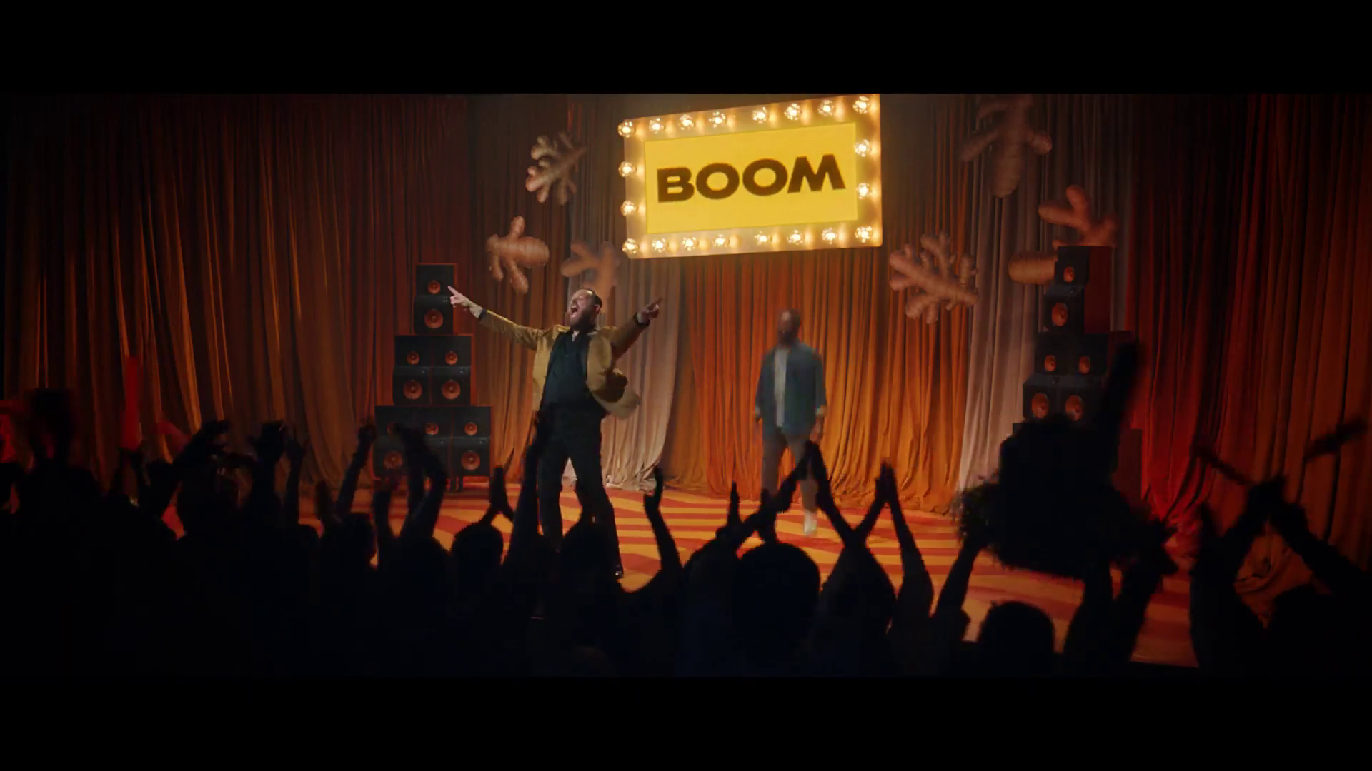
TV: the most effective advertising
SECTION THREE
Moju - Game Show

Slide 22
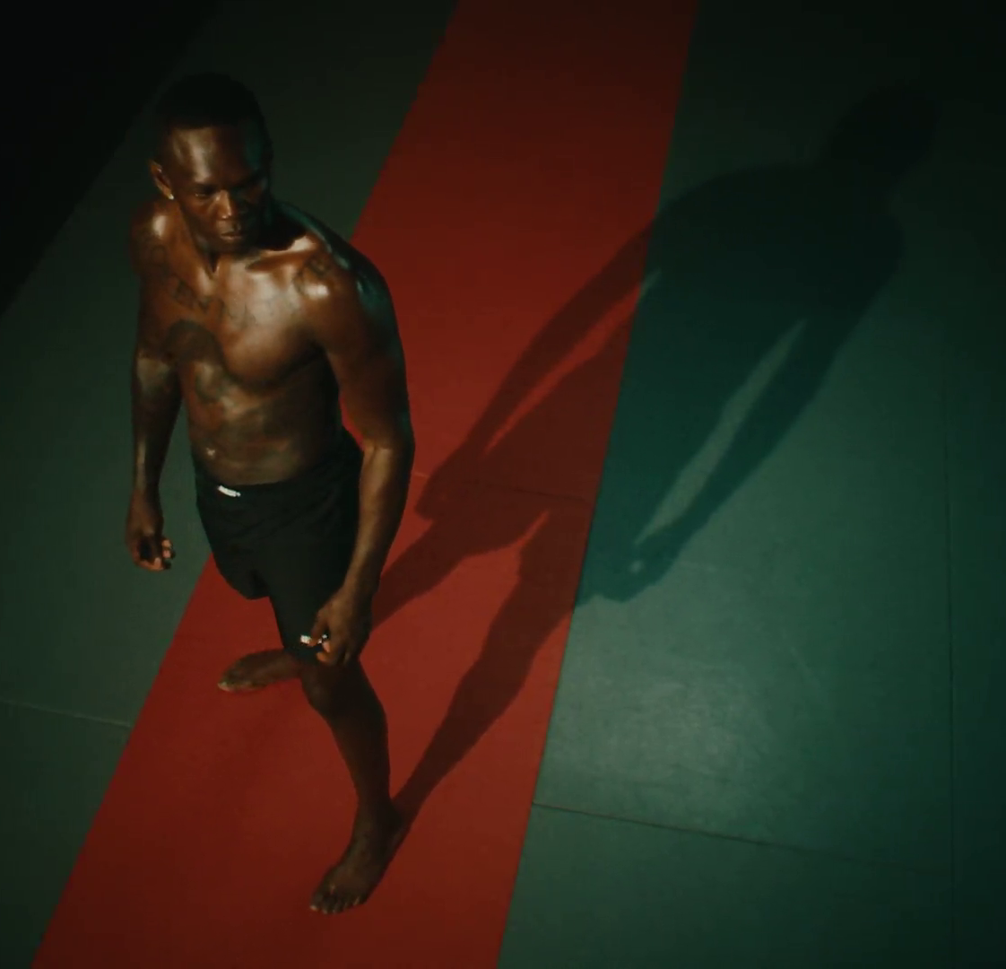
Summary –
TV: the most effective advertising
The optimal budget mix varies by sector with TV often commanding the lions share
TV constitutes on average 66% of smaller brands media budget but returned 80% of all ad-generated sales
Tradeify - Champion Mindset
Sources: please see notes
Notes:
Source: ‘As Seen on TV: supercharging your small business’, May 2019, Data2Decisions/Work/Thinkbox. Data2Decisions database of smaller brands. All categories.

Slide 23
Optimal budget mix varies by sector – TV has the largest share
Optimal media mix
Source: Media Mix Navigator, 2025. Based on a mass market appeal, 11-20% online sales (finance 71-80%), short-term, high risk, further details for each category is included in the notes
Notes:
Optimal ad mix varies dramatically by product sector
This chart shows how there are big variances in the optimal media mix between different product sectors.
It is based on data from the ‘Media Mix Navigator’, which lets brands easily explore the impact on revenue and profit that different budget levels have on budget allocation across channels.
The Media Mix Navigator tool has been engineered by EssenceMediacom and is powered by the blockbuster Profit Ability 2 databank, which takes in £1.8 billion of media spend across 141 brands during 2021-23. The brands included were carefully chosen to represent as many business types as possible. Each brand commissioned and paid for their own econometric analysis; the databank aggregated this existing data.
Media Mix Navigator enables analysis bespoke to a brand’s specific situation and attitude to risk. For this analysis, we have used an ‘average’ brand position.
This chart shows how the optimal media mix differs by category, and there are some interesting variances. For example, looking specifically at Generic PPC, the investment allocation is particularly high for sectors such as Finance, Travel and Automotive. This is explained by the fact that these sectors often deal with higher priced items which are usually ‘considered purchases – ones where consumers are likely to conduct online research before making a purchase decision. Similarly, Print is an important channel for Automotive and Travel, both of which benefit from extensive specialist titles that provide the opportunity to reach key audiences.
The one consistent factor throughout all the scenarios is that Linear TV is the largest single channel, although the extent to which it is the largest channel can vary greatly – e.g. higher in Retail, FMCG and Automotive but lower in Finance.
For more information, visit: https://www.thinkbox.tv/training-and-tools/media-mix-navigator/media-mix-navigator
Category input details:
All – Brand size (£m): 10,000, Annual Media Spend (£m): 50
Automotive - Brand size (£m): 2,600, Annual Media Spend (£m): 17
Finance - Brand size (£m): 10,000, Annual Media Spend (£m): 20
FMCG - Brand size (£m): 60, Annual Media Spend (£m): 6
Retail - Large - Brand size (£m): 9,000, Annual Media Spend (£m): 25
Retail - Small - Brand size (£m): 200, Annual Media Spend (£m): 10
Travel - Brand size (£m): 5,200, Annual Media Spend (£m): 19
Telecoms - Brand size (£m): 7,000, Annual Media Spend (£m): 45
Output: Revenue
The brand size for each product category has been calculated by taking 20% of the maximum brand size whilst the annual media spend is an estimate of the average spend for that category.

Slide 24
TV is the battery that charges other media
% average reduction in Purchase Intent over 8 weeks if TV is NOT included alongside…
Other Online (search, display) | Audio (radio & streaming) | Social Media | Online Video | Print (physical) | OOH
Source: Staying Power: The longevity of advertising, Tapestry Research, 2025.
Purchase Intent (‘definitely consider’): All brands, among those exposed (nat rep, 18-75). Online Video is mostly YouTube.
Notes:
This chart from ‘Staying Power: the longevity of advertising’ explores how advertising continues to drive impact long after campaigns end.
Based on data from almost 20,000 UK adults aged 18–75, the research tracked post-campaign effects of advertising by measuring purchase intent over eight weeks from nine major brands — uncovering what really helps ads stay impactful over time.
Analysis revealed that campaigns using four or more media channels are twice as likely to make people definitely consider buying a product compared with single-channel campaigns (40% vs. 20%). And TV plays a crucial role in that mix as the battery that charges other media. When TV is included, it boosts the impact of other media on definite purchase intent by an average of 26%.
But when TV is excluded, the effect drops sharply across the board, with Print and OOH seeing the largest declines in definite purchase intent (-28%), whilst Other Online (mainly search and display) experienced the least (-9%).
For more insight on the longevity of advertising, watch Staying Power on demand: https://www.thinkbox.tv/news-and-opinion/events/staying-power-the-longevity-of-av-advertising
Source: A5 [Definitely consider]. How likely (if at all) would you be to consider [SELECTED BRAND] the next time you come to [CATEGORY OCCASION]?
Base: 19,251 respondents aged 18-75; 19,251 Wave 1, 5,569 Wave 2, 6,000 Wave 3, 3,595 Wave 4

Slide 25
TV gives low risk, predictable results
Increasing risk / reward of achieving return
Source: Profit Ability 2 – Ebiquity, EssenceMediacom, Gain Theory, Mindshare, Wavemaker, April 2024​
Notes:
Findings from ‘Profit Ability 2: the new business case for advertising’, shows that the predictability of payback varies greatly by channel. Profit Ability 2 was conducted by Ebiquity, EssenceMediacom, Gain Theory, Mindshare, and Wavemaker UK. It’s a meta-analysis of econometric studies from 141 brands covering £1.8 billion of media spend across 10 media channels and 14 business sectors (where 7 are reported individually).
The charts presents the percentage standard deviation (the standard deviation divided by the mean, expressed as a percentage). The wider the bar, the more variable around the average ROI a channel is. Channels like Linear TV, Print and BVOD have low variation and therefore represent a lower risk investment.
It’s worth noting that high variability works both ways: although it involves greater risk, there is the possibility of achieving a much higher than average ROI (as well as a much lower one).

Slide 26
TV delivers greater sales versus spend for smaller brands
Share of spend
Share of advertising-generated sales
Source: ‘As Seen on TV: supercharging your small business’, May 2019, Data2Decisions/Work/Thinkbox. Data2Decisions database of smaller brands. All categories.
Notes:
Thinkbox study ‘As Seen on TV: supercharging your small business’, conducted by marketing effectiveness consultancy D2D, shows how well TV performs in terms of sales versus spend.
Out of the D2D dataset of 78 smaller brands across all categories, TV constituted on average 66% of their media budget but returned 80% of all ad-generated sales. This is due to two factors – the high ROI (return on investment) and the fact that it can deliver scale without saturating.
This demonstrates the key role of TV for advertisers looking to drive brand growth.
For more information on this study please see:
https://www.thinkbox.tv/research/thinkbox-research/as-seen-on-tv-supercharging-your-small-business/

Slide 27
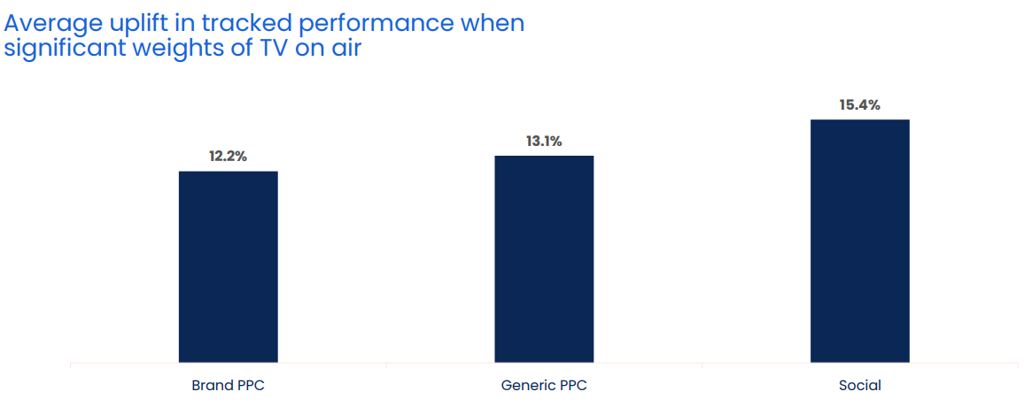
When TV is on air, digital channel performance is uplifted by 13.7%
Source: Why the Eff would you cut TV? GroupM, 2025
Notes:
When TV is on air, digital channel performance is uplifted by 13.7%
One of TV advertising’s most underestimated strengths is its halo effect — the way it boosts the performance of other media channels. While often misattributed, this cross-channel impact is both real and measurable.
According to GroupM analysis in ‘Why the Eff would you cut TV?’ presented at Thinkbox Trends in TV 2025, digital response channels see a clear uplift when TV is live. The study analysed the performance of TV, brand PPC, generic PPC and social across 14 brands, which included 1,489 weeks, and £283m total performance media spend.
Analysis found that on average, the performance of lower-funnel response channels improves by 13.7% when TV is part of the media mix.
More specifically, brand PPC, generic PPC and social saw an average uplift of 12.2%, 13.1% and 15.4% respectively in tracked performance when significant weights of TV were on air. This shows how TV makes digital channels work harder.
For a deeper dive on the consequences of taking TV out of the plan, watch ‘Why the Eff would you cut TV?’ on demand.

Slide 28
All channels deliver a return: short-term Profit ROI = £1.87
Short-term profit volume & profit ROI
Bubble size represents % of short-term profit volume
Overall Short-Term Profit ROI: £1.87
Short-term Profit ROI (£)
% of Spend
Source: Profit Ability 2, April 2024 – Short term benchmarks: Ebiquity, EssenceMediacom, Gain Theory, Mindshare, Wavemaker UK.
Long Term Multipliers: EssenceMediacom, Gain Theory, Mindshare, Wavemaker UK
Notes:
According to Profit Ability 2, Profitability varies by media channel
This study proves that advertising is a profitable driver of business growth. Put simply, advertising works. All categories analysed in the study generated a positive payback from advertising. Advertising has an average short-term profit ROI of £1.87 per pound invested which increases to £4.11 when sustained effects are included.
Looking at short-term profit ROI, this chart shows the overall view by channel of profitability, mapping the spend (x axis) and the Profit ROI (y axis). Each channel is mapped using a bubble, with the size representing how much profit is driven. The chart is also split at a profit ROI of 1, anything above this line is considered profitable.

Slide 29
Linear TV: unmatched as the total Profit ROI volume driver
Source: Profit Ability 2, April 2024 – Short term benchmarks: Ebiquity, EssenceMediacom, Gain Theory, Mindshare, Wavemaker UK. Long Term Multipliers: EssenceMediacom, Gain Theory, Mindshare, Wavemaker UK. Immediate contribution = same week as advertising, Carryover = within 13 weeks, Sustained = within 2 years
Notes:
Analysis from Profit Ability 2 found that when considering all three speeds of payback (immediate, carryover and sustained), Linear TV is unmatched as the full profit volume driver – delivering c. 47% of total volume.

Slide 30
TV helps brands project quality, stability and authority
Source: Tapestry Research, 2025, ADS1a. Thinking about different places in which you see advertising, please tell us how you feel about brands that advertise [INSERT TYPE OF AD]. Social media e.g. Facebook, Instagram, TikTok.
Notes:
Analysis from Tapestry Research shows that TV emerges as most reputable, high quality and less risky

Slide 31

TV has unbeatable scale and reach
SECTION FOUR
TNT Sports - Dare to Dream

Slide 32

Summary - TV has unbeatable scale and reach
Total TV reaches 88% of the adult population each week
A broadcast TV campaign of 400 TVRs in the UK gets 245 million views
Waitrose - The Gastronaut
Sources: please see notes
Notes:
Source: Barb, Online Multiple Screens Network, reach 3+ mins, all devices, 2025. Total TV = Broadcaster TV, SVODs & AVODs. Adults
Source: Barb Dec 2025, Individuals

Slide 33

Total TV reaches 88% of adults each week
Taskmaster, Channel 4
Source: Barb, Online Multiple Screens Network, reach 3+ mins, all devices, 2025. Total TV = Broadcaster TV, SVODs & AVODs. Adults
Notes:
Total TV reaches 88% of the population each week.

Slide 34
Total TV reaches 88% of adult each week
% weekly reach
87.5 | 87.4 | 78.2 | 86.0 | 88.9 | 90.2
Adults
ABC1 Adults
16-34
Men
Women
HP+CH
Source: Barb, Online Multiple Screens Network, reach 3+ mins, all devices, 2025. Total TV = Broadcaster TV, SVODs & AVODs.

Slide 35
Commercial broadcasters are unrivalled for scale
Adults – All devices
Bubble area represents total volume of daily viewing
AVERAGE DAILY REACH (000s)
Other
SVOD
Other AVOD
Twitch
AVE TIME VIEWED PER VIEWER PER DAY
Source: Barb / Adults, all devices – 2025
Notes:
This chart breaks down viewing to the various platforms in terms of the average number of people watching per day (for at least 3 minutes) compared with the average time spent watching per viewer (i.e. only counting those who watched on that day).
Analysis across 2025 shows that the commercial broadcasters (linear and on demand) collectively reach over 26 million viewers every day, with each of those viewers watching for an average of 3hrs, 40 mins a day. The combined portfolio of BBC channels (linear and on demand) attracts the second largest volume of viewing, with 22 million daily reach and an average view time of 2 hours, 12 mins a day. YouTube is next, with a daily reach of 18 million and a view time of 1hr 53 mins (Barb only measure in-home viewing, we estimate that YouTube would be larger in viewing time if out of home viewing was included).
SVOD services such as Netflix has a daily reach of 12 million people and a view time of 1hr 52 mins.

Slide 36
Highest reach & most viewing is delivered by Commercial TV
Adults – TV Set
Bubble area represents total volume of daily viewing
AVERAGE DAILY REACH (000s)
Other AVOD
Other SVOD
TikTok
Twitch
AVE TIME VIEWED PER VIEWER PER DAY
Source: Barb / All adults, TV sets – 2025
Notes:
This chart breaks down viewing to the various platforms in terms of the average number of adults watching per day (for at least 3 minutes) on a TV set compared with the average time spent watching per viewer (i.e. only counting those who watched on that day).
Analysis across 2025 shows that the commercial broadcasters (linear and on demand) collectively reach 26 million adult viewers every day, with each of those viewers watching for an average of 3hrs, 40 mins a day. The combined portfolio of BBC channels (linear and on demand) has a daily reach of 21 million and an average view time of 2hr 12 mins. YouTube has a daily reach of 7 million adults and a view time of 2hr 13 mins.
SVOD services such as Netflix has a daily reach of 10 million people and a view time of 1hr 51 mins.

Slide 37
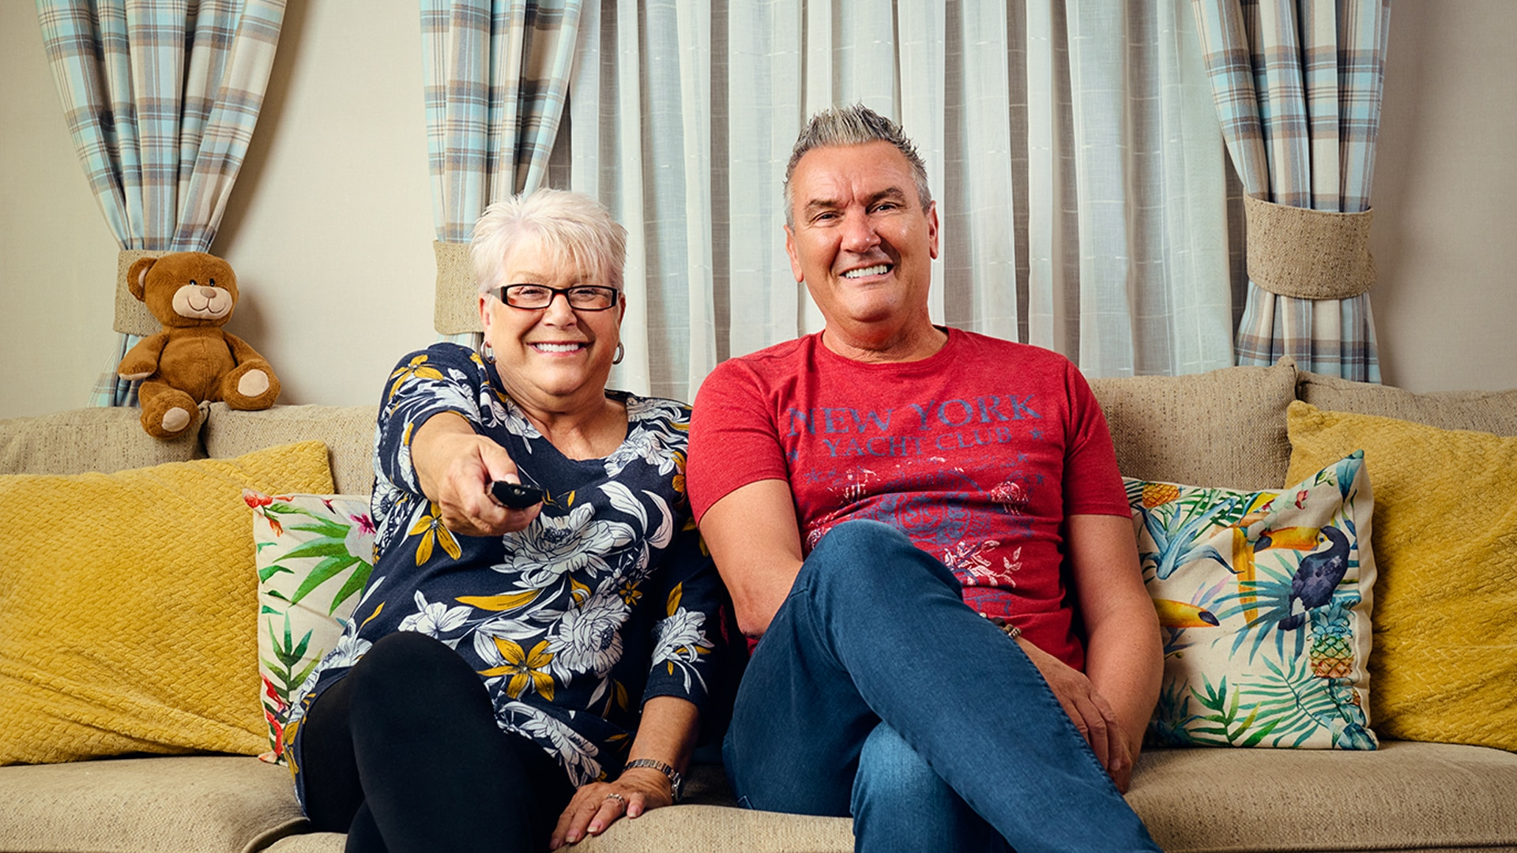
A broadcast
TV campaign of 400 TVRs in the UK gets
245 million views
“Gogglebox”, Channel 4
Source: Barb Dec 2025, Individuals
Notes:
Beware the seduction of ‘views’. Views that TV ads get online are an important part of the way brands now communicate. However, because the figures are so visible, the offline views – which are often driving them – can get overlooked. A million online views is not to be sniffed at, but a broadcast TV campaign in the UK gets 245 million ‘views’ – and that is before you consider the different quality of the viewing experiences.
How this is calculated:
A broadcast TV campaign of 400 ratings expressed as views is 4 times the TV universe.

Slide 38
TV’s shared experience makes a lasting difference
48% lower decay
More emotive brand associations are sustained
+75% greater liking of the TV ads
Source: Staying Power: The longevity of advertising, Tapestry Research, 2025.
Notes:
One of TV strengths is shared viewing as it makes a lasting difference.
As seen in Context Effects, viewing with other people has a positive impact on ad recall. In the same way, Staying Power showed how TV’s lasting impact is closely tied to the way we watch it. Unlike Social Media, TV remains a shared experience — often viewed on a big screen, in a relaxed living room setting, and crucially, with other people.
This social context appears to strengthen advertising’s effects. Purchase intent declined by only 14% over eight weeks when ads were viewed with others present, compared with a 27% drop when watched alone.
Additionally, across the eight-week period, liking of the TV ads in this study was 75% higher among those who were exposed to them with others (vs. seeing alone.) The findings suggest that TV’s enduring influence isn’t just about sight and sound — it’s about the social connection that comes from watching together.
For more information on the TV strengths, read: https://www.thinkbox.tv/research/thinkbox-research/staying-power-the-longevity-of-advertising#the-headlines
g

Slide 39

TV is the emotional medium and builds brand fame
SECTION FIVE
The Birthday Draw - Is It Your Lucky Day

Slide 40

Summary - TV is the emotional medium and builds brand fame
TV advertising is most likely to make you laugh (52%) and is the most liked (40%)
TV is the medium most likely to signal brand fame
Higher-performing creatively-awarded campaigns are most likely to have higher shares of spend on TV
Sky Mobile - Keep Rollin
Sources: please see notes
Notes:
Source: Adnormal Behaviour, 2022, Ipsos / Thinkbox. Q.TN3: In which, if any, of the following places are you most likely to find advertising that...
Source: Signalling Success, 2020, house51 / Thinkbox. Adults 16+. Top 2 box agreement “This brand will become well known”
Source: ‘The Crisis in Creative Effectiveness’, Peter Field Consulting / IPA, June 2019

Slide 41
TV ads evoke emotion more than those in other media
In which, if any, of the following places are you most likely to find advertising that…
 | TV | Social Media | Radio | YouTube | Cinema | Magazines | Outdoor | Newspapers | Search | Direct Mail | Websites
Makes you laugh | 52% | 35% | 13% | 21% | 16% | 5% | 6% | 6% | 4% | 2% | 3%
Makes you feel emotional | 47% | 17% | 6% | 10% | 15% | 5% | 3% | 9% | 4% | 2% | 2%
You like | 40% | 27% | 10% | 12% | 14% | 15% | 8% | 12% | 14% | 4% | 4%
Source: Adnormal Behaviour, 2022, Ipsos / Thinkbox. Q.TN3: In which, if any, of the following places are you most likely to find advertising that...
Base: ‘normal’ people (1,158)
Notes:
Thinkbox’s ‘Adnormal Behaviour’ showed that TV ads were by far the most likely to make people feel emotional, and creating an emotional response is incredibly effective in advertising. It also showed that TV ads were by far the most likely to make people laugh.
For more information on this study, see the full write up on the Thinkbox website.

Slide 42
Brands on TV stand out as more trusted and established
Source: Tapestry Research, 2025, ADS1a. Thinking about different places in which you see advertising, please tell us how you feel about brands that advertise [INSERT TYPE OF AD]. Social media e.g. Facebook, Instagram, TikTok.
Notes:
Analysis from Tapestry research found that brands on TV stand out as more trusted and established.

Slide 43
TV advertising signals brand fame
Brand will become well known
52%
48%
44%
44%
40%
38%
Source: Signalling Success, 2020, house51 / Thinkbox. Adults 16+. Top 2 box agreement “This brand will become well known”
Notes:
House51 & Thinkbox’s ‘Signalling Success’ used an experimental design to evaluate the advertising signals which are driven by each medium.
The results confirmed that TV is the medium most likely to signal brand fame.
For more information on this study, see the full write up on the Thinkbox website:
https://www.thinkbox.tv/research/thinkbox-research/signalling-success/

Slide 44
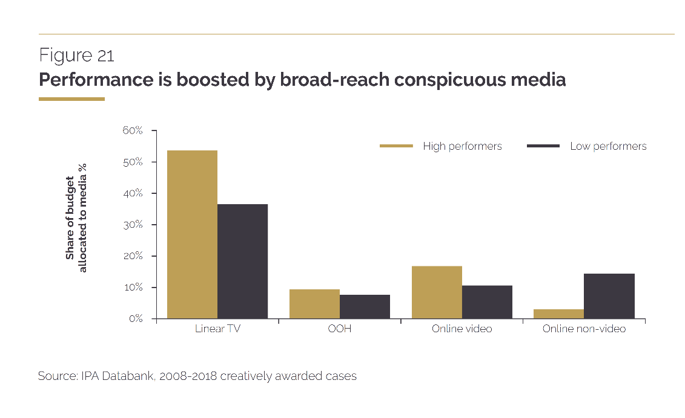
It is revealing to contrast creative high performers’ media tendencies with those generally favoured by creative awards judges.
TV is the biggest media tendency for high performers and yet, overall, judges tend to give creative awards much more often to those that use online video and social media. These media can be effective too, but their effectiveness doesn’t really justify all the attention they are getting.
“
“
Source: ‘The Crisis in Creative Effectiveness’, Peter Field Consulting / IPA, June 2019
Notes:
In his 2019 IPA report, ‘The Crisis in Creative Effectiveness’, Peter Field looked at creatively-awarded campaigns and the pattern of media used within submissions. The data shows that the higher-performing creatively-awarded campaigns are more likely to have higher shares of spend on TV. The lower-performing campaigns are more likely to use online advertising.
For more information about this report, please see:
https://ipa.co.uk/media/7699/ipa_crisis_in_creative_effectiveness_2019.pdf

Slide 45
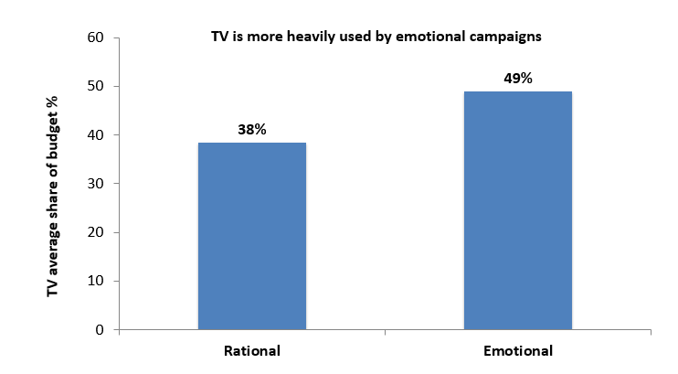


TV is important for emotional campaigns
Source: IPA Databank, 2014-2022 cases
Notes:
https://www.thinkbox.tv/research/nickable-charts/effectiveness-and-planning/tv-at-the-heart-of-effectiveness-by-peter-field
If you look at media usage amongst emotional IPA case studies vs. rational ones, TV occupies a much bigger share of ‘emotional’ marketing budgets [see chart above]. Smart marketers worked out many years ago that TV is a brilliant platform for creating vital emotional, mental availability building associations. TV is less important amongst the rational campaigns, but then who wants to work in the slow lane of effectiveness?

Slide 46
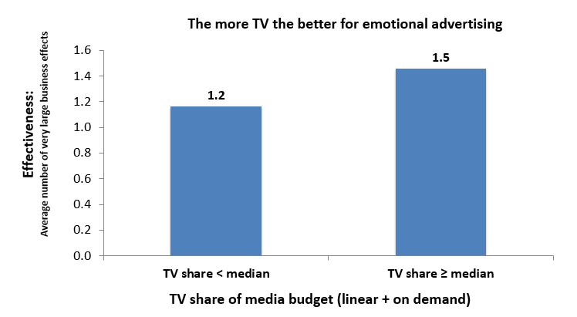
TV boosts effectiveness of emotional campaigns
Source: IPA Databank, 2014-2022 cases
Notes:
https://www.thinkbox.tv/research/nickable-charts/effectiveness-and-planning/tv-at-the-heart-of-effectiveness-by-peter-field
Examining the impact on effectiveness of TV share of budget by these emotional campaigns suggests that you almost can’t have too much TV advertising [see chart above]. Those that made above median use of TV were distinctly more effective than those that didn’t. Obviously, no one is arguing for 100% TV advertising campaigns, because there is the rest of the funnel to think about. But let’s be clear: there’s a particularly strong relationship between TV and the fast lane of effectiveness strategy.

Slide 47
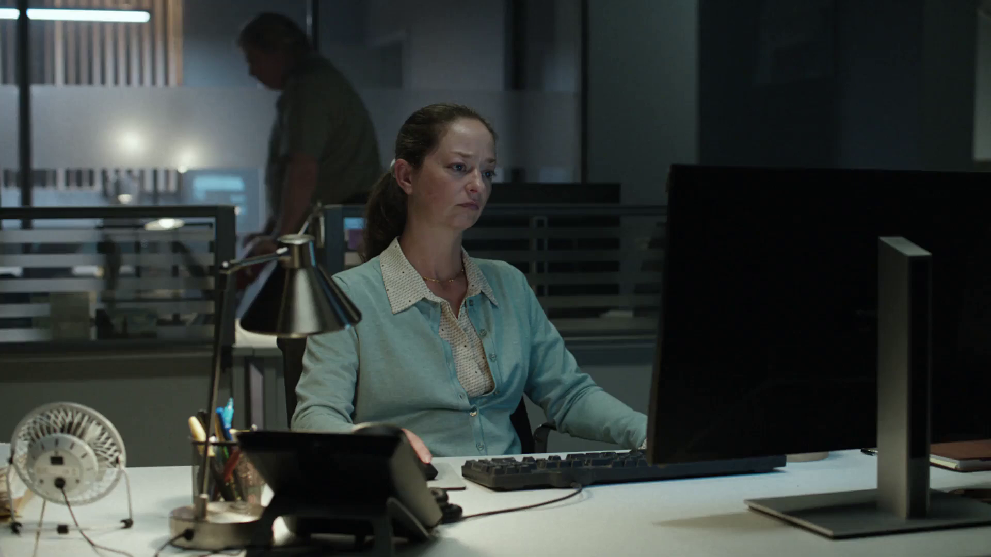
TV is great value
SECTION SIX
Financial Conduct - Authority Firm Checker

Slide 48

Summary - TV is great value
The average cost of buying the media space to get one person in the UK
to see a TV (linear and addressable) advert is 0.72p (in 2025)
The average cost across TV advertising (linear and addressable) for 30 seconds is just £7.23, for online video (including YouTube), it goes up to a £59.41.
Staysure - Where the Sun Don't Shine
Sources: please see notes
Notes:
Source: 2025, Thinkbox estimates using AA/WARC
Source: 2025, TV is inclusive of linear and addressable. Thinkbox estimates using AA/WARC (estimates), Barb / Broadcaster stream data / UK Cinema Association. Ipsos Iris.

Slide 49

Average TV view costs 0.72p (in 2025)
The average cost
of buying the media space to get one
person in the UK
to see a TV (linear and addressable) advert
costs over half a penny
Source: 2025, Thinkbox estimates using AA/WARC
Notes:
The average cost of buying the media space to enable one person in the UK to see a TV (linear, BVOD and SVOD) advert only costs just under a penny.

Slide 50
TV remains the lowest priced video channel
Average cost per 30 second (000s)
TV
Social Media - Video
£59.41
£7.23
Source: 2025, TV is inclusive of Linear and Addressable. Thinkbox estimates using AA/WARC (estimates), Barb / Broadcaster stream data / UK Cinema Association. Ipsos Iris.
Notes:
The chart combines AA/WARC revenue estimates, with the video advertising time data to create a relative cost per 30 seconds of AV ad exposure.
Spot TV advertising (linear and addressable) averages £7 per thousand exposures. Social media video (which also includes YouTube) is £59.

Slide 51
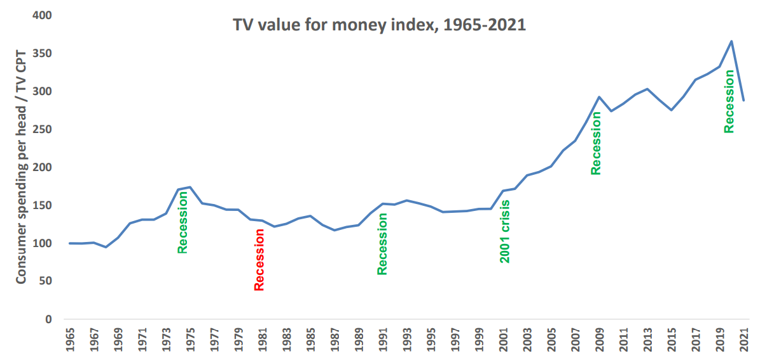
The value of TV increases during downturns
A high TV value for money index means that the price of TV is low, relative to total consumer spend levels
TV value for money index*
Source: Les Binet, ‘Marketing in the post-covid economy: A planning framework for turbulent times’. ONS, Advertising Association, WARC. *TV value for money index = consumer spending / TV CPT indexed from 1965
Notes:
Given the current economic climate, marketing budgets are increasingly under pressure with every investment needing to be justified.
At the 2022 IPA EffWorks Global, Les Binet (Group Head of Effectiveness of adam&eveDDB) provided a framework for planning media in economic uncertainty. During the session, ‘Marketing in the post covid economy’, Binet highlighted how short and long term investments should be dialled up and down depending on various factors.
One of the factors that Binet advises marketers to take advantage of is the value for money ratio for TV – a measure of the relative cost (CPT) of TV compared with the volume of total consumer spending. Binet’s data shows that the ratio has been rising over time as TV pricing has not kept pace with consumer spending in the long run – TV’s value for money has been getting better over time, particularly since 2000 due to increased competition from the tech giants.
Interestingly, when we focus specifically on times of recession (the 1970s, the 1990s, 2001 and more recently 2020 which was impacted by the global financial crisis and Covid), TV’s value for money increased sharply. The 1981 recession is the only exception.
This highlights the opportunity that advertisers and planners can take advantage of. If your particular sector is performing well, this is the perfect opportunity to buy share of voice, a method utilised by FMCG advertisers as they increased investment in TV during the pandemic.
For more insight on how brands can navigate through turbulent economic times, click here: https://www.thinkbox.tv/research/media-mix-navigator/strategies-for-marketing-through-a-downturn/

Slide 52
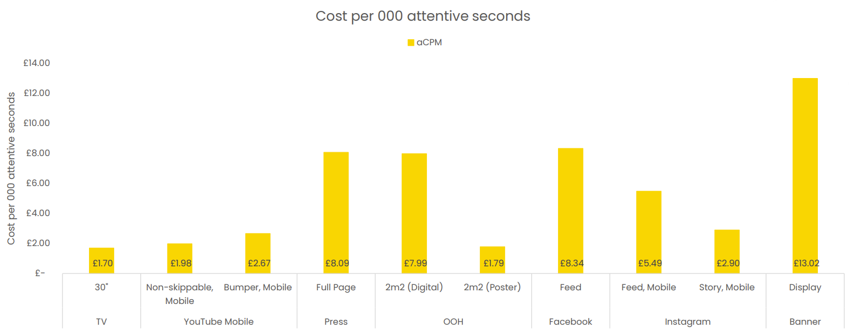
TV is an ‘attention bargain’
Attention data Sources: TV: Tvision/Lumen UK TV Panel. YT, Instream, Teads, Facebook Feed, Banners: Lumen digital panels. Press: Lumen Omnibus. OOH: AM4DOOH project. IG, FB Watch, TikTok: Lumen studies (weighted to be consistent with passive panel). CPM sources: Ebiquity
Notes:
Data from Lumen and Tvision shows how TV is an ‘attention bargain’, with a 30” TV creative generating a cost per 000 attentive second of £1.70

Slide 53
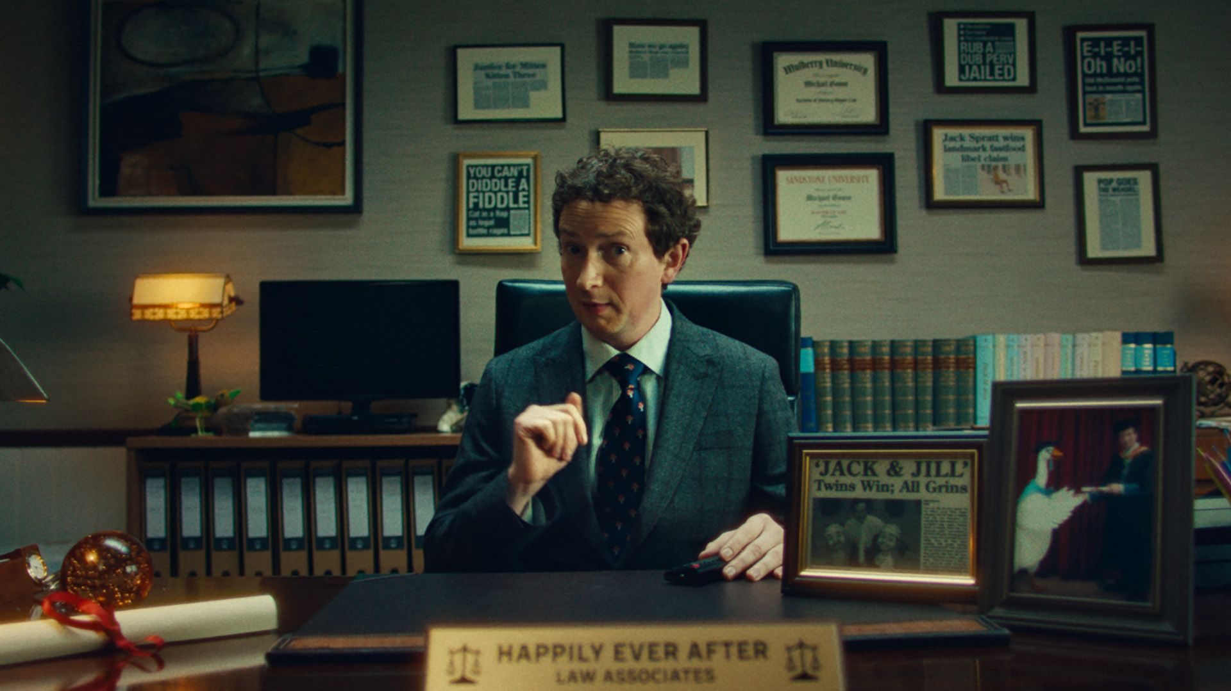
Find out more at Thinkbox.tv
Helping you get the best out of TV
Notes:
Find out more from Thinkbox
Whether you are in need of information or inspiration, we’ll keep you up to date:
Visit www.thinkbox.tv
Register for our newsletter
Or simply talk to us

