Slide 1


TV advertising’s ultimate nickable charts
What every marketer should know
UPDATED August 2023
Notes:
Hello. Welcome to ‘TV advertising’s ultimate nickable charts’. This deck brings together the ultimate evidence which explains how and why TV is the most effective form of advertising – and is, in fact, becoming more effective.
If you have any questions about this deck – or would like more information on any topic – please contact us via info@thinkbox.tv.
Cover image by Raphael Rychetsky on Unsplash

Slide 2














1. Who is Thinkbox?
Thinkbox is the marketing body for commercial TV in the UK, in all its forms. It works with the marketing community with a single ambition: to help advertisers get the best out of today’s TV.
Main shareholders
Associates & supporters
Member of

Slide 3
Why nick these?
You probably already have plenty of charts in your life, so why do you need these?
Well, if you work in marketing, these are essential.
Whether you’re working on a pitch, looking for facts to share with colleagues, want to know what TV can now do, or just really enjoy charts, this deck is for you.
It’s packed with insight and evidence, from the facts about our transforming TV viewing to the latest on how and why TV advertising works.
It covers lots of ground but with a single purpose: to give you the proof of why TV advertising is so valuable and vital to businesses of all shapes and sizes – more so now than perhaps ever.
If you want to nick even more charts or have any questions, please get in touch with us at research@thinkbox.tv
Notes:
If you want to nick even more charts or have any questions, please get in touch with us at research@thinkbox.tv

Slide 4

In this deck…
TV VIEWING: THE FACTS | 01
TV IS A TRUSTED & SAFE ENVIRONMENT FOR BRANDS | 02
TV: THE MOST EFFECTIVE ADVERTISING | 03
TV HAS UNBEATABLE SCALE AND REACH | 04
TV IS THE EMOTIONAL MEDIUM AND BUILDS BRAND FAME | 05
TV IS GREAT VALUE | 06
McDonalds – Raise Your Arches

Slide 5
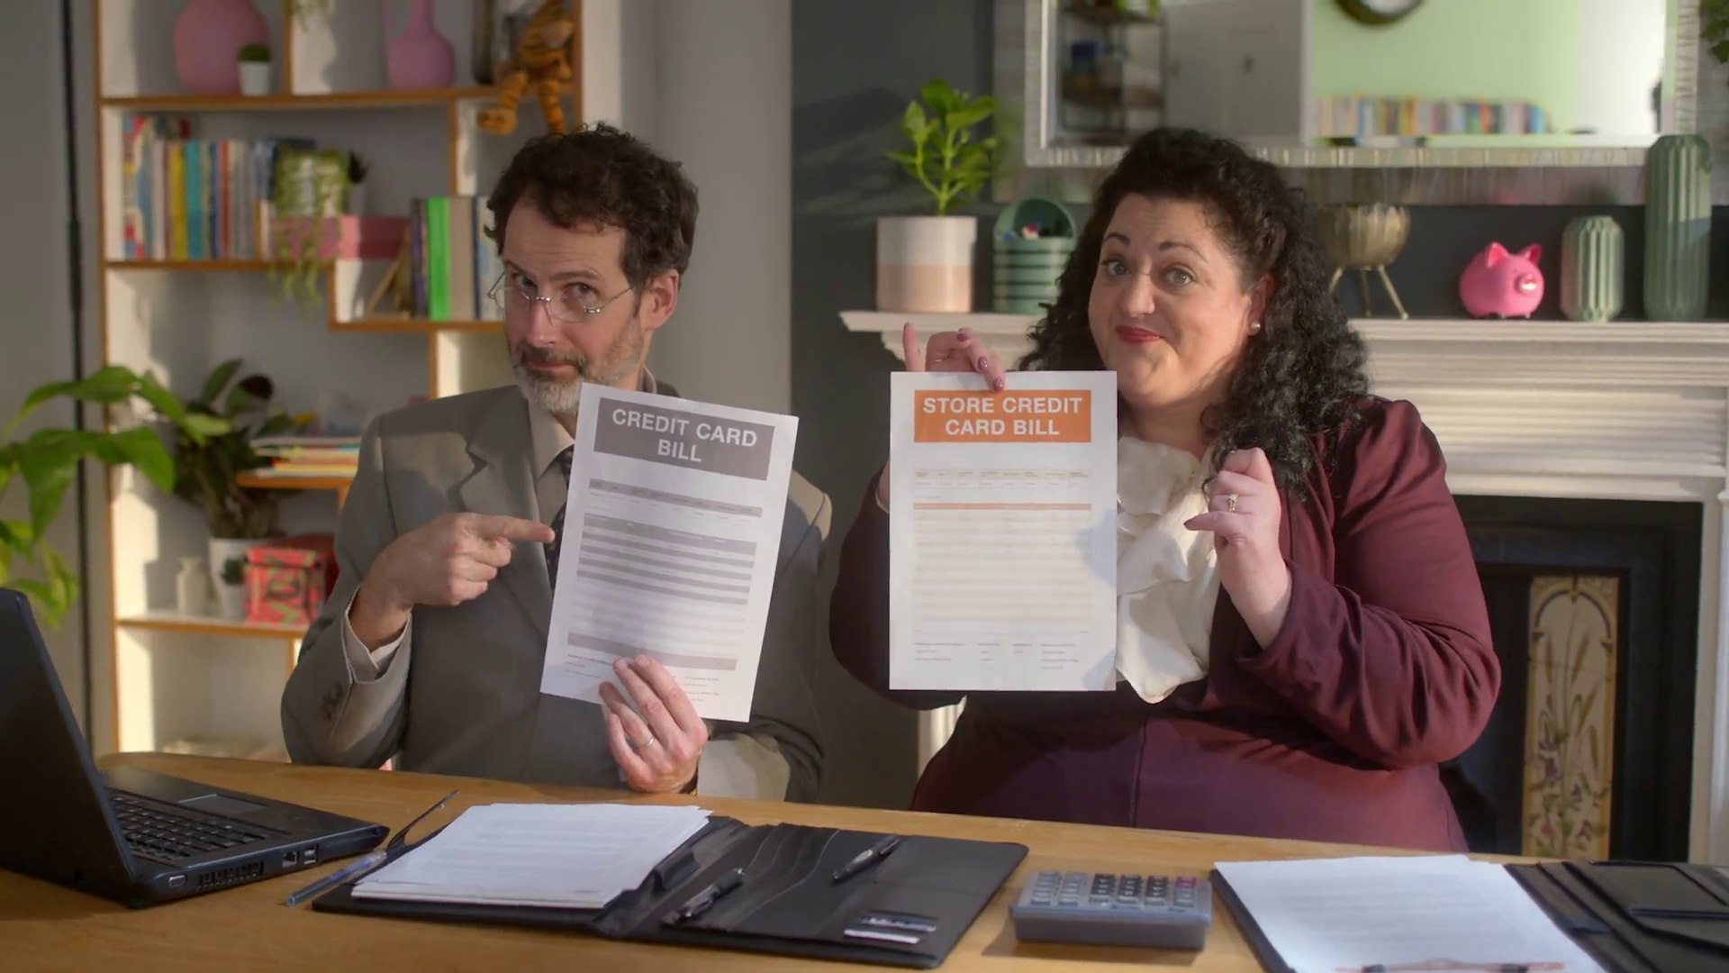
TV viewing: the facts
SECTION ONE
Barclaycard – Cost Controllers

Slide 6


Summary –
TV Viewing: the facts
In 2022, we watched 2h, 41m of broadcaster TV each day.
BVOD represents 28% of all broadcaster TV viewing for 16-34s
TV advertising accounted for 84% of the video advertising we saw each day in 2022, and 56% for 16-34s.
House of the Dragon - Sky
The Handmaid’s Tale, Channel 4
Sources: please see notes
Notes:
Source: 2022, Barb / Broadcaster stream data
Source: 2022, Barb / Broadcaster stream data
Source: 2022, Barb / Broadcaster stream data / IPA TouchPoints 2022 / UK Cinema Association / ViewersLogic to model OOH viewing time * YouTube ad time modelled at 4.1% of content time, TikTok ad time modelled at 3.4% of content time using agency and broadcaster data, Other online modelled at 4% of content time)

Slide 7
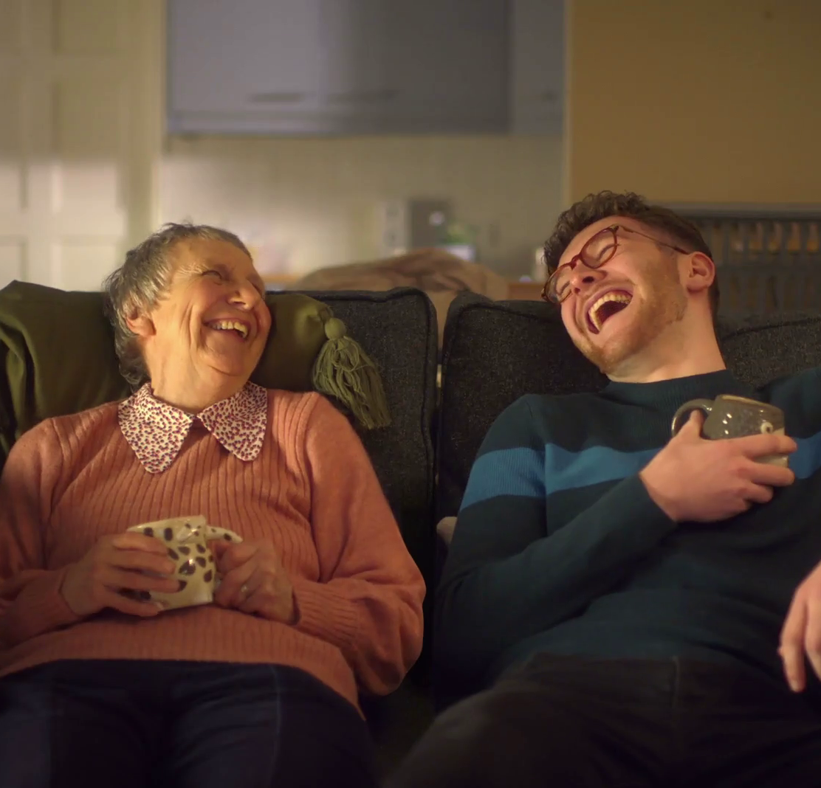
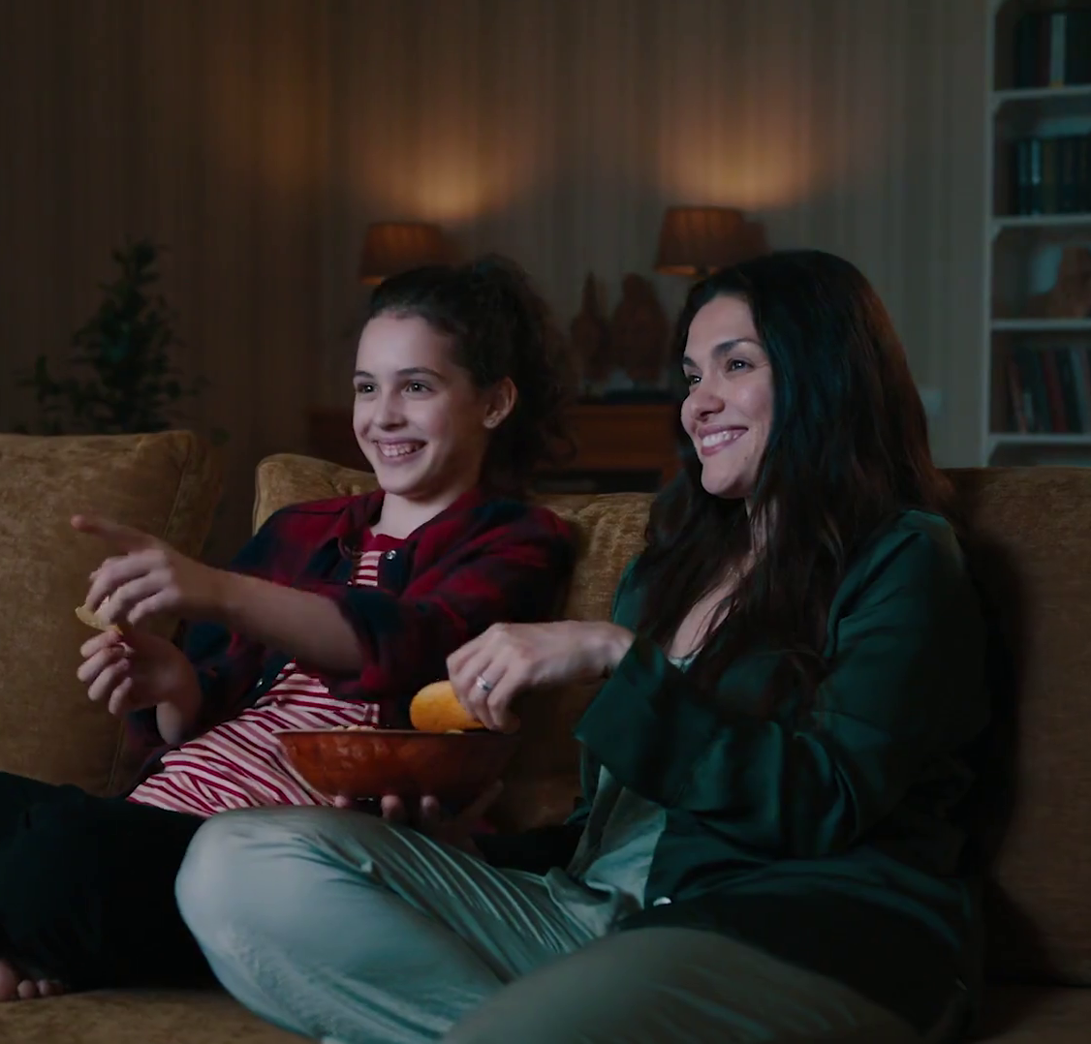
TV viewers have never had it better
71.5% of main TV screens 40” or bigger
81% have access to broadcaster VOD on TV set
LG Televisions - Mega
Dunelm “Home Truths”
Source: Barb, Touchpoints, Thinkbox estimates
Notes:
TV technology and content quality have improved dramatically in the past decade.

Slide 8
Video viewing has reverted to pre-pandemic levels
HOURS PER PERSON PER DAY (Adults)
Source: IPA TouchPoints, Adults, Average of Wave 1 and Wave 2 2022, Barb and Broadcaster data

Slide 9
ALL INDIVIDUALS
Broadcasters account for 84% of all video advertising
Average video advertising time per day
All Individuals: 17 mins
16-34s
16-34s: 10.3 mins
Source: 2022, Barb / Broadcaster stream data / IPA TouchPoints 2022 / UK Cinema Association / ViewersLogic to model OOH viewing time * YouTube ad time modelled at 4.1% of content time, TikTok ad time modelled at 3.4% of content time using agency and broadcaster data, Other online modelled at 4% of content time)
Notes:
Without a single source data provider on time-spent watching AV advertising, this analysis takes a jigsaw approach, using a variety of data sources to build the most accurate picture of AV viewing time possible.
The data approach used to build the estimate for each platform:
Broadcaster TV: Barb data for linear and playback advertising time and the broadcasters’ own census data for BVOD advertising viewing time.
Cinema: The UK Cinema Association provides total box office seats sold. We’ve estimated 15 minutes of advertising per seat.
YouTube: Barb data for time spent viewing content, ViewersLogic panel data to estimate out of home viewing not measured by Barb (73.5% in home, 26.5% out of home), broadcasters’ own data of ad load per hour of YouTube viewing, and agency data for average duration of ad view.
TikTok: Barb data for time spent viewing content, ViewersLogic panel data to estimate out of home viewing not measured by Barb (77.5% in home, 22.5% out of home), Thinkbox estimates for ad load per hour of TikTok viewing, and agency data for average duration of view.
Other online video: IPA TouchPoints data for % of other online video viewing relative to all video viewing, Thinkbox estimate of % ad time to content time (based on YouTube/TikTok).

Slide 10
BVOD accounts for over ¼ of 16-34s broadcaster TV viewing
Inds
16-34
2 hrs 41 mins
1 hr 1 min
Source: 2022, Barb / Broadcaster stream data
Notes:
BVOD is vital to different audiences
Breaking down broadcaster TV into the different ways it can be accessed reveals the increasingly important role of BVOD for 16-34s, now 28% of all broadcaster TV viewing.

Slide 11








There are 8 need states which drive video viewing
content
7% ESCAPE
10% EXPERIENCE
9% INDULGE
12% IN TOUCH
2% DO
16% COMFORT
personal
social
18% DISTRACT
26% UNWIND
context
Source: The Age of Television, 2018, MTM/Thinkbox.
Notes:
The Age of Television study, conducted by MTM, on behalf of Thinkbox, observed there are eight need states which define our video viewing habits:
Escape (7% viewing time) - The need to lose yourself in another world and become fully immersed in highly involving and engaging content .
Experience (10% viewing time) - The need to feel part of a shared viewing experience, either by watching live or being able to participate in a wider social conversation.
In Touch (12% viewing time) - The need to feel aware of what’s happening in the world, by being informed about political, social and cultural events.
Comfort (16% viewing time) - The need for shared family / couple time, which tends to be served by familiar programmes and viewing routines.
Unwind (26% viewing time) - The need to relax and de-stress from the pressures of the day, through familiar and undemanding content.
Distract (18% viewing time) - The need for instant gratification to fill time, counter boredom or provide a short break from other tasks.
Do (2% viewing time) - The need to find useful information that can be practically applied to any area of life.
Indulge (9% viewing time) - The need to pursue personal interests, hobbies and fulfil guilty pleasures.
The study sized these eight need states in terms of the time audiences spend meeting each one with video content.
We found that the largest proportion of time spent watching videos is to satisfy the need to unwind, the need for a distraction and the need for comfort.
The role of content and context differ across each need state, with content is particularly important for escape and experience.
In contrast, the need to unwind is far more likely to be driven by context – such as the need to wind down after work.
The need states also differ in terms of being personally or socially driven. For example, the need for comfort is driven by a desire to spend time with others, while the need for a distraction is more personal.
For more information on this study please see:
https://www.thinkbox.tv/Research/Thinkbox-research/The-Age-of-Television-the-needs-that-drive-us

Slide 12
Broadcasters deliver the biggest hits
Source: Barb, 2022, individuals. Average audience figures. Consolidated 1-28 days, excludes one-offs, films and sports

Slide 13
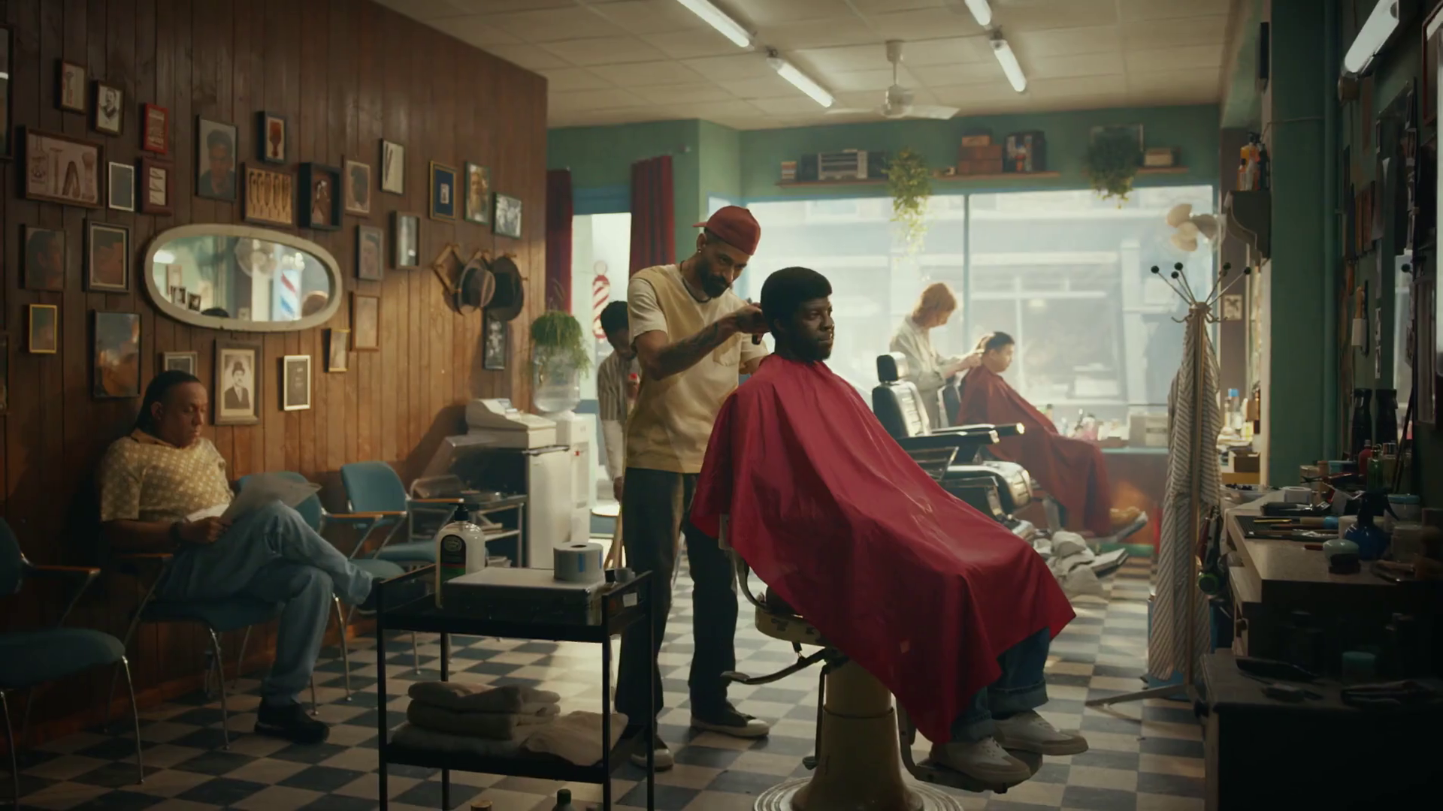
TV is a trusted & safe environment for brands
SECTION TWO
Carwow - Snip
Notes:
TV in the UK is full of wonderful, high quality content which broadcasters invest in heavily. This, alongside the tight regulation which governs TV content and advertising, makes it a safe environment for viewers and brands.
In addition, TV has a robust, metred measurement system, Barb, which provides a joint industry currency for TV advertising trading based on completed ads, watched full screen (and by humans).

Slide 14

Summary –
TV is a trusted & safe environment for brands
TV’s hidden value includes high value exchange, strong costly signals and high attention levels.
TV ads were most trusted by the UK public (35%)
The Island, UKTV
Sources: please see notes
Notes:
Source: Adnormal Behaviour, 2022, Ipsos / Thinkbox. Q.TN3: In which, if any, of the following places are you most likely to find advertising that...you trust

Slide 15
TV’s hidden value
High value exchange
Shared viewing
Strong costly signals
Trusted
Not perceived to be targeted
Big screen
High attention levels
High completion rates
Bot free
Regulated / Ad clearance
Notes:
TV in the UK is full of wonderful, high quality content which broadcasters invest in heavily. This, alongside the tight regulation which governs TV content and advertising, makes it a safe environment for viewers and brands.
In addition, TV has a robust, metred measurement system, Barb, which provides a joint industry currency for TV advertising trading based on completed ads, watched full screen (and by humans).

Slide 16



TV advertising is seen as most trustworthy
Newspapers
Radio
Magazines
Search
Cinema
TV
Social Media
Outdoor
Direct Mail
YouTube
Websites
Source: Adnormal Behaviour, 2022, Ipsos / Thinkbox. Q.TN3: In which, if any, of the following places are you most likely to find advertising that...you trust
Base: ‘normal’ people (1,158)
Notes:
Thinkbox’s ‘Adnormal Behaviour’ work showed that TV ads were see as the most trusted form of advertising.
For more information on this study, see the full write up on the Thinkbox website:
https://www.thinkbox.tv/research/thinkbox-research/adnormal-behaviour/

Slide 17

TV: the most effective advertising
SECTION THREE
LG – Light Up Your World

Slide 18

Summary –
TV: the most effective advertising
TV boosts effects of other ad channels by up to 54%
The optimal budget mix varies by sector with TV often commanding the lions share
TV constitutes on average 66% of smaller brands media budget but returned 80% of all ad-generated sales
On Running – Speed Runner
Sources: please see notes
Notes:
Source: ‘Demand Generation’ Nov 2019, MediaCom/Wavemaker/Gain Theory/Thinkbox
Source: ‘As Seen on TV: supercharging your small business’, May 2019, Data2Decisions/Work/Thinkbox. Data2Decisions database of smaller brands. All categories.

Slide 19
Linear TV and BVOD both deliver strong ROI performance
Total (short and long-term) ROI Index Channel Hierarchy
Source: Media Mix Navigator, Sept. 2022, EssenceMediacom / Wavemaker / Mindshare / Gain Theory
Notes:
Both Linear TV and BVOD deliver good ROI performance, as shown by findings from ‘BVOD Almighty: Reach and Return’ commissioned by Thinkbox.
This chart demonstrates the total (short and long term) ROI performance by channel. It’s worth noting that the data is shown as indices (and not absolute ROI delivery). Thus, it means that linear TV is 41% better than the average of all channels (and Generic Search 40% worse).
The data is shown as indices because the dataset behind the analysis includes a range of product categories. The absolute £££ return you would normally expect from advertising, of course, varies by category. Thus using indices helps understand overall normative performance of each channel relative to everything else.
The channels are ranked by total performance. But in the bars you can see the differing delivery of return by short term (up to 3-months) and long-term (3-months up to three years).
You can see that linear TV has the highest proportion of longer term delivery.
For more information on this study please see:
https://www.thinkbox.tv/research/thinkbox-research/bvod-almighty-reach-and-return/

Slide 20
BVOD and Linear TV are the least risky media channels
The Variability of Returns by Channel
(Data 2018 – Mid 2021)
Increasing risk / reward of achieving return
0% = Median ROI
Source: Media Mix Navigator, Sep. 2022, EssenceMediacom / Wavemaker / Mindshare / Gain Theory
Notes:
Findings from ‘BVOD Almighty: Reach and Return’, shows that the predictability of payback varies greatly by channel. Using the Media Mix Navigator, it’s based on data from Gain Theory, EssenceMediacom, Wavemaker, and Mindshare which covers 52 brands and £2.2 billion of media spend over 3 years.
The charts shows how the variability of returns differs significantly across different forms of advertising. This essentially indicates the risk of investing in different channels based on the predictability of their returns.
The median brand ROI in the databank for each channel is represented by the zero across the middle. To assess the predictability of each channel, the analysis looks at how spread out the different brand ROIs are for each channel in comparison to that middle brand. Basically, the bigger the bar, the bigger variance there is between the best performer and the worst performer – so the greater degree of risk. Outliers have been removed.
As you can see, BVOD is the most predictable (therefore least risky) channel, delivering 20% of variance compared with the median return. This was closely followed by linear TV with a variability of 24%.
It’s worth noting that high variability works both ways: although it involves greater risk, there is the possibility of achieving a much higher than average ROI (as well as a much lower one).

Slide 21
TV boosts effects of other ad channels by up to 54%
 | Channel Benefiting from the Effect
Channel Generating the Effect | TV | Online Video + VOD | Social Media | Online Display | Out of Home | Radio | Print | Generic Search | Cinema | Direct Mail
TV |  | 20% | 31% | 31% | 22% | 31% | 31% | 8% | 54% | 20%
Online Video + VOD | 3% |  | 5% | 2% | 5% | 3% | 12% | 1% | 7% | 2%
Social Media | 2% | 2% |  | 2% | 3% | 2% | 3% | 1% | 3% | 1%
Online Display | 3% | 4% | 4% |  | 4% | 3% | 9% | 3% | 11% | 4%
Out of Home | 6% | 8% | 9% | 8% |  | 9% | 11% | 1% | 3% | 1%
Radio | 4% | 4% | 4% | 6% | 4% |  | 3% | 2% | 1% | 1%
Print | 5% | 6% | 7% | 5% | 6% | 4% |  | 4% | 13% | 7%
Generic Search | 3% | 2% | 4% | 2% | 2% | 3% | 7% |  | * | 6%
Key: | 0-2% | 3-4% | 5-8% | 9-20% | 20%+
Source: ‘Demand Generation’ Nov 2019, MediaCom/Wavemaker/Gain Theory/Thinkbox
NB: Insufficient data to robustly report Cinema & Direct Mail’s effect on other channels. *insufficient data to report effect
Notes:
‘Demand Generation’, commissioned by Thinkbox and conducted WPP agencies Mediacom, Wavemaker and Gain Theory, looked at how one ad channel boosts the efficiency of another ad channel. Most channels boost the efficiency of others, but the scale and consistency of the effect differs significantly.
This chart outlines this multiplier effect between ad channels and the effects each channel can receive. The Y axis indicates the active channel generating the effect, with the X axis relating to the channel benefiting from that effect.
We can see that when TV is active, the effectiveness of Cinema is bolstered up by 54% - more than any other channel. This makes sense as Cinema has a relatively small reach but a high impact, and with TV copy tending to be a cutdown version of what Cinema shows, it is extending its reach.
TV stands out as having the biggest and most consistent effect on other channels. This isn’t a coincidence. On average brands are spending 45% of their advertising budgets on TV, so it is bound to have a bigger effect.
For more information on this study please see:
https://www.thinkbox.tv/research/thinkbox-research/demand-generation/

Slide 22
Optimal budget mix varies by sector – TV has the largest share
Source: ‘Media Mix Navigator’ Sep 2022, EssenceMediacom / Wavemaker / Gain Theory / Thinkbox
NB: Channels with sufficient sector level benchmarks only. 11-20% online sales (online retail 100%), low risk tolerance, further details for each category is included in the notes
Notes:
‘Media Mix Navigator’, commissioned by Thinkbox and conducted WPP agencies Mediacom, Wavemaker and Gain Theory, demonstrated the difference in optimal media mix depending on the product category.
The first bar represents the entire Media Mix Navigator tool database – the ‘average’ – and we can see that it doesn’t represent any of the other six bars that are split down by category. In being able to split down to category level we can see how the optimum media mix changes for each based on that sectors specific needs.
The one consistent factor throughout all is that TV is the largest single channel. But even within that, the extent to which TV is the largest channel can vary greatly.
Data for each product category:
All – Brand size (£m): 7,000, Annual Media Spend (£m): 72
Automotive - Brand size (£m): 2,600, Annual Media Spend (£m): 17
Finance - Brand size (£m): 7,000, Annual Media Spend (£m): 32
FMCG - Brand size (£m): 60, Annual Media Spend (£m): 6
Online Retail - Brand size (£m): 165, Annual Media Spend (£m): 9
Retail - Brand size (£m): 7,000, Annual Media Spend (£m): 25
Telecoms - Brand size (£m): 17,525, Annual Media Spend (£m): 59
Travel - Brand size (£m): 5,200, Annual Media Spend (£m): 22
The brand size for each product category has been calculated by taking 20% of the maximum brand size, whilst the annual media spend is an estimate of the average spend for that category.
For more information on this study please see:
https://www.thinkbox.tv/research/media-mix-navigator/media-mix-navigator/

Slide 23
TV delivers greater sales versus spend for smaller brands
Share of spend
Share of advertising-generated sales
Source: ‘As Seen on TV: supercharging your small business’, May 2019, Data2Decisions/Work/Thinkbox. Data2Decisions database of smaller brands. All categories.
Notes:
Thinkbox study ‘As Seen on TV: supercharging your small business’, conducted by marketing effectiveness consultancy D2D, shows how well TV performs in terms of sales versus spend.
Out of the D2D dataset of 78 smaller brands across all categories, TV constituted on average 66% of their media budget but returned 80% of all ad-generated sales. This is due to two factors – the high ROI (return on investment) and the fact that it can deliver scale without saturating.
This demonstrates the key role of TV for advertisers looking to drive brand growth.
For more information on this study please see:
https://www.thinkbox.tv/research/thinkbox-research/as-seen-on-tv-supercharging-your-small-business/

Slide 24

TV has unbeatable scale and reach
SECTION FOUR
Sonos – Home Theatre

Slide 25

Summary - TV has unbeatable scale and reach
Linear TV and broadcaster VOD combined reaches 89% of the adult population each week
Adults spend an average 13.2 hours per week watching commercial TV reaching 43 million individuals
An average broadcast TV campaign of 400 TVRs in the UK gets 244 million views
Rob and Romesh Vs., Sky
Sources: please see notes
Notes:
Source: Source: IPA TouchPoints 2023, Wave 1 (Fieldwork Dates: 17th January – 26th March 2023). Adults 15+
Source: Source: Source: IPA TouchPoints 2023, Wave 1 (Fieldwork Dates: 17th January – 26th March 2023). Base: adults 15+. Newspaper/magazine/TV figures include online/app consumption.
Source: Barb Dec 2022, Individuals

Slide 26

Linear TV and BVOD reaches 89% of adults each week
Taskmaster, Channel 4
Source: IPA TouchPoints 2023, Wave 1 (Fieldwork Dates: 17th January – 26th March 2023). Adults 15+
Notes:
Linear TV and broadcaster combined reaches 89% of the population each week.

Slide 27
Total TV weekly reach (linear TV + BVOD)
Weekly Reach % | 2019 | 2020 | 2021 | 2022 | 2023
Adults | 93 | 91 | 91 | 91 | 89
ABC1 adults | 94 | 91 | 91 | 91 | 90
15-34 | 86 | 81 | 81 | 80 | 76
Men | 92 | 90 | 90 | 90 | 89
Women | 95 | 92 | 91 | 93 | 89
HP+CH | 94 | 90 | 90 | 91 | 89
Source: IPA TouchPoints, 2018 – 2019 , 2020 (average of both waves), 2021 (average of both waves), 2022 (average of both waves), 2023 Wave 1 (Fieldwork Dates: 17th January – 26th March 2023)
Notes:
Linear TV and broadcaster combined reaches 88.8% of the adult population each week.

Slide 28
Commercial TV delivers scale
ADULTS REACHED PER WEEK
(MILLIONS)
Newsbrand / Mag
Social Media
Commercial TV
Commercial Radio
YouTube
TikTok
AVERAGE HOURS PER WEEK
Source: IPA TouchPoints 2023, Wave 1 (Fieldwork Dates: 17th January – 26th March 2023). Base: adults 15+. Newspaper/magazine/TV figures include online/app consumption.
Notes:
As well as reaching into every corner of the country, people also spend a lot of time with TV. It is the most popular medium.

Slide 29
Commercial broadcasters collectively provide the highest reach and time spent
All Individuals – All devices
Bubble area represents total volume of daily viewing
Source: Barb / All Individuals, all devices – 2022
Notes:
This chart breaks down viewing to the various platforms in terms of the average number of people watching per day (for at least 3 minutes) compared with the average time spent watching per viewer (i.e. only counting those who watched on that day).
Analysis across 2022 shows that the commercial broadcasters (linear and on demand) collectively reach just over 33 million viewers every day, with each of those viewers watching for an average of 3hrs, 25 mins a day. The combined portfolio of BBC channels (linear and on demand) attracts the second largest volume of viewing, with 27 million daily reach and an average view time of just over 2 hours. YouTube is next, with a daily reach of 20 million people and a view time of 1hr 42 mins (Barb only measure in-home viewing, we estimate that YouTube would be circa. 25% larger in viewing time if out of home viewing was included).
SVOD services such as Netflix has a daily reach of 12.4 million people and a view time of 1hr 47 mins, whilst other AVOD services (covering Chili, Rakuten TV, Samsung TV Plus, Red Bull TV, TVPlayer, Vevo, W4FREE, and YuppTV) have a collective average daily reach of 83,000 viewers and a view time of 38 mins a day.

Slide 30

An average broadcast
TV campaign of 400 TVRs in the UK gets
244 million views
“Gogglebox”, Channel 4
Source: Barb Dec 2022, Individuals
Notes:
Beware the seduction of ‘views’. Views that TV ads get online are an important part of the way brands now communicate. However, because the figures are so visible, the offline views – which are often driving them – can get overlooked. A million online views is not to be sniffed at, but an average broadcast TV campaign in the UK gets 244 million ‘views’ – and that is before you consider the different quality of the viewing experiences.
How this is calculated:
A typical campaign of 400 ratings expressed as views is 4 times the TV universe.

Slide 31
BVOD is critical for delivering cost effective reach for 16-34s
Source: Barb BVOD Planner (2022, 6 weeks 39-44) / natural delivery / station average prices
Notes:
Total TV builds cost effective reach
As TV viewing has spread across linear and on demand, TV’s ability to deliver high volumes of cost-effective reach has changed and BVOD has become even more important on the plan.
The latest data from Barb’s total TV planning tool clearly shows how planning linear and BVOD together deliver higher levels of reach at lower AV budgets.

Slide 32
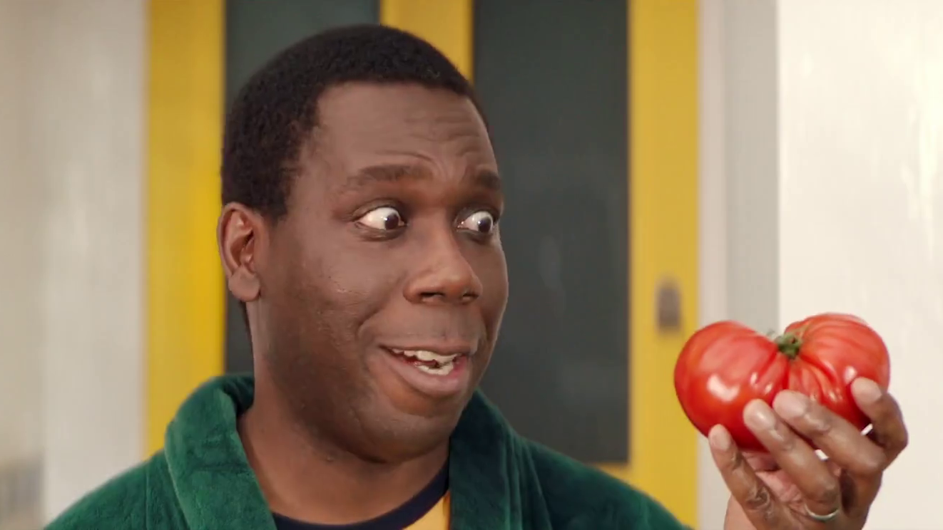
TV is the emotional medium and builds brand fame
SECTION FIVE
Oddbox - Neighbours

Slide 33
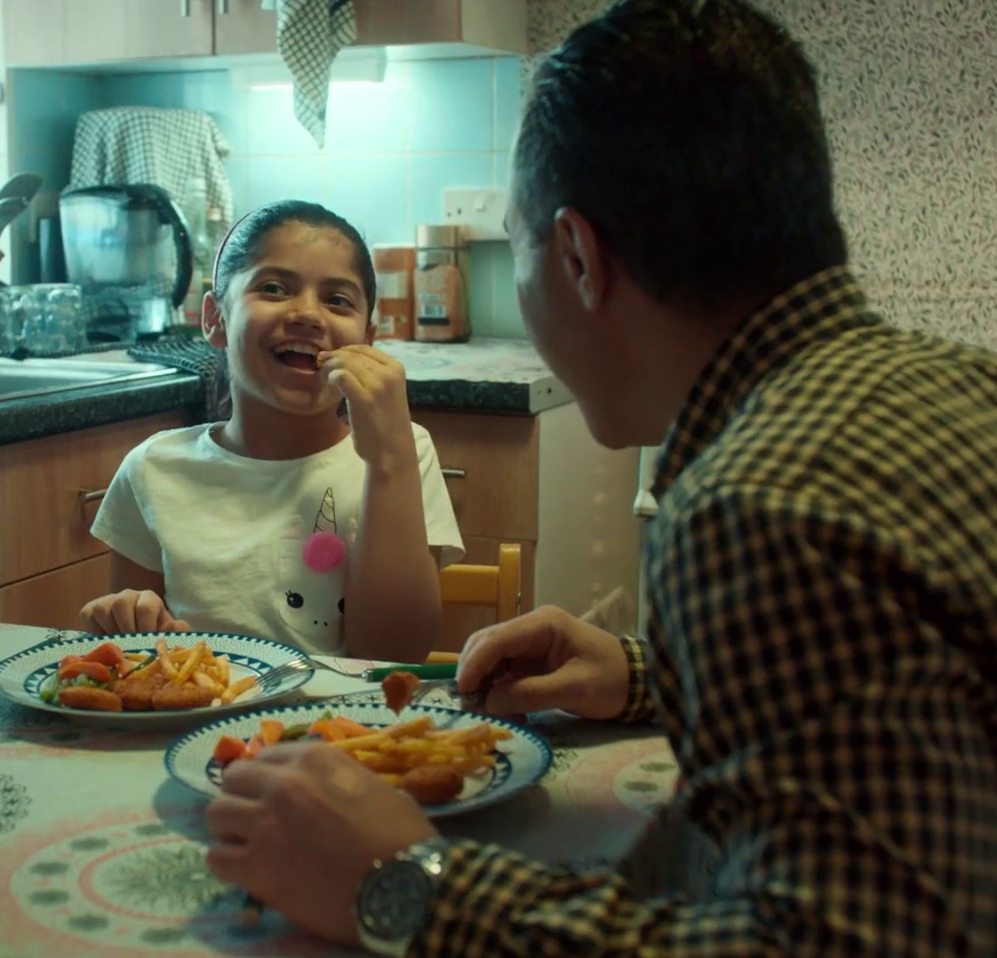
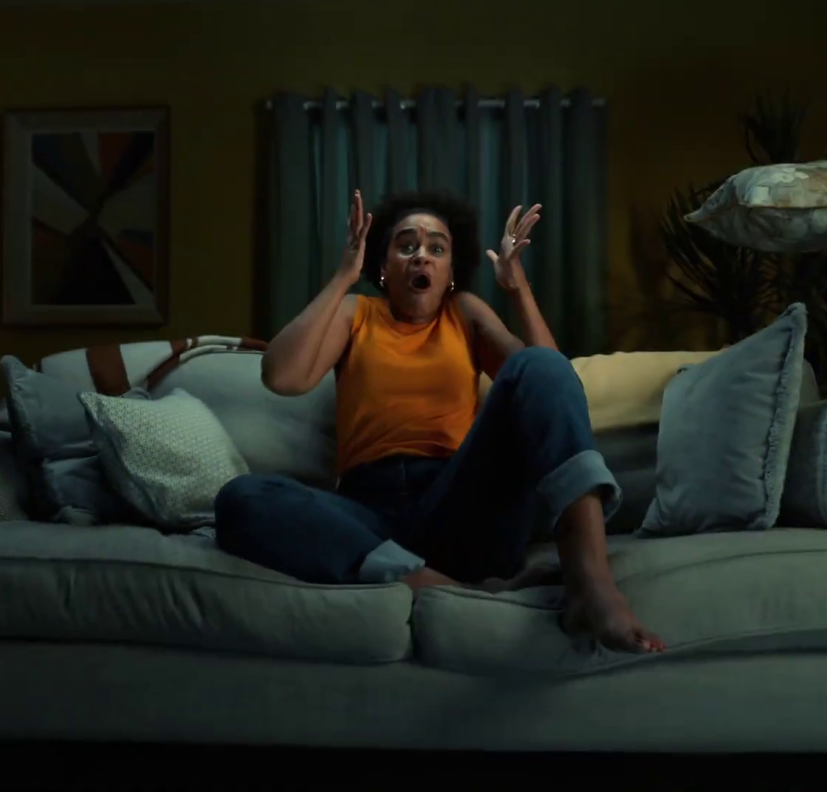
Summary - TV is the emotional medium and builds brand fame
TV advertising is most likely to make you laugh (52%) and is the most liked (40%)
TV is the medium most likely to signal brand fame
Higher-performing creatively-awarded campaigns are most likely to have higher shares of spend on TV
Lionsgate+ Reactions
McCain “Little Moments”
Sources: please see notes
Notes:
Source: Adnormal Behaviour, 2022, Ipsos / Thinkbox. Q.TN3: In which, if any, of the following places are you most likely to find advertising that...
Source: Signalling Success, 2020, house51 / Thinkbox. Adults 16+. Top 2 box agreement “This brand will become well known”
Source: ‘The Crisis in Creative Effectiveness’, Peter Field Consulting / IPA, June 2019

Slide 34
TV ads evoke emotion more than those in other media
In which, if any, of the following places are you most likely to find advertising that…’
 | TV | Social Media | Radio | YouTube | Cinema | Magazines | Outdoor | Newspapers | Search | Direct Mail | Websites
Makes you laugh | 52% | 35% | 13% | 21% | 16% | 5% | 6% | 6% | 4% | 2% | 3%
Makes you feel emotional | 47% | 17% | 6% | 10% | 15% | 5% | 3% | 9% | 4% | 2% | 2%
You like | 40% | 27% | 10% | 12% | 14% | 15% | 8% | 12% | 14% | 4% | 4%
Source: Adnormal Behaviour, 2022, Ipsos / Thinkbox. Q.TN3: In which, if any, of the following places are you most likely to find advertising that...
Base: ‘normal’ people (1,158)
Notes:
Thinkbox’s ‘Adnormal Behaviour’ showed that TV ads were by far the most likely to make people feel emotional, and creating an emotional response is incredibly effective in advertising. It also showed that TV ads were by far the most likely to make people laugh.
For more information on this study, see the full write up on the Thinkbox website.

Slide 35
TV advertising signals brand fame
Brand will become well known
52%
48%
44%
44%
40%
38%
Source: Signalling Success, 2020, house51 / Thinkbox. Adults 16+. Top 2 box agreement “This brand will become well known”
Notes:
House51 & Thinkbox’s ‘Signalling Success’ used an experimental design to evaluate the advertising signals which are driven by each medium.
The results confirmed that TV is the medium most likely to signal brand fame.
For more information on this study, see the full write up on the Thinkbox website:
https://www.thinkbox.tv/research/thinkbox-research/signalling-success/

Slide 36
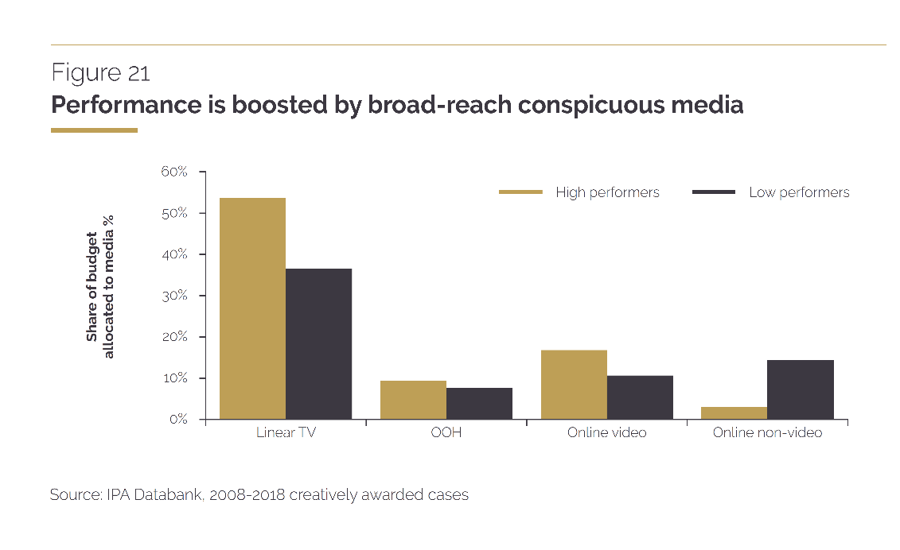
It is revealing to contrast creative high performers’ media tendencies with those generally favoured by creative awards judges.
TV is the biggest media tendency for high performers and yet, overall, judges tend to give creative awards much more often to those that use online video and social media. These media can be effective too, but their effectiveness doesn’t really justify all the attention they are getting.
“
“
Source: ‘The Crisis in Creative Effectiveness’, Peter Field Consulting / IPA, June 2019
Notes:
In his 2019 IPA report, ‘The Crisis in Creative Effectiveness’, Peter Field looked at creatively-awarded campaigns and the pattern of media used within submissions. The data shows that the higher-performing creatively-awarded campaigns are more likely to have higher shares of spend on TV. The lower-performing campaigns are more likely to use online advertising.
For more information about this report, please see:
https://ipa.co.uk/media/7699/ipa_crisis_in_creative_effectiveness_2019.pdf

Slide 37

TV is great value
SECTION SIX
Jaguar – Night Drive

Slide 38

Summary - TV is great value
The average cost of buying the media space to get one person in the UK
to see a TV (linear and BVOD) advert is 0.8p (in 2022)
The average cost across TV advertising (linear and BVOD) for 30 seconds is just £8, for YouTube, its £12, whilst for non-broadcaster online video (excluding YouTube), it goes up to a £130.
When buying 1 million 16-34s on linear TV, you also get 3.5m 4-15s / 35+ for free!
Ant and Dec’s Limitless Win, ITV
Sources: please see notes
Notes:
Source: 2022, Thinkbox estimates using AA/WARC
Source: 2022, Thinkbox estimates using AA/WARC, Barb, ViewersLogic, IPA TouchPoints 2022
Source: Barb: linear TV data based on top 50 profiling campaigns (over 10m impacts) for 16-34s, June 2019. Online video based on Nielsen digital ad ratings UK benchmarks (18-34) Q3 2018

Slide 39

Average TV view costs 0.8p (in 2022)
The average cost
of buying the media space to get one
person in the UK
to see a TV (linear and VOD) advert
costs over half a penny
Source: 2022, Thinkbox estimates using AA/WARC
Notes:
The average cost of buying the media space to enable one person in the UK to see a TV (linear and VOD) advert only costs just under a penny.

Slide 40
TV advertising is great value
Revenue
£ billion
Minutes of AV advertising per person, per day
Cost per Thousand
(30 sec)
£5.1
14.2
Broadcaster TV
(Inc BVOD)
£8
YouTube
£1.1
2.1
£12
£3.9
£130
All other online video
0.7
Source: 2022, Thinkbox estimates using AA/WARC, Barb, ViewersLogic, IPA TouchPoints 2022
Notes:
According to AA/WARC Expenditure Report, in 2022 ad spend on online video (excluding Broadcaster VOD) was £3.9bn.
TV including BVOD accounts for 84% of video advertising time, according to analysis of industry data.
Online video such as YouTube, TikTok, Facebook and the long programmatic tail together account for 16%.
In other words, the average person watches nearly 14.2 minutes of TV advertising a day (the 84%) and 2.8 minutes of non-broadcaster online video advertising (2.1 minutes for YouTube and 0.7 minutes for all other online video).
Yet AA/Warc figures show that £5bn was poured into those 2.8 minutes a day and £5.1bn into the 14.2 minutes.
Let’s turn this into the comparable measure of cost per completed views. Online video ads are usually priced on a cost-per-start basis, but that is obviously the lowest of benchmarks, so let’s look at the average cost for 30 seconds of video ad viewing for a meaningful like-for-like comparison:
As you can see, the average cost across TV advertising (linear and BVOD) for 30 seconds is just £8, for YouTube, its £12, whilst for non-broadcaster online video (excluding YouTube), it goes up to a £130.

Slide 41
The great ‘wastage’ illusion
When you buy one million 16-34 exposures you get…
LINEAR TV
ONLINE ADVERTISING
Zero
EXPOSURES (MILLIONS)
Source: Barb: linear TV data based on top 50 profiling campaigns (over 10m impacts) for 16-34s, June 2019.
Online video based on Nielsen digital ad ratings UK benchmarks (18-34) Q3 2018
Notes:
In online advertising, advertisers have to pay for every view their ad gets, whether or not they are the desired audience. Nielsen data suggests that 65% of online impressions for 16-34s are ‘in target’, 35% ‘out of target’.
This chart demonstrates the difference in the nature of online advertising and linear TV advertising. It compares campaigns buying 1 million 16-34 exposures.
Linear TV isn’t perfect. When buying 1 million 16-34s the sampling margin of error is roughly 10% or more 16-34s than you bought. But you don’t pay for any of the out-of-target audience, which, as you can see, is substantial. This exposure is absolutely free.
For a million 16-34 online impressions, on average only 65% will be aged 16-34. But the advertiser still has to pay for those who aren’t. There is nothing extra for free.

Slide 42
UK linear TV is great value
Source: WARC estimates 2022, calculated by applying the WFA’s media inflation figures – drawn from a panel of agencies and consultancies – to historic data

Slide 43
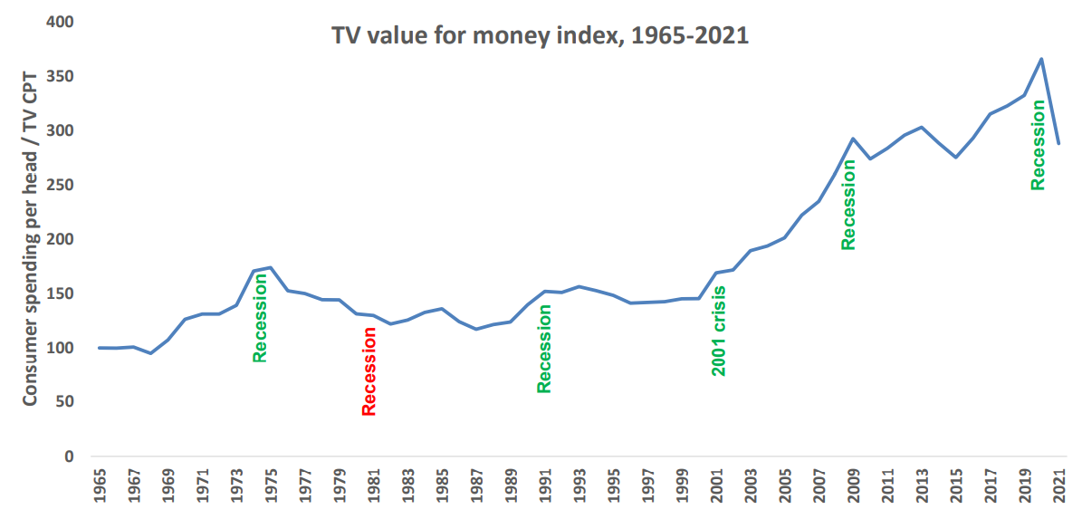
The value of TV increases during downturns
A high TV value for money index means that the price of TV is low, relative to total consumer spend levels
TV value for money index*
Source: Les Binet, ‘Marketing in the post-covid economy: A planning framework for turbulent times’. ONS, Advertising Association, WARC. *TV value for money index = consumer spending / TV CPT indexed from 1965
Notes:
Given the current economic climate, marketing budgets are increasingly under pressure with every investment needing to be justified.
At the 2022 IPA EffWorks Global, Les Binet (Group Head of Effectiveness of adam&eveDDB) provided a framework for planning media in economic uncertainty. During the session, ‘Marketing in the post covid economy’, Binet highlighted how short and long term investments should be dialled up and down depending on various factors.
One of the factors that Binet advises marketers to take advantage of is the value for money ratio for TV – a measure of the relative cost (CPT) of TV compared with the volume of total consumer spending. Binet’s data shows that the ratio has been rising over time as TV pricing has not kept pace with consumer spending in the long run – TV’s value for money has been getting better over time, particularly since 2000 due to increased competition from the tech giants.
Interestingly, when we focus specifically on times of recession (the 1970s, the 1990s, 2001 and more recently 2020 which was impacted by the global financial crisis and Covid), TV’s value for money increased sharply. The 1981 recession is the only exception.
This highlights the opportunity that advertisers and planners can take advantage of. If your particular sector is performing well, this is the perfect opportunity to buy share of voice, a method utilised by FMCG advertisers as they increased investment in TV during the pandemic.
For more insight on how brands can navigate through turbulent economic times, click here: https://www.thinkbox.tv/research/media-mix-navigator/strategies-for-marketing-through-a-downturn/

Slide 44
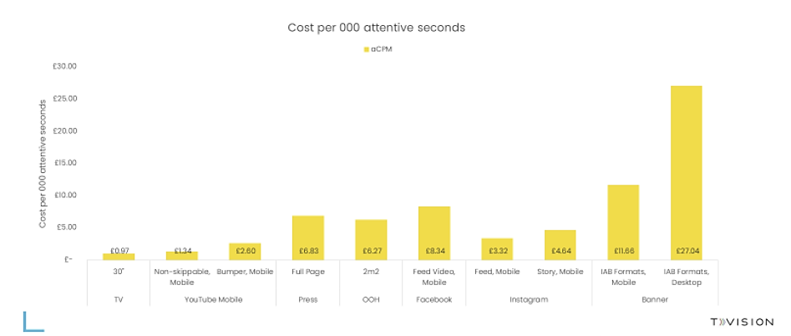
TV is an ‘attention bargain’
Source: TV: Tvision / Lumen UK TV Panel. YT, Instream, Teads, Facebook Feed, Banners: Lumen digital panels. Press: Lumen Omnibus. OOH: AM4DOOH project. IG, FB Watch, TikTok: Lumen studies (weighted to be consistent with passive panel). CPM sources: Ebiquity / Fou Analytics (taken from The Challenge of Attention, 2020)

Slide 45
Find out more at Thinkbox.tv
Helping you get the best out of TV
Notes:
Find out more from Thinkbox
Whether you are in need of information or inspiration, we’ll keep you up to date:
Visit www.thinkbox.tv
Register for our newsletter
Or simply talk to us
Image by Raphael Rychetsky on Unsplash

