Slide 1
TV advertising’s ultimate nickable charts What every marketer should know
UPDATED October 2024
Notes:
Hello. Welcome to ‘TV advertising’s ultimate nickable charts’. This deck brings together the ultimate evidence which explains how and why TV is the most effective form of advertising – and is, in fact, becoming more effective.
If you have any questions about this deck – or would like more information on any topic – please contact us via info@thinkbox.tv.
Cover image by Raphael Rychetsky on Unsplash

Slide 2
1. Who is Thinkbox?
Thinkbox is the marketing body for commercial TV in the UK, in all its forms. It works with the marketing community with a single ambition: to help advertisers get the best out of today’s TV.
Main shareholders
Associates & supporters
Member of

Slide 3
Why nick these?
You probably already have plenty of charts in your life, so why do you need these?
Well, if you work in marketing, these are essential.
Whether you’re working on a pitch, looking for facts to share with colleagues, want to know what TV can now do, or just really enjoy charts, this deck is for you.
It’s packed with insight and evidence, from the facts about our transforming TV viewing to the latest on how and why TV advertising works.
It covers lots of ground but with a single purpose: to give you the proof of why TV advertising is so valuable and vital to businesses of all shapes and sizes – more so now than perhaps ever.
If you want to nick even more charts or have any questions, please get in touch with us at research@thinkbox.tv
Notes:
If you want to nick even more charts or have any questions, please get in touch with us at research@thinkbox.tv

Slide 4
In this deck…
TV VIEWING: THE FACTS | 01
TV IS A TRUSTED & SAFE ENVIRONMENT FOR BRANDS | 02
TV: THE MOST EFFECTIVE ADVERTISING | 03
TV HAS UNBEATABLE SCALE AND REACH | 04
TV IS THE EMOTIONAL MEDIUM AND BUILDS BRAND FAME | 05
TV IS GREAT VALUE | 06
TV DELIVERS AGAINST MULTIPLE OBJECTIVES | 07
Doritos – Extra Flamin’ Hot

Slide 5
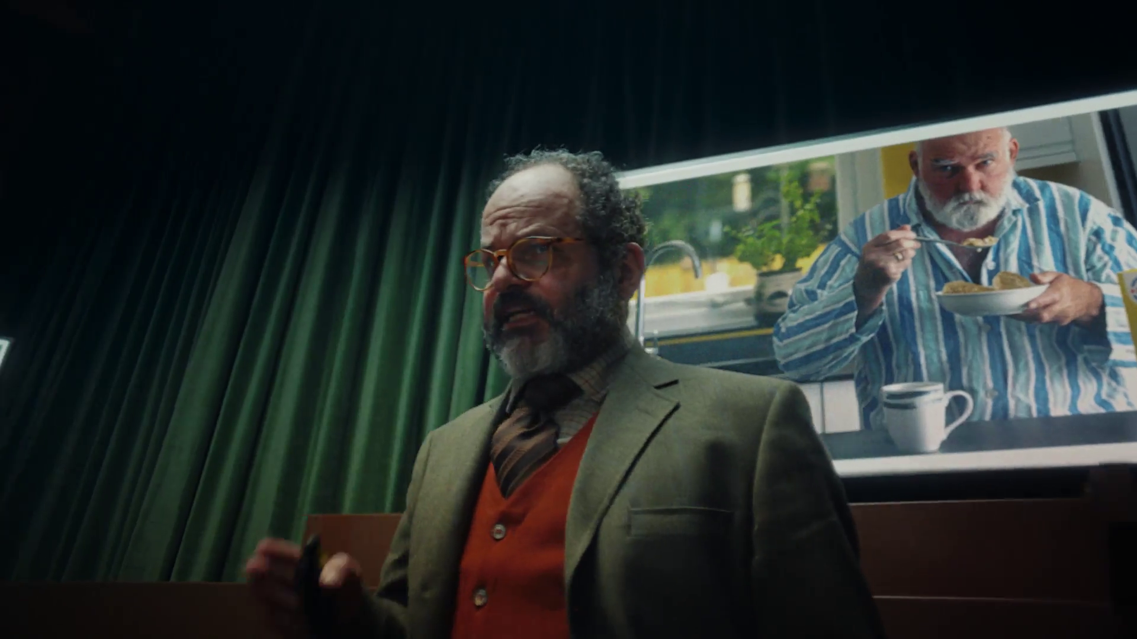
TV viewing: the facts
SECTION ONE
Weetabix – Fixing Britain

Slide 6
Summary – TV Viewing: the facts
In 2023, we watched 2h, 40m of broadcaster TV each day.
BVOD represents 24% of all broadcaster TV viewing for 16-34s
TV advertising accounted for 84% of the video advertising we saw each day in 2023, and 54% for 16-34s.
Succession - Sky
Sources: please see notes
Notes:
Source: 2023, Barb
Source: 2023, Barb
Source: 2023, Barb / Broadcaster stream data / IPA TouchPoints 2023 / UK Cinema Association / ViewersLogic to model OOH viewing time *YouTube ad time modelled at 4.1% of content time and excludes those estimated to be on the YouTube Premium tier, TikTok ad time modelled at 3.4% of content time using agency and broadcaster data, Other online modelled at 4% of content time)

Slide 7
TV viewers have never had it better
72.7% of main TV screens 40” or bigger
81.5% have access to broadcaster VOD on TV set
Confused.com – Emmerdale Sponsorship
Source: Barb, Touchpoints, Thinkbox estimates
Notes:
TV technology and content quality have improved dramatically in the past decade.

Slide 8
Overall, it’s a much more stable viewing landscape
HOURS PER PERSON PER DAY (Adults)
Source: IPA TouchPoints, Adults, Barb, All devices, includes estimates for OOH viewing to TikTok, YouTube and Other online video
Notes:
Looking at the long-term trend 2023 viewing levels have flattened out and paint a picture of much more stability, with this pattern looking set to continue into 2024 – interestingly there was slight growth in total viewing levels, suggesting that the increases to TikTok and YouTube seen doesn’t all need to substitute TV viewing.

Slide 9
ALL INDIVIDUALS
Broadcasters account for 84% of all video advertising
Average video advertising time per day
All Individuals: 17.0 mins
16-34s
16-34s: 9.8 mins
Source: 2023, Barb / Broadcaster stream data / IPA TouchPoints 2023 / UK Cinema Association / ViewersLogic to model OOH viewing time *YouTube ad time modelled at 4.1% of content time, TikTok ad time modelled at 3.4% of content time using agency and broadcaster data, Other online modelled at 4% of content time)
Notes:
Without a single source data provider on time-spent watching AV advertising, this analysis takes a jigsaw approach, using a variety of data sources to build the most accurate picture of AV viewing time possible.
The data approach used to build the estimate for each platform:
Broadcaster TV: Barb data for linear and playback advertising time and the broadcasters’ own census data for BVOD advertising viewing time.
Cinema: The UK Cinema Association provides total box office seats sold. We’ve estimated 15 minutes of advertising per seat.
YouTube: Barb data for time spent viewing content, ViewersLogic panel data to estimate out of home viewing not measured by Barb, broadcasters’ own data of ad load per hour of YouTube viewing, and agency data for average duration of ad view.
TikTok: Barb data for time spent viewing content, ViewersLogic panel data to estimate out of home viewing not measured by Barb, Thinkbox estimates for ad load per hour of TikTok viewing, and agency data for average duration of view.
Other online video: IPA TouchPoints data for % of other online video viewing relative to all video viewing, Thinkbox estimate of % ad time to content time

Slide 10
BVOD accounts for 24% of 16-34s broadcaster TV viewing
Inds
16-34
2 hrs 40 mins
1 hr 5 mins
Source: 2023, Barb
Notes:
BVOD is vital to different audiences
Breaking down broadcaster TV into the different ways reveals the increasingly important role of BVOD for 16-34, now 24% of all broadcaster TV viewing.
This data uses both Barb data and includes an estimate of any unknown viewing that is thought to fall into Playback and Live viewing.

Slide 11
There are 8 need states which drive video viewing
content
7% ESCAPE
10% EXPERIENCE
9% INDULGE
12% IN TOUCH
2% DO
16% COMFORT
personal
social
18% DISTRACT
26% UNWIND
context
Source: The Age of Television, 2018, MTM/Thinkbox.
Notes:
The Age of Television study, conducted by MTM, on behalf of Thinkbox, observed there are eight need states which define our video viewing habits:
Escape (7% viewing time) - The need to lose yourself in another world and become fully immersed in highly involving and engaging content .
Experience (10% viewing time) - The need to feel part of a shared viewing experience, either by watching live or being able to participate in a wider social conversation.
In Touch (12% viewing time) - The need to feel aware of what’s happening in the world, by being informed about political, social and cultural events.
Comfort (16% viewing time) - The need for shared family / couple time, which tends to be served by familiar programmes and viewing routines.
Unwind (26% viewing time) - The need to relax and de-stress from the pressures of the day, through familiar and undemanding content.
Distract (18% viewing time) - The need for instant gratification to fill time, counter boredom or provide a short break from other tasks.
Do (2% viewing time) - The need to find useful information that can be practically applied to any area of life.
Indulge (9% viewing time) - The need to pursue personal interests, hobbies and fulfil guilty pleasures.
The study sized these eight need states in terms of the time audiences spend meeting each one with video content.
We found that the largest proportion of time spent watching videos is to satisfy the need to unwind, the need for a distraction and the need for comfort.
The role of content and context differ across each need state, with content is particularly important for escape and experience.
In contrast, the need to unwind is far more likely to be driven by context – such as the need to wind down after work.
The need states also differ in terms of being personally or socially driven. For example, the need for comfort is driven by a desire to spend time with others, while the need for a distraction is more personal.
For more information on this study please see:
https://www.thinkbox.tv/Research/Thinkbox-research/The-Age-of-Television-the-needs-that-drive-us

Slide 12
UK original content dominates the top 30 series of 2023
Top 30 series on UK Television 2023 (All Inds 4+, TV set viewing only)
Rank | Channel | Title | Series | Ave aud (m) | Episodes
1 | BBC | Happy Valley | 3 | 12.8 | 6
2 | CH4 | The Great British Bake Off | 14 | 9.1 | 10
3 | BBC | Strictly Come Dancing | 21 | 8.5 | 25
4 | BBC | Death in Paradise | 12 | 8.5 | 8
5 | ITV | I'm a Celebrity... Get Me Out of Here! | 23 | 8.4 | 22
6 | BBC | Wild Isles | 1 | 8.4 | 5
7 | BBC | Beyond Paradise | 1 | 8.3 | 6
8 | Amazon | Clarkson's Farm | 2 | 8.2 | 8
9 | ITV | Unforgotten | 5 | 8.2 | 6
10 | BBC | Planet Earth III | 1 | 8.0 | 8
11 | BBC | Call the Midwife | 12 | 8.0 | 8
12 | BBC | Silent Witness | 26 | 7.2 | 10
13 | BBC | The Apprentice | 17 | 7.1 | 12
14 | ITV | The 1% Club | 2 | 7.0 | 8
15 | BBC | Vigil | 2 | 7.0 | 6
Top 30 series on UK Television 2023 (All Inds 4+, TV set viewing only)
Rank | Channel | Title | Series | Ave aud (m) | Episodes
16 | BBC | The Sixth Commandment | 1 | 7.0 | 4
17 | BBC | Shetland | 8 | 6.8 | 6
18 | ITV | Vera | 12 | 6.8 | 5
19 | Netflix | The Night Agent | 1 | 6.8 | 10
20 | ITV | Britain's Got Talent | 16 | 6.6 | 14
21 | ITV | Maryland | 1 | 6.6 | 3
22 | BBC | The Gold | 1 | 6.6 | 6
23 | ITV | Grace | 3 | 6.5 | 3
24 | ITV | The Hunt for Raoul Moat | 1 | 6.5 | 3
25 | ITV | Endeavour | 9 | 6.5 | 3
26 | ITV | The Long Shadow | 1 | 6.4 | 7
27 | Netflix | Beckham | 1 | 6.4 | 4
28 | ITV | The Bay | 4 | 6.4 | 6
29 | CH4 | Gogglebox | 21 | 6.4 | 16
30 | BBC | The Reckoning | 1 | 6.3 | 4
Source: Barb, 2023, Individuals. TV set viewing, Average audience per episode (excludes one-offs, kids, films and sports), all channels, and includes repeats.
Notes:
UK original content dominates the top 30 series of 2023.

Slide 13
The TV set remains the home for viewing to high-quality content
TV set viewing time by platform
2023, All Adults
3hrs 34 mins
PER DAY
Source: Barb
Notes:
Looking at the breakdown of TV set viewing, to provide a bit more granularity, professionally produced content takes up the vast majority of time.
71% is linear TV, 9% is BVOD, 15% is SVOD and 5% is YouTube. The emerging AVOD players, Samsung, Rakutun, Roku who are big in the states are yet to make a meaningful impact in the UK – they account for less than 0.1% of total TV viewing time.

Slide 14
TV is a trusted & safe environment for brands
SECTION TWO
Boots – Spring Mission
Notes:
TV in the UK is full of wonderful, high quality content which broadcasters invest in heavily. This, alongside the tight regulation which governs TV content and advertising, makes it a safe environment for viewers and brands.
In addition, TV has a robust, metred measurement system, Barb, which provides a joint industry currency for TV advertising trading based on completed ads, watched full screen (and by humans).

Slide 15
Summary – TV is a trusted & safe environment for brands
TV’s hidden value includes high value exchange, strong costly signals and high attention levels.
TV ads were most trusted by the UK public (35%)
Jamie’s 5 Ingredient Meals – Channel 4
Sources: please see notes
Notes:
Source: Adnormal Behaviour, 2022, Ipsos / Thinkbox. Q.TN3: In which, if any, of the following places are you most likely to find advertising that...you trust

Slide 16
TV’s hidden value
High value exchange
Shared viewing
Strong costly signals
Trusted
Not perceived to be targeted
Big screen
High attention levels
High completion rates
Bot free
Regulated / Ad clearance
Notes:
TV in the UK is full of wonderful, high quality content which broadcasters invest in heavily. This, alongside the tight regulation which governs TV content and advertising, makes it a safe environment for viewers and brands.
In addition, TV has a robust, metred measurement system, Barb, which provides a joint industry currency for TV advertising trading based on completed ads, watched full screen (and by humans).

Slide 17
TV advertising is seen as most trustworthy
Newspapers
Radio
Magazines
Search
Cinema
TV
Social Media
Outdoor
Direct Mail
YouTube
Websites
Source: Adnormal Behaviour, 2022, Ipsos / Thinkbox. Q.TN3: In which, if any, of the following places are you most likely to find advertising that...you trust
Base: ‘normal’ people (1,158)
Notes:
Thinkbox’s ‘Adnormal Behaviour’ work showed that TV ads were see as the most trusted form of advertising.
For more information on this study, see the full write up on the Thinkbox website:
https://www.thinkbox.tv/research/thinkbox-research/adnormal-behaviour/

Slide 18
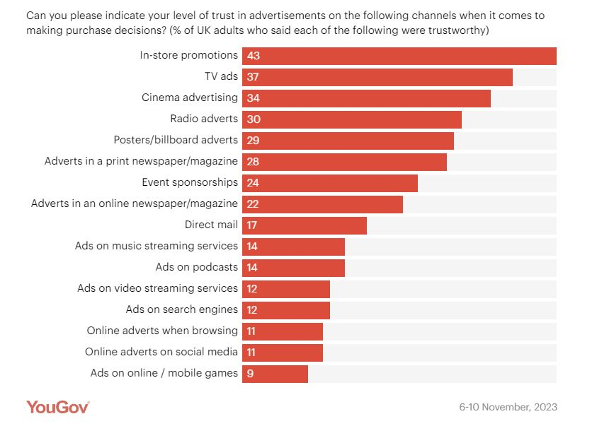
Trust is higher for traditional ad channels
Source: YouGov 2024, 3 big questions for advertisers marketers research
Notes:
Data from YouGov shows how Trust is higher for traditional ad channels such as TV and Cinema.
https://business.yougov.com/content/48911-3-big-questions-for-advertisers-marketers-research-2024

Slide 19
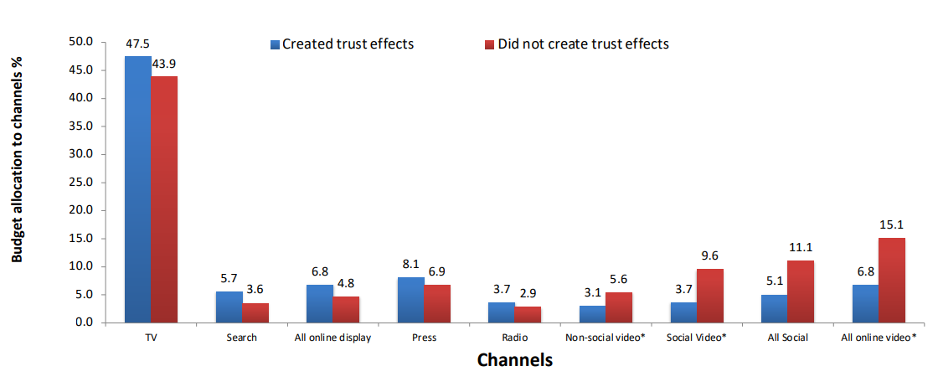
TV is a trusted medium
Source: IPA Databank 2014-2022 for profit cases *data available from 2016
Notes:
Recent years have seen a strengthening relationship between advertising trust and advertising driven profit. Comparing IPA survey data from 2014-2022 with data from 2000-2012, trust jumped from the seventh-highest brand metric linked to profit to the second-highest, just below quality.
Trust is often correlated with quality and has become increasingly important. Consumers are continuously forming assessments of the quality of the brands they may buy, based on whether they trust the brand (and its advertising).
Data showcased by effectiveness expert Peter Field at The Future of TV Advertising Global 2023 suggests that there seems to be a relationship between campaigns that created trust effects and their budget allocation to different media. Field’s work shows that campaigns using TV, search, online display, press, and radio achieved enhanced trust effects; whilst social media, social video, and online video were much less likely to deliver positive trust effects.
Additionally, many previous research studies have emphasised the importance of trust – not least Thinkbox’s ‘Adnormal Behaviour’ (conducted by Ipsos), which revealed how TV outperformed all other media as the leading source of advertising that people trust.

Slide 20
TV: the most effective advertising
SECTION THREE
Snickers – Own Goal

Slide 21
Summary – TV: the most effective advertising
TV boosts effects of other ad channels by up to 54%
The optimal budget mix varies by sector with TV often commanding the lions share
TV constitutes on average 66% of smaller brands media budget but returned 80% of all ad-generated sales
Sittingon a Fortune - ITV
Sources: please see notes
Notes:
Source: ‘Demand Generation’ Nov 2019, MediaCom/Wavemaker/Gain Theory/Thinkbox
Source: ‘As Seen on TV: supercharging your small business’, May 2019, Data2Decisions/Work/Thinkbox. Data2Decisions database of smaller brands. All categories.

Slide 22
Linear TV and BVOD both deliver strong ROI performance
Total (short and long-term) ROI Index Channel Hierarchy
Source: Media Mix Navigator, Sept. 2022, EssenceMediacom / Wavemaker / Mindshare / Gain Theory
Notes:
Both Linear TV and BVOD deliver good ROI performance, as shown by findings from ‘BVOD Almighty: Reach and Return’ commissioned by Thinkbox.
This chart demonstrates the total (short and long term) ROI performance by channel. It’s worth noting that the data is shown as indices (and not absolute ROI delivery). Thus, it means that linear TV is 41% better than the average of all channels (and Generic Search 40% worse).
The data is shown as indices because the dataset behind the analysis includes a range of product categories. The absolute £££ return you would normally expect from advertising, of course, varies by category. Thus using indices helps understand overall normative performance of each channel relative to everything else.
The channels are ranked by total performance. But in the bars you can see the differing delivery of return by short term (up to 3-months) and long-term (3-months up to three years).
You can see that linear TV has the highest proportion of longer term delivery.
For more information on this study please see:
https://www.thinkbox.tv/research/thinkbox-research/bvod-almighty-reach-and-return/

Slide 23
BVOD and Linear TV are the least risky media channels
The Variability of Returns by Channel
(Data 2018 – Mid 2021)
Increasing risk / reward of achieving return
0% = Median ROI
Source: Media Mix Navigator, Sep. 2022, EssenceMediacom / Wavemaker / Mindshare / Gain Theory
Notes:
Findings from ‘BVOD Almighty: Reach and Return’, shows that the predictability of payback varies greatly by channel. Using the Media Mix Navigator, it’s based on data from Gain Theory, EssenceMediacom, Wavemaker, and Mindshare which covers 52 brands and £2.2 billion of media spend over 3 years.
The charts shows how the variability of returns differs significantly across different forms of advertising. This essentially indicates the risk of investing in different channels based on the predictability of their returns.
The median brand ROI in the databank for each channel is represented by the zero across the middle. To assess the predictability of each channel, the analysis looks at how spread out the different brand ROIs are for each channel in comparison to that middle brand. Basically, the bigger the bar, the bigger variance there is between the best performer and the worst performer – so the greater degree of risk. Outliers have been removed.
As you can see, BVOD is the most predictable (therefore least risky) channel, delivering 20% of variance compared with the median return. This was closely followed by linear TV with a variability of 24%.
It’s worth noting that high variability works both ways: although it involves greater risk, there is the possibility of achieving a much higher than average ROI (as well as a much lower one).

Slide 24
TV boosts effects of other ad channels by up to 54%
 | Channel Benefiting from the Effect
Channel Generating the Effect | TV | Online Video + VOD | Social Media | Online Display | Out of Home | Radio | Print | Generic Search | Cinema | Direct Mail
TV |  | 20% | 31% | 31% | 22% | 31% | 31% | 8% | 54% | 20%
Online Video + VOD | 3% |  | 5% | 2% | 5% | 3% | 12% | 1% | 7% | 2%
Social Media | 2% | 2% |  | 2% | 3% | 2% | 3% | 1% | 3% | 1%
Online Display | 3% | 4% | 4% |  | 4% | 3% | 9% | 3% | 11% | 4%
Out of Home | 6% | 8% | 9% | 8% |  | 9% | 11% | 1% | 3% | 1%
Radio | 4% | 4% | 4% | 6% | 4% |  | 3% | 2% | 1% | 1%
Print | 5% | 6% | 7% | 5% | 6% | 4% |  | 4% | 13% | 7%
Generic Search | 3% | 2% | 4% | 2% | 2% | 3% | 7% |  | * | 6%
Key: | 0-2% | 3-4% | 5-8% | 9-20% | 20%+
Source: ‘Demand Generation’ Nov 2019, MediaCom/Wavemaker/Gain Theory/Thinkbox NB: Insufficient data to robustly report Cinema & Direct Mail’s effect on other channels. *insufficient data to report effect
Notes:
‘Demand Generation’, commissioned by Thinkbox and conducted WPP agencies Mediacom, Wavemaker and Gain Theory, looked at how one ad channel boosts the efficiency of another ad channel. Most channels boost the efficiency of others, but the scale and consistency of the effect differs significantly.
This chart outlines this multiplier effect between ad channels and the effects each channel can receive. The Y axis indicates the active channel generating the effect, with the X axis relating to the channel benefiting from that effect.
We can see that when TV is active, the effectiveness of Cinema is bolstered up by 54% - more than any other channel. This makes sense as Cinema has a relatively small reach but a high impact, and with TV copy tending to be a cutdown version of what Cinema shows, it is extending its reach.
TV stands out as having the biggest and most consistent effect on other channels. This isn’t a coincidence. On average brands are spending 45% of their advertising budgets on TV, so it is bound to have a bigger effect.
For more information on this study please see:
https://www.thinkbox.tv/research/thinkbox-research/demand-generation/

Slide 25
Optimal budget mix varies by sector – TV has the largest share
Optimal media mix
Source: Media Mix Navigator, 2024. Based on a mass market brand, 11-20% online sales (finance 71-80%), high risk, further details for each category is included in the notes
Notes:
Optimal ad mix varies dramatically by product sector
This chart shows how there are big variances in the optimal media mix between different product sectors.
It is based on data from the ‘Media Mix Navigator’, which lets brands easily explore the impact on revenue and profit that different budget levels have on budget allocation across channels.
The Media Mix Navigator tool has been engineered by EssenceMediacom and is powered by the blockbuster Profit Ability 2 databank, which takes in £1.8 billion of media spend across 141 brands during 2021-23. The brands included were carefully chosen to represent as many business types as possible. Each brand commissioned and paid for their own econometric analysis; the databank aggregated this existing data.
Media Mix Navigator enables analysis bespoke to a brand’s specific situation and attitude to risk. For this analysis, we have used an ‘average’ brand position.
This chart shows how the optimal media mix differs by category, and there are some interesting variances. For example, looking specifically at Generic PPC, the investment allocation is particularly high for sectors such as Finance, Travel and Automotive. This is explained by the fact that these sectors often deal with higher priced items which are usually ‘considered purchases – ones where consumers are likely to conduct online research before making a purchase decision. Similarly, Print is an important channel for Automotive and Travel, both of which benefit from extensive specialist titles that provide the opportunity to reach key audiences.
The one consistent factor throughout all the scenarios is that Linear TV is the largest single channel, although the extent to which it is the largest channel can vary greatly – e.g. higher in Retail, FMCG and Automotive but lower in Finance.
For more information, visit: https://www.thinkbox.tv/training-and-tools/media-mix-navigator/media-mix-navigator
Category input details:
All – Brand size (£m): 10,000, Annual Media Spend (£m): 50
Automotive - Brand size (£m): 2,600, Annual Media Spend (£m): 17
Finance - Brand size (£m): 10,000, Annual Media Spend (£m): 20
FMCG - Brand size (£m): 60, Annual Media Spend (£m): 6
Retail - Brand size (£m): 9,000, Annual Media Spend (£m): 25
Travel - Brand size (£m): 5,200, Annual Media Spend (£m): 19
Telecoms - Brand size (£m): 7,000, Annual Media Spend (£m): 45
Output: Revenue
The brand size for each product category has been calculated by taking 20% of the maximum brand size whilst the annual media spend is an estimate of the average spend for that category.

Slide 26
TV delivers greater sales versus spend for smaller brands
Share of spend
Share of advertising-generated sales
Source: ‘As Seen on TV: supercharging your small business’, May 2019, Data2Decisions/Work/Thinkbox. Data2Decisions database of smaller brands. All categories.
Notes:
Thinkbox study ‘As Seen on TV: supercharging your small business’, conducted by marketing effectiveness consultancy D2D, shows how well TV performs in terms of sales versus spend.
Out of the D2D dataset of 78 smaller brands across all categories, TV constituted on average 66% of their media budget but returned 80% of all ad-generated sales. This is due to two factors – the high ROI (return on investment) and the fact that it can deliver scale without saturating.
This demonstrates the key role of TV for advertisers looking to drive brand growth.
For more information on this study please see:
https://www.thinkbox.tv/research/thinkbox-research/as-seen-on-tv-supercharging-your-small-business/

Slide 27
TV has unbeatable scale and reach
SECTION FOUR
Easyjet – Get Out There

Slide 28
Summary - TV has unbeatable scale and reach
Linear TV and broadcaster VOD combined reaches 89% of the adult population each week
Adults spend an average 13.2 hours per week watching commercial TV reaching 43 million individuals
A broadcast TV campaign of 400 TVRs in the UK gets 244 million views
I’m a Celebrity…Get Me Out of Here! - ITV
Sources: please see notes
Notes:
Source: Source: IPA TouchPoints 2023, Wave 1 (Fieldwork Dates: 17th January – 26th March 2023). Adults 15+
Source: Source: Source: IPA TouchPoints 2023, Wave 1 (Fieldwork Dates: 17th January – 26th March 2023). Base: adults 15+. Newspaper/magazine/TV figures include online/app consumption.
Source: Barb Dec 2023, Individuals

Slide 29
Linear TV and BVOD reaches 89% of adults each week
Evil Genius with Russell Kane - Sky
Source: IPA TouchPoints 2023. (Fieldwork Dates: 17th January – 26th March 2023). Adults 15+
Notes:
Linear TV and broadcaster combined reaches 89% of the population each week.

Slide 30
Total TV weekly reach (linear TV + BVOD)
Weekly Reach % | 2019 | 2020 | 2021 | 2022 | 2023
Adults | 93 | 91 | 91 | 91 | 89
ABC1 adults | 94 | 91 | 91 | 91 | 90
15-34 | 86 | 81 | 81 | 80 | 76
Men | 92 | 90 | 90 | 90 | 89
Women | 95 | 92 | 91 | 93 | 89
HP+CH | 94 | 90 | 90 | 91 | 89
Source: IPA TouchPoints, 2018 – 2019 , 2020 (average of both waves), 2021 (average of both waves), 2022 (average of both waves), 2023 (Fieldwork Dates: 17th January – 26th March 2023)
Notes:
Linear TV and broadcaster combined reaches 88.8% of the adult population each week.

Slide 31
Commercial TV delivers scale
ADULTS REACHED PER WEEK
(MILLIONS)
Newsbrand / Mag
Social Media
Commercial TV
Commercial Radio
YouTube
TikTok
AVERAGE HOURS PER WEEK
Source: IPA TouchPoints 2023, Wave 1 (Fieldwork Dates: 17th January – 26th March 2023). Base: adults 15+. Newspaper/magazine/TV figures include online/app consumption.
Notes:
As well as reaching into every corner of the country, people also spend a lot of time with TV. It is the most popular medium.

Slide 32
Commercial broadcasters collectively provide the highest reach and time spent
All Individuals – All devices
Bubble area represents total volume of daily viewing
AVERAGE DAILY REACH (000s)
Other AVOD
Other
SVOD
Twitch
Dailymotion
AVE TIME VIEWED PER VIEWER PER DAY
Source: Barb / All Individuals, all devices – 2023
Notes:
This chart breaks down viewing to the various platforms in terms of the average number of people watching per day (for at least 3 minutes) compared with the average time spent watching per viewer (i.e. only counting those who watched on that day).
Analysis across 2023 shows that the commercial broadcasters (linear and on demand) collectively reach just over 31 million viewers every day, with each of those viewers watching for an average of 3hrs, 33 mins a day. The combined portfolio of BBC channels (linear and on demand) attracts the second largest volume of viewing, with 25 million daily reach and an average view time of just over 2 hours. YouTube is next, with a daily reach of 21 million people and a view time of 1hr 49 mins (Barb only measure in-home viewing, we estimate that YouTube would be larger in viewing time if out of home viewing was included).
SVOD services such as Netflix has a daily reach of 12.3 million people and a view time of 1hr 47 mins.

Slide 33
A broadcast TV campaign of 400 TVRs in the UK gets 244 million views
“Gogglebox”, Channel 4
Source: Barb Dec 2023, Individuals
Notes:
Beware the seduction of ‘views’. Views that TV ads get online are an important part of the way brands now communicate. However, because the figures are so visible, the offline views – which are often driving them – can get overlooked. A million online views is not to be sniffed at, but a broadcast TV campaign in the UK gets 244 million ‘views’ – and that is before you consider the different quality of the viewing experiences.
How this is calculated:
A broadcast TV campaign of 400 ratings expressed as views is 4 times the TV universe.

Slide 34
BVOD is critical for delivering cost effective reach for 16-34s
Source: Barb BVOD Planner (2023, 6 weeks 35-40) / natural delivery / station average prices. Optimised to determine linear and BVOD split.

Slide 35
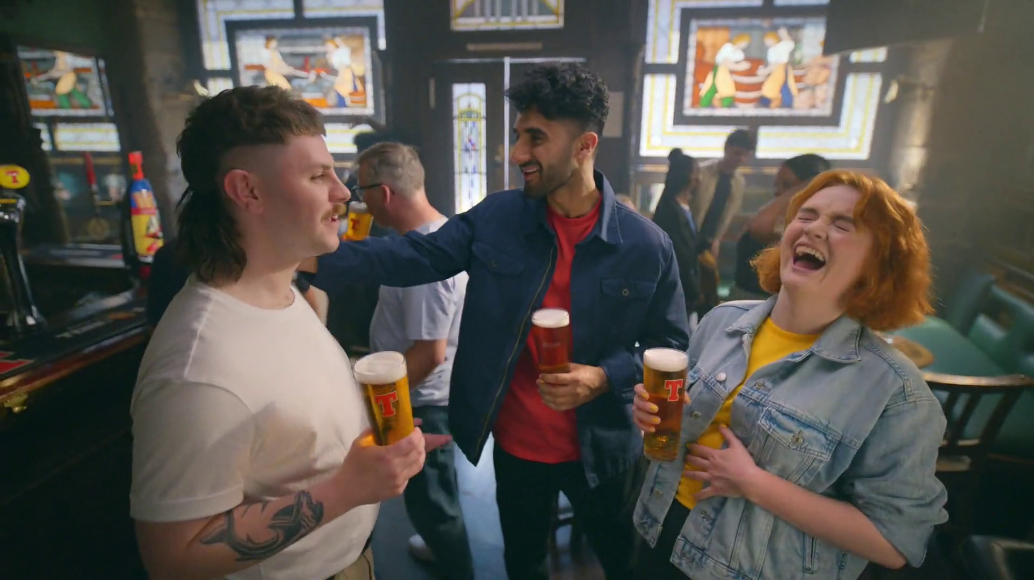
TV is the emotional medium and builds brand fame
SECTION FIVE
Tennent’s Lager - Ooft

Slide 36
Summary - TV is the emotional medium and builds brand fame
TV advertising is most likely to make you laugh (52%) and is the most liked (40%)
TV is the medium most likely to signal brand fame
Higher-performing creatively-awarded campaigns are most likely to have higher shares of spend on TV
Meet teRichardsons - UKTV
Sources: please see notes
Notes:
Source: Adnormal Behaviour, 2022, Ipsos / Thinkbox. Q.TN3: In which, if any, of the following places are you most likely to find advertising that...
Source: Signalling Success, 2020, house51 / Thinkbox. Adults 16+. Top 2 box agreement “This brand will become well known”
Source: ‘The Crisis in Creative Effectiveness’, Peter Field Consulting / IPA, June 2019

Slide 37
TV ads evoke emotion more than those in other media
In which, if any, of the following places are you most likely to find advertising that…’
 | TV | Social Media | Radio | YouTube | Cinema | Magazines | Outdoor | Newspapers | Search | Direct Mail | Websites
Makes you laugh | 52% | 35% | 13% | 21% | 16% | 5% | 6% | 6% | 4% | 2% | 3%
Makes you feel emotional | 47% | 17% | 6% | 10% | 15% | 5% | 3% | 9% | 4% | 2% | 2%
You like | 40% | 27% | 10% | 12% | 14% | 15% | 8% | 12% | 14% | 4% | 4%
Source: Adnormal Behaviour, 2022, Ipsos / Thinkbox. Q.TN3: In which, if any, of the following places are you most likely to find advertising that...
Base: ‘normal’ people (1,158)
Notes:
Thinkbox’s ‘Adnormal Behaviour’ showed that TV ads were by far the most likely to make people feel emotional, and creating an emotional response is incredibly effective in advertising. It also showed that TV ads were by far the most likely to make people laugh.
For more information on this study, see the full write up on the Thinkbox website.

Slide 38
TV advertising signals brand fame
Brand will become well known
52%
48%
44%
44%
40%
38%
Source: Signalling Success, 2020, house51 / Thinkbox. Adults 16+. Top 2 box agreement “This brand will become well known”
Notes:
House51 & Thinkbox’s ‘Signalling Success’ used an experimental design to evaluate the advertising signals which are driven by each medium.
The results confirmed that TV is the medium most likely to signal brand fame.
For more information on this study, see the full write up on the Thinkbox website:
https://www.thinkbox.tv/research/thinkbox-research/signalling-success/

Slide 39
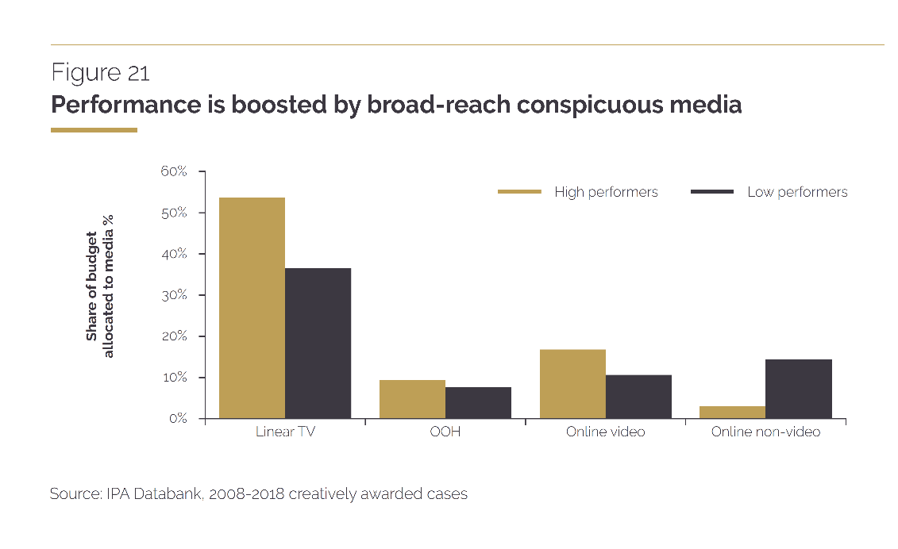
It is revealing to contrast creative high performers’ media tendencies with those generally favoured by creative awards judges. TV is the biggest media tendency for high performers and yet, overall, judges tend to give creative awards much more often to those that use online video and social media. These media can be effective too, but their effectiveness doesn’t really justify all the attention they are getting.
“
“
Source: ‘The Crisis in Creative Effectiveness’, Peter Field Consulting / IPA, June 2019
Notes:
In his 2019 IPA report, ‘The Crisis in Creative Effectiveness’, Peter Field looked at creatively-awarded campaigns and the pattern of media used within submissions. The data shows that the higher-performing creatively-awarded campaigns are more likely to have higher shares of spend on TV. The lower-performing campaigns are more likely to use online advertising.
For more information about this report, please see:
https://ipa.co.uk/media/7699/ipa_crisis_in_creative_effectiveness_2019.pdf

Slide 40
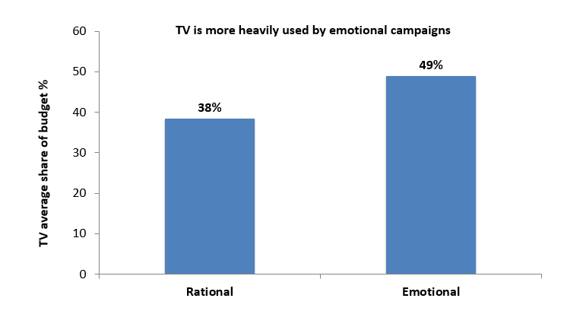
TV is important for emotional campaigns
Source: IPA Databank, 2014-2022 cases
Notes:
https://www.thinkbox.tv/research/nickable-charts/effectiveness-and-planning/tv-at-the-heart-of-effectiveness-by-peter-fi
If you look at media usage amongst emotional IPA case studies vs. rational ones, TV occupies a much bigger share of ‘emotional’ marketing budgets [see chart above]. Smart marketers worked out many years ago that TV is a brilliant platform for creating vital emotional, mental availability building associations. TV is less important amongst the rational campaigns, but then who wants to work in the slow lane of effectiveness? eld

Slide 41
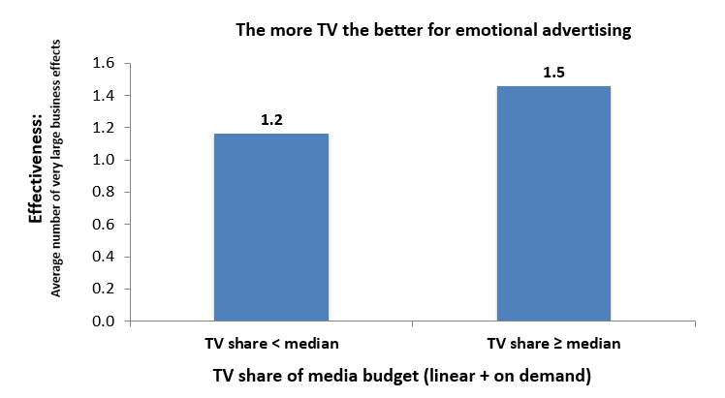
TV boosts effectiveness of emotional campaigns
Source: IPA Databank, 2014-2022 cases
Notes:
https://www.thinkbox.tv/research/nickable-charts/effectiveness-and-planning/tv-at-the-heart-of-effectiveness-by-pete
Examining the impact on effectiveness of TV share of budget by these emotional campaigns suggests that you almost can’t have too much TV advertising [see chart above]. Those that made above median use of TV were distinctly more effective than those that didn’t. Obviously, no one is arguing for 100% TV advertising campaigns, because there is the rest of the funnel to think about. But let’s be clear: there’s a particularly strong relationship between TV and the fast lane of effectiveness strategy.r-field

Slide 42
TV is great value
SECTION SIX
Branston – Bring Out The Branstorm

Slide 43
Summary - TV is great value
The average cost of buying the media space to get one person in the UK to see a TV (linear and BVOD) advert is 0.65p (in 2023)
The average cost across TV advertising (linear and BVOD) for 30 seconds is just £6.50, for YouTube, its £13.86, whilst for non-broadcaster online video (excluding YouTube), it goes up to a £131.03.
Deal or No Deal - TV
Sources: please see notes
Notes:
Source: 2023, Thinkbox estimates using AA/WARC
Source: 2023, Thinkbox estimates using AA/WARC estimates, Barb, ViewersLogic, IPA TouchPoints 2023

Slide 44
Average TV view costs 0.65p (in 2023)
The average cost of buying the media space to get one person in the UK to see a TV (linear and VOD) advert costs over half a penny
Source: 2023, Thinkbox estimates using AA/WARC
Notes:
The average cost of buying the media space to enable one person in the UK to see a TV (linear and VOD) advert only costs just under a penny.

Slide 45
TV advertising is great value
Revenue
£ billion
Minutes of AV advertising per person, per day
Cost per Thousand
(30 sec)
14.2
Broadcaster TV
(Inc BVOD)
£4.3
£6.50
YouTube
£1.3
1.9
£13.86
£4.9
All other online video
0.8
£131.03
Source: 2023, Thinkbox estimates using AA/WARC estimates, Barb, ViewersLogic, IPA TouchPoints 2023
Notes:
According to AA/WARC Expenditure Report, in 2023 ad spend on online video (excluding Broadcaster VOD) was £4.3bn.
TV including BVOD accounts for 84% of video advertising time, according to analysis of industry data.
Online video such as YouTube, TikTok, Facebook and the long programmatic tail together account for 16%.
In other words, the average person watches nearly 14.2 minutes of TV advertising a day (the 84%) and 2.7 minutes of non-broadcaster online video advertising (1.8 minutes for YouTube and 0.8 minutes for all other online video).
AA/Warc figures show that £6.2bn was poured into those 2.8 minutes a day and £4.3bn into the 14.2 minutes.
Let’s turn this into the comparable measure of cost per completed views. Online video ads are usually priced on a cost-per-start basis, but that is obviously the lowest of benchmarks, so let’s look at the average cost for 30 seconds of video ad viewing for a meaningful like-for-like comparison:
As you can see, the average cost across TV advertising (linear and BVOD) for 30 seconds is just £7, for YouTube, its £14, whilst for non-broadcaster online video (excluding YouTube), it goes up to a £131.

Slide 46
TV stands out across the measures that matter
Source: Dentsu / Lumen / TVision / Media Mix Navigator / Thinkbox Adnormal Behaviour 2022 / Signalling Success 2020 / IPA Touchpoints 2023
Notes:
You don’t see any of this in MRC standard reach data and it’s why planning across more than just reach is more vital now than ever before.

Slide 47
Experienced marketers are betting on TV
Change in linear TV spend 2023 Vs 2022
Source: Nielsen Ad Intel
Notes:
The best marketing companies know this.
It’s likely not a coincidence that the companies that have increased investment in TV the most last year all mostly FMCG businesses – perhaps it’s because as by their nature they’re immune to the lure of search advertising – but it’s also about pricing power – they know brand strength is key to their future margin and so they’re doubling down on building it.

Slide 48
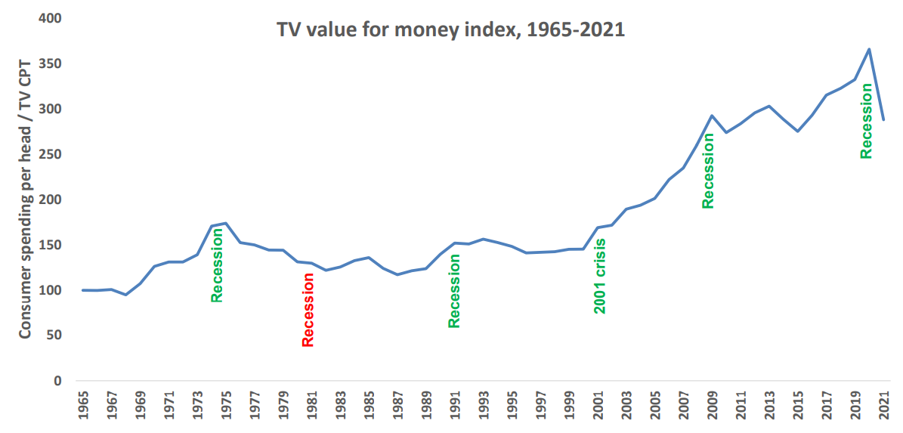
The value of TV increases during downturns
A high TV value for money index means that the price of TV is low, relative to total consumer spend levels
TV value for money index*
Source: Les Binet, ‘Marketing in the post-covid economy: A planning framework for turbulent times’. ONS, Advertising Association, WARC. *TV value for money index = consumer spending / TV CPT indexed from 1965
Notes:
Given the current economic climate, marketing budgets are increasingly under pressure with every investment needing to be justified.
At the 2022 IPA EffWorks Global, Les Binet (Group Head of Effectiveness of adam&eveDDB) provided a framework for planning media in economic uncertainty. During the session, ‘Marketing in the post covid economy’, Binet highlighted how short and long term investments should be dialled up and down depending on various factors.
One of the factors that Binet advises marketers to take advantage of is the value for money ratio for TV – a measure of the relative cost (CPT) of TV compared with the volume of total consumer spending. Binet’s data shows that the ratio has been rising over time as TV pricing has not kept pace with consumer spending in the long run – TV’s value for money has been getting better over time, particularly since 2000 due to increased competition from the tech giants.
Interestingly, when we focus specifically on times of recession (the 1970s, the 1990s, 2001 and more recently 2020 which was impacted by the global financial crisis and Covid), TV’s value for money increased sharply. The 1981 recession is the only exception.
This highlights the opportunity that advertisers and planners can take advantage of. If your particular sector is performing well, this is the perfect opportunity to buy share of voice, a method utilised by FMCG advertisers as they increased investment in TV during the pandemic.
For more insight on how brands can navigate through turbulent economic times, click here: https://www.thinkbox.tv/research/media-mix-navigator/strategies-for-marketing-through-a-downturn/

Slide 49
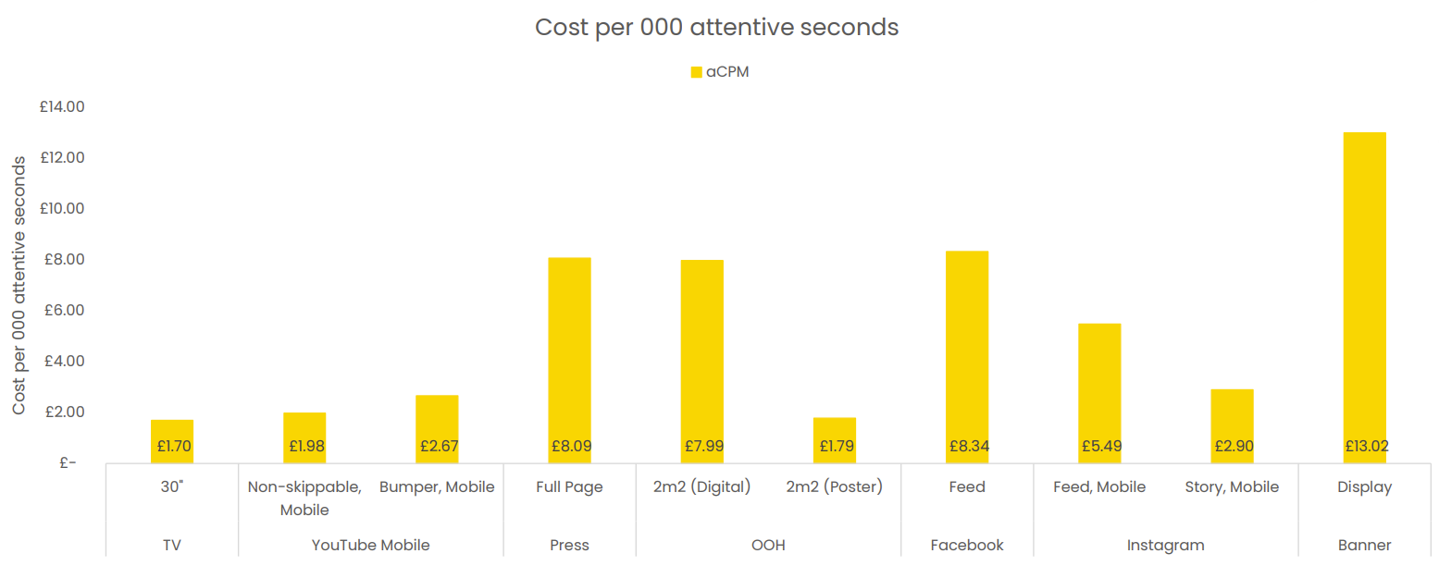
TV is an ‘attention bargain’
Attention data Sources: TV: Tvision/Lumen UK TV Panel. YT, Instream, Teads, Facebook Feed, Banners: Lumen digital panels. Press: Lumen Omnibus. OOH: AM4DOOH project. IG, FB Watch, TikTok: Lumen studies (weighted to be consistent with passive panel). CPM sources: Ebiquity
Notes:
Data from Lumen and Tvision shows how TV is an ‘attention bargain’, with a 30” TV creative generating a cost per 000 attentive second of £1.70

Slide 50
TV delivers against multiple objectives
SECTION SEVEN
Dulux – Change Starts Here

Slide 51
Mapping media on ‘Influence’
Higher weekly reach
TV
Social media
Radio
More trusted
Print
YouTube
Bubble size = average media multiplier
Source: IPA Touchpoints / Media Mix Navigator / YouGov 2024
Notes:
When we think about the power to influence – to change or create perceptions.
To do this effectively you’ll need to reach lots of people – but critically you’ll also need to be trusted. You’ll also want to take advantage of the media-multiplier effect, so that one channel influences the effectiveness of another. When we map these metrics against each other, we can see that TV performs favourable in comparison to other media channels.

Slide 52
Mapping media on ‘Memorability’
Ave ad view time (secs)
TV
More emotive
YouTube
Print
Social media
OOH
Bubble size = long-term multiplier
Source: Dentsu / Lumen / TVision / Media Mix Navigator / Thinkbox Adnormal Behaviour 2022
Notes:
When we think about memorability, we’ve used ad view time data from Lumen and TVision and emotion – the ability to drive high levels of prolonged visual attention allows you to tell a story, and this in turn delivers the emotive power. If you’re able to do both of these, your ad message can live long in the memory and drive high long-term multiplier effects.
This is TV’s super power. Memorability.
Ask someone to tell you about an ad they’ve seen recently, it will be a TV ad.

Slide 53
Mapping media on ‘Sales power’
Lower cost per second of visual attention
TV
YouTube
OOH
Social media
Higher weekly reach
Print
Bubble size = Total ROI Index
Source: Dentsu / Lumen / TVision / Media Mix Navigator / Thinkbox Adnormal Behaviour 2022
Notes:
What about simply the ability to sell stuff?
For this you need to provide attention at a low cost, you need scale to speak to as many people as possible and you want to be proven to deliver a strong ROI. Mapping weekly reach, cost per second of visual attention and total ROI index, we can see that TV performs favourably.

Slide 54
Find out more at Thinkbox.tv
Helping you get the best out of TV
Notes:
Find out more from Thinkbox
Whether you are in need of information or inspiration, we’ll keep you up to date:
Visit www.thinkbox.tv
Register for our newsletter
Or simply talk to us
Image by Raphael Rychetsky on Unsplash

