Slide 1


TV advertising’s ultimate nickable charts
What every marketer should know
UPDATED OCTOBER 2025
Notes:
Hello. Welcome to ‘TV advertising’s ultimate nickable charts’. This deck brings together the ultimate evidence which explains how and why TV is the most effective form of advertising – and is, in fact, becoming more effective.
If you have any questions about this deck – or would like more information on any topic – please contact us via info@thinkbox.tv.

Slide 2



















1. Who is Thinkbox?
Thinkbox is the marketing body for commercial TV in the UK, in all its forms. It works with the marketing community with a single ambition: to help advertisers get the best out of today’s TV.
Main shareholders
Associates & supporters
Member of

Slide 3
Why nick these?
You probably already have plenty of charts in your life, so why do you need these?
Well, if you work in marketing, these are essential.
Whether you’re working on a pitch, looking for facts to share with colleagues, want to know what TV can now do, or just really enjoy charts, this deck is for you.
It’s packed with insight and evidence, from the facts about our transforming TV viewing to the latest on how and why TV advertising works.
It covers lots of ground but with a single purpose: to give you the proof of why TV advertising is so valuable and vital to businesses of all shapes and sizes – more so now than perhaps ever.
If you want to nick even more charts or have any questions, please get in touch with us at research@thinkbox.tv
Notes:
If you want to nick even more charts or have any questions, please get in touch with us at research@thinkbox.tv

Slide 4

In this deck…
TV VIEWING: THE FACTS | 01
TV IS A TRUSTED & SAFE ENVIRONMENT FOR BRANDS | 02
TV: THE MOST EFFECTIVE ADVERTISING | 03
TV HAS UNBEATABLE SCALE AND REACH | 04
TV IS THE EMOTIONAL MEDIUM AND BUILDS BRAND FAME | 05
TV IS GREAT VALUE | 06
Alpen, It’s the Grown Up Thing to Do

Slide 5

TV viewing: the facts
SECTION ONE
Currys, Ball Pit

Slide 6
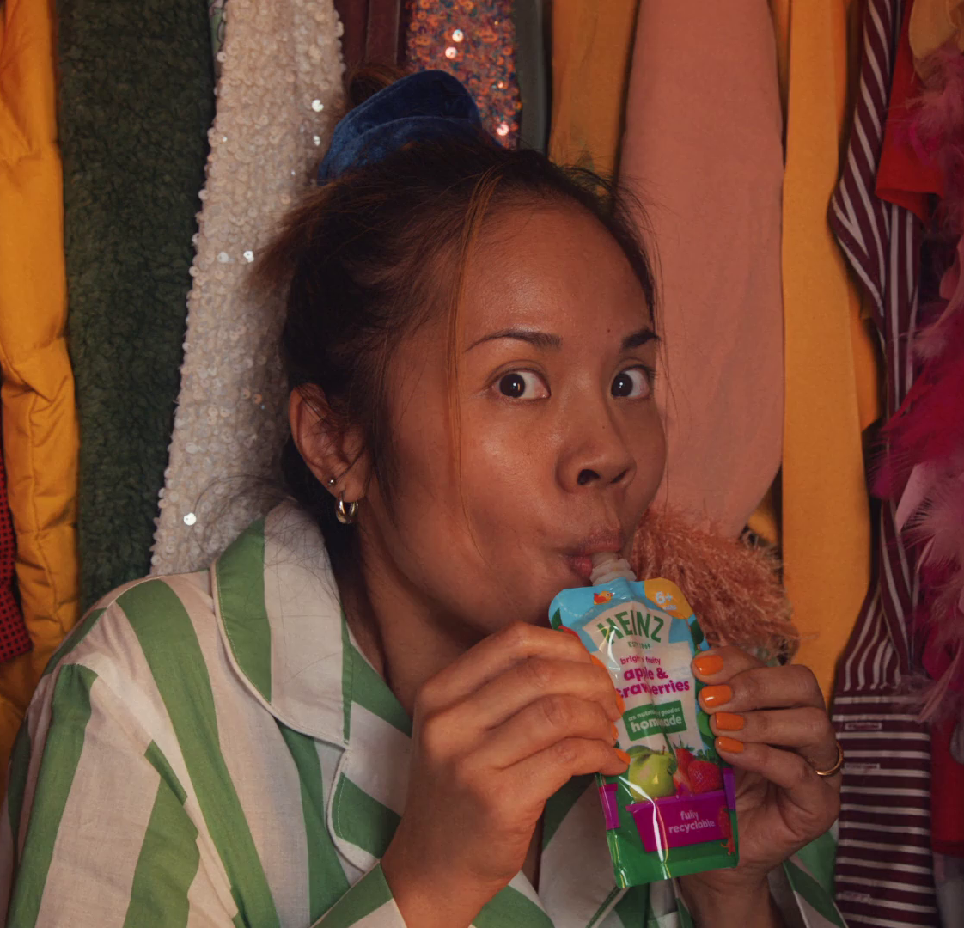
Summary –
TV Viewing: the facts
In 2024, we watched 2h, 36m of broadcaster TV each day.
BVOD represents 29% of all broadcaster TV viewing for 16-34s
TV advertising accounted for 85% of the video advertising we saw each day in 2024, and 53% for 16-34s.
Heinz, Loved by Babies, Craved by Parents
Sources: please see notes
Notes:
Source: 2024, Barb
Source: 2024, Barb
Source: 2024, Barb / Broadcaster stream data / UK Cinema Association / Ipsos Iris
**YouTube ad time modelled at 3.33% of content time (Enders Analysis, 23rd October 2024) and excludes those estimated to be on the YouTube Premium tier. *TikTok ad time modelled at 3.4% of content time using agency and broadcaster estimates. **Other online modelled at 3.33% of content time.

Slide 7

TV viewers have never had it better
75% of main TV screens 40” or bigger
90% have access to broadcaster VOD on TV set
TV Licensing, Vampire
Source: Barb, Touchpoints, Thinkbox estimates
Notes:
TV technology and content quality have improved dramatically in the past decade.

Slide 8
Stability continues…
Hours per person per day (Adults)
Source: IPA TouchPoints, Adults 15+
Notes:
Stability continues, with adults viewing the same amount of video content as they did in 2015

Slide 9
All Individuals
Average video advertising time per day
All Individuals: 18:05
16-34s: 9:49
Today’s TV accounts for 85.0% of AV advertising time
(vs 83.5% in 2023)
16-34s
Source: 2024, Barb / Broadcaster stream data / UK Cinema Association / Ipsos Iris
**YouTube ad time modelled at 3.33% of content time (Enders Analysis, 23rd October 2024) and excludes those estimated to be on the YouTube Premium tier. *TikTok ad time modelled at 3.4% of content time using agency and broadcaster estimates. **Other online modelled at 3.33% of content time.
Notes:
Broadcaster TV & SVOD accounts for 85.0% of all AV advertising time

Slide 10
BVOD accounts for 29% of 16-34s broadcaster TV viewing
Inds
16-34
2 hrs 36 mins
59 mins
Source: 2024, Barb
Notes:
BVOD is vital to different audiences
Breaking down broadcaster TV into the different ways reveals the increasingly important role of BVOD for 16-34, now 29% of all broadcaster TV viewing.
This data uses both Barb data and includes an estimate of any unknown viewing that is thought to fall into Playback and Live viewing.

Slide 11








There are 8 need states which drive video viewing
content
7% ESCAPE
10% EXPERIENCE
9% INDULGE
12% IN TOUCH
2% DO
16% COMFORT
personal
social
18% DISTRACT
26% UNWIND
context
Source: The Age of Television, 2018, MTM/Thinkbox.
Notes:
The Age of Television study, conducted by MTM, on behalf of Thinkbox, observed there are eight need states which define our video viewing habits:
Escape (7% viewing time) - The need to lose yourself in another world and become fully immersed in highly involving and engaging content .
Experience (10% viewing time) - The need to feel part of a shared viewing experience, either by watching live or being able to participate in a wider social conversation.
In Touch (12% viewing time) - The need to feel aware of what’s happening in the world, by being informed about political, social and cultural events.
Comfort (16% viewing time) - The need for shared family / couple time, which tends to be served by familiar programmes and viewing routines.
Unwind (26% viewing time) - The need to relax and de-stress from the pressures of the day, through familiar and undemanding content.
Distract (18% viewing time) - The need for instant gratification to fill time, counter boredom or provide a short break from other tasks.
Do (2% viewing time) - The need to find useful information that can be practically applied to any area of life.
Indulge (9% viewing time) - The need to pursue personal interests, hobbies and fulfil guilty pleasures.
The study sized these eight need states in terms of the time audiences spend meeting each one with video content.
We found that the largest proportion of time spent watching videos is to satisfy the need to unwind, the need for a distraction and the need for comfort.
The role of content and context differ across each need state, with content is particularly important for escape and experience.
In contrast, the need to unwind is far more likely to be driven by context – such as the need to wind down after work.
The need states also differ in terms of being personally or socially driven. For example, the need for comfort is driven by a desire to spend time with others, while the need for a distraction is more personal.
For more information on this study please see:
https://www.thinkbox.tv/Research/Thinkbox-research/The-Age-of-Television-the-needs-that-drive-us

Slide 12
UK original content dominates the top series in 2024
Rank | Channel Group | Programme Title | Series | Average Audience (m) | Origin
1 | ITV | Mr Bates vs The Post Office | 1 | 14.4 | UK
2 | Netflix | Fool Me Once | 1 | 11.7 | UK
3 | Netflix | Baby Reindeer | 1 | 9.6 | UK
4 | Amazon | Clarkson's Farm | 3 | 9.3 | UK
5 | Netflix | The Gentlemen | 1 | 9.0 | UK
6 | ITV | I'm a Celebrity... Get Me Out of Here! | 24 | 8.8 | UK
7 | ITV | Vera | 13 | 8.6 | UK
8 | BBC | Death in Paradise | 13 | 8.6 | UK / France
9 | BBC | Ludwig | 1 | 8.6 | UK
10 | ITV | Trigger Point | 2 | 8.4 | UK
Rank | Channel Group | Programme Title | Series | Average Audience (m) | Origin
11 | Channel 4 | The Great British Bake Off | 15 | 8.2 | UK
12 | BBC | The Traitors | 2 | 8.1 | UK
13 | BBC | Strictly Come Dancing | 22 | 8.1 | UK
14 | BBC | Call the Midwife | 13 | 7.8 | UK
15 | ITV | After The Flood | 1 | 7.7 | UK
16 | ITV | Red Eye | 1 | 7.7 | UK
17 | BBC | Silent Witness | 27 | 7.4 | UK
18 | BBC | Celebrity Race Across the World | 2 | 7.3 | UK
19 | ITV | Until I Kill You | 1 | 7.2 | UK
20 | BBC | Nightsleeper | 1 | 7.1 | UK
Source: Barb, 2024, Individuals. TV set viewing. Average audience per episode (excludes one-offs, kids, films and sports)
Notes:
UK original content dominates the top series in 2024. Mr Bates vs The Post Office on ITV was the most-watched series of the year, averaging 14.4 million viewers per episode on a TV set.

Slide 13
The TV set remains the home for viewing to high-quality content
TV set viewing time by platform
2024, All Adults
3hrs 35 mins
PER DAY
Source: Barb
Notes:
Looking at the breakdown of TV set viewing, to provide a bit more granularity, professionally produced content takes up the vast majority of time.
77% is Broadcaster TV, 16% is SVOD and 7% is YouTube. The emerging AVOD players, Pluto TV, Samsung TV, Rakutun TV, Tubi who are big in the states are yet to make a meaningful impact in the UK – they account for less than 0.2% of total TV viewing time.

Slide 14

TV is a trusted & safe environment for brands
SECTION TWO
Twix, Twofers
Notes:
TV in the UK is full of wonderful, high quality content which broadcasters invest in heavily. This, alongside the tight regulation which governs TV content and advertising, makes it a safe environment for viewers and brands.
In addition, TV has a robust, metred measurement system, Barb, which provides a joint industry currency for TV advertising trading based on completed ads, watched full screen (and by humans).

Slide 15

Summary –
TV is a trusted & safe environment for brands
TV’s hidden value includes high value exchange, strong costly signals and high attention levels.
TV ads were most trusted by the UK public (35%)
Etsy, Don’t Celebrate Birthdays
Sources: please see notes
Notes:
Source: Adnormal Behaviour, 2022, Ipsos / Thinkbox. Q.TN3: In which, if any, of the following places are you most likely to find advertising that...you trust

Slide 16
TV’s hidden value
High value exchange
Shared viewing
Strong costly signals
Trusted
Not perceived to be targeted
Big screen
High attention levels
High completion rates
Bot free
Regulated / Ad clearance
Notes:
TV in the UK is full of wonderful, high quality content which broadcasters invest in heavily. This, alongside the tight regulation which governs TV content and advertising, makes it a safe environment for viewers and brands.
In addition, TV has a robust, metred measurement system, Barb, which provides a joint industry currency for TV advertising trading based on completed ads, watched full screen (and by humans).

Slide 17



TV advertising is seen as most trustworthy
Newspapers
Radio
Magazines
Search
Cinema
TV
Social Media
Outdoor
Direct Mail
YouTube
Websites
Source: Adnormal Behaviour, 2022, Ipsos / Thinkbox. Q.TN3: In which, if any, of the following places are you most likely to find advertising that...you trust
Base: ‘normal’ people (1,158)
Notes:
Thinkbox’s ‘Adnormal Behaviour’ work showed that TV ads were see as the most trusted form of advertising.
For more information on this study, see the full write up on the Thinkbox website:
https://www.thinkbox.tv/research/thinkbox-research/adnormal-behaviour/

Slide 18
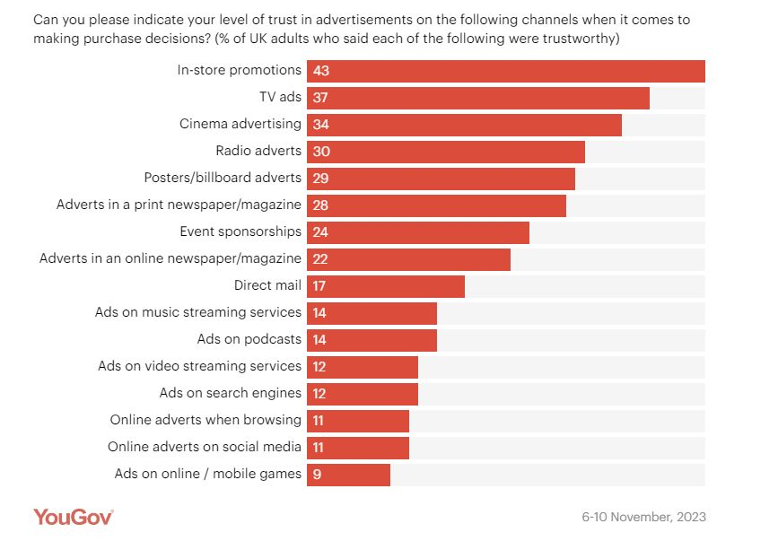
Trust is higher for traditional ad channels
Source: YouGov 2024, 3 big questions for advertisers marketers research
Notes:
Data from YouGov shows how Trust is higher for traditional ad channels such as TV and Cinema.
https://business.yougov.com/content/48911-3-big-questions-for-advertisers-marketers-research-2024

Slide 19
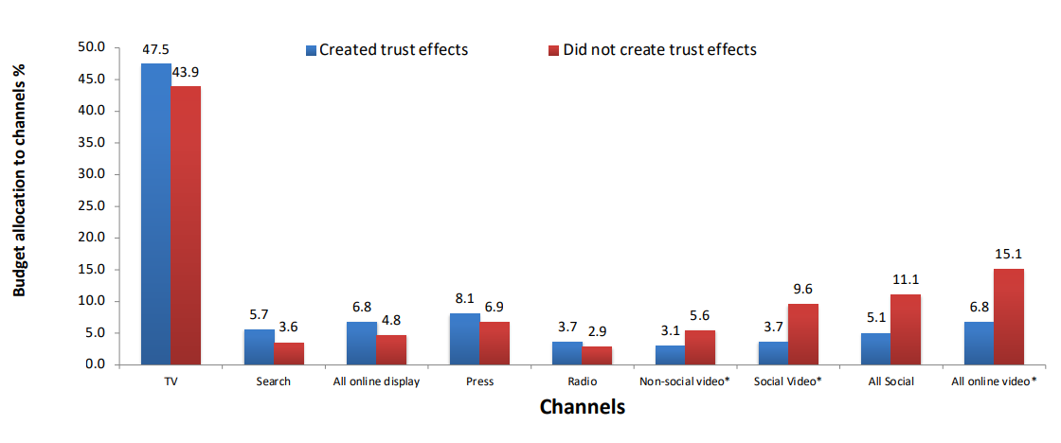


TV is a trusted medium
Source: IPA Databank 2014-2022 for profit cases *data available from 2016
Notes:
Recent years have seen a strengthening relationship between advertising trust and advertising driven profit. Comparing IPA survey data from 2014-2022 with data from 2000-2012, trust jumped from the seventh-highest brand metric linked to profit to the second-highest, just below quality.
Trust is often correlated with quality and has become increasingly important. Consumers are continuously forming assessments of the quality of the brands they may buy, based on whether they trust the brand (and its advertising).
Data showcased by effectiveness expert Peter Field at The Future of TV Advertising Global 2023 suggests that there seems to be a relationship between campaigns that created trust effects and their budget allocation to different media. Field’s work shows that campaigns using TV, search, online display, press, and radio achieved enhanced trust effects; whilst social media, social video, and online video were much less likely to deliver positive trust effects.
Additionally, many previous research studies have emphasised the importance of trust – not least Thinkbox’s ‘Adnormal Behaviour’ (conducted by Ipsos), which revealed how TV outperformed all other media as the leading source of advertising that people trust.

Slide 20
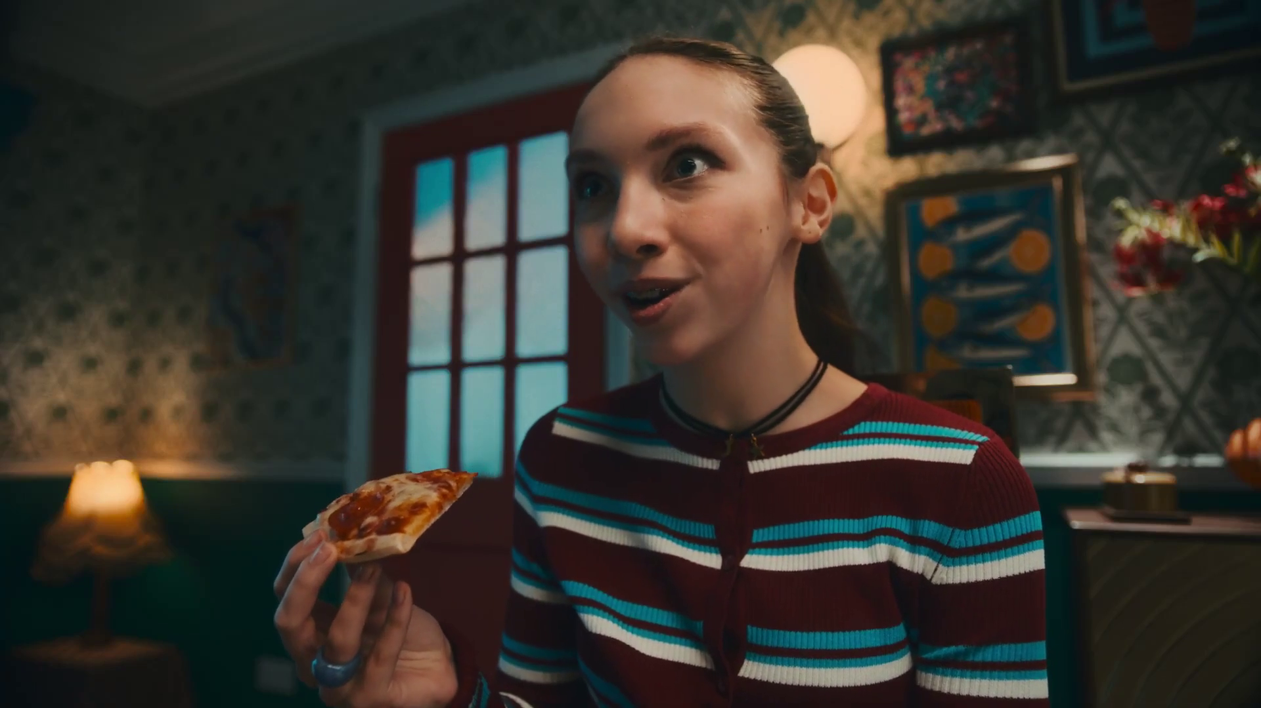
TV: the most effective advertising
SECTION THREE
Goodfella’s – Goooood

Slide 21

Summary –
TV: the most effective advertising
TV boosts effects of other ad channels by up to 54%
The optimal budget mix varies by sector with TV often commanding the lions share
TV constitutes on average 66% of smaller brands media budget but returned 80% of all ad-generated sales
P&O, Norwegian Fjords Like Never Before
Sources: please see notes
Notes:
Source: ‘Demand Generation’ Nov 2019, MediaCom/Wavemaker/Gain Theory/Thinkbox
Source: ‘As Seen on TV: supercharging your small business’, May 2019, Data2Decisions/Work/Thinkbox. Data2Decisions database of smaller brands. All categories.

Slide 22
The predictability of payback varies greatly by channel
Increasing risk / reward of achieving return
Source: Profit Ability 2 – Ebiquity, EssenceMediacom, Gain Theory, Mindshare, Wavemaker, April 2024​
Notes:
Findings from ‘Profit Ability 2: the new business case for advertising’, shows that the predictability of payback varies greatly by channel. Profit Ability 2 was conducted by Ebiquity, EssenceMediacom, Gain Theory, Mindshare, and Wavemaker UK. It’s a meta-analysis of econometric studies from 141 brands covering £1.8 billion of media spend across 10 media channels and 14 business sectors (where 7 are reported individually).
The charts presents the percentage standard deviation (the standard deviation divided by the mean, expressed as a percentage). The wider the bar, the more variable around the average ROI a channel is. Channels like Linear TV, Print and BVOD have low variation and therefore represent a lower risk investment.
It’s worth noting that high variability works both ways: although it involves greater risk, there is the possibility of achieving a much higher than average ROI (as well as a much lower one).

Slide 23
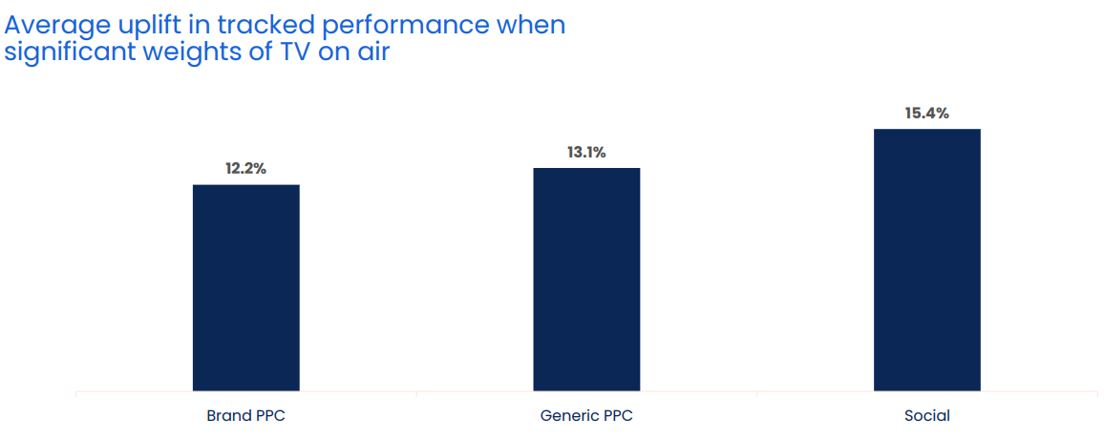
When TV is on air, digital channel performance is uplifted by 13.7%
Source: Why the Eff would you cut TV? GroupM, 2025
Notes:
When TV is on air, digital channel performance is uplifted by 13.7%
One of TV advertising’s most underestimated strengths is its halo effect — the way it boosts the performance of other media channels. While often misattributed, this cross-channel impact is both real and measurable.
According to GroupM analysis in ‘Why the Eff would you cut TV?’ presented at Thinkbox Trends in TV 2025, digital response channels see a clear uplift when TV is live. The study analysed the performance of TV, brand PPC, generic PPC and social across 14 brands, which included 1,489 weeks, and £283m total performance media spend.
Analysis found that on average, the performance of lower-funnel response channels improves by 13.7% when TV is part of the media mix.
More specifically, brand PPC, generic PPC and social saw an average uplift of 12.2%, 13.1% and 15.4% respectively in tracked performance when significant weights of TV were on air. This shows how TV makes digital channels work harder.
For a deeper dive on the consequences of taking TV out of the plan, watch ‘Why the Eff would you cut TV?’ on demand.

Slide 24
Optimal budget mix varies by sector – TV has the largest share
Optimal media mix
Source: Media Mix Navigator, 2025. Based on a mass market appeal, 11-20% online sales (finance 71-80%), short-term, high risk, further details for each category is included in the notes
Notes:
Optimal ad mix varies dramatically by product sector
This chart shows how there are big variances in the optimal media mix between different product sectors.
It is based on data from the ‘Media Mix Navigator’, which lets brands easily explore the impact on revenue and profit that different budget levels have on budget allocation across channels.
The Media Mix Navigator tool has been engineered by EssenceMediacom and is powered by the blockbuster Profit Ability 2 databank, which takes in £1.8 billion of media spend across 141 brands during 2021-23. The brands included were carefully chosen to represent as many business types as possible. Each brand commissioned and paid for their own econometric analysis; the databank aggregated this existing data.
Media Mix Navigator enables analysis bespoke to a brand’s specific situation and attitude to risk. For this analysis, we have used an ‘average’ brand position.
This chart shows how the optimal media mix differs by category, and there are some interesting variances. For example, looking specifically at Generic PPC, the investment allocation is particularly high for sectors such as Finance, Travel and Automotive. This is explained by the fact that these sectors often deal with higher priced items which are usually ‘considered purchases – ones where consumers are likely to conduct online research before making a purchase decision. Similarly, Print is an important channel for Automotive and Travel, both of which benefit from extensive specialist titles that provide the opportunity to reach key audiences.
The one consistent factor throughout all the scenarios is that Linear TV is the largest single channel, although the extent to which it is the largest channel can vary greatly – e.g. higher in Retail, FMCG and Automotive but lower in Finance.
For more information, visit: https://www.thinkbox.tv/training-and-tools/media-mix-navigator/media-mix-navigator
Category input details:
All – Brand size (£m): 10,000, Annual Media Spend (£m): 50
Automotive - Brand size (£m): 2,600, Annual Media Spend (£m): 17
Finance - Brand size (£m): 10,000, Annual Media Spend (£m): 20
FMCG - Brand size (£m): 60, Annual Media Spend (£m): 6
Retail - Large - Brand size (£m): 9,000, Annual Media Spend (£m): 25
Retail - Small - Brand size (£m): 200, Annual Media Spend (£m): 10
Travel - Brand size (£m): 5,200, Annual Media Spend (£m): 19
Telecoms - Brand size (£m): 7,000, Annual Media Spend (£m): 45
Output: Revenue
The brand size for each product category has been calculated by taking 20% of the maximum brand size whilst the annual media spend is an estimate of the average spend for that category.

Slide 25
TV delivers greater sales versus spend for smaller brands
Share of spend
Share of advertising-generated sales
Source: ‘As Seen on TV: supercharging your small business’, May 2019, Data2Decisions/Work/Thinkbox. Data2Decisions database of smaller brands. All categories.
Notes:
Thinkbox study ‘As Seen on TV: supercharging your small business’, conducted by marketing effectiveness consultancy D2D, shows how well TV performs in terms of sales versus spend.
Out of the D2D dataset of 78 smaller brands across all categories, TV constituted on average 66% of their media budget but returned 80% of all ad-generated sales. This is due to two factors – the high ROI (return on investment) and the fact that it can deliver scale without saturating.
This demonstrates the key role of TV for advertisers looking to drive brand growth.
For more information on this study please see:
https://www.thinkbox.tv/research/thinkbox-research/as-seen-on-tv-supercharging-your-small-business/

Slide 26

TV has unbeatable scale and reach
SECTION FOUR
Papaya, Solitaire

Slide 27

Summary - TV has unbeatable scale and reach
Linear TV and broadcaster VOD combined reaches 88% of the adult population each week
A broadcast TV campaign of 400 TVRs in the UK gets 247 million views
Android, Wanderlust
Sources: please see notes
Notes:
Source: IPA TouchPoints 2025 SuperHub (W2 2024 + W1 2025), Fieldwork Dates: 3rd Sep 2024 – 15th Nov 2024, 14th Jan 2025 – 24th Mar 2025. Adults 15+
Source: Barb Dec 2024, Individuals

Slide 28

Linear TV and BVOD reaches 88% of adults each week
Taskmaster, Channel 4
Source: IPA TouchPoints 2025 SuperHub (W2 2024 + W1 2025), Fieldwork Dates: 3rd Sep 2024 – 15th Nov 2024, 14th Jan 2025 – 24th Mar 2025. Adults 15+
Notes:
Linear TV and broadcaster combined reaches 88% of the population each week.

Slide 29
Linear TV and BVOD reaches 88% of adults each week
Weekly Reach % | 2023 | 2024 | 2025
Adults | 89 | 90 | 88
ABC1 adults | 90 | 91 | 89
15-34 | 76 | 81 | 77
Men | 89 | 90 | 87
Women | 89 | 91 | 88
HP+CH | 89 | 90 | 87
Source: IPA TouchPoints, 2021 (average of both waves), 2022 (average of both waves), 2023, 2024 SuperHub (W2 2023 + W1 2024), 2025 SuperHub (W2 2024 + W1 2025). Fieldwork Dates: 3rd Sep 2024 – 15th Nov 2024, 14th Jan 2025 – 24th Mar 2025..
Notes:
Linear TV and broadcaster combined reaches 88% of the adult population each week.

Slide 30
Commercial broadcasters are unrivalled for scale
Individuals – All devices
Bubble area represents total volume of daily viewing
AVERAGE DAILY REACH (000s)
Other
SVOD
Other AVOD
Twitch
AVE TIME VIEWED PER VIEWER PER DAY
Source: Barb / Individuals, all devices – 2024
Notes:
This chart breaks down viewing to the various platforms in terms of the average number of people watching per day (for at least 3 minutes) compared with the average time spent watching per viewer (i.e. only counting those who watched on that day).
Analysis across 2024 shows that the commercial broadcasters (linear and on demand) collectively reach 30 million viewers every day, with each of those viewers watching for an average of 3hrs, 34 mins a day. The combined portfolio of BBC channels (linear and on demand) attracts the second largest volume of viewing, with 25 million daily reach and an average view time of 2 hours, 11 mins a day. YouTube is next, with a daily reach of 21 million and a view time of 1hr 58 mins (Barb only measure in-home viewing, we estimate that YouTube would be larger in viewing time if out of home viewing was included).
SVOD services such as Netflix has a daily reach of 13 million people and a view time of 1hr 48 mins.

Slide 31
Broadcasters are unrivalled in the commercial viewing landscape
Individuals – Commercial TV Set
Bubble area represents total volume of daily viewing
AVERAGE DAILY REACH (000s)
TikTok
Other AVOD
Twitch
AVE TIME VIEWED PER VIEWER PER DAY
Source: Barb / Individuals, TV sets – Q4 2024, Netflix & Amazon Ad Tiers.
Notes:
This chart breaks down viewing to the various commercial platforms in terms of the average number of individuals watching per day (for at least 3 minutes) on a TV set compared with the average time spent watching per viewer (i.e. only counting those who watched on that day). This analysis covers Q4 2024 to utilise Barbs ad tier data for Netflix & Amazon Prime.
Analysis of Q4 2024 shows that SVOD services like Netflix have a much smaller commercial daily reach of 2.6 million (ad tier) compared to their total TV set reach of 11.4 million (all tiers). Amazon Prime has a commercial reach of 3.5 million, compared to a total TV set reach of 4.4 million.
The commercial broadcasters (linear and on demand) collectively reach 29.6 million viewers every day, with each of those viewers watching for an average of 3hrs, 38 mins a day. YouTube follows, with a daily reach of 8.6 million people and a view time of 2hr 11 mins.

Slide 32
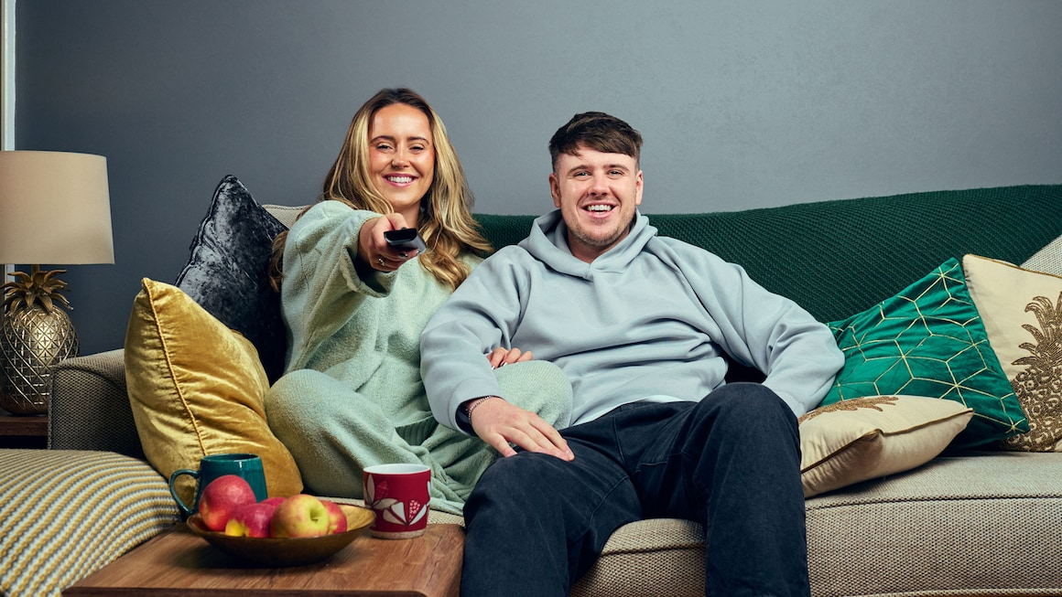
A broadcast
TV campaign of 400 TVRs in the UK gets
247 million views
“Gogglebox”, Channel 4
Source: Barb Dec 2024, Individuals
Notes:
Beware the seduction of ‘views’. Views that TV ads get online are an important part of the way brands now communicate. However, because the figures are so visible, the offline views – which are often driving them – can get overlooked. A million online views is not to be sniffed at, but a broadcast TV campaign in the UK gets 247 million ‘views’ – and that is before you consider the different quality of the viewing experiences.
How this is calculated:
A broadcast TV campaign of 400 ratings expressed as views is 4 times the TV universe.

Slide 33

TV is the emotional medium and builds brand fame
SECTION FIVE
Aviva, Bestest Day Ever

Slide 34
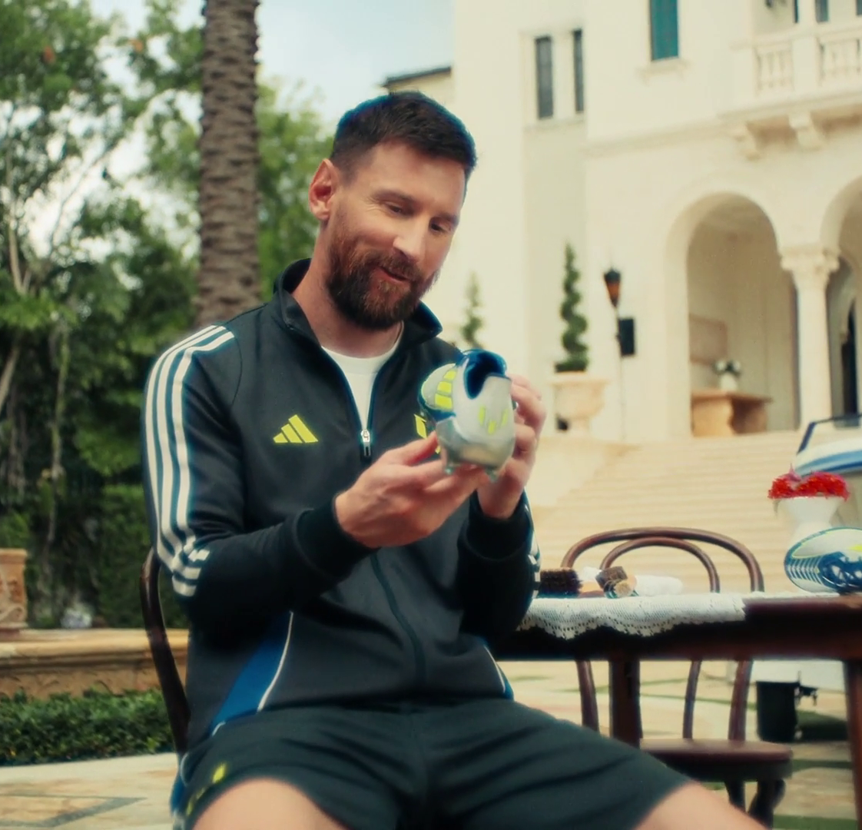
Summary - TV is the emotional medium and builds brand fame
TV advertising is most likely to make you laugh (52%) and is the most liked (40%)
TV is the medium most likely to signal brand fame
Higher-performing creatively-awarded campaigns are most likely to have higher shares of spend on TV
Adidas, Just Relax
Sources: please see notes
Notes:
Source: Adnormal Behaviour, 2022, Ipsos / Thinkbox. Q.TN3: In which, if any, of the following places are you most likely to find advertising that...
Source: Signalling Success, 2020, house51 / Thinkbox. Adults 16+. Top 2 box agreement “This brand will become well known”
Source: ‘The Crisis in Creative Effectiveness’, Peter Field Consulting / IPA, June 2019

Slide 35
TV ads evoke emotion more than those in other media
In which, if any, of the following places are you most likely to find advertising that…’
 | TV | Social Media | Radio | YouTube | Cinema | Magazines | Outdoor | Newspapers | Search | Direct Mail | Websites
Makes you laugh | 52% | 35% | 13% | 21% | 16% | 5% | 6% | 6% | 4% | 2% | 3%
Makes you feel emotional | 47% | 17% | 6% | 10% | 15% | 5% | 3% | 9% | 4% | 2% | 2%
You like | 40% | 27% | 10% | 12% | 14% | 15% | 8% | 12% | 14% | 4% | 4%
Source: Adnormal Behaviour, 2022, Ipsos / Thinkbox. Q.TN3: In which, if any, of the following places are you most likely to find advertising that...
Base: ‘normal’ people (1,158)
Notes:
Thinkbox’s ‘Adnormal Behaviour’ showed that TV ads were by far the most likely to make people feel emotional, and creating an emotional response is incredibly effective in advertising. It also showed that TV ads were by far the most likely to make people laugh.
For more information on this study, see the full write up on the Thinkbox website.

Slide 36
TV advertising signals brand fame
Brand will become well known
52%
48%
44%
44%
40%
38%
Source: Signalling Success, 2020, house51 / Thinkbox. Adults 16+. Top 2 box agreement “This brand will become well known”
Notes:
House51 & Thinkbox’s ‘Signalling Success’ used an experimental design to evaluate the advertising signals which are driven by each medium.
The results confirmed that TV is the medium most likely to signal brand fame.
For more information on this study, see the full write up on the Thinkbox website:
https://www.thinkbox.tv/research/thinkbox-research/signalling-success/

Slide 37
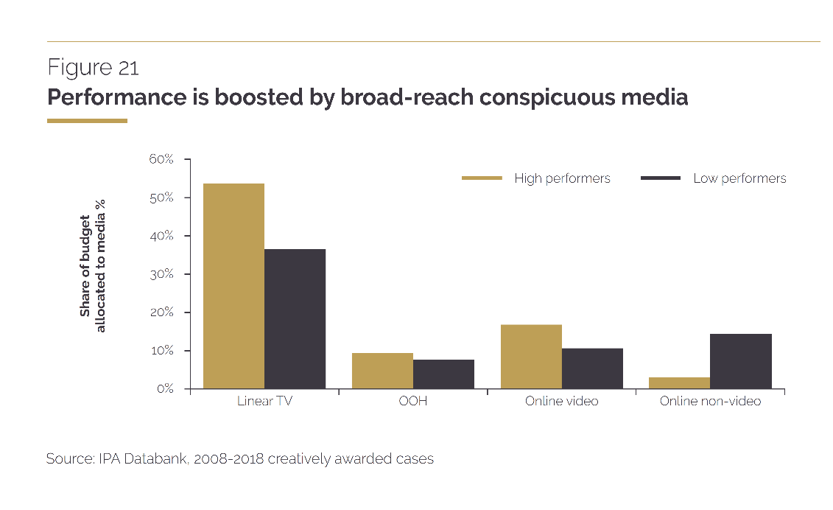
It is revealing to contrast creative high performers’ media tendencies with those generally favoured by creative awards judges.
TV is the biggest media tendency for high performers and yet, overall, judges tend to give creative awards much more often to those that use online video and social media. These media can be effective too, but their effectiveness doesn’t really justify all the attention they are getting.
“
“
Source: ‘The Crisis in Creative Effectiveness’, Peter Field Consulting / IPA, June 2019
Notes:
In his 2019 IPA report, ‘The Crisis in Creative Effectiveness’, Peter Field looked at creatively-awarded campaigns and the pattern of media used within submissions. The data shows that the higher-performing creatively-awarded campaigns are more likely to have higher shares of spend on TV. The lower-performing campaigns are more likely to use online advertising.
For more information about this report, please see:
https://ipa.co.uk/media/7699/ipa_crisis_in_creative_effectiveness_2019.pdf

Slide 38
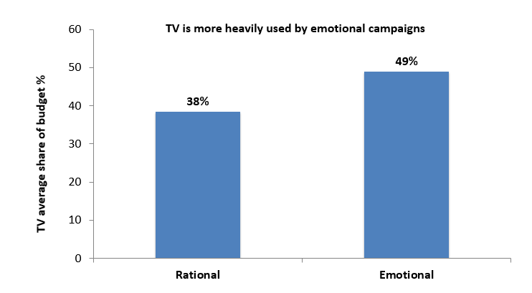
TV is important for emotional campaigns
Source: IPA Databank, 2014-2022 cases
Notes:
https://www.thinkbox.tv/research/nickable-charts/effectiveness-and-planning/tv-at-the-heart-of-effectiveness-by-peter-fi
If you look at media usage amongst emotional IPA case studies vs. rational ones, TV occupies a much bigger share of ‘emotional’ marketing budgets [see chart above]. Smart marketers worked out many years ago that TV is a brilliant platform for creating vital emotional, mental availability building associations. TV is less important amongst the rational campaigns, but then who wants to work in the slow lane of effectiveness? eld

Slide 39
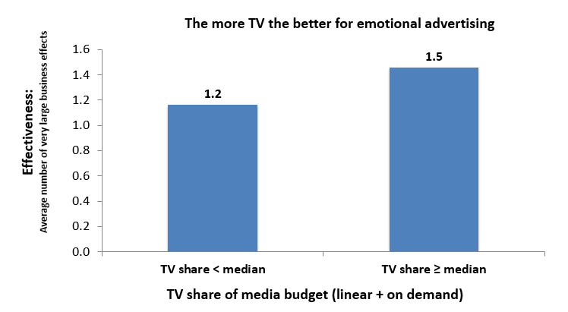
TV boosts effectiveness of emotional campaigns
Source: IPA Databank, 2014-2022 cases
Notes:
https://www.thinkbox.tv/research/nickable-charts/effectiveness-and-planning/tv-at-the-heart-of-effectiveness-by-pete
Examining the impact on effectiveness of TV share of budget by these emotional campaigns suggests that you almost can’t have too much TV advertising [see chart above]. Those that made above median use of TV were distinctly more effective than those that didn’t. Obviously, no one is arguing for 100% TV advertising campaigns, because there is the rest of the funnel to think about. But let’s be clear: there’s a particularly strong relationship between TV and the fast lane of effectiveness strategy.r-field

Slide 40

TV is great value
SECTION SIX
HubSpot, Spread Too Thin

Slide 41

Summary - TV is great value
The average cost of buying the media space to get one person in the UK
to see a TV (linear, BVOD and SVOD) advert is 0.73p (in 2024)
The average cost across TV advertising (linear and BVOD) for 30 seconds is just £7.32, for online video (including YouTube), it goes up to a £52.59.
Vitality, Life’s Pretty Good
Sources: please see notes
Notes:
Source: 2024, Thinkbox estimates using AA/WARC
Source: 2024, TV is inclusive of Linear, BVOD and SVOD. Thinkbox estimates using AA/WARC (estimates), Barb / Broadcaster stream data / UK Cinema Association. Ipsos Iris.

Slide 42

Average TV view costs 0.73p (in 2024)
The average cost
of buying the media space to get one
person in the UK
to see a TV (linear, BVOD and SVOD) advert
costs over half a penny
Source: 2024, Thinkbox estimates using AA/WARC
Notes:
The average cost of buying the media space to enable one person in the UK to see a TV (linear, BVOD and SVOD) advert only costs just under a penny.

Slide 43
TV remains the lowest priced video channel
Average cost per 30 second (000s)
TV
Social Media - Video
£52.59
£7.32
Source: 2024, TV is inclusive of Linear, BVOD and SVOD. Thinkbox estimates using AA/WARC (estimates), Barb / Broadcaster stream data / UK Cinema Association. Ipsos Iris.
Notes:
The chart combines AA/WARC revenue estimates, with the video advertising time data to create a relative cost per 30 seconds of AV ad exposure.
Spot TV advertising (linear, BVOD and SVOD) averages £7 per thousand exposures. Social media video (which also includes YouTube) is £53.

Slide 44
Experienced marketers are betting on TV
Change in linear TV spend 2024 Vs 2023
Source: Nielsen Ad Intel, *Scottish Power new to TV 2024.
Notes:
The best marketing companies know this.
It’s likely not a coincidence that the companies that have increased investment in TV the most last year all mostly FMCG businesses – perhaps it’s because as by their nature they’re immune to the lure of search advertising – but it’s also about pricing power – they know brand strength is key to their future margin and so they’re doubling down on building it.

Slide 45
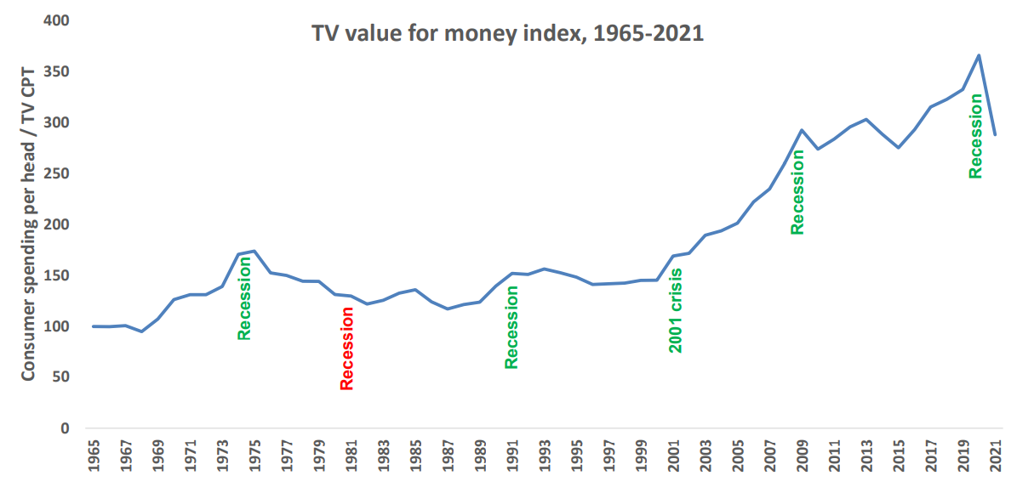
The value of TV increases during downturns
A high TV value for money index means that the price of TV is low, relative to total consumer spend levels
TV value for money index*
Source: Les Binet, ‘Marketing in the post-covid economy: A planning framework for turbulent times’. ONS, Advertising Association, WARC. *TV value for money index = consumer spending / TV CPT indexed from 1965
Notes:
Given the current economic climate, marketing budgets are increasingly under pressure with every investment needing to be justified.
At the 2022 IPA EffWorks Global, Les Binet (Group Head of Effectiveness of adam&eveDDB) provided a framework for planning media in economic uncertainty. During the session, ‘Marketing in the post covid economy’, Binet highlighted how short and long term investments should be dialled up and down depending on various factors.
One of the factors that Binet advises marketers to take advantage of is the value for money ratio for TV – a measure of the relative cost (CPT) of TV compared with the volume of total consumer spending. Binet’s data shows that the ratio has been rising over time as TV pricing has not kept pace with consumer spending in the long run – TV’s value for money has been getting better over time, particularly since 2000 due to increased competition from the tech giants.
Interestingly, when we focus specifically on times of recession (the 1970s, the 1990s, 2001 and more recently 2020 which was impacted by the global financial crisis and Covid), TV’s value for money increased sharply. The 1981 recession is the only exception.
This highlights the opportunity that advertisers and planners can take advantage of. If your particular sector is performing well, this is the perfect opportunity to buy share of voice, a method utilised by FMCG advertisers as they increased investment in TV during the pandemic.
For more insight on how brands can navigate through turbulent economic times, click here: https://www.thinkbox.tv/research/media-mix-navigator/strategies-for-marketing-through-a-downturn/

Slide 46
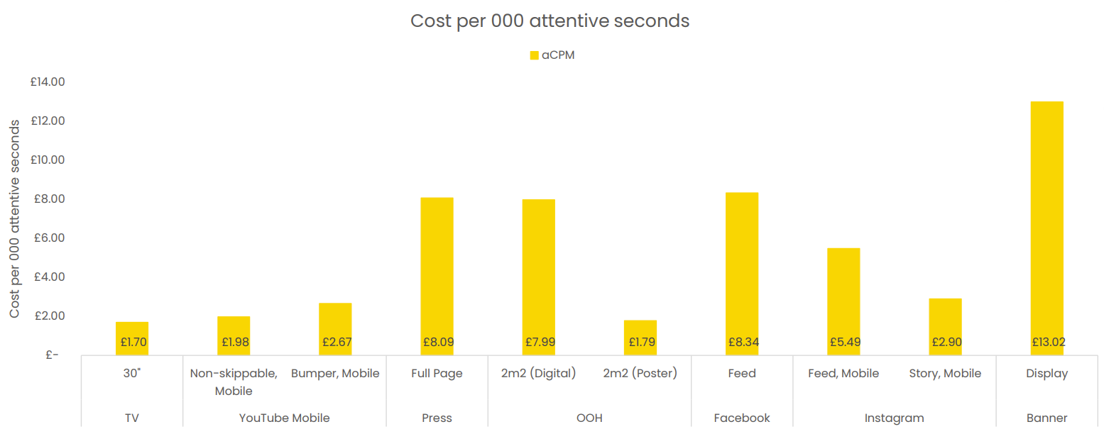
TV is an ‘attention bargain’
Attention data Sources: TV: Tvision/Lumen UK TV Panel. YT, Instream, Teads, Facebook Feed, Banners: Lumen digital panels. Press: Lumen Omnibus. OOH: AM4DOOH project. IG, FB Watch, TikTok: Lumen studies (weighted to be consistent with passive panel). CPM sources: Ebiquity
Notes:
Data from Lumen and Tvision shows how TV is an ‘attention bargain’, with a 30” TV creative generating a cost per 000 attentive second of £1.70

Slide 47
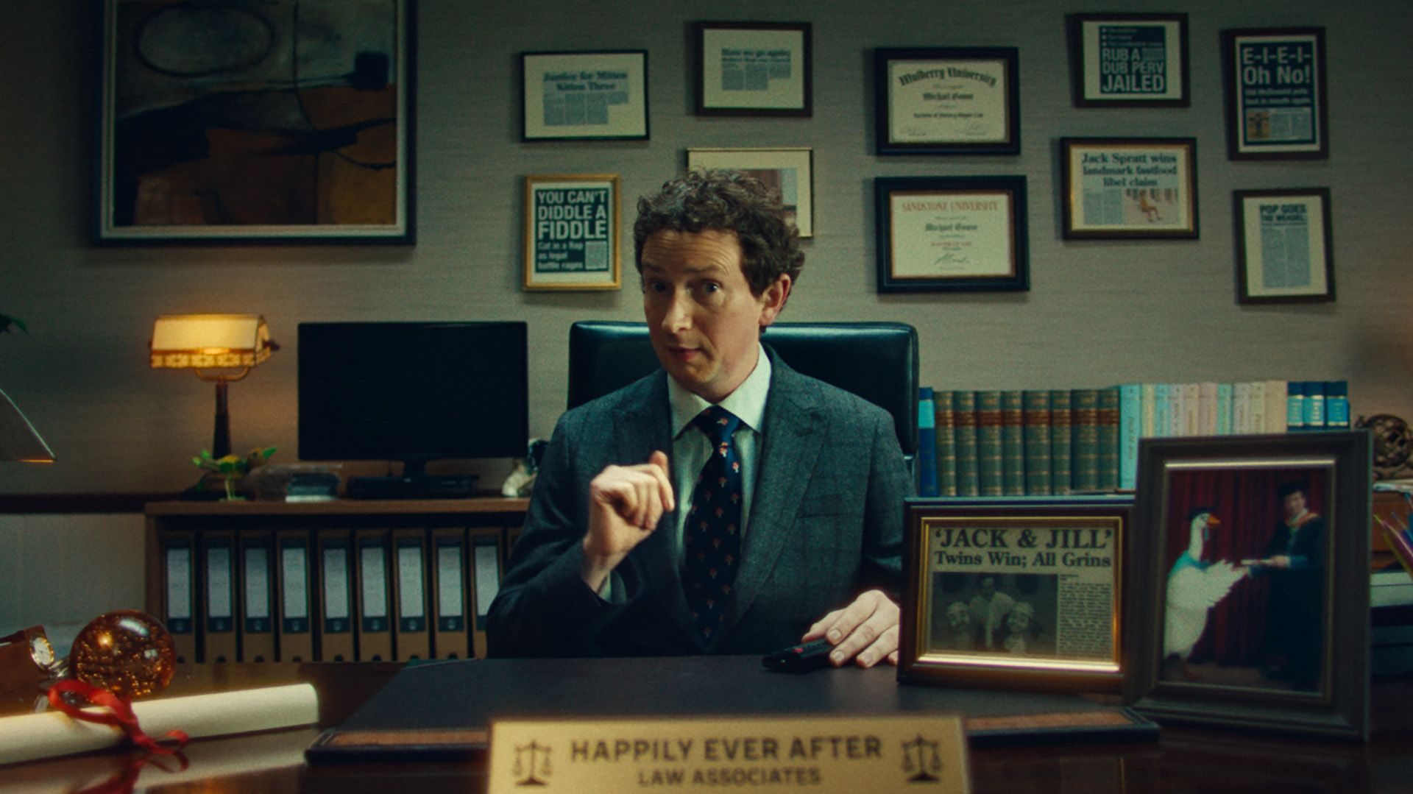
Find out more at Thinkbox.tv
Helping you get the best out of TV
Notes:
Find out more from Thinkbox
Whether you are in need of information or inspiration, we’ll keep you up to date:
Visit www.thinkbox.tv
Register for our newsletter
Or simply talk to us

