Slide 1
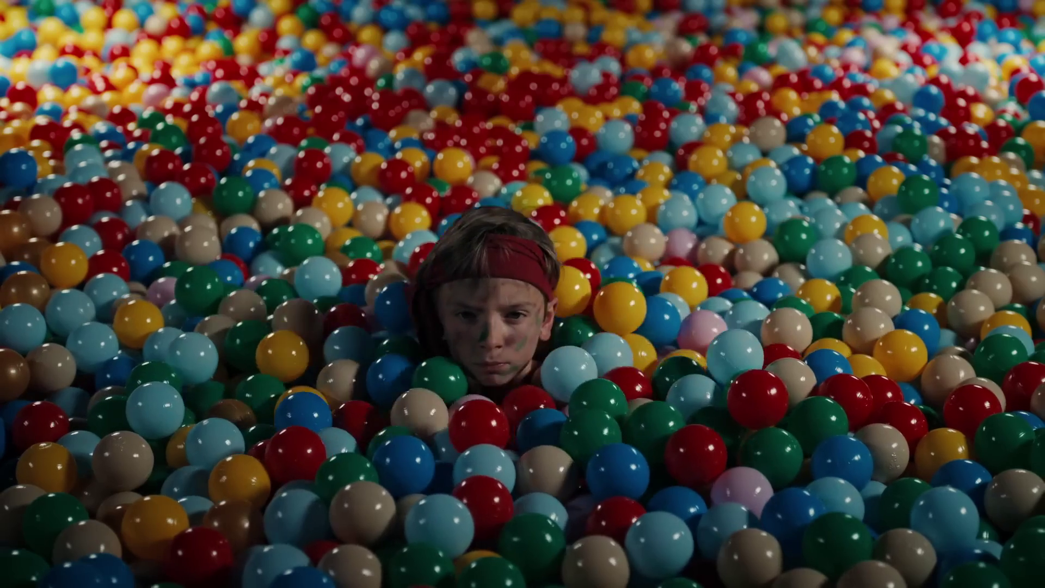
Monthly TV viewing report
November 2024
Smyths, “Two Magical Words”

Slide 2
November linear TV facts & figures
Total TV weekly reach %
Total TV viewed per day
Commercial TV viewed per day
Impacts
Individuals
77.7 | 54.2bn | 2h 22m | 1h 34m
80.4 | 52.5bn | 2h 41m | 1h 47m
79.9 | 20.7bn | 2h 8m | 1h 19m
60.5 | 3.9bn | 41m | 30m
78.7 | 23.3bn | 2h 34m | 1h 42m
82.1 | 29.2bn | 2h 48m | 1h 51m
78.6 | 3.9bn | 1h 27m | 1h 2m
Adults
ABC1 adults
16-34
Men
Women
Housepersons with children
Sources: Barb November 2024, industry standard TV viewing in-home on a TV set. Reach 3min+. 30” equivalent impacts.
Notes:
November linear TV figures for weekly reach, impacts, total TV viewing hours and commercial TV viewing hours

Slide 3
Some notable TV moments in November
On 17 November, ITV1 aired the first episode of I'm a Celebrity... Get Me Out of Here! to an average audience of 10.09m.
On 26 November, Channel 4 aired The Great British Bake Off final to an average audience of 6.75m
On 14 November, Channel 5 aired Ellis to an average audience of 2.42m.
On 7 November, Sky Showcase aired new series The Day of the Jackal to an average audience of 1.62m.
Source: Barb, November 2024, individuals. Average audience figures, TV set and devices viewing 1-7 days (includes pre-broadcast figures, if applicable).

Slide 4
Top 5 ITV1 programmes
I'm a Celebrity... Get Me Out of Here! (17 November) 10.09 million viewers
Until I Kill You (3 November) 5.79 million viewers
Coronation Street (18 November) 4.69 million viewers
Emmerdale (28 November) 4.10 million viewers
UEFA Nations League: England v Republic of Ireland (17 November) 4.00 million viewers
“I’m a Celebrity…Get Me Out of Here!”, ITV1
Source: Barb, November 2024, individuals. Average audience figures, TV set and devices viewing 1-7 days (includes pre-broadcast figures, if applicable)
Notes:
Top 5 programmes - ITV

Slide 5
Top 5 Channel 4 programmes
The Great British Bake Off (26 November) 6.75 million viewers
Gogglebox (1 November) 3.29 million viewers
24 Hours in Police Custody (25 November) 2.59 million viewers
Taskmaster (14 November) 1.80 million viewers
Location, Location, Location (6 November) 1.77 million viewers
“The Great British Bake Off”, Channel 4
Source: Barb, November 2024, individuals. Average audience figures, TV set and devices viewing 1-7 days (includes pre-broadcast figures, if applicable)
Notes:
Top 5 programmes – Channel 4

Slide 6
Top 5 Channel 5 programmes
Ellis (14 November) 2.42 million viewers
The Hardacres (11 November) 2.40 million viewers
Peter Kay Live: Comedy Genius (22 November) 1.52 million viewers
Cause of Death (27 November) 1.29 million viewers
Police Interceptors (18 November) 1.22 million viewers
“Ellis”, Channel 5
Source: Barb, November 2024, individuals. Average audience figures, TV set and devices viewing 1-7 days (includes pre-broadcast figures, if applicable)
Notes:
Top 5 programmes – Channel 5

Slide 7
Top 5 commercial non-PSB* programmes (non-sport)
Married at First Sight UK, E4 (11 November) 2.57 million viewers
The Day of the Jackal, Sky Atlantic (7 November) 1.62 million viewers
Sweetpea, Sky Showcase (14 November) 1.37 million viewers
Big Brother, ITV2 (6 November) 1.28 million viewers
Our Farm Next Door: Amanda, Clive and Kids, More4 (4 November) 0.86 million viewers
“Sweetpea”, Sky Showcase
Source: Barb, November 2024, individuals. Average audience figures, TV set and devices viewing 1-7 days (includes pre-broadcast figures, if applicable)
Notes:
Top 5 programmes – commercial non-public service broadcasting channels

Slide 8
Top 5 Netflix programmes
A Man on the Inside (21 November) 1.63 million viewers
Spellbound (22 November) 1.14 million viewers
Our Little Secret (27 November) 1.01 million viewers
JOY: The Birth of IVF (22 November) 0.92 million viewers
Cobra Kai (15 November) 0.90 million viewers
“A Man on the Inside”, Netflix
Source: Barb, November 2024, individuals. Average audience achieved during the first seven days of their availability. Only includes TV set viewing.
Notes:
Top 5 programmes – Netflix

Slide 9
Top 5 Disney+ programmes
Deadpool and Wolverine (12 November) 1.94 million viewers
Agatha All Along (31 October) 0.66 million viewers
Grey's Anatomy (14 November) 0.57 million viewers
9-1-1 (7 November) 0.52 million viewers
An Almost Christmas Story (15 November) 0.42 million viewers
“An Almost Christmas Story”, Disney+
Source: Barb, November 2024, individuals. Average audience achieved during the first seven days of their availability. Only includes TV set viewing.
Notes:
Top 5 programmes – Disney+

Slide 10
Top 5 Amazon Prime Video programmes
Cross (14 November) 1.72 million viewers
Black Adam (20 November) 0.57 million viewers
UEFA Champions League (5 November) 0.49 million viewers
Paris Has Fallen (5 November) 0.45 million viewers
The World According to Kaleb: On Tour (29 November) 0.23 million viewers
“The World According to Kaleb: On Tour”, Amazon Prime Video
Source: Barb, November 2024, individuals. Average audience achieved during the first seven days of their availability. Only includes TV set viewing.
Notes:
Top 5 programmes – Amazon Prime Video

Slide 11
Top commercial programmes with largest proportion of device viewing
Total audience
2.21m
1.10m
1.16m
1.21m
8.51m
Source: Barb, November 2024, individuals. Average audience figures, TV set and devices viewing up to 7 days post-broadcast. Based on programmes with 1 million+ total TV viewers
Notes:
Top commercial programmes with largest proportion of device viewing

Slide 12
Top commercial programmes with largest proportion of pre-broadcast boxset BVOD viewing
Total audience
1.25m
1.32m
5.46m
2.83m
1.00m
Source: Barb, November 2024, individuals. Average audience figures, TV set and devices viewing up to 7 days post-broadcast. Based on programmes with 1 million+ total TV viewers
Notes:
Top commercial programmes with largest proportion of pre-broadcast boxset BVOD viewing

Slide 13
Key new to linear TV advertisers in November
Schuh Footwear retailer, Schuh return to TV after more than a decade with their ‘Same, But Different’ campaign.
Isle of Raasay Hebridean Distillers, Isle of Raasay, launched its first ever TV campaign.
Multibank Produced by Sky Creative, Multibank debut their TV campaign starring Peter Capaldi.
Schuh, “Same, but different”
Notes:
New to TV advertisers in November.

