Slide 1


Monthly TV viewing report
May 2025
Aldi – SpecialBuys

Slide 2
May linear TV facts & figures
Total TV weekly reach %
Total TV viewed per day
Commercial TV viewed per day
Impacts
Individuals
74.3 | 48.1bn | 2h 0m | 1h 21m
77.3 | 46.6bn | 2h 17m | 1h 32m
76.0 | 17.2bn | 1h 44m | 1h 4m
55.3 | 2.7bn | 30m | 21m
76.3 | 21.5bn | 2h 14m | 1h 31m
78.3 | 25.1bn | 2h 19m | 1h 33m
74.2 | 2.8bn | 1h 3m | 43m
Adults
ABC1 adults
16-34
Men
Women
Housepersons with children
Source: Barb, May 2025, industry standard TV viewing in-home on a TV set. Reach 3min+. 30” equivalent impacts.
Notes:
May linear TV figures for weekly reach, impacts, total TV viewing hours and commercial TV viewing hours

Slide 3


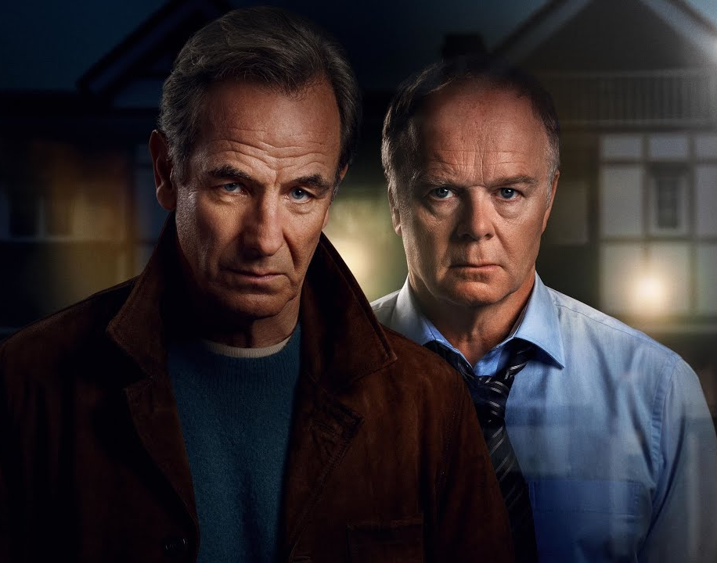

Some notable TV moments in May
On 31 May, ITV1 aired the live final of Britain’s Got Talent to an average audience of 5.32m.
On 25 May, Channel 4 aired the final of The Piano to an average audience of 1.94m.
On 13 May, Channel 5 aired new drama The Game to an average audience of 2.28m.
On 25 May, Sky Atlantic aired the finale of The Last of Us to an average audience of 1.22m.
Source: Barb, May 2025, individuals. Average audience figures, TV set and devices viewing 1-7 days (includes pre-broadcast figures, if applicable).

Slide 4

Top 5 ITV1 programmes
Britain’s Got Talent (31 May)
5.32 million viewers
Code of Silence (18 May)
5.26 million viewers
Coronation Street (23 May)
4.28 million viewers
The 1% Club (24 May)
4.22 million viewers
Emmerdale (27 May)
3.87 million viewers
Code of Silence, ITV1
Source: Barb, May 2025, individuals. Average audience figures, TV set and devices viewing 1-7 days (includes pre-broadcast figures, if applicable)
Notes:
Top 5 programmes - ITV

Slide 5
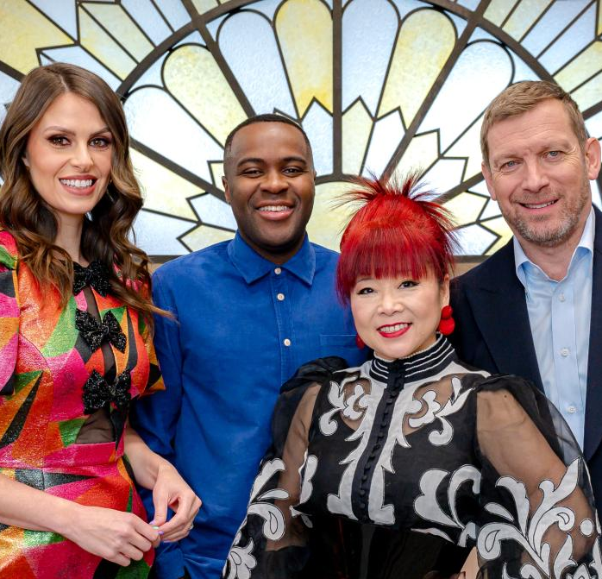
Top 5 Channel 4 programmes
Gogglebox (9 May)
3.23 million viewers
Taskmaster (1 May)
2.17 million viewers
The Piano (25 May)
1.94 million viewers
Bake Off: The Professionals (27 May)
1.56 million viewers
Madeleine McCann: The Unseen Evidence (7 May)
1.48 million viewers
Bake Off: The Professionals, Channel 4
Source: Barb, May 2025, individuals. Average audience figures, TV set and devices viewing 1-7 days (includes pre-broadcast figures, if applicable)
Notes:
Top 5 programmes – Channel 4

Slide 6

Top 5 Channel 5 programmes
The Game (13 May)
2.28 million viewers
Cause of Death (25 May)
1.23 million viewers
Fare Dodgers: At War With The Law (26 May)
1.20 million viewers
Rueben: Life in the Dales (27 May)
1.19 million viewers
The Secret Life of Bees (22 May)
1.15 million viewers
Rueben: Life in the Dales, Channel 5
Source: Barb, May 2025, individuals. Average audience figures, TV set and devices viewing 1-7 days (includes pre-broadcast figures, if applicable)
Notes:
Top 5 programmes – Channel 5

Slide 7

Top 5 commercial non-PSB* programmes (non-sport)
Married at First Sight Australia, E4 (7 May)
1.58 million viewers
The Chelsea Detective, U&Drama (29 May)
1.45 million viewers
The Last of Us, Sky Atlantic (25 May)
1.22 million viewers
Our Farm Next Door: Amanda, Clive and Kids, More4 (13 May)
0.84 million viewers
Hollyoaks, E4 (27 May)
0.62 million viewers
The Chelsea Detective, U&Drama
Source: Barb, May 2025, individuals. Average audience figures, TV set and devices viewing 1-7 days (includes pre-broadcast figures, if applicable)
Notes:
Top 5 programmes – commercial non-public service broadcasting channels

Slide 8
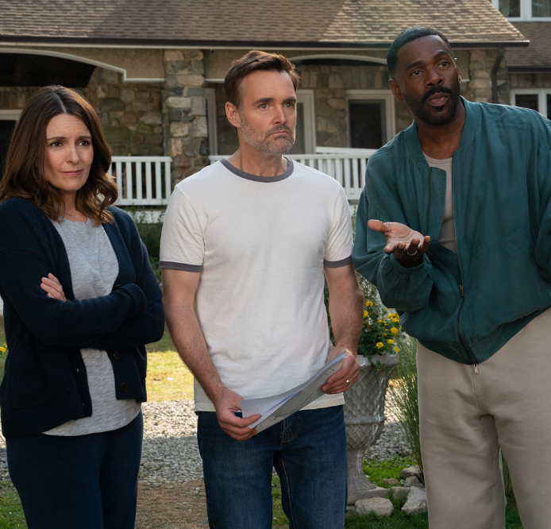
Top 5 Netflix programmes
Fred and Rose West: A British Horror Story (14 May)
2.38 million viewers
The Four Seasons (1 May)
1.58 million viewers
Sirens (22 May)
1.55 million viewers
A Deadly American Marriage (9 May)
1.32 million viewers
Dept. Q (29 May)
1.31 million viewers
The Four Seasons, Netflix
Source: Barb, May 2025, individuals. Average audience achieved during the first seven days of their availability. Only includes TV set viewing.
Notes:
Top 5 programmes – Netflix

Slide 9
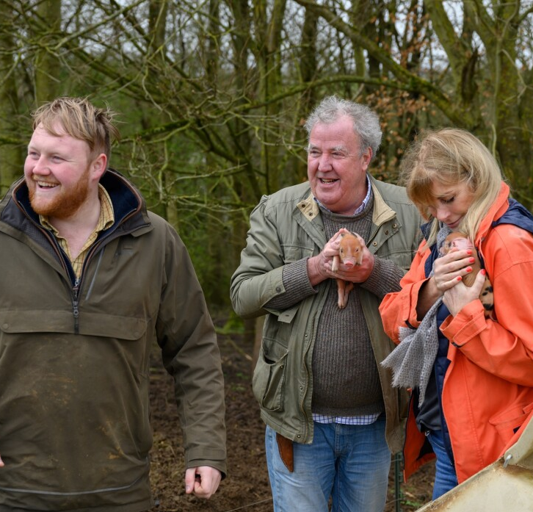
Top 5 Amazon Prime Video programmes
Clarkson’s Farm (23 May)
5.24 million viewers
A Working Man (15 May)
1.34 million viewers
UEFA Champions League INT Vs BAR (6 May)
1.29 million viewers
Conclave (30 Apr)
0.92 million viewers
Another Simple Favor (1 May)
0.84 million viewers
Clarkson’s Farm, Amazon Prime Video
Source: Barb, May 2025, individuals. Average audience achieved during the first seven days of their availability. Only includes TV set viewing.
Notes:
Top 5 programmes – Amazon Prime Video

Slide 10

Top 5 Disney+ programmes
Captain America Brave New World (28 May)
0.77 million viewers
Star Wars: Andor (14 May)
0.54 million viewers
9-1-1 (2 May)
0.51 million viewers
Welcome to Wrexham (16 May)
0.42 million viewers
Grey’s Anatomy (16 May)
0.42 million viewers
Welcome to Wrexham, Disney+
Source: Barb, May 2025, individuals. Average audience achieved during the first seven days of their availability. Only includes TV set viewing.
Notes:
Top 5 programmes – Disney+

Slide 11
Top commercial programmes with largest proportion of device viewing
Total audience
1.22m
1.44m
1.19m
1.48m
2.89m
Source: Barb, May 2025, individuals. Average audience figures, TV set and devices viewing up to 7 days post-broadcast. Based on programmes with 1 million+ total TV viewers
Notes:
Top commercial programmes with largest proportion of device viewing

Slide 12
Top commercial programmes with largest proportion of pre-broadcast boxset BVOD viewing
Total audience
1.80m
1.19m
1.45m
2.80m
2.89m
Source: Barb, May 2025, individuals. Average audience figures, TV set and devices viewing up to 7 days post-broadcast. Based on programmes with 1 million+ total TV viewers
Notes:
Top commercial programmes with largest proportion of pre-broadcast boxset BVOD viewing

Slide 13
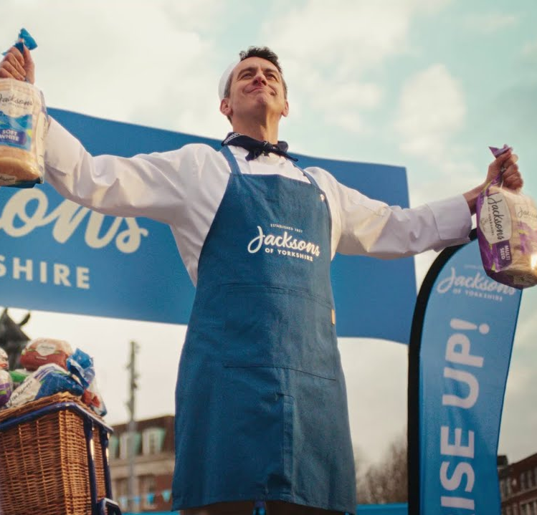
Key new to linear TV advertisers in May
WhatsApp
WhatsApp launched for the first time on UK TV with a new privacy ad in its biggest global campaign to date.
Jacksons of Yorkshire
Yorkshire bread brand, Jacksons, embarked on its first ever TV ad campaign showcasing the brands heritage.
Beards & Daisies
Online houseplants business, Beards & Daisies, launched its inaugural TV campaign on Sky.
Jacksons of Yorkshire – Rise Up
Notes:
New to TV advertisers in May.

