Slide 1
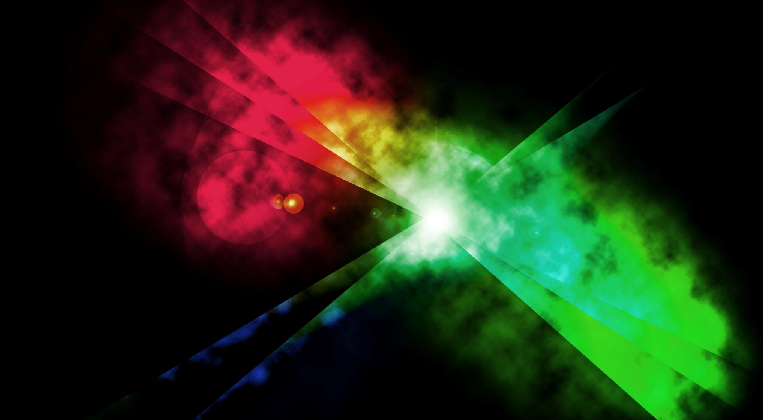
Creative Drivers of Effectiveness
2023

Slide 2
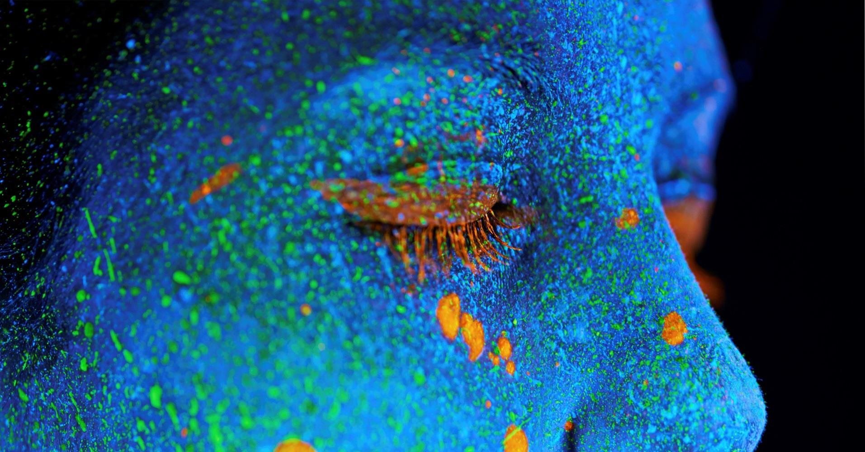
Creative Drivers of Effectiveness (2016)
A lot has changed since then…
Notes:
The first iteration of Creative Drivers of Effectiveness was in 2016, working with Neuro-Insight to provide evidence to support the importance of storytelling and brilliant creativity.
A difficult truth is that our brains are not interested in brands but instead are interested in stories and a search for human connection. The context of the world that we live in hugely impacts the way in which we consume and respond to stories, media and therefore advertising.
Given the world has moved on significantly in recent years since the last iteration (major events like the pandemic and Brexit to name a few), Thinkbox worked with Neuro-Insight to update this piece of research. It’s important to note that all of these societal shifts have impacted our subconscious and therefore is an important piece of context to keep in mind when looking at this data.

Slide 3
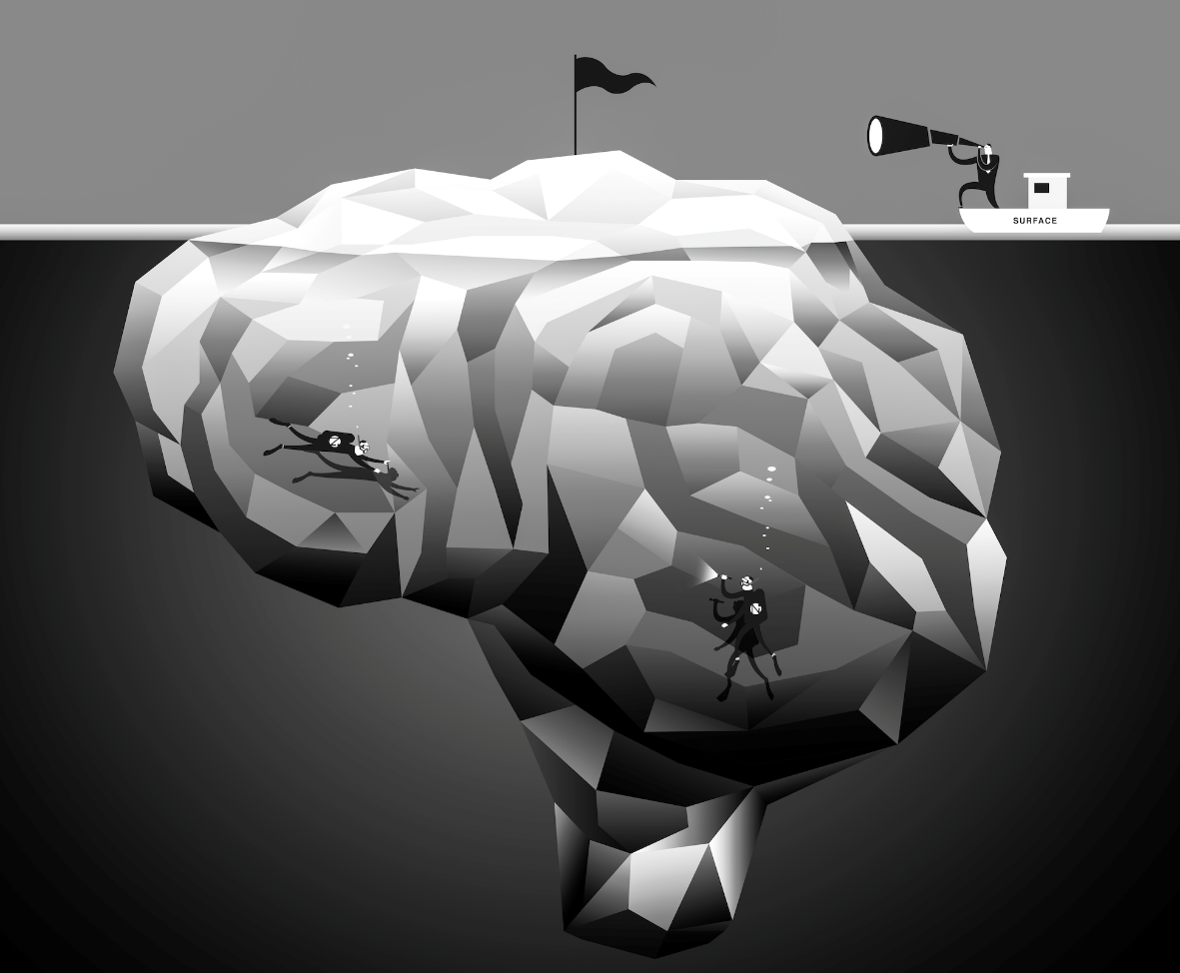
90% OF ALL DECISIONS ARE MADE IN THE SUBCONSCIOUS
“What lies behind us and what lies before us are tiny matters compared to what lies within us.” - Emerson
Source: Creative Drivers of Effectiveness, 2023, Neuro-Insight/Thinkbox
Notes:
Our subconscious makes 90% of our decisions.
An example of this is seen in the 1999 study, ‘the influence of in-store music on wine selections.’ A supermarket played French and German music over the speaker and observed shoppers buying wine. Results showed that the days when French music was played, 76% of the wine that was bought was French. Similarly, when German music was played, 73% of the wine bought was German. When asked about the music and their purchase, shoppers stated that music hadn’t influenced their decisions, further stating that most had not registered it.
This shows the power of your subconscious, whilst we generally like to believe we are making all of our decisions consciously, this is not always the case.
Naturally, you may be wondering, how am I meant to know if I am getting into the consumer’s subconscious?

Slide 4
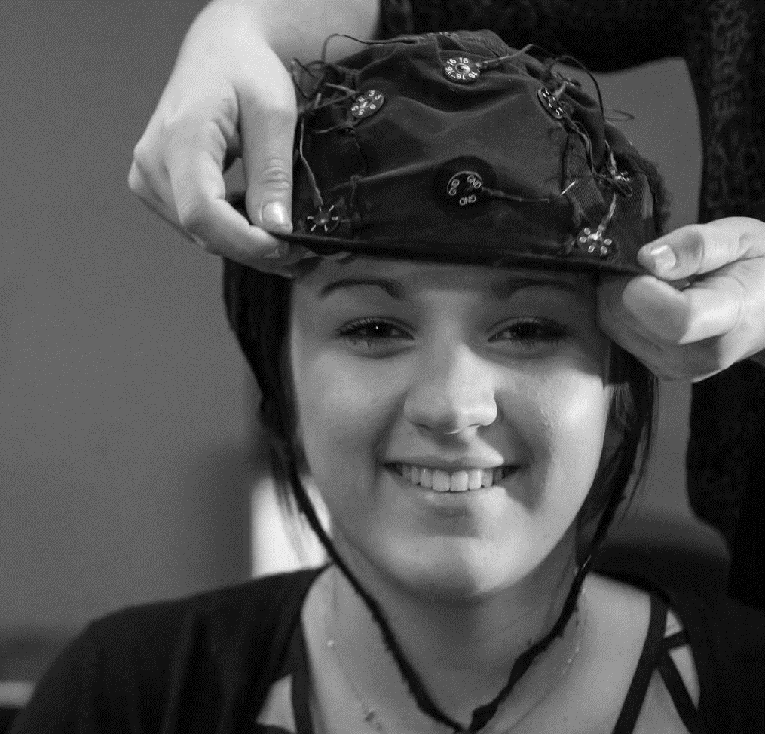
Neuro-Insight measure electrical brain activity using:
Steady
State
Topography
Source: Creative Drivers of Effectiveness, 2023, Neuro-Insight/Thinkbox
Notes:
We worked with Neuro-Insight to help answer this question. The organisation was initially founded within academia by Professor Richard Silberstein, and has a unique method of conducting analysis.
Neuro-Insight use a patented technology called SST (Steady State Topography) which specifically measure the speed of electrical activity within the brain.
As the brain is highly specialised, this mean that we can look at a variety of different things…

Slide 5
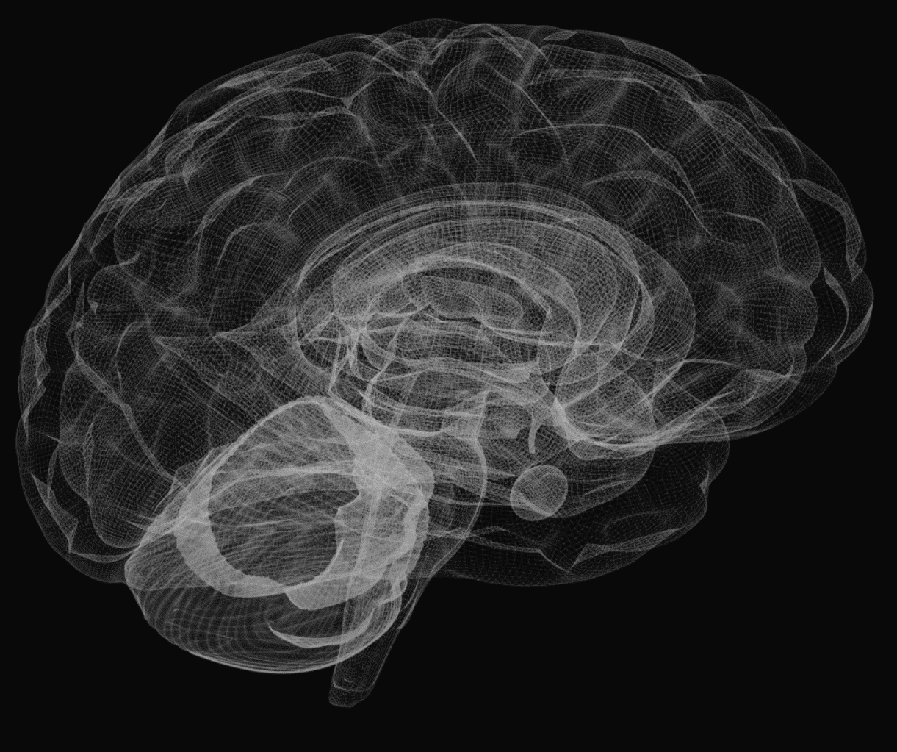
LONG-TERM MEMORABILITY
PERSONAL RELEVANCE
EMOTIONAL IMPACT
EMOTIONAL APPEAL
Notes:
Specifically these four key metrics…
The first (and main) metric is long term memorability.
Neuro-Insight can use SST to look at what goes into our long-term memory. This can include both detailed encoding, which includes things like text, branding, key messages etc. and global memory encoding, which is more around the big picture, narrative connection and overall feel of an ad.
Research has shows that long term memory has a strong link to future behaviour and decision making.
Essentially, if something hasn’t gone in memory, then it can’t impact our behaviour, and if something has gone into memory, it is an indication that we perceive there is a use for it in the future.
The next metric that is a strong driver of memory is personal relevance.
Having high levels of activity within this area of the brain indicates how personally relevant something is to you e.g. this part of your brain would light up, if you were to see a picture of your family.
Neuro-Insight also look at emotional responses. This area in the back of your brain shows the level of emotional impact, in particular, it is the area of the brain responsible for an arousal response and shows the strength of emotion being experienced.
The final key metric shows the direction of the emotion and therefore how appealing or unappealing something is.
More specifically, this is a lean in and lean out response, so it can also indicate interest

Slide 6
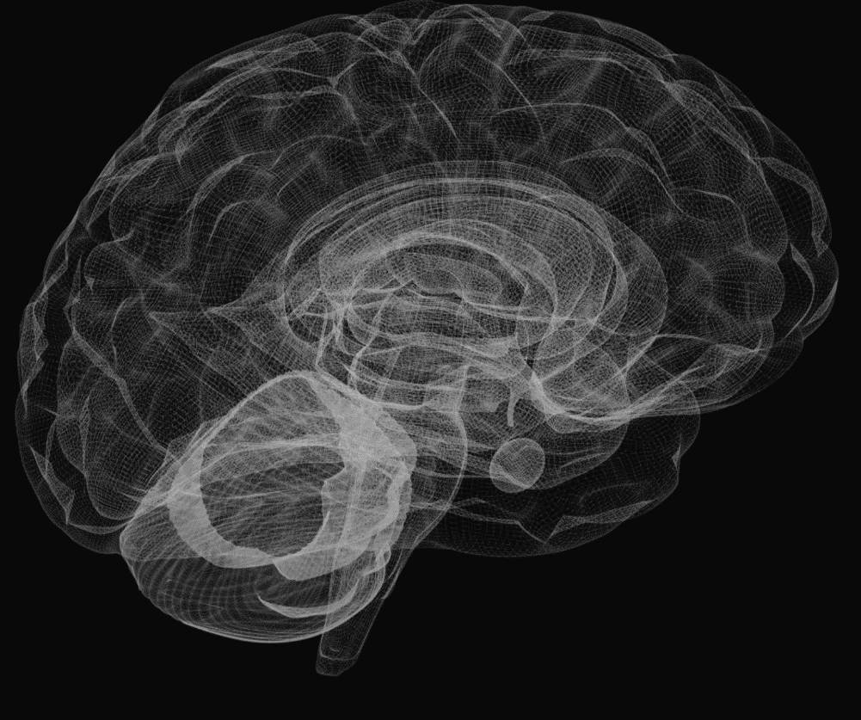
SST™ is the most powerful neuro-marketing technology
86%
Linkage to in-store sales
Source: Creative Drivers of Effectiveness, 2023, Neuro-Insight/Thinkbox
Notes:
Neuro-Insight can use SST to truly measure the impact of advertising, with results having shown that the metrics have an 86% correlation to in market sales.

Slide 7
Creative contributes to 47% of sales
So, understanding of key creative drivers is crucial.
Branston, “Bring Out The Branston”
Source: Nielsen, https://www.nielsen.com/insights/2017/when-it-comes-to-advertising-effectiveness-what-is-key/, Neilsen, https://www.nielsen.com/insights/2017/perspectives-want-a-successful-ad-get-creative/
Notes:
Why is creative so important?
Creative has been shown to impact a large proportion of sales, data from a Nielsen study suggests that 47% of sales are attributed to creative.
As a result, it is incredibly important that we understand the key drivers of creative effectiveness, as this allows us to have an effective tool kit that we can use to make great advertising.

Slide 8
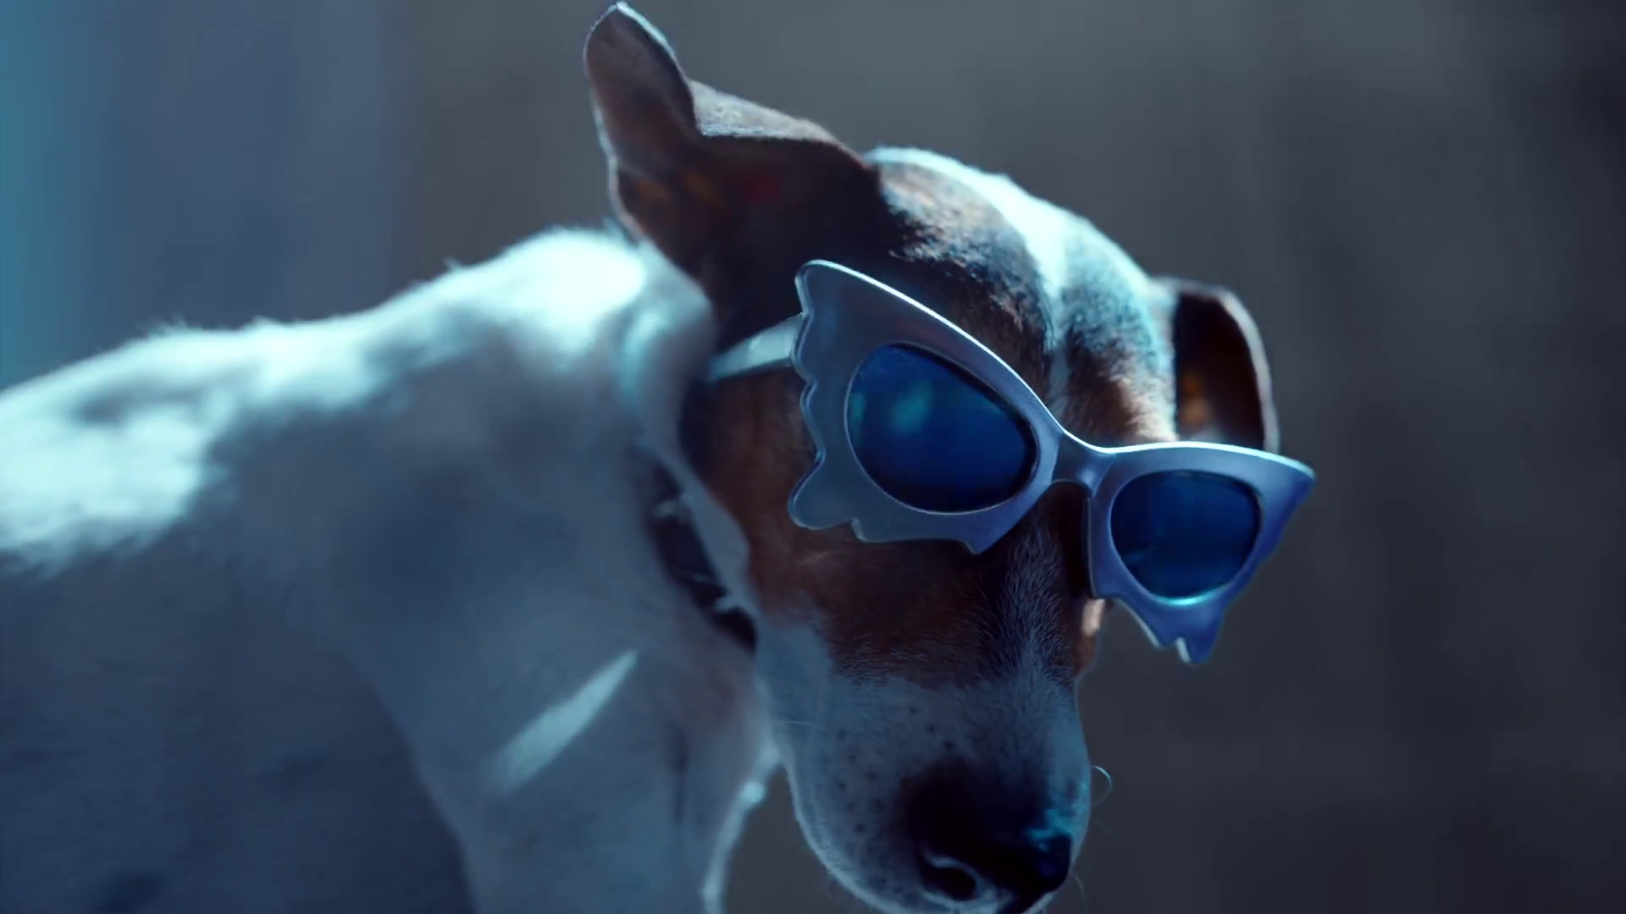
We coded 150 UK ads against a range of creative variables
Ads were included from 2019-2023
Samsung Galaxy, “Awesome For Everyone”
Source: Creative Drivers of Effectiveness, 2023, Neuro-Insight/Thinkbox
Notes:
When updating this study, Neuro-Insight took 150 ads from their database and categorised them against a list of creative variables.
The ads were taken from 2019 – 2023, which encompasses before, during and after the pandemic.

Slide 9
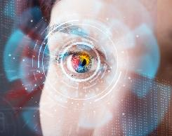
Actors
Animals
Brand assets
Brand colour
Branding moments
Category
Celebs
Children
Duration
Early branding
Final branding
Interaction
Music
Product role
Real people
Sonic branding
Story type
Style
Tonality
Verbal branding
Visual branding
Source: Creative Drivers of Effectiveness, 2023, Neuro-Insight/Thinkbox
Notes:
The next stage was to classify all 150 ads within 21 different categories, including brand assets, category, children, sonic branding, style, etc.
The results shown in this presentation will specifically explore the categories that delivered strong and meaningful results.

Slide 10
Statistical analysis was conducted on each variable
Source: Creative Drivers of Effectiveness, 2023, Neuro-Insight/Thinkbox
Notes:
Statistical analysis was conducted on each variable to identify which categories had a strong impact.
This chart is a time series showing memory responses on a second-by-second basis. The Y axis shows the strength of brain response, and the X axis shows the time in seconds.
Two dotted lines have been marked across the chart, the top line is the benchmark line, set at 0.7 and indicates a strong level of brain response.
This benchmark has been set by Neuro-Insight’s academic research and is indicative of an impactful response, this means we can be sure when memory is above 0.7, whatever is being seen or heard is stored into long term memory.

Slide 11
Statistical analysis was conducted on each variable
Source: Creative Drivers of Effectiveness, 2023, Neuro-Insight/Thinkbox
Notes:
This study covered several different data points, however the two most important points are the peak of brain response during ads at final branding and the number of brain response peaks.
Firstly, the peak of brain response during ads at final branding is an important datapoint as it is the most important branding moment and is the most comparable point across all ads.
Looking at the same time series chart, the green area and arrow represents when this moment occurs – which is the top of this peak, as this is when branding was on the screen and the strongest moment of brain response. A peak is defined as the highest moment above the benchmark line.

Slide 12
Statistical analysis was conducted on each variable
Source: Creative Drivers of Effectiveness, 2023, Neuro-Insight/Thinkbox
Notes:
The next datapoint Neuro-Insight investigated was the number of brain response peaks.
Looking at the same time series chart, the green areas represent the peaks of response as they are above the benchmark line, this particular ad has 8 peaks of memory.

Slide 13
Long-term memorability (detail)
1
Primary metric
Personal relevance
Game, “Never Grow Up”
2
Secondary metrics
(key drivers of memory)
Emotional Impact
Source: Creative Drivers of Effectiveness, 2023, Neuro-Insight/Thinkbox
Notes:
For this particular study, Neuro-Insight focused on three key metrics.
The primary metric is long-term memorability, specifically detailed long-term memorability as this has shown to directly correlate with future purchase behaviour.
The secondary metrics have been chosen as they are key drivers of long-term memory. The first is personal relevance which will show how engaged and relevant the ads feel to the audience. The second is emotional impact, which allows us to understand how the audience is responding on an emotional level.

Slide 14
Creativity is not a paint by numbers
But utilising a toolbox of techniques can help to maximise your impact
Screwfix, “Don’t Stop - Sprint”
Source: Creative Drivers of Effectiveness, 2023, Neuro-Insight/Thinkbox
Notes:
Before diving into the results, it is important to note that creativity and the making of ads and narratives does not have any perfect formula.
However, the findings within this research provides a useful toolbox of creative strategies that can be utilised within storytelling to ensure that we are creating the most impactful advertising that we can.

Slide 15
From this 5 big conclusions were seen…
Showcase, don’t shout
People are paramount
Utilise your brand assets
Give audio a clear role
Impact is in the timing
Subway, “Two Ways”
Source: Creative Drivers of Effectiveness, 2023, Neuro-Insight/Thinkbox
Notes:
The analysis found 5 key conclusions.
Showcase your product, don’t shout about it
People are paramount – it’s important for us to keep in mind that we like seeing other humans
Brand assets can be impactful and should be utilised
Audio can be misused and making sure it has a key role is important
Timing can have a big impact on your ad, both for ad duration and final branding

Slide 16
1. Showcase your product, don’t shout
Burger King, “We Give Up”
Notes:
Showcase your product, don’t shout. As mentioned earlier, our brains do not like being advertised to.
Essentially, our brain has a built-in ad blocker. During adolescence, we develop this ‘blocker’, it is an evolutionary mechanism that allows us to avoid danger. Therefore, if we feel as though we are being overtly advertised to, this ad blocker can get in the way.

Slide 17
Weave your product into the narrative
x1.4
x1.4
Source: Creative Drivers of Effectiveness, 2023, Neuro-Insight/Thinkbox
Notes:
A way to navigate around this blocker is to weave your product into the narrative. Analysis found that utilising this technique elicits more peaks of memory and personal relevance throughout an ad.
This gives your brand more opportunity to get into the audience’s memory as there are 1.4x more peaks of strong brain response throughout the ad, than when you have an overt focus on the product.
Here are a few example ads.

Slide 18
Notes:
***VIDEO***
This is an example of how an overt focus on a product elicits much worse levels of memory response.
As a reminder, the Y axis shows the strength of memory response and X axis is the time. The top dotted line is the benchmark showing strong levels of memory. For this particular ad, there is only one peak of memory throughout the ad and final branding is missed.

Slide 19
Notes:
***VIDEO***
Conversely, this particular ad is one where the product has been woven into the narrative well. The time series chart shows that there are multiple peaks of memory above the top dotted line including when the Heineken beer bottle is on screen.
This is therefore showing that these branding moments are being encoded into memory.

Slide 20
2. People are paramount
Dave, “We Also Wrote A Song”
Notes:
The second key finding is that people are paramount

Slide 21
Human focus is important to ad success
Ads with people present deliver more impact
+15%
+24%
Personal relevance
Long-term memorability
Source: Creative Drivers of Effectiveness, 2023, Neuro-Insight/Thinkbox
Notes:
The analysis from Neuro-Insight shows that it is very important to include people within your ads to help create an impact.
Findings shows that ads which included people were 15% more relevant to the audience and drove 24% higher levels of memory encoding at final branding vs. ads with no people.
As humans, we search for human connection, so making an ads narrative revolve around a person allows the audience to create a connection with this on-screen character and allows the audience to become more involved.

Slide 22
However, children can be polarising
Source: Creative Drivers of Effectiveness, 2023, Neuro-Insight/Thinkbox
Notes:
However, not all onscreen characters work the same.
Analysis suggests that people don’t relate to the narrative as much when children are the focus. Instead, seeing children appear briefly or as more secondary characters was significantly more impactful.
It should also be noted that although the findings didn’t reach statistical significance, results pointed to animals eliciting the opposite response, where having them as the main focus was more impactful.

Slide 23
3. Utilise your brand assets
Kayak, “Go See For Yourself”
Notes:
The third key finding was around how to utilise your key brand assets.

Slide 24
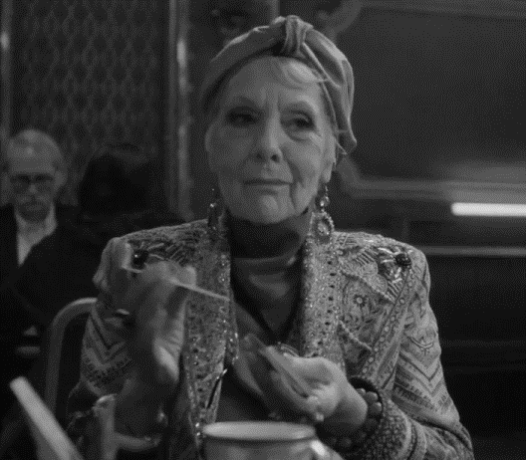
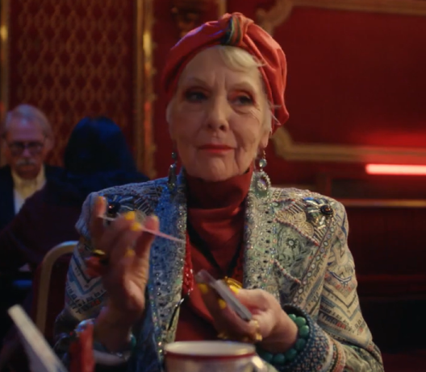
Integrating brand colours is subtle but effective
+9%
Emotional Impact
Source: Creative Drivers of Effectiveness, 2023, Neuro-Insight/Thinkbox
Notes:
Neuro-Insight found that integrating brand colours into the narrative is effective and significantly drove strong emotional impact.
Utilising brand colours is a subtle way to weave your branding into a narrative which your audience is connecting with. As a result, when the switch to final branding is made, it feels less jarring and more congruent with the narrative that was just told, and therefore driving this more positive emotional outcome.

Slide 25
4. Give audio a clear role
DFS, “Everyone's Got A Thing”
Notes:
Neuro-Insight also found that audio creates a big impact.

Slide 26
Use music to drive the action
Source: Creative Drivers of Effectiveness, 2023, Neuro-Insight/Thinkbox
Notes:
Music can often be used in an ad, without any specific reason, however audio can make or break an ad.
When categorising the use of music into different levels – no music, passive/background music, music prominent and music driving the ad. Neuro-Insight found that ads which used music to drive the action, elicited significant more peaks of memory and emotional impact throughout the ad. As a result, this gives a brand more opportunity to deliver the intended impact in comparison to not using music or using a passive background track.
It’s important to remember that you can’t turn off your ears so utilising audio to its full extent is important

Slide 27
5. Impact is in the timing
Cornish Orchards, “Squash”
Notes:
Impact is in the timing

Slide 28
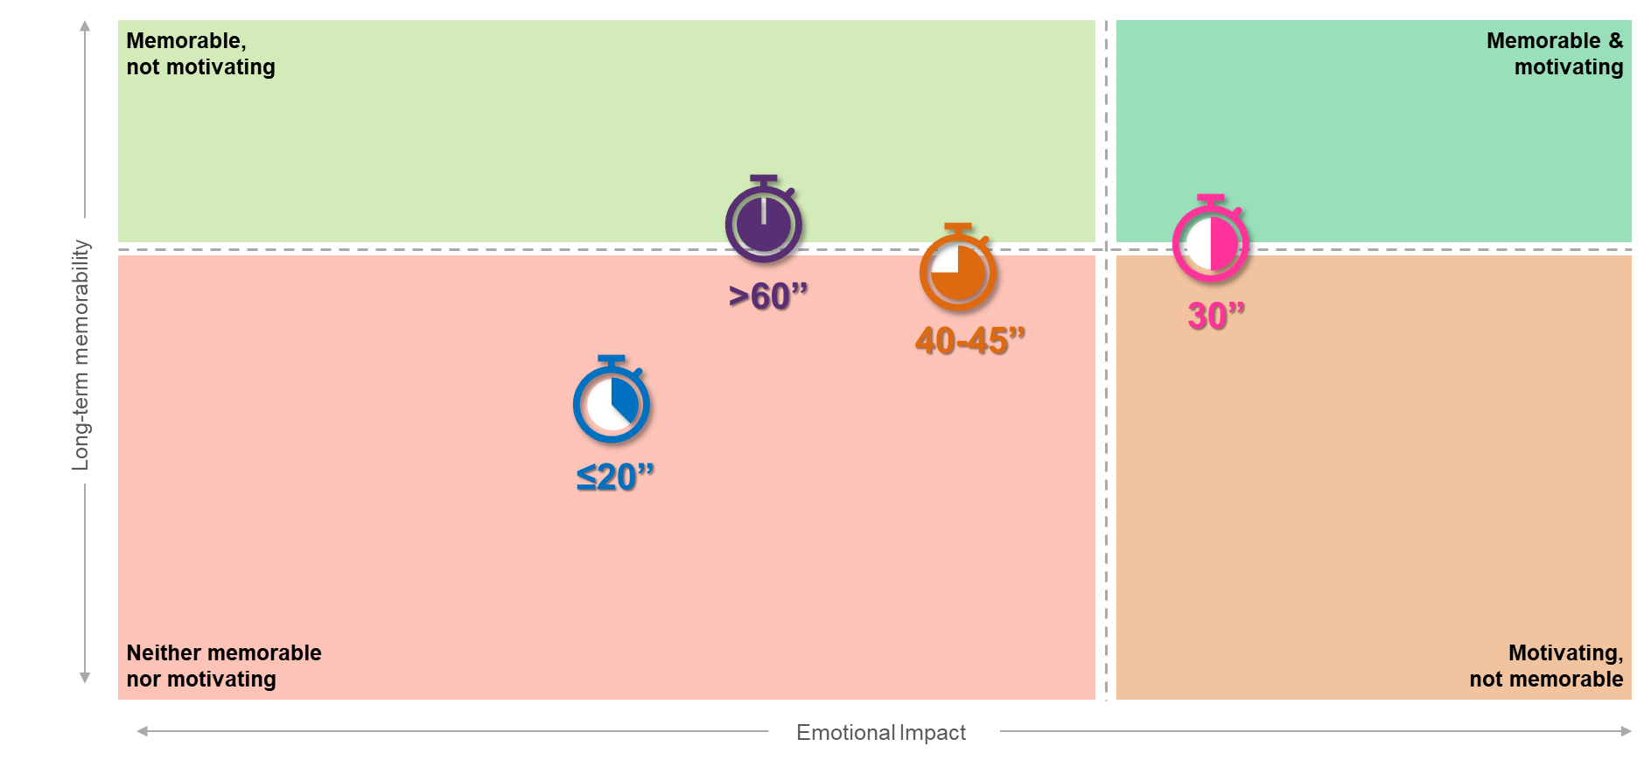
30 second ads deliver the greatest impact
Source: Creative Drivers of Effectiveness, 2023, Neuro-Insight/Thinkbox
Notes:
Neuro-Insight wanted to explore whether the ad duration influenced the impact of the ads. Finding include:
20 second ads were the least impactful
30 second ads were both memorable and emotionally motivating
When you increased the time length to 45-45 seconds, memory levels dropped slightly but it felt a lot less emotionally impactful
Increasing again to 60 seconds caused even less emotional impact but these ads were very memorable
These findings are rooted around the connection to the narrative. Ads which are under 30 seconds often fail to create a strong connection with the audience and develop a compelling narrative, causing the audience to be less involved emotionally and therefore less likely to store these stories into memory.
Analysis suggests that 30 seconds seem to be the optimal time to develop a narrative and build a strong connection with your audience. Anything more than 30 seconds whilst still memorable lose their emotional impact slightly.
After 30 seconds, the emotional impact is more dampened down, this metric can be driven by pace, music and developing excitement but after 30 seconds these mechanisms can lose some of their impact.

Slide 29
Having final branding on screen for longer (3+ seconds) drives the strongest impact
+11%
+11%
+3%
Emotional Impact
Personal relevance
Long-term memorability
This is due to conceptual closure…
Source: Creative Drivers of Effectiveness, 2023, Neuro-Insight/Thinkbox
Notes:
Neuro-Insight also explored the time length at final branding.
Analysis showed that ads that kept branding on screen for longer (in this case 3 seconds or more), delivered stronger levels of impact, with significantly higher levels of memory, emotion and relevance. This result is due to a phenomenon known as conceptual closure.

Slide 30
Conceptual closure is a subconscious processing pause
Narrative development
Narrative end
Conceptual closure
Source: Creative Drivers of Effectiveness, 2023, Neuro-Insight/Thinkbox
Notes:
Conceptual Closure occurs in the brain when you are storing a chunk of information into your memory e.g. like the buffering symbol that appears on your laptop when saving a piece of work.
Typically, Conceptual Closure is triggered when the brain perceives an ending to a narrative, once a narrative ends, responses fall sharply as demonstrated by the red portion of the chart. When Conceptual Closure happened, the brain is unreceptive to new information during and for a couple of seconds after as it is preoccupied as it stores this information.
Conceptual Closure is neither good or bad, however within advertising, you need to ensure that this isn’t triggered directly before branding moments or key messages. Typically, we see the introduction of overt final branding as a point where Conceptual Closure can occur, allowing a moment for recovery by having branding on screen for a few seconds longer can be a safe bet to ensure impactful final branding.

Slide 31
Notes:
***VIDEO OPTION***
This ad is from the American Superbowl by Hyundai and features the same time series chart featured on the previous slide. Whilst this is a good ad, you will be able to notice that final branding has been missed due to Conceptual Closure.
Branding is then only on screen for a couple of second, which does not allow for the recovery time and this branding moment is therefore missed.

Slide 32
Notes:
***VIDEO OPTION***
On the other hand, this Walkers ad keeps branding on screen for long enough that the brain recovers, and final branding is encoded into memory.

Slide 33
Creative licence to play
Branding moments
Brand assets
Tonality
Celebrities
Character interaction
Thatchers, “Pint-Sized Perfection”
Source: Creative Drivers of Effectiveness, 2023, Neuro-Insight/Thinkbox
Notes:
Neuro-Insight also found that there are areas where there is creative license to play:
How you use branding moments
Use of different brand assets
The tone your ads take
How you use celebrities
The use of interaction between characters

Slide 34
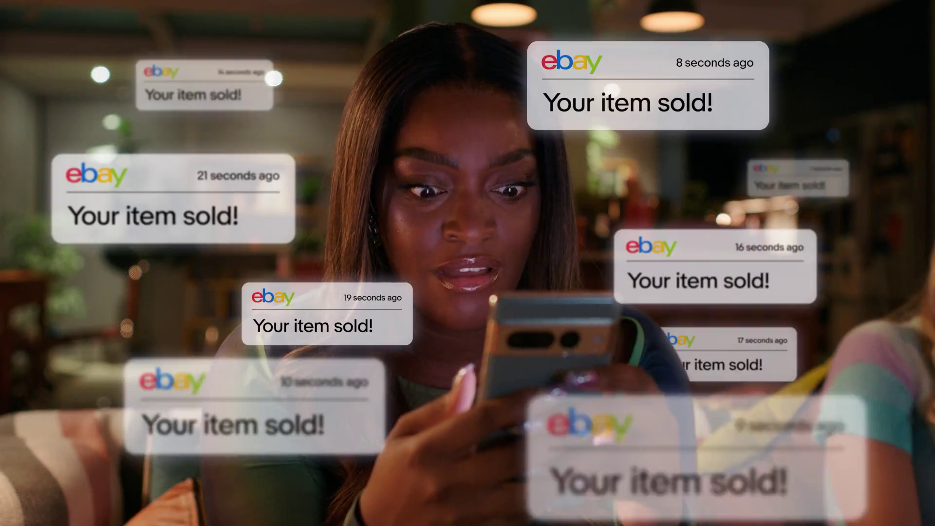
Branding moments
eBay, “Official Pre-Loved Fashion Partner”
Notes:
The analysis showed that there was no statistically significant difference in how many branding moments you use, either visual or audio.
Therefore, this means that as long as the brand is woven into the narrative, there are no hard and fast rules on how many times you should show branding.
On interesting directional finding was that sonic branding seems to deliver strong impact, there was no statistical significance due to low sample size, however Neuro-Insight often so see in ads that sonic branding can be very impactful.

Slide 35
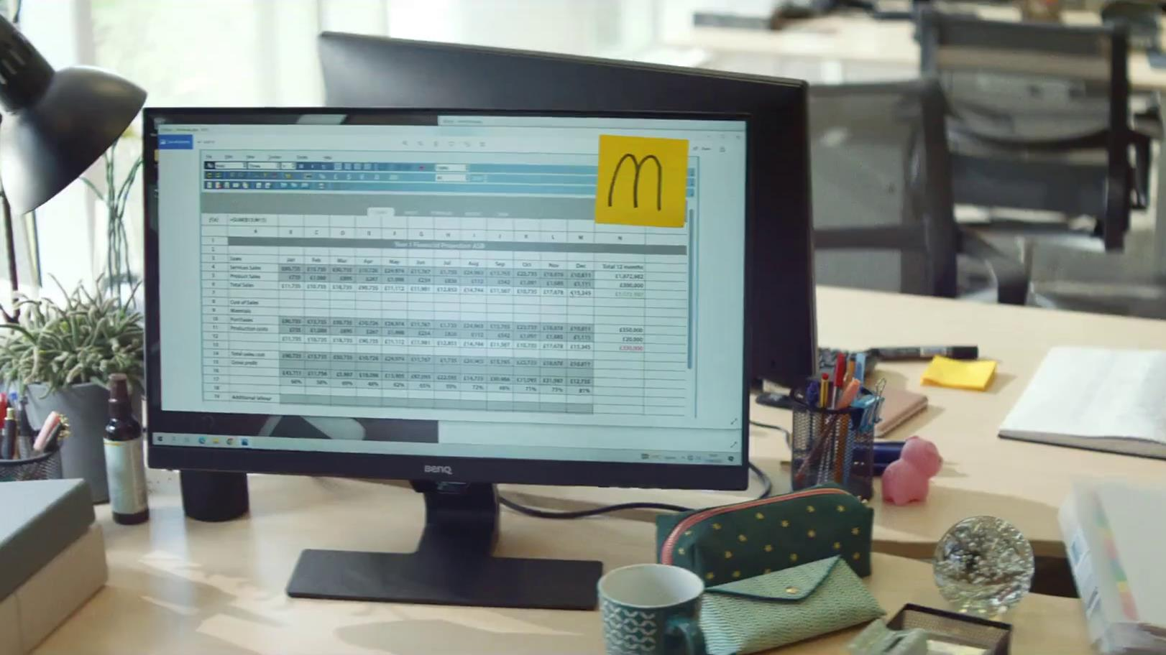
Brand assets
McDonalds, “Raise Your Arches”
Notes:
Neuro-Insight also looked at brand assets other than colour which included use of celebrities, brand characters and iconic packaging and shapes.
Findings shows that there was no significant differences due to low sample sizes, but they have seen in the past that brand assets, like colour, can be used as a good way to get around the ad blocker. However, this would be an area for potential future investigation.

Slide 36
Tonality
Pot Noodle, “Holes”
Notes:
Neuro-Insight also investigated different tonalities – such as light-hearted, factual, serious, humorous etc.
There was no statistically significant difference seen but analysis did shows that they worked slightly differently to each other. For example, factual ads were well remembered but not appealing, whereas humorous ads were less memorable but more appealing.
However, it is important to note that any ad tonality can work if you utilise the creative driver of effectiveness.

Slide 37
Celebrities
Santander, “Connections”
Notes:
The study also explored the use of celebrities, this was any use of celebrities rather than celebrities that had a strong connection with the brand. Findings show that celebrities had little impact on any responses and therefore will not either make or break your ad.

Slide 38
Character interaction
Barclaycard, “Cost Controllers”
Notes:
Lastly, Neuro-Insight also looked at character interaction.
Whilst the 2016 iteration found that character interaction was highly impactful. When reconducting this study, analysis showed that having interaction or no interaction made no statistically significant difference. However, when the type of interaction was broken down, there were interesting differences between the use of verbal and physical interaction. This time, physical interaction elicited a less positive response.
It is important to note that these ads were tested throughout and immediately post pandemic. With physical interactions restricted, we have been conditioned to see this as a bad thing, and therefore have likely built negative associations with it – this was reflected in the subconscious data.
Contrastingly, verbal interaction elicited strong levels of response as this was the only type of ‘safe’ interaction during the pandemic. It is likely as we get further away from the pandemic, there may be a shift back towards physical interaction.

Slide 39
Key creative drivers to take away with you:
Showcase don’t shout
People are paramount
Utilise your brand assets
Give audio a clear role
Impact is in the timing
Material Focus, “Hypnocat”
Source: Creative Drivers of Effectiveness, 2023, Neuro-Insight/Thinkbox
Notes:
Overall, the key takeaways from this iteration of Creative Drivers of Effectiveness are:
Showcase your product don’t shout
People are incredibly important
Use your brand assets – especially colour!
Utilise music to the full extent
Make sure your timing is on point
Hopefully, this toolbox of techniques discovered through unveiling the subconscious will be helpful for you and your brand to make the most impactful ads you can.

