Slide 1
TV for SMEs
Skipton Building Society – Fortune Teller

Slide 2
SMEs make up most of the UK business population
SMEs make up a whopping 99% of the UK business population
There were 5.5 million small business at the start of 2024
SMEs account for 60% of employment and 52% of turnover at the start of 2024.
Toyota - Counselling
Source: www.gov.uk
Notes:
The majority of businesses in the UK class as small or medium enterprises.

Slide 3
675 advertisers spent less than £50k on TV in 2024
Source: Nielsen Ad Intel, 2024
Notes:
Looking at the make-up of TV advertisers across 2024, 675 - which is 30% of all advertisers - spent less than 50 thousand pounds on TV and 1,152, which is 51%, spent less than 250 thousand. 31% of all advertisers spent over a million pounds and 5% spent over ten million.

Slide 4
TV accounted for over 50% of our video viewing in 2024
ALL INDIVIDUALS
Average video time per day
All Individuals: 4 hrs, 47 mins
16-34
16-34s: 4 hrs, 32 mins
Source: 2024, Barb / IPA TouchPoints / Pornhub / UK Cinema Association / Ipsos Iris
Notes:
Broadcaster TV accounts for 54.3% of video viewing for all individuals and 21.7% for 16-34s.
Methodology
The quantitative analysis of total video consumption in the UK was undertaken by Thinkbox. It combined 2024 data from Barb, the IPA’s TouchPoints, Pornhub, UK Cinema Association, and Ipsos Iris.
Barb data shows how much time is spent viewing broadcaster content, live or time-shifted (including BVOD) on all devices as well as Blu-Ray/DVD viewing. This chart also utilises Barb’s expanding audience reporting capabilities to provide a view of time spent viewing content on YouTube, TikTok, other video sharing services (such as Twitch) as well as SVOD/AVOD platforms. Whilst Barb reports on in-home consumption, a combination of Ipsos Iris and IPA TouchPoints data was used to determine the remaining out-of-home consumption.
The combination of these sources creates a solid estimate as it utilises the robustness of Barb data (11,500 panel members, representative of the UK TV population, metered actual consumption data, analysis across a whole year) alongside Ipsos Iris and IPA TouchPoints data to capture any out-of-home consumption.
Time spent viewing video at cinemas was based on total admissions data from the UK Cinema Association profiled for each audience using data from DCM.
Source: Ipsos iris Online Audience Measurement Service, 12-month average Jan – Dec 2024. Internet users aged 15+, using PC/laptop, smartphone or tablet device.
Technical note: [Broadcaster] data for YouTube includes content owner data for the BBC, Channel 4, CNBC, ITV, NBC and Sky. [Commercial broadcaster] data for YouTube includes content owner data for Channel 4, CNBC, ITV, NBC and Sky. TikTok data is both website and app.
Ipsos iris is the UKOM endorsed service for the measurement of audiences of online content. We passively track the online behaviour of a single-source panel of over 10,000 UK adults, who install software across their devices (a combination of smartphones, tablets, PCs and laptops). The panel is recruited to be representative of the internet population demographically, geographically and by device type. This passive data is fused with anonymous, device-level data derived from site-centric tags on hundreds of the biggest sites and apps to create a synthetic panel of around 1 million synthetic panellists. More detail on the methodology can be found here.

Slide 5
All Individuals
Average video advertising time per day
All Individuals: 18:05
16-34s: 9:49
Today’s TV accounts for 85.0% of AV advertising time
(vs 83.5% in 2023)
16-34s
Source: 2024, Barb / Broadcaster stream data / UK Cinema Association / Ipsos Iris
**YouTube ad time modelled at 3.33% of content time (Enders Analysis, 23rd October 2024) and excludes those estimated to be on the YouTube Premium tier. *TikTok ad time modelled at 3.4% of content time using agency and broadcaster estimates. **Other online modelled at 3.33% of content time.
Notes:
Broadcaster TV & SVOD accounts for 85.0% of all AV advertising time

Slide 6
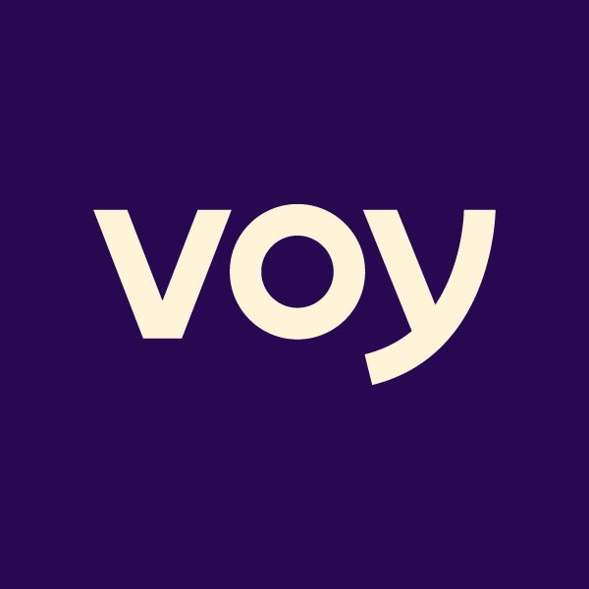
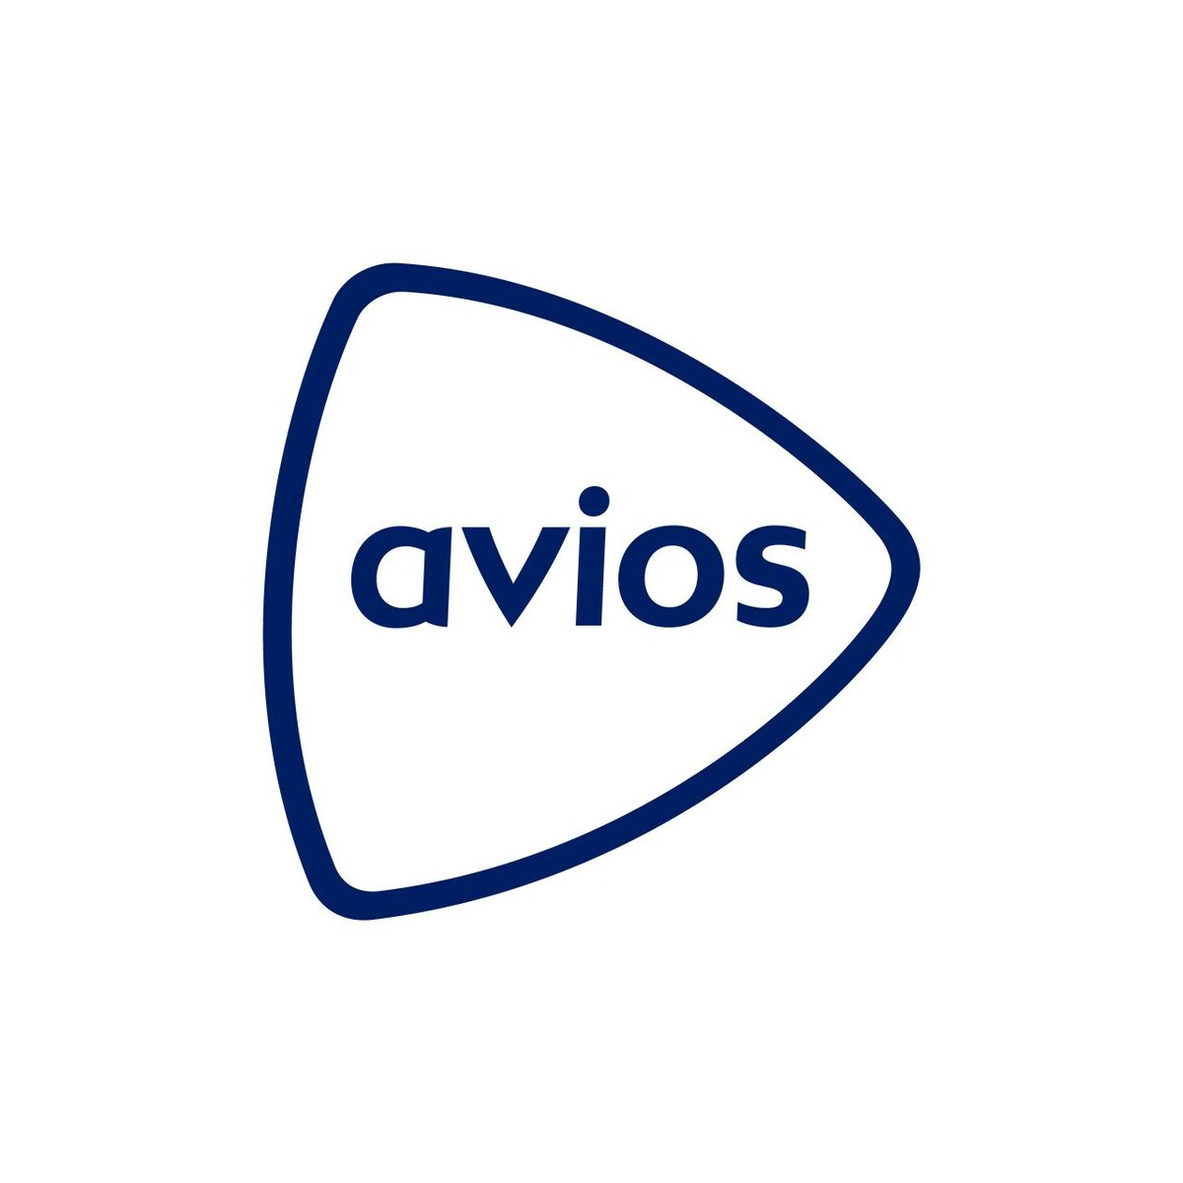
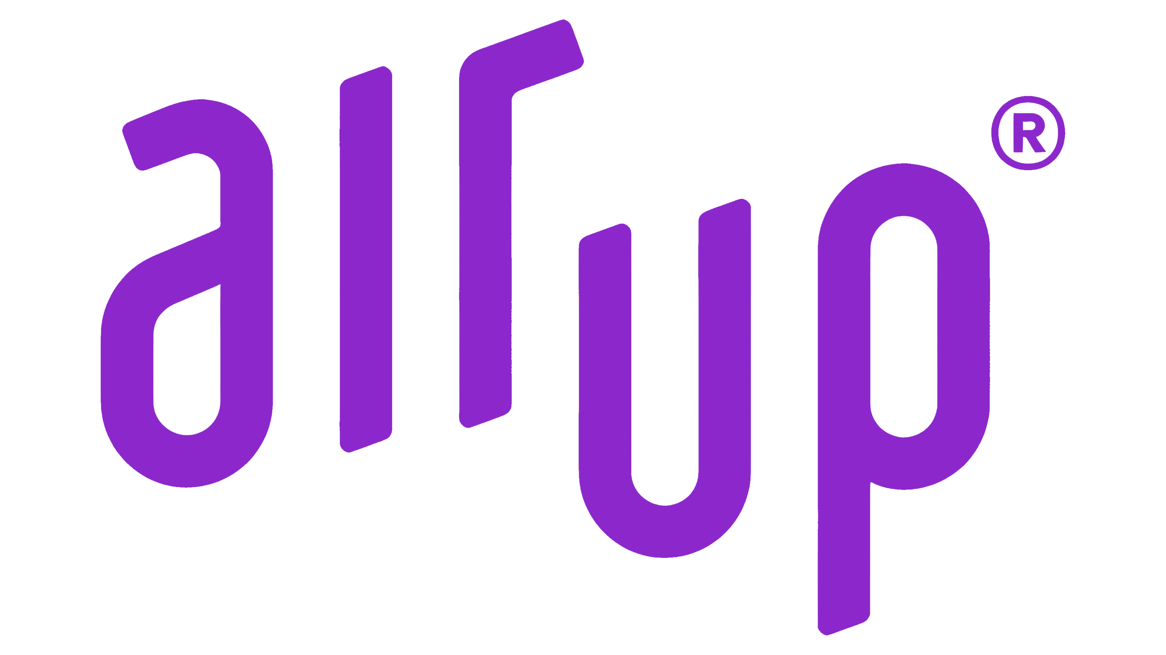
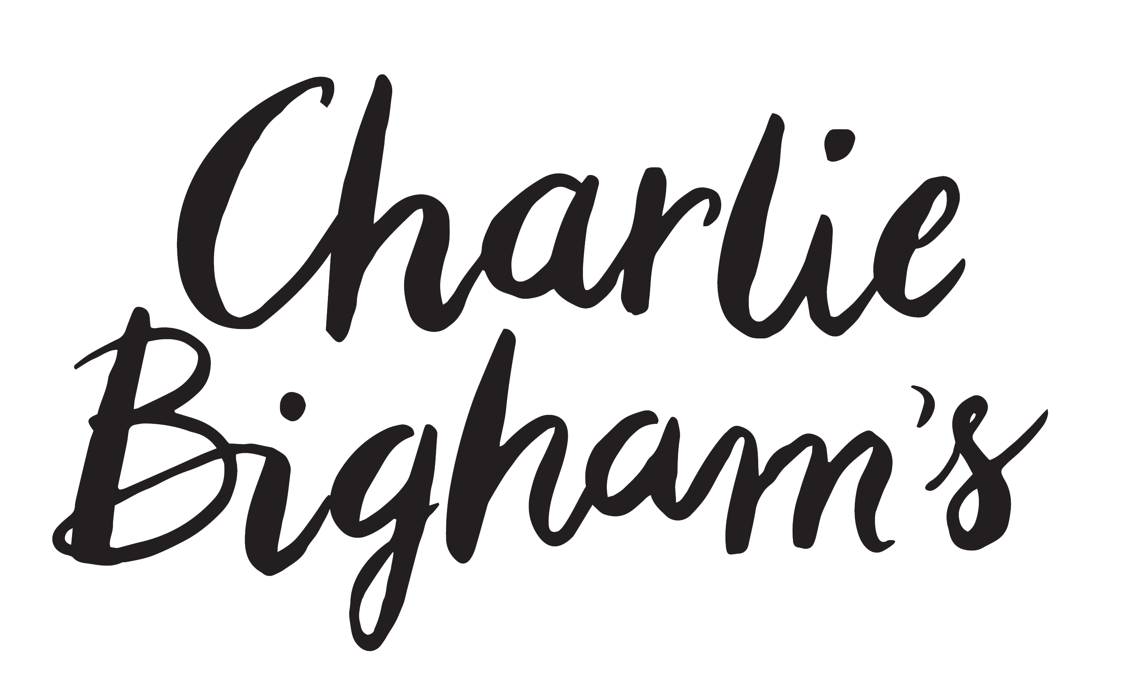
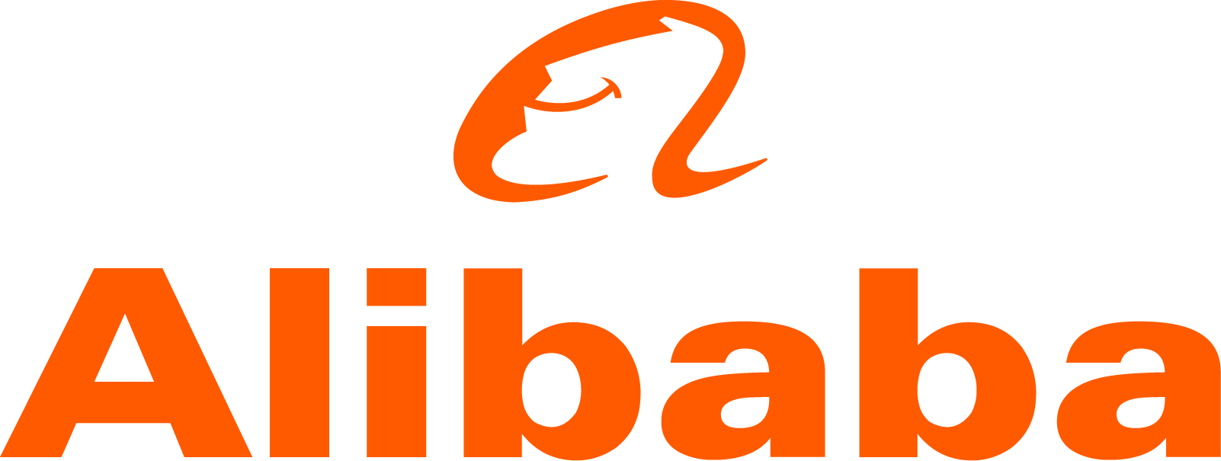
932 advertisers used TV for the first time in 2024
Source: Nielsen Ad Intel / Sky – New to TV advertisers classed as those not advertising on TV 5 years prior (2019—2024) on Linear TV and Sky AdSmart
Notes:
In 2024, there were 932 new to TV advertisers, many of whom were ecommerce business looking to supercharge their growth through TV.

Slide 7
Average TV view costs 0.73p (in 2024)
The average cost of buying the media space to get one person in the UK to see a TV (linear, BVOD and SVOD) advert costs over half a penny
Source: 2024, Thinkbox estimates using AA/WARC
Notes:
The average cost of buying the media space to enable one person in the UK to see a TV (linear, BVOD and SVOD) advert only costs just under a penny.

Slide 8
TV delivers results for small businesses quickly
An average 4 week TV campaign builds to a weekly sales uplift of c. 25%
The typical gross profit payback point is at c. 4 months
4 WEEK TV CAMPAIGN
Source: ‘Supercharge: TV for small businesses’, May 2019, Data2Decisions/Work/Thinkbox. Data2Decisions database of smaller brands. All categories. Based on campaign spend of £1.25m.
Notes:
Research shows that TV starts delivering sales results from week 1 of a campaign, and generally up to 3-6 months after a campaign has finished.

Slide 9
Smaller brands see the biggest uplifts in sales
TV efficiently creates sales uplifts even at low levels of investment
For a small brand with <£50m brand value a £0.5m TV campaign can drive sales by 10%
Source: ‘Supercharge: TV for small businesses’, May 2019, Data2Decisions/Work/Thinkbox. Data2Decisions database of smaller brands. All categories.
Notes:
TV is highly responsive across all brand sizes and can efficiently create sales uplifts at even low investment levels.
But TV has a stronger proportional effect for smaller brands – showing the power of TV to help build the brand. This is because small brands are working from a lower base and are often new brands where they are communicating new news.

Slide 10
TV delivers both short-term and sustained sales effects
The immediate & sustained effects of TV can be isolated & measured.
TV drives revenue both in the short and long term.
Source: ‘Supercharge: TV for small businesses’, May 2019, Data2Decisions/Work/Thinkbox. Data2Decisions database of smaller brands. All categories.
Brand size
Notes:
TV is a key channel for delivering both short term and sustained effects.
Small advertisers can confidently invest in TV to help them drive growth.

Slide 11
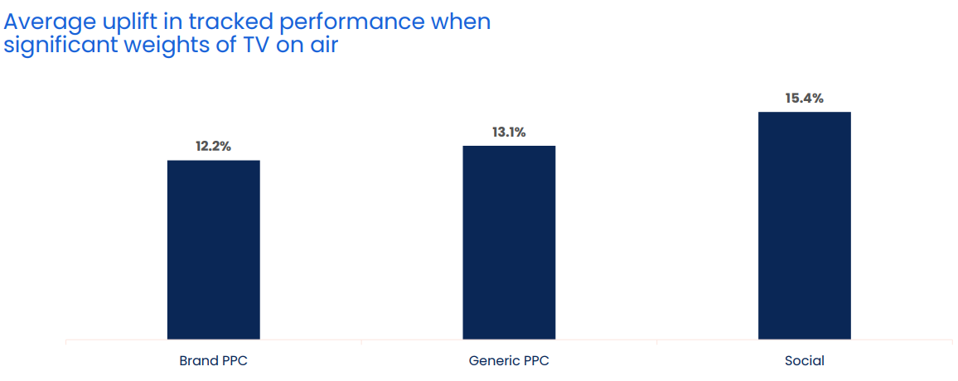
When TV is on air, digital channel performance is uplifted by 13.7%
Source: Why the Eff would you cut TV? GroupM, 2025
Notes:
When TV is on air, digital channel performance is uplifted by 13.7%
One of TV advertising’s most underestimated strengths is its halo effect — the way it boosts the performance of other media channels. While often misattributed, this cross-channel impact is both real and measurable.
According to GroupM analysis in ‘Why the Eff would you cut TV?’ presented at Thinkbox Trends in TV 2025, digital response channels see a clear uplift when TV is live. The study analysed the performance of TV, brand PPC, generic PPC and Social across 14 brands, which included 1,489 weeks, and £283m total performance media spend.
Analysis found that on average, the performance of lower-funnel response channels improves by 13.7% when TV is part of the media mix.
More specifically, brand PPC, generic PPC and social saw an average uplift of 12.2%, 13.1% and 15.4% respectively in tracked performance when significant weights of TV were on air. This shows how TV makes digital channels work harder.

Slide 12
TV advertising is a class apart in the video world
High completion rates
Robust measurement
Full Screen
Brand safe content & pre-cleared ads
Sound on
Shared viewing
Professionally produced and curated content
Viewed by humans
Notes:
TV in the UK is full of wonderful, high-quality content which broadcasters invest in heavily. This, alongside the tight regulation which governs TV content and advertising, makes it a safe environment for viewers and brands.
In addition, TV has a robust, metred measurement system, Barb, which provides a joint industry currency for TV advertising trading based on completed ads, watched full screen (and by humans).

Slide 13
Brand of all sizes benefit from TV’s ‘signalling’ power
TV can work across a range of budgets
Effects of digital should be maximised at low levels of spend
Move into other media to avoid diminishing returns
Advertising is as important as the message itself at driving important signals
TV conveys,‘fitness’ and ‘social’ signals
Shows confidence in brand & product
As seen on TV suggest implies stature and trust
Notes:
Thinkbox’s ‘Signalling for Success’ research by House 51 demonstrated that the mere act of advertising on TV signals something about brands. It was the first known UK research dedicated to the behavioural science principle of media ‘signalling’ – how the perceived cost and scale of advertising channels can enhance brand attributes in the eyes of the consumer.
In a nutshell, thousands of people were split into groups to judge fictionalised brands based solely on a description of them and details of a launch advertising campaign using a single medium. In each case, the information given was identical except for the medium being used in the ad campaign. This isolated the signalling effects of the media channel used, as all other variables were identical.
There were three types of signalling effect analysed:
Fitness signals: perceived brand quality, financial strength of the company, and the company’s confidence in their brand.
Social signals: the brand’s perceived fame, popularity, and success.
Trust: the degree to which the brand was perceived to deliver the promises of its advertising.
The results showed the immense variability in how different forms of advertising communicate vital brand signals, which is shown on the next chart.
The fact is, that the smaller the brand, the more they have to benefit. The first element of this is the concept of costly signalling.
Driven by our innate need to short-cut our decisions, we’re constantly seeking sub-conscious reassurance that the decisions we make are worthy.
The fact that advertisers are willing to invest in their brands through advertising is almost as important as the messages themselves.
Advertising plays a similar role. It’s a costly signal that shows an advertiser is high quality and so worthy of our time, attention and investment. ‘As Seen on TV’ carries both weight, stature and reassurance.

Slide 14
TV drives the strongest signals overall
Ad signalling power by media channel (% positively scoring / agreeing to statement) - Adults
Signal | Average | TV | Newspapers | Magazines | Radio | Social Media | Video sharing
Quality | 32% | 43% | 34% | 38% | 37% | 19% | 22%
Financial strength | 31% | 50% | 32% | 32% | 32% | 21% | 20%
Confidence | 47% | 58% | 49% | 45% | 49% | 40% | 42%
'Fitness' signal average | 37% | 50% | 39% | 38% | 39% | 27% | 28%
Well known | 44% | 52% | 44% | 44% | 48% | 40% | 38%
Popularity | 37% | 50% | 39% | 41% | 39% | 24% | 29%
Success | 37% | 43% | 37% | 41% | 38% | 32% | 31%
'Social' signal average | 39% | 49% | 40% | 42% | 41% | 32% | 33%
Trust | 25% | 30% | 26% | 29% | 28% | 20% | 19%
All measure average | 36% | 47% | 37% | 38% | 39% | 28% | 29%
Source: Signalling Success, 2020, house51/Thinkbox. Base: all adults (3,654)
Notes:
TV drives the strongest fitness and social signals
Fitness signals are about the perceived brand quality, financial strength of the company, and the company’s confidence in their brand.
Social signals are the brand’s perceived fame, popularity, and success.
Trust is the degree to which the brand was perceived to deliver the promises of its advertising.
Performance across each media varied little by category but TV drove the strongest signals in all categories tested (online retail, FMCG, mobile networks and home insurance). Social media and video sharing sites were the advertising channels least likely to drive these signals.
Here’s how the signalling stacked up by media.
The findings in the table above show the % of respondents positively scoring the brand, or agreeing with statements in relation to the brands. The ‘fitness’ and ‘social’ signals are composite averages of the metrics listed above.

Slide 15
Advanced TV for SMEs
Advanced TV advertising brings together best of TV and online - reach, tight targeting, measurement & the premium ad environment.
Broadcaster VOD + Adsmart from Sky = amazing opportunities for smaller brands.
97% of BVOD ads deliver 100% completion
The broadcasters have rich first party data.
LinkedIn – Making Work Make Sense
Source: Broadcaster data
Notes:
Advanced TV advertising brings together the best of both worlds – dynamic ad delivery based on mass first party data delivered in a premium TV environment.
Broadcaster VOD and Adsmart from Sky are the two main ways that advertisers can access advanced opportunities in high quality TV content.
BVOD’s ‘hygiene factors’ set an incredibly high bar with 97% of ads delivering 100% completion.
The broadcasters are rich in terms of first party data.
Adsmart from Sky offers a unique opportunity to reach viewers with addressable advertising across both linear TV and VOD within 40% of UK homes.

Slide 16
Bringing together the best of both worlds
Best of online:
Dynamic one-to-one ad delivery
Mass first-party data
Best of TV:
Big screen & sound on
Fully viewable & viewed
High quality, brand-safe content
Shared viewing
Twix – Twofers

Slide 17
Using advanced TV to enhance SME marketing
1. Linear Reach Extension
2. Geo-Targeting
3. Customised Target
Audiences
4. Customer Data-Matching
Notes:
Advanced TV provides a variety of different options:
Linear Reach Extension
2. Geo-Targeting
Customised Target Audiences
Customer Data-Matching

Slide 18
Sponsorship can make small brands seem bigger
78%
*Sig higher
68%
% AGREE BRAND IS POPULAR
Source: Get with the Programmes, 2017, Thinkbox/House 51.
Base: 8 sponsorships (1,199 viewers; 1,202 non-viewers). *Statistically significant to 95%
Notes:
Viewers of sponsored TV programmes are significantly more likely than non-viewers to think of the sponsoring brand as popular.
This is because TV sponsorship is perceived to be costly, so it signals success by taking advantage of ‘costly signalling’.
For more information, please see:
https://www.thinkbox.tv/research/thinkbox-research/get-with-the-programmes/

Slide 19
TV sponsorship boosts awareness for lesser-known brands
% POINT DIFF VIEWERS VS NON-VIEWERS
Source: Get with the Programmes, 2017, Thinkbox/YouGov.
Base: 6 high awareness brands, 5 lower awareness brands
Notes:
Analysis of YouGov research data demonstrates that TV sponsorship is effective at increasing awareness for lesser-known brands.
This chart shows that lower-awareness brands who sponsor TV shows are much more likely to benefit from increased brand and ad awareness than brands which are already better-known.
For more information, please see:
https://www.thinkbox.tv/research/thinkbox-research/get-with-the-programmes/

Slide 20
Tide: Changing the TIDE for the business banking sector
Challenge
Tide needed to drive awareness and increase app installs to grow its customer base
Solution
Remained on air throughout the pandemic to offer support to businesses that might be suffering through the tough times.
Results
Reached 92% of target SME business owners; 187% increase in brand awareness; 60% share of voice in business banking sector; 259% increase in customers by end of year three.
Notes:
Read more here: https://www.thinkbox.tv/case-studies/tide
The Challenge
Founded in 2017, Tide is a business banking app that was designed to disrupt the banking sector, offer business owners a genuine alternative to the ‘big 5’ banks and make business banking more accessible. It had relied largely on digital routes to help grow brand awareness and acquire customers through socials, search, regional out of home and radio advertising to establish themselves as an SME player. Results however had reached a plateau.
One of the biggest problems was a cluttered marketplace. With a slew of new brands vying for customers, it was getting harder for Tide to stand out from the crowd and take on established nationwide brands. Shifting the attitudes of SME business owners would be no easy feat, either. Research showed that SMEs where risk adverse, with 52% believing that traditional banks were more reliable than digital only options; in fact research, showed that you’re more likely to get a divorce than switch banks.
Tide set themselves and media agency, Guerillascope, the objectives of growing brand awareness and market share, and increasing app installs. The mission was clear: disrupt the market by making SMEs aware that it offered them a genuine, accessible alternative.
The TV Solution
It was obvious to Guerillascope that there was one channel that would deliver both increases brand awareness and app installs for Tide. That was TV. It was the perfect choice to allow Tide to consistently showcase its unique selling points: 24-hour support; quick and simple registration; easy account access; no monthly fees; and expenses/accountancy integration.
The Plan
Tide’s TV activity kicked off in 2019, with a creative that would play up the unique selling points for the brand. By using a series of tools like Adintel, TechEdge and Touchpoints, Guerillascope were able to pinpoint the TV channels, programming and day-parts that profiled best for small to medium business owners.
This process revealed that Film4 on weekends wasn’t delivering the required response, so it was removed from the channel mix. Meanwhile, a focus was placed on Sky News post-23:00 to capitalise on the night owl tendencies of entrepreneurs, as well as contextual placements around programming like the Martin Lewis Money show. These refinements to the plan saw this first campaign reach 63% of business owners, overall Tide achieved a 62% uplift in app installs during the time of the campaign.
The second year of Tide’s activity coincided with the height of the pandemic. While many businesses pulled their campaigns off air or reduced their marketing activity, Tide lent in. They wanted to maintain a reassuring presence and champion small business owners that were dealing with the knock-on effects of a pandemic. This saw spends increase, making the brand one of the top 75 spenders in the TV market and one of the biggest banking brands on TV (even outspending the likes of HSBC and Santander). With the help of higher viewing and lower pricing, Tide was able to accrue a 60% share of voice in the business banking sector.
Guerillascope optimised the campaign by finding contextually relevant content on the widest reaching channels. This saw spots aired in the Six Nations, Celebrity Bake Off, SAS: Who Dares Wins and the Martin Lewis Money Show. These placements allowed the second-year campaign to reach 82% of the business-owning target audience.
To maximise the effectiveness of phase two, the creative shifted from its previous focus on functionality to a more emotive tone; this switch was backed up by industry research, which highlighted the need for finance brands to to bring emotion into their communications - especially during tougher economic and societal times. The change in approach drove a 37% year-on-year increase in new customers, and a 45% year on year increase in prompted brand awareness.
Moving into 2021’s third instalment of the campaign, economic conditions meant that the budget had decreased. By using analysis tools, programme viewing data and Tide’s target spend, Guerillascope developed an approach that would make the brand’s investment stretch as far as possible.
The solution was a pulsed strategy that would alternate between awareness and response weeks. The former was focus on reach in order to grow share of voice, while the latter centred on frequency to drive engagement. This approach would see spikes in awareness coming from high-reaching channels and spots in popular programming - such as the Great British Bake Off and live sports on Sky Sports - while a 10” DR creative would be deployed during daytime to boost impacts.
It was a success. The campaign generated the 2nd highest volume of visits for 6 months despite being run with the lowest spend in 6 months. This translated into the best Cost Per Visit measured over the same period. Ultimately, Tide saw a 22% increase in customer growth, driven in part by a 7.35% increase in prompted brand awareness.
Tide’s television activity was a core part of a wider marketing plan. It constituted the top of the funnel that would prime consumers to remember the brand; OOH placements worked as a secondary local touchpoint to drive frequency, while paid digital was deployed as a final conversion tool. The TV creative pulled through into other media, with cutdowns and stills being used for digital and OOH campaigns to ensure synergy across the media mix.
Results
The campaign was a roaring success across the three years for Tide. In year one, Tide’s campaign reached 63% of the core audience and achieved a 36% Share of Voice in the business banking sector. In terms of business results within 3 years Tide saw a 72% uplift in web traffic and a 62% increase in app downloads.
By the end of the campaign, the brand had reached 92% of the target audience through TV with a frequency of 50; this in turn contributed to a 187% increase in prompted brand awareness.
TV helped Tide grow their share of market from 0.5% to 8% with a massive 60% share of voice in the business banking sector. Attribution following the campaign showed that TV had generated 1.2 million web visits, which accounted for 19% of total site visits. By the end of the three year period, Tide had seen a 259% increase in customers.

Slide 21
Summary
The majority of UK advertisers are SMEs and smaller spenders.
TV drives both short-term sales and long-term growth
TV creates trust and drives reach
TV boosts the effects of other media channels
TV is affordable & accountable
The effects of TV are immediate for most but also sustained
There are many options beyond linear TV advertising.
Snickers – Own Goal
Notes:
The majority of UK advertisers are SMEs and smaller spenders.
TV drives both short-term sales and long-term growth
TV creates trust and drives reach
TV boosts the effects of other media channels
TV is right once other media become less efficient
TV is affordable & accountable
The effects of TV are immediate for most but also sustained
There are many options beyond linear TV advertising.

