Slide 1





BVOD Almighty:
Reach and Return
BVOD Almighty:
Reach and Return

Slide 2
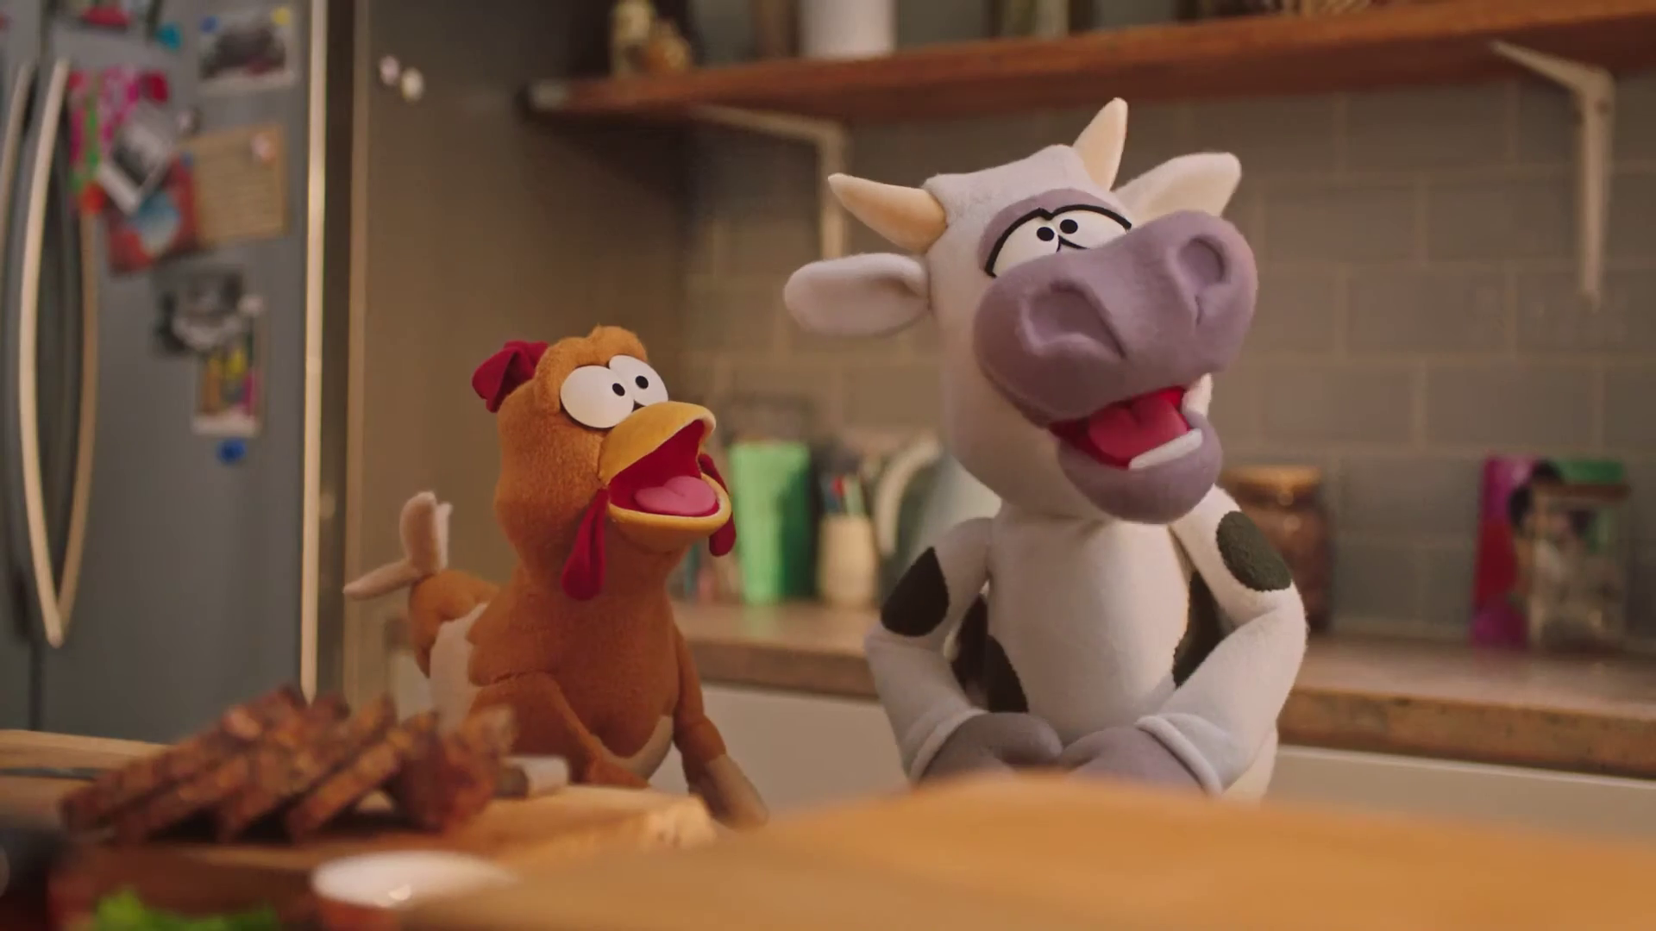

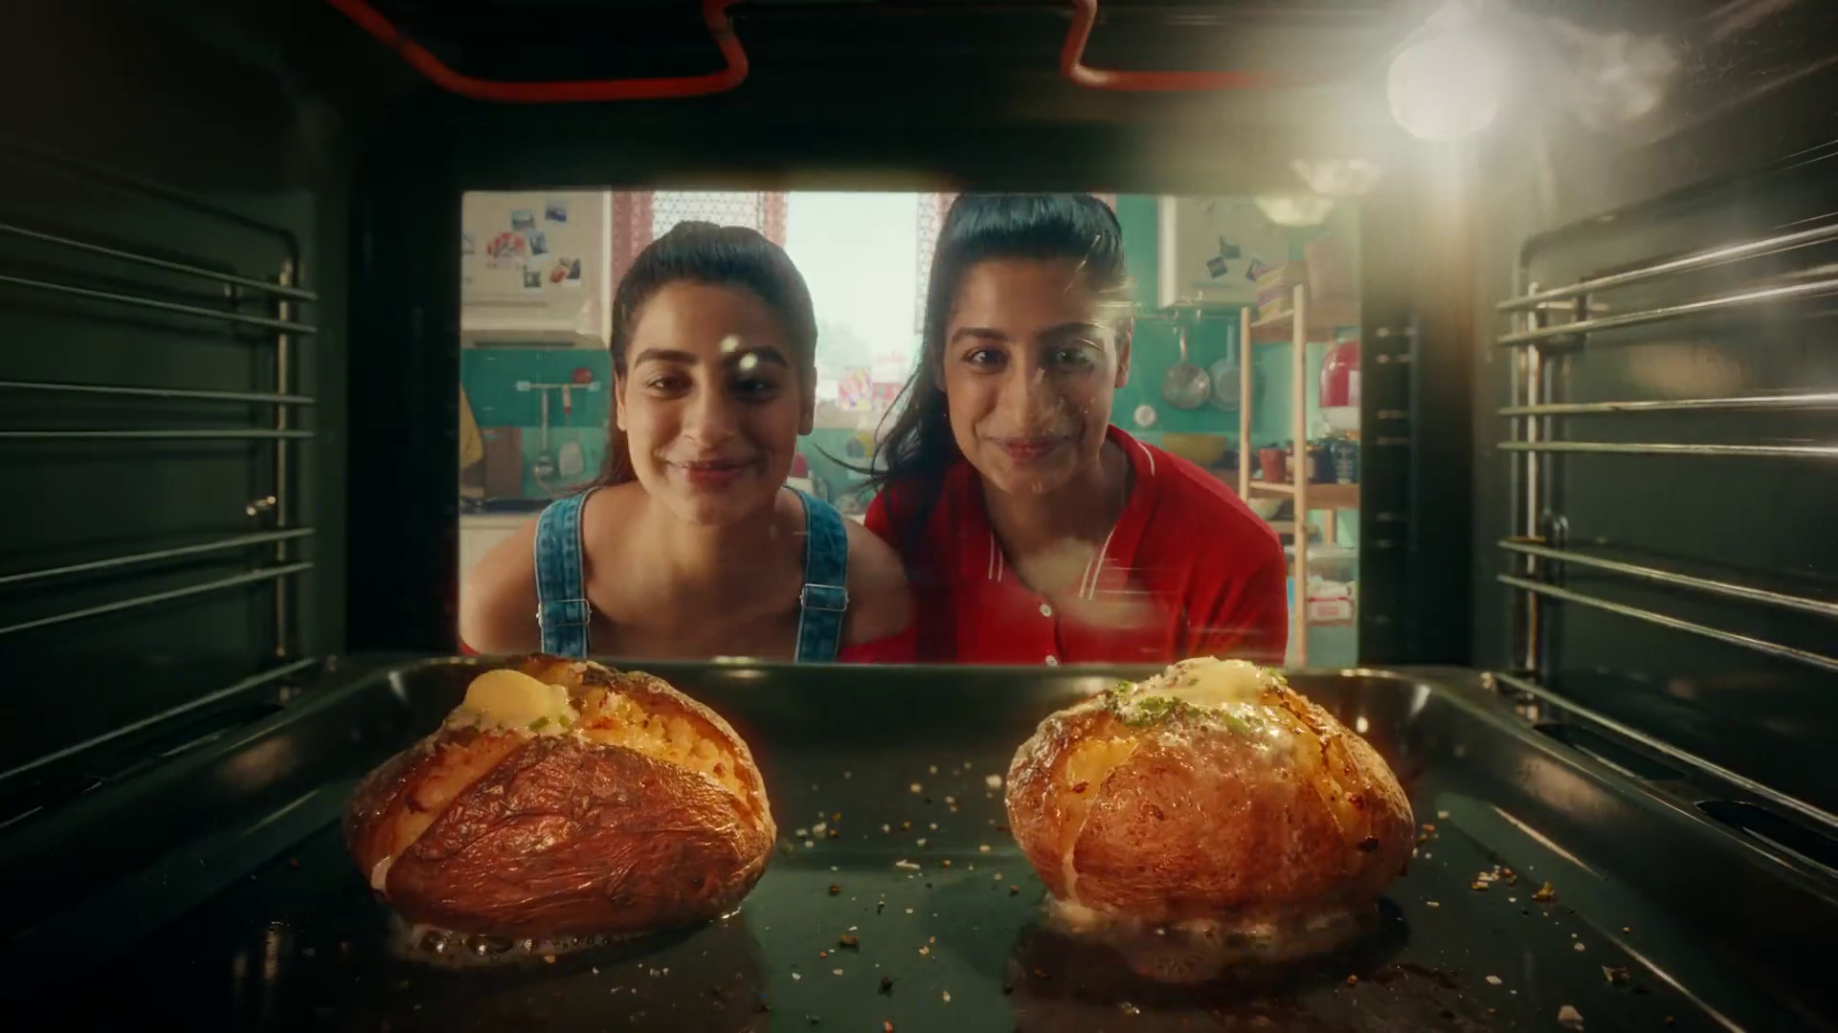

BVOD has become a significant part of the video world
2-hours 30-minutes
per week (adults 16+)
£810m
spent on BVOD in 2022
Predicted to grow
by 4.4% in 2023
Source: Barb, Thinkbox + Advertising Association / WARC
Notes:
Across a whole week, on average adults watch two and a half hours of BVOD. This equates to 6.2% of all their video viewing.
16-34’s on average watch two hours 33-minutes of BVOD – 7.7% of their total video viewing consumption.
ABC1 adults watch two hours 49-minutes of BVOD in a week – 7.9% of their total video consumption.
BVOD is already a significant medium in it’s own right … £810m in 2022 – bigger than radio. (AA/WARC – Jan 2023 release.)
And predicted by AA/WARC to be one of the fastest growing areas in 2023 … +4.4% (AA/WARC – Jan 2023 release.)

Slide 3
But many questions have remained unanswered
Does BVOD viewing follow the same patterns as linear TV?
What guidelines do you have for how best to implement BVOD alongside linear TV?
Does BVOD have a role beyond reaching light viewers to help add incremental reach?
Should I plan BVOD in bursts or is it a more ‘always on’ medium?
Do consumers think about BVOD ads differently from the ones they see on video sharing platforms?
With a higher CPT than linear for most audiences, how can I be sure BVOD delivers an ROI?

Slide 4



BVOD Almighty: Reach and Return
Ethnographic and videographic study of video advertising experience in 30 households
What impact do device, platform, environment and creative have on advertising engagement?
Econometric analysis of £1.1 billion of advertising expenditure in video channels
What ROI does BVOD deliver?
Advanced data science evaluation of 1,259 campaigns using BVOD measured by CFlight
What variables impact total campaign reach?
Notes:
Three separate studies conducted in summer 2022.
Published in November 2022.

Slide 5

Agenda
factors driving VIDEO ad ENGagement
Does BVOD deliver a decent ROI?
variables impactING total campaign reach
BVOD planning levers
SUMMARY
“Mega” – LG Televisions

Slide 6

What factors drive advertising engagement on video platforms?
Gangs of London, Sky Atlantic

Slide 7
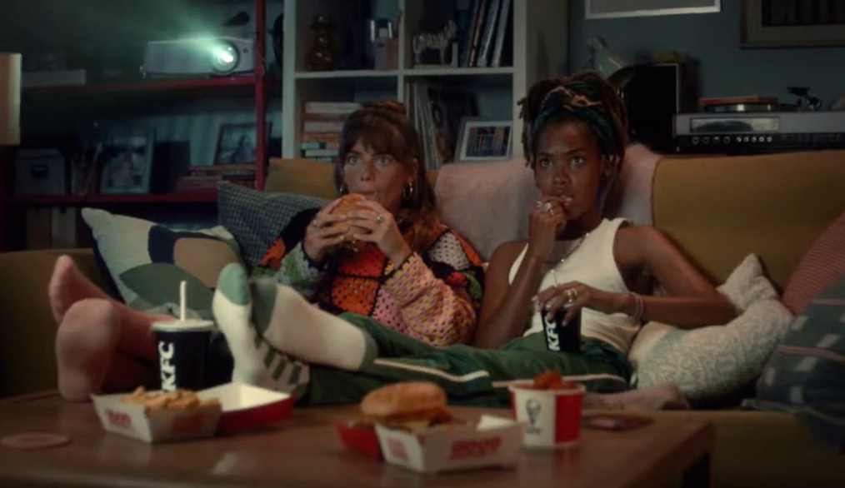


Acacia Avenue Methodology
Individual content and ad diaries
Ads close up and personal
Ads in a social environment
20-people
What, where, when and how
Reactions and feelings about ads
Moderated online conversation
10 fresh respondents
Video recording glasses
In situ commentary on content viewing
Thoughts on ad placements
Home visit with glasses respondents
Revisit and dive into their recordings
Ad reel exposure
Videographic interview
Source: BVOD Almighty: Reach and Return, Acacia Avenue, 2022
Notes:
Acacia Avenue methodology

Slide 8


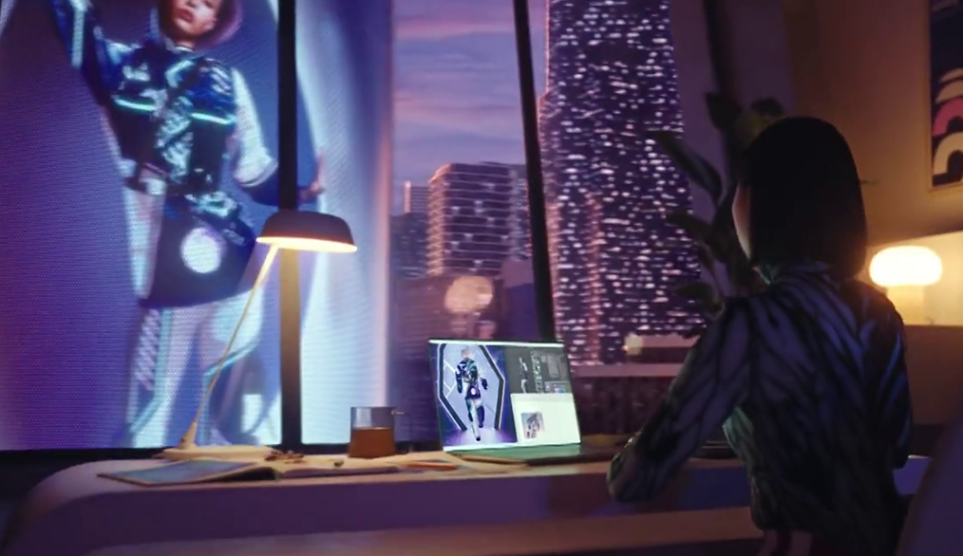
Interplay of 3 factors sets expectations for ad engagement
Content Signals
Device Signals
Ad Signals
Who the sender brand is
How much the content is valued
Content to ad viewing ratio
Content: fresh/relevant vs old/niche
Nature of interaction with device
Size and volume (sound)
Solus vs co-viewed
Perceived use of algorithm/tracking
Harmony of ad + brand to environment
Frequency
How targeted or tailored it is
How recognisable it is as an ad
Source: BVOD Almighty: Reach and Return, Acacia Avenue, 2022
Notes:
Specifically looking at what people feel about ads they are exposed to via the different video platforms, three factors impact how people engage (or not) with the advertising.
The signals that the content surrounding the ad sends:
This is about the expectations of the content and how this impacts the expectations of the ads in that environment
Who the sender brand is (i.e., the broadcaster/publisher) + whether it’s established and trusted, or an unknown, question-raising newcomer
How much people value this content: whether it’s a beloved appointment-to-view favourite, or ‘anything will do’ filler
Content-to-ad viewing time ratio: whether there’s a balance vs skew of how much of overall time is taken watching content vs ads
Whether content is brand new or older: if the content is fresh and thus has current relevance/ social currency, or if it’s older and/or more niche
In essence, this is about the value exchange - the implicit contract between media owner and viewer in terms of what they’re going to get and whether it’s a fair exchange or not when it comes to the advertising on that platform
The signals that the physical device being used to watch the content brings:
This is about the nature of the interaction people have with a device – what attention do they pay it; and therefore the advertising that’s on it
How big + loud the device is: actual size and volume potential of the screen in use [especially when multi-screening!]
If it’s a ‘we’ experience or a ‘me’ experience: is it a shared screen whereby everyone is watching together or is it a personal ‘my own’ device?
And lastly, the perceived use of data based on the device. Is the device felt to be ‘tracking’ you to show advertising and/or is it believed that there is a clever algorithm at play? Or are the ads felt to be generically targeted?
And, of course, the signals that the actual advertising is producing:
Given the backdrop of the content and the device, the ad signals are all about how the ads fit in those environments.
It’s about an intuitive feeling of harmony when an ad appears that either feels natural or rubs people the wrong way.
How often the ads is shown/seen
How targeted/tailored the ad is – the extent to which the ad is appearing as a result of what you’ve done/ who you are, vs simply being a ‘good fit’ for the sort of content
How the ad is used alongside content: how clearly an ad is recognisable as an ad – whether there’s a clear delineation, or it’s difficult to discern ads from content

Slide 9

Ad factors that differ across platforms
Ad to content value exchange
Advertising environment
Perception of targeting
“Wits End”, Dunelm
Notes:
Before looking specifically at BVOD (or any other video platform) it is important to understand the general themes that came out of the interviews and videography in respect of how people feel about content (and advertising) they see on a platform.
Value exchange between platform and consumer:
There are different value exchanges across advertising environments
If that value exchange falls short, viewers will move on or actively avoid the ads – i.e. if too many ads for the content they want to watch they may just move on if they feel the content doesn’t merit them wading through ads to get to it.
Advertising environment:
Viewers like the predictability of established advertising rhythms and patterns (i.e. on linear/BVOD); but are less keen on random slew of ads on some social platforms)
Random or disguised ads (especially in social media) create mistrust and frustration
Perception of targeting:
Ads on a TV screen aren’t scrutinised for their relevance - as long as they resonate with the viewer, they’re accepted – i.e. people don’t feel that linear and BVOD ads are directly targeted to them.
Ads on a device are scrutinised for their personal relevance – i.e. a questioning as to why I am being exposed to ‘that product’ when it is totally wrong for me!

Slide 10
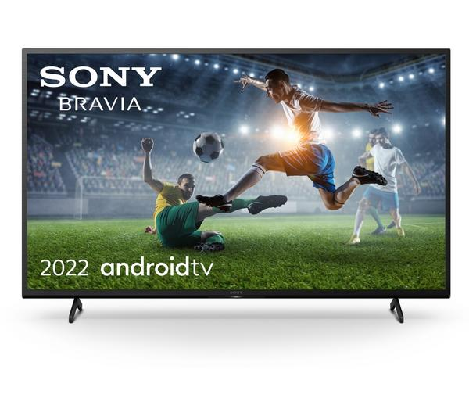





Ad to content value exchange
Linear
Long established, fulfils lots of roles, mix of fresh and older content
Aligned to linear, actively sought out, respected, quality signals
Admired as an aggregator, inconsistent skipability, value exchange can often fall short (especially for UGC)
Valued content, ads easily avoided
High distraction and entertainment value, ads easily avoided
Source: BVOD Almighty: Reach and Return, Acacia Avenue, 2022

Slide 11
Advertising environment
Linear
Established ad structure, well known brands, curated ad breaks, distinguished from content, ads reflect content quality
Same as linear although higher frequency can standout
Random ad styles, ads interrupting mid-sentence, ads clearly labelled
Issue with trust, associated with small / unknown brands, high frequency
Associated with small / unknown brands, ads disguised as content frustrates
Source: BVOD Almighty: Reach and Return, Acacia Avenue, 2022

Slide 12
Perception of targeting
Linear
Shared screen = no expectation of targeting, ads are enjoyed if they resonate, big screen plays to high quality creative
Same as linear, ads perceived to be paired to content (not viewer)
Ads are expected to be relevant – they really frustrate when they’re not
Source: BVOD Almighty: Reach and Return, Acacia Avenue, 2022

Slide 13

Summary
Video environment affects ad perception
Big screen / premium content signals quality
You are judged by the company you keep
Linear and BVOD have license to advertise anything
Social platforms ads are expected to be relevant / targeted
Break architecture matters - viewers enjoy TV’s usual rhythms and patterns
Infinite play, Ikea
Source: BVOD Almighty: Reach and Return, Acacia Avenue, 2022

Slide 14
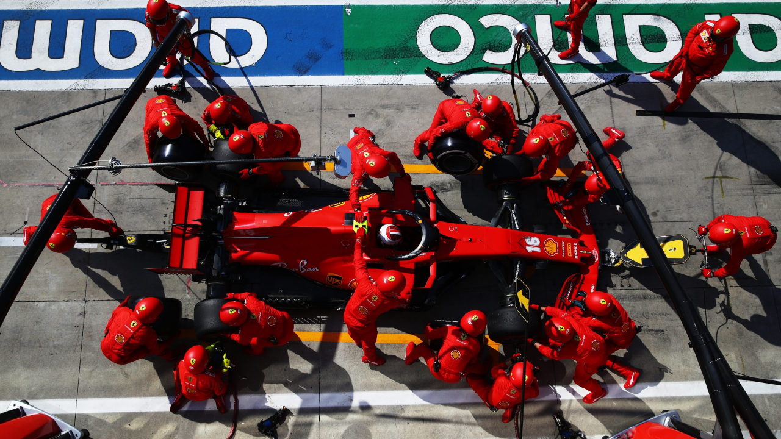
Does BVOD deliver a decent return on investment?
Emilia Romagna Grand Prix, Sky Atlantic

Slide 15

Four key take-outs for video from the latest data
Linear TV and BVOD both deliver good short-term and long-term ROI

Slide 16
WPP effectiveness databank: £1.1bn of video spend
Share of Media Spend
(52 brands, across 2018 – mid 2021)
52
brands
10
media channels
14
categories
£2.2bn
spend (2018-2021)

Slide 17
Both linear TV and BVOD deliver good ROI performance
Total (short and long-term) ROI Index Channel Hierarchy
Source: Media Mix Navigator, Sept. 2022, EssenceMediacom / Wavemaker / Mindshare / Gain Theory
Notes:
This data is total (short and long term) ROI performance by channel.
This data is shown as indices, not absolute ROI delivery. Thus, it means that linear TV is 41% better than the average of all channels (and Generic Search 40% worse). However, it does not mean that TV delivers £1.41 return for every pound spent!!
The data is shown as indices because the dataset behind the analysis includes a range of product categories. The absolute £££ return you would normally expect from advertising, of course, varies by category. Thus using indices helps understand overall normative performance of each channel relative to everything else.
The channels are ranked by total performance. But in the bars you can see the differing delivery of return by short term (up to 3-months) and long-term (3-months up to three years).
You can see that linear TV has the highest proportion of longer term delivery. Meanwhile Search is very short term! It is interesting to note that BVOD is proportionally better than TV in the short term.

Slide 18
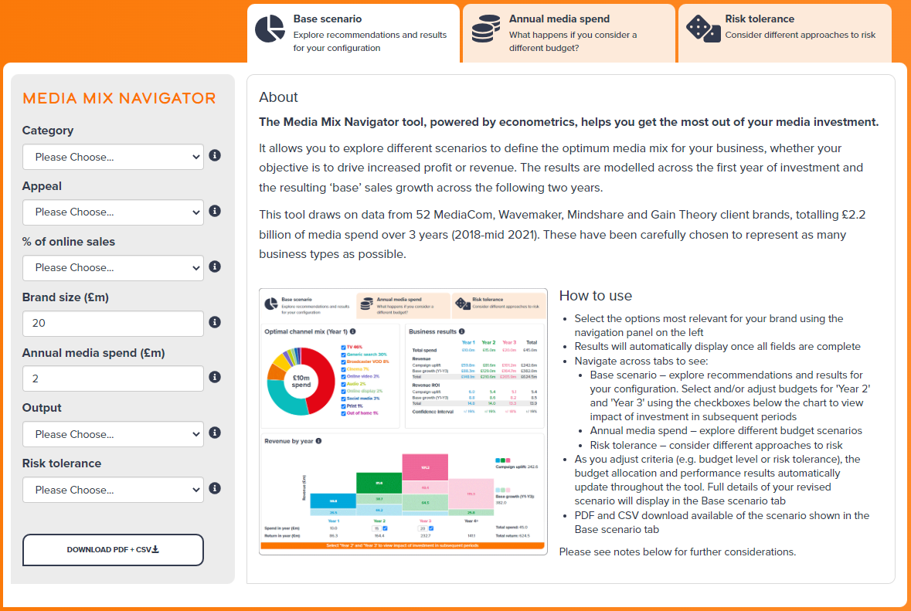

Media Mix Navigator identifies optimal mix for your business
OR free access at
https://www.thinkbox.tv/mediamixnavigator/
Notes:
The importance of BVOD (and any other channel) is impacted by many factors – category, objectives, importance of online sales, attitude to risk, budget level, etc.
The good news is that Thinkbox’s free to access Media Mix Navigator tool incorporating £2.2 billion of econometrically modelled campaigns (£1.1 billion of which are in video channels) is the perfect tool to help advertisers and agencies to work through options.

Slide 19

Four key take-outs for video from the latest data
Linear TV and BVOD both deliver good short-term and long-term ROI
Optimal share of total spend into video varies greatly by product category

Slide 20
Share of total spend into video varies greatly by sector
Source: Media Mix Navigator, Sept. 2022, EssenceMediacom / Wavemaker / Mindshare / Gain Theory
Channels with sufficient sector level benchmarks only. Based on £500m brand size (£300m for FMCG), 10-20% online sales high risk tolerance and media budget of £20m.
Notes:
Product category is a key factor in determining the optimised budget allocation, and thus how much should be allocated to video (and BVOD).
When looking at product sector variance, unsurprisingly, FMCG has a larger share allocated to video formats, whilst online retail has the lowest blend of AV, but with a higher proportion of budget going into search (see below) than other product categories.
Similarly, automotive has a much higher share of visual-based media because it’s a category that lends itself well to visually imagery. As an aside, press has a higher budget allocation in automotives than in other categories because there are specialist titles dedicated to the audience who are in-market.
However, these “optimal” mixes may not reflect what’s actually being used in reality as there may be other marketing considerations – e.g. retail support, ability to produce relevant creative work, etc..
SEARCH
One interesting insight from running many optimised budget allocation’s with Media Mix Navigator is the fact that a major factor in how much budget should be allocated to video (and BVOD as part of that) is the amount of budget and category scalability of Search.
In effect, if Search has a very strong role for a category/brand then budget is allocated to that channel and the optimised budget going into video drops.
Key factors driving the importance of Search for a category are how much business is done online (e.g. much more for online retail than FMCG) and the availability of good quality first party data to help inform search targeting decisions.

Slide 21
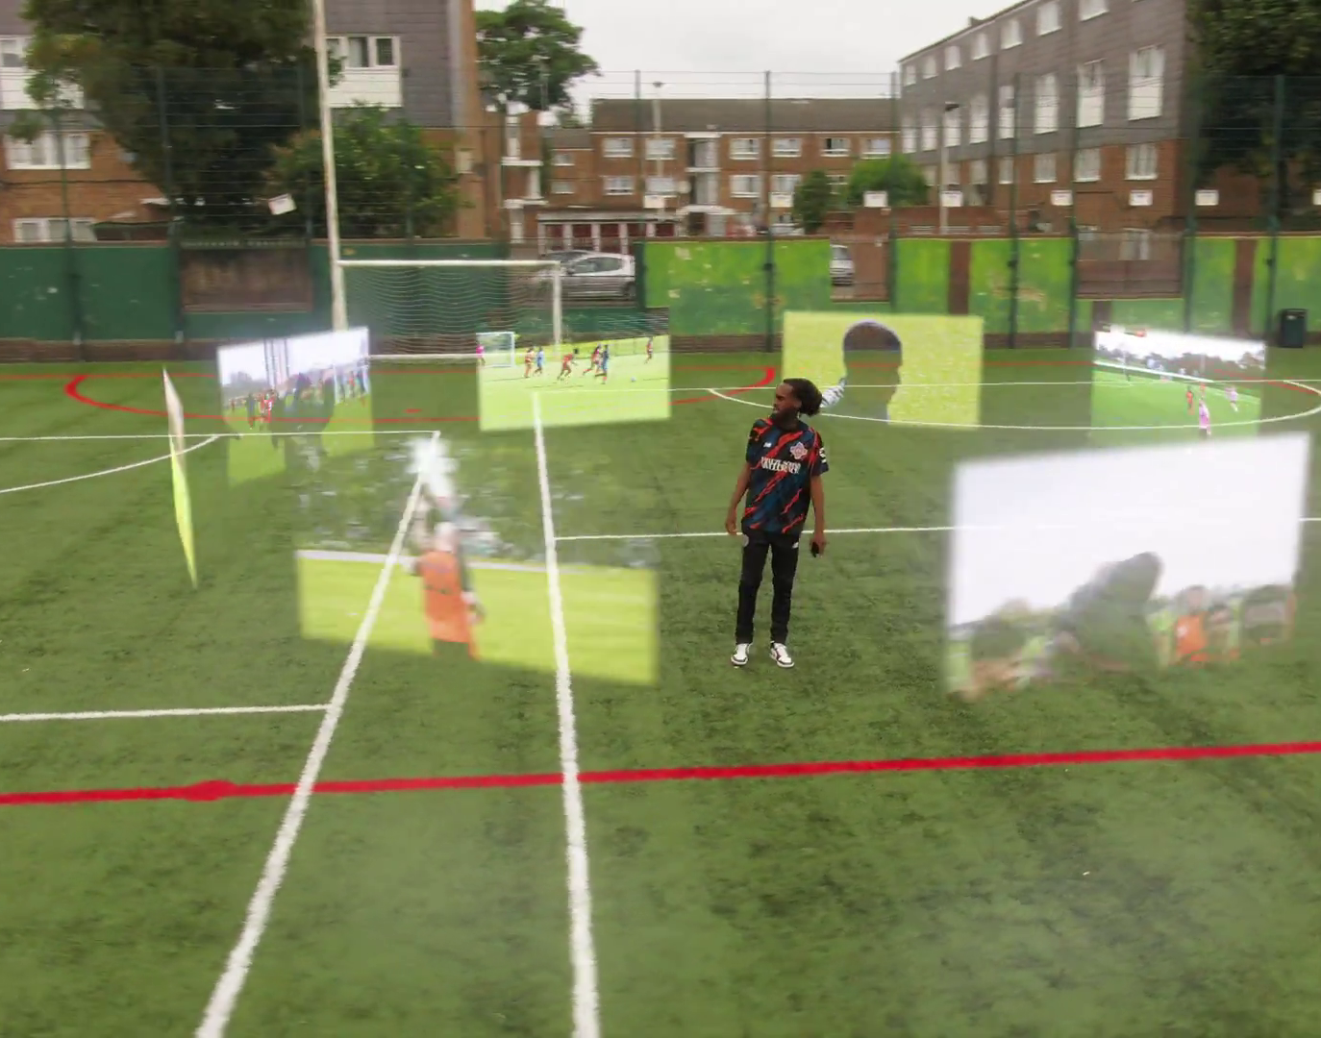
Four key take-outs for video from the latest data
Linear TV and BVOD both deliver good short-term and long-term ROI
Optimal share of total spend into video varies greatly by product category
Video’s optimised share of budget is impacted by budget level – driven by the law of diminishing returns

Slide 22
Optimal video share of total investment varies by budget
Source: Media Mix Navigator, Sept. 2022, EssenceMediacom / Wavemaker / Mindshare / Gain Theory
Note: These scenarios are based on a Mass Market brand, with 11-20% Online Sales, £500m brand size, high risk tolerance and across all categories
Notes:
The optimal budget for video needs to be considered within the wider all media mix.
Media Mix Navigator helps provide guidance.
And in this example for a mass market brand, the optimised budget allocation going into video channels increases as the total budget grows. Once again, the key driver of this is linear TV’s ability to deliver at scale.

Slide 23


“Will performance improve if a brand spends more money in a given media channel?”
“The Awesome Product Adventure” – Samsung
Notes:
Naturally, the next question that occurs is ‘will performance improve if a brand spends more money in a given media channel?’
To answer this question, it is necessary to consider the scalability each channel is able to deliver.
Instead of thinking of ROI as one static number, it actually varies depending upon budget levels - i.e. not every media can achieve volume as well as efficiency.

Slide 24
Not necessarily - all channels experience diminishing returns
Average ROI
the total return / total spend
Revenue
total return from total spend
Source: ‘Demand Generation’, Nov. 2019, MediaCom / Wavemaker / Gain Theory
Notes:
Looking more closely at how advertising works, the concept that if we spend more on a particular channel, in a particular period, we should drive more and more revenue, but it will be at a diminished rate.
A better way to understand performance is to look at average ROI delivered by a campaign for a certain budget. Average ROI is the total return at any point divided by the budget spent at that point. Because of the diminishing rate of revenue delivery, the average ROI will normally decrease as the total budget increases.
As a result of this calculation, it’s best not to think of ROI as a static figure independent of budget as it varies depending on the budget spent and thus the place you are on the diminishing marginal returns curve.

Slide 25
But this happens at different rates in different channels
Average Short-term Revenue ROI Curves
Source: ‘Demand Generation’, Nov. 2019, MediaCom / Wavemaker / Gain Theory
Notes:
As a result, focusing on ROI (as a pound and pence figure), is not the best approach. This chart shows the average short-term revenue ROI across channels as budgets increase.
Focusing on TV, data suggests that it may not be the most efficient channel at very small levels of spend, however it has scale and keeps its efficiency at large levels of spend. On the other hand, other channels start off very efficient but do not have as much headroom as linear TV.

Slide 26
BVOD + Linear TV generates up to a 10% higher ROI
Average Short-term Revenue ROI Curves
25% BVOD
75% Linear TV
Combined ROI Index = 110
100% Linear TV
ROI Index = 100
Source: Media Mix Navigator, Sept. 2022, EssenceMediacom / Wavemaker / Mindshare / Gain Theory
Notes:
Understanding that channels deliver a return as different rates, helps us look at a key question people have - does adding BVOD to a Linear TV schedule improve ROI?
Using the database behind the Media Mix Navigator tool (which incorporates all of the ROI curves just discussed) shows that adding BVOD can improve ROI by up to 10%.
The example here shows the ROI (index of 100) for a £200k linear-only budget vs splitting it 25% BVOD / 75% linear. Adding 25% to BVOD results in a total 10% uplift in ROI.
The analysis here focussed on short-term only performance. As previously mentioned, BVOD has a good short-term ROI performance.

Slide 27

Considerations for proportion of budget into BVOD
Budget
Competitive context
Target audience (BVOD more relevant for younger and more upscale audiences)
Desire and ability to use enhanced targeting options
Use of interactive ad formats
Access to flagship content
Sales split on-line vs off-line
Brand attitude to risk
Panini - Negotiation
Notes:
Budget is a key factor in helping determine the appropriate amount of budget allocated to BVOD.

Slide 28

Four key take-outs for video from the latest data
Linear TV and BVOD both deliver good short-term and long-term ROI
Optimal share of total spend into video varies greatly by product category
Video’s optimised share of budget is impacted by budget level – driven by the law of diminishing returns
Predictability of payback varies by video channel
Attitude to risk has a bearing on optimal mix and potential ROI

Slide 29
Video channels at different ends of predictability spectrum
Increasing risk / reward of achieving return
0% = Median ROI
Source: Media Mix Navigator, Sept. 2022, EssenceMediacom / Wavemaker / Mindshare / Gain Theory
Notes:
Risk is essentially the predictability of a channel to deliver the expected performance.
This chart, covering all the channels in the Media Mix Navigator database, shows how the variability of returns differs significantly across different forms of advertising. This essentially indicates the risk of investing in different channels based on the predictability of their returns.
The median brand ROI in the databank for each channel is represented by the zero across the middle. To assess the predictability of each channel, the analysis looks at how spread out the different brand ROIs are for each channel in comparison to that middle brand. Basically, the bigger the bar, the bigger variance there is between the best performer and the worst performer – so the greater degree of risk. Outliers have been removed.
As you can see, BVOD is the most predictable (therefore least risky) channel, delivering 20% of variance compared with the median return. This was closely followed by linear TV with a variability of 24%.
It’s worth noting that high variability works both ways: although it involves greater risk, there is the possibility of achieving a much higher than average ROI (as well as a much lower one).

Slide 30
Risk appetite impacts share of spend allocated to video
Optimised Media Deployment By Risk Level
Profit ROI & Confidence Interval
By Risk Level
6.2
5.9
5.6
5.3
4.7
4.7
4.5
4.6
3.7
3.5
3.4
3.2
Very Low Risk
Low Risk
Medium Risk
High Risk
Source: Media Mix Navigator, Sept. 2022, EssenceMediacom / Wavemaker / Mindshare / Gain Theory
Note: Based on a mass market brand, £500m brand size, 11-20% online sales and media budget of £20m. Assumes 30% margin.
Notes:
Media Mix Navigator provides users with 4 risk level options from very low to high. The tool will take into account the predictability of each channel and work out - depending on the desired level of risk - what the optimal media mix is.
The level of risk/reward tolerance brands are comfortable with impacts both recommended media mix and predicted ROI return range.
Advertisers will have to weigh up whether they want to prioritise certainty, so focus a higher proportion of the budget into the channels that we know are more consistent with their performance such as linear TV and BVOD.
Or prioritise opportunity, where they focus a higher proportion of the budget into the channels with the highest potential returns with the increased risk that it might not work for that particular brand.
In this example of a mass market brand, the optimal media mix is shown for the four risk levels.
And on the right of the chart, the predicted profit ROI return is shown for each risk level – the higher the risk the greater the predicted average return (rising from 4.5 up to 4.7).
… but it is important to understand that there is a range around the average in terms of likely actual success. In effect a kind of confidence range of performance.
In most cases, the higher the risk tolerance the greater the potential upside that could be delivered (5.3 up to 6.2).
… but with more risk come a potential downside if the risker channels fail to deliver.
In this scenario the bottom of the range is between 3.7 and 3.2.
In summary, the differences in predicted performance are quite significant. Although, the average is similar, as risk tolerance increases (with the resulting increase in budgets going to channels with higher variability in performance) the range of predicted result gets bigger and bigger.
Media Mix Navigator enables users to have data-led discussions about the risk/reward impact of media mix choices.

Slide 31
Four key take-outs for video from the latest data
Linear TV and BVOD both deliver good short-term and long-term ROI
Optimal share of total spend into video varies greatly by product category
Video’s optimised share of budget is impacted by budget level – driven by the law of diminishing returns
Predictability of payback varies by video channel
Attitude to risk has a bearing on optimal mix and potential ROI

Slide 32

What variables impact total campaign reach?
Taskmaster, Channel 4

Slide 33

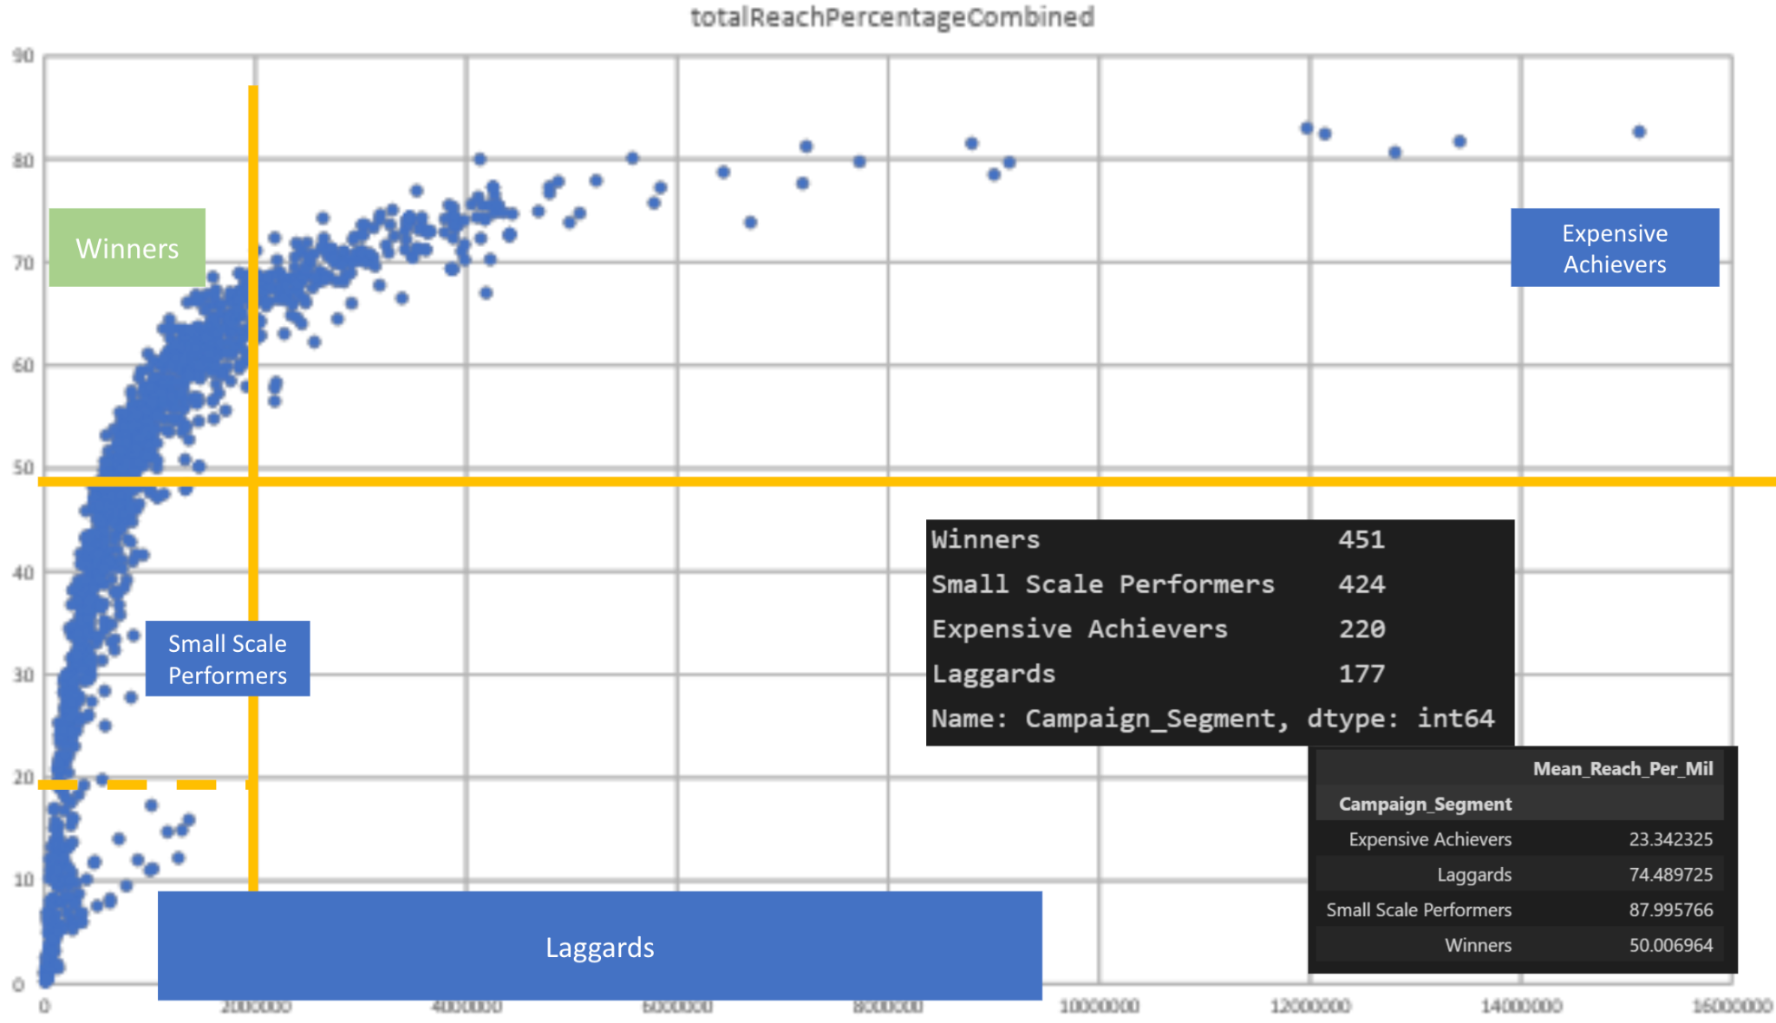
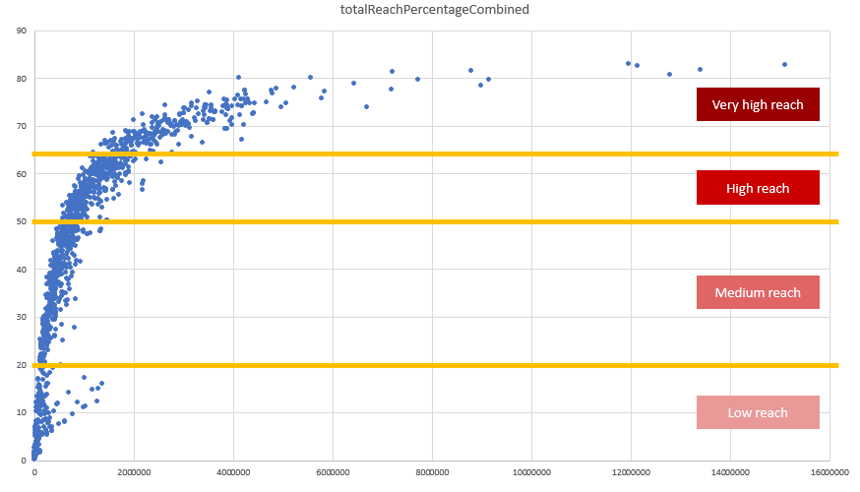
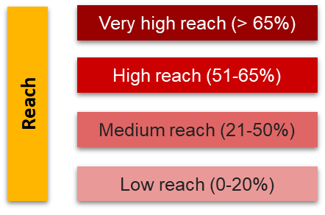
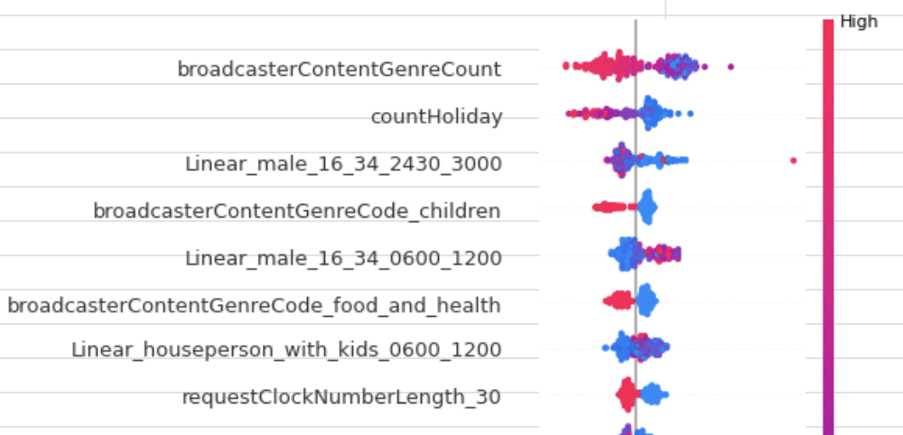
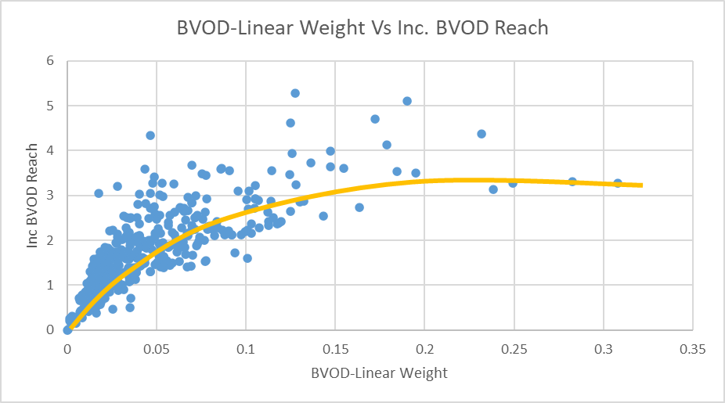
PwC Methodology
CFlight output data
  Campaign reach values (Linear, BVOD, Total, Incremental)
  1,259 campaigns, 292 brand advertisers, 9 broadcasters
  July 2021 - August 2022
Enriched with:
  CFlight impression data (from broadcasters)
  Additional metadata: device, content genre, dayparts (from broadcasters)
  Demographics data (Barb)
  Estimated campaign CPT pricing data (WARC)
Campaign segmentation
  Split campaigns into segments based on overall reach
Feature estimation:
  Aids identification of key features impacting a BVOD incremental reach
  Provides deeper understanding of viewer demographics and viewing preferences
Notes:
PwC did two main bodies of work:
A detailed analysis of BVOD viewing, using the new Barb focal meter data, to understand at a wider level how people are consuming BVOD – including demographic profiles, how their time is spent between BVOD and linear TV and the role of solus vs joint viewing.
A meta analysis of 1,259 campaigns using BVOD and linear that have been through the CFlight analysis system. As agencies only get to see their own campaigns, this is the first time visibility of performance across multiple campaigns has been seen. To add deeper insight, additional data (e.g. raw server logs from broadcasters providing additional classifications such as programme genre, device and dayparts) was added to the core CFlight impression data. Demographic data was imputed from Barb. PwC also segmented campaigns based upon total reach to understand if BVOD fulfilled a different role based upon the size of the campaign. All of this data was then analysed via PwC’s machine learning data science platform to identify the key drivers of campaign reach – and specifically the role BVOD plays in delivery.

Slide 34

BVOD viewing habits
Drama & Entertainment account for 77% of BVOD average daily minutes
64% of BVOD viewing is through the TV set
Average adult BVOD Viewer-Per-View (VPV) is 1.34
Average 16-34 BVOD VPV is 1.72
Skewed towards ABC1s and 16-34s:
ABC1: 61% of BVOD minutes vs 49% of linear
16-34: 26% of BVOD minutes vs 8% of linear
The Masked Singer, ITV
Source: PwC UK, Barb
Notes:
To note that the 64% of BVOD viewing via a TV set does not include when people watch live TV via a BVOD app.
If this was included, the amount of BVOD viewing via a TV set would rise to around 80%.

Slide 35

BVOD adds incremental reach to linear campaigns
On average, BVOD adds:
4% increase adult (16+) reach
6% increase for Adult ABC1s
8% increase for 16-34s
Among the top 10% performing campaigns, BVOD adds:
9% increase for Adults
8% increase for Adult ABC1s
11% increase for 16-34s
Gogglebox, Channel 4
Source: PwC UK, Barb
Notes:
To note that the increases are percentage increase , not percentage point.

Slide 36
Weight of viewing is a key factor in incremental reach
4
12
25
47
75
115
169
244
360
734
Average mins per day of linear TV
Lightest tier 0-19%
Middle tier 20-49%
Heaviest tier 50-100%
Source: PwC UK, Barb, all viewers split into tenths based upon their weight of linear TV viewing
Notes:
Detailed analysis by PwC has identified a segment that are important drivers of why BVOD is delivering incremental reach.
This chart shows the viewing population split into ten equal groups (deciles) based upon amount of liner TV viewing per week.
The lightest decile averages 4-mins of linear viewing per day. Up to the heaviest decile who view for 734-minutes (12-hours 14-minutes) per day.
The deciles have been split into three groups:
Lightest tier. These are very hard to reach on TV (linear or BVOD) and are most likely to be targeted via platforms such as YouTube
Middle tier.
Heaviest tier. These are quite east to reach via linear TV and, as a result, BVOD probably has little role to play.

Slide 37
‘Middle tier’ of viewers are key to BVOD’s incremental reach
All viewers split into tenths based on their weight of linear TV viewing
Linear
0-19%
Lightest tier
Middle tier 20-49%
Heaviest tier 50-100%
BVOD
% contribution to viewing
Source: PwC UK, Barb, all viewers split into tenths based upon their weight of linear TV viewing
Notes:
This chart shows for each of the three tiers (and the deciles within them) what proportion of linear and BVOD consumption they account for.
Key to note is that the middle tier (green) proportionally watch a lot of BVOD. Whilst they account for 7% of linear TV viewing, they make up 28% of BVOD consumption.
This makes them the key audience for extending campaign via the use of BVOD – relatively they are easier to reach via BVOD then linear TV.

Slide 38
BVOD provides good odds of reaching an attractive audience
Lightest tier
0-19%
Middle tier
20-49%
Heaviest tier
50-100%
Hard to reach via TV
TV reach extenders
Easily reachable via linear TV
Average odds of reaching segment per exposure
Linear: 1 in 185
Linear: 1 in 14
Linear: 1 in 1.1
BVOD: 1 in 12
BVOD: 1 in 4
BVOD: 1 in 2
Average linear TV viewing per day
8 minutes
49 minutes
5 hours and 24 minutes
skews towards:
ABC1 adults (71%) and 16-34 adults (42%)
Source: PwC UK, Barb, all viewers split into tenths based upon their weight of linear TV viewing
Notes:
… or to put it another way, for every 14 impressions you buy on linear one person falls into the middle tier group (assuming natural delivery)
But on BVOD, it only takes four impressions to, on average, reach somebody in the middle tier. As such, on average, using BVOD is three and a half more efficient than linear at reaching the middle tier of viewers.
The middle tier are very attractive audiences for many advertisers (proportionally younger and upscale) and BVOD enables them to be reached in an efficient way.

Slide 39

Five BVOD planning levers that help deliver increased total TV campaign reach
“Planet Chorizo”, Papa John's

Slide 40

Five BVOD planning levers that deliver increased total TV reach
Plan longer campaigns:
Campaigns that run for 30-50 days deliver 3 times the incremental reach of sub 30 day campaigns
Plan across all three TV sales houses:
27% uplift in incremental reach using 2 sales houses
41% uplift in incremental reach using 3 sales houses
Plan across multiple genres:
Campaigns delivered across 6-10 genres provide twice the incremental reach of those delivered across 1-5 genres
Plan in and around key programming:
e.g. Love Island (ITV), Gogglebox (Channel 4), high profile box sets like The Midwich Cuckoos (Sky)
Plan across a longer daypart window:
BVOD peak time is 17.30-00.30 vs linear’s 20.00-23.00
The White Lotus, Sky Atlantic
Notes:
PwC identified that when using BVOD it is best to spread your investment as broadly as possible: because reach grows slowly on BVOD run longer campaigns, spread your investments across channels/genres/dayparts. And identify and plan into key, higher rating, programmes.

Slide 41
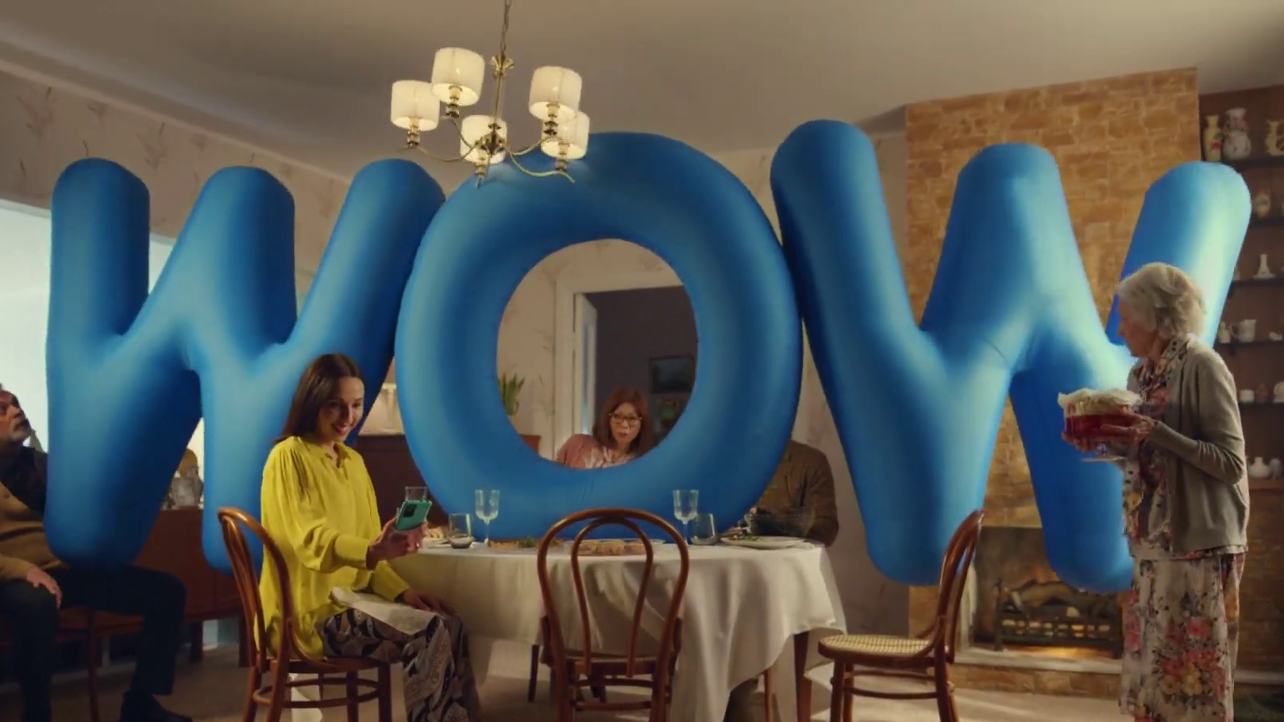
Summary
“Snip” – Carwow

Slide 42
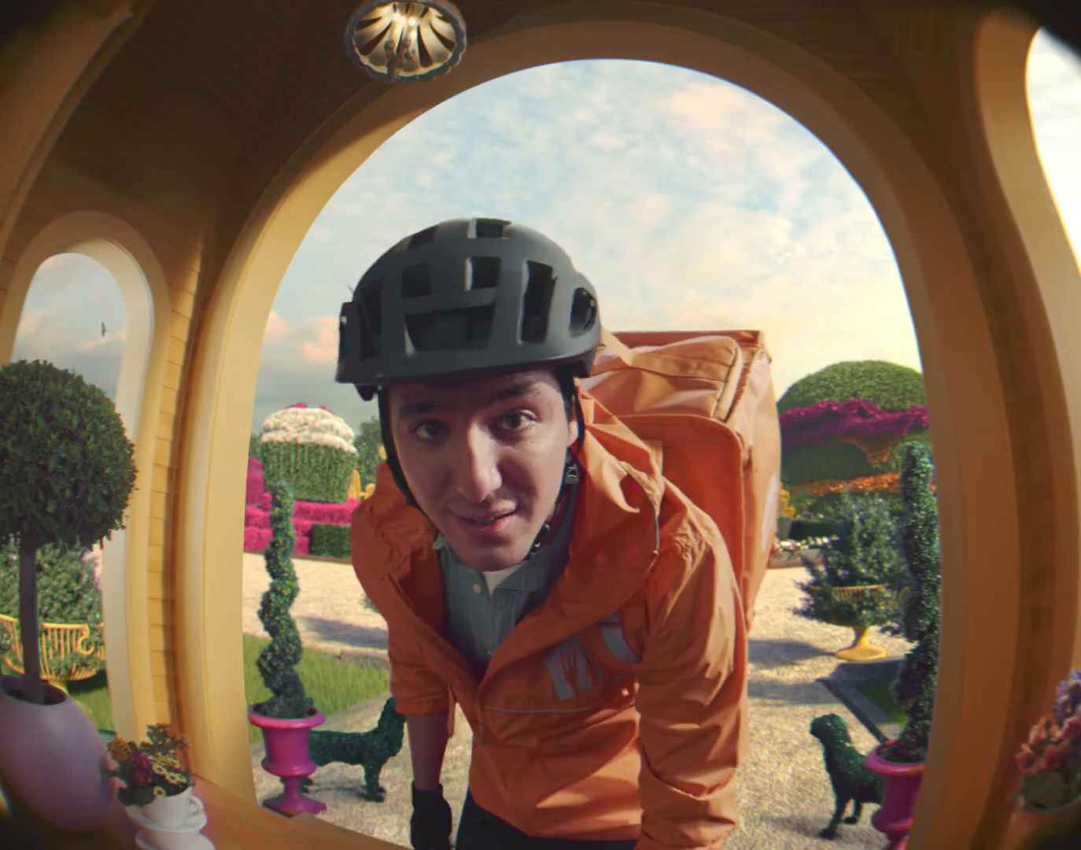
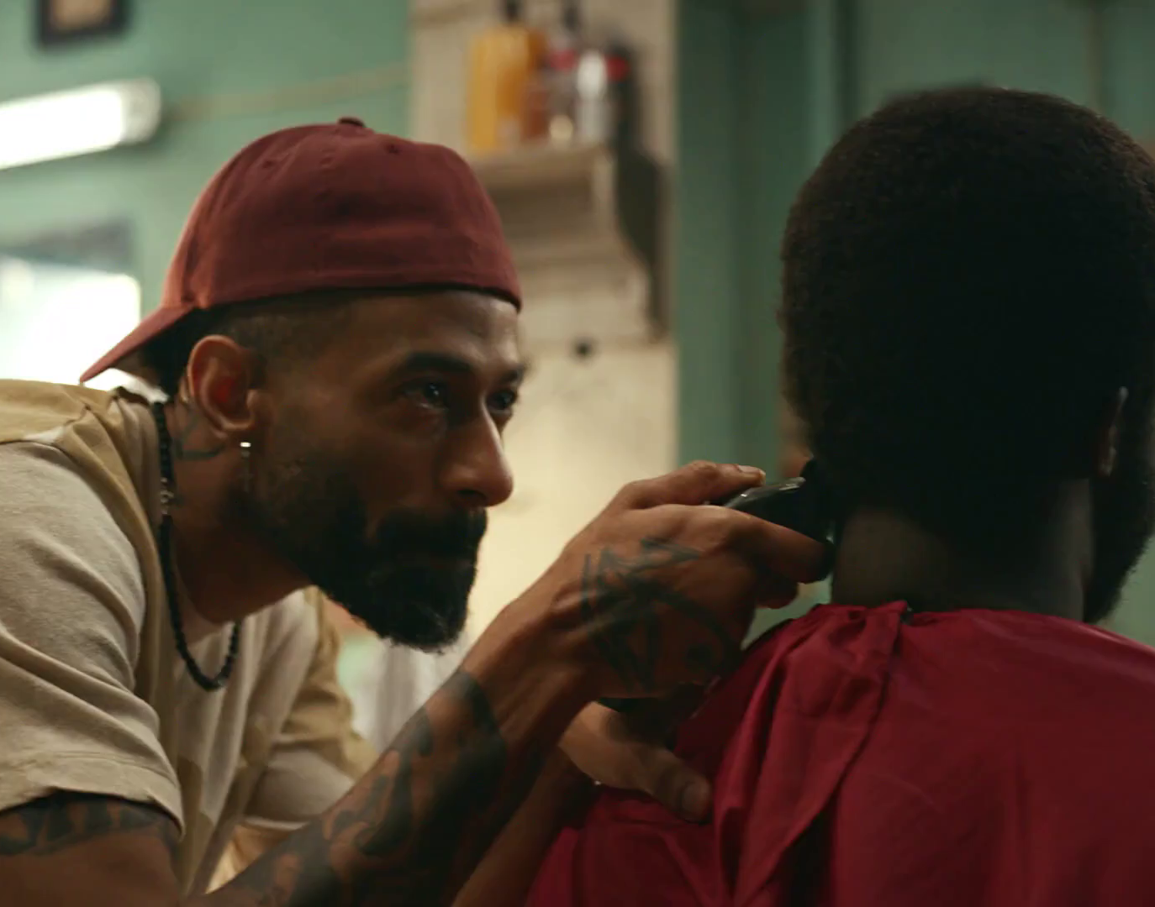


Summary
BVOD is a significant medium in it’s own right – and predicted to grow strongly
Driven by screen size, shared viewing and an appreciated value exchange, BVOD delivers advertising engagement
BVOD delivers good short-term and long-term ROI and improves total ROI by up to 10%
BVOD adds incremental campaign reach – driven by its ability to reach the valuable ‘middle tier’ of viewers

