Slide 1
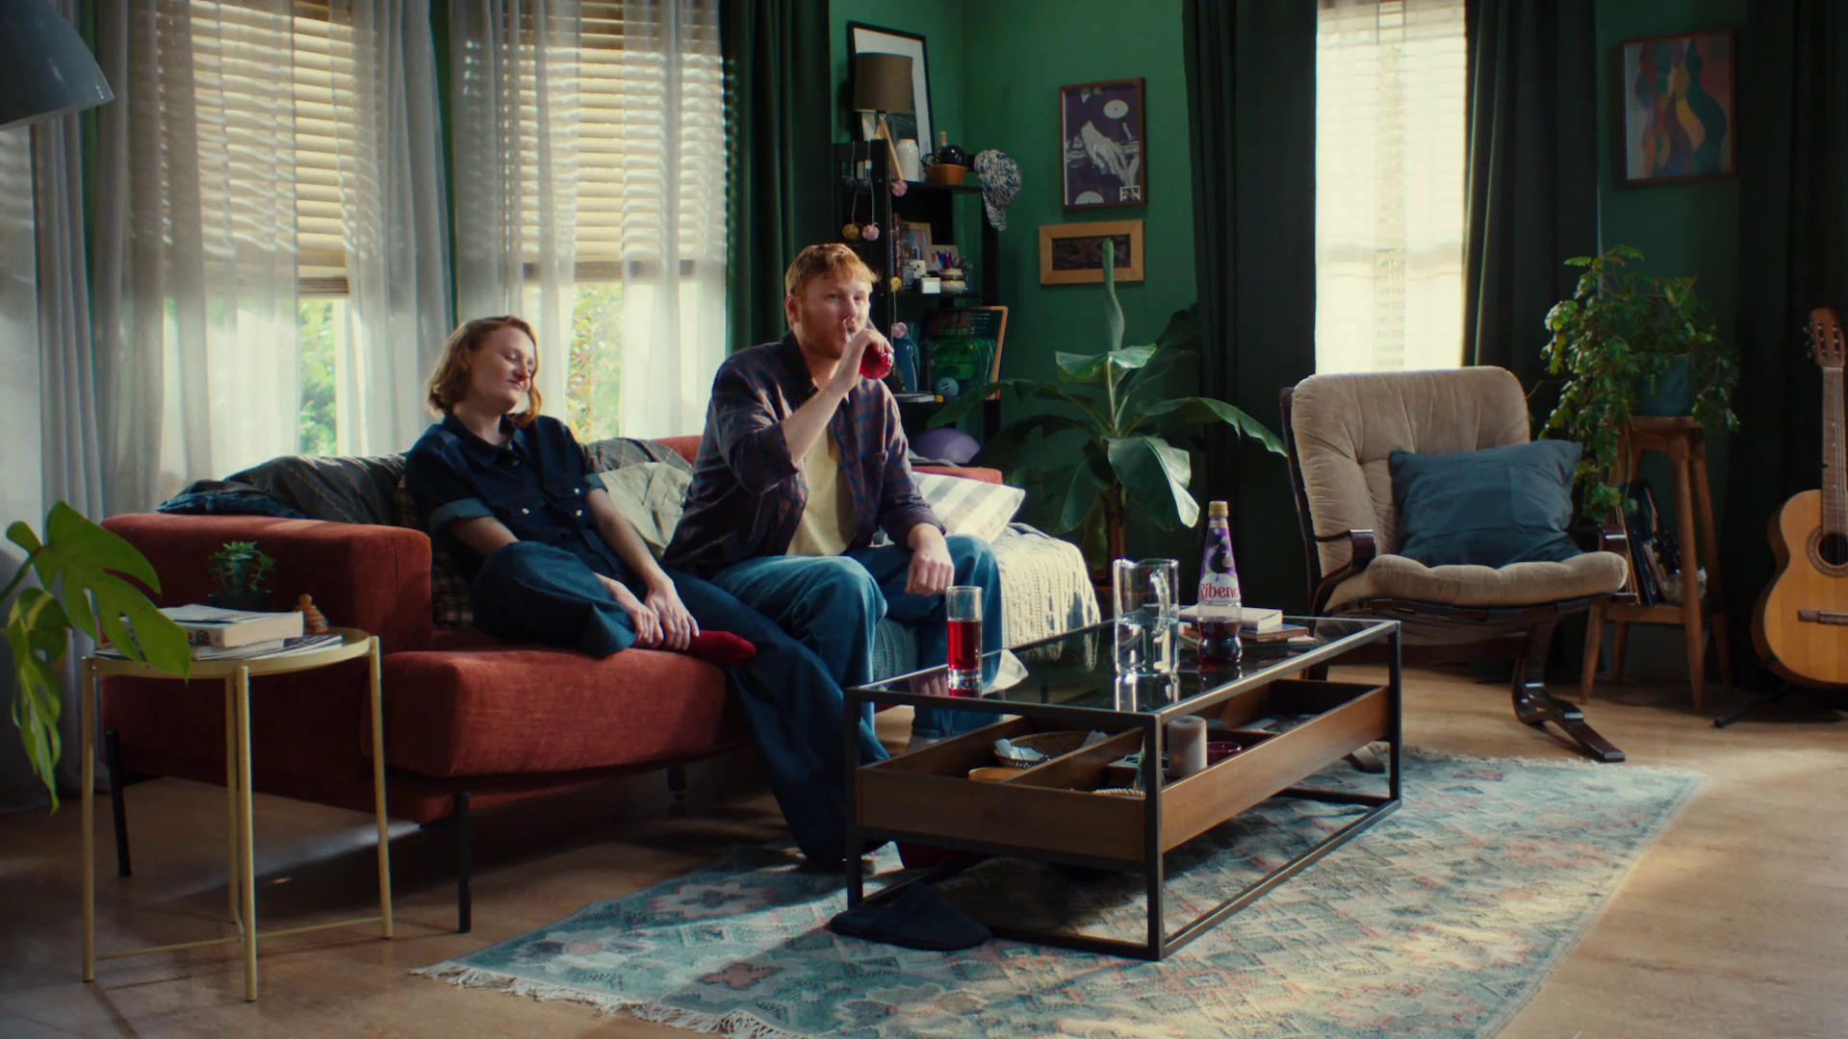

FMCG Deep Dive
Ribena – There’s No Taste Like Home

Slide 2
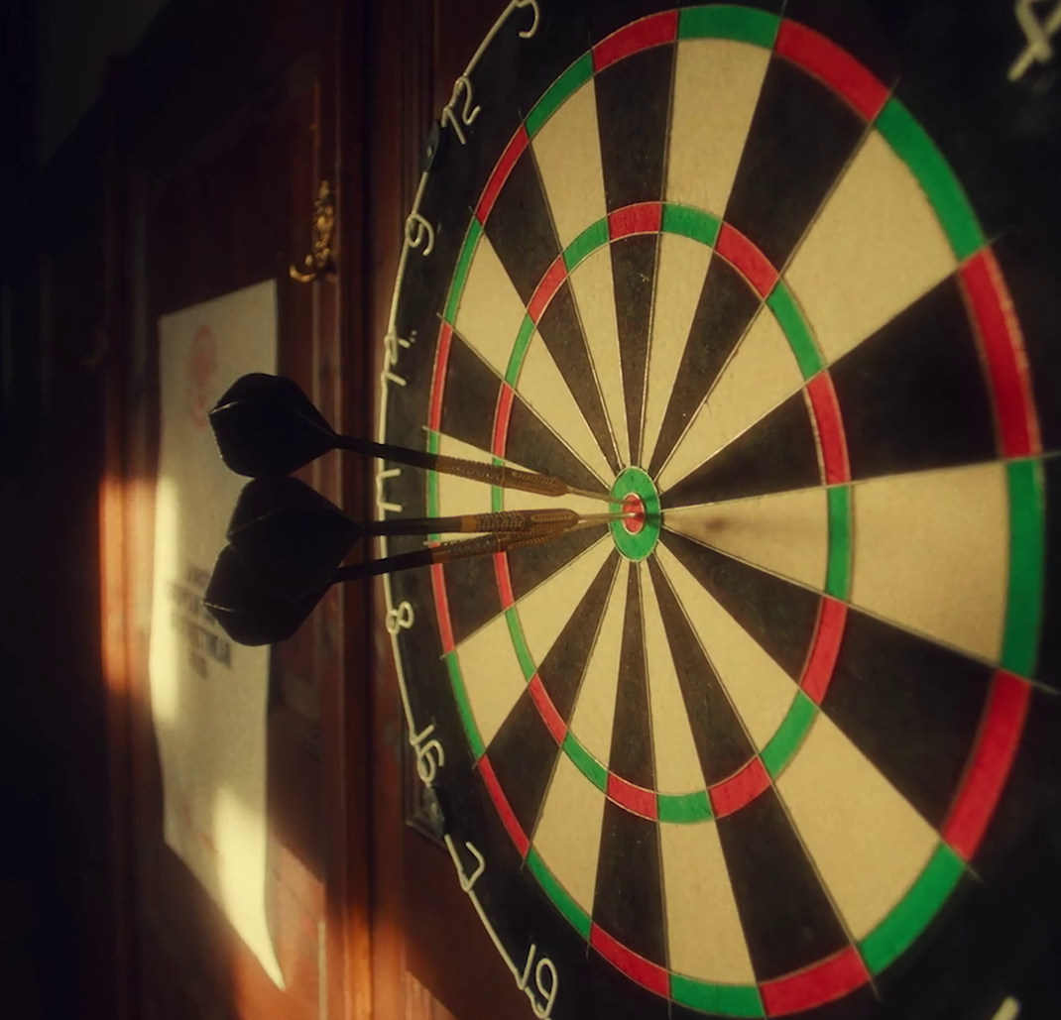
In this deck…
To provide an analysis of the FMCG category this deck explores the following areas:
Macro Spend Patterns:
Spending behaviour and patterns
Effectiveness:
TV is crucial to the plan
Media Planning:
Weekday, and daypart analysis
Ad time-lengths
Case Studies:
McVitie’s, Hellmann’s, The Coconut Collab
Jägermeister - Flowers
Notes:
To provide an analysis of the FMCG category this deck explores the following areas:
Macro Spend Patterns:
Spending behaviour and patterns
Effectiveness:
TV is crucial to the plan
Media Planning:
Weekday, and daypart analysis
Ad time-lengths
Case Studies:
McVitie’s, Hellmann’s, The Coconut Collab

Slide 3

Macro spend patterns
Warburton's – The Inspection

Slide 4
FMCG investment stable year-on-year
+16%
-1%
+2%
+44m
+3%
+195m
-£10m
+22m
-0.2%
-£2m
Source: Nielsen Ad Intel, 2019-2024. FMCG category consists of Food, Cosmetics & Personal Care, Household FMCG, and Drink. Linear TV Spend, %’s show YoY change.
Notes:
FMCG investment stable year-on-year following an almost £200m spend increase in 2021.

Slide 5
Food advertisers are the largest FMCG investors in TV
+16%
-1%
+2%
+44m
+3%
+195m
-£10m
+22m
-0.2%
-£2m
Source: Nielsen Ad Intel, 2019-2024. FMCG category consists of Food, Cosmetics & Personal Care, Household FMCG, and Drink. TV Spend, %’s show YoY change.
Notes:
Food remains the largest spender on linear TV.

Slide 6
FMCG share of TV impacts has increased over last few years
Source: Barb, 2010-2024, individuals, linear impacts (R/W), FMCG share of voice vs all other categories. FMCG category consists of Food, Cosmetics & Personal Care, Household FMCG, and Drink.
Notes:
FMCG share of linear TV impacts has increased to levels seen a decade ago.

Slide 7
FMCG advertisers SoV has fluctuated across the last decade
Source: Barb, 2010-2024, individuals, top 10 FMCG advertisers by total linear impacts from 2010-2024. FMCG category consists of Food, Cosmetics & Personal Care, Household FMCG, and Drink.
Notes:
In 2024, P&G and Unilever took the lions share of linear TV impacts.

Slide 8






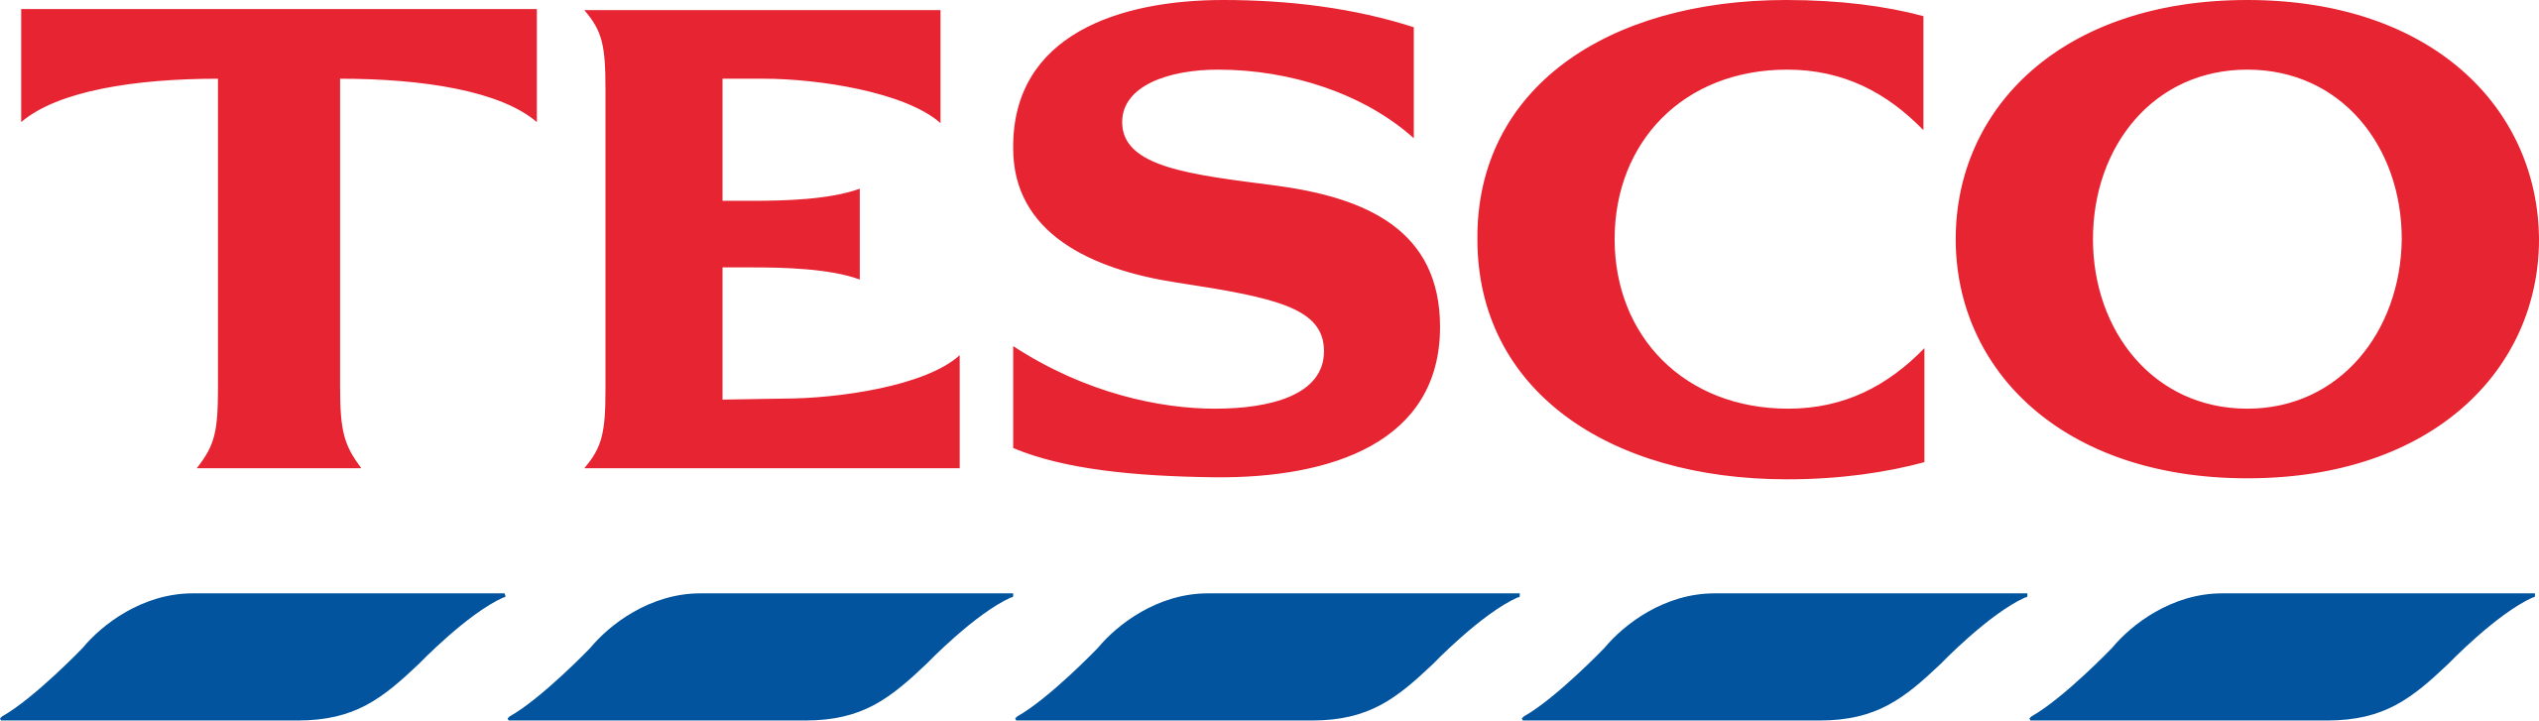



P&G is the largest FMCG investor in linear TV
Source: Barb, 2024, individuals, linear impacts (R/W) (million). Top 10 2024 FMCG advertisers by total linear TV impacts. FMCG = Food, Cosmetics & Personal Care, Household FMCG, and Drink.
Notes:
In 2024, over each quarter P&G was consistently the largest FMCG investor in linear TV

Slide 9
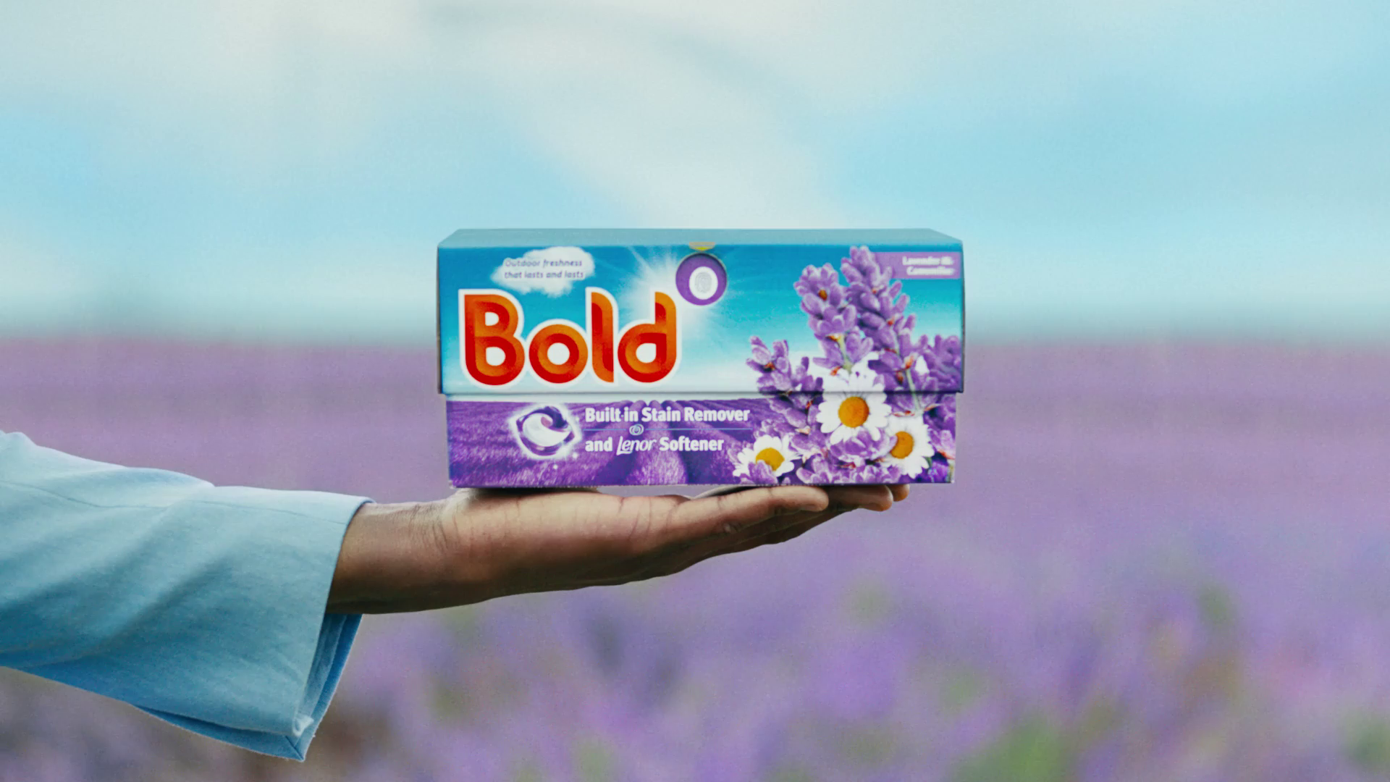
Effectiveness
Bold – Breathe It All In

Slide 10

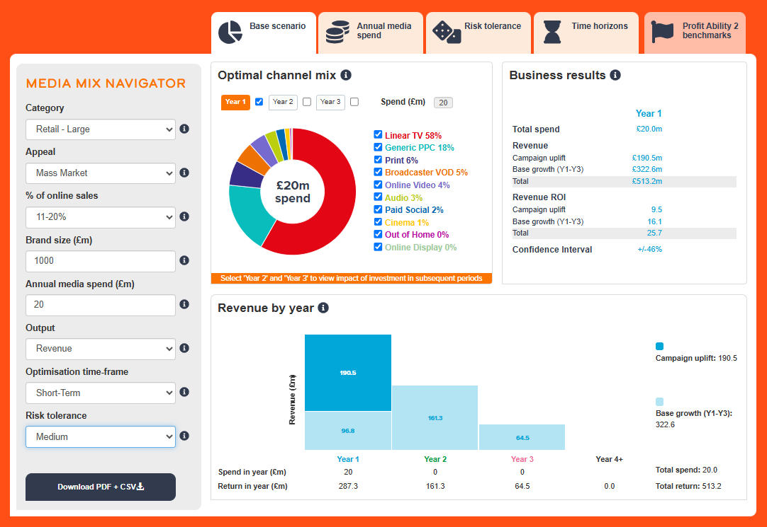
Profit Ability 2 and Media Mix Navigator
Profit Ability 2 was conducted by Ebiquity, EssenceMediacom, Gain Theory, Mindshare, and Wavemaker UK.
It’s a meta-analysis of econometric studies from 141 brands covering £1.8 billion of media spend across 10 media channels and 14 business sectors.
The Media Mix Navigator (MMN) tool, powered by the data from Profit Ability 2, allows you to explore different scenarios to define the optimum media mix for your business, whether your objective is to drive increased profit or revenue.

Slide 11
Optimised MMN scenario for finance recommends higher share of TV vs. actual databank share
Actual vs. Media Mix Navigator Optimised channel mix
Source: Media Mix Navigator, Optimised based on £250m brand size, mass market, high risk and media budget of £5m.
Notes:
Channel investment strategy depends on not only a brand’s objective but also the category it is in, as well as budget, brand size and risk appetite. There is no better tool than the Media Mix Navigator (MMN) to provide a benchmark view that takes into account these crucial factors. The MMN recommends a higher share of Linear TV & BVOD when compared against the actual databanks share.
The Media Mix Navigator is available here:
https://www.thinkbox.tv/training-and-tools/media-mix-navigator/media-mix-navigator

Slide 12
Short-term ROIs low; Full ROIs show profitable payback with Linear TV the key volume driver
Short-term effects
Bubble size represents % of short-term profit volume
FMCG Short-Term ROI: £0.48
Full effects
Bubble size represents % of full profit volume
FMCG Full Profit ROI: £1.48
Source: Profit Ability 2, April 2024 – Short term benchmarks: Ebiquity, EssenceMediacom, Gain Theory, Mindshare, Wavemaker UK.
Long Term Multipliers: EssenceMediacom, Gain Theory, Mindshare, Wavemaker UK
Notes:
In the short-term, FMCG doesn’t even breakeven - spend £1, get about 50p back.
Linear, TV is the large driver of short-term profit (58%) with the other channels are clustered around each other.
Fortunately, when adding in the sustained effects, all but one channel (Online Display) moves above break-even.
Linear TV, when including that sustained effect, drives nearly 70% of all profit volume. Online Video also works pretty well.

Slide 13
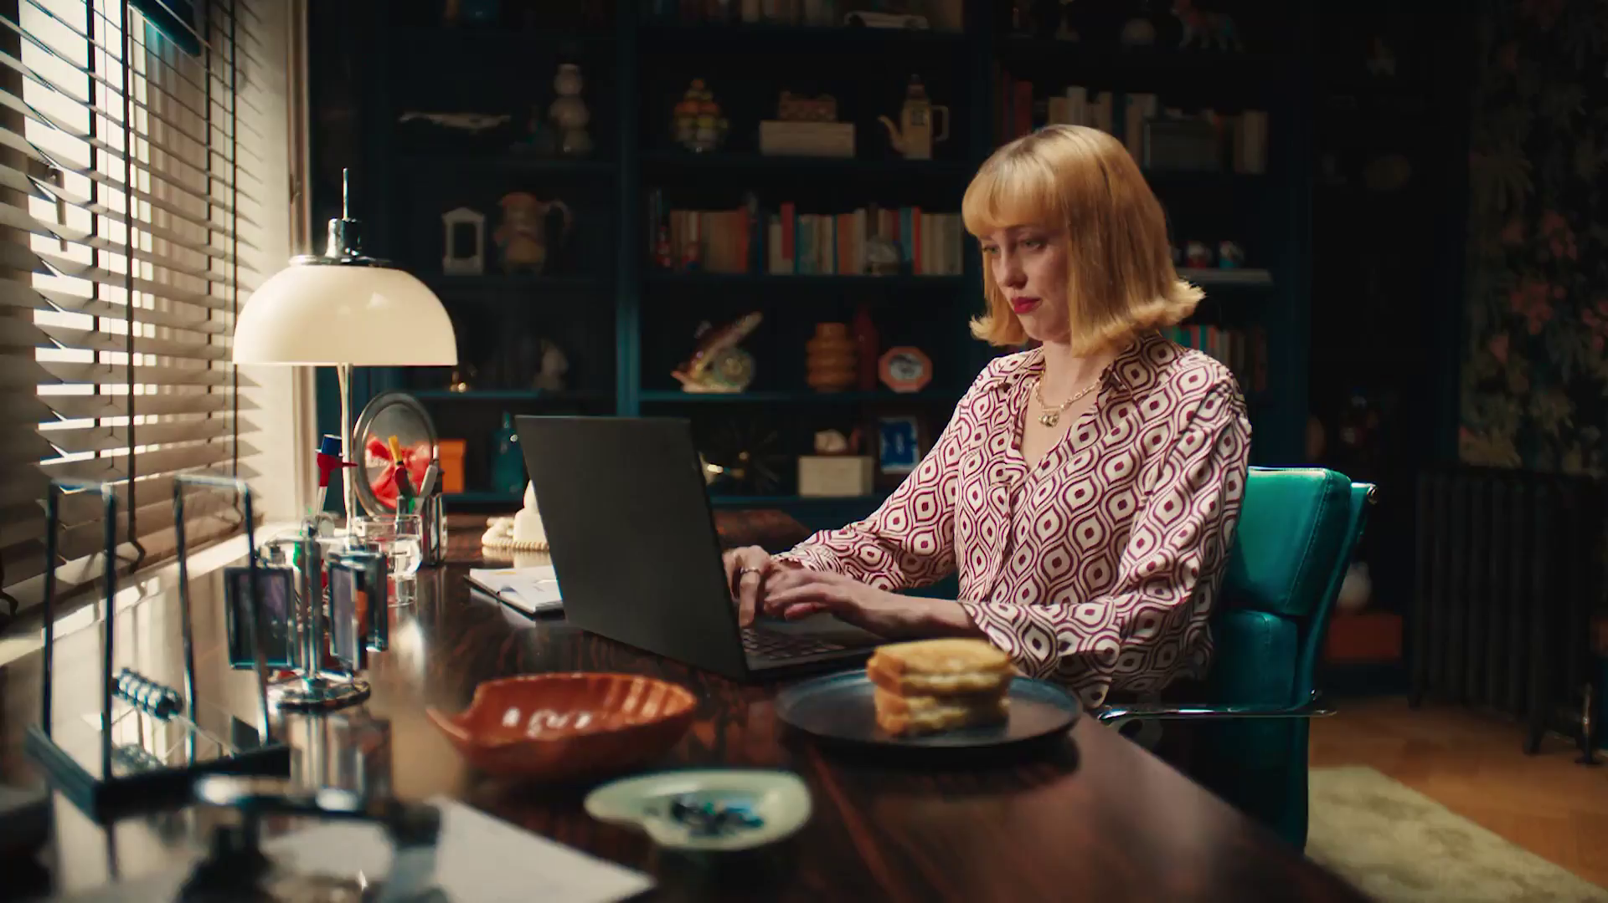
Media planning
Smug Dairy - Jane

Slide 14
FMCG linear TV spend skews toward the spring months
Index of FMCG commercial linear TV impacts vs all categories
FMCG commercial linear TV index by month
Jan | Feb | Mar | Apr | May | Jun | Jul | Aug | Sep | Oct | Nov | Dec
75 | 93 | 98 | 113 | 116 | 109 | 107 | 107 | 89 | 87 | 103 | 107
Top 10 FMCG advertisers commercial linear TV index by month
 | Jan | Feb | Mar | Apr | May | Jun | Jul | Aug | Sep | Oct | Nov | Dec
Procter & Gamble | 67 | 94 | 80 | 117 | 123 | 110 | 105 | 100 | 115 | 110 | 99 | 90
Unilever | 9 | 12 | 73 | 125 | 173 | 227 | 191 | 188 | 104 | 66 | 56 | 26
Loreal | 35 | 169 | 168 | 50 | 78 | 81 | 61 | 21 | 64 | 106 | 159 | 184
Reckitt benckiser | 116 | 113 | 111 | 112 | 166 | 107 | 173 | 149 | 53 | 58 | 16 | 42
Tesco | 62 | 152 | 76 | 69 | 83 | 52 | 50 | 128 | 111 | 103 | 144 | 165
Mars | 122 | 80 | 152 | 144 | 155 | 116 | 151 | 96 | 64 | 63 | 15 | 50
Ferrero | 40 | 98 | 126 | 57 | 57 | 48 | 34 | 312 | 18 | 148 | 156 | 117
Coty | 28 | 71 | 143 | 83 | 39 | 60 | 66 | 113 | 92 | 85 | 174 | 229
Aldi | 131 | 71 | 90 | 88 | 82 | 75 | 125 | 79 | 66 | 83 | 141 | 154
Nestle | 136 | 140 | 107 | 69 | 131 | 92 | 64 | 28 | 112 | 172 | 78 | 60
Source: Barb, 2024, monthly index vs full-year 2024, individuals, top 10 advertisers by total linear impacts. FMCG category consists of Food, Cosmetics & Personal Care, Household FMCG, and Drink.
Notes:
FMCG linear TV spend skews toward the spring months and top 10 advertisers all take varied approaches.

Slide 15
FMCG linear TV spend skews toward peak time viewing
Index of FMCG commercial linear TV impacts vs all categories
Finance commercial linear TV index by daypart
 | 6am | 7am | 8am | 9am | 10am | 11am | 12pm | 1pm | 2pm | 3pm | 4pm | 5pm | 6pm | 7pm | 8pm | 9pm | 10pm | 11pm | 12am | 1am | 2am | 3am | 4am | 5am
Monday | 88 | 100 | 81 | 68 | 64 | 64 | 66 | 61 | 53 | 58 | 59 | 92 | 115 | 127 | 130 | 120 | 121 | 119 | 122 | 123 | 126 | 119 | 116 | 100
Tuesday | 89 | 101 | 86 | 70 | 65 | 65 | 66 | 60 | 54 | 58 | 60 | 96 | 119 | 131 | 115 | 119 | 126 | 123 | 126 | 133 | 131 | 133 | 129 | 105
Wednesday | 81 | 100 | 81 | 67 | 63 | 65 | 65 | 61 | 54 | 58 | 60 | 97 | 112 | 124 | 127 | 117 | 122 | 124 | 127 | 131 | 129 | 128 | 124 | 105
Thursday | 82 | 100 | 79 | 70 | 60 | 61 | 64 | 62 | 54 | 56 | 60 | 99 | 113 | 129 | 122 | 121 | 126 | 119 | 121 | 126 | 128 | 125 | 124 | 106
Friday | 97 | 105 | 88 | 71 | 69 | 69 | 71 | 68 | 57 | 60 | 64 | 96 | 114 | 125 | 121 | 112 | 120 | 121 | 126 | 133 | 137 | 133 | 130 | 102
Saturday | 77 | 69 | 74 | 63 | 64 | 67 | 68 | 66 | 62 | 61 | 66 | 89 | 118 | 126 | 125 | 129 | 131 | 127 | 129 | 135 | 140 | 131 | 129 | 118
Sunday | 75 | 73 | 78 | 68 | 64 | 68 | 69 | 70 | 73 | 69 | 72 | 98 | 124 | 123 | 117 | 121 | 137 | 126 | 132 | 138 | 145 | 139 | 133 | 120
Monday | Tuesday | Wednesday | Thursday | Friday | Saturday | Sunday
104 | 101 | 103 | 105 | 95 | 97 | 95
Source: Barb, 2024, individuals, commercial linear, finance index vs all categories. FMCG category consists of Food, Cosmetics & Personal Care, Household FMCG, and Drink.
Notes:
FMCG linear TV spend skews toward peak time mid-week viewing.

Slide 16
Use of 20” spot high amongst FMCG advertisers
Source: Barb, 2024, Individuals. FMCG category consists of Food, Cosmetics & Personal Care, Household FMCG, and Drink.
Notes:
The FMCG category is the most prevalent users of 20” spots. Even, more widely used than the 30” spot.

Slide 17
FMCG ad lengths have shortened over the last twenty years
Source: Barb, 2003-2024, individuals. FMCG category consists of Food, Cosmetics & Personal Care, Household FMCG, and Drink.
Notes:
FMCG ads have progressively shortened over the last 20 years, now typically lasting 20 seconds.

Slide 18
FMCG advertisers opting for shorter ads
Source: Barb, 2024, individuals, linear only, top 15 advertisers by total linear impacts. Source: Barb, 2024, Individuals. FMCG = Food, Cosmetics & Personal Care, Household FMCG, and Drink.
Notes:
Use of spot length varies across the FMCG category with 20” being the most popular choice.

Slide 19
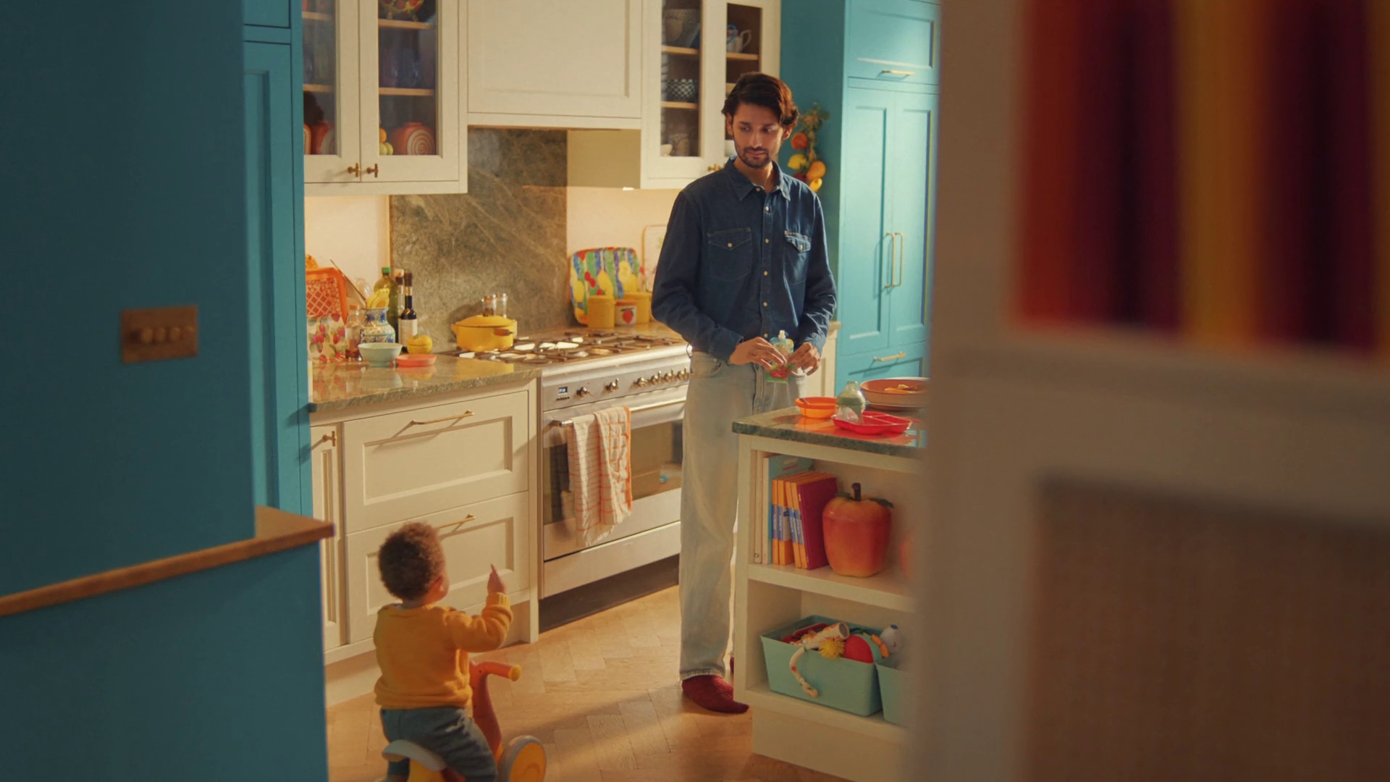
Case Studies
Heinz – Loved by Babies, Craved by Parents

Slide 20



Biscuit’s Got Talent: How Britian’s Got Talent Sweetened Mcvitie’s
Challenge
McVitie’s while still well-loved wasn’t being talked about in the same way. They needed a campaign that would set them apart from other brands and showcase their unique place in British society.
Solution
Sponsorship of Britain’s Got Talent to reach 7.5 million individuals on linear alone and a programme licence to bring the IP to life instore.
Results
Social activity reached 43.7 million individuals, 73% of viewers recalled the sponsorship, 82% of viewers remembered seeing at least one or more campaign execution.
Purchase intent rose by 5% over the sponsorship period. It established McVitie’s as the UKs number 1 Biscuit brand.
Notes:
The Challenge
McVitie’s vision is to be Britain’s best loved snacking brand. The brand while still well-known, research showed that while there was a huge amount of love the brand, no one was talking about it or recognising it. McVitie’s needed a campaign that would awaken the love for the brand and get people talking about them.
McVitie’s, as a result, had clear of objectives of changing perceptions and driving awareness for the brand. But the campaign needed to set McVitie’s apart from other biscuits, it needed to be a premium brand that customers would pay more for. Consumer research showed that people saw McVitie’s as part of British true fabric and a national brand. The campaign needed to make McVitie’s feel like a British Icon while still driving sales for the brand.
The TV Solution
Armed with clear objectives, MGOMD got to work in finding the best way to hit these goals and ambitions. While TV had always worked well for McVitie’s but with small budgets than the competition, they weren’t getting the right cut through. Having seen the power of sponsorship with other clients, MG went into the market looking for the right property that would deliver the Britishness needed to cut through. At that moment the perfect property landed on the market, ITV’s Britian’s Got Talent. With 7.5 million adults watching each episode and the last series being the second most watched entertainment show for 16-34-year-olds. With an ambition to tap into shared moments, BGT also fitted the bill, with 44% of the series viewed as a co-viewed with 2 or more people watching together. The high frequency of idents would also allow McVitie’s to showcase the full range on offer from the digestive to the newly relaunched BN.
The Plan
Inspired by Britian’s Got Talent’s display of skills from singing to dancing, Comedy to sword swallowing, McVitie’s idents showcased the original, unique and golden ways people can share a McVitie’s biscuit. To build on the partnership beyond the idents, McVitie’s created a BGT first, contextual ads that sat in airtime around the shows to maximise conversation, create a stand out and a point of difference. When the iconic golden buzzer was pressed during the show, the contextual ads would play directly in the next break to the buzzer press. The contextual ads would encourage the viewer to pick up a pack of McVitie’s and enter a competition to win ‘money can’t buy prizes.’ In the eyes of MG, it was the perfect way to bridge the gap between advertising and in store sales.
To intergrate the campaign with wider activity, McVitie’s took the campaign to social media with a plan that ran across Meta and TikTok and was aligned to the golden moments of a buzzer press. When the buzzer was pressed, a give away was deployed in real time so that viewers could play along with the show. Taking this one step further, MG also created a competition called ‘BixTrix’ across TikTok that would see users vote for their favourite content creator, who’d used biscuits to display their own talents. In a TV first, this content was then brought to TV and used to bookend the ad breaks of the BGT final live on air with the winner revealed and all the talents showcased.
In terms of in store activations, MG were able to secure over 700,000 Touchpoints via licensing, this allowed McVitie’s to use BGT IP in supermarkets and independent stores nationwide. The McVitie’s retail team were also able to leverage the IP and secured eye-catching units around stores that would build excitement and interest in the competition and the all-important sales they needed.
Results
The campaign was a massive success for McVitie’s. From a media standpoint, the sponsorship of BGT proved fruitful totalling 1,371 TVRs with owned and earned social activity reaching 43.7 million people. The sponsorship also stood out and set McVitie’s apart from the category. 73% of viewers recalled the sponsorship against a norm of 53%. 82% of BGT viewers remembered seeing at least one other campaign execution beyond the idents.
The campaign also got people talking about the brand, brand talkability was 17% higher for those who recognised the campaign. The sponsorship also re-established McVitie’s as a loved British icon. 9 out of 10 people said it was a perfect brand match. Perceptions of McVitie’s being ‘a brand I love’ rose from 46% to 51% among viewers who recognised the campaign.
Finally, purchase intent increased 5% over the course of the sponsorship. 87% of viewers said the partnership made them want to buy some McVitie’s the next time they went shopping. And finally, the campaign helped to establish McVitie’s as the number 1 biscuit brand in the country.

Slide 21


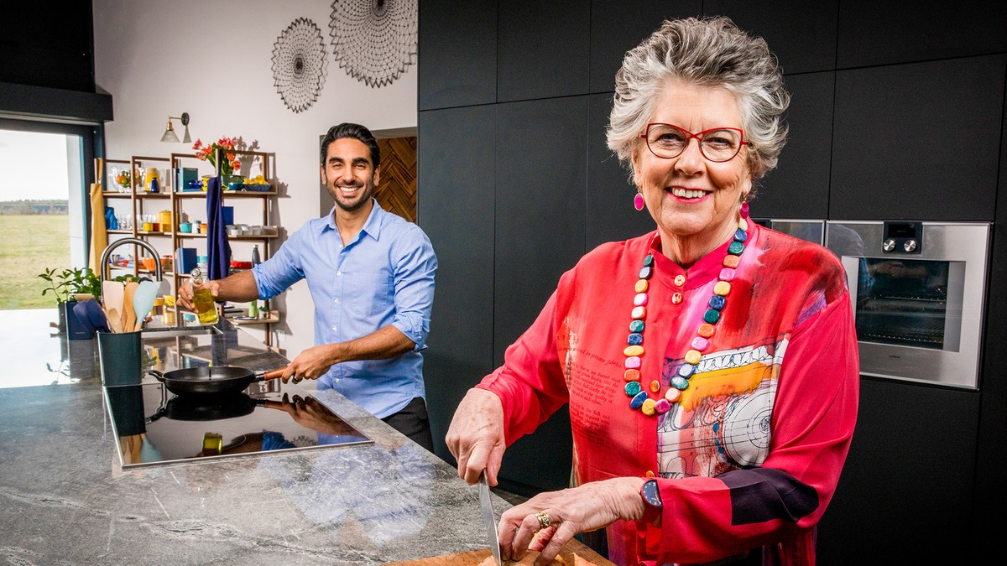
Hellmann’s shows us how to cook clever and waste less
Challenge
Hellmann’s wanted to encourage a reduction in food waste and promote their product as the perfect ingredient to improve a leftovers meal
Solution
They created a 4-part prime time TV series, ‘Cook Clever, Waste Less’ that ran on Channel 4
The programme, starring Prue Leith, gave practical tips and money-saving advice
Results
Traffic to Hellmann’s website increased by 500%
Viewers saved 3.1m kg of food waste, saving 5.9m kg of CO2 emissions
Notes:
The Challenge
If food waste was a country, it would be the third largest emitter of greenhouse gases in the world. However, mass awareness of the impact of food waste on global warming was still lacking compared to other, more widely accepted, contributors.
Hellmann’s is on a mission to help people say no to waste and yes to taste. As Hellmann’s is the perfect ingredient to turn leftovers into a delicious meal, the challenge was about how to raise awareness of the fact that UK households are major contributors to the food waste issue.
Simply highlighting the food waste problem was not enough. Helmann’s needed to demonstrate their passion for taste over waste, establish credibility for their purpose and make a genuine difference. They needed to convince the UK public to start saving meals from the bin and in the process, save tonnes of carbon.
The TV Solution
Mindshare’s research around sustainable behaviours uncovered an important and powerful insight – in recent years it has been broadcast programmes that have been the catalyst for environmental behaviour change. For example, 88% of Blue Planet 2 viewers changed their plastic lifestyle. This type of hard-hitting, long-form content creates impact and builds an emotional connection that makes the issue matter more, which in turn inspires change.
To make Hellmann’s the beacon for food waste and to trigger behaviour change, Mindshare used this insight and created a prime-time TV programme, ‘Cook Clever, Waste Less’, that put the issue front and centre, engaging the audience to affect change.
They enlisted top UK cook and self-proclaimed Queen of Leftovers, Prue Leith, along with NHS GP and food expert, Dr. Rupy Aujla, to turn four British families from food wasters to waste warriors, showing them the impact of their food waste and inspiring them to change their cooking and eating behaviours for good. The programme gave practical tips and money-saving advice such as the benefits of meal planning, batch cooking and re-using leftovers.
The Plan
The series consisted of four 30-minute episodes that aired in peak on Channel 4 and on All 4, with the usual sponsorship idents around the show. To complement the series, they created a TV ad with Dr. Rupy Aujla that set out Hellmann’s commitment to food waste. These spots ran first-in-break in each episode as well as across the C4 network.
Alongside the TV activity, they created a host of digital assets for social media and online video that ran throughout the campaign period. In addition, they produced a downloadable recipe book that sat on Hellmann’s website and meant that people had a useful resource to help combat their waste at home.
Results
15% uplift in people agreeing with the statement “Hellmann’s helps use food that would otherwise go to waste”
Traffic to Hellmann’s website increased by 500%
Over 40,000 recipe books were downloaded
3.4m people tuned in to watch ‘Cook Clever, Waste Less’
32% of viewers said they would start using leftovers from their meals after watching the show
Viewers saved 3.1m kg of food waste from landfill, saving 5.9m kg of CO2 emissions which is equivalent to a full year of electricity for 1,450 British households

Slide 22



The Coconut Collab: free from dairy, not from temptation
Challenge
The Coconut Collab needed to grow share in an increasingly competitive market
By increasing brand awareness and purchase intent, they aimed to grow sales and recruit new shoppers
Solution
Partnering with Sky, mass reach was delivered using linear TV in key programming environments
Precise targeting was achieved via Mosiac data on VOD and Nectar data for a custom audience on AdSmart
Results
Sales growth more than x2 that of the overall category
Shopper number growth 65% higher than category average.
Notes:
The Challenge
Selling a range of plant-based yoghurts and puddings, The Coconut Collab needed to grow share in an increasingly competitive market featuring some well-known competitors and a raft of new brands.
Having built sales primarily through shopper marketing and promotions, they knew it was time to invest in brand building. In doing so, they could shift from being a niche brand to being more broadly recognised and positioned as offering delicious treats that are better for you, and for the planet.
The campaign objectives were:
Increase both brand awareness and purchase intent by 25%
Grow sales volumes ahead of the category average rate
Recruit 100,000 new shoppers, thereby providing a foundation for future growth
The TV Solution
January is a key sales period for plant-based products, with supermarkets getting behind ‘Veganuary’ and shoppers being primed for plant alternatives. Rather than just focusing on existing dairy-free buyers, Yonder Media knew that attracting new, ‘plant-curious’ customers was key to long-term brand growth, and therefore opted for a mixed-targeting approach that would also reach both dairy-free shoppers and the millions of flexitarians who give Veganuary a go. Their full funnel strategy had three layers:
Increase awareness and start building long-term brand growth – using linear TV to introduce the brand to a new audience, and with a creative canvas that could effectively communicate the ‘free from dairy, but not temptation’ positioning
Drive purchase intent amongst potential buyers – using Nectar purchasing data and addressable TV to reach existing dairy-free category buyers, as well as those that were already buying plant-based alternatives
Increase penetration, by capitalising on immediate prospects – investing in sponsored product listings on Tesco.com and Sainsburys.com to leverage increased brand awareness from upper funnel AV activities and take advantage of the significant impact TV has on search
The Plan
With a limited budget and ambitions to reach a large TV audience, Yonder Media chose to allocate all of their investment with Sky Media who could offer both mass reach and data-driven targeting across linear TV, VOD, and AdSmart.
For linear TV, they planned a campaign with precise channel planning, upweighting stations featuring entertainment, food, movies, and high-quality dramas to reach the targeted audiences in the right high attention environments.
This was supplemented with a BVOD campaign, with a combination of Mosaic targeting to focus in on the most likely households, together with a channel select strategy which concentrated on the environments that chimed with the health- and planet-conscious audience.
Finally, using Nectar data, a sophisticated custom audience was built based on category purchasers (excluding The Coconut Collab buyers) and those who had bought into the vegan category the previous January. This was then activated using Sky AdSmart.
Results
Double digit growth in awareness against all adults
Awareness growth amongst core target was twice that of the all adults figure
Purchase intent also saw double digit growth
Sales growth more than double that of the overall category
Growth in shopper number 65% higher than the category average

