Slide 1
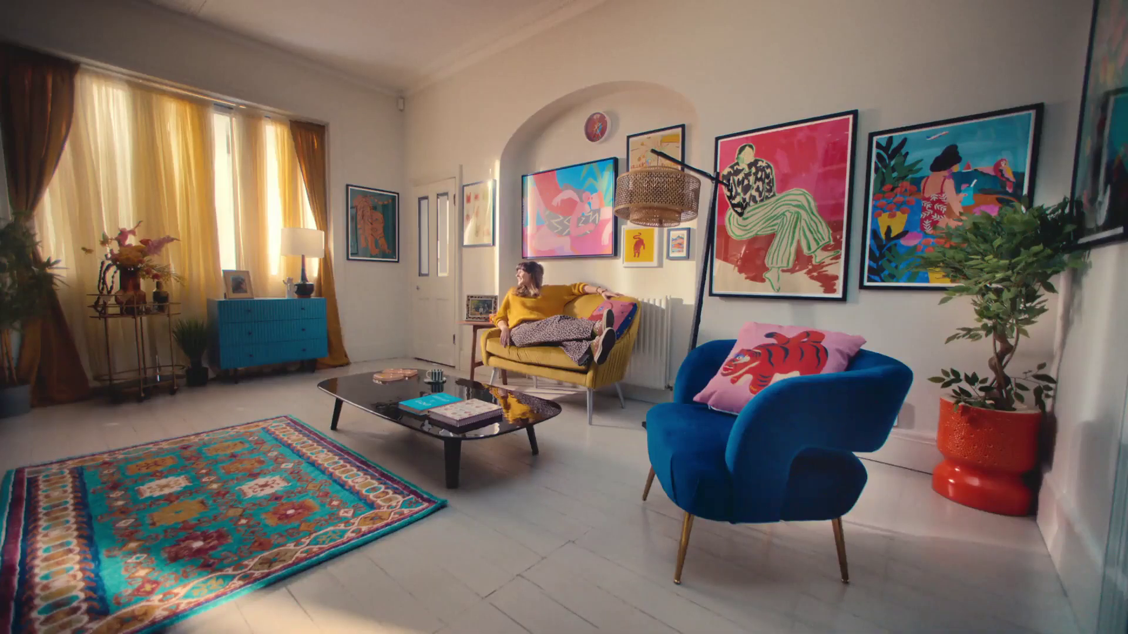
Trends in TV 2025
FY!, “Less Bland More You”

Slide 2
Stability continues…
Hours per person per day (Adults)
Source: IPA TouchPoints, Adults 15+

Slide 3
SVOD subscriptions returned to growth
Source: Barb Establishment Survey
* = Due to the COVID-19 pandemic and the suspension of face-to-face interviewing, quarterly BARB Establishment Survey data were not produced for Q4 2020, as a result, 2020 Q3 data is used

Slide 4
The gradual shift of viewing from linear to VOD continues
To note: SVOD and YouTube viewing includes ad free tiers
-9%
+5%
+9%
+23%
-2%
+65%
Source: Barb, All devices, Adults 16+, Total commercial linear TV and BVOD
% difference based on 24 vs. 23

Slide 5
VOD enabling us to watch more entertainment, drama & films
Source: Barb - TV set only, Adults

Slide 6
Adults: UK original content dominates the top series in 2024
Rank | Channel Group | Programme Title | Series | Average Audience (m) | Origin
1 | ITV | Mr Bates vs The Post Office | 1 | 14.1 | UK
2 | Netflix | Fool Me Once | 1 | 11.4 | UK
3 | Netflix | Baby Reindeer | 1 | 9.4 | UK
4 | Amazon | Clarkson's Farm | 3 | 8.9 | UK
5 | Netflix | The Gentlemen | 1 | 8.7 | UK
6 | ITV | Vera | 13 | 8.5 | UK
7 | BBC | Ludwig | 1 | 8.4 | UK
8 | BBC | Death in Paradise | 13 | 8.4 | UK / France
9 | ITV | I'm a Celebrity... Get Me Out of Here! | 24 | 8.2 | UK
10 | ITV | Trigger Point | 2 | 8.2 | UK
Rank | Channel Group | Programme Title | Series | Average Audience (m) | Origin
11 | CH4 | The Great British Bake Off | 15 | 7.8 | UK
12 | BBC | Call the Midwife | 13 | 7.7 | UK
13 | BBC | Strictly Come Dancing | 22 | 7.6 | UK
14 | ITV | After the Flood | 1 | 7.6 | UK
15 | ITV | Red Eye | 1 | 7.5 | UK
16 | BBC | The Traitors | 2 | 7.5 | UK
17 | BBC | Silent Witness | 27 | 7.3 | UK
18 | ITV | Until I Kill You | 1 | 7.0 | UK
19 | BBC | Nightsleeper | 1 | 7.0 | UK
20 | BBC | Celebrity Race Across the World | 2 | 6.9 | UK
Source: Barb, 2024, Adults. TV set viewing. Average audience per episode (excludes one-offs, kids, films and sports)

Slide 7
Similar programmes & size to 10-years ago… but now watched in different ways
Rank (2014) | Channel | Programme Title | Series | Average Audience (m) | Origin
1 | BBC 1 | Sherlock | 3 | 11.7 | UK
2 | BBC 1 | Call the Midwife | 3 | 10.6 | UK
3 | ITV1 | Downton Abbey | 5 | 10.4 | UK
4 | BBC 1 | The Great British Bake Off | 5 | 9.5 | UK
5 | BBC 1 | Strictly Come Dancing | 12 | 9.5 | UK
6 | ITV1 | I'm a Celebrity Get Me Out of Here! | 14 | 9.3 | UK
7 | ITV1 | Cilla | 1 | 8.8 | UK
8 | ITV1 | Britain's Got Talent | 8 | 8.7 | UK
9 | BBC 1 | Death in Paradise | 3 | 8.6 | UK
10 | ITV1 | The X Factor | 11 | 8.2 | UK
Source: Barb 2014, UK Consolidated 28 Day, Series average audience per episode calculated from initial broadcast.
TSB, “Businmess”
Source: Barb, 2014, Adults. Consolidated 28 Day. Average audience per episode (excludes one-offs, kids, films and sports)

Slide 8
The importance of advertising context
EE, “Weekender”

Slide 9
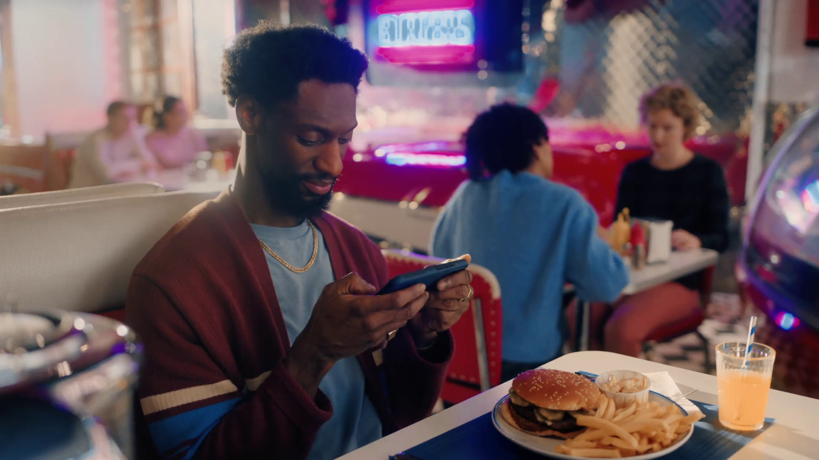
“The context within which you see something affects how you react to it”
I’m A Celebrity, “2024 Season Trailer”, ITV

Slide 10
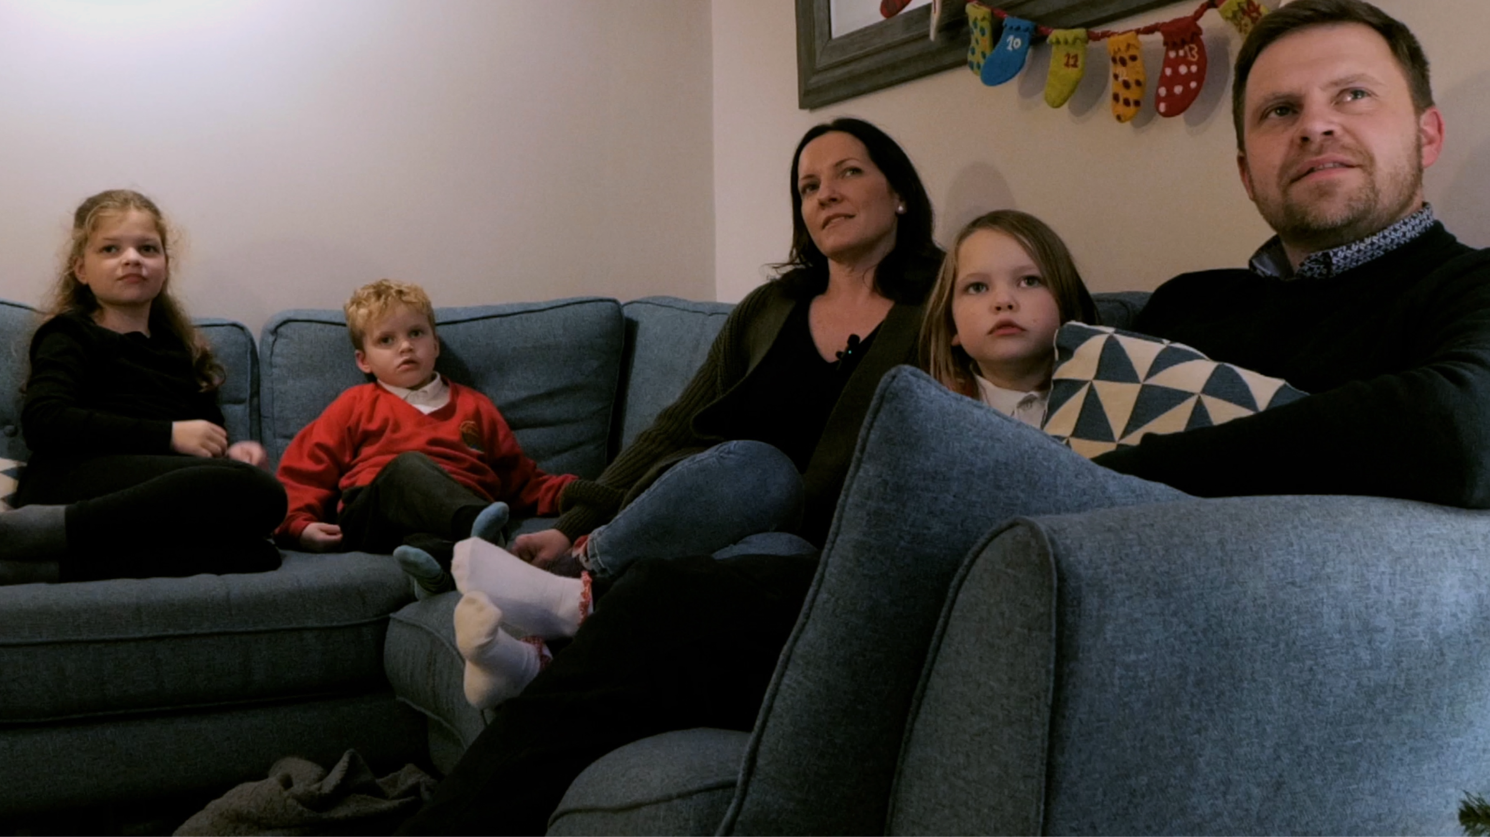
6.3x
The right in-home advertising context can increase ad recall by up to 6.3 times
Source: Context Effects, Map The Territory & Tapestry Research, 2024

Slide 11
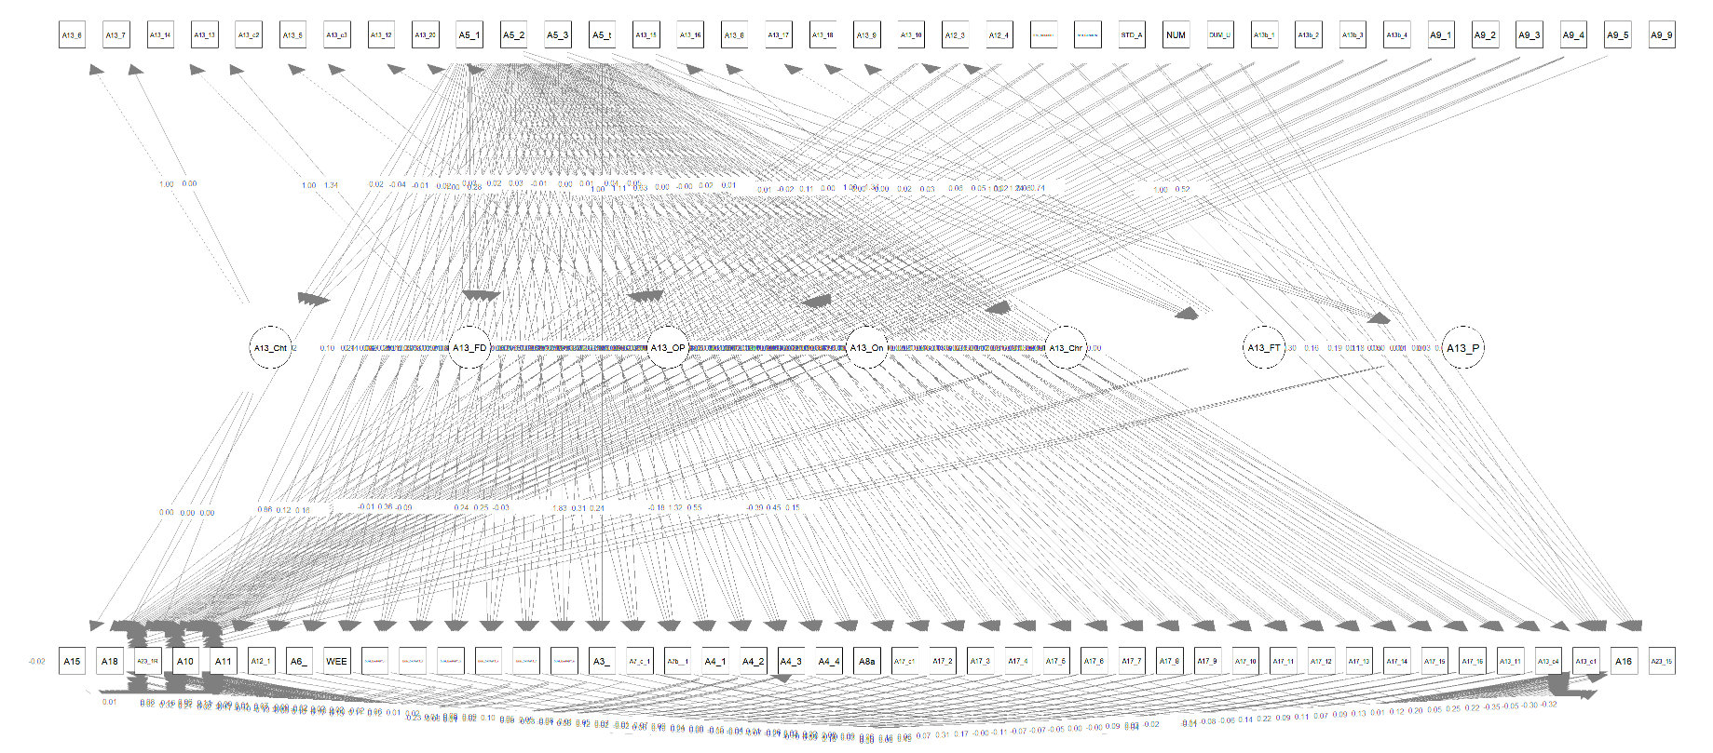
Ecosystem quantified via Structural Equation Modelling
348,435
data points
87
different variables
Source: Context Effects, Map The Territory & Tapestry Research, 2024

Slide 12
Factors having biggest influence on advertising recall
DEVICE
OTHER PEOPLE
CONTENT
MOOD
SATISFACTION
LOCATION
Source: Context Effects, Map The Territory & Tapestry Research, 2024

Slide 13
Factors having biggest influence on advertising recall
DEVICE
OTHER PEOPLE
Source: Context Effects, Map The Territory & Tapestry Research, 2024

Slide 14
Shared viewing is important Ad recall +23% when watching with others vs. alone 2x more likely to repeat / mimic the ads (increasing to 3.2x when watching with kids)
Adidas, “Hey Jude”
Source: Context Effects, Map The Territory & Tapestry Research, 2024

Slide 15
TV is the shared medium
Source: Barb / TRP / 2023 / All devices

Slide 16
Shared viewing happens across all genres – especially sport, drama and entertainment
% of all co-viewing
Source: Barb 2024, Co-viewing 2+.

Slide 17
Why is the TV set so important? TV screen drives highest ad recall: +34% vs. computer +60% vs. tablet / smartphone
Goodfella’s, “Goooood”
Source: Context Effects, Map The Territory & Tapestry Research, 2024

Slide 18
93% of TV set viewing is to high-quality TV content
TV set viewing time by platform
2024, All Adults
3hrs 35 mins
PER DAY
Source: Barb

Slide 19
For 16-34s, the TV set is for… high-quality TV content
TV set viewing time by platform
2024, 16-34s
1hr 53 mins
PER DAY
Source: Barb

Slide 20
Video planning (or what does all of this mean for AV planning?)
TV Licensing, “Archie”

Slide 21
Highest reach & most viewing is delivered by Commercial TV
Adults – TV Set
Bubble area represents total volume of daily viewing
AVERAGE DAILY REACH (000s)
Other SVOD
Other AVOD
Twitch
AVE TIME VIEWED PER VIEWER PER DAY
Source: Barb / All adults, TV sets – 2024
Notes:
This chart breaks down viewing to the various platforms in terms of the average number of adults watching per day (for at least 3 minutes) on a TV set compared with the average time spent watching per viewer (i.e. only counting those who watched on that day).
Analysis across 2024 shows that the commercial broadcasters (linear and on demand) collectively reach just over 27 million adult viewers every day, with each of those viewers watching for an average of 3hrs, 42 mins a day. The combined portfolio of BBC channels (linear and on demand) has a daily reach of 22 million and an average view time of 2hr 14 mins. YouTube has a daily reach of 6 million adults and a view time of 2hr 4 mins.
SVOD services such as Netflix has a daily reach of 9 million people and a view time of 1hr 50 mins.

Slide 22
Three areas
More quality opportunities for advertisers
YouTube and TV
Measurement and Outcomes

Slide 23
SVOD ad tier growth increasing high quality TV inventory
Source: Barb Establishment Survey, subscription to ad-tier service

Slide 24
More opportunities for advertisers as viewing to ad-supported quality content grows
All Adults
16-34 Adults
Source: Barb – TV set viewing

Slide 25
All Individuals
Average video advertising time per day
All Individuals: 18:05
16-34s: 9:49
Today’s TV accounts for 85.0% of AV advertising time
(vs 83.5% in 2023)
16-34s
Source: 2024, Barb / Broadcaster stream data / UK Cinema Association / Ipsos Iris
**YouTube ad time modelled at 3.33% of content time (Enders Analysis, 23rd October 2024) and excludes those estimated to be on the YouTube Premium tier. *TikTok ad time modelled at 3.4% of content time using agency and broadcaster estimates. **Other online modelled at 3.33% of content time.

Slide 26
Advertising time in high-quality video content now growing
Minutes per day per person (Individuals)
Source: 2024, Barb / Broadcaster stream data / UK Cinema Association / Ipsos Iris
2024 YouTube ad time modelled at 3.33% of content time (Enders Analysis, 23rd October 2024) and excludes those estimated to be on the YouTube Premium tier. 2024 TikTok ad time modelled at 3.4% of content time using agency and broadcaster estimates. 2024 Other online modelled at 3.33% of content time.

Slide 27
YouTube TV-set viewing very skewed to heavy users
Three quarters of viewers
13% of viewing
5 minutes per day
Heaviest quartile of viewers
87% of viewing
1 hrs 47 min per day
YouTube
TV set
Oct 2024
For comparison, Commercial Broadcaster TV-set viewing is much less skewed
Heaviest quartile = 68% of viewing
5 hrs 34 min per day
Source: Barb, October 2024, YouTube TV set viewing split into quartiles, 16+

