Slide 1


Automotive Deep Dive
Hyundai – Bigger, Better, Smarter, and Faster

Slide 2
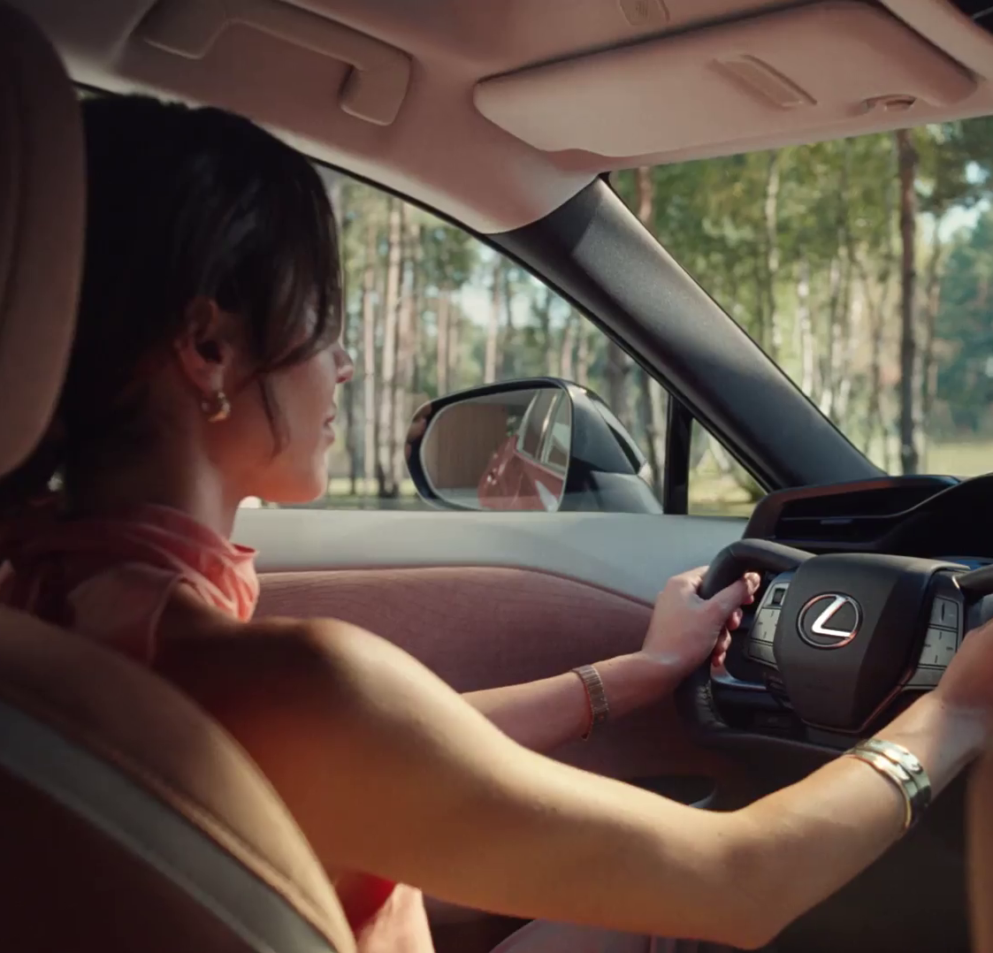
In this deck…
To provide an analysis of the Automotive category this deck explores the following areas:
Macro Spend Patterns:
Spending behaviour and patterns
Effectiveness:
TV is crucial to the plan
Media Planning:
Weekday, and daypart analysis
Ad time-lengths
Case Studies:
Toyota, Peugeot, and Volvo
Lexus - Details
Notes:
To provide an analysis of the Automotive category this deck explores the following areas:
Macro Spend Patterns:
Spending behaviour and patterns
Effectiveness:
TV is crucial to the plan
Media Planning:
Weekday, and daypart analysis
Ad time-lengths
Case Studies:
Toyota, Peugeot, and Volvo

Slide 3

Macro spend patterns
Toyota – Imagine the Possibilities

Slide 4
In 2025, £227m was spent on linear TV by automotive brands
+82m
+30%
-11%
-£38m
-11%
-£33m
-11%
-£32m
-10%
-£23m
Source: Nielsen Ad Intel, 2020-2025. Automotive, Linear TV Spend, %’s show YoY change.
Notes:
Automotive investment peaked in 2021 and has been decreasing since.

Slide 5
Decline in linear TV car retailer spend
+82m
+30%
-11%
-£38m
-11%
-£33m
-11%
-£32m
-10%
-£23m
Source: Nielsen Ad Intel, 2020-2025. Automotive, TV Spend, %’s show YoY change.

Slide 6
Automotive share of linear TV impacts has declined
Source: Barb, 2010-2024, individuals, linear impacts (R/W), Automotive share of voice vs all other categories.

Slide 7
Manufacturers SoV has fluctuated across the last decade
Source: Barb, 2010-2025, individuals, top 10 Automotive advertisers by total linear impacts from 2010-2025. Manufacturers only.
Notes:
In 2025, Toyota Group had the largest share of linear TV impacts.

Slide 8
Online car sellers SoV fragmented and then consolidated
Source: Barb, 2018-2025, individuals, top 10 Automotive advertisers by total linear impacts from 2018-2025. Online car sellers only.
Notes:
Online new and used car sellers SoV has consolidated in recent years. In 2024, Motorway & We Buy Any Car accounted for over half of all linear impacts.

Slide 9










Toyota was the largest Automotive investor in linear TV in 2025
Source: Barb, 2025, individuals, linear impacts (R/W) (million). Top 10 2025 Automotive advertisers by total linear TV impacts. Manufacturers only.
Notes:
In 2025, over each quarter P&G was consistently the largest Automotive investor in linear TV

Slide 10
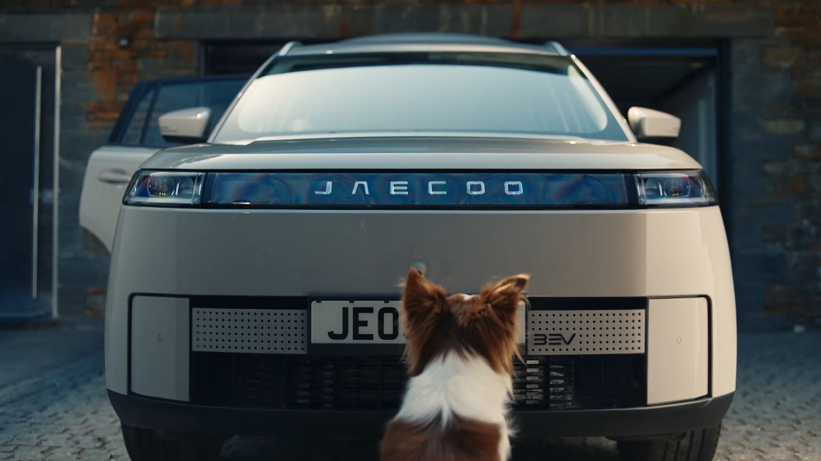
Effectiveness
Jaecoo - See the Road Through a Dog’s Eyes

Slide 11

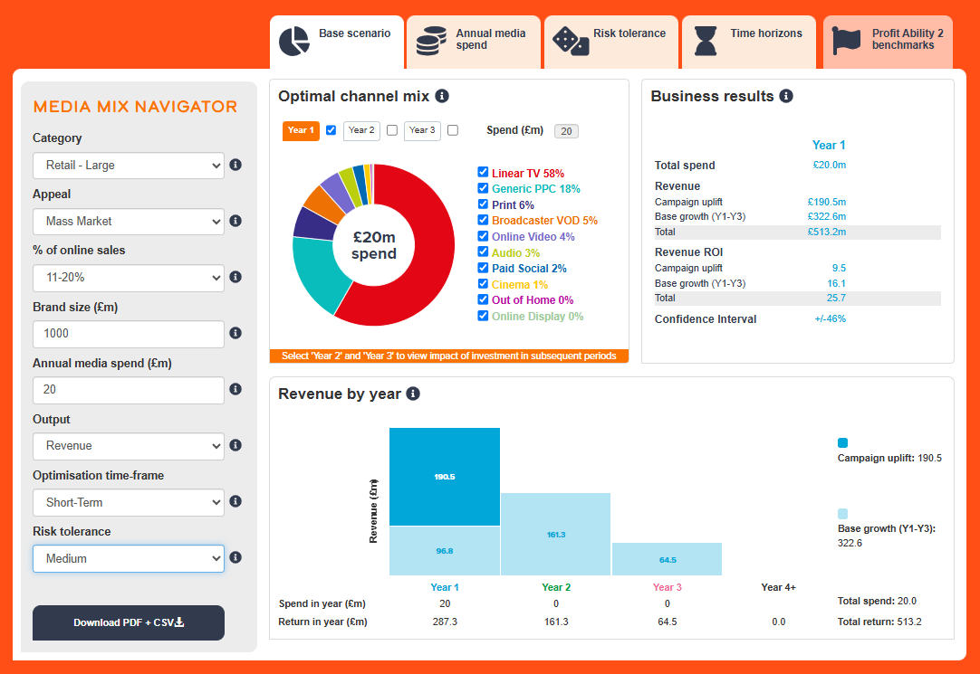
Profit Ability 2 and Media Mix Navigator
Profit Ability 2 was conducted by Ebiquity, EssenceMediacom, Gain Theory, Mindshare, and Wavemaker UK.
It’s a meta-analysis of econometric studies from 141 brands covering £1.8 billion of media spend across 10 media channels and 14 business sectors.
The Media Mix Navigator (MMN) tool, powered by the data from Profit Ability 2, allows you to explore different scenarios to define the optimum media mix for your business, whether your objective is to drive increased profit or revenue.

Slide 12
Optimised MMN scenario for automotive recommends higher share of TV vs. actual databank share
Actual vs. Media Mix Navigator Optimised channel mix
Source: Actual taken from Profit Ability 2 dataset, Optimised based on Media Mix Navigator analysis of £7,500m brand size, mass market, short-term, high risk and media budget of £20m.
Notes:
Channel investment strategy depends on not only a brand’s objective but also the category it is in, as well as budget, brand size and risk appetite. There is no better tool than the Media Mix Navigator (MMN) to provide a benchmark view that takes into account these crucial factors. The MMN recommends a higher share of Linear TV & BVOD when compared against the actual databanks share.
The Media Mix Navigator is available here:
https://www.thinkbox.tv/training-and-tools/media-mix-navigator/media-mix-navigator

Slide 13
Sustained effects important; Linear TV the key profit volume driver with a strong ROI
Short-term effects
Bubble size represents % of short-term profit volume
Automotive Short-Term ROI: £1.30
Full effects
Bubble size represents % of full profit volume
Automotive Full Profit ROI: £4.65
Source: Profit Ability 2, April 2024 – Short term benchmarks: Ebiquity, EssenceMediacom, Gain Theory, Mindshare, Wavemaker UK.
Long Term Multipliers: EssenceMediacom, Gain Theory, Mindshare, Wavemaker UK
N.B. low sample size for cinema
Notes:
Automotive - this one's quite stark
Short term ROI (£1.30) is low compared to some other sectors
Linear TV accounts for c. 60% of profit volume.
All the other channels are quite grouped together.
In this sector the sustained effects are very important – in the main because of the long purchase cycles in the category.
When you add in the sustained effect, the role of TV becomes even more important – driving 70% of profit volume.
Print, Audio & OOH all work very strongly; but at quite low levels of spend.
Automotive is a sector where print works excellently at those levels of spend due to dedicated print titles.

Slide 14
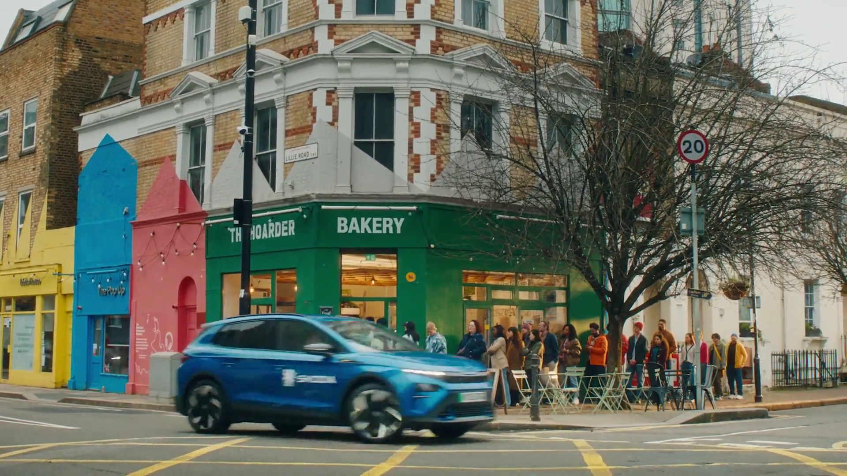
Media planning
Skoda – Your Weekend Subbed

Slide 15
Automotive linear TV spend skews toward new registrations
Index of Automotive commercial linear TV impacts vs all categories
Automotive linear TV index by month
Jan | Feb | Mar | Apr | May | Jun | Jul | Aug | Sep | Oct | Nov | Dec
165 | 134 | 72 | 95 | 114 | 101 | 89 | 130 | 123 | 96 | 52 | 31
Top 10 automotive advertisers commercial linear TV index by month
 | Jan | Feb | Mar | Apr | May | Jun | Jul | Aug | Sep | Oct | Nov | Dec
Toyota | 161 | 105 | 93 | 44 | 116 | 171 | 129 | 109 | 125 | 98 | 0 | 53
Renault | 207 | 0 | 79 | 86 | 211 | 2 | 1 | 232 | 274 | 111 | 1 | 1
Volkswagen Group | 110 | 112 | 119 | 175 | 135 | 70 | 108 | 174 | 111 | 36 | 12 | 45
We Buy Any Car | 229 | 281 | 40 | 0 | 0 | 217 | 3 | 264 | 87 | 0 | 0 | 78
Volvo | 167 | 141 | 0 | 0 | 149 | 86 | 202 | 222 | 75 | 74 | 97 | 1
Peugeot | 198 | 313 | 32 | 362 | 276 | 0 | 0 | 0 | 0 | 0 | 0 | 0
Omoda & Jaecoo | 0 | 65 | 39 | 43 | 41 | 37 | 67 | 363 | 174 | 203 | 209 | 0
Vauxhall | 126 | 140 | 176 | 0 | 192 | 0 | 0 | 0 | 323 | 241 | 0 | 0
Kia | 176 | 124 | 198 | 116 | 0 | 229 | 182 | 52 | 103 | 16 | 0 | 0
Byd | 234 | 115 | 3 | 251 | 56 | 144 | 174 | 1 | 125 | 95 | 0 | 0
Source: Barb, 2025, monthly index vs full-year 2025, individuals, top 10 advertisers by total linear impacts.
Notes:
Automotive linear TV spend is seasonal and skews toward new car registrations in March and September.

Slide 16
Automotive linear TV spend skews toward peak time viewing
Index of Automotive commercial linear TV impacts vs all categories
Automotive commercial linear TV index by daypart
 | 6am | 7am | 8am | 9am | 10am | 11am | 12pm | 1pm | 2pm | 3pm | 4pm | 5pm | 6pm | 7pm | 8pm | 9pm | 10pm | 11pm | 12am | 1am | 2am | 3am | 4am | 5am
Monday | 91 | 59 | 61 | 52 | 54 | 54 | 50 | 51 | 45 | 45 | 57 | 98 | 121 | 126 | 144 | 143 | 124 | 113 | 107 | 95 | 87 | 99 | 105 | 103
Tuesday | 105 | 46 | 59 | 48 | 50 | 49 | 52 | 48 | 47 | 45 | 55 | 102 | 123 | 136 | 146 | 134 | 128 | 113 | 102 | 98 | 86 | 101 | 117 | 117
Wednesday | 100 | 58 | 61 | 49 | 52 | 48 | 51 | 51 | 49 | 49 | 57 | 100 | 123 | 130 | 145 | 140 | 125 | 110 | 101 | 91 | 91 | 96 | 106 | 109
Thursday | 111 | 63 | 62 | 50 | 56 | 52 | 53 | 52 | 48 | 47 | 61 | 104 | 127 | 139 | 140 | 129 | 124 | 113 | 99 | 92 | 95 | 98 | 105 | 131
Friday | 92 | 66 | 64 | 46 | 52 | 51 | 54 | 54 | 49 | 46 | 58 | 102 | 127 | 132 | 141 | 135 | 131 | 115 | 108 | 97 | 90 | 87 | 128 | 87
Saturday | 107 | 80 | 78 | 57 | 61 | 67 | 66 | 83 | 84 | 77 | 79 | 110 | 131 | 122 | 118 | 123 | 114 | 103 | 99 | 96 | 82 | 87 | 93 | 102
Sunday | 93 | 73 | 72 | 62 | 63 | 66 | 71 | 76 | 82 | 80 | 86 | 116 | 124 | 118 | 131 | 128 | 103 | 92 | 88 | 85 | 91 | 92 | 87 | 95
Monday | Tuesday | Wednesday | Thursday | Friday | Saturday | Sunday
92 | 97 | 98 | 98 | 98 | 106 | 111
Source: Barb, 2025, individuals, commercial linear, automotive index vs all categories.
Notes:
Automotive linear TV spend skews toward peak time weekend viewing.

Slide 17
Use of 30” is high amongst Automotive advertisers
Source: Barb, 2025, individuals.
Notes:
The most prevalent users of longer spots is the charity sector (Govt, Social, Political Org). This will consist of DR daytime and small channel spots, but shows the power of longer spots in delivering a more emotive impact. This emotive impact is dependent on good storytelling – something much easier to do successfully in longer ads.

Slide 18
Automotive ad lengths have shortened over the last 20 years
Source: Barb, 2003-2025, individuals.
Notes:
Automotive ads have progressively shortened over the last 20 years, now typically lasting 30 seconds or less.

Slide 19
Automotive advertisers opting for shorter ads
Source: Barb, 2025, individuals, linear only, top 15 advertisers by total linear impacts.
Notes:
Use of spot length varies across the Automotive category with 30” being the most popular choice.

Slide 20
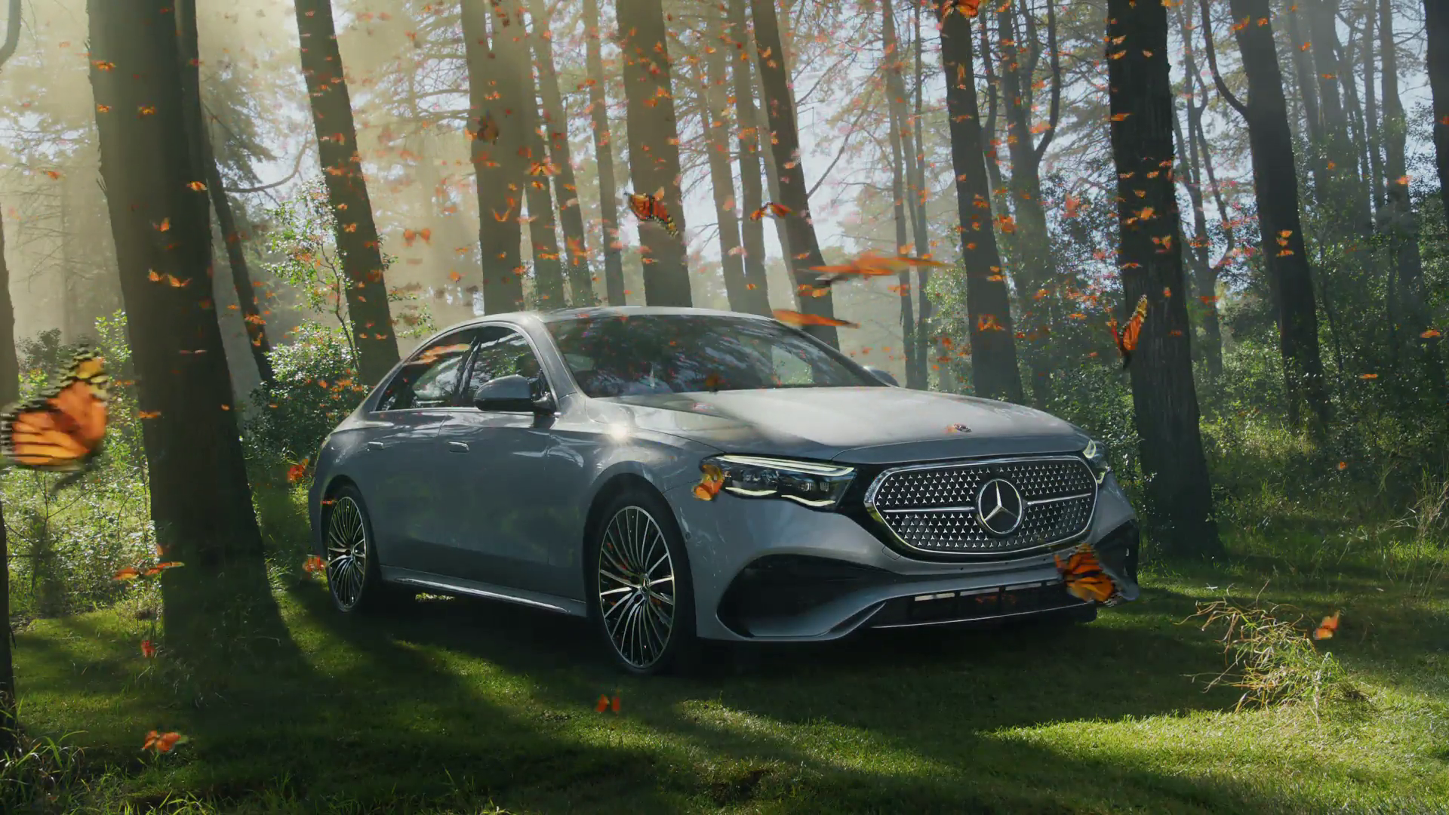
Case Studies
Mercedes-Benz – Dream Days: Many Forms

Slide 21




Toyota stands out from the crowd and shines
Challenge:
After the successful relaunch of its Supra sports car, Toyota needed to drive awareness and sales after the launch hype had died down
Solution:
Using brilliant creative and a multimedia plan that included a focus on the televised coverage of Goodwood Speedweek, Toyota managed to successfully engage sports car enthusiasts
Results:
Aided awareness grew by 15pp to 94%
Consideration grew by 40pp to 76%
First choice increased by 21pp to 28%
Notes:
The Challenge
Having successfully relaunched and sold out their iconic Supra sports car in 2019, Toyota needed to boost sales the following year when hype turned into ‘business as usual’, when new news became old news and when sales were slower.
Five months into 2020, Supra had achieved a portion of its sales for the whole of the year and with a target that was already 32% higher than 2019 launch sales, there was some serious catching up to do.
In a declining category dominated by players like Porsche (718) and Audi (TT), who accounted for 61.2% of the Sports coupe sub-category at the beginning of 2020, the objectives were to:
Shift model aided awareness above category average (82%) amongst Sports Car Owners and Enthusiasts
Reverse the sales that were trending down and increase sales above 2019’s successful launch
The TV Solution
Toyota knew that they needed to get sports coupe buyers to want to feel what it’s like to drive the Supra. Research revealed that they were independent and non-conformist drivers who craved uniqueness. They wanted to stand out and avoid driving the same car as everyone else.
However, this desire for individuality conflicted with the reality of the sports car market dominated by models like the Porsche 718 and Audi TT. "You Don't Buy A Sports Car To Blend In" was born. This creative concept recognized that buying a sports car should affirm individuality while subtly challenging the competition.
Due to the GR Supra's recent return, there were few on the road. Toyota transformed this potential weakness into a strength, leveraging the car's distinctive design and performance to position it as the choice for non-conformists. Creative agency, The&Partnership, produced a beautiful 30” spot bringing the concept to life and this formed the backbone of the campaign.
The Plan
As a result of the lockdown restrictions in place due to the pandemic, July 2020’s Goodwood Festival of Speed – the annual motorsports festival that welcomes motoring enthusiasts from around the world - was postponed. The organisers replaced the event with the Goodwood Speedweek, a new, one-time-only interactive entertainment experience behind-closed-doors planned for October. The event was to be televised on ITV channels and m/Six leapt on this as the perfect environment in which to run the Supra ad, reaching sports car enthusiasts live on ITV and on catch-up on ITV Hub.
Following this successful burst, a second phase of activity was planned for the end of Q1 2021, using addressable TV alongside content-led buys in high-indexing F1 and sports content across broadcaster VOD.
Both bursts of TV were part of a wider, multi-media plan developed by m/Six spanning print, display, YouTube and social.
Results
Aided awareness increased by 15pp from 79% pre-campaign to 94% post-campaign
Consideration increased by 40pp from 36% to 76%
First choice increased by 21pp from 7% to 28%
Against a backdrop of a passenger car market down -29% (2021 vs 2019) and a declining segment down -51% (2021 vs ‘2019), 2020 sales of GR Supra were up 44% on 2019 and 2021 was up a further 12% up on 2020
In System 1 quantitative research, the TV ad scored #2 in top 5 UK automotive adverts at that time, ordered by brand building potential, and #33 in the best adverts of all time

Slide 22


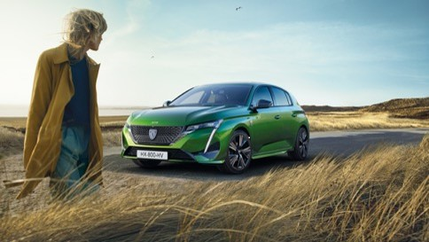
Peugeot 308- How to make consideration ‘alluring’
Challenge:
Peugeot, a legacy brand had dropped from people’s minds in the category and wasn’t cutting through with its audience. But the launch of the New 308 model in 2022 presented the brand with an opportunity to shift the brand’s awareness levels and relaunch Peugeot’s new brand positioning.
Solution:
Understanding fully the audience habits through data to find the right moments of talkability across both linear and BVOD to drive conversation and consideration.
Results:
88% increase in web traffic over the campaign period, 144% increase in search volumes on the launch day of the campaign and winning number 1 spot in the Automotive Share of Voice battle.
Notes:
The Challenge
Peugeot is a legacy brand in the automotive category, having been founded over 200 years ago. They are a brand that many believe they understand fully with many not taking steps to reappraise what the new and improved Peugeot stands for in the modern age. often associated with being ‘cheap’ ‘small cars’, the brand was getting lost in the mainstream as a result. Peugeot had, however, been on a transformation journey that saw Peugeot start to produce stunning new designs with high end quality throughout. They weren’t however joined by their audience on this journey and as a result there was a gap between the perception and the reality of the experience for the brand.
Having launched the 308 range in 2014 it was not well established in the market with low awareness levels among the small hatchback buying audience and hadn’t been seen on TV much as a result. But with the launch of the new hybrid in June 2022 and the car now carrying the new face of Peugeot, it was seen as the perfect time to launch the new brand platform of ‘The World’s Better With Allure’. The campaign needed to drive brand awareness and uplifts in both consideration and perception of Peugeot.
The TV Solution
308 as a brand hadn’t been on TV for 4 years which presented Starcom and Peugeot with an issue. Peugeot media habits and consumption habits of their Progressive Hedonist audience had changed dramatically, and the ad stock of the launch activity had long since faded. The brand had been focusing on short term channels which focused on sales over brand building. This led to the brand perceptions being underpinned by this activity with nothing on TV driving mass awareness of the changes the brand had undertaken. Starcom knew that the only way to shift this perception was to unleash the power of TV. With no AD stock to leverage, Peugeot knew they couldn’t buy their way out of the situation and would need to leverage the full scope of TV to get the brand out of the perception pit they found themselves in.
The Plan
With TV being highlighted as the only way to combat their perception problem, Peugeot and Starcom got to work in understanding how they could make the budget go as far as possible. Using their Planning tool TV+, Starcom set out to work out the optimal weekly weights that would allow the brand to create the strongest levels of Ad Stock from a standing start. It was decided that a 4-week campaign would give the campaign the highest levels of Ad stock to work off. Having found the right ad stock levels, Starcom set out to find the right frequency levels to meet the core objectives of brand consideration and get the new quality perceptions across with the Progressive Hedonist audience. This allowed Starcom to come at a target frequency of between 4 and 5.
With the goal of growing share of voice to place them in the top 3 for the EV category; Peugeot and Starcom needed to understand at what weekly weights the campaign would deliver the required cut through to raise awareness of Peugeot’s new brand platform. This would allow them to fully understand the different scenarios and at what weekly weights they would outshout competitors and deliver the required cut through with target audience to ensure Peugeot were in contention for the top 3 share of voice at campaigns end.
Having found the correct level for weekly weights and frequency, Starcom need to fully understand how they could optimise the campaign to try and hit the right consumers at the right time. Using in house planning tool TV+, Starcom were able to locate the top performing Channels, day of the week, daypart and programming that would allow them to pinpoint moments through the eyes of in-market EV buyers to ensure they were presenting the new image of Peugeot to consumers at the right times while viewers were in the right mind sets.
BVOD was added as a key element in helping to deliver incremental reach to combat the change nature of TV consumption in comparison to past 308 activity. This would allow Peugeot to deliver extended reach and lower the average age of the total AV campaign given the use of BVOD by 1634’s and lighter viewers. The campaign was planned so that it would match up with programming launches, which led to ITV taking higher levels of spend for the activity causing spikes against Love Island, a key show for the campaign to deliver against it goals. Using AV optimisation tools, Starcom were able to determine that the optimal split to hit the audience was 70/30 in favour of linear, this was a 10% higher BVOD spend then typical on Peugeot activity. The split allowed Starcom to show that BVOD was critical in helping to negate the declines in commercial reach that would have come from just using linear channels alone.
While TV formed the backbone of the activity, they integrated the campaign with wider media by activating around the biggest cinema release of the year, Top Gun Maverick, which amplified the TV activity and positioned the brand perfectly as being a contemporary in the most alluring, high end environment.
Results
As a result of the campaign, Peugeot saw significant increases in live sessions on their site. Over the campaign period, they saw an 88% increase in people accessing a Peugeot related page during the campaign period vs the past campaign period. On top of this, on the day the campaign went live, Peugeot saw an outstanding 144% increase in active daily sessions on their sites.
The effect of the campaign was seen right away with Starcom’s optimisation showing spikes around key programming with the biggest spike coming from Love Island, a key programme for the campaign and audience. This was something that Peugeot hadn’t seen before and haven’t seen since. Finally, the campaign saw that Peugeot had delivered against it goal of being in the top 3 in terms of Share of Voice for the EV category during the campaign period.

Slide 23


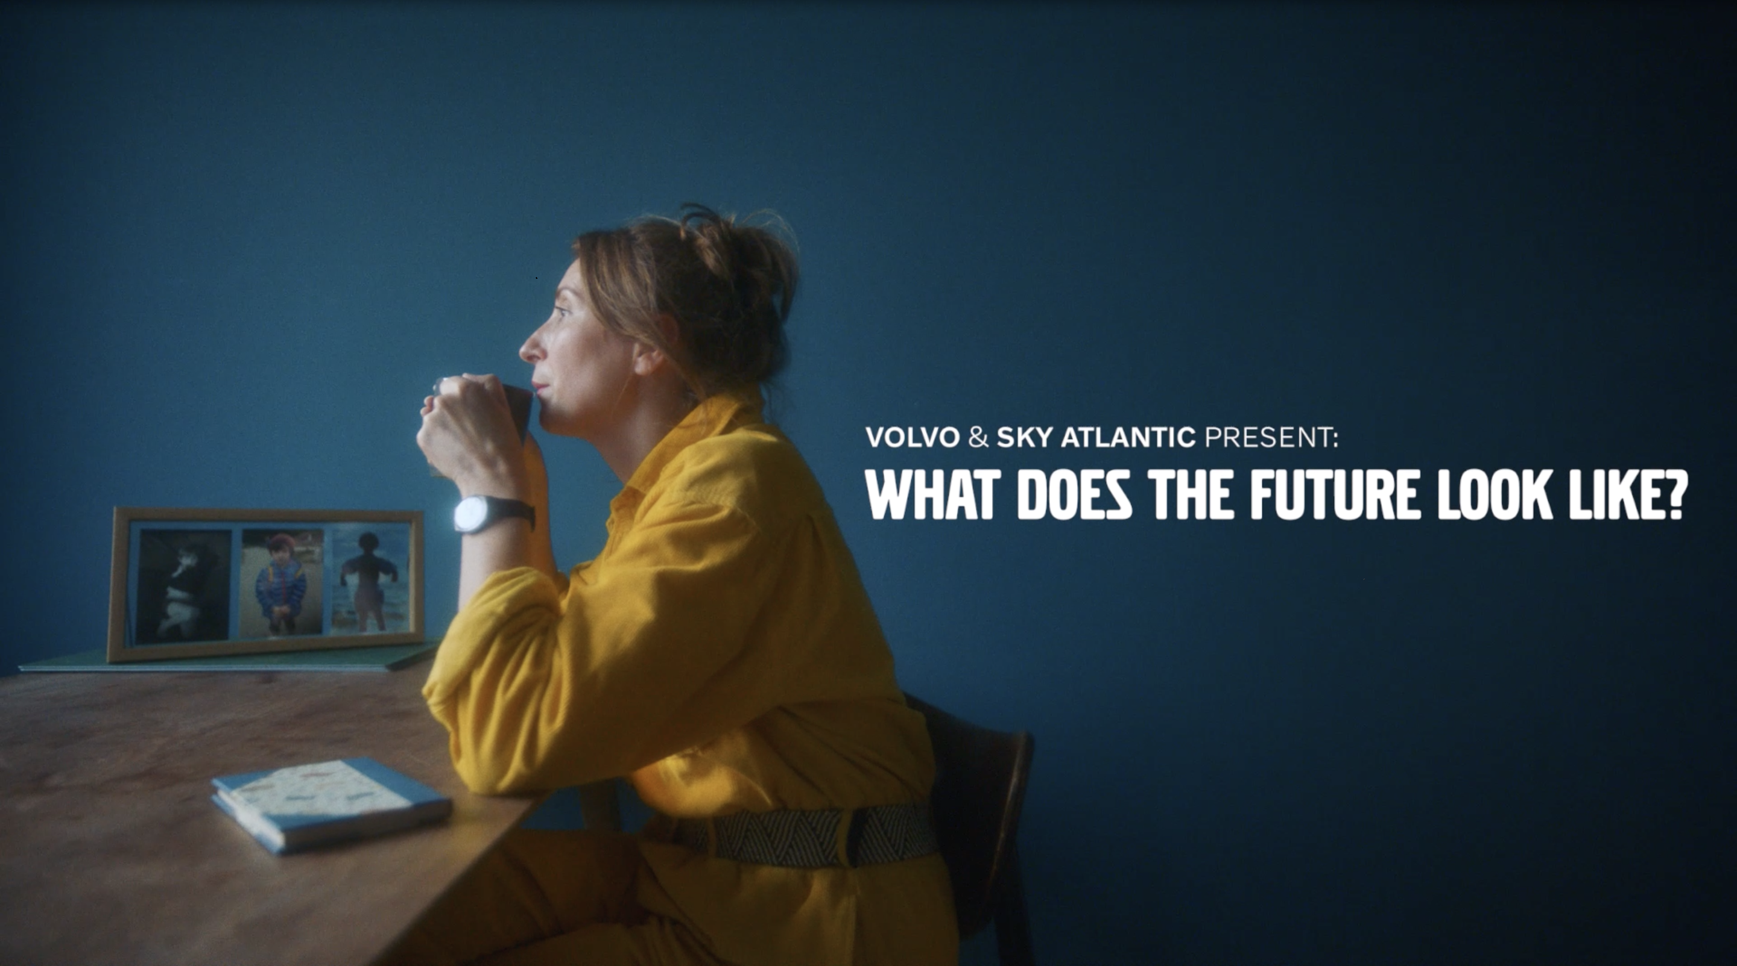
Volvo: using premium TV content to build a premium brand
Challenge:
Wanting to enter the High-end automotive sector, Volvo needed to change perceptions on the brand beyond being the safest around, while also increasing purchase intent.
Solution:
Sponsoring Sky Atlantic, Volvo used high-end programming to create the association of the brand with the high end, while also telling human stories about how the brand can help the world around them.
Results:
Sponsoring Sky Atlantic, Volvo used high-end programming to create the association of the brand with the high end, while also telling human stories about how the brand can help the world around them.
Notes:
The Challenge
In 2013, Volvo aspired to moving into the premium space while still providing and unrelenting focus on safety. They had worked hard to produce stunning new designs; but hadn’t started to build the premium association with the brand. Volvo turned to agency Mindshare with a brief containing clear objectives; change consumer perceptions to be more than safety, increase consideration and further consumer engagement with new and existing customers.
With challenge ahead of them with clear objectives to hit, Volvo needed to build a strategy that would allow them to build a new association and memory for the brand, that would see them habitually reach premium consumers in the most premium environment.
The TV Solution
With the clear objective of reaching a more premium upmarket audience with the highest frequency possible to make the association as habitual as possible. Mindshare set out to find the right property that would deliver this frequency. Having a clear objective of creating premium associations as regularly as possible, it was clear that sponsorship would be the only route to hit the objectives.
The Plan
Having found that sponsorship was the correct route, Mindshare needed to find the right sponsorship avenue for Volvo. Enter Sky Atlantic. The Sky channel was 5 years old at the time and has a history of being the highest end, high gloss media entity on the market; were looking for a new sponsor. Volvo jumped at this chance and launched with glossy idents asking the viewers ‘What makes a quality production?’ which linked together the high-end production of Volvo cars with the high-end productions sitting on Sky Atlantic. Not being able to directly sponsor HBO programming on the channel, Mindshare and Volvo brought the sponsorship into the real world by placing cars at premiers of each of the new HBO shows like Penny Dreadful and Game of Thrones. This provided the perfect backdrop to engage Volvo consumers with integrated solutions including tickets and branded cars.
After seeing success with the partnership in the first few years, Volvo, were now starting to gain a foothold in the premium automotive sector but needed to do more to stand out from the crowd. As a brand, Volvo has always prided itself on putting people’s wellbeing first. Originally this meant making cars safter than any other. With safety now ubiquitous in the sector, it was now right at the bottom of the consideration pile with ‘proud to own’ now the most important factor for those in market. Understanding a small but growing consumer base was key to this approach. This audience wanted to purchase things that would inspire them to make a positive impact on the world. This led to Volvo creating a new brand position as a ‘Defiant Pioneer brand for Defiant Pioneers’. Flipping the traditional narrative of Cars people are driving to stories about people driving the cars. Volvo’s new platform of ‘Human Stories’ was born. These ‘Human Stories’ were 4–7-minute docudramas produced with Sky, Grey and Mindshare- told the story of people trying to make the world a better place. The series launched with 30” ad-like trailers on Sky Atlantic and 15 and 5 second idents to drive the coverage and frequency. Launching in 2016, the campaign evolved the partnership into something more comprehensive with multiple touchpoints across Sky. This partnership continues to evolve with product -led idents, laying audience targeting to enable engagement, retargeting between branded and product content. They also became the first partner to be included in Sky’s EPG takeover.
Having seen huge success with the partnership in the last few years, the Automotive industry was entering a pivotal period with the EV market now being a huge section of new cars sold each year. With a growing consideration with high end players in the market starting to erode Volvo position, they needed to change their approach. Having seen that the automotive sector was starting to forget about women, Volvo saw the opportunity to signal they weren’t just part of the electric revolution but were in fact the leaders. Leveraging insights that the Sky Atlantic was the perfect platform to reach their new ‘purposefully progressive’ audience; down to the fact that viewers of the channel over indexed for alternative fuel autos, they were also more like to consider purchasing in the next 12 months. Both Sky and Volvo were at the forefront of sustainability and seen as leaders in their efforts for their sectors. New idents that placed the new Hybrid and full electric range were created along with a new version of ‘Human Stories’ under the banner of ‘What does the future Look like?’ all featuring women working in production from costume design to makeup. These stories highlighted the sustainable elements of production on Sky Atlantic productions while mirroring the efforts that Volvo were undertaking. The shorts were launched across Linear, VOD and Sky social channels and included integration with Sky’s EPG guide via voice search on sky remotes. Mindshare and Volvo were able to take the learnings from this activity in 2022 and aim to take the partnership to new heights in 2023.
Results
After the first year of sponsoring Sky Atlantic, Volvo saw spontaneous awareness more than double, while promoted awareness almost trebled. The partnership was having an outstanding impact on all brand health metrics; by November 2016, Sky Atlantic viewers were twice as likely to consider Volvo and purchase intent had grown by almost 4 times the rate of non-viewers.
Having seen success with the channel partnership and off-screen integration, in 2016 with the launch of ‘Human Made Stories’, Volvo continued to see outstanding results. The films themselves were viewed a whooping, 32 million times with 97% of viewers watching them to completion. The films continued to showcase increases in spontaneous awareness and promoted recognition. They also started to separate Volvo out from its competitors, All key metrics showed upticks in performance with key metric of ‘Proud to Own’ and ‘Understands People Like Me’ were showing steady growth over the 3 year period the ‘Human Made Stories’ campaign ran for. The campaign also coincided with a 28% increase in sales. Although it can’t be directly linked back to the campaign; the association with Sky Atlantic clearly showed links with purchase intent to be purely coincidence.
With the backdrop of the pandemic and Brexit pinching the supply chain, Volvo still delivered results and the partnership continued to perform. Spontaneous and promoted awareness both saw increases over the period the ‘What Will the Future Look Like?’ films ran of 21% and 13% respectively. And bucking a category trend in 2022, purchase intent also grew. The metrics around sustainability also saw increases across the campaign period with all metrics showing improvements post campaign. Finally, as the campaign was aiming to engage females in a meaningful way, all the metrics tracked showed increases with female viewers with purchase intent jumping to 52%, 22% higher than the category norm.

