Slide 1
TV ad time-lengths
H&M – Fall in Love
Notes:
One of the most common questions we receive on our TV planning helpdesk is ‘what is the optimal spot length for my TV ad?’. The simple answer is that the length of an ad should be as long as it needs to be in order to effectively achieve its objective. However, to help flesh this statement out and offer some practical guidance on how to determine the right ad length for your marketing objective, we’ve pulled this presentation together based on the wise words of Les Binet, one of the Godfathers of effectiveness.

Slide 2
The 30” spot is the most common time-length
% TVRs
Source: Barb, 2022, Individuals, proportion of TVRs by ad duration
Notes:
30 second ads are by far the most popular and indicate that this time-length, in general, provides that right balance between cost effectiveness and providing enough time to communicate a core brand message and create a lasting emotional effect.

Slide 3
The use of time-lengths differs by category
Source: Barb, 2022, Individuals
Notes:
The most prevalent users of longer spots is the charity sector. This will consist of DR daytime and small channel spots, but shows the power of longer spots in delivering a more emotive impact. This emotive impact is dependent on good storytelling – something much easier to do successfully in longer ads.

Slide 4
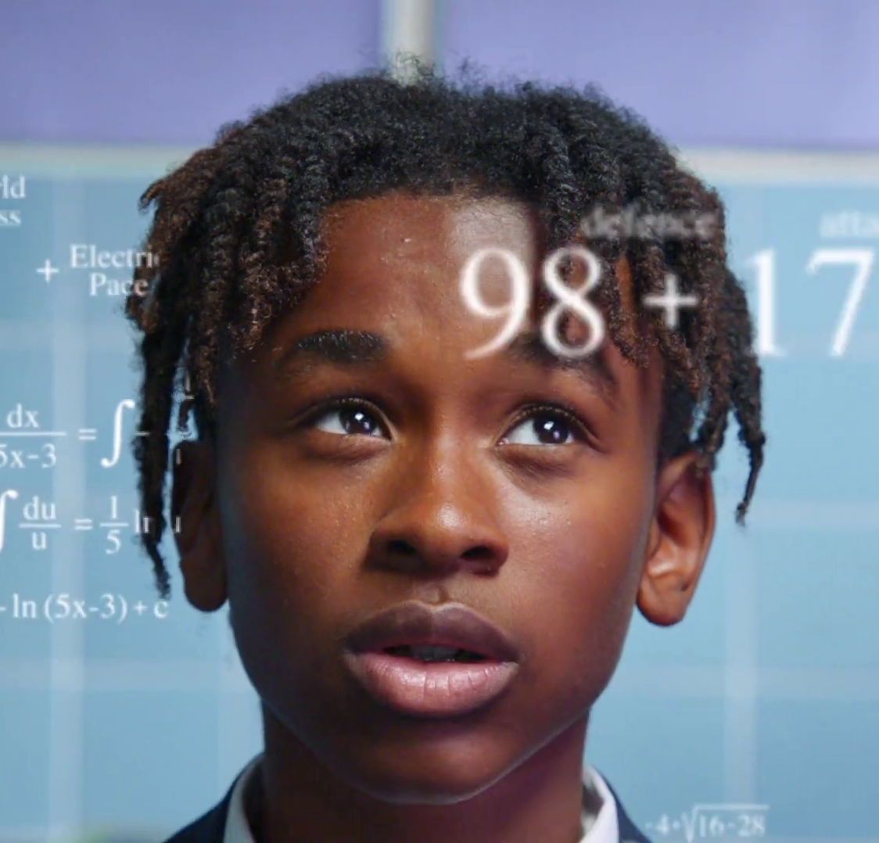
Time-lengths
These are the main variables that will influence the most suitable time-length for a TV ad:
Communication Objective
Budget
The creative execution
Creative copy rotation
Competitor activity
The following slides break down where these factors come into play.
Panini – The GOAT of Swaps

Slide 5
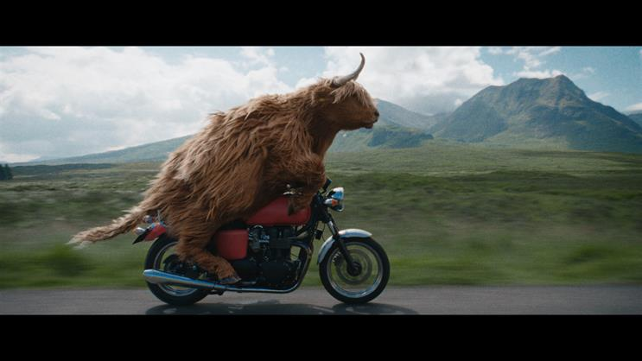
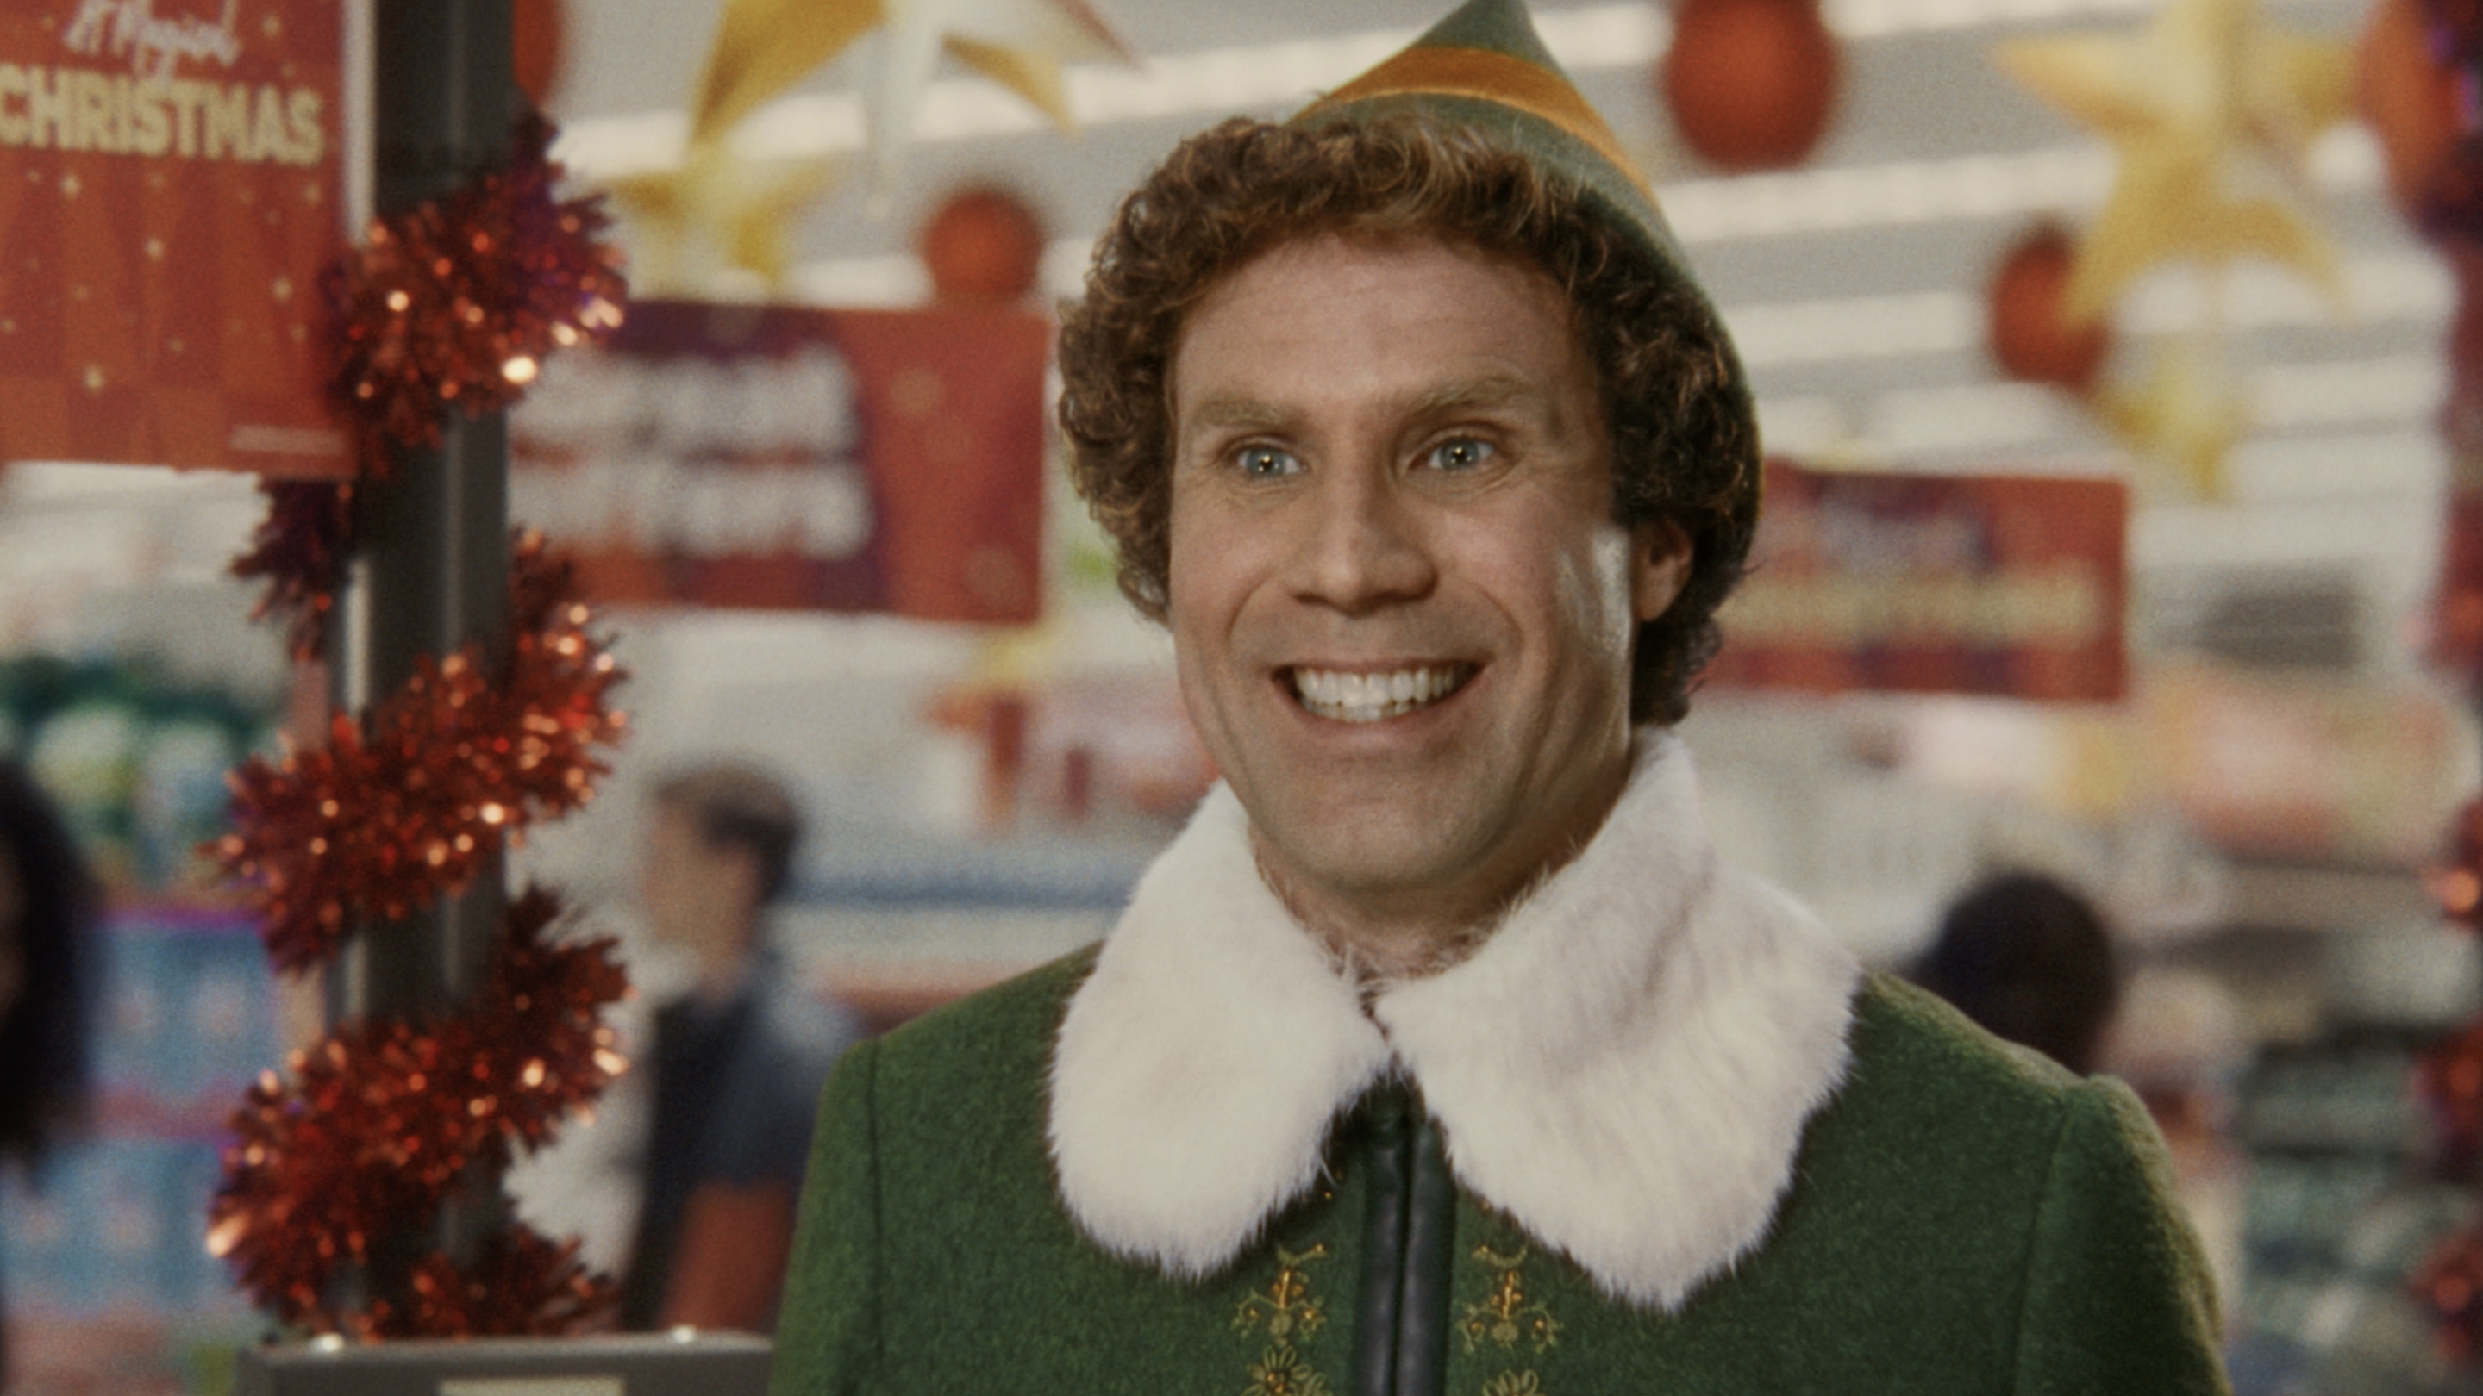
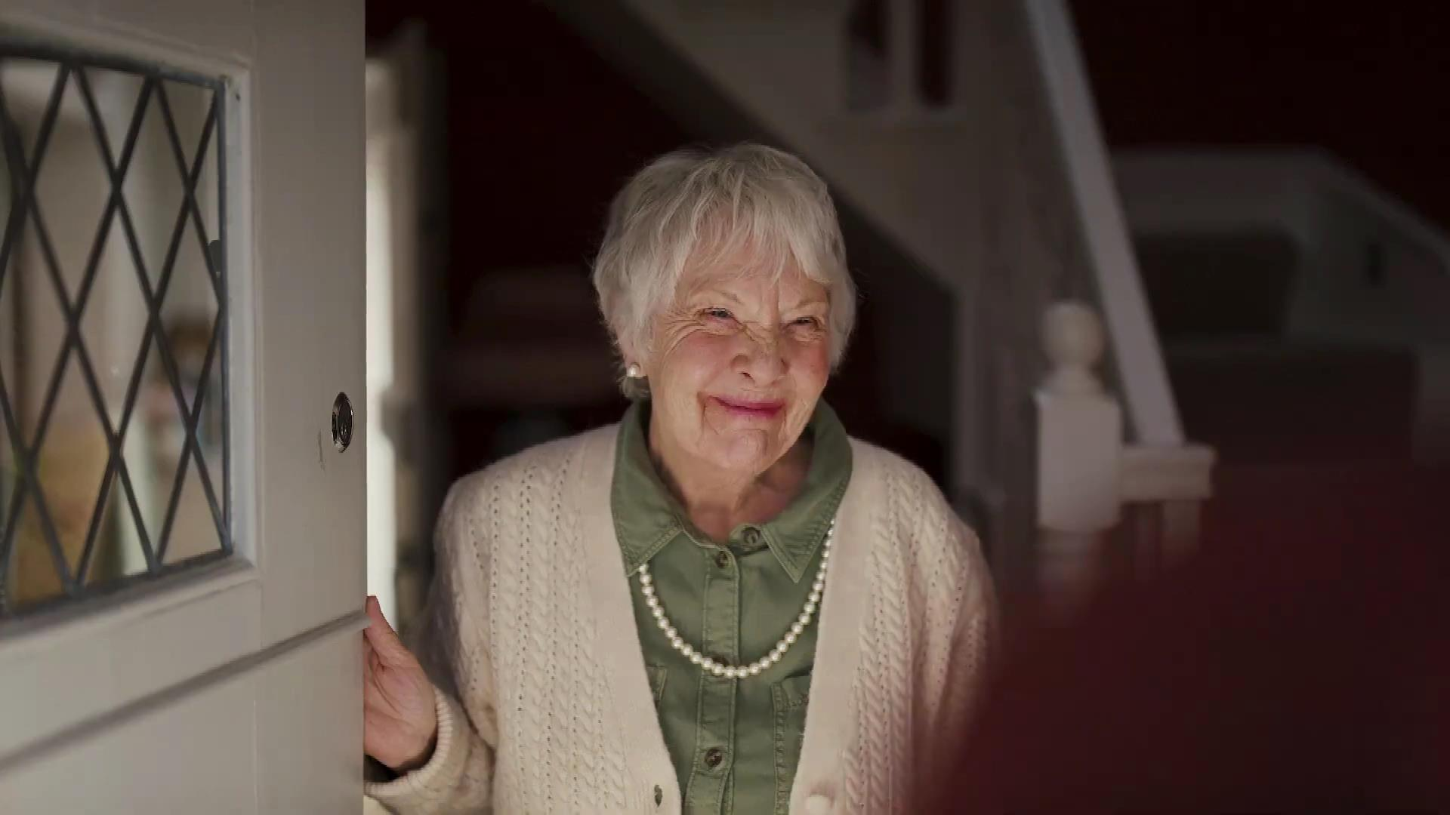
1. Longer ads are better for communicating more complex ideas and stories
Conveying multiple/complex messages is more difficult in a very short TV ad
Short ads are better for short, simple messages
Good storytelling involves taking people on an emotional journey. This is hard to do in a short ad
Millward Brown’s 2014 analysis shows that longer ads tend to score higher on a range of emotional metrics
Source: Les Binet. Millward Brown, 2014

Slide 6
Longer ads deliver more explicit brand information
Explicit agreement to brand statements
91%
64%
Source: A Matter of Time, 2019, Work/Walnut/Thinkbox. Based on 3 brands (3 x short ad; 3 x long ad)
Notes:
Longer ads delivered a 42% uplift to explicit brand statements over short ones and were therefore, unsurprisingly, better at delivering a greater volume of information.
Methodology:
Partnering with Walnut, Work Research devised the research framework. Firstly, they selected four existing creative treatments (three emotional and one rational) for brands that were unknown in the UK but sat within categories that were very familiar. These were retail, insurance, broadband and washing detergent.
Just to be certain, a team of real-life ad agency creatives tweaked the brands, giving them new identities. This way, none of the respondents had any previous brand history that could impact the results.
Next, the team of creatives formed a set of cut-downs for each using exactly the same processes they would for any of their clients. These cut-downs were then vetted by several different teams to ensure that creatively, they made sense and were fair representations of the original ads. Time-lengths were categorised as follows:
Long: 60”
Medium: 30”
Short: 10”, 6” or 5”
Finally, each of the ads were taken into an online test where each iteration was shown, in amongst a reel of other ad ‘clutter’, to 200 people each.
They were tested against two factors:
Explicit perception statements (to see what people thought and consciously remembered about the brands)
Implicit brand perceptions tests (to understand what people felt about them or thought they just knew for themselves)
The latter was tested via ‘IRT’ (Implicit Reaction Testing). If someone truly believes or disbelieves something, their initial reaction tends to be strong and automatic. The more doubt they have the slower the reaction time as the brain must consciously consider what is being processed and this slows the response down.
Around half of the respondents were tested again several days later. Some saw the ad repeated (either full length or cut-down) again whilst others didn’t which gave an indication of the decay rate for the measured effects.

Slide 7
Longer ads work even harder at an implicit level
Implicit agreement to brand statements
64%
36%
Source: A Matter of Time, 2019, Work/Walnut/Thinkbox. Based on 3 brands (3 x short ad; 3 x long ad)
Notes:
Longer ads worked much harder at an implicit level, however, where they almost doubled the implicit effects over short ads. The longer ads were evidently shifting brand feeling and sentiment more effectively, which is especially poignant when you consider that these brands were totally unknown to the respondents.
Methodology:
Partnering with Walnut, Work Research devised the research framework. Firstly, they selected four existing creative treatments (three emotional and one rational) for brands that were unknown in the UK but sat within categories that were very familiar. These were retail, insurance, broadband and washing detergent.
Just to be certain, a team of real-life ad agency creatives tweaked the brands, giving them new identities. This way, none of the respondents had any previous brand history that could impact the results.
Next, the team of creatives formed a set of cut-downs for each using exactly the same processes they would for any of their clients. These cut-downs were then vetted by several different teams to ensure that creatively, they made sense and were fair representations of the original ads. Time-lengths were categorised as follows:
Long: 60”
Medium: 30”
Short: 10”, 6” or 5”
Finally, each of the ads were taken into an online test where each iteration was shown, in amongst a reel of other ad ‘clutter’, to 200 people each.
They were tested against two factors:
Explicit perception statements (to see what people thought and consciously remembered about the brands)
Implicit brand perceptions tests (to understand what people felt about them or thought they just knew for themselves)
The latter was tested via ‘IRT’ (Implicit Reaction Testing). If someone truly believes or disbelieves something, their initial reaction tends to be strong and automatic. The more doubt they have the slower the reaction time as the brain must consciously consider what is being processed and this slows the response down.
Around half of the respondents were tested again several days later. Some saw the ad repeated (either full length or cut-down) again whilst others didn’t which gave an indication of the decay rate for the measured effects.

Slide 8
2. Longer ads may be more distinctive
Longer ads can provide stand out, particularly in categories where shorter ads are the norm
McDonald’s – Raise Your Arches
Source: Les Binet

Slide 9
Longer ads enhance memory effects
=
+28%
Improvement in explicit brand perception
3-5 days
=
Improvement in explicit perception
+9%*
3-5 days
=
Improvement in explicit perception
+51%
Source: A Matter of Time, 2019, Work/Walnut/Thinkbox. Based on 3 brands (3 x short ad; 3 x long ad) * Based on one test cell for one 10 second ad
Notes:
When a short ad is seen after a long ad, there’s a 51% uplift in explicit memory effects versus just 9% for seeing a short ad in isolation. This is including a gap of several days between viewing the ads and testing.
Methodology:
Partnering with Walnut, Work Research devised the research framework. Firstly, they selected four existing creative treatments (three emotional and one rational) for brands that were unknown in the UK but sat within categories that were very familiar. These were retail, insurance, broadband and washing detergent.
Just to be certain, a team of real-life ad agency creatives tweaked the brands, giving them new identities. This way, none of the respondents had any previous brand history that could impact the results.
Next, the team of creatives formed a set of cut-downs for each using exactly the same processes they would for any of their clients. These cut-downs were then vetted by several different teams to ensure that creatively, they made sense and were fair representations of the original ads. Time-lengths were categorised as follows:
Long: 60”
Medium: 30”
Short: 10”, 6” or 5”
Finally, each of the ads were taken into an online test where each iteration was shown, in amongst a reel of other ad ‘clutter’, to 200 people each.
They were tested against two factors:
Explicit perception statements (to see what people thought and consciously remembered about the brands)
Implicit brand perceptions tests (to understand what people felt about them or thought they just knew for themselves)
The latter was tested via ‘IRT’ (Implicit Reaction Testing). If someone truly believes or disbelieves something, their initial reaction tends to be strong and automatic. The more doubt they have the slower the reaction time as the brain must consciously consider what is being processed and this slows the response down.
Around half of the respondents were tested again several days later. Some saw the ad repeated (either full length or cut-down) again whilst others didn’t which gave an indication of the decay rate for the measured effects.

Slide 10
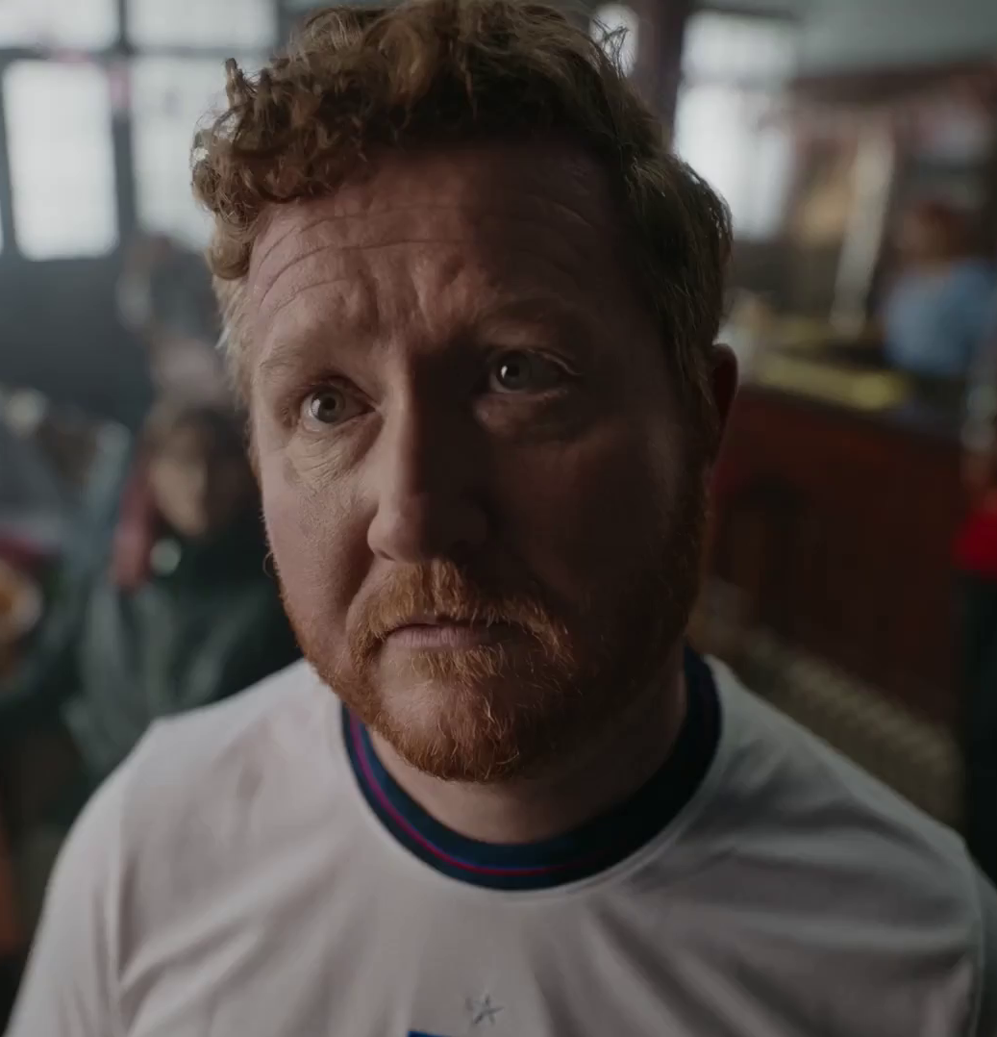
3. Longer ads are more likely to create fame
Millward Brown suggest that long ads are more likely to be seen as an "event“
As long ads are more likely to be noticed, tell interesting stories and create a bigger emotional reaction – they are more likely to be talked about
However, this is dependent on great creativity
Snickers – Full Support
Source: Millward Brown, 2014. Les Binet

Slide 11
4. There are diminishing returns, but longer ads are cheaper per second
Doubling the length of the ad does not double recall (see chart)
But 30” plus ads are cheaper per second than 10” or 20” ads
Beyond a certain length, attention may drop
The optimum length will depend on context and creative
% OF VIEWERS WHO RECALLED THE AD
Indexed cost relative to a 30”
50
85
100
133
166+
Source: billetts research, 1998. Les Binet

Slide 12
5. Short ads serve many useful purposes within a campaign
Short ads may be useful at driving response, serving as a trigger/reminder and more efficient for communicating simple messages
Short ads can be useful for broadening reach/continuous presence – especially if budget is low
Colgate – Change Please
Source: Millward Brown, 2014. Les Binet

Slide 13
Summary
Time length should be as long as is required to effectively achieve the objective.
Longer ads: more memorable, more emotion, create more stand out and are better at driving brand fame.
Short ads: more cost efficient, good for simple messaging, better for low budgets, serve as a trigger / reminder for a longer ad.
LinkedIn – Find Your Space

