Slide 1


Telecoms Deep Dive
Sky Mobile – Keep Rollin

Slide 2

This deck is packed with insights
To provide an analysis of the Telecoms category this deck explores the following areas:
Macro Spend Patterns:
Spending behaviour and patterns
Effectiveness:
TV is crucial to the plan
Media Planning:
Weekday, and daypart analysis
Ad time-lengths
Case Studies:
Sky Mobile and EE
Vodafone – Two Networks Are Better One
Notes:
To provide an analysis of the Telecoms category this deck explores the following areas:
Macro Spend Patterns:
Spending behaviour and patterns
Effectiveness:
TV is crucial to the plan
Media Planning:
Weekday, and daypart analysis
Ad time-lengths
Case Studies:
Sky Mobile and EE

Slide 3

Macro spend patterns
EE – Hidden Treasures

Slide 4
In 2025, £231m was spent on linear TV by Telecoms brands
+£46m
+14%
+23%
-£43m
-12%
+£60m
-£74m
-23%
-£17m
-7%
Source: Nielsen Ad Intel, 2020-2025, TV Spend, %’s show YoY change.
Notes:
Telecoms TV spend has fluctuated over recent years due to external factors such as the COVID-19 pandemic and the cost of living crisis.

Slide 5
Fixed line services drove the overall decline in 2025
+£46m
+14%
+23%
-£43m
-12%
+£60m
-£74m
-23%
-£17m
-7%
Source: Nielsen Ad Intel, 2020-2025, TV Spend, %’s show YoY change.
Notes:
In 2023, the primary factor behind the overall decline in TV investment in the telecoms sector was the reduction in spending by mobile networks.

Slide 6
Telecoms share of linear TV impacts remains c. 5%
Source: Barb, 2010-2025, impacts (R/W), telecoms share of voice vs all other categories.
Notes:
Telecoms share of voice relative to all other categories has increased since 2010.

Slide 7
Telecoms advertisers SoV has fluctuated across last decade
Source: Barb, 2010-2025, individuals, impacts (R/W), linear only, top 10 telecoms providers by linear impacts from 2010-2025.

Slide 8










In 2025, EE was the largest Telecoms investor in linear TV
Source: Barb, 2025, Individuals, Impacts (R/W) (million). Top 10 Telecoms advertisers by total linear TV impacts.

Slide 9

Effectiveness
Virgin Media – Trunk Trcuker

Slide 10

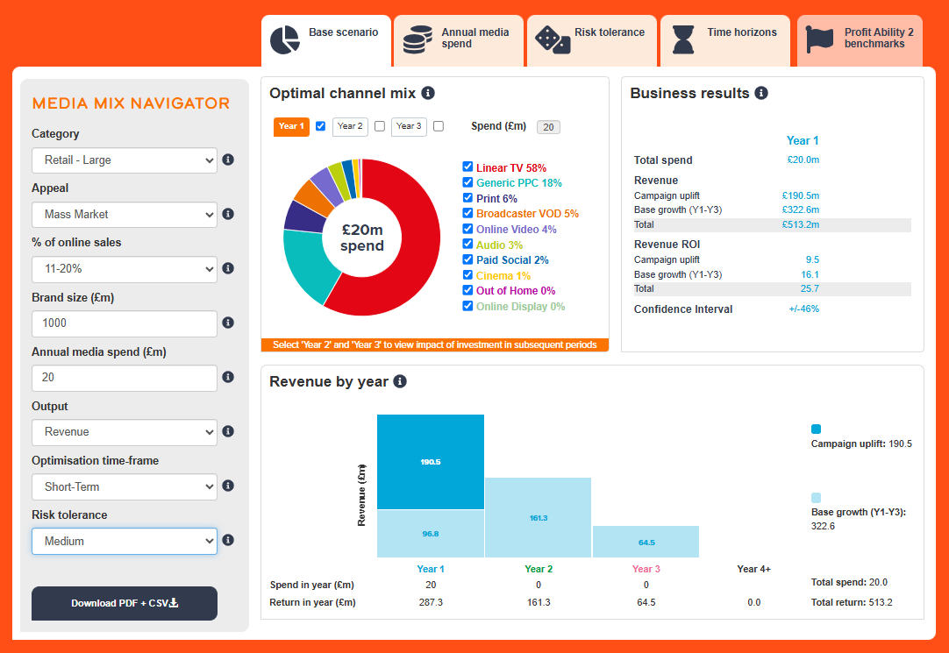
Profit Ability 2 and Media Mix Navigator
Profit Ability 2 was conducted by Ebiquity, EssenceMediacom, Gain Theory, Mindshare, and Wavemaker UK.
It’s a meta-analysis of econometric studies from 141 brands covering £1.8 billion of media spend across 10 media channels and 14 business sectors.
The Media Mix Navigator (MMN) tool, powered by the data from Profit Ability 2, allows you to explore different scenarios to define the optimum media mix for your business, whether your objective is to drive increased profit or revenue.

Slide 11
Optimised MMN scenario for Telecoms recommends higher share of TV vs. actual databank share
Actual vs. Media Mix Navigator Optimised channel mix
Source: Media Mix Navigator, Optimised based on Telecoms, £10,000m brand size, mass market, short-term, medium risk and media budget of £15m.
Notes:
Channel investment strategy depends on not only a brand’s objective but also the category it is in, as well as budget, brand size and risk appetite. There is no better tool than the Media Mix Navigator (MMN) to provide a benchmark view that takes into account these crucial factors. The MMN recommends a higher share of Linear TV & BVOD when compared against the actual databanks share.
The Media Mix Navigator is available here:
https://www.thinkbox.tv/training-and-tools/media-mix-navigator/media-mix-navigator

Slide 12
Total TV is the most effective channel in both short & full term
Short-term effects
Bubble size represents % of short-term profit volume
Telecoms Short-Term ROI: £1.49
Full effects
Bubble size represents % of full profit volume
Telecoms Full Profit ROI: £3.13
Source: Profit Ability 2, April 2024 – Short term benchmarks: Ebiquity, EssenceMediacom, Gain Theory, Mindshare, Wavemaker UK.
Notes:
In Telecoms, all channel short term Profit ROI is just under £1.50.
Linear TV delivers 39% of the total profit volume.
Generic PPC is quite strong - as you’d expect given a lot of the sales in the sector are transacted online.
Looking at longer-term view, it’s a similar story with all the bubbles moving up, but to different ratios.
Linear TV is driving just over half of all profit.
BVOD, although a smaller driver of profit, has the highest ROI – c.£5, compared to the overall average of £3.13,
Paid Social and Online Video are also pretty strong when sustained effects are included.

Slide 13

Media planning
O2 – England, Meet England

Slide 14
In 2025, Telecoms linear TV spend skewed toward Apr & Sep
Index of telecoms commercial linear TV impacts vs all categories
Telecoms linear TV index by month
Jan | Feb | Mar | Apr | May | Jun | Jul | Aug | Sep | Oct | Nov | Dec
90 | 75 | 101 | 119 | 99 | 109 | 94 | 102 | 129 | 97 | 104 | 84
Automotive linear TV index by month
Jan | Feb | Mar | Apr | May | Jun | Jul | Aug | Sep | Oct | Nov | Dec
165 | 134 | 72 | 95 | 114 | 101 | 89 | 130 | 123 | 96 | 52 | 31
Top 10 telecoms advertisers commercial linear TV index by month
 | Jan | Feb | Mar | Apr | May | Jun | Jul | Aug | Sep | Oct | Nov | Dec
EE | 133 | 104 | 72 | 99 | 81 | 125 | 69 | 80 | 116 | 107 | 136 | 77
Vodafone | 53 | 99 | 69 | 98 | 114 | 142 | 143 | 121 | 74 | 82 | 73 | 144
Three | 58 | 43 | 154 | 182 | 137 | 128 | 144 | 77 | 129 | 110 | 54 | 1
Virgin Media O2 | 35 | 44 | 53 | 175 | 90 | 167 | 98 | 117 | 111 | 60 | 141 | 126
Sky | 169 | 96 | 78 | 137 | 85 | 37 | 0 | 43 | 247 | 143 | 91 | 64
Google | 152 | 1 | 104 | 147 | 2 | 41 | 113 | 73 | 140 | 81 | 229 | 102
Virgin Media | 73 | 98 | 175 | 91 | 50 | 59 | 81 | 108 | 186 | 199 | 67 | 19
Samsung | 56 | 138 | 24 | 0 | 200 | 158 | 186 | 208 | 100 | 0 | 0 | 154
Tesco | 46 | 70 | 133 | 207 | 106 | 61 | 70 | 80 | 201 | 84 | 91 | 61
Lebara | 78 | 107 | 113 | 109 | 127 | 119 | 93 | 119 | 70 | 81 | 86 | 102
Source: Barb, 2025, monthly index vs full-year 2025, individuals, top 10 advertisers by total linear impacts.
Notes:
Telecoms linear TV spend is seasonal and skews toward April and September.

Slide 15
Telecoms linear TV spend skews towards daytime viewing
Index of telecoms commercial linear TV impacts vs all categories
Telecoms commercial linear TV index by daypart
 | 6am | 7am | 8am | 9am | 10am | 11am | 12pm | 1pm | 2pm | 3pm | 4pm | 5pm | 6pm | 7pm | 8pm | 9pm | 10pm | 11pm | 12am | 1am | 2am | 3am | 4am | 5am
Monday | 58 | 45 | 99 | 104 | 116 | 118 | 116 | 124 | 122 | 132 | 120 | 100 | 88 | 84 | 94 | 92 | 91 | 91 | 92 | 95 | 88 | 100 | 110 | 119
Tuesday | 53 | 47 | 88 | 100 | 115 | 118 | 113 | 123 | 120 | 123 | 121 | 97 | 90 | 84 | 113 | 87 | 91 | 87 | 89 | 98 | 89 | 83 | 99 | 110
Wednesday | 55 | 47 | 92 | 102 | 115 | 114 | 117 | 120 | 121 | 126 | 120 | 99 | 92 | 85 | 96 | 92 | 96 | 92 | 93 | 96 | 94 | 88 | 102 | 116
Thursday | 70 | 43 | 85 | 101 | 109 | 115 | 116 | 120 | 120 | 130 | 123 | 100 | 90 | 84 | 102 | 94 | 88 | 92 | 90 | 91 | 88 | 90 | 103 | 119
Friday | 64 | 42 | 84 | 96 | 110 | 115 | 110 | 117 | 116 | 121 | 117 | 97 | 85 | 89 | 98 | 104 | 99 | 89 | 90 | 94 | 91 | 97 | 98 | 119
Saturday | 70 | 55 | 89 | 87 | 101 | 104 | 103 | 117 | 112 | 115 | 108 | 97 | 102 | 100 | 109 | 99 | 83 | 81 | 83 | 87 | 82 | 84 | 93 | 113
Sunday | 68 | 61 | 92 | 89 | 93 | 99 | 102 | 116 | 117 | 118 | 109 | 121 | 96 | 98 | 90 | 96 | 87 | 76 | 83 | 90 | 94 | 80 | 103 | 100
Monday | Tuesday | Wednesday | Thursday | Friday | Saturday | Sunday
95 | 99 | 96 | 97 | 98 | 108 | 107
Source: Barb, 2025, individuals, commercial linear, telecoms index vs all categories.
Notes:
Telecoms linear TV spend skews toward daytime and weekend viewing.

Slide 16
Use of 30” is high amongst Telecoms advertisers
Source: Barb, 2025, individuals.
Notes:
The most prevalent users of longer spots is the charity sector (Govt, Social, Political Org). This will consist of DR daytime and small channel spots, but shows the power of longer spots in delivering a more emotive impact. This emotive impact is dependent on good storytelling – something much easier to do successfully in longer ads.

Slide 17
Telecoms ad lengths have shortened over the last ten years
Source: Barb, 2003-2025, individuals, telecoms category
Notes:
Telecoms ads have progressively shortened over the last 10 years, now typically lasting 30 seconds or less.

Slide 18
Use of spot length varies across most advertisers
Source: Barb, 2025, individuals, linear only, telecoms category, top 15 by total linear impacts.
Notes:
Use of spot length varies across most of the telecoms category with 30” being the most popular choice.

Slide 19

Case Studies
Google Pixel – Oscar Piastri

Slide 20


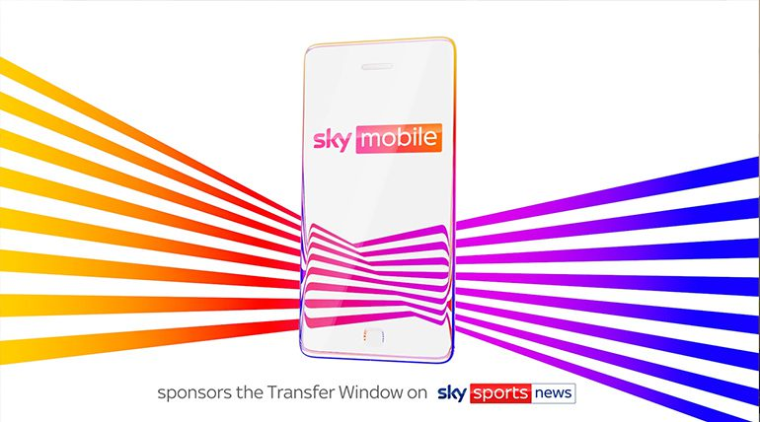
Sky Mobile partners with Transfer Deadline Day
Challenge:
Sky Mobile needed to create standout in a highly competitive market and encourage people to switch from their current provider to Sky Mobile
Solution:
They sponsored Sky Sports News’ Summer Transfer Window as part of a strategic partnership
This involved sponsoring a package of transfer programming, a contextual spot, a licensing deal, social media and PR
Results:
Advocacy +48%,
Talkability +86%,
Purchase Intent + 49%
Consideration +70%
Notes:
The Challenge
The lead-up to the highly anticipated iPhone 15 launch in September 2023 marked the busiest period of the year for mobile networks. As a relatively new player, Sky Mobile needed to cut through the noise in a market that is highly contested through contract pricing, network coverage and access to the latest handsets.
Developing a platform that created a point of difference for Sky Mobile vs. their competitive set, by promoting properties that are unique to the brand, would be key to driving strong front of mind awareness, increasing consideration, purchase intent and most importantly driving incremental sales.
The TV Solution
Sky Mobile had previously Sponsored This Morning (ITV), Sky Max and more recently, A League of Their Own, so they were well aware of the benefits a well-executed sponsorship delivers, particularly when it comes to increasing key consumer behaviour metrics. They also understood the value of sponsorship as a primer, making sales-focussed advertising work harder as a result, and so they looked for a potential sponsorship property in 2023.
The perfect vehicle was secured. Sky Mobile signed up to sponsor Sky Sports News' Summer Transfer Window - a strategic partnership that enabled the brand to align with unmissable content, promote “Watch” and build credibility for their “Switch” messaging.
To create a point of difference, the brand’s comms would focus on:
Promotion of “Watch”: The ability to stream Sky apps like Sky News, Sky Sports and Sky Go without using data allowance.
Encouraging prospects to “switch”: Surfacing unique Sky Mobile offers and promoting the “text-to-switch” mechanic that made it easier than ever for UK mobile customers to transfer to a new network.
The Plan
The sponsorship package consisted of:
All Sky Sports News transfer programming from June to September 2023 including:
Good Morning Transfers
Transfer Talk
The Transfer Show
The Transfer Centre
Sky Sports News 5 to 7 (this is where the biggest transfer stories would be covered)
Alongside this, Sky Mobile ran an in-programming graphic sponsorship of the Transfer Window Countdown Clock that ran throughout the Transfer Window.
They also negotiated a licensing deal which enabled them to create a bespoke Transfer Window spot using Sky Sports News branding that announced Sky Mobile’s bespoke Transfer Offer for new customers. This contextual spot was highly targeted to ensure it played out in content that would appeal to football fans in the build up to Transfer Deadline Day. This included spots in Sky Sports News, Gillette Soccer Saturday, Saturday Social and also key Premier League games such as Sheffield Utd v Man City and Newcastle v Liverpool. The TV ad also included a QR code that drove users to a landing page that promoted Sky Mobile’s ‘Transfer Offer’.
The partnership provided an excellent opportunity to get a high frequency of message across at a critical time. It also meant that Sky Mobile could ‘own’ the 2023 summer transfer window and that they would be part of the ‘switch’ conversation wherever and however the UK’s football fans got their transfer fix.
To support the TV activity, Sky Mobile ran activity online which included a 5 second sponsor pre-roll on all Transfer content on SkySports.com and the Sky Sports app as well as a contextual display ad around Transfer editorial. There was also a homepage takeover that ran on SkySports.com on Transfer Deadline Day with the special offer for new customers.
On social media, there was branded content featuring Dharmesh Sheth from Sky Sports News and other Sky Sports talent. This content was called ‘Switch List’ and covered the biggest transfer stories of the day.
For PR, they recruited Harry Redknapp who delivered a ‘Talk to ‘Arry’ stunt where he visited iconic locations in London to talk to the public, discussing the Transfer Deadline stories and promoting Sky Mobile’s ‘Transfer Offer’.
Results
In total, there were 187 sponsored shows on TV with 12,495 seconds of sponsor branding
Approx. 5m individuals were reached by the TV partnership
Sponsorship effectiveness research, conducted independently by Savanta, showed substantial increases in key consumer behaviour metrics across the board (comparing viewers vs. non-viewers):
Advocacy +48%
Talkability +86%
Purchase intent +49%
Consideration +70%

Slide 21


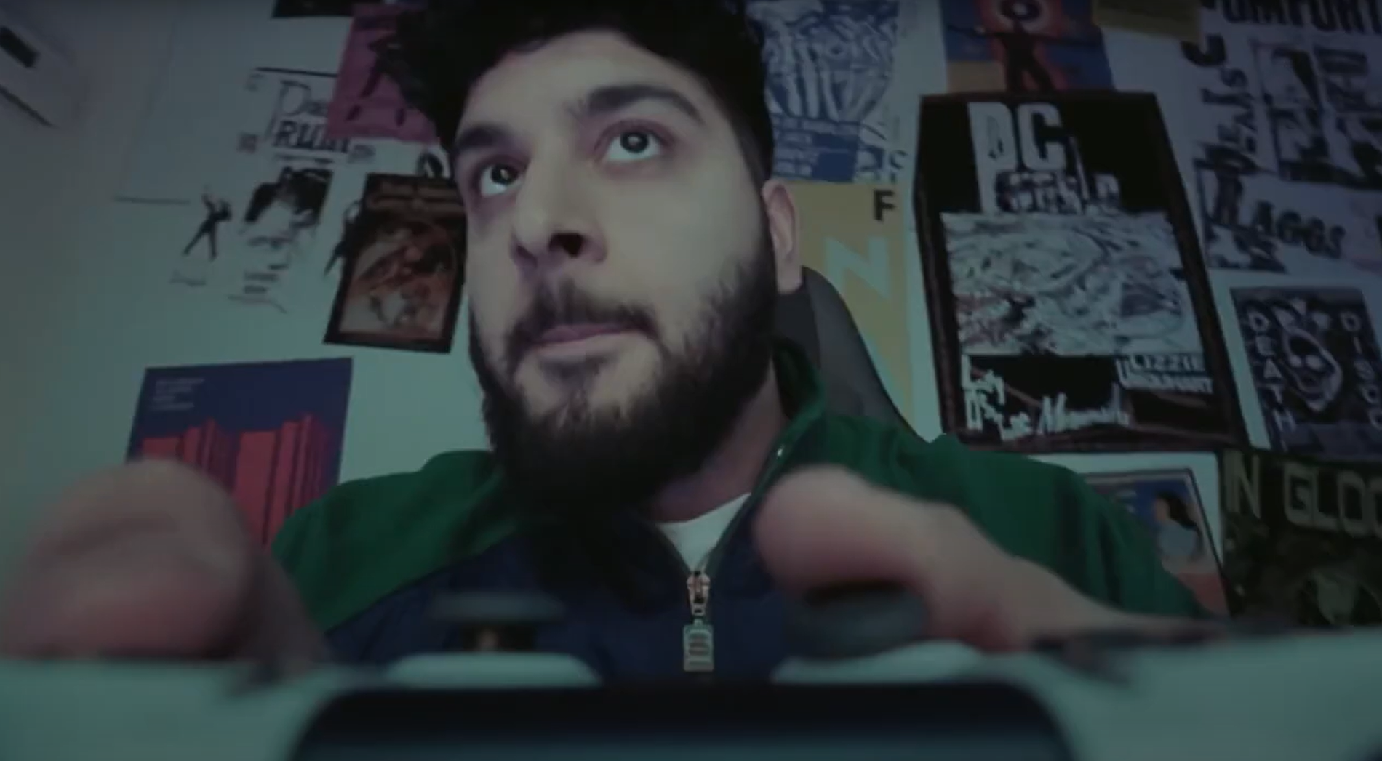
EE Game Store: TV reaching Gamers and Gifters to drive sales
Challenge:
In 2023, EE launched its Game Store to tap into gaming growth. Early momentum was promising, but stronger reach was needed to drive sustained growth, boosting consideration, purchase intent and sales among ‘gamers’ and ‘gifters’.
Solution:
Sales analysis revealed two key audiences: Gamers and Gifters. While TV hadn’t been used before, Thinkbox’s Profit Ability 2 and econometric analysis showed TV could drive immediate sales and efficiently reach both audiences through live sport and family entertainment.
Results:
TV became the campaign backbone and delivered standout growth. Sales hit 3x target, gamer purchase intent surged 200% above target, and consideration from both new and existing customers exceeded expectations.
Notes:
The Challenge
In 2023, EE launched their Game Store, having identified gaming as a key and new growth area for the business. Setting up the store saw them competing with established retailers like Amazon, Curry’s and John Lewis. The challenge facing EE was that gamers were reluctant to let a new brand into the space. Since the launch of the store, EE had worked to establish awareness and consideration through social and platform partnerships. This had created bursts of success, but nothing sustained in the way the brand had been hoping to see.
In 2024, EE changed focused and looked to bring TV into the mix. TV is a proven weapon that would move the dial on both brand building and sales, providing media agency WPP Media with a clear set of objectives. The campaign would need to increase consideration, increase purchase intent from ‘All in Gamers’ and increase sales.
The TV Solution
Armed with a clear set of objectives, WPP Media got to work in crafting an approach to the problem. Analysis of sales highlighted two clear audiences, gamers themselves and gifters. To be successful, WPP Media and EE Game Store needed to speak to and convert both groups, even more so when heading into the golden quarter in the lead up to Christmas. With both audiences needing unique messaging to deliver success, WPP Media crafted a consumer journey across platforms and devices underpinned by linear TV.
TV had been avoided at launch in 2023, as it was deemed that the gaming audience wouldn’t resonate with the channel. But by using Thinkbox’s Profit Ability 2 research, along with EE’s own econometric analysis, WPP Media presented a clear argument.
TV delivers a short term ROI and drives immediate sales throughout the Golden Quarter. Along with this, TV provided the ability to leverage high profile co-viewing moments, which would enhance recall and attention.
By building specific audiences to overcome the fragmentation of viewing, WPP Media were able to craft an audience that allowed them to pinpoint key viewing moments across all broadcasters. By focusing on big sporting moments, EE Game Store would be able to reach both gamers and gifters at the same time. Coupled with the top programming, WPP Media would be able to deliver against their steep targets.
The Plan
With a clear approach laid down, WPP Media put their plan into action. EE’s Game Store campaign kicked off on Saturday 1st November with a 30” creative. Launching right in the thick of the major retailers’ festive campaigns helped frame the campaign. Kicking off in November would allow EE to run a heavy weight campaign and gain a significant share of voice advantage across the month.
With a focus on ABC1adults, WPP Media crafted a plan that would allow targeting across ABC1adults, 1634s and ABC1Men, ensuring access to key programming for success. Along with this, WPP Media wanted to ensure they delivered appointment to view programming throughout the month, while ensuring the campaign still packed a punch in the final week.
This approach saw the campaign launch in Gogglebox to reach the gifters audience and followed up with a spot in live football on Sky in the game between Tottenham and Aston Villa to reach the key ‘All In Gamers’ audience segment.
This approach continued with a focus on reaching the ‘All In Gamers’ segment en masse with more live sport. Spots were bought in the UFEA Nations League match between England and Greece, ensuring they maintained a good share of voice across the month of November.
By holding some budget back for the final week, EE and WPP Media were able to finish the campaign with a bang in the lead up to Black Friday and Cyber Monday. WPP Media ensured a presence in the key family programming across the week to hit the gifters audience segment. This included a spot in the final of The Great British Bake Off on Channel 4, followed by one on Black Friday in Gogglebox.
The attention then moved to the ‘All In Gamers’ segment, with spots in the London derby between West Ham and Arsenal. This final week of activity ensured that EE Game Store stood out in a saturated market. The campaign was supported with integrations across VOD, SVOD and Cinema.
Results
The campaign was a massive success in establishing EE Game Store, with TV forming the backbone of the campaign, proving it could still resonate with gamers.
With an objective of increasing sales, the campaign smashed the target delivering 3x the sales vs the target.
There was remarkable growth in first choice purchase intent among the ‘All In Gamers’ - 200% above target.
Consideration also jumped among new customers, double the target. Even with existing customers, consideration also jumped.
‘Moving into the TV space was our next step in growing EE’s presence in the gaming vertical since its launch in 2023. Targeting families in the connected home, we focussed on the storytelling power of TV to perfectly illustrate EE’s ability to ‘do more’, and deliver the seamless gaming experience that gamers crave. The results didn’t disappoint, with TV’s transformative ability helping establish EE Game Store as a premium destination for gamers through increased awareness and consideration, most notably shown by the closing gap between us and the established competitors. We’re excited to see what TV can being to our future Game Store Activity.’
Laura Stone, Senior Media Manager, EE

