Slide 1
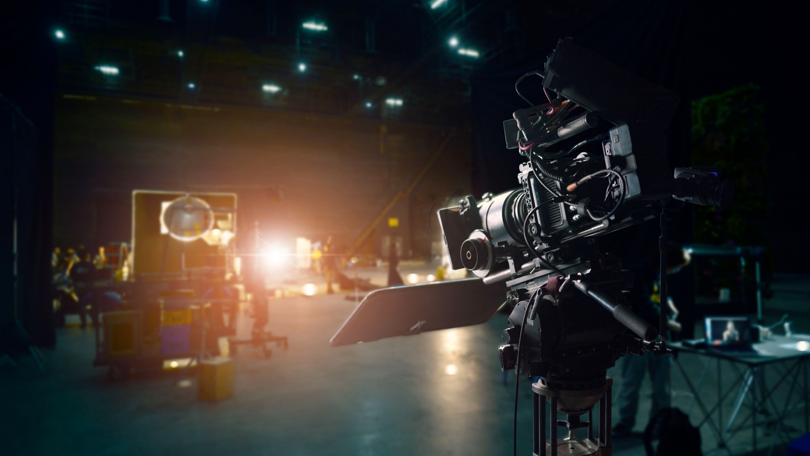
Getting on TV
Tuesday 31st October 2023
#GettingOnTV
@ThinkboxTV

Slide 2
Welcome
Harry Ward-Masters
Agency Relationships Manager, Thinkbox
#GettingOnTV
@ThinkboxTV

Slide 3
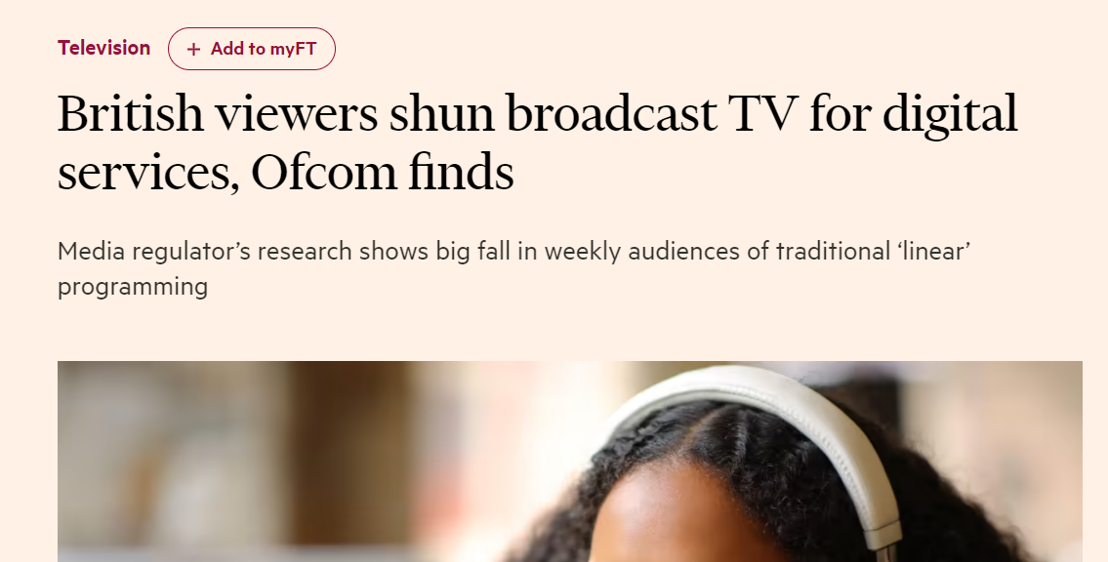
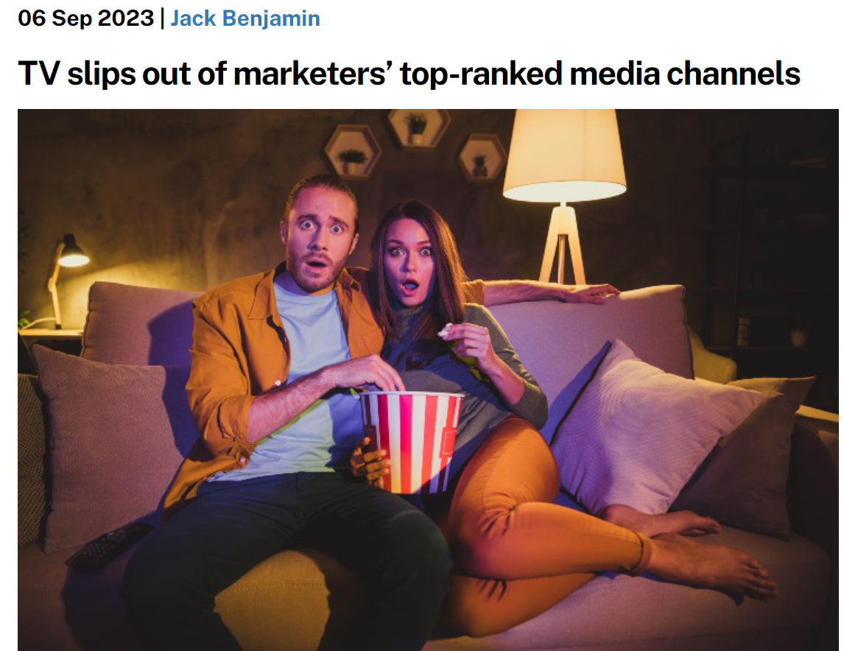
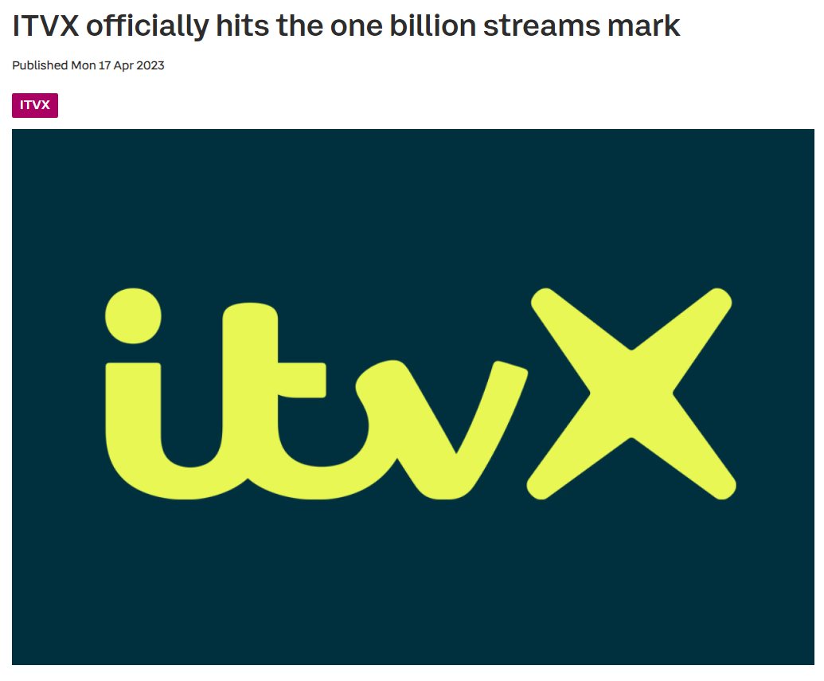
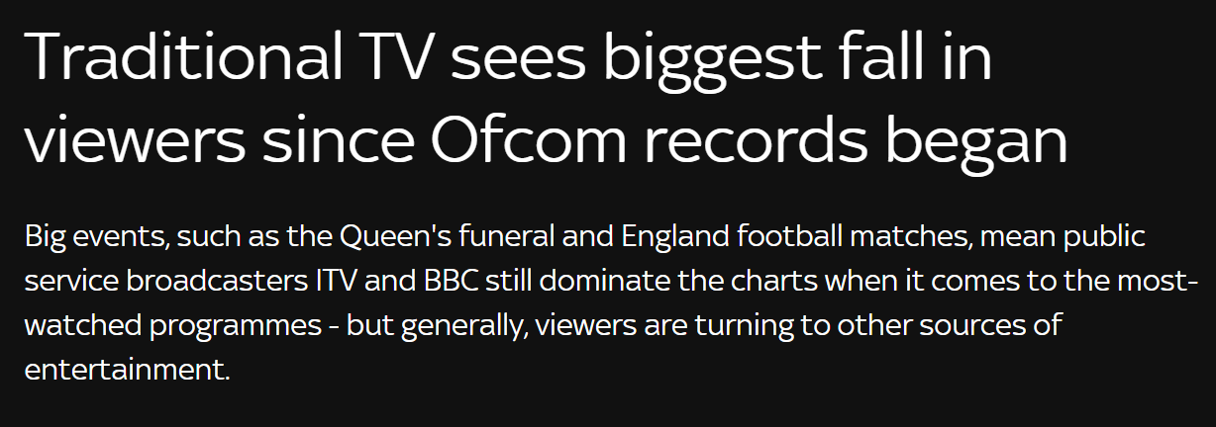
TVs in decline, but not how you think…

Slide 4
How we watch broadcaster TV – ABC1 Adults
Inds
ABC1 Adults
2 hrs 41 mins
2 hrs 34 mins
Source: 2022, Barb / Broadcaster stream data

Slide 5
How we watch broadcaster TV – 16-34
Inds
16-34
2 hrs 41 mins
1 hr 1 min
Source: 2022, Barb / Broadcaster stream data

Slide 6
Video viewing is spread across various platforms
HOURS PER PERSON PER DAY (Adults 15+)
Source: IPA Touchpoints, Adults 15+, average of Wave 1 and Wave 2 2022, 2023 Wave 1 (Fieldwork Dates: 17th January – 26th March 2023)

Slide 7
2023 is a picture of stability
Source: Barb, Individuals, Jan-Sep 22, Jan-Sep 23

Slide 8
All Individuals
All Individuals – All devices
Bubble size represents total volume of daily viewing
Other
AVOD
Other
SVOD
Twitch
Source: Barb / All Individuals, all devices – Jan – Sep 2023

Slide 9
16-34s
16-34s– All devices
Bubble size represents total volume of daily viewing
Other
AVOD
Other
SVOD
Twitch
Source: Barb / 16-34s, all devices – Jan – Sep 2023

Slide 10
Insights for the
‘New to TV’ advertiser
Zoe Harkness
Head of Training, Thinkbox
#GettingOnTV
@ThinkboxTV

Slide 11
Agenda
PART ONE: PERCEIVED BARRIERS TO GETTING ON TV
PART TWO: TV PLAYBOOK FOR ONLINE BRANDS
Dettol, Let Life Flow

Slide 12
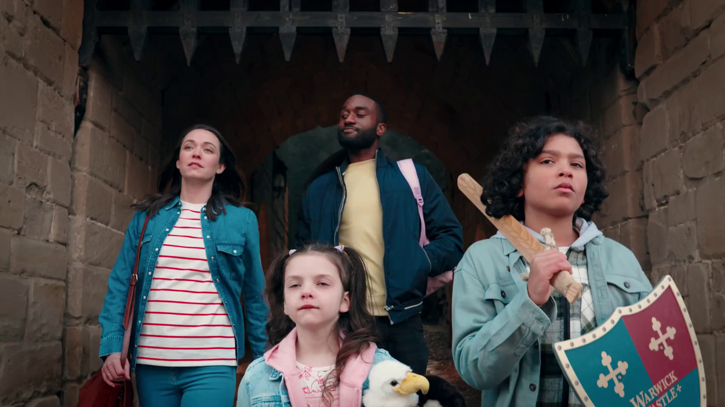
Part one: The perceived barriers to using TV
Warwick Castle, ‘The Wilsons’

Slide 13
Analysis of 78 brands and 300+ campaigns
45 x FMCG brands
169 campaigns
Mean brand size £39m
20 x Retail brands
107 campaigns
Mean brand size £110m
7 x Finance brands
15 campaigns
Mean brand size £56m
6 x Services brands
20 campaigns
Mean brand size £87m
Source: ‘Supercharge: TV for small businesses’, May 2019, Data2Decisions/Work/Thinkbox. Data2Decisions database of smaller brands. All categories. Based on campaign spend of £1.25m.

Slide 14
Many small advertisers see similar barriers to TV
My brand’s not big enough
TV costs too much
It’s not as accountable as digital
There’s too much risk
It’s difficult to make a TV ad
Warburtons, ‘Mad about Bread’

Slide 15
Many small advertisers see similar barriers to TV
My brand’s not big enough
TV costs too much
It’s not as accountable as digital
There’s too much risk
It’s difficult to make a TV ad
Warburtons, ‘Mad about Bread’

Slide 16
My brand’s not big enough
Lots of brands spend small amounts on TV
All brands, but particularly small brands, benefit from TV’s costly signalling
Egard & Cooper, ‘They Are What They Eat’

Slide 17
763 advertisers spent less than £50k on TV in 2022
Source: Nielsen Ad Intel, 2022

Slide 18
Brands of all sizes benefit from ‘costly signalling’
TV can work across a range of budgets
Effects of digital should be maximised at low levels of spend
Move into other media to avoid diminishing returns
Advertising is as important as the message itself
Brand fame
Shows confidence in brand & product

Slide 19
TV ads deliver quality, self-confidence and strength signals
Fitness signals
FITNESS SIGNALS (% POSITIVELY SCORING / AGREEING TO STATEMENTS)
Source: Signalling Success, house51/Thinkbox. Base: all adults (3,654)

Slide 20
Many small advertisers see similar barriers to TV
My brand’s not big enough
TV costs too much
It’s not as accountable as digital
There’s too much risk
It’s difficult to make a TV ad
Warburtons, ‘Mad about Bread’

Slide 21
TV costs too much
TV is more affordable than you might think
It’s much better value than online video
UK is half the price of the global average
WWF, ‘Watching Grass Grow’
Egard & Cooper, ‘They Are What They Eat’

Slide 22
Average TV view costs 0.8p (in 2022)
The average cost of buying the media space to get one person in the UK to see a TV (linear and VOD) advert costs less than a penny
Source: 2022, Thinkbox estimates using AA/WARC

Slide 23
TV advertising is great value
Revenue
£ billion
Minutes of AV advertising per person, per day
Cost per Thousand
(30 sec)
£5.1
14.2
Broadcaster TV
(Inc BVOD)
£8
YouTube
£1.1
2.1
£12
£3.9
£130
All other online video
0.7
Source: 2022, Thinkbox estimates using AA/WARC, Barb, ViewersLogic, IPA TouchPoints 2022

Slide 24
UK linear TV is half the price of global average
Source: WARC estimates 2022, calculated by applying the WFA’s media inflation figures – drawn from a panel of agencies and consultancies – to historic data

Slide 25
Many small advertisers see similar barriers to TV
My brand’s not big enough
TV costs too much
It’s not as accountable as digital
There’s too much risk
It’s difficult to make a TV ad
Warburtons, ‘Mad about Bread’

Slide 26
TV is accountable
Many of TV’s effects are immediate
Others are sustained & build the business over the longer term
JBL, ‘Authentics’

Slide 27
Immediate effect - TV drives search
R^{2=0.77}
Source: BARB/Google Trends, Jan 2020 – Jun 2022, please note, an improvement to Google Trend’s data collection system was applied from 01/01/22

Slide 28
Immediate effect - TV drives search
R^{2=0.66}
Source: BARB/Google Trends, Jan 2020 – Jun 2022, please note, an improvement to Google Trend’s data collection system was applied from 01/01/22

Slide 29
TV delivers results quickly
An average 4-week TV campaign builds to a weekly sales uplift of c. 25%
The typical profit payback point is at c. 4 months
4 WEEK TV CAMPAIGN
Source: ‘Supercharge: TV for small businesses’, Data2Decisions/Work/Thinkbox. Data2Decisions database of smaller brands. All categories. Based on campaign spend of £1.25m.

Slide 30
TV has a significant long-term / sustained impact
An example for a typical media response from a 4-week campaign
45% of total impact 55% of total impact
Source: Media Mix Navigator, Sep. 2022, MediaCom / Wavemaker / Mindshare / Gain Theory

Slide 31
TV delivers both short-term and sustained sales effects
The immediate & sustained effects of TV can be isolated & measured
Brand size
Source: ‘Supercharge: TV for small businesses’, Data2Decisions/Work/Thinkbox. Data2Decisions database of smaller brands. All categories.

Slide 32
Many small advertisers see similar barriers to TV
My brand’s not big enough
TV costs too much
It’s not as accountable as digital
There’s too much risk
It’s difficult to make a TV ad
Warburtons, ‘Mad about Bread’

Slide 33
There’s too much risk
TV and BVOD are the least risky channels
It punches above its weight for small brands
Air Wick, ‘Flowers’

Slide 34
TV and BVOD the least risky channels
Increasing risk / reward of achieving return
0% = Median ROI
Source: Media Mix Navigator, Sept. 2022, EssenceMediacom / Wavemaker / Mindshare / Gain Theory

Slide 35
TV punches above its weight in terms of sales versus spend
Share of spend
Share of advertising-generated sales
Source: ‘Supercharge: TV for small businesses’, Data2Decisions/Work/Thinkbox. Data2Decisions database of smaller brands. All categories.

Slide 36
Many small advertisers see similar barriers to TV
My brand’s not big enough
TV costs too much
It’s not as accountable as digital
There’s too much risk
It’s difficult to make a TV ad
Warburtons, ‘Mad about Bread’

Slide 37
Creative
Broadcasters can help with creative production
Production companies can make ads for as little as £3-5k
Great ideas don’t cost the earth
Visit Egypt, ‘Beyond Expectations’

Slide 38
Creativity is the biggest ROI multiplier within our control
Potential multipliers of advertising profitability - (2023)
Potential multipliers of advertising profitability - (2023)
X 20
X 12
X 5
X 2.5
X 3
X 1.6
X 1.7
X 2.0
X 1.1
X 1.2
Cost / Product seasonality
Budget setting across variants
Brand : Performance
Multi-media
Budget setting across portfolios
Budget setting across geographies
Target audience
Laydown / Phasing
Creative quality
Brand size
Source: The Drivers of Profitability, 2023, Paul Dyson - accelero, ROI multiplier = area of the circle

Slide 39
Cracking Creativity

Slide 40
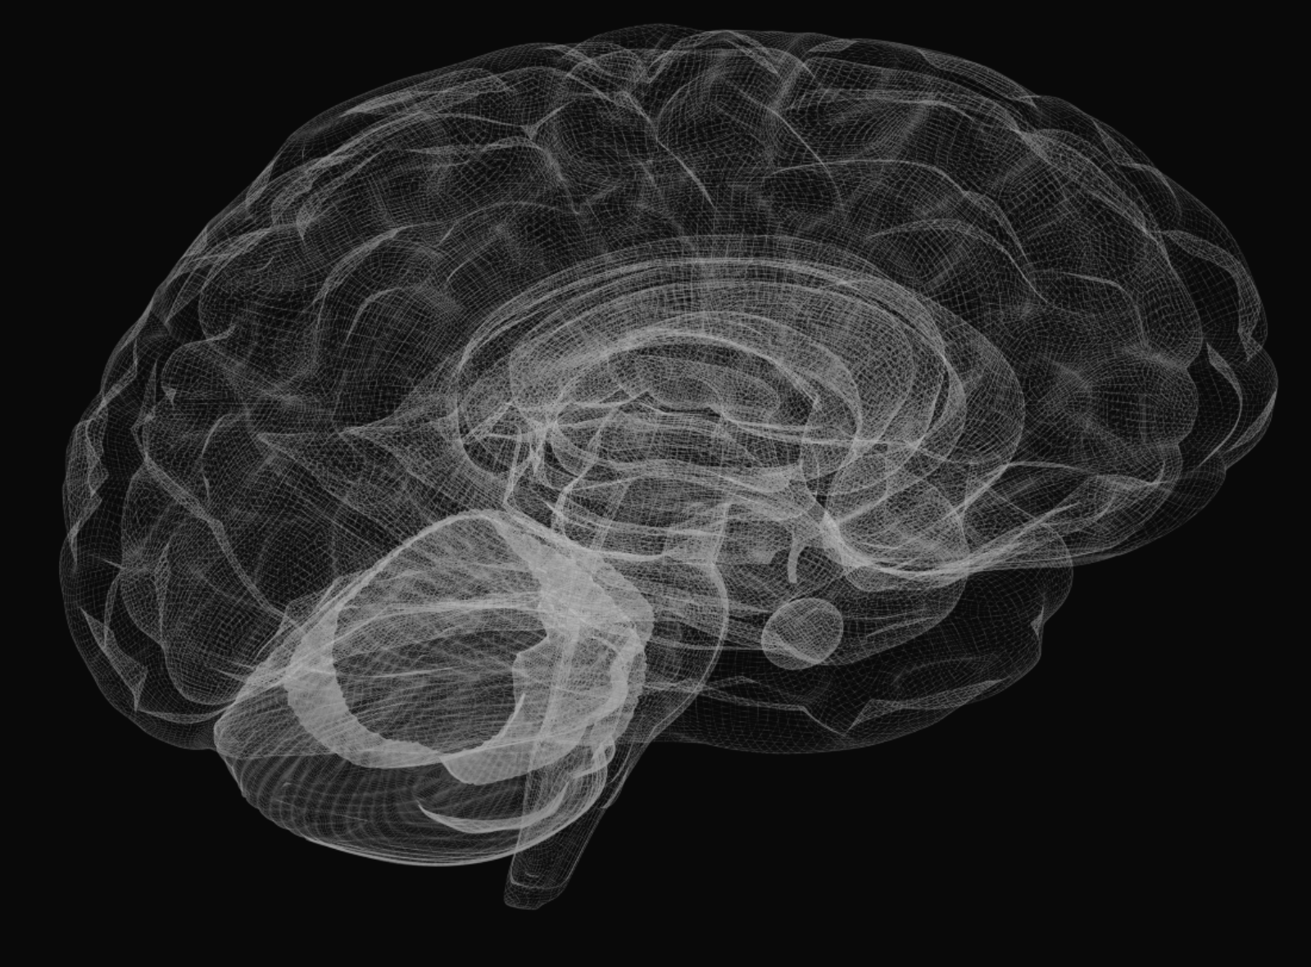
LONG-TERM MEMORABILITY
PERSONAL RELEVANCE
EMOTIONAL IMPACT
EMOTIONAL APPEAL

Slide 41
Five conclusions were seen
Showcase, don’t shout
People are paramount
Utilise your brand assets
Give audio a clear role
Impact is in the timing
Bakers Meaty Meals, ‘Digging’
Source: Creative Drivers of Effectiveness, 2023, Neuro-Insight/Thinkbox

Slide 42
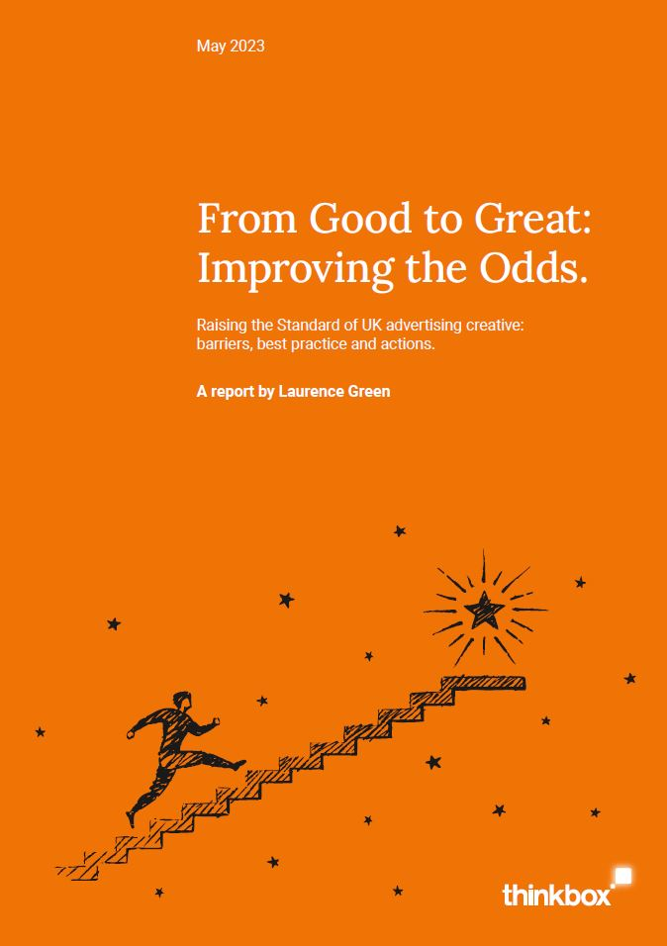
From Good to Great: Improving the Odds
Report by Laurence Green, Director of Effectiveness, IPA
7-point guide to creative development best practice
Practical actions that can improve the odds of getting your creative right

Slide 43
Summary of perceived barriers to using TV
Any size brand can be successful on TV
TV is more affordable than you might think
TV drives immediate and sustained measurable effects
BVOD and TV are the least risky media channels
You can get help with your creative
Greater Anglia, ‘Rabbit Hole’

Slide 44
Part two: The TV playbook for online businesses

Slide 45
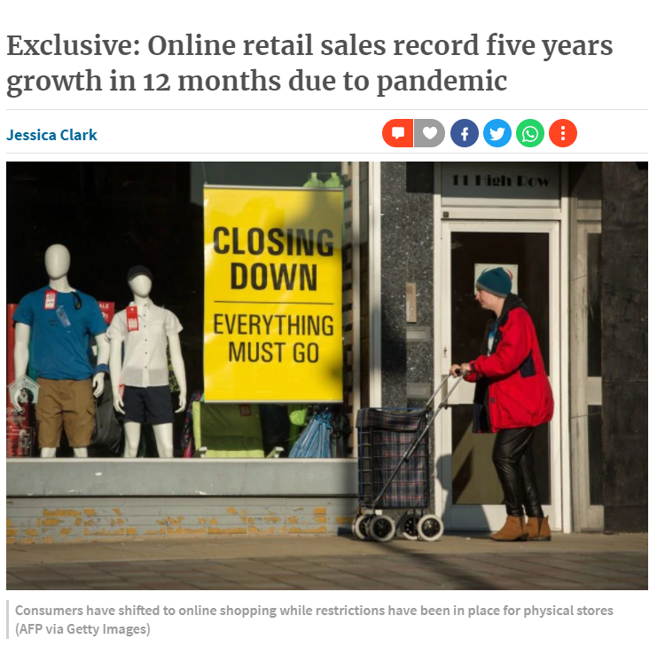
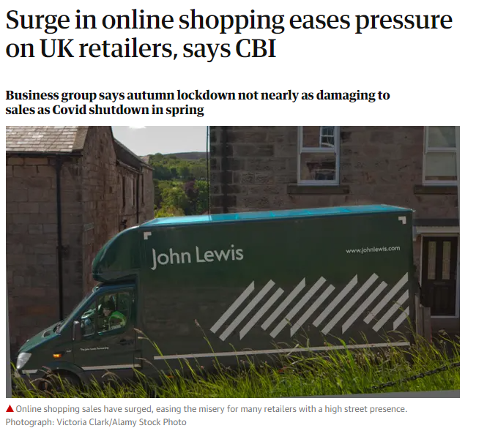
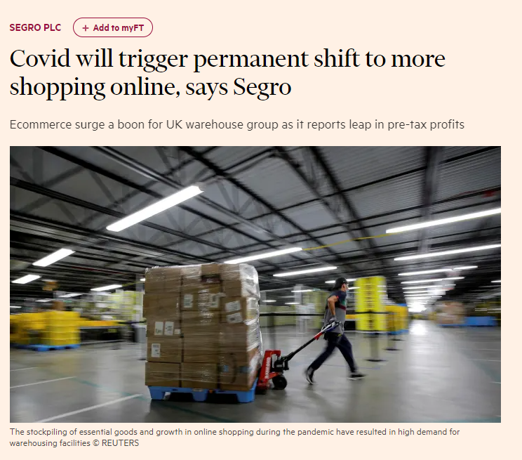
Increased ecommerce is arguably the biggest Covid behavioural shift

Slide 46
Online born businesses are the biggest investors in TV
MILLIONS
Source: Nielsen Ad Intel, 2022, Thinkbox-created category of online-born businesses (YoY category % change).

Slide 47
Online born businesses spend over last 5 years
42%
+£334m
-6%
-£67m
2%
3%
+£16m
+£22m
MILLIONS
Source: Nielsen Ad Intel, 2018-2022, TV Spend, %’s show YoY Increase, Thinkbox-created category of online-born businesses

Slide 48
Research conducted by Magic Numbers
Comprehensive econometric analysis
Ten online brands who had seen success through TV advertising
Phase 1 – source of web visits
Phase 2 – different online journeys
Compare The Market, ‘VR Fight’

Slide 49
Findings
3 signs it’s time for TV
The effects of TV on your business
TV drives cost-effective search
Source: Magic Numbers, The TV playbook for online businesses

Slide 50
3 signs it’s time for TV
“Good Finds” – Gumtree

Slide 51
Three signs it’s time for TV
Need to scale fast
Run out of efficient online buys
A clever new product you need to explain
Flash, ‘Duster’
Source: Magic Numbers, The TV playbook for online businesses

Slide 52
This furniture brand saw website conversion improve with TV advertising
TV brings people that understand the proposition and more likely to buy
Source: Advertiser own econometric data

Slide 53
The effects of TV on your business
“Low Prices on Gifts” – Amazon

Slide 54
TV was the biggest single source of traffic
Contributing 42% of all visits, around 50m in all
Breakdown of web visits by driver
Source: Magic Numbers, The TV playbook for online businesses

Slide 55
Cost per visit was £1.90-£2.50 for 6 of our 10 brands
This is a pretty good benchmark to use in planning
£1.90-£2.50 is a good benchmark
But there is variation
Complex financial product
Simple D2C highly optimised
Compares favourably to generic search cost
e.g. gift delivery £1-3
e.g. financial services £5-11
6 of the 10 brands we modelled had a TV cost per visit between £1.90 and £2.50
Source: Magic Numbers, The TV playbook for online businesses, Google Ads, FS – Financial Services

Slide 56
TV drives cost-effective search
“Did Somebody Say Just Eat” – Just Eat

Slide 57
Most online journeys prompted by TV involve your brand name early
Which means more cost effective search performance
The journeys initiated by ATL channel
Source: Magic Numbers, The TV playbook for online businesses

Slide 58
In summary
3 signs it’s time for TV
The effects of TV on your business
TV drives cost-effective search
Source: Magic Numbers, The TV playbook for online businesses

Slide 59
Summary / top tips
There are many perceived barriers to getting on TV but these can easily be overcome
Top tips:
- work with a good agency
- speak to the broadcasters
- let Thinkbox help
Hillary’s Blinds, ‘For the Window Wise’

Slide 60
Getting on TV
Thank you for joining us.
Visit Thinkbox.tv to find out more.

