Slide 1
Profit Ability 2 The new business case for advertising

Slide 2
This deck covers:
Setting the scene:
Background and context
Methodology and definitions
Impact of the Covid pandemic
Advertising works:
Profitable driver of business growth
Three dimensions impacting profitability (SET)
Summary and additional resources
Cruzcampo – “Choose to Cruz”

Slide 3
Setting the scene
Doritos – “Extra Flamin Hot”

Slide 4
It’s been 7 years since the original Profit Ability study
Meta-analysis of econometric benchmarks
Provided understanding of the short- and long-term profit payback of advertising
First of its kind study

Slide 5
But it’s fair to say a few things have happened since then
Privacy winning out in how we leverage data
Explosion in connectivity
Rise of the streamers
New distribution channels opening up (and some traditional ones closing)
Disruption to business supply chains
A pandemic

Slide 6
79%
of analysts believe brand and marketing is important in appraising a business
Ian Whittaker
Source: IPA investment analysis survey

Slide 7
Disconnect with boardroom around language & metrics used
Reach and Frequency
Share of Voice
Brand & Performance
vs.
Incremental Profit
Return on Investment
Payback Horizons

Slide 8
Built the first post-Covid advertising effectiveness databank
5
Agencies
141
Brands
£1.8bn
Media spend analysed (2021-2023)*
14
Sectors**
10
Media channels
53
Brands matched pre & post Covid
*Based on end date of analysis period. Spend by year: 21% 2021, 32% 2022, 47% 2023. All analysis based on most recent 52 weeks available.
**Total databank has 14 categories, only 7 have sufficient granularity to report individually

Slide 9
Profit Ability 2 database: quality, independence, current
Quality:
Market Mix Modelling, the gold standard for understanding media effectiveness
Truly independent database:
Collaboration across five modelling agencies
Utilises real client data
Models included had been commissioned and paid-for by the respective brand
Ensure no inherent bias towards any channel
Current:
Exclusively features campaigns from 2021–2023
Only the most recent 52-weeks available for each brand was included

Slide 10
Areas it can help with
Proof that advertising works
Building / supporting the case for advertising
How the ad effectiveness landscape has shifted
Sense-checking your own econometrics
Benchmarking ad profitability in your category
Budget setting
Channel allocation
Guidance on likely speed of payback
Thinkbox, Happily Ever After

Slide 11
Doesn’t reflect ‘all advertisers’ but a valid read for ‘big brands’
Source: AA/WARC / Profit Ability 2

Slide 12
Channel investment varies by sector reflecting market reality
Source: Profit Ability 2, April 2024 – Ebiquity, EssenceMediacom, Gain Theory, Mindshare, Wavemaker UK.

Slide 13
Some important definitions: What’s included in each channel
Audio | All forms of audio advertising including linear radio, digital radio & podcasts.
BVOD | Video on Demand on broadcaster platforms
Cinema | On screen advertising in cinemas
Generic PPC | Pay per click search advertising on non-branded keywords
Linear TV | Broadcast TV advertising
Online Display | All formats of display advertising
Online Video | All formats of online video pre/mid/post roll including YouTube
Out of Home | Digital and static posters in all environments
Paid Social | All advertising within social platforms including in-feed video
Print | All advertising within newspapers & magazines. Digital spend with newsbrands etc. included in Online Display

Slide 14
Some important definitions: Profit
Profit volume
The incremental contribution of advertising to business profit based on unit sales, revenue contribution, profit margin and/or lifetime value
Profit ROI
The ratio between profit volume and advertising spend
(ROI = profit volume / media spend where 1 = breakeven)

Slide 15
Some important definitions: Payback Time Periods
Immediate Payback
In the same week as advertising
Carryover Payback
(week 2 – week 13)
Sustained Payback
(week 14 – 2 years)
Short-Term Payback
(up to 13 weeks)
Full Payback

Slide 16
Impact of the Covid pandemic
Bumble, Incognito Mode

Slide 17
New normal after economic shock of Covid lockdown period
UK Leaves EU
Ukraine Conflict
Brexit Vote
Covid
Source: ONS Series ID ABMI Indexed to 100 from Q1-2010

Slide 18
Media habits changed by pandemic affect ad effectiveness
Source: ONS Opinions and Lifestyle Survey, Barb Establishment Survey

Slide 19
So how have advertising ROIs changed? Composition effects can plague efforts to compare benchmark studies over time
Brand A
Brand A
Brand B
Brand C
Brand C
Pre Covid
Brand D
Post Covid
Brand E
Brand E
Brand F
Brand F
Brand G
Brand H
Note: Pre-Covid is defined as 52 week ending results reported between 2018 and Q1-2020.
Post-Covid is defined as projects ending in 2022 to 2023. Where multiple projects have been captured we use only the most recent results.

Slide 20
Compare brands with like-for-like data pre & post pandemic
Brand A
Brand A
Only A,C,E and F will be included when reporting ROI trends. Spend mix is standardised to latest blend.
We found 53 brands which could be matched on this basis
Brand C
Brand C
Pre Covid
Post Covid
Brand E
Brand E
Brand F
Brand F
Note: Pre-Covid is defined as 52 week ending results reported between 2018 and Q1-2020.
Post-Covid is defined as projects ending in 2022 to 2023. Where multiple projects have been captured we use only the most recent results.

Slide 21
How to read the charts in this section
Annual short-term profit ROI change pre/post Covid
Bubble size represents % of short-term profit volume (Post-Covid).
Change in Spend
Average annual ROI change
Source: Profit Ability 2, April 2024 – Short term benchmarks: Ebiquity, EssenceMediacom, Gain Theory, Mindshare, Wavemaker UK.
ROI Change & Spend Change based on 53 matched brands with pre/post observations only. Profit volume percentage based on full sample post-covid

Slide 22
How to read the charts in this section
Annual short-term profit ROI change pre/post Covid
Bubble size represents % of short-term profit volume (Post-Covid).
Spend increase
Spend in the channel has increased post-Covid vs pre-Covid
Change in Spend
Spend decrease
Spend in the channel has decreased post-Covid vs pre-Covid
Average annual ROI change
Source: Profit Ability 2, April 2024 – Short term benchmarks: Ebiquity, EssenceMediacom, Gain Theory, Mindshare, Wavemaker UK.
ROI Change & Spend Change based on 53 matched brands with pre/post observations only. Profit volume percentage based on full sample post-covid

Slide 23
How to read the charts in this section
Annual short-term profit ROI change pre/post Covid
Bubble size represents % of short-term profit volume (Post-Covid).
ROI decline
ROI in the channel has declined post-Covid vs pre-Covid
ROI improvement
ROI in the channel has improved post-Covid vs pre-Covid
Change in Spend
Average annual ROI change
Source: Profit Ability 2, April 2024 – Short term benchmarks: Ebiquity, EssenceMediacom, Gain Theory, Mindshare, Wavemaker UK.
ROI Change & Spend Change based on 53 matched brands with pre/post observations only. Profit volume percentage based on full sample post-covid

Slide 24
How to read the charts in this section
Annual short-term profit ROI change pre/post Covid
Bubble size represents % of short-term profit volume (Post-Covid).
Change in Spend
Each channel has a bubble, the size of the bubble represents the size of the short-term profit volume (post Covid) – the larger the bubble, the larger the short-term profit volume. The label also shows the short-term profit volume for the channel
Average annual ROI change
Source: Profit Ability 2, April 2024 – Short term benchmarks: Ebiquity, EssenceMediacom, Gain Theory, Mindshare, Wavemaker UK.
ROI Change & Spend Change based on 53 matched brands with pre/post observations only. Profit volume percentage based on full sample post-covid

Slide 25
Advertising is as effective as it’s always been
Annual short-term profit ROI change pre/post Covid
Bubble size represents % of short-term profit volume (Post-Covid). All-channel bubble size illustrative only
Change in Spend
Average annual ROI change
Source: Profit Ability 2, April 2024 – Short term benchmarks: Ebiquity, EssenceMediacom, Gain Theory, Mindshare, Wavemaker UK.
ROI Change & Spend Change based on 53 matched brands with pre/post observations only. Profit volume percentage based on full sample post-covid

Slide 26
Advertising is as effective as it’s always been
Annual short-term profit ROI change pre/post Covid
Bubble size represents % of short-term profit volume (Post-Covid). All-channel bubble size illustrative only
Change in Spend
Average annual ROI change
Source: Profit Ability 2, April 2024 – Short term benchmarks: Ebiquity, EssenceMediacom, Gain Theory, Mindshare, Wavemaker UK.
ROI Change & Spend Change based on 53 matched brands with pre/post observations only. Profit volume percentage based on full sample post-covid

Slide 27
Little effective change - ROI variations within +/- 5%
Annual short-term profit ROI change pre/post Covid
Bubble size represents % of short-term profit volume (Post-Covid).
Change in Spend
Average annual ROI change
Source: Profit Ability 2, April 2024 – Short term benchmarks: Ebiquity, EssenceMediacom, Gain Theory, Mindshare, Wavemaker UK.
ROI Change & Spend Change based on 53 matched brands with pre/post observations only. Profit volume percentage based on full sample post-covid

Slide 28
Larger shifts in AV but with efficiency following eyeballs
Annual short-term profit ROI change pre/post Covid
Bubble size represents % of short-term profit volume (Post-Covid).
Change in Spend
Average annual ROI change
Source: Profit Ability 2, April 2024 – Short term benchmarks: Ebiquity, EssenceMediacom, Gain Theory, Mindshare, Wavemaker UK.
ROI Change & Spend Change based on 53 matched brands with pre/post observations only. Profit volume percentage based on full sample post-covid

Slide 29
Online Display right-sized: lower spend bringing ROI benefits
Annual short-term profit ROI change pre/post Covid
Bubble size represents % of short-term profit volume (Post-Covid).
Change in Spend
Average annual ROI change
Source: Profit Ability 2, April 2024 – Short term benchmarks: Ebiquity, EssenceMediacom, Gain Theory, Mindshare, Wavemaker UK.
ROI Change & Spend Change based on 53 matched brands with pre/post observations only. Profit volume percentage based on full sample post-covid

Slide 30
Increased Paid Social spend out of step with big ROI decline
Annual short-term profit ROI change pre/post Covid
Bubble size represents % of short-term profit volume (Post-Covid).
Change in Spend
Average annual ROI change
Source: Profit Ability 2, April 2024 – Short term benchmarks: Ebiquity, EssenceMediacom, Gain Theory, Mindshare, Wavemaker UK.
ROI Change & Spend Change based on 53 matched brands with pre/post observations only. Profit volume percentage based on full sample post-covid

Slide 31
Rather than a seismic shift, advertising effectiveness has more gradually changed as media consumption has evolved
HP – Wise Moves

Slide 32
Advertising works
Barclaycard – “Lawnmower”

Slide 33
Profit Ability 2: three key headlines
Advertising is a profitable driver of business growth
Sustained effects are significant as part of advertising’s overall payback
Performance varies greatly channel to channel / sector to sector

Slide 34
How to read the bubble charts in this section
Short-term profit volume & profit ROI
Bubble size represents % of short-term profit volume
Overall Short-Term Profit ROI:
Short-term Profit ROI (£)
% of Spend
Source: Profit Ability 2, April 2024 – Short term benchmarks: Ebiquity, EssenceMediacom, Gain Theory, Mindshare, Wavemaker UK.
Long Term Multipliers: EssenceMediacom, Gain Theory, Mindshare, Wavemaker UK

Slide 35
How to read the bubble charts in this section
Short-term profit volume & profit ROI
Bubble size represents % of short-term profit volume
Overall Short-Term Profit ROI:
% spend
The percentage of analysed spend in a given channel
Short-term Profit ROI (£)
% of Spend
Source: Profit Ability 2, April 2024 – Short term benchmarks: Ebiquity, EssenceMediacom, Gain Theory, Mindshare, Wavemaker UK.
Long Term Multipliers: EssenceMediacom, Gain Theory, Mindshare, Wavemaker UK

Slide 36
How to read the bubble charts in this section
Short-term profit volume & profit ROI
Bubble size represents % of short-term profit volume
Overall Short-Term Profit ROI:
Profit ROI
The ratio between profit volume and spend
(ROI = profit volume / spend)
Short-term Profit ROI (£)
% of Spend
Source: Profit Ability 2, April 2024 – Short term benchmarks: Ebiquity, EssenceMediacom, Gain Theory, Mindshare, Wavemaker UK.
Long Term Multipliers: EssenceMediacom, Gain Theory, Mindshare, Wavemaker UK

Slide 37
How to read the bubble charts in this section
Short-term profit volume & profit ROI
Bubble size represents % of short-term profit volume
Overall Short-Term Profit ROI:
Profitable return
Profit ROI > 1 meaning we get more in profit than we spend
Short-term Profit ROI (£)
Unprofitable return
Profit ROI < 1 meaning we spend more than we get back in profit
% of Spend
Source: Profit Ability 2, April 2024 – Short term benchmarks: Ebiquity, EssenceMediacom, Gain Theory, Mindshare, Wavemaker UK.
Long Term Multipliers: EssenceMediacom, Gain Theory, Mindshare, Wavemaker UK
To note: as a rule creative production costs and some non-COGs variable costs may be not included in the reported ROIs, so true break-even would be slightly higher than 1

Slide 38
How to read the bubble charts in this section
Short-term profit volume & profit ROI
Bubble size represents % of short-term profit volume
Overall Short-Term Profit ROI:
The time horizon the payback is based on will be in the headline above the chart and also on the axis label
Short-term Profit ROI (£)
% of Spend
Source: Profit Ability 2, April 2024 – Short term benchmarks: Ebiquity, EssenceMediacom, Gain Theory, Mindshare, Wavemaker UK.
Long Term Multipliers: EssenceMediacom, Gain Theory, Mindshare, Wavemaker UK

Slide 39
How to read the bubble charts in this section
Short-term profit volume & profit ROI
Bubble size represents % of short-term profit volume
Overall Short-Term Profit ROI: £££££
Total Profit ROI for the sector / channels / timeframe that are being shown will be in the heading above the chart
Short-term Profit ROI (£)
% of Spend
Source: Profit Ability 2, April 2024 – Short term benchmarks: Ebiquity, EssenceMediacom, Gain Theory, Mindshare, Wavemaker UK.
Long Term Multipliers: EssenceMediacom, Gain Theory, Mindshare, Wavemaker UK

Slide 40
How to read the bubble charts in this section
Short-term profit volume & profit ROI
Bubble size represents % of short-term profit volume
Overall Short-Term Profit ROI:
The number next to the bubble, is the percentage of profit contributed by that channel
Each bubble represents a channel's profit volume; larger bubbles indicate higher profit contribution.
Short-term Profit ROI (£)
% of Spend
Source: Profit Ability 2, April 2024 – Short term benchmarks: Ebiquity, EssenceMediacom, Gain Theory, Mindshare, Wavemaker UK.
Long Term Multipliers: EssenceMediacom, Gain Theory, Mindshare, Wavemaker UK

Slide 41
All channels deliver a return: short-term Profit ROI = £1.87
Short-term profit volume & profit ROI
Bubble size represents % of short-term profit volume
Overall Short-Term Profit ROI: £1.87
Short-term Profit ROI (£)
% of Spend
Source: Profit Ability 2, April 2024 – Short term benchmarks: Ebiquity, EssenceMediacom, Gain Theory, Mindshare, Wavemaker UK.
Long Term Multipliers: EssenceMediacom, Gain Theory, Mindshare, Wavemaker UK

Slide 42
Sustained effects are substantial: c.60% of total profit volume
Full Payback
Short-Term Payback
(up to 13 weeks)
Source: Profit Ability 2, April 2024 – Short term benchmarks: Ebiquity, EssenceMediacom, Gain Theory, Mindshare, Wavemaker UK.
Long Term Multipliers: EssenceMediacom, Gain Theory, Mindshare, Wavemaker UK

Slide 43
Including sustained effects, average Profit ROI increases to £4.11
Full profit volume & profit ROI
Bubble size represents % of full profit volume
Overall Full Profit ROI: £4.11
Profit ROI (£)
% of Spend
Source: Profit Ability 2, April 2024 – Short term benchmarks: Ebiquity, EssenceMediacom, Gain Theory, Mindshare, Wavemaker UK.
Long Term Multipliers: EssenceMediacom, Gain Theory, Mindshare, Wavemaker UK

Slide 44
Profit Ability 2: The new business case for advertising - Data summary
Profit Ability 2: The new business case for advertising - Data summary
 | % of advertising investment | % of profit volume |  |  |  | Profit ROI
 |  | % of full payback | % of sustained payback | % of short-term payback | % of immediate payback | Full payback | Short-term payback
All media | 100% | 100% | 100% | 100% | 100% | £4.11 | £1.87
TV (Linear + BVOD) | 43.6% | 54.7% | 64.3% | 41.5% | 27.8% | £5.61 | £1.79
Linear TV only | 35.0% | 46.6% | 55.7% | 33.9% | 20.5% | £5.94 | £1.82
Generic PPC | 18.9% | 14.6% | 8.8% | 22.5% | 30.5% | £3.52 | £2.29
Paid Social | 13.2% | 9.4% | 8.0% | 11.4% | 15.1% | £3.20 | £1.62
BVOD only | 8.6% | 8.2% | 8.6% | 7.6% | 7.3% | £4.25 | £1.66
Audio | 6.2% | 6.9% | 6.0% | 8.2% | 8.6% | £4.98 | £2.47
Print | 3.3% | 4.8% | 4.7% | 4.9% | 4.8% | £6.36 | £2.74
Online video | 3.9% | 3.4% | 3.2% | 3.7% | 3.6% | £3.86 | £1.76
OOH | 5.0% | 3.1% | 3.0% | 3.1% | 3.3% | £2.78 | £1.19
Online display | 5.5% | 2.9% | 1.8% | 4.4% | 5.9% | £2.34 | £1.50
Cinema | 0.4% | 0.3% | 0.2% | 0.3% | 0.3% | £2.56 | £1.19
Source: Ebiquity, EssenceMediacom, Gain Theory, Mindshare, Wavemaker UK; 141 brands (UK), £1.8Bn media spend

Slide 45
Channel effectiveness varies by sector – e.g. Print
Source: Profit Ability 2, April 2024 – Short term benchmarks: Ebiquity, EssenceMediacom, Gain Theory, Mindshare, Wavemaker UK.
Long Term Multipliers: EssenceMediacom, Gain Theory, Mindshare, Wavemaker UK

Slide 46
Advertising profitability levels vary greatly sector to sector
Source: Profit Ability 2, April 2024 – Short term benchmarks: Ebiquity, EssenceMediacom, Gain Theory, Mindshare, Wavemaker UK.
Long Term Multipliers: EssenceMediacom, Gain Theory, Mindshare, Wavemaker UK. Travel based on all sector multiplier of 2.2

Slide 47
Much of this is due to the products & businesses themselves
The revenue value of the product
The operating margin of the business
The relative strength of advertising on sales

Slide 48
Sector performance
Taiuls.com, Never Average

Slide 49
We’ve got findings on…
Automotive
Financial Services
FMCG
Retail (Large - £1b+)
Retail (Small)
Telecoms
Travel
Bumble- Advanced Filters

Slide 50
Key sector highlights
Large Retail: all channels are profitable in the short-term but get even stronger with the full effect
Small Retail: Generic PPC stands out as a strong channel
Financial Services: very strong Generic PPC ROI + BVOD punching above the efficiency of Linear TV
Telecoms: Strong BVOD performance although Linear TV dominates the full profit volume
Automotive: Sustained effects important; Linear TV the key profit volume driver with a strong ROI
FMCG: Short-term ROIs low; Full ROIs show profitable payback with Linear TV the key volume driver
Travel: All video channels perform well but sustained effects needed to yield strong ROIs
Matson’s Fridge Raiders- Clean up Crew

Slide 51
Large Retail: all channels are profitable in the short-term… but get even stronger with the full effect
Short-term effects
Bubble size represents % of short-term profit volume
Retail (Large) Short-Term ROI: £3.15
Full effects
Bubble size represents % of full profit volume
Retail (Large) Full Profit ROI: £6.93
Source: Profit Ability 2, April 2024 – Short term benchmarks: Ebiquity, EssenceMediacom, Gain Theory, Mindshare, Wavemaker UK.
Long Term Multipliers: EssenceMediacom, Gain Theory, Mindshare, Wavemaker UK
N.B. low sample size for cinema

Slide 52
Small Retail: Generic PPC stands out as a strong channel
Short-term effects
Bubble size represents % of short-term profit volume
Retail (Small) Short-Term ROI: £1.66
Full effects
Bubble size represents % of full profit volume
Retail (Small) Full Profit ROI: £3.37
Source: Profit Ability 2, April 2024 – Short term benchmarks: Ebiquity, EssenceMediacom, Gain Theory, Mindshare, Wavemaker UK.
Long Term Multipliers: EssenceMediacom, Gain Theory, Mindshare, Wavemaker UK
N.B. Linear TV, OOH, Online Display, Online Video, Paid Social, Print and Audio have low samples

Slide 53
Financial Services see a very strong Generic PPC ROI with BVOD punching above the efficiency of Linear TV
Short-term effects
Bubble size represents % of short-term profit volume
Financial Services Short-Term ROI: £0.94
Full effects
Bubble size represents % of full profit volume
Financial Services Full Profit ROI: £1.95
Source: Profit Ability 2, April 2024 – Short term benchmarks: Ebiquity, EssenceMediacom, Gain Theory, Mindshare, Wavemaker UK.
Long Term Multipliers: EssenceMediacom, Gain Theory, Mindshare, Wavemaker UK
N.B. low sample size for OOH

Slide 54
Telecoms: Strong BVOD performance although Linear TV dominates the full profit volume
Short-term effects
Bubble size represents % of short-term profit volume
Telecoms Short-Term ROI: £1.49
Full effects
Bubble size represents % of full profit volume
Telecoms Full Profit ROI: £3.13
Source: Profit Ability 2, April 2024 – Short term benchmarks: Ebiquity, EssenceMediacom, Gain Theory, Mindshare, Wavemaker UK.
Long Term Multipliers: EssenceMediacom, Gain Theory, Mindshare, Wavemaker UK

Slide 55
Automotive: Sustained effects important; Linear TV the key profit volume driver with a strong ROI
Short-term effects
Bubble size represents % of short-term profit volume
Automotive Short-Term ROI: £1.30
Full effects
Bubble size represents % of full profit volume
Automotive Full Profit ROI: £4.65
Source: Profit Ability 2, April 2024 – Short term benchmarks: Ebiquity, EssenceMediacom, Gain Theory, Mindshare, Wavemaker UK.
Long Term Multipliers: EssenceMediacom, Gain Theory, Mindshare, Wavemaker UK
N.B. low sample size for cinema

Slide 56
FMCG: Short-term ROIs low; Full ROIs show profitable payback with Linear TV the key volume driver
Short-term effects
Bubble size represents % of short-term profit volume
FMCG Short-Term ROI: £0.48
Full effects
Bubble size represents % of full profit volume
FMCG Full Profit ROI: £1.48
Source: Profit Ability 2, April 2024 – Short term benchmarks: Ebiquity, EssenceMediacom, Gain Theory, Mindshare, Wavemaker UK.
Long Term Multipliers: EssenceMediacom, Gain Theory, Mindshare, Wavemaker UK

Slide 57
Travel: All video channels perform well but sustained effects needed to yield strong ROIs
Short-term effects
Bubble size represents % of short-term profit volume
Travel Short-Term ROI: £1.19
Full effects
Bubble size represents % of full profit volume
Travel Full Profit ROI: £2.62
Source: Profit Ability 2, April 2024 – Short term benchmarks: Ebiquity, EssenceMediacom, Gain Theory, Mindshare, Wavemaker UK.
Long Term Multipliers: EssenceMediacom, Gain Theory, Mindshare, Wavemaker UK

Slide 58
A quick recap
Advertising is a profitable driver of business growth
Sustained effects are significant as part of advertising’s overall payback
Performance varies greatly channel to channel / sector to sector

Slide 59
Dimensions that impact profitability
Burger King - Climbing

Slide 60
Be cautious of lazy generalisations
Performance
Commercial Measurable Immediate
Creative work can be specifically brand or performance focussed – e.g. no call to action
BUT
Rare a media channel purely delivers only on one dimension - e.g. Brand TV can have an immediate sales response
vs.
Brand
Theoretical
Distant
Fluffy

Slide 61
A more helpful view: the three dimensions of effectiveness
Scale
Efficiency
Time
The size of the advertising’s effect on the business
The ratio between cost and payback
The period that the advertising payback is over
Get SET

Slide 62
1. Scale As spend increases, the scale of the advertising grows but with diminishing returns
Profit Volume
Increases with spend but the payback of each extra £1 of investment reduces as diminishing returns kick in
Source: Profit Ability 2, April 2024 – Short term benchmarks: Ebiquity, EssenceMediacom, Gain Theory, Mindshare, Wavemaker UK.

Slide 63
The diminishing returns profile and scalability vary by channel
Source: Profit Ability 2, April 2024 – Short term benchmarks: Ebiquity, EssenceMediacom, Gain Theory, Mindshare, Wavemaker UK. Immediate effect = profit volume in week of advertising spend

Slide 64
2. Efficiency Scale and efficiency are linked – optimising towards one will impact the other
Profit Volume
Increases with spend but the payback of each extra £1 of investment reduces as diminishing returns kick in
Profit ROI
As each incremental £1 spend is slightly less effective, this reduces as overall spend increases
Source: Profit Ability 2, April 2024 – Short term benchmarks: Ebiquity, EssenceMediacom, Gain Theory, Mindshare, Wavemaker UK.

Slide 65
Channel saturation point helps budget allocation
Diminishing returns means each pound generates slightly less profit than the one before
Saturation point is the last point where every pound spent in a channel generates at least £1 profit
Source: Profit Ability 2, April 2024 – Short term benchmarks: Ebiquity, EssenceMediacom, Gain Theory, Mindshare, Wavemaker UK. Immediate effect = profit volume in week of advertising spend
Chart is illustrative example

Slide 66
Linear TV immediate payback saturation 3x the next channel
Saturation point based on all category average. Saturation ranking & values will vary sector to sector
Source: Profit Ability 2, April 2024 – Short term benchmarks: Ebiquity, EssenceMediacom, Gain Theory, Mindshare, Wavemaker UK. Immediate effect = profit volume in week of advertising spend

Slide 67
3. Time When does the benefit from advertising need to impact the business?
Timeframe you’re planning over
Type of payback to prioritise
This Week
Immediate payback
This Quarter
Short-term payback
This Year
Sustained & Full payback

Slide 68
Immediate payback not exclusive to ‘performance’ media
Source: Profit Ability 2, April 2024 – Short term benchmarks: Ebiquity, EssenceMediacom, Gain Theory, Mindshare, Wavemaker UK.
Immediate contribution = the same week of advertising exposure

Slide 69
Adstock is used to calculate wider effect of advertising
Adstock factors for the sales/profit effect of today’s advertising in future weeks
Adstock decay rate calculated by the econometric modelling:
Low Adstock means a channel’s total effect is generated in a short amount of time
High Adstock carryover means the effect persists over a longer period of time
Source: Profit Ability 2, April 2024 – Short term benchmarks: Ebiquity, EssenceMediacom, Gain Theory, Mindshare, Wavemaker UK. Immediate contribution = the same week of advertising exposure

Slide 70
Adstock: TV biggest; Generic PPC & Online Display the least
Source: Ebiquity

Slide 71
Weeks to full short-term effect: TV = 8; Generic PPC = 2
Whilst TV pays back its effect over a longer period than Generic PPC, its total effect is also bigger so after 2 weeks the effect driven by TV surpasses that of Generic PPC
To put that into perspective – TV will take about 8 weeks to fully realise its short-term effect whilst PPC takes about 2 weeks

Slide 72
Audio, BVOD & Print also short-term ‘performance’ drivers
Source: Profit Ability 2, April 2024 – Short term benchmarks: Ebiquity, EssenceMediacom, Gain Theory, Mindshare, Wavemaker UK. Immediate contribution = the same week of advertising exposure.
Carryover contribution = the contribution within 13 weeks of ad exposure

Slide 73
The sustained impact of advertising
As well as the short-term payback, advertising creates a sustained effect - generally through changing brand preferences
This effect gradually flows into the ‘base’ sales over a sustained period (typically around 6 months – 2 years)
Illustrative example

Slide 74
Long-term multiplier: ratio between short-term & full payback
Total Sales
Long-Term Multiplier
Short-term payback
Sustained payback
66 Sales
33 Sales
99
1.5
50 sales
20 Sales
70
1.4
15 sales
60 sales
75
5.0
Long Term Multiplier = (Sustained Effect + Short-term Effect) / Short-term Effect
Illustrative example

Slide 75
Long-term multiplier varies by sector: automotive the highest
Source: EssenceMediacom, Gain Theory, Mindshare, Wavemaker UK – Long Term Multiplier = (Sustained Effect + Short-term Effect) / Short-term Effect, Travel long-term multipliers are currently supressed due to Covid. Likely not representative of the level moving forward. All sector average used in place of Travel multiplier where applicable
Notes:
.

Slide 76
Variance by channel but average long-term multiplier = 2.2
All channel average: 2.2
Source: EssenceMediacom, Gain Theory, Mindshare, Wavemaker UK – Long Term Multiplier = (Sustained Effect + Short-term Effect) / Short-term Effect

Slide 77
Linear TV: unmatched as the total Profit ROI volume driver
Source: Profit Ability 2, April 2024 – Short term benchmarks: Ebiquity, EssenceMediacom, Gain Theory, Mindshare, Wavemaker UK. Long Term Multipliers: EssenceMediacom, Gain Theory, Mindshare, Wavemaker UK. Immediate contribution = same week as advertising, Carryover = within 13 weeks, Sustained = within 2 years

Slide 78
TV (Linear & BVOD): two-thirds of payback beyond 1st week
Source: Profit Ability 2, April 2024 – Short term benchmarks: Ebiquity, EssenceMediacom, Gain Theory, Mindshare, Wavemaker UK. Immediate contribution = the same week of advertising exposure

Slide 79
A quick recap
Brand and Performance doesn’t reflect how advertising actually pays back - instead think of SET (Scale, Efficiency & Time)
Scale and Efficiency are inherently linked so optimal investment is about balancing diminishing returns
When you need the impact of advertising brings different channels into play

Slide 80
Summary and additional resources
Natwest – Let’s Get Going

Slide 81
Profit Ability 2: three key headlines
Rather than a seismic shift, advertising effectiveness has gradually changed as media consumption has evolved
Advertising is a profitable driver of business growth, but profitability varies greatly by sector
Three dimensions impact profitability Scale, Efficiency, & Time. Get SET.

Slide 82
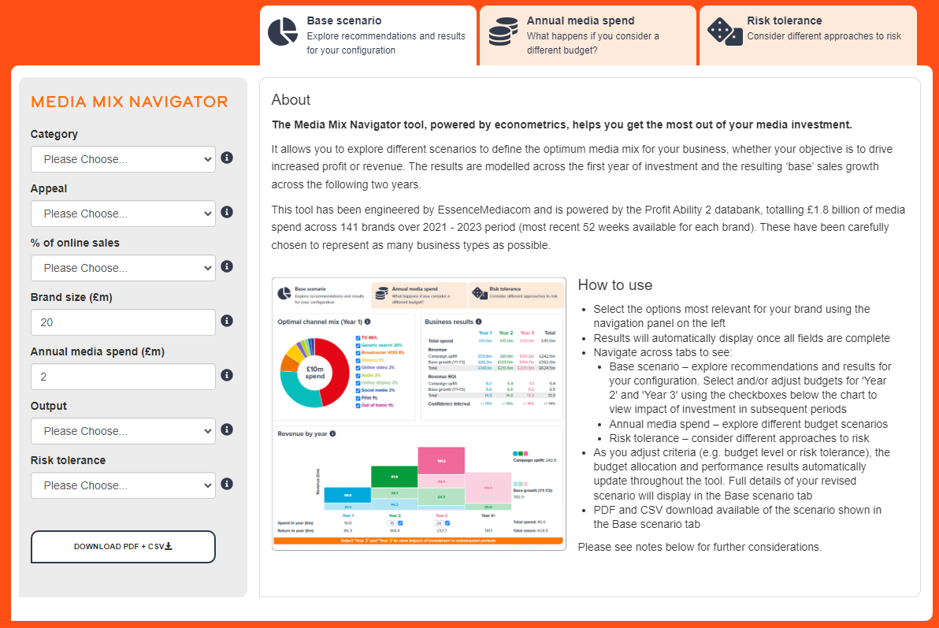
All this data powers the Media Mix Navigator
https://www.thinkbox.tv/training-and-tools/media-mix-navigator/media-mix-navigator

Slide 83
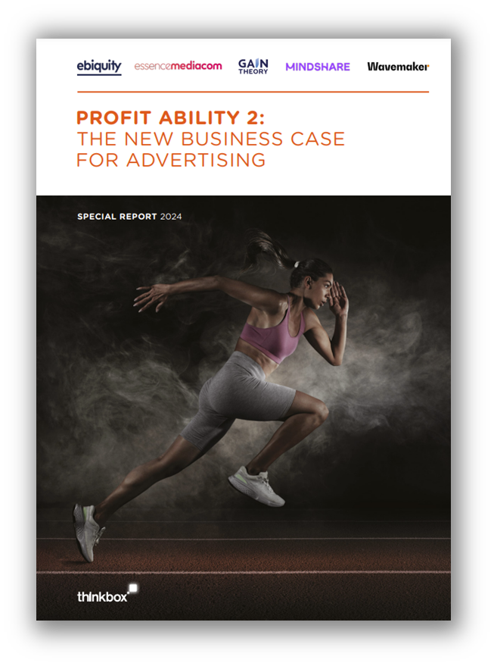
Download the Profit Ability 2 report here…
https://www.thinkbox.tv/profitability2

