Slide 1
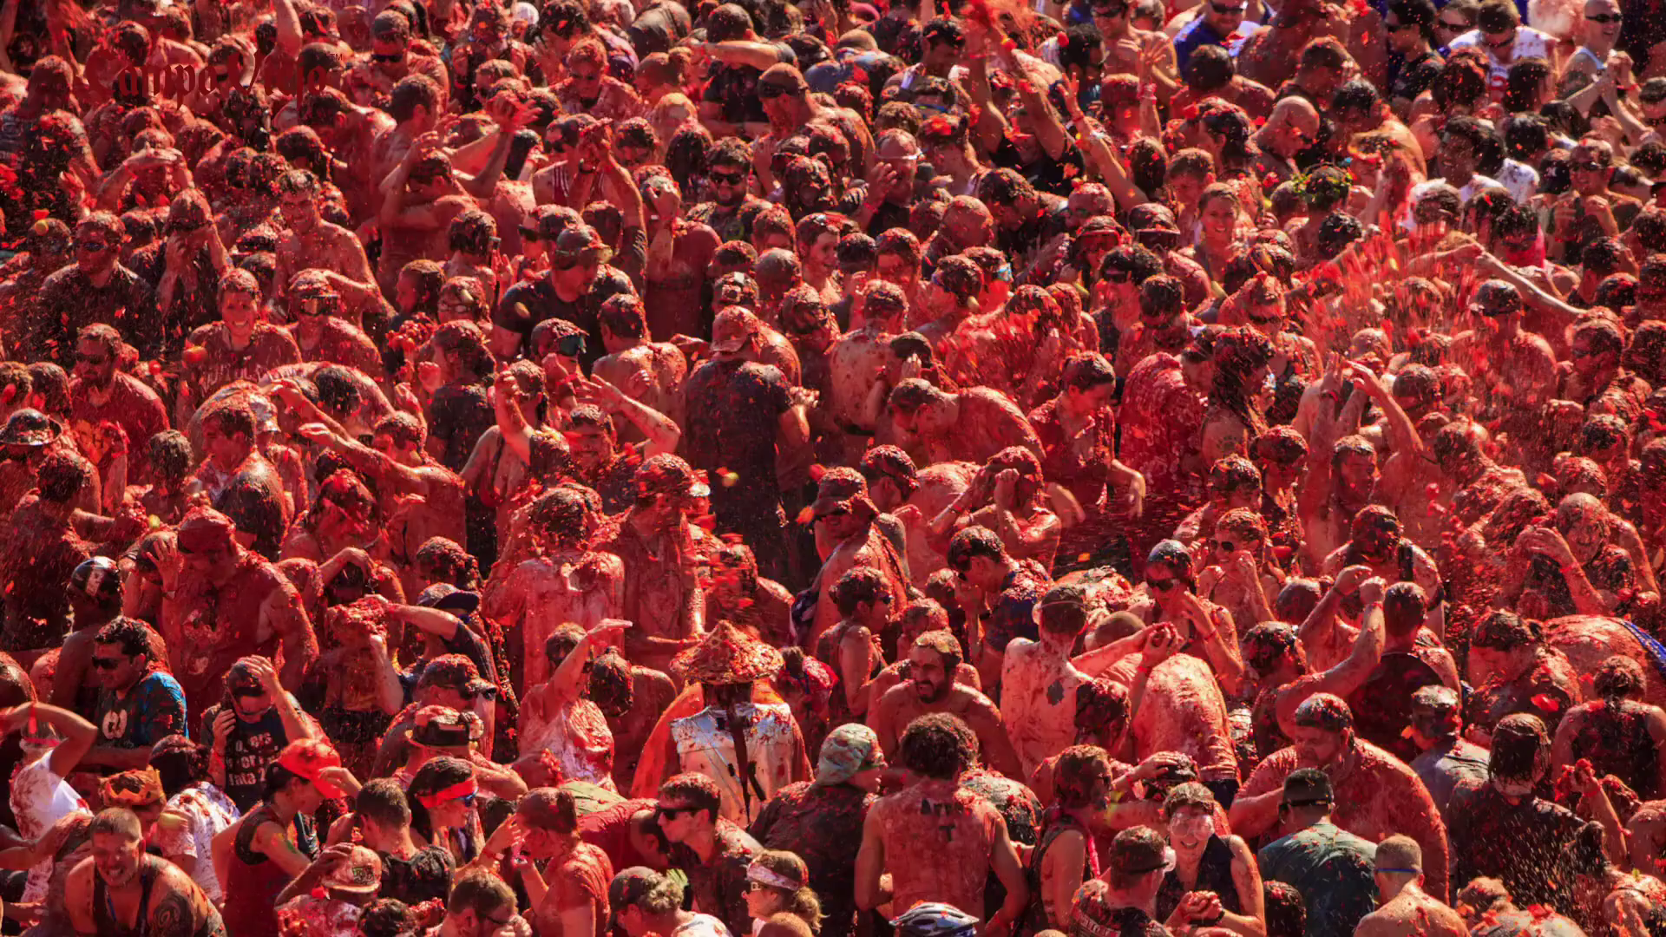
The Cultural Power of TV
Campo Vego, “Add Some Passion”

Slide 2
What's in this deck?
TV has influenced every facet of our culture. This presentation reveals numerous examples of how TV can ignite cultural change:
Direct Power
Daily Life
Culture
Charity
Societal Change
Employment
Tourism
Gentle impact
Cruzcampo, “Choose To Cuz”

Slide 3
“TV…is a kind of culture and it does what culture does - it gives us an understanding of our place in the universe, how to act, eat, dress ourselves…”
Arthur Asa Beager – Cultural Scientist and Professor in Broadcast and Electronic Communication Art at San Francisco State University

Slide 4
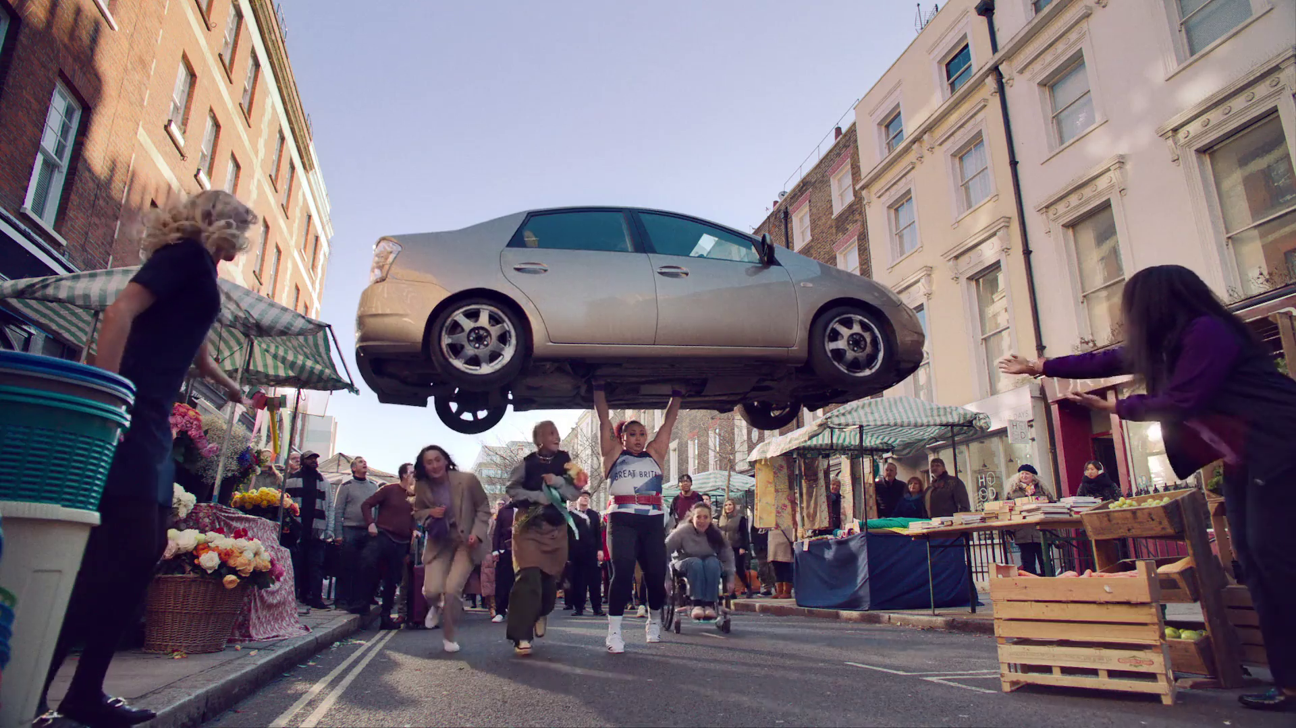
Direct Power
NatWest, “Let's Get Going”

Slide 5
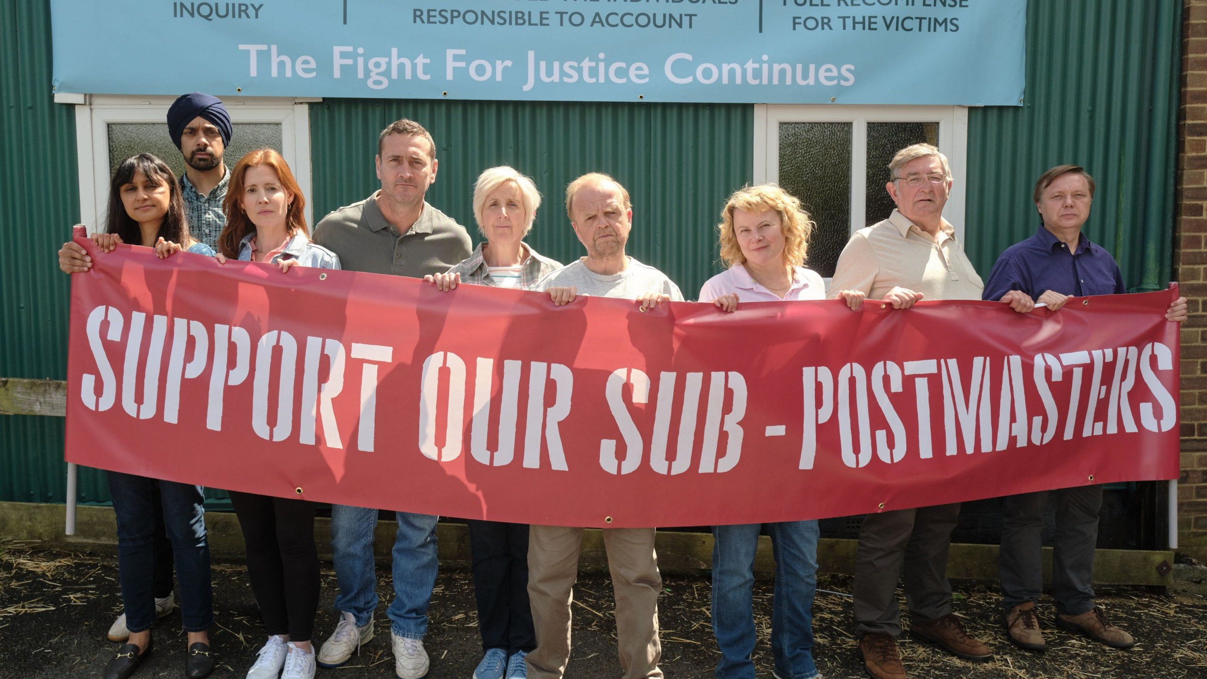
Mr Bates Vs the Post Office
ITV, 2024
‘Mr Bates Vs The Post Office’, ITV
Through humanising the story of the scandal, Mr Bates Vs the Post Office has started a police investigation into wrongdoing and on behalf of the Post Office and cleared the path to have hundreds of convictions overturned.
Notes:
The most recent showcase of the Cultural power of TV. Mr Bates Vs the Post Office has captured the attention of the public, with 9 million viewers watching the show so far.
Telling the story of the Post Office/Horizon Computer Scandal that raged for 20 years. As a direct result of the show, there has been a police investigation opened, Paula Vennels has given back her CBE and a route to having all the wrongful convictions has been cleared and justice can finally be sort for the Sub-Postmasters effected by the scandal.
Kelly Williams, Managing Director, ITV Commercial, told Campaign UK: “It was only when a linear TV drama was broadcast that anyone really sat up and noticed this story. It’s a very timely reminder to our industry of the enduring, unique power of television. Memorable storytelling broadcast to an attentive, mass audience in a trusted, emotionally engaging environment delivers unrivalled effectiveness – these are also the critical ingredients for great advertising.”

Slide 6
It’s a Sin
Channel 4, 2021
‘It’s a Sin’, Channel 4
Record number of HIV tests ordered in one week. Up 5,000 on the previous best. 30% increase in calls to the Terrence Higgins Trust in 24 hours after the airing of the first episode.
Notes:
Saw a recording breaking number of tests sent out by the Terrence Higgins Trust. Launched the same week as National HIV Testing Week saw a record number of 8,207 tests ordered. The previous record was 2,709.
30% increase in calls to the charity help line in the 24 hours after the first episode aired. And a sharp increase in HIV related searches.
https://www.gaytimes.co.uk/culture/its-a-sin-reaches-nearly-19-million-viewers-on-all4-and-increases-hiv-testing/

Slide 7
Dopesick
Disney, 2021
‘Dopesick’, Hulu
Telling the story of America’s Opioid Crisis and the devastating effect it had on working-class communities in the mid-west. It also highlighted the involvement of Purdue Pharma owned by the Sackler Family. As a result of the show, a host of international art galleries, museums and art institutions removed the Sackler name from their buildings.
Notes:
The story of America’s opioid crisis and the devastating impact that it had on the working-class communities in the mid-west was a roaring success for Disney. But in a cultural sense it really highlighted the involvement of Purdue Pharma owned by the Sackler Family. Following the shows transmission on US streaming service Hulu, New York’s Metropolitan Museum of Art announced they would remove the Sackler name from its galleries, joining a host of international museums, galleries and art institutions to do the same.

Slide 8
The Jinx
Sky, 2015
‘The Jinx’, HBO
The Jinx tells the story of Robert Durst, whose wife disappeared in 1982. The series was directly responsible for a warrant being issued for his arrest on the day the final episode aired. Durst was found guilty of first-degree murder in 2019, with sections of the series being used in court to prove his guilt.
Notes:
A documentary series that directly led to the arrest and jailing of New York Real Estate heir, Robert Durst, who was found guilty in 2019 of the murder of his first wife in 1982 with footage from the series used in Court as evidence to help make the case that he should be sent to prison for his crimes.

Slide 9
Daily Life
Barclaycard, “Lawnmower”

Slide 10
Love Island x eBay
ITV, 2021-
‘Love Island’, eBay
After sponsoring Love Island as the official fashion partner, eBay saw massive spikes in searches for pre-loved clothing across the site with 80% of Gen Z audiences now saying they have recently brought second hand.
Notes:
Since making the choice to sponsor Love Island in 2021, eBay have seen a huge spike in searches for 2nd hand clothing on the site. Each of the Islanders now only wear second hand clothing, cutting the need for people to flock to fast fashion after the cast members were encouraged to ‘Eat, Sleep, Rewear and Repeat’.
80% of Gen z audiences (the main viewers of the show) are now buying second-hand goods.

Slide 11
Dragons’ Den
BBC, 2005-
‘Dragons’ Den’, BBC
Dragons’ Den has been a staple of British TV for nearly 20 years now. In that time, the Dragons’ have seen over 1000 business pitches, investing in 124. The show has made household names of Levi Roots and his sauce, which now outsells Heinz Ketchup (according to Sainsbury’s) and even the businesses that don’t get investments have become household names like BrewDog.
Notes:
Dragons’ Den has been on British TV for nearly 20 years as of this year, Over 1,000 businesses have pitched for an investment from the 5 famous business minds. 124 of these have received funding from the Dragons’. Raging from electrical connection boxes, ChocBox to ride on children’s luggage, Dragons’ Den has been imprinting on British life since day one. Launching the careers of Levi Roots and Reggae Reggae Sauce, which according to Sainsbury’s outsells Heinz Ketchup. IN fact you might have seen some of the brands funded on Dragons’ Den on your TV sets with advertising like Craft Gin Club and personalised children’s book brand; Wonderbly now committed spenders on TV.

Slide 12
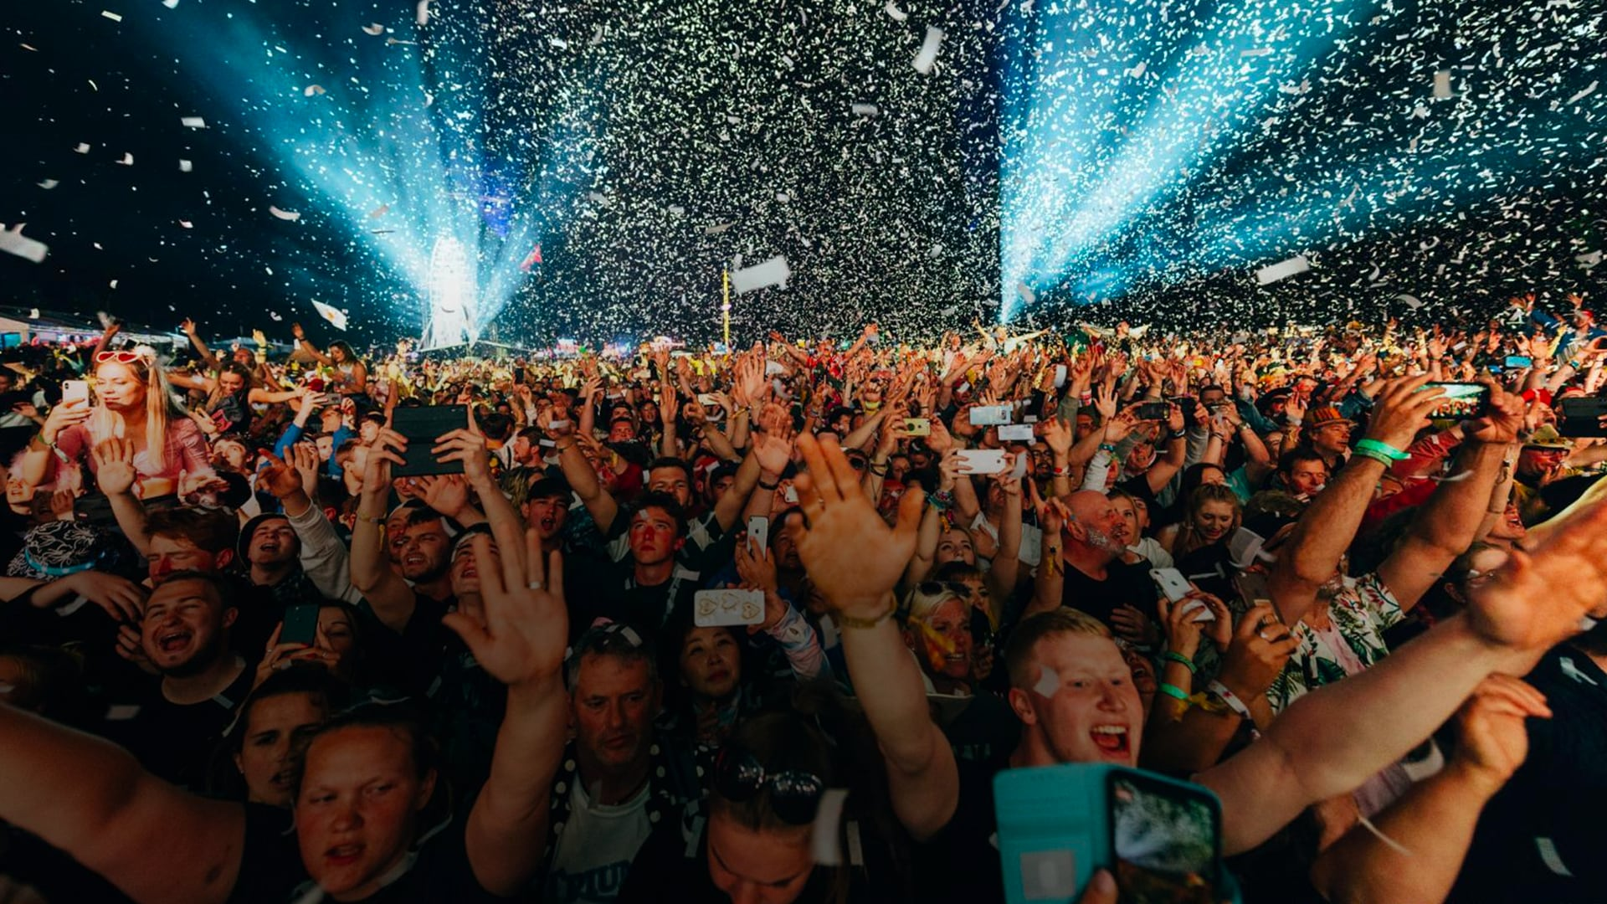
Sky Arts
‘Sky Arts’, Sky Media
Since going free to air in 2020, Sky Arts and Access All Arts has helped over 360,000 children, 13,500 teachers across 7,900 schools to access the arts across 10 different art formats.
Notes:
Research from Public first highlighted that 1 in 3 British adults say they would go to the theatre more if they could afford, which is why Sky made channel Sky Arts free to air in 2020. with shows like Portrait Artist of the Year regularly pulling in over 1 million viewers.
Sky Arts also run something called Sky Arts Access All Arts. They support teachers to take their students on a confidence bosting creative journey, with free, easy to easy resources that cover 10 different art formats. Since it’s inception, Sky Arts Access All Arts has helped over 360,000 children across over 7,900 schools assisting 13,500 teachers

Slide 13
Watchdog
BBC, 1985-2019
‘Watchdog’, BBC
A champion of the British consumer for over 30 years. The investigations undertaken by Watchdog have led to the change of laws around the fitting of plugs to electrical appliances, the closure of a TV Channel, and a vacuum manufacturer having to fork out £40 million in free airline flights to its customers.
Notes:
The Home of British Consumer support for over 30 years, Watchdog has fought many a case on behalf of the British public. The first major investigation undertaken by Watchdog led to the change in law in the late 80s that required all new electrical appliances to be fitted with a plug. An investigation into Hoover’s ‘Free Flights’ promotion in the 90s led to headline news and Hoover having to honour the promotion to the tune of £40 million.

Slide 14
Grange Hill
BBC, 1978-2008
‘Grange Hill’, BBC
A staple of Children’s TV for 30 years, Grange Hill, much like the soaps was a deception of daily school life with the drama dial turned all the way up. The height of the series saw the release of a number 1 anti-drug track ‘Just Say No’ and a trip to the White House to meet the face of America’s Anti-Drug movement, Nancy Reagan.
Notes:
A staple of Children’s TV for 30 years, Grange Hill was not too dissimilar to the soaps. With hard hitting storylines like teenage pregnancy, bullying and suicide all covered by the show. The height of the show in the 1980s saw the show tackle drug addiction when beloved character Zammo McGurie becoming addicted to heroin. The story which spanned across 2 series of the show, showed Zammo’s fall into addiction and the effect it had on his relationships with his girlfriend and best friend Kevin. The story culminated in the release of the number 1 song ‘Just Say No’ and a trip for the cast to the White House to meet then First Lady, Nancy Reagan, the face of America’s Anti-Drug campaign.

Slide 15
Culture
Eon, “It's on us”

Slide 16
Clarkson’s Farm
Prime Video, 2020-
‘Clarkson’s Farm’, Prime Video
Launching at the height of the Pandemic, Clarkson’s Farm highlighted the plight that British farmers are facing across the country. One noted that Clarkson has ‘done more for the farming industry in one series than 30 years of Countryfile.’
Notes:
With the launch of Clarkson’s Farm in 2020, Amazon Prime and Jeremy Clarkson have been able to highlight the plight faced by farmers up and down the country. Highlighting the impact of Brexit and regulations. The series was such a success that it seems to have reframed Clarkson as a farmer resulting in him and his Farmhand helper Caleb winning a British Farming Award in 2021 for growing the profile of farming and farmers in the UK.

Slide 17
RuPaul’s Drag Race UK
BBC, 2019-
‘RuPaul’s Drag Race UK’, BBC
Although an American show to start with, RuPaul’s Drag Race UK is now a must watch for millions every year. Although we have a strong affinity with drag in the UK. Drag Race reignited our love of drag introducing phrases like ‘Slay’ and filling brunches with drag acts up and down the country; while also making a worldwide name for RuPaul himself.
Notes:
A staple of both sexes for some time now, Drag Race originally started in the US, began the process of shining a light on the underrepresented cabaret act of Drag. As a nation we have a strong affinity with Drag acts with the likes of Dame Edna and Lily Savage being staples of British TV since the 1970s but Drag Race regalvanised the Drag movement in the UK. Now a highlight of many peoples viewing calendars when the new series drops. RuPaul’s Drag Race has been responsible for the introduction of Drag Brunches up and down the country, the introduction of words like ‘Slay’ and several other famous catchphrases and sayings coming from the mouth of Ru, a man who is now a global celebrity purely from this outstanding competition format.

Slide 18
Stranger Things
Netflix, 2014-
‘Stranger Things’, Netflix
Stranger Things has been a cultural behemoth since it launched in 2014. With the peak coming after Kate Bush’s iconic track, ‘Running Up that Hill’ reaching Number 1 in the charts; 44 years after her last number 1 in 1978 for ‘Wuthering Heights’.
Notes:
Stranger Things has been a cultural hit across the world since it launched on Netflix in 2014. Since then it has been creating cultural moments that have had a profound effect on society. The main one of these being that it gave Kate Bush her first number 1 in the UK in 44 years since Wuthering Heights in 1978, setting the record for the longest period between number 1 singles, beating Wham! By 1 year. In fact, every single one of Kate Bush’s albums re-entered the charts off the back of the success of Running Up that Hill. Leading to the performer being inducted into the Rock and Roll Hall of Fame in 2023 and her being named the 60th greatest singer of all time by Rolling Stone Magazine.

Slide 19
The X Factor
ITV, 2004-2018
‘The X Factor’, ITV
Songs from performers on The X Factor have resulted in 42 number 1 singles, 30 million singles and 18 million albums sold in the UK. For 7 years running the coveted Christmas Number 1 was taken by the winner of that year’s series. In 2007 at the height of its power, bookies were so certain the winner would take number 1, they started to take bets on what would be Christmas number 2.
Notes:
Along with giving us some of the most iconic moments in TV history, the X Factor has been responsible for the sale of over 30 million singles and 18 million albums in the UK, resulting in 42 number 1 singles. But more important than that, it would set instant culture with 7 of the winner's singles topping charts on Christmas day between 200 and 2014. in fact in 2007, bookies started to take bets on Christmas Number 2, as they were certain the X Factor winner would take the crown. And they also gave us One Direction, a worldwide behemoth.

Slide 20
Levi’s and number 1’s
The Laundrette, Levi’s
An iconic brand in clothing since 1853 and the American Gold Rush, Levi’s has been setting culture in the UK with TV for a long time. With there TV campaigns resulting in 7 UK number 1 singles including Stand By Me by Ben E. King and The Joker by The Steve Miller Band.
Notes:
Levi’s as a brand has been around for over 100 years, starting during the American Gold Rush. But their iconic TV campaigns were directly responsible for 7 number one singles including Stand By Me by Ben E. King and the Joker By the Steve Miller Band both charting higher than they ever did when they were original released.

Slide 21
Charity
Benenden Health, “Alex Brooker & Judi Love”

Slide 22
Paul O’Grady: For the Love of Dogs
ITV, 2012-2023
‘Paul O’Grady: For the Love of Dogs’, ITV
Launched in 2012, Paul O’Grady’s partnership with Battersea Dogs and Cats home, has been cited for the record numbers of pet adoptions for the charity. His ad campaign resulted in 2,163 brand new donations.

Slide 23
Joe and John Bishop: Life After Deaf
ITV, 2022
‘Joe and John Bishop: Life After Death’, ITV
After the show aired in 2022, British Sign Language Charity, Signature, reported a 210% surge in people looking to learn British Sign Language.
Notes:
When Comedian John Bishop and his Son Joe, who lost most of his hearing at 15, go on a journey to understand more about the deaf community and learn British Sign Language. Off the back of the show, British Sign Language Charity; Signature reported a 210% surge in people looking to learn sign language after the show aired.

Slide 24
Sky Zero
Sky Media, 2017-
‘Sky Net Zero’, Sky
Since launching in 2017, Sky Media’s Sky Zero mission has been at the front and centre of embedding sustainable behaviours into everyday life. Research conducted in 2021 highlighted that 1 in 4 viewers would follow in the footsteps of a TV character and make a change to their daily lives.
Notes:
Research conducted by Sky in 2021 found that 1 in 3 viewers say that a TV programme has inspired them to make a change in their lives. And more impactfully, 1 in 4 viewers would follow in the footsteps of a TV character and do something differently. Broadcasters and TV programming can help improve people’s knowledge, perceived ease and normality of sustainable behaviours, boosting the willingness to make a change.

Slide 25
Soccer Aid
ITV, 2006-
‘Soccer Aid for UNICEF’, ITV
Since partnering with UNICEF in 2006, Soccer Aid has raised over £75 million for UNICEF with the game in 2022 breaking all the records and raising £15 million on its own.
Notes:
Since partnering with UNICEF in 2006, Soccer Aid has raised over £75 million for the charity with the world’s biggest celebrity football match. The last game in 2022, saw a record £15.7 million raised.

Slide 26
Children in Need
BBC, 1980-
‘Children in Need’, BBC
Since launching in 1980, BBC’s Annual fundraiser which culminates on the telethon across BBC has raised over £1 billion to support children in need.
Notes:
Since launching in 1980, the annual fundraising event culminating in the telethon on BBC one in November has raised over £1 billion helping children all over the country with care needs or just someone to talk too.

Slide 27
Societal changes
Avios, “Everyday”

Slide 28
Women’s Football
Sky and BBC
‘Women’s World Cup 2023’, ITV
We now watch 9 hours and 5 mins of women’s sport (as of August 2023), up 2 hours on 2022. And the government is now committing £30 million to get 2.5 million additional women playing football by 2030.
Notes:
TV has helped to accelerated the growth of Women’s Football in this country. Off the back of winning the Women’s Euros in 2022 the Government noticed the growth in Women’s Football and committed £30 million to improve the facilities across all levels of the game with the aim of getting 2.5 million additional women playing the game by 2030. We are now watching more women’s sport than ever before with Football driving it! Up to August 2023, we watched 9 hours and 5 minutes of Women’s Sport, up 2 hours on 2021.
Female footballers are now quite rightly, no matter what Joey Burton says, taking up spots as pundits on every type of football game we see on our TVs. Names like Jill Scott and Alex Scott are now household names thanks to being on shows like Football Focus or a League of Their Own.

Slide 29
Soccer AM
Sky, 1994-2023
‘Soccer Am’, Sky Sports
A Saturday morning staple for almost 30 years, Soccer AM is responsible for more than you might think. A home for music of all genres to be showcased and popularised the use of terms like ‘Tekkers’ and ‘Nuts’ all comes from the Sports entertainment magazine show.
Notes:
Although the effect of Soccer AM on culture might seem small on the face of it, I’m sure you’ve been influenced by the 20 year Saturday morning Football show. A show that come around at a time when Football and culture where closer than ever before, When Brit Pop was rising with Blur and Oasis storming the charts. A show right at the cutting edge of culture with its music choices over compilations of wonder goals from around the leagues that week. A show that would become a must visit for musicians like the stalwarts of indie music Kasabian and Liam Gallagher to the new school sound of Grime with Skepta and Kano.
The show also saw the introduction of many words to the British lexicon, like Tekkers; a show of unbelievable skill, came from the shows long running segment ‘Unbelievable Tekkers’ that would show you outstanding things done with a football each week. The footballing worlds love of the term ‘Nuts’ or ‘Meg’, the act of putting a ball through the legs of a defending player, also likely exploded because of the continual use of the term on Saturday mornings.

Slide 30
When They See Us
Netflix, 2019
‘When They See US’, Netflix
The story of the Central Park Five, who on 1980s were falsely accused of rape and sentenced to 30 years in prison. Although they’d already had their convictions overturned in 2002, the story cleared the route for the accused to seek reparations for the time they spent in prison.
Notes:
When They See Us, tells a fictionalised version of the Central Park Five case, where a group of 5 African Americans teenagers were falsely accused of Rape and sentenced to 30 years in prison. While the 5 had been their convictions overturned in 2002, the miniseries was directly responsible for clearing the path that allowed the five to seek reparations for the years they spent in prison thanks in part to the depiction of the American legal system being weighted against the 5 black teenagers.

Slide 31
Blue Planet II
BBC, 2017
‘Blue Planet II’, BBC
After seeing the series, 88% of the population said they would make ‘Changes to their lifestyle’ to combat plastic waste in the world's oceans.
Notes:
After the episode about the effects of plastic waste in the ocean aired in 2017, there was a stark impact that could be seen on the viewer. 88% of people said that they would change their lifestyle off the back of seeing the show. After the first episode aired there was a surge in search activity for the Marine Conservation Society, WWF and Plastic Oceans Foundation all saw spiked in traffic. In April 2018, under growing public support directly linked back to Blue Planet II, the Government announced it was considering a ban on single use plastics. The Queen banned the use of plastic bottles and straws across all royal estates in response to seeing the documentary.
British Universities like University of Southampton saw increases in applications for marine biology course following the airing of the show. All linked back to the so called ‘Blue Planet Effect’. The effect was felt as far as China with 80 million streaming the show at the same time causing a noticeable slowing of internet speeds in the country.

Slide 32
London 2012 Paralympics
Channel 4, 2012-
‘London 2012 Paralympics, Channel 4
When Channel 4 became the broadcast partner for the Paralympics in 2012, they launched their largest ever marketing campaign to promote the arrival of ‘The Superhumans’. After the games, 64% of viewers said they felt more positively about disabled people. Many athletes became household names, and The Last Leg, originating from the Paralympics, continues to run today.
Notes:
When the BBC didn’t take up the broadcasting rights for the Paralympics in 2012, Channel 4 stepped in and took up the rights. Undertaking their biggest ever marketing campaign to announce the arrival of ‘the superhumans’ . Unpromoted awareness of the games rose by 16% in June and a massive 77% before the start of the games themselves. After the games, 64% of viewers said they felt more positive towards disabled people as a result of the games.

Slide 33
The Soaps
ITV, Channel 4 & BBC
‘Coronation Street’, ITV
As a reflection of daily life with the drama dial turned up all the way, Soaps have a long history of showing the changes in society. From having the first gay kiss pre watershed on Eastenders in the 90s to Hayley Crooper being the first transgender character to feature regularly across British TV pre watershed.
Notes:
Soaps have been pushing the boundaries and having a distinct cultural impact on British life since day one.
As a reflection of daily life with the drama dial turned all the way up, they have long held a mirror up the world and put things clearly in the limelight often for the first time to the masses.
Brookside was the home of the first ever lesbian kiss broadcast on British Television in 1994, 5 years before Eastenders broadcast the first ever kiss between two men pre watershed, which resulted in actor Michael Cashman getting bricks through his window.
Coronation Street had the first ever Transgender character to make it pre watershed with Hayley Crooper. Their storyline with X Factor winner Shayne Ward falling into depression and suicide led to record number in calls to Samaritans all from people looking for help.
Hollyoaks’ Long Walk Home Story line promoted nationwide discussion about Violence Against Women and Girls.

Slide 34
Employment
Bumble, “Incognito Mode”

Slide 35
Policing
‘The Tower’, ITV
27% of serving officers have said that the decision to join the force was because of the depictions they see on their TVs when they were younger.
Notes:
Just like One Born Every Minute, the showcasing of Police work across British Television has left an indelible imprint on culture. As many as 27% of active officers chose their profession as a Copper because of what they saw on TV. Either in The Bill with authentic portrayals of Bobbies on the Beat or 24 Hours in Police Custody showing the hard work of officers to close a case, TV is influencing the choice to stand on the Thin Blue Line.

Slide 36
Suits
UKTV & Netflix, 2012-2019
‘Suits’, USA Network
Over half of a law firm agreed that their career choice was influenced by what they had seen on TV, with 30% of those influenced saying it was popular drama Suits that persuaded them to join the legal profession. A further 22% cited Law and Order.
Notes:
Over half of lawyers surveyed said they made the choice to become a lawyer based on a TV show. Suits was the most influential with 30% saying they chose the profession after watching Suits and 22% citied Law & Order.
https://www.legalcheek.com/2023/01/half-of-law-firm-workers-say-legal-tv-shows-influenced-their-career-choice/

Slide 37
One Born Every Minute
Channel 4, 2010-
‘One Born Every Minute’, Channel 4
When it started in 2010, there were 36,700 Midwives in the UK. By 2021, 3 years after the last episode there are now 57,600 Midwives in the UK. Largely a direct result of One Born Every Minute.
Notes:
Although not directly responsible in itself. The run of One Born Every Minute from 2010 has resulted in a boom in the vocation. The same can be said about Emma Wills delivering Babies on W.
Before the start of the show there were 36,700 midwifes in the UK. In 2021 the figure had climbed to 57,600.
https://www.dailymail.co.uk/femail/article-12808933/midwifery-health-careers-popularity.html

Slide 38
The Great British Bake Off
BBC & Channel 4, 2010-
‘The Great British Bake Off’, Channel 4
Bake Off has been a stalwart of British TV since 2010 but did you know that it’s responsible for 79% of British adults picking up the whisk and grease proof paper. Alongside a 230% increase in home baking businesses.
Notes:
Having been a mainstay on British television since it first launched on BBC 2 in 2010, Bake Off has been directly responsible for a huge 230% rise in home baking businesses according to business insurance brand, Simply Business. With many now turning side hustles into businesses. Even if we aren’t making money from the Flapjacks and cookies, we making them to eat at home with research from Mintel showing that as many as 41 million brits are now baking at home, that’s 79% of all adults.

Slide 39
Tourism
Expedia, “Chaos”

Slide 40
Bridgerton
Netflix, 2020-
‘Bridgerton’, Netflix
Whether travelling to Croatia to see Game of Thrones imposing King’s Landing or a little closer to home. Over half of international travel is inspired by what we see on our TV screens. For example, since the launch of Bridgerton, Castle Howard in North Yorkshire has seen a 3,400% increase in 18–24-year-old visitors.
Notes:
According to a study conducted by Expedia, more than half of international travel is inspired by film and TV. Partly driven by a desire to see the breathtaking landscapes of the likes of Dubrovnik in Croatia to see King’s Landing from Game of Thrones we are also travelling in the UK to see locations. For example, Castle Howard in North Yorkshire saw a 3400% increase in visitors aged between 18-24 after the launch of Bridgerton on Netflix. Visitors to Birmingham have jumped 26% from 2013 thanks to Peaky Blinders. The Londonderry Town Museum in Berry has seen record numbers of visitors since the launch of their Derry Girls exhibition. In fact, in 2019 just under £600 million was generated by inbound tourism to the UK, leading to companies being establish to just provide ‘Screen Tourism’ to travellers all over the world.

Slide 41
Downton Abbey
ITV, 2010-2015
‘Downton Abbey’, ITV
A Sunday night staple for 5 years, Downton Abbey was directly responsible for saving one of the nation's many stately homes from falling into disrepair. Off the back of the show, visitor numbers to Highclere Castle doubled to 1,200 a day and remain around that level to this day.
Notes:
A staple of Sunday nights for 5 years, Downton Abbey is directly responsible for saving Highclere Castle from falling into disrepair. Visitor numbers doubled to 1,200 a day where it remains even to this day.
https://www.theguardian.com/tv-and-radio/2015/sep/19/downton-abbey-highclere-castle-tourist-cash-funds-repairs#:~:text=Then%20Downton%20came%20along%20and,and%20then%20in%20the%20US.

Slide 42
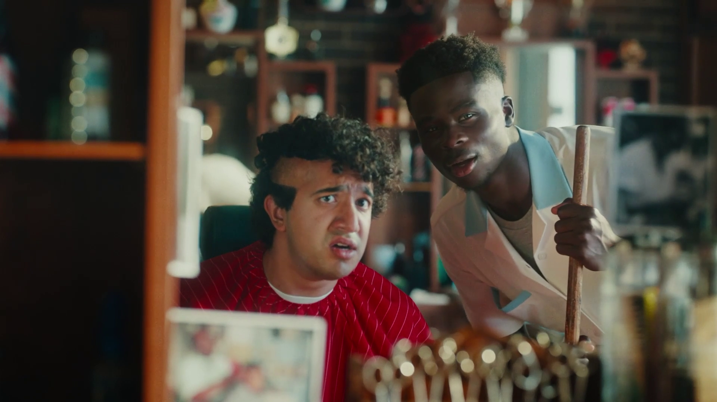
Gentle Impact
Snickers, “Own Goal”

Slide 43
Queer as Folk
Channel 4, 1999-2000
‘Queer as Folk’. Channel 4
For many Queer as Folk was the first time that they had seen gay characters as well developed and realistic. It also helped to improve attitudes toward the gay community.
Notes:
One of the first series to actually portray what life was like for gay men living in the UK, Queer as Folk might not on the face of it have had much of an impact on British society. For many it was the first time they had seen gay characters as well developed and realistic. The show squashed perceived prejudices and showed the fun and enjoyable side of life rather than just the tragedy which could have easily been shown given the time in which the show first aired. The use of the term Queer in the title was also a huge step forward for the LGBTQ+ community as they reclaimed the word and the show helped to pave the way for massive improvements in attitudes toward the community.

Slide 44
Hillsborough
ITV, 1996
‘Hillsborough’, ITV
First broadcast in 1996, Jimmy McGovern’s hard-hitting docu-drama, Hillsborough, was the catalyst for public understanding that Hillsborough was caused not by the fans and built the understanding that was needed to help the families of the 97 Fans who didn’t come home get justice, nearly 30 years later.
Notes:
Jimmy McGovern's hard hitting Docu-drama, Hillsborough, first broadcast in 1996. was a major catalyst in restarting the quest for justice that the families of 97 Liverpool fans, who never came home from Sheffield in 1989. The film helped to educate the nation as to the causes of fatal crush, which till that point had been largely blamed on the Liverpool fans and not on the effects of crowd control and policing. Walton MP Steve Rotheram, said ‘It was massively influential - the country didn’t want to listen then. It was a drama-documentary but it was factual - it is only subsequently, now that we know the full truth, that we can see how accurate Jimmy was able to write something 20 years before we got to the situation in the country that we are in now… Now I think most people accept what really happened on the day’

