Slide 1
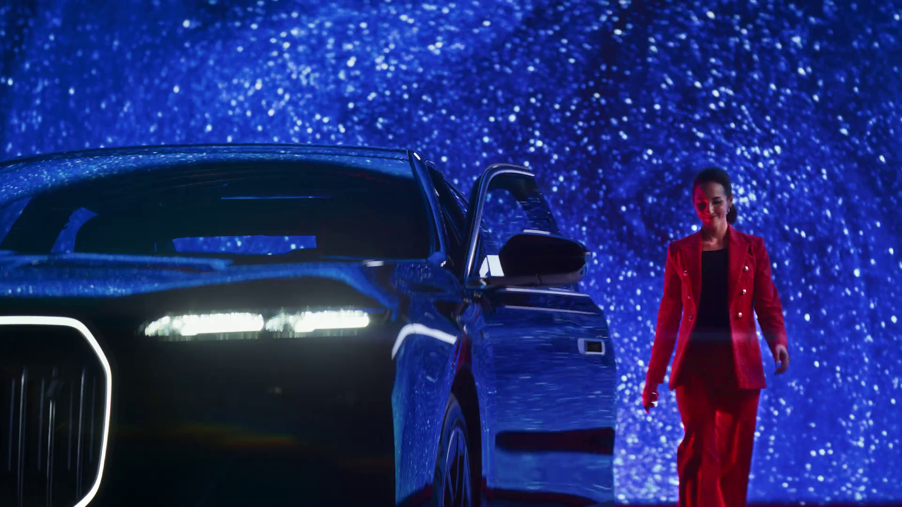
TV: The Growth Engine for Autos
BMW– Entrance Moments

Slide 2
In this deck…
PLANNING YOUR JOURNEY | 01
DRIVING THE BOTTOM LINE | 02
ON THE ROAD TO THE FUTURE | 03
SHIFTING GEAR: CASE STUDIES | 04
Jaguar – Night Drive

Slide 3
Planning your journey
Expedia - Arrows

Slide 4
Commercial broadcasters are unrivalled for scale
All Individuals – All devices
Bubble area represents total volume of daily viewing
Source: Barb / All Individuals, all devices – 2022
Notes:
This chart breaks down viewing to the various platforms in terms of the average number of people watching per day (for at least 3 minutes) compared with the average time spent watching per viewer (i.e. only counting those who watched on that day).
Analysis across 2022 shows that the commercial broadcasters (linear and on demand) collectively reach just over 33 million viewers every day, with each of those viewers watching for an average of 3hrs, 25 mins a day. The combined portfolio of BBC channels (linear and on demand) attracts the second largest volume of viewing, with 27 million daily reach and an average view time of just over 2 hours. YouTube is next, with a daily reach of 20 million people and a view time of 1hr 42 mins (Barb only measure in-home viewing, we estimate that YouTube would be circa. 25% larger in viewing time if out of home viewing was included).
SVOD services such as Netflix has a daily reach of 12.4 million people and a view time of 1hr 47 mins, whilst other AVOD services (covering Chili, Rakuten TV, Samsung TV Plus, Red Bull TV, TVPlayer, Vevo, W4FREE, and YuppTV) have a collective average daily reach of 83,000 viewers and a view time of 38 mins a day.

Slide 5
Commercial TV quickly delivers mass exposure
% of the UK population watching commercial linear TV
49.9%
74.6%
87.1%
Daily
Weekly
Monthly
Source: Barb, Individuals, Commercial linear TV, H1 2023, reach 3+ mins
Notes:
Commercial linear TV reaches 75% of the population each week.

Slide 6
TV is an essential part of video advertising
Average video advertising time per day
All Individuals: 17 mins
% breakdown of time spent watching AV advertising
All Individuals
Source: 2022, Barb / Broadcaster stream data / IPA TouchPoints 2022 / UK Cinema Association / ViewersLogic to model OOH viewing time * YouTube ad time modelled at 4.1% of content time, TikTok ad time modelled at 3.4% of content time using agency and broadcaster data, Other online modelled at 4% of content time)
Notes:
Without a single source data provider on time-spent watching AV advertising, this analysis takes a jigsaw approach, using a variety of data sources to build the most accurate picture of AV viewing time possible.
The data approach used to build the estimate for each platform:
Broadcaster TV: Barb data for linear and playback advertising time and the broadcasters’ own census data for BVOD advertising viewing time.
Cinema: The UK Cinema Association provides total box office seats sold. We’ve estimated 15 minutes of advertising per seat.
YouTube: Barb data for time spent viewing content, ViewersLogic panel data to estimate out of home viewing not measured by Barb (73.5% in home, 26.5% out of home), broadcasters’ own data of ad load per hour of YouTube viewing, and agency data for average duration of ad view.
TikTok: Barb data for time spent viewing content, ViewersLogic panel data to estimate out of home viewing not measured by Barb (77.5% in home, 22.5% out of home), Thinkbox estimates for ad load per hour of TikTok viewing, and agency data for average duration of view.
Other online video: IPA TouchPoints data for % of other online video viewing relative to all video viewing, Thinkbox estimate of % ad time to content time (based on YouTube/TikTok).

Slide 7
TV advertising sends the strongest ‘signals’ of brand strength
Ad signalling power by media channel
Source: Signalling Success, 2020, house51/Thinkbox. Base: all adults (3,654)
Notes:
TV drives the strongest fitness and social signals
Fitness signals are about the perceived brand quality, financial strength of the company, and the company’s confidence in their brand.
Social signals are the brand’s perceived fame, popularity, and success.
Trust is the degree to which the brand was perceived to deliver the promises of its advertising.
Performance across each media varied little by category but TV drove the strongest signals in all categories tested (online retail, FMCG, mobile networks and home insurance). Social media and video sharing sites were the advertising channels least likely to drive these signals.
Here’s how the signalling stacked up by media.
The findings in the table above show the % of respondents positively scoring the brand, or agreeing with statements in relation to the brands. The ‘fitness’ and ‘social’ signals are composite averages of the metrics listed above.
For more information, check out: https://www.thinkbox.tv/research/thinkbox-research/signalling-success

Slide 8
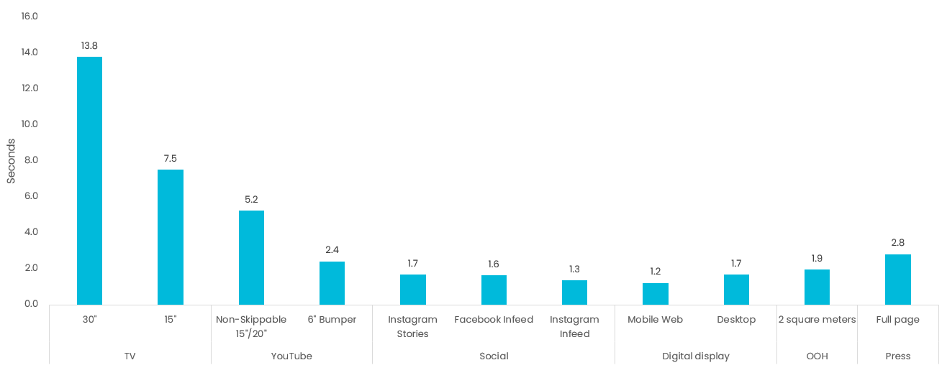
TV provides time to tell your story
Visual attention to advertising: average ‘gaze time’ by ad format
Sources: Attention data from TVision (TV), Lumen (Digital, print, OOH).
Notes:
Data from Lumen shows that viewing time varies between media.

Slide 9
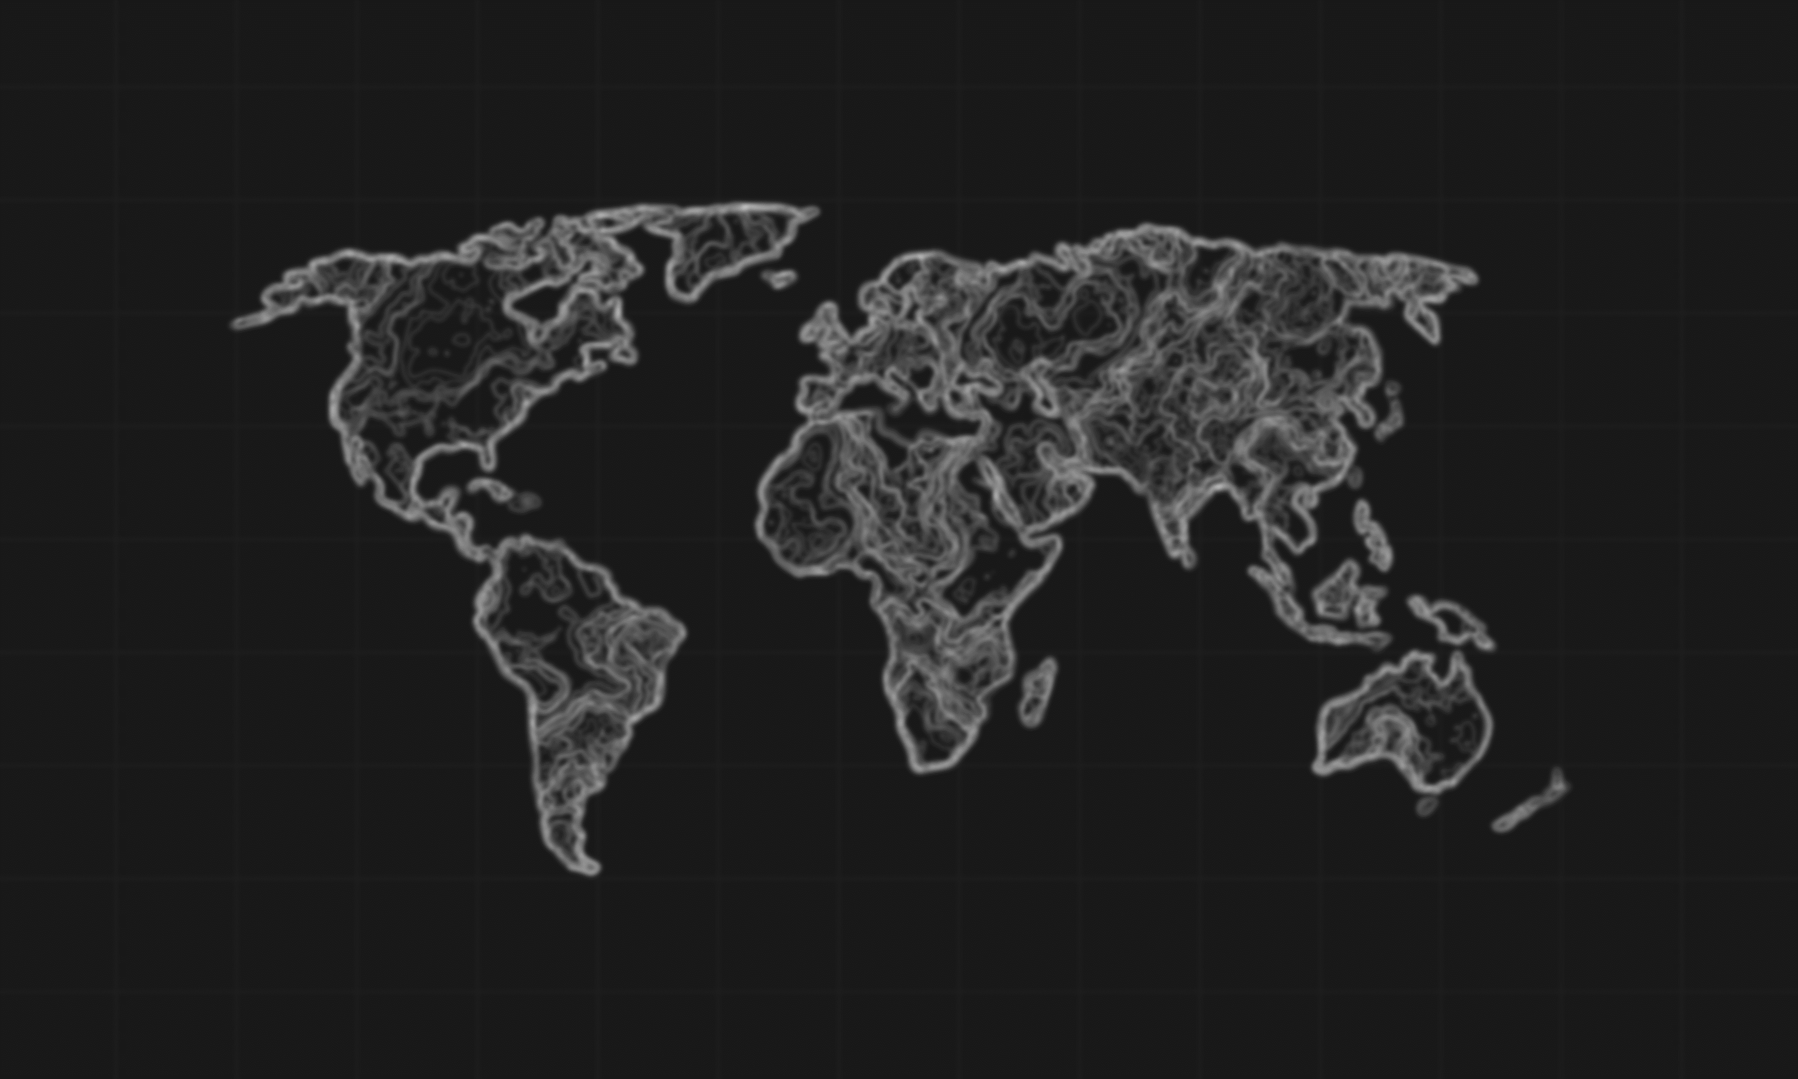
A globally dominant media channel
Daily length of time spent watching linear TV
World
2^{h}36
Europe
North America
3^{h}40
Asia
3^{h}05
2^{h}07
Middle East
3^{h}37
Africa
Oceania
South America
3^{h}05
2^{h}00
3^{h}36
Source: RTL AdAlliance, ‘TV Key Facts 2022, Total video international trends’, GLANCE / relevant partner – reproduction forbidden, all rights reserved by MEDIAMETRIE, Linear TV
Notes:
Data from RTL AdAlliance shows the time spent watching Linear TV around the world.

Slide 10
Driving the bottom line
Land Rover Range Rover – Sport SV

Slide 11
TV is the lowest priced video option
Average cost per 30 seconds (000s)
Other online video
TV
YouTube
£130
£8
£12
Source: 2022, Thinkbox estimates using AA/WARC, Barb, ViewersLogic, IPA TouchPoints 2022
Notes:
TV advertising is incredible value. TV is on average almost two thirds the price of YouTube, for example, and sixteen times cheaper than other online video advertising, like Facebook. These other forms of video cost advertisers more because of their cost-per-start trading model and the ease with which users can avoid the ads.

Slide 12
Losing TV = Losing money
-49%
-57%
-20%
The combined return expected in the three months after each week’s investment
The sustained sales over three years
The combined total of campaign uplift and base growth
Source: EssenceMediacom / Wavemaker / Gain Theory / Mindshare econometric analysis. Based on £2bn Automotive brand.
Notes:
The Media Mix Navigator tool, developed by WPP for Thinkbox, proves just how powerful TV is for automotive brands.
This chart shows the revenue effect from one year’s investment for an automotive brand with an annual media budget of £20m. Including TV on the media plan (linear & broadcaster video on demand) alongside the other channels (Print, Social Media, Audio, Generic Search, Out of Home, Online Display and Cinema) drives a shorter-term campaign uplift compared with the same budget excluding TV.
This scenario is based on a £2bn automotive mass market brand, 0-10% online sales, £20m annual spend and high tolerance.
More about the Media Mix Navigator:
The Media Mix Navigator tool, powered by econometrics, helps you get the most out of your media investment.
It allows you to explore different scenarios to define the optimum media mix for your business, whether your objective is to drive increased profit or revenue. The results are modelled across the first year of investment and the resulting ‘base’ sales growth across the following two years.
This tool draws on data from 52 EssenceMediacom, Wavemaker, Mindshare and Gain Theory client brands, totalling £2.2 billion of media spend over 3 years (2018-mid 2021). These have been carefully chosen to represent as many business types as possible. Cost of media is based on 2021 prices.
For more information on the Media Mix Navigator please see:
https://www.thinkbox.tv/training-and-tools/media-mix-navigator/media-mix-navigator

Slide 13
TV belongs at the heart of an effective plan
Source EssenceMediacom / Wavemaker / Gain Theory / Mindshare econometric analysis. Larger brand: based on £2bn brand size and £20m annual spend. Smaller brand based on £500m brand size and £5m annual spend.
Notes:
The Media Mix Navigator can be used to look at the optimum media allocation for different brand sizes and different product sectors. When looking at brand size variance, specifically for the automotive sector, we can see that a larger share is allocated to video-based formats, specifically TV and broadcaster VOD.
More about the Media Mix Navigator:
The Media Mix Navigator tool, powered by econometrics, helps you get the most out of your media investment.
It allows you to explore different scenarios to define the optimum media mix for your business, whether your objective is to drive increased profit or revenue. The results are modelled across the first year of investment and the resulting ‘base’ sales growth across the following two years.
This tool draws on data from 52 EssenceMediacom, Wavemaker, Mindshare and Gain Theory client brands, totalling £2.2 billion of media spend over 3 years (2018-mid 2021). These have been carefully chosen to represent as many business types as possible. Cost of media is based on 2021 prices.
For more information on the Media Mix Navigator please see:
https://www.thinkbox.tv/training-and-tools/media-mix-navigator/media-mix-navigator

Slide 14
TV significantly boosts the effectiveness of other ad channels
Cinema | Online Video + VOD | Social Media | Online Display | Radio | Print | Out of Home | Direct Mail | Generic Search
54% | 20% | 31% | 31% | 31% | 31% | 22% | 20% | 8%
The ‘Media Multiplier Effect’
% increase in media channel effectiveness when a campaign is running in conjunction with TV
TV
Source: ‘Demand Generation’ Nov 2019 (econometric analysis across Mediacom / Wavemaker / Gain Theory)
Notes:
‘Demand Generation’, commissioned by Thinkbox and conducted WPP agencies Mediacom, Wavemaker and Gain Theory, looked at how one ad channel boosts the efficiency of another ad channel. Most channels boost the efficiency of others, but the scale and consistency of the effect differs significantly.
This chart outlines this multiplier effect between ad channels and the effects each channel can receive. In this case, TV is the active channel generating the effect, with the remaining channels benefiting from that effect.
We can see that when TV is active, the effectiveness of Cinema is bolstered up by 54% - more than any other channel. This makes sense as Cinema has a relatively small reach but a high impact, and with TV copy tending to be a cutdown version of what Cinema shows, it is extending its reach.
TV stands out as having the biggest and most consistent effect on other channels. This isn’t a coincidence. On average brands are spending 45% of their advertising budgets on TV, so it is bound to have a bigger effect.
For more information on this study please see:
https://www.thinkbox.tv/research/thinkbox-research/demand-generation

Slide 15
Long-term effects are particularly critical for autos
Long term multiplier = a measure of the long term (3 months – 2 years) return achieved above the short term (0 – 3 months) performance
Average long-term multiplier = 1.23
Source: Media Mix Navigator, Sep. 2022, EssenceMediacom / Wavemaker / Mindshare / Gain Theory
Notes:
The dataset behind the Media Mix Navigator allows us to look at multipliers in more detail.
Average long-term multipliers differ by product sector.
Various factors contribute to this such as the actual channel mix itself, but also the purchase cycle. In this case the long-term multiplier for automotive is much larger as consumers are likely to be in market once every few years.
For more information on the Media Mix Navigator please see:
https://www.thinkbox.tv/training-and-tools/media-mix-navigator/media-mix-navigator

Slide 16
TV is critical for long term effects
Long term multiplier = a measure of the long term (3 months – 2 years) return achieved above the short term (0 – 3 months) performance
Average long-term multiplier = 1.23
Source: Media Mix Navigator, Sep. 2022, EssenceMediacom / Wavemaker / Mindshare / Gain Theory.
Notes:
The dataset behind the Media Mix Navigator allows us to look at multipliers in more detail. Average long term multipliers differ by product sector but also by channel.
When we look at long-term multipliers, on average across all channels, for every pound we spend in the short-term, we get another 1.23 in the longer term. This figure varies by channel as each has a different role in driving long-term sales, we can see that TV is critical for long term effects.

Slide 17
On the road to the future
Lexus – The Energy That Drives You On

Slide 18
Get the best of both worlds
Best of online:
Dynamic one-to-one ad delivery
Mass first-party data
Best of TV:
Big screen & sound on
Fully viewable & viewed
High quality, brand-safe content
Shared viewing
H&M – Fall in Love
Notes:
The new frontier of TV advertising shows how the broadcasters have invested in new technologies and developed advanced advertising opportunities that bring together the best of the internet and TV advertising.

Slide 19
Speaking to a connected customer
74%
of UK households have a TV connected to the internet
eBay – Official Pre-Loved Fashion Partner
Source: Barb Establishment Survey, 2023 Q2 Annual Report Vol 1, Q3 2022 - Q2 2023
Notes:
According to the Barb Establishment Survey, 74% of UK households have a TV connected to the internet

Slide 20
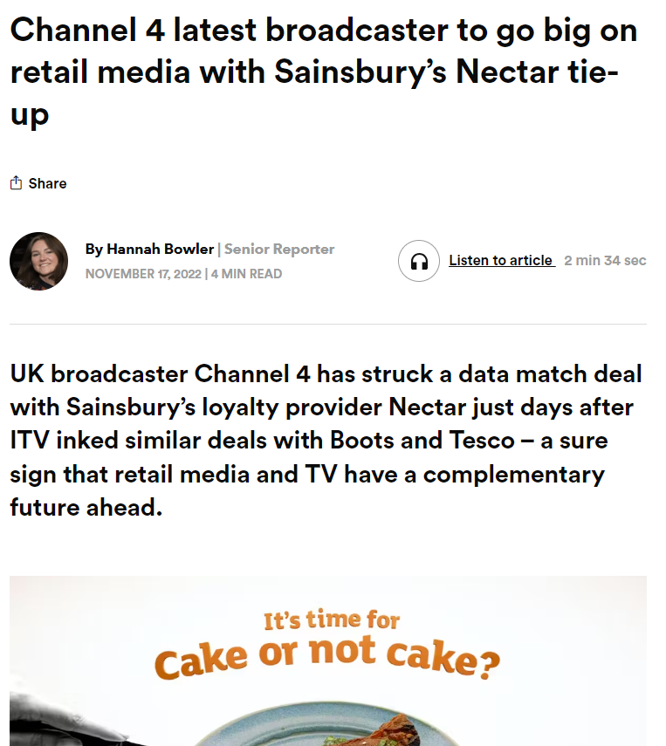
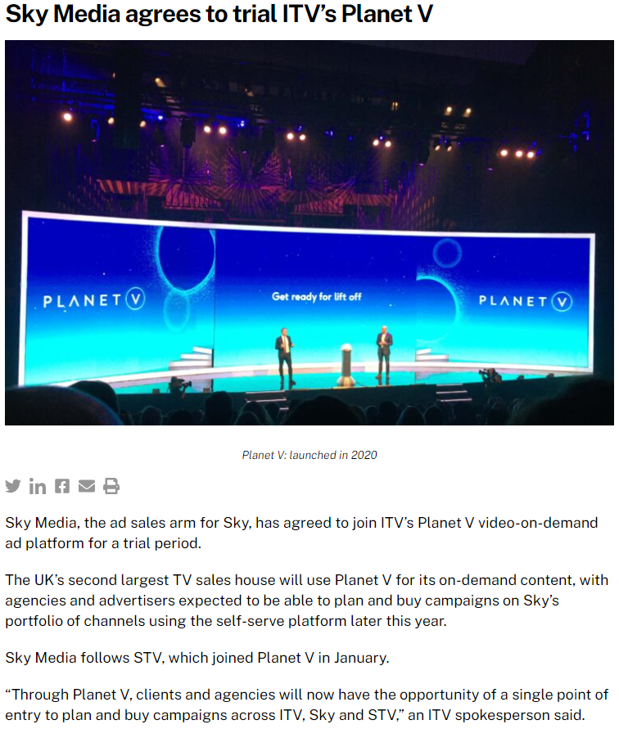
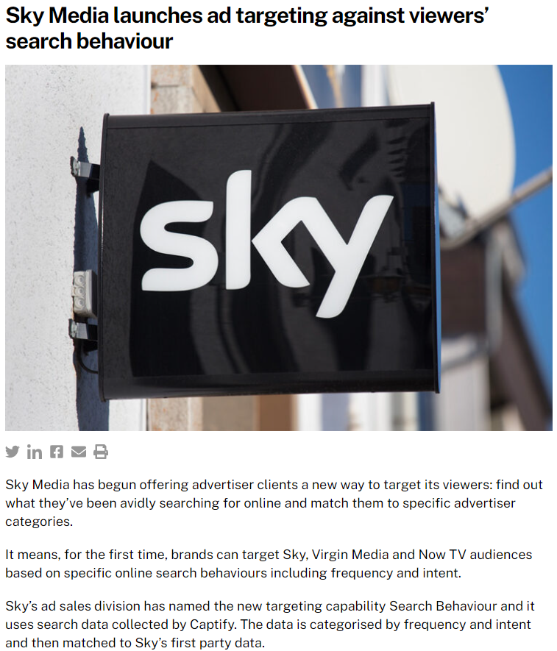
Broadcasters have invested in advanced targeting capabilities
Source: The Drum, The Media Leader
Notes:
Recent news in the trade press shows the steps taken by broadcasters in their commitment to the development in advanced targeting capabilities.
Source:
https://www.thedrum.com/news/2022/11/17/channel-4-latest-broadcaster-go-big-retail-media-with-sainsbury-s-nectar-tie-up
https://the-media-leader.com/sky-media-agrees-to-trial-itvs-planet-v/
https://the-media-leader.com/sky-media-launches-ad-targeting-against-viewers-search-behaviour/

Slide 21
Who cares about cookies when you’re rich in first-party data
ITV – 37m registered users
Channel 4 – 27m registered users
Channel 5 – 8m registered users
Sky – 10m+ subscribers
Extreme Cookie Cone – Pillow Fight
Source: Broadcaster data
Notes:
The broadcasters are rich in terms of first party data as they require users to register and log-in to use their BVOD services, or to have a contract with their subscribers in the case of Sky.
This kind of scale in terms of high quality, first party data, combined with high time spent and high potential reach, is vital for both highly targeted advertising and mass advertising.

Slide 22
Shifting Gear
Case Studies
Jaguar – Night Drive

Slide 23
Volvo: using premium TV content to build a premium brand
Challenge:
Wanting to enter the high-end automotive sector, Volvo needed to change perceptions on the brand beyond being the safest around, while also increasing purchase intent.
Solution:
Sponsoring Sky Atlantic, Volvo used high-end programming to create the association of the brand with the high end, while also telling human stories about how the brand can help the world around them.
Results:
First year of sponsorship saw spontaneous awareness more than double, and promoted awareness trebled
Brand metrics such as consideration and purchase intent grew
Notes:
To read the full case study, visit: https://www.thinkbox.tv/case-studies/volvo-using-premium-tv-content-to-build-a-premium-brand

Slide 24
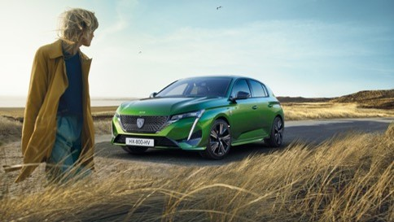
Peugeot 308 use linear TV and BVOD to drive +88% web traffic
Challenge:
Peugeot, a legacy brand had dropped from people’s minds and wasn’t cutting through with its audience. But the launch of the New 308 model in 2022 presented the brand with an opportunity to shift the brand’s awareness levels and relaunch Peugeot’s new brand positioning.
Solution:
Understanding fully the audience habits through data to find the right moments of talkability across both linear and BVOD to drive conversation and consideration.
Results:
88% increase in web traffic over the campaign period
144% increase in search volumes on the launch day of the campaign
Won number 1 spot in the Automotive Share of Voice battle

Slide 25
MG Motor’s ITV partnership generates 590% surge in test drive requests
Challenge:
MG Motor UK wanted to launch the all-electric ZS model, targeting mainstream family car buyers and using TV to drive awareness.
Solution:
They partnered with ITV to reach their target audience at scale.
They took advantage of ITV regionality to upweight activity in proximity to dealerships.
Results:
Test Drive requests increased 590% and find a dealership enquires rose 114%
Web visits increased by 127%
Source: ITV Media
Notes:
To read the full case study, visit: https://www.itvmedia.co.uk/case-studies/mg-motors-test-drives-soar

Slide 26
#SuzukiSaturdays generates 70% increase in enquiry rates
Challenge:
Suzuki Vitara wanted to cut through a competitive market for the launch of their all-new model.
Solution:
They recruited Ant & Dec to its dealer sales team in TV commercials and sponsored Saturday Night Take Away ahead of March car registrations, creating 10”/30” creatives using the show’s IP.
Results:
The #SuzukiSaturdays campaign was 2016’s most watched online car ad (3 million views)
70% increase in enquiry rates
Source: ITV Media
Notes:
To read the full case study, visit: https://www.itvmedia.co.uk/case-studies/suzukis-saturday-campaign-most-watched-car-ad

Slide 27
Suzuki’s bespoke C4 programme reached 2.35m individuals
Challenge:
Suzuki wanted to build awareness and increase appeal amongst a younger demographic.
Solution:
Suzuki worked closely with C4 to create 15x30 minute episodes of a new reality series that saw three celebrities take part in a series of challenges and core driving skills, with the Suzuki Ignis seamlessly integrated into the editorial.
Results:
Each episode consistently averaged 430k individuals (20%+ above the E4 slot average)
Reached 2.35m individuals across the series
Source: 4Sales
Notes:
To read the full case study, visit: https://www.4sales.com/our-work/suzukis-all-star-driving-school-e4

Slide 28
Vauxhall’s bespoke mini-series with C4 reached over 12m adults
Challenge:
Vauxhall wanted to launch the Crossland-X and redefine both the Vauxhall brand and car marketing to Mums.
Solution:
Vauxhall worked with C4 to create mini-episodes with award-winning comediennes (Sally Phillips & Jessica Hynes) called Mamas Uncut. They also launched the campaign with a bespoke C4/Vauxhall intro in The Crystal Maze, as well as contextually relevant spots. They extended reach on All 4 with a homepage takeover on launch day and an interactive VOD format
Results:
This campaign reached over 12m adults
The three-week campaign generated a positive sentiment, 25% of viewers felt much more positively towards Vauxhall
Source: 4Sales
Notes:
To read the full case study, visit: https://www.4sales.com/our-work/mamas-uncut-vauxhall

Slide 29
Automotive brand uses Sky AdSmart to generate 34% uplift in web visits
Challenge:
Create awareness & interest in the automotive brand and their range of vehicles, using Sky AdSmart to target the most relevant audience over a four-week period.
Solution:
Using our unique partnership with Experian, we directly targeted Households most likely to be in market for their specific brand.
Target: Mid- High Affluent households using Experian Automotive data .
Results:
+34.2% uplift in Web visits vs. control
+3.8k incremental Web Visits driven by TV
49% conversion to Car’s page
+2k incremental Visits to Car’s page
Source: Sky Media, image used is not reflective of the case study advertiser

Slide 30
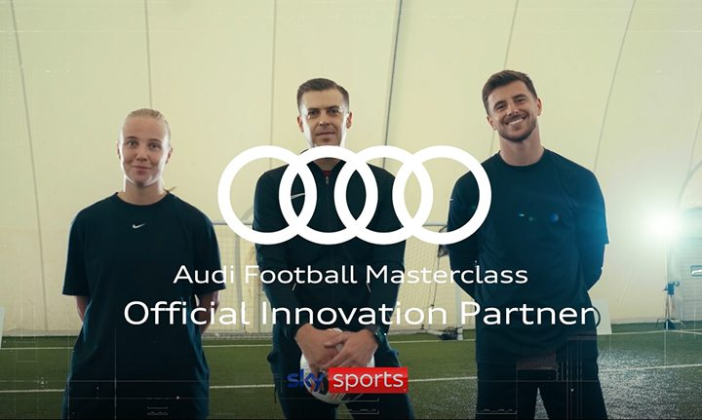
Audi partner with Sky to drive over 4.7m views across branded content
Challenge:
Audi wanted to increase perceptions of the brand as ‘a leader in electric vehicles’ and ‘a manufacturer of cars with innovative technology’ and increase the proportion of drivers who would consider Audi for their next EV.
Solution:
Audi became Sky Sports’ Official Innovation Partner with an always on co-branded 20” creative, a bespoke Sky Sports-produced Behind The Scenes explainer video and targeted digital and social masterclasses, with seamless Audi brand integration across cricket and football
Results:
+4.7m views across the cricket and football Masterclass content
1.3x more participants viewing vs. Lumen’s norms
Source: Sky Media
Notes:
To read the full case study, visit: https://www.skymedia.co.uk/case-studies/audi-sky-sports/

