Slide 1
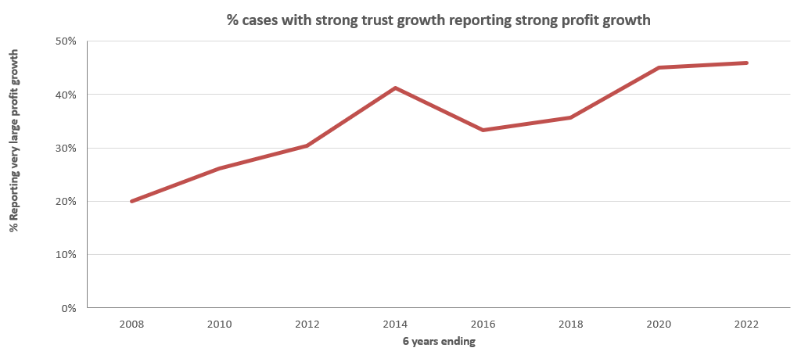


The link between trust and profit has grown especially strongly
Source: Base: IPA Databank 2004-2022 for profit cases reporting very large trust improvements. NB: insufficient data prior to 2008.

Slide 2
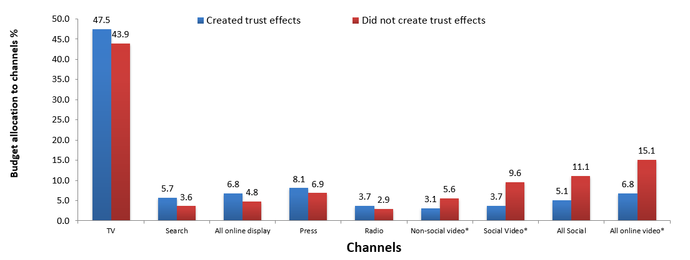
TV is one of the trusted media
Source: IPA Databank 2014-2022 for profit cases *data available from 2016

Slide 3
Perceived cost signals trust
TRUST SIGNAL
Source: Signalling Success, 2020, house51/Thinkbox. Base: all adults (3,654)
Notes:
A very obvious linear relationship between perceived cost of an advertising channel, and key brand metrics, such as brand quality & brand trust.
As perception of advertising cost increases, so do trust & quality scores of brands advertising on those channels.

Slide 4
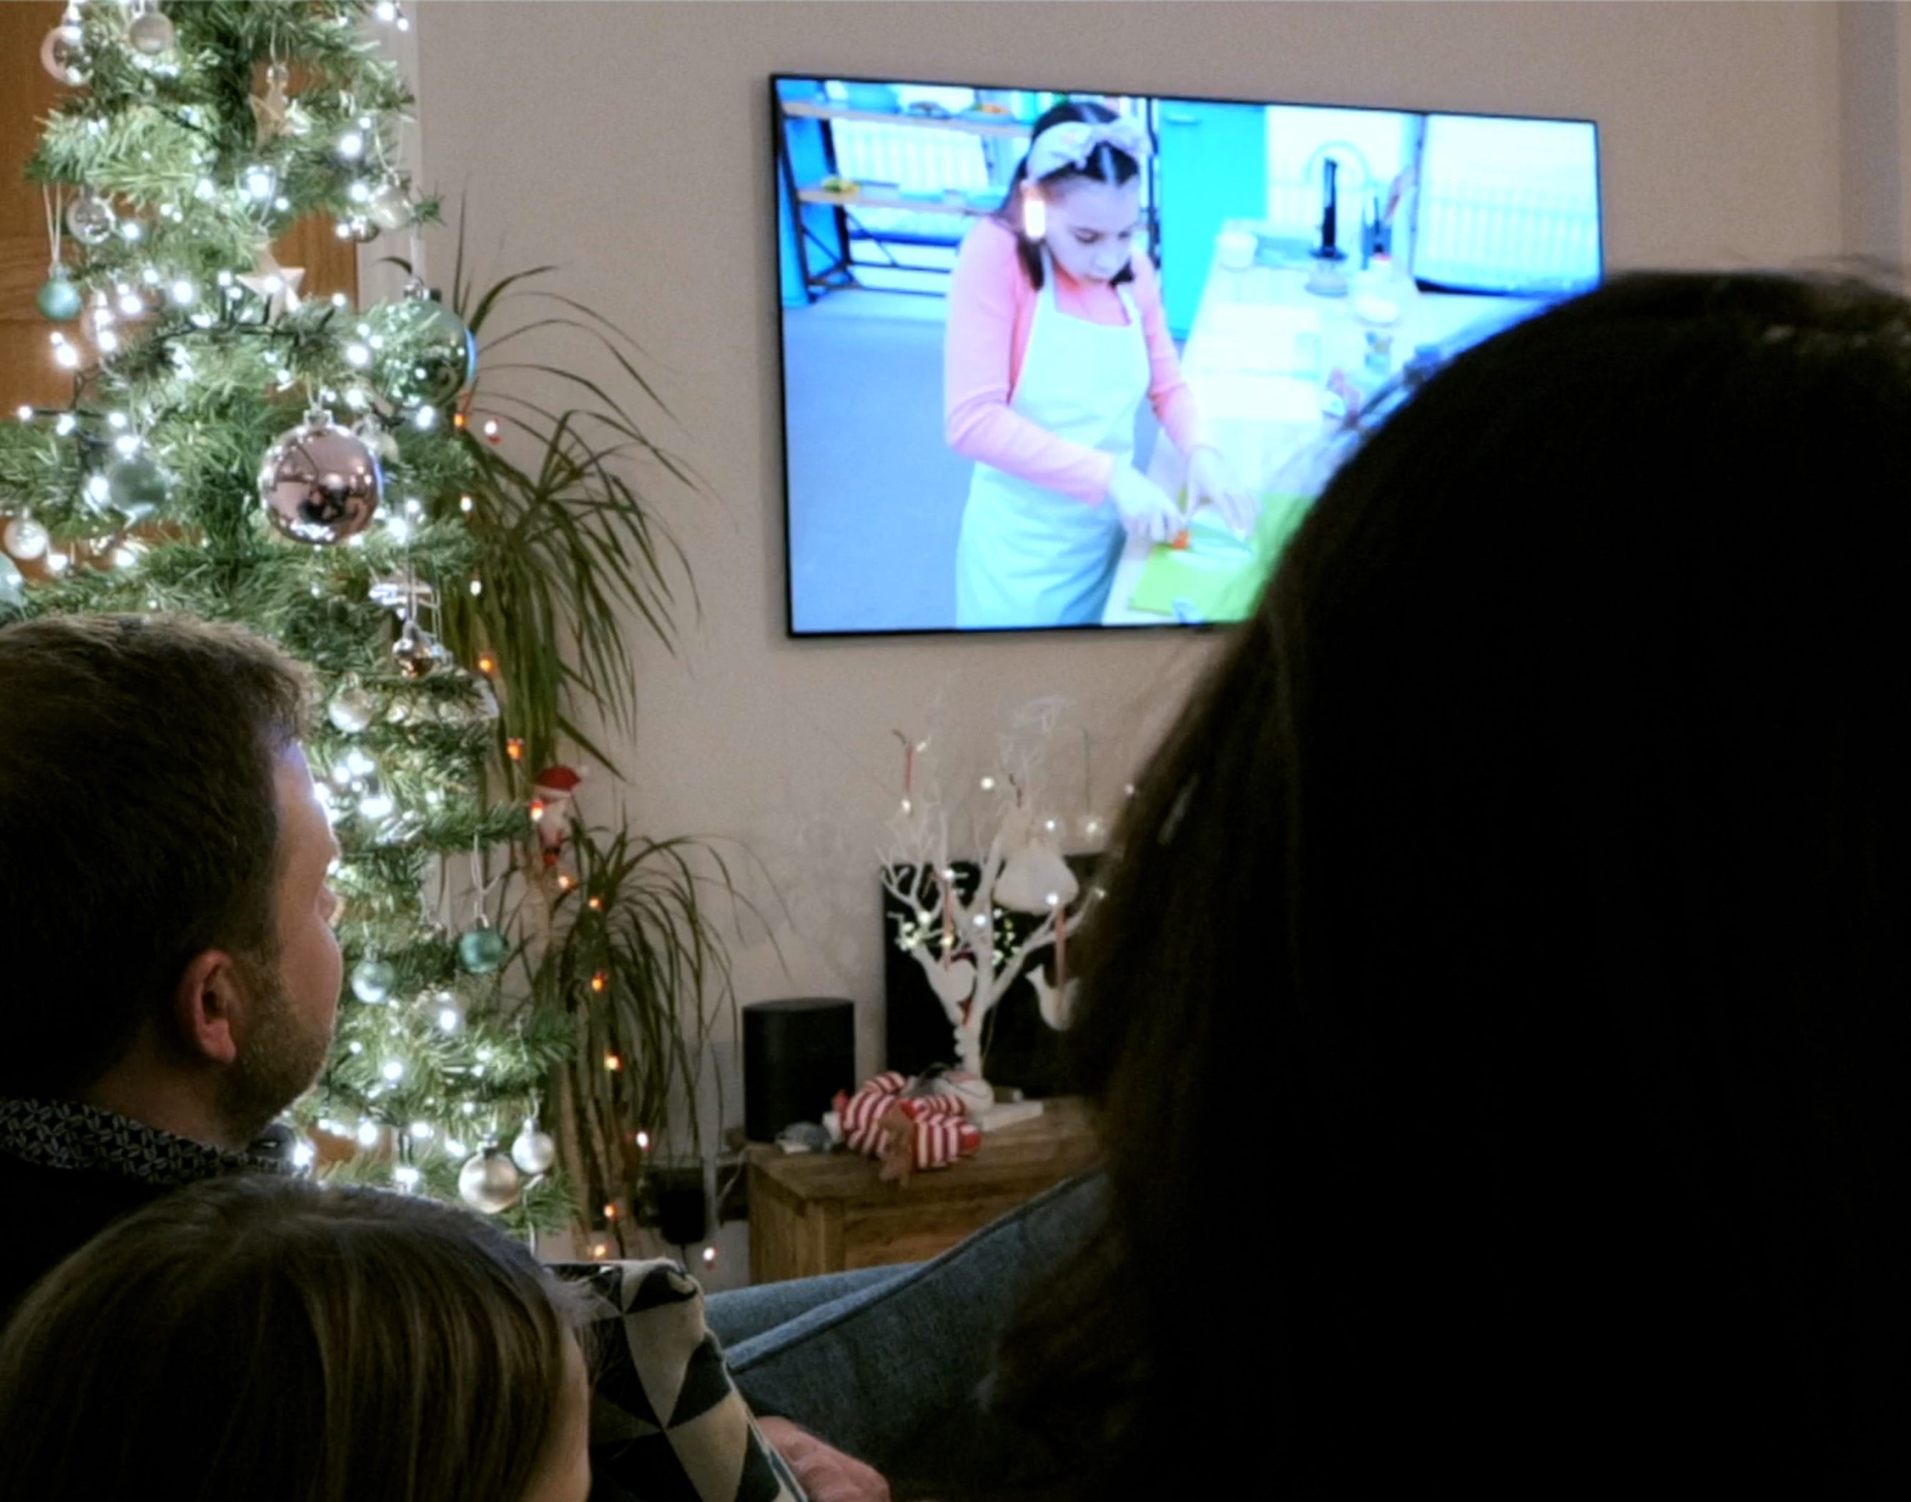
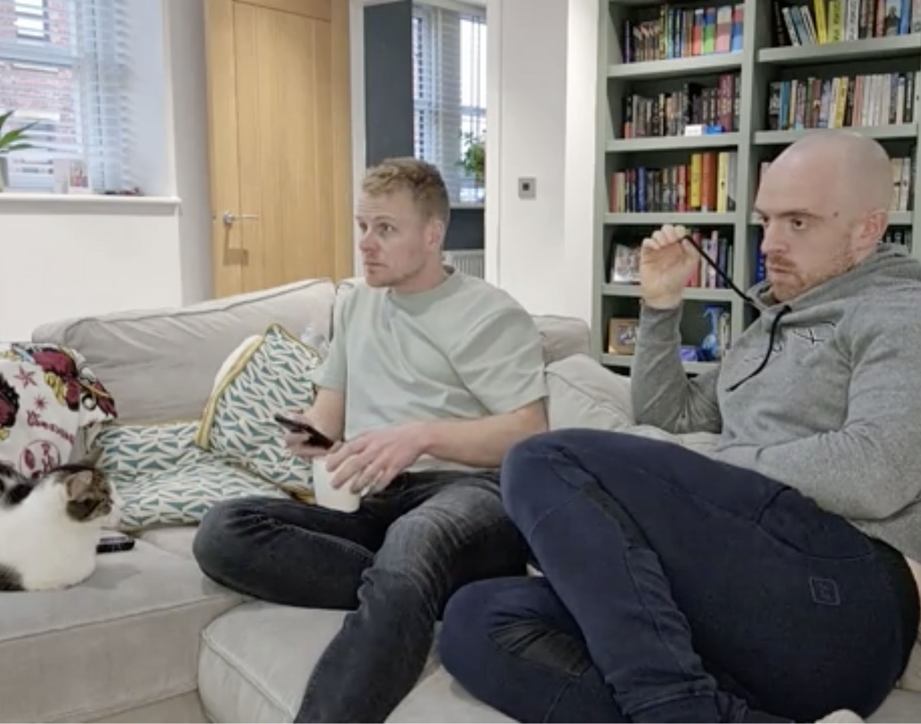
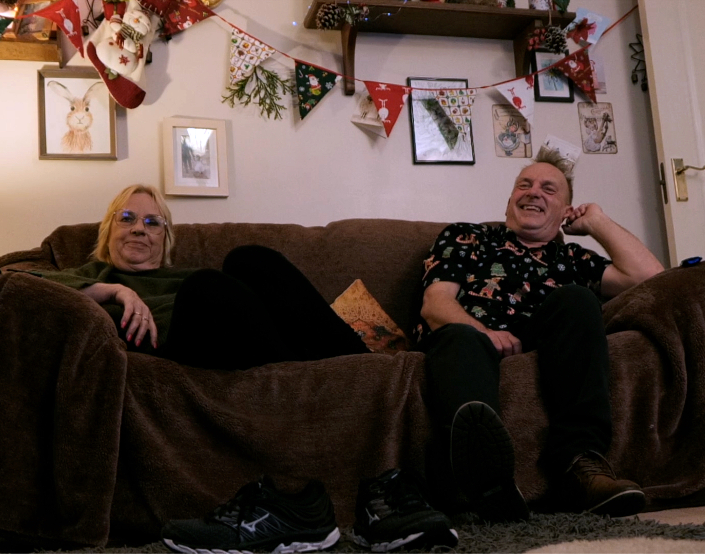
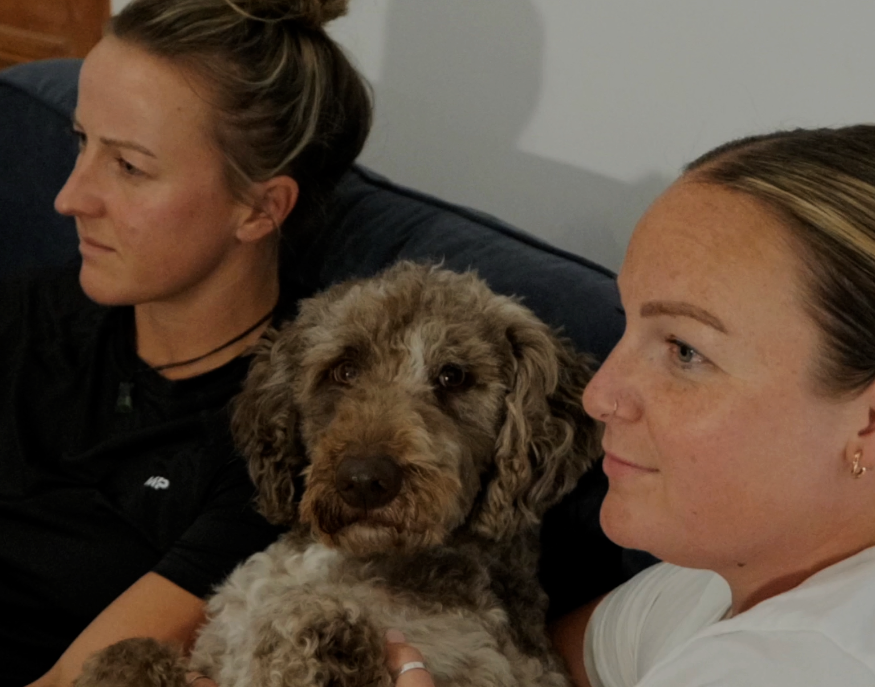
The living room encourages us to watch professional content
Ad recall is much higher from occasions involving professional content (vs. non-professional content)
+60%
higher ad recall for professional vs. non-professional content
+44%
seeing an ad within professional content makes it feel more trustworthy
+39%
more entertaining
-80%
less intrusive vs. non-professional content
Source: Context Effects, Map The Territory & Tapestry Research, 2024
Notes:
+23% recall when watching with others - The living room makes us more likely to be watching with others in a democratic way
+60% recall watching TV vs. personal device - The living room makes us more likely to be watching on a TV screen
+44% higher trust vs. non-professional content - The living room makes us more likely to be watching professional content
-80% less intrusive vs. non-professional content - Combined this all makes us satisfied and creates an environment where ads are more welcome
Source: Context Effects, Map The Territory & Tapestry Research, 2024
A18. Do you remember seeing any advertising when you watched [OCCASION]? Base: 2,927 viewing occasions with ads answered by 2,017 online respondents aged 18-75 who watched any type of video content via any source the previous day. Sample matched to Barb.
A23. How strongly do you agree or disagree with the following statements when it comes to the ads you saw when you watched [OCCASION]?
Base: 1,950 occasions where ads were recalled (1,499 Professional, 451 Non-professional)

Slide 5
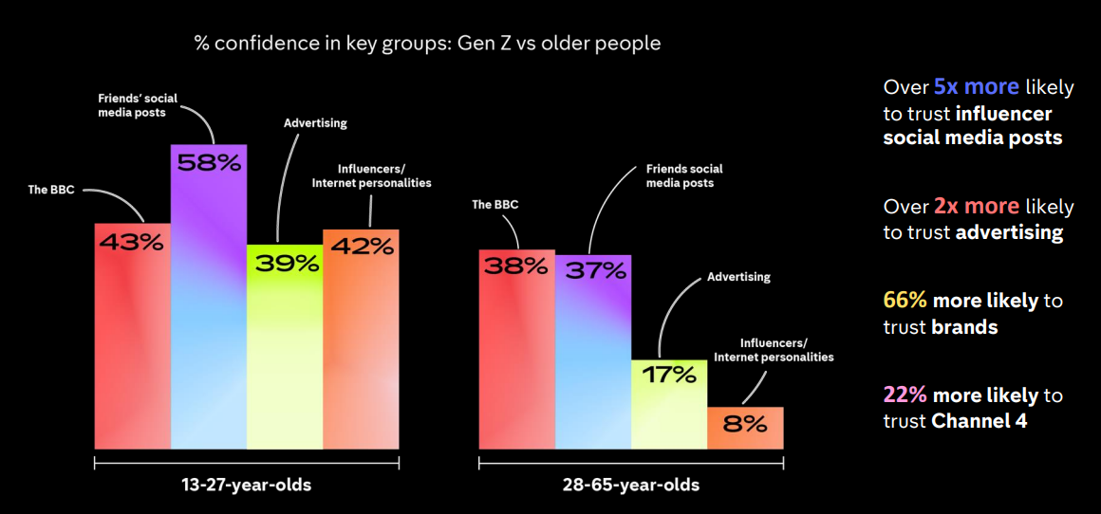
Gen Z place similar trust in friends’ posts and influencers as they do in journalism
Source: Gen Z: Trends, Truth and Trust. Channel 4 / Craft (2024)

Slide 6



TV advertising is seen as most trustworthy
Newspapers
Radio
Magazines
Search
Cinema
TV
Social Media
Outdoor
Direct Mail
YouTube
Websites
Source: Adnormal Behaviour, 2022, Ipsos / Thinkbox. Q.TN3: In which, if any, of the following places are you most likely to find advertising that...you trust
Base: ‘normal’ people (1,158)
Notes:
Thinkbox’s ‘Adnormal Behaviour’ work showed that TV ads were see as the most trusted form of advertising.
For more information on this study, see the full write up on the Thinkbox website:
https://www.thinkbox.tv/research/thinkbox-research/adnormal-behaviour/

Slide 7
TV, magazines & radio deliver strongest trust signal
Trust to deliver on promises made
Average trust signal
TRUST SIGNAL (% POSITIVELY SCORING)
Source: Signalling Success, 2020, house51/Thinkbox. Base: all adults (3,654)
Notes:
Brands advertising on TV, magazines and radio are perceived as most trusted to deliver on promises made.
30% rated brands advertising on TV as trusted to deliver on promises made, making TV the most trustworthy medium, just ahead of magazines (29%) and radio (28%).
Advertising on video sharing sites was least likely to deliver brand trust at 19%.

Slide 8
Online born business sector is the largest investor in TV
Millions
Source: Nielsen Ad Intel, 2024, Thinkbox-created category of online-born businesses (YoY category % change).
Notes:
Despite a year-on-year decline, online born businesses persist as the biggest investors in TV. TV investment has experienced its most significant growth from Household FMCG and Retail categories.

