Slide 1
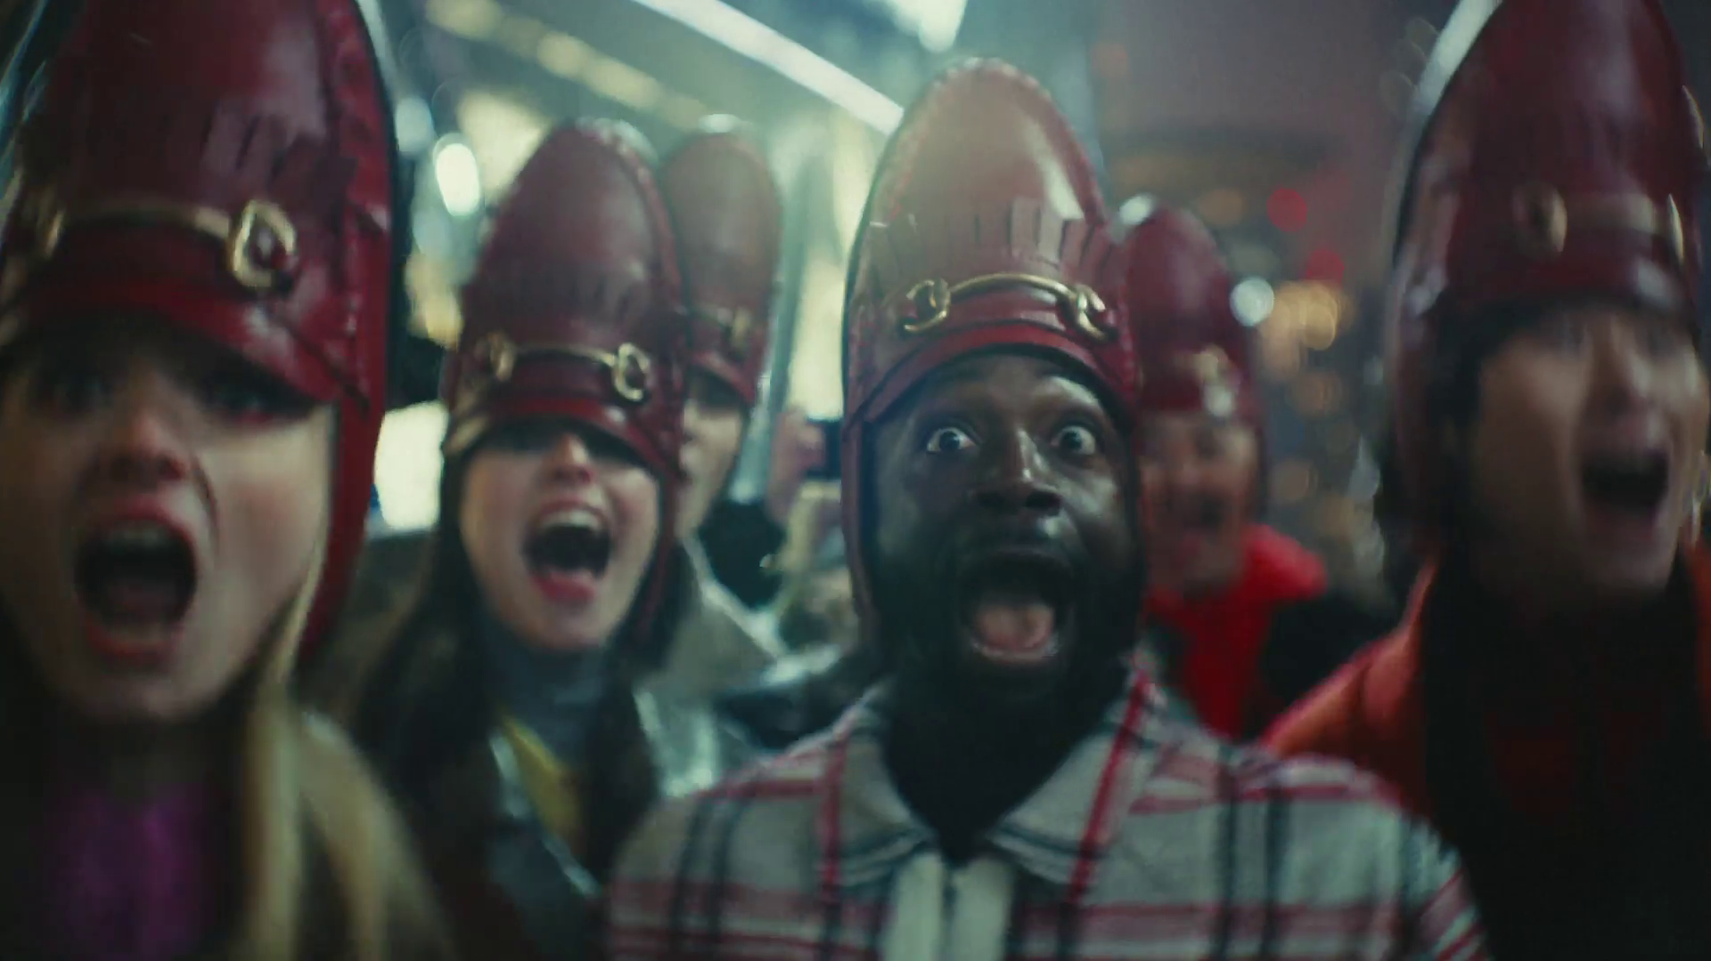


Cultural Advantage
TK Maxx - Iconic

Slide 2
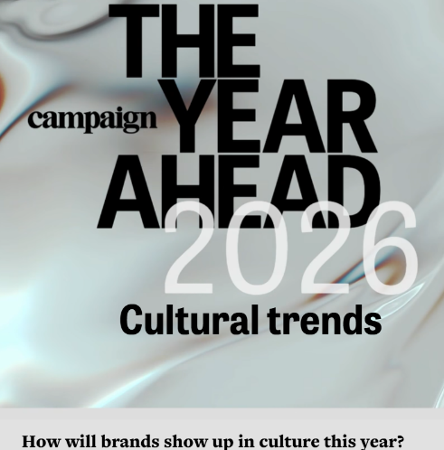
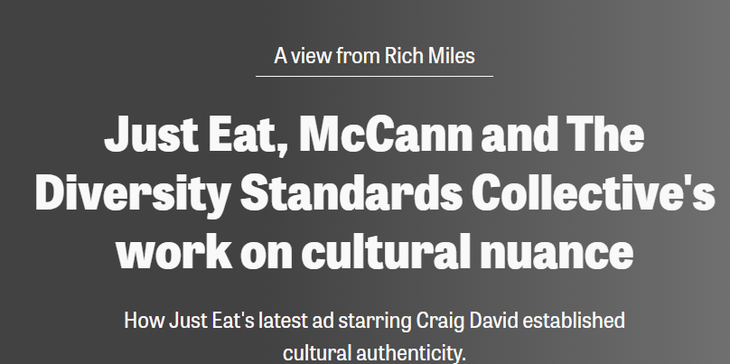

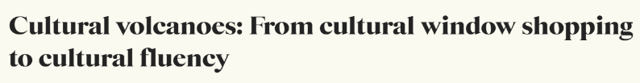
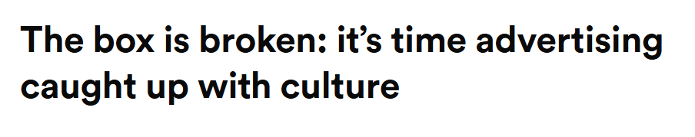
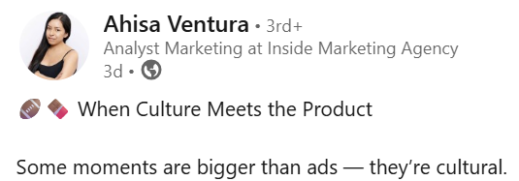
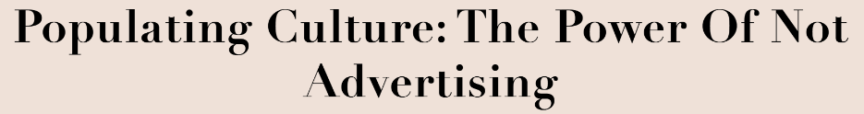
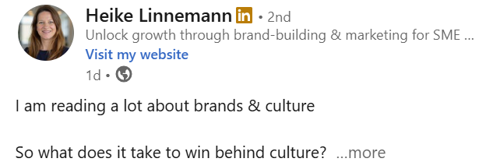
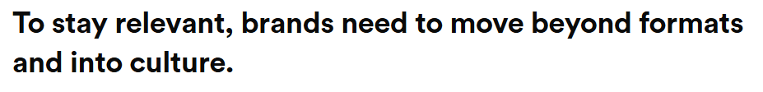
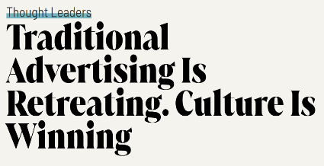
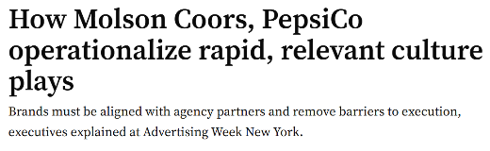
Notes:
Culture seems to be a hot topic of conversation within the industry.
Everyone seems to have a view, with various organisations trying to define culture.

Slide 3


Belief 1: Culture is driven by the young
Gen Z and Gen Alpha are reshaping culture, influence and consumer expectations
This report explores their impact on identity, media and spending, and what brands must do to stay relevant
Source: https://www.mastercard.com/global/en/news-and-trends/stories/2026/gen-z-gen-alpha-culture.html
Notes:
There’s a belief that culture is driven by the young.
How many of us work in an organisation that are obsessed with Gen Z? The industry’s narrative about the cultural influence of young people rarely rises above the status of stereotype.
There’s no doubt that since the dawn of marketing, young people have always been important to our industry, but any conversation about shaping our way of life is surely incomplete if it only focuses on a narrow segment of the population.

Slide 4

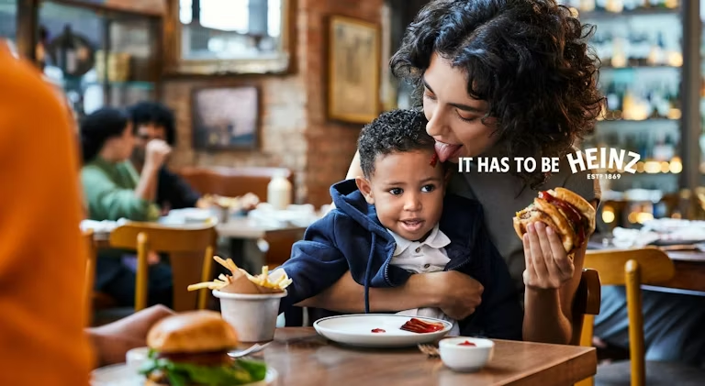
Belief 2: Culture is fast
Heinz says it has moved “at the speed of culture” to create its latest ad in just five days, in a bid to capture the energy and dynamism of social media
Source: https:// www.marketingweek.com/heinz-speed-culture-ad-five-days/
Notes:
Another belief is that culture is fast.
How many of us here have used the term moving at the speed of culture?
More recently, some of the language used by Heinz follows the general narrative in the industry. When we talk about culture, we assume that it’s fast, and synonymous with technological disruption.

Slide 5
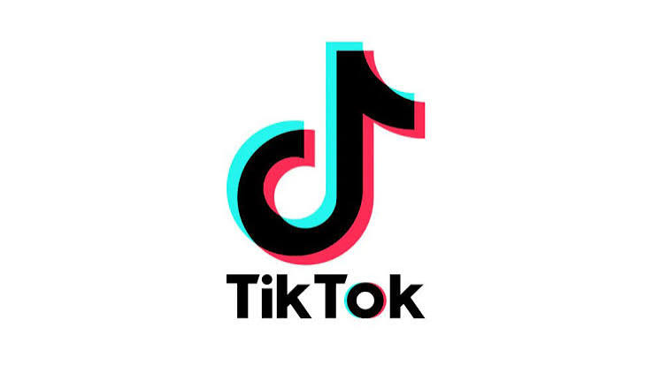

Belief 3: Culture is linear
“Moments don't just stay on TikTok – they're amplified by our community, creators and brands until they spill over into the real world, influencing culture and ultimately driving consumer behaviours...”
Source: https://ads.tiktok.com/business/en-GB/blog/create-cultural-moments-with-tiktok
Notes:
And lastly, the belief that culture is linear.
This example illustrates the more general point that our industry’s view of culture is narrow and suggesting that culture is linear.
TikTok have stated that “Moments don't just stay on TikTok – they're amplified by our community, creators and brands until they spill over into the real world, influencing culture and ultimately driving consumer behaviours...”

Slide 6
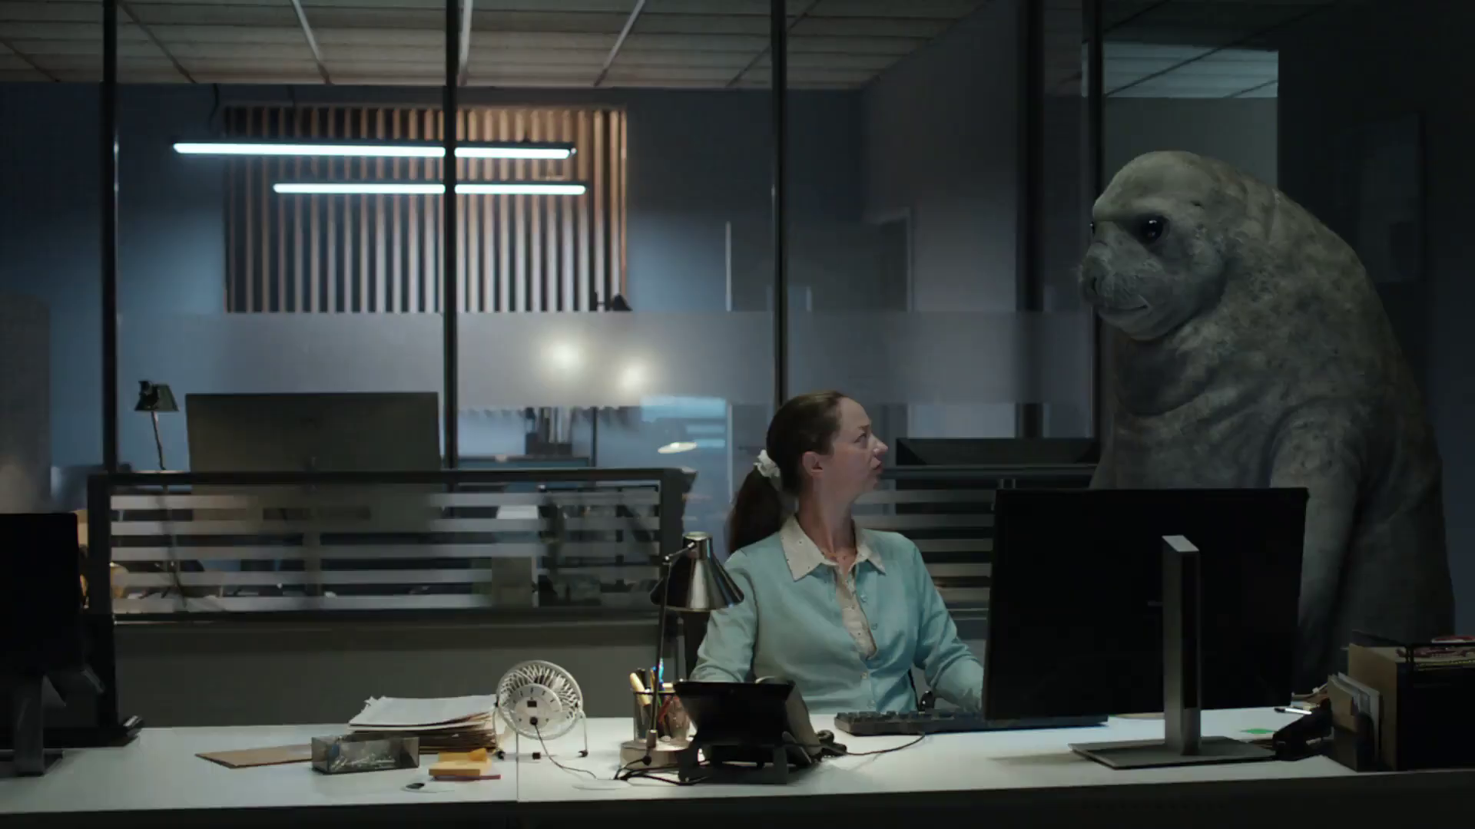
What is culture?
Financial Conduct - Authority Firm Checker
Notes:
Which brings us back to the key question: what is culture?
How can you define it? Measure it? Plan to be part of it? Predict it?

Slide 7
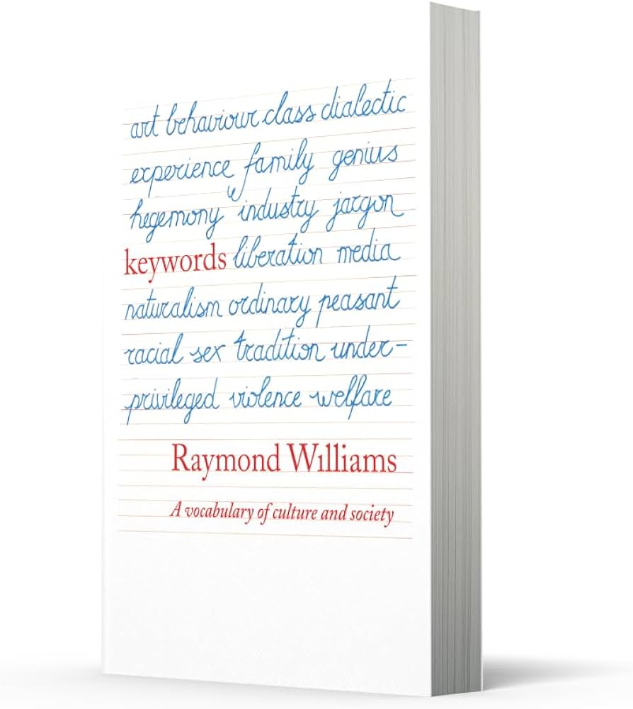
“Culture is one of the two or three most complicated words in the English language”
Source: Raymond Williams, Keywords – A vocabulary of culture and society, 1976
Notes:
Our industry loves to talk about culture, a lot. And it’s remarkably confident in its pronouncement of what culture means. But as Raymond Williams acknowledged 50 years ago, culture is a very complicated word.
For Williams, it’s one of the two or three most complicated words in the English language, and it certainly hasn’t become less complicated in the decades since Williams wrote his seminal work.
(Raymond Henry Williams was a Welsh socialist writer, academic, novelist and critic influential within the New Left and in wider culture).

Slide 8
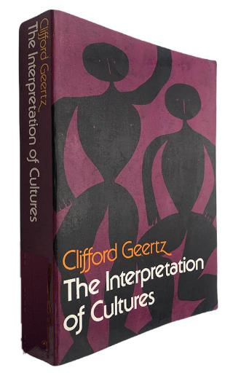
“…the stories we tell ourselves about ourselves”
Source: The Interpretation of Cultures, Clifford Geertz, 1973
Notes:
As with many other complicated concepts, as soon as the industry talk about culture, a simple and reductionist definition is never far behind!
But as Clifford Geertz makes clear in his classic book ‘Interpretation of Cultures’, there simply is no straightforward definition.
Geertz was arguably the most distinguished anthropologist of our time. He spent his career searching for the meaning of culture, and at the end of his incredibly eclectic body of work, he concluded that the best we can say is that culture is the stories that we tell ourselves about ourselves. The key take out must be that culture is inherently subjective.

Slide 9
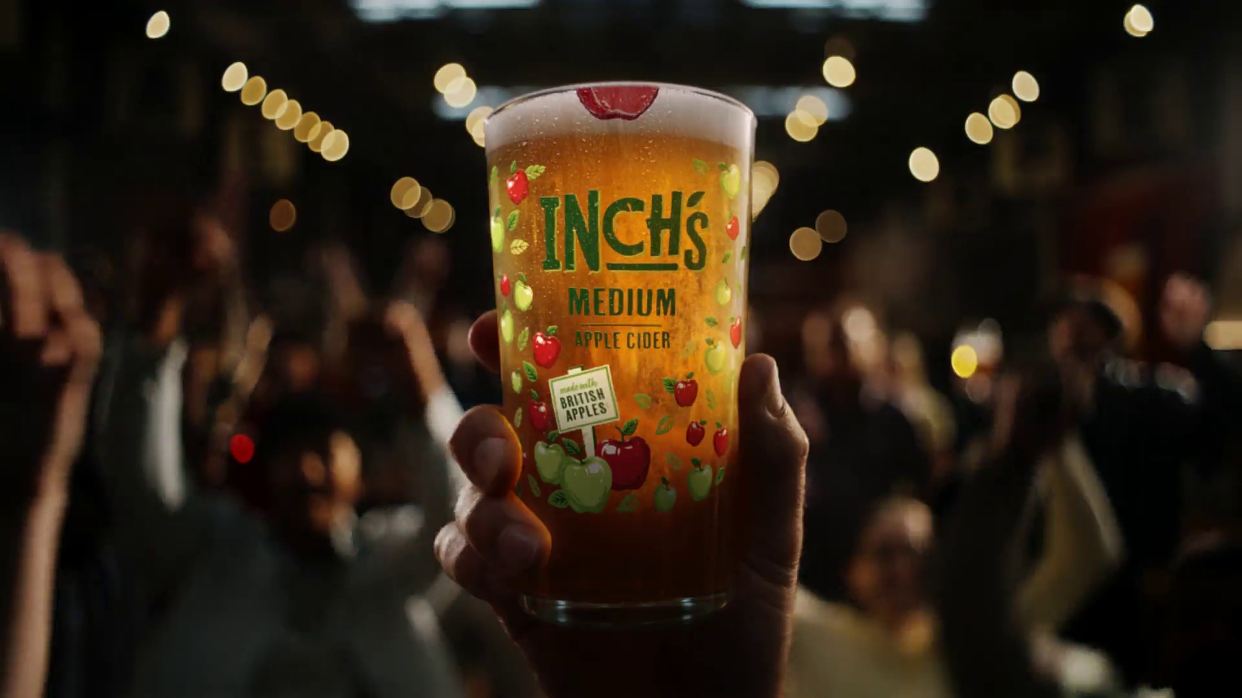
Creating a model to define and measure culture
Inch's - Story On A Pint Glass
Notes:
Measuring the cultural influence of different media is a hot topic in the industry. So, we commissioned everyday people to create a model to define and measure culture

Slide 10
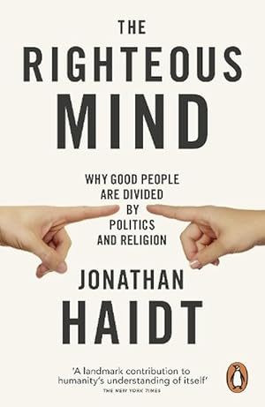







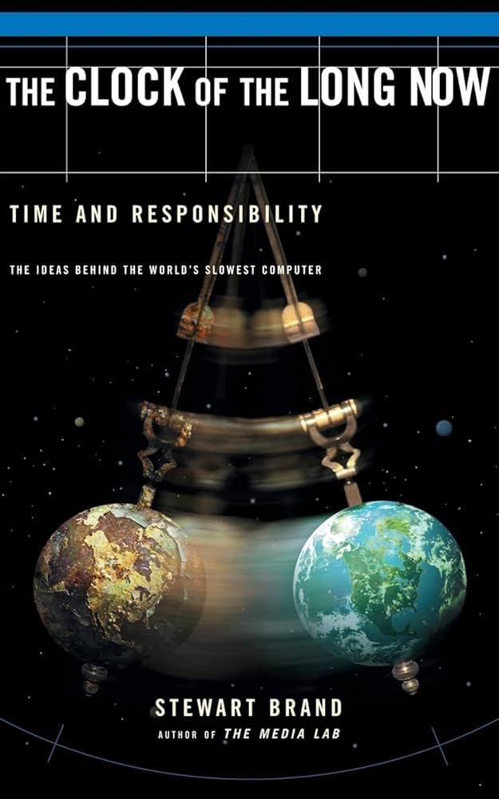



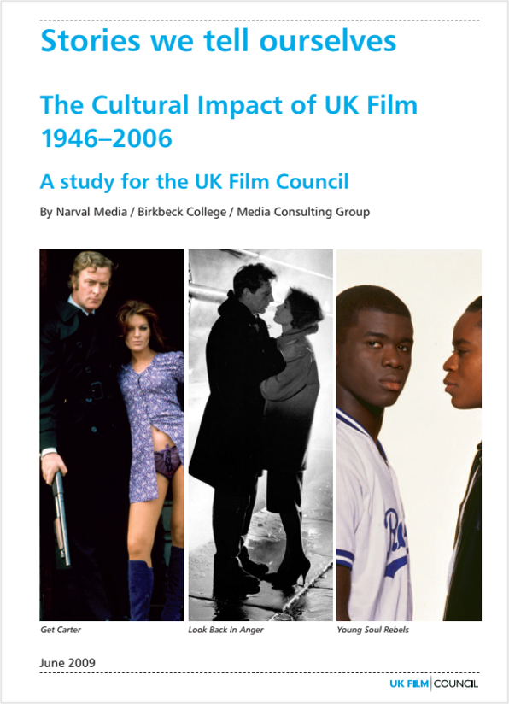

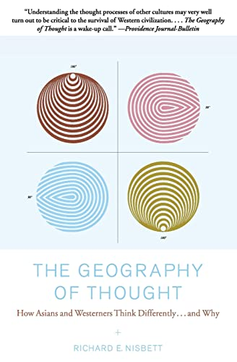
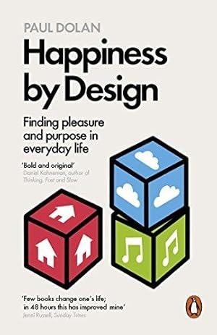


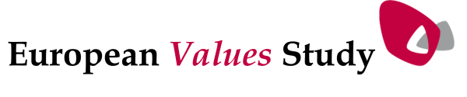
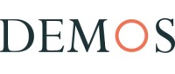
Incorporating diverse perspectives on culture
Diverse sources & reference points
Notes:
The way to get this holistic view is to step outside the bubble of the marketing industry and take a broader perspective.
It’s a highly contested cultural space and the many different disciplines that operate in this space.
This resulted in a literature review, ranging from specialist academic disciplines like cultural economics, think tanks and reports about the culture impact of the UK film industry.

Slide 11
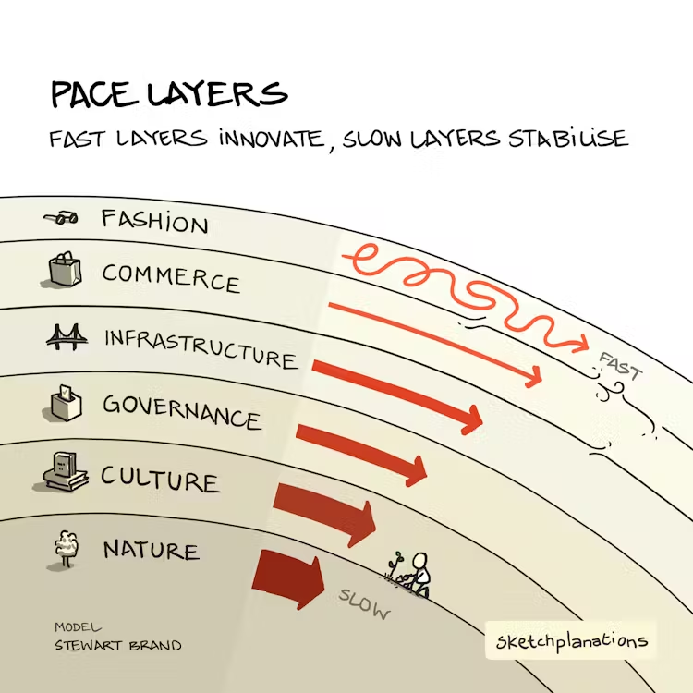
To create a framework that covers 7 lenses
‘Pace Layers’
Long Now Foundation, Stewart Brand
Happiness by Design, Paul Dolan
British Film Institute
Bowling Alone,
Robert D. Putnam
Currency
Continuity
Transformation
Affirmation
Bridging
Bonding
Purpose
Focus on now, zeitgeist, fashion, niche
Relevance and influence
over the long term
Celebrates change, challenges norms
Celebrates heritage,
sustains norms
Connection with people who are different from you
    Strengthens bond with own community, place, identity
Worthwhile, contributing to
‘good life’ and wellbeing
Source: Cultural Advantage, Thinkbox / everyday people, 2026.
Notes:
Everyday people drew on established academic literature to develop seven core lenses, or ‘cultural entry points.’ The concepts of currency and continuity were informed by Stewart Brand's Pace Layers framework and the work of the Long Now Foundation. Transformation and affirmation were derived from the cultural value frameworks developed by the British Film Institute (BFI). Bridging and bonding were informed by Robert D. Putnam's research, while purpose was drawn from Paul Dolan's work on happiness and wellbeing. Together, these seven lenses formed the foundation of the survey, with individual statements designed to measure and map respondents' attitudes across each cultural entry point.

Slide 12
A holistic view: 7 lenses on culture
7
Purpose
Worthwhile, contributing to
‘good life’ and wellbeing
1
Currency
2
Continuity
Focus on now, zeitgeist,
fashion, niche
Relevance and influence
over the long term
3
Transformation
4
Affirmation
Celebrates change, challenges norms
Celebrates heritage,
sustains norms
5
Bridging
6
Bonding
    Connection with people who
    are different from you
    Strengthens bond with own community, place, identity
Notes:
And we can map this by its relative importance

Slide 13
A holistic view: 7 lenses on culture
7
Purpose
Worthwhile, contributing to
‘good life’ and wellbeing
1
Currency
2
Continuity
Focus on now, zeitgeist,
fashion, niche
Relevance and influence
over the long term
3
Transformation
4
Affirmation
Celebrates change, challenges norms
Celebrates heritage,
sustains norms
5
Bridging
6
Bonding
    Connection with people who
    are different from you
    Strengthens bond with own community, place, identity
Notes:
The argument is that the industry isn’t thinking about the right shape of culture. It’s only really interested in three of these lenses. This model will show the importance of taking a broader view and thinking about different shapes of culture.

Slide 14

How do we measure it?
Bath & Body Works – All Aboard
Notes:
How do we measure it

Slide 15
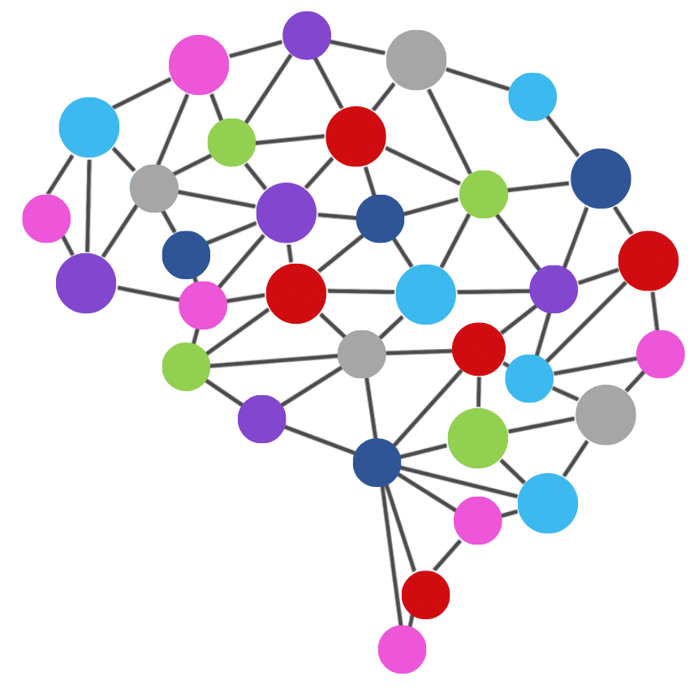
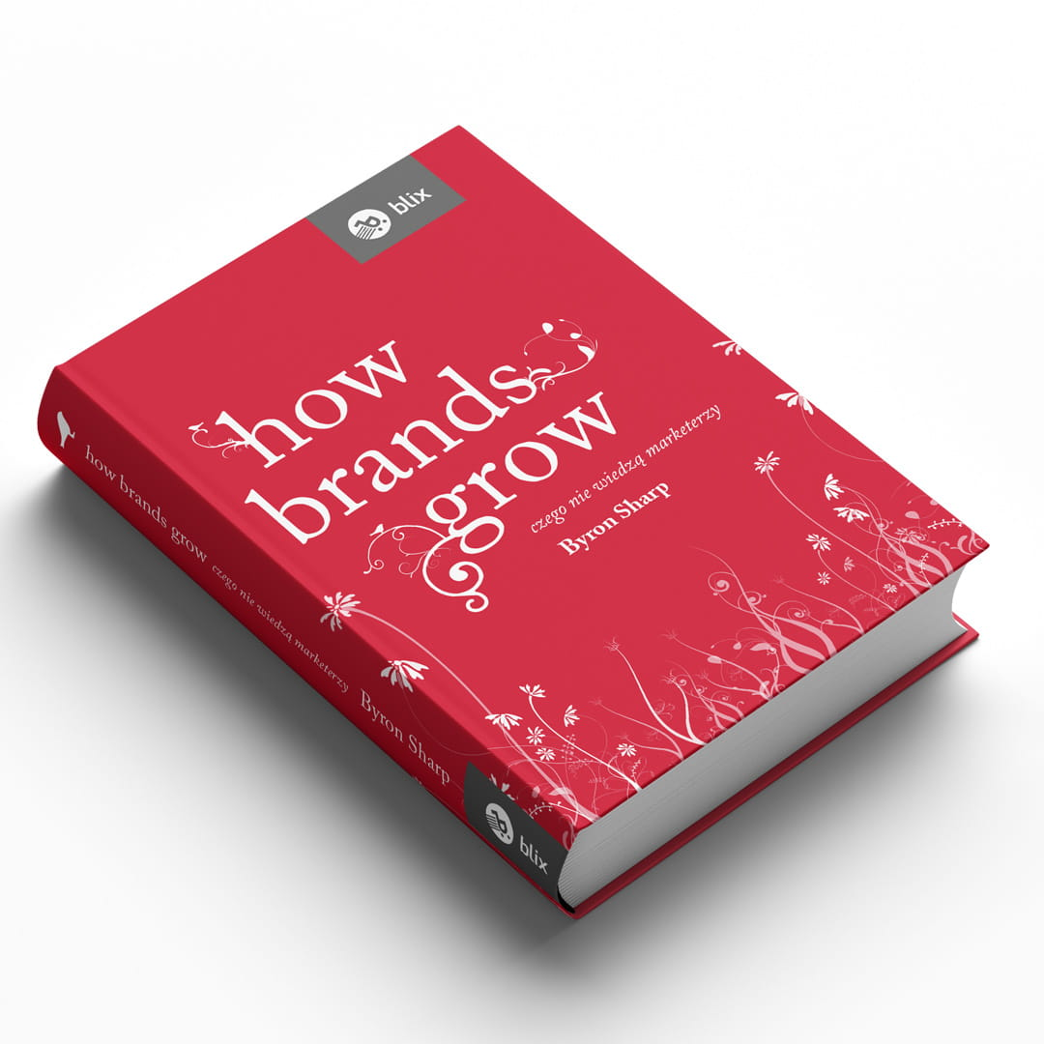

A framework to measure media’s ‘cultural advantage’
BRAND PERSPECTIVE
CULTURAL PERSPECTIVE
      Mental Advantage =
      % Share of Category Entry Points
      Cultural Advantage =
      % Share of Cultural Entry Points
Continuity
Currency
Affirmation
Transformation
Bonding
Bridging
Purpose
Source: Cultural Advantage, Thinkbox / everyday people, 2026.
Notes:
So how do we measure the cultural advantage of media?
Everyday people measured these association through a methodological approach that might be familiar – the mental availability framework as outlined by Byron Sharp and the measurement approach provided by Jenni Romaniuk
From a brand perspective, Byron Sharp tells us that mental advantage is about getting the biggest share of relevant network of brand association – i.e. category entry points.
We can apply this way of thinking to culture, so when we’re talking about cultural advantage, we’re talking about share of cultural entry points.
Everyday people conducted regression analysis to enable them to conduct statistical analysis to identify the most important lenses in shaping culture and people’s way of life.

Slide 16
A nat rep survey measuring media and content
MEDIA LEVEL
CONTENT LEVEL
      A nationally representative sample of 2,000 UK adults testing the cultural associations of different media channels
      A nationally representative sample of 1,000 UK adults testing the cultural associations of TV content and YouTube content
      TV (e.g. BBC, ITV, ITVX, iPlayer, Netflix etc)
      Cinema
      Radio
      Podcasts
      Video Sharing Sites (e.g. YouTube)
      Social Media (e.g. TikTok, Instagram, Facebook)
      Newspapers or magazines
      Content Creators
      TV content x10
      YouTube content x5
Source: Cultural Advantage, Thinkbox / everyday people, 2026.
Notes:
Everyday people then conducted a survey, where the sample was split to look at the cultural impact of both media channels and specific content from TV and some of the biggest creators on YouTube. So, if you’re a respondent in the media cell, you are asked which media channels you associate with the statements in the framework aka ‘cultural entry points’. If you’re in the content cell you do this for the listed content.

Slide 17
‘Pace Layers’
The Long Now Foundation, Stewart Brand
Happiness by Design, Paul Dolan
British Film Institute
Bowling Alone,
Robert D. Putnam
Currency
Continuity
Transformation
Affirmation
Bridging
Bonding
Purpose
Focus on now, zeitgeist, fashion, niche
Relevance and influence
over the long term
Celebrates change, challenges norms
Celebrates heritage,
sustains norms
Connection with people who are different from you
    Strengthens bond with own community, place, identity
Worthwhile, contributing to
‘good life’ and wellbeing
Shapes the future
Creates iconic moments that everybody remembers
Celebrates the changing face of British society
An institution / part of the fabric of British Society
Inspires people across all generations
Creates a sense of belonging / connectedness
Good for people’s sense of well being
Part of the zeitgeist i.e. captures the spirit of now
People would miss it deeply if it no longer existed
Has the power to change society
Celebrates and sustains my cultural heritage
Gives a new understanding of people who are different from you
Strengthens my bond with my own identity or community
Informative / educational
Source: Cultural Advantage, Thinkbox / everyday people, 2026.
Notes:
In the survey we asked about the seven cultural lenses, using statements that laddered up to these concepts.

Slide 18
Some cultural entry points are more important than others
Relative importance of cultural entry points (regression vs. scale of cultural importance of media channels)
Source: Cultural Advantage, Thinkbox / everyday people, 2026.
Base: UK Nat Rep (n=2,000)
Notes:
Everyday people conducted regression analysis to determine which cultural entry points have the greatest influence on shaping culture and people's way of life. The study found that continuity – things with influence and relevance that last – had a 22% share of importance, playing the most important role in how media shapes culture and the way of life for people in the UK.
Purpose – how culture positively influences people’s sense of wellbeing and contributes to ‘good life’ – is the second most important aspect in how media shapes culture in the UK with a 17% share of importance.
By contrast, currency – fashionable or faddish moments in the zeitgeist – plays the least important role with a 9% share of importance.

Slide 19
For younger demos currency is much stronger, purpose weaker
Relative importance of cultural entry points (regression vs. scale of cultural importance of media channels)
Source: Cultural Advantage, Thinkbox / everyday people, 2026.
Base: UK Nat Rep (n=2,000), 16-24 (n=231)
Notes:
Among 16–24-year-olds, however, the picture shifts. While continuity remains the strongest driver, currency rises to become the second most important factor, reflecting younger audiences’ greater engagement with emerging trends, social movements and fast-evolving cultural moments.

Slide 20
The shape of TV’s cultural advantage
All adults
% Share of cultural entry points indexed vs. all media average (i=100)
 | Podcasts
 | Newspapers/magazines
 | Radio
 | Cinema
 | Content Creators
 | Video Sharing Sites
 | Social Media
 | TV
Source: Cultural Advantage, Thinkbox / everyday people, 2026.
Base: UK Nat Rep (n=2,000)
Notes:
The analysis also measured the performance of each cultural lens by channel. The larger the area represented, the more holistic and culturally advantaged a channel is across the full range of cultural entry points.
When mapped against the media channels included in the study, TV demonstrates the strongest and most comprehensive cultural signature. Its profile envelops those of other channels, indicating consistently stronger performance across a broad range of cultural entry points. In particular, TV excels on dimensions such as affirmation and continuity, reflecting its ability to create lasting cultural influence over time.
Social media is particularly strong on currency and bonding, reflecting its ability to drive real-time cultural conversations and foster community connection.
Content creators, meanwhile, demonstrate strength in currency and transformation by inspiring audiences, shaping perspectives and connecting people across different interests and communities. However, their overall cultural footprint remains less extensive than TV, which continues to lead through its unmatched ability to create shared cultural experiences at scale.

Slide 21
Mapping cultural advantage
High
All adults
IMPORTANCE
Low
Source: Cultural Advantage, Thinkbox / everyday people, 2026.
Base: UK Nat Rep (n=2,000)
Notes:
But we can also map this in another way to see what channels have a cultural advantage.
If we rank the cultural entry points in order of importance, we get this order.

Slide 22
Mapping cultural advantage
High
All adults
IMPORTANCE
Low
High
SHARE OF CULTURAL ENTRY POINTS
Source: Cultural Advantage, Thinkbox / everyday people, 2026.
Base: UK Nat Rep (n=2,000)
Notes:
We can then plot this against the share of cultural entry points for each channel

Slide 23
Mapping cultural advantage
High
All adults
IMPORTANCE
Low
High
SHARE OF CULTURAL ENTRY POINTS
Source: Cultural Advantage, Thinkbox / everyday people, 2026.
Base: UK Nat Rep (n=2,000)
Notes:
If we split the chart into quadrants, this gives us a general idea on where we want all our cultural entry points to be

Slide 24
Mapping cultural advantage
All adults
CULTURAL ADVANTAGE
High
High importance
High share
IMPORTANCE
Low
High
SHARE OF CULTURAL ENTRY POINTS
Source: Cultural Advantage, Thinkbox / everyday people, 2026.
Base: UK Nat Rep (n=2,000)
Notes:
We can then test each media channel’s performance against the importance ranking I’ve shown you on the previous chart. The ranking of importance is fixed for all channels. So, when we talk about cultural advantage, it’s about how big a share each channel gets for each cultural entry point. The goal is to have the biggest share of the most important entry points – and that’s the green box labelled cultural advantage in the top right hand of the chart.

Slide 25

Content creators are the strongest on the least important cultural entry points
CONTENT
CREATORS
All adults
CULTURAL ADVANTAGE
High
IMPORTANCE
Low
High
SHARE OF CULTURAL ENTRY POINTS
Source: Cultural Advantage, Thinkbox / everyday people, 2026.
Base: UK Nat Rep (n=2,000)
Notes:
For an all adult audience, looking first at content creators, their profile sits well outside this cultural advantage zone. Instead, they perform most strongly on the least important cultural entry points (e.g. currency), suggesting a misalignment between where they deliver value and the cultural drivers that have the greatest impact on shaping people's lives.

Slide 26

Video sharing sites are stronger but still lack cultural advantage
VIDEO
SHARING
All adults
CULTURAL ADVANTAGE
High
IMPORTANCE
Low
High
SHARE OF CULTURAL ENTRY POINTS
Source: Cultural Advantage, Thinkbox / everyday people, 2026.
Base: UK Nat Rep (n=2,000)
Notes:
For video sharing sites, the cultural entry points are moving to the left showing stronger associations, but they still lack any specific cultural advantages.

Slide 27

Bonding is social media’s cultural advantage
SOCIAL
MEDIA
All adults
CULTURAL ADVANTAGE
High
IMPORTANCE
Low
High
SHARE OF CULTURAL ENTRY POINTS
Source: Cultural Advantage, Thinkbox / everyday people, 2026.
Base: UK Nat Rep (n=2,000)
Notes:
Social media performs more strongly overall, with bonding emerging as its key cultural advantage. However, it under-performs on continuity and performs weakest on purpose.
This is an important distinction: while people recognise social media's cultural influence, they do not necessarily see it as a positive one. Purpose reflects personal growth, wellbeing and living a good life - areas where social media falls short. The contrast between its scores on purpose and transformation – its ability to celebrate change and challenge norms - also mirrors wider concerns about the impact and safety of social media.

Slide 28

TV has a strong advantage on the cultural entry points that matter
TV
All adults
CULTURAL ADVANTAGE
High
IMPORTANCE
Low
High
SHARE OF CULTURAL ENTRY POINTS
Source: Cultural Advantage, Thinkbox / everyday people, 2026.
Base: UK Nat Rep (n=2,000)
Notes:
Crucially, TV leads on the cultural entry points that matter most such as continuity and purpose. It consistently over-performs on the dimensions that have the greatest influence on shaping, reinforcing its position as a channel with a strong and enduring cultural advantage.

Slide 29
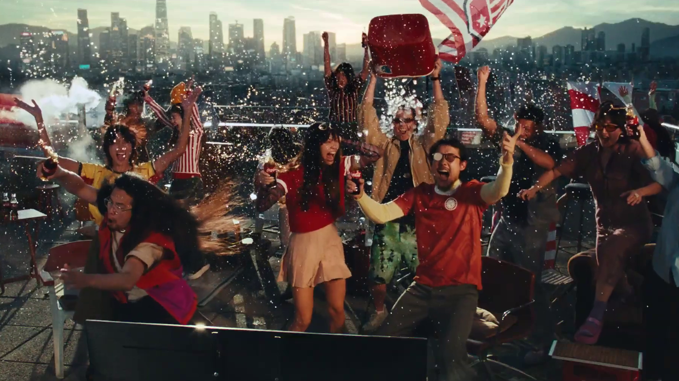
What does this look like for younger audiences
Coca Cola – no Better Feeling
Notes:
What does this look like for younger audiences

Slide 30
The importance of cultural entry points differs for 16-24s
Relative importance of cultural entry points (regression vs. scale of cultural importance of media channels)
Source: Cultural Advantage, Thinkbox / everyday people, 2026.
Base: UK Nat Rep (n=2,000), 16-24 (n=231)
Notes:
A quick reminder that the cultural entry points differ for 16-24s

Slide 31
For young people, content creators have a relatively weak cultural signature
CONTENT
CREATORS
16-24s
CULTURAL ADVANTAGE
High
IMPORTANCE
Low
High
SHARE OF CULTURAL ENTRY POINTS
Source: Cultural Advantage, Thinkbox / everyday people, 2026.
Base: UK Nat Rep 16-24 (n=231)
Notes:
So let’s look at these maps again, for 16-24 year olds. Whilst currency is creeping into the top right box, content creators still have a relatively weak cultural advantage.

Slide 32
Video sharing sites have stronger continuity and currency
VIDEO
SHARING
16-24s
CULTURAL ADVANTAGE
High
IMPORTANCE
Low
High
SHARE OF CULTURAL ENTRY POINTS
Source: Cultural Advantage, Thinkbox / everyday people, 2026.
Base: UK Nat Rep 16-24 (n=231)
Notes:
Video sharing sites has cultural advantage for the entry points that really matter.

Slide 33
Social media has a clear cultural advantage on currency
SOCIAL
MEDIA
16-24s
CULTURAL ADVANTAGE
High
IMPORTANCE
Low
High
SHARE OF CULTURAL ENTRY POINTS
Source: Cultural Advantage, Thinkbox / everyday people, 2026.
Base: UK Nat Rep 16-24 (n=231)
Notes:
When we look at the same data for 16–24s, social media’s cultural strength among 16–24s is far more concentrated, with currency standing out as its primary area of advantage.

Slide 34
TV is stronger for continuity
TV
16-24s
CULTURAL ADVANTAGE
High
IMPORTANCE
Low
High
SHARE OF CULTURAL ENTRY POINTS
Source: Cultural Advantage, Thinkbox / everyday people, 2026.
Base: UK Nat Rep 16-24 (n=231)
Notes:
Meanwhile, TV slightly trails social media in overall cultural share, but it remains a strong performing channel overall for this age group. Its key advantage is continuity, while it also holds its own on currency, matching content creators on this dimension.

Slide 35

Which channel is most culturally significant?
Toyota - Imagine the Possibilities
Notes:
But which channel is most culturally significant?

Slide 36
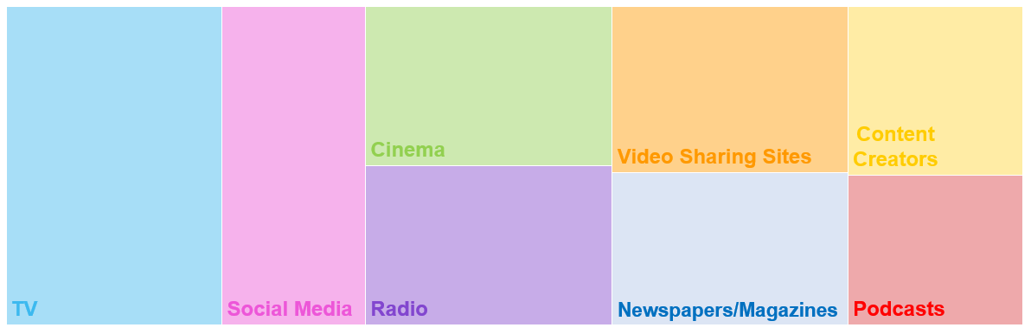
TV has the highest share of cultural availability across the media landscape
All adults – Share of cultural availability (%)
    21.3%
    14.4%
    12.3%
    11.7%
    8.6%
    12.2%
    11.3%
    8.2%
Source: Cultural Advantage, Thinkbox / everyday people, 2026.
Base: UK Nat Rep (n=2,000)
Notes:
As well as understanding different media’s impact on different types of cultural associations, everyday people calculated an overall cultural impact for different media channels incorporating all seven lenses.
They found that TV accounts for 21% of media’s cultural impact, followed by social media (14%), cinema (12%), radio (12%), and video sharing sites (12%). The media with the least cultural impact are content creators (9%) and podcasts (8%).

Slide 37
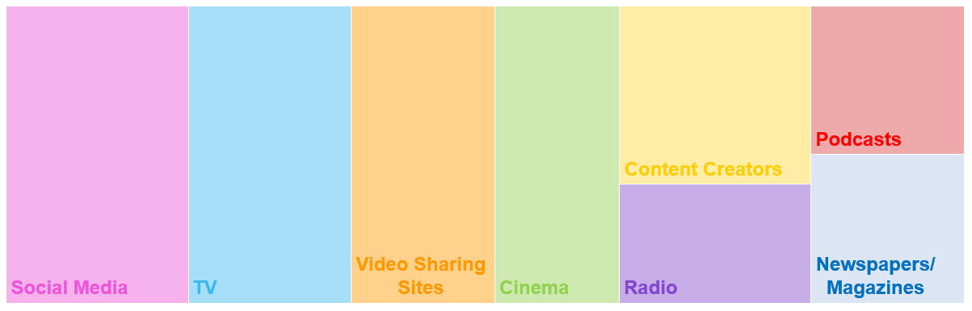
TV is still a huge part of the cultural landscape for younger demographics
16-24s – Share of cultural availability (%)
    18.9%
    17.5%
    14.6%
    13.4%
    11.6%
    8.3%
    8.0%
    7.7%
Source: Cultural Advantage, Thinkbox / everyday people, 2026.
Base: UK Nat Rep 16-24 (n=231)
Notes:
For 16-24s specifically, social media had 19% and TV 17%. These were followed by video sharing sites (15%), cinema (13%), content creators (12%), radio (8%), newspapers/magazines (8%), and podcasts (8%).

Slide 38

TV’s role in building a holistic cultural impact for brands
Open AI – Chat Football
Notes:
Everyday people also measured the associations in the framework against content.
The content level testing helps us to understand how content contributes to the overall shape of culture for each channel and also provide practical ways which can help the industry plan for holistic cultural impact.

Slide 39

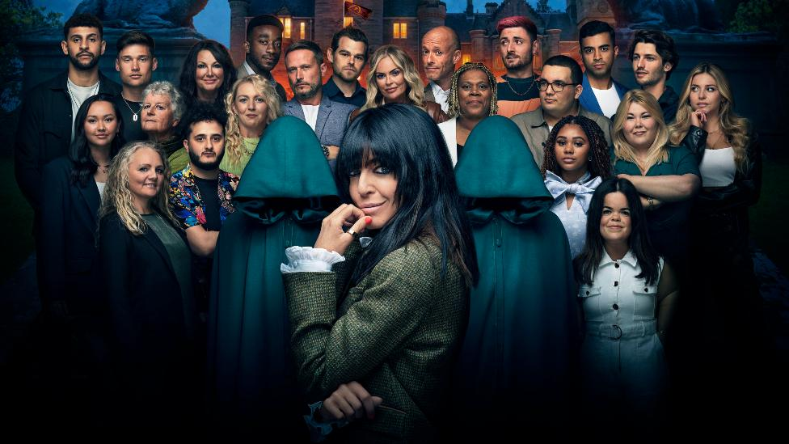





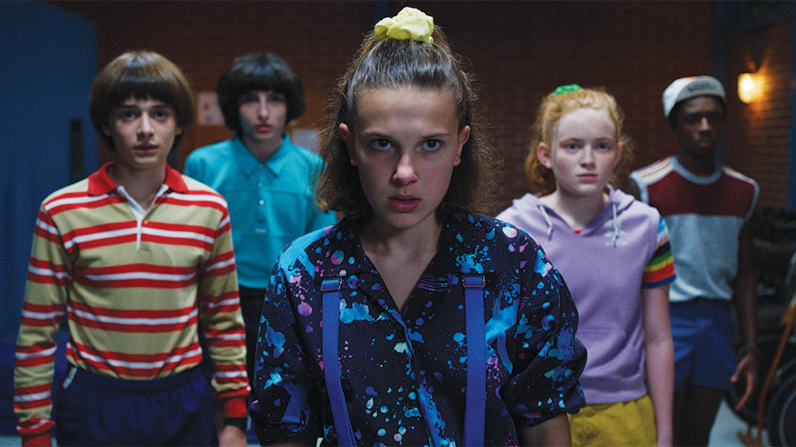


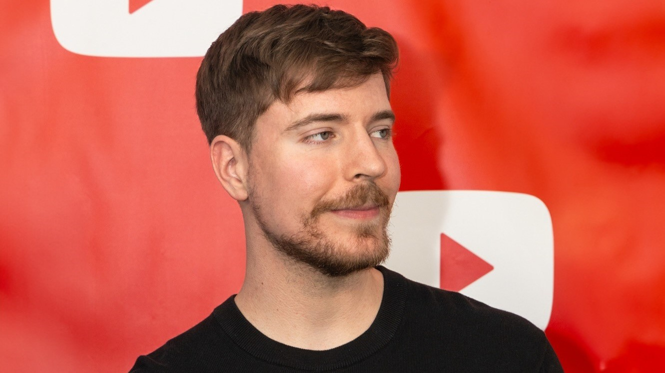
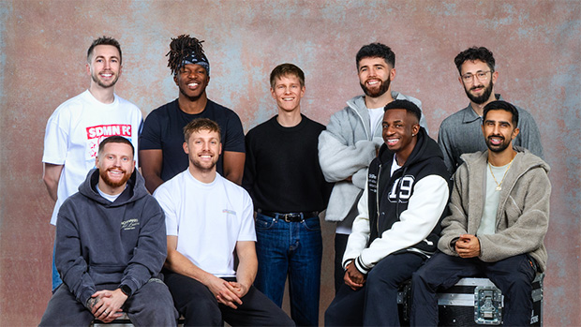

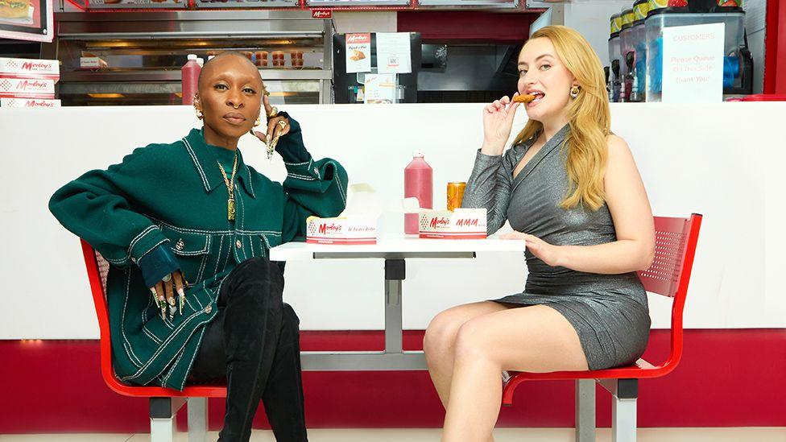
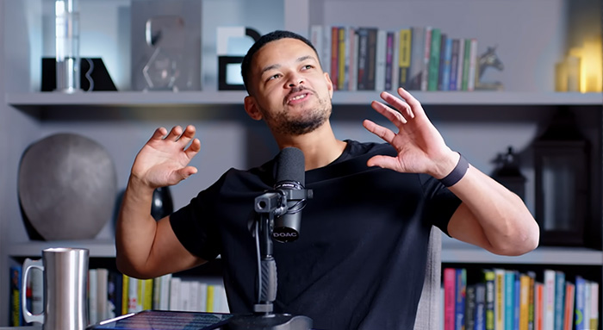
Content overview
The Great British Bake Off
The Traitors
Love Island
The Last of Us
Gogglebox
Bridgerton
Clarkson’s Farm
Stranger Things
Coronation Street
I’m a Celebrity… Get me out of here!
Mr Beast
Sidemen
IShowSpeed
Chicken Shop Date
The Diary of a CEO
Source: Cultural Advantage, Thinkbox / everyday people, 2026.
Notes:
Everyday people tested 10 TV programmes and 5 of the biggest creators/creator content on YouTube as a pilot of how we can measure and plan for the cultural impact of content moving forward.

Slide 40
TV content works across diverse cultural entry points
All adults
% Share of cultural entry points indexed vs. all content average (i=100)
The Traitors
Coronation Street
Gogglebox
Source: Cultural Advantage, Thinkbox / everyday people, 2026.
Base: UK Nat Rep (n=1,000)
Notes:
The model is able to differentiate content on a meaningful cultural level.
For all adults, you would expect a soap like Coronation Street to score really strongly on continuity and affirming the British way of life. And it does.
The Traitors cultural advantage is currency – again unsurprising because it’s one of the most talked about programmes on TV.
Gogglebox pulls out on purpose and bridging – again this makes perfect sense. We are going into the living rooms of a diverse set of people across the country. Geertz warned us of the dangers of losing touch with reality, the power of the holistic framework is that it connects our industry with the different realities of mainstream culture.

Slide 41
This is consistent for 16-24s
16-24s
% Share of cultural entry points indexed vs. all content average (i=100)
I’m a Celebrity… Get me out of here!
Love Island
Gogglebox
Clarkson’s Farm
Source: Cultural Advantage, Thinkbox / everyday people, 2026.
Base: UK Nat Rep 16-24 (n=116)
Notes:
But how do TV programmes compare to creator content? Given the demographic target of the YouTuber’s in our test, it’s only fair that we look at this amongst the youngest cohort of 16-24s.

Slide 42
Even for 16-24s, the biggest content creators cannot rival the cultural power of TV
16-24s
% Share of cultural entry points indexed vs. all content average (i=100)
The Great British Bake Off
Mr Beast
Sidemen
Source: Cultural Advantage, Thinkbox / everyday people, 2026.
Base: UK Nat Rep 16-24 (n=116)
Notes:
The likes of Mr Beast and Sidemen are no match for The Great British Bake Off.
Both Mr Beast and Sidemen are about big stunts and challenges and place strong emphasis on their philanthropic positioning. But there are many routes to purpose - just look at how much stronger, Bake Off performs on purpose.

Slide 43
Even for 16-24s, the biggest content creators cannot rival the cultural power of TV
16-24s
% Share of cultural entry points indexed vs. all content average (i=100)
Clarkson’s Farm
The Diary of a CEO
Source: Cultural Advantage, Thinkbox / everyday people, 2026.
Base: UK Nat Rep 16-24 (n=116)
Notes:
Similarly, Steven Bartlett is no match for Clarkson’s Farm.

Slide 44
Even for 16-24s, the biggest content creators cannot rival the cultural power of TV
16-24s
% Share of cultural entry points indexed vs. all content average (i=100)
Love Island
Chicken Shop Date
Source: Cultural Advantage, Thinkbox / everyday people, 2026.
Base: UK Nat Rep 16-24 (n=116)
Notes:
And finally, YouTube tell us that Chicken Shop Date is renowned for it’s pop-culture dominance amongst a young audience. The truth is that its signature and shape is much weaker than Love Island’s – another thing that has also been part of pop culture for many years.

Slide 45
All media contribute to culture, but some deliver more cultural impact than others
Essential to consider a holistic view of what forms and drives culture
TV has the highest share (21.3%) of media’s cultural availability
TV content works across diverse cultural entry points
What lasts matters more than what’s fashionable - media like TV and cinema deliver that continuity
Content Creators account for just 8.6% of media’s cultural impact – only podcasts rank lower (8.2%)
Even for 16-24s, the biggest Content Creators cannot rival the cultural power of TV
Notes:
Overall, all media contribute to culture, but some deliver more cultural impact than others

Slide 46
Cultural Advantage
TK Maxx - Iconic

