Slide 1
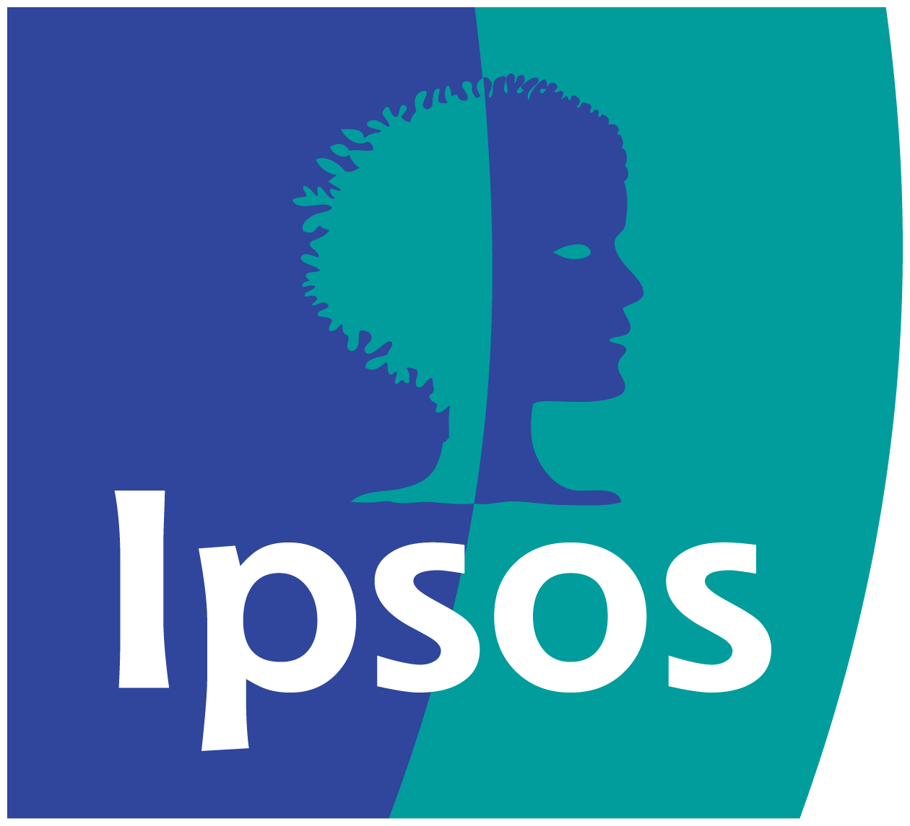
Adnormal Behaviour
2022
“Second Screeners” – Three

Slide 2
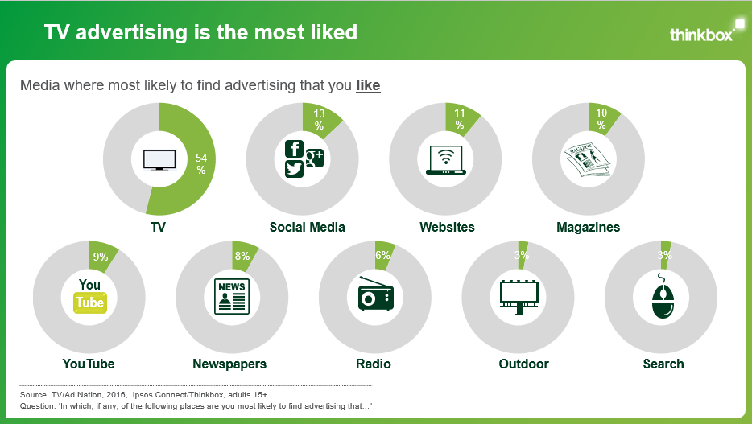
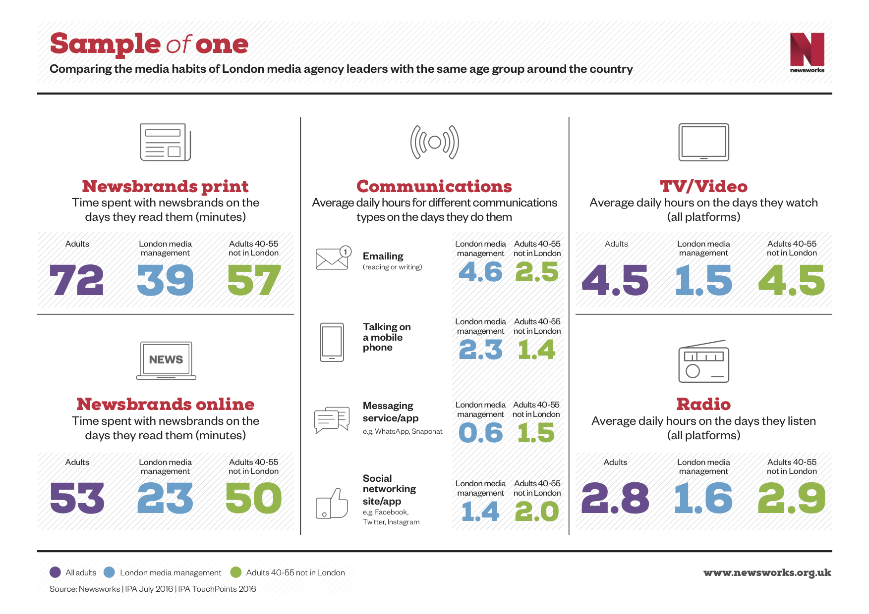
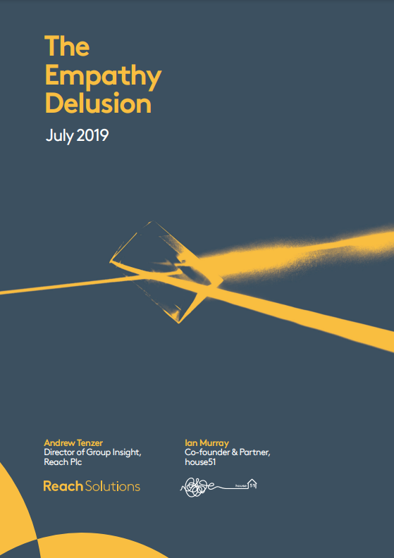
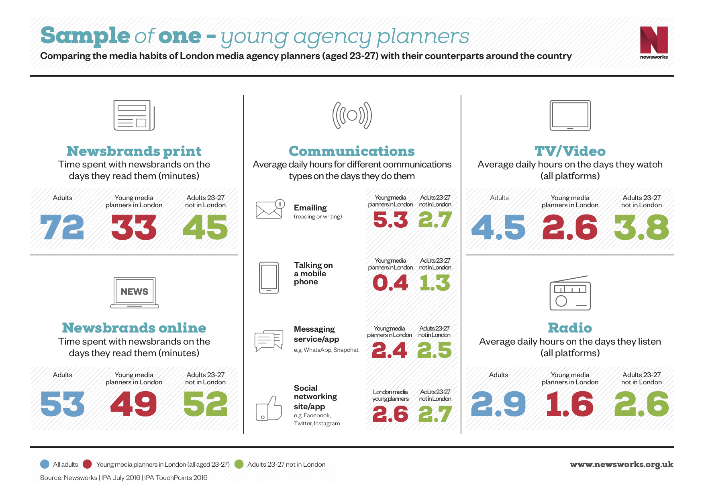
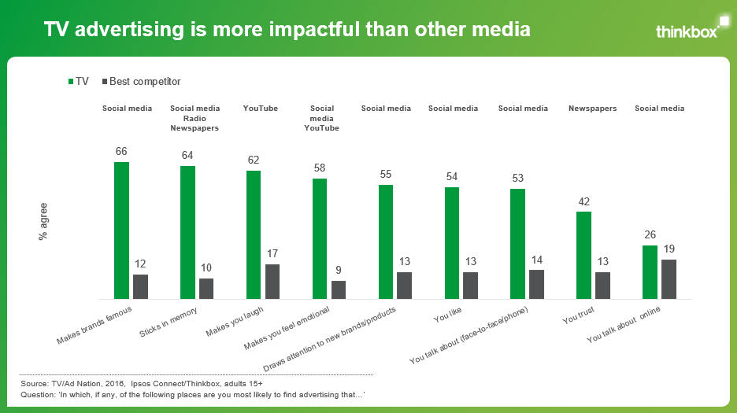
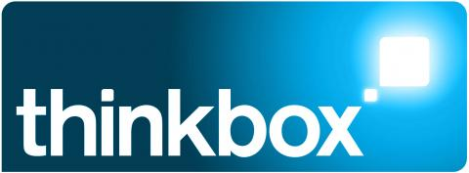
Differences between the ad industry and the general public is an ongoing topic of conversation
‘TV Nation / Ad Nation’
2012, 2013, 2014, 2016
‘Sample of one’
February 2018
‘The Empathy Delusion’
July 2019
Notes:
Differences between the ad industry and the general public is an ongoing topic of conversation. Understanding your audiences is the golden rule within marketing and ensuring that their behaviour is accurately reflected is key. At Thinkbox, we’ve explored this area, having published our TV and Ad Nation study, that explores the differences in media consumption and perception between those who work in media and the average person in the UK. Similarly, there have been a number of other ad industry studies, including Newsworks’ ‘Sample of one’ and Reach Solutions ‘The Empathy Delusion.’ Much like our project, these studies sought to have a positive impact on media professionals ability to better estimate the media consumption patterns of the UK.

Slide 3
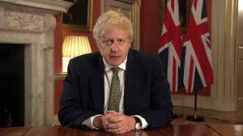
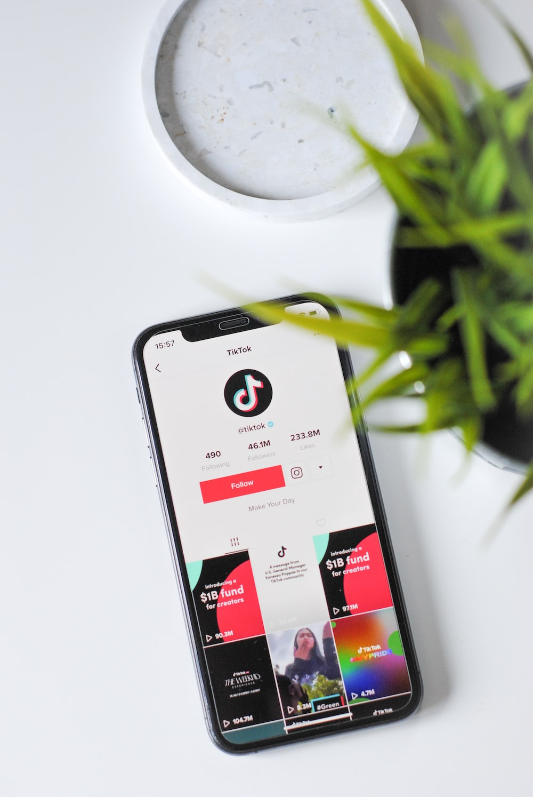
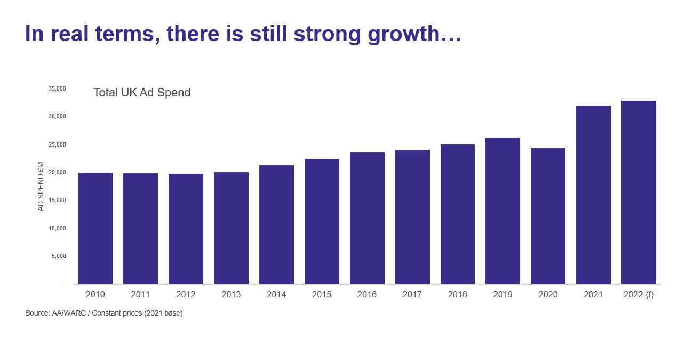
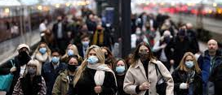
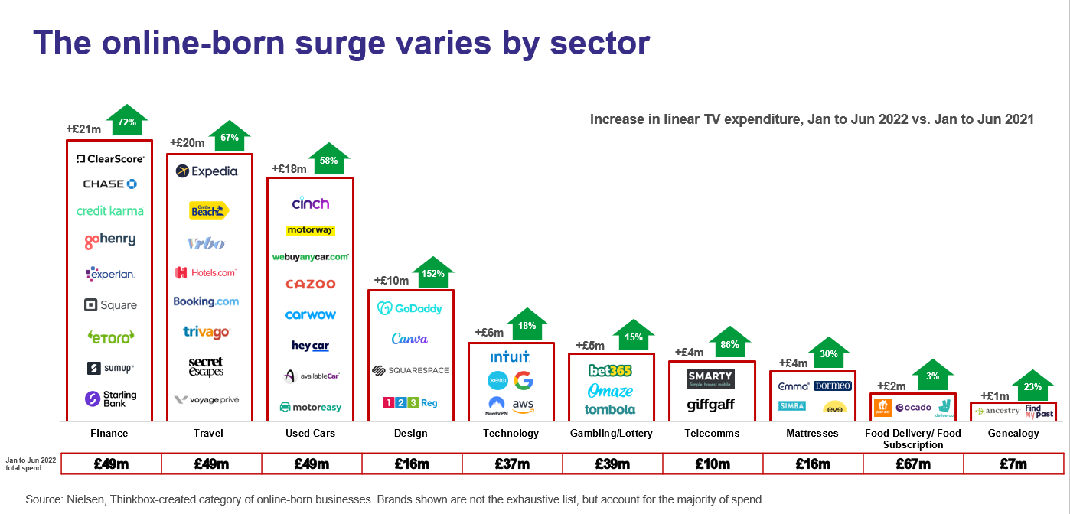
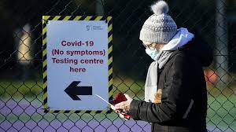
The industry has evolved significantly since our last study
Rise of subscription streaming services
Surge of social platforms e.g. TikTok
Growth in advertising expenditure
Impact of COVID-19
Notes:
Since our last landmark study in 2016, there has been a wealth of change that has made this study more important than ever.
The landscape is constantly changing, with the last few years seeing the rise of subscription streaming services. Services such as Netflix, Amazon Prime and Disney+ have marked out a place in people’s home and has evolved the way in which people consume TV content.
The proliferation and variety of platforms have changed the online video landscape, with a surge of short-form video social platforms such as TikTok.
Advertising expenditure has also evolved, with strong growth in expenditure and the rise of certain sectors such as online born businesses.
Arguably the pandemic has resulted in a shift in behaviour, the impact of Covid-19 has been a large influence in changing media consumption patterns.

Slide 4
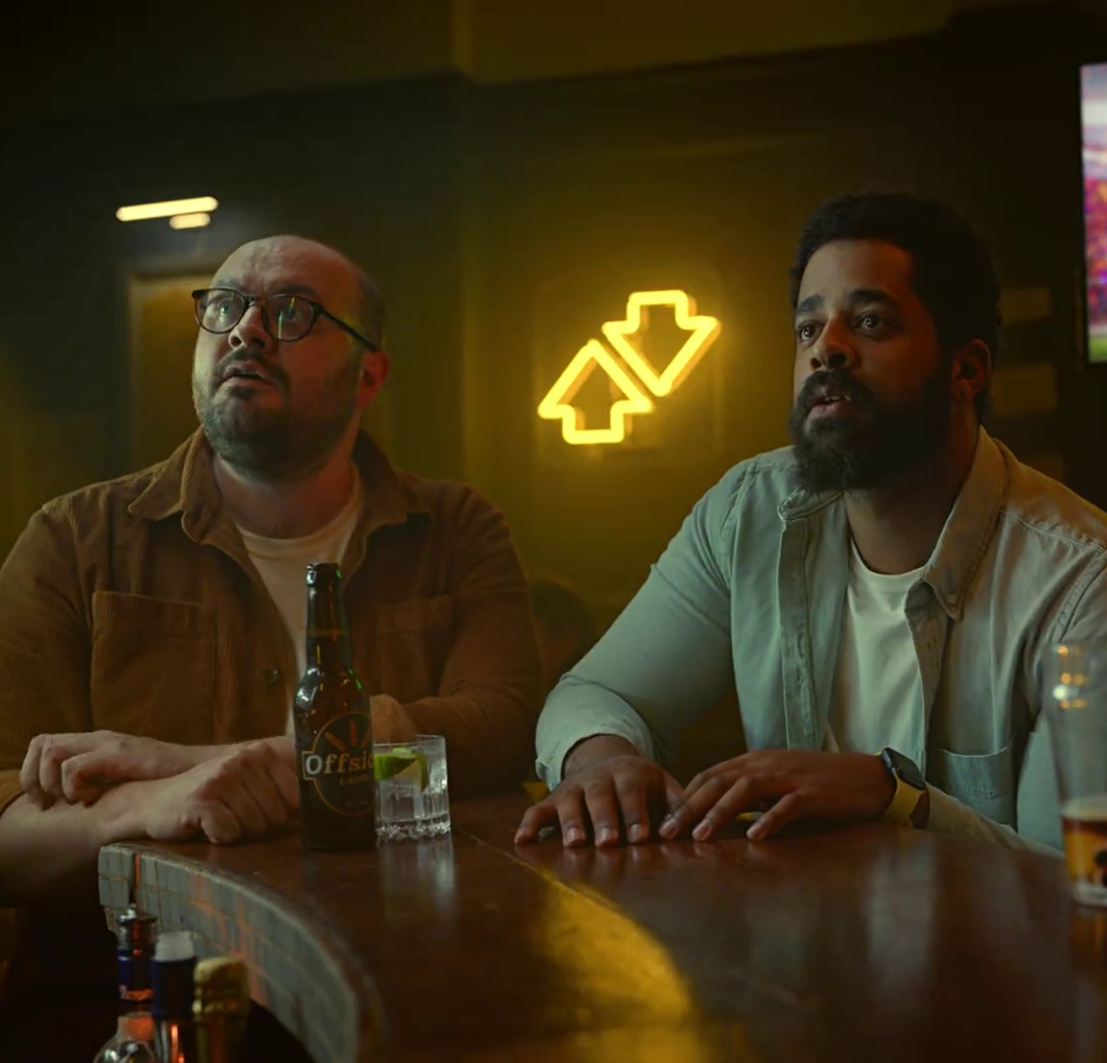
Our brief to Ipsos
Has the chasm between the media consumption habits of the British public and media professionals changed?
Has the way in which we consume TV content evolved?
What impact has the Covid-19 pandemic had on media consumption habits?
“Finger Ball” – Betfair
Notes:
Taking into account the variety of ways media consumption has evolved in recent years, we felt it was right to recommission Ipsos to conduct this landmark study. We wanted to uncover insights into these key questions, which formed the basis of our brief to Ipsos.
Has the chasm between the media consumption habits of the British public and media professionals changed?
Has the way in which we consume TV content evolved?
What impact has the Covid-19 pandemic had on media consumption habits?

Slide 5
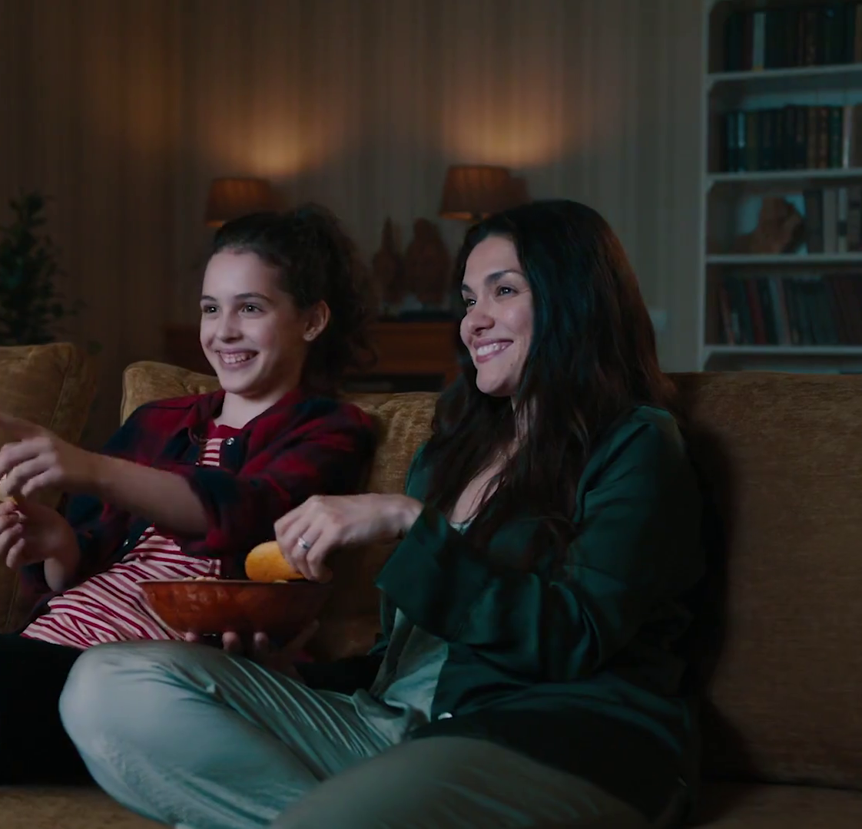
Agenda
METHODOLOGY
HOW DO AD PEOPLE DIFFER FROM ‘NORMAL’ PEOPLE?
WHICH MEDIA SERVICES ARE MOST COMMONLY ACCESSED BY ‘NORMAL’ PEOPLE AND AD PEOPLE?
HOW DO PEOPLE WATCH VIDEO CONTENT?
ARE TWO SCREENS BETTER THAN ONE?
ATTITUDES TO ADVERTISING
“Mega” – LG Televisions
Notes:
This formed the basis of Adnormal Behaviour.

Slide 6
Methodology
“Gym Face” – The Gym Group
Notes:
Methodology

Slide 7
The study consisted of two separate samples
Claimed attitudinal and behavioural data regarding:
‘Normal’
people
UK nationally representative survey
1,158 responses
June 2022
TV content viewership
Device / platform usage
Perceptions of advertising
Evolution of content consumption compared to pre-pandemic
Voluntary response survey from the Ad industry
216 responses
June – August 2022
Additional data on respondents’ perceptions of how the British public consume media content
Ad
people
Source: Adnormal Behaviour, 2022, Ipsos / Thinkbox.
Notes:
The study consisted of two samples:
The British public – aka ‘normal’ people was based on a random probability survey by Ipsos of 1,158 people weighted to be representative of the national population.
The study also surveyed 216 media professionals.
The study examines claimed attitudinal and behavioural data on TV content and viewership, device / platform usage, and perceptions of advertising. Whilst both samples were asked the same set of questions, ad people were also asked about perceptions of how the British public consume media content.
We also touched on the evolution of content consumption compared to pre-pandemic.

Slide 8
Normal people’s behaviour post pandemic changed – but ad people’s behaviour changed even more
% net change*
Watch live or recorded TV on a TV set
Watch an SVOD service
Watch a BVOD service
Watch YouTube
Use a video conferencing service (Zoom, MS Teams)
Source: Adnormal Behaviour, 2022, Ipsos / Thinkbox. Q.TNAN23/23a. Thinking about now, as compared to February 2020 (prior to the start of the pandemic), how has the frequency with which you do each of the following been impacted, if at all?
Base: ‘normal’ people (1,158); Ad people (216). *Net change = % stating frequency of doing activity increased minus % stating frequency of doing activity decreased
Notes:
To understand more about the COVID effect, the survey probed respondents to think about whether the frequency with which they did particular activities had been impacted in any way (so whether it increased, decreased or stayed the same).
Specifically focusing on video-based content and looking at the net change for each activity (subtracting the percentage of people that stated that they decreased the frequency of doing that particular activity from the percentage that stated that their frequency had increased), data shows that ‘normal’ people saw an increase in change across the board. However, ad people saw greater change.
Whilst watching live or recorded TV on a TV set decreased, the consumption of other video-based platforms such as watching a subscription service, consuming Broadcaster VOD (BVOD) and watching YouTube had increased, and at a higher rate than ‘normal’ people. Unsurprisingly, the largest change was seen in using a video-conferencing service, with 93% of ad industry respondents stating that they increased their use of Zoom and Microsoft Teams.

Slide 9
Normal people’s behaviour post pandemic changed – but ad people’s behaviour changed even more
% net change*
0
Listen to the radio
Listen to other audio (audiobooks, podcasts, music)
Use social media
Read a newspaper (print or online)
Read a magazine (print or online)
Source: Adnormal Behaviour, 2022, Ipsos / Thinkbox. Q.TNAN23/23a. Thinking about now, as compared to February 2020 (prior to the start of the pandemic), how has the frequency with which you do each of the following been impacted, if at all?
Base: ‘normal’ people (1,158); Ad people (216). *Net change = % stating frequency of doing activity increased minus % stating frequency of doing activity decreased
Notes:
When looking at other forms of media, ‘normal’ people saw a modest increase in audio-based consumption such as listening to the radio or podcasts, audiobooks or streaming music, with a greater increase in the latter. A similar trend was seen in ad people for digital forms of audio, whilst they claimed there was no change in their consumption of radio. Social media saw similar increases, with more ad people reporting that their consumption increased. On the other hand, both groups claimed to have decreased their consumption of newspaper and magazines.
Whilst ad people saw a larger shift in their consumption habits, it is clear that the British public did not mimic the same behaviour.

Slide 10
How do ad people differ from ‘normal’ people?
“One Good Thing” – Capital One
Notes:
How do Ad people differ from ‘normal’ people?

Slide 11
Differences between the two samples
Gender
Age
Region
16-34: | 26%
35-54: | 33%
55+: | 40%
Greater London: | 13%
Rest of UK: | 87%
Women: | 53%
Men: | 47%
‘Normal’ people
18-34: | 48%
35-54: | 41%
55+: | 11%
Women: | 51%
Men: | 49%
Greater London: | 49%
Rest of UK: | 51%
Ad
people
Source: Adnormal Behaviour, 2022, Ipsos / Thinkbox.
Notes:
With two very different samples in the study, it’s worth noting the demographic breakdown. Whilst the gender split between both samples are relatively equal, ad people were on the younger end of the scale and much more London focused.

Slide 12
What is our sample talking about?
1
2
3
4
5
‘Normal’ people
Family / friends
Current affairs / politics
TV
programmes
Work
Food / drink
Ad
people
Current affairs / politics
TV
programmes
Sports / fitness
Work
Family / friends
Source: Adnormal Behaviour, 2022, Ipsos / Thinkbox. Q.TN / AN1: Which, if any, of these things do you talk about with other people the most? This could be either face to face, via messaging apps like iMessage or WhatsApp, on social media sites like Facebook or Twitter, or on the phone. Base: ‘normal’ people (1,158)
Notes:
Whilst both samples differ in age composition and location, when comparing most common topics of conversation, they are practically the same. Family / Friends, Current affairs / politics and work occupy the top three spots (albeit in a slightly different order) for both samples, TV programmes also appear in the top 5 with other topics such as Food & drink as well as Sports & fitness making the list.

Slide 13
Which media services are most commonly accessed by ‘normal’ people and ad people?
“Natural Instincts” – Batiste
Notes:
Which media services are most commonly accessed by ‘normal’ people and Ad people?

Slide 14
Broadcast TV services were the most accessed service by ‘normal’ people
% accessing each service
Source: Adnormal Behaviour, 2022, Ipsos / Thinkbox. Q.TN / AN6. Which, if any, of these services have you accessed in the last 3 months?
Base: ‘normal’ people (1,158); Ad people (216)
Notes:
Dwelling on TV based services, 97% of ‘normal’ people claimed to have accessed any TV service in the last 3 months. The leading form of media was Linear TV for this sample, with 4 in 5 claiming to have used it. This was also 11 percentage points above SVOD services, whilst two thirds of our sample claimed to have used BVOD.
When we delve into the consumption of Ad people, the entire sample had used some form of TV service in the last 3 months , with 3 in 4 claiming to have used linear TV. However, SVOD and BVOD access were the most popular platforms, with 9 in 10 have used BVOD and almost the entire sample having access a subscription streaming service.

Slide 15
Which streaming services (SVOD / BVOD) are most popular?
% accessing each streaming service
Source: Adnormal Behaviour, 2022, Ipsos / Thinkbox. Q.TN / AN8:And which, if any, of the following streaming services have you accessed in the last 3 months?
Base: ‘normal’ people (1,158); Ad people (216)
Notes:
With SVOD and BVOD consumption a popular form of consuming TV, it’s hard to ignore the constantly evolving landscape for streaming services. With the variety of different platforms available, do the streaming services that are used differ between both samples?
Across the board, both samples generally followed the same pattern, a mixture of both broadcaster and subscription services lead the way such as Netflix, BBC iPlayer, Amazon Prime Video and ITV Hub. The main point of difference is the proportion of people in each sample, with ad people generally seeing a larger rate of access. The only exception is My5, with ‘normal’ people overtaking the industry with 16% claiming to have accessed it in the last 3 months.

Slide 16
What content are they watching via SVOD?
% who have watched at least one episode in the past 2 years
Source: Adnormal Behaviour, 2022, Ipsos / Thinkbox. Q.TN / AN10: Which, if any, of the following series have you watched at least one episode of in the last two years using a streaming service?
Base: ‘normal’ people (1,158); Ad people (216)
Notes:
To gain an understanding of what draws people to streaming services, we gave our respondents a list of some of the biggest streaming programmes and asked which they had watched at least one episode of in the past two years.
Of the SVOD programmes, none were watched by the majority of ‘normal’ people. Unsurprisingly, world phenomenon Squid Game appeared at the top of the list. However, despite its global fame, only 26% of ‘normal’ people had tuned into this international title. Bridgerton was the next leading title with only 24%.
In contrast, the share of ad people who watched any one programme is dramatically larger than the share of the public, with 62% of the sample having watched one episode of Squid Game and over half of the sample tuning into Sex Education.

Slide 17
Ad people have much higher usage of social media
% who accessed website / service / app in past 3 months
% pt. difference (AP-NP)
‘Normal’ people
Ad people
Facebook
YouTube
Instagram
Twitter
LinkedIn
Pinterest
TikTok
Snapchat
Reddit
+10
+20
+44
+36
+69
+12
+26
+4
+14
Source: Adnormal Behaviour, 2022, Ipsos / Thinkbox. Q.TN / AN21. Which, if any, of the following websites, apps or services have you visited or used in the last 3 months?
Base: ‘normal’ people (1,158); Ad people (216)
Notes:
With ad people having a higher consumption of streaming services, a similar trend was seen in social media. Looking at platform access in the last 3 months, Facebook and YouTube were the most popular services for ‘normal people’. On the other end of the spectrum, TikTok, Snapchat and Reddit were least popular, with under 20% of the sample claiming to have used each of these platforms.
However, when compared with ad people, a different story emerges. Unsurprisingly, LinkedIn is the most popular platform, with Instagram, YouTube, Facebook and Twitter also seeing over 70% of the sample using these social services. Interestingly, 43% of ad people had used TikTok at some point in the past 3 months, with Snapchat seeing the least penetration. Ad people consistently had larger usage of social media platforms.

Slide 18
Ad people overestimate the use of TikTok and underestimate Facebook and YouTube
% who accessed website / service / app in past 3 months
% pt. difference (APE-NP)
‘Normal’ people
Ad people expectations
Facebook
YouTube
Instagram
Twitter
LinkedIn
Pinterest
TikTok
Snapchat
Reddit
-11
-15
+7
+1
+1
-
+18
+8
+1
Source: Adnormal Behaviour, 2022, Ipsos / Thinkbox. Q.TN / AN21. Which, if any, of the following websites, apps or services have you visited or used in the last 3 months?
Base: ‘normal’ people (1,158); Ad people (216)
Notes:
However, as industry professionals, understanding your audience is key! As a group, we are generally at the forefront of technology, we know the ins and outs of the fast-paced and evolving landscape. As an industry, ad people are already consuming more social media than the average person, but how well did ad people do when asked to predict the behaviour of ‘normal’ people?
Ad people’s estimates of Facebook, Instagram, Twitter, Reddit and Snapchat were around a 10-percentage point margin of the penetration reported by ‘normal’ people. Pinterest estimates were spot on. Despite this, ad people underestimated the usage of Facebook and YouTube, with 65% of ‘normal’ people claiming to have used YouTube whilst ad people believed this to be far lower at 50%. Similarly, ad people perceived TikTok usage to be 2 times higher at 35% whereas only 17% of ‘normal’ people said they had used the video sharing platform in the last 3 months.
Data suggests that ad people were able to accurately estimate most platforms but need to be aware of the claimed penetration of new and emerging services. Whilst their prediction likely mirrors their own greater consumption of social media, this is a great reminder of the differences between the two groups as well as highlights the issue with projecting our own technological confidence onto the rest of the population.

Slide 19
How do people watch video content?
“Full Support” – Snickers
Notes:
How do people watch video content?

Slide 20
People are underestimating the proportion of Live TV
Live
Recorded / Catch Up
SVOD
% of time spent watching each form of content
Ad people
Ad people’s expectations
‘Normal’ people
Actual – BARB Q2
Source: Adnormal Behaviour, 2022, Ipsos / Thinkbox. Q.AN14 / TN14. Of the time you (the British public) spend watching television, what proportion of that time (do you think) is spent watching…
Base: ‘normal’ people (1,158); Ad people (216). BARB, Q2 2022, Adults 16+, Online Multiple Screens Network – viewing across four screens – TV sets, tablet, PCs and smartphones
Notes:
Consuming TV content comprises of various elements, and TV in all its forms plays a large role in our lives. When looking at the proportion of each component (live, recorded / catch up and SVOD), it provides a more detailed view on how the nation engages with TV.
We investigated the time spent watching TV, and further segmented this into each element. Ad people claimed that over half of their time spent watching TV was spent watching SVOD, with recorded / catch up accounting for 27%, whilst 20% of their time was spent watching live. The same question was asked to the sample to predict the behaviour of ‘normal’ people. Ad people predicted that SVOD accounted for a smaller share (31%), a similar proportion of their own behaviour was also reflected in recorded / catch up (26%) whilst live TV accounted for 43%. Contrastingly, ‘normal’ people were more equal in their allocation, with SVOD only slightly leading at 36%, whilst live and recorded / catch up accounted for 32% each.
Despite the claimed time spent, actual data from BARB displays a completely different story. In contrast, live accounts for the largest share with 63%, whilst recorded / catch up accounts for 21%. Contrastingly SVOD accounts for the smallest proportion with just 17%. Despite the reported claims, live viewing plays a much larger role in the way TV content is consumed, with both groups considerably underestimating the proportion of live viewing.

Slide 21
Device usage is similar between both groups
TV Set
Laptop / PC
Tablet
Smartphone
78%
10%
6%
6%
‘Normal’ people
71%
15%
6%
8%
Ad people
Source: Adnormal Behaviour, 2022, Ipsos / Thinkbox. Q.TN17 / AN17a. Of the time you spend watching TV content, what proportion of that time is spent watching…
Base: ‘normal’ people (1,158); Ad people (216)
Notes:
The device used to watch content is also an important factor in how people choose to consume content. Interestingly device usage is similar between both groups. Unsurprisingly, TV set is the leading device with both samples claiming to spend over 70% of their time consuming TV content via the larger screens. The smaller screens account for a much smaller share across both groups.

Slide 22
Are two screens better than one?
“Second Screeners” – Three
Notes:
Are two screens better than one?

Slide 23
More ad people multiscreen and do so for a greater proportion of time
% of respondents who use another device whilst watching TV at the same time
Proportion of time spent multi-screening
Multiscreen
31%
‘Normal’ people
47%
Ad people
‘Normal’ people
Ad people
Source: Adnormal Behaviour, 2022, Ipsos / Thinkbox. Q.TN18 / AN18a: When watching content on a TV set, for what proportion of time do you estimate you use another device (e.g. your smartphone, tablet, laptop, etc.) at the same time? Base TN18: All who ever watch TV content on a TV set (‘normal’ people = 963, Ad people = 202)
Notes:
Whilst TV set is the most prominent device, using more than one device at the same time is also prevalent.
Whilst 92% of ad people claim to have ever used multiple devices at the same time, surprisingly only 69% of ‘normal’ people claim to ever multi-screen. This level of non multi-screening is likely driven predominantly by those over the age of 55.
When asked about the proportion of time, ‘normal’ people estimated that 31% of their time spent watching TV was also spent on another device, whilst ad people attributed a larger proportion at 47%.

Slide 24
Ad people are more likely to be checking on work, social and programme information than ‘normal’ people
Source: Adnormal Behaviour, 2022, Ipsos / Thinkbox. Q.TN / AN19. What are the main reasons for using another device at the same time as you are watching content on a TV set?
Base: All who ever use multiple devices at one time (‘normal’ people = 774; Ad people = 198)
Notes:
Whilst there are differences in uptake and time spent in terms of multi-screening, the reasons for multi-screening are actually quite similar. For both groups, discussing with family and friends and to get more information about products or services they saw on TV played the smallest factor in their choice to consume more than one screen, but generally ad people reigned supreme, outperforming ‘normal’ people on all bar one of the statements. The main factor in the decision to multiscreen include checking personal emails or sending text messages, as well as catching up on social media, talk or message someone via mobile phone and shopping online.

Slide 25
Attitudes to advertising
“Arrows” – Expedia
Notes:
Attitudes to advertising

Slide 26
Where do ‘normal’ people find advertising that…
% who selected each medium
 | TV | Social Media | Radio | YouTube | Cinema | Magazines | Outdoor | Newspapers | Search | Direct Mail | Websites
Sticks in their memory | 57% | 28% | 19% | 13% | 12% | 12% | 12% | 11% | 10% | 6% | 3%
Makes them laugh | 52% | 35% | 13% | 21% | 16% | 5% | 6% | 6% | 4% | 2% | 3%
Entertains them | 51% | 30% | 13% | 19% | 21% | 9% | 3% | 7% | 9% | 3% | 4%
Makes them feel emotional | 47% | 17% | 6% | 10% | 15% | 5% | 3% | 9% | 4% | 2% | 2%
They like | 40% | 27% | 10% | 12% | 14% | 15% | 8% | 12% | 14% | 4% | 4%
They trust | 35% | 6% | 16% | 4% | 9% | 12% | 6% | 19% | 11% | 6% | 4%
Source: Adnormal Behaviour, 2022, Ipsos / Thinkbox. Q.TN3: In which, if any, of the following places are you most likely to find advertising that...
Base: ‘normal’ people (1,158)
Notes:
As we all know there is a wealth of effectiveness data out there that shows how advertising that elicits an emotional response creates a lasting impact. We asked ‘normal’ people about their attitudes to advertising to see what channels generated particular outcomes.
When asked what channel they were most likely to find advertising that sticks in their memory, makes them laugh and entertains them, the majority of ‘normal’ people selected TV, with over half claiming that TV has the ability to generate these emotions. Social Media and radio also appeared at the top of the list however when looking at how the different media channels performed against the other attributes, TV outperformed all other media.

Slide 27
Where do ‘normal’ people find advertising that…
% who selected each medium
 | TV | Social Media | Radio | YouTube | Cinema | Magazines | Outdoor | Newspapers | Search | Direct Mail | Websites
Makes brands, products or services more famous | 66% | 34% | 12% | 16% | 16% | 19% | 19% | 19% | 15% | 6% | 8%
Draws their attention to a new product, brand or service | 49% | 39% | 14% | 15% | 10% | 17% | 14% | 17% | 18% | 7% | 8%
They talk about with other people verbally | 46% | 28% | 14% | 11% | 9% | 10% | 8% | 13% | 11% | 3% | 6%
Provides helpful information | 38% | 21% | 18% | 9% | 3% | 18% | 8% | 27% | 31% | 11% | 10%
They talk about with other people electronically | 26% | 33% | 8% | 10% | 6% | 6% | 4% | 8% | 9% | 3% | 6%
Source: Adnormal Behaviour, 2022, Ipsos / Thinkbox. Q.TN3: In which, if any, of the following places are you most likely to find advertising that...
Base: ‘normal’ people (1,158)
Notes:
TV also performed favourably when asked about actionable outcomes, and is seen as the medium that provides helpful information, draws your attention and provides topics for verbal conversations, although it did come second to social media when providing content for electronic conversations.

Slide 28
Where are you most likely to find advertising that…
You trust
Makes you feel emotional
Draws your attention to a new product, brand or service
1.
TV
TV
TV
TV
TV
Social media
2.
Newspapers
Cinema
Social media
Cinema
Social media
TV
3.
Radio
Newspapers
Cinema
YouTube
Search
Outdoor
4.
Magazines
Outdoor
YouTube
Social media
Newspapers
YouTube
5.
Search
Radio
Newspapers
Radio
Magazines
Audio
‘Normal’ people
Ad people
Source: Adnormal Behaviour, 2022, Ipsos / Thinkbox. Q.TN3 / AN3a: In which, if any, of the following places are you (do you think the British public are) most likely to find advertising that ...
Base: ‘normal’ people (1,158); Ad people (216)
Notes:
But how does this compare with ad people’s attitudes to advertising
Looking at the top 5 media channels for both groups, when asked about where you’d find advertising that you trust, TV is the leading medium for both groups. ‘Normal’ people also selected newspapers and magazines, radio and search as places to find trustworthy advertisements. In contrast, ad people included cinema and outdoor.
When asked about where they were most likely to find advertising that made them feel emotional, TV was also the leading medium for both groups. Interestingly, both groups were also aligned with their selection of media channels, including social media, cinema and YouTube as places you are most likely to find emotional advertising. Whilst ‘normal’ people included newspapers, ad people selected radio.
Lastly, when asked where they felt they could find advertising that drew their attention to a new brand, product, or service, both ‘normal’ people and ad people selected TV and social media as the most popular medium (albeit with TV leading for ‘normal’ people). Newspapers and magazines once again plays a large role for ‘normal people whilst outdoor, YouTube and audio service are more popular for ad people.

Slide 29
Summary
The pandemic has not impacted behaviour as much as the industry believes
‘Normal’ people and ad people underestimate the proportion of live TV viewing
Ad people have a good feel for the penetration of platforms but overestimate for the new emerging platforms
Both groups acknowledge TV as the medium you are most likely to find advertising that is trustworthy, emotional and memorable
“The GOAT of Swaps” – Panini
Notes:
This study highlights the need to evaluate our own behaviour as industry professionals and how it compares to the average person in the UK. Whilst there are various points where both groups align in their consumption of certain media, the study has also shown of variety of different points of difference, beyond just the age composition and geographical location.
Overall the study has exposed some key findings such as despite the pandemic being the largest event in recent years, it has not impacted behaviour as much as we thought.
Both ‘normal’ people and ad people underestimate the proportion of live viewing with actual BARB data allocating 63% of TV viewing to live content.
Ad people have also shown a good understanding of the penetration of most social platforms however they have overestimated the use of new emerging platforms such as TikTok.
Both groups acknowledge TV as the medium you are most likely to find advertising that is trustworthy, emotional and memorable.

