Slide 1
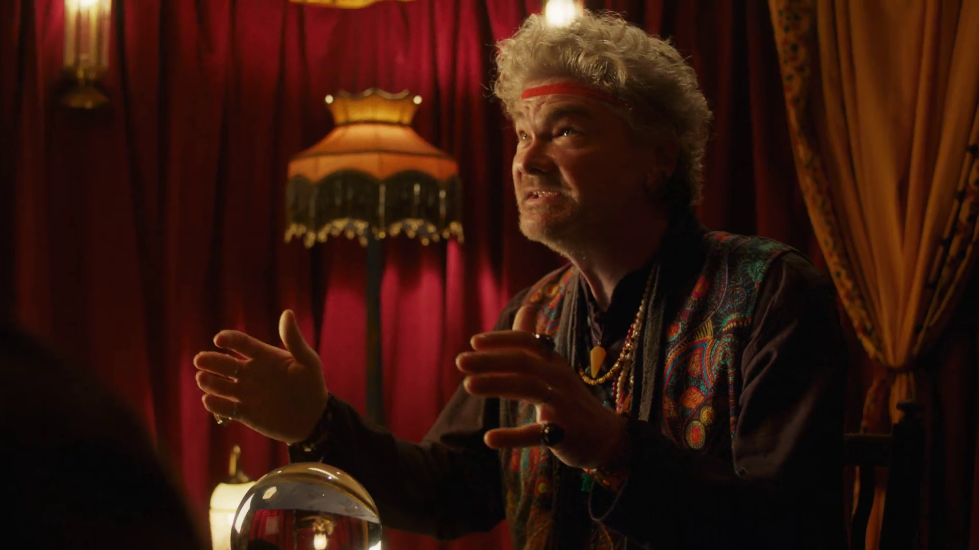

Financial Services Deep Dive
Skipton Building Society – Fortune Teller

Slide 2
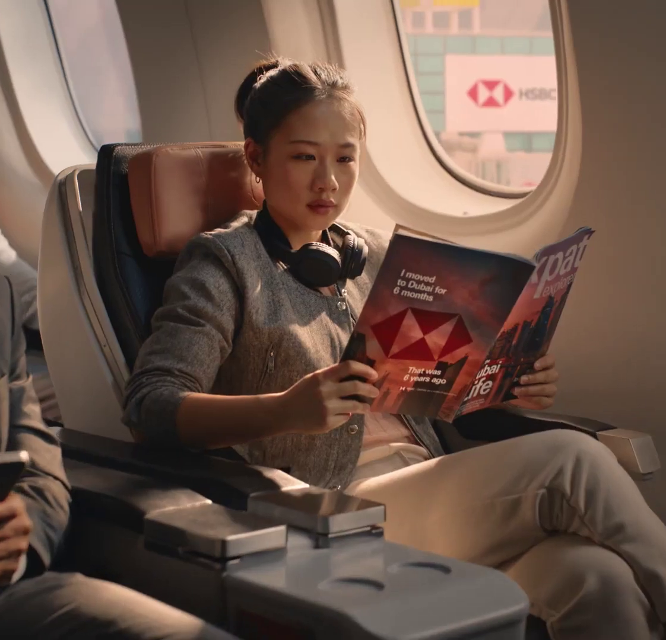
In this deck…
To provide an analysis of the finance category this deck explores the following areas:
Macro Spend Patterns:
Spending behaviour and patterns
Effectiveness:
TV is crucial to the plan
Media Planning:
Weekday, and daypart analysis
Ad time-lengths
Case Studies:
Nationwide, Tide, and Go.Compare
HSBC – Life Is Rarely a Straight Line
Notes:
To provide an analysis of the finance category this deck explores the following areas:
Macro Spend Patterns:
Spending behaviour and patterns
Effectiveness:
TV is crucial to the plan
Media Planning:
Weekday, and daypart analysis
Ad time-lengths
Case Studies
Nationwide, Tide, and Go.Compare

Slide 3

Macro spend patterns
Lloyds Bank – Best Grandparents

Slide 4
Financial services investment stabilising year-on-year
+137m
+30%
-2%
-£14m
-17%
-£93m
-£181m
-31%
-2%
-£7m
Source: Nielsen Ad Intel, 2019-2024, Finance, Linear TV Spend, %’s show YoY change.

Slide 5
Insurance consistently leads financial services TV investment
+137m
+30%
-2%
-£14m
-17%
-£93m
-£181m
-31%
-2%
-£7m
Source: Nielsen Ad Intel, 2019-2024, Finance, TV Spend, %’s show YoY change.
Notes:
General Insurance remains the largest spender on linear TV.

Slide 6
Finance share of TV impacts has fluctuated over last decade
Source: Barb, 2010-2024, individuals, linear impacts (R/W), finance share of voice vs all other categories.
Notes:
Finance share of voice relative to all other categories has decreased in recent years. Potentially offering more favourable conditions to those Finance brands looking to build share.

Slide 7
Finance advertisers SoV has changed across the last decade
Source: Barb, 2010-2024, individuals, linear impacts (R/W), top 10 finance advertisers by total linear impacts from 2010-2024.

Slide 8

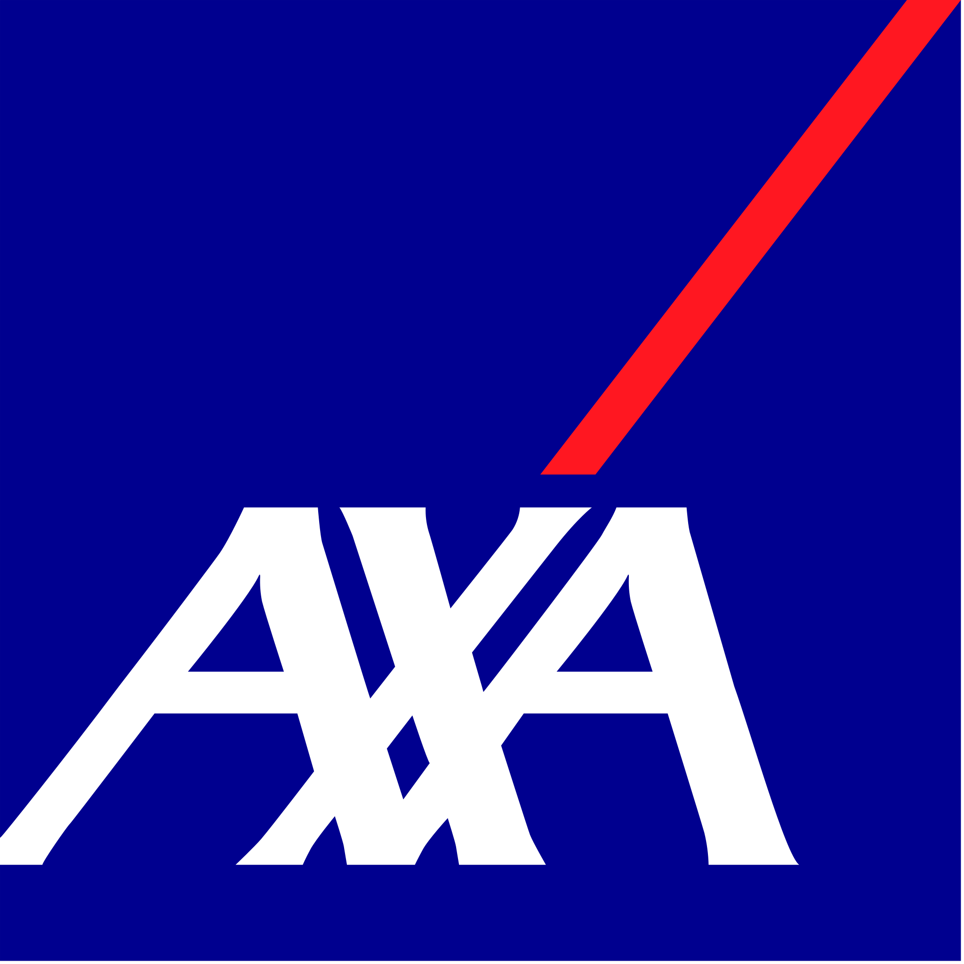









Pure Cremation is the largest finance investor in linear TV
Source: Barb, 2024, individuals, linear impacts (R/W) (million). Top 10 2024 finance advertisers by total linear TV impacts.

Slide 9

Effectiveness
Confused.com - Wife

Slide 10

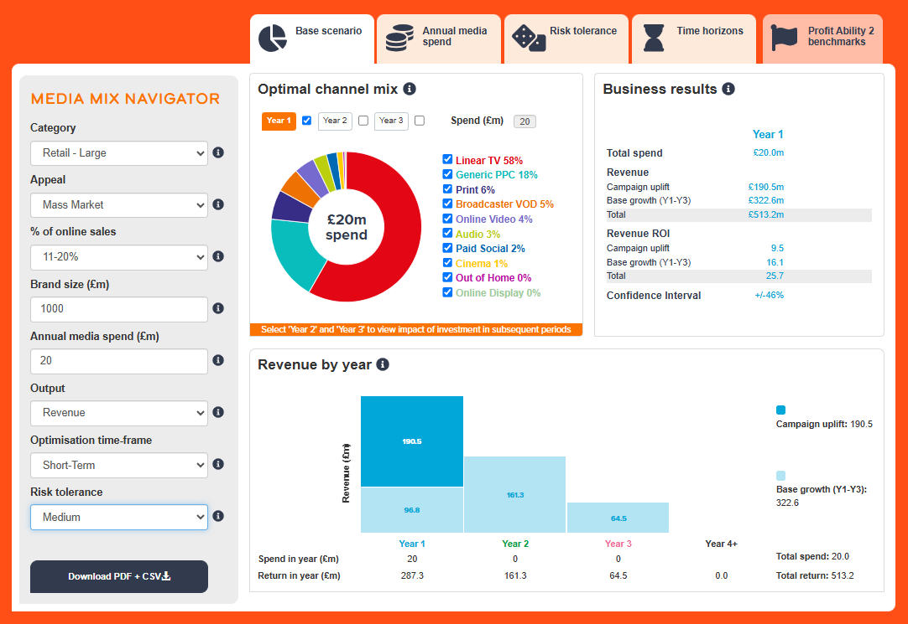
Profit Ability 2 and Media Mix Navigator
Profit Ability 2 was conducted by Ebiquity, EssenceMediacom, Gain Theory, Mindshare, and Wavemaker UK.
It’s a meta-analysis of econometric studies from 141 brands covering £1.8 billion of media spend across 10 media channels and 14 business sectors.
The Media Mix Navigator (MMN) tool, powered by the data from Profit Ability 2, allows you to explore different scenarios to define the optimum media mix for your business, whether your objective is to drive increased profit or revenue.

Slide 11
Optimised MMN scenario for finance recommends higher share of TV vs. actual databank share
Actual vs. Media Mix Navigator Optimised channel mix
Source: Media Mix Navigator, Optimised based on £500m brand size, mass market, high risk and media budget of £20m.
Notes:
Channel investment strategy depends on not only a brand’s objective but also the category it is in, as well as budget, brand size and risk appetite. There is no better tool than the Media Mix Navigator (MMN) to provide a benchmark view that takes into account these crucial factors. The MMN recommends a higher share of Linear TV & BVOD when compared against the actual databanks share.
The Media Mix Navigator is available here:
https://www.thinkbox.tv/training-and-tools/media-mix-navigator/media-mix-navigator

Slide 12
BVOD allows precise targeting for financial services
Short-term effects
Bubble size represents % of short-term profit volume
Financial Services Short-Term ROI: £0.94
Source: Profit Ability 2, April 2024 – Short term benchmarks: Ebiquity, EssenceMediacom, Gain Theory, Mindshare, Wavemaker UK.
Long Term Multipliers: EssenceMediacom, Gain Theory, Mindshare, Wavemaker UK
N.B. low sample size for OOH
Notes:
In Financial Services, total short-term ROI is just under breakeven but a word of caution…
When calculating profit in a Financial Services MMM project, different brands will use different definitions of profit depending upon their internal conventions (e.g. income per sale, 3-yr net present value, 5-yr net present value, sometimes cross-sell is included, sometimes not, etc.).
As a result, the definition of profit is not very consistent. In the Profit Ability 2 dataset we incorporated already finished models with the metrics that the respective advertisers were using. It is, therefore, appropriate to treat the absolute profit figure with a little bit of a pinch of salt; but we can still look at the relative performance, which is also quite interesting.
A big Generic PPC bubble shows that a lot of generic search behaviour is happening - people typing in car insurance - and that contributes a lot of volume.
In terms of brand media, Linear TV doesn't quite breakeven in the short-term but what’s really interesting is that BVOD (orange) seems to perform quite well in this data set - leading to the hypothesis that financial service advertisers have access to good data, which they can leverage to play to the strengths of BVOD in terms of precise targeting (renewal windows, propensity to apply for a mortgage, etc).

Slide 13
Financial services blended full profit ROI increases to £1.95
Full effects
Bubble size represents % of full profit volume
Financial Services Full Profit ROI: £1.95
Source: Profit Ability 2, April 2024 – Short term benchmarks: Ebiquity, EssenceMediacom, Gain Theory, Mindshare, Wavemaker UK.
Long Term Multipliers: EssenceMediacom, Gain Theory, Mindshare, Wavemaker UK
N.B. low sample size for OOH
Notes:
Longer term view - blended Full ROI goes up to about £1.95, which makes more commercial sense.
This is completely uncontroversial - Financial Services brands know that investing more in ATL advertising tends to help improve scores for things like trust, value for money, etc. which are key drivers of longer-term effects.
Actually, if you think about that homogenous environment of search engine results and price comparison websites, where you're one of many brands that's listed, the marginal gains you get from having a slightly stronger brand actually translates into a lot of additional volume.
Within this sector, you definitely should be setting your budgets and planning according to the long-term view rather than the short-term view.

Slide 14
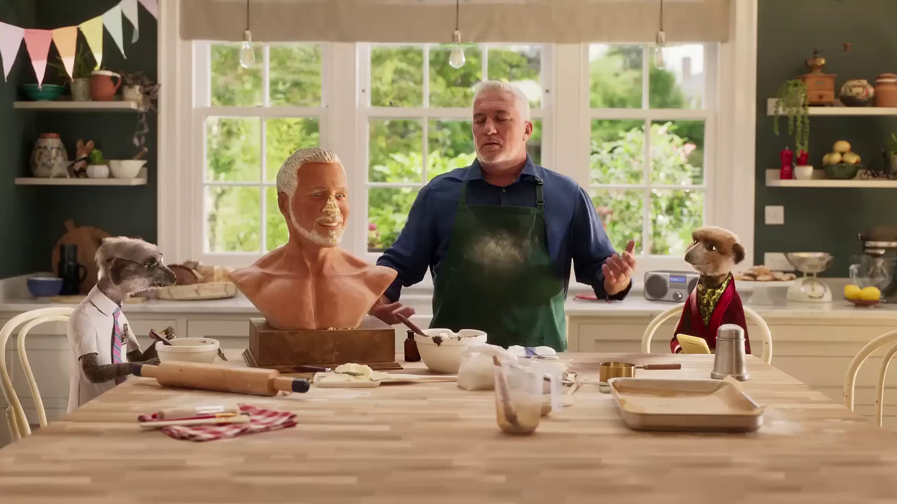
Media planning
Compare The Market – Paul’s Bust

Slide 15
Finance linear TV spend skews toward the start of the year
Index of finance commercial linear TV impacts vs all categories
Finance commercial linear TV index by month
Jan | Feb | Mar | Apr | May | Jun | Jul | Aug | Sep | Oct | Nov | Dec
113 | 120 | 101 | 102 | 105 | 109 | 112 | 115 | 112 | 108 | 66 | 47
Top 10 finance advertisers commercial linear TV index by month
 | Jan | Feb | Mar | Apr | May | Jun | Jul | Aug | Sep | Oct | Nov | Dec
Pure Cremation | 79 | 79 | 81 | 97 | 98 | 92 | 93 | 109 | 120 | 116 | 177 | 86
AXA Sun Life | 108 | 181 | 84 | 80 | 89 | 86 | 55 | 64 | 110 | 119 | 134 | 71
Neilson | 158 | 126 | 135 | 83 | 72 | 64 | 93 | 82 | 71 | 71 | 123 | 119
Barclays | 118 | 84 | 61 | 50 | 63 | 65 | 114 | 90 | 217 | 129 | 98 | 102
Compare The Market | 118 | 67 | 91 | 168 | 113 | 97 | 115 | 63 | 103 | 94 | 83 | 72
Go.Compare | 130 | 89 | 140 | 105 | 97 | 87 | 87 | 102 | 104 | 66 | 114 | 59
Admiral / Confused | 99 | 74 | 62 | 26 | 116 | 137 | 80 | 134 | 129 | 102 | 117 | 165
The AA | 59 | 62 | 68 | 155 | 82 | 113 | 161 | 189 | 55 | 65 | 81 | 149
Liverpool Victoria | 100 | 103 | 110 | 156 | 105 | 96 | 117 | 121 | 102 | 91 | 0 | 38
Pet Plan | 140 | 124 | 39 | 47 | 41 | 145 | 245 | 180 | 35 | 35 | 30 | 107
Source: Barb, 2024, monthly index vs full-year 2024, individuals, top 10 advertisers by total linear impacts.
Notes:
Finance linear TV spend skews toward the start of the year and later summer months.

Slide 16
Finance linear TV spend skews toward daytime viewing
Index of finance commercial linear TV impacts vs all categories
Finance commercial linear TV index by daypart
 | 6am | 7am | 8am | 9am | 10am | 11am | 12pm | 1pm | 2pm | 3pm | 4pm | 5pm | 6pm | 7pm | 8pm | 9pm | 10pm | 11pm | 12am | 1am | 2am | 3am | 4am | 5am
Monday | 107 | 80 | 102 | 143 | 136 | 143 | 147 | 142 | 152 | 152 | 136 | 98 | 88 | 81 | 75 | 71 | 73 | 74 | 78 | 88 | 87 | 98 | 105 | 105
Tuesday | 111 | 79 | 107 | 141 | 140 | 143 | 153 | 149 | 157 | 157 | 139 | 101 | 87 | 79 | 77 | 68 | 66 | 69 | 72 | 76 | 74 | 78 | 91 | 112
Wednesday | 114 | 86 | 106 | 139 | 142 | 146 | 155 | 153 | 157 | 157 | 139 | 101 | 86 | 79 | 73 | 71 | 68 | 67 | 72 | 74 | 73 | 78 | 96 | 102
Thursday | 107 | 81 | 100 | 140 | 142 | 147 | 158 | 154 | 162 | 159 | 139 | 99 | 85 | 76 | 74 | 70 | 65 | 71 | 74 | 79 | 77 | 81 | 91 | 104
Friday | 113 | 77 | 101 | 139 | 143 | 145 | 153 | 149 | 157 | 156 | 142 | 100 | 83 | 77 | 75 | 70 | 67 | 69 | 78 | 83 | 83 | 79 | 100 | 110
Saturday | 145 | 135 | 122 | 124 | 124 | 126 | 132 | 125 | 118 | 122 | 119 | 97 | 94 | 87 | 84 | 74 | 81 | 77 | 86 | 91 | 88 | 91 | 106 | 112
Sunday | 158 | 143 | 128 | 121 | 123 | 118 | 131 | 114 | 117 | 117 | 110 | 97 | 91 | 90 | 87 | 84 | 76 | 79 | 85 | 89 | 88 | 91 | 106 | 114
Monday | Tuesday | Wednesday | Thursday | Friday | Saturday | Sunday
103 | 107 | 105 | 104 | 102 | 91 | 88
Source: Barb, 2024, individuals, commercial linear, finance index vs all categories.
Notes:
Finance linear TV spend skews toward midweek daytime viewing, when viewers are more likely to be in the market for financial products – whether it's changing a current account or getting car insurance.

Slide 17
Use of 60” is high amongst Finance advertisers
Source: Barb, 2024, Individuals
Notes:
The finance category are the second most prevalent users of longer spots behind the charity sector (Govt, Social, Political Org). However, the 30” spot is the most popular time-length.

Slide 18
Finance ad lengths have shortened over the last twenty years
Source: Barb, 2003-2024, individuals, finance category.
Notes:
Finance ads have progressively shortened over the last 20 years, now typically lasting 30 seconds or less.

Slide 19
Financial advertisers opting for shorter ads
Source: Barb, 2024, individuals, linear only, finance category, top 15 advertisers by total linear impacts.
Notes:
Use of spot length varies across the finance category with 30” being the most popular choice.

Slide 20
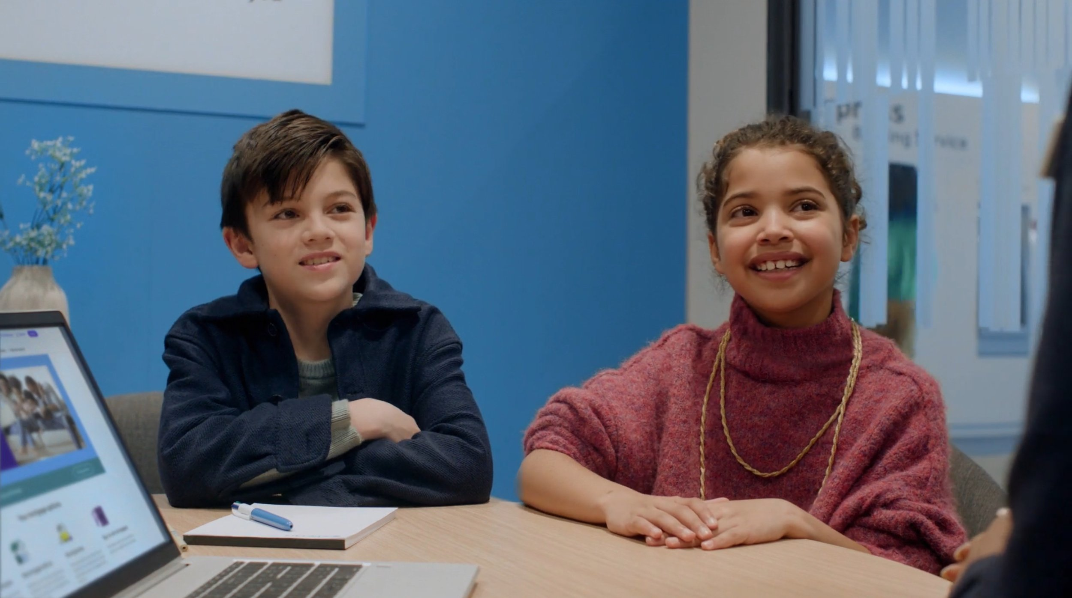
Case Studies
Barclays – Dream Home

Slide 21


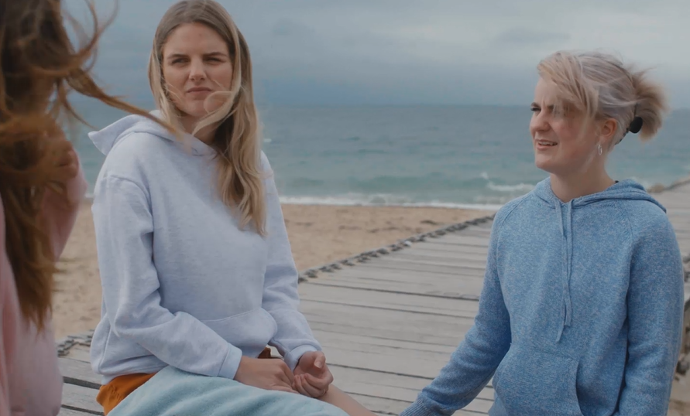
Nationwide: Planning for empathy to deliver Business results
The Challenge:
With an oncoming Cost-of-Living crisis hitting hard, Nationwide needed to show they were offering support to its customers.
The Solution:
Realising shame about struggling financially was rife amongst younger audiences, Nationwide launched a free cost of living hotline and used the emotional power of TV to promote it within the content they love the most.
The Results:
Doubling down on October, when the energy price cap increase was dominating the news, Nationwide achieved 1st place in Share of Voice for the financial services sector, reaching 75.4% of target audiences across Linear and BVOD. They saw increases in brand health measures against younger audiences and 7,000 new accounts opened directly attributed back to TV, higher than that of pure acquisition channel, PPC.
Notes:
The Challenge
Nationwide Building Society is different to the banks it competes with. It exists solely for the benefit of its members and has a long history of helping through the toughest times. With the onset of the Cost-of-Living Crisis, Nationwide couldn’t just sit by, they had a duty to respond.
TGI data showed that parents with young children were the hardest hit by the crisis. As younger life stages are a key priority for Nationwide’s business, there was an opportunity to improve brand perceptions amongst this group by supporting them when they needed it most.
The objective was clear; influence perceptions of younger audiences and show them that Nationwide was there for them.
The TV Solution
Wavemaker set out to show humanity in the face of the crisis – their strategy was to plan for empathy.. Nationwide needed actions not just words to connect with the audience, so they launched a free national helpline, staffed by dedicated cost-of-living experts.
They then crafted a campaign to encourage people to seek help and reassure them they weren’t alone.
TV would be crucial to this. With its unrivalled ability to drive an emotional connection, its broadcast nature would also provide a social proofing effect, helping to break down the stigma of seeking help. With a focus on younger audiences, it would have been easy to place money into channels like Social, but Wavemaker and Nationwide went all in on AV as they knew nothing gets people talking like TV does.
The Plan
Wavemaker doubled down on adults 25-44, and built proxy audiences for Nationwide’s most vulnerable younger segments across BVOD, based on media attitudes and financial behaviours. A small amount of budget was planned into YouTube and search data was used to target those that were showing ‘money worry’ signals. Research showed that families from ethnically diverse backgrounds were being disproportionately impacted by the crisis. To combat this Wavemaker directed spend into VOD environments with Red Media and Diversity Media Sales to increase reach and resonance with those audiences.
Launching the hotline couldn’t wait, so budget was planned into August to support its launch. But Wavemaker knew the energy price hikes were coming in October and would be dominating news cycles. Coupled with the half term and Christmas on the horizon, families would be feeling the strain. As a result, Nationwide were fully committed to a share of voice play in the market around this time. Instead of stretching the spend across the period, Wavemaker went heavy with a 4-week campaign in October when anxiety was likely to be at its highest. Buying around 560 TVRs, Nationwide were aiming to be the most prominent financial services brand at the most crucial time of year.
When looking at programming for the campaign, Wavemaker needed to strike the right balance between escapism and support. Wavemaker made sure that Nationwide were in the biggest entertainment shows that would naturally draw in viewers looking for an escape. This included the likes of The Masked Singer, House of the Dragon and Live Premier League football on Sky Sports. Along with this, Wavemaker looked to harness shows with the most contextual relevance that offered practical support; shows like the Martin Lewis Money Show, Jamie Oliver’s £1 wonders and Steph’s Packed Lunch Cost-of-Living special. In addition Wavemaker sought out TV moments that embodied empathy. Shows like Gogglebox, which showed real people talking and supporting each other; and the Pride of Britian Awards, celebrating kindness and humanity, to create the link that Nationwide was there to help its customers.
While cinema would usually have been part of Nationwide’s total media mix, the Crisis saw families forgoing leisure spending. As a result, Wavemaker increased spend back into TV,upweighted free-to-air channels and down weighted spend behind pay walls. This ensured that those who were cutting back would still be exposed to Nationwide’s message of support. Furthermore, Nationwide joined forces with the likes of Boots, Lidl and Co-Op for Channel 4’s ‘Ad Break that Gives back’, where brands that were offering practical help for those struggling with the growing crisis came together.
To supplement the TV activity, Nationwide focused on out of home to support their freephone Helpline, literally posting the number directly into UK communities. PPC activity was deployed to direct those looking for help to Nationwide. Finally, owned activity across branches, app and website all carried the support message.
Results
An Ebiquity audit showed that the campaign was market leading for the category, achieving first place in share-of-sector for 25-44 target audience, with leading peak and centre break access. The targeting of younger audiences was also shown to be extremely effective with the activity showing a 20% higher conversation vs previous campaigns. The use of BVOD to target younger audiences also proved very successful, delivering . huge incremental coverage, allowing the campaign to achieve 75.4% combined reach.
A study commissioned by Nationwide showed the campaign had positive impact on several brand sentiment and heath metrics.
There were statistical uplifts amongst younger non-customers for ‘Are Committed to Act on Their Social Responsibility’ (+6pp), making Nationwide the leading brand in the category for this measure
(Source: Brand Pulse from the 3 months ending Aug 22 to the 3 months ending Dec 22).
And statistically significant uplifts in ‘Advocacy’ (+11pp) and ‘Are Appropriate for Me Personally’ (+10pp) amongst Nationwide’s younger customers
(Source: Brand Pulse, from the 3 months ending Jun 22 and Sep 22 respectively.

Slide 22
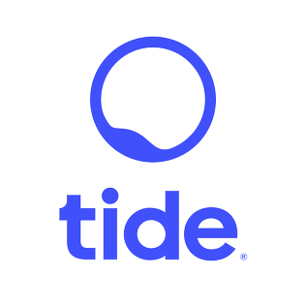

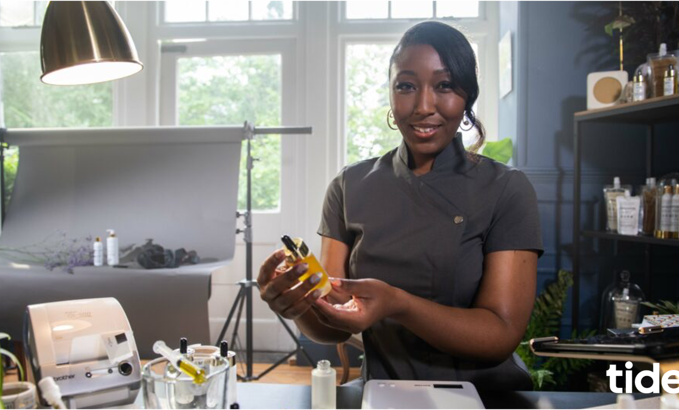
Tide: Changing the TIDE for the business banking sector
The Challenge:
Tide needed to drive awareness and increase app installs to grow its customer base
The Solution:
Remained on air throughout the pandemic to offer support to businesses that might be suffering through the tough times.
The Results:
Reached 92% of target SME business owners; 187% increase in brand awareness; 60% share of voice in business banking sector; 259% increase in customers by end of year three.
Notes:
The Challenge
Founded in 2017, Tide is a business banking app that was designed to disrupt the banking sector, offer business owners a genuine alternative to the ‘big 5’ banks and make business banking more accessible. It had relied largely on digital routes to help grow brand awareness and acquire customers through socials, search, regional out of home and radio advertising to establish themselves as an SME player. Results however had reached a plateau.
One of the biggest problems was a cluttered marketplace. With a slew of new brands vying for customers, it was getting harder for Tide to stand out from the crowd and take on established nationwide brands. Shifting the attitudes of SME business owners would be no easy feat, either. Research showed that SMEs where risk adverse, with 52% believing that traditional banks were more reliable than digital only options; in fact research, showed that you’re more likely to get a divorce than switch banks.
Tide set themselves and media agency, Guerillascope, the objectives of growing brand awareness and market share, and increasing app installs. The mission was clear: disrupt the market by making SMEs aware that it offered them a genuine, accessible alternative.
The TV Solution
It was obvious to Guerillascope that there was one channel that would deliver both increases brand awareness and app installs for Tide. That was TV. It was the perfect choice to allow Tide to consistently showcase its unique selling points: 24-hour support; quick and simple registration; easy account access; no monthly fees; and expenses/accountancy integration.
The Plan
Tide’s TV activity kicked off in 2019, with a creative that would play up the unique selling points for the brand. By using a series of tools like Adintel, TechEdge and Touchpoints, Guerillascope were able to pinpoint the TV channels, programming and day-parts that profiled best for small to medium business owners.
This process revealed that Film4 on weekends wasn’t delivering the required response, so it was removed from the channel mix. Meanwhile, a focus was placed on Sky News post-23:00 to capitalise on the night owl tendencies of entrepreneurs, as well as contextual placements around programming like the Martin Lewis Money show. These refinements to the plan saw this first campaign reach 63% of business owners, overall Tide achieved a 62% uplift in app installs during the time of the campaign.
The second year of Tide’s activity coincided with the height of the pandemic. While many businesses pulled their campaigns off air or reduced their marketing activity, Tide lent in. They wanted to maintain a reassuring presence and champion small business owners that were dealing with the knock-on effects of a pandemic. This saw spends increase, making the brand one of the top 75 spenders in the TV market and one of the biggest banking brands on TV (even outspending the likes of HSBC and Santander). With the help of higher viewing and lower pricing, Tide was able to accrue a 60% share of voice in the business banking sector.
Guerillascope optimised the campaign by finding contextually relevant content on the widest reaching channels. This saw spots aired in the Six Nations, Celebrity Bake Off, SAS: Who Dares Wins and the Martin Lewis Money Show. These placements allowed the second-year campaign to reach 82% of the business-owning target audience.
To maximise the effectiveness of phase two, the creative shifted from its previous focus on functionality to a more emotive tone; this switch was backed up by industry research, which highlighted the need for finance brands to to bring emotion into their communications - especially during tougher economic and societal times. The change in approach drove a 37% year-on-year increase in new customers, and a 45% year on year increase in prompted brand awareness.
Moving into 2021’s third instalment of the campaign, economic conditions meant that the budget had decreased. By using analysis tools, programme viewing data and Tide’s target spend, Guerillascope developed an approach that would make the brand’s investment stretch as far as possible.
The solution was a pulsed strategy that would alternate between awareness and response weeks. The former was focus on reach in order to grow share of voice, while the latter centred on frequency to drive engagement. This approach would see spikes in awareness coming from high-reaching channels and spots in popular programming - such as the Great British Bake Off and live sports on Sky Sports - while a 10” DR creative would be deployed during daytime to boost impacts.
It was a success. The campaign generated the 2nd highest volume of visits for 6 months despite being run with the lowest spend in 6 months. This translated into the best Cost Per Visit measured over the same period. Ultimately, Tide saw a 22% increase in customer growth, driven in part by a 7.35% increase in prompted brand awareness.
Tide’s television activity was a core part of a wider marketing plan. It constituted the top of the funnel that would prime consumers to remember the brand; OOH placements worked as a secondary local touchpoint to drive frequency, while paid digital was deployed as a final conversion tool. The TV creative pulled through into other media, with cutdowns and stills being used for digital and OOH campaigns to ensure synergy across the media mix.
Results
The campaign was a roaring success across the three years for Tide. In year one, Tide’s campaign reached 63% of the core audience and achieved a 36% Share of Voice in the business banking sector. In terms of business results within 3 years Tide saw a 72% uplift in web traffic and a 62% increase in app downloads.
By the end of the campaign, the brand had reached 92% of the target audience through TV with a frequency of 50; this in turn contributed to a 187% increase in prompted brand awareness.
TV helped Tide grow their share of market from 0.5% to 8% with a massive 60% share of voice in the business banking sector. Attribution following the campaign showed that TV had generated 1.2 million web visits, which accounted for 19% of total site visits. By the end of the three year period, Tide had seen a 259% increase in customers.

Slide 23


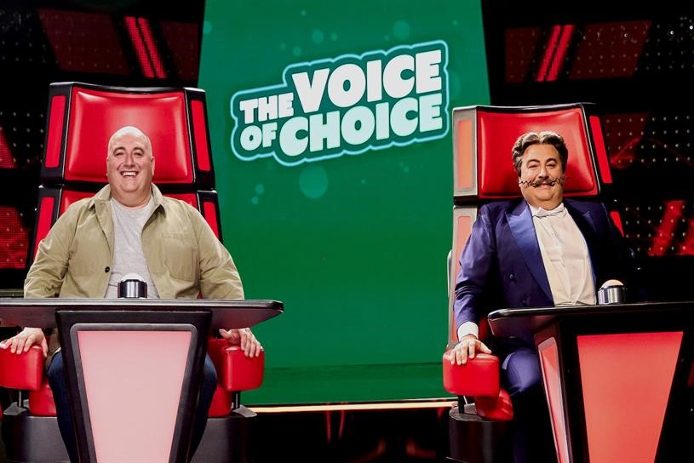
Go Compare: The Voice of Choice
The Challenge:
GoCompare were rebranding to Go.Compare and needed to communicate this subtle but important difference to a wide audience
The Solution:
They sponsored The Voice on ITV
The Voice of Choice was created – a parody of the show that told the story of finding Dot through sequential and entertaining idents
The Results:
12% increase in consideration for Go.Compare
Reached 16m people, driving awareness
Notes:
The Challenge
Go Compare, the price comparison website, first launched in 2006 and has gone from strength to strength. Much of their success is down to their impactful and engaging TV advertising featuring the moustachioed opera singer Gio Compario and his real-life counterpart Wynne Evans.
In 2022, they were re-branding to become Go.Compare – a subtle but important difference that needed to be communicated widely in an entertaining and memorable way.
The TV Solution
Historical research had shown that activity featuring Wynne Evans (the real man behind Gio), alongside his Italian alter ego, yielded positive upticks in brand perceptions, so what if the rebrand was communicated through the addition of a third character - the new Dot?! With such a distinctive jingle, the solution needed to involve music, so they partnered with ITV’s The Voice, which millions of viewers watch weekly, to bring this story to life.
Broadcast sponsorship alongside IP licensing, all brokered by Hearts & Science and DRUM, meant that they could establish their own search for talent to find the voice of Dot -The Voice of Choice. This was a parody of the show to find a talented rough diamond who is as passionate about singing and insurance as they are; famous red chairs included.
The Plan
Eighteen 10” & 15” films documenting the search for Dot were broadcast alongside the TV show. The idents were shot on a modified The Voice set, tailored to mimic the show’s schedule across its ten-week run; from auditions to coach mentoring and the final itself. Singing dogs, magicians and everything in-between helped develop the story arc at each stage and keep an avid audience entertained without fatigue.
The final episode of the show saw the three tenors sing the new jingle together. The idents showcased the brand ambassador, providing good awareness whilst also aligning with the style and tone of the show to bring added value to the viewer.
The story-based approach of the sponsorship was mirrored across Go.Compare’s own brand channels and ITV’s social channels with bespoke content on TikTok, Twitter and Facebook, and an extension into VOD.
To support the partnership and engage the audience even further, a three-minute branded mockumentary, “The Wyn-ner’s Story” told the full story of The Voice of Choice vocal competition and provided behind-the-scenes clips and character back story profiles.
Results
Reached 16m people driving awareness of the name change
Strong recall of The Voice idents among wider audience, increasing by 43% for those who claim to watch The Voice
35% claimed to be aware of the sponsorship, which sits significantly above sponsorship norms and increased a further 32% among viewers
+12% in consideration for Go.Compare with +8% claiming Go.Compare to be one of the first brands they would consider

