Slide 1
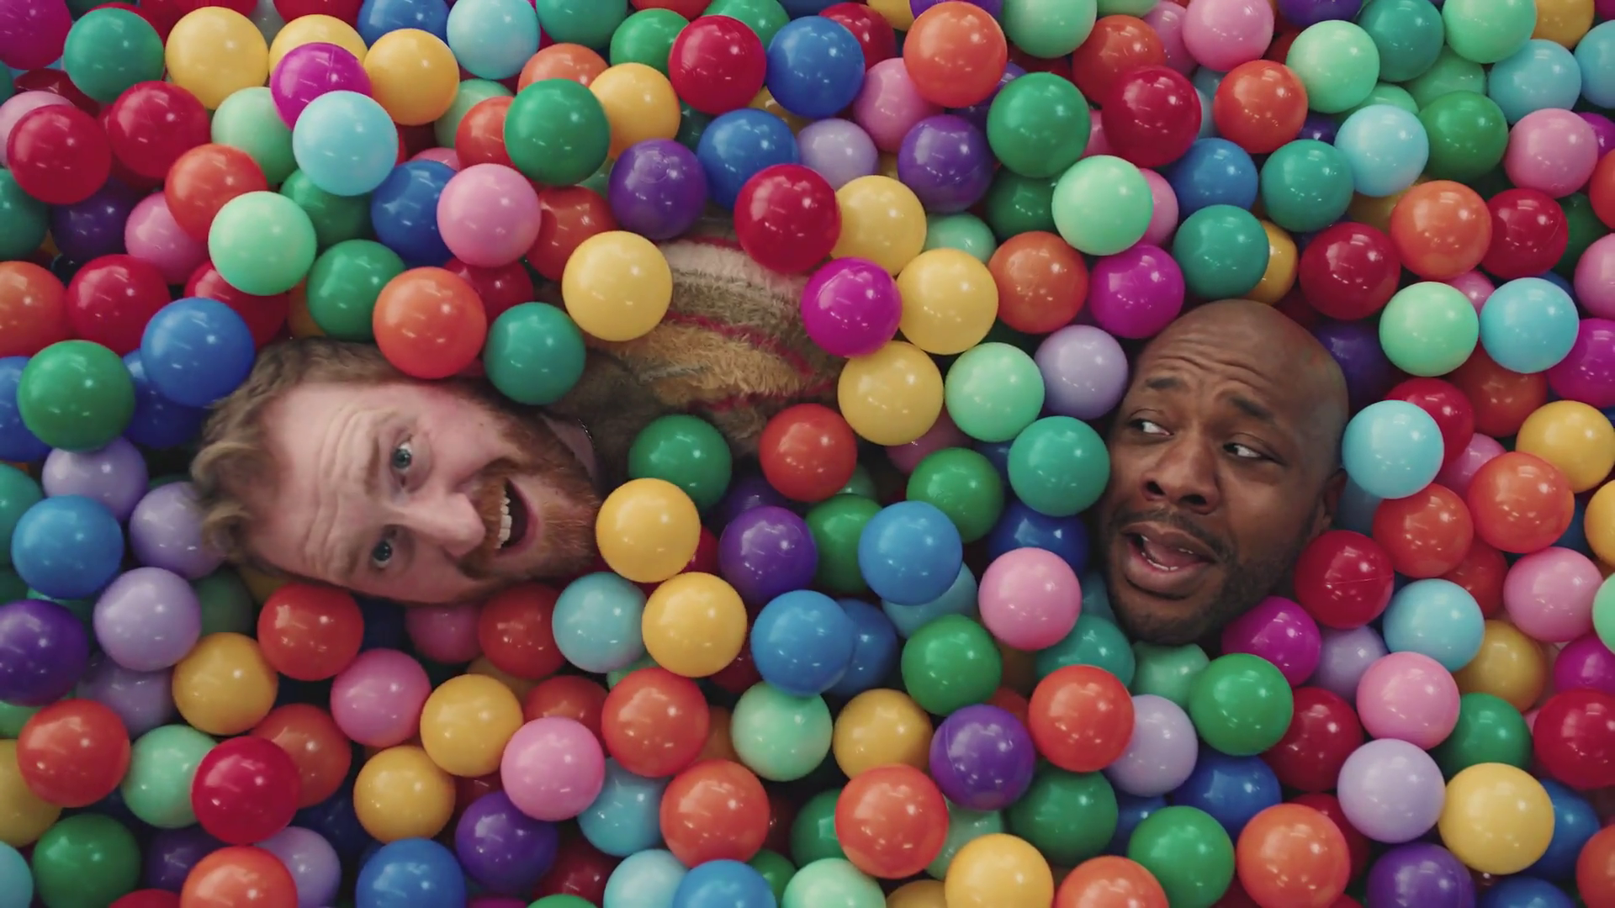

Retail Deep Dive
Currys – Ball Pit

Slide 2
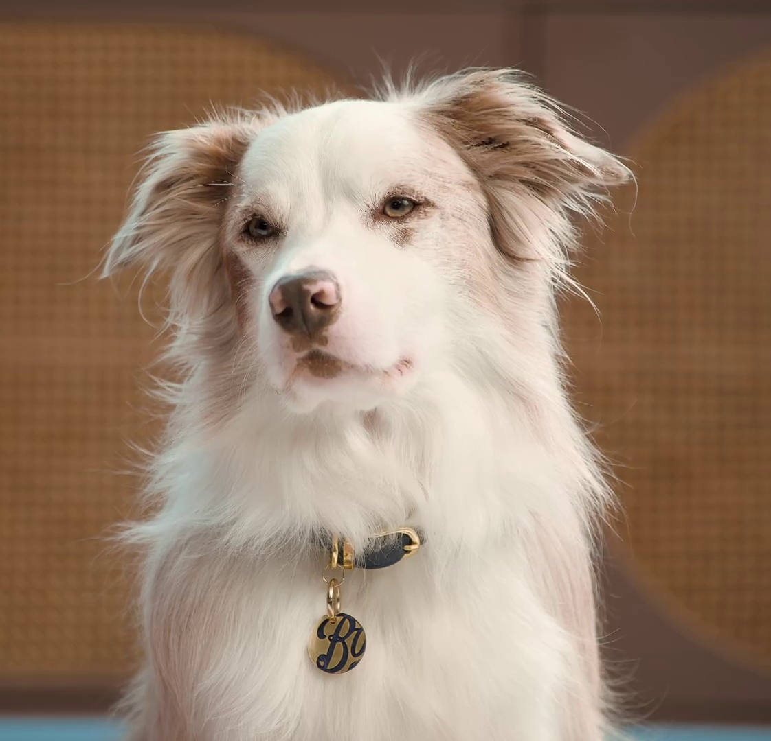
In this deck…
To provide an analysis of the Retail category this deck explores the following areas:
Macro Spend Patterns:
Spending behaviour and patterns
Effectiveness:
TV is crucial to the plan
Media Planning:
Weekday, and daypart analysis
Ad time-lengths
Case Studies:
JD Williams, Boots, Back Market, and Love Island
Boots – Hearing Care: Dog
Notes:
To provide an analysis of the Retail category this deck explores the following areas:
Macro Spend Patterns:
Spending behaviour and patterns
Effectiveness:
TV is crucial to the plan
Media Planning:
Weekday, and daypart analysis
Ad time-lengths
Case Studies
Nationwide, Tide, and Go.Compare

Slide 3
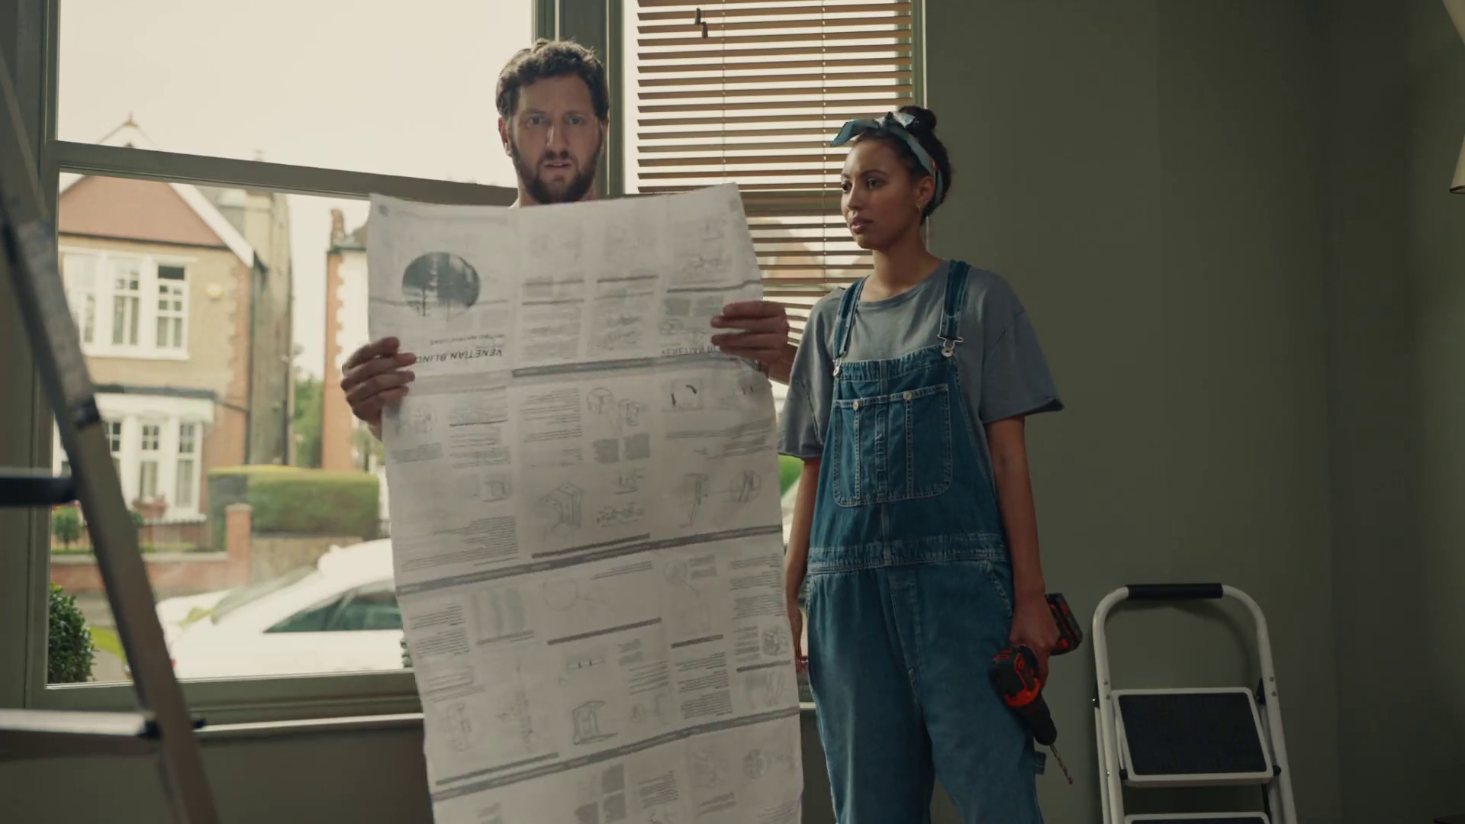
Macro spend patterns
Hillary’s Blinds – For the Window Wise

Slide 4
Retail investment increased year-on-year
+110m
+40%
+54m
+17%
-7%
-£25m
-10%
-£34m
-17%
-£56m
Source: Nielsen Ad Intel, 2019-2024, Retail & Online Retail, Linear TV Spend, %’s show YoY change.
Notes:
Retail investment has increased by £54m year-on-year.

Slide 5
Household retailers increased investment year-on-year
+110m
+40%
+54m
+17%
-7%
-£25m
-10%
-£34m
-17%
-£56m
Source: Nielsen Ad Intel, 2019-2024, Retail & Online Retail, Linear TV Spend, %’s show YoY change.
Notes:
Household and General Retail are the largest spenders on linear TV.

Slide 6
Retail share of impacts highest in over a decade
Source: Barb, 2014-2024, individuals, linear impacts (R/W), Retail & Online Retail share of voice vs all other categories.
Notes:
Retail share of impacts reached 8% in 2024 the highest level in over a decade.

Slide 7
Retail advertisers* SoV has fluctuated across the last decade
Source: Barb, 2014-2024, individuals, linear impacts (R/W), top 10 Retail & Online Retail advertisers by total linear impacts from 2010-2024. *All Grocery Retailers removed.
Notes:
Retail advertisers* share of linear impacts has fluctuated across the last decade with Amazon taking the lion’s share in 2024.

Slide 8
Discount supermarkets significantly increased linear share
Source: Barb, 2010-2024, individuals, linear impacts (R/W), Grocery Retailers by total linear impacts from 2010-2024.
Notes:
Discount supermarkets have significantly increased their share of linear impacts since 2010.

Slide 9










Tesco and Co-op lead linear TV share of voice
Linear share 2024
Linear average share 2010-2023
Source: Barb, 2010-2024, individuals, linear impacts (R/W), Grocery Retailers by total linear impacts from 2010-2024. Worldpanel by Numerator.
Notes:
Tesco and Co-op lead linear TV share of voice in 2024 with the discount supermarkets close behind.

Slide 10





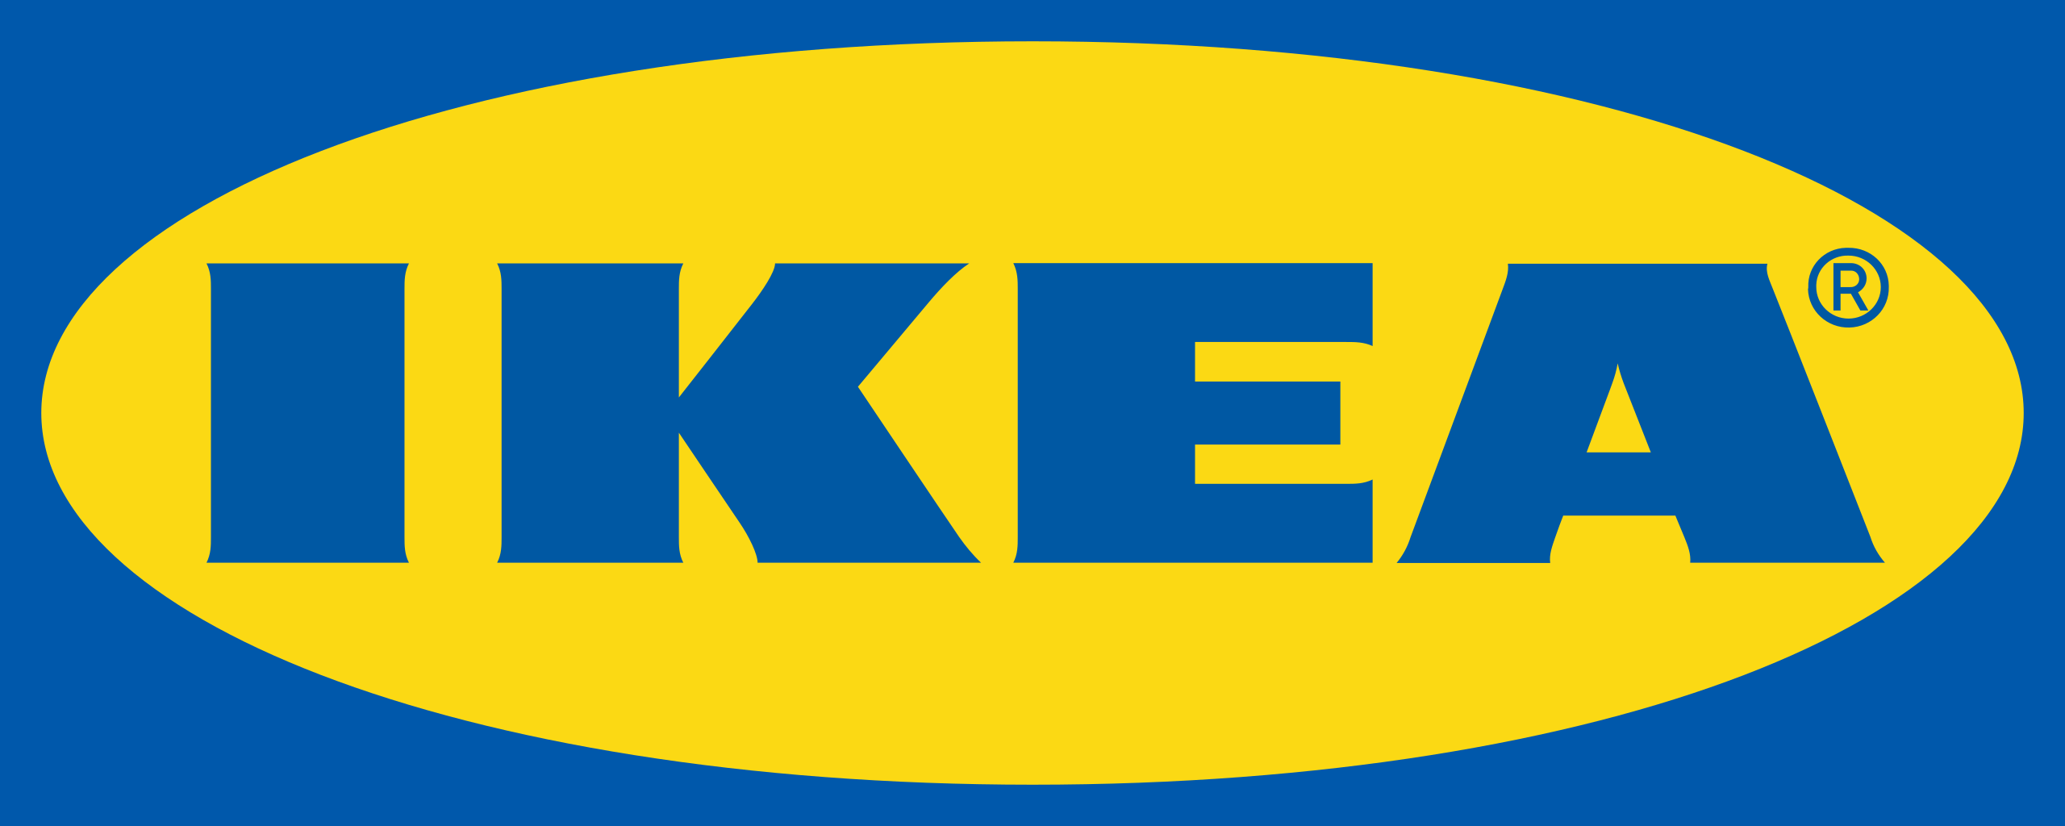



Amazon is the largest Retail investor in linear TV
Source: Barb, 2024, individuals, linear impacts (R/W) (million). Top 10 2024 Retail & Online Retail advertisers by total linear TV impacts.
Notes:
Amazon is the largest Retail investor in linear TV increasing activity significantly in Q4.

Slide 11
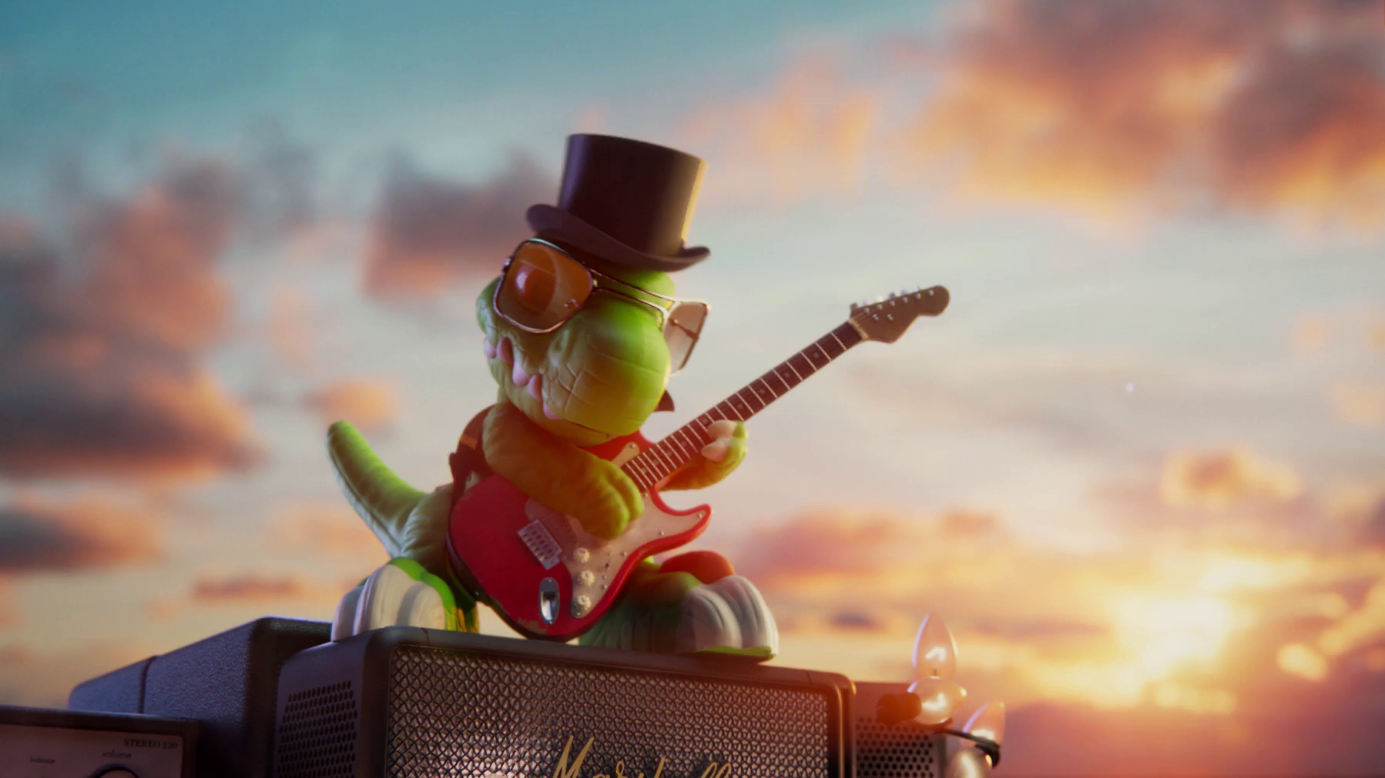
Effectiveness
Argos – 20th Century Toy

Slide 12

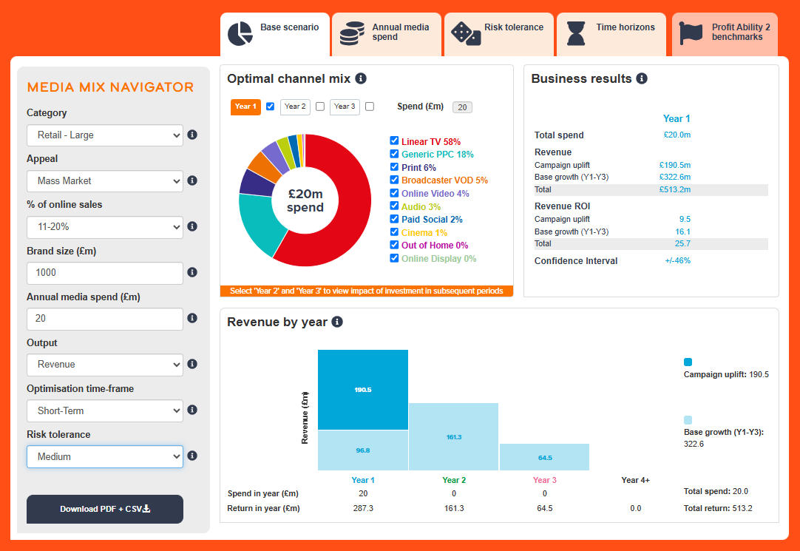
Profit Ability 2 and Media Mix Navigator
Profit Ability 2 was conducted by Ebiquity, EssenceMediacom, Gain Theory, Mindshare, and Wavemaker UK.
It’s a meta-analysis of econometric studies from 141 brands covering £1.8 billion of media spend across 10 media channels and 14 business sectors.
The Media Mix Navigator (MMN) tool, powered by the data from Profit Ability 2, allows you to explore different scenarios to define the optimum media mix for your business, whether your objective is to drive increased profit or revenue.

Slide 13
Optimised MMN scenario for Retail recommends higher share of Linear TV & BVOD vs. actual databank share
Actual vs. Media Mix Navigator Optimised channel mix
Source: Media Mix Navigator, Retail: Large, Optimised based on £30bn brand size, mass market, 91-100% online sales, short-term, high risk, and media budget of £50m.
Notes:
Channel investment strategy depends on not only a brand’s objective but also the category it is in, as well as budget, brand size and risk appetite. There is no better tool than the Media Mix Navigator (MMN) to provide a benchmark view that takes into account these crucial factors. The MMN recommends a higher share of Linear TV & BVOD when compared against the actual databanks share.
The Media Mix Navigator is available here:
https://www.thinkbox.tv/training-and-tools/media-mix-navigator/media-mix-navigator

Slide 14
Large Retail: all channels are profitable in the short-term… but get even stronger with the full effect
Short-term effects
Bubble size represents % of short-term profit volume
Retail (Large) Short-Term ROI: £3.15
Full effects
Bubble size represents % of full profit volume
Retail (Large) Full Profit ROI: £6.93
Source: Profit Ability 2, April 2024 – Short term benchmarks: Ebiquity, EssenceMediacom, Gain Theory, Mindshare, Wavemaker UK.
Long Term Multipliers: EssenceMediacom, Gain Theory, Mindshare, Wavemaker UK
N.B. low sample size for cinema
Notes:
Retailers are split into two in the PA2 database - large and small using a round number of £1bn of revenue. Why? Advertising does reward scale - true in all sectors, but particularly in retail.
Examples of large retailers - large home improvement brands, multi-category retailers, supermarkets, etc.
SHORT TERM
£3.15 ROI – really strong results.
Audio (lime green) does very well - it's quite scalable, delivering about 10% of profits - it's a great promotional activation channel. “Sale now on!” - works well to amplify discounts & promotions
The other interesting story is print – a media line where budgets have declined over the last few years, following readership and circulations falling. However, where print is still being used, it’s still working and brands that can't make it work no longer use it.
It gives you one of these paradoxical things where, yes, less people are reading print newspapers and circulation is declining, but where it's in use, it delivers a decent ROI.
Looking at (red) Linear TV bubble, can see it leads the pack in terms of profit contribution (33%).
ROIs are all around the average.
When you combine linear TV, BVOD and online video, AV as a whole is about 43% of the profit contribution in the large retail sector.
Returns are so strong in the short term that you don't really need to look at the long-term story to make the case for advertising.
You should be able to go to your stakeholders and just say, look, it's an absolute no-brainer…
FULL TERM
…but in terms of optimizing the media mix you probably want to have a view of long-term or sustained returns.
Having compiled data for long-term multipliers by sector and by channel, these have been applied – so what do you we see changing?
Total ROI goes up to £6.93.
Linear TV pulls slightly ahead of print and radio if you're taking the long-term into account and is clearly the key full profit volume driver for the sector.

Slide 15
Small Retail: Generic PPC stands out as a strong channel
Short-term effects
Bubble size represents % of short-term profit volume
Retail (Small) Short-Term ROI: £1.66
Full effects
Bubble size represents % of full profit volume
Retail (Small) Full Profit ROI: £3.37
Source: Profit Ability 2, April 2024 – Short term benchmarks: Ebiquity, EssenceMediacom, Gain Theory, Mindshare, Wavemaker UK.
Long Term Multipliers: EssenceMediacom, Gain Theory, Mindshare, Wavemaker UK
N.B. Linear TV, OOH, Online Display, Online Video, Paid Social, Print and Audio have low samples
Notes:
In Small Retail, the short-term profit ROI is £1.66.
Types of retailers in this cut of the data are single-category retailers - furniture sales, bathroom specialists, opticians, etc. Obviously, as scale is that much lower, they struggle to get the same returns as the Large Retail brands.
What really jumps out as a story here is how well Generic PPC seems to do. A lot of these retailers have larger ticket items, considered purchase, where you might do research online and then purchase offline.
There may be a blind spot here where e-commerce managers who are really focused on online sales don't fully appreciate that Generic PPC is also helping drive in-store footfall, to get someone to come and make a booking with a consultant.
What's also interesting is that the blind spot runs in the opposite direction for this kind of retailer insofar as ATL media (including TV) have a very big role in driving people to the websites in the first instance and driving online sales.
If you have a look at the total effects, the Full ROI is £3.37 - can see here that TV pulls more or less level with Generic PPC in terms of ROI (but delivers a lot more volume).
Again, you need to have both views when you're optimising your media plan.

Slide 16
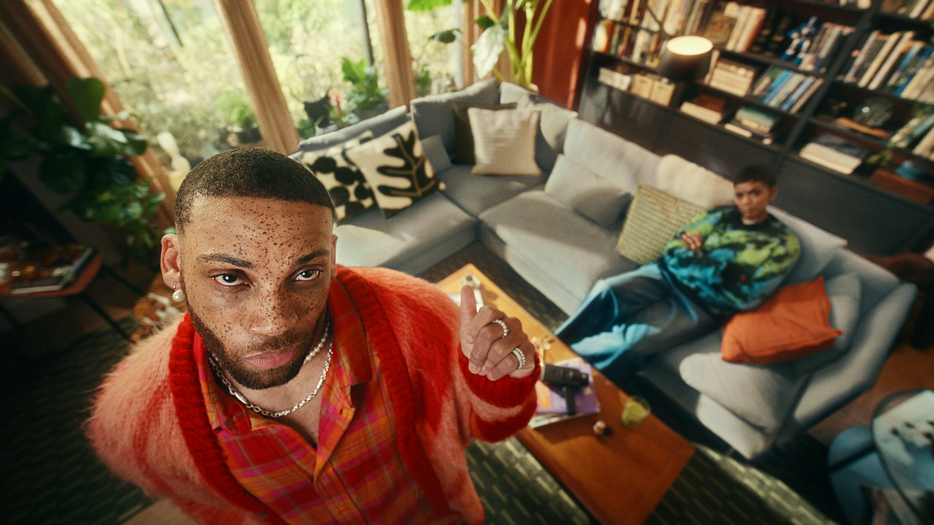
Media planning
Ikea – Show Your Savvy

Slide 17
Retail linear TV spend skews toward the end of the year
Index of Retail commercial linear TV impacts vs all categories
Retail commercial linear TV index by month
Jan | Feb | Mar | Apr | May | Jun | Jul | Aug | Sep | Oct | Nov | Dec
83 | 79 | 96 | 106 | 88 | 98 | 92 | 65 | 89 | 131 | 138 | 127
Top 10 retail advertisers commercial linear TV index by month
 | Jan | Feb | Mar | Apr | May | Jun | Jul | Aug | Sep | Oct | Nov | Dec
Amazon | 16 | 16 | 95 | 53 | 61 | 120 | 164 | 0 | 143 | 134 | 196 | 194
Currys | 58 | 15 | 148 | 16 | 47 | 74 | 56 | 130 | 29 | 105 | 245 | 251
Boots | 72 | 62 | 69 | 39 | 49 | 135 | 135 | 42 | 80 | 144 | 177 | 186
Etsy | 56 | 113 | 121 | 115 | 46 | 96 | 117 | 103 | 51 | 142 | 138 | 101
Hillary's Blinds | 84 | 74 | 208 | 76 | 56 | 79 | 102 | 98 | 102 | 218 | 99 | 6
IKEA | 0 | 0 | 116 | 132 | 90 | 103 | 214 | 117 | 90 | 121 | 168 | 70
eBay | 0 | 140 | 68 | 54 | 189 | 101 | 0 | 0 | 9 | 302 | 201 | 125
Vintage Cash Cow | 54 | 58 | 55 | 60 | 85 | 134 | 141 | 168 | 148 | 207 | 76 | 44
Tesco | 117 | 67 | 0 | 254 | 0 | 0 | 366 | 0 | 88 | 278 | 43 | 0
Wowcher | 99 | 106 | 96 | 107 | 109 | 106 | 101 | 103 | 96 | 90 | 99 | 91
Source: Barb, 2024, monthly index vs full-year 2024, individuals, retail & online retail, top 10 advertisers by total linear impacts.
Notes:
Retail linear TV spend skews toward the end of the year.

Slide 18
Retail linear TV spend skews toward early morning
Index of Retail commercial linear TV impacts vs all categories
Retail commercial linear TV index by daypart
 | 6am | 7am | 8am | 9am | 10am | 11am | 12pm | 1pm | 2pm | 3pm | 4pm | 5pm | 6pm | 7pm | 8pm | 9pm | 10pm | 11pm | 12am | 1am | 2am | 3am | 4am | 5am
Monday | 104 | 124 | 122 | 96 | 102 | 98 | 100 | 101 | 96 | 97 | 101 | 99 | 98 | 103 | 101 | 104 | 96 | 93 | 88 | 87 | 85 | 84 | 98 | 111
Tuesday | 127 | 131 | 118 | 102 | 102 | 101 | 103 | 101 | 93 | 96 | 105 | 98 | 99 | 102 | 105 | 97 | 94 | 90 | 96 | 91 | 86 | 92 | 98 | 98
Wednesday | 133 | 124 | 105 | 102 | 99 | 102 | 99 | 94 | 91 | 92 | 102 | 99 | 98 | 106 | 105 | 101 | 98 | 90 | 94 | 91 | 92 | 95 | 95 | 116
Thursday | 129 | 120 | 107 | 103 | 103 | 99 | 101 | 97 | 89 | 94 | 104 | 104 | 101 | 104 | 105 | 97 | 95 | 90 | 91 | 88 | 89 | 93 | 109 | 111
Friday | 119 | 125 | 120 | 98 | 97 | 98 | 99 | 95 | 87 | 95 | 102 | 101 | 103 | 105 | 105 | 98 | 94 | 95 | 95 | 91 | 90 | 93 | 108 | 114
Saturday | 133 | 96 | 98 | 93 | 99 | 94 | 94 | 91 | 93 | 93 | 99 | 101 | 106 | 103 | 114 | 98 | 100 | 98 | 101 | 99 | 96 | 103 | 117 | 121
Sunday | 119 | 103 | 95 | 97 | 98 | 93 | 94 | 98 | 96 | 91 | 94 | 97 | 110 | 102 | 105 | 107 | 103 | 100 | 98 | 98 | 95 | 102 | 109 | 122
Monday | Tuesday | Wednesday | Thursday | Friday | Saturday | Sunday
98 | 96 | 101 | 103 | 104 | 97 | 101
Source: Barb, 2024, individuals, commercial linear, Retail & Online Retail index vs all categories.
Notes:
Retail linear TV spend skews toward Thursday & Friday early morning viewing.

Slide 19
Use of 30” is high amongst Retail advertisers
Source: Barb, 2024, Individuals, Retail & Online Retail
Notes:
The Retail category are the second most prevalent users of 10” spots behind the Entertainment & Leisure sector. However, the 30” spot is the most popular time-length.

Slide 20
30” ads remain the most popular choice for Retail brands
Source: Barb, 2003-2024, individuals, Retail & Online Retail categories.
Notes:
Retail ads now typically last 30 seconds or less.

Slide 21
Retail advertisers opt for shorter ads
Source: Barb, 2024, individuals, linear only, Retail category, top 15 advertisers by total linear impacts.
Notes:
Use of spot length varies across the Retail category with 30” being the most popular choice.

Slide 22
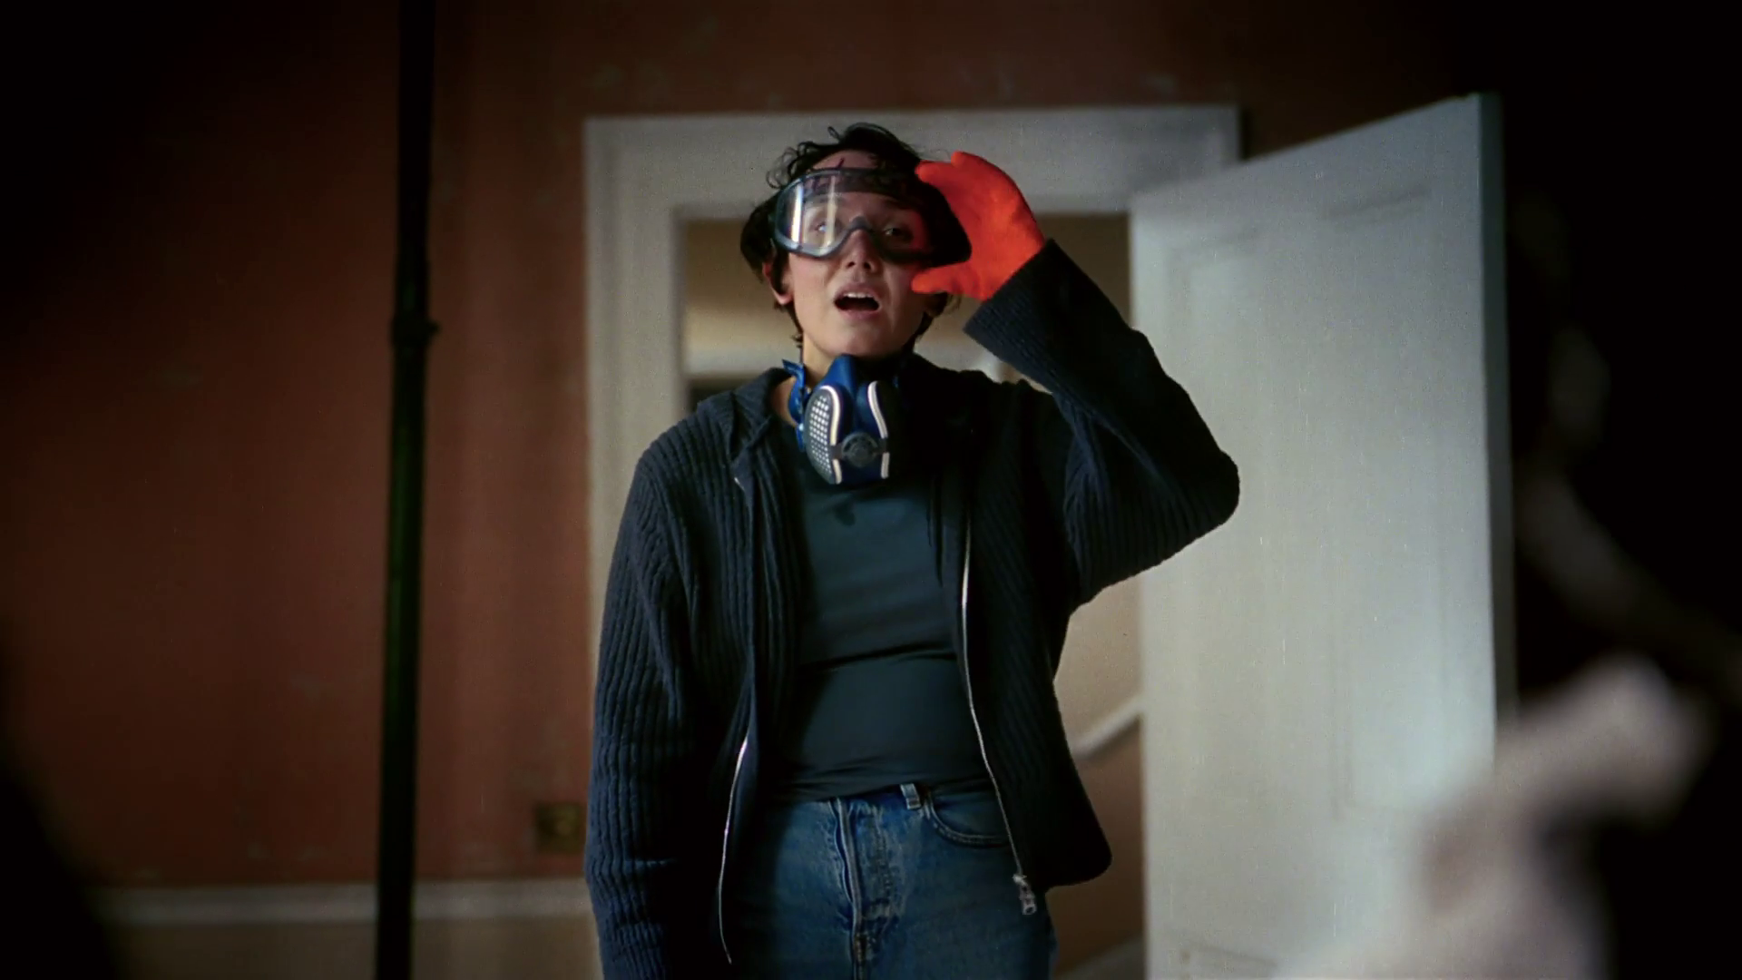
Case Studies
Barclays – Dream Home

Slide 23


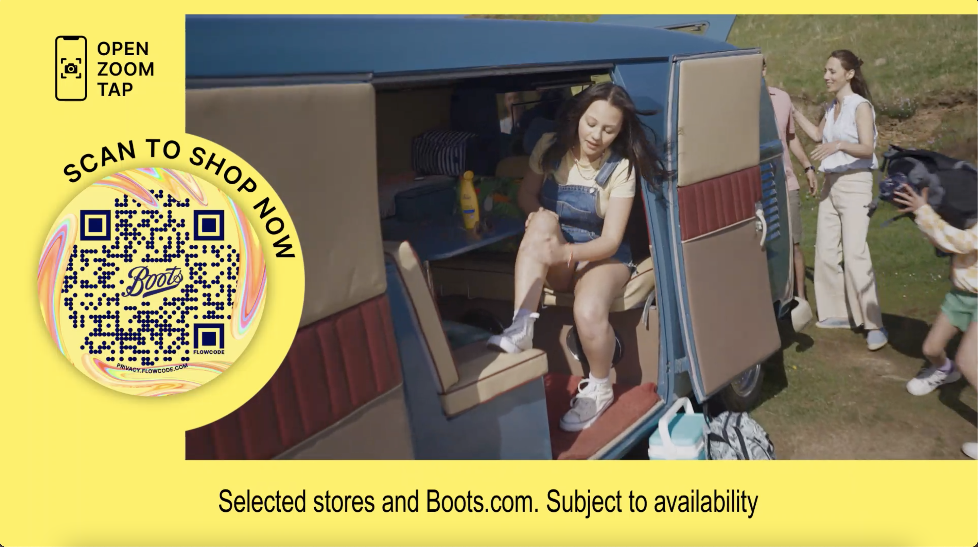
Boots: Leveraging data to fight against growing competition
The Challenge:
The brand was still well known with high scores in awareness, trust and perception but was fighting against growing competition and decline in footfall.
The Solution:
Leverage their first party data from over 15 million Advantage Card holders to offer personalisation on mass.
The Results:
Highest ever Share of Voice score, increased share of market for 7 consecutive quarters, maintained a stable ROI against increased spend for 3 consecutive years, AV accounted for 30% of in store sales growth and increased estimated bag value of 25-44 audience off the back of Love Island activity.
Notes:
The Challenge
Boots has been a high street staple for over 170 years with generation after generation using the store to pick-up last-minute holiday essentials or make use of the chemist in stores. 2019/20 had been a difficult period for Boots. Competition had increased with Supermarkets offering a wider beauty selection, online players like Cult Beauty entering the market and online retail juggernauts move into the beauty space. While Boots was still well-known and loved with brand metrics showing that awareness levels, trust and perception all in a healthy position, but the brand wasn’t giving customers a reason to return to stores either in person or online.
The objectives of the campaign were clear as a result, they needed to reverse the decline in penetration and increase market share.
The TV Solution
Boots had been long standing supporters of TV but in recent years with media budgets declining, TV had started to be used as more of a short-term response channel as a way of supporting offers or hitting short term business objectives. There were only 2 brand building campaigns a year, summer and Christmas, the remainder of the activity was focused on short bursts with short time lengths that would promote time-limited offers.
This activity wasn’t growing the brand and wasn’t leaning into what Boots’ main strength is, their offering. With a range that helped you through all the times in your life both good and bad. This would highlight Boots as the go to in both the best and worst moments of our lives.
Boots also have a secret weapon, they have over 15 million Boots advantage card holders. First party data that could be leveraged across broadcast channels to improve the long-term effectiveness and switch the narrative of TV from short term to long term investment that would deliver business results.
The Plan
The use of data in Boots TV activity kicked off at Christmas 2020. To understand the way in which current Boots customers consume TV, media agency, EssenceMediacom overlayed Advantage Card data with Barb data with agency tool, Minsights. This allowed EssenceMediacom to create 4 audience segments around shopping habits at Christmas. The four groups were called Core Carol, Online Engagement Sophie, Causal Sarah Jane and Deal Engaged Michele. The decision was made to focus on Core Carol for the brand linear TV Christmas activity as this group represented the biggest revenue opportunity and their media habits fitted with channel consumption around Christmas. This focused attention to a channel mix that best represented the Core Carol group’s media habits. This leveraging of Advantage Card data allowed Boots to increase the efficiency of their targeting by 13% and ensured that 83% of the Core Carol audience was exposed to the Christmas campaign. The remaining three audience groups were recreated using YouGov data, this allowed EssenceMediacom to target them across BVOD environments with a 48% increase in efficiency vs a broader audience buy. This showed Boots that they could offer mass personalisation to their key audiences at a macro level with broader audience receiving the most relevant messaging for their shopping and media habits.
This activity in 2020, showed that Boots could leverage data and create personal relevance to their customers. But this approach would only allow Boots to offer hyper targeting which would drive demand, but they need a broad audience approach that would deliver scale to drive the demand. To create this demand, Boots became the first EssenceMediacom brand to leverage its data across all three sales houses simultaneously. This allowed Boots to create 4 audiences within data bunkers based on the best source of growth of the brand. These covered Pharmacy, Beauty, Brand and Lapsed customers. This data match gave them a pool of viewers known to Boots across Sky, ITV Hub and All4, allowing them to target them with more relevant copy based on their purchasing habits. These audiences were scaled up with lookalike modelling to increase the pool of consumers and drive-up sales in stores.
Mass personalisation of their campaigns had been a success for Boots but in 2021, they noticed they were losing ground to competitors for younger audiences with under 25s 2 times less likely to shop at Boots compared to over 55s. To combat this, Boots sort out the biggest property on TV. They aligned with Love Island, as beauty partner with passive and active product placement in show. EssenceMediacom then increased spends into Love Island across linear and BVOD to drive home the association for younger audiences buying 9 spots in 2021 and 58 in 2022.
Boots learnt their use of data and targeting of existing customers would only take them so far. They needed to find a way that fuse TVs ability to tap into the nation’s mood with their wealth of first party data. This would allow EssenceMediacom to align the brand further with themes and moments that matched with Boots’ motto ‘With you for Life’. To do this, EssenceMediacom used HPTOs and 24-hour surges on BVOD to own moments and became a collection lounge partner with All4 during Christmas 2021. To take this further in 2022, Boots became one of the first brands to use ITV new Automated Contextual Targeting (ACT), which uses an AI to scan through every show on ITVX allowing targeting of certain moods, moments, or objects. Boots leveraged this to target moments of joy across ITV to align with their Christmas message of ‘Joy for All’, this created the association of finding the joy in finding the right gift for the right person all around the right contextual moments to create a contextual link between Boots and the viewer.
Results
The step change in TV activity had a profound effect on Boots business. Firstly, they were able to wrestle back share of voice from new players in the category, taking them to their highest ever score and moving them up to 3rd in the category. The campaign reversed the four years decline that Boots had experienced and increased their share of market for 7 consecutive quarters.
Econometrics run during the campaign proved that the ROI for the activity had increased for three years in a row. Against three back-to-back years of increasing spend Boots were able to maintain a stable ROI for 2022 despite being much higher up the return curve. In terms of in store sales overall media double its contribution over the 2020-2022 period with AV accounting for 30% of this in store sales growth.
The commitment to using first party data was also showed huge success. Brand tracking through first party data campaigns showed an increase in spontaneous ad recall for the in-market audiences with an increase in purchase consideration for 45–54-year-olds. The focus on Love Island also proved to be extremely successful, there was an increase in the estimated bag value with the highest value coming from 25-44 adults, the core viewers of Love Island across Linear and BVOD.

Slide 24



JD Williams – Made for Midlife
The Challenge:
JD Williams wanted to support their new creative positioning, Made for Midlife and drive consideration amongst 45-65 women in their key trading period of September
The Solution:
They sponsored ITV1’s new dating show ‘My Mum Your Dad’ which ran in peak time in September 2023
Ten episodes over a two week period
The Results:
Brand consideration grew by 10%
Significant increase in search
Notes:
The Challenge
JD Williams is a lifestyle brand with a long heritage of more than 150 years. But despite good prompted awareness and an established presence in British households, the brand was increasingly being overlooked by newer brands with deeper pockets in the world of fashion retail.
The key trading period is around September, when a change in the fashion season coincides with the early ramp up for Christmas. JD Williams needed to find a way to keep their brand top of mind, drive consideration and ensure stand out amongst their key target audience on women aged 45-65.
The TV Solution
Research conducted by the7stars found that this age group of women felt that the media didn’t reflect them accurately and that they were underrepresented in the clothing industry, leading them to feel undervalued and invisible within the world of fashion. The reality is that middle age is a vibrant, energetic and positive time of life and so JD Williams wanted to show the 8.5m middle age women in the UK that they understood this and celebrated them wholeheartedly.
JD Williams had a new creative positioning – ‘Made for Midlife’ with a comms strategy to make the invisible unmissable. They found the perfect property to tie in with this in the new ITV show ‘My Mum Your Dad’ – a dating show for older single parents.
Not only was this a great fit for the brand, but with the show going out in prime time on ITV1, they could expect large numbers of viewers, although as a brand new programme, it was an unknown entity.
The Plan
The series had ten episodes in late peak every weeknight for two weeks in September, providing JD Williams with a consistent presence at a key time and a high frequency of idents.
The idents, made in partnership with House 337, featured midlife women having candid conversations with Davina McCall about their dating experiences. They revealed the highs and lows of midlife dating with humour, warmth and positivity and were a good fit with the programme itself.
The sponsorship was extended into BVOD and by sponsoring the catch-up content on ITVX they were able to increase the reach and scale of the partnership. In addition, they extended the association into paid, owned and earned comms including a photoshoot with the show’s contestants, social support and a PR event to launch the partnership to journalists.
Results
Brand consideration grew by 10% - impressive for a slow-moving metric in a competitive category
Search increased significantly and there was a sharp spike in Google Trends data every weeknight when the programme was on air
Analysis showed that there was a positive and long-lasting effect on site traffic
The show was a great success and has been recommissioned for a second series
The campaign was shortlisted in Best Use of Sponsorship at the TV Planning Awards 2024

Slide 25


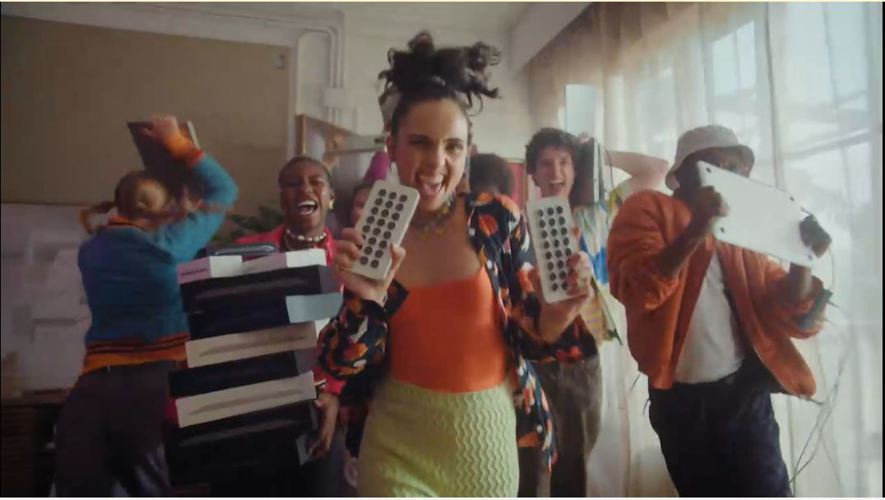
Back Market: TV’s trust building power
The Challenge:
6 million tonnes of e-waste (tech) finds its way into landfills each year. Back Market wanted to halt this and build trust and awareness in both the brand and refurbished tech.
The Solution:
Use TV to insert the brand into moments of family co-viewing to drive fame, awareness and trust in the brand among an audience of 12.3 million Chief Family Officers.
The Results:
Awareness lifts above target of 40%, 13% increase on target agreement with statement ‘Back Market is a brand I trust’ and increase site traffic of 46%.
Notes:
The Challenge
Every year in the UK, a huge 6 million tonnes of e-waste (tech) finds its way into landfill, with old phones, tablets and smart watches being binned off in favour of the shiny and new. Having launched in the UK in 2022, Back Market, were offering something new but also old to the market, refurbished tech. Back Market expertly refurbishes tech and offers it to the market at a more affordable price. Despite offering phones like new at a fraction of the cost and the obvious advantages of sustainability; there was an issue in the UK. Refurbished tech was unknown and untrusted; with 87% of the population saying they wouldn’t buy refurbished, 21% believing that refurbished meant stolen and 77% believing the product simply wouldn’t work. Refurbished tech had an image problem.
Back Market had been largely focused on digital marketing and was yet to really make an impact, stuck behind the likes of CEX and Music Magpie, brands that are both synonymous with refurbished tech in the UK. Back Market needed to drive awareness of their offering, build trust in the brand and drive web traffic.
The TV Solution
Armed with clear objectives of driving awareness, building trust and growing web traffic, Wavemaker UK got to work in understanding the problem at hand. Pre campaign research had indicated they needed to normalise refurbished tech by making it a purchase you can trust which would ultimately make Back Market the go to platform. With their current approach the campaign wouldn’t move the needle for Back Market, if they were going to hit their objectives, Wavemaker would need to get them acting like a category leader.
Leveraging Thinkbox research, it was clear to Wavemaker that only one channel would deliver the trust, fame and have an immediate impact on web traffic, TV. Wavemaker then used Cost of Living research to highlight that families were increasingly cash strapped but under pressure from Children for the latest tech and gadgets. This audience of 12.3 million were dubbed the Chief Family Officers- those in charge of the household buying and they could be captured in moments of co-viewing, putting Back Market right at the heart of the living room and the conversation.
The Plan
Using agency tools, Wavemaker allocated two thirds of the annual budget into TV. To maximise the impact of the campaign with the budget on hand, Wavemaker needed to normalise refurbished tech to as many people as possible as quickly as possible; all while balancing the line between effectiveness and efficiency. To achieve this, Back Market launched with a roadblock, cherry picking the biggest programming across linear to aid the goal of fast 1+ reach over the first three days of the campaign. This launch activity saw the campaign reach 28% of the population within the first 72 hours; making them the one of the top 3% most viewed advertisers across the 3-day period. The launch and wider campaign activity was selected to ensure that Back Market would have a foot hold in the market in the lead up to the key Black Friday and festive period. Launch activity was planned for October to negate the higher TV costs of September. This allowed the brand to remain on air for longer with higher weekly weights.
Leveraging Thinkbox research about the impact of longer ad lengths, the campaign kicked off with a 30” creative that was deployed to deliver impact and awareness from a standing start. After 2 weeks of sustained 30” messaging, reach curves started to plateau. This plateauing promoted a changed in second length to a 20” creative. This change ensured that the campaign delivered cost savings to the campaign with no impact on the brand messaging delivering maximum TVRs over a key period for the category.
Having launched the campaign with success, Wavemaker again turned to Thinkbox research that showed the environment for the brand was just as important as the channel it’s in. This promoted Wavemaker to focus on the biggest and best cultural moments over the period. This would see Back Market positioned alongside some of the UKs biggest known brands. This approach saw the campaign feature is some of the biggest shows across the campaign period like Bake Off, the Rugby World Cup and I’m a Celebrity. By using historical Barb data, Wavemaker were able to profile the core audience of Chief Family Officer. This created a hitlist of programming that would reach families in moments of shared viewing and help to shift perceptions of Back Market and refurbished tech with both the ‘wanters’ and the ‘buyers’. This approach meant Back Market featured in 8 out of the 10 top shows with the highest family co-viewing like The Voice, The Masker Singer and Great British Bake Off; all with a position in break to place them right next to the content to drive home the perception of quality.
Results
With the aim or rising brand awareness, Wavemaker’s meticulous approach to planning saw Back Market smash its targets and lift brand awareness over the campaign benchmark of 40%. Along side this, the campaign needed to foster trust in refurbished tech and Back Market being the place to get it. The campaign was again a raging success delivering 13% increase in target with audience’s agreeing that ‘Back market is a brand I trust’. Finally, Site traffic for the brand increased by 46% over the course of the TV campaign with it on average delivering 920,000 site visits a week.

Slide 26

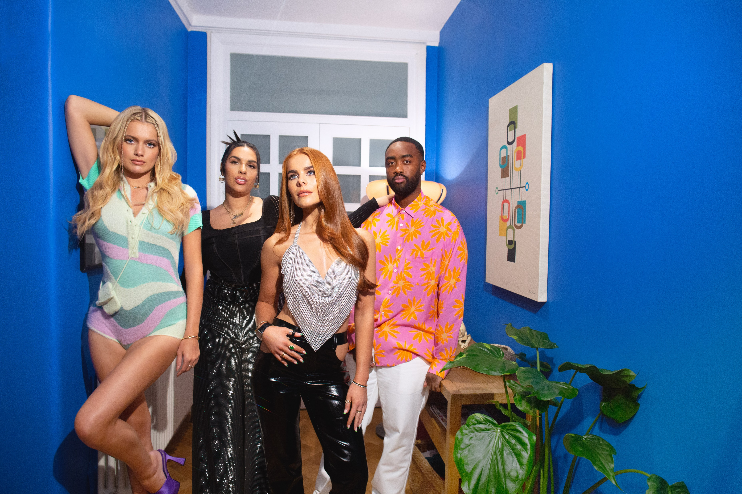
eBay: Making the pre-loved Loved with a TV Partnership
The Challenge:
eBay wanted to drive mass appeal for second-hand fashion with 16-34-year-olds against a backdrop where fast fashion was still king.
The Solution:
A partnership with Love Island that would reframe second-hand clothing as ‘pre-loved’.
The Results:
1,700 positive pieces of press coverage which resulted in over 14 billion impressions. A 935% increase in mentions of ‘pre-loved fashion’ recorded across all online platforms. 7,000% increase in ‘pre-loved fashion’ searches on eBay and 756% increase in searches on Google for ‘eBay pre-loved clothes’.
Notes:
The Challenge
eBay is the world’s original second-hand marketplace, launching in the UK in 1999, with the first item sold being a copy of ‘You & I’ by German rock band Scorpions for £2.89. Going into 2022 however they wanted to drive mass appeal for second-hand clothing because if the category grew, eBay would too.
Against a backdrop of a world where fast fashion was still king, but this activity was damaging the environment. Greenpeace research showed that 300,000 tonnes of clothing are burned in the UK every year. With eBay having a long history in the second-hand clothing there was still a perception problem with the category. It didn’t have anywhere the mass appeal of fast fashion. A study from Leeds University highlighted this with findings showing that 69% of shoppers had a negative view of second-hand clothing.
Put simply, second-hand clothing wasn’t seen as either stylish or cool. eBay needed to shift these perceptions and ignite a second-hand clothing revolution among Gen Z and Millennial audiences. They needed to show that second-hand clothing was on-trend and desirable.
The TV Solution
EssenceMediacom (EM), armed with clear objectives of shifting the perception of pre-loved clothing, got to work in finding the right way to engage with a younger audience and get them talking about second-hand fashion.
Despite the growth of digital channels, TV was seen as the best way to reach the younger audience on mass and make a cultural impact. And EM found the perfect property in ITV’s Love Island. Love Island is the biggest commercial show on TV for the 16-34 audience, reaching 1.4 million of them. Now in its 8th series, Love Island had had a fast fashion sponsor for 7 of the 8 series. Through product placement and advertising, fast fashion that featured on the show regularly sold out in under 10 minutes. Couple this with ex-Love Islanders becoming fast fashion brand advocates when leaving the show, eBay wanted to take the power of Love Island and rewrite the narrative.
The Plan
Having identified Love Island as the perfect property, EM and eBay got to work in bring ‘Pre-Love Island’ to life. The partnership was a deep collaboration between client, agency and broadcaster, creating a partnership that would see Love Island and eBay work as one.
For the first time ever, EM created a pre-loved product placement at the heart of the show. Having recognised the power of product placement to impact viewer behaviour; eBay provided islanders with a wardrobe of second-hand clothes, chosen by a celebrity stylist, with looks bang on trend. Islanders were encouraged to re-wear and shape items and talk about it. Show narrator Iain Sterling, made regular in show shout outs about the brand. To embed the partnership beyond the product partnership, eBay created a selection of TV and video ads that celebrated the amazing pre-loved looks. To make second-hand more loved, EM changed the wording to ‘pre-loved’, giving the category a Love Island twist.
With TV spots that were designed to amplify the connection between eBay’s preloved fashion and Love Island, EM needed to maximise reach to the 16-34 audience in moments of high talkability. Using traditional Barb data, analysed on a minute-by-minute basis to work out the episodes, breaks and positions within breaks to maximise 1+ reach and maximise engagement. Along with this, EM leverage social listening tools to identify episodes and breaks where chat was most potent. These insights lead to buying into the first three episodes with first in breaks, to ensure reach to the target audience at the start of the series. The bespoke assets reached 15% of 16–34-year-olds in three days through linear alone. They then planned a spot in the Monday of each week, as it was the best performing day of the 2021 series. EM then extended this to BVOD with 50% of Love Island viewing coming from BVOD in 2021. To make sure TV ads drove conversation, eBay layered in time targeted twitter content to naturally insert pre-loved fashion into the Love Island conversation.
EM harnessed the power of live TV by giving viewers the opportunity to buy the clothes just seen on screen. Around the shows most talked about moments, eBay created live auctions. This enabled fans to get the look with the chance to bid on over 40 of the season’s most-coveted outfits. With Love Island’s power to turn people into platforms, with millions of followers waiting for them on social media when they leave. So, on social media, eBay created content that showed contestants unboxing pre-loved clothing and talking about their favourite looks. And finally, eBay, wanted to follow suit to the fast fashion sponsors of the past by signing up contestant, Tash, as a pre-loved ambassador.
Results
The campaign was a roaring success for eBay. There were over 1,700 pieces of positive press coverage from the first season’s partnership alone. This activity generated over 14 billion impressions across all the content. The campaign also got people talking about ‘pre-loved’ fashion. There was a 935% increase in mentions of ‘pre-loved fashion’ recorded across all online platforms’ vs the same period the pervious year.
With a goal of changing behaviour, the campaign was a huge success. eBay saw more people than ever before looking for ‘pre-loved’ clothing, with searches up 7,000% across the site. Across Google, there was a 756% increase in searches for ‘eBay pre-loved clothes’ and a 600% increase month on month. eBay is now the number one for pre-loved fashion in the UK.

