Slide 1
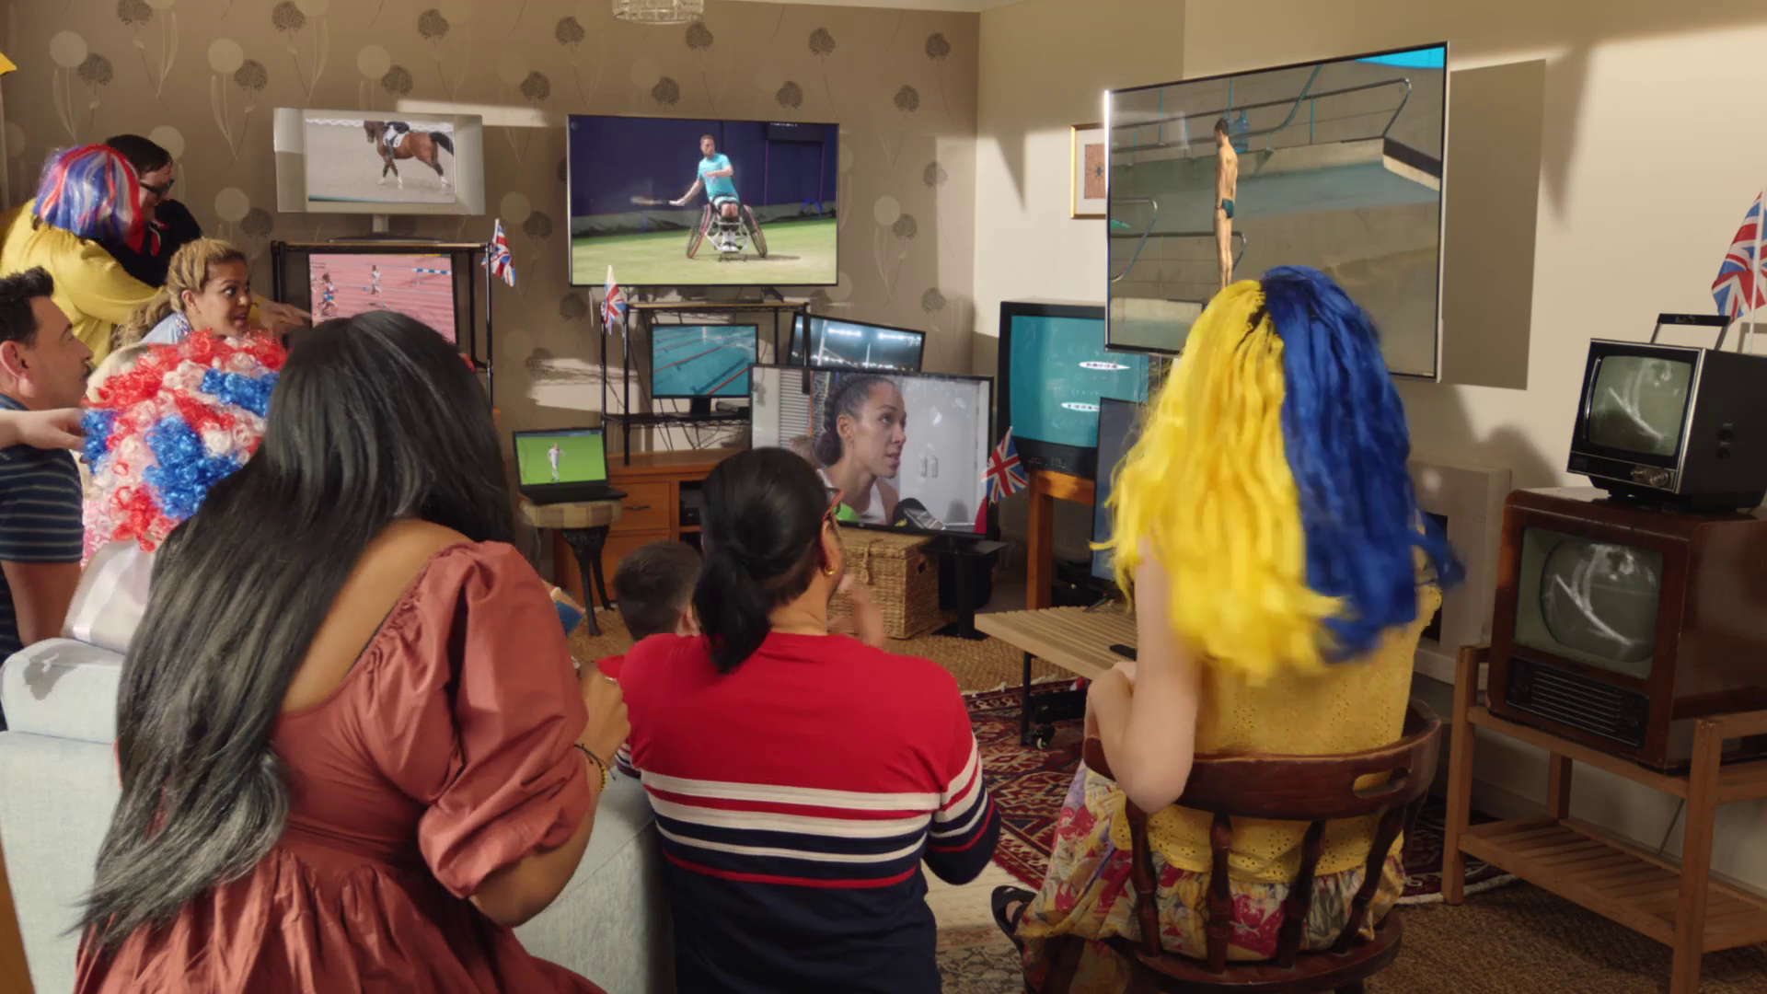
Monthly TV viewing report
June 2024
British Gas, “Powering Home Fans”

Slide 2
June linear TV facts & figures
Total TV weekly reach %
Total TV viewed per day
Commercial TV viewed per day
Impacts
Individuals
78.4 | 48.1bn | 2h 15m | 1h 30m
81.0 | 46.5bn | 2h 32m | 1h 42m
80.1 | 18.3bn | 2h 2m | 1h 16m
63.1 | 3.5bn | 44m | 29m
80.2 | 21.0bn | 2h 31m | 1h 40m
81.7 | 25.5bn | 2h 34m | 1h 44m
79.2 | 3.4bn | 1h 24m | 57m
Adults
ABC1 adults
16-34
Men
Women
Housepersons with children
Sources: Barb June 2024, industry standard TV viewing in-home on a TV set. Reach 3min+. 30” equivalent impacts.
Notes:
June linear TV figures for weekly reach, impacts, total TV viewing hours and commercial TV viewing hours

Slide 3
Some notable TV moments in June
On 30 June, ITV1 aired England’s R16 victory Euro 2024: ENG V SVK to an average audience of 11.80m.
On 13 June, Channel 4 aired The Fall: Skydive Murder Plot to pre-broadcast audience of 329k, a live audience of 811k and time- shifted audience of 1.27m.
On 17 June, Channel 5 aired new drama Cold Call to an average audience of 1.35m.
On 6 June, Sky Showcase aired The Tattooist Of Auschwitz to an average audience of 1.36m.
Source: Barb, June 2024, individuals. Average audience figures, TV set and devices viewing 1-7 days (includes pre-broadcast figures, if applicable).

Slide 4
Top 5 ITV1 programmes
Euro 2024: ENG v SVK (30 June) 11.80 million viewers
Euro 2024: ENG v SVN (25 June) 9.66 million viewers
Euro 2024: ESP v GEO (30 June) 6.96 million viewers
Euro 2024: GER v SCO (14 June) 6.47 million viewers
Britain’s Got Talent (2 June) 6.04 million viewers
“Britain’s Got Talent”, ITV1
Source: Barb, June 2024, individuals. Average audience figures, TV set and devices viewing 1-7 days (includes pre-broadcast figures, if applicable)
Notes:
Top 5 programmes - ITV

Slide 5
Top 5 Channel 4 programmes
International Football: ENG v BIH (3 June) 3.03 million viewers
Celebrity Gogglebox (7 June) 2.94 million viewers
International Football: ENG v ISL (7 June) 2.85 million viewers
The Fall: Skydive Murder Plot (12 June) 2.56 million viewers
The Piano (9 June) 2.31 million viewers
“Celebrity Gogglebox”, Channel 4
Source: Barb, June 2024, individuals. Average audience figures, TV set and devices viewing 1-7 days (includes pre-broadcast figures, if applicable)
Notes:
Top 5 programmes – Channel 4

Slide 6
Top 5 Channel 5 programmes
Cold Call (17 June) 1.35 million viewers
Motorway Cops: Catching Britain's Speeders (10 June) 1.31 million viewers
The Soham Murder Trial (27 June) 1.22 million viewers
The Hospital: Life on the Line (3 June) 1.21 million viewers
China's Terracotta Army (28 June) 1.20 million viewers
“The Soham Murder Trial”, Channel 5
Source: Barb, June 2024, individuals. Average audience figures, TV set and devices viewing 1-7 days (includes pre-broadcast figures, if applicable)
Notes:
Top 5 programmes – Channel 5

Slide 7
Top 5 commercial non-PSB* programmes (non-sport)
Love Island, ITV2 (4 June) 2.76 million viewers
House of the Dragon, Sky Atlantic (23 June) 1.42 million viewers
Canadian F1 GP, Sky F1 (9 June) 1.41 million viewers
The Tattooist Of Auschwitz, Sky Showcase (6 June) 1.36 million viewers
UEFA Champions League: DOR v RMA, TNT Sports 1 (1 June) 1.29 million viewers
“Love Island”, ITV2
Source: Barb, June 2024, individuals. Average audience figures, TV set and devices viewing 1-7 days (includes pre-broadcast figures, if applicable)
Notes:
Top 5 programmes – commercial non-public service broadcasting channels

Slide 8
Top 5 Netflix programmes
Bridgerton (13 June) 4.00 million viewers
Hit Man (7 June) 1.53 million viewers
Trigger Warning (21 June) 1.17 million viewers
Eric (30 June) 1.13 million viewers
Car Crash: Who's Lying? (12 June) 1.04 million viewers
“Hit Man”, Netflix
Source: Barb, June 2024, individuals. Average audience achieved during the first seven days of their availability. Only includes TV set viewing. Top performing episode only.
Notes:
Top 5 programmes – Netflix

Slide 9
Top 5 Disney+ programmes
The Acolyte (5 June) 1.21 million viewers
Welcome to Wrexham (7 June) 0.49 million viewers
Grey’s Anatomy (13 June) 0.47 million viewers
9-1-1 (19 June) 0.45 million viewers
The Bear (27 June) 0.39 million viewers
“Welcome to Wrexham”, Disney+
Source: Barb, June 2024, individuals. Average audience achieved during the first seven days of their availability. Only includes TV set viewing. Top performing episode only.
Notes:
Top 5 programmes – Disney+

Slide 10
Top 5 Amazon Prime Video programmes
The Boys (13 June) 1.61 million viewers
I Am Celine Dion (25 June) 0.51 million viewers
The Hunger Games: The Ballad of Songbirds Snakes (31 June) 0.47 million viewers
My Lady Jane (27 June) 0.26 million viewers
Sleeping Dogs (21 June) 0.26 million viewers
“The Boys”, Amazon Prime Video
Source: Barb, June 2024, individuals. Average audience achieved during the first seven days of their availability. Only includes TV set viewing. Top performing episode only.
Notes:
Top 5 programmes – Amazon Prime Video

Slide 11
Top commercial programmes with largest proportion of device viewing
Total audience
2.27m
1.60m
1.57m
3.49m
1.20m
Source: Barb, June 2024, individuals. Average audience figures, TV set and devices viewing up to 7 days post-broadcast. Based on programmes with 1 million+ total TV viewers
Notes:
Top commercial programmes with largest proportion of device viewing

Slide 12
Top commercial programmes with largest proportion of pre-broadcast boxset BVOD viewing
Total audience
1.36m
2.41m
1.14m
1.06m
1.12m
Source: Barb, June 2024, individuals. Average audience figures, TV set and devices viewing up to 7 days post-broadcast. Based on programmes with 1 million+ total TV viewers
Notes:
Top commercial programmes with largest proportion of pre-broadcast boxset BVOD viewing

Slide 13
Key new to linear TV advertisers in June
VoucherCodes The online savings website, VoucherCodes, returned to TV screens with its first ad in 12 years.
Epilepsy Action The charity debuted its first ever campaign on TV on what to do if someone has a tonic-clonic seizure.
Ultrasun Swiss sun protection brand, Ultrasun, launched its first ever TV campaign in the UK.
VocuherCodes, “Whisperer”
Notes:
New to TV advertisers in June.

