Slide 1
Thinkbox TV viewing report
2024
“Archie“, TV Licensing
Notes:
Thinkbox TV viewing report

Slide 2
Overview
In 2024, we watched 2h 36m of broadcaster TV each day and 41m of SVOD & AVOD viewing
BVOD represents 29% of all broadcaster TV viewing for 16-34s
TV advertising accounted for 85% of the video advertising we saw each day in 2024, and 53% for 16-34s
“Paralympics” Channel 4

Slide 3
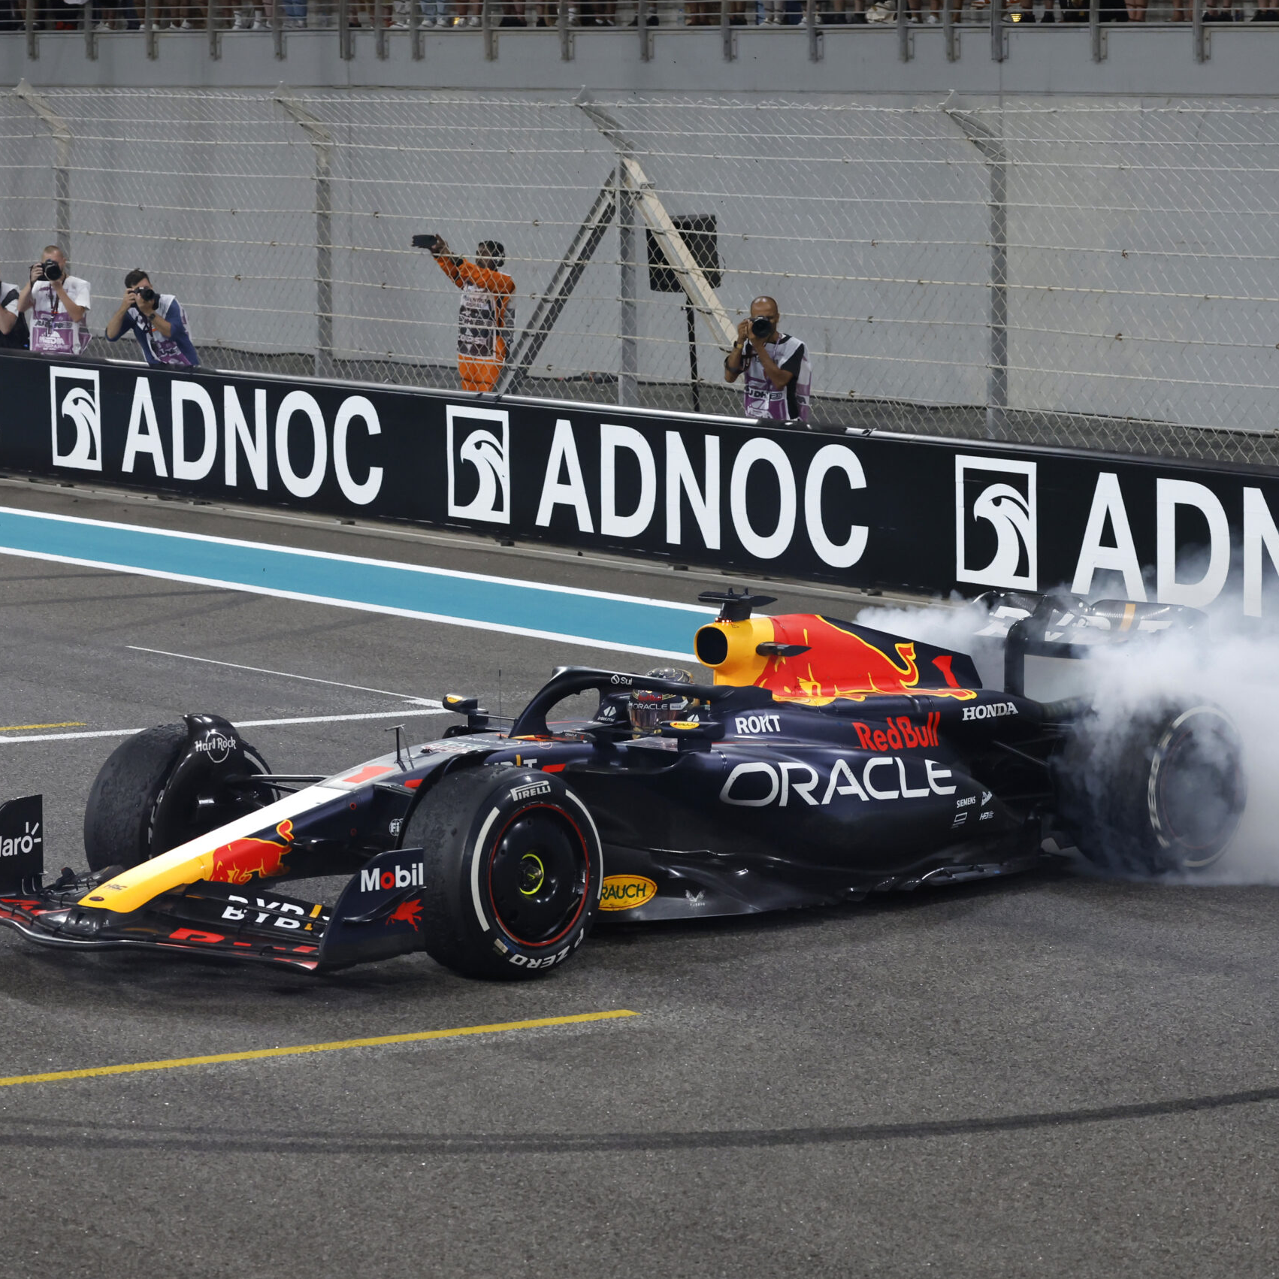
The last decade has seen huge improvements in TV quality
75% of main TV screens 40”+
(vs. 35.2% in 2012)
Access to broadband speeds required to support streaming TV have peaked
89.3% of households have broadcaster VOD on TV set
Over 98% of homes have access to over 30 Mbps
Source: Barb, Ofcom.
Notes:
TV technology and content quality have improved dramatically in the past decade.
Images:
Gunpowder, U
F1, Sky F1
Taskmaster, Channel 4

Slide 4
Stability continues…
Hours per person per day (Adults)
Source: IPA TouchPoints, Adults 15+
Notes:
Stability continues, with adults viewing the same amount of video content as they did in 2015

Slide 5
2024 video viewing – 16-34
ALL INDIVIDUALS
Average video time per day
All Individuals: 4 hrs, 47 mins
16-34
16-34s: 4 hrs, 32 mins
Source: 2024, Barb / IPA TouchPoints / Pornhub / UK Cinema Association / Ipsos Iris
Notes:
Broadcaster TV accounts for 54.3% of video viewing for all individuals and 21.7% for 16-34s.
Methodology
The quantitative analysis of total video consumption in the UK was undertaken by Thinkbox. It combined 2024 data from Barb, the IPA’s TouchPoints, Pornhub, UK Cinema Association, and Ipsos Iris.
Barb data shows how much time is spent viewing broadcaster content, live or time-shifted (including BVOD) on all devices as well as Blu-Ray/DVD viewing. This chart also utilises Barb’s expanding audience reporting capabilities to provide a view of time spent viewing content on YouTube, TikTok, other video sharing services (such as Twitch) as well as SVOD/AVOD platforms. Whilst Barb reports on in-home consumption, a combination of Ipsos Iris and IPA TouchPoints data was used to determine the remaining out-of-home consumption.
The combination of these sources creates a solid estimate as it utilises the robustness of Barb data (11,500 panel members, representative of the UK TV population, metered actual consumption data, analysis across a whole year) alongside Ipsos Iris and IPA TouchPoints data to capture any out-of-home consumption.
Time spent viewing video at cinemas was based on total admissions data from the UK Cinema Association profiled for each audience using data from DCM.
Source: Ipsos iris Online Audience Measurement Service, 12-month average Jan – Dec 2024. Internet users aged 15+, using PC/laptop, smartphone or tablet device.
Technical note: [Broadcaster] data for YouTube includes content owner data for the BBC, Channel 4, CNBC, ITV, NBC and Sky. [Commercial broadcaster] data for YouTube includes content owner data for Channel 4, CNBC, ITV, NBC and Sky. TikTok data is both website and app.
Ipsos iris is the UKOM endorsed service for the measurement of audiences of online content. We passively track the online behaviour of a single-source panel of over 10,000 UK adults, who install software across their devices (a combination of smartphones, tablets, PCs and laptops). The panel is recruited to be representative of the internet population demographically, geographically and by device type. This passive data is fused with anonymous, device-level data derived from site-centric tags on hundreds of the biggest sites and apps to create a synthetic panel of around 1 million synthetic panellists. More detail on the methodology can be found here.

Slide 6
How we watch broadcaster TV – 16-34
Inds
16-34
2 hrs 36 mins
59 mins
Source: 2024, Barb
Notes:
BVOD is vital to different audiences
Breaking down broadcaster TV into the different ways reveals the increasingly important role of BVOD for 16-34, now 29% of all broadcaster TV viewing.
This data uses both Barb data and includes an estimate of any unknown viewing that is thought to fall into Playback and Live viewing.

Slide 7
Three quarters of individuals now have access to a SVOD service
Source: Barb Establishment Survey, % of population
* = Due to the COVID-19 pandemic and the suspension of face-to-face interviewing, quarterly BARB Establishment Survey data were not produced for Q4 2020, as a result, 2020 Q3 data is used
Notes:
Almost three quarters of individuals now have access to a SVOD service (Amazon Prime Video, Apple TV +, Britbox, Disney +, Hayu, NowTV, Paramount+, Discovery and Netflix.)

Slide 8
Commercial broadcasters are unrivalled for scale
Individuals – All devices
Bubble area represents total volume of daily viewing
AVERAGE DAILY REACH (000s)
Other
SVOD
Other AVOD
Twitch
AVE TIME VIEWED PER VIEWER PER DAY
Source: Barb / Individuals, all devices – 2024
Notes:
This chart breaks down viewing to the various platforms in terms of the average number of people watching per day (for at least 3 minutes) compared with the average time spent watching per viewer (i.e. only counting those who watched on that day).
Analysis across 2024 shows that the commercial broadcasters (linear and on demand) collectively reach 30 million viewers every day, with each of those viewers watching for an average of 3hrs, 34 mins a day. The combined portfolio of BBC channels (linear and on demand) attracts the second largest volume of viewing, with 25 million daily reach and an average view time of 2 hours, 11 mins a day. YouTube is next, with a daily reach of 21 million and a view time of 1hr 58 mins (Barb only measure in-home viewing, we estimate that YouTube would be larger in viewing time if out of home viewing was included).
SVOD services such as Netflix has a daily reach of 13 million people and a view time of 1hr 48 mins.

Slide 9
Commercial broadcasters are unrivalled for scale on TV Set
Individuals – TV Set
Bubble area represents total volume of daily viewing
AVERAGE DAILY REACH (000s)
Other SVOD
TikTok
Other AVOD
Twitch
AVE TIME VIEWED PER VIEWER PER DAY
Source: Barb / All Individuals, TV sets – 2024
Notes:
This chart breaks down viewing to the various platforms in terms of the average number of individuals watching per day (for at least 3 minutes) on a TV set compared with the average time spent watching per viewer (i.e. only counting those who watched on that day).
Analysis across 2024 shows that the commercial broadcasters (linear and on demand) collectively reach just over 29 million viewers every day, with each of those viewers watching for an average of 3hrs, 34 mins a day. The combined portfolio of BBC channels (linear and on demand) has a daily reach of 24 million and an average view time of 2hr 11 mins. YouTube has a daily reach of 8 million people and a view time of 2hr 6 mins.
SVOD services such as Netflix has a daily reach of 11 million people and a view time of 1hr 49 mins.

Slide 10
Broadcasters are unrivalled in the commercial viewing landscape
Individuals – Commercial TV Set
Bubble area represents total volume of daily viewing
AVERAGE DAILY REACH (000s)
TikTok
Other AVOD
Twitch
AVE TIME VIEWED PER VIEWER PER DAY
Source: Barb / Individuals, TV sets – Q4 2024, Netflix & Amazon Ad Tiers.
Notes:
This chart breaks down viewing to the various commercial platforms in terms of the average number of individuals watching per day (for at least 3 minutes) on a TV set compared with the average time spent watching per viewer (i.e. only counting those who watched on that day). This analysis covers Q4 2024 to utilise Barbs ad tier data for Netflix & Amazon Prime.
Analysis of Q4 2024 shows that SVOD services like Netflix have a much smaller commercial daily reach of 2.6 million (ad tier) compared to their total TV set reach of 11.4 million (all tiers). Amazon Prime has a commercial reach of 3.5 million, compared to a total TV set reach of 4.4 million.
The commercial broadcasters (linear and on demand) collectively reach 29.6 million viewers every day, with each of those viewers watching for an average of 3hrs, 38 mins a day. YouTube follows, with a daily reach of 8.6 million people and a view time of 2hr 11 mins.

Slide 11
Competition is more even amongst younger audiences
16-34s – All devices
Bubble area represents total volume of daily viewing
AVERAGE DAILY REACH (000s)
Other
SVOD
Twitch
Other AVOD
AVE TIME VIEWED PER VIEWER PER DAY
Source: Barb / 16-34s, all devices – 2024
Notes:
This chart breaks down viewing to the various platforms in terms of the average number of 16-34s watching per day (for at least 3 minutes) compared with the average time spent watching per viewer (i.e. only counting those who watched on that day).
Analysis across 2024 shows that the commercial broadcasters (linear and on demand) collectively reach 4.0 million viewers every day, with each of those viewers watching for an average of 2hrs, 15 mins a day. The combined portfolio of BBC channels (linear and on demand) has a daily reach of 2.7 million and an average view time of 1hr 38 mins. YouTube has a daily reach of 6.2 million people and a view time of 2 hours 11 mins (Barb only measure in-home viewing, we estimate that YouTube would be larger in viewing time if out of home viewing was included).
SVOD services such as Netflix has a daily reach of 3.9 million 16-34s and a view time of 1hr 57 mins.

Slide 12
Commercial broadcasters deliver the most scale for 16-34s on the TV set
16-34s – TV Set
Bubble area represents total volume of daily viewing
AVERAGE DAILY REACH (000s)
Other SVOD
TikTok
Other AVOD
Twitch
AVE TIME VIEWED PER VIEWER PER DAY
Source: Barb / 16-34s, TV sets – 2024
Notes:
This chart breaks down viewing to the various platforms in terms of the average number of 16-34s watching per day (for at least 3 minutes) on a TV set compared with the average time spent watching per viewer (i.e. only counting those who watched on that day).
Analysis across 2024 shows that the commercial broadcasters (linear and on demand) collectively reach 3.8 million viewers every day, with each of those viewers watching for an average of 2hrs, 16 mins a day. The combined portfolio of BBC channels (linear and on demand) has a daily reach of 2.4 million and an average view time of 1hr 39 mins. YouTube has a daily reach of 2.2 million people and a view time of 2hr 11 mins.
SVOD services such as Netflix has a daily reach of 3.2 million people and a view time of 1hr 58 mins.

Slide 13
Broadcasters deliver the largest scale for 16-34s compared to other commercial platforms on the TV set
16-34 – Commercial TV Set
Bubble area represents total volume of daily viewing
AVERAGE DAILY REACH (000s)
TikTok
Other AVOD
Twitch
AVE TIME VIEWED PER VIEWER PER DAY
Source: Barb, 16-34, TV sets – Q4 2024, Netflix & Amazon Ad Tiers.
Notes:
This chart breaks down viewing to the various commercial platforms in terms of the average number of 16-34s watching per day (for at least 3 minutes) on a TV set compared with the average time spent watching per viewer (i.e. only counting those who watched on that day). This analysis covers Q4 2024 to utilise Barbs ad tier data for Netflix & Amazon Prime.
Analysis of Q4 2024 shows that SVOD services like Netflix have a much smaller commercial daily reach of 0.6 million (ad tier) compared to their total TV set reach of 3.2 million (all tiers). Amazon Prime has a commercial reach of 0.9 million, compared to a total TV set reach of 1.2 million.
The commercial broadcasters (linear and on demand) collectively reach 3.9 million 16-34s every day, with each of those viewers watching for an average of 2hrs, 20 mins a day. YouTube follows, with a daily reach of 2.3 million people and a view time of 2hrs 15 mins.

Slide 14
How TV content is viewed
“Brassic” Sky Max

Slide 15
Sports is time-sensitive so has high levels of live viewing
3.75 million
97% Live
viewing
(any device)
126k
3.88
million total viewers
3% On-demand viewing (any device)
Source: Barb 2024. Individuals, Live +3min. International Football: ENG V BRA, Channel 4. 23rd Mar. Device and time-shifted viewing within 28 days of broadcast.
Notes:
Sport tends to be watched live as it is time sensitive.
For example, if you look at this International Football game between England and Brazil on Channel 4 - 97% of the viewing was live
97% live
3% on-demand

Slide 16
Sports is time-sensitive so has high levels of live viewing
12.95 million
98% Live
viewing
(any device)
308k
13.26 million total viewers
2% On-demand viewing (any device)
Source: Barb 2024. Individuals, Live +3min. UEFA European Football Championship: NED V ENG, ITV1. 10th July. Device and time-shifted viewing within 28 days of broadcast.
Notes:
Sport tends to be watched live as it is time sensitive.
For example, if you look at this Euro 2024 game between Netherlands and England on ITV1 - 98% of the viewing was live
98% live
2% on-demand

Slide 17
Daily shows generate a ‘drive to live’
6.10 million
68% Live
viewing
(any device)
9.01
million total viewers
2.91 million
32% On-demand viewing (any device)
Source: Barb 2024. Individuals, Live +3min. I’m a Celebrity Get Me Out of Here, ITV1. 8th Dec. Device and time-shifted viewing within 28 days of broadcast.
Notes:
Daily entertainment shows with broad appeal, have high levels of live viewing, as audiences try to keep up to date.
An episode of I'm a Celebrity... Get Me Out of Here! on ITV1 had 68% live viewing.
68% live
32% on-demand

Slide 18
Primetime drama has high levels of on-demand viewing
3.02 million
24% Live
viewing (any device)
12.86 million total viewers
9.84 million
76% On-demand viewing (any device)
Source: Barb 2024. Individuals, Live +3min. Mr Bates vs The Post Office, ITV1, 4th Jan, Device and time-shifted viewing within 28 days of broadcast.
Notes:
Prime time drama has high levels of on-demand viewing because it’s not time sensitive so people choose to watch it at a time that suits them.
In this example, an episode of Mr Bates vs The Post Office on ITV1, 24% of viewing was live and 76% on-demand.
24% live
76% on-demand

Slide 19
Primetime drama has high levels of on-demand viewing
1.66 million
35% Live
viewing (any device)
4.69
million total viewers
3.02 million
65% On-demand viewing (any device)
Source: Barb 2024. Individuals, Live +3min. Coma, Channel 5, 18 Mar, Device and time-shifted viewing within 28 days of broadcast.
Notes:
Primetime drama receives high levels of on-demand viewing.
For example, if you look at this episode of Coma on Channel 5 - 35% of the viewing was live.
35% live
65% on-demand

Slide 20
Device viewing allows flexibility in watching live sport
122k
9% Device viewing
1.44
million total viewers
1.32m
91% TV Set viewing
Source: Barb 2024. Individuals, PDC World Championship Darts, Sky Sports Main Event, 3 Jan, Device and time-shifted viewing within 28 days of broadcast.
Notes:
Sport tends to be watched live as it is time sensitive, with many viewers streaming on devices for added flexibility.
For example, if you look at the PDC World Championship Darts on Sky Sports Main Event - 9% of the viewing was on device
91% TV set
9% Device

Slide 21
Device viewing allows flexibility in watching reality TV
579k
26% Device viewing
2.23
million total viewers
1.65m
74% TV Set viewing
Source: Barb 2024. Individuals, Love Island All Stars, ITV2, 30 Jan, Device and time-shifted viewing within 28 days of broadcast.
Notes:
For programmes that appeal to young people, who want flexible viewing options, there is much higher levels of device viewing.
In this example, an episode of Love Island on ITV2 saw 26% of all viewing done on a device.
74% TV set
26% Device

Slide 22
Device viewing allows flexibility in watching reality TV
374k
15% Device viewing
2.53
million total viewers
2.15m
85% TV Set viewing
Source: Barb 2024. Individuals, Married at First Sight UK, E4, 21st Oct, Device and time-shifted viewing within 28 days of broadcast.
Notes:
For programmes that appeal to young people, who want flexible viewing options, there is much higher levels of device viewing.
In this example, an episode of Married at First Sight UK on Channel 4 saw 15% of all viewing done on a device.
85% TV set
15% Device

Slide 23
Broad appeal entertainment shows have high TV set viewing
206k
3% Device viewing
7.02
million total viewers
6.81m
97% TV Set viewing
Source: Barb 2024. Individuals, The Great British Bake Off, Channel 4, 26th Nov, Device and time-shifted viewing within 28 days of broadcast.
Notes:
Entertainment shows with broad appeal, have high TV set viewing.
In this example, an episode of The Great British Bake Off on Channel 4 saw 97% of all viewing done by TV Set.
97% TV set
3% Device

Slide 24
Content released as a boxset can receive high pre-broadcast viewing
674k
58% Pre-broadcast viewing (any device)
1.17 million total viewers
447k
38% Time-shifted viewing (any device) within 28 days of broadcast
48k
4% Live TV set viewing
Source: Barb 2024. Individuals, Live +3min. The Tattooist Of Auschwitz, Sky Showcase, 9 May. Device and time-shifted viewing within 28 days of broadcast.
Notes:
Content that’s released as a boxset before being shown live on broadcaster TV often attracts high levels of pre-broadcast viewing.
In this example, this episode of The Tattooist of Auschwitz, received 58% of the total audience to the pre-broadcast on-demand release.
58% pre-broadcast
4% live on a TV set
38% time shifted

Slide 25
Content released as a boxset can receive high pre-broadcast viewing
4.23m
58% Pre-broadcast viewing (any device)
7.31 million total viewers
1.63m
22% Time-shifted viewing (any device) within 28 days of broadcast
1.45m
20% Live TV set viewing
Source: Barb 2024. Individuals, Live +3min. Red Eye, ITV1, 26 May. Device and time-shifted viewing within 28 days of broadcast.
Notes:
Content that’s released as a boxset before being shown live on broadcaster TV often attracts high levels of pre-broadcast viewing.
In this example, this episode of Red Eye on ITV1, received 58% of the total audience to the pre-broadcast on-demand release.
58% pre-broadcast
20% live on a TV set
22% time shifted

Slide 26
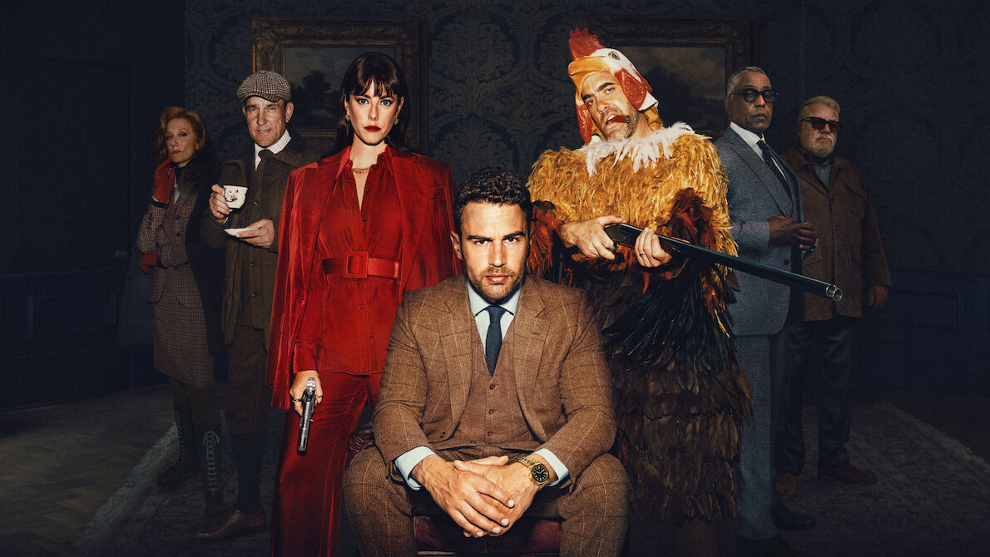
TV landscape
“The Gentlemen” Netflix

Slide 27
Commercial linear TV daily, weekly & monthly reach
Reach % | Daily | Weekly | Monthly
Individuals | 46.1 | 70.7 | 84.9
Adults | 50.6 | 74.2 | 86.6
ABC1 adults | 46.2 | 72.1 | 85.7
16-34 | 24.4 | 52.5 | 73.8
Men | 49.3 | 73.2 | 85.8
Women | 51.8 | 75.1 | 87.4
HP+CH | 40.2 | 68.7 | 84.4
Source: Barb, 2024, industry standard TV viewing in-home on a TV set. Reach 3min+
Notes:
Commercial Linear TV reaches 71% of the population each week.

Slide 28
TV population (universe) sizes in millions
61.7
52.6
29.5
27.2
25.4
14.6
9.1
6.8
Individuals
Adults
ABC1 Adults
Women
Men
16-34 Adults
Kids
Housepersons with Kids
Source: Barb, Dec 2024
Notes:
In 2024, the population of people aged 4+ with access to a TV set was 61.7m.

Slide 29
Time lengths & advertising
“The Walking Dead” Sky Max

Slide 30
Time lengths & advertising
TV advertising accounted for 85% of the video advertising we saw each day in 2024, and 53% for 16-34s.
Procter & Gamble was the biggest TV advertiser in 2024.
30-second TV ads consistently account for over half of all impacts.
Linear TV delivered 633 billion impacts across 2024.
937 advertisers used TV for the first time in 2024.
“Queenie” Channel 4
Sources: Barb, Nielsen Ad Intel

Slide 31
All Individuals
Average video advertising time per day
All Individuals: 18:05
16-34s: 9:49
Today’s TV accounts for 85.0% of AV advertising time
(vs 83.5% in 2024)
16-34s
Source: 2024, Barb / Broadcaster stream data / UK Cinema Association / Ipsos Iris
**YouTube ad time modelled at 3.33% of content time (Enders Analysis, 23rd October 2024) and excludes those estimated to be on the YouTube Premium tier. *TikTok ad time modelled at 3.4% of content time using agency and broadcaster estimates. **Other online modelled at 3.33% of content time.
Notes:
Broadcaster TV & SVOD accounts for 85.0% of all AV advertising time

Slide 32
The use of time-lengths differs by category
Source: Barb, 2024, Individuals
Notes:
The most prevalent users of longer spots is the charity sector (Govt, Social, Political Org). This will consist of DR daytime and small channel spots, but shows the power of longer spots in delivering a more emotive impact. This emotive impact is dependent on good storytelling – something much easier to do successfully in longer ads.

Slide 33
30-second TV ads consistently account for half of all impacts
Source: Barb, 2014-2024, Individuals, Proportion of Impacts (R/W) by ad duration
Notes:
30-second TV ads consistently account for half of all impacts
This chart shows how the 30-second spot continues to be the most popular time length in UK ad breaks.
The main shift since 2014 has been less use of 40 to 50-second ads on TV. The prevalence of shorter time lengths (20-second, 10-second and under) and 60-second ads has remained stable. While there has been a small increase in the use 60-second+ ads.

Slide 34
Linear TV delivered 633 billion impacts across 2024
Source: Barb, Individuals, UK Full Network, 2024. Base: 30” reweighted impacts. An impact = one person viewing one TV ad in its entirety. Impacts only count when viewed at normal speed
Notes:
Linear TV delivered 633 billion impacts across 2024.

Slide 35
The most viewed holding companies on TV in 2024
Impacts (Billions)
Source: Barb, 2024, R/W commercial impacts according to Barb reporting
Notes:
Procter and Gamble was the most viewed advertiser on TV in 2024 with 35.9 billion impacts.

Slide 36
932 advertisers used TV for the first time in 2024
Source: Nielsen Ad Intel / Sky – New to TV advertisers classed as those not advertising on TV 5 years prior (2019—2024) on Linear TV and Sky AdSmart
Notes:
In 2024, there were 932 new to TV advertisers, many of whom were ecommerce business looking to supercharge their growth through TV.

Slide 37
Top programmes
“Dancing on Ice”, ITV1

Slide 38
UK original content dominates the top series in 2024
Rank | Channel Group | Programme Title | Series | Average Audience (m) | Origin
1 | ITV | Mr Bates vs The Post Office | 1 | 14.4 | UK
2 | Netflix | Fool Me Once | 1 | 11.7 | UK
3 | Netflix | Baby Reindeer | 1 | 9.6 | UK
4 | Amazon | Clarkson's Farm | 3 | 9.3 | UK
5 | Netflix | The Gentlemen | 1 | 9.0 | UK
6 | ITV | I'm a Celebrity... Get Me Out of Here! | 24 | 8.8 | UK
7 | ITV | Vera | 13 | 8.6 | UK
8 | BBC | Death in Paradise | 13 | 8.6 | UK / France
9 | BBC | Ludwig | 1 | 8.6 | UK
10 | ITV | Trigger Point | 2 | 8.4 | UK
Rank | Channel Group | Programme Title | Series | Average Audience (m) | Origin
11 | Channel 4 | The Great British Bake Off | 15 | 8.2 | UK
12 | BBC | The Traitors | 2 | 8.1 | UK
13 | BBC | Strictly Come Dancing | 22 | 8.1 | UK
14 | BBC | Call the Midwife | 13 | 7.8 | UK
15 | ITV | After The Flood | 1 | 7.7 | UK
16 | ITV | Red Eye | 1 | 7.7 | UK
17 | BBC | Silent Witness | 27 | 7.4 | UK
18 | BBC | Celebrity Race Across the World | 2 | 7.3 | UK
19 | ITV | Until I Kill You | 1 | 7.2 | UK
20 | BBC | Nightsleeper | 1 | 7.1 | UK
Source: Barb, 2024, Individuals. TV set viewing. Average audience per episode (excludes one-offs, kids, films and sports)
Notes:
UK original content dominates the top series in 2024. Mr Bates vs The Post Office on ITV was the most-watched series of the year, averaging 14.4 million viewers per episode.

Slide 39
16-34’s: SVOD’s strong; UK original content dominates
Rank | Channel Group | Programme Title | Series | Average Audience (m) | Origin
1 | Netflix | Baby Reindeer | 1 | 3.2 | UK
2 | Amazon | Clarkson's Farm | 3 | 3.0 | UK
3 | Netflix | Fool Me Once | 1 | 2.8 | UK
4 | Netflix | Bridgerton | 3 | 2.3 | UK / USA
5 | Netflix | The Gentlemen | 1 | 2.2 | UK
6 | ITV | I'm a Celebrity... Get Me Out of Here! | 24 | 1.9 | UK
7 | BBC | The Traitors | 2 | 1.8 | UK
8 | Netflix | Friday Night Dinner | 2 | 1.8 | UK
9 | Amazon | Fallout | 1 | 1.8 | USA
10 | Netflix | Friday Night Dinner | 1 | 1.8 | UK
Rank | Channel Group | Programme Title | Series | Average Audience (m) | Origin
11 | Netflix | American Nightmare | 1 | 1.4 | USA
12 | BBC | The Apprentice | 18 | 1.4 | UK
13 | ITV | Mr Bates vs The Post Office | 1 | 1.3 | UK
14 | Netflix | One Day | 1 | 1.3 | UK
15 | Netflix | Monsters: The Lyle and Erik Menendez Story | 1 | 1.2 | USA
16 | CH4 | The Great British Bake Off | 15 | 1.2 | UK
17 | Netflix | Friday Night Dinner | 5 | 1.2 | UK
18 | Netflix | Rick and Morty | 7 | 1.1 | USA
19 | Netflix | Supacell | 1 | 1.1 | UK
20 | Amazon | The Boys | 4 | 1.1 | USA
Source: Barb, 2024, 16-34. TV set viewing, Average audience per episode (excludes one-offs, kids, films and sports)
Notes:
UK original content dominates the top series for 16-34s in 2024. Baby Reindeer on Netflix was the most-watched series of the year for this age group, averaging 3.2 million viewers per episode.

Slide 40
Sport highest live viewing numbers; Drama on-demand
Top 10 Programmes Viewed Live
Rank | Channel Group | Genre | Programme Title | Audience (m)
1 | BBC / ITV | Sport | Euro 2024: Spain v England | 15.23
2 | ITV | Sport | Euro 2024: Netherlands v England | 12.59
3 | ITV | Sport | Euro 2024: England v Slovakia | 12.10
4 | BBC | Entertainment | New Year's Eve Fireworks | 11.19
5 | BBC | Sport | Euro 2024: England v Switzerland | 10.46
6 | BBC | Sport | Euro 2024: Serbia v England | 10.28
7 | ITV | Sport | Euro 2024: England v Slovenia | 9.20
8 | BBC | Sport | Euro 2024: Spain v France | 8.24
9 | BBC | Sport | Euro 2024: Denmark v England | 7.86
10 | BBC | Entertainment | Gavin & Stacey | 7.76
Top 10 Programmes Viewed On Demand
Rank | Channel Group | Genre | Programme Title | Audience (m)
1 | Netflix | Films | Minions The Rise of Gru | 13.67
2 | Netflix | Drama | Fool Me Once | 12.90
3 | Netflix | Drama | Baby Reindeer | 11.61
4 | Disney+ | Films | Moana Sing Along | 11.50
5 | Disney+ | Children | Bluey | 11.47
6 | BBC | Films | Wallace & Gromit: Vengeance Most Fowl | 16.87
7 | Netflix | Drama | The Gentlemen | 11.43
8 | BBC | Entertainment | Gavin & Stacey | 18.55
9 | ITV | Drama | Mr Bates vs The Post Office | 14.36
10 | Amazon | Hobbies & Leisure | Clarkson's Farm | 10.07
Source: Barb, 2024, Individuals, Live +3 mins, TV set viewing, Top performing episode.
Notes:
Sport generates the highest live viewing numbers, while drama is predominantly consumed on-demand

Slide 41
16-34’s: Sport & Entertainment live; Films for on-demand
Top 10 Programmes Viewed Live
Rank | Channel Group | Genre | Programme Title | Audience (m)
1 | BBC / ITV | Sport | Euro 2024: Spain v England | 2.48
2 | BBC | Entertainment | New Year's Eve Fireworks | 2.17
3 | ITV | Sport | Euro 2024: Netherlands v England | 2.10
4 | ITV | Sport | Euro 2024: England v Slovakia | 1.71
5 | BBC | Entertainment | Gavin & Stacey | 1.62
6 | BBC | Sport | Euro 2024: Serbia v England | 1.50
7 | BBC | Sport | Euro 2024: England v Switzerland | 1.42
8 | ITV | Sport | Euro 2024: England v Slovenia | 1.40
9 | BBC | Sport | Euro 2024: Spain v France | 1.19
10 | BBC | Entertainment | Eurovision Song Contest | 1.10
Top 10 Programmes Viewed On Demand
Rank | Channel Group | Genre | Programme Title | Audience (m)
1 | Disney+ | Children | Bluey | 4.72
2 | Disney+ | Films | Moana Sing Along | 4.49
3 | Netflix | Drama | Baby Reindeer | 3.71
4 | Amazon | Hobbies & Leisure | Clarkson's Farm | 3.14
5 | Netflix | Films | Minions The Rise of Gru | 3.12
6 | Disney+ | Films | Frozen Sing Along | 3.03
7 | Netflix | Drama | Fool Me Once | 2.95
8 | Disney+ | Films | Encanto | 2.93
9 | Disney+ | Films | Elemental | 2.86
10 | Netflix | Films | Dr. Seuss' The Grinch | 2.80
Source: Barb, 2024, 16-34, Live +3 mins, TV set viewing, Top performing episode.
Notes:
For 16-34s, sport and entertainment are primarily watched live, while films are regularly consumed on-demand.

Slide 42
In 2024, Gavin & Stacey ended, and England reached a final
On Christmas Day, the nation tuned in to BBC1 to watch the finale of Gavin & Stacey with an average audience of 20.6 million.
In July, ITV1 aired England’s triumph in the semi-final of Euro 2024: NED v END to an average audience of 13.3 million.
In September, Channel 4 aired the eagerly awaited 15th season of The Great British Bake Off to an average audience of 7.4 million.
In November, Sky Atlantic launched new spy thriller The Day of the Jackal to an average audience of 2.6 million.
Source: Barb, 2024, individuals. TV and Online Pre-Broadcast 1-28 days. *Barb reported figure for multiple channels
Notes:
In 2024, we saw the final episode of Gavin & Stacey, England's victory over the Netherlands in Euro 2024, the return of old favorites with The Great British Bake Off on Channel 4, and new thrillers like The Day of the Jackal on Sky Atlantic.

Slide 43
Top TV programmes 2024 (TV set and device)
Gavin & Stacey
BBC1, 25 Dec
20,564,457
Wallace & Gromit: Vengeance Most Fowl BBC1, 25 Dec
17,599,770
Euro 2024: ESP v ENG
BBC1 & ITV1, 14 Jun
15,856,740
Euro 2024: NED v ENG
ITV1, 10 Jul
13,257,223
Mr Bates vs The Post Office ITV1, 4 Jan
12,863,356
Euro 2024: ENG v SVK
ITV1, 30 Jun
11,798,148
Euro 2024: ENG v SUI
BBC1, 6 Jul
11,206,399
Euro 2024: SER v ENG
BBC1, 16 Jul
10,771,678
New Year’s Eve Fireworks
BBC1, 31 Dec
10,506,766
I'm a Celebrity... Get Me Out of Here!
ITV1, 17 Nov
10,306,339
Source: Barb, 2024, individuals. Average audience figures. TV and / or Online Network. TV and Online Pre-Broadcast 1-28 days. Top performing episode only.
Notes:
Top TV programme 2024 (TV set & device).
In 2024, Gavin & Stacey emerged as the top TV programme of the year, pulling an average audience of 20.6 million viewers.

Slide 44
Top ITV1 programmes 2024 (TV set and device)
Euro 2024: NED v ENG
10 Jul
13,257,223
Mr Bates vs The Post Office 4 Jan
12,863,356
Euro 2024: ENG v SVK
30 Jun
11,798,148
I'm a Celebrity... Get Me Out of Here!
17 Nov
10,306,339
Euro 2024: ENG V SLV
25 Jun
9,665,548
Trigger Point
25 Feb
8,293,992
Red Eye
21 Apr
8,278,153
Vera
7 Jan
7,678,422
Until I Kill You
3 Nov
7,587,925
Britain’s Got Talent
20 Apr
7,528,940
Source: Barb, 2024, individuals. Average audience figures. TV and / or Online Network. TV and Online Pre-Broadcast 1-28 days. Top performing episode only.
Notes:
Top ITV1 programme 2024 (TV set & device).
Euro 2024: NED v ENG was most watched ITV1 show of 2024, with England’s triumph pulling an average audience of 13.3 million viewers.

Slide 45
Top Channel 4 programmes 2024 (TV set and device)
The Great British Bake Off
24 Sep
7,416,976
24 Hours In Police Custody
9 Jan
3,920,861
International Football: England v Brazil
23 Mar
3,880,006
Gogglebox
26 Apr
3,817,239
International Football: England v Belguim
26 Mar
3,599,032
The Jury: Murder Trial
26 Feb
3,515,845
The Great Celebrity Bake Off for SU2C
17 Mar
3,299,578
Celebrity Gogglebox
7 Jun
3,285,528
The Great British Bake Off: Festive Specials
24 Dec
3,249,071
Big Fat Quiz
27 Dec
3,157,135
Source: Barb, 2024, individuals. Average audience figures. TV and / or Online Network. TV and Online Pre-Broadcast 1-28 days. Top performing episode only.
Notes:
Top Channel 4 programme 2024 (TV set & device).
The Great British Bake Off was the most watched Channel 4 show of 2024, with a single episode pulling an average audience of 7.4 million viewers.

Slide 46
Top Channel 5 programmes 2024 (TV set and device)
Coma
18 Mar
4,685,117
All Creatures Great and Small
10 Oct
4,189,127
Love Rat
11 Mar
4,099,753
The Cuckoo
8 Apr
4,090,020
The Hardacres
7 Oct
3,604,997
The Teacher
9 Sep
3,442,718
Ellis
31 Oct
3,417,803
Too Good to Be True
14 Feb
2,967,161
Finders Keepers
17 Jan
2,963,067
The Wives
16 Sep
2,951,597
Source: Barb, 2024, individuals. Average audience figures. TV and / or Online Network. TV and Online Pre-Broadcast 1-28 days. Top performing episode only.
Notes:
Top Channel 5 programme 2024 (TV set & device).
Coma was the most watched Channel 5 show of 2024, with a single episode pulling an average audience of 4.7 million viewers.

Slide 47
Top commercial non-PSB* programmes 2024 (non-sport)
Sightseers
Film4, 30 Mar
4,412,110
Married at First Sight UK
E4, 26 Sep
3,070,302
Love Island
ITV2, 4 Jun
2,969,088
Love Island: All Stars ITV2, 16 Jan
2,801,680
The Day Of The Jackal
Sky Atlantic, 7 Nov
2,599,900
Married at First Sight Australia
E4, 11 Apr
2,398,581
The Marlow Murder Club
U&Drama, 6 Mar
2,101,782
Premier League: Man Utd v Liverpool
Sky Sports Main Event,
7 Apr, 2,066,687
House Of The Dragon
Sky Atlantic, 23 Jun
1,933,228
Premier League: Man City V Arsenal
Sky Sports Main Event,
31 Mar, 1,881,700
Source: Barb, 2024, individuals. Average audience figures. TV and / or Online Network. TV and Online Pre-Broadcast 1-28 days. Top performing episode only.
Notes:
Top commercial non-PSB programme 2024 (TV set & device).
Sightseers was the most watched non-PSB programme of 2024, pulling an average audience of 4.4 million viewers.

Slide 48
Top Netflix programmes 2024 (TV Set)
Fool Me Once
1 Jan
10,466,931
That Christmas
4 Dec
9,461,144
Baby Reindeer
11 Apr
8,474,040
Black Doves
5 Dec
8,143,845
The Gentlemen
7 Mar
7,973,957
Carry-On
13 Dec
7,902,095
Sing: Thriller
16 Oct
6,207,235
Bridgerton
16 May
5,600,017
Minions: The Rise of Gru
14 May
4,813,120
Damsel
8 Mar
4,664,910
Source: Barb, 2024, Individuals. Average audience achieved during the first 28 days of their availability. Only includes TV set viewing. Top performing episode only.
Notes:
Top Netflix programme 2024 (TV set).
Fool Me Once was the most watched Netflix programme of 2024, pulling an average audience of 10.5 million viewers within 28 days.

Slide 49
Top Amazon Prime Video programmes 2024 (TV Set)
Red One
12 Dec
8,057,005
Clarkson’s Farm
3 May
7,761,072
Fallout
11 Apr
5,052,682
The Grand Tour
13 Sep
4,822,029
The Ministry of Ungentlemanly Warfare
25 Jul
3,794,484
Reacher
5 Jan
3,727,887
Road House
21 Mar
3,426,327
The Lord of the Rings: The Rings of Power
29 Aug
2,843,873
Cross
14 Nov
2,831,399
The Boys
13 Jun
2,422,845
Source: Barb, 2024, Individuals. Average audience achieved during the first 28 days of their availability. Only includes TV set viewing. Top performing episode only.
Notes:
Top Amazon Prime Video programme 2024 (TV set).
Red One was the most watched Amazon Prime Video programme of 2024, pulling an average audience of 8.1 million viewers within 28 days.

Slide 50
Top Disney+ programmes 2024 (TV Set)
Inside Out 2
25 Sep
5,143,882
Wish
3 Apr
4,156,895
Bluey
14 Apr
3,978,767
Deadpool and Wolverine
12 Nov
3,272,158
Bluey Minisodes
3 Jul
2,538,842
Rivals
18 Oct
2,121,958
The Marvels
7 Feb
1,937,972
Descendants: The Rise of Red
12 Jul
1,909,420
Shogun
27 Feb
1,839,164
The Acolyte
5 Jun
1,838,729
Source: Barb, 2024, Individuals. Average audience achieved during the first 28 days of their availability. Only includes TV set viewing. Top performing episode only.
Notes:
Top Disney+ programme 2024 (TV set).
Inside Out 2 was the most watched Disney+ programme of 2024, pulling an average audience of 5.1 million viewers within 28 days.

Slide 51
Top commercial sport programmes
Top commercial sport:
Euro 2024: Netherlands v England – ITV1, 10 July – 20,617,300
Euro 2024: England v Slovakia – ITV1, 30 Jun – 17,536,700
Euro 2024: England v Slovenia – ITV1, 25 Jun – 14,646,900
Top commercial non-PSB:
UEFA Champions League Final: Borussia Dortmund v Real Madrid – TNT Sport 1, 1 June – 3,034,500
Premier League: Manchester United V Liverpool – Sky Sports Main Event, 7 April – 2,917,600
Premier League: Manchester City V Manchester United– Sky Sports Premier League, 3 March – 2,641,200
Source: Barb, 2024, Individuals. Peak minute audience, consolidated 28 days
Notes:
Top commercial sport programmes. ITV1 hosted the semi-final of Euro 2024 to a peak audience of 20.6 million.

Slide 52
Top 5 commercial programmes with largest proportion of device viewing
Total audience
2.14m
2.53m
1.57m
1.04m
Source: Barb, 2024, Individuals, Average audience figures, TV and Online Pre-broadcast and 1-28 days, TV set and devices viewing. Based on programmes with 1 million+ total TV viewers
Notes:
Top 5 commercial programmes with largest proportion of device viewing.
In 2024, Love Island on ITV2 received the highest proportion of device viewing, with 29.1% of viewers tuning in via laptop, tablet, or mobile.

Slide 53
Top commercial programmes with largest proportion of pre-broadcast boxset BVOD viewing
Total audience
1.26m
1.34m
1.03m
7.31m
2.39m
Source: Barb, 2024, Individuals, Average audience figures, TV set and devices viewing up to 28 days post-broadcast. Based on programmes with 1 million+ total TV viewers. Live +3 mins.
Notes:
Top commercial programmes with largest proportion of pre-broadcast boxset BVOD viewing

