Slide 1


Thinkbox TV viewing report
2023
“Whopper“, Burger King
Notes:
Thinkbox TV viewing report 2021

Slide 2

Overview
In 2023, we watched 2h, 40m of broadcaster TV each day and 39m of subscription VOD viewing.
BVOD represents 24% of all broadcaster TV viewing for 16-34s
Almost three quarters of individuals now have access to a SVOD service.
“Big Brother” ITV1

Slide 3

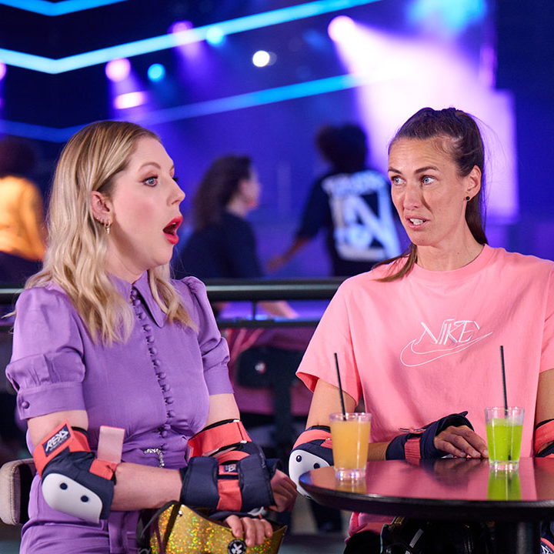

The last decade has seen huge improvements in TV quality
72.7% of main TV screens 40”+
(vs. 35.2% in 2012)
Access to broadband speeds required to support streaming TV have peaked
Over 88% of homes have access to over 30 Mbps
81.5% now have broadcaster VOD on TV set
Source:Barb, Ofcom, IPA Touchpoints 2023 (wave 1), Thinkbox estimates
Notes:
TV technology and content quality have improved dramatically in the past decade.
Images:
Murder in Provence, ITV1
Train, Sky Sci-Fi
Taskmaster, Channel 4

Slide 4
Overall, it’s a much more stable viewing landscape
HOURS PER PERSON PER DAY (Adults)
Source: IPA TouchPoints, Adults, Barb, All devices, includes estimates for OOH viewing to TikTok, YouTube and Other online video
Notes:
Looking at the long-term trend 2023 viewing levels have flattened out and paint a picture of much more stability, with this pattern looking set to continue into 2024 – interestingly there was slight growth in total viewing levels, suggesting that the increases to TikTok and YouTube seen doesn’t all need to substitute TV viewing.

Slide 5
2023 video viewing – 16-34
ALL INDIVIDUALS
Average video time per day
All Individuals: 4 hrs, 36 mins
16-34
16-34s: 4 hrs, 6 mins
Source: 2023, Barb / ViewersLogic / IPA TouchPoints 2023 / Pornhub / UK Cinema Association
Notes:
Broadcaster TV accounts for 57.9% of video viewing for all individuals and 26.3% for 16-34s.
Methodology
The quantitative analysis of total video consumption in the UK was undertaken by Thinkbox. It combined 2023 data from Barb, ViewersLogic, Pornhub, the IPA’s TouchPoints and UK Cinema Association.
Barb data shows how much time is spent viewing broadcaster content, live or time-shifted (including BVOD) on all devices as well as Blu-Ray/DVD viewing. This chart also utilises Barb’s expanding audience reporting capabilities to provide a view of time spent viewing content on YouTube, TikTok, other video sharing services (such as Twitch) as well as SVOD/AVOD platforms. Whilst Barb reports on in-home consumption, a combination of ViewersLogic and IPA TouchPoints data was used to determine the remaining out-of-home consumption.
The combination of these sources creates a solid estimate as it utilises the robustness of Barb data (11,500 panel members, representative of the UK TV population, metered actual consumption data, analysis across a whole year) alongside ViewersLogic and IPA TouchPoints data to capture any out-of-home consumption.
Time spent viewing video at cinemas was based on total admissions data from the UK Cinema Association profiled for each audience using data from DCM.

Slide 6
How we watch broadcaster TV – 16-34
Inds
16-34
2 hrs 40 mins
1 hr 5 mins
Source: 2023, Barb
Notes:
BVOD is vital to different audiences
Breaking down broadcaster TV into the different ways reveals the increasingly important role of BVOD for 16-34, now 24% of all broadcaster TV viewing.
This data uses both Barb data and includes an estimate of any unknown viewing that is thought to fall into Playback and Live viewing.

Slide 7
Almost three quarters of individuals now have access to a SVOD service
Source: Barb Establishment Survey, % of population, *Q1 2021 data unavailable as fieldwork was suspended
Notes:
Almost three quarters of individuals now have access to a SVOD service (Amazon Prime Video, Apple TV +, Britbox, Disney +, Hayu, NowTV, Paramount+, Discovery and Netflix.)

Slide 8

How TV content is viewed
“Al Murray: Why Does Everyone Hate the British Empire” Sky History

Slide 9

Sports is time-sensitive so has high levels of live viewing
40k
1.90 million
Viewed on same day as live viewing
Live TV set viewing
2.06 million total viewers
112k
Device viewing
5k
Time-shifted TV set viewing
Source: Barb 2023. Individuals, Live +3min. Arsenal v Man Utd, Sky Sports Main Event. 22nd January. Device and time-shifted viewing within 28 days of broadcast.
Notes:
Sport tends to be watched live as it is time sensitive.
For example, if you look at this Premier League game between Arsenal and Man Utd - 92% of the viewing was live
92% live
2% VOSDAL
1% time shifted
5% device

Slide 10

Primetime drama has high levels of time-shifted viewing
2.97 million
Live TV set viewing
7.69 million total viewers
281k
Device viewing
Live, and time-shifted
4.44 million
Time-shifted TV set viewing within 28 days of broadcast
Source: Barb 2023. Individuals, Live +3min. Unforgotten, Episode 1, ITV1, 27 February 2023.
Notes:
Prime time drama has high levels of time-shifted viewing because it’s not time sensitive so people choose to watch it at a time that suits them
In this example, an episode of Unforgotten on ITV, 39% of viewing was live and 58% was time shifted on a TV set.
39% live on a TV set
58% time shifted on a TV set
3% device

Slide 11

Broad appeal entertainment shows have high TV set viewing
3.41 million
Live TV set viewing
8.39 million total viewers
351k
Device viewing
live, and time-shifted
4.63 million
Time-shifted TV set viewing within 28 days of broadcast
Source: Barb 2023. Individuals, Live +3min. The Great British Bake Off, Channel 4, 26 September 2023.
Notes:
Entertainment shows with broad appeal, have high TV set viewing, which is split between live and time-shifted.
An episode of 2023’s The Great British Bake Off had 41% of people watch it live.
41% live TV set
55% time shifted TV set
4% device

Slide 12

Device viewing allows flexibility in watching reality TV
1.15 million
Live TV set viewing
3.40 million total viewers
616k
1.63 million
Device viewing
live, and time-shifted
Time-shifted TV set viewing within 28 days of broadcast
Source: Barb 2023. Individuals, Live +3min. Love Island, ITV2, 5 June 2023.
Notes:
For programmes that appeal to young people, who want flexible viewing options, there is much higher levels of device viewing.
In this example, for the first episode of Love Island, 18% of all viewing was done via a device.
34% live
48% time shifted
18% device

Slide 13

Daily shows generate a ‘drive to live’
5.51 million
Live TV set viewing
8.49 million total viewers
276k
Device viewing
live, and time-shifted
2.71 million
Time-shifted TV set viewing within 28 days of broadcast
Source: Barb 2023. Individuals, Live +3min. I'm a Celebrity... Get Me Out of Here!, ITV1, 10 December 2023.
Notes:
Entertainment shows with broad appeal, have high TV set viewing, which is split between live and time-shifted.
An episode of I'm a Celebrity... Get Me Out of Here! had 65% of people watch it live.
65% live TV set
32% time shifted TV set
3% device

Slide 14

Documentaries have varied viewing methods
1.37 million
Live TV set viewing
18k
2.08 million total viewers
Device viewing
live, and time-shifted
692k
Time-shifted TV set viewing within 28 days of broadcast
Source: Barb 2023. Individuals, Live +3min. Captain Tom: Where Did the Money Go?, Channel 5, 12 November 2023.
Notes:
Documentaries aren’t necessarily time sensitive so tend to have quite varied viewing methods.
For example, Captain Tom: Where Did the Money Go? – 33% of viewing was time shifted and 66% watched live.
66% live on TV set
33% time shifted on TV set
1% device

Slide 15
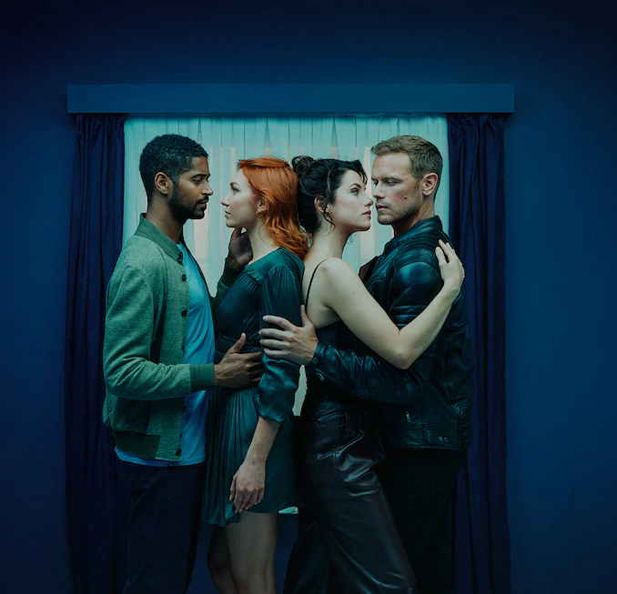
Content released as a boxset can receive high pre-broadcast viewing
1.4m
Pre-broadcast viewing (any device)
2.76 million total viewers
850k
Time-shifted viewing (any device) within 28 days of broadcast
504k
Live TV set viewing
Source: Barb 2023. Individuals, Live +3min. The Couple Next Door, Channel 4, 12 December 2023.
Notes:
Content that’s released as a boxset before being shown live on broadcaster TV often attracts high levels of pre-broadcast viewing.
In this example, an episode of The Couple Next Door, received 51% of the total audience to the pre-broadcast on-demand release.
51% pre-broadcast
18% live on a TV set
31% time shifted

Slide 16

TV landscape
“The Voice UK” ITV1

Slide 17
















TV platforms: broadcast television remains valued
Subscription VOD - % individuals with access
 | 65%
 | 49%
 | 31%
 | 7%
 | 7%
 | 7%
 | 5%
 | 1%
 | 1%
+2 subscriptions | 52%
+3 subscriptions | 30%
Internet connection
only
% main TV sets
Source: Barb Establishment Survey Q1 2023 – Q4 2023
Notes:
While subscriptions to TV streaming services are increasing, broadcast television remains valued and still accounts for the majority of people’s TV viewing. The wide variety of TV platforms available and subscribed to in the UK demonstrates that broadcasters retain a vital and unique place in meeting the needs of UK audiences.

Slide 18
TV population (universe) sizes in millions
60.9
51.7
29.2
26.7
25.0
14.3
9.2
6.7
Individuals
Adults
ABC1 Adults
Women
Men
16-34 Adults
Kids
Housepersons
with Kids
Sources: Barb, Dec 2023
Notes:
In 2023, the population of people aged 4+ with access to a TV set was 60.9m.

Slide 19

Time lengths & advertising
“Hullraisers” Channel 4

Slide 20

Time lengths & advertising
TV advertising accounted for 84% of the video advertising we saw each day in 2023, and 54% for 16-34s.
Procter & Gamble was the biggest TV advertiser in 2023.
30-second TV ads consistently account for half of all impacts
Linear TV delivered 679 billion impacts across 2023
According to Nielsen data, online businesses - as a collective category - are the heaviest investors in TV advertising and have seen the biggest growth.
“Britain Get Singing” ITV1
Sources: Barb, Nielsen Ad Intel

Slide 21
ALL INDIVIDUALS
Broadcasters account for over 80% of all video advertising
Average video advertising time per day
All Individuals: 17.0 mins
16-34s
16-34s: 9.8 mins
Source: 2023, Barb / Broadcaster stream data / IPA TouchPoints 2023 / UK Cinema Association / ViewersLogic to model OOH viewing time *YouTube ad time modelled at 4.1% of content time, TikTok ad time modelled at 3.4% of content time using agency and broadcaster data, Other online modelled at 4% of content time)
Notes:
Without a single source data provider on time-spent watching AV advertising, this analysis takes a jigsaw approach, using a variety of data sources to build the most accurate picture of AV viewing time possible.
The data approach used to build the estimate for each platform:
Broadcaster TV: Barb data for linear and playback advertising time and the broadcasters’ own census data for BVOD advertising viewing time.
Cinema: The UK Cinema Association provides total box office seats sold. We’ve estimated 15 minutes of advertising per seat.
YouTube: Barb data for time spent viewing content, ViewersLogic panel data to estimate out of home viewing not measured by Barb, broadcasters’ own data of ad load per hour of YouTube viewing, and agency data for average duration of ad view.
TikTok: Barb data for time spent viewing content, ViewersLogic panel data to estimate out of home viewing not measured by Barb, Thinkbox estimates for ad load per hour of TikTok viewing, and agency data for average duration of view.
Other online video: IPA TouchPoints data for % of other online video viewing relative to all video viewing, Thinkbox estimate of % ad time to content time

Slide 22
Advertising on broadcaster TV – how it’s watched
Inds
16-34
14.2 mins
5.3 mins
Source: 2023 - Barb / Broadcaster stream data
Notes:
BVOD is a key part of total TV advertising
By breaking the broadcaster AV advertising time down by type, we can see that whilst live TV is the primary means of getting ads seen, both playback, where ads are watched back at normal speed within recorded content, and BVOD make up a significant chunk of ad viewing time – especially amongst younger audiences. N.B. advertisers only pay for ads watched in playback at normal speed.

Slide 23
The use of time-lengths differs by category
Source: Barb, 2023, Individuals
Notes:
The most prevalent users of longer spots is the charity sector. This will consist of DR daytime and small channel spots, but shows the power of longer spots in delivering a more emotive impact. This emotive impact is dependent on good storytelling – something much easier to do successfully in longer ads.

Slide 24
30-second TV ads consistently account for half of all impacts
Source: Barb, 2013-2023, Individuals, Proportion of Impacts (R/W) by ad duration
Notes:
30-second TV ads consistently account for half of all impacts
This chart shows how the 30-second spot continues to be the most popular time length in UK ad breaks.
The main shift since 2013 has been less use of 40 to 50-second ads on TV. The prevalence of shorter time lengths (20-second, 10-second and under) and 60-second ads has remained stable. While there has been a small increase in the use 60-second+ ads.

Slide 25
Linear TV delivered 679 billion impacts across 2023
Source: Barb, Individuals, UK Full Network, 2023. Base: 30” reweighted impacts. An impact = one person viewing one TV ad in its entirety. Impacts only count when viewed at normal speed
Notes:
Linear TV delivered 679 billion impacts across 2023

Slide 26









The most viewed holding companies on TV in 2023
IMPACTS (BILLIONS)
Source: Barb, 2023, R/W commercial impacts according to Barb reporting
Notes:
Procter and Gamble was the most viewed advertiser on TV in 2023 with 29.4 billion impacts.

Slide 27










































791 advertisers used TV for the first time in 2023
Source: Nielsen Ad Intel / Sky – New to TV advertisers classed as those not advertising on TV 5 years prior (2018—2022) on Linear TV and Sky AdSmart
Notes:
In 2023, there were 791 new to TV advertisers, many of whom were ecommerce business looking to supercharge their growth through TV.

Slide 28

TV reach
“The Big Fat Quiz Of The Year” Channel 4

Slide 29
Total TV weekly reach (linear TV + BVOD)
Weekly Reach % | 2019 | 2020 | 2021 | 2022 | 2023
Adults | 93 | 91 | 91 | 91 | 89
ABC1 adults | 94 | 91 | 91 | 91 | 90
15-34 | 86 | 81 | 81 | 80 | 76
Men | 92 | 90 | 90 | 90 | 89
Women | 95 | 92 | 91 | 93 | 89
HP+CH | 94 | 90 | 90 | 91 | 89
Source: IPA TouchPoints, 2018 – 2019 , 2020 (average of both waves), 2021 (average of both waves), 2022 (average of both waves), 2023 Wave 1 (Fieldwork Dates: 17th January – 26th March 2023)
Notes:
Linear TV and broadcaster combined reaches 88.8% of the adult population each week.

Slide 30
Total TV weekly reach is high for adults
Source: Total TV. Adults 15+, IPA TouchPoints, 2019 , 2020 (average of both waves), 2021 (average of both waves), 2022 (average of both waves), 2023 Wave 1 (Fieldwork Dates: 17th January – 26th March 2023)
Notes:
Linear TV and broadcaster combined reaches 89% of the adult population each week.

Slide 31
BVOD drives 12% incremental weekly TV reach for 15-34s
Source: Total TV, 15-34s, IPA TouchPoints, 2019 , 2020 (average of both waves), 2021 (average of both waves), 2022 (average of both waves), 2023 Wave 1 (Fieldwork Dates: 17th January – 26th March 2023)
Notes:
Linear TV and broadcaster combined reaches 76% of 15-34s each week.

Slide 32

Top programmes
“Dancing On Ice” ITV1

Slide 33
UK original content dominates the top 30 series of 2023
Top 30 series on UK Television 2023 (All Inds 4+, TV set viewing only)
Rank | Channel | Title | Series | Ave aud (m) | Episodes
1 | BBC | Happy Valley | 3 | 12.8 | 6
2 | CH4 | The Great British Bake Off | 14 | 9.1 | 10
3 | BBC | Strictly Come Dancing | 21 | 8.5 | 25
4 | BBC | Death in Paradise | 12 | 8.5 | 8
5 | ITV | I'm a Celebrity... Get Me Out of Here! | 23 | 8.4 | 22
6 | BBC | Wild Isles | 1 | 8.4 | 5
7 | BBC | Beyond Paradise | 1 | 8.3 | 6
8 | Amazon | Clarkson's Farm | 2 | 8.2 | 8
9 | ITV | Unforgotten | 5 | 8.2 | 6
10 | BBC | Planet Earth III | 1 | 8.0 | 8
11 | BBC | Call the Midwife | 12 | 8.0 | 8
12 | BBC | Silent Witness | 26 | 7.2 | 10
13 | BBC | The Apprentice | 17 | 7.1 | 12
14 | ITV | The 1% Club | 2 | 7.0 | 8
15 | BBC | Vigil | 2 | 7.0 | 6
Top 30 series on UK Television 2023 (All Inds 4+, TV set viewing only)
Rank | Channel | Title | Series | Ave aud (m) | Episodes
16 | BBC | The Sixth Commandment | 1 | 7.0 | 4
17 | BBC | Shetland | 8 | 6.8 | 6
18 | ITV | Vera | 12 | 6.8 | 5
19 | Netflix | The Night Agent | 1 | 6.8 | 10
20 | ITV | Britain's Got Talent | 16 | 6.6 | 14
21 | ITV | Maryland | 1 | 6.6 | 3
22 | BBC | The Gold | 1 | 6.6 | 6
23 | ITV | Grace | 3 | 6.5 | 3
24 | ITV | The Hunt for Raoul Moat | 1 | 6.5 | 3
25 | ITV | Endeavour | 9 | 6.5 | 3
26 | ITV | The Long Shadow | 1 | 6.4 | 7
27 | Netflix | Beckham | 1 | 6.4 | 4
28 | ITV | The Bay | 4 | 6.4 | 6
29 | CH4 | Gogglebox | 21 | 6.4 | 16
30 | BBC | The Reckoning | 1 | 6.3 | 4
Source: Barb, 2023, Individuals. TV set viewing, Average audience per episode (excludes one-offs, kids, films and sports), all channels, and includes repeats.
Notes:
UK original content dominates the top 30 series of 2023.

Slide 34
SVODs play a significant role in the top shows for 16-34s
Top 30 series on UK Television 2023 (16-34, TV set viewing only)
Rank | Channel | Title | Series | Ave aud (m) | Episodes
1 | Amazon | Clarkson's Farm | 2 | 2.7 | 8
2 | Netflix | Sex Education | 4 | 2.2 | 8
3 | Netflix | Beckham | 1 | 2.0 | 4
4 | ITV | I'm a Celebrity... Get Me Out of Here! | 23 | 1.8 | 22
5 | BBC | Doctor Who | 2023 | 1.7 | 3
6 | BBC | The Apprentice | 17 | 1.7 | 12
7 | Netflix | The Night Agent | 1 | 1.7 | 10
8 | CH4 | The Great British Bake Off | 14 | 1.6 | 10
9 | Netflix | At Home With The Furys | 1 | 1.6 | 9
10 | BBC | Happy Valley | 3 | 1.5 | 6
11 | Netflix | You | 4 | 1.5 | 10
12 | Netflix | Black Mirror | 6 | 1.4 | 5
13 | Sky Atlantic | The Last Of Us | 1 | 1.3 | 9
14 | Netflix | Queen Charlotte: A Bridgerton Story | 1 | 1.3 | 6
15 | Amazon | The Grand Tour | 5 | 1.2 | 2
Top 30 series on UK Television 2023 (16-34, TV set viewing only)
Rank | Channel | Title | Series | Ave aud (m) | Episodes
16 | Disney+ | The Mandalorian | 3 | 1.2 | 8
17 | Netflix | The Witcher | 3 | 1.2 | 8
18 | Netflix | Brooklyn Nine-Nine | 8 | 1.1 | 10
19 | Netflix | Wednesday | 1 | 1.1 | 8
20 | Netflix | Rick and Morty | 6 | 1.1 | 10
21 | Amazon | The Grand Tour | 4 | 1.0 | 4
22 | Netflix | Ginny & Georgia | 2 | 1.0 | 10
23 | Netflix | Murdaugh Murders: A Southern Scandal | 1 | 1.0 | 3
24 | Netflix | Top Boy | 3 | 1.0 | 6
25 | Netflix | Brooklyn Nine-Nine | 3 | 1.0 | 23
26 | BBC | Happy Valley | 1 | 1.0 | 6
27 | CH4 | Married at First Sight UK | 8 | 1.0 | 3
28 | Netflix | Brooklyn Nine-Nine | 4 | 0.9 | 22
29 | Netflix | Squid Game: The Challenge | 1 | 0.9 | 10
30 | Netflix | Bodies | 1 | 0.9 | 8
Source: Barb, 2023, 16-34. TV set viewing, Average audience per episode (excludes one-offs, kids, films and sports), all channels, and includes repeats.
Notes:
In 2023, Clarkson's Farm was by far the most watched series amongst 16-34s.

Slide 35
The Coronation was the most watched one-off event of 2023
Top 30 one-offs on UK Television 2023 (All Inds 4+, TV set viewing only)
Rank | Channel | Title | Ave aud (m)
1 | BBC | The Coronation - The Coronation | 12.6
2 | BBC | The Coronation - The Celebration | 11.5
3 | BBC | The Coronation - The Coronation Concert | 11.4
4 | BBC | New Year's Eve Fireworks | 11.2
5 | BBC | Eurovision Song Contest | 10.2
6 | BBC | Glastonbury - Elton John | 9.5
7 | BBC | Doctor Who - Christmas Special: The Church on Ruby Road | 7.6
8 | BBC | The King | 7.5
9 | BBC | Call the Midwife (Christmas Special) | 7.4
10 | ITV | Harry: The Interview | 6.7
11 | CH4 | Gogglebox (Festive Special) | 6.7
12 | BBC | Ghosts (Christmas Special) | 6.6
13 | BBC | Strictly Come Dancing (Christmas Special) | 6.6
14 | ITV | The 1% Club (Christmas Special) | 6.2
15 | BBC | Death in Paradise (Christmas Special) | 6.2
Top 30 one-offs on UK Television 2023 (All Inds 4+, TV set viewing only)
Rank | Channel | Title | Ave aud (m)
16 | BBC | Beyond Paradise (Christmas Special) | 6.2
17 | ITV | Vera (Christmas Special) | 6.0
18 | ITV | I'm a Celebrity... Get Me Out of Here! Coming Out | 5.6
19 | BBC | Rick Astley Rocks New Year’s Eve* | 5.4
20 | BBC | Michael McIntyre's Christmas Wheel | 5.2
21 | BBC | Mrs Brown's Boys (New Years Special) | 5.2
22 | BBC | Charles R: The Making of a Monarch | 5.1
23 | ITV | The Chase: The Bloopers | 5.0
24 | BBC | Mrs Brown's Boys (Christmas Special) | 5.0
25 | CH4 | Air Fryers: Are They Worth It? | 4.8
26 | CH4 | Gogglebox 10 Year Anniversary Special | 4.8
27 | ITV | For the Love of Paul O'Grady | 4.8
28 | BBC | Charles III: The Coronation Year | 4.7
29 | CH4 | The Great British Bake Off: Festive Specials | 4.7
30 | ITV | The Royal Variety Performance | 4.6
Source: Barb, 2023, individuals. Average audience figures. UK all viewing, excludes kids, films, and sports.
Notes:
In 2023, The Coronation of Charles III and Camilla was the most watched one-off event on TV.

Slide 36
16-34s welcomed in the new year with the BBC
Top 30 one-offs on UK Television 2023 (16-34s, TV set viewing only)
Rank | Channel | Title | Ave aud (m)
1 | BBC | New Year's Eve Fireworks | 2.4
2 | BBC | Eurovision Song Contest | 1.9
3 | BBC | Doctor Who - Christmas Special: The Church on Ruby Road | 1.7
4 | BBC | The Coronation - The Coronation | 1.5
5 | BBC | The Coronation - The Celebration | 1.3
6 | BBC | Rick Astley Rocks New Year’s Eve | 1.2
7 | BBC | The Coronation - The Coronation Concert | 1.1
8 | Netflix | MH370: The Plane That Disappeared (Malay) | 1.0
9 | BBC | The King | 1.0
10 | BBC | Ghosts (Christmas Special 2023) | 1.0
11 | CH4 | Taskmaster's New Year Treat | 0.9
12 | ITV | The BRIT Awards | 0.9
13 | Disney+ | Encanto at the Hollywood Bowl | 0.9
14 | CH4 | Big Fat Quiz | 0.9
15 | ITV | The 1% Club (Christmas Special) | 0.9
Top 30 one-offs on UK Television 2023 (16-34s, TV set viewing only)
Rank | Channel | Title | Ave aud (m)
16 | BBC | Call the Midwife (Christmas Special) | 0.8
17 | CH4 | Gogglebox (Festive Special) | 0.8
18 | BBC | Michael McIntyre’s Christmas Wheel | 0.7
19 | CH4 | The Great British Bake Off: Festive Specials | 0.7
20 | BBC | Strictly Come Dancing (Christmas Special) | 0.7
21 | Netflix | Ricky Gervais: Armageddon | 0.6
22 | CH4 | The Great British Bake Off: Festive Specials | 0.6
23 | BBC | Gavin & Stacey (Christmas Special) | 0.5
24 | BBC | Ghosts (Christmas Special 2022) | 0.5
25 | BBC | Gavin & Stacey | 0.5
26 | BBC | Mrs Brown's Boys | 0.5
27 | BBC | Numberblocks | 0.5
28 | BBC | Jools' Annual Hootenanny | 0.5
29 | CH4 | 8 Out of 10 Cats Does Countdown | 0.5
30 | Netflix | Costco: Is It Really Worth It? | 0.4
Source: Barb, 2023, 16-34s. Average audience figures. UK all viewing, excludes kids, films, and sports.
Notes:
16-34s welcomed in the new year with the BBC’s coverage of the London fireworks.

Slide 37



In 2023, we saw The Coronation, blockbuster epics, and the return of old favourites
In May, the nation tuned in to BBC1 to watch The Coronation of TM The King and Queen Camilla to an average audience of 12.0 million.
In November, ITV1 aired the latest edition of I’m a Celebrity Get Me Out of Here… to an average. audience of 10.4 million.
In September, Channel 4 aired the eagerly awaited 14th season of The Great British Bake Off to an average audience of 8.4 million.
In January, Sky Atlantic transported viewers to the post-apocalyptic world of The Last of Us to an average audience of 3.1 million.
Source: Barb, 2023, individuals. TV and Online Pre-Broadcast 1-28 days. *Barb reported figure for multiple channels

Slide 38

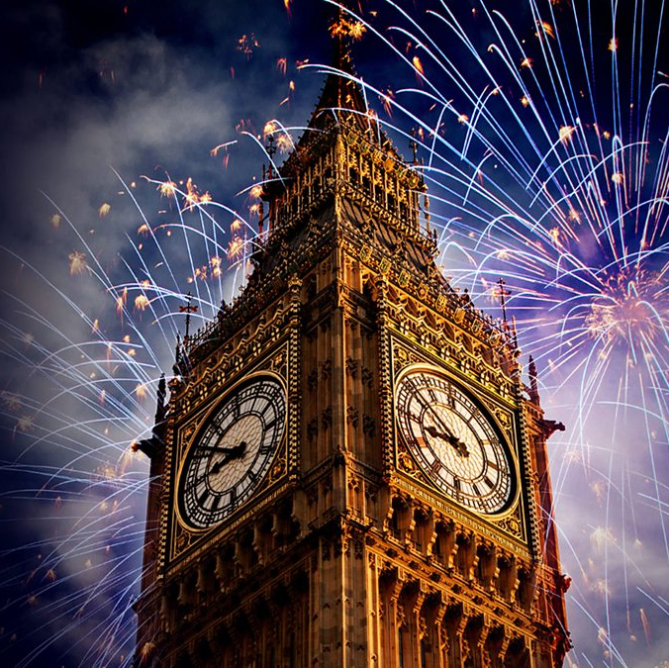





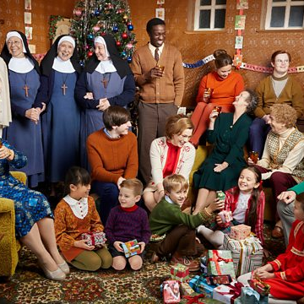
Top TV programmes 2023 (TV set and device)
Happy Valley
BBC1, 5 Feb
12,817,035
New Year's Eve Fireworks
BBC1, 31 Dec
12,242,811
The Coronation of TM The King and Queen Camilla
BBC1, 6 May
12,044,500
I'm a Celebrity... Get Me Out of Here!
ITV, 19 Nov
10,364,346
Eurovision Song Contest
BBC1, 13 May
10,280,359
Strictly Come Dancing
BBC1, 16 Dec
10,088,940
Beyond Paradise
BBC1, 24 Feb
9,324,676
Death in Paradise
BBC1, 13 Jan
8,913,012
The Gold
BBC1, 12 Jan
8,655,297
Call The Midwife
BBC1, 25 Dec
8,615,667
Source: Barb, 2023, individuals. Average audience figures. TV and / or Online Network. TV and Online Pre-Broadcast 1-28 days. Top performing episode only.
Notes:
Top TV programme 2023 (TV set & device).
In 2023, Happy Valley emerged as the top TV programme of the year, pulling an average audience of 12.82 million viewers.

Slide 39


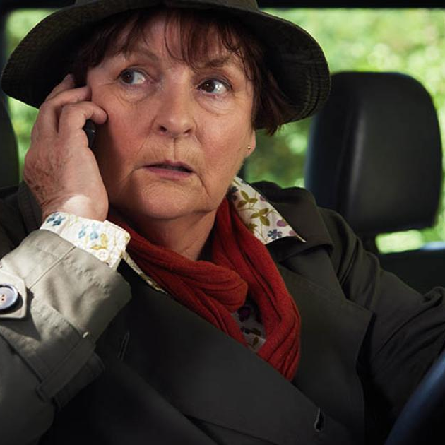





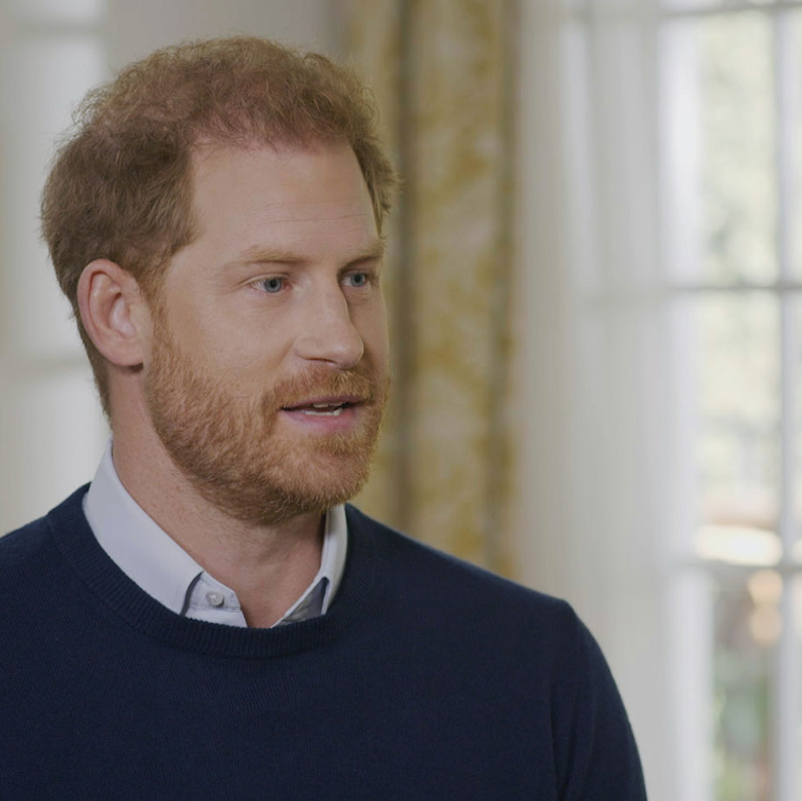
Top ITV1 programmes 2023 (TV set and device)
I'm a Celebrity... Get Me Out of Here!
19 Nov
10,364,346
Unforgotten
13 Mar
8,272,465
Britain’s Got Talent
22 Apr
7,731,191
Vera
19 Feb
7,085,277
Grace
19 Mar
6,724,761
Malpractice
23 Apr
6,706,117
The Hunt for Raoul Moat
17 Apr
6,677,602
Ant & Dec's Saturday Night Takeaway
25 Feb
6,647,981
The Long Shadow
25 Sep
6,642,295
Harry: The Interview
8 Jan
6,451,806
Source: Barb, 2023, individuals. Average audience figures. TV and / or Online Network. TV and Online Pre-Broadcast 1-28 days. Top performing episode only.
Notes:
Top ITV1 programme 2023 (TV set & device).
I’m a Celebrity… Get Me Out of Here! was most watched ITV1 show of 2023, with a single episode pulling an average audience of 10.36 million viewers.

Slide 40


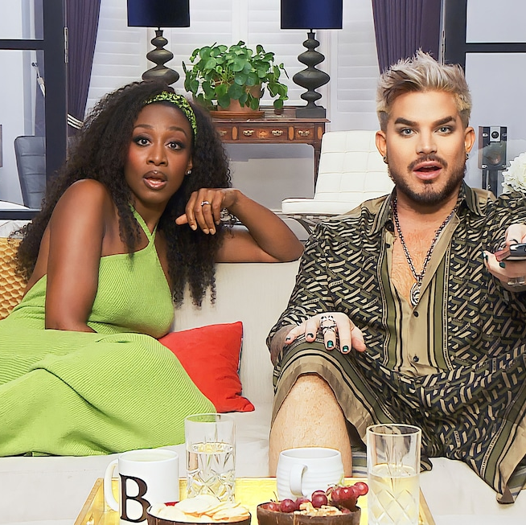

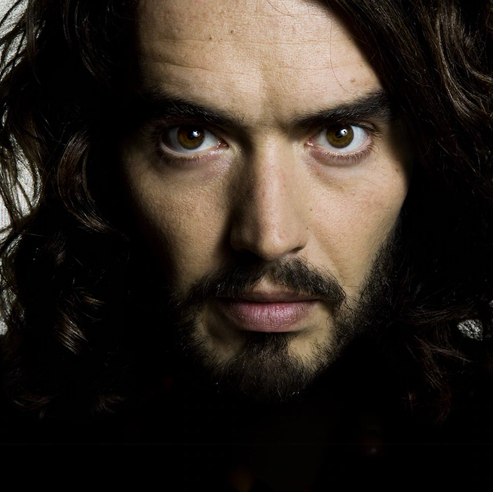

Top Channel 4 programmes 2023 (TV set and device)
The Great British Bake Off
26 Sep
8,390,022
Gogglebox
24 Feb
4,872,541
International Football: Scotland v England
12 Sep
4,489,108
International Football: England v Italy
17 Oct
4,488,179
Celebrity Gogglebox
14 Jul
4,310,213
The Great Celebrity Bake Off for SU2C
19 Mar
4,307,443
Euros Qualifiers: England v Ukraine
26 Mar
4,278,028
Euros Qualifiers:
Italy v England
23 Mar
4,078,096
Russell Brand: In Plain Sight: Dispatches
16 Sep
3,994,458
The Light in the Hall
4 Jan
3,782,159
Source: Barb, 2023, individuals. Average audience figures. TV and / or Online Network. TV and Online Pre-Broadcast 1-28 days. Top performing episode only.
Notes:
Top Channel 4 programme 2023 (TV set & device).
The Great British Bake Off was the most watched Channel 4 show of 2023, with a single episode pulling an average audience of 8.39 million viewers.

Slide 41


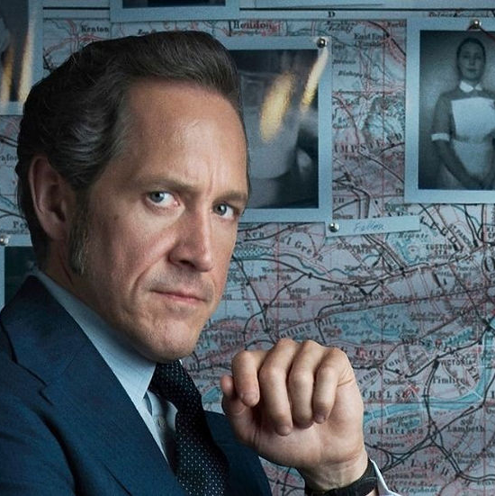







Top Channel 5 programmes 2023 (TV set and device)
All Creatures Great and Small
19 Oct
4,655,516
The Inheritance
4 Sep
4,578,241
PD James Dalgliesh
27 Apr
3,673,900
The Catch
25 Jan
3,672,150
For Her Sins
5 Jun
3,224,599
The Good Ship Murder
13 Oct
2,860,248
Madame Blanc
19 Jan
2,789,864
Blindspot
4 Jul
2,463,899
Heat
11 Jul
2,291,561
All Creatures Great & Small: Yorkshire Vet Special
21 Dec
2,127,567
Source: Barb, 2023, individuals. Average audience figures. TV and / or Online Network. TV and Online Pre-Broadcast 1-28 days. Top performing episode only.
Notes:
Top Channel 5 programme 2023 (TV set & device).
All Creatures Great and Small was the most watched Channel 5 show of 2023, with a single episode pulling an average audience of 4.66 million viewers.

Slide 42






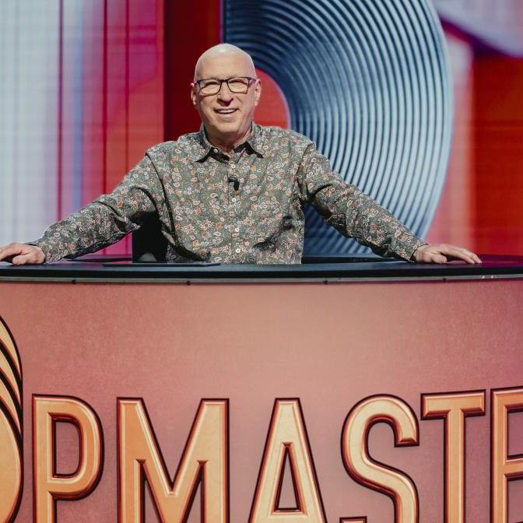
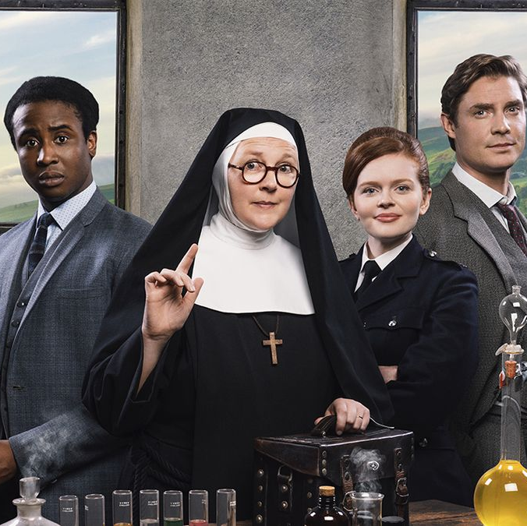
Top commercial non-PSB* programmes 2023 (non-sport)
Love Island
ITV2, 16 Jan
3,461,362
The Last Of Us
Sky Atlantic, 15 Jan
3,068,939
Married at First Sight UK
E4, 19 Oct
3,030,487
Big Brother
ITV2, 9 Oct
2,599,441
Married at First Sight Australia
E4, 30 Mar
2,143,653
The Great British Bake Off
4seven, 24 Oct
1,367,350
Annika
Alibi, 9 Aug
1,287,797
Mrs Sidhu Investigates
Drama, 4 Oct
1,274,578
PopMaster TV
More4, 26 Jun
1,261,585
Sister Boniface Mysteries
Drama, 26 May
1,251,518
Source: Barb, 2023, individuals. Average audience figures. TV and / or Online Network. TV and Online Pre-Broadcast 1-28 days. Top performing episode only.
Notes:
Top commercial non-PSB programme 2023 (TV set & device).
Love Island was the most watched non-PSB show of 2023, with a single episode pulling an average audience of 3.46 million viewers.

Slide 43

Top commercial sport programmes
Top commercial sport:
Rugby World Cup 2023: England v South Africa – ITV1, 21 October– 8,952,100
Rugby World Cup 2023: England v Fiji – ITV1, 15 October – 7,768,600
Rugby World Cup 2023: New Zealand v South Africa – ITV1, 28 October – 7,507,300
Top commercial non-PSB:
UEFA Champions League Final Man City v Inter Milan – TNT Sport 1, 10 June – 5,735,300
UEFA Europa Conference League Fiorentina v West Ham United – TNT Sports 1, 7 June – 3,348,500
FA Cup Liverpool v Wolves – ITV4, 7 Jan – 3,302,000
Source: Barb, 2023, individuals. Peak minute audience, consolidated 28 days
Notes:
Top commercial sport programmes. ITV1 hosted the semi-final of the Rugby World Cup to a peak audience of 8.95 million.

Slide 44
Top 5 commercial programmes with largest proportion of device viewing
Total audience
2.55m
2.42m
1.08m
1.68m
Source: Barb, 2023, individuals. Average audience figures, TV and Online Pre-broadcast and 1-28 days, TV set and devices viewing. Based on programmes with 1 million+ total TV viewers
Notes:
Top 5 commercial programmes with largest proportion of device viewing.
In 2023, an episode of ITV2’s Love Island received the highest proportion of device viewing, with 23.1% of viewers tuning in via laptop, tablet, or mobile.

Slide 45
Top 5 commercial programmes with largest proportion of pre-broadcast boxset BVOD viewing
Total audience
2.76m
7.90m
4.12m
1.93m
Source: Barb, 2023, individuals. Average audience figures, TV and Online Pre-broadcast and 1-28 days, TV set and devices viewing. Based on programmes with 1 million+ total TV viewers
Notes:
Top 5 commercial programmes with largest proportion of pre-broadcast boxset BVOD viewing
In 2023, an episode of Channel 4’s The Couple Next Door was watched by a pre-broadcast audience of 50.9%, time-shifted audience of 31.4%, and live audience of 17.7%.

