Slide 1



Thinkbox TV viewing report
2025
ITV – There’s No Place Like ITV
Notes:
Thinkbox TV viewing report

Slide 2

Overview
In 2025, we watched 3h 26m of Total TV each day.
VOD represents 69% of Total TV viewing for 16-34s.
Total TV advertising accounted for 85% of the video advertising we saw each day in 2025.
16-34s spend more time with TV advertising than with YouTube & TikTok's combined.
Rob & Romesh vs…, Sky Max

Slide 3



The last decade has seen huge improvements in TV quality
78% of main TV screens 40”+ (vs. 35.2% in 2012)
Access to broadband speeds required to support streaming TV have peaked
88% of households can access broadcaster VOD on a TV set
Over 98% of homes have access to over 30 Mbps
Source: Barb, Ofcom.
Notes:
TV technology and content quality have improved dramatically in the past decade.
Images:
Gogglebox, Channel 4
Fight or Flight, Sky
I’m a Celebrity, ITV1

Slide 4
Total TV accounted for 70% of total video viewing in 2025
4 hrs 54 mins
Source: 2025, Barb / IPA TouchPoints 2025 / Pornhub / UK Cinema Association / Ipsos Iris
Total TV = Broadcaster TV, SVODs & AVODs
Notes:
Methodology
The quantitative analysis of total video consumption in the UK was undertaken by Thinkbox. It combined 2025 data from Barb, the IPA’s TouchPoints, Pornhub, UK Cinema Association, and Ipsos Iris.
Barb data shows how much time is spent viewing broadcaster content, live or time-shifted (including BVOD) on all devices as well as Blu-Ray/DVD viewing. This chart also utilises Barb’s expanding audience reporting capabilities to provide a view of time spent viewing content on YouTube, TikTok, other video sharing services (such as Twitch) as well as SVOD/AVOD platforms. Whilst Barb reports on in-home consumption, a combination of Ipsos Iris and IPA TouchPoints data was used to determine the remaining out-of-home consumption.
The combination of these sources creates a solid estimate as it utilises the robustness of Barb data (11,500 panel members, representative of the UK TV population, metered actual consumption data, analysis across a whole year) alongside Ipsos Iris and IPA TouchPoints data to capture any out-of-home consumption.
Time spent viewing video at cinemas was based on total admissions data from the UK Cinema Association profiled for each audience using data from DCM.
Source: Ipsos iris Online Audience Measurement Service, 12-month average Jan – Dec 2025. Internet users aged 15+, using PC/laptop, smartphone or tablet device.
Technical note: [Broadcaster] data for YouTube includes content owner data for the BBC, Channel 4, CNBC, ITV, NBC and Sky. [Commercial broadcaster] data for YouTube includes content owner data for Channel 4, CNBC, ITV, NBC and Sky. TikTok data is both website and app.
Ipsos iris is the UKOM endorsed service for the measurement of audiences of online content. We passively track the online behaviour of a single-source panel of over 10,000 UK adults, who install software across their devices (a combination of smartphones, tablets, PCs and laptops). The panel is recruited to be representative of the internet population demographically, geographically and by device type. This passive data is fused with anonymous, device-level data derived from site-centric tags on hundreds of the biggest sites and apps to create a synthetic panel of around 1 million synthetic panellists. More detail on the methodology can be found here.

Slide 5
Three ways to watch Total TV
Adults
16-34
3 hrs 26 mins
1 hr 47 mins
Source: 2025, Barb, Thinkbox estimates, VOD includes Broadcaster VOD, SVOD and AVOD
Notes:
Breaking down Total TV into the different ways reveals the increasingly important role of Live and VOD viewing.
This data uses both Barb data and includes an estimate of any unknown viewing that is thought to fall into Playback and Live viewing.

Slide 6
Commercial broadcasters are unrivalled for scale
Adults – All devices
Bubble area represents total volume of daily viewing
AVERAGE DAILY REACH (000s)
Other
SVOD
Other AVOD
Twitch
AVE TIME VIEWED PER VIEWER PER DAY
Source: Barb / Adults, all devices – 2025
Notes:
This chart breaks down viewing to the various platforms in terms of the average number of people watching per day (for at least 3 minutes) compared with the average time spent watching per viewer (i.e. only counting those who watched on that day).
Analysis across 2025 shows that the commercial broadcasters (linear and on demand) collectively reach over 26 million viewers every day, with each of those viewers watching for an average of 3hrs, 40 mins a day. The combined portfolio of BBC channels (linear and on demand) attracts the second largest volume of viewing, with 22 million daily reach and an average view time of 2 hours, 12 mins a day. YouTube is next, with a daily reach of 18 million and a view time of 1hr 53 mins (Barb only measure in-home viewing, we estimate that YouTube would be larger in viewing time if out of home viewing was included).
SVOD services such as Netflix has a daily reach of 12 million people and a view time of 1hr 52 mins.

Slide 7
Commercial broadcasters unrivalled for scale on the TV set
Adults – TV Set
Bubble area represents total volume of daily viewing
AVERAGE DAILY REACH (000s)
Other AVOD
Other SVOD
TikTok
Twitch
AVE TIME VIEWED PER VIEWER PER DAY
Source: Barb / All adults, TV sets – 2025
Notes:
This chart breaks down viewing to the various platforms in terms of the average number of adults watching per day (for at least 3 minutes) on a TV set compared with the average time spent watching per viewer (i.e. only counting those who watched on that day).
Analysis across 2025 shows that the commercial broadcasters (linear and on demand) collectively reach 26 million adult viewers every day, with each of those viewers watching for an average of 3hrs, 40 mins a day. The combined portfolio of BBC channels (linear and on demand) has a daily reach of 21 million and an average view time of 2hr 12 mins. YouTube has a daily reach of 7 million adults and a view time of 2hr 13 mins.
SVOD services such as Netflix has a daily reach of 10 million people and a view time of 1hr 51 mins.

Slide 8

How TV content is viewed
Taskmaster – Channel 4

Slide 9

Sports is time-sensitive so has high levels of live viewing
2.69 million
97% Live
viewing
(any device)
85k
2.78 million adult viewers
3% On-demand viewing (any device)
Source: Barb, 2025, Adults, Live +3min. Premier League: Liverpool v Arsenal, 31st Aug, Sky Sports, All Devices.
Notes:
Sport tends to be watched live as it is time sensitive.
In this example- 97% of the viewing was live
97% live
3% on-demand

Slide 10

Primetime drama has high levels of on-demand viewing
1.49m
37% Live
viewing (any device)
4.03 million adult viewers
2.54m
63% On-demand viewing (any device)
Source: Barb, 2025, Adults, Live +3min. Murder Before Evensong, S1 Ep1, 7th Oct, Channel 5, All Devices.
Notes:
Prime time drama has high levels of on-demand viewing because it’s not time sensitive so people choose to watch it at a time that suits them.
In this example, the launch episode of Murder Before Evensong on Channel 5 had 37% live viewing and 63% on-demand.
37% live
63% on-demand

Slide 11

Device viewing allows flexibility in watching reality TV
592k
25% Device viewing
2.41 million adult viewers
1.82m
75% TV Set viewing
Source: Barb, 2025, Adults. Love Island, S12 Ep47, 25th Jul, ITV2, All Devices.
Notes:
For programmes that appeal to young people, who want flexible viewing options, there is much higher levels of device viewing.
In this example, an episode of Love Island on ITV2 saw 25% of all viewing done on a device.
75% TV set
25% Device

Slide 12

Broad appeal entertainment has high TV set viewing
6.11 million
96% TV Set viewing
255k
4% Device
viewing
6.37 million adult viewers
Source: Barb, 2025, Adults, Live +3min. The Great British Bake Off, S16, Ep1, 2nd Sep, Channel 4, All Devices.
Notes:
Entertainment shows with broad appeal, have high TV Set viewing.
In this example, the launch episode of The Great British Bake Off on Channel 4 saw 96% of all viewing on the TV Set.
96% TV Set
4% Device

Slide 13

Content released as a boxset can receive high pre-broadcast viewing
3.42m
47% Pre-broadcast viewing (any device)
7.41 million total viewers
2.16m
29% Time-shifted viewing (any device) within 28 days of broadcast
1.74m
24% Live TV set viewing
Source: Barb, 2025, Adults, Live +3min. Protection (PKA Witness Protection), ITV1, 31st Mar, Online Multiple Screens, All Devices.
Notes:
Content that’s released as a boxset before being shown live on broadcaster TV often attracts high levels of pre-broadcast viewing.
In this example, this episode of Protection (PKA Witness Protection) on ITV1, received 47% of the total audience to the pre-broadcast on-demand release.
47% pre-broadcast
24% live on a TV set
29% time shifted

Slide 14

TV landscape
The Last of Us – Sky Atlantic

Slide 15
Commercial linear TV daily, weekly & monthly reach
Reach % | Daily | Weekly | Monthly
Individuals | 42.3 | 66.7 | 81.6
Adults | 46.7 | 70.5 | 83.9
ABC1 adults | 42.1 | 67.9 | 82.7
16-34 | 20.4 | 47.5 | 69.6
Men | 45.5 | 69.5 | 83.0
Women | 47.8 | 71.5 | 84.7
HP+CH | 34.8 | 63.4 | 81.3
Source: Barb, 2025, industry standard TV viewing in-home on a TV set. Reach 3min+
Notes:
Commercial Linear TV reaches 67% of the population each week.

Slide 16
TV population (universe) sizes in millions
61.3
52.3
29.9
27.0
25.2
14.4
9.0
6.9
Individuals
Adults
ABC1 Adults
Women
Men
16-34 Adults
Kids
Housepersons
with Kids
Source: Barb, Dec 2025
Notes:
In 2025, the population of people aged 4+ with access to a TV set was 61.3m.

Slide 17

Time lengths & advertising
Pete Wicks: For Dogs' Sake – U&W

Slide 18

Time lengths & advertising
Total TV advertising accounted for 85% of the video advertising we saw each day in 2025.
16-34s spend more time with TV advertising than with YouTube & TikTok's combined.
30-second TV ads consistently account for over half of all impacts.
Linear TV delivered 590 billion impacts across 2025.
Procter & Gamble was the biggest TV advertiser in 2025.
984 advertisers used TV for the first time in 2025.
Trigger Point – ITV1
Sources: Barb, Nielsen Ad Intel

Slide 19
Total TV accounts for 85% of all AV advertising time
12%
Individuals
Ad time per day: 16:38
85%
Source: 2025, Barb / Broadcaster stream data / UK Cinema Association / Ipsos Iris
**YouTube ad time modelled at 3.33% of content time (Enders Analysis, 23rd October 2024) and excludes those estimated to be on the YouTube Premium tier. *TikTok ad time modelled at 3.4% of content time using agency and broadcaster estimates. **Other online modelled at 3.33% of content time.
Notes:
Without a single source data provider on time-spent watching AV advertising, this analysis takes a jigsaw approach, using a variety of data sources to build the most accurate picture of AV viewing time possible.
The data approach used to build the estimate for each platform:
Total TV: Barb data for Total TV (broadcaster and SVOD/AVOD services) and the broadcasters’ own census data for BVOD advertising viewing time.
Cinema: The UK Cinema Association provides total box office seats sold. We’ve estimated 15 minutes of advertising per seat.
YouTube: Ad time modelled at 3.33% of content time (Enders Analysis, 23rd October 2024) and excludes those estimated to be on the YouTube Premium tier.
TikTok: Ad time modelled at 3.4% of content time using agency and broadcaster estimates.
Other online video: ad time modelled at 3.33% of content time.

Slide 20
16-34s spend more time with TV advertising than YouTube and TikTok combined
14%
48%
16-34s
Ad time per day: 8:58
33%
Source: 2025, Barb / Broadcaster stream data / UK Cinema Association / Ipsos Iris
**YouTube ad time modelled at 3.33% of content time (Enders Analysis, 23rd October 2024) and excludes those estimated to be on the YouTube Premium tier. *TikTok ad time modelled at 3.4% of content time using agency and broadcaster estimates. **Other online modelled at 3.33% of content time.
Notes:
Without a single source data provider on time-spent watching AV advertising, this analysis takes a jigsaw approach, using a variety of data sources to build the most accurate picture of AV viewing time possible.
The data approach used to build the estimate for each platform:
Total TV: Barb data for Total TV (broadcaster and SVOD/AVOD services) and the broadcasters’ own census data for BVOD advertising viewing time.
Cinema: The UK Cinema Association provides total box office seats sold. We’ve estimated 15 minutes of advertising per seat.
YouTube: Ad time modelled at 3.33% of content time (Enders Analysis, 23rd October 2024) and excludes those estimated to be on the YouTube Premium tier.
TikTok: Ad time modelled at 3.4% of content time using agency and broadcaster estimates.
Other online video: ad time modelled at 3.33% of content time.

Slide 21
30-second TV ads consistently account for half of all impacts
Source: Barb, 2015-2025, Individuals, Proportion of Impacts (R/W) by ad duration
Notes:
30-second TV ads consistently account for half of all impacts
This chart shows how the 30-second spot continues to be the most popular time length in UK ad breaks.
The main shift since 2015 has been less use of 40 to 50-second ads on TV. The prevalence of shorter time lengths (20-second, 10-second and under) and 60-second ads has remained stable. While there has been a small increase in the use 60-second+ ads.

Slide 22
The use of time-lengths differs by category
Source: Barb, 2025, Individuals
Notes:
The most prevalent users of longer spots is the charity sector (Govt, Social, Political Org). This will consist of DR daytime and small channel spots, but shows the power of longer spots in delivering a more emotive impact. This emotive impact is dependent on good storytelling – something much easier to do successfully in longer ads.

Slide 23
Linear TV delivered 590 billion impacts across 2025
Source: Barb, Individuals, UK Full Network, 2025. Base: 30” reweighted impacts. An impact = one person viewing one TV ad in its entirety. Impacts only count when viewed at normal speed
Notes:
Linear TV delivered 590 billion impacts across 2025.

Slide 24









The most viewed holding companies on TV in 2025
Impacts (Billions)
Source: Barb, 2025, R/W commercial impacts according to Barb reporting
Notes:
Procter and Gamble was the most viewed advertiser on TV in 2025 with 30.1 billion impacts.

Slide 25
598 advertisers spent less than £50k on TV in 2025
Source: Nielsen Ad Intel, 2025
Notes:
Looking at the make-up of TV advertisers across 2025, 598 - which is 27% of all advertisers - spent less than 50 thousand pounds on TV and 1,103, which is 50%, spent less than 250 thousand. 31% of all advertisers spent over a million pounds and 5% spent over ten million.

Slide 26
In 2025, there were 984 new to TV advertisers
Source: Nielsen Ad Intel / Sky. *New to TV advertisers classed as those not advertising on TV within the last 5 years on Linear TV and Sky AdSmart
Notes:
In 2025, there were 984 new to TV advertisers.

Slide 27



























































984 advertisers used TV for the first time in 2025
Source: Nielsen Ad Intel / Sky – New to TV advertisers classed as those not advertising on TV 5 years prior (2020-2024) on Linear TV and Sky AdSmart
Notes:
In 2025, there were 984 new to TV advertisers, many of whom were ecommerce business looking to supercharge their growth through TV.

Slide 28

Top programmes
“Celebrity Big Borther”, ITV1

Slide 29




2025 was the year of familiar favourites and Adolescence
On 16th November, ITV1 launched the 25th series of I’m a Celebrity Get Me Out of Here, to an average audience of 9.7 million.
In September, Channel 4 aired the eagerly awaited 16th season of The Great British Bake Off to an average audience of 6.4 million.
In April, Sky Atlantic launched the second series of The Last of Us to an average audience of 1.6 million.
On 13th March, Netflix aired Adolescence, new drama about a teen accused of murder to an average audience of 12.7 million.
Source: Barb, 2025, Adults. TV and Online Pre-Broadcast 1-28 days. Average audience achieved during the first 28 days of their availability.
Notes:
In 2025, we saw the 25th series of I’m a Celeb, Adolescence shook the nation, the return of old favorites with The Great British Bake Off on Channel 4, and the return of The Last of Us on Sky Atlantic.

Slide 30









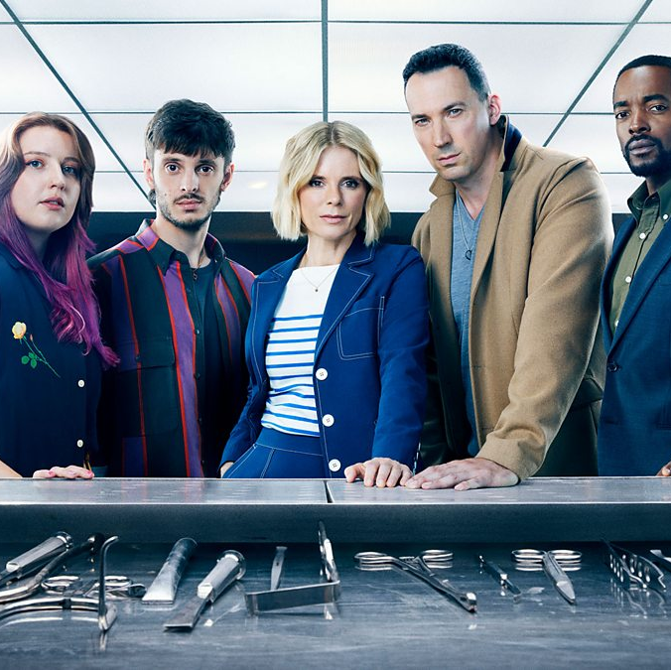
Top broadcaster TV programmes 2025 (All devices)
The Celebrity Traitors
BBC 1, 6 Nov
14,254,334
I'm a Celebrity... Get Me Out of Here!
ITV1, 16 Nov
9,726,894
The Traitors
BBC 1, 24 Jan
9,346,391
New Year’s Eve Fireworks
BBC 1, 31 Dec
9,311,132
Strictly Come Dancing
BBC 1, 20 Dec
8,055,742
Unforgotten
ITV1, 9 Feb
8,050,064
Call the Midwife
BBC 1, 12 Jan
7,648,978
Playing Nice
ITV1, 5 Jan
7,578,773
Protection
ITV1, 31 Mar
7,321,610
Silent Witness
BBC 1, 13 Jan
7,112,823
Source: Barb, 2025, Adults. Average audience figures. TV and / or Online Network. TV and Online Pre-Broadcast 1-28 days. Top performing episode only.
Notes:
Top TV programme 2025 (All devices).
In 2025, The Celebrity Traitors emerged as the top TV programme of the year, pulling an average audience of 14.3 million viewers.

Slide 31






16-34 Top TV programmes 2025 (All devices)
The Celebrity Traitors
BBC 1, 6 Nov
3,106,686
I'm a Celebrity... Get Me Out of Here!
ITV1, 16 Nov
2,596,235
The Traitors
BBC 1, 17 Jan
2,262,985
New Year's Eve Fireworks
BBC 1, 31 Dec
1,823,870
The Apprentice
BBC 1, 6 Mar
1,416,929
The Great British Bake Off
Channel 4, 2 Sep
1,364,135
Love Island
ITV2, 11 Jul
1,359,259
Eurovision Song Contest
BBC 1, 17 May
1,225,224
Amandaland
BBC 1, 25 Dec
1,168,353
Love Island All Stars
ITV2, 4 Feb
1,157,498
Source: Barb, 2025, 16-34. Average audience figures. TV and / or Online Network. TV and Online Pre-Broadcast 1-28 days. Top performing episode only.
Notes:
Top TV programme 2025 for 16-34’s (All devices).
In 2025, The Celebrity Traitors emerged as the top TV programme of the year, pulling an average audience of 3.1 million viewers.

Slide 32






Top ITV1 programmes 2025 (All devices)
I'm a Celebrity... Get Me Out of Here!
16 Nov
9,726,894
Unforgotten
9 Feb
8,050,064
Playing Nice
5 Jan
7,578,773
Protection
31 Mar
7,321,610
Trigger Point
26 Oct
6,906,920
Vera
2 Jan
6,887,829
Code of Silence
18 May
6,437,810
The Bay
2 Mar
6,344,595
Out There
19 Jan
6,112,833
UEFA Women’s Euro 2025: ENG v ITA
22 Jul
6,078,907
Source: Barb, 2025, Adults. Average audience figures. TV and / or Online Network. TV and Online Pre-Broadcast 1-28 days. Top performing episode only.
Notes:
Top ITV1 programme 2025 (All devices).
I’m a Celebrity…Get Me Out of Here was most watched ITV1 show of 2025, with an average audience of 9.7 million viewers.

Slide 33



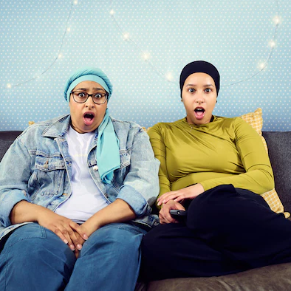

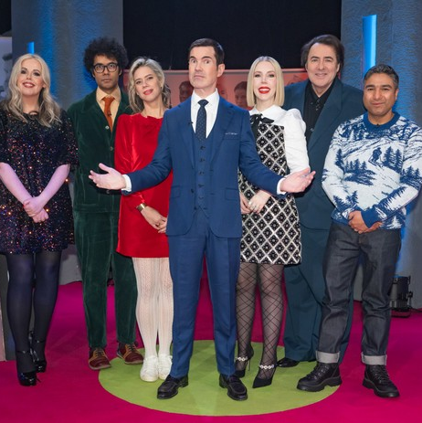


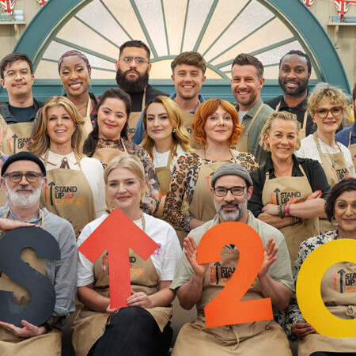
Top Channel 4 programmes 2025 (All devices)
The Great British Bake Off
16 Sep
6,428,598
Patience
9 Jan
4,575,175
24 Hours In Police Custody
6 Oct
3,696,029
The Great British Bake Off: Festive Specials
25 Dec
3,495,999
Gogglebox
9 May
3,401,011
The Great Pottery Throw Down
9 Mar
3,206,234
Big Fat Quiz
26 Dec
3,149,398
Celebrity Gogglebox
6 Jun
3,140,180
In Flight
12 Aug
2,978,176
The Great Celebrity Bake Off for SU2C
16 Mar
2,908,201
Source: Barb, 2025, Adults. Average audience figures. TV and / or Online Network. TV and Online Pre-Broadcast 1-28 days. Top performing episode only.
Notes:
Top Channel 4 programme 2025 (TV set & device).
The Great British Bake Off was the most watched Channel 4 show of 2025, with a single episode pulling an average audience of 6.4 million viewers.

Slide 34



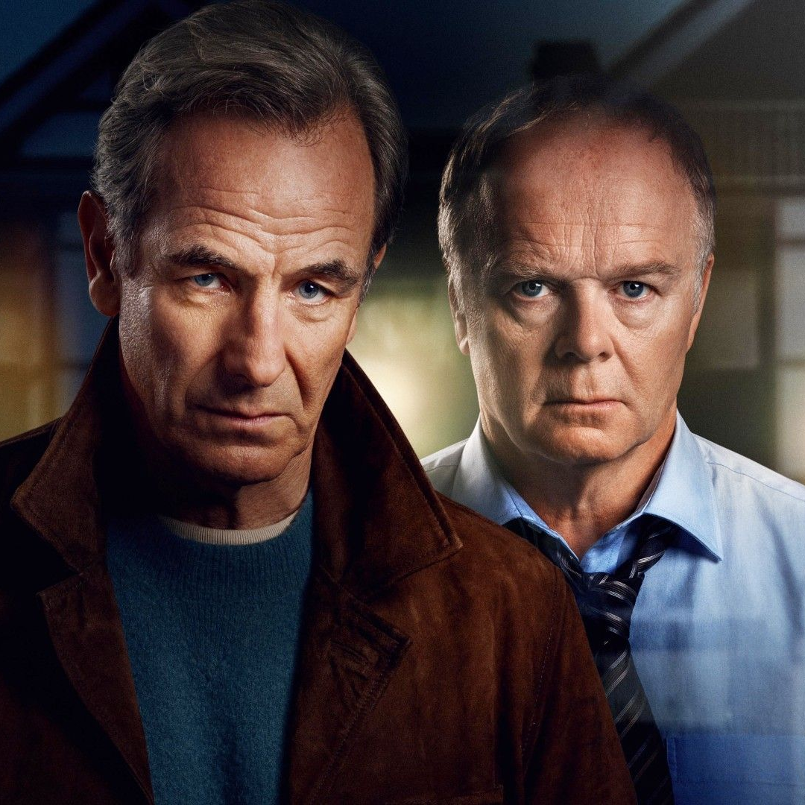





Top Channel 5 programmes 2025 (All device)
Murder Before Evensong
7 Oct
4,026,861
The Feud
14 Apr
3,916,146
All Creatures Great and Small
25 Sep
3,875,916
Cooper & Fry
18 Nov
3,126,523
The Game
13 May
3,049,685
The Castaways
26 Jan
2,686,115
The Au Pair
10 Mar
2,609,132
Murder Most Puzzling
19 Jun
2,405,375
Madame Blanc
27 Mar
2,349,948
The Rumour
10 Sep
2,299,661
Source: Barb, 2025, Adults. Average audience figures. TV and / or Online Network. TV and Online Pre-Broadcast 1-28 days. Top performing episode only.
Notes:
Top Channel 5 programme 2025 (TV set & device).
Murder Before Evensong was the most watched Channel 5 show of 2025, with a single episode pulling an average audience of 4.0 million viewers.

Slide 35







Top commercial non-PSB channel programmes 2025 (non-sport)
Love Island
ITV2, 11 Jul
2,777,606
Married at First Sight UK
E4, 2 Oct
2,537,866
Love Island: All Stars ITV2, 4 Feb
2,295,623
Married at First Sight Australia
E4, 27 Mar
2,228,252
Bergerac
U&Drama, 27 Feb
2,130,653
Married at First Sight UK: The Reunions
E4, 24 Feb
1,875,003
Lockerbie: A Search For Truth
Sky Atlantic, 16 Jan
1,738,337
The Chelsea Detective
U&Drama, 29 May 1,722,926
The Marlow Murder Club
U&Drama, 19 Mar 1,694,360
The Last Of Us
Sky Atlantic, 20 Apr 1,601,577
Source: Barb, 2025, Adults. Average audience figures. TV and / or Online Network. TV and Online Pre-Broadcast 1-28 days. Top performing episode only.
Notes:
Top commercial non-PSB programme 2025 (All devices).
Love Island was the most watched non-PSB programme of 2025, pulling an average audience of 2.8 million viewers.

Slide 36
Top commercial sport programmes
Top commercial sport:
Women’s Euro 2025: England v Italy – ITV1, 22 Jul – 9,429,000
Six Nations Championship: England v Scotland – ITV1, 22 Feb – 5,939,200
Six Nations Championship: England v France – ITV1, 8 Feb – 5,800,200
Top commercial non-PSB:
UEFA Europa League: Tottenham v Manchester United – TNT Sports 1, 21 May – 3,754,200
Premier League: Liverpool v Manchester United – Sky Sports Main Event, 5 Jan– 2,561,000
Premier League: Manchester City v Liverpool – Sky Sports Main Event, 23 Feb – 2,407,500
Source: Barb, 2025, Adults. Peak minute audience, consolidated 28 days
Notes:
Top commercial sport programmes. ITV1 hosted the final of Women’s Euro 2025 to a peak audience of 9.4 million.

Slide 37







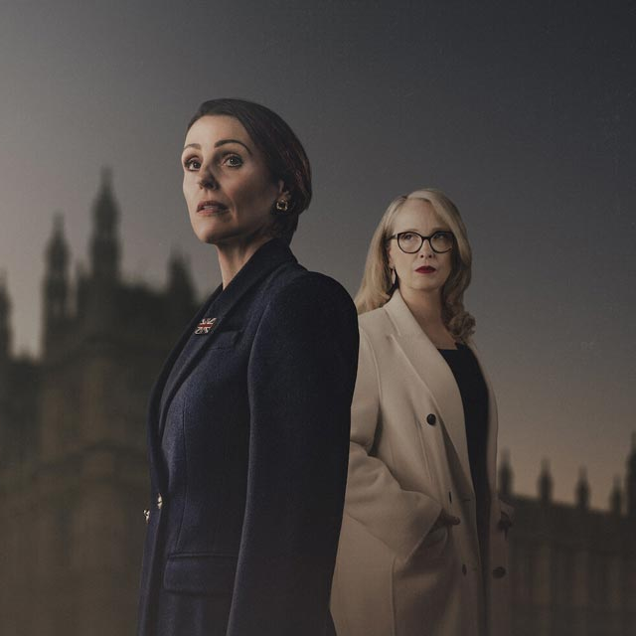

Top Netflix programmes 2025 (TV Set)
Adolescence
13 Mar
12,691,496
The Thursday Murder Club
28 Aug
9,661,971
Harlen Coben's Missing You
1 Jan
6,897,047
Wake Up Dead Man: A Knives Out Mystery
12 Dec
6,825,783
Happy Gilmore 2
25 Jul
5,912,767
Wednesday
6 Aug
5,882,202
Stranger Things
27 Nov
5,795,558
Dept. Q
29 May
5,781,102
Hostage
21 Aug
5,732,640
Monster: The Ed Gein Story
3 Oct
5,181,064
Source: Barb, 2025, Adults. Average audience achieved during the first 28 days of their availability. Only includes TV set viewing. Top performing episode only.
Notes:
Top Netflix programme 2025 (TV set).
Adolescence was the most watched Netflix programme of 2025, pulling an average audience of 12.7 million viewers within 28 days.

Slide 38










Top Amazon Prime Video programmes 2025 (TV Set)
Clarkson’s Farm
23 May
7,259,234
LOL: Last One Laughing UK
20 Mar
6,008,952
Reacher
20 Feb
4,033,557
Heads Of State
2 Jul
3,103,777
The Assassin
25 Jul
2,938,317
The Accountant 2
5 Jun
2,714,648
A Working Man
15 May
2,431,251
Playdate
12 Nov
2,405,642
The Girlfriend
10 Sep
2,257,737
Fallout
17 Dec
2,153,202
Source: Barb, 2025, Adults. Average audience achieved during the first 28 days of their availability. Only includes TV set viewing. Top performing episode only.
Notes:
Top Amazon Prime Video programme 2025 (TV set).
Clarkson’s Farm was the most watched Amazon Prime Video programme of 2025, pulling an average audience of 7.3 million viewers within 28 days.

Slide 39










Top Disney+ programmes 2025 (TV Set)
Moana 2
12 Mar
3,593,422
Thunderbolts
27 Aug
2,183,865
Alien: Earth
13 Aug
2,005.840
Lilo & Stitch
3 Sep
1,891,505
The Fantastic Four: First Steps
5 Nov
1,782,008
The Stolen Girl
16 Apr
1,755,028
Captain America: Brave New World
28 May
1,746,603
A Thousand Blows
21 Feb
1,576,368
Star Wars: Andor
23 Apr
1,508,662
High Potential
1 Oct
1,375,090
Source: Barb, 2025, Adults. Average audience achieved during the first 28 days of their availability. Only includes TV set viewing. Top performing episode only.
Notes:
Top Disney+ programme 2025 (TV set).
Moana 2 was the most watched Disney+ programme of 2025, pulling an average audience of 3.6 million viewers within 28 days.

