Slide 1

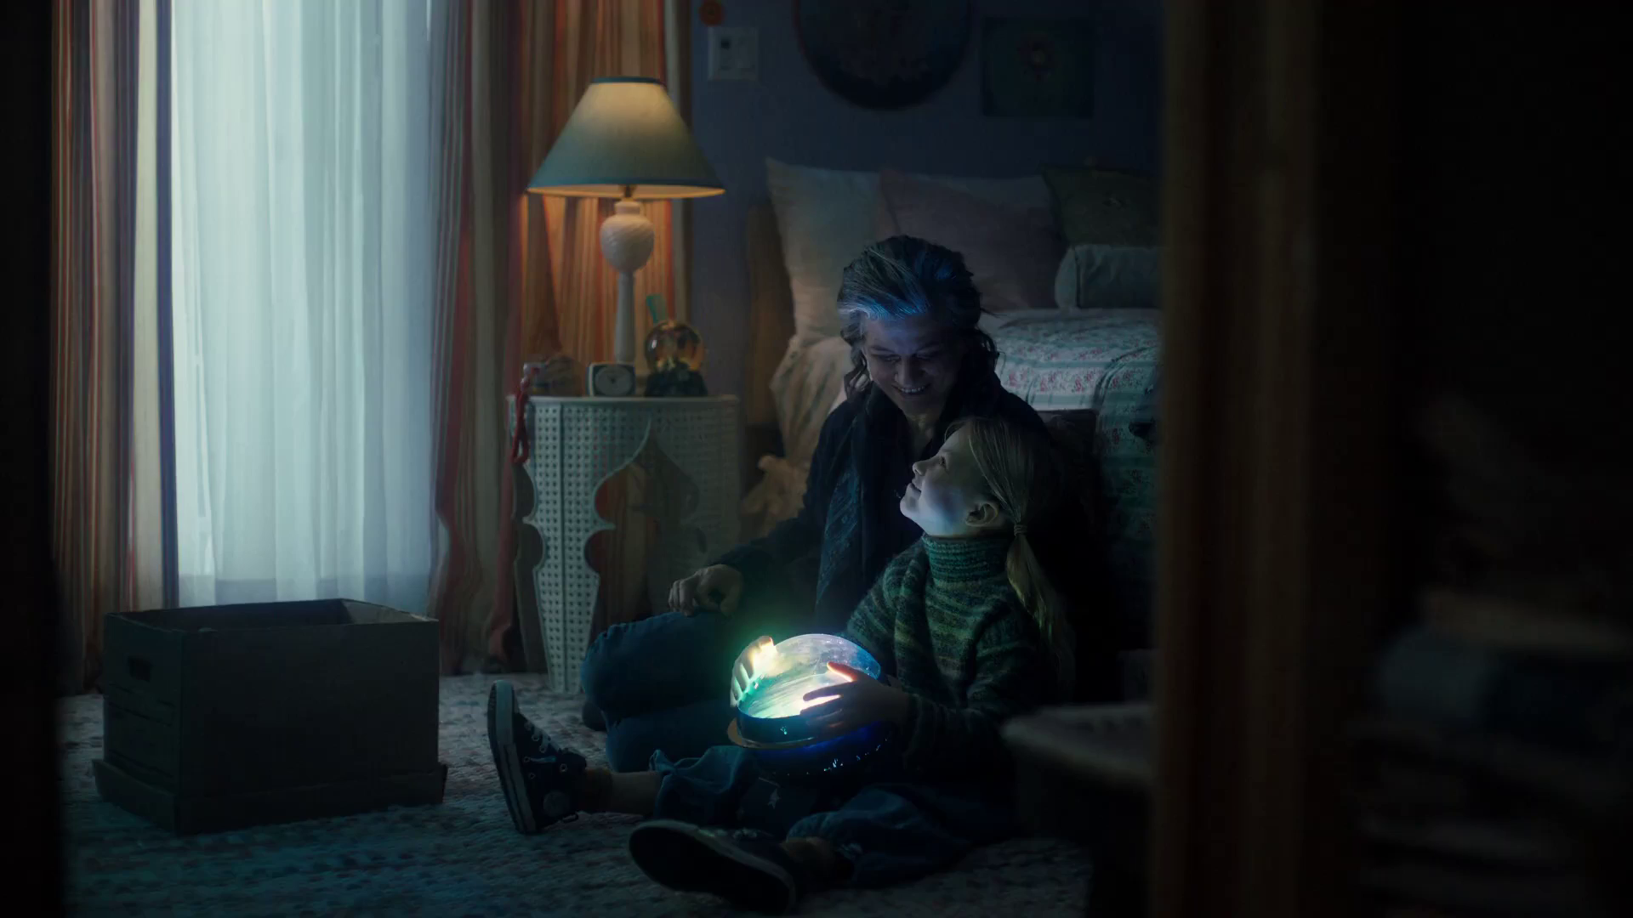

Advanced TV Advertising
Expedia – Northern Lights

Slide 2

Advanced TV – bringing together the best of both worlds
Best of online:
Dynamic one-to-one ad delivery
Mass first-party data
Best of TV:
Big screen & sound on
Fully viewable & viewed
High quality, brand-safe content
Shared viewing
Domino’s Pizza – Channel 4 & ITVX Idents
Notes:
In this presentation, we’re going to be delving into the new frontier of TV advertising, exploring how the broadcasters have invested in new technologies and developed advanced advertising opportunities that bring together the best of the internet and TV advertising.

Slide 3

In this deck
THE ADVANCED TV OPPORTUNITY
THE ADVANCED TV TOOLKIT
ADVANCED TV MEASUREMENT
BUYING ADVANCED TV
THE EXPANDING WORLD OF TV
Subway – Two Ways

Slide 4

The advanced TV opportunity
Mary & George - Sky
Notes:
There are two main access points for advanced TV advertising - Broadcaster Video On Demand (BVOD) and AdSmart from Sky.
Let’s start by looking into the numbers for BVOD.

Slide 5

Advanced TV offers unrivalled scale
82% of the population have access to BVOD on a TV set
BVOD represents 11% of all broadcaster TV viewing
Among 16-34s, BVOD accounts for an even greater portion - 24%
Just under 2 hours per person per week
Campo Vejo – Add Some Passion
Source: Touchpoints 2023, Broadcaster data
Notes:
Advanced TV offers not only a high quality, sophisticated ad offering but also unrivalled scale:
82% of the population have access to BVOD on a TV set
11% of all broadcaster TV viewed by individuals is BVOD
Among 16-34s, BVOD accounts for 28% of all broadcaster TV viewing - just under 2 hours per person per week

Slide 6

Fuelled by the richness of broadcasters’ first-party data
ITV – 40m registered users
Channel 4 – 29m registered users
Channel 5 – 9.2m registered users
Sky – 10m+ subscribers
There’s No Deal like a TK Deal – TK Maxx
Source: Broadcaster data
Notes:
The broadcasters are rich in terms of first party data as they require users to register and log-in to use their BVOD services, or to have a contract with their subscribers in the case of Sky.
This kind of scale in terms of high quality, first party data, combined with high time spent and high potential reach, is vital for both highly targeted advertising and mass advertising.

Slide 7

Advanced TV lives in a premium environment
87% of BVOD is viewed on the TV set
97% of ads are played out in full across all broadcaster VOD
Broadcasters are committed to guaranteeing 100% view-through
Lidl – You Got This
Source: Barb / Broadcaster data
Notes:
VOD advertising, unlike many online video platforms, has all the basics you’d expect, in terms of only paying for an ad if it’s played out in full, with 100% viewability and with the sound on.
86.7% of BVOD is viewed on the TV set. (Barb)
View-through rates are crucial for effective video advertising, 97% of all BVOD ads were played out in full from start to finish, but broadcasters are aiming to increase that to 100%.

Slide 8
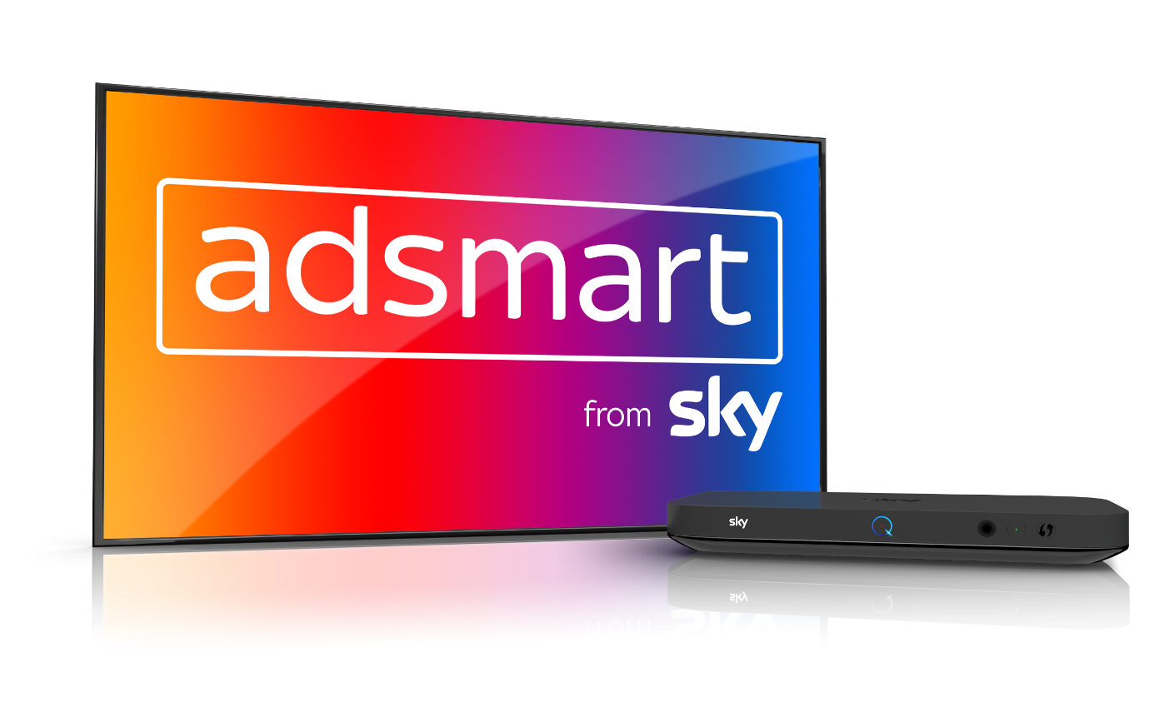
AdSmart from Sky
Fully established and scalable means of accessing advanced TV advertising options
Ads are dynamically inserted into the linear stream when a chosen audience is watching
Can replace ads within linear TV with targeted ads specifically addressed to a given household
Potential reach of 40% of homes or 30m individuals
Notes:
Outside of BVOD, AdSmart from Sky is the other fully established and scalable means of accessing advanced advertising opportunities within the high quality TV environment.
AdSmart works by dynamically inserting ads into the linear stream when a chosen audience is watching
AdSmart is available across the majority of Sky and Virgin Media homes, which means that it’s possible to reach 40% of all homes or 30 million individuals.

Slide 9

A recap of advanced TV’s credentials
Brings together the best of both worlds
BVOD and AdSmart provide advanced opportunities
97% of BVOD ads deliver 100% completion
The broadcasters are rich in terms of first party data
AdSmart offers addressability across 40% of homes
Thortful - Congratulations

Slide 10

The advanced TV toolkit
Passenger - Sky
Notes:
Let’s now examine the most common ways advanced TV advertising can be used to meet advertising objectives.

Slide 11

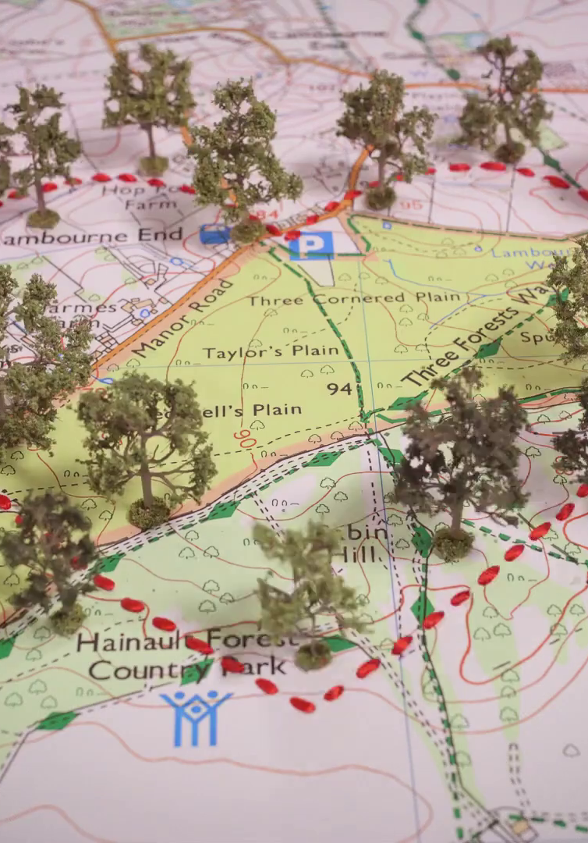


Using advanced TV to enhance effectiveness
1. Linear Reach Extension
2. Geo-Targeting
3. Customised Target
Audiences
4. Customer Data-Matching

Slide 12
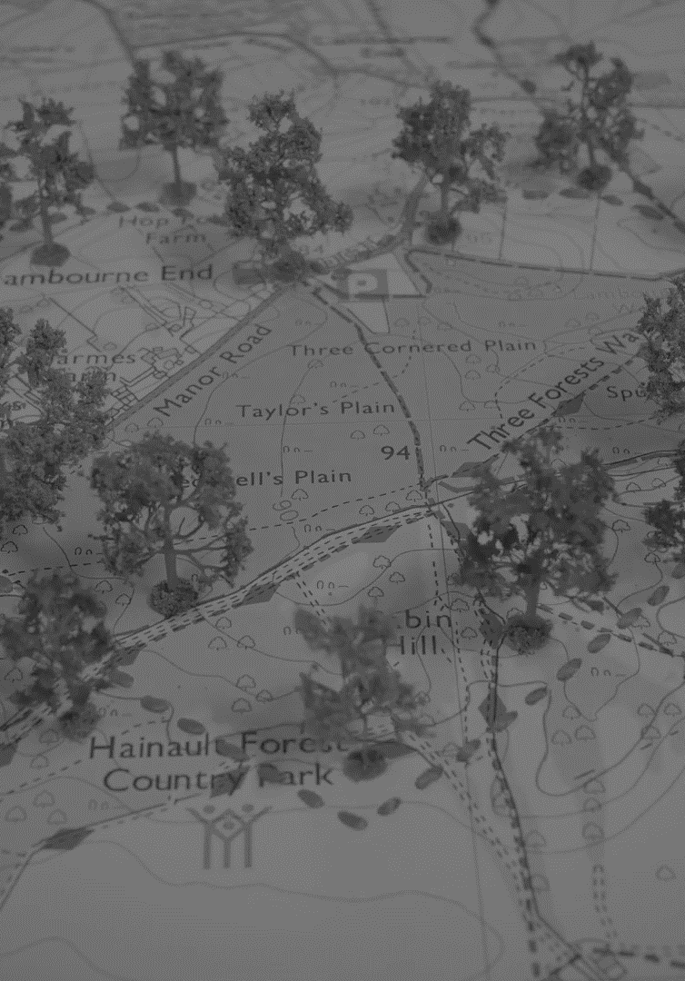


Using advanced TV to enhance effectiveness
1. Linear Reach Extension
2. Geo-Targeting
3. Customised Target
Audiences
4. Customer Data-Matching

Slide 13

‘Middle tier’ of viewers are key to BVOD’s incremental reach
All viewers split into tenths based on their weight of linear TV viewing
Linear
0-19%
Lightest tier
Middle tier 20-49%
Heaviest tier 50-100%
BVOD
% contribution to viewing
Source: PwC UK, Barb, all viewers split into tenths based upon their weight of linear TV viewing
Notes:
PwC’s analysis in ‘BVOD Almighty: Reach and Return’ found that, on average, BVOD adds a 4% increase in incremental Adult (16+) reach to a linear TV campaign, a 6% increase for Adult ABC1s, and an 8% increase for 16-34s.
Among the top performing 10% of campaigns, the percentage increase rises to 9% for Adults, 8% for Adult ABC1s, and 11% for 16-34s.
One of the main reasons for this incremental reach is the ease of reaching light linear TV viewers on BVOD – specifically the ‘middle tier’.
The middle tier is the 20-49% decile group in terms of linear TV viewing who also heavily over index on BVOD. They account for 7% of total linear TV viewing but 28% of BVOD consumption.

Slide 14
BVOD provides good odds of reaching an attractive audience
Lightest tier
0-19%
Middle tier
20-49%
Heaviest tier
50-100%
Hard to reach via TV
TV reach extenders
Easily reachable via linear TV
Average odds of reaching segment per exposure
Linear: 1 in 185
Linear: 1 in 14
Linear: 1 in 1.1
BVOD: 1 in 12
BVOD: 1 in 4
BVOD: 1 in 2
Average linear TV viewing per day
8 minutes
49 minutes
5 hours and 24 minutes
skews towards:
ABC1 adults (71%) and 16-34 adults (42%)
Source: PwC UK, Barb, all viewers split into tenths based upon their weight of linear TV viewing
Notes:
Analysis shows that the chance of reaching somebody in this attractive group with a spot on linear TV is 1 in 14.
But on BVOD, it only takes four impressions to, on average, reach somebody in the middle tier. As such, on average, using BVOD is three and a half more efficient than linear at reaching the middle tier of viewers.
The middle tier are very attractive audiences for many advertisers (proportionally younger and upscale) and BVOD enables them to be reached in an efficient way.

Slide 15
A 25:75 blend of Linear:BVOD is optimal for cost effective 16-34 reach
Source: Barb BVOD Planner (2023, 6 weeks 35-40) / natural delivery / station average prices. Optimised to determine linear and BVOD split.
Notes:
Using cover curve analysis, it is clear to see that planning across both linear TV and BVOD achieves higher levels of cost effective 1+ reach for 16-34s compared to linear TV alone.

Slide 16
Broad audiences also benefit from VOD
Source: Barb BVOD Planner (2023, 6 weeks 35-40) / natural delivery / station average prices. Optimised to determine linear and BVOD split, ABC1 Adults
Notes:
For ABC1 adults, at higher levels of spend, it’s more cost effective to use both linear TV and BVOD rather than linear TV alone.

Slide 17
What matters is the reach opportunity in ad-supported content
TV set viewing to ad supported content
AVERAGE TIME VIEWED
Source: Barb, Sep 23, decile ranked in terms of weight of viewing to linear TV, TV set viewing
Notes:
What matters is the reach opportunity in ad-supported content

Slide 18
BVOD & SVOD ad tiers are key to reaching lighter linear viewers
AVE HRS OF TV SET VIEWING TIME PER GROUP PER DAY
Source: Barb – Sept 2023, Adults, TV set viewing, deciles ranked on weight of viewing to linear TV
Notes:
BVOD & SVOD ad tiers are key to reaching lighter linear viewers

Slide 19
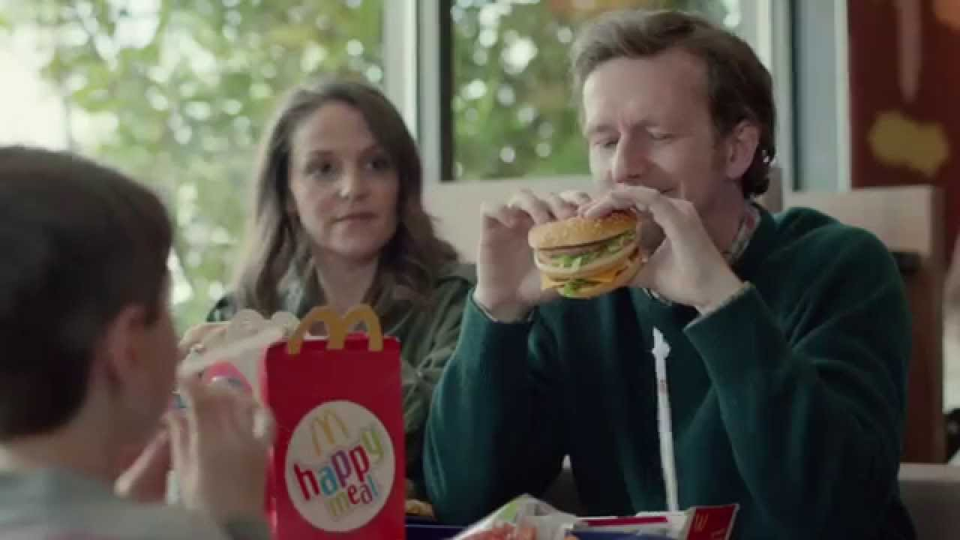
McDonald’s: Extending Cost Effective Reach
Objective:
Drive awareness and uptake of My McDonald’s Rewards amongst 16-44s
Advanced TV Solution(s):
Channel 4 Superspot, ITV Coverplus and Adsmart Reach Booster to maximise cost effective reach followed by a campaign re-fresh to reach unexposed viewers
Results:
Significant incremental reach delivered driving revenue growth and business growth
Notes:
McDonald’s launched a campaign focused on trying to drive awareness and uptake of My McDonald’s Rewards, their customer loyalty scheme and is designed to benefit every customer, unlocking opportunities for them to get more out of what they love – McDonalds food.
As regular McDonald’s customers would most likely see Rewards comms in restaurant, the activity was focused on infrequent McDonalds customers.
They wanted to drive mass excitement and let customers know that the McDonald’s Rewards programme had arrived.
With the ability to reach around 65% of infrequent McDonald’s customers on a weekly basis, TV was the perfect channel to do exactly that. TV could drive the long-term emotional connection that they needed when communicating a functional message in a cluttered market. In order to reach their audience, they built a bespoke Rewards audience of 16- to 44-year-olds who are most likely to download and use a loyalty app, using Barb infused with TGI data and launched on TV with a 60 second spot that drove understanding of the Rewards programme.
For this broad reaching campaign, they wanted to maximise cost effective reach and so they utilised advanced TV solutions.
This included ITV Cover Plus, AdSmart reach booster and an exclusive All 4 Superspot. These tactics were great for bolstering cover and reaching lighter viewers and between them drove an incremental 13.4% reach of the 16 to 44 audience.
Once the 60 second copy had hit diminishing returns with regards 1+ reach, they introduced a 30 second time length to maintain efficiencies and sustain our messaging. To extend reach further, they implemented a ‘campaign re-fresh’ planning tactic when TV reach started to diminish in-campaign.
They did this using Barb data, building an audience of any 16- to 44-year-olds who hadn’t yet seen our campaign and then we identified which content these people were consuming in order to optimise our buying.
This increased our reach by two percentage points. From a media perspective, they reached 69% of 16 to 44 year olds and from a business perspective the campaign has been a significant revenue driver and contributor to business growth, helping to generate an excellent ROI for TV and millions of opts in on the app.

Slide 20

Using advanced TV to enhance effectiveness
1. Linear Reach Extension
2. Geo-Targeting
3. Customised Target
Audiences
4. Customer Data-Matching

Slide 21

Geo-targeting
Smaller businesses with local footprints
Upweighting spend to postcodes in close proximity to stores
Restricting activity to post codes where promotions run
Geo-based creative targeting
reland - Jamie-Lee Donnell & Saoirse-Monica Jacson
Notes:
Geo-targeting (or geography based addressability) is also available through BVOD and AdSmart from Sky.
By providing a list of predefined postcodes to broadcasters, smaller businesses can hyper-target people who live within their catchment areas only.
Larger businesses can upweight campaigns in areas where they have a high number of stores, or to those postcodes that are within a certain distance from their stores.
Advertisers can run offers in certain areas but not in others to ensure that customers who aren’t open to the offer don’t see the ad.
It’s also possible to run different versions of creative based on the location of the viewer watching the ad.

Slide 22
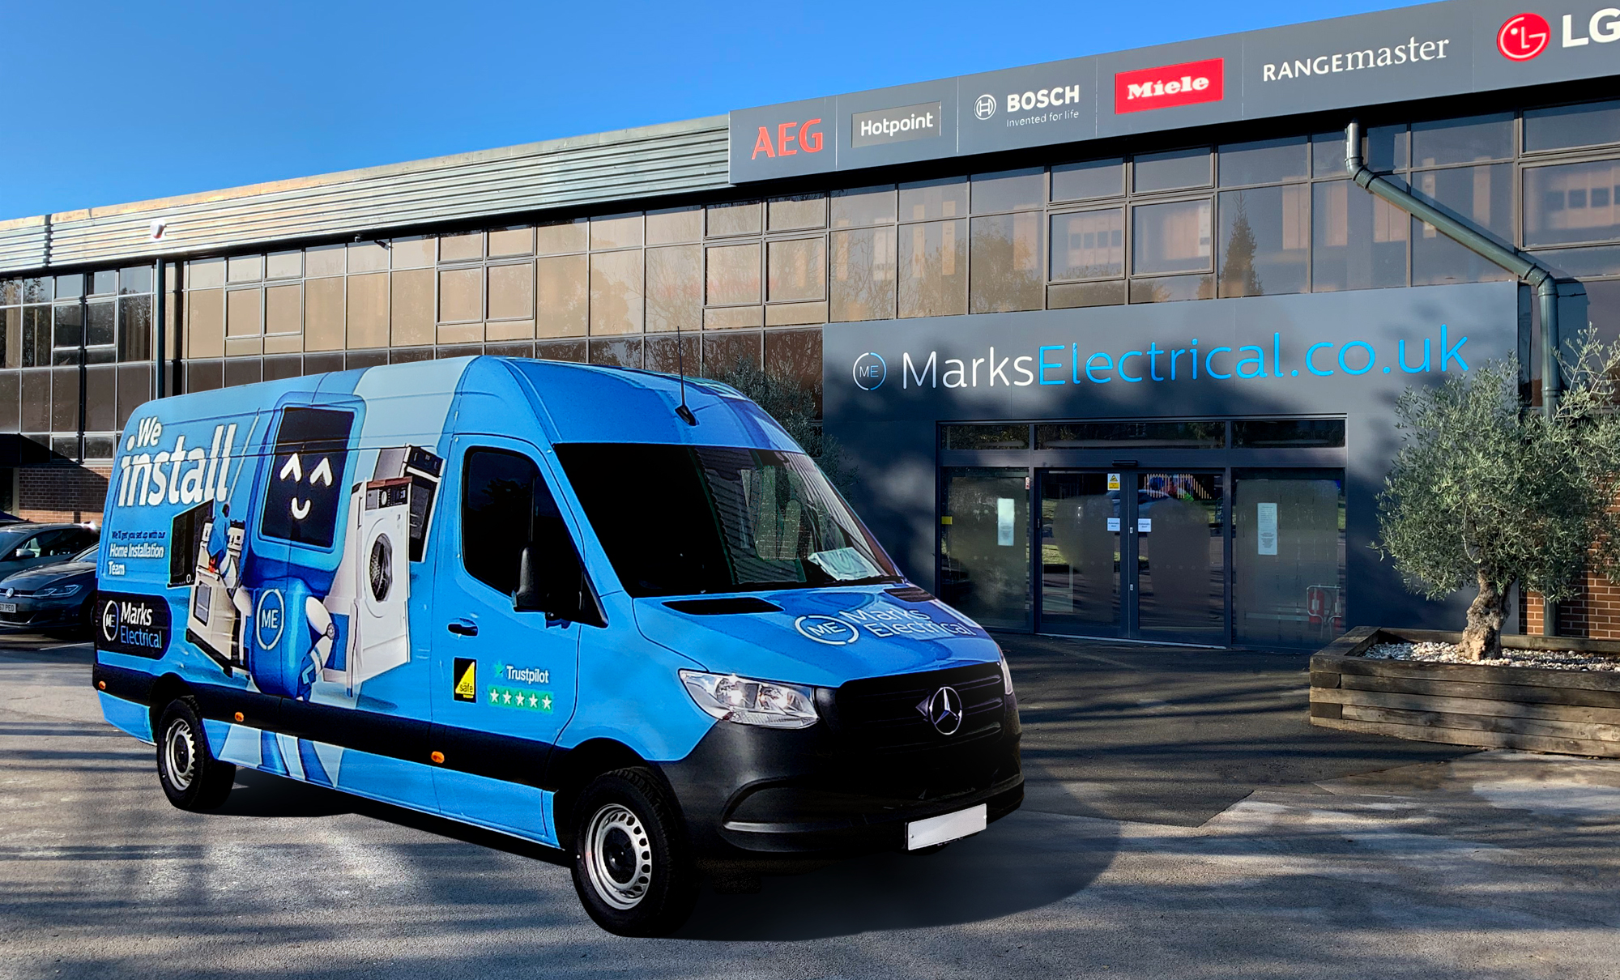
Marks Electrical: Geo-Targeting
Objective:
Business growth in serviceable areas
Advanced TV Solution(s):
Postcode-based and catchment area-based targeting via AdSmart
Results:
Delivered ROI in excess of 20:1
Grown to become #3 electrical retailer in the country (from #5)
Notes:
Marks Electrical are an electrical retailer. They sell online, delivering high quality electrical products direct to customer homes.
They had never advertised on TV before, and wanted to grow their business, they thought this could be their route to growth, but they did have challenges because they only delivered to specific areas in England and Wales.
If people outside of their delivery area saw the TV ad, not only would this be inefficient for their business but it could also frustrate these potential customers. You don’t want to be creating interest with TV advertising and then not be able to fulfil that demand because you can’t actually deliver to them.
Mark Electrical used Sky’s postcode-based targeting via AdSmart, as they had specific geographical areas that they wanted to reach.
That first campaign delivered some really impressive results. They saw an ROI of 8 to 1 and a campaign uplift of over 300% for people who saw that campaign through AdSmart versus those that didn’t. These results showed Marks Electrical how geo-targeted advertising through AdSmart could help grow their business and it gave them the confidence to invest further in TV advertising.
Since that first campaign, they’ve developed their geo-targeting to cover their expanding footprint across the country and have split that down into individual local catchment areas so they can better manage delivery and understand performance. This has helped them continue to drive better and better results with their most recent campaign delivering a return on investment of above 20 to 1.
They are now the number three electrical retailer in the country, up from number 5 before they started using AdSmart.

Slide 23
Using advanced TV to enhance effectiveness
1. Linear Reach Extension
2. Geo-Targeting
3. Customised Target
Audiences
4. Customer Data-Matching

Slide 24

Customised target audiences
Additional data sources offered by broadcasters:
Historic viewing data
Viewer panel data
3rd party data providers
Walkers – Made for Sharing
Notes:
In addition to standard buying audiences, all of the sales houses offer a huge array of more targeted, customisable audiences that can be bought by combining their first party registration or customer data sets with other data sources that they have access to:
Audiences can be created based on historic viewing preferences, patterns or interests.
Using viewer panels, broadcasters can combine more detailed viewer data alongside their first party data to create custom ‘lookalike’ audiences.
High quality data sets from 3rd party data providers (like Experian or Mastercard) can be matched against the broadcasters own data through sophisticated, data compliant means.

Slide 25
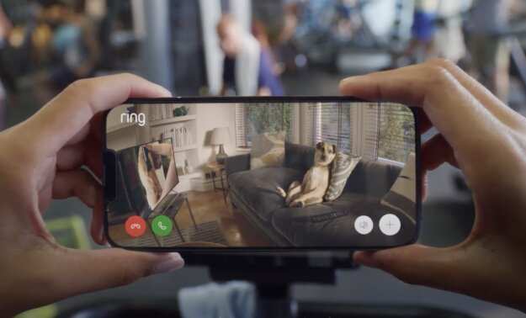
Customised target audiences example – Ring
Objective:
Drive awareness amongst Security Conscious Homeowners
Advanced TV Solution(s):
Using Channel 4’s Create custom audience proposition, built a bespoke audience based on YouGov panel data
Results:
Significant increases in awareness and positive opinion
60% increase in brand recognition
Notes:
Ring, the doorbell and home security company and a brand that utilised Create targeting, their core audience could be neatly summarised as Security Conscious Homeowners.
In order to reach this core audience, a lot of the time brands will choose an existing targeting option that most closely represents it. In Ring’s case, this could be a demographic audience such as ABC1 adults. And this would be a good fit, and there’s plenty of scale in it, although it is a very broad audience.
Using Create, Channel 4 were able to build a brand-new audience for Ring that consisted of those Security Conscious Homeowners, so that they were able to reach the individuals most valuable to them and be more targeted in their approach.
Channel 4 built these new audiences in two stages. Firstly, they worked with the YouGov panel. This is a panel of individuals that regularly answer questions on their attitudes, purchase intent and several other areas. These panellists were asked questions such as, do you own your own home, and, how often do you buy home security products? Channel 4 were able to make sure that the only panellists surveyed were also registered 4Streaming viewers. That way, the security conscious homeowners within Channel 4’s userbase could be identified.
Next, Channel 4’s team of data scientists analyse the profile and viewing behaviours of those Security Conscious Homeowners within the YouGov panel, to see what commonality there is amongst them, so that similar people, or lookalikes as they are often referred, can be found. I.e. Channel 4 viewers that are around the same age, live in similar cities and watch the same programmes as the original panellists.
Targeting this custom audience led to great results for Ring, including significant increases in awareness and positive opinion for their brand and a massive 60% increase in brand recognition.
This is a great example of how broadcasters can customise their audience proposition for brands, so that they can advertise to a group that are most likely to engage with them and buy their products.

Slide 26


Using advanced TV to enhance effectiveness
1. Linear Reach Extension
2. Geo-Targeting
3. Customised Target
Audiences
4. Customer Data-Matching

Slide 27
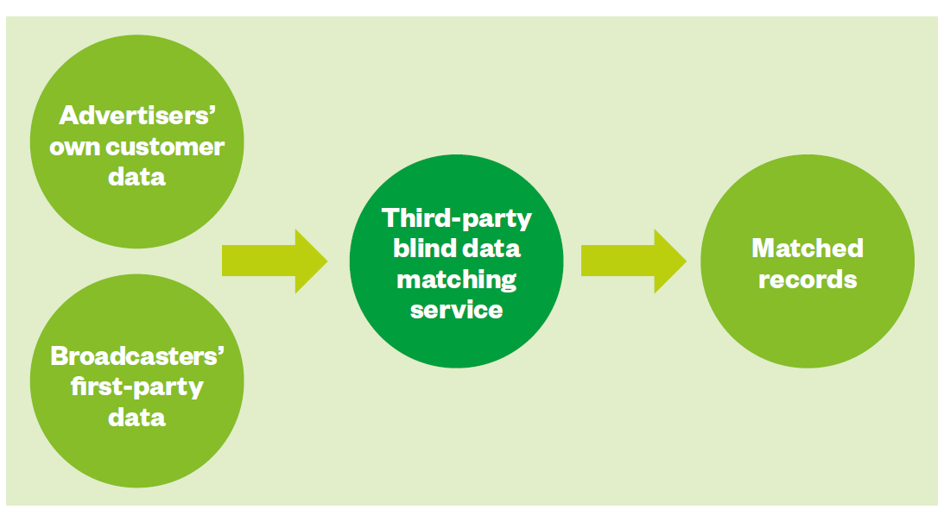
Customer data-matching & opportunities for targeting
Targeting opportunities:
Existing customers or non-customers
Customers approaching a renewal date
Customers likely to churn
Those who could benefit from another product / service
Different creative executions based on customer insight
Notes:
Through customer data matching, broadcasters offer a means of combining advertisers’ own customer data sets with the broadcasters’ own 1st party data.
This is done by a 3rd party company taking both datasets and blind-matching individuals in a completely secure, GDPR compliant way.
This sort of data matching opens up a whole range of targeting opportunities.

Slide 28

Boots – Customer Data Matching
Objective:
Reverse decline in penetration and footfall and grow market share through increased relevance
Advanced TV Solution(s):
ITV’s Data Match solution to create 4 audience groups based on 1PD
Matchmaker partnership announced
ITV AdLab’s Automated Contextual Targeting
Results:
Market share growth and multiple consecutive quarters of growth
Just Eat “Snoop”

Slide 29
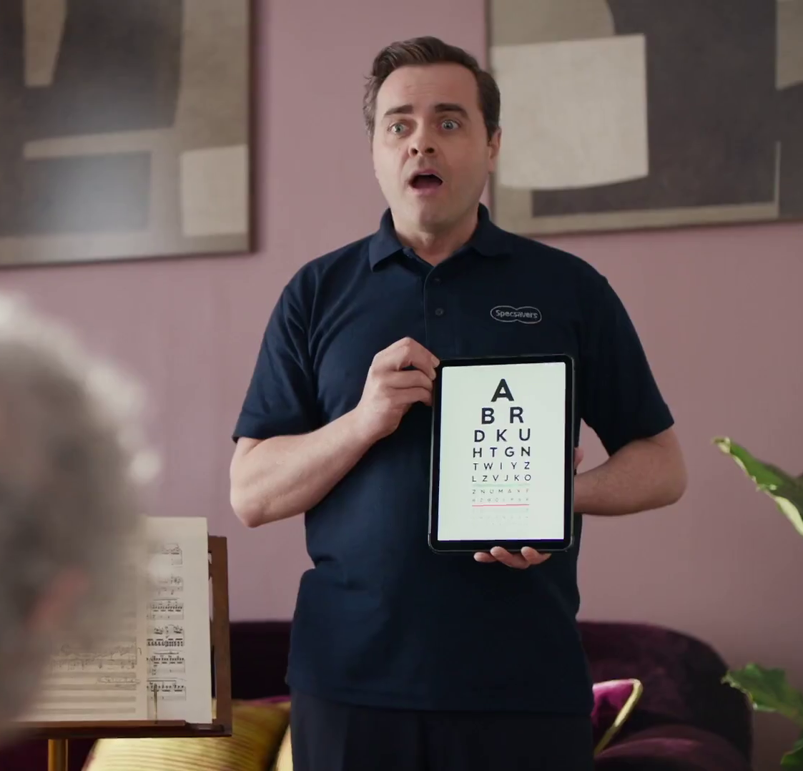
A review of the advanced TV toolkit
Linear reach extension to build cost effective reach
Geo-targeting for more precise geographical targeting
Custom targeted audiences using additional data sets for more enhanced targeting
Customer data matching fusing 1st party and broadcaster data to open a new world of opportunities
Specsavers - Countdown
Notes:
In summary, advanced TV can help advertisers in four main ways:
Linear reach extension: BVOD and AdSmart from Sky can help build higher levels of cost-effective reach than using linear TV alone.
Geo targeting: postcode-based ad delivery has opened up a new world of opportunities for advertisers.
Custom target audiences: the broadcasters offer a huge array of targeting options based on interests or viewing patterns, viewer panel based ‘lookalike’ audiences or by combining 3rd party data.
Customer data matching: advertisers can combine their own customer data, combined with the broadcasters’ own first party data to create countless targeting possibilities.

Slide 30
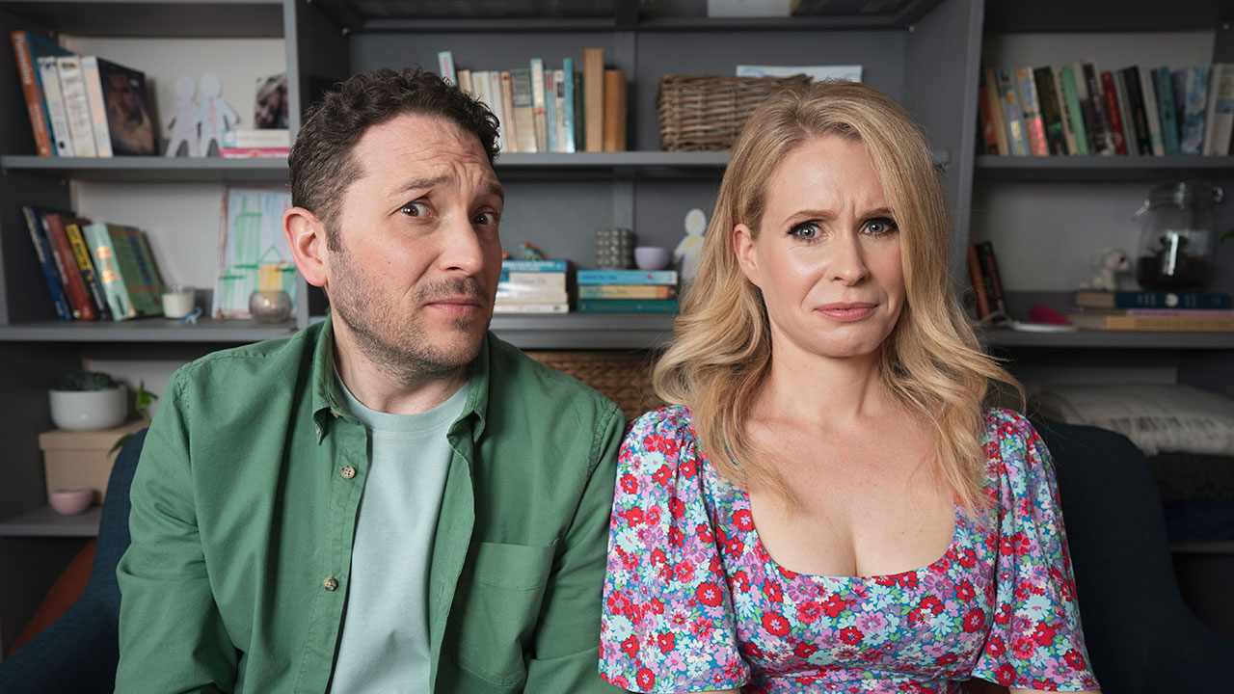

Advanced TV measurement
Meet The Richardsons - UKTV

Slide 31

Advanced TV measurement
There’s a growing range of campaign metrics to capture advanced TV advertising exposure
Panel-based metrics work best for linear TV
(Barb: impacts, coverage and frequency)
Census-based metrics are used on ad-served campaigns, derived from return path data e.g.
  BVOD (often TV traded audience impressions)
  Sky AdSmart (bespoke target impressions)
Measuring total TV campaign reach involves combining panel and census data, which is far from simple
The good news: CFlight now provides deduplicated campaign reach and average frequency across most of the UK’s TV inventory
Eon – It’s On Us
Just Eat – Katy Perry
Notes:
There are a growing number of TV campaign metrics, reflecting the increased range of platforms and formats available.
Each platform has a measurement technique suited to the nature of the medium:
- Barb measures linear TV campaigns using a panel, due to its broadcast nature and scale.
- Ad-served platforms such as BVOD and Sky AdSmart are census-based, captured using return path data.
Measuring the combined metrics of campaigns using both broadcast and on demand exposure has been a highly complex undertaking, as it involves drawing together panel and census data in a statistically coherent way.
Rising to the challenge, Broadcaster CFlight was launched in Q1 2022. CFlight is a post-fact analysis tool which can report deduplicated reach and frequency for campaigns with both linear and BVOD elements.
Sky AdSmart impressions are not included within broadcaster CFlight, because they usually use bespoke target audiences. Note the existence of Sky CFlight as a separate entity as well, which focuses on the Sky Media portfolio in more depth. Sky Media can tell you more about both those proprietary advanced TV metrics.

Slide 32
CFlight: deduplicated reach and frequency
Linear TV reach ✓
BVOD reach ✓
De-duped reach ✓
Only linear TV ad exposure
Only BVOD ad exposure
Both linear TV and BVOD ad exposure
Notes:
Using BVOD to extend the reach of linear TV is one of the primary uses of advanced TV advertising.
From a planning perspective, Barb’s Advanced Campaign Hub TV planning tool (via AdvantEdge’s strategic optimiser K2) enables planners to optimise the blend of linear TV and BVOD to maximise reach.
It uses monthly VOD inventory data (from broadcasters) coupled with data from Touchpoints and Barb on the degree of viewing overlap between linear TV and BVOD for different buying audiences across different platforms.
But what about actual campaign delivery?
Calculating total bought exposures is just a question of adding up the reported impacts/impressions from all the salehouses.
But determining the total reach of a campaign is only possible by calculating the deduplication of reach across linear and VOD.
Enter CFlight, which is the single point of measurement for linear and BVOD delivery, separately and combined. CFlight integrates Barb linear impacts with its own calculated delivery of VOD audience impressions.
CFlight’s reported exposures should be close to the bought totals, but they are two different methods of measuring much the same thing so they won’t match exactly.

Slide 33
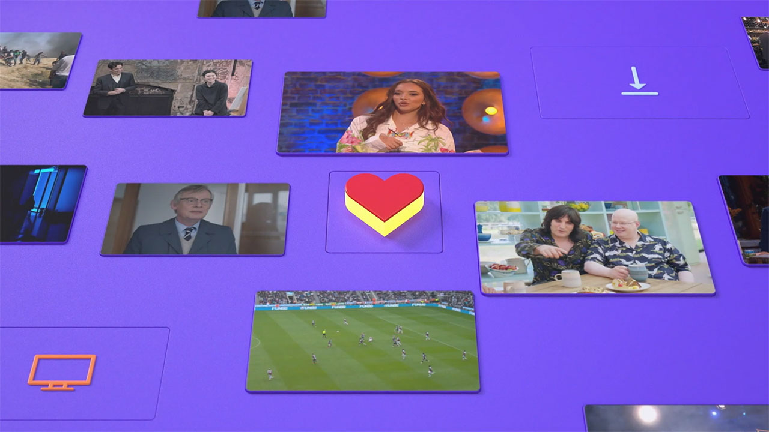
Total TV campaign measurement is here
Notes:
To answer the ‘holy grail’ challenge of a cross-platform, pan-broadcaster, total TV campaign reach & frequency system, the broadcasters have been hard at work building and upgrading CFlight.
CFlight first originated in the US in 2018 by Comcast-owned NBC Universal. When Sky was bought by Comcast, Sky Media took on CFlight and developed it substantially for just the Sky portfolio of channels.
Sky saw the benefits to agencies if it was applied across UK broadcasters, so they offered to share it with ITV Media and 4 Sales, paving the way for a world-leading metric of this sophistication and scale.

Slide 34






A major TV collaboration
Notes:
CFlight is underpinned by the 3 large sales houses ITV Media, 4 Sales and Sky Media. STV and UKTV are also directly involved. Other broadcasters (like Channel 5) are involved indirectly through sales house representation.
Beyond broadcasters, all the main TV industry bodies are engaged in CFlight:
Clearcast has enabled the common identification and attribution of BVOD creative copy
Barb provides the linear measurement aspects
Thinkbox has provided project management in CFlight’s early years
RSMB are the measurement methodology designers, and TechEdge are behind the data processing and user access.
CFlight is being developed with the full co-operation of Barb, and the possibility exists that Barb could take CFlight on in the future.

Slide 35










All key platforms and devices…
Notes:
CFlight measurement covers all key platforms and devices. It only reports ads that are 100% completed views, setting the bar for high quality video inventory.
The data inputs for CFlight are scrutinised by ABC, which is the joint industry committee for media measurement auditing. This ensures the system uses the best available data across all key platforms and devices. By having CFlight independently checked and verified, the broadcasters are demonstrating their commitment to high standards of openness and scrutiny.

Slide 36
CFlight answers these 3 questions
How many people your TV and BVOD campaign reached
The average frequency of the campaign
The reach contribution for the BVOD element of the campaign
Notes:
CFlight helps agencies and advertisers by answering 3 key questions:
How many people did the total TV campaign reach?
What was the average frequency of the campaign?
What was the contribution to reach of the BVOD element?

Slide 37



CFlight calculates total reach for 32,000 different segments
1) Calculate total R+F
by account
2) Scale machine impressions to total
people reached
3) Segment UK TV / VOD population into 32,000 cells
Notes:
There are 3 key elements of the methodology:
Total reach for every single VOD Player – TechEdge calculate R&F curves for each of the platforms (up to 30 in total) for any campaign from the data sent by each broadcaster using RSMB-designed algorithms. At this point, the system can see the Individual reach delivered across all the platforms from the broadcaster players.
People reach conversion - the machine reach is converted to people reach by applying co-viewing or ‘viewer per view’ calculations from the Barb panel’s multi-platform information. Viewer per view scaling tells us how many people are in front of each screen by player type, by device, by daypart, and by genre.
Deduplication - RSMB splits the total UK population into 32,000 different segments, each of which is defined specifically by the TV platforms they watch. Using these segments, probabilistic models determine the likelihood of reach overlap between linear TV and BVOD within each segment. With each segment distinct from one another, the final stage is to sum the reach across all segments to determine the total R&F.

Slide 38
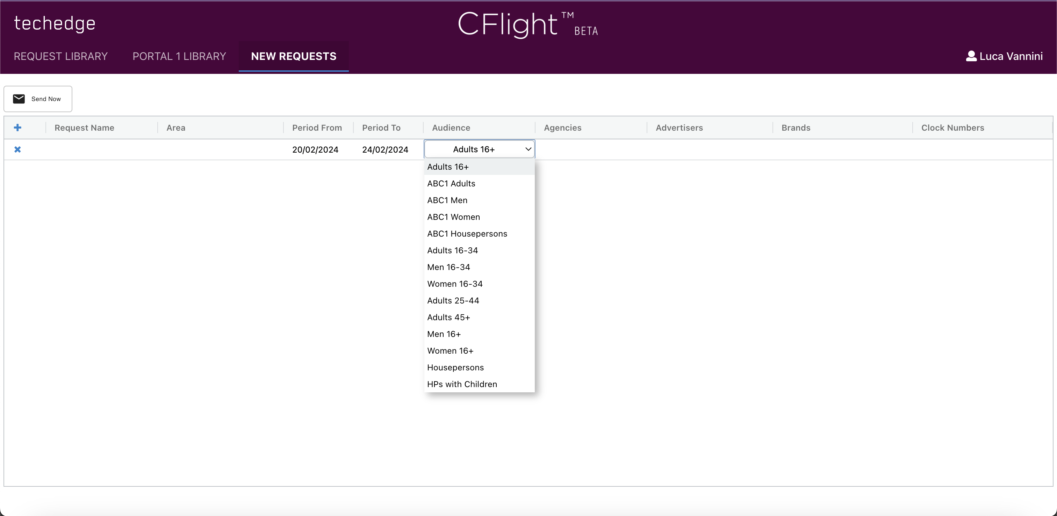
Accessing the portal
Notes:
Media buyers run CFlight reports via TechEdge’s web-based portal. The system gives secure and private access on request to the campaigns for which they are responsible.
From here, buyers run their reports by:
Selecting the ‘From’ and ‘To’ dates for the campaign (up to 63 days = 2 months, or 9 weeks)
Selecting the advertiser and up to 25 brands
Selecting up to 25 of the relevant clock numbers (unique codes that relate to all the various creative copy versions used)
Selecting the appropriate audience from the list of 14 main TV buying audiences
Due to the extensive collation of VOD data from each of the broadcasters’ ad servers and the Barb linear data held by TechEdge, plus the significant volume of processing required for each run, the report is produced overnight.
Today’s media buyers have access to comprehensive ad campaign performance across these additional audiences.

Slide 39
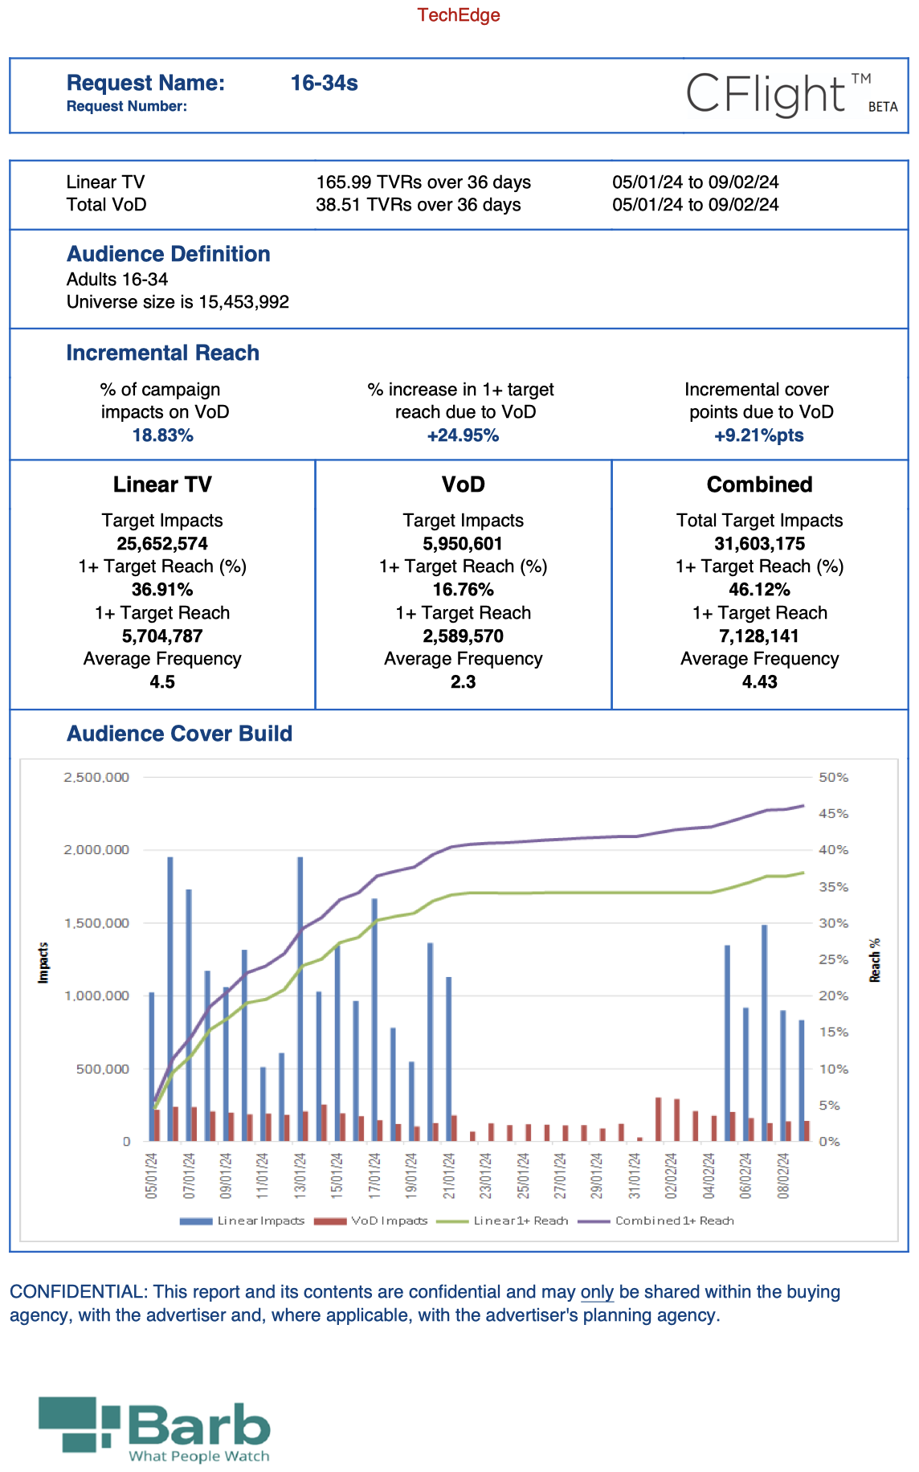
A CFlight report
The universe counts non-TV households which saw the campaign on mobile devices, so it differs a little to Barb
These show the incremental effects of the VOD activity
Information contained in the report includes:
All the campaign inputs including target audience, campaign dates and linear impacts
The combined reach and frequency for the campaign
The split by the linear and BVOD elements, and therefore the total and incremental reach contribution BVOD has made
How the reach build occurred across the campaign period.
The overall metrics for linear+ VOD combined
Reach build day-by-day for the campaign, with cumulative cover build
Example report: retail brand targeting young adults
On p2 (not shown), it lists the agency, client, brand, and the copy numbers you combined

Slide 40

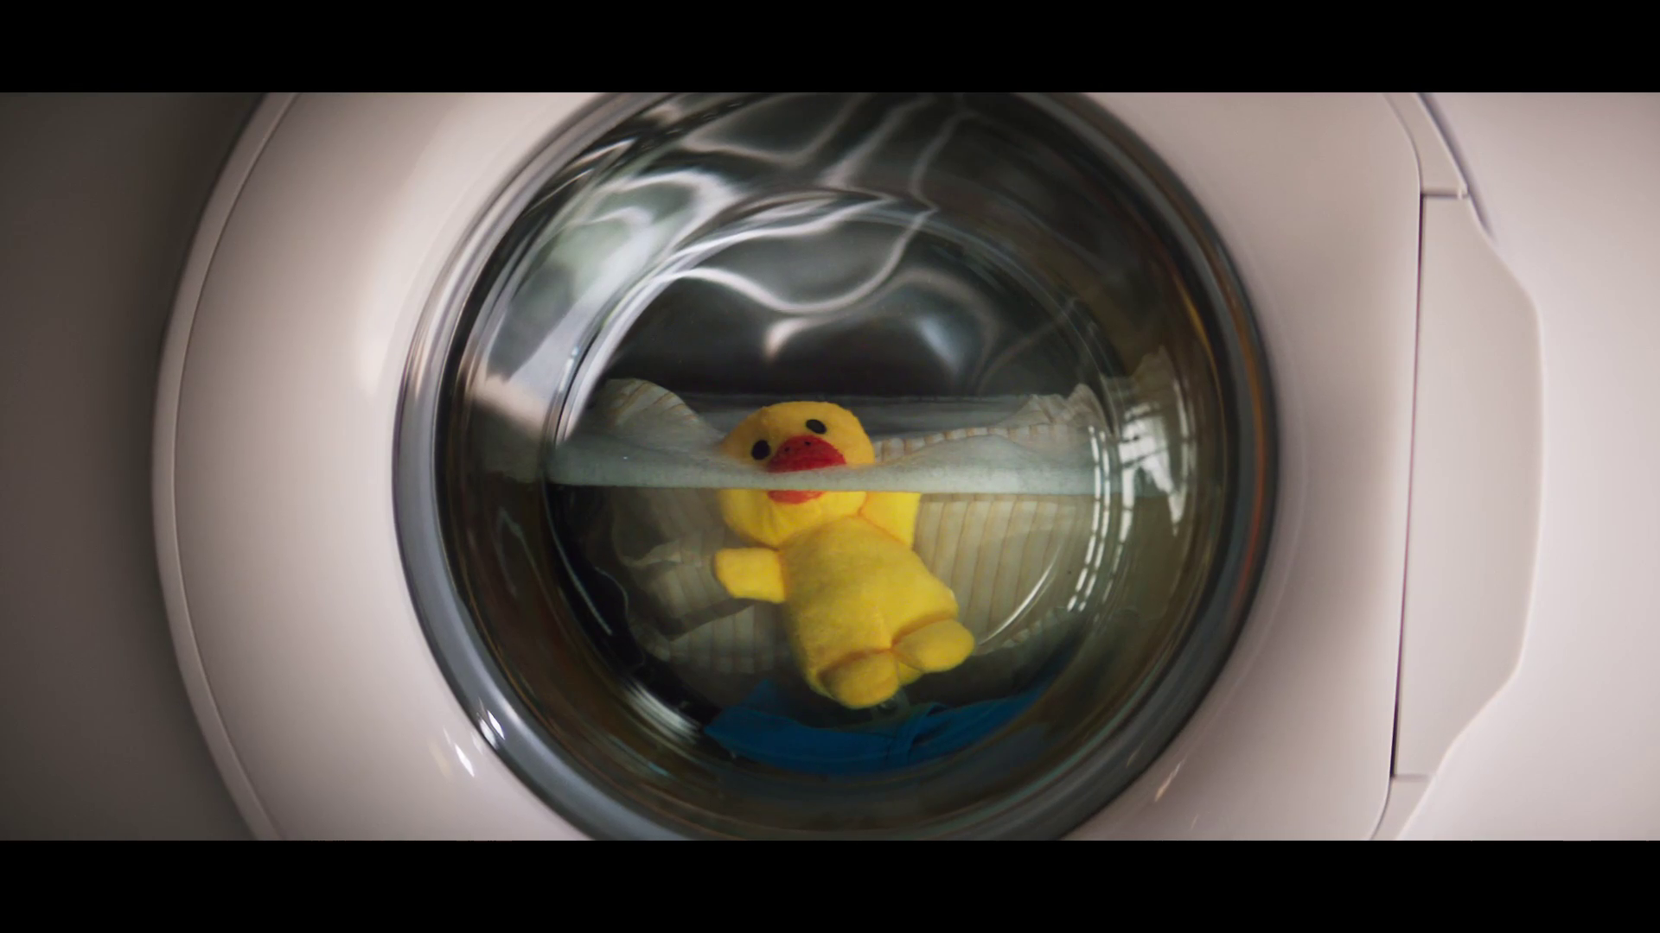
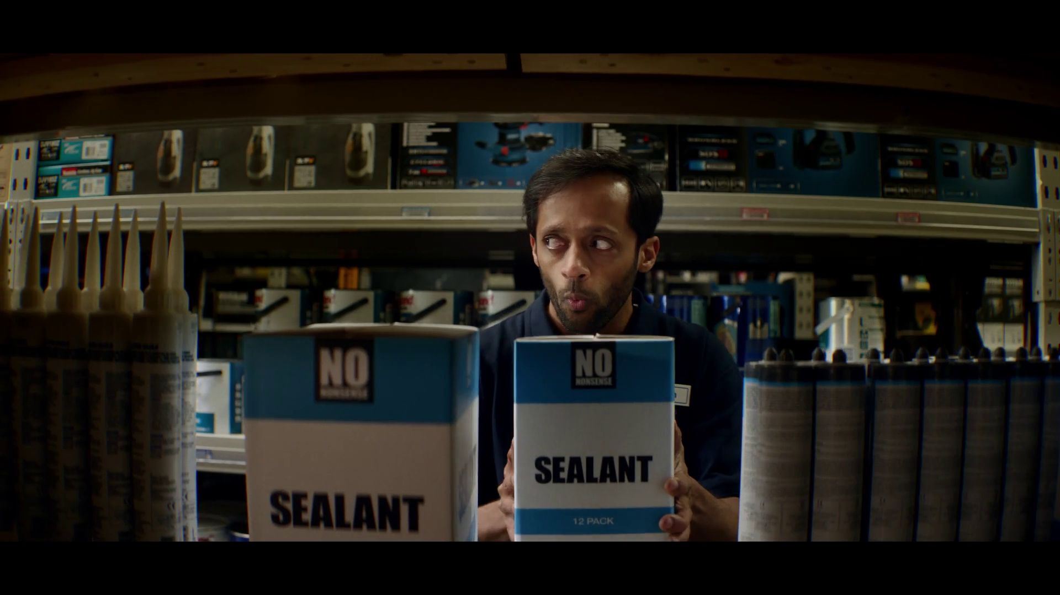
What’s next?
Extension of CFlight and Advanced Campaign Hub to deliver comprehensive coverage of linear + VOD
Exploring the addition of SVOD services and additional BVOD services (i.e. STV, TNT Sports, Sky AVOD)
Reporting enhancements (i.e. delineation by sales point and VOD campaigns only)
Notes:
With the introduction of traded audiences, CFlight and Barb are continuously looking at how to develop the tool further:
The next wave of CFlight upgrades is in motion as overseen by Barb
Barb are also investigating the expansion of what is covered by total campaign reporting tools, both ACH and Cflight. This applies to more delineation and granularity of the services that are already covered but also to any services that are not included yet
Barb are also developing reporting enhancements (i.e. delineation by sales point and VOD campaigns only)

Slide 41

Advanced TV measurement summary
CFlight is the broadcasters’ answer to the total TV R&F measurement challenge
CFlight will hold TV to the highest standards - 100% completed ads only & audited by ABC
Currently reports against 14 main TV target audiences
B&Q – You Can Do It
Notes:
Advanced TV opportunities have fundamentally changed the nature of TV campaign measurement.
CFlight has been developed to provide deduplicated reach and frequency measurement across both linear and broadcaster VOD, uniting two previously separate worlds of measurement.
CFlight has quality built-in. On the linear side CFlight uses Barb’s ‘gold standard’ impacts. On the VOD side CFlight only includes 100% completed view impressions, and the independent media auditors ABC have been brought in to ensure CFlight is adopting the highest standards.

Slide 42

Buying Advanced TV
Big Mood– Channel 4

Slide 43

BVOD & AdSmart Pricing
Doesn’t fluctuate with supply and demand like linear TV but operates on fixed cost per thousand (CPM)
Ratecard mainly varies based on degree of targeting with some seasonal variation based on demand
No advanced booking required but incentives for early booking
Most VOD bought through agencies and now available programmatically
Vinted - Clothes
Notes:
Advanced TV advertising has always been bought distinctly to linear TV.
Pricing doesn’t fluctuate with supply and demand in the same way linear TV does, instead operating on fixed cost per thousands, or CPM. These prices are fixed, but the ratecard will vary depending on how tightly defined the target audience is or the degree of complexity and process required to deliver the target audience. Some seasonal variations come into play with VOD pricing based on demand, but it’s not dictated by market supply and demand mechanics.
Unlike linear TV, VOD doesn’t require advanced booking, although there are some incentives for early booking. Linear TV needs some form of advanced booking to help broadcasters be efficient with their airtime and deliver against deals. As VOD is one to one delivery (taking audience efficiencies out of the equation) and broadcasters can increase ad loads if required, there’s less need for a lead time between booking and placement.
Most VOD campaigns are bought through media agencies however, this practice is rapidly evolving. TV is becoming more automated, sophisticated and data driven, which means that agencies can completely automate the way they buy audiences from the broadcaster VOD players:
ITV’s Planet V offer a means for advertisers and agencies to plug their own trading desks in so they can directly place orders against their custom audiences.
Channel 4 operate on a DSP agnostic basis, and have partnerships already formed with The Trade Desk and Adobe, who can plug into Channel 4’s SSP Freewheel, and they also have integrations with Google’s DSP called DV360.
Sky's AVX proposition offers access to long-form VOD ad inventory via their partnerships with Freewheel and Adobe DSP and continues to evolve to become DSP agnostic.

Slide 44
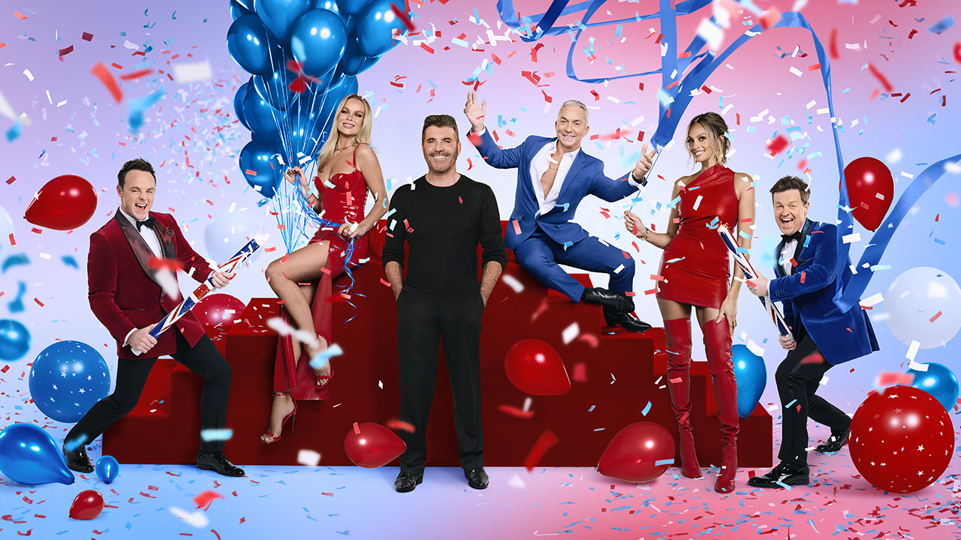
The expanding world of TV
Britain’s Got Talent- ITV

Slide 45
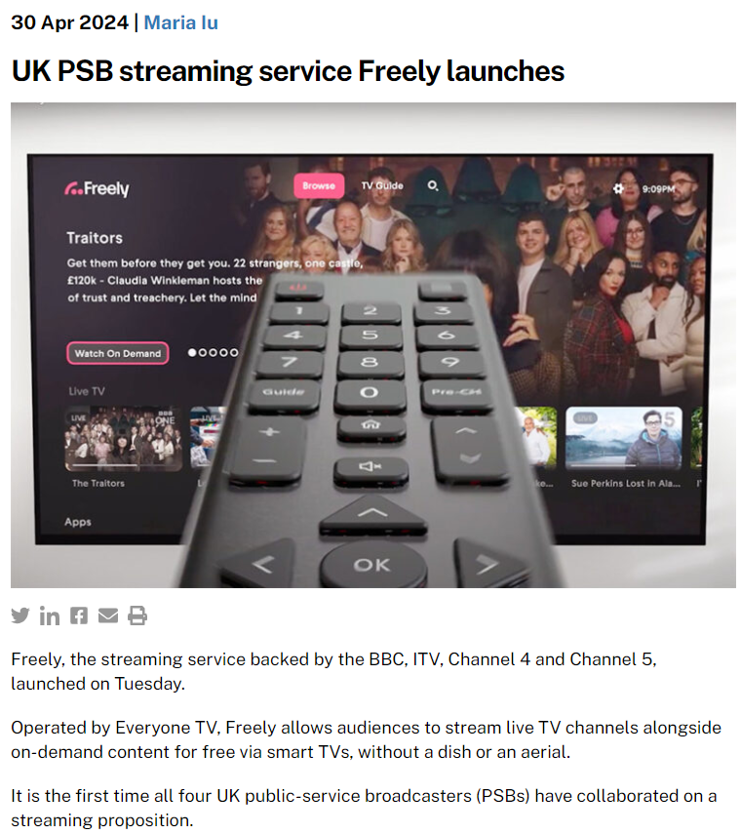
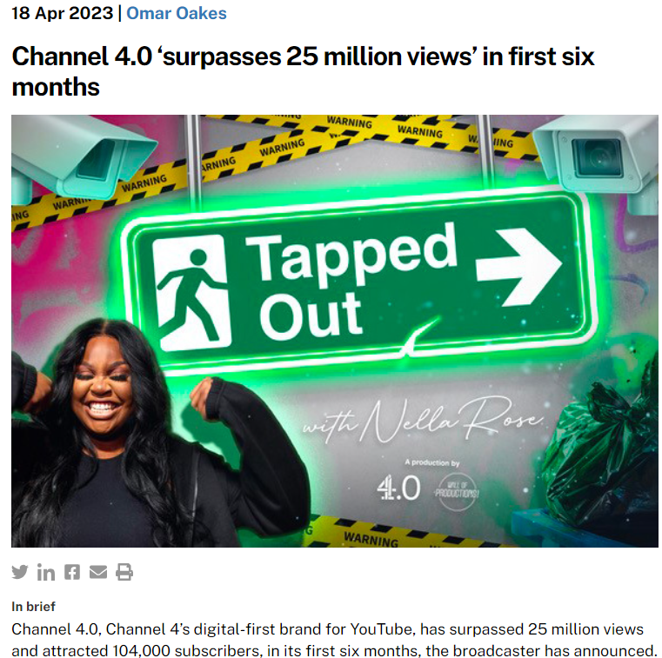
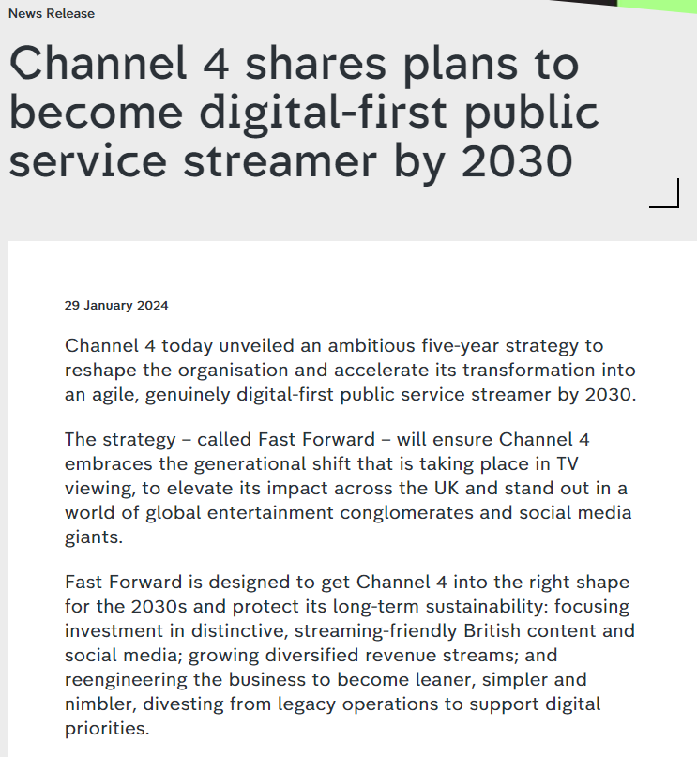
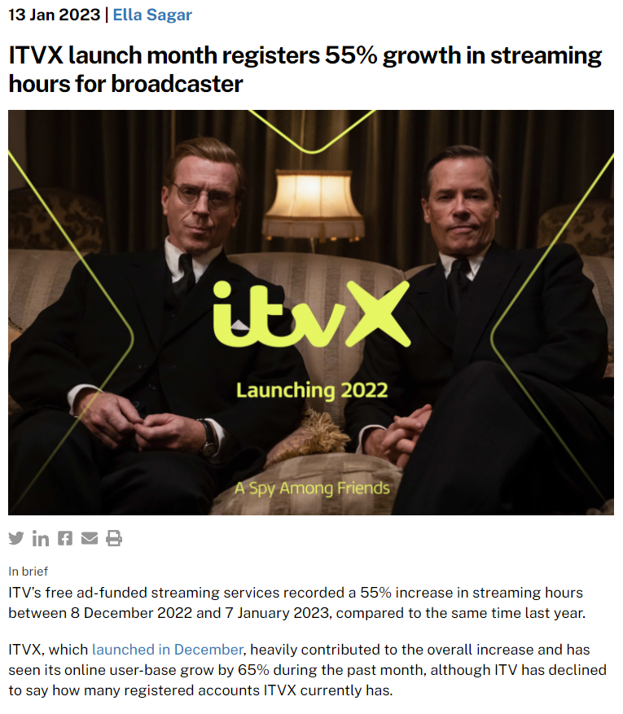
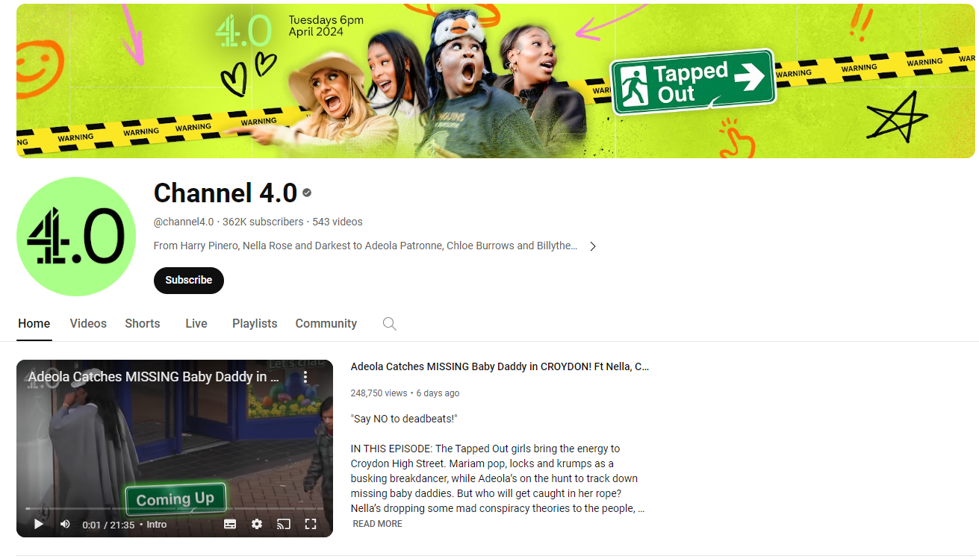
Broadcaster presence continues to grow in the wider online world
Sources: MediaLeader, Channel 4, January 2024
Notes:
Whilst the social media and online video platforms are competitors to the TV broadcasters, they are also business partners. This means that the broadcasters’ content isn’t restricted solely to long-form, content-based TV platforms and as such, it maximises the chance of reaching viewers in all potential viewing situations.
Sky have presence across different social media platforms - they run Sky Sports Football and Sky News channels on YouTube.
ITV partners with various platforms, like YouTube, providing clips from some of their most popular shows, such as This Morning, which generates millions of views in addition to the launch of ITVX.
Channel 4 distribute clips, short programme extensions of shows and original content (editorial and branded content) across a range of social media platforms.

Slide 46
Commercial broadcasters are unrivalled for scale in the larger video landscape
All Individuals – All devices
Bubble area represents total volume of daily viewing
AVERAGE DAILY REACH (000s)
Other AVOD
Other
SVOD
Twitch
Dailymotion
AVE TIME VIEWED PER VIEWER PER DAY
Source: Barb / All Individuals, all devices – 2023
Notes:
This chart breaks down viewing to the various platforms in terms of the average number of people watching per day (for at least 3 minutes) compared with the average time spent watching per viewer (i.e. only counting those who watched on that day).
Analysis across 2023 shows that the commercial broadcasters (linear and on demand) collectively reach just over 31 million viewers every day, with each of those viewers watching for an average of 3hrs, 33 mins a day. The combined portfolio of BBC channels (linear and on demand) attracts the second largest volume of viewing, with 25 million daily reach and an average view time of just over 2 hours. YouTube is next, with a daily reach of 21 million people and a view time of 1hr 49 mins (Barb only measure in-home viewing, we estimate that YouTube would be larger in viewing time if out of home viewing was included).
SVOD services such as Netflix has a daily reach of 12.3 million people and a view time of 1hr 47 mins.

Slide 47

























The expanding world of TV means an array of choice for viewers
SVOD
Other SVOD / AVOD
Video-Sharing platforms
Notes:
The vast majority of homes have a TV connected to internet, meaning that content producers & / or aggregators aren’t reliant on platforms / channels to distribute their programmes. Often referred to as connected TV (CTV) or OTT (over the top).
As well as subscription-based OTT / CTV players (Netflix, etc) there are also some ad-supported players that exist. This slide shows the selection of some of the platforms measured by Barb.
The market in the US for this type of content delivery is pretty established, whereas the UK market is only really just emerging.

Slide 48

Advanced TV – a recap
Advanced TV is scalable and offers the best of both worlds
TV now has a plethora of options to supercharge your campaign
Expect to see buying and measurement evolve over the next few years
TV now also lives in the wider video world
Lyle’s Golden Syrup – Absolutely Golden
Notes:
Advanced TV is here – it’s scalable and brings the best of the opportunities of online advertising together with the premium qualities of TV.
There’s a huge array of opportunities on offer from geo-targeting, hyper targeted audiences to customer data matching.
Over the next couple of years, we’re going to see rapid enhancement in the way VOD can be bought and measured.
And don’t forget to consider the opportunities TV now offers in the wider world of online and social video.

