Slide 1


Future Focus Report
Q3 2025
TV Licensing, “Invasion”

Slide 2

In this deck...
With Q3 planning well under way, this report will be a handy guide on what to expect over the coming months.
To provide a useful base on what to expect this year we look historically to Q3 2024:
Category & advertiser analysis
‘Reach Extenders’ analysis & TV viewing overview
Programming highlights across a range of genres
To better prepare you, we include key considerations for the quarter ahead:
Important dates – from 1st October, the new HFSS (High in Fat, Salt, or Sugar) advertising restrictions will come into effect.
Preview on programming to expect in Q3 2025
Humane World for Animals, “Humane World for Animals”
Notes:
The Future Focus Report puts Q3 in the spotlight and is a useful guide to help with planning for the upcoming quarter.

Slide 3

Category & Advertiser Analysis Q3 2024
EMR, “Business”

Slide 4
Q3 2024 TV Impacts by Category
High
Mid
Low
Relative propensity of media spend by category
 | Computers | Telecoms | Finance | Automotive | Business & Industrial | Household FMCG | Cosmetics & Personal Care | Food | Media | Household Equipment & DIY | Health & Wellbeing | Entertainment & Leisure | Travel & Transport | Government Social Political Organisation | Retail
Jul | 149 | 121 | 112 | 107 | 73 | 113 | 102 | 100 | 100 | 82 | 94 | 105 | 95 | 75 | 88
Aug | 153 | 134 | 115 | 110 | 91 | 114 | 100 | 110 | 101 | 128 | 97 | 88 | 77 | 82 | 72
Sep | 117 | 116 | 112 | 120 | 168 | 90 | 105 | 95 | 102 | 94 | 94 | 91 | 104 | 99 | 85
Q3 | 139 | 124 | 113 | 112 | 111 | 105 | 103 | 102 | 101 | 100 | 95 | 95 | 92 | 86 | 82
Source: Barb, Q3 2024 vs 2024 Index, Adults, Top 15 categories by total impacts. Historic not forward looking.
Notes:
Q3 TV Impacts by category. Indexed % spend by category for each month vs. the average % for 2023

Slide 5
Top sectors by Q3 2024 impacts
102
113
95
103
105
86
92
124
112
100
82
95
111
139
101
Source: Barb, Q3 2024, All Adults, Impacts (R/W) (million). Numbers above bars show Q3 index vs 2024. Historic not forward looking.

Slide 6










Computers - Advertiser
Source: Barb, Q3 2024, All Adults, Impacts (R/W) (million). Top 10 2024 Q3 advertisers by total impacts.

Slide 7











Finance - Advertiser
Source: Barb, Q3 2024, All Adults, Impacts (R/W) (million). Top 10 2024 Q3 advertisers by total impacts.

Slide 8









Telecoms - Advertiser
Source: Barb, Q3 2024, All Adults, Impacts (R/W) (million). Top 10 2024 Q3 advertisers by total impacts.

Slide 9

Reach Extenders & Viewing Overview
Esty, “Don’t Celebrate Birthdays”

Slide 10
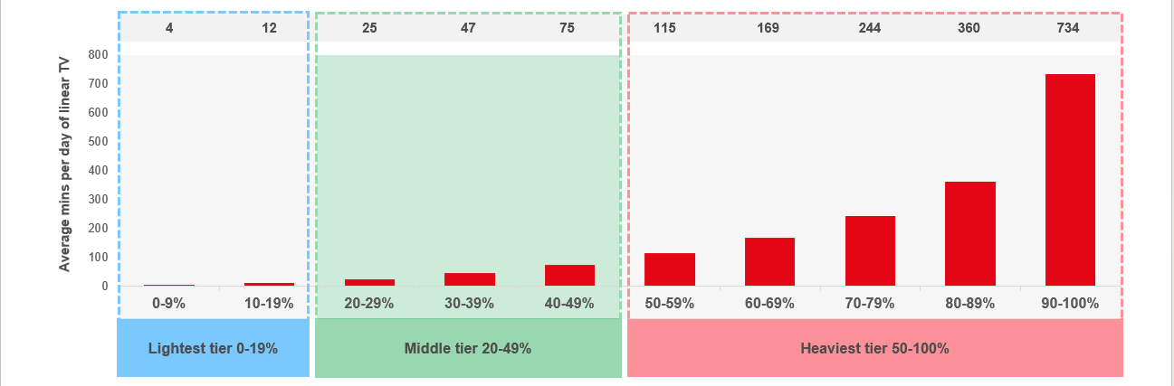
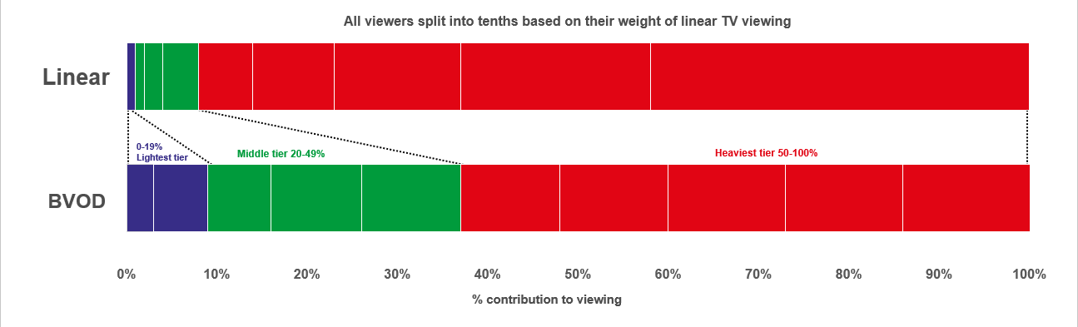

Identifying the ‘Reach Extenders’
Weight of viewing is a key factor
in incremental reach
‘Middle tier’ of viewers are key to
BVOD’s incremental reach
Research from BVOD Almighty divided viewers into deciles based on weekly linear TV viewing. Light viewers are hard to target on TV, while heavy viewers are easily targeted via linear TV, reducing the role of BVOD. PwC’s analysis identifies the ‘middle tier’ as the key segment driving incremental reach via BVOD.
This chart displays the proportion of linear and BVOD consumption for each of the three tiers and their deciles. Notably, the ‘middle tier’, accounting for 7% of linear TV viewing, makes up 28% of BVOD consumption, making them the key audience to extend campaigns through BVOD; we call them the ‘Reach Extenders’.
Source: BVOD Almighty
Notes:
Left Chart: Detailed analysis by PwC has identified a segment that are important drivers of why BVOD is delivering incremental reach.
This chart shows the viewing population split into ten equal groups (deciles) based upon amount of liner TV viewing per week.
The lightest decile averages 4-mins of linear viewing per day. Up to the heaviest decile who view for 734-minutes (12-hours 14-minutes) per day.
The deciles have been split into three groups:
Lightest tier. These are very hard to reach on TV (linear or BVOD) and are most likely to be targeted via platforms such as YouTube
Middle tier.
Heaviest tier. These are quite easy to reach via linear TV and, as a result, BVOD probably has little role to play.
Right Chart: This chart shows for each of the three tiers (and the deciles within them) what proportion of linear and BVOD consumption they account for.
Key to note is that the middle tier (green) proportionally watch a lot of BVOD. Whilst they account for 7% of linear TV viewing, they make up 28% of BVOD consumption.
This makes them the key audience for extending campaign via the use of BVOD – relatively they are easier to reach via BVOD then linear TV.

Slide 11
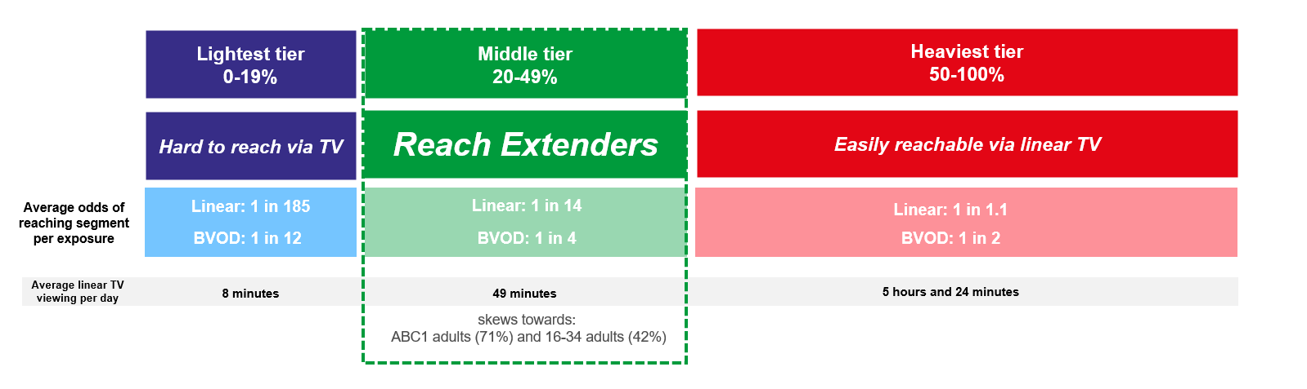
Identifying the ‘Reach Extenders’
BVOD provides good odds of reaching an attractive audience
Where and when can we effectively reach this valuable audience of ‘Reach Extenders’?
While BVOD excels at reaching this audience there are key programmes and times you’re very likely to reach them across the whole of TV.
‘Reach Extenders’ display a strong affinity for the following genres:
Drama
Films
Children
Their peak viewing hours take place daily from 8-11pm, with a higher likelihood of viewership occurring at the weekend.
On average, it takes only four impressions to reach a ‘middle tier’ viewer through BVOD, as opposed to 14 impressions on linear. This makes BVOD 3.5 times more efficient in targeting the ‘middle tier’ group, which often consists of younger and upscale viewers, highly sought after by advertisers.
Source: BVOD Almighty
Notes:
Left Chart: BVOD provides good odds of reaching an attractive audience or to put it another way, for every 14 impressions you buy on linear one person falls into the middle tier group (assuming natural delivery)
But on BVOD, it only takes four impressions to, on average, reach somebody in the middle tier. As such, on average, using BVOD is three and a half more efficient than linear at reaching the middle tier of viewers.
The middle tier are very attractive audiences for many advertisers (proportionally younger and upscale) and BVOD enables them to be reached in an efficient way.

Slide 12
Top genres watched by ‘Reach Extenders’
% of all viewing
Genre | Adults | Reach Extenders | Index
Drama | 27% | 32% | 116
Entertainment | 22% | 21% | 94
Films | 12% | 18% | 150
Sport | 11% | 11% | 96
Documentaries | 12% | 8% | 65
Children | 2% | 4% | 253
Hobbies/Leisure | 6% | 3% | 47
News/Weather | 4% | 2% | 50
Source: Barb Q3 2024, % of all viewing, index vs all adults.

Slide 13
High indexing drama content
Drama - Commercial TV
Channel | Programme Title | Index
Sky | House Of The Dragon | 271
Sky | Brassic | 219
Channel 4 | The Great | 202
ITV | Douglas Is Cancelled | 182
ITV | The Twelve | 175
Sky | Game of Thrones | 144
Sky | The Sopranos | 142
Channel 4 | Suspect | 135
Sky | The Rookie | 131
Channel 5 | All Creatures Great and Small | 121
Drama - SVOD
Channel | Programme Title | Index
Disney+ | Grey's Anatomy | 298
Netflix | The Perfect Couple | 273
Netflix | Brassic | 269
Amazon | The Boys | 262
Netflix | Emily in Paris | 258
Netflix | New Amsterdam | 254
Netflix | Dexter | 242
Amazon | The Lord of the Rings: The Rings of Power | 236
Disney+ | Criminal Minds | 226
Netflix | The Umbrella Academy | 203
Source: Barb Q3 2024, ‘Reach Extender’ index vs all adults, Thinkbox created list of programmes ranked by volume of viewing and index. Commercial broadcasters and SVODs are separated because we can’t currently separate viewing by homes that are / are not on the SVOD ad tiers.

Slide 14
High indexing film content
Films are popular among the ‘Reach Extender’ audience, but planning for this genre is less straightforward due to the variance in film scheduling. To help, here is a breakdown of which sub-genres the ‘Reach Extenders’ are watching.
Films - Commercial TV
Sub-Genre | Channel | Programme Title | Index
Family | Sky | The Super Mario Bros. Movie | 271
Family | ITV | Charlie and the Chocolate Factory | 131
Comedy | Sky | Barbie | 223
Comedy | Channel 4 | The Inbetweeners 2 | 380
Romcom | Sky | Anyone But You | 159
Romcom | Channel 5 | The Proposal | 162
Historical & Period | Channel 4 | Titanic | 109
Historical & Period | Sky | Oppenheimer | 244
% of all film viewing
Genre | Adults | Reach Extenders | Index
Action / Adventure / Thriller | 29% | 22% | 79
Family | 14% | 21% | 149
Comedy | 15% | 16% | 109
Sci-Fi and Fantasy | 16% | 15% | 88
Romcom | 4% | 6% | 136
Other | 4% | 4% | 115
Horror | 4% | 4% | 93
Historical and Period | 3% | 3% | 125
Films - SVOD
Sub-Genre | Channel | Programme Title | Index
Family | Disney+ | Inside Out 2 | 263
Comedy | Amazon | The Ministry of Ungentlemanly Warfare | 226
Romcom | Netflix | A Family Affair | 262
Historical & Period | Netflix | Troy | 257
Source: Barb Q3 2024, ‘Reach Extender’ index vs all adults, Thinkbox created list of programmes ranked by sub-genre, volume of viewing and index. Commercial broadcasters and SVODs are separated because we can’t currently separate viewing by homes that are / are not on the SVOD ad tiers.

Slide 15
‘Reach Extenders’ aren’t solely limited to high indexing genres
Sport - Commercial TV
Channel | Programme Title | Index
ITV | Tour de France Highlights | 225
ITV | UEFA European Football Championship | 177
TNT Sport | Premier League | 172
ITV | FA Community Shield | 138
Sky Sports | International Rugby | 137
Channel 4 | Paralympics Opening and Closing Ceremonies | 136
Channel 4 | Formula 1 | 134
Sky Sports | British F1 GP | 128
Sky Sports | Premier League | 122
Entertainment - Commercial TV
Channel | Programme Title | Index
Sky | Funny Woman | 216
Sky | Rob & Romesh vs... | 208
Channel 4 | Taskmaster | 201
ITV | Love Island | 156
ITV | Olivia Attwood's Bad Boyfriends | 146
Channel 4 | Married at First Sight UK | 145
Entertainment - SVOD
Channel | Programme Title | Index
Amazon | Two and a Half Men | 411
Amazon | The Big Bang Theory | 315
Netflix | Brooklyn Nine-Nine | 297
Disney+ | Modern Family | 280
Netflix | Love Is Blind: UK | 248
Disney+ | Family Guy | 229
Sport - SVOD
Channel | Programme Title | Index
Amazon | UEFA Champions League | 205
Source: Barb Q3 2024, ‘Reach Extender’ index vs all adults, Thinkbox created list of programmes ranked by volume of viewing and index. Limited SVOD Sport Programmes. Commercial broadcasters and SVODs are separated because we can’t currently separate viewing by homes that are / are not on the SVOD ad tiers.

Slide 16
When to target the ‘Reach Extenders’
Reach Extenders' index by daypart
 | 6am | 7am | 8am | 9am | 10am | 11am | 12pm | 1pm | 2pm | 3pm | 4pm | 5pm | 6pm | 7pm | 8pm | 9pm | 10pm | 11pm | 12am | 1am | 2am | 3am | 4am | 5am
Monday | 49 | 66 | 56 | 50 | 55 | 60 | 70 | 71 | 65 | 62 | 62 | 76 | 95 | 120 | 145 | 164 | 137 | 104 | 79 | 65 | 57 | 44 | 34 | 42
Tuesday | 53 | 69 | 59 | 50 | 51 | 51 | 65 | 69 | 60 | 54 | 55 | 68 | 85 | 119 | 153 | 171 | 139 | 112 | 86 | 69 | 54 | 40 | 29 | 43
Wednesday | 52 | 75 | 61 | 50 | 54 | 54 | 63 | 64 | 58 | 53 | 52 | 60 | 77 | 118 | 156 | 170 | 139 | 108 | 86 | 68 | 58 | 42 | 33 | 45
Thursday | 55 | 71 | 61 | 53 | 56 | 60 | 71 | 70 | 61 | 58 | 60 | 70 | 86 | 113 | 141 | 168 | 144 | 114 | 95 | 81 | 74 | 67 | 62 | 61
Friday | 56 | 69 | 64 | 58 | 59 | 61 | 74 | 77 | 66 | 60 | 60 | 76 | 93 | 116 | 133 | 159 | 145 | 119 | 99 | 76 | 63 | 48 | 51 | 46
Saturday | 44 | 67 | 77 | 70 | 65 | 71 | 84 | 96 | 89 | 86 | 84 | 86 | 101 | 113 | 132 | 142 | 126 | 104 | 87 | 71 | 58 | 49 | 50 | 42
Sunday | 46 | 56 | 63 | 68 | 69 | 71 | 74 | 86 | 98 | 100 | 99 | 97 | 104 | 113 | 135 | 139 | 117 | 88 | 68 | 54 | 55 | 45 | 48 | 47
Monday | Tuesday | Wednesday | Thursday | Friday | Saturday | Sunday
94 | 93 | 98 | 91 | 95 | 112 | 115
Source: Barb Q3 2024, commercial linear & BVOD, ‘Reach Extender’ index vs all adults.

Slide 17
Q3 2024 linear TV facts & figures
Total TV weekly reach %
Total TV viewed per day
Commercial TV viewed per day
Impacts
Individuals
76.0 | 146.3bn | 2h 12m | 1h 25m
78.7 | 141.9bn | 2h 30m | 1h 37m
78.0 | 53.3bn | 1h 59m | 1h 9m
58.5 | 9.1bn | 38m | 24m
77.6 | 63.6bn | 2h 25m | 1h 33m
79.8 | 78.3bn | 2h 35m | 1h 39m
75.8 | 9.4bn | 1h 17m | 49m
Adults
ABC1 adults
16-34
Men
Women
Housepersons with children
Sources: Barb Q3 2024, industry standard TV viewing in-home on a TV set. Reach 3min+. 30” equivalent impacts.
Notes:
Q3 2024 linear TV figures for weekly reach, impacts, total TV viewing hours and commercial TV viewing hours

Slide 18
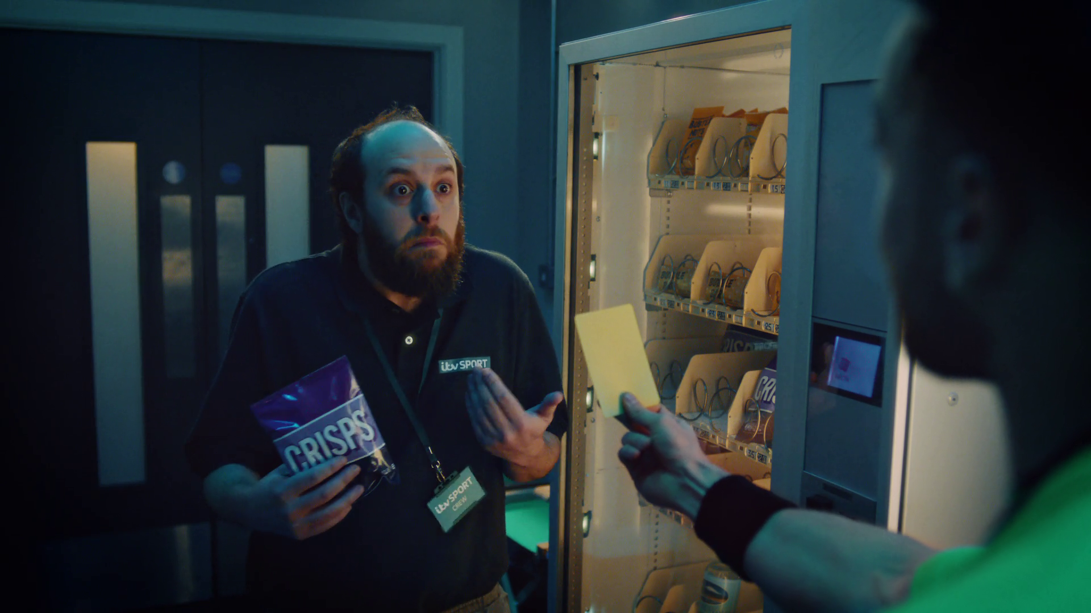
Programming
Q3 2024
Subway, “Putting Lunch Back on the Menu”

Slide 19




Programming Highlights – Q3 2024
The Voice UK
ITV1, 7 Sep
Average Audience
Individuals: 3,162,600
Adults: 3,020,200
ABC1 Ads: 1,324,400
16-34: 200,700
HP+CH: 284,000
Paralympics Opening and Closing Ceremonies
Channel 4, 28 Aug
Average Audience
Individuals: 1,518,400
Adults: 1,433,800
ABC1 Ads: 796,700
16-34: 144,500
HP+CH: 91,200
All Creatures Great and Small
Channel 5, 26 Sep
Average Audience
Individuals: 3,325,900
Adults: 3,303,200
ABC1 Ads: 1,772,100
16-34: 122,600
HP+CH: 107,700
Hungarian F1 GP
Sky Sports F1, 21 Jul
Average Audience
Individuals: 1,551,500
Adults: 1,489,600
ABC1 Ads: 850,600
16-34: 433,400
HP+CH: 89,200
Source: Barb, Q3 2024. Average audience figures - Consolidated, Top performing episode of series (if applicable).

Slide 20




Drama - Programming Highlights
Grace
ITV1, 1 Sep
Average Audience
Individuals: 4,086,600
Adults: 4,047,900
ABC1 Ads: 2,164,700
16-34: 80,900
HP+CH: 120,400
Suspect
Channel 4, 17 Jul
Average Audience
Individuals: 1,384,800
Adults: 1,371,800
ABC1 Ads: 677,900
16-34: 9,500
HP+CH: 57,600
All Creatures Great and Small
Channel 5, 26 Sep
Average Audience
Individuals: 3,325,900
Adults: 3,303,200
ABC1 Ads: 1,772,100
16-34: 122,600
HP+CH: 107,700
House Of The Dragon
Sky Atlantic, 7 Jul
Average Audience
Individuals: 1,299,500
Adults: 1,279,700
ABC1 Ads: 787,700
16-34: 456,900
HP+CH: 193,700
The Chelsea Detective
U&Drama, 11 Sep
Average Audience
Individuals: 851,800
Adults: 848,300
ABC1 Ads: 454,400
16-34: 6,200
HP+CH: 10,900
Source: Barb, Q3 2024. Average audience figures - Consolidated, Top performing episode of series (if applicable).

Slide 21




Entertainment - Programming Highlights
The Voice UK
ITV1, 7 Sep
Average Audience
Individuals: 3,162,600
Adults: 3,020,200
ABC1 Ads: 1,324,400
16-34: 200,700
HP+CH: 284,000
The Great British Bake Off
Channel 4, 24 Sep
Average Audience
Individuals: 6,381,900
Adults: 6,045,300
ABC1 Ads: 3,802,400
16-34: 878,900
HP+CH: 838,300
Phillip Schofield Cast Away
Channel 5, 30 Sep
Average Audience
Individuals: 2,323,900
Adults: 2,277,400
ABC1 Ads: 986,300
16-34: 215,300
HP+CH: 255,400
Rob & Romesh vs...
Sky Max, 27 Aug
Average Audience
Individuals: 527,300
Adults: 489,700
ABC1 Ads: 276,200
16-34: 167,600
HP+CH: 82,800
Married at First Sight UK
E4, 25 Sep
Average Audience
Individuals: 2,321,600
Adults: 2,231,500
ABC1 Ads: 1,178,100
16-34: 566,000
HP+CH: 456,500
Source: Barb, Q3 2024. Average audience figures - Consolidated, Top performing episode of series (if applicable)

Slide 22



Sports - Programming Highlights
Euro 2024: Netherlands v England
ITV1, 10 Jul
Average Audience
Individuals: 12,658,200
Adults: 11,447,200
ABC1 Ads: 6,428,200
16-34: 2,108,900
HP+CH: 1,467,400
Paralympics Opening and Closing Ceremonies
Channel 4, 28 Aug
Average Audience
Individuals: 1,518,400
Adults: 1,433,800
ABC1 Ads: 796,700
16-34: 144,500
HP+CH: 91,200
Red Bull Soapbox Race
Channel 5, 25 Aug
Average Audience
Individuals: 414,900
Adults: 400,300
ABC1 Ads: 128,900
16-34: 17,800
HP+CH: 9,200
Man Utd v Tottenham Sky Sports Main Event, 29 Sep
Average Audience
Individuals: 1,600,900
Adults: 1,524,800
ABC1 Ads: 837,800
16-34: 337,000
HP+CH: 118,800
Hungarian F1 GP
Sky Sports F1, 21 Jul
Average Audience
Individuals: 1,551,500
Adults: 1,489,600
ABC1 Ads: 850,600
16-34: 433,400
HP+CH: 89,200
Source: Barb, Q3 2024. Average audience figures - Consolidated, Top performing episode of series (if applicable)

Slide 23





Hobbies & Leisure - Programming Highlights
Love Your Garden
ITV1, 22 Aug
Average Audience
Individuals: 1,037,400
Adults: 1,027,100
ABC1 Ads: 421,300
16-34: 53,000
HP+CH: 58,400
Grand Designs
Channel 4, 25 Sep
Average Audience
Individuals: 1,714,800
Adults: 1,656,500
ABC1 Ads: 902,500
16-34: 129,700
HP+CH: 141,500
Your Kitchen: 60 Years of Fads & Gadgets
Channel 5, 6 Aug
Average Audience
Individuals: 794,600
Adults: 781,400
ABC1 Ads: 362,800
16-34: 31,100
HP+CH: 37,400
Bangers & Cash:
U&Yesterday, 22 Aug
Average Audience
Individuals: 382,200
Adults: 376,400
ABC1 Ads: 120,200
16-34: 5,200
HP+CH: 8,200
Shed and Buried
Really, 30 Sep
Average Audience
Individuals: 333,900
Adults: 312,700
ABC1 Ads: 66,000
16-34: 4,600
HP+CH: 1,500
Source: Barb, Q3 2024. Average audience figures - Consolidated, Top performing episode of series (if applicable)

Slide 24










SVOD Drama & Entertainment - Programming Highlights
The Perfect Couple S1, Ep1
Netflix, Drama
Individuals: 2,501,992
Adults: 2,427,035
Monsters: The Lyle and Erik Menendez Story S1, Ep1
Netflix, Drama
Individuals: 2,007,212
Adults: 1,951,560
The Lord of the Rings: The Rings of Power S2, Ep1
Amazon, Drama
Individuals: 1,966,231
Adults: 1,937,105
The Boys S4, Ep8
Amazon, Drama
Individuals: 1,554,857
Adults: 1,533,963
Agatha All Along S1, Ep1
Disney+, Drama
Individuals: 1,069,421
Adults: 986,865
Love Is Blind: UK S1, Ep1
Netflix, Entertainment
Individuals: 1,175,059
Adults: 1,137,645
Selling Sunset S8, Ep1
Netflix, Entertainment
Individuals: 744,717
Adults: 732,954
The Kardashians S5 Ep9
Disney+, Entertainment
Individuals: 295,208
Adults: 276,619
Sausage Party: Foodtopia S1, Ep1 Amazon, Entertainment
Individuals: 258,695
Adults: 257,181
Futurama S12, Ep3
Disney+, Entertainment
Individuals: 248,335
Adults: 212,032
Source: Barb, Q3 2024, individuals and adults. Average audience achieved during the first seven days of their availability. Only includes TV set viewing.

Slide 25

Q3 2025
Kelloggs, “See You In The Morning”

Slide 26
Key Dates
 | Week Commencing
 | 30-Jun | 07-Jul | 14-Jul | 21-Jul | 28-Jul | 04-Aug | 11-Aug | 18-Aug | 25-Aug | 01-Sep | 08-Sep | 15-Sep | 22-Sep | 29-Sep
Wimbledon
Tour de France
UEFA Women's EURO
Formula 1
Premier League
Womens Rugby World Cup
Bank Holiday
US Open
UEFA Champions League
Ryder Cup
HFSS Restrictions*
*From 1st October 2025, the new HFSS (High in Fat, Salt, or Sugar) advertising restrictions will come into effect.

Slide 27


























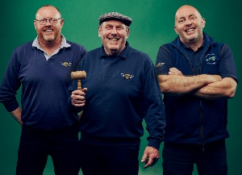





Programming Highlights – Q3 2025
ITV
I Fought the Law
You Bet!
The National TV Awards
UEFA Women's EURO 2025
The Carabao Cup 2025
Tour de France
England Men's International Football
Shark! Celebrity Infested Waters
Ridley
Karen Pirie
Long Lost Family
The Fortune Hotel
Cold Water
Channel 4
The Couple Next Door S2
The Great British Bake Off
Married at First Sight UK
Trespasses
Mitchell & Webb
The Inheritance
Taskmaster
Sky
The Equalizer S5
Rob & Romesh vs S8
SWAT S8
Sonic the Hedgehog 3
The Yogurt Shop Murders
Mr Bigstuff S2
Fire Country S3
Love Hurts
Wicked
UKTV
Channel 5
All Creatures Great & Small S6
The Rumour
Bangers & Cash S12
Side Hustlers
Sister Boniface S4
Bookish
The Forsytes

