Slide 1
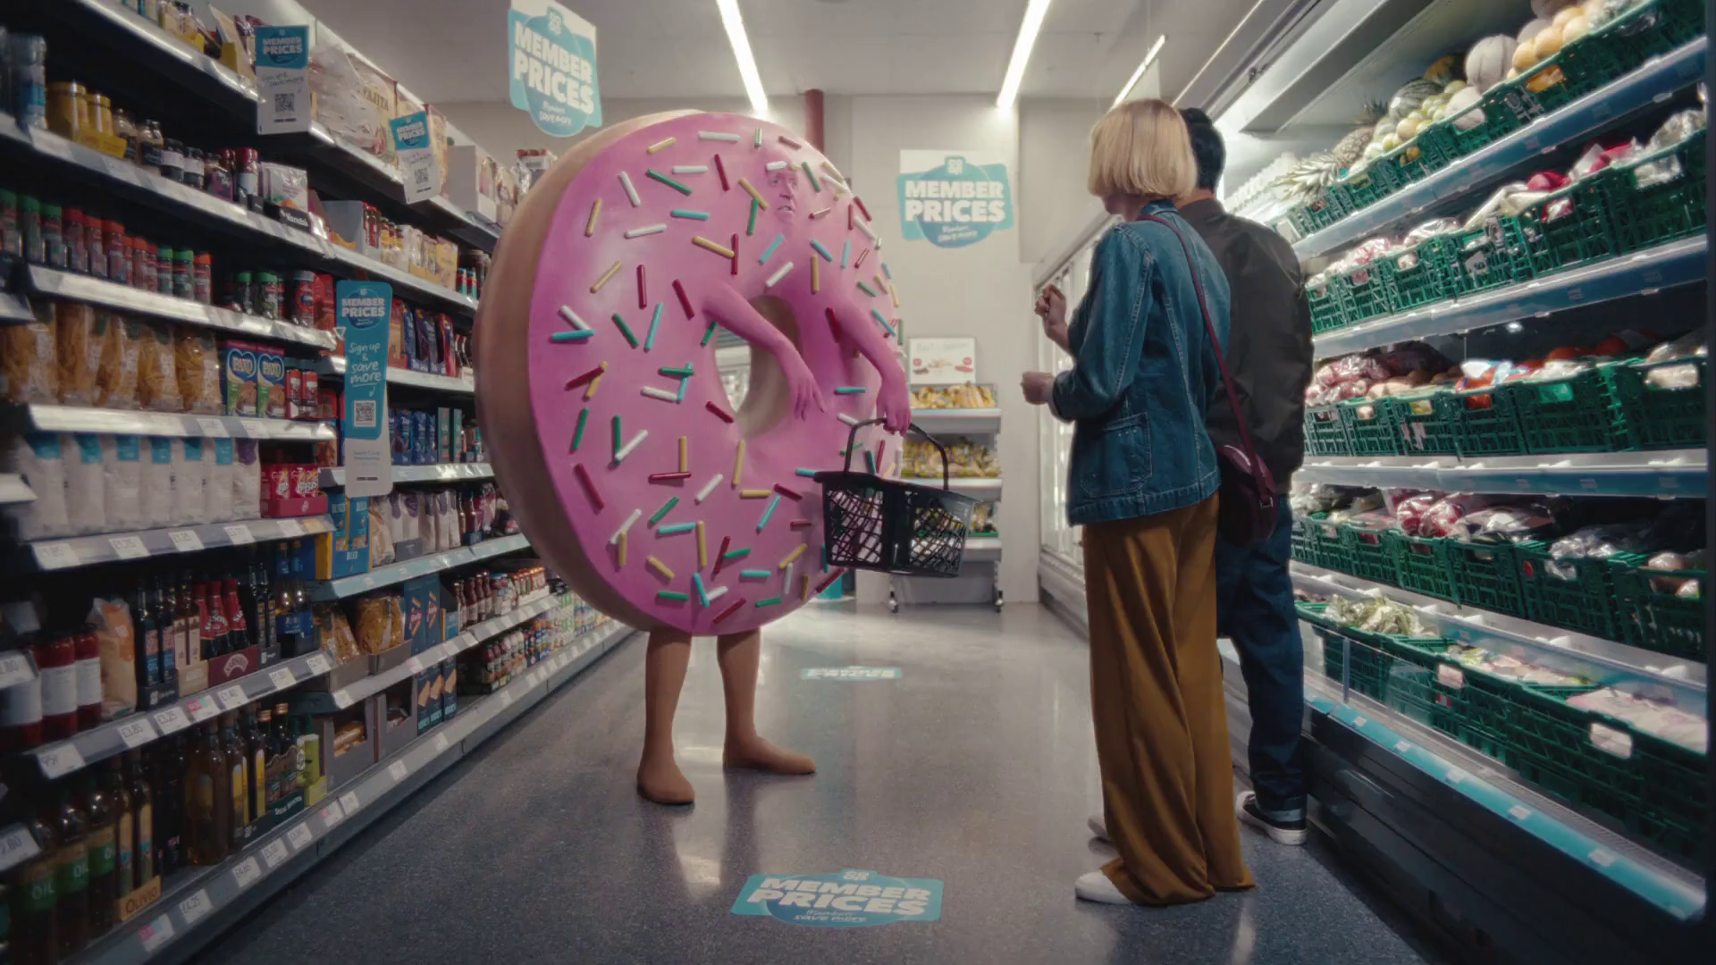
Future Focus Report
Q4 2023
Co-op, “Proper Doughnut”

Slide 2
This deck is packed with insights
With Q4 planning well under way, this report will be a handy guide on what to expect over the coming months.
To provide a useful base on what to expect this year we look historically to Q4 2022:
Category & advertiser analysis
‘Reach Extenders’ analysis
TV viewing overview with cover guides for key buying audiences
Programming highlights across a range of genres
To better prepare you, we include key considerations for the quarter ahead:
Important dates
Preview on programming to expect in Q4 2023
Thatcher's, “Blood Orange”
Notes:
The Future Focus Report puts Q4 in the spotlight and is a useful guide to help with planning for the upcoming quarter.

Slide 3
Category & Advertiser Analysis Q4 2022
Frijj, “The Drop”

Slide 4
Q4 2022 TV Impacts by Category
High
Mid
Low
Relative propensity of media spend by category
 | Cosmetics & Personal Care | Electronics | Government Social Political Organisation | Retail | Drink | Online Retail | Food | Household Equipment & DIY | Household FMCG | Entertainment & Leisure | Telecoms | Health & Wellbeing | Travel & Transport | Finance | Automotive
October | 87 | 137 | 111 | 85 | 51 | 99 | 95 | 100 | 101 | 92 | 116 | 108 | 82 | 113 | 91
November | 125 | 133 | 111 | 176 | 101 | 126 | 116 | 76 | 86 | 95 | 109 | 95 | 52 | 71 | 68
December | 175 | 107 | 146 | 102 | 191 | 109 | 107 | 121 | 111 | 106 | 62 | 75 | 107 | 39 | 46
Total | 130 | 125 | 123 | 121 | 116 | 111 | 106 | 99 | 99 | 98 | 95 | 92 | 81 | 73 | 68
Source: Barb, 2022 (Q4) and 2022 Index, Adults, Top 15 categories by total impacts
Notes:
Q4 TV Impacts by category. Indexed % spend by category for each month (Oct-Dec) vs. the average % for 2022

Slide 5
Top sectors by Q4 2022 impacts
106
130
98
73
123
95
81
125
121
99
99
116
92
68
111
Source: Barb, Q4 2022, All Adults, Impacts (R/W) (million). Numbers above bars show Q4 index vs 2022.

Slide 6
Cosmetics & Personal Care - Advertiser
Source: Barb, Q4 2022, All Adults, Impacts (R/W) (million). Top 10 2022 Q4 advertisers by total impacts.

Slide 7
Electronics - Advertiser
Source: Barb, Q4 2022, All Adults, Impacts (R/W) (million). Top 10 2022 Q4 advertisers by total impacts.

Slide 8
Retail - Advertiser
Source: Barb, Q4 2022, All Adults, Impacts (R/W) (million). Top 10 2022 Q4 advertisers by total impacts.

Slide 9
Reach Extenders
Emirates, “Lovers of Sport”

Slide 10
Identifying the ‘Reach Extenders’
Weight of viewing is a key factor
in incremental reach
‘Middle tier’ of viewers are key to
BVOD’s incremental reach
Research from BVOD Almighty divided viewers into deciles based on weekly linear TV viewing. Light viewers are hard to target on TV, while heavy viewers are easily targeted via linear TV, reducing the role of BVOD. PwC’s analysis identifies the ‘middle tier’ as the key segment driving incremental reach via BVOD.
This chart displays the proportion of linear and BVOD consumption for each of the three tiers and their deciles. Notably, the ‘middle tier’, accounting for 7% of linear TV viewing, makes up 28% of BVOD consumption, making them the key audience to extend campaigns through BVOD; we call them the ‘Reach Extenders’.
Source: BVOD Almighty
Notes:
Left Chart: Detailed analysis by PwC has identified a segment that are important drivers of why BVOD is delivering incremental reach.
This chart shows the viewing population split into ten equal groups (deciles) based upon amount of liner TV viewing per week.
The lightest decile averages 4-mins of linear viewing per day. Up to the heaviest decile who view for 734-minutes (12-hours 14-minutes) per day.
The deciles have been split into three groups:
Lightest tier. These are very hard to reach on TV (linear or BVOD) and are most likely to be targeted via platforms such as YouTube
Middle tier.
Heaviest tier. These are quite easy to reach via linear TV and, as a result, BVOD probably has little role to play.
Right Chart: This chart shows for each of the three tiers (and the deciles within them) what proportion of linear and BVOD consumption they account for.
Key to note is that the middle tier (green) proportionally watch a lot of BVOD. Whilst they account for 7% of linear TV viewing, they make up 28% of BVOD consumption.
This makes them the key audience for extending campaign via the use of BVOD – relatively they are easier to reach via BVOD then linear TV.

Slide 11
Identifying the ‘Reach Extenders’
BVOD provides good odds of reaching an attractive audience
Where and when can we effectively reach this valuable audience of ‘Reach Extenders’?
While BVOD excels at reaching this audience there are key programmes and times you’re very likely to reach them across the whole of TV.
‘Reach Extenders’ display a strong affinity for the following genres:
Entertainment
Sport
Films
Their peak viewing hours take place daily from 8-11pm, with a higher likelihood of viewership occurring at the weekend.
On average, it takes only four impressions to reach a ‘middle tier’ viewer through BVOD, as opposed to 14 impressions on linear. This makes BVOD 3.5 times more efficient in targeting the ‘middle tier’ group, which often consists of younger and upscale viewers, highly sought after by advertisers.
Source: BVOD Almighty
Notes:
Left Chart: BVOD provides good odds of reaching an attractive audience or to put it another way, for every 14 impressions you buy on linear one person falls into the middle tier group (assuming natural delivery)
But on BVOD, it only takes four impressions to, on average, reach somebody in the middle tier. As such, on average, using BVOD is three and a half more efficient than linear at reaching the middle tier of viewers.
The middle tier are very attractive audiences for many advertisers (proportionally younger and upscale) and BVOD enables them to be reached in an efficient way.

Slide 12
Top genres watched by ‘Reach Extenders’
% of All Viewing
Genre | Adults | Reach Extenders | Index
Entertainment | 28% | 31% | 113
Sport | 13% | 20% | 158
Drama | 16% | 12% | 73
Films | 10% | 11% | 102
Documentaries | 13% | 10% | 76
Hobbies/Leisure | 7% | 6% | 78
News/Weather | 5% | 5% | 89
Current Affairs | 3% | 2% | 70
Source: Barb Q4 2022, % of all viewing, index vs all adults.

Slide 13
High indexing entertainment content
Entertainment
Channel | Programme Title | Index
CH4 | Taskmaster | 381
CH4 | The Great British Bake Off | 342
CH4 | Big Fat Quiz | 297
Sky Max | The Unofficial Science of Home Alone | 265
Sky Max | Never Mind the Buzzcocks | 257
Sky Max | Rob & Romesh vs... | 252
E4 | Married at First Sight UK | 241
CH4 | The Last Leg | 237
CH4 | 8 Out of 10 Cats Does Countdown | 222
ITV1 | I'm a Celebrity... Get Me Out of Here! | 205
Entertainment
Channel | Programme Title | Index
CH4 | Gogglebox | 202
Channel 5 | Morecambe & Wise's 30 Funniest… | 190
CH4 | Aldi's Next Big Thing | 183
ITV1 | The 1% Club | 178
Sky Arts | Portrait Artist of the Year | 173
E4 | Modern Family | 164
ITV1 | Who Wants to Be a Millionaire? Celeb… | 154
ITV1 | The Jonathan Ross Show | 151
CH4 | The Simpsons | 150
Comedy Central | Friends | 146
Source: Barb Q4 2022, ‘Reach Extender’ index vs all adults, Thinkbox created list of programmes based on volume of viewing and index.

Slide 14
High indexing sport content
Sport
Channel | Programme Title | Index
CH4 | ICC T20 Cricket World Cup Final | 260
Sky Sports | NFL RedZone | 259
Sky Sports | Brazilian F1 GP | 259
CH4 | Formula 1 | 218
Sky Sports | EFL Cup | 217
Sky Sports | Gillette Soccer Saturday | 209
ITV1 | World Cup | 200
Channel 5 | World's Strongest Man | 198
BT Sport | UEFA Champions League | 195
Sky Sports | Premier League | 186
Sport
Channel | Programme Title | Index
BT Sport | Gallagher Premiership Rugby | 182
Sky Sports | Test Match Cricket | 182
BT Sport | Moto GP | 177
ITV1 | Heineken Champions Cup: Rugby | 173
BT Sport | UEFA Europa League | 164
ITV1 | NFL | 160
Sky Sports | English Football League (EFL) | 155
ITV1 | Rugby: Women's World Cup | 150
Channel 5 | UK's Strongest Man | 149
Sky Sports | ICC World T20 Cricket | 146
Sport
Channel | Programme Title | Index
BT Sport | UEFA Champions League | 193
BT Sport | UFC | 189
Sky Sports | Super Sunday | 181
ITV1 | FA Community Shield | 179
Sky Sports | International Rugby | 167
ITV1 | British Touring Car Championship | 162
BT Sport | UEFA Europa League | 154
ITV4 | All Elite Wrestling: Dynamite | 144
Sky Sports | English Football League (EFL) | 131
Sky Sports | PGA Tour Golf | 124
Source: Barb Q4 2022, ‘Reach Extender’ index vs all adults, Thinkbox created list of programmes based on volume of viewing and index.

Slide 15
High indexing movie content
Films are popular among the ‘Reach Extender’ audience, but planning for this genre is less straightforward due to the variance in film scheduling. To help, here is a breakdown of which sub-genres the ‘Reach Extenders’ are watching.
Films
Sub-Genre | Channel | Programme Title | Index
Family | ITV2 | Despicable Me 3 | 281
Family | Sky Cinema Drama… | Elf | 273
Family | CH4 | Home Alone | 146
Family | Channel 5 | Hook | 119
Sci-Fi and Fantasy | 5STAR | The Fifth Element | 211
Sci-Fi and Fantasy | Sky Cinema Premiere | Fantastic Beasts: The Secrets… | 200
Sci-Fi and Fantasy | CH4 | Star Wars: Episode IX… | 159
Sci-Fi and Fantasy | ITV1 | Aquaman | 112
Romcom | ITV2 | Love Actually | 273
Romcom | CH4 | Four Weddings and a Funeral | 210
Romcom | Sky Cinema Premiere | This is Christmas | 174
Romcom | Channel 5 | Bridget Jones's Baby | 149
Historical and Period | Sky Cinema Drama… | Little Women | 202
Historical and Period | CH4 | Titanic | 151
Historical and Period | CH4 | Hidden Figures | 140
Historical and Period | ITV1 | Downton Abbey | 121
% of all film viewing
Genre | Adults | Reach Extenders | Index
Action / Adventure / Thriller | 27% | 26% | 98
Family | 13% | 18% | 141
Sci-Fi and Fantasy | 13% | 16% | 120
Comedy | 14% | 14% | 100
Romcom | 4% | 6% | 149
Crime Drama | 5% | 4% | 75
War | 5% | 3% | 52
Horror | 4% | 3% | 68
Other | 3% | 2% | 75
Historical and Period | 2% | 2% | 105
Source: Barb Q4 2022, ‘Reach Extender’ index vs all adults, Thinkbox created list of programmes based on volume of viewing and index.

Slide 16
‘Reach Extenders’ aren’t solely limited to high indexing genres
Dramas
Channel | Programme Title | Index
Sky Atlantic | The White Lotus | 422
Sky Atlantic | House Of The Dragon | 368
CH4 | The Handmaid's Tale | 268
Channel 5 | Maxine | 220
Channel 5 | All Creatures Great and Small | 210
E4 | Hollyoaks | 175
ITV1 | Karen Pirie | 157
ITV1 | Doc Martin | 146
ITV1 | The Larkins | 129
ITV1 | The Walk-In | 126
Documentaries
Channel | Programme Title | Index
ITV1 | Paxman: Putting Up With Parkinson's | 231
CH4 | 24 Hours in Police Custody | 191
Channel 5 | Ben Fogle's Lost Worlds | 163
CH4 | Christmas at... | 157
CH4 | 24 Hours in A&E | 155
ITV1 | Inside M&S at Christmas | 147
Channel 5 | Inside the Tower of London | 137
Channel 5 | Susan Calman's Grand Days Out | 133
Sky Crime | Libby, Are You Home Yet? | 129
ITV1 | Charles: Our New King | 127
Source: Barb Q4 2022, ‘Reach Extender’ index vs all adults, Thinkbox created list of programmes based on volume of viewing and index.

Slide 17
When to target the ‘Reach Extenders’
Reach Extenders' index by daypart
 | 6am | 7am | 8am | 9am | 10am | 11am | 12pm | 1pm | 2pm | 3pm | 4pm | 5pm | 6pm | 7pm | 8pm | 9pm | 10pm | 11pm | 12am | 1am | 2am | 3am | 4am | 5am
Monday | 47 | 71 | 67 | 56 | 59 | 58 | 60 | 66 | 64 | 54 | 62 | 78 | 93 | 127 | 152 | 154 | 122 | 88 | 69 | 51 | 39 | 28 | 17 | 34
Tuesday | 57 | 66 | 58 | 56 | 59 | 60 | 62 | 64 | 56 | 53 | 57 | 71 | 88 | 121 | 162 | 159 | 125 | 96 | 67 | 50 | 35 | 19 | 21 | 27
Wednesday | 57 | 65 | 65 | 61 | 62 | 64 | 69 | 69 | 61 | 56 | 58 | 73 | 93 | 118 | 142 | 164 | 131 | 100 | 78 | 61 | 42 | 45 | 25 | 32
Thursday | 61 | 69 | 70 | 69 | 64 | 63 | 66 | 57 | 55 | 53 | 62 | 74 | 92 | 119 | 142 | 162 | 135 | 99 | 78 | 61 | 47 | 40 | 28 | 31
Friday | 44 | 60 | 65 | 61 | 59 | 59 | 61 | 61 | 59 | 52 | 59 | 76 | 91 | 123 | 143 | 152 | 140 | 116 | 91 | 67 | 45 | 40 | 34 | 28
Saturday | 40 | 72 | 83 | 78 | 70 | 66 | 73 | 81 | 78 | 78 | 85 | 90 | 104 | 123 | 135 | 138 | 124 | 103 | 85 | 63 | 52 | 41 | 37 | 34
Sunday | 40 | 72 | 77 | 78 | 77 | 80 | 78 | 79 | 80 | 80 | 90 | 101 | 111 | 127 | 133 | 136 | 114 | 79 | 58 | 37 | 31 | 28 | 14 | 22
Monday | Tuesday | Wednesday | Thursday | Friday | Saturday | Sunday
96 | 101 | 87 | 89 | 94 | 111 | 118
Source: Barb Q4 2022, commercial linear & BVOD, ‘Reach Extender’ index vs all adults.

Slide 18
TV Viewing Overview Q4 2022
Now TV, “Toughest Critic”

Slide 19
Q4 2022 linear TV facts & figures
Total TV weekly reach %
Total TV viewed per day
Commercial TV viewed per day
Impacts
Individuals
80.3 | 187.0bn | 2h 42m | 1h 48m
82.9 | 178.5bn | 3h 4m | 2h 2m
81.9 | 75.2bn | 2h 34m | 1h 35m
66.6 | 17.6bn | 1h 3m | 45m
81.7 | 79.5bn | 2h 55m | 1h 55m
84.0 | 99.0bn | 3h 12m | 2h 8m
80.6 | 16.0bn | 1h 54m | 1h 20m
Adults
ABC1 adults
16-34
Men
Women
Housepersons with children
Sources: Barb Q4 2022, industry standard TV viewing in-home on a TV set. Reach 3min+. 30” equivalent impacts.
Notes:
Q4 2022 linear TV figures for weekly reach, impacts, total TV viewing hours and commercial TV viewing hours

Slide 20
Q4 2022 – Cover guide – ABC1 Ads
Source: Barb BVOD Planner (2022, 6 weeks 41-46) / natural delivery / station average prices. FIFA World Cup began 20th Nov.

Slide 21
Q4 2022 – Cover guide – 16-34
Source: Barb BVOD Planner (2022, 6 weeks 41-46) / natural delivery / station average prices. FIFA World Cup began 20th Nov.

Slide 22
Q4 2022 – Cover guide – Housepersons with children
Source: Barb BVOD Planner (2022, 6 weeks 41-46) / natural delivery / station average prices. FIFA World Cup began on 20th Nov.

Slide 23
Programming Q4 2022
KFC, “Delivery”

Slide 24
Programming Highlights – Q4 2022
I’m a Celebrity... Get Me Out of Here! ITV1, 6 Nov
Average Audience
Individuals: 11,895,900
Adults: 11,222,700
ABC1 Ads: 6,021,400
16-34: 2,767,500
HP+CH: 1,895,000
Married at First Sight UK
E4, 3 Oct
Average Audience
Individuals: 2,262,200
Adults: 2,214,800
ABC1 Ads: 1,399,500
16-34: 690,000
HP+CH: 400,000
All Creatures Great and Small
Channel 5, 23 Dec
Average Audience
Individuals: 3,825,000
Adults: 3,743,200
ABC1 Ads: 2,190,700
16-34: 111,200
HP+CH: 102,000
Brazilian F1 GP
Sky Sports F1, 13 Nov
Average Audience
Individuals:1,718,800
Adults: 1,644,300
ABC1 Ads: 932,700
16-34: 458,900
HP+CH: 151,400
Source: Barb, Q4 2022. Average audience figures - Consolidated, Top performing episode of series (if applicable)

Slide 25
Drama - Programming Highlights
Doc Martin
ITV1, 26 Oct
Average Audience
Individuals: 6,011,000
Adults: 5,977,400
ABC1 Ads: 3,134,700
16-34: 209,600
HP+CH: 170,600
The Handmaid's Tale Channel 4, 23 Oct
Average Audience
Individuals: 1,697,200
Adults: 1,644,900
ABC1 Ads: 1,089,000
16-34: 265,100
HP+CH: 253,600
All Creatures Great and Small
Channel 5, 23 Dec
Average Audience
Individuals: 3,825,000
Adults: 3,743,200
ABC1 Ads: 2,190,700
16-34: 111,200
HP+CH: 102,000
Christmas Carole
Sky Atlantic, 23 Dec
Average Audience
Individuals: 2,098,600
Adults: 2,025,400
ABC1 Ads: 1,376,800
16-34: 802,300
HP+CH: 318,800
The Brokenwood Mysteries
Drama, 13 Jul
Average Audience
Individuals: 732,800
Adults: 724,400
ABC1 Ads: 366,300
16-34: 3,500
HP+CH: 4,900
Source: Barb, Q4 2022. Average audience figures - Consolidated, Top performing episode of series (if applicable)

Slide 26
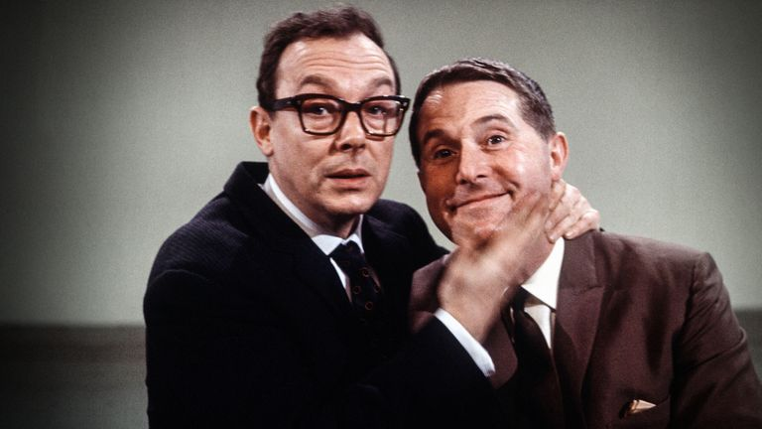
Entertainment - Programming Highlights
I'm a Celebrity... Get Me Out of Here!
ITV1, 6 Nov
Average Audience
Individuals: 11,895,900
Adults: 11,222,700
ABC1 Ads: 6,021,400
16-34: 2,767,500
HP+CH: 1,895,000
The Great British Bake Off
Channel 4, 11 Oct
Average Audience
Individuals: 8,030,000
Adults: 7,564,900
ABC1 Ads: 5,175,500
16-34: 1,670,600
HP+CH: 1,248,100
Morecambe & Wise's 30 Funniest Moments Channel 5, 5 Nov
Average Audience
Individuals: 1,028,500
Adults: 1,019,700
ABC1 Ads: 515,200
16-34: 52,200
HP+CH: 21,500
Portrait Artist of the Year
Sky Arts, 12 Oct
Average Audience
Individuals: 520,300
Adults: 515,800
ABC1 Ads: 381,400
16-34: 10,300
HP+CH: 36,800
QI XL
Dave, 31 Oct
Average Audience
Individuals: 437,200
Adults: 434,400
ABC1 Ads: 240,700
16-34: 46,600
HP+CH: 26,700
Source: Barb, Q4 2022. Average audience figures - Consolidated, Top performing episode of series (if applicable)

Slide 27
Sports - Programming Highlights
World Cup QF: England v France
ITV1, 10 Dec
Average Audience
Individuals: 15,415,800
Adults: 13,477,800
ABC1 Ads: 7,982,400
16-34: 2,536,000
HP+CH: 1,714,100
Formula 1: Singapore Grand Prix Highlights
Channel 4, 2 Oct
Average Audience
Individuals: 1,410,200
Adults: 1,370,600
ABC1 Ads: 733,800
16-34: 214,100
HP+CH: 85,300
World's Strongest Man
Channel 5, 31 Dec
Average Audience
Individuals: 1,432,300
Adults: 1,266,400
ABC1 Ads: 563,400
16-34: 217,900
HP+CH: 181,800
Brazilian F1 GP
Sky Sports F1, 13 Nov
Average Audience
Individuals:1,718,800
Adults: 1,644,300
ABC1 Ads: 932,700
16-34: 458,900
HP+CH: 151,400
Premier League: Everton v Manchester United
BT Sport 1, 9 Oct
Average Audience
Individuals: 1,133,100
Adults: 1,041,800
ABC1 Ads: 613,200
16-34: 263,000
HP+CH: 95,000
Source: Barb, Q4 2022. Average audience figures - Consolidated, Top performing episode of series (if applicable)

Slide 28
Hobbies & Leisure - Programming Highlights
A Royal Grand Design ITV1, 30 Nov
Average Audience
Individuals: 2,510,500
Adults: 2,485,900
ABC1 Ads: 1,323,400
16-34: 101,100
HP+CH: 117,600
Escape to the Chateau
Channel 4, 30 Oct
Average Audience
Individuals: 2,501,300
Adults: 2,425,700
ABC1 Ads: 1,527,300
16-34: 158,900
HP+CH: 128,000
The Gadget Show
Channel 5, 16 Nov
Average Audience
Individuals: 628,100
Adults: 568,900
ABC1 Ads: 317,600
16-34: 60,600
HP+CH: 98,800
Bangers and Cash
Yesterday, 13 Oct
Average Audience
Individuals: 587,200
Adults: 560,100
ABC1 Ads: 201,300
16-34: 10,600
HP+CH: 27,500
Shed and Buried
Quest, 29 Nov
Average Audience
Individuals: 423,600
Adults: 423,600
ABC1 Ads: 182,000
16-34: 2,200
HP+CH: 20,100
Source: Barb, Q4 2022. Average audience figures - Consolidated, Top performing episode of series (if applicable)

Slide 29
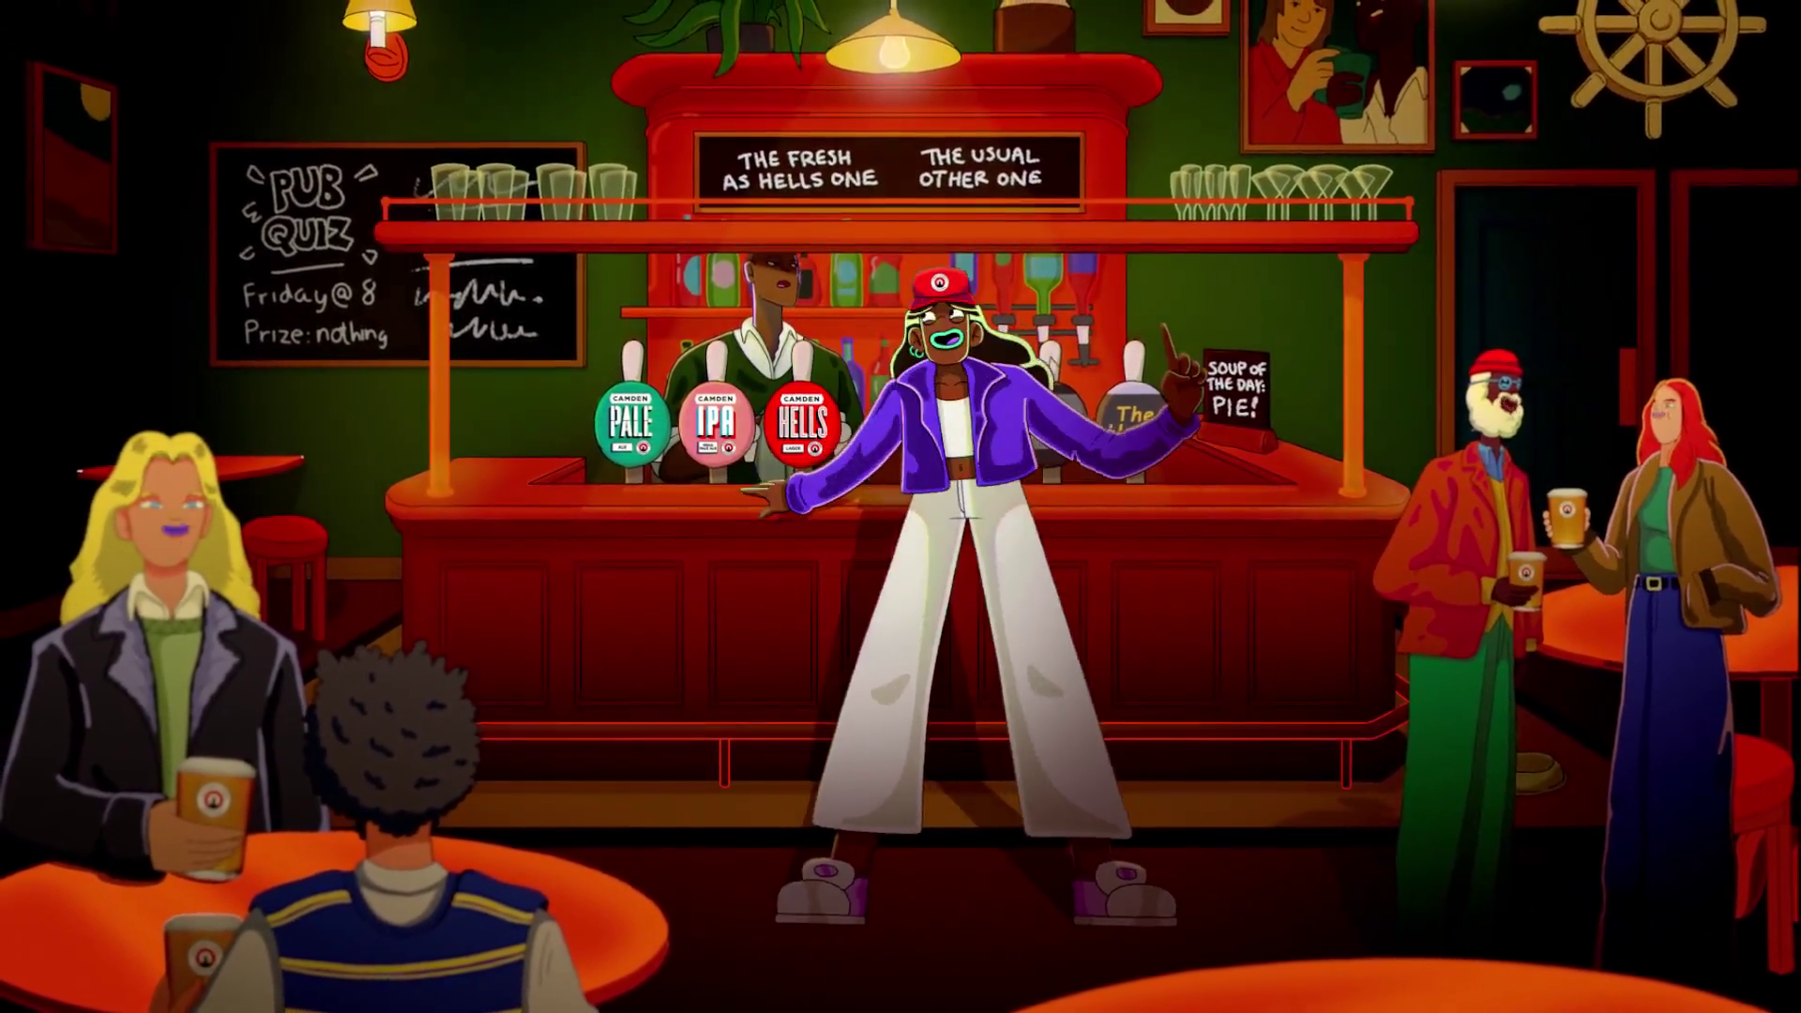
Q4 2023
Camden Town Brewery, “Fresh Choice”

Slide 30
Key Dates
 | Week Commencing
 | 02-Oct | 09-Oct | 16-Oct | 23-Oct | 30-Oct | 06-Nov | 13-Nov | 20-Nov | 27-Nov | 04-Dec | 11-Dec | 18-Dec | 25-Dec
Rugby World Cup
Halloween
Black Friday
Champions League
Premier League
Christmas

Slide 31
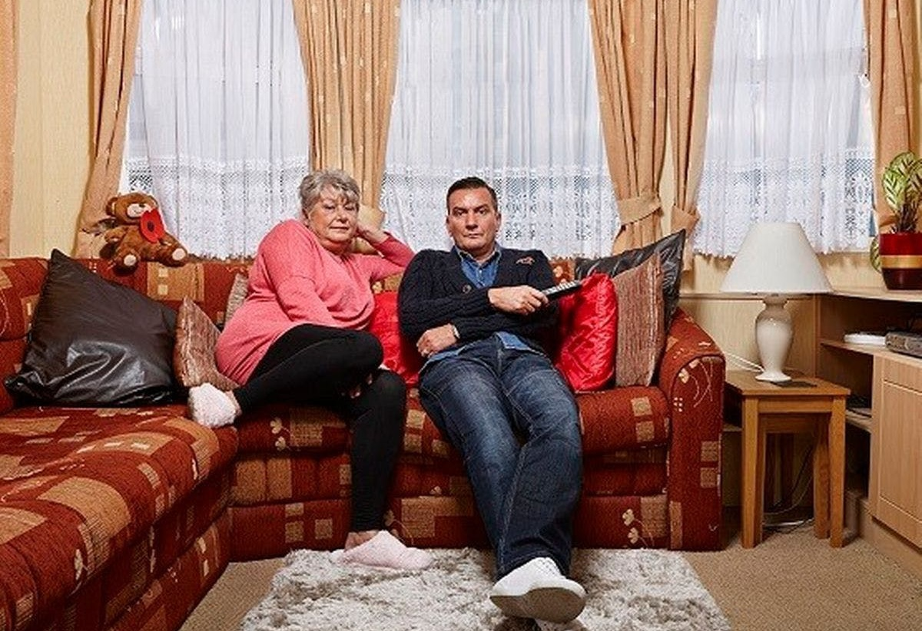
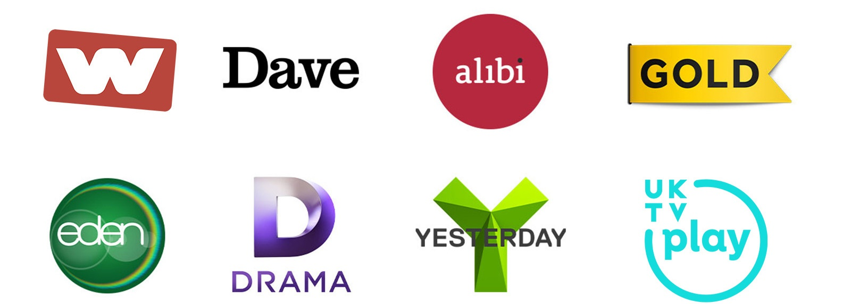
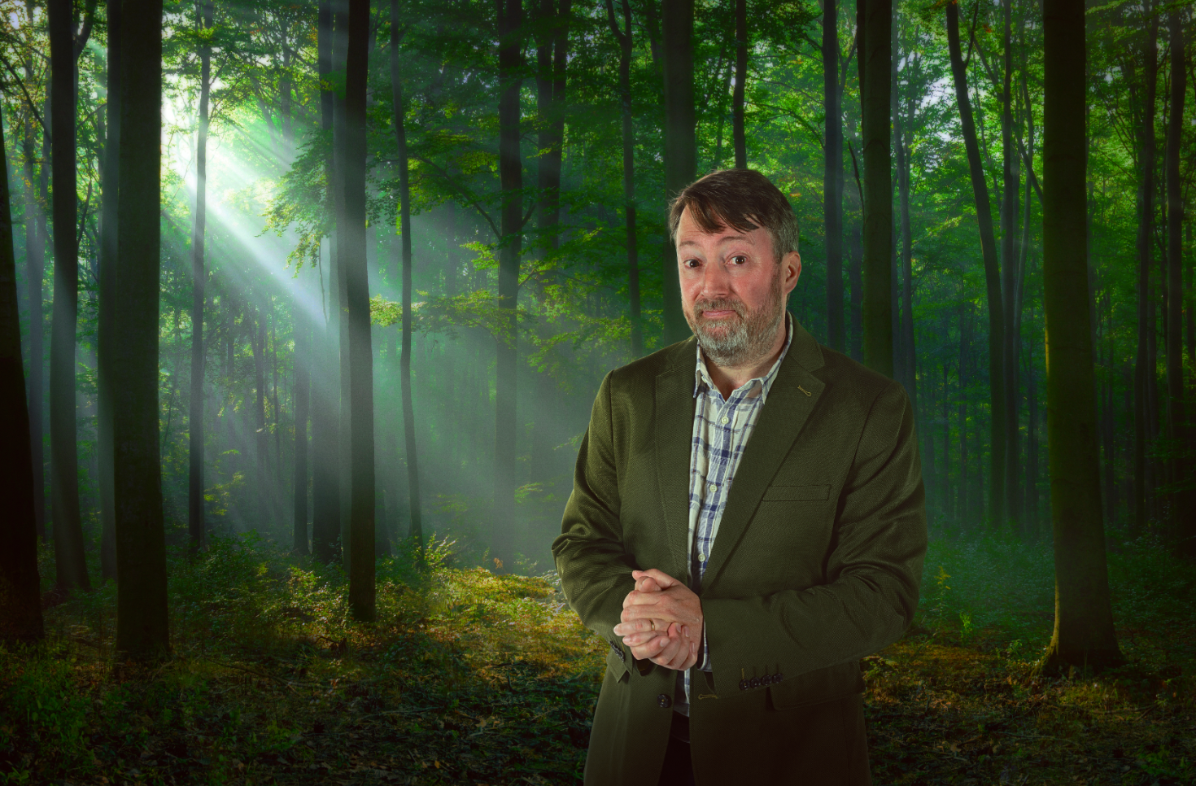
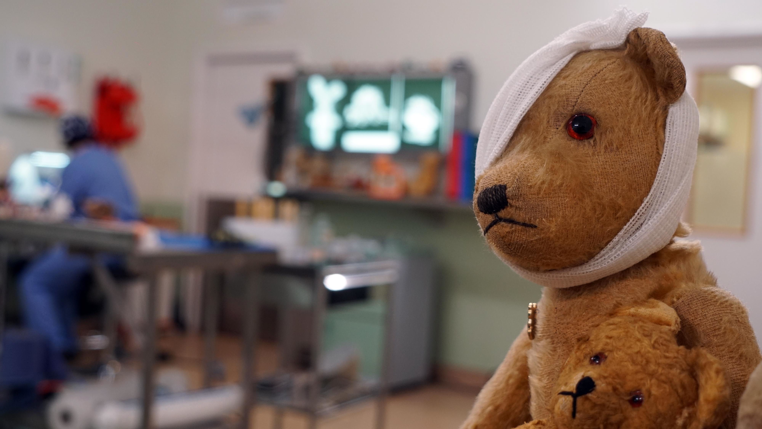
Programming Highlights – Q4 2023
ITV
I’m A Celebrity Get Me Out Of Here!
Mamma Mia: I Have A Dream
Three Little Birds
Three Little Birds
The Voice
Big Brother
The Long Shadow
Channel 4
The Great British Bake Off
Married at First Sight UK
Celebrity SAS
Mog’s Christmas
Gogglebox
Gogglebox
Bangers
The Couple Next Door
Sky
Whale with Steve Backshall
True Detective: Night Country
Lazarus Project S2
Smothered
COBRA: Rebellion
UKTV
Channel 5
Sister Boniface: Christmas Special
Outsiders with David Mitchell S3
Sister Boniface: Christmas Special
Outsiders with David Mitchell
Murder, They Hope: Bloody Actually
Murder, They Hope: Bloody Actually
Elementary
Endurance: Race to the Pole
The Toy Hospital
Cruising with Susan Calman
Wedding Valley

