Slide 1


Future Focus Report
Q4 2025
Goodfella’s - Goooood

Slide 2

In this deck...
With Q4 planning well under way, this report will be a handy guide on what to expect over the coming months.
To provide a useful base on what to expect this year we look historically to Q4 2024:
Category & advertiser analysis
‘Reach Extenders’ analysis & TV viewing overview
Programming highlights across a range of genres
To better prepare you, we include key considerations for the quarter ahead:
Important dates
Preview on programming to expect in Q4 2025
Thortful - Creator
Notes:
The Future Focus Report puts Q4 in the spotlight and is a useful guide to help with planning for the upcoming quarter.

Slide 3
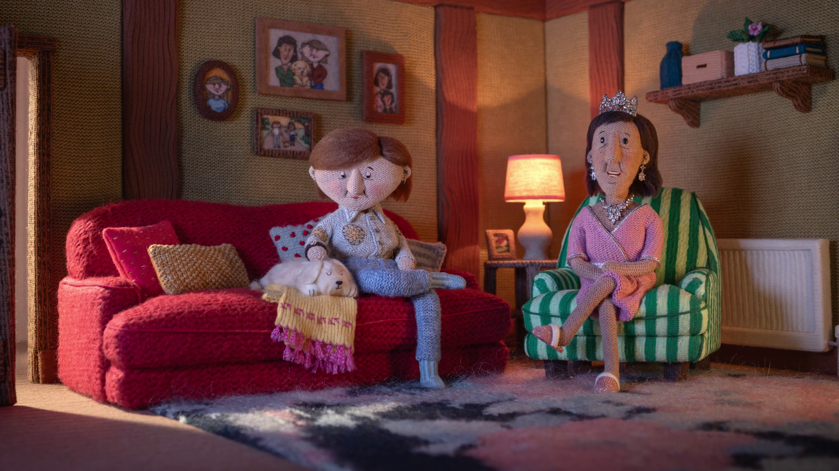
Category & Advertiser Analysis Q4 2024
Department for Energy Security and Net Zero – Warm and Fuzzy

Slide 4
Q4 2024 TV Impacts by Category
High
Mid
Low
Relative propensity of media spend by category
 | Online retail | Retail | Business & Industrial | Government Social Political Organisation | Electronics, Household Appliances & Tech | Cosmetics & Personal Care | Household Equipment & DIY | Entertainment & Leisure | Food | Telecoms | Household FMCG | Health & Wellbeing | Finance | Automotive | Travel & Transport
Oct | 147 | 122 | 167 | 110 | 113 | 91 | 111 | 95 | 82 | 109 | 104 | 96 | 108 | 95 | 63
Nov | 147 | 134 | 122 | 111 | 152 | 111 | 107 | 113 | 112 | 96 | 93 | 96 | 66 | 61 | 35
Dec | 135 | 123 | 91 | 148 | 106 | 138 | 113 | 120 | 101 | 80 | 86 | 81 | 47 | 53 | 82
Q4 | 143 | 126 | 126 | 124 | 123 | 114 | 110 | 110 | 99 | 94 | 94 | 91 | 73 | 69 | 61
Source: Barb, Q4 2024 vs 2024 Index, Adults, Top 15 categories by total impacts. Historic not forward looking.
Notes:
Q4 TV Impacts by category. Indexed % spend by category for each month vs. the average % for 2023

Slide 5
Top sectors by Q4 2024 impacts
99
110
124
114
94
73
126
94
110
61
143
91
123
69
126
Source: Barb, Q4 2024, All Adults, Impacts (R/W) (million). Numbers above bars show Q4 index vs 2024. Historic not forward looking.

Slide 6










Online Retail - Advertiser
Source: Barb, Q4 2024, All Adults, Impacts (R/W) (million). Top 10 2024 Q4 advertisers by total impacts.

Slide 7










Retail - Advertiser
Source: Barb, Q4 2024, All Adults, Impacts (R/W) (million). Top 10 2024 Q4 advertisers by total impacts.

Slide 8









Business & Industrial - Advertiser
Source: Barb, Q4 2024, All Adults, Impacts (R/W) (million). Top 10 2024 Q4 advertisers by total impacts.

Slide 9

Reach Extenders & Viewing Overview
Great Western Railway – Thrilling Engagement

Slide 10
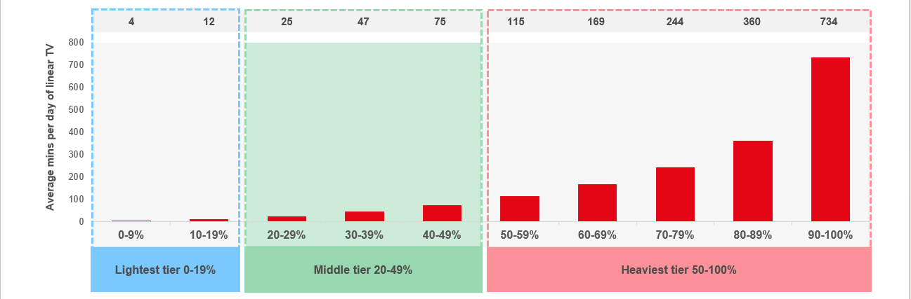
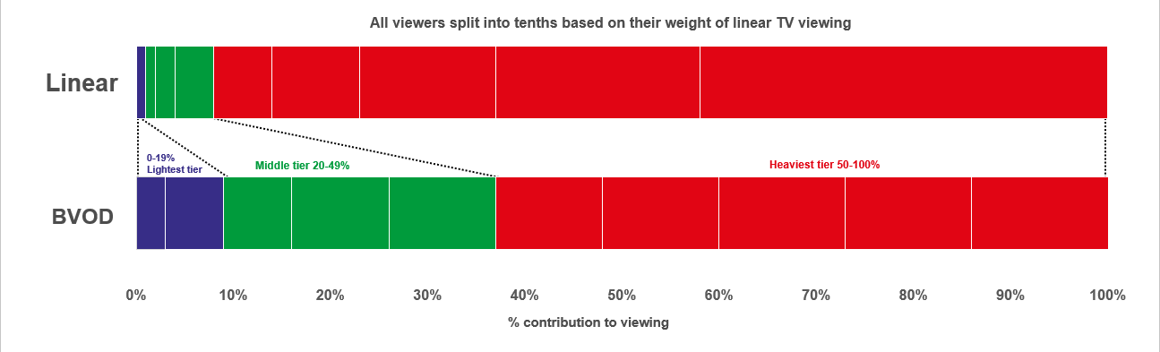

Identifying the ‘Reach Extenders’
Weight of viewing is a key factor
in incremental reach
‘Middle tier’ of viewers are key to
BVOD’s incremental reach
Research from BVOD Almighty divided viewers into deciles based on weekly linear TV viewing. Light viewers are hard to target on TV, while heavy viewers are easily targeted via linear TV, reducing the role of BVOD. PwC’s analysis identifies the ‘middle tier’ as the key segment driving incremental reach via BVOD.
This chart displays the proportion of linear and BVOD consumption for each of the three tiers and their deciles. Notably, the ‘middle tier’, accounting for 7% of linear TV viewing, makes up 28% of BVOD consumption, making them the key audience to extend campaigns through BVOD; we call them the ‘Reach Extenders’.
Source: BVOD Almighty
Notes:
Left Chart: Detailed analysis by PwC has identified a segment that are important drivers of why BVOD is delivering incremental reach.
This chart shows the viewing population split into ten equal groups (deciles) based upon amount of liner TV viewing per week.
The lightest decile averages 4-mins of linear viewing per day. Up to the heaviest decile who view for 734-minutes (12-hours 14-minutes) per day.
The deciles have been split into three groups:
Lightest tier. These are very hard to reach on TV (linear or BVOD) and are most likely to be targeted via platforms such as YouTube
Middle tier.
Heaviest tier. These are quite easy to reach via linear TV and, as a result, BVOD probably has little role to play.
Right Chart: This chart shows for each of the three tiers (and the deciles within them) what proportion of linear and BVOD consumption they account for.
Key to note is that the middle tier (green) proportionally watch a lot of BVOD. Whilst they account for 7% of linear TV viewing, they make up 28% of BVOD consumption.
This makes them the key audience for extending campaign via the use of BVOD – relatively they are easier to reach via BVOD then linear TV.

Slide 11
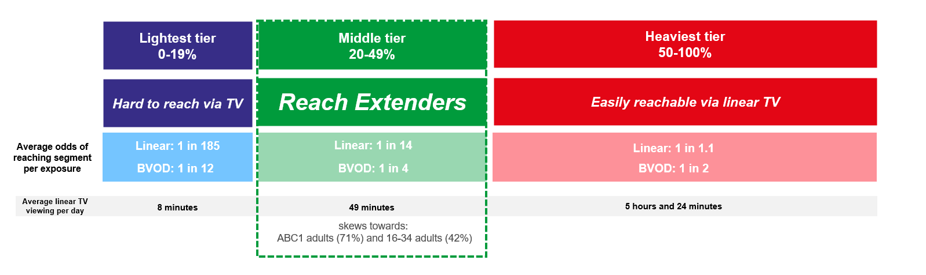
Identifying the ‘Reach Extenders’
BVOD provides good odds of reaching an attractive audience
Where and when can we effectively reach this valuable audience of ‘Reach Extenders’?
While BVOD excels at reaching this audience there are key programmes and times you’re very likely to reach them across the whole of TV.
‘Reach Extenders’ display a strong affinity for the following genres:
Drama
Films
Children
Their peak viewing hours take place daily from 8-11pm, with a higher likelihood of viewership occurring at the weekend.
On average, it takes only four impressions to reach a ‘middle tier’ viewer through BVOD, as opposed to 14 impressions on linear. This makes BVOD 3.5 times more efficient in targeting the ‘middle tier’ group, which often consists of younger and upscale viewers, highly sought after by advertisers.
Source: BVOD Almighty
Notes:
Left Chart: BVOD provides good odds of reaching an attractive audience or to put it another way, for every 14 impressions you buy on linear one person falls into the middle tier group (assuming natural delivery)
But on BVOD, it only takes four impressions to, on average, reach somebody in the middle tier. As such, on average, using BVOD is three and a half more efficient than linear at reaching the middle tier of viewers.
The middle tier are very attractive audiences for many advertisers (proportionally younger and upscale) and BVOD enables them to be reached in an efficient way.

Slide 12
Top genres watched by ‘Reach Extenders’
% of all viewing
Genre | Adults | Reach Extenders | Index
Drama | 25% | 28% | 114
Entertainment | 27% | 27% | 100
Films | 14% | 20% | 139
Sport | 9% | 8% | 92
Documentaries | 10% | 7% | 65
Children | 2% | 4% | 211
Hobbies/Leisure | 6% | 3% | 48
News/Weather | 4% | 2% | 51
Source: Barb Q4 2024, % of all viewing, index vs all adults.

Slide 13
High indexing drama content
Drama - Commercial TV
Channel | Programme Title | Index
Sky | Brassic | 188
Sky | The Day Of The Jackal | 177
Sky | The Penguin | 172
Channel 4 | After the Party | 171
ITV | The Twelve | 166
Sky | Sweetpea | 143
Channel 5 | All Creatures Great and Small | 139
ITV | Joan | 138
Channel 4 | The West Wing | 137
ITV | Until I Kill You | 135
Drama - SVOD
Channel | Programme Title | Index
Netflix | Dexter | 295
Disney+ | Rivals | 277
Disney+ | Only Murders in the Building | 269
Netflix | Gilmore Girls | 268
Amazon | The Lord of the Rings: The Rings of Power | 267
Amazon | House | 259
Disney+ | Grey's Anatomy | 249
Amazon | The Devil's Hour | 239
Disney+ | Criminal Minds | 238
Netflix | Squid Game | 237
Source: Barb Q4 2024, ‘Reach Extender’ index vs all adults, Thinkbox created list of programmes ranked by volume of viewing and index. Commercial broadcasters and SVODs are separated because we can’t currently separate viewing by homes that are / are not on the SVOD ad tiers.

Slide 14
High indexing film content
Films are popular among the ‘Reach Extender’ audience, but planning for this genre is less straightforward due to the variance in film scheduling. To help, here is a breakdown of which sub-genres the ‘Reach Extenders’ are watching.
Films - Commercial TV
Sub-Genre | Channel | Programme Title | Index
Family | Sky | Elf | 109
Family | CH4 | Mog's Christmas | 130
Family | ITV | Santa Claus - The Movie | 290
Comedy | Sky | The Holdovers | 128
Comedy | CH4 | The Inbetweeners Movie | 106
Comedy | ITV | Deck the Halls | 107
Romcom | Sky | Love Actually | 136
Romcom | ITV | You've Got Mail | 105
Romcom | CH4 | Rosaline | 140
Films - Commercial TV
Sub-Genre | Channel | Programme Title | Index
Family | ITV | Santa Claus - The Movie | 290
Family | CH4 | Mog's Christmas | 130
Family | Sky | Elf | 109
Comedy | Sky | The Holdovers | 128
Comedy | ITV | Deck the Halls | 107
Comedy | CH4 | The Inbetweeners Movie | 106
Romcom | CH4 | Rosaline | 140
Romcom | Sky | Love Actually | 136
Romcom | ITV | You've Got Mail | 105
% of all film viewing
Genre | Adults | Reach Extenders | Index
Family | 20% | 26% | 128
Action / Adventure / Thriller | 23% | 20% | 87
Sci-Fi and Fantasy | 16% | 14% | 91
Comedy | 13% | 14% | 105
Romcom | 5% | 6% | 128
Horror | 4% | 4% | 96
Crime Drama | 4% | 3% | 85
Other | 3% | 3% | 102
Films - SVOD
Sub-Genre | Channel | Programme Title | Index
Family | Netflix | That Christmas | 160
Comedy | Amazon | Red One | 154
Romcom | Disney+ | The Princess Diaries | 184
Source: Barb Q4 2024, ‘Reach Extender’ index vs all adults, Thinkbox created list of programmes ranked by sub-genre, volume of viewing and index. Commercial broadcasters and SVODs are separated because we can’t currently separate viewing by homes that are / are not on the SVOD ad tiers.

Slide 15
‘Reach Extenders’ aren’t solely limited to high indexing genres
Sport - Commercial TV
Channel | Programme Title | Index
Sky | NFL RedZone | 193
Sky | USA F1 GP | 182
Channel 4 | Formula 1 | 158
TNT Sport | Autumn International Rugby | 127
Sky | EFL Cup | 123
TNT Sport | Premier League | 120
TNT Sport | UEFA Champions League | 115
ITV | UEFA Nations League | 114
Sky | Premier League | 112
TNT Sport | UEFA Europa League | 112
Entertainment - Commercial TV
Channel | Programme Title | Index
Channel 4 | Taskmaster | 248
ITV | Love Island: Australia | 207
Channel 4 | The Great British Bake Off | 181
ITV | I'm a Celebrity... Get Me Out of Here! | 133
Sky | Never Mind the Buzzcocks | 128
Sky | Portrait Artist of the Year | 127
Entertainment - SVOD
Channel | Programme Title | Index
Amazon | The Office US | 384
Netflix | Brooklyn Nine-Nine | 361
Disney+ | Modern Family | 354
Netflix | The Big Bang Theory | 343
Amazon | 2 Broke Girls | 300
Disney+ | Bob's Burgers | 299
Sport - SVOD
Channel | Programme Title | Index
Netflix | Boxing: Jake Paul vs Mike Tyson | 226
Amazon | UEFA Champions League | 207
Amazon | Premier League | 158
Source: Barb Q4 2024, ‘Reach Extender’ index vs all adults, Thinkbox created list of programmes ranked by volume of viewing and index. Limited SVOD Sport Programmes. Commercial broadcasters and SVODs are separated because we can’t currently separate viewing by homes that are / are not on the SVOD ad tiers.

Slide 16
When to target the ‘Reach Extenders’
Reach Extenders' index by daypart
 | 6am | 7am | 8am | 9am | 10am | 11am | 12pm | 1pm | 2pm | 3pm | 4pm | 5pm | 6pm | 7pm | 8pm | 9pm | 10pm | 11pm | 12am | 1am | 2am | 3am | 4am | 5am
Monday | 47 | 66 | 60 | 55 | 54 | 54 | 61 | 68 | 59 | 52 | 54 | 70 | 90 | 123 | 148 | 169 | 140 | 105 | 77 | 58 | 48 | 34 | 35 | 34
Tuesday | 45 | 59 | 48 | 50 | 46 | 50 | 58 | 68 | 63 | 54 | 56 | 70 | 89 | 117 | 156 | 170 | 138 | 106 | 82 | 64 | 48 | 47 | 39 | 33
Wednesday | 56 | 68 | 58 | 59 | 62 | 61 | 68 | 80 | 69 | 58 | 59 | 71 | 92 | 118 | 151 | 165 | 133 | 99 | 71 | 51 | 42 | 32 | 20 | 39
Thursday | 61 | 63 | 56 | 48 | 51 | 55 | 62 | 68 | 61 | 56 | 55 | 66 | 84 | 120 | 151 | 177 | 140 | 103 | 81 | 55 | 51 | 40 | 31 | 40
Friday | 46 | 55 | 50 | 54 | 58 | 59 | 63 | 71 | 64 | 57 | 61 | 73 | 90 | 120 | 140 | 162 | 148 | 119 | 93 | 71 | 62 | 50 | 32 | 31
Saturday | 36 | 51 | 58 | 66 | 63 | 63 | 72 | 82 | 81 | 78 | 83 | 95 | 112 | 124 | 136 | 146 | 135 | 113 | 86 | 65 | 51 | 47 | 41 | 32
Sunday | 46 | 60 | 60 | 58 | 54 | 57 | 63 | 74 | 82 | 88 | 96 | 110 | 119 | 124 | 136 | 143 | 120 | 89 | 65 | 48 | 39 | 24 | 15 | 17
Monday | Tuesday | Wednesday | Thursday | Friday | Saturday | Sunday
90 | 96 | 96 | 94 | 93 | 109 | 118
Source: Barb Q4 2024, commercial linear & BVOD, ‘Reach Extender’ index vs all adults.

Slide 17
Q4 2024 linear TV facts & figures
Total TV weekly reach %
Total TV viewed per day
Commercial TV viewed per day
Impacts
Individuals
77.2 | 165.6bn | 2h 20m | 1h 34m
79.9 | 160.2bn | 2h 39m | 1h 46m
79.4 | 62.8n | 2h 6m | 1h 18m
59.6 | 11.5bn | 41m | 29m
78.4 | 71.7bn | 2h 32m | 1h 42m
81.3 | 88.5bn | 2h 45m | 1h 50m
77.8 | 11.6bn | 1h 26m | 1h 0m
Adults
ABC1 adults
16-34
Men
Women
Housepersons with children
Sources: Barb Q4 2024, industry standard TV viewing in-home on a TV set. Reach 3min+. 30” equivalent impacts.
Notes:
Q4 2024 linear TV figures for weekly reach, impacts, total TV viewing hours and commercial TV viewing hours

Slide 18

Programming
Q4 2024
National Cyber Security Centre - Knight

Slide 19




Programming Highlights – Q4 2024
I’m a Celebrity Get Me Out of Here!
ITV1, 17 Nov
Average Audience
Individuals: 9,630,400
Adults: 9,020,700
ABC1 Ads: 4,239,200
16-34: 2,148,400
HP+CH: 1,477,400
Formula 1
Channel 4, 24 Nov
Average Audience
Individuals: 1,233,900
Adults: 1,193,700
ABC1 Ads: 647,300
16-34: 64,700
HP+CH: 51,700
All Creatures Great and Small
Channel 5, 10 Oct
Average Audience
Individuals: 3,416,900
Adults: 3,376,200
ABC1 Ads: 1,799,400
16-34: 134,200
HP+CH: 103,000
World’s Strongest Man
Channel 5, 28 Dec
Average Audience
Individuals: 1,286,200
Adults: 1,180,600
ABC1 Ads: 542,500
16-34: 92,500
HP+CH: 151,900
Source: Barb, Q4 2024. Average audience figures - Consolidated, Top performing episode of series (if applicable).

Slide 20




Drama - Programming Highlights
Until I Kill You
ITV1, 3 Nov
Average Audience
Individuals: 5,300,000
Adults: 5,225,500
ABC1 Ads: 2,718,200
16-34: 245,800
HP+CH: 353,500
After the Party
Channel 4, 20 Nov
Average Audience
Individuals: 1,529,800
Adults: 1,511,600
ABC1 Ads: 860,600
16-34: 50,000
HP+CH: 99,300
All Creatures Great and Small
Channel 5, 10 Oct
Average Audience
Individuals: 3,416,900
Adults: 3,376,200
ABC1 Ads: 1,799,400
16-34: 134,200
HP+CH: 103,000
The Day of the Jackal
Sky Atlantic, 7 Nov
Average Audience
Individuals: 1,616,500
Adults: 1,584,900
ABC1 Ads: 1,019,700
16-34: 218,400
HP+CH: 204,800
The Chelsea Detective: Everyone Loves Chloe
U&Drama, 19 Dec
Average Audience
Individuals: 888,900
Adults: 865,600
ABC1 Ads: 459,900
16-34: 14,000
HP+CH: 3,300
Source: Barb, Q4 2024. Average audience figures - Consolidated, Top performing episode of series (if applicable).

Slide 21





Entertainment - Programming Highlights
I’m a Celebrity Get Me Out of Here!
ITV1, 17 Nov
Average Audience
Individuals: 9,630,400
Adults: 9,020,700
ABC1 Ads: 4,239,200
16-34: 2,148,400
HP+CH: 1,477,400
The Great British Bake Off
Channel 4, 26 Nov
Average Audience
Individuals: 6,522,500
Adults: 6,269,900
ABC1 Ads: 4,035,200
16-34: 850,300
HP+CH: 776,300
Phillip Schofield Cast Away
Channel 5, 1 Oct
Average Audience
Individuals: 1,834,800
Adults: 1,795,700
ABC1 Ads: 771,600
16-34: 165,900
HP+CH: 209,200
Rob & Romesh vs...
Sky Max, 30 Dec
Average Audience
Individuals: 594,300
Adults: 566,500
ABC1 Ads: 278,600
16-34: 154,200
HP+CH: 103,800
Married at First Sight UK
E4, 24 Oct
Average Audience
Individuals: 2,404,500
Adults: 2,308,500
ABC1 Ads: 1,318,700
16-34: 590,500
HP+CH: 462,300
Source: Barb, Q4 2024. Average audience figures - Consolidated, Top performing episode of series (if applicable)

Slide 22



Sports - Programming Highlights
UEFA Nations League
ITV1, 17 Nov
Average Audience
Individuals: 3,898,600
Adults: 3,575,200
ABC1 Ads: 1,895,600
16-34: 333,300
HP+CH: 288,300
Formula 1
Channel 4, 24 Nov
Average Audience
Individuals: 1,233,900
Adults: 1,193,700
ABC1 Ads: 647,300
16-34: 64,700
HP+CH: 51,700
World’s Strongest Man
Channel 5, 28 Dec
Average Audience
Individuals: 1,286,200
Adults: 1,180,600
ABC1 Ads: 542,500
16-34: 92,500
HP+CH: 151,900
Premier League
Sky Sports Main Event, 24 Nov
Average Audience
Individuals: 1,798,300
Adults: 1,674,000
ABC1 Ads: 964,200
16-34: 327,000
HP+CH: 160,000
UEFA Champions League
TNT Sports 1, 27 Nov
Average Audience
Individuals: 817,000
Adults: 769,700
ABC1 Ads: 491,200
16-34: 178,300
HP+CH: 67,100
Source: Barb, Q4 2024. Average audience figures - Consolidated, Top performing episode of series (if applicable)

Slide 23





Hobbies & Leisure - Programming Highlights
John and Lisa's Weekend Kitchen
ITV1, 23 Nov
Average Audience
Individuals: 619,600
Adults: 593,900
ABC1 Ads: 306,300
16-34: 49,100
HP+CH: 17,500
Location, Location, Location
Channel 4, 6 Nov
Average Audience
Individuals: 1,748,500
Adults: 1,714,600
ABC1 Ads: 1,013,400
16-34: 96,600
HP+CH: 182,400
Holidaying with Jane McDonald
Channel 5, 11 Oct
Average Audience
Individuals: 691,200
Adults: 657,000
ABC1 Ads: 349,300
16-34: 39,000
HP+CH: 58,500
Bangers & Cash
U&Yesterday, 7 Nov
Average Audience
Individuals: 356,100
Adults: 353,000
ABC1 Ads: 131,400
16-34: 10,100
HP+CH: 5,300
The Yorkshire Auction House
Really, 28 Oct
Average Audience
Individuals: 375,500
Adults: 361,800
ABC1 Ads: 137,500
16-34: 1,600
HP+CH: 9,800
Source: Barb, Q4 2024. Average audience figures - Consolidated, Top performing episode of series (if applicable)

Slide 24










SVOD Drama & Entertainment - Programming Highlights
Black Doves S1, Ep1
Netflix, Drama
Individuals: 4,560,826
Adults: 4,468,665
Squid Game S2, Ep1
Netflix, Drama
Individuals: 3,943,310
Adults: 3,659,886
Cross S1, Ep1
Amazon, Drama
Individuals: 1,717,299
Adults: 1,679,342
The Lord of the Rings: The Rings of Power S2, Ep8
Amazon, Drama
Individuals: 1,401,994
Adults: 1,376,984
Agatha All Along S1, Ep8
Disney+, Drama
Individuals: 1,140,835
Adults: 1,063,400
A Man on the Inside
S1, Ep1
Netflix, Entertainment
Individuals: 1,628,797
Adults: 1,556,925
Beast Games S1, Ep1
Netflix, Entertainment
Individuals: 940,721
Adults: 670,378
Is It Cake? Holiday
S1, Ep1
Disney+, Entertainment
Individuals: 937,368
Adults: 468,273
The World According to Kaleb: On Tour
Amazon, Entertainment
Individuals: 711,620
Adults: 690,074
The Simpsons: O Cmon All Ye Faithful
Disney+, Entertainment
Individuals: 592,615
Adults: 458,039
Source: Barb, Q4 2024, individuals and adults. Average audience achieved during the first seven days of their availability. Only includes TV set viewing.

Slide 25

Q4 2025
Away – Travel Changed Me

Slide 26
Key Dates
 | Week Commencing
 | 29-Sep | 06-Oct | 13-Oct | 20-Oct | 27-Oct | 03-Nov | 10-Nov | 17-Nov | 24-Nov | 01-Dec | 08-Dec | 15-Dec | 22-Dec | 29-Dec
Champions League
Formula 1
Premier League
Halloween
Black Friday
Africa Cup of Nations
Christmas

Slide 27

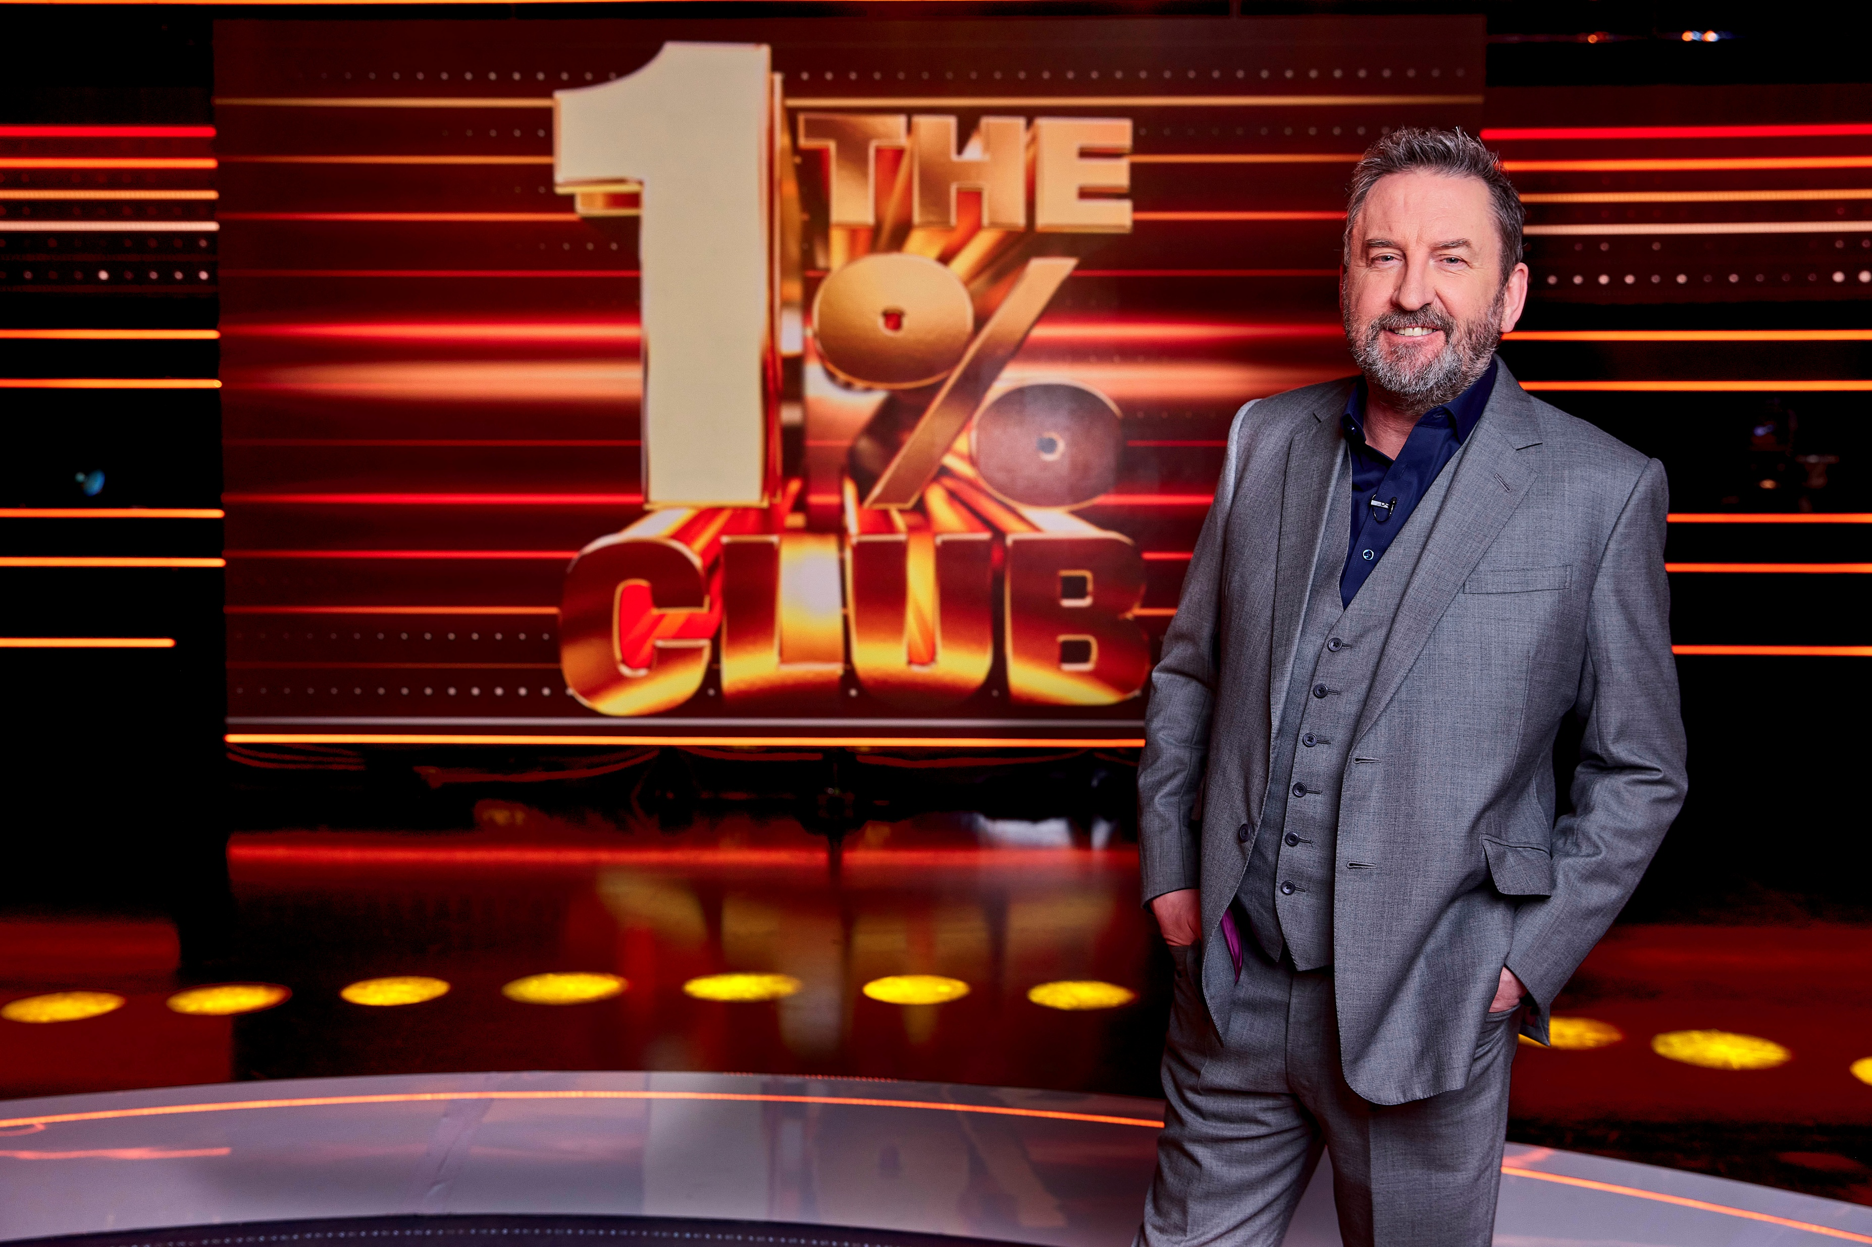























Programming Highlights – Q4 2025
ITV
Celebrity Sabotage
The Accidental Tourist
The Frauds
Carabao Cup
England International Football
Romesh Ranganathan's Parent's Evening
Trigger Point
The 1% Club
Bullseye
I’m a Celebrity Get Me Out of Here
Pride of Britain
Channel 4
Married at First Sight UK
The Great British Bake Off
Taskmaster
Gogglebox
Women’s FA Cup
Trespasses
Hunted
In Flight
Mitchell and Webb Sketch Show
Game of Wool
Sky
Bridget Jones:
Mad About the Boy
Classic Movies
Ted S2
Matlock S2
IT: Welcome To Derry
Tinsel Town
A Minecraft Movie
Amsterdam Narcos
UKTV
Channel 5
Robson Green: World’s Most Amazing Walks
Murder Before Evensong
Michael Palin in Venezuela
Pete Wicks: For Dogs’ Sake S2
Will and Ralf Should Know Better S2
The Good Life: Inside Out
The Rumour

