Slide 1


Future Focus Report
Q1 2026
Virgin Media – Trunk Trucker

Slide 2
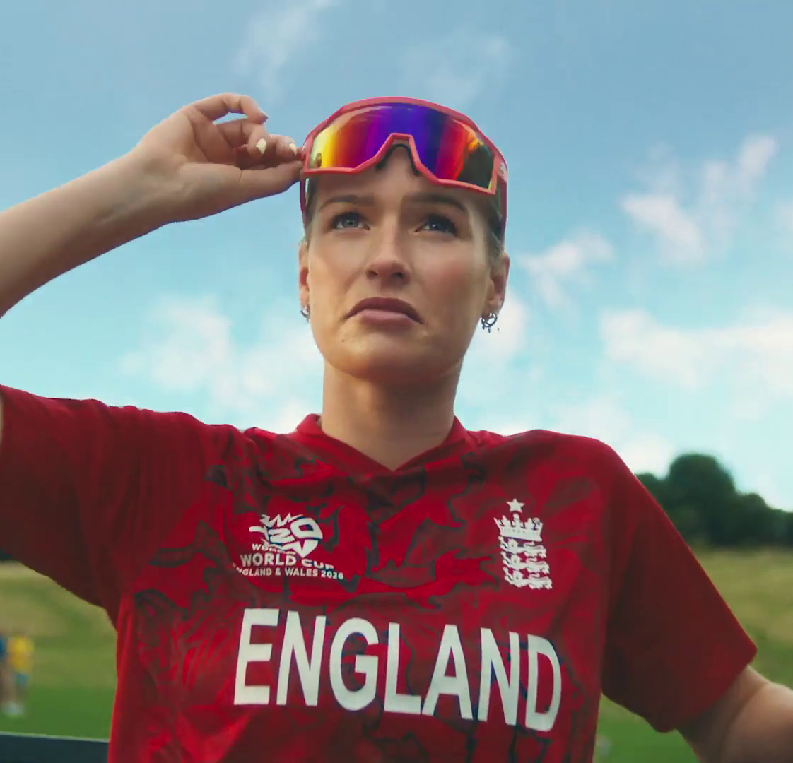
In this deck...
With Q1 planning well under way, this report will be a handy guide on what to expect over the coming months.
To provide a useful base on what to expect next year we look historically to Q1 2025:
Category & advertiser analysis
‘Reach Extenders’ analysis & TV viewing overview
Programming highlights across a range of genres
To better prepare you, we include key considerations for the quarter ahead:
Important dates
Preview on programming to expect in Q1 2026
International Cricket Council – Catch The Spirit
Notes:
The Future Focus Report puts Q4 in the spotlight and is a useful guide to help with planning for the upcoming quarter.

Slide 3

Category & Advertiser Analysis Q1 2025
EDF Energy - House

Slide 4
Q1 2025 TV Impacts by Category
High
Mid
Low
Relative propensity of media spend by category
 | Travel & Transport | Health & Wellbeing | Finance | Government Social Political Organisation | Household Equipment & DIY | Entertainment & Leisure | Automotive | Business & Industrial | Media | Household FMCG | Electronics, Household Appliances & Tech | Food | Telecoms | Retail | Cosmetics & Personal Care
Jan | 191 | 125 | 127 | 115 | 134 | 98 | 146 | 101 | 94 | 94 | 90 | 77 | 84 | 76 | 36
Feb | 136 | 140 | 121 | 114 | 114 | 108 | 118 | 110 | 96 | 109 | 99 | 98 | 70 | 65 | 72
Mar | 115 | 115 | 112 | 115 | 94 | 127 | 64 | 105 | 125 | 87 | 98 | 111 | 94 | 69 | 84
Q1 | 149 | 126 | 120 | 115 | 115 | 111 | 110 | 105 | 105 | 96 | 95 | 95 | 83 | 70 | 63
Source: Barb, Q1 2025 vs 2024 Index, Adults, Top 15 categories by total impacts. Historic not forward looking.
Notes:
Q4 TV Impacts by category. Indexed % spend by category for each month vs. the average % for 2023

Slide 5
Top sectors by Q1 2025 impacts
120
149
95
111
115
96
63
126
115
110
83
70
105
95
105
Source: Barb, Q1 2025, All Adults, Impacts (R/W) (million). Numbers above bars show Q1 index vs 2024. Historic not forward looking.

Slide 6










Travel & Transport - Advertiser
Source: Barb, Q1 2025, All Adults, Impacts (R/W) (million). Top 10 Q1 2025 advertisers by total impacts.

Slide 7










Health & Wellbeing - Advertiser
Source: Barb, Q1 2025, All Adults, Impacts (R/W) (million). Top 10 Q1 2025 advertisers by total impacts.

Slide 8











Finance - Advertiser
Source: Barb, Q1 2025, All Adults, Impacts (R/W) (million). Top 10 Q1 2025 advertisers by total impacts.

Slide 9

Reach Extenders & Viewing Overview
Nothing - Feraligatr

Slide 10
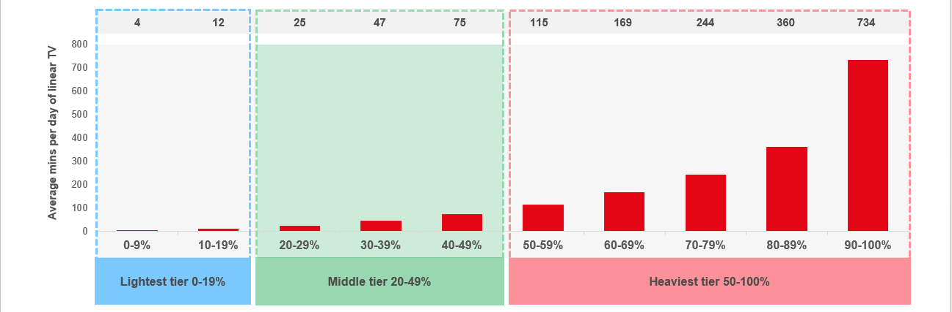
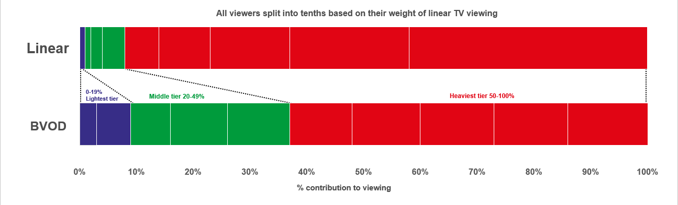

Identifying the ‘Reach Extenders’
Weight of viewing is a key factor
in incremental reach
‘Middle tier’ of viewers are key to
BVOD’s incremental reach
Research from BVOD Almighty divided viewers into deciles based on weekly linear TV viewing. Light viewers are hard to target on TV, while heavy viewers are easily targeted via linear TV, reducing the role of BVOD. PwC’s analysis identifies the ‘middle tier’ as the key segment driving incremental reach via BVOD.
This chart displays the proportion of linear and BVOD consumption for each of the three tiers and their deciles. Notably, the ‘middle tier’, accounting for 7% of linear TV viewing, makes up 28% of BVOD consumption, making them the key audience to extend campaigns through BVOD; we call them the ‘Reach Extenders’.
Source: BVOD Almighty
Notes:
Left Chart: Detailed analysis by PwC has identified a segment that are important drivers of why BVOD is delivering incremental reach.
This chart shows the viewing population split into ten equal groups (deciles) based upon amount of liner TV viewing per week.
The lightest decile averages 4-mins of linear viewing per day. Up to the heaviest decile who view for 734-minutes (12-hours 14-minutes) per day.
The deciles have been split into three groups:
Lightest tier. These are very hard to reach on TV (linear or BVOD) and are most likely to be targeted via platforms such as YouTube
Middle tier.
Heaviest tier. These are quite easy to reach via linear TV and, as a result, BVOD probably has little role to play.
Right Chart: This chart shows for each of the three tiers (and the deciles within them) what proportion of linear and BVOD consumption they account for.
Key to note is that the middle tier (green) proportionally watch a lot of BVOD. Whilst they account for 7% of linear TV viewing, they make up 28% of BVOD consumption.
This makes them the key audience for extending campaign via the use of BVOD – relatively they are easier to reach via BVOD then linear TV.

Slide 11
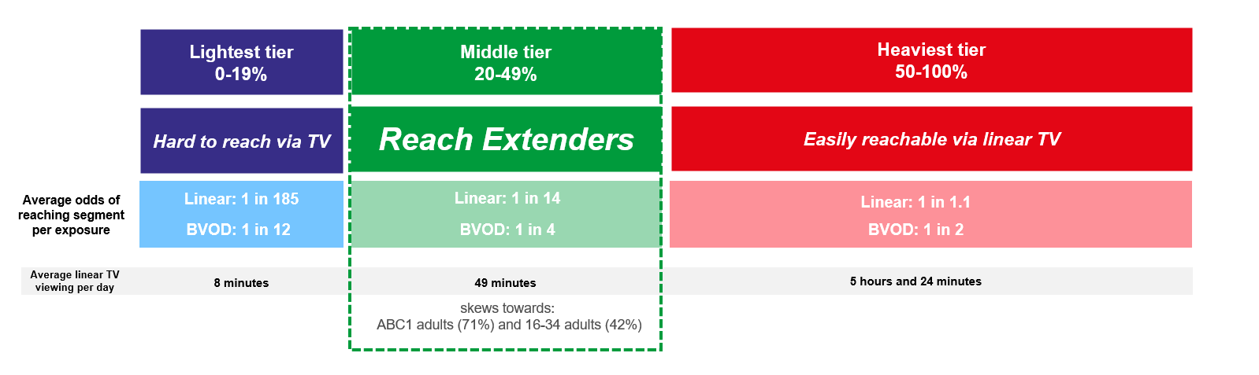
Identifying the ‘Reach Extenders’
BVOD provides good odds of reaching an attractive audience
Where and when can we effectively reach this valuable audience of ‘Reach Extenders’?
While BVOD excels at reaching this audience there are key programmes and times you’re very likely to reach them across the whole of TV.
‘Reach Extenders’ display a strong affinity for the following genres:
Drama
Films
Children
Their peak viewing hours take place daily from 8-11pm, with a higher likelihood of viewership occurring at the weekend.
On average, it takes only four impressions to reach a ‘middle tier’ viewer through BVOD, as opposed to 14 impressions on linear. This makes BVOD 3.5 times more efficient in targeting the ‘middle tier’ group, which often consists of younger and upscale viewers, highly sought after by advertisers.
Source: BVOD Almighty
Notes:
Left Chart: BVOD provides good odds of reaching an attractive audience or to put it another way, for every 14 impressions you buy on linear one person falls into the middle tier group (assuming natural delivery)
But on BVOD, it only takes four impressions to, on average, reach somebody in the middle tier. As such, on average, using BVOD is three and a half more efficient than linear at reaching the middle tier of viewers.
The middle tier are very attractive audiences for many advertisers (proportionally younger and upscale) and BVOD enables them to be reached in an efficient way.

Slide 12
Top genres watched by ‘Reach Extenders’
% of all viewing
Genre | Adults | Reach Extenders | Index
Drama | 29% | 34% | 119
Entertainment | 24% | 23% | 95
Films | 11% | 15% | 143
Sport | 10% | 9% | 95
Documentaries | 11% | 8% | 69
Children | 2% | 4% | 204
Hobbies/Leisure | 6% | 3% | 50
News/Weather | 4% | 2% | 49
Source: Barb Q1 2025, % of all viewing, index vs all adults.

Slide 13
High indexing drama content
Drama - Commercial TV
Channel | Programme Title | Index
CH4 | This Is Us | 315
CH5 | All Creatures Great and Small | 273
Sky | The Day Of The Jackal | 256
Sky | The White Lotus | 207
Sky | Lockerbie: A Search For Truth | 197
ITV | Playing Nice | 180
Sky | From | 177
CH4 | Patience | 163
ITV | Unforgotten | 130
CH4 | Astrid: Murder in Paris | 125
Drama - SVOD
Channel | Programme Title | Index
Disney+ | Desperate Housewives | 426
Disney+ | 9-1-1 | 338
Amazon | Elementary | 325
Netflix | Harlen Coben's Missing You | 251
Netflix | The Night Agent | 239
Netflix | Yellowstone | 225
Disney+ | Grey's Anatomy | 220
Amazon | House | 217
Amazon | Reacher | 152
Netflix | Adolescence | 132
Source: Barb Q1 2025, ‘Reach Extender’ index vs all adults, Thinkbox created list of programmes ranked by volume of viewing and index. Commercial broadcasters and SVODs are separated because we can’t currently separate viewing by homes that are / are not on the SVOD ad tiers.

Slide 14
High indexing film content
Films are popular among the ‘Reach Extender’ audience, but planning for this genre is less straightforward due to the variance in film scheduling. To help, here is a breakdown of which sub-genres the ‘Reach Extenders’ are watching.
Films - Commercial TV
Sub-Genre | Channel | Programme Title | Index
Family | Sky | Sing | 230
Family | Sky | Wonka | 157
Family | ITV | Matilda | 148
Family | CH4 | The Borrowers | 116
Romcom | ITV | Overboard | 362
Romcom | CH5 | Hitch | 234
Romcom | Sky | Bridget Jones's Baby | 174
Romcom | CH4 | 13 Going on 30 | 119
% of all film viewing
Genre | Adults | Reach Extenders | Index
Family | 17% | 24% | 140
Action / Adventure / Thriller | 25% | 22% | 87
Sci-Fi and Fantasy | 16% | 15% | 94
Comedy | 13% | 13% | 99
Romcom | 5% | 6% | 111
Crime Drama | 4% | 4% | 91
Horror | 4% | 3% | 88
Other | 3% | 3% | 121
Films - SVOD
Sub-Genre | Channel | Programme Title | Index
Family | Disney+ | Moana Sing Along | 147
Family | Netflix | The Super Mario Bros. Movie | 131
Romcom | Netflix | Kinda Pregnant | 159
Romcom | Amazon | You are Cordially Invited | 127
Source: Barb Q1 2025, ‘Reach Extender’ index vs all adults, Thinkbox created list of programmes ranked by sub-genre, volume of viewing and index. Commercial broadcasters and SVODs are separated because we can’t currently separate viewing by homes that are / are not on the SVOD ad tiers.

Slide 15
‘Reach Extenders’ aren’t solely limited to high indexing genres
Sport - Commercial TV
Channel | Programme Title | Index
ITV | NFL | 184
CH5 | World's Strongest Man | 179
TNT Sports | UFC | 155
Sky | PDC World Championship Darts | 153
ITV | Six Nations Championship | 148
Sky | EFL Cup | 143
TNT Sports | Premier League | 143
TNT Sports | UEFA Europa League | 125
TNT Sports | Gallagher Premiership Rugby | 119
CH4 | Formula 1 | 106
Entertainment - Commercial TV
Channel | Programme Title | Index
CH4 | Taskmaster | 280
ITV | Love Island All Stars | 216
CH4 | The Great Pottery Throw Down | 168
Sky | A League of Their Own | 164
Sky | Landscape Artist of the Year | 138
ITV | Hell's Kitchen (USA) | 129
CH5 | Rich House, Poor House | 128
Entertainment - SVOD
Channel | Programme Title | Index
Amazon | MasterChef Australia | 466
Disney+ | Modern Family | 375
Amazon | The Big Bang Theory | 303
Netflix | Friends | 278
Disney+ | Family Guy | 274
Amazon | Beast Games | 232
Netflix | Brooklyn Nine-Nine | 203
Sport - SVOD
Channel | Programme Title | Index
Amazon | Premier League | 214
Netflix | WWE Raw | 214
Amazon | UEFA Champions League | 194
Netflix | WWE SmackDown | 179
Source: Barb Q1 2025, ‘Reach Extender’ index vs all adults, Thinkbox created list of programmes ranked by volume of viewing and index. Limited SVOD Sport Programmes. Commercial broadcasters and SVODs are separated because we can’t currently separate viewing by homes that are / are not on the SVOD ad tiers.

Slide 16
When to target the ‘Reach Extenders’
Reach Extenders' index by daypart
 | 6am | 7am | 8am | 9am | 10am | 11am | 12pm | 1pm | 2pm | 3pm | 4pm | 5pm | 6pm | 7pm | 8pm | 9pm | 10pm | 11pm | 12am | 1am | 2am | 3am | 4am | 5am
Monday | 50 | 76 | 60 | 53 | 53 | 56 | 54 | 60 | 56 | 55 | 62 | 78 | 93 | 130 | 153 | 177 | 128 | 88 | 73 | 50 | 35 | 27 | 19 | 34
Tuesday | 50 | 71 | 57 | 51 | 55 | 58 | 66 | 72 | 64 | 55 | 57 | 73 | 92 | 126 | 162 | 179 | 132 | 91 | 72 | 52 | 36 | 27 | 20 | 29
Wednesday | 53 | 77 | 65 | 51 | 53 | 56 | 64 | 70 | 63 | 56 | 59 | 70 | 89 | 123 | 161 | 174 | 128 | 89 | 65 | 49 | 36 | 34 | 26 | 31
Thursday | 52 | 69 | 59 | 54 | 54 | 60 | 63 | 66 | 62 | 60 | 65 | 75 | 95 | 131 | 157 | 166 | 134 | 98 | 75 | 46 | 37 | 24 | 17 | 27
Friday | 48 | 65 | 58 | 54 | 49 | 57 | 65 | 67 | 64 | 58 | 59 | 69 | 91 | 116 | 148 | 176 | 152 | 121 | 100 | 66 | 40 | 51 | 47 | 36
Saturday | 28 | 60 | 60 | 55 | 56 | 59 | 71 | 85 | 88 | 82 | 87 | 106 | 114 | 127 | 138 | 136 | 117 | 91 | 70 | 57 | 46 | 50 | 51 | 37
Sunday | 46 | 70 | 71 | 67 | 64 | 66 | 70 | 76 | 88 | 97 | 109 | 115 | 113 | 115 | 138 | 133 | 104 | 82 | 67 | 51 | 46 | 34 | 22 | 21
Monday | Tuesday | Wednesday | Thursday | Friday | Saturday | Sunday
89 | 88 | 94 | 89 | 90 | 122 | 121
Monday | Tuesday | Wednesday | Thursday | Friday | Saturday | Sunday
90 | 96 | 96 | 94 | 93 | 109 | 118
Source: Barb Q1 2025, commercial linear & BVOD, ‘Reach Extender’ index vs all adults.

Slide 17
Q1 2025 linear TV facts & figures
Total TV weekly reach %
Total TV viewed per day
Commercial TV viewed per day
Impacts
Individuals
76.2 | 56.3bn | 2h 17m | 1h 30m
78.8 | 54.4bn | 2h 35m | 1h 42m
77.9 | 21.0bn | 2h 2m | 1h 13m
57.9 | 3.6bn | 36m | 24m
77.5 | 24.4bn | 2h 29m | 1h 38m
80.0 | 30.0bn | 2h 40m | 1h 45m
77.5 | 4.0bn | 1h 23m | 56m
Adults
ABC1 adults
16-34
Men
Women
Housepersons with children
Source: Barb Q1 2025, industry standard TV viewing in-home on a TV set. Reach 3min+. 30” equivalent impacts.
Notes:
Q1 2025 linear TV figures for weekly reach, impacts, total TV viewing hours and commercial TV viewing hours

Slide 18

Programming
Q1 2025
Canva – Debbie & Sons

Slide 19

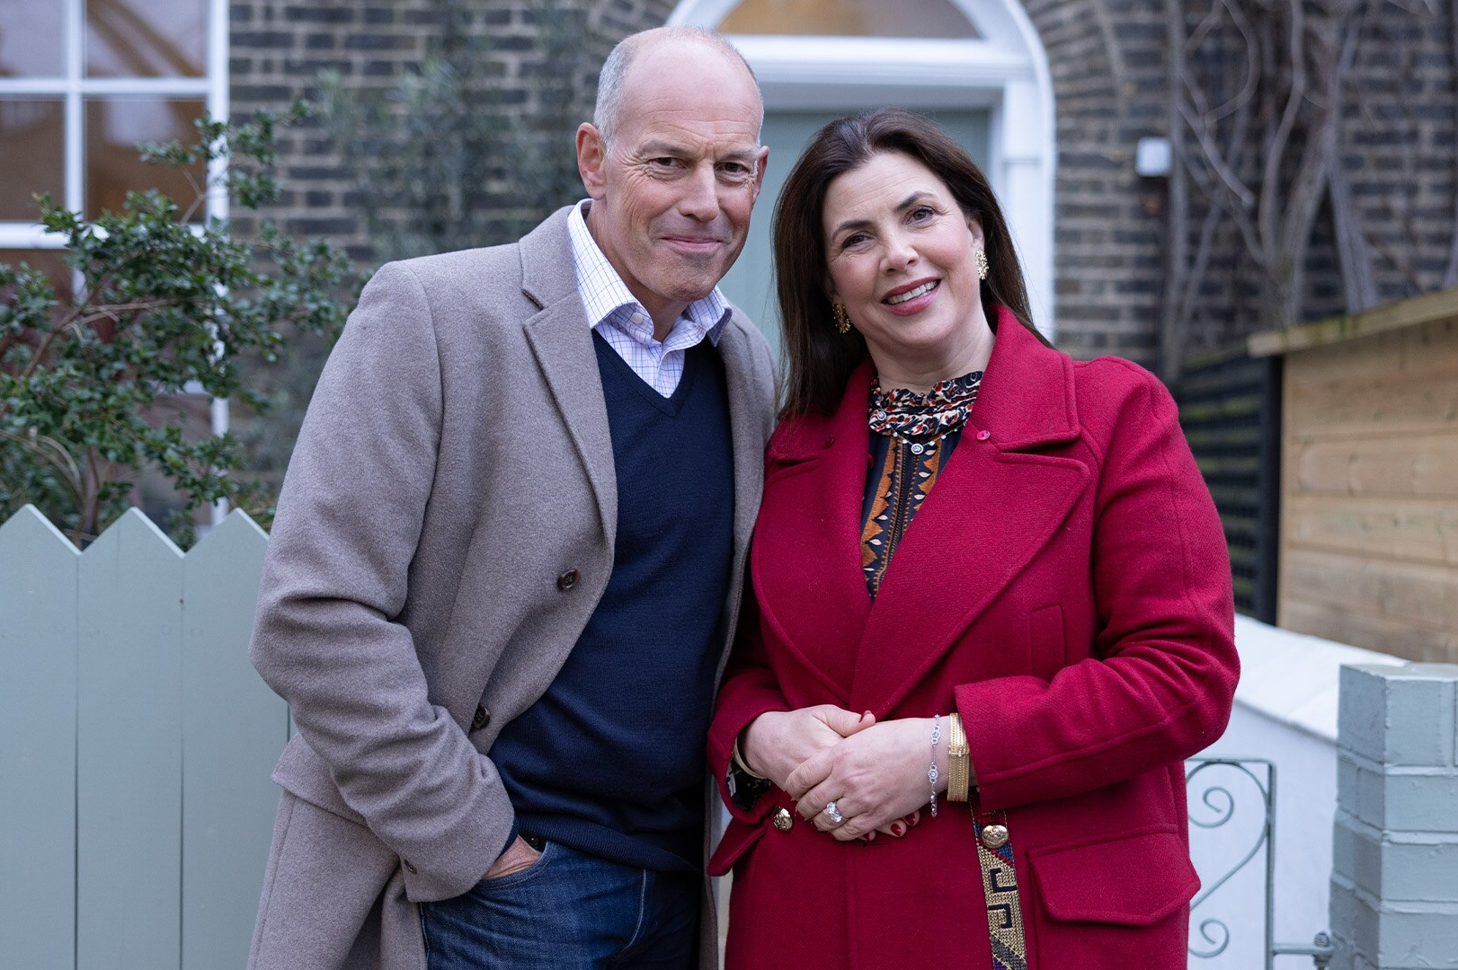


Programming Highlights – Q1 2025
Love Island All Stars
ITV2, 9 Feb
Average Audience
Individuals: 1,778,300
Adults: 1,707,100
ABC1 Ads: 921,600
16-34: 762,900
HP+CH: 368,800
Kirstie and Phil's Love It or List It Channel 4, 22 Jan
Average Audience
Individuals: 1,857,100
Adults: 1,821,100
ABC1 Ads: 1,143,100
16-34: 115,600
HP+CH: 179,600
World’s Strongest Man
Channel 5, 1 Jan
Average Audience
Individuals: 1,286,200
Adults: 1,180,600
ABC1 Ads: 542,500
16-34: 92,500
HP+CH: 151,900
Lockerbie: A Search For Truth
Sky Atlantic, 1 Jan
Average Audience
Individuals: 986,000
Adults: 973,700
ABC1 Ads: 592,100
16-34: 100,800
HP+CH: 151,300
Source: Barb, Q1 2025. Average audience figures - Consolidated, Top performing episode of series (if applicable).

Slide 20




Drama - Programming Highlights
Vera
ITV1, 1 Jan
Average Audience
Individuals: 6,093,100
Adults: 6,054,000
ABC1 Ads: 3,037,400
16-34: 178,200
HP+CH: 237,000
Patience
Channel 4, 8 Jan
Average Audience
Individuals: 3,027,000
Adults: 2,983,700
ABC1 Ads: 1,789,500
16-34: 134,000
HP+CH: 196,300
The Castaways
Channel 5, 26 Jan
Average Audience
Individuals: 2,138,400
Adults: 2,073,200
ABC1 Ads: 855,400
16-34: 63,800
HP+CH: 169,200
Lockerbie: A Search For Truth
Sky Atlantic, 1 Jan
Average Audience
Individuals: 986,000
Adults: 973,700
ABC1 Ads: 592,100
16-34: 100,800
HP+CH: 151,300
Bergerac
U&Drama, 27 Feb
Average Audience
Individuals: 1,657,700
Adults: 1,644,900
ABC1 Ads: 995,800
16-34: 23,200
HP+CH: 19,300
Source: Barb, Q1 2025. Average audience figures - Consolidated, Top performing episode of series (if applicable).

Slide 21




Entertainment - Programming Highlights
Love Island All Stars
ITV2, 9 Feb
Average Audience
Individuals: 1,778,300
Adults: 1,707,100
ABC1 Ads: 921,600
16-34: 762,900
HP+CH: 368,800
The Great Pottery Throw Down
Channel 4, 9 Mar
Average Audience
Individuals: 3,073,800
Adults: 2,999,100
ABC1 Ads: 1,728,600
16-34: 176,800
HP+CH: 192,800
Rich House, Poor House
Channel 5, 19 Jan
Average Audience
Individuals: 1,025,100
Adults: 1,000,300
ABC1 Ads: 376,200
16-34: 69,600
HP+CH: 81,700
A League of Their Own: The Rally
Sky Max, 24 Mar
Average Audience
Individuals: 263,300
Adults: 257,100
ABC1 Ads: 117,200
16-34: 91,000
HP+CH: 59,000
Dave Gorman: Modern Life is Goodish
U&Drama, 24 Feb
Average Audience
Individuals: 471,300
Adults: 450,500
ABC1 Ads: 328,100
16-34: 11,200
HP+CH: 58,500
Source: Barb, Q1 2025. Average audience figures - Consolidated, Top performing episode of series (if applicable).

Slide 22




Sports - Programming Highlights
Six Nations Championship: ENG v FRA
ITV1, 8 Feb
Average Audience
Individuals: 4,427,700
Adults: 4,225,800
ABC1 Ads: 2,681,100
16-34: 483,900
HP+CH: 310,400
Formula 1 Australian GP
Channel 4, 16 Mar
Average Audience
Individuals: 1,428,100
Adults: 1,378,400
ABC1 Ads: 733,300
16-34: 103,100
HP+CH: 72,500
World's Strongest Man
Channel 5, 1 Jan
Average Audience
Individuals: 1,536,300
Adults: 1,407,300
ABC1 Ads: 567,600
16-34: 84,000
HP+CH: 181,800
Premier League - Manchester City V Liverpool
Sky Sports, 23 Feb
Average Audience
Individuals: 1,754,600
Adults: 1,639,700
ABC1 Ads: 922,600
16-34: 298,700
HP+CH: 133,900
UEFA Champions League: PSG v Liverpool
TNT Sports, 5 Mar
Average Audience
Individuals: 1,038,200
Adults: 991,800
ABC1 Ads: 589,600
16-34: 224,500
HP+CH: 71,500
Source: Barb, Q1 2025. Average audience figures - Consolidated, Top performing episode of series (if applicable).

Slide 23




Hobbies & Leisure - Programming Highlights
Dickinson's Real Deal
ITV1, 26 Feb
Average Audience
Individuals: 805,300
Adults: 783,000
ABC1 Ads: 265,700
16-34: 40,700
HP+CH: 51,100
Kirstie and Phil's Love It or List It
Channel 4, 22 Jan
Average Audience
Individuals: 1,857,100
Adults: 1,821,100
ABC1 Ads: 1,143,100
16-34: 115,600
HP+CH: 179,600
The Air Fryer Diet: Lose Weight, Cook Fast
Channel 5, 8 Jan
Average Audience
Individuals: 1,077,100
Adults: 1,054,100
ABC1 Ads: 474,500
16-34: 76,900
HP+CH: 94,500
Bangers & Cash
U&Yesterday, 20 Feb
Average Audience
Individuals: 416,800
Adults: 413,300
ABC1 Ads: 154,700
16-34: 50,500
HP+CH: 22,100
Car S.O.S
More4, 17 Feb
Average Audience
Individuals: 286,100
Adults: 283,900
ABC1 Ads: 99,500
16-34: 2,700
HP+CH: 6,900
Source: Barb, Q1 2025. Average audience figures - Consolidated, Top performing episode of series (if applicable).

Slide 24










SVOD Drama & Entertainment - Programming Highlights
Adolescence
S1, Ep1, Netflix, Drama
Individuals: 7,110,607
Adults: 6,933,871
Harlen Coben’s Missing You S1, Ep1, Netflix, Drama
Individuals: 4,794,163
Adults: 4,619,541
Reacher S3, Ep1
Amazon, Drama
Individuals: 2,729,126
Adults: 2,659,368
A Thousand Blows
S1, Ep1, Disney+, Drama
Individuals: 955,237
Adults: 916,816
The Rig S2, Ep1
Amazon, Drama
Individuals: 772,863
Adults: 762,280
LOL: Last One Laughing UK S1, Ep1 Amazon, Ent.
Individuals: 3,194,198
Adults: 3,063,121
Celebrity Bear Hunt
S1, Ep1 Netflix, Ent.
Individuals: 1,815,207
Adults: 1,657,890
Beast Games S1, Ep10
Amazon, Ent.
Individuals: 856,175
Adults: 684,547
The Other One S1, Ep1 Netflix, Ent.
Individuals: 663,788
Adults: 631,346
The Simpsons S36, Ep2 Disney+, Ent.
Individuals: 298,914
Adults: 223,051
Source: Barb, Q1 2025, individuals and adults. Average audience achieved during the first seven days of their availability. Only includes TV set viewing.

Slide 25
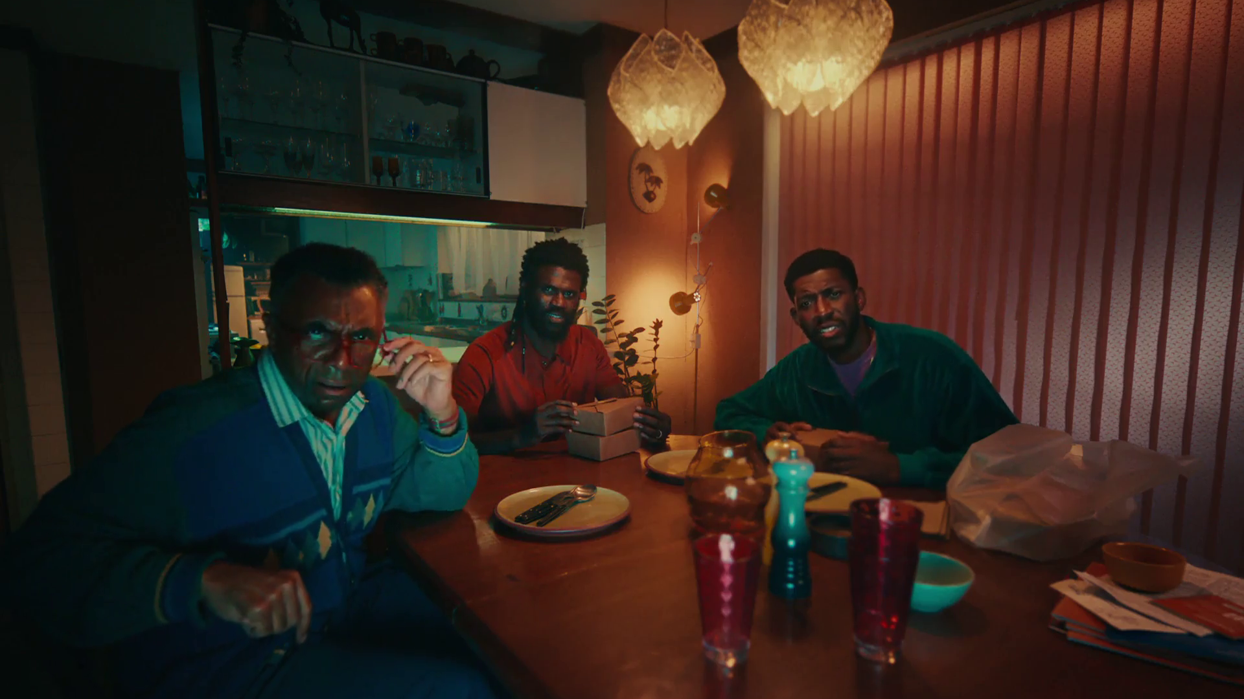
Q1 2026
U – U Talking to Me

Slide 26
Key Dates
 | Week Commencing
 | 30-Dec | 06-Jan | 13-Jan | 20-Jan | 27-Jan | 03-Feb | 10-Feb | 17-Feb | 24-Feb | 03-Mar | 10-Mar | 17-Mar | 24-Mar
New Years Day
Premier League
EFL Cup
The FA Cup
Super Bowl
Winter Olympics
The Six Nations
Valentines Day
Winter Paralympics
Formula 1
Mother's Day

Slide 27
















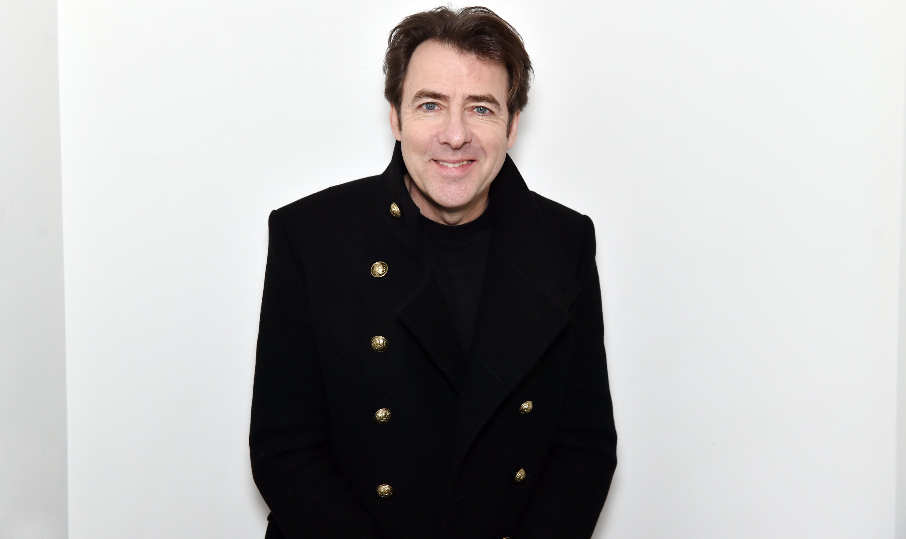





















Programming Highlights – Q1 2026
ITV
The Brits
The Oscars
The Six Nations
The Carabao Cup
The Masked
Singer
Ant and Dec's Limitless Win
Britain’s
Got Talent
Love Island
All Stars
Red Eye
After The Flood
The Voice UK
Wheel of Fortune
The 1% Club
Channel 4
A Woman of Substance
Married at First Sight Australia
The Hunt
The Great Pottery Throw Down
Winter
Paralympics
The Great Celebrity Bake Off: SU2C
Handcuffed
Sky
Under Salt Marsh
Ted S2
28 Years Later
Landscape Artist of the Year 2026
Romesh: Can’t Knock the Hustle
Gomorrah:
The Origins
How To Train
Your Dragon
The Naked Gun
UKTV
Channel 5
Pete Wicks: For Dog’s Sake S3
Dom Chinea’s Cornish Workshop
Guy Martin:
Proper Jobs S2
Bangers & Cash S13
Platoon: Life in
the Barracks
Good Ship
Murder S3
Jane: Pole To Pole

