Slide 1


Future Focus Report
Q3 2026
Waitrose – The Gastronaut

Slide 2

In this deck...
With Q3 planning well under way, this report will be a handy guide on what to expect over the coming months.
To provide a useful base on what to expect next year we look historically to Q3 2025:
Category & advertiser analysis
‘Reach Extenders’ analysis & TV viewing overview
Where to find the FIFA World Cup 2026 audience
Programming highlights across a range of genres
To better prepare you, we include key considerations for the quarter ahead:
Important dates
Preview on programming to expect in Q3 2026
Sky Mobile – Keep Rollin’
Notes:
The Future Focus Report puts Q4 in the spotlight and is a useful guide to help with planning for the upcoming quarter.

Slide 3
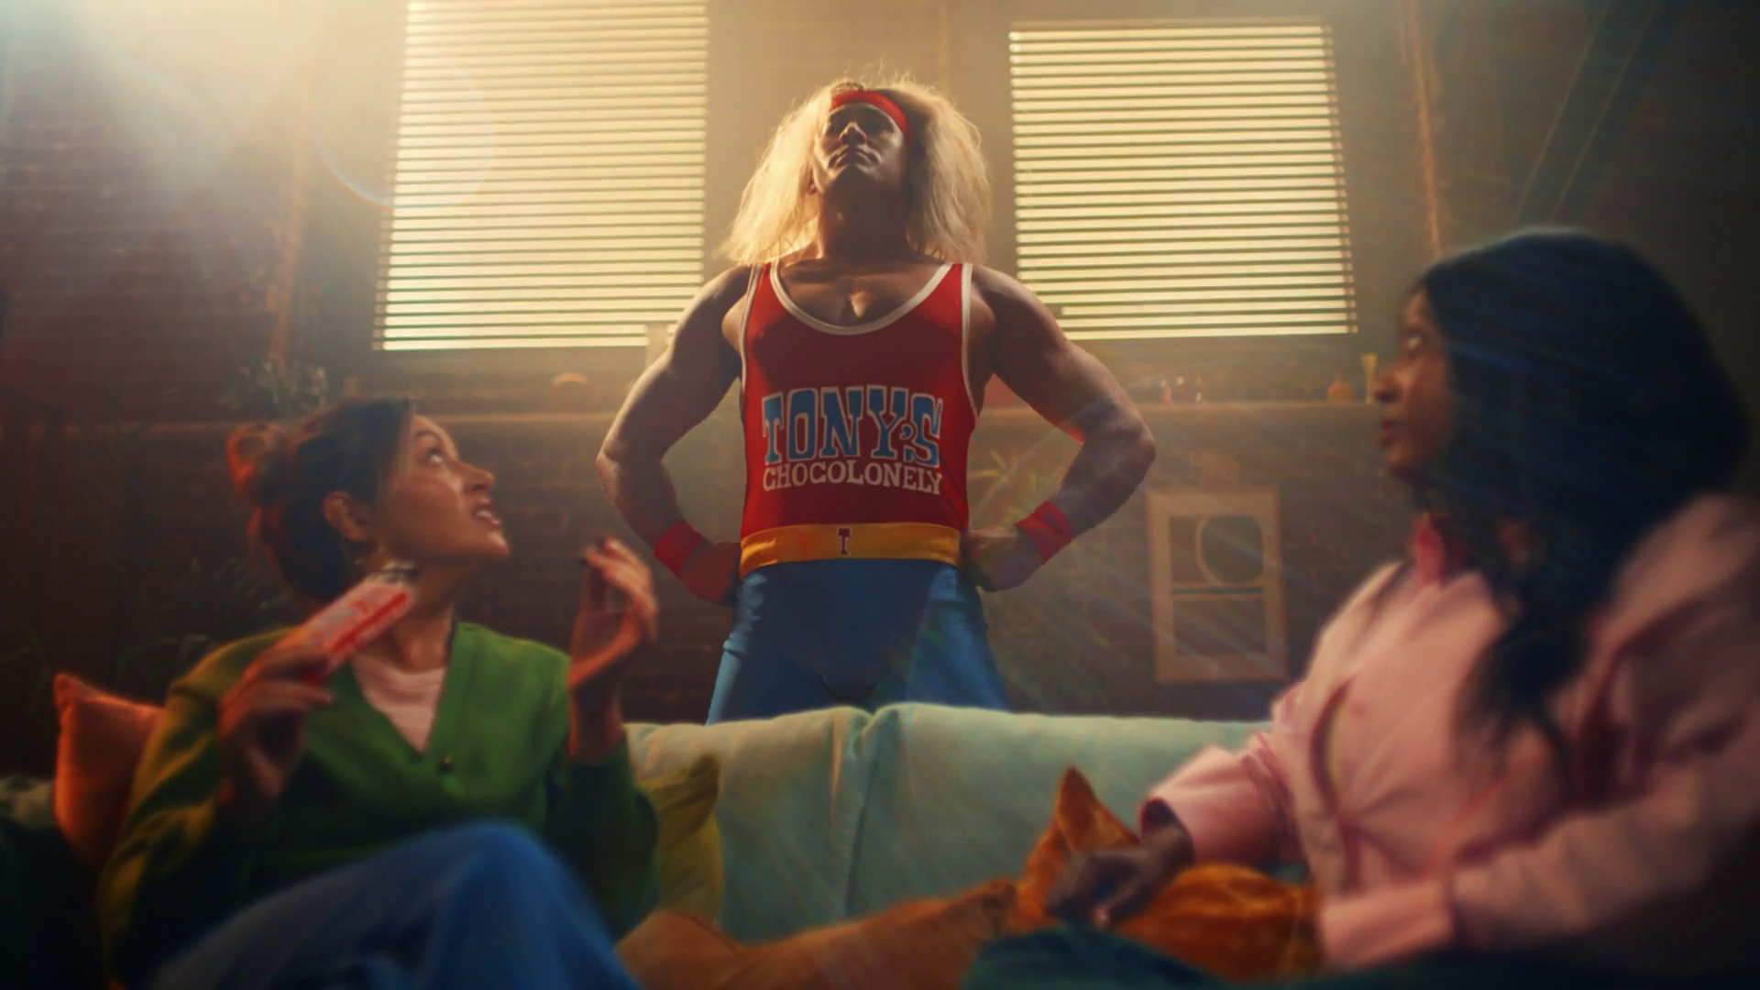
Category & Advertiser Analysis Q3 2025
Tony’s Chocolonely - Wrestlers

Slide 4
Q3 2025 TV Impacts by Category
High
Mid
Low
Relative propensity of media spend by category
 | Business & Industrial | Finance | Automotive | Household FMCG | Telecoms | Media | Food | Retail | Drink | Cosmetics & Personal Care | Household Equipment & DIY | Health & Wellbeing | Travel & Transport | Entertainment & Leisure | Government Social Political Organisation
Jul | 122 | 126 | 89 | 110 | 94 | 83 | 107 | 106 | 156 | 107 | 71 | 100 | 99 | 91 | 72
Aug | 116 | 109 | 130 | 116 | 102 | 105 | 119 | 105 | 93 | 104 | 107 | 103 | 79 | 83 | 80
Sep | 124 | 115 | 123 | 100 | 129 | 128 | 87 | 97 | 56 | 86 | 101 | 75 | 91 | 92 | 97
Q3 | 121 | 116 | 113 | 109 | 108 | 105 | 104 | 103 | 102 | 99 | 93 | 92 | 90 | 89 | 83
Source: Barb, Q3 2025 vs 2025 Index, Adults, Top 15 categories by total impacts. Historic not forward looking.
Notes:
Q4 TV Impacts by category. Indexed % spend by category for each month vs. the average % for 2023

Slide 5
Top sectors by Q3 2025 impacts
Source: Barb, Q3 2025, All Adults, Impacts (R/W) (million). Numbers above bars show Q3 index vs 2025. Historic not forward looking.

Slide 6










Business & Industrial - Advertiser
Source: Barb, Q3 2025, All Adults, Impacts (R/W) (million). Top 10 Q3 2025 advertisers by total impacts.

Slide 7









Finance - Advertiser
Source: Barb, Q3 2025, All Adults, Impacts (R/W) (million). Top 10 Q3 2025 advertisers by total impacts.

Slide 8










Automotive - Advertiser
Source: Barb, Q3 2025, All Adults, Impacts (R/W) (million). Top 10 Q3 2025 advertisers by total impacts.

Slide 9
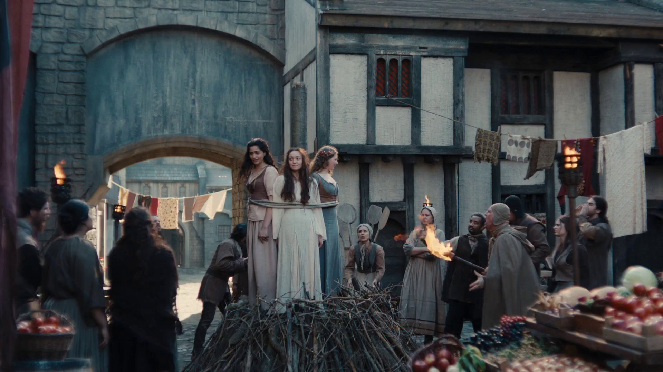
Reach Extenders & Viewing Overview
Maltesers – Look On The Light Side

Slide 10
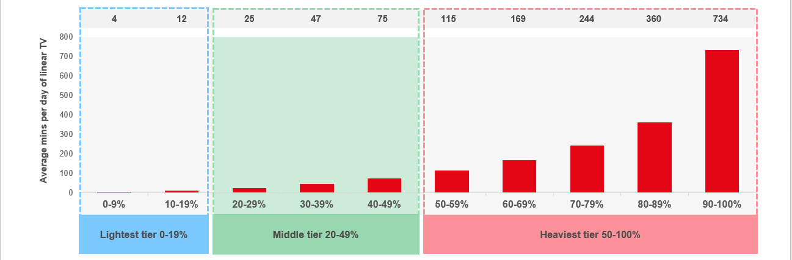
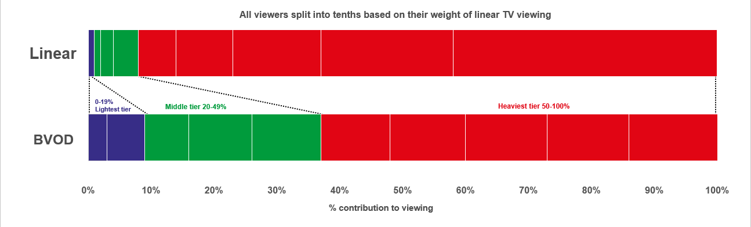

Identifying the ‘Reach Extenders’
Weight of viewing is a key factor
in incremental reach
‘Middle tier’ of viewers are key to
BVOD’s incremental reach
Research from BVOD Almighty divided viewers into deciles based on weekly linear TV viewing. Light viewers are hard to target on TV, while heavy viewers are easily targeted via linear TV, reducing the role of BVOD. PwC’s analysis identifies the ‘middle tier’ as the key segment driving incremental reach via BVOD.
This chart displays the proportion of linear and BVOD consumption for each of the three tiers and their deciles. Notably, the ‘middle tier’, accounting for 7% of linear TV viewing, makes up 28% of BVOD consumption, making them the key audience to extend campaigns through BVOD; we call them the ‘Reach Extenders’.
Source: BVOD Almighty
Notes:
Left Chart: Detailed analysis by PwC has identified a segment that are important drivers of why BVOD is delivering incremental reach.
This chart shows the viewing population split into ten equal groups (deciles) based upon amount of liner TV viewing per week.
The lightest decile averages 4-mins of linear viewing per day. Up to the heaviest decile who view for 734-minutes (12-hours 14-minutes) per day.
The deciles have been split into three groups:
Lightest tier. These are very hard to reach on TV (linear or BVOD) and are most likely to be targeted via platforms such as YouTube
Middle tier.
Heaviest tier. These are quite easy to reach via linear TV and, as a result, BVOD probably has little role to play.
Right Chart: This chart shows for each of the three tiers (and the deciles within them) what proportion of linear and BVOD consumption they account for.
Key to note is that the middle tier (green) proportionally watch a lot of BVOD. Whilst they account for 7% of linear TV viewing, they make up 28% of BVOD consumption.
This makes them the key audience for extending campaign via the use of BVOD – relatively they are easier to reach via BVOD then linear TV.

Slide 11
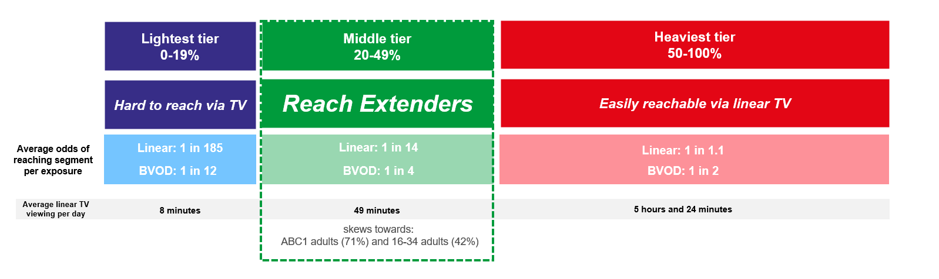
Identifying the ‘Reach Extenders’
BVOD provides good odds of reaching an attractive audience
Where and when can we effectively reach this valuable audience of ‘Reach Extenders’?
While BVOD excels at reaching this audience there are key programmes and times you’re very likely to reach them across the whole of TV.
‘Reach Extenders’ display a strong affinity for the following genres:
Drama
Films
Children
Their peak viewing hours take place daily from 8-11pm, with a higher likelihood of viewership occurring at the weekend.
On average, it takes only four impressions to reach a ‘middle tier’ viewer through BVOD, as opposed to 14 impressions on linear. This makes BVOD 3.5 times more efficient in targeting the ‘middle tier’ group, which often consists of younger and upscale viewers, highly sought after by advertisers.
Source: BVOD Almighty
Notes:
Left Chart: BVOD provides good odds of reaching an attractive audience or to put it another way, for every 14 impressions you buy on linear one person falls into the middle tier group (assuming natural delivery)
But on BVOD, it only takes four impressions to, on average, reach somebody in the middle tier. As such, on average, using BVOD is three and a half more efficient than linear at reaching the middle tier of viewers.
The middle tier are very attractive audiences for many advertisers (proportionally younger and upscale) and BVOD enables them to be reached in an efficient way.

Slide 12
Top genres watched by ‘Reach Extenders’
% of all viewing
Genre | Adults | Reach Extenders | Index
Drama | 29% | 34% | 118
Entertainment | 23% | 22% | 97
Films | 11% | 18% | 159
Sport | 11% | 9% | 78
Documentaries | 12% | 8% | 66
Children | 2% | 5% | 244
Hobbies/Leisure | 6% | 2% | 41
News/Weather | 4% | 2% | 40
Source: Barb Q3 2025, % of all viewing, index vs all adults.

Slide 13
High indexing drama content
Drama - Commercial TV
Channel | Programme Title | Index
ITV | Legacies | 373
Sky | Sex and the City | 232
Channel 4 | The Handmaid's Tale | 219
Sky | And Just Like That... | 201
Channel 4 | Ghost Whisperer | 196
Sky | Peacemaker | 179
Channel 5 | The Following | 169
ITV | Broadchurch | 157
ITV | The Hack | 132
UKTV | Outrageous | 131
Drama - SVOD
Channel | Programme Title | Index
Amazon | The Summer I Turned Pretty | 296
Amazon | The Walking Dead | 271
Netflix | House | 249
Disney+ | Grey's Anatomy | 237
Netflix | Wednesday | 236
Netflix | Hostage | 231
Disney+ | Alien: Earth | 224
Netflix | Untamed | 213
Amazon | The Assassin | 200
Disney+ | Criminal Minds | 180
Source: Barb Q3 2025, ‘Reach Extender’ index vs all adults, Thinkbox created list of programmes ranked by volume of viewing and index. Commercial broadcasters and SVODs are separated because we can’t currently separate viewing by homes that are / are not on the SVOD ad tiers.

Slide 14
High indexing film content
Films are popular among the ‘Reach Extender’ audience, but planning for this genre is less straightforward due to the variance in film scheduling. To help, here is a breakdown of which sub-genres the ‘Reach Extenders’ are watching.
Films - Commercial TV
Sub-Genre | Channel | Programme Title | Index
Family | ITV | Coraline | 245
Family | ITV | Shrek Forever After | 188
Family | Channel 5 | PAW Patrol, Ready, Race, Rescue! | 151
Family | Sky | Home | 136
Romcom | ITV | Jack and Sarah | 349
Romcom | ITV | There's Something About Mary | 282
Romcom | Sky | Roxanne | 148
Romcom | Channel 5 | As Good As It Gets | 134
% of all film viewing
Genre | Adults | Reach Extenders | Index
Family | 16% | 24% | 146
Action / Adventure / Thriller | 26% | 21% | 81
Sci-Fi and Fantasy | 16% | 15% | 94
Comedy | 12% | 13% | 104
Crime Drama | 6% | 6% | 104
Horror | 4% | 4% | 110
Romcom | 3% | 4% | 120
Films - SVOD
Sub-Genre | Channel | Programme Title | Index
Romcom | Netflix | This Time Next Year | 199
Romcom | Amazon | He's Just Not That Into You | 182
Family | Disney+ | Cars | 163
Family | Netflix | KPop Demon Hunters | 118
Source: Barb Q3 2025, ‘Reach Extender’ index vs all adults, Thinkbox created list of programmes ranked by sub-genre, volume of viewing and index. Commercial broadcasters and SVODs are separated because we can’t currently separate viewing by homes that are / are not on the SVOD ad tiers.

Slide 15
‘Reach Extenders’ aren’t solely limited to high indexing genres
Sport - Commercial TV
Channel | Programme Title | Index
TNT | UFC | 275
ITV | Tour de France Highlights | 185
TNT Sports | Premier League | 145
Channel 5 | FIFA Club World Cup 2025 | 144
TNT Sports | Cycling: UCI World Tour | 140
Sky | Belgian F1 GP | 136
Channel 4 | Formula 1 | 134
TNT Sports | UEFA Champions League | 133
TNT Sports | Moto GP | 125
ITV | UEFA Women's Euro 2025 | 121
Sport - Commercial TV
Channel | Programme Title | Index
ITV | NFL | 184
CH5 | World's Strongest Man | 179
TNT Sports | UFC | 155
Sky | PDC World Championship Darts | 153
ITV | Six Nations Championship | 148
Sky | EFL Cup | 143
TNT Sports | Premier League | 143
TNT Sports | UEFA Europa League | 125
TNT Sports | Gallagher Premiership Rugby | 119
CH4 | Formula 1 | 106
Entertainment - Commercial TV
Channel | Programme Title | Index
UKTV | Anthony Bourdain: Parts Unknown | 709
UITV | Plebs | 313
Channel 4 | Taskmaster | 249
Sky | Mr Bigstuff | 219
Channel 4 | The Great British Bake Off | 205
Sky | Last Week Tonight With John Oliver | 187
Sky | The Paper | 174
Entertainment - SVOD
Channel | Programme Title | Index
Disney+ | The Big Bang Theory | 404
Disney+ | Modern Family | 355
Netflix | The Big Bang Theory | 320
Amazon | The Osbournes | 284
Netflix | Love Is Blind: UK | 277
Disney+ | Family Guy | 255
Netflix | Brooklyn Nine-Nine | 241
Sport - SVOD
Channel | Programme Title | Index
Netflix | WWE Raw | 181
Amazon | UEFA Champions League | 169
Disney+ | La Liga Football | 133
Source: Barb Q3 2025, ‘Reach Extender’ index vs all adults, Thinkbox created list of programmes ranked by volume of viewing and index. Limited SVOD Sport Programmes. Commercial broadcasters and SVODs are separated because we can’t currently separate viewing by homes that are / are not on the SVOD ad tiers.

Slide 16
When to target the ‘Reach Extenders’
Reach Extenders' index by daypart
 | 6am | 7am | 8am | 9am | 10am | 11am | 12pm | 1pm | 2pm | 3pm | 4pm | 5pm | 6pm | 7pm | 8pm | 9pm | 10pm | 11pm | 12am | 1am | 2am | 3am | 4am | 5am
Monday | 52 | 73 | 68 | 60 | 56 | 57 | 63 | 69 | 57 | 52 | 56 | 68 | 87 | 122 | 152 | 175 | 142 | 100 | 75 | 50 | 46 | 32 | 44 | 44
Tuesday | 58 | 67 | 61 | 49 | 52 | 48 | 59 | 62 | 55 | 49 | 47 | 61 | 80 | 116 | 169 | 185 | 148 | 101 | 66 | 47 | 45 | 21 | 22 | 31
Wednesday | 50 | 70 | 65 | 47 | 47 | 44 | 50 | 59 | 58 | 53 | 53 | 67 | 85 | 121 | 154 | 185 | 153 | 105 | 74 | 61 | 37 | 24 | 18 | 34
Thursday | 68 | 74 | 67 | 64 | 61 | 55 | 59 | 62 | 54 | 51 | 55 | 67 | 84 | 118 | 142 | 192 | 153 | 107 | 79 | 56 | 40 | 33 | 26 | 32
Friday | 49 | 67 | 62 | 56 | 54 | 47 | 59 | 67 | 53 | 54 | 60 | 68 | 87 | 113 | 143 | 178 | 158 | 120 | 90 | 69 | 55 | 46 | 31 | 39
Saturday | 44 | 55 | 63 | 63 | 65 | 75 | 90 | 95 | 93 | 86 | 83 | 88 | 103 | 113 | 135 | 143 | 128 | 109 | 87 | 67 | 49 | 41 | 33 | 37
Sunday | 37 | 57 | 61 | 57 | 56 | 59 | 69 | 78 | 98 | 106 | 113 | 115 | 111 | 115 | 131 | 140 | 115 | 80 | 54 | 29 | 24 | 18 | 18 | 21
Monday | Tuesday | Wednesday | Thursday | Friday | Saturday | Sunday
84 | 92 | 85 | 80 | 87 | 111 | 119
Monday | Tuesday | Wednesday | Thursday | Friday | Saturday | Sunday
93 | 87 | 89 | 88 | 92 | 118 | 126
Source: Barb Q3 2025, commercial linear & BVOD, ‘Reach Extender’ index vs all adults.

Slide 17
Q3 2025 linear TV facts & figures
Total TV weekly reach %
Total TV viewed per day
Commercial TV viewed per day
Impacts
Individuals
71.1 | 139.2bn | 1h 57m | 1h 19m
74.5 | 135.7bn | 2h 13m | 1h 30m
73.1 | 51.9bn | 1h 43m | 1h 4m
51.9 | 7.5bn | 28m | 20m
73.5 | 61.2bn | 2h 9m | 1h 28m
75.5 | 74.4bn | 2h 17m | 1h 32m
68.9 | 7.7bn | 59m | 40m
Adults
ABC1 adults
16-34
Men
Women
Housepersons with children
Source: Barb Q3 2025, industry standard TV viewing in-home on a TV set. Reach 3min+. 30” equivalent impacts.
Notes:
Q3 2025 linear TV figures for weekly reach, impacts, total TV viewing hours and commercial TV viewing hours

Slide 18

Where to find the FIFA World Cup 2026 audience
ITV Football - ITV

Slide 19

Where to find the FIFA World Cup 2026 audience
This year’s FIFA World Cup will likely produce a surge in overall viewing – how can brands capture this engaged audience beyond the matches themselves?
We answer this by analysing Euros 2024* viewing habits, identifying key programmes and genres where this audience can be reached.
Snickers -Own Goal
*Last major men’s international football tournament that featured England and Scotland.

Slide 20
Top genres watched by the Euros 2024 audience
% of all viewing
Genre | Adults | Euros Audience | Index
Drama | 27% | 24% | 89
Entertainment | 22% | 21% | 98
Sport | 12% | 16% | 133
Documentaries | 12% | 12% | 99
Films | 12% | 10% | 89
Hobbies/Leisure | 6% | 6% | 102
News/Weather | 4% | 5% | 122
Current Affairs | 3% | 3% | 118
Source: Barb, July 2024, % of all viewing, Euros 2024 audience: watched the ENG v NED semi-final on ITV1, index vs all adults.

Slide 21
What else the Euros 2024 audience watched
Sport - Commercial TV
Channel | Programme Title | Index
ITV | Women's International Football | 143
Sky | Test Match Cricket | 135
Sky | World Matchplay Darts | 134
ITV | ITV Racing | 133
Sky | Golf: The Open | 132
Sky | British F1 GP | 123
Sky | Cricket: The Hundred | 121
Channel 5 | Cycling: UCI World Tour | 114
ITV | Tour de France | 114
CH4 | Formula 1 | 107
Hobbies & Leisure - Commercial TV
Channel | Programme Title | Index
UKTV | Top Gear | 121
CH4 | Jamie: What to Eat This Week | 116
UKTV | Storage Hunters UK | 115
CH4 | A New Life in the Sun: Where Are They Now? | 112
Channel 5 | Wheeler Dealers | 110
CH4 | A Place in the Sun | 109
CH4 | Grand Designs | 108
CH4 | Worst House on the Street | 105
CH4 | George Clarke's Amazing Spaces | 103
Channel 5 | Salvage Hunters: Classic Cars | 102
Source: Barb, July 2024, % of all viewing, Euros 2024 audience: watched the ENG v NED semi-final on ITV1, index vs all adults. Top 10 programmes by total volume of viewing with an index above 100.

Slide 22

Programming
Q3 2025
Inch’s – Story On A Pint Glass

Slide 23




Programming Highlights – Q3 2025
UEFA Women’s Euro 2025:
ENG v ITA
ITV1, 22 Jul
Average Audience
Individuals: 6,187,500
Adults: 5,880,800
ABC1 Ads: 3,388,600
16-34: 751,300
HP+CH: 451,700
The Great British Bake Off
Channel 4, 2 Sep
Average Audience
Individuals: 5,778,600
Adults: 5,494,100
ABC1 Ads: 3,716,100
16-34: 1,125,600
HP+CH: 697,900
All Creatures Great and Small
Channel 5, 25 Sep
Average Audience
Individuals: 3,127,100
Adults: 3,093,400
ABC1 Ads: 1,628,100
16-34: 99,800
HP+CH: 116,400
Premier League: Liverpool V Arsenal
Sky Sports, 31 Aug
Average Audience
Individuals: 1,818,000
Adults: 1,679,000
ABC1 Ads: 982,900
16-34: 358,300
HP+CH: 112,400
Source: Barb, Q3 2025. Average audience figures - Consolidated, Top performing episode of series (if applicable).

Slide 24




Drama - Programming Highlights
I Fought the Law
ITV1, 31 Aug
Average Audience
Individuals: 3,976,000
Adults: 3,935,000
ABC1 Ads: 1,681,300
16-34: 1,880,00
HP+CH: 225,300
In Flight
Channel 4, 12 Aug
Average Audience
Individuals: 2,074,000
Adults: 2,038,800
ABC1 Ads: 1,145,500
16-34: 96,600
HP+CH: 157,500
All Creatures Great and Small
Channel 5, 25 Sep
Average Audience
Individuals: 3,127,100
Adults: 3,093,400
ABC1 Ads: 1,628,100
16-34: 99,800
HP+CH: 116,400
The Rookie
Sky Witness, 15 Sep
Average Audience
Individuals: 672,300
Adults: 664,500
ABC1 Ads: 332,900
16-34: 120,600
HP+CH: 83,900
Bookish
U&Drama, 16 Jul
Average Audience
Individuals: 1,129,300
Adults: 1,112,500
ABC1 Ads: 685,700
16-34: 28,500
HP+CH: 36,000
Source: Barb, Q3 2025. Average audience figures - Consolidated, Top performing episode of series (if applicable).

Slide 25




Entertainment - Programming Highlights
The National Television Awards
ITV1, 10 Sep
Average Audience
Individuals: 2,733,200
Adults: 2,684,200
ABC1 Ads: 1,175,900
16-34: 217,300
HP+CH: 213,000
The Great British Bake Off
Channel 4, 2 Sep
Average Audience
Individuals: 5,778,600
Adults: 5,494,100
ABC1 Ads: 3,716,100
16-34: 1,125,600
HP+CH: 697,900
The Hotel Inspectors
Channel 5, 4 Sep
Average Audience
Individuals: 1,028,800
Adults: 1,021,100
ABC1 Ads: 485,200
16-34: 37,500
HP+CH: 46,800
Love Island
ITV2, 11 Jul
Average Audience
Individuals: 2,120,900
Adults: 2,030,500
ABC1 Ads: 1,124,100
16-34: 842,000
HP+CH: 444,900
Married at First Sight UK
E4, 22 Sep
Average Audience
Individuals: 1,927,300
Adults: 1,879,300
ABC1 Ads: 1,061,000
16-34: 428,000
HP+CH: 356,600
Source: Barb, Q3 2025. Average audience figures - Consolidated, Top performing episode of series (if applicable).

Slide 26



Sports - Programming Highlights
UEFA Women’s Euro 2025: ENG v ITA
ITV1, 22 Jul
Average Audience
Individuals: 6,187,500
Adults: 5,880,800
ABC1 Ads: 3,388,600
16-34: 751,300
HP+CH: 451,700
Formula 1: British GP
Channel 4, 6 Jul
Average Audience
Individuals: 2,223,400
Adults: 2,150,400
ABC1 Ads: 1,084,600
16-34: 218,900
HP+CH: 145,200
FIFA Club World Cup 2025: CHE v PSG Channel 5, 13 Jul
Average Audience
Individuals: 1,202,100
Adults: 1,126,800
ABC1 Ads: 651,200
16-34: 183,600
HP+CH: 98,000
Premier League: Liverpool V Arsenal Sky Sports, 31 Aug
Average Audience
Individuals: 1,818,000
Adults: 1,679,000
ABC1 Ads: 982,900
16-34: 358,300
HP+CH: 112,400
FA Community Shield: Crystal Palace v Liverpool
TNT Sports, 10 Aug
Average Audience
Individuals: 906,000
Adults: 853,900
ABC1 Ads: 495,700
16-34: 207,600
HP+CH: 50,900
Source: Barb, Q3 2025. Average audience figures - Consolidated, Top performing episode of series (if applicable).

Slide 27





Hobbies & Leisure - Programming Highlights
Noel Edmonds' Kiwi Adventure
ITV1, 11 Jul
Average Audience
Individuals: 1,156,000
Adults: 1,147,100
ABC1 Ads: 432,700
16-34: 27,800
HP+CH: 34,900
Location, Location, Location
Channel 4, 10 Sep
Average Audience
Individuals: 1,387,300
Adults: 1,355,700
ABC1 Ads: 880,900
16-34: 59,700
HP+CH: 85,300
The Air Fryer Diet: Lose Weight, Cook Fast
Channel 5, 10 Aug
Average Audience
Individuals: 483,500
Adults: 475,800
ABC1 Ads: 221,000
16-34: 58,300
HP+CH: 17,800
Bangers & Cash
U&Yesterday, 31 Jul
Average Audience
Individuals: 384,400
Adults: 383,500
ABC1 Ads: 158,400
16-34: 6,100
HP+CH: 3,200
Ant Anstead: Born Mechanic
Quest, 16 Sep
Average Audience
Individuals: 312,800
Adults: 308,100
ABC1 Ads: 119,800
16-34: 21,300
HP+CH: 4,400
Source: Barb, Q3 2025. Average audience figures - Consolidated, Top performing episode of series (if applicable).

Slide 28










SVOD Drama & Entertainment - Programming Highlights
Wednesday
S2, Ep1, Netflix, Drama
Individuals: 4,739,557
Adults: 4,074,346
Hostage
S1, Ep1, Netflix, Drama
Individuals: 3,625,735
Adults: 3,542,986
The Assassin S1, Ep1
Amazon, Drama
Individuals: 1,735,537
Adults: 1,724,329
Alien: Earth
S1, Ep1, Disney+, Drama
Individuals: 1,312,820
Adults: 1,260,579
The Girlfriend S1, Ep1
Amazon, Drama
Individuals: 1,034,053
Adults: 1,016,053
Love is Blind
S2, Ep9 Netflix, Ent.
Individuals: 725,491
Adults: 714,688
Plebs
S1, Ep1 Netflix, Ent.
Individuals: 482,202
Adults: 459,989
Marvel Zombies S1, Ep1 Disney+, Ent.
Individuals: 311,243
Adults: 286,510
Futurama S13, Ep1 Disney+, Ent.
Individuals: 252,996
Adults: 222,138
007: Road To A Million S2, Ep1 Amazon, Ent.
Individuals: 165,519
Adults: 159,429
Source: Barb, Q3 2025, individuals and adults. Average audience achieved during the first seven days of their availability. Only includes TV set viewing.

Slide 29

Q3 2026
McDonald’s - Cards

Slide 30
Key Dates
 | Week Commencing
 | 29-Jun | 06-Jul | 13-Jul | 20-Jul | 27-Jul | 03-Aug | 10-Aug | 17-Aug | 24-Aug | 31-Aug | 07-Sep | 14-Sep | 21-Sep | 28-Sep
Wimbledon
FIFA World Cup
Tour de France
Formula 1
Premier League
Bank Holiday
US Open
UEFA Champions League

Slide 31


































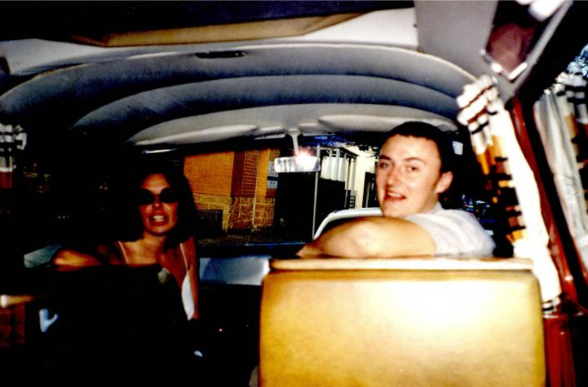

Programming Highlights – Q3 2026
ITV
The Chase Around The World
The Dark
Professor T
The NTA’s
FIFA World Cup Final
Carabao Cup Live
Celebrity Deal
or No Deal
Romesh Ranganathan's Parent's Evening
The Only Way
Is Essex
Force of Nature
Van Der Valk
Trigger Point
The Voice UK
The 1% Club
Channel 4
Still Waters
The Undeclared War
The Court
Apocalypse
The Great British Bake Off
The Celebrity Pottery Throw Down
Jury Duty
Taskmaster
Live British F1
The Piano
Sky
Wicked: For Good
Possession
Fire County S4
Katie Price:
My Reality
Gemma Collins
Gomorrah: The Origins
The Paper S2
UKTV
Channel 5
Benidorm is Murder
The Game S2
Forever Home
All Creatures Great and Small
Joe & David’s Magical Sitcom Tour
Outback Terror:
The Falconio Murder
Dream Car Fixers
Bookish
*Please be aware this information is not to be shared on social media or TV forums / websites.

