Slide 1


Future Focus Report
Q2 2026
Center Parcs - Bubbles

Slide 2

In this deck...
With Q2 planning well under way, this report will be a handy guide on what to expect over the coming months.
To provide a useful base on what to expect next year we look historically to Q2 2025:
Category & advertiser analysis
‘Reach Extenders’ analysis & TV viewing overview
Programming highlights across a range of genres
To better prepare you, we include key considerations for the quarter ahead:
Important dates
Preview on programming to expect in Q2 2026
Great Western Railway – Thrilling Engagement
Notes:
The Future Focus Report puts Q4 in the spotlight and is a useful guide to help with planning for the upcoming quarter.

Slide 3
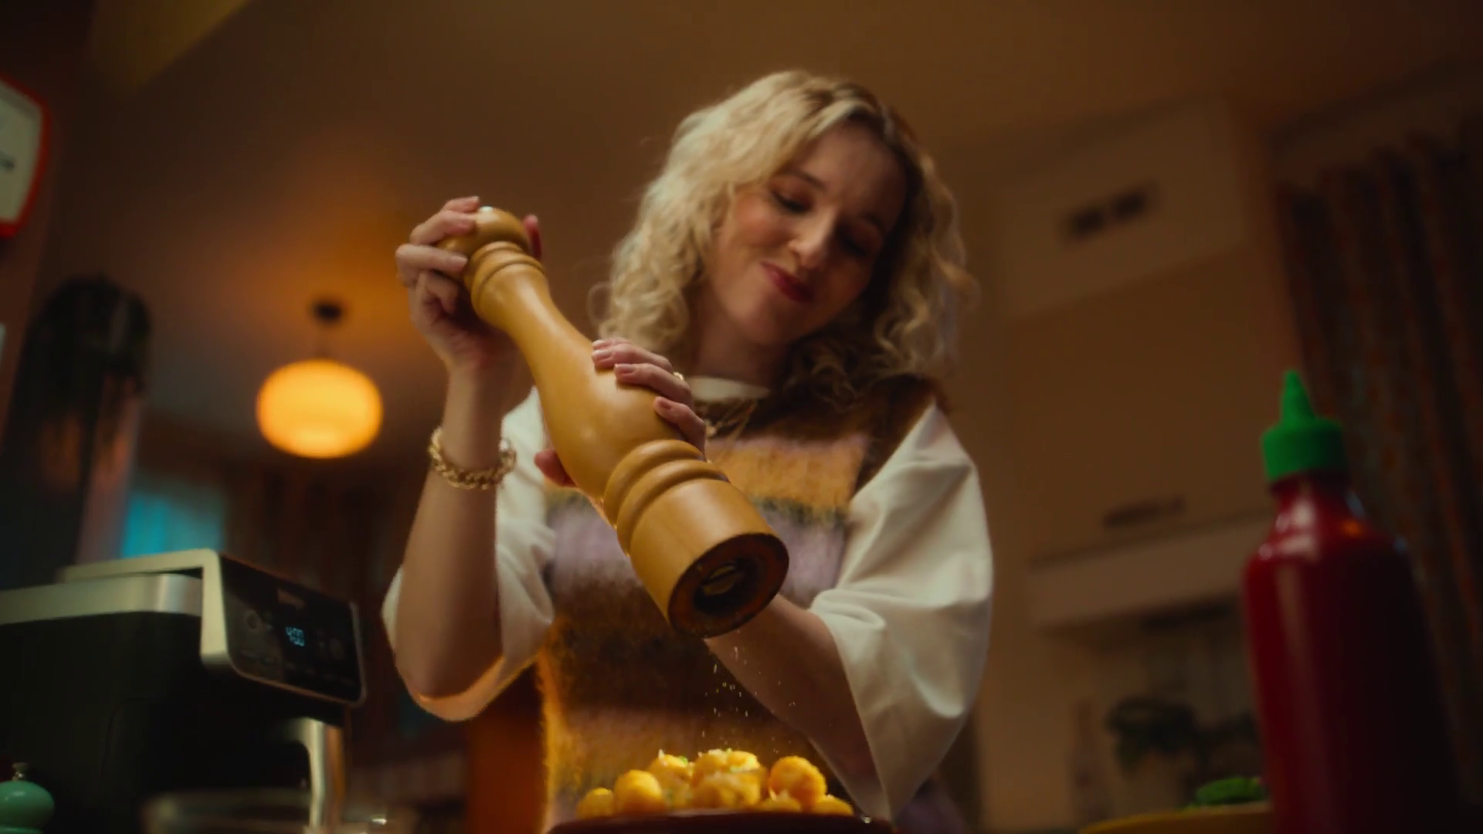
Category & Advertiser Analysis Q2 2025
McCain – Hash Brown

Slide 4
Q2 2025 TV Impacts by Category
High
Mid
Low
Relative propensity of media spend by category
 | Drink | Business & Industrial | Travel & Transport | Finance | Household FMCG | Health & Wellbeing | Telecoms | Food | Entertainment & Leisure | Household Equipment & DIY | Retail | Automotive | Online Retail | Government Social Political Organisation | Cosmetics & Personal Care
Apr | 129 | 100 | 113 | 101 | 108 | 104 | 111 | 101 | 99 | 124 | 92 | 84 | 75 | 77 | 81
May | 141 | 157 | 131 | 110 | 106 | 94 | 92 | 102 | 101 | 95 | 86 | 101 | 95 | 66 | 66
Jun | 177 | 148 | 115 | 114 | 109 | 113 | 101 | 100 | 96 | 69 | 98 | 89 | 86 | 85 | 68
Q2 | 149 | 135 | 120 | 108 | 108 | 104 | 101 | 101 | 98 | 97 | 92 | 92 | 85 | 76 | 72
Source: Barb, Q2 2025 vs 2024 Index, Adults, Top 15 categories by total impacts. Historic not forward looking.
Notes:
Q4 TV Impacts by category. Indexed % spend by category for each month vs. the average % for 2023

Slide 5
Top sectors by Q2 2025 impacts
Source: Barb, Q2 2025, All Adults, Impacts (R/W) (million). Numbers above bars show Q2 index vs 2024. Historic not forward looking.

Slide 6










Drink - Advertiser
Source: Barb, Q2 2025, All Adults, Impacts (R/W) (million). Top 10 Q2 2025 advertisers by total impacts.

Slide 7










Business & Industrial - Advertiser
Source: Barb, Q2 2025, All Adults, Impacts (R/W) (million). Top 10 Q2 2025 advertisers by total impacts.

Slide 8










Travel & Transport - Advertiser
Source: Barb, Q2 2025, All Adults, Impacts (R/W) (million). Top 10 Q2 2025 advertisers by total impacts.

Slide 9
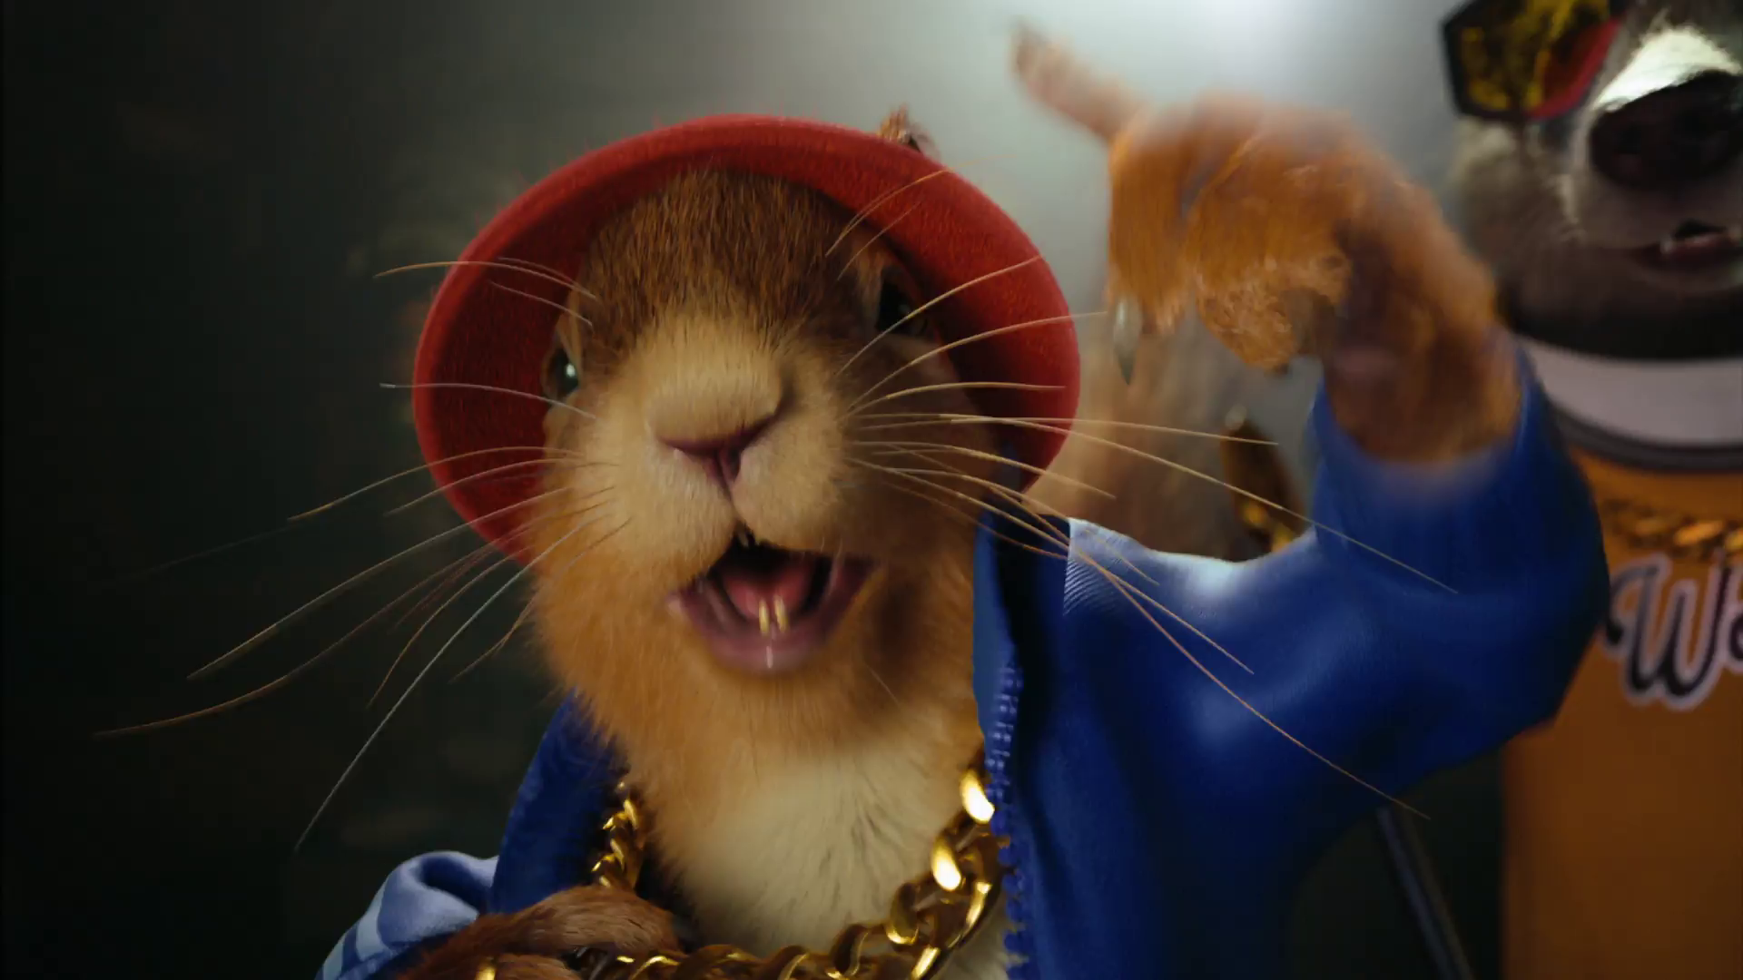
Reach Extenders & Viewing Overview
KP Nuts – A Handful of Happiness

Slide 10
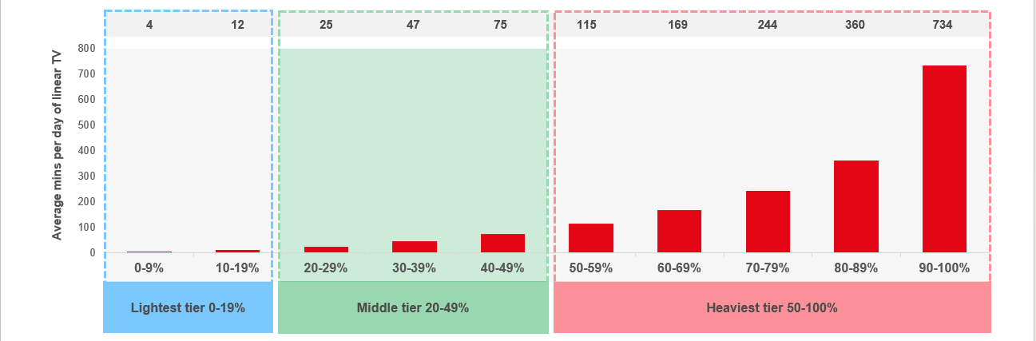
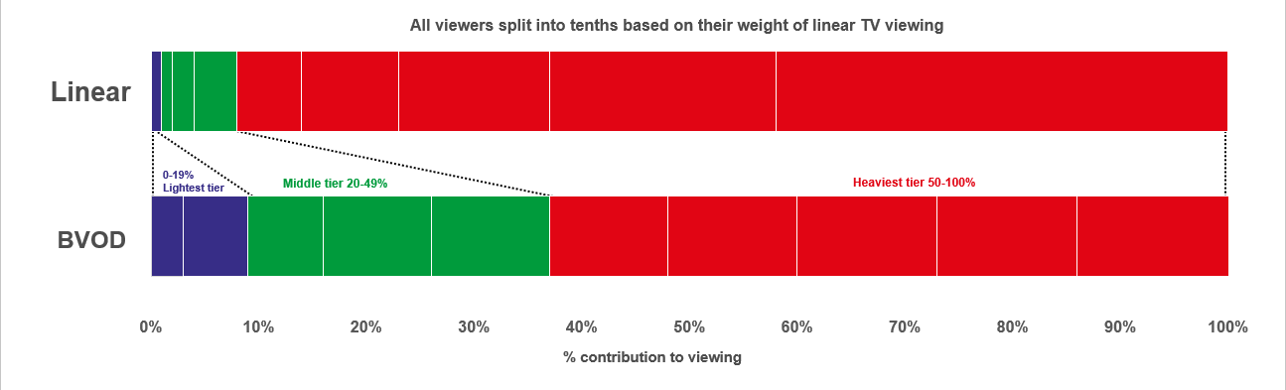

Identifying the ‘Reach Extenders’
Weight of viewing is a key factor
in incremental reach
‘Middle tier’ of viewers are key to
BVOD’s incremental reach
Research from BVOD Almighty divided viewers into deciles based on weekly linear TV viewing. Light viewers are hard to target on TV, while heavy viewers are easily targeted via linear TV, reducing the role of BVOD. PwC’s analysis identifies the ‘middle tier’ as the key segment driving incremental reach via BVOD.
This chart displays the proportion of linear and BVOD consumption for each of the three tiers and their deciles. Notably, the ‘middle tier’, accounting for 7% of linear TV viewing, makes up 28% of BVOD consumption, making them the key audience to extend campaigns through BVOD; we call them the ‘Reach Extenders’.
Source: BVOD Almighty
Notes:
Left Chart: Detailed analysis by PwC has identified a segment that are important drivers of why BVOD is delivering incremental reach.
This chart shows the viewing population split into ten equal groups (deciles) based upon amount of liner TV viewing per week.
The lightest decile averages 4-mins of linear viewing per day. Up to the heaviest decile who view for 734-minutes (12-hours 14-minutes) per day.
The deciles have been split into three groups:
Lightest tier. These are very hard to reach on TV (linear or BVOD) and are most likely to be targeted via platforms such as YouTube
Middle tier.
Heaviest tier. These are quite easy to reach via linear TV and, as a result, BVOD probably has little role to play.
Right Chart: This chart shows for each of the three tiers (and the deciles within them) what proportion of linear and BVOD consumption they account for.
Key to note is that the middle tier (green) proportionally watch a lot of BVOD. Whilst they account for 7% of linear TV viewing, they make up 28% of BVOD consumption.
This makes them the key audience for extending campaign via the use of BVOD – relatively they are easier to reach via BVOD then linear TV.

Slide 11
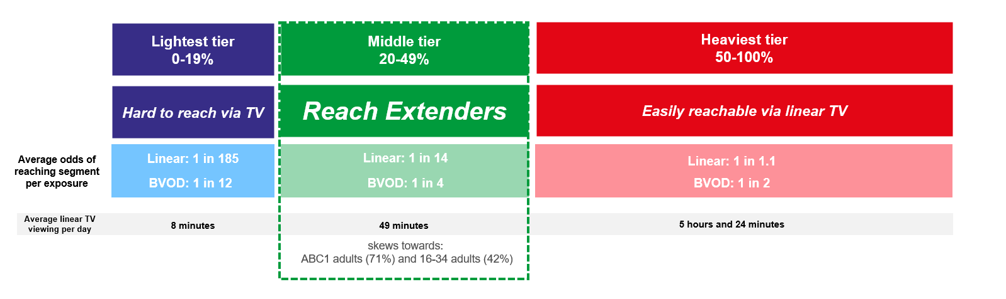
Identifying the ‘Reach Extenders’
BVOD provides good odds of reaching an attractive audience
Where and when can we effectively reach this valuable audience of ‘Reach Extenders’?
While BVOD excels at reaching this audience there are key programmes and times you’re very likely to reach them across the whole of TV.
‘Reach Extenders’ display a strong affinity for the following genres:
Drama
Films
Children
Their peak viewing hours take place daily from 8-11pm, with a higher likelihood of viewership occurring at the weekend.
On average, it takes only four impressions to reach a ‘middle tier’ viewer through BVOD, as opposed to 14 impressions on linear. This makes BVOD 3.5 times more efficient in targeting the ‘middle tier’ group, which often consists of younger and upscale viewers, highly sought after by advertisers.
Source: BVOD Almighty
Notes:
Left Chart: BVOD provides good odds of reaching an attractive audience or to put it another way, for every 14 impressions you buy on linear one person falls into the middle tier group (assuming natural delivery)
But on BVOD, it only takes four impressions to, on average, reach somebody in the middle tier. As such, on average, using BVOD is three and a half more efficient than linear at reaching the middle tier of viewers.
The middle tier are very attractive audiences for many advertisers (proportionally younger and upscale) and BVOD enables them to be reached in an efficient way.

Slide 12
Top genres watched by ‘Reach Extenders’
% of all viewing
Genre | Adults | Reach Extenders | Index
Drama | 28% | 32% | 117
Entertainment | 25% | 23% | 90
Films | 10% | 17% | 159
Sport | 10% | 9% | 86
Documentaries | 11% | 8% | 73
Hobbies/Leisure | 7% | 4% | 65
Children | 2% | 4% | 249
News/Weather | 4% | 2% | 46
Source: Barb Q2 2025, % of all viewing, index vs all adults.

Slide 13
High indexing drama content
Drama - Commercial TV
Channel | Programme Title | Index
Channel 4 | The Great | 447
Channel 5 | All Creatures Great and Small | 434
Channel 4 | The West Wing | 311
ITV | Unforgotten | 304
Sky | The White Lotus | 275
Sky | The Last Of Us | 224
Channel 5 | The Flatshare | 218
ITV | Protection (PKA Witness Protection) | 184
Channel 5 | Ellis | 169
Channel 4 | The Handmaid's Tale | 130
Drama - SVOD
Channel | Programme Title | Index
Netflix | Black Mirror | 258
Disney+ | Grey's Anatomy | 257
Disney+ | Star Wars: Andor | 246
Netflix | You | 241
Amazon | The Handmaid's Tale | 236
Netflix | Dept. Q | 230
Amazon | The Wheel of Time | 225
Netflix | House | 221
Amazon | Reacher | 191
Disney+ | NCIS | 143
Source: Barb Q2 2025, ‘Reach Extender’ index vs all adults, Thinkbox created list of programmes ranked by volume of viewing and index. Commercial broadcasters and SVODs are separated because we can’t currently separate viewing by homes that are / are not on the SVOD ad tiers.

Slide 14
High indexing film content
Films are popular among the ‘Reach Extender’ audience, but planning for this genre is less straightforward due to the variance in film scheduling. To help, here is a breakdown of which sub-genres the ‘Reach Extenders’ are watching.
Films - Commercial TV
Sub-Genre | Channel | Programme Title | Index
Family | Sky | Charlie and the Chocolate Factory | 235
Family | Sky | Robin And The Hoods | 205
Family | ITV | Hop | 131
Family | Channel 5 | Scooby-Doo! Return to Zombie Island | 123
Romcom | Channel 4 | Friends with Benefits | 404
Romcom | Sky | Love & Other Drugs | 274
Romcom | ITV | The Princess Diaries | 217
Romcom | ITV | 13 Going on 30 | 177
% of all film viewing
Genre | Adults | Reach Extenders | Index
Family | 17% | 24% | 141
Action / Adventure / Thriller | 29% | 24% | 83
Sci-Fi and Fantasy | 14% | 14% | 99
Comedy | 11% | 11% | 101
Crime Drama | 5% | 5% | 101
Horror | 5% | 5% | 101
Romcom | 3% | 4% | 124
Other | 2% | 2% | 113
Films - SVOD
Sub-Genre | Channel | Programme Title | Index
Family | Netflix | The Super Mario Bros. Movie | 210
Family | Amazon | Minions | 181
Romcom | Netflix | The Life List | 163
Romcom | Disney+ | 10 Things I Hate About You | 256
Source: Barb Q2 2025, ‘Reach Extender’ index vs all adults, Thinkbox created list of programmes ranked by sub-genre, volume of viewing and index. Commercial broadcasters and SVODs are separated because we can’t currently separate viewing by homes that are / are not on the SVOD ad tiers.

Slide 15
‘Reach Extenders’ aren’t solely limited to high indexing genres
Sport - Commercial TV
Channel | Programme Title | Index
ITV | NFL | 184
CH5 | World's Strongest Man | 179
TNT Sports | UFC | 155
Sky | PDC World Championship Darts | 153
ITV | Six Nations Championship | 148
Sky | EFL Cup | 143
TNT Sports | Premier League | 143
TNT Sports | UEFA Europa League | 125
TNT Sports | Gallagher Premiership Rugby | 119
CH4 | Formula 1 | 106
Sport - Commercial TV
Channel | Programme Title | Index
TNT Sports | UFC | 214
Sky | Live: Baller League UK | 212
TNT Sports | UEFA Champions League | 184
TNT Sports | UEFA Europa League | 165
TNT Sports | Gallagher Premiership Rugby | 156
Channel 4 | Formula 1 | 141
Sky | Miami F1 GP | 137
ITV | UEFA Nations League | 133
Sky | Premier League | 111
ITV | International Football | 110
Entertainment - Commercial TV
Channel | Programme Title | Index
Discovery | Marooned With Ed Stafford | 411
Sky | The Rehearsal | 291
Channel 4 | Taskmaster | 269
Sky | Saturday Night Live | 253
ITV | Love Island | 145
Channel 4 | The Piano | 142
ITV | The Real Housewives of Cheshire | 142
Entertainment - SVOD
Channel | Programme Title | Index
Disney+ | Bob's Burgers | 524
Disney+ | The Simpsons | 354
Netflix | The Office US | 324
Disney+ | Modern Family | 299
Amazon | The Big Bang Theory | 285
Netflix | Friends | 284
Netflix | Love on the Spectrum | 270
Sport - SVOD
Channel | Programme Title | Index
Netflix | WWE Raw | 220
Netflix | WWE SmackDown | 218
Amazon | UEFA Champions League | 211
Source: Barb Q2 2025, ‘Reach Extender’ index vs all adults, Thinkbox created list of programmes ranked by volume of viewing and index. Limited SVOD Sport Programmes. Commercial broadcasters and SVODs are separated because we can’t currently separate viewing by homes that are / are not on the SVOD ad tiers.

Slide 16
When to target the ‘Reach Extenders’
Reach Extenders' index by daypart
 | 6am | 7am | 8am | 9am | 10am | 11am | 12pm | 1pm | 2pm | 3pm | 4pm | 5pm | 6pm | 7pm | 8pm | 9pm | 10pm | 11pm | 12am | 1am | 2am | 3am | 4am | 5am
Monday | 62 | 71 | 58 | 61 | 59 | 56 | 66 | 71 | 66 | 63 | 64 | 73 | 92 | 124 | 148 | 173 | 138 | 91 | 62 | 41 | 37 | 22 | 24 | 47
Tuesday | 73 | 85 | 52 | 50 | 59 | 53 | 60 | 65 | 57 | 47 | 46 | 62 | 87 | 121 | 160 | 180 | 151 | 105 | 76 | 53 | 38 | 27 | 14 | 49
Wednesday | 62 | 67 | 48 | 50 | 53 | 46 | 56 | 64 | 57 | 48 | 47 | 64 | 83 | 115 | 155 | 190 | 147 | 105 | 68 | 45 | 40 | 32 | 19 | 57
Thursday | 66 | 69 | 57 | 53 | 55 | 55 | 68 | 65 | 57 | 51 | 53 | 63 | 82 | 112 | 143 | 189 | 155 | 113 | 84 | 48 | 39 | 30 | 22 | 49
Friday | 52 | 72 | 61 | 59 | 50 | 47 | 59 | 60 | 57 | 55 | 59 | 66 | 89 | 115 | 133 | 177 | 158 | 134 | 103 | 65 | 55 | 49 | 33 | 33
Saturday | 38 | 68 | 64 | 53 | 56 | 55 | 61 | 71 | 80 | 88 | 91 | 90 | 102 | 118 | 141 | 149 | 136 | 105 | 83 | 63 | 51 | 40 | 33 | 41
Sunday | 51 | 64 | 61 | 61 | 65 | 65 | 67 | 77 | 97 | 103 | 98 | 108 | 110 | 114 | 130 | 144 | 120 | 88 | 61 | 37 | 29 | 22 | 20 | 33
Monday | Tuesday | Wednesday | Thursday | Friday | Saturday | Sunday
93 | 87 | 89 | 88 | 92 | 118 | 126
Monday | Tuesday | Wednesday | Thursday | Friday | Saturday | Sunday
90 | 96 | 96 | 94 | 93 | 109 | 118
Source: Barb Q2 2025, commercial linear & BVOD, ‘Reach Extender’ index vs all adults.

Slide 17
Q2 2025 linear TV facts & figures
Total TV weekly reach %
Total TV viewed per day
Commercial TV viewed per day
Impacts
Individuals
73.6 | 142.5bn | 2h 1m | 1h 21m
76.7 | 138.3bn | 2h 18m | 1h 33m
75.3 | 51.2bn | 1h 44m | 1h 4m
54.6 | 8.0bn | 30m | 21m
75.7 | 63.2bn | 2h 14m | 1h 31m
77.8 | 75.1bn | 2h 20m | 1h 34m
73.8 | 8.3bn | 1h 4m | 44m
Adults
ABC1 adults
16-34
Men
Women
Housepersons with children
Source: Barb Q2 2025, industry standard TV viewing in-home on a TV set. Reach 3min+. 30” equivalent impacts.
Notes:
Q2 2025 linear TV figures for weekly reach, impacts, total TV viewing hours and commercial TV viewing hours

Slide 18

Programming
Q2 2025
Tops – What You Got?

Slide 19




Programming Highlights – Q2 2025
Britain’s Got Talent
ITV1, 31 May
Average Audience
Individuals: 5,272,700
Adults: 4,802,600
ABC1 Ads: 1,983,900
16-34: 501,300
HP+CH: 522,300
The Handmaid's Tale
Channel 4, 3 May
Average Audience
Individuals: 972,200
Adults: 956,900
ABC1 Ads: 547,800
16-34: 32,000
HP+CH: 88,400
Live: FIFA Club World Cup 2025
Channel 5, 16 Jun
Average Audience
Individuals: 984,000
Adults: 938,400
ABC1 Ads: 526,100
16-34: 109,100
HP+CH: 56,400
Bahrain F1 GP
Sky Sports, 13 Apr
Average Audience
Individuals: 1,558,700
Adults: 1,498,600
ABC1 Ads: 878,700
16-34: 301,900
HP+CH: 87,000
Source: Barb, Q2 2025. Average audience figures - Consolidated, Top performing episode of series (if applicable).

Slide 20




Drama - Programming Highlights
Code of Silence
ITV1, 18 May
Average Audience
Individuals: 5,118,800
Adults: 5,044,900
ABC1 Ads: 2,343,100
16-34: 353,100
HP+CH: 387,000
The Handmaid's Tale
Channel 4, 3 May
Average Audience
Individuals: 972,200
Adults: 956,900
ABC1 Ads: 547,800
16-34: 32,000
HP+CH: 88,400
The Feud
Channel 5, 22 Apr
Average Audience
Individuals: 2,780,200
Adults: 2,744,400
ABC1 Ads: 1,320,200
16-34: 115,500
HP+CH: 126,500
The Last of Us
Sky Atlantic, 20 Apr
Average Audience
Individuals: 1,213,100
Adults: 1,200,700
ABC1 Ads: 754,300
16-34: 404,300
HP+CH: 157,000
The Chelsea Detective
U&Drama, 21 May
Average Audience
Individuals: 1,139,400
Adults: 1,131,700
ABC1 Ads: 593,800
16-34: 11400
HP+CH: 11,400
Source: Barb, Q2 2025. Average audience figures - Consolidated, Top performing episode of series (if applicable).

Slide 21




Entertainment - Programming Highlights
Britain’s Got Talent
ITV1, 31 May
Average Audience
Individuals: 5,272,700
Adults: 4,802,600
ABC1 Ads: 1,983,900
16-34: 501,300
HP+CH: 522,300
Gogglebox
Channel 4, 9 Mar
Average Audience
Individuals: 3,170,700
Adults: 3,123,600
ABC1 Ads: 1,699,000
16-34: 256,100
HP+CH: 271,700
Celebrity Puzzling
Channel 5, 23 Jun
Average Audience
Individuals: 751,700
Adults: 738,900
ABC1 Ads: 380,900
16-34: 49,100
HP+CH: 20,200
Love Island
ITV2, 30 Jun
Average Audience
Individuals: 1,978,200
Adults: 1,913,500
ABC1 Ads: 951,300
16-34: 831,700
HP+CH: 434,100
Married at First Sight Australia
E4, 3 Apr
Average Audience
Individuals: 1,690,600
Adults: 1,659,200
ABC1 Ads: 970,600
16-34: 310,200
HP+CH: 292,000
Source: Barb, Q2 2025. Average audience figures - Consolidated, Top performing episode of series (if applicable).

Slide 22



Sports - Programming Highlights
International Football: ENG v SEN
ITV1, 10 Jun
Average Audience
Individuals: 2,918,700
Adults: 2,766,200
ABC1 Ads: 1,412,300
16-34: 271,600
HP+CH: 204,800
Football: UEFA U21 Championship 2025
Channel 4, 28 Jun
Average Audience
Individuals: 2,565,500
Adults: 2,422,800
ABC1 Ads: 1,166,800
16-34: 279,400
HP+CH: 159,900
Live: FIFA Club World Cup 2025: CHE v LAF Channel 5, 16 Jun
Average Audience
Individuals: 984,000
Adults: 938,400
ABC1 Ads: 526,100
16-34: 109,100
HP+CH: 56,400
Bahrain F1 GP
Sky Sports, 13 Apr
Average Audience
Individuals: 1,558,700
Adults: 1,498,600
ABC1 Ads: 878,700
16-34: 301,900
HP+CH: 87,000
UEFA Europa League: TOT v MUN
TNT Sports, 21 May
Average Audience
Individuals: 1,207,000
Adults: 1,115,600
ABC1 Ads: 656,300
16-34: 232,500
HP+CH: 92,400
Source: Barb, Q2 2025. Average audience figures - Consolidated, Top performing episode of series (if applicable).

Slide 23





Hobbies & Leisure - Programming Highlights
Noel Edmonds' Kiwi Adventure
ITV1, 20 Jun
Average Audience
Individuals: 1,716,600
Adults: 1,676,700
ABC1 Ads: 750,600
16-34: 24,300
HP+CH: 90,700
Grand Designs
Channel 4, 20 Jun
Average Audience
Individuals: 1,707,400
Adults: 1,681,900
ABC1 Ads: 975,600
16-34: 117,500
HP+CH: 141,000
Royal Residences: A Map of Britain
Channel 5, 7 Jun
Average Audience
Individuals: 803,400
Adults: 802,900
ABC1 Ads: 433,400
16-34: 4,600
HP+CH: 13,400
Bangers & Cash: Restoring Classics
U&Yesterday, 15 May
Average Audience
Individuals: 360,200
Adults: 357,000
ABC1 Ads: 137,200
16-34: 12,900
HP+CH: 1,600
Shed & Buried: Classic Cars
Quest, 12 May
Average Audience
Individuals: 337,500
Adults: 327,500
ABC1 Ads: 94,100
16-34: 21,100
HP+CH: 4,700
Source: Barb, Q2 2025. Average audience figures - Consolidated, Top performing episode of series (if applicable).

Slide 24







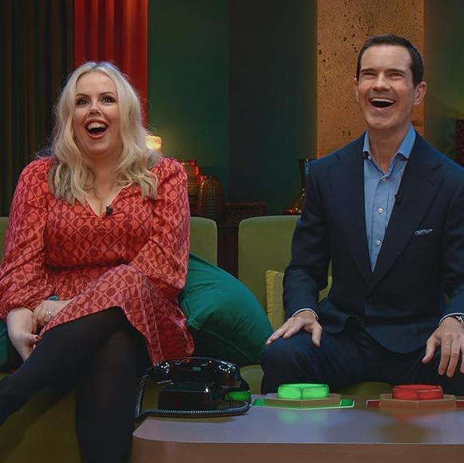

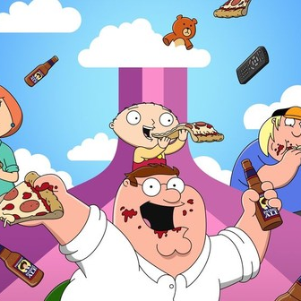
SVOD Drama & Entertainment - Programming Highlights
Dept. Q
S1, Ep1, Netflix, Drama
Individuals: 3,064,480
Adults: 3,027,273
Black Mirror S7, Ep1, Netflix, Drama
Individuals: 2,327,829
Adults: 2,172,265
The Stolen Girl S1, Ep2
Disney+, Drama
Individuals: 996,703
Adults: 970,953
Star Wars: Andor
S2, Ep1, Disney+, Drama
Individuals: 905,043
Adults: 876,803
The Bondsman S1, Ep1
Amazon, Drama
Individuals: 726,438
Adults: 709,221
Love on the Spectrum S3, Ep1 Netflix, Ent.
Individuals: 737,373
Adults: 711,541
America’s Sweethearts: Dallas Cowboy S2, Ep1 Netflix, Ent.
Individuals: 609,345
Adults: 576,338
LOL: Last One Laughing UK S1, Ep6 Amazon, Ent.
Individuals: 553,318
Adults: 530,356
The Secret Lives of Mormon Wives S2, Ep1 Disney+, Ent.
Individuals: 316,156
Adults: 293,660
Family Guy S23, Ep5 Disney+, Ent.
Individuals: 194,431
Adults: 193,454
Source: Barb, Q2 2025, individuals and adults. Average audience achieved during the first seven days of their availability. Only includes TV set viewing.

Slide 25

Q2 2026
U – U Talking to Me?

Slide 26
Key Dates
 | Week Commencing
 | 30-Mar | 06-Apr | 13-Apr | 20-Apr | 27-Apr | 04-May | 11-May | 18-May | 25-May | 01-Jun | 08-Jun | 15-Jun | 22-Jun | 29-Jun
Premier League
Bank Holidays
Formula 1
Grand National
Champions League
FA Cup
FIFA World Cup
Father's Day
Wimbledon*
*In 2026 Wimbledon highlights will be shown on TNT Sports.

Slide 27








































Programming Highlights – Q2 2026
ITV
Bradely & Barney Walsh: Breaking Dad
The Neighbourhood
The Box
Believe Me
Women's England Football
FIFA World Cup
Soccer Aid
The Grand National
I’m a Celebrity South Africa
Britain’s
Got Talent
For The Love
of Dogs
The Only Way Is Essex
Grace
Love Island
Secret Service
Nobody’s Fool
Channel 4
Virgin Island
Your Song
Celebrity
Gogglebox
WFA Cup Final
Falling
A Woman
of Substance
The Great Celebrity Bake Off: SU2C
Big Mood 2
The Boat Race
Married at First
Sight Australia
Sky
Gabby’s Dollhouse: The Movie
House of
the Dragon
The Miniature
Wife
Prisoner
Rob & Romesh vs…
Euphoria
Flavia
UKTV
Channel 5
Dom Chinea’s Cornish Workshop
Canal Boat
Diaries S7
The Marlow Murder Club S3
Ellis S2
Jane McDonald’s Nashville
Bergerac S2
*Please be aware this information is not to be shared on social media or TV forums / websites.

