Slide 1


Future Focus Report
Q1 2027
Audi – After Dark

Slide 2

In this deck...
With Q1 planning well under way, this report will be a handy guide on what to expect over the coming months.
To provide a useful base on what to expect next year we look historically to Q1 2026:
Category & advertiser analysis
‘Lighter Viewers’ analysis & TV viewing overview
Programming highlights across a range of genres
To better prepare you, we include key considerations for the quarter ahead:
Important dates
Preview on programming to expect in Q1 2027
Tombola – bus Stop Bodypop
Notes:
The Future Focus Report puts Q1 in the spotlight and is a useful guide to help with planning for the upcoming quarter.

Slide 3
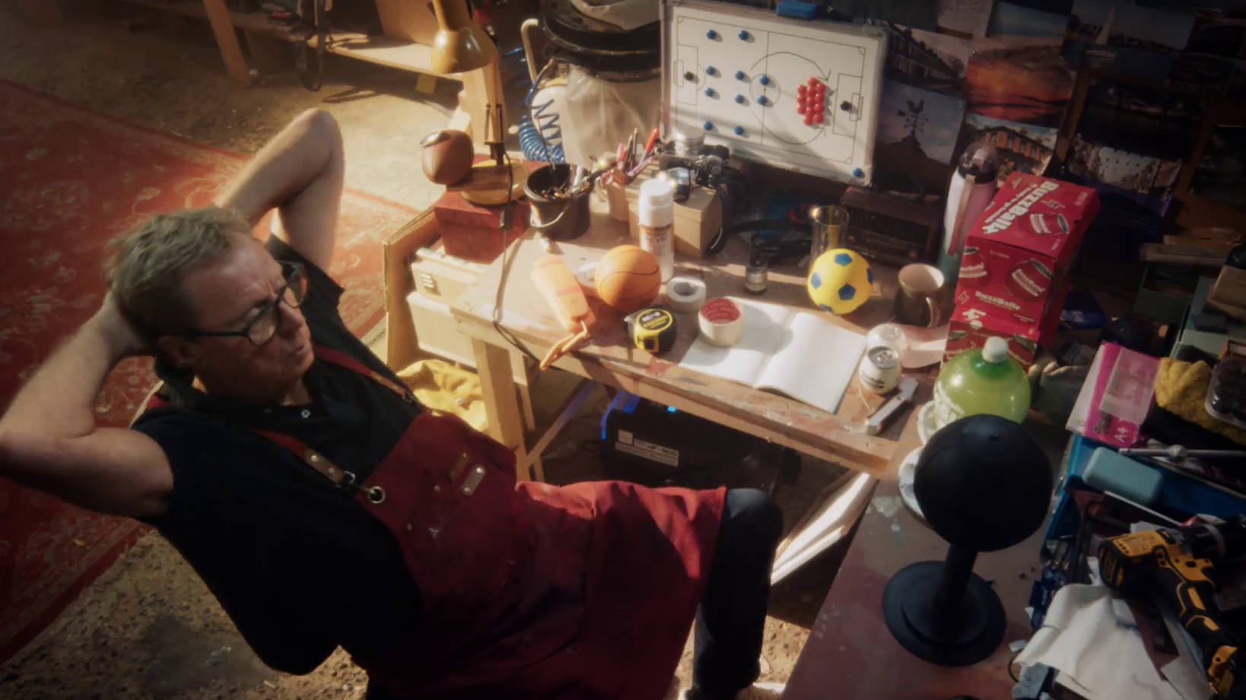
Category & Advertiser Analysis Q1 2026
BuzzBallz – Harry Redknapp

Slide 4
Q1 2026 TV Impacts by Category
High
Mid
Low
Relative propensity of media spend by category
 | Automotive | Travel & Transport | Business & Industrial | Finance | Household Equipment & DIY | Health & Wellbeing | Government Social Political Organisation | Food | Online Retail | Media | Telecoms | Household FMCG | Entertainment & Leisure | Retail | Cosmetics & Personal Care
Jan | 151 | 185 | 122 | 128 | 128 | 106 | 106 | 83 | 65 | 88 | 74 | 72 | 85 | 90 | 45
Feb | 152 | 131 | 149 | 121 | 94 | 116 | 110 | 102 | 99 | 80 | 92 | 92 | 76 | 65 | 75
Mar | 136 | 104 | 119 | 128 | 119 | 101 | 99 | 94 | 112 | 96 | 93 | 94 | 89 | 79 | 98
Q1 | 146 | 141 | 130 | 126 | 115 | 107 | 105 | 92 | 91 | 88 | 86 | 85 | 83 | 79 | 72
Source: Barb, Q1 2026 vs 2025 Index, Adults, Top 15 categories by total impacts. Historic not forward looking.
Notes:
Q1 TV Impacts by category. Indexed % spend by category for each month vs. the average % for 2025

Slide 5
Top sectors by Q1 2026 impacts
Source: Barb, Q1 2026, All Adults, Impacts (R/W) (million). Numbers above bars show Q1 index vs 2025. Historic not forward looking.

Slide 6










Automotive - Advertiser
Source: Barb, Q1 2026, All Adults, Impacts (R/W) (million). Top 10 Q1 2026 advertisers by total impacts.

Slide 7










Travel - Advertiser
Source: Barb, Q1 2026, All Adults, Impacts (R/W) (million). Top 10 Q1 2026 advertisers by total impacts.

Slide 8










Finance - Advertiser
Source: Barb, Q1 2026, All Adults, Impacts (R/W) (million). Top 10 Q1 2026 advertisers by total impacts.

Slide 9

Lighter Viewers & Viewing Overview
Jägermeister – Crab

Slide 10
Identifying the ‘lighter viewers’
Average Mins Per Day of Total TV
Lightest Viewers 0-19%
Lighter Viewers 20-49%
Heaviest Viewers 50-100%
Source: Barb, Total TV, Feb 26, Adults, TV Set.
Notes:
Where can we find those valuable lighter viewers? What programmes do they watch? Which genres do they love? This section of the report has the answers for you.

Slide 11
Top genres watched by ‘Lighter Viewers’
% of all viewing
Genre | Adults | Lighter Viewers | Index
Drama | 30% | 37% | 126
Entertainment | 24% | 21% | 88
Films | 11% | 16% | 153
Sport | 10% | 9% | 90
Documentaries | 11% | 7% | 66
Children | 2% | 4% | 216
Hobbies/Leisure | 5% | 2% | 41
News/Weather | 5% | 2% | 41
Source: Barb Q1 2026, % of all viewing, index vs all adults.

Slide 12
High indexing drama content
Drama - Commercial TV
Channel | Programme Title | Index
Sky | Heated Rivalry | 360
CH4 | Nurse Jackie | 339
Sky | A Knight of the Seven Kingdoms | 247
CH4 | Dirty Business | 164
Sky | Under Salt Marsh | 145
Sky | Game of Thrones | 140
CH5 | All Creatures Great and Small | 132
ITV | The Hunting Wives | 129
ITV | Red Eye | 112
CH4 | Patience | 111
Drama - SVOD
Channel | Programme Title | Index
Disney+ | Paradise | 287
Disney+ | High Potential | 274
Disney+ | Grey's Anatomy | 248
Amazon | Steal | 237
Netflix | Stranger Things | 235
Amazon | Young Sherlock | 230
Netflix | Run Away | 228
Amazon | Fallout | 223
Netflix | Bridgerton | 221
Netflix | The Good Doctor | 206
Source: Barb Q1 2026, ‘Lighter Viewers’ index vs all adults, Thinkbox created list of programmes ranked by volume of viewing and index. Commercial broadcasters and SVODs are separated because we can’t currently separate viewing by homes that are / are not on the SVOD ad tiers.

Slide 13
High indexing film content
Films are popular among the ‘Lighter Viewers’ audience, but planning for this genre is less straightforward due to the variance in film scheduling. To help, here is a breakdown of which sub-genres the ‘Lighter Viewers’ are watching.
Films - Commercial TV
Sub-Genre | Channel | Programme Title | Index
Family | ITV | Blippi's Big Dino Adventure | 213
Family | Sky | Madagascar: Escape 2 Africa | 207
Family | Sky | A Minecraft Movie | 170
Family | CH4 | Dora and the Lost City of Gold | 113
Romcom | Sky | Anora | 261
Romcom | ITV | Bride Wars | 237
Romcom | CH4 | The Worst Person in the World | 189
Romcom | Sky | The Wedding Singer | 130
% of all film viewing
Genre | Adults | Lighter Viewers | Index
Family | 20% | 28% | 142
Action / Adventure / Thriller | 23% | 17% | 75
Sci-Fi and Fantasy | 14% | 13% | 99
Comedy | 12% | 12% | 98
Crime Drama | 6% | 6% | 104
Romcom | 4% | 5% | 115
Horror | 4% | 4% | 93
Other | 3% | 4% | 116
Films - SVOD
Sub-Genre | Channel | Programme Title | Index
Family | Netflix | KPop Demon Hunters | 181
Family | Disney+ | Zootropolis 2 | 168
Romcom | Disney+ | The Princess Diaries | 207
Romcom | Netflix | People We Meet on Vacation | 147
Source: Barb Q1 2026, ‘Lighter Viewers’ index vs all adults, Thinkbox created list of programmes ranked by sub-genre, volume of viewing and index. Commercial broadcasters and SVODs are separated because we can’t currently separate viewing by homes that are / are not on the SVOD ad tiers.

Slide 14
‘Lighter Viewers’ aren’t solely limited to high indexing genres
Sport - Commercial TV
Channel | Programme Title | Index
ITV | Six Nations Championship | 158
Sky | Chinese F1 GP | 152
CH4 | Formula 1 | 144
TNT Sport | UEFA Champions League | 136
TNT Sport | Gallagher PREM Rugby | 133
TNT Sport | Premier League | 126
Sky | EFL Cup | 123
ITV | Carabao Cup Live | 116
Sky | PDC World Championship Darts | 107
ITV | International Football | 103
Entertainment - Commercial TV
Channel | Programme Title | Index
CH4 | Taskmaster | 344
Sky | Saturday Night Live UK | 254
U | Parks and Recreation | 204
ITV | Love Island All Stars | 170
CH4 | The Great Pottery Throw Down | 170
ITV | The BRIT Awards | 144
TLC | Mock the Week | 127
Entertainment - SVOD
Channel | Programme Title | Index
Disney+ | Family Guy | 305
Netflix | Brooklyn Nine-Nine | 288
Amazon | LOL: Last One Laughing UK | 279
Disney+ | The Simpsons | 277
Netflix | 2 Broke Girls | 228
Netflix | The Middle | 217
Disney+ | Modern Family | 180
Sport - SVOD
Channel | Programme Title | Index
Disney+ | UEFA Women's Champions League | 279
Amazon | UEFA Champions League | 203
Netflix | WWE Raw | 144
Source: Barb Q1 2026, ‘Lighter Viewers’ index vs all adults, Thinkbox created list of programmes ranked by volume of viewing and index. Limited SVOD Sport Programmes. Commercial broadcasters and SVODs are separated because we can’t currently separate viewing by homes that are / are not on the SVOD ad tiers.

Slide 15
When to target the ‘Lighter Viewers’
Lighter Viewers' index by daypart
 | 6am | 7am | 8am | 9am | 10am | 11am | 12pm | 1pm | 2pm | 3pm | 4pm | 5pm | 6pm | 7pm | 8pm | 9pm | 10pm | 11pm | 12am | 1am | 2am | 3am | 4am | 5am
Monday | 50 | 71 | 56 | 61 | 56 | 54 | 62 | 75 | 60 | 56 | 62 | 78 | 96 | 131 | 156 | 164 | 125 | 92 | 71 | 59 | 52 | 36 | 33 | 33
Tuesday | 46 | 55 | 45 | 54 | 61 | 57 | 66 | 65 | 58 | 53 | 54 | 68 | 92 | 131 | 164 | 176 | 133 | 93 | 65 | 50 | 32 | 22 | 21 | 32
Wednesday | 44 | 60 | 49 | 53 | 51 | 50 | 55 | 65 | 54 | 50 | 51 | 66 | 93 | 130 | 165 | 171 | 135 | 97 | 67 | 56 | 51 | 35 | 37 | 33
Thursday | 41 | 57 | 50 | 50 | 52 | 53 | 56 | 64 | 63 | 59 | 61 | 75 | 97 | 136 | 159 | 168 | 132 | 99 | 76 | 53 | 50 | 27 | 24 | 41
Friday | 38 | 58 | 52 | 58 | 57 | 57 | 61 | 66 | 60 | 57 | 56 | 66 | 91 | 122 | 147 | 174 | 154 | 124 | 100 | 70 | 52 | 47 | 45 | 53
Saturday | 39 | 60 | 59 | 61 | 55 | 54 | 62 | 78 | 89 | 85 | 89 | 102 | 112 | 120 | 137 | 141 | 127 | 99 | 72 | 52 | 47 | 42 | 52 | 46
Sunday | 50 | 56 | 66 | 68 | 64 | 63 | 70 | 77 | 86 | 93 | 98 | 108 | 119 | 123 | 138 | 132 | 112 | 88 | 69 | 55 | 51 | 38 | 30 | 31
Monday | Tuesday | Wednesday | Thursday | Friday | Saturday | Sunday
91 | 92 | 90 | 89 | 90 | 121 | 122
Monday | Tuesday | Wednesday | Thursday | Friday | Saturday | Sunday
84 | 92 | 85 | 80 | 87 | 111 | 119
Monday | Tuesday | Wednesday | Thursday | Friday | Saturday | Sunday
93 | 87 | 89 | 88 | 92 | 118 | 126
Monday | Tuesday | Wednesday | Thursday | Friday | Saturday | Sunday
95 | 100 | 91 | 89 | 93 | 110 | 117
Source: Barb Q1 2026, commercial linear & BVOD, TV set, ‘Lighter Viewers’ index vs all adults.

Slide 16
Q1 2026 linear TV facts & figures
Total TV weekly reach %
Total TV viewed per day
Commercial TV viewed per day
Impacts
Individuals
73.3 | 137.6bn | 2h 7m | 1h 21m
76.4 | 134.2bn | 2h 25m | 1h 32m
75.7 | 52.7bn | 1h 54m | 1h 6m
54.1 | 7.3bn | 31m | 20m
75.1 | 60.0bn | 2h 20m | 1h 29m
77.6 | 74.2bn | 2h 29m | 1h 35m
73.3 | 7.5bn | 1h 4m | 40m
Adults
ABC1 adults
16-34
Men
Women
Housepersons with children
Source: Barb Q1 2026, industry standard TV viewing in-home on a TV set. Reach 3min+. 30” equivalent impacts.
Notes:
Q1 2026 linear TV figures for weekly reach, impacts, total TV viewing hours and commercial TV viewing hours

Slide 17

Programming
Q1 2026
Bath & Body Works – All Aboard

Slide 18

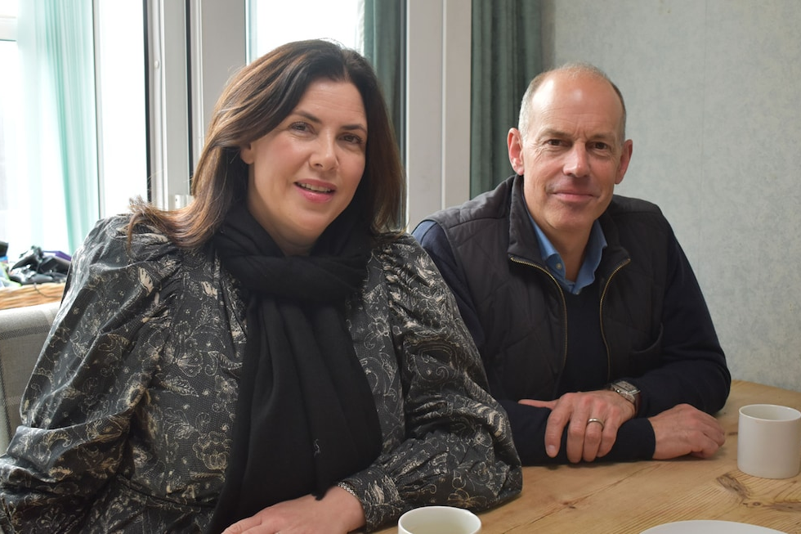


Programming Highlights – Q1 2026
Britain's Got Talent
ITV1, 7 Mar
Average Audience
Individuals: 4,506,700
Adults: 4,038,900
ABC1 Ads: 1,809,700
16-34: 382,000
HP+CH: 476,600
Kirstie and Phil's Love It or List It
Channel 4, 4 Feb
Average Audience
Individuals: 1,302,600
Adults: 1,260,700
ABC1 Ads: 871,800
16-34: 65,200
HP+CH: 125,700
World's Strongest Man
Channel 5, 1 Jan
Average Audience
Individuals: 1,466,300
Adults: 1,353,200
ABC1 Ads: 594,300
16-34: 129,200
HP+CH: 142,400
A Knight of the Seven Kingdoms
Sky Atlantic, 22 Feb
Average Audience
Individuals: 1,040,000
Adults: 1,027,700
ABC1 Ads: 632,900
16-34: 257,100
HP+CH: 128,900
Source: Barb, Q1 2026. Average audience figures - Consolidated, Top performing episode of series (if applicable).

Slide 19

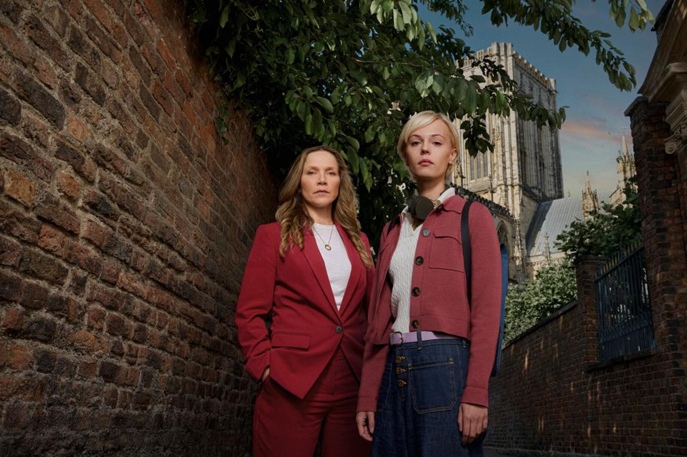


Drama - Programming Highlights
Grace
ITV1, 29 Mar
Average Audience
Individuals: 4,465,600
Adults: 4,420,300
ABC1 Ads: 2,228,400
16-34: 79,100
HP+CH: 112,200
Patience
Channel 4, 7 Jan
Average Audience
Individuals: 2,767,600
Adults: 2,742,100
ABC1 Ads: 1,651,400
16-34: 63,800
HP+CH: 100,800
Power: The Downfall of Huw Edwards
Channel 5, 24 Mar
Average Audience
Individuals: 3,252,900
Adults: 3,240,000
ABC1 Ads: 1,630,200
16-34: 120,700
HP+CH: 151,500
A Knight of the Seven Kingdoms
Sky Atlantic, 22 Feb
Average Audience
Individuals: 1,040,000
Adults: 1,027,700
ABC1 Ads: 632,900
16-34: 257,100
HP+CH: 128,900
The Marlow Murder Club
U&Drama, 18 Feb
Average Audience
Individuals: 772,300
Adults: 766,900
ABC1 Ads: 420,600
16-34: 13,700
HP+CH: 4,800
Source: Barb, Q1 2026. Average audience figures - Consolidated, Top performing episode of series (if applicable).

Slide 20
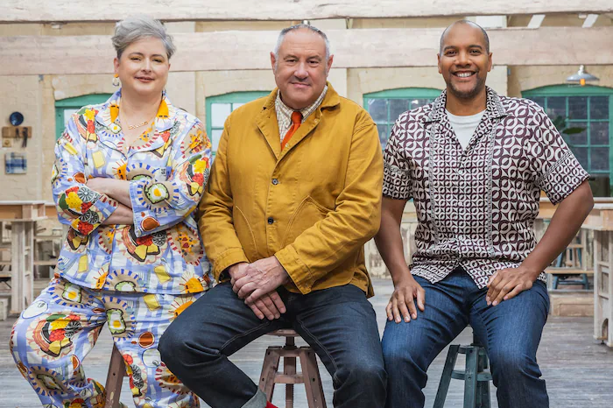
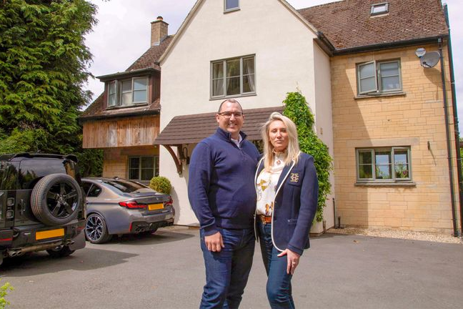

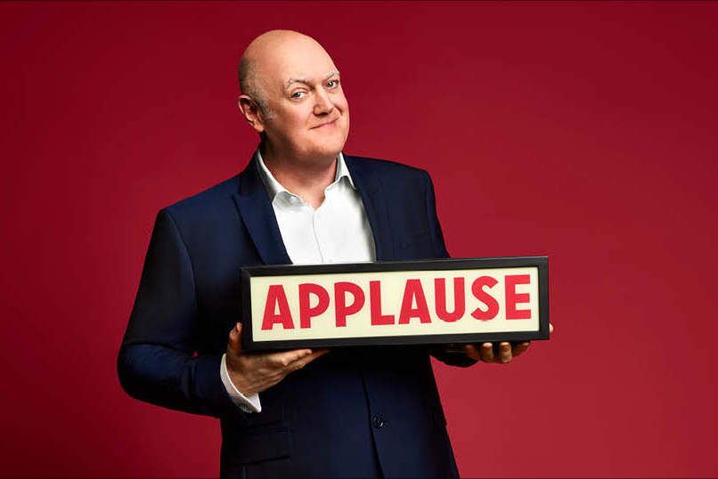
Entertainment - Programming Highlights
Britain's Got Talent
ITV1, 7 Mar
Average Audience
Individuals: 4,506,700
Adults: 4,038,900
ABC1 Ads: 1,809,700
16-34: 382,000
HP+CH: 476,600
The Great Pottery Throw Down
Channel 4, 25 Jan
Average Audience
Individuals: 2,723,600
Adults: 2,668,200
ABC1 Ads: 1,540,600
16-34: 165,500
HP+CH: 154,300
Rich House, Poor House
Channel 5, 29 Mar
Average Audience
Individuals: 1,043,800
Adults: 1,025,400
ABC1 Ads: 462,500
16-34: 126,200
HP+CH: 142,600
The Dyers' Caravan Park
Sky Max, 23 Feb
Average Audience
Individuals: 661,500
Adults: 631,000
ABC1 Ads: 293,900
16-34: 102,700
HP+CH: 105,600
Mock the Week
TLC, 22 Feb
Average Audience
Individuals: 674,400
Adults: 651,600
ABC1 Ads: 420,200
16-34: 59,000
HP+CH: 49,300
Source: Barb, Q1 2026. Average audience figures - Consolidated, Top performing episode of series (if applicable).

Slide 21
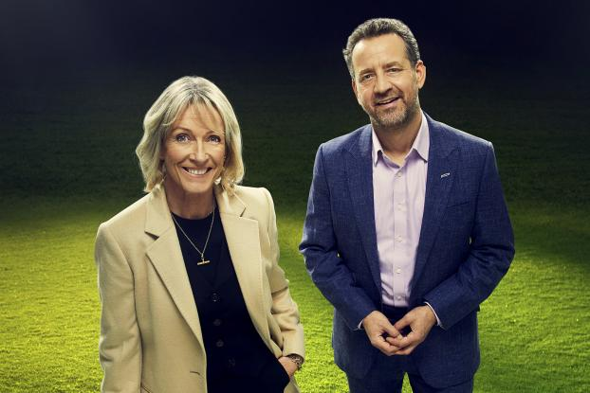



Sports - Programming Highlights
Six Nations Championship: Scotland v England
ITV1, 14 Feb
Average Audience
Individuals: 4,048,000
Adults: 3,869,600
ABC1 Ads: 2,467,400
16-34: 423,600
HP+CH: 269,800
Formula 1: Australian GP
Channel 4, 8 Mar
Average Audience
Individuals: 1,412,400
Adults: 1,370,700
ABC1 Ads: 738,700
16-34: 104,600
HP+CH: 748,00
World's Strongest Man
Channel 5, 1 Jan
Average Audience
Individuals: 1,466,300
Adults: 1,353,200
ABC1 Ads: 594,300
16-34: 129,200
HP+CH: 142,400
PDC World Championship Darts
Sky Sports, 3 Jan
Average Audience
Individuals: 1,164,700
Adults: 1,117,900
ABC1 Ads: 591,100
16-34: 294,200
HP+CH: 114,500
Premier League: Liverpool v Newcastle
TNT Sports, 31 Jan
Average Audience
Individuals: 766,900
Adults: 728,800
ABC1 Ads: 412,400
16-34: 178,400
HP+CH: 57,400
Source: Barb, Q1 2026. Average audience figures - Consolidated, Top performing episode of series (if applicable).

Slide 22




Hobbies & Leisure - Programming Highlights
Dickinson's Real Deal
ITV1, 27 Jan
Average Audience
Individuals: 965,500
Adults: 946,300
ABC1 Ads: 270,500
16-34: 18,600
HP+CH: 50,500
Kirstie and Phil's Love It or List It
Channel 4, 4 Feb
Average Audience
Individuals: 1,302,600
Adults: 1,260,700
ABC1 Ads: 871,800
16-34: 65,200
HP+CH: 125,700
Royal Residences: A Map of Britain
Channel 5, 7 Feb
Average Audience
Individuals: 559,900
Adults: 553,000
ABC1 Ads: 247,200
16-34: 9,700
HP+CH: 15,900
Dom Chinea's Cornish Workshop
U&Yesterday, 16 Mar
Average Audience
Individuals: 361,200
Adults: 360,700
ABC1 Ads: 120,900
16-34: 18,700
HP+CH: 3,900
Shed & Buried: Classic Cars
Quest, 30 Mar
Average Audience
Individuals: 333,300
Adults: 328,100
ABC1 Ads: 114,600
16-34: 12,000
HP+CH: 500
Source: Barb, Q1 2026. Average audience figures - Consolidated, Top performing episode of series (if applicable).

Slide 23


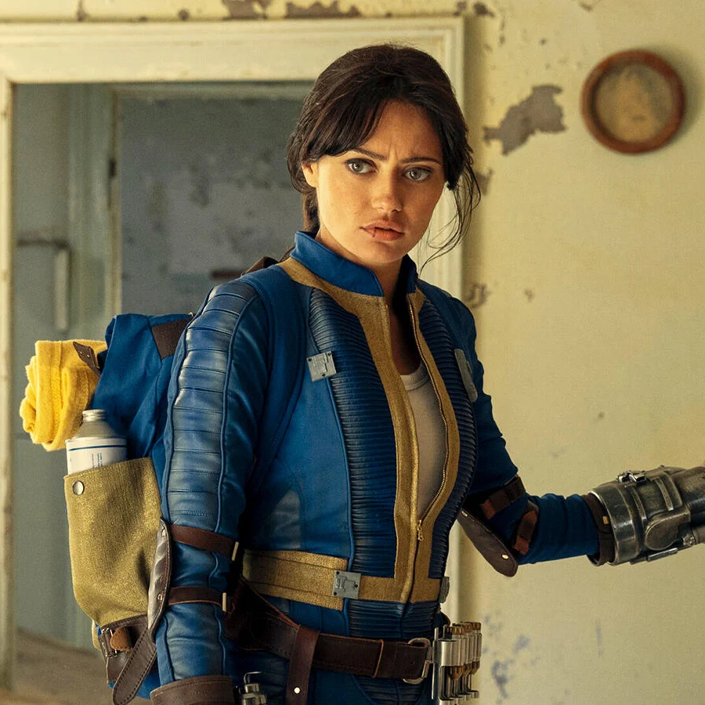
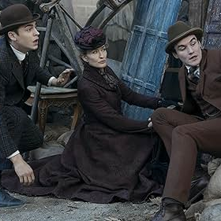
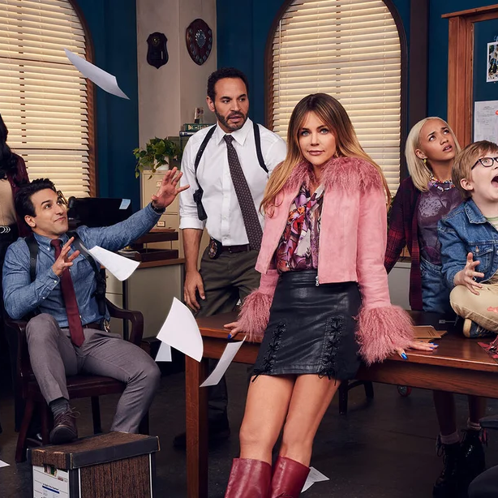
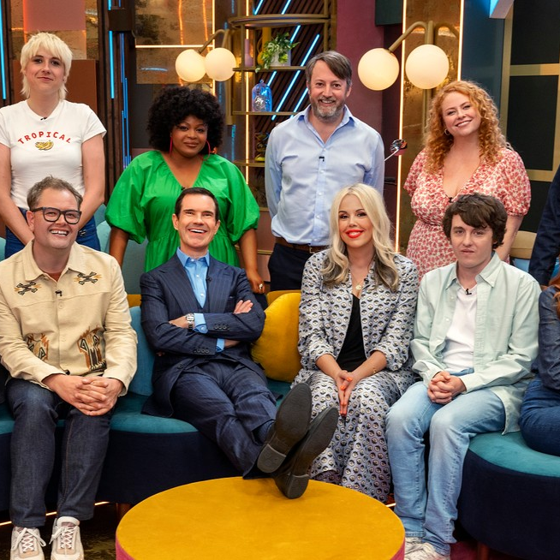




SVOD Drama & Entertainment - Programming Highlights
Stranger Things
S5, Ep8, Netflix, Drama
Individuals: 5,596,269
Adults: 5,170,962
Bridgerton
S4, Ep5, Netflix, Drama
Individuals: 4,017,671
Adults: 3,874,890
Fallout S2, Ep7
Amazon, Drama
Individuals: 1,715,583
Adults: 1,647,473
Young Sherlock
S1, Ep1, Amazon, Drama
Individuals: 1,252,954
Adults: 1,203,543
High Potential
S2, Ep14, Disney+, Drama
Individuals: 916,066
Adults: 859,349
LOL: Last One Laughing UK S2, Ep1, Amazon, Ent.
Individuals: 4,531,748
Adults: 4,257,919
Reality Check: Inside America's Next Top Model S1, Ep1 Netflix, Ent.
Individuals: 1,371,622
Adults: 1,333,626
Ricky Gervais: Mortality
S37, Ep8, Netflix, Ent.
Individuals: 878,990
Adults: 847,294
Scrubs S1, Ep1, Disney+, Ent.
Individuals: 751,393
Adults: 732,909
Hannah Montana 20th Anniversary Special
2026, Disney+ , Ent.
Individuals: 415,531
Adults: 384,069
Source: Barb, Q1 2026, individuals and adults. Average audience achieved during the first seven days of their availability. Only includes TV set viewing.

Slide 24
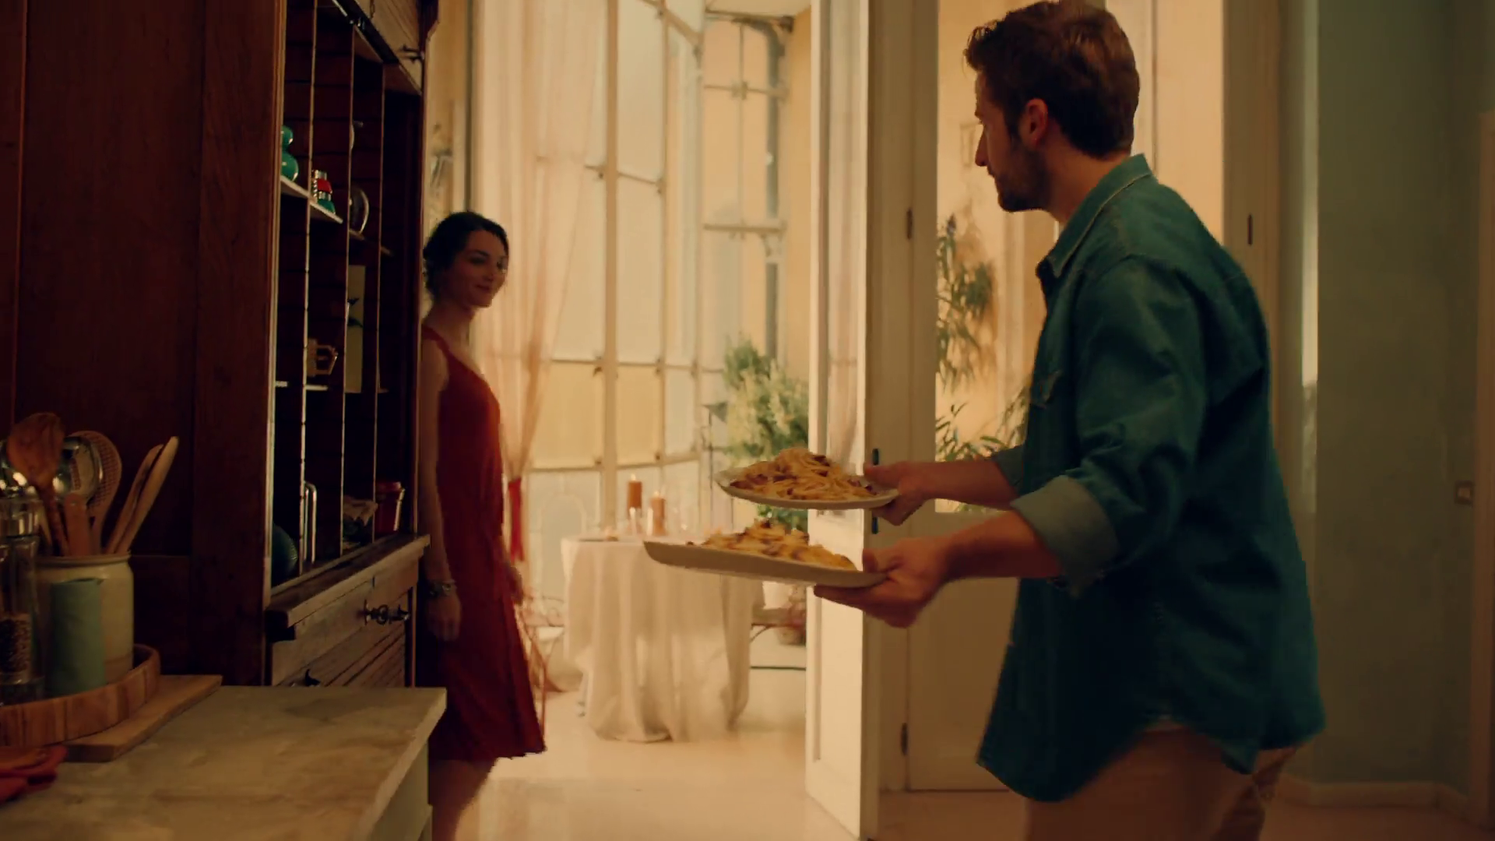
Q1 2027
La Famiglia Rana – Grazie, Sofia

Slide 25
Key Dates
 | Week Commencing
 | 28-Dec | 04-Jan | 11-Jan | 18-Jan | 25-Jan | 01-Feb | 08-Feb | 15-Feb | 22-Feb | 01-Mar | 08-Mar | 15-Mar | 22-Mar | 29-Mar
New Years Day
Premier League
EFL Cup
The FA Cup
The Six Nations
Valentines Day
Formula 1
Mother's Day

Slide 26



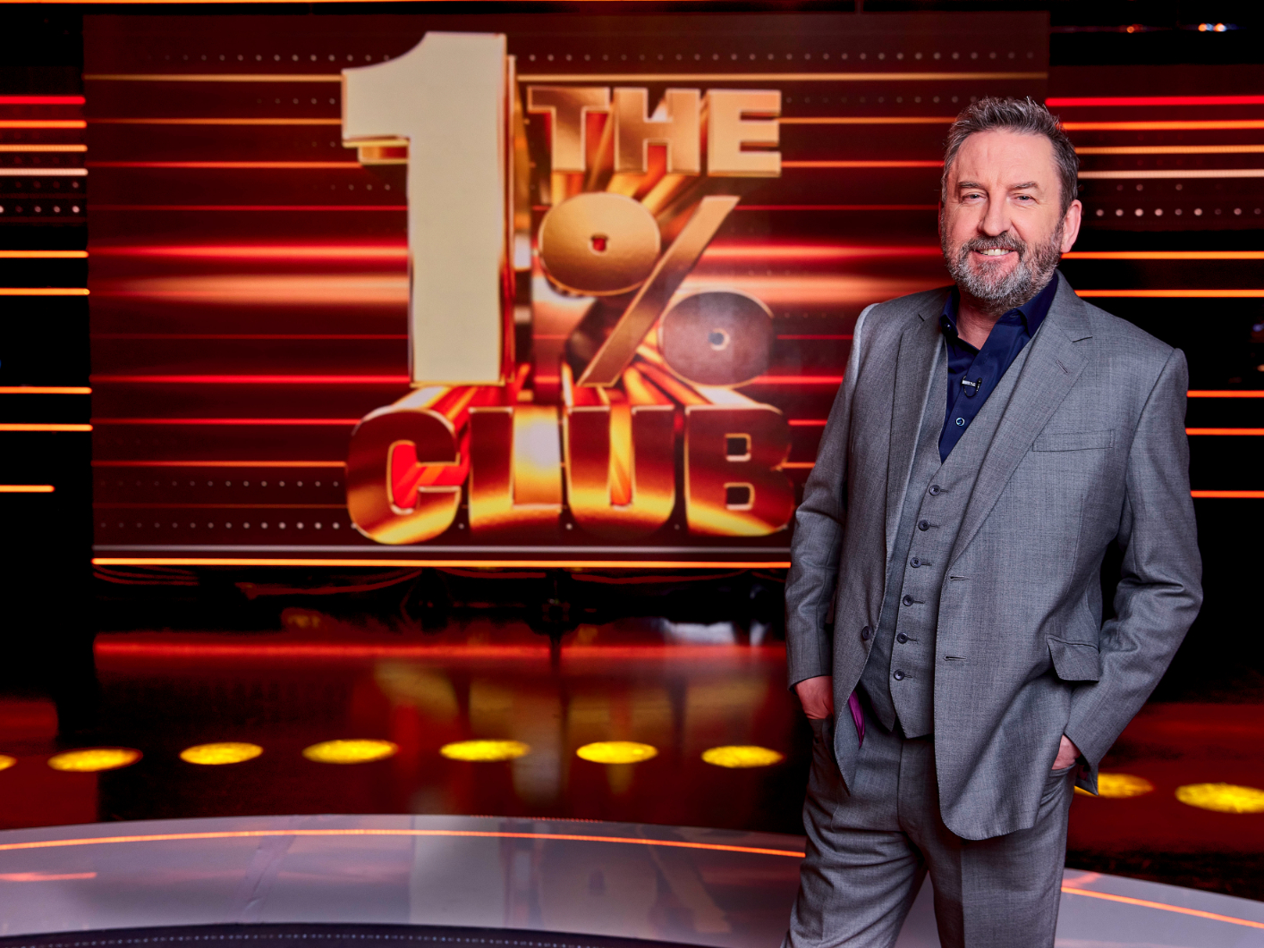






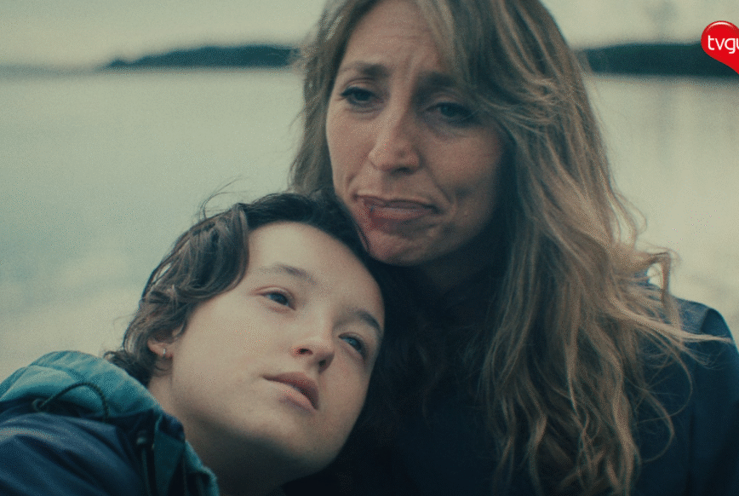
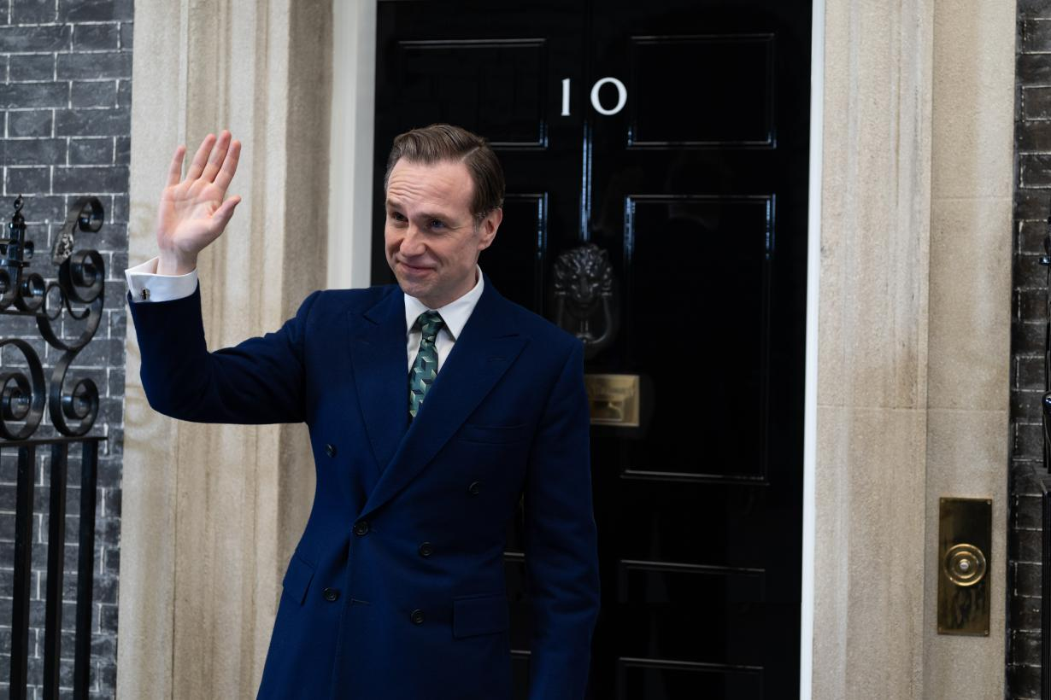
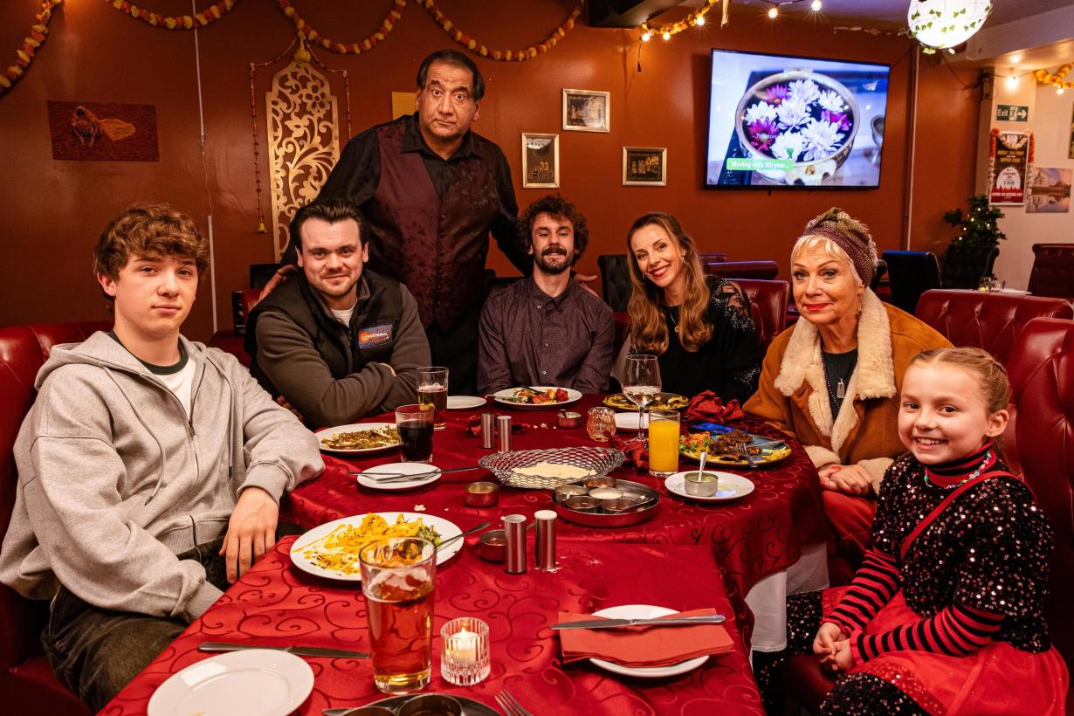
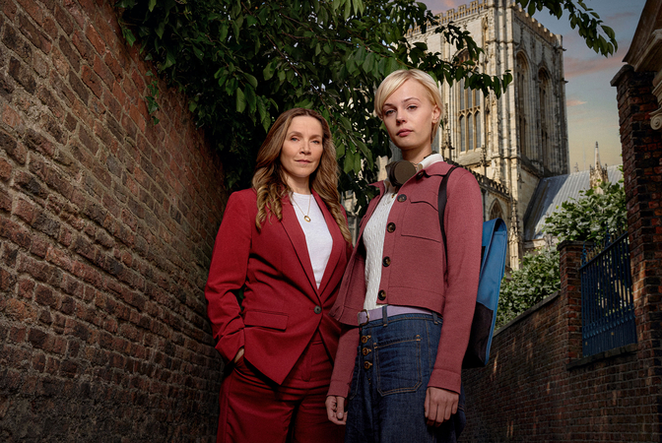
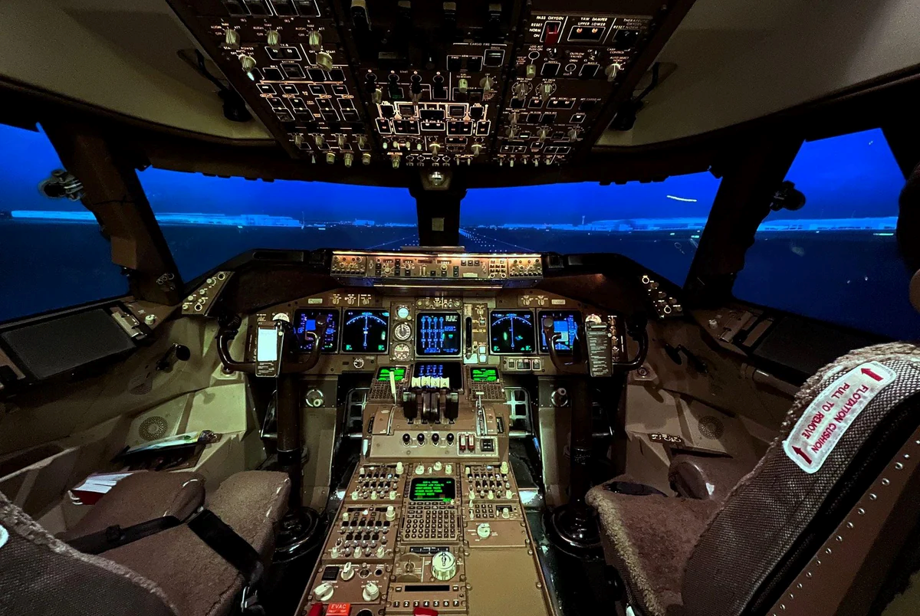








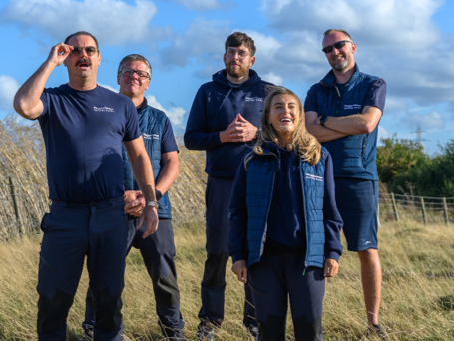
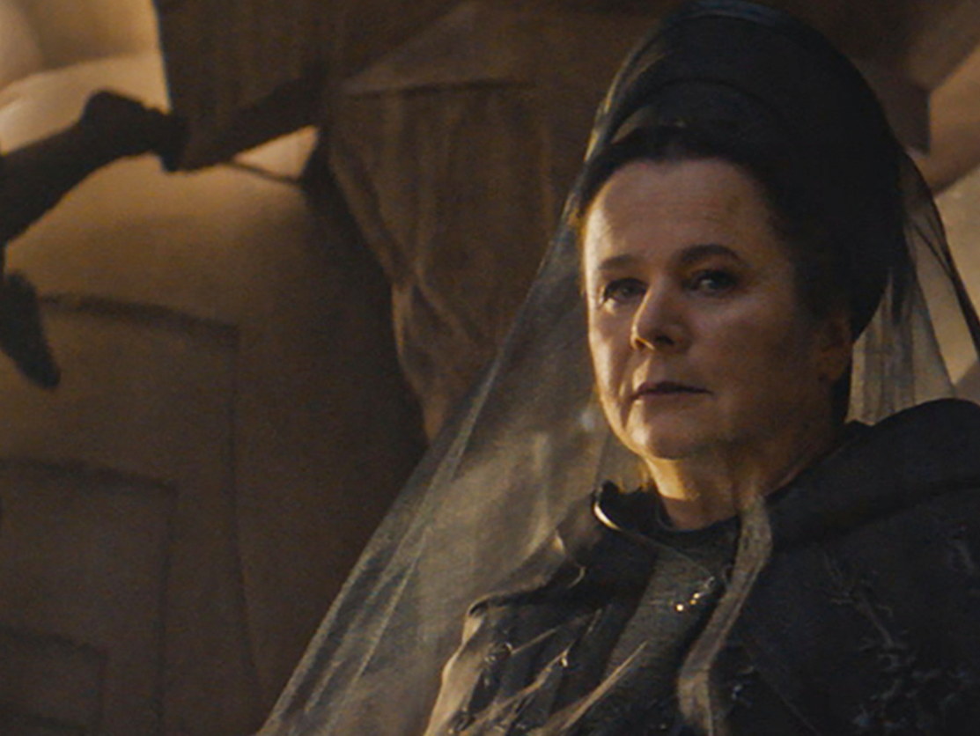









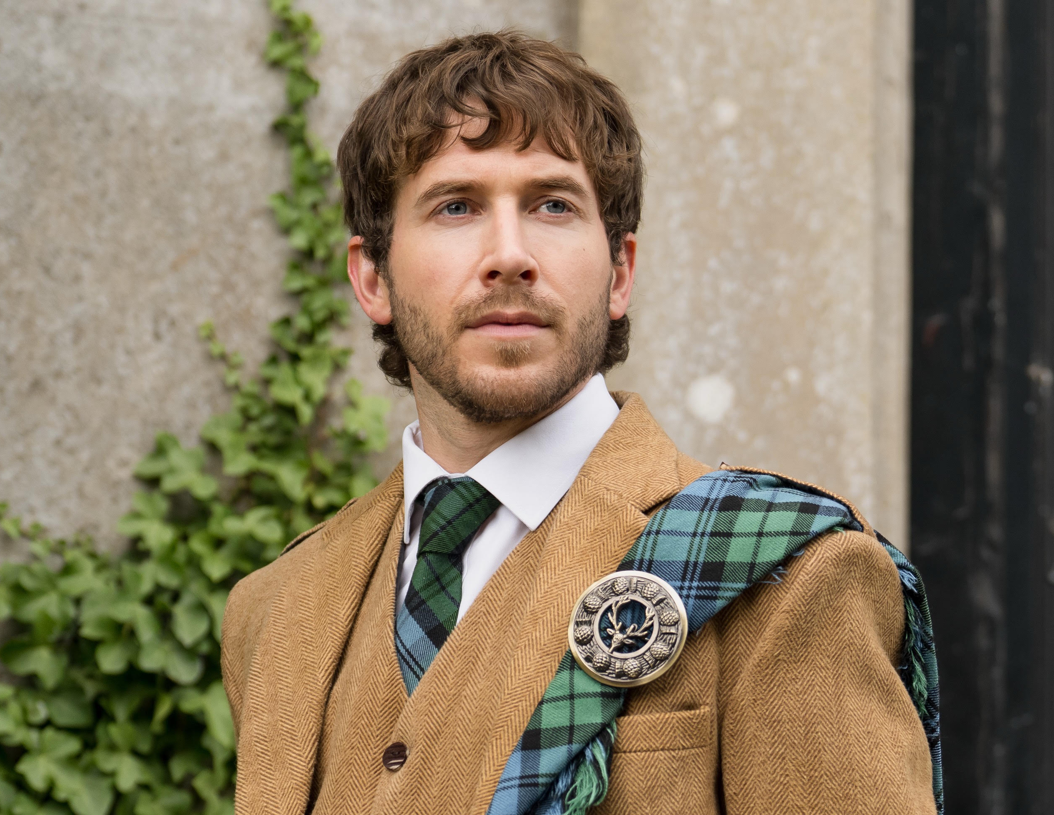

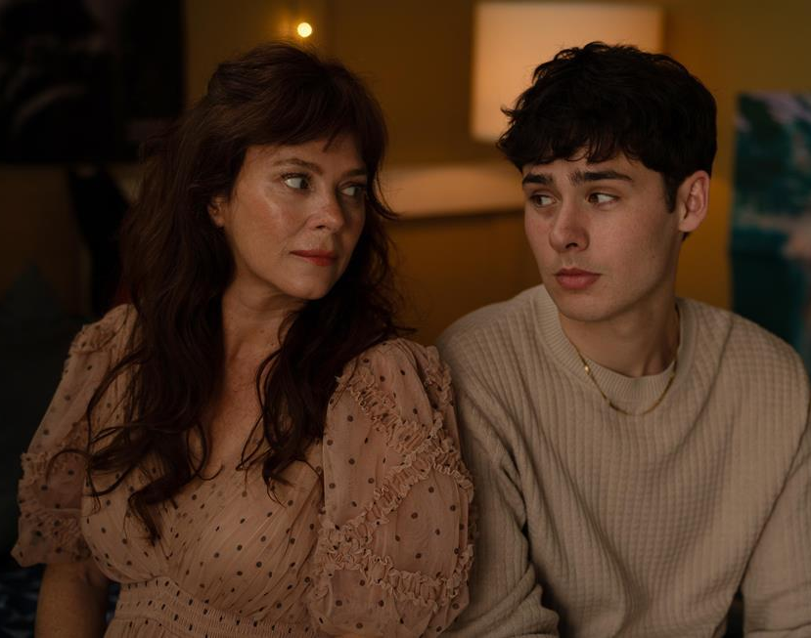

Programming Highlights – Q1 2027
ITV
Romesh Ranganathan's Parent's Evening
Grantchester
Millionaire Hotseat
The Brits
The Carabao Cup
The Six Nations
Unforgotten
The Floor
The Masked Singer
The 1% Club
Britain’s Got Talent
The Jonathan
Ross Show
Love Island
Channel 4
Can You Land This Plane?
Your Time
Starts Now
Celeb Handcuffed
Maya
No.10
Stepping Up
Patience S3
Incognito
Sky
SNL UK S2
I Love LA S2
Landscape Artist of the Year 2027
The Dyers’
Caravan Park
Dune: Prophecy S2
Spider-Man: Brand New Day
Dune: Part III
The Good Daughter
UKTV
Channel 5
Canal Boat Diaries S7
Will & Ralf Should Know Better S3
Stacey Dooley Sleeps Over S7
Guy Martin Proper Jobs S3
Monarch of the Glen
Cooper & Fry S2
The Heights
Life Support
*Please be aware this information is not to be shared on social media or TV forums / websites.

