Slide 1
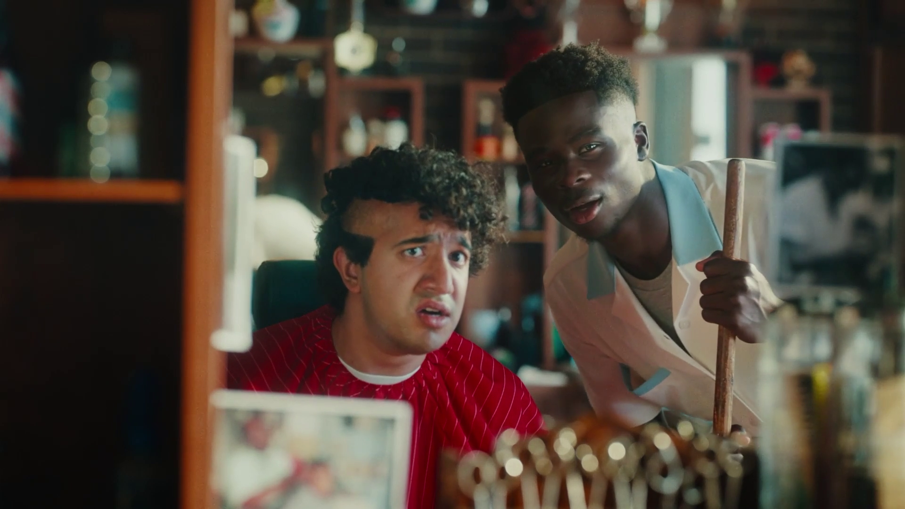
Future Focus Report
Q3 2024
Snickers, “Own Goal”

Slide 2
This deck is packed with insights
With Q3 planning well under way, this report will be a handy guide on what to expect over the coming months.
To provide a useful base on what to expect this year we look historically to Q3 2023:
Category & advertiser analysis
‘Reach Extenders’ analysis
TV viewing overview with cover guides for key buying audiences
Programming highlights across a range of genres
To better prepare you, we include key considerations for the quarter ahead:
Important dates
Preview on programming to expect in Q3 2024
TransPennine Express, “Lovely Day”
Notes:
The Future Focus Report puts Q3 in the spotlight and is a useful guide to help with planning for the upcoming quarter.

Slide 3
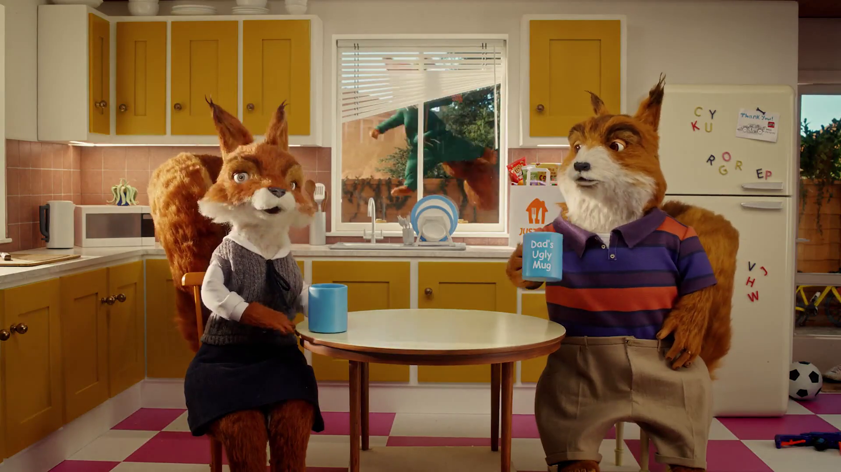
Category & Advertiser Analysis Q3 2023
Just Eat, “Grocery Grab”

Slide 4
Q3 2023 TV Impacts by Category
High
Mid
Low
Relative propensity of media spend by category
 | Drink | Household FMCG | Automotive | Telecoms | Finance | Media | Cosmetics & Personal Care | Food | Entertainment & Leisure | Health & Wellbeing | Charities | Electronics, Household Appliances & Tech | Travel & Transport | Retail | Household Equipment & DIY
July | 180 | 111 | 125 | 120 | 102 | 85 | 99 | 108 | 92 | 92 | 85 | 98 | 101 | 81 | 74
August | 117 | 121 | 135 | 130 | 106 | 109 | 95 | 104 | 91 | 93 | 84 | 102 | 71 | 85 | 107
September | 65 | 116 | 78 | 87 | 105 | 117 | 115 | 94 | 108 | 103 | 106 | 68 | 97 | 103 | 69
Total | 122 | 116 | 113 | 113 | 104 | 103 | 103 | 102 | 97 | 96 | 91 | 90 | 90 | 89 | 83
Source: Barb, 2023 (Q3) and 2022 Index, Adults, Top 15 categories by total impacts
Notes:
Q3 TV Impacts by category. Indexed % spend by category for each month (Apr-Jun) vs. the average % for 2022

Slide 5
Top sectors by Q3 2023 impacts
102
104
97
103
91
113
116
90
113
96
122
83
89
90
103
Source: Barb, Q3 2023, All Adults, Impacts (R/W) (million). Numbers above bars show Q3 index vs 2022.

Slide 6
Drinks - Advertiser
Source: Barb, Q3 2023, All Adults, Impacts (R/W) (million). Top 10 Q3 2023 advertisers by total impacts.

Slide 7
Household FMCG - Advertiser
Source: Barb, Q3 2023, All Adults, Impacts (R/W) (million). Top 10 Q3 2023 advertisers by total impacts.

Slide 8
Automotive - Advertiser
Source: Barb, Q3 2023, All Adults, Impacts (R/W) (million). Top 10 Q3 2023 advertisers by total impacts.

Slide 9
Reach Extenders
Peoples Post Code Lottery, “Ask Everyone”

Slide 10
Identifying the ‘Reach Extenders’
Weight of viewing is a key factor
in incremental reach
‘Middle tier’ of viewers are key to
BVOD’s incremental reach
Research from BVOD Almighty divided viewers into deciles based on weekly linear TV viewing. Light viewers are hard to target on TV, while heavy viewers are easily targeted via linear TV, reducing the role of BVOD. PwC’s analysis identifies the ‘middle tier’ as the key segment driving incremental reach via BVOD.
This chart displays the proportion of linear and BVOD consumption for each of the three tiers and their deciles. Notably, the ‘middle tier’, accounting for 7% of linear TV viewing, makes up 28% of BVOD consumption, making them the key audience to extend campaigns through BVOD; we call them the ‘Reach Extenders’.
Source: BVOD Almighty
Notes:
Left Chart: Detailed analysis by PwC has identified a segment that are important drivers of why BVOD is delivering incremental reach.
This chart shows the viewing population split into ten equal groups (deciles) based upon amount of liner TV viewing per week.
The lightest decile averages 4-mins of linear viewing per day. Up to the heaviest decile who view for 734-minutes (12-hours 14-minutes) per day.
The deciles have been split into three groups:
Lightest tier. These are very hard to reach on TV (linear or BVOD) and are most likely to be targeted via platforms such as YouTube
Middle tier.
Heaviest tier. These are quite easy to reach via linear TV and, as a result, BVOD probably has little role to play.
Right Chart: This chart shows for each of the three tiers (and the deciles within them) what proportion of linear and BVOD consumption they account for.
Key to note is that the middle tier (green) proportionally watch a lot of BVOD. Whilst they account for 7% of linear TV viewing, they make up 28% of BVOD consumption.
This makes them the key audience for extending campaign via the use of BVOD – relatively they are easier to reach via BVOD then linear TV.

Slide 11
Identifying the ‘Reach Extenders’
BVOD provides good odds of reaching an attractive audience
Where and when can we effectively reach this valuable audience of ‘Reach Extenders’?
While BVOD excels at reaching this audience there are key programmes and times you’re very likely to reach them across the whole of TV.
‘Reach Extenders’ display a strong affinity for the following genres:
Entertainment
Sport
Films
Their peak viewing hours take place daily from 8-11pm, with a higher likelihood of viewership occurring at the weekend.
On average, it takes only four impressions to reach a ‘middle tier’ viewer through BVOD, as opposed to 14 impressions on linear. This makes BVOD 3.5 times more efficient in targeting the ‘middle tier’ group, which often consists of younger and upscale viewers, highly sought after by advertisers.
Source: BVOD Almighty
Notes:
Left Chart: BVOD provides good odds of reaching an attractive audience or to put it another way, for every 14 impressions you buy on linear one person falls into the middle tier group (assuming natural delivery)
But on BVOD, it only takes four impressions to, on average, reach somebody in the middle tier. As such, on average, using BVOD is three and a half more efficient than linear at reaching the middle tier of viewers.
The middle tier are very attractive audiences for many advertisers (proportionally younger and upscale) and BVOD enables them to be reached in an efficient way.

Slide 12
Top genres watched by ‘Reach Extenders’
% of All Viewing
Genre | Adults | Reach Extenders | Index
Entertainment | 23% | 25% | 110
Sport | 14% | 21% | 147
Documentaries | 16% | 13% | 83
Drama | 19% | 13% | 69
Films | 9% | 11% | 120
Hobbies/Leisure | 6% | 5% | 76
News/Weather | 5% | 5% | 84
Source: Barb Q3 2023, % of all viewing, index vs all adults.

Slide 13
High indexing entertainment content
Entertainment
Channel | Programme Title | Index
Comedy Central | South Park | 891
E4 | Made in Chelsea: Corsica | 401
CH4 | Taskmaster | 362
CH4 | The Great British Bake Off | 331
Sky Max | Rob & Romesh vs... | 323
E4 | Celebs Go Dating | 319
Sky Max | Never Mind the Buzzcocks | 298
ITV2 | Love Island | 275
CH4 | Celebrity Gogglebox | 264
E4 | Married at First Sight UK | 248
Entertainment
Channel | Programme Title | Index
CH4 | Bake Off: The Professionals | 213
CH4 | The Last Leg | 212
CH4 | Alone | 198
ITV1 | Gordon, Gino & Fred: Road Trip | 197
CH4 | Gogglebox | 197
Comedy Central | Friends | 184
E4 | Young Sheldon | 178
CH4 | The Simpsons | 174
ITV1 | The National Television Awards | 166
Channel 5 | Puzzling with Lucy Worsley | 165
Source: Barb Q3 2023, ‘Reach Extender’ index vs all adults, Thinkbox created list of programmes based on volume of viewing and index.

Slide 14
High indexing sport content
Sport
Channel | Programme Title | Index
Sky Sports | Japanese F1 GP | 320
ITV4 | Tour De France | 313
TNT Sports | UEFA Super Cup | 306
Sky Sports | Fight Night | 267
TNT Sports | UFC | 262
Sky Sports | Premier League | 241
CH4 | Formula 1 | 237
CH4 | International Football | 234
ITV1 | FA Community Shield | 225
ITV1 | Rugby World Cup | 200
Sport
Channel | Programme Title | Index
TNT Sports | UEFA Champions League | 194
ITV1 | FIFA Women's World Cup 2023 | 169
Sky Sports | NFL | 150
Sky Sports | Tennis: US Open | 148
Sky Sports | English Football League (EFL) | 148
ITV1 | The NFL Show | 133
Sky Sports | EFL Cup | 132
Sky Sports | PGA Tour Golf | 114
Channel 5 | World Championship Boxing | 117
ITV1 | International Football | 117
Source: Barb Q3 2023, ‘Reach Extender’ index vs all adults, Thinkbox created list of programmes based on volume of viewing and index.

Slide 15
High indexing movie content
Films are popular among the ‘Reach Extender’ audience, but planning for this genre is less straightforward due to the variance in film scheduling. To help, here is a breakdown of which sub-genres the ‘Reach Extenders’ are watching.
Films
Sub-Genre | Channel | Programme Title | Index
Sci-Fi and Fantasy | Sky Cinema… | Black Adam | 296
Sci-Fi and Fantasy | 5STAR | Hellboy | 264
Sci-Fi and Fantasy | CH4 | Venom | 176
Sci-Fi and Fantasy | ITV2 | Harry Potter and the Deathly Hallows: Part 2 | 157
Comedy | Sky Cinema… | Babylon | 303
Comedy | Film4 | Fisherman's Friends | 285
Comedy | ITV2 | We're the Millers | 254
Comedy | Channel 5 | Miss Congeniality | 173
Family | Sky Cinema… | Shrek | 354
Family | CH4 | Megamind | 292
Family | E4 | Mrs Doubtfire | 288
Family | ITV1 | Despicable Me 3 | 183
Romcom | Comedy Central | The Other Woman | 430
Romcom | Sky Cinema… | Ticket to Paradise | 296
Romcom | Film4 | A Good Year | 210
Romcom | ITVBe | My Big Fat Greek Wedding | 195
% of all film viewing
Genre | Adults | Reach Extenders | Index
Action / Adventure / Thriller | 33% | 32% | 97
Sci-Fi and Fantasy | 15% | 18% | 123
Comedy | 13% | 14% | 108
Family | 6% | 9% | 144
Other | 4% | 5% | 119
Crime Drama | 6% | 4% | 75
Horror | 4% | 4% | 91
Romcom | 3% | 3% | 112
Western | 7% | 2% | 36
Source: Barb Q3 2023, ‘Reach Extender’ index vs all adults, Thinkbox created list of programmes based on volume of viewing and index.

Slide 16
‘Reach Extenders’ aren’t solely limited to high indexing genres
Drama
Channel | Programme Title | Index
Sky Comedy | And Just Like That... | 355
ITV1 | Van der Valk | 211
E4 | Hollyoaks | 198
CH4 | Becoming Elizabeth | 186
CH4 | Screw | 180
ITV1 | A Spy Among Friends | 177
Sky Witness | The Good Doctor | 172
Channel 5 | The Inheritance | 169
ITV1 | The Tower | 168
Alibi | Annika | 167
Documentaries
Channel | Programme Title | Index
Sky Docu… | To End All War: Oppenheimer… | 319
Sky Arts | David Hockney | 254
Channel 5 | Dan & Helen's Pennine Adventure | 192
CH4 | Top Guns: Inside the RAF | 253
CH4 | A Cotswold Farmshop | 218
Yesterday | Secrets of the London Underground | 169
ITV1 | Long Lost Family | 160
ITV1 | Joanna Lumley's Spice Trail Adventure | 151
Channel 5 | Dorset: Country and Coast | 144
Channel 5 | Coastguard: Search & Rescue SOS | 144
Source: Barb Q3 2023, ‘Reach Extender’ index vs all adults, Thinkbox created list of programmes based on volume of viewing and index.

Slide 17
When to target the ‘Reach Extenders’
Reach Extenders' index by daypart
 | 6am | 7am | 8am | 9am | 10am | 11am | 12pm | 1pm | 2pm | 3pm | 4pm | 5pm | 6pm | 7pm | 8pm | 9pm | 10pm | 11pm | 12am | 1am | 2am | 3am | 4am | 5am
Monday | 58 | 70 | 68 | 66 | 73 | 72 | 76 | 85 | 69 | 65 | 65 | 68 | 83 | 109 | 134 | 165 | 137 | 96 | 66 | 58 | 54 | 34 | 39 | 41
Tuesday | 68 | 84 | 73 | 66 | 65 | 62 | 76 | 84 | 64 | 56 | 57 | 65 | 73 | 107 | 145 | 163 | 138 | 110 | 83 | 57 | 41 | 34 | 22 | 29
Wednesday | 56 | 74 | 69 | 64 | 62 | 69 | 76 | 79 | 63 | 59 | 57 | 65 | 81 | 112 | 141 | 165 | 140 | 114 | 82 | 67 | 49 | 27 | 24 | 30
Thursday | 60 | 84 | 74 | 71 | 67 | 70 | 75 | 90 | 73 | 58 | 57 | 63 | 84 | 111 | 138 | 159 | 135 | 108 | 91 | 79 | 65 | 50 | 40 | 43
Friday | 60 | 72 | 65 | 62 | 62 | 64 | 79 | 87 | 62 | 58 | 60 | 70 | 80 | 104 | 136 | 164 | 147 | 118 | 92 | 70 | 57 | 49 | 33 | 29
Saturday | 42 | 62 | 88 | 91 | 84 | 88 | 94 | 92 | 83 | 82 | 79 | 88 | 102 | 107 | 125 | 137 | 125 | 106 | 86 | 67 | 52 | 31 | 32 | 33
Sunday | 47 | 62 | 67 | 70 | 73 | 76 | 82 | 84 | 92 | 97 | 98 | 104 | 108 | 114 | 132 | 138 | 108 | 79 | 65 | 52 | 43 | 35 | 22 | 23
Monday | Tuesday | Wednesday | Thursday | Friday | Saturday | Sunday
92 | 94 | 93 | 88 | 95 | 112 | 120
Source: Barb Q3 2023, commercial broadcasters, ‘Reach Extender’ index vs all adults.

Slide 18
TV Viewing Overview Q3 2023
ICC Cricket World Cup, “Out of this world”

Slide 19
Q3 2023 linear TV facts & figures
Total TV weekly reach %
Total TV viewed per day
Commercial TV viewed per day
Impacts
Individuals
77.0 | 162.4bn | 2h 15m | 1h 32m
79.8 | 156.5bn | 2h 33m | 2h 45m
79.1 | 61.6bn | 2h 2m | 1h 17m
60.8 | 12.1bn | 42m | 31m
78.7 | 71.9bn | 2h 28m | 1h 43m
80.9 | 84.6bn | 2h 39m | 1h 47m
76.4 | 12.1bn | 1h 22m | 58m
Adults
ABC1 adults
16-34
Men
Women
Housepersons with children
Sources: Barb Q3 2023, industry standard TV viewing in-home on a TV set. Reach 3min+. 30” equivalent impacts.
Notes:
Q3 2023 linear TV figures for weekly reach, impacts, total TV viewing hours and commercial TV viewing hours

Slide 20
Q3 2023 – Cover guide – ABC1 Ads
Source: Barb BVOD Planner (2023, 6 weeks 31-36) / natural delivery / station average prices.

Slide 21
Q3 2023 – Cover guide – 16-34
Source: Barb BVOD Planner (2023, 6 weeks 31-36) / natural delivery / station average prices.

Slide 22
Q3 2023 – Cover guide – Housepersons with children
Source: Barb BVOD Planner (2023, 6 weeks 31-36) / natural delivery / station average prices.

Slide 23
Programming Q3 2023
Just Eat, “Season Finale”

Slide 24
Programming Highlights – Q3 2023
Gordon, Gino & Fred: Road Trip
ITV1, 3 Sep
Average Audience
Individuals: 3,674,200
Adults: 3,499,100
ABC1 Ads: 1,857,500
16-34: 471,200
HP+CH: 462,900
International Football
Channel 4, 12 Sep
Average Audience
Individuals: 4,328,400
Adults: 4,139,100
ABC1 Ads: 2,294,100
16-34: 667,800
HP+CH: 273,300
The Inheritance
Channel 5, 25 Sep
Average Audience
Individuals: 3,358,600
Adults: 3,322,900
ABC1 Ads: 1,861,700
16-34: 155,500
HP+CH: 191,600
Hungarian F1 GP
Sky Sports F1, 23 Jul
Average Audience
Individuals: 1,586,600
Adults: 1,499,300
ABC1 Ads: 909,400
16-34: 348,200
HP+CH: 147,200
Source: Barb, Q3 2023. Average audience figures - Consolidated, Top performing episode of series (if applicable)

Slide 25
Drama - Programming Highlights
The Long Shadow
ITV1, 25 Sep
Average Audience
Individuals: 4,194,900
Adults: 4,161,400
ABC1 Ads: 2,299,200
16-34: 199,900
HP+CH: 339,600
Screw
Channel 4, 30 Aug
Average Audience
Individuals: 1,425,600
Adults: 1,408,500
ABC1 Ads: 628,400
16-34: 161,100
HP+CH: 134,000
The Inheritance
Channel 5, 25 Sep
Average Audience
Individuals: 3,358,600
Adults: 3,322,900
ABC1 Ads: 1,861,700
16-34: 155,500
HP+CH: 191,600
FBI
Sky Witness, 13 Sep
Average Audience
Individuals: 554,800
Adults: 554,800
ABC1 Ads: 300,200
16-34: 92,500
HP+CH: 78,300
Annika
Alibi, 13 Sep
Average Audience
Individuals: 1,056,000
Adults: 1,056,000
ABC1 Ads: 675,200
16-34: 31,700
HP+CH: 89,600
Source: Barb, Q3 2023. Average audience figures - Consolidated, Top performing episode of series (if applicable)

Slide 26
Entertainment - Programming Highlights
Gordon, Gino & Fred: Road Trip
ITV1, 3 Sep
Average Audience
Individuals: 3,674,200
Adults: 3,499,100
ABC1 Ads: 1,857,500
16-34: 471,200
HP+CH: 462,900
The Great British Bake Off
Channel 4, 26 Sep
Average Audience
Individuals: 7,565,400
Adults: 7,204,200
ABC1 Ads: 4,770,100
16-34: 1,553,600
HP+CH: 1,029,800
Rich Holiday, Poor Holiday
Channel 5, 13 Aug
Average Audience
Individuals: 1,211,400
Adults: 1,181,500
ABC1 Ads: 507,100
16-34: 134,500
HP+CH: 102,000
Rob & Romesh vs...
Sky Max, 18 Jul
Average Audience
Individuals: 400,000
Adults: 380,500
ABC1 Ads: 222,900
16-34: 147,300
HP+CH: 49,400
Last of the Summer Wine
Drama, 8 Aug
Average Audience
Individuals: 381,800
Adults: 381,800
ABC1 Ads: 95,000
16-34: 8,400
HP+CH: 4,600
Source: Barb, Q3 2023. Average audience figures - Consolidated, Top performing episode of series (if applicable)

Slide 27
Sports - Programming Highlights
FIFA Women's World Cup 2023
ITV1, 12 Aug
Average Audience
Individuals: 5,252,300
Adults: 4,846,600
ABC1 Ads: 2,784,000
16-34: 565,900
HP+CH: 337,900
International Football
Channel 4, 12 Sep
Average Audience
Individuals: 4,328,400
Adults: 4,139,100
ABC1 Ads: 2,294,100
16-34: 667,800
HP+CH: 273,300
World Championship Boxing
Channel 5, 1 Sep
Average Audience
Individuals: 350,500
Adults: 333,800
ABC1 Ads: 135900
16-34: 15,900
HP+CH: 26,000
Hungarian F1 GP
Sky Sports F1, 23 Jul
Average Audience
Individuals: 1,586,600
Adults: 1,499,300
ABC1 Ads: 909,400
16-34: 348,200
HP+CH: 147,200
UEFA Champions League TNT Sports 2, 20 Sep
Average Audience
Individuals: 949,300
Adults: 894,300
ABC1 Ads: 495,100
16-34: 246,500
HP+CH: 69,800
Source: Barb, Q3 2023. Average audience figures - Consolidated, Top performing episode of series (if applicable)

Slide 28
Hobbies & Leisure - Programming Highlights
Love Your Garden
ITV1, 15 Aug
Average Audience
Individuals: 1,621,700
Adults: 1,583,600
ABC1 Ads: 547,700
16-34: 78,100
HP+CH: 97,600
Grand Designs
Channel 4, 27 Sep
Average Audience
Individuals: 1,664,700
Adults: 1,642,700
ABC1 Ads: 946,400
16-34: 186,800
HP+CH: 157,800
Million Pound Motorhomes
Channel 5, 16 Jul
Average Audience
Individuals: 1,346,400
Adults: 1,298,300
ABC1 Ads: 693,600
16-34: 139,600
HP+CH: 93,200
Bangers and Cash
Yesterday, 24 Aug
Average Audience
Individuals: 444,000
Adults: 443,900
ABC1 Ads: 153,300
16-34: 8,500
HP+CH: 1,500
The Repair Shop
Quest, 20 Aug
Average Audience
Individuals: 405,800
Adults: 405,500
ABC1 Ads: 126,000
16-34: 12,300
HP+CH: 10,000
Source: Barb, Q3 2023. Average audience figures - Consolidated, Top performing episode of series (if applicable)

Slide 29
Q3 2024
Burger King, “Climbing”

Slide 30
Key Dates
 | Week Commencing
 | 01-Jul | 08-Jul | 15-Jul | 22-Jul | 29-Jul | 05-Aug | 12-Aug | 19-Aug | 26-Aug | 02-Sep | 09-Sep | 16-Sep | 23-Sep
Euro 2024
Wimbledon
Tour de France
Formula 1
Summer Olympics
Premier League
Bank Holiday
US Open
Paralympic Games
UEFA Champions League

Slide 31
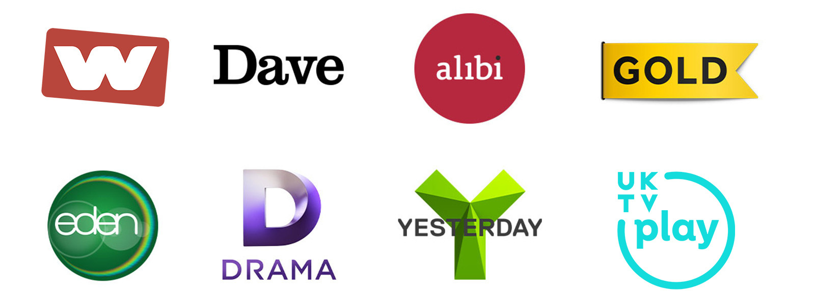
Programming Highlights – Q3 2024
ITV
England Internationals
The Voice UK
My Mum Your Dad
Changing Ends
The Tower
Password
Channel 4
The Great British Bake Off
Celebrity Gogglebox
Married at First Sight: UK
Live Paris Paralympics
Leaving Neverland 2
Everyone Else Burns S2
Suspect S2
Made in Bondi
Sky
Channel 5
House of the Dragon S2
Ibiza Narcos
Arts Matter
The Overlap On Tour S2
Jay Blades’ West End Through Time
Dalgliesh S3
Stalker
UKTV
Follow the Leader
Emma Willis: Delivering Babies
Find It, Fix It, Flog It
Canal Boat Diaries
Bangers & Cash
Secrets of the London Underground

