Slide 1
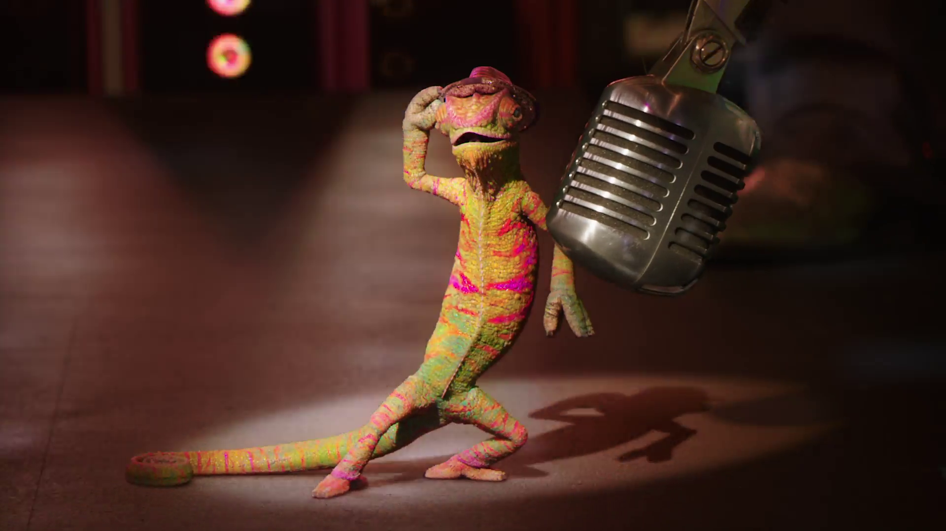

Future Focus Report
Q2 2025
Sky, “That Sky Feeling”

Slide 2

In this deck...
With Q2 planning well under way, this report will be a handy guide on what to expect over the coming months.
To provide a useful base on what to expect this year we look historically to Q2 2024:
Category & advertiser analysis
‘Reach Extenders’ analysis & TV viewing overview
Programming highlights across a range of genres
To better prepare you, we include key considerations for the quarter ahead:
Important dates
Preview on programming to expect in Q2 2025
I’m A Celebrity, “2024 Season Trailer”
Notes:
The Future Focus Report puts Q2 in the spotlight and is a useful guide to help with planning for the upcoming quarter.

Slide 3

Category & Advertiser Analysis Q2 2024
TransPennine Express, “Building Momentum”

Slide 4
Q2 2024 TV Impacts by Category
High
Mid
Low
Relative propensity of media spend by category
 | Household fmcg | Retail | Drink | Cosmetics & personal care | Food | Finance | Health & wellbeing | Travel & transport | Entertainment & leisure | Online retail | Electronics, household appliances & tech | Automotive | Government social political organisation | Household equipment & diy | Telecoms
Apr | 154 | 159 | 136 | 102 | 107 | 98 | 92 | 92 | 104 | 93 | 73 | 60 | 88 | 79 | 80
May | 160 | 138 | 157 | 100 | 106 | 101 | 110 | 93 | 85 | 69 | 88 | 98 | 74 | 89 | 68
Jun | 144 | 134 | 129 | 117 | 93 | 105 | 87 | 100 | 90 | 102 | 94 | 90 | 82 | 69 | 79
Total | 153 | 144 | 141 | 106 | 102 | 101 | 97 | 95 | 93 | 88 | 85 | 83 | 82 | 79 | 76
Source: Barb, Q2 2024 vs 2023 Index, Adults, Top 15 categories by total impacts
Notes:
Q2 TV Impacts by category. Indexed % spend by category for each month vs. the average % for 2023

Slide 5
Top sectors by Q2 2024 impacts
102
101
153
93
106
95
82
144
76
141
83
97
79
85
88
Source: Barb, Q2 2024, All Adults, Impacts (R/W) (million). Numbers above bars show Q2 index vs 2023.

Slide 6










Household FMCG - Advertiser
Source: Barb, Q2 2024, All Adults, Impacts (R/W) (million). Top 10 2024 Q2 advertisers by total impacts.

Slide 7










Retail - Advertiser
Source: Barb, Q2 2024, All Adults, Impacts (R/W) (million). Top 10 2024 Q2 advertisers by total impacts.

Slide 8










Drink - Advertiser
Source: Barb, Q2 2024, All Adults, Impacts (R/W) (million). Top 10 2024 Q2 advertisers by total impacts. Lidl retail spend associated with mobile app.

Slide 9

Reach Extenders & Viewing Overview
McDonalds, “Power Peel”

Slide 10
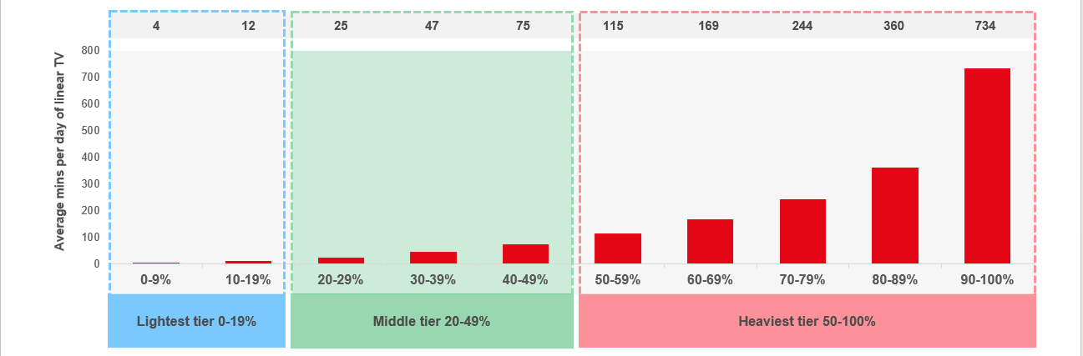
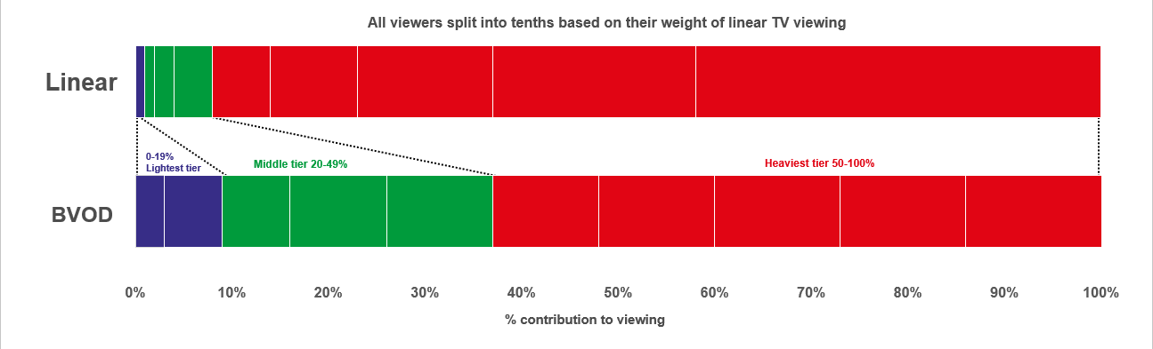

Identifying the ‘Reach Extenders’
Weight of viewing is a key factor
in incremental reach
‘Middle tier’ of viewers are key to
BVOD’s incremental reach
Research from BVOD Almighty divided viewers into deciles based on weekly linear TV viewing. Light viewers are hard to target on TV, while heavy viewers are easily targeted via linear TV, reducing the role of BVOD. PwC’s analysis identifies the ‘middle tier’ as the key segment driving incremental reach via BVOD.
This chart displays the proportion of linear and BVOD consumption for each of the three tiers and their deciles. Notably, the ‘middle tier’, accounting for 7% of linear TV viewing, makes up 28% of BVOD consumption, making them the key audience to extend campaigns through BVOD; we call them the ‘Reach Extenders’.
Source: BVOD Almighty
Notes:
Left Chart: Detailed analysis by PwC has identified a segment that are important drivers of why BVOD is delivering incremental reach.
This chart shows the viewing population split into ten equal groups (deciles) based upon amount of liner TV viewing per week.
The lightest decile averages 4-mins of linear viewing per day. Up to the heaviest decile who view for 734-minutes (12-hours 14-minutes) per day.
The deciles have been split into three groups:
Lightest tier. These are very hard to reach on TV (linear or BVOD) and are most likely to be targeted via platforms such as YouTube
Middle tier.
Heaviest tier. These are quite easy to reach via linear TV and, as a result, BVOD probably has little role to play.
Right Chart: This chart shows for each of the three tiers (and the deciles within them) what proportion of linear and BVOD consumption they account for.
Key to note is that the middle tier (green) proportionally watch a lot of BVOD. Whilst they account for 7% of linear TV viewing, they make up 28% of BVOD consumption.
This makes them the key audience for extending campaign via the use of BVOD – relatively they are easier to reach via BVOD then linear TV.

Slide 11
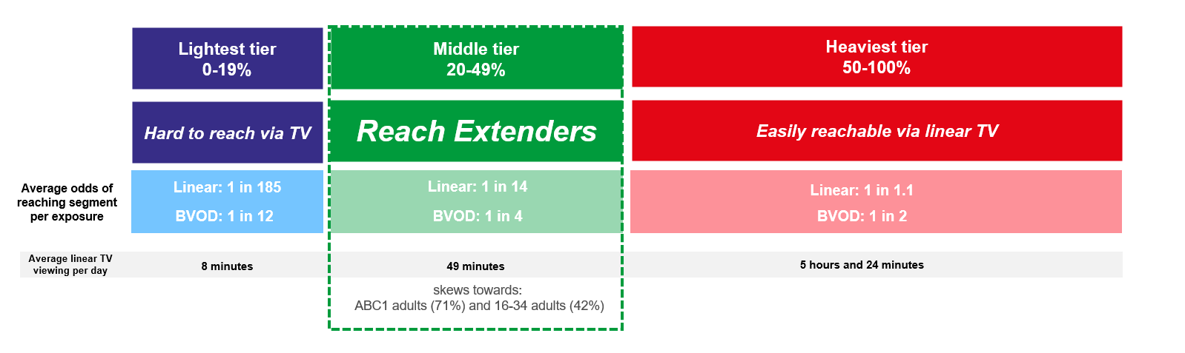
Identifying the ‘Reach Extenders’
BVOD provides good odds of reaching an attractive audience
Where and when can we effectively reach this valuable audience of ‘Reach Extenders’?
While BVOD excels at reaching this audience there are key programmes and times you’re very likely to reach them across the whole of TV.
‘Reach Extenders’ display a strong affinity for the following genres:
Drama
Films
Children
Their peak viewing hours take place daily from 8-11pm, with a higher likelihood of viewership occurring at the weekend.
On average, it takes only four impressions to reach a ‘middle tier’ viewer through BVOD, as opposed to 14 impressions on linear. This makes BVOD 3.5 times more efficient in targeting the ‘middle tier’ group, which often consists of younger and upscale viewers, highly sought after by advertisers.
Source: BVOD Almighty
Notes:
Left Chart: BVOD provides good odds of reaching an attractive audience or to put it another way, for every 14 impressions you buy on linear one person falls into the middle tier group (assuming natural delivery)
But on BVOD, it only takes four impressions to, on average, reach somebody in the middle tier. As such, on average, using BVOD is three and a half more efficient than linear at reaching the middle tier of viewers.
The middle tier are very attractive audiences for many advertisers (proportionally younger and upscale) and BVOD enables them to be reached in an efficient way.

Slide 12
Top genres watched by ‘Reach Extenders’
% of All Viewing
Genre | Adults | Reach Extenders | Index
Drama | 26% | 30% | 116
Entertainment | 24% | 24% | 99
Films | 10% | 14% | 135
Sport | 12% | 11% | 94
Documentaries | 12% | 8% | 68
Hobbies/Leisure | 7% | 5% | 72
Children | 2% | 3% | 207
News/Weather | 4% | 2% | 59
Source: Barb Q2 2024, % of all viewing, index vs all adults.

Slide 13
High indexing drama content
Drama - Commercial TV
Channel | Programme Title | Index
Channel 4 | The West Wing | 462
Channel 4 | The Gathering | 171
Sky | House Of The Dragon | 165
Channel 4 | Bones | 152
Channel 4 | Astrid: Murder in Paris | 151
ITV | Red Eye | 137
ITV | Passenger | 134
Sky | The Tattooist Of Auschwitz | 127
Sky | The Rookie | 126
Channel 5 | The Cuckoo | 124
ITV | Professor T | 122
Sky | Chicago Fire | 105
Drama - SVOD
Channel | Programme Title | Index
Disney+ | Buffy the Vampire Slayer | 310
Disney+ | Grey's Anatomy | 304
Netflix | The Gentlemen | 283
Netflix | Baby Reindeer | 278
Netflix | Dexter | 266
Amazon | Fallout | 255
Netflix | Monk | 249
Disney+ | 9-1-1 | 248
Disney+ | Shogun | 239
Disney+ | NCIS | 229
Netflix | Bridgerton | 208
Amazon | The Boys | 111
Source: Barb Q2 2024, ‘Reach Extender’ index vs all adults, Thinkbox created list of programmes ranked by volume of viewing and index. Commercial broadcasters and SVODs are separated because we can’t currently separate viewing by homes that are / are not on the SVOD ad tiers.

Slide 14
High indexing entertainment content
Entertainment - Commercial TV
Channel | Programme Title | Index
Channel 4 | Taskmaster | 265
Paramount | South Park | 222
Sky | Curb Your Enthusiasm | 189
UKTV | Gavin & Stacey | 184
Sky | Hold The Front Page | 176
Channel 4 | Married at First Sight Australia | 164
ITV | Hell's Kitchen (USA) | 162
Channel 4 | The Great Celebrity Bake Off for SU2C | 147
UKTV | Richard Osman's House of Games | 138
ITV | Ant & Dec's Saturday Night Takeaway | 128
Sky | The Office US | 124
ITV | The 1% Club | 115
Entertainment - SVOD
Channel | Programme Title | Index
Disney+ | Bob's Burgers | 367
Amazon | The Big Bang Theory | 305
Disney+ | The Simpsons | 259
Netflix | Brooklyn Nine-Nine | 240
Disney+ | Family Guy | 219
Disney+ | Modern Family | 208
Netflix | The Big Bang Theory | 196
Netflix | The Office US | 191
Amazon | Invincible | 174
Netflix | Young Sheldon | 165
Netflix | Friends | 161
Amazon | The Office US | 141
Source: Barb Q2 2024, ‘Reach Extender’ index vs all adults, Thinkbox created list of programmes ranked by volume of viewing and index. Commercial broadcasters and SVODs are separated because we can’t currently separate viewing by homes that are / are not on the SVOD ad tiers.

Slide 15
High indexing film content
Films are popular among the ‘Reach Extender’ audience, but planning for this genre is less straightforward due to the variance in film scheduling. To help, here is a breakdown of which sub-genres the ‘Reach Extenders’ are watching.
Films - Commercial TV
Sub-Genre | Channel | Programme Title | Index
Family | Sky | The Super Mario Bros. Movie | 190
Family | Sky | Despicable Me | 153
Family | ITV | Sing 2 | 140
Romcom | Channel 4 | 10 Things I Hate About You | 138
Romcom | ITV | Wedding Crashers | 133
Romcom | ITV | Legally Blonde | 110
Historical and Period | Channel 4 | The Handmaiden | 146
Historical and Period | Sky | Oppenheimer | 118
% of all film viewing
Genre | Adults | Reach Extenders | Index
Action / Adventure / Thriller | 30% | 26% | 85
Family | 15% | 20% | 133
Sci-Fi and Fantasy | 15% | 14% | 97
Comedy | 12% | 12% | 99
Romcom | 4% | 5% | 132
Crime Drama | 5% | 4% | 96
Other | 4% | 4% | 112
Historical and Period | 3% | 3% | 125
Films - SVOD
Sub-Genre | Channel | Programme Title | Index
Family | Disney+ | Wish | 175
Family | Netflix | Minions: The Rise Of Gru | 161
Romcom | Amazon | The Idea of You | 235
Historical and Period | Netflix | Scoop | 198
Source: Barb Q2 2024, ‘Reach Extender’ index vs all adults, Thinkbox created list of programmes ranked by sub-genre, volume of viewing and index. Commercial broadcasters and SVODs are separated because we can’t currently separate viewing by homes that are / are not on the SVOD ad tiers.

Slide 16
‘Reach Extenders’ aren’t solely limited to high indexing genres
Documentaries - Commercial TV
Channel | Programme Title | Index
Sky | Hardcore Pawn | 185
Channel 5 | Michael Palin in Nigeria | 145
Sky | An Idiot Abroad | 142
Channel 5 | Michael Portillo's Long Weekends | 126
Channel 4 | Murder Case: The Digital Detectives | 125
Channel 4 | Imposter: The Man Who Came Back from the Dead | 123
Sport - Commercial TV
Channel | Programme Title | Index
Sky | Chinese F1 GP | 190
TNT Sport | UEFA Europa League | 163
TNT Sport | UEFA Champions League | 153
ITV | FA Cup | 152
Sky | Premier League | 143
Channel 4 | Formula 1 | 137
TNT Sport | Premier League | 128
Channel 5 | The Big Fight Live | 126
Sky | Golf: The Masters | 125
ITV | Gallagher Premiership Rugby | 123
Sky | EFL Play-Offs | 106
Sky | Golf: US PGA Championship | 129
Documentaries - SVOD
Channel | Programme Title | Index
Disney+ | Welcome to Wrexham | 275
Netflix | Ashley Madison: Sex, Lies and Scandal | 274
Amazon | Mythbusters | 257
Netflix | What Jennifer Did | 246
Amazon | 99 | 216
Netflix | Dancing for the Devil: The 7M TikTok Cult | 172
Source: Barb Q2 2024, ‘Reach Extender’ index vs all adults, Thinkbox created list of programmes ranked by volume of viewing and index. Limited SVOD Sport Programmes. Commercial broadcasters and SVODs are separated because we can’t currently separate viewing by homes that are / are not on the SVOD ad tiers.

Slide 17
When to target the ‘Reach Extenders’
Reach Extenders' index by daypart
 | 6am | 7am | 8am | 9am | 10am | 11am | 12pm | 1pm | 2pm | 3pm | 4pm | 5pm | 6pm | 7pm | 8pm | 9pm | 10pm | 11pm | 12am | 1am | 2am | 3am | 4am | 5am
Monday | 51 | 60 | 64 | 64 | 61 | 60 | 66 | 73 | 73 | 67 | 69 | 78 | 92 | 118 | 141 | 159 | 128 | 101 | 74 | 53 | 42 | 35 | 29 | 31
Tuesday | 50 | 65 | 60 | 55 | 58 | 55 | 63 | 69 | 65 | 65 | 66 | 75 | 84 | 112 | 149 | 167 | 129 | 99 | 79 | 70 | 54 | 33 | 26 | 28
Wednesday | 50 | 65 | 63 | 62 | 65 | 66 | 69 | 74 | 66 | 67 | 62 | 74 | 92 | 116 | 141 | 156 | 131 | 103 | 83 | 67 | 57 | 55 | 43 | 41
Thursday | 58 | 72 | 68 | 64 | 63 | 64 | 66 | 77 | 75 | 66 | 63 | 73 | 83 | 113 | 138 | 159 | 134 | 101 | 82 | 66 | 62 | 60 | 62 | 56
Friday | 57 | 67 | 60 | 63 | 63 | 64 | 75 | 76 | 69 | 63 | 66 | 77 | 90 | 111 | 138 | 154 | 137 | 113 | 91 | 75 | 66 | 51 | 40 | 46
Saturday | 44 | 66 | 68 | 62 | 57 | 66 | 70 | 84 | 86 | 87 | 86 | 89 | 97 | 113 | 134 | 144 | 129 | 107 | 87 | 71 | 61 | 53 | 42 | 40
Sunday | 53 | 63 | 70 | 66 | 67 | 67 | 67 | 72 | 87 | 93 | 103 | 114 | 114 | 116 | 128 | 137 | 112 | 87 | 68 | 50 | 38 | 25 | 21 | 24
Monday | Tuesday | Wednesday | Thursday | Friday | Saturday | Sunday
96 | 97 | 93 | 92 | 95 | 110 | 114
Source: Barb Q2 2024, commercial linear & BVOD, ‘Reach Extender’ index vs all adults.

Slide 18
Q2 2024 linear TV facts & figures
Total TV weekly reach %
Total TV viewed per day
Commercial TV viewed per day
Impacts
Individuals
77.9 | 151.8bn | 2h 14m | 1h 30m
80.6 | 146.5bn | 2h 32m | 1h 42m
79.9 | 57.4bn | 2h 1m | 1h 15m
61.6 | 10.5bn | 41m | 29m
79.8 | 65.8bn | 2h 28m | 1h 39m
81.3 | 80.7bn | 2h 36m | 1h 44m
78.6 | 10.9bn | 1h 25m | 57m
Adults
ABC1 adults
16-34
Men
Women
Housepersons with children
Sources: Barb Q2 2024, industry standard TV viewing in-home on a TV set. Reach 3min+. 30” equivalent impacts.
Notes:
Q2 2024 linear TV figures for weekly reach, impacts, total TV viewing hours and commercial TV viewing hours

Slide 19

Programming
Q2 2024
Remember A Charity, “House of Gnomes”

Slide 20




Programming Highlights – Q2 2024
Britain’s Got Talent
ITV1, 20 Apr
Average Audience
Individuals: 6,884,500
Adults: 6,021,500
ABC1 Ads: 2,798,000
16-34: 819,000
HP+CH: 876,300
International Football: England v Bosnia and Herzegovina
Channel 4, 3 Jun
Average Audience
Individuals: 2,916,700
Adults: 2,761,200
ABC1 Ads: 153,1400
16-34: 341,200
HP+CH: 246,000
The Hotel Inspector
Channel 5, 18 Apr
Average Audience
Individuals: 1,222,500
Adults: 1,206,200
ABC1 Ads: 613,600
16-34: 68,400
HP+CH: 70,800
House Of The Dragon
Sky Atlantic, 23 Jun
Average Audience
Individuals: 1,360,600
Adults: 1,333,500
ABC1 Ads: 819,300
16-34: 434,600
HP+CH: 203,600
Source: Barb, Q2 2024. Average audience figures - Consolidated, Top performing episode of series (if applicable).

Slide 21




Drama - Programming Highlights
Red Eye
ITV1, 21 Apr
Average Audience
Individuals: 5,712,700
Adults: 5,596,300
ABC1 Ads: 2,998,100
16-34: 373,500
HP+CH: 390,400
The Gathering
Channel 4, 14 May
Average Audience
Individuals: 1,853,000
Adults: 1,836,700
ABC1 Ads: 953,200
16-34: 164,400
HP+CH: 160,000
The Cuckoo
Channel 5, 8 Apr
Average Audience
Individuals: 3,344,900
Adults: 3,335,500
ABC1 Ads: 1,601,500
16-34: 190,100
HP+CH: 245,400
House Of The Dragon
Sky Atlantic, 23 Jun
Average Audience
Individuals: 1,360,600
Adults: 1,333,500
ABC1 Ads: 819,300
16-34: 434,600
HP+CH: 203,600
Whitstable Pearl
U&Drama, 11 Apr
Average Audience
Individuals: 759,500
Adults: 758,800
ABC1 Ads: 423,600
16-34: 3,200
HP+CH: 13,100
Source: Barb, Q2 2024. Average audience figures - Consolidated, Top performing episode of series (if applicable).

Slide 22



Entertainment - Programming Highlights
Britain’s Got Talent
ITV1, 20 Apr
Average Audience
Individuals: 6,884,500
Adults: 6,021,500
ABC1 Ads: 2,798,000
16-34: 819,000
HP+CH: 876,300
Gogglebox
Channel 4, 26 Apr
Average Audience
Individuals: 3,511,100
Adults: 3,430,000
ABC1 Ads: 1,905,100
16-34: 444,700
HP+CH: 405,000
The Hotel Inspector
Channel 5, 18 Apr
Average Audience
Individuals: 1,222,500
Adults: 1,206,200
ABC1 Ads: 613,600
16-34: 68,400
HP+CH: 70,800
A League Of Their Own: Mexican Road Trip
Sky Max, 20 May
Average Audience
Individuals: 268,100
Adults: 258,500
ABC1 Ads: 162,500
16-34: 31,400
HP+CH: 40,400
Married at First Sight Australia
E4, 8 Apr
Average Audience
Individuals: 1,931,600
Adults: 1,853,900
ABC1 Ads: 909,000
16-34: 371,100
HP+CH: 382,000
Source: Barb, Q2 2024. Average audience figures - Consolidated, Top performing episode of series (if applicable)

Slide 23

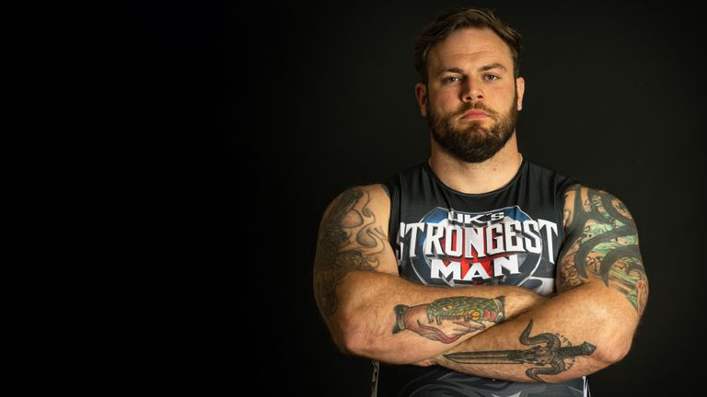


Sports - Programming Highlights
Euro 2024: England v Slovakia
ITV1, 30 Jun
Average Audience
Individuals: 11,270,400
Adults: 10,060,800
ABC1 Ads: 5,650,700
16-34: 1,577,100
HP+CH: 1,062,500
International Football: England v Bosnia and Herzegovina
Channel 4, 3 Jun
Average Audience
Individuals: 2,916,700
Adults: 2,761,200
ABC1 Ads: 153,1400
16-34: 341,200
HP+CH: 246,000
UK's Strongest Man 2024
Channel 5, 9 Jun
Average Audience
Individuals: 478,800
Adults: 462,400
ABC1 Ads: 204,600
16-34: 27,200
HP+CH: 34,400
Monaco F1 GP
Sky Sports F1, 26 May
Average Audience
Individuals: 1,458,300
Adults: 1,430,700
ABC1 Ads: 812,300
16-34: 367,500
HP+CH: 73,200
UEFA Champions League: Borussia Dortmund v Real Madrid Sky Sports Main Event, 1 Jun
Average Audience
Individuals: 1,292,100
Adults: 1,153,700
ABC1 Ads: 725,100
16-34: 248,300
HP+CH: 131,200
Source: Barb, Q2 2024. Average audience figures - Consolidated, Top performing episode of series (if applicable)

Slide 24


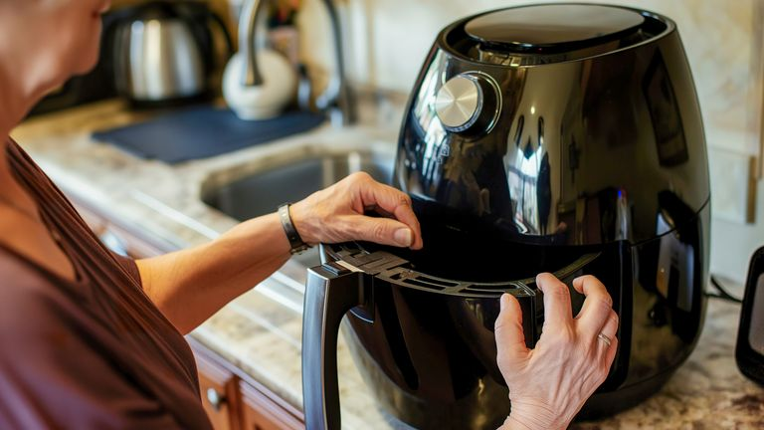


Hobbies & Leisure - Programming Highlights
Dickinson's Real Deal
ITV1, 4 Jun
Average Audience
Individuals: 801,400
Adults: 794,500
ABC1 Ads: 250,200
16-34: 71,000
HP+CH: 42,300
Stacey Solomon's Renovation Rescue
Channel 4, 10 Apr
Average Audience
Individuals: 1,738,900
Adults: 1,656,700
ABC1 Ads: 879,700
16-34: 230,400
HP+CH: 199,000
Air Fryers Made Easy
Channel 5, 3 Apr
Average Audience
Individuals: 799,900
Adults: 782,100
ABC1 Ads: 397,800
16-34: 29,800
HP+CH: 25,600
Bangers & Cash: Restoring Classics
U&Yesterday, 6 Jun
Average Audience
Individuals: 404,700
Adults: 399,200
ABC1 Ads: 149,400
16-34: 2,500
HP+CH: 2,900
Shed and Buried
Quest, 4 Apr
Average Audience
Individuals: 312,000
Adults: 289,000
ABC1 Ads: 87,500
16-34: 15,400
HP+CH: 19,400
Source: Barb, Q2 2024. Average audience figures - Consolidated, Top performing episode of series (if applicable)

Slide 25
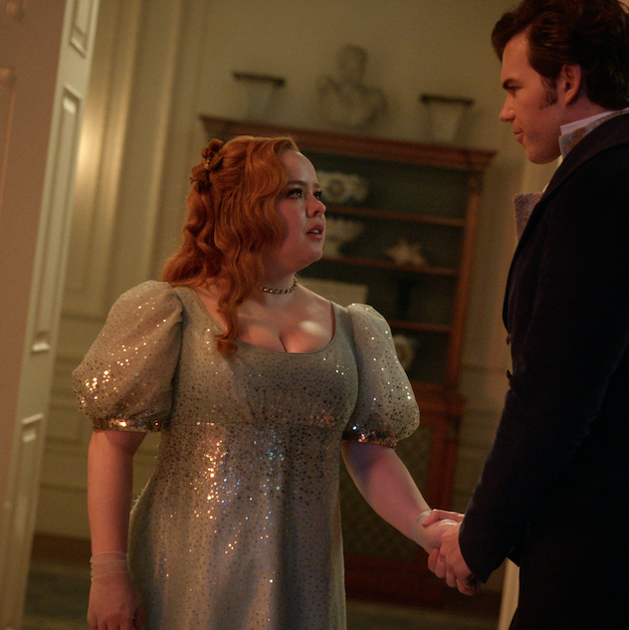









SVOD Drama & Entertainment - Programming Highlights
Bridgerton S3, Ep5
Netflix, Drama
Individuals: 4,000,970
Adults: 3,925,471
Fallout S1, Ep1
Prime, Drama
Individuals: 3,325,539
Adults: 3,158,714
Baby Reindeer S1, Ep1
Netflix, Drama
Individuals: 2,216,543
Adults: 2,165,631
The Boys S4, Ep1
Prime, Drama
Individuals: 1,605,338
Adults: 1,572,748
The Acolyte S1, Ep1
Disney+, Drama
Individuals: 1,208,359
Adults: 1,131,449
Unlocked: A Jail Experiment S1, Ep1
Netflix, Entertainment
Individuals: 981,343
Adults: 906,814
Jimmy Carr: Natural Born Killer Special
Netflix, Entertainment
Individuals: 839,276
Adults: 792,894
The Kardashians S15 Ep1
Disney+, Entertainment
Individuals: 335,120
Adults: 314,003
Star Wars: Tales of the Empire S21 Ep1
Disney+, Entertainment
Individuals: 262,116
Adults: 233,643
Invincible S2, Ep8
Prime, Entertainment
Individuals: 260,440
Adults: 245,571
Source: Barb, Q2 2024, individuals and adults. Average audience achieved during the first seven days of their availability. Only includes TV set viewing.

Slide 26

Q2 2025
Smyths, “Two Magical Words”

Slide 27
Key Dates
 | Week Commencing
 | 31-Mar | 07-Apr | 14-Apr | 21-Apr | 28-Apr | 05-May | 12-May | 19-May | 26-May | 02-Jun | 09-Jun | 16-Jun | 23-Jun | 30-Jun
Premier League
Bank Holidays
Formula 1
Grand National
Champions League
FA Cup
Father's Day
Wimbledon

Slide 28












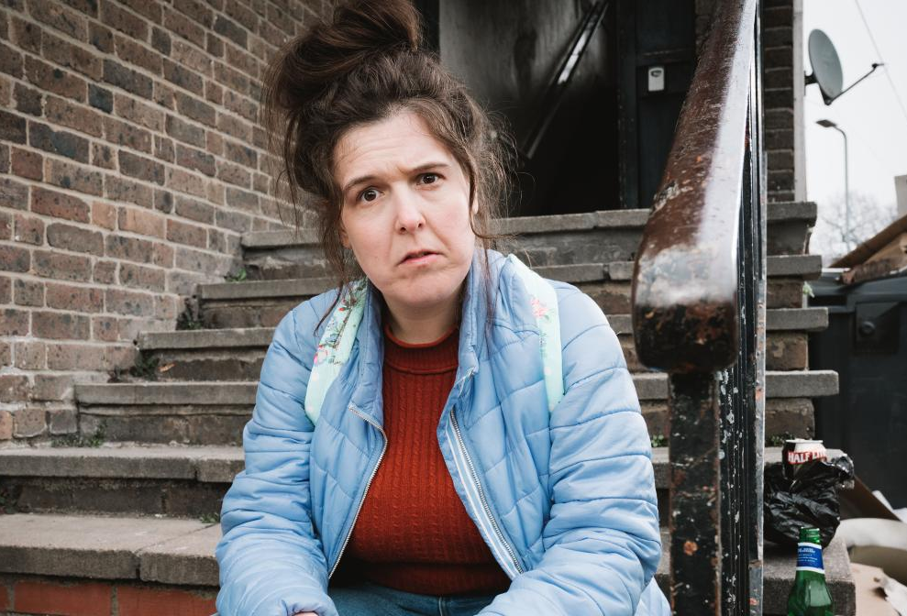

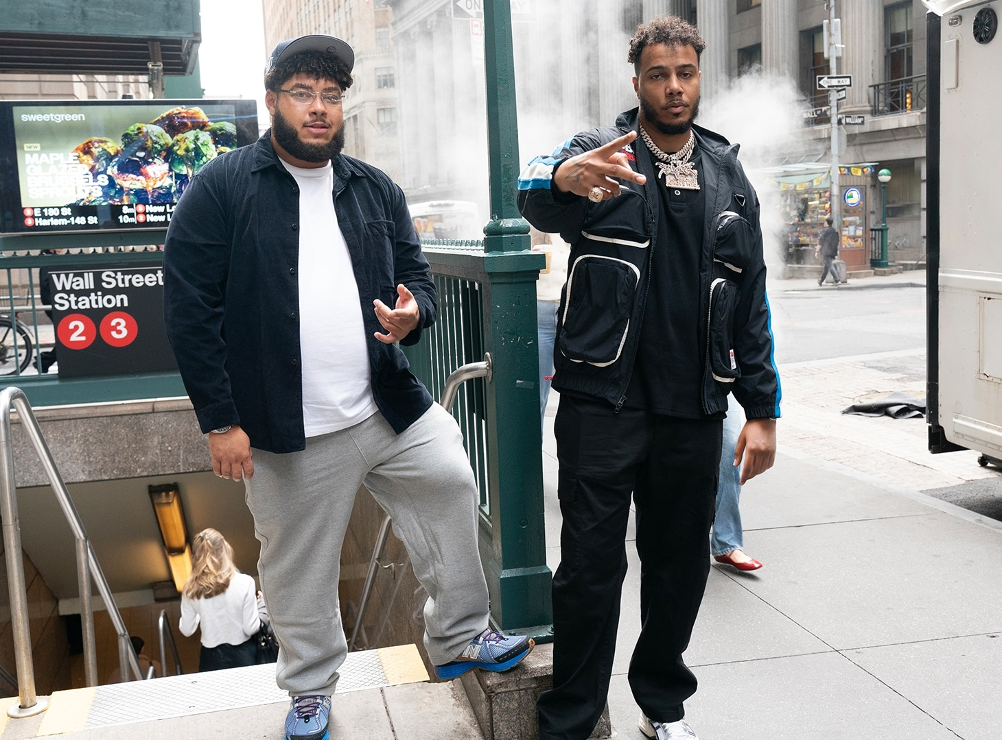
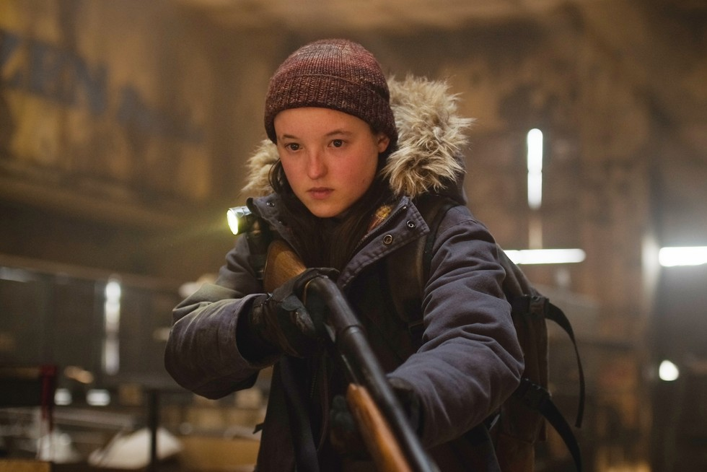





















Programming Highlights – Q2 2025
ITV
Malpractice
Code of Silence
Noel’s Kiwi Kingdom
Grace
The FA Cup Final
Men’s & Women’s England Football Internationals
Celebrity Big Brother
Ridley
Genius Game
Soccer Aid
Love Island
Channel 4
Bake Off: The Professionals
The Handmaids Tale S6
Taskmaster
Disability Benefits
Virgin Island
Murder Squad: PSNI
Celebrity Gogglebox
The Honesty Box
Sky
Big Zuu & AJ Tracey’s Seriously Rich Flavours
Beetlejuice
Beetlejuice
Greta Garbo: Leave Me
Romesh Don't Knock The Hustle
The Equalizer S5
The Last of Us S2
Smile
100 Foot Wave
UKTV
Classic Car Kings
Outrageous
I, Jack Wright
Signora Valope

