Slide 1
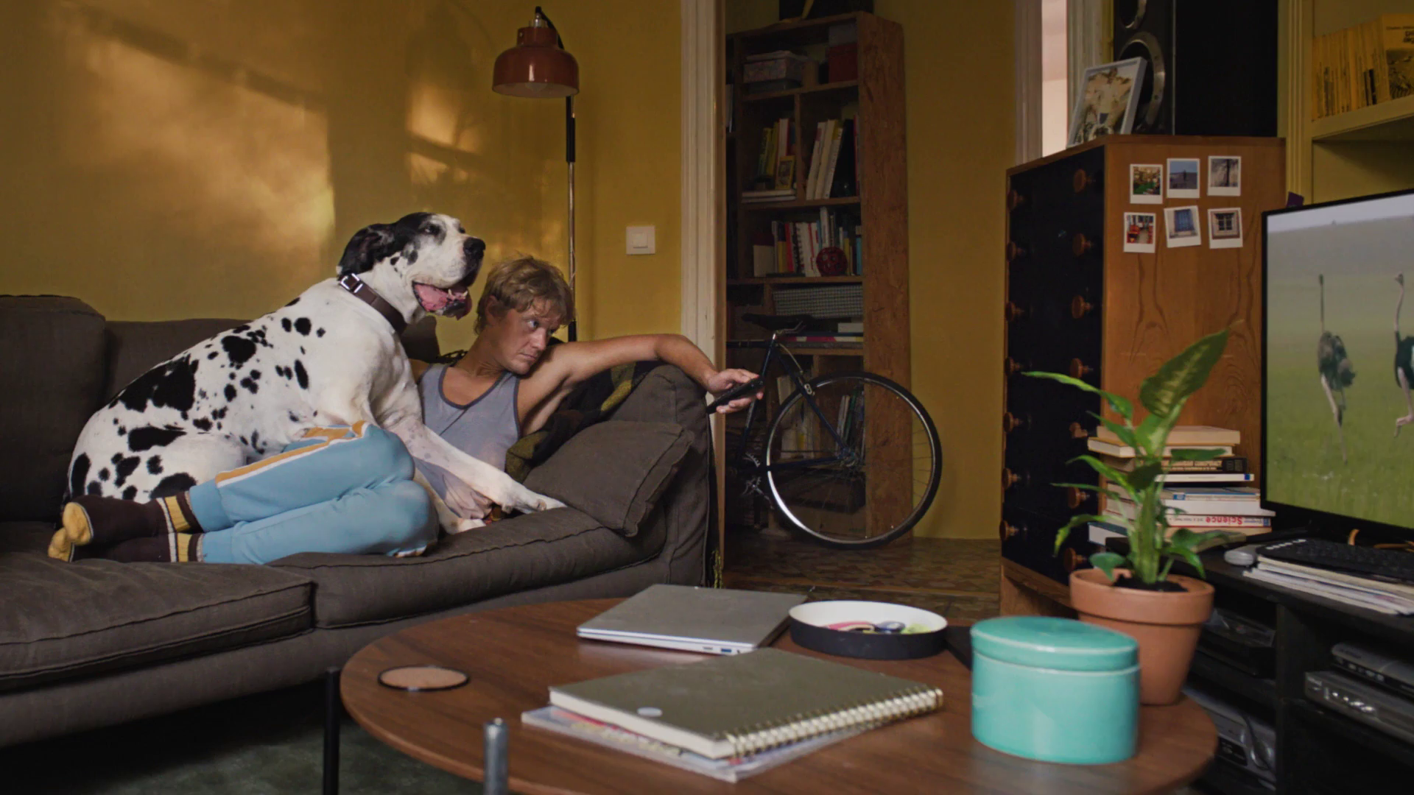
Future Focus Report
Q4 2024
hotels.com, “Big Sampson”

Slide 2
This deck is packed with insights
With Q4 planning well under way, this report will be a handy guide on what to expect over the coming months.
To provide a useful base on what to expect this year we look historically to Q4 2023:
Category & advertiser analysis
‘Reach Extenders’ analysis
TV viewing overview with cover guides for key buying audiences
Programming highlights across a range of genres
To better prepare you, we include key considerations for the quarter ahead:
Important dates
Preview on programming to expect in Q4 2024
ClearScore, “Washing Machine”
Notes:
The Future Focus Report puts Q4 in the spotlight and is a useful guide to help with planning for the upcoming quarter.

Slide 3
Category & Advertiser Analysis Q4 2023
Bumble, “The Like Detector”

Slide 4
Q4 2023 TV Impacts by Category
High
Mid
Low
Relative propensity of media spend by category
 | Retail | Electronics, Household Appliances & Tech | Online Retail | Charities | Cosmetics & Personal Care | Food | Household FMCG | Health & Wellbeing | Entertainment & Leisure | Household Equipment & DIY | Drink | Telecoms | Automotive | Travel & Transport | Finance
Oct | 145 | 117 | 71 | 111 | 78 | 114 | 104 | 121 | 95 | 106 | 92 | 95 | 80 | 69 | 89
Nov | 170 | 146 | 145 | 107 | 120 | 118 | 106 | 109 | 100 | 94 | 92 | 100 | 53 | 36 | 63
Dec | 125 | 102 | 136 | 134 | 149 | 113 | 120 | 83 | 107 | 102 | 113 | 83 | 60 | 83 | 35
Total | 146 | 121 | 118 | 118 | 117 | 115 | 110 | 104 | 101 | 101 | 99 | 92 | 64 | 63 | 61
Source: Barb, Q4 2023, Q4 index vs full-year 2023, Adults, Top 15 categories by total impacts
Notes:
Q4 TV Impacts by category. Indexed % spend by category for each month (Oct-Dec) vs. the average % for 2023

Slide 5
Top sectors by Q4 2023 impacts
115
101
117
118
110
61
92
146
63
101
104
121
118
64
99
Source: Barb, Q4 2023, All Adults, Impacts (R/W) (million). Numbers above bars show Q4 index vs 2023.

Slide 6
Retail - Advertiser
Source: Barb, Q4 2023, All Adults, Impacts (R/W) (million). Top 10 Q4 2023 advertisers by total impacts.

Slide 7
Electronics, Household Appliances & Tech - Advertiser
Source: Barb, Q4 2023, All Adults, Impacts (R/W) (million). Top 10 Q4 2023 advertisers by total impacts.

Slide 8
Online Retail - Advertiser
Source: Barb, Q4 2023, All Adults, Impacts (R/W) (million). Top 10 Q4 2023 advertisers by total impacts.

Slide 9
Reach Extenders
Barclaycard, “Lawnmower”

Slide 10
Identifying the ‘Reach Extenders’
Weight of viewing is a key factor
in incremental reach
‘Middle tier’ of viewers are key to
BVOD’s incremental reach
Research from BVOD Almighty divided viewers into deciles based on weekly linear TV viewing. Light viewers are hard to target on TV, while heavy viewers are easily targeted via linear TV, reducing the role of BVOD. PwC’s analysis identifies the ‘middle tier’ as the key segment driving incremental reach via BVOD.
This chart displays the proportion of linear and BVOD consumption for each of the three tiers and their deciles. Notably, the ‘middle tier’, accounting for 7% of linear TV viewing, makes up 28% of BVOD consumption, making them the key audience to extend campaigns through BVOD; we call them the ‘Reach Extenders’.
Source: BVOD Almighty
Notes:
Left Chart: Detailed analysis by PwC has identified a segment that are important drivers of why BVOD is delivering incremental reach.
This chart shows the viewing population split into ten equal groups (deciles) based upon amount of liner TV viewing per week.
The lightest decile averages 4-mins of linear viewing per day. Up to the heaviest decile who view for 734-minutes (12-hours 14-minutes) per day.
The deciles have been split into three groups:
Lightest tier. These are very hard to reach on TV (linear or BVOD) and are most likely to be targeted via platforms such as YouTube
Middle tier.
Heaviest tier. These are quite easy to reach via linear TV and, as a result, BVOD probably has little role to play.
Right Chart: This chart shows for each of the three tiers (and the deciles within them) what proportion of linear and BVOD consumption they account for.
Key to note is that the middle tier (green) proportionally watch a lot of BVOD. Whilst they account for 7% of linear TV viewing, they make up 28% of BVOD consumption.
This makes them the key audience for extending campaign via the use of BVOD – relatively they are easier to reach via BVOD then linear TV.

Slide 11
Identifying the ‘Reach Extenders’
BVOD provides good odds of reaching an attractive audience
Where and when can we effectively reach this valuable audience of ‘Reach Extenders’?
While BVOD excels at reaching this audience there are key programmes and times you’re very likely to reach them across the whole of TV.
‘Reach Extenders’ display a strong affinity for the following genres:
Entertainment
Drama
Films
Their peak viewing hours take place daily from 8-11pm, with a higher likelihood of viewership occurring at the weekend.
On average, it takes only four impressions to reach a ‘middle tier’ viewer through BVOD, as opposed to 14 impressions on linear. This makes BVOD 3.5 times more efficient in targeting the ‘middle tier’ group, which often consists of younger and upscale viewers, highly sought after by advertisers.
Source: BVOD Almighty
Notes:
Left Chart: BVOD provides good odds of reaching an attractive audience or to put it another way, for every 14 impressions you buy on linear one person falls into the middle tier group (assuming natural delivery)
But on BVOD, it only takes four impressions to, on average, reach somebody in the middle tier. As such, on average, using BVOD is three and a half more efficient than linear at reaching the middle tier of viewers.
The middle tier are very attractive audiences for many advertisers (proportionally younger and upscale) and BVOD enables them to be reached in an efficient way.

Slide 12
Top genres watched by ‘Reach Extenders’
% of All Viewing
Genre | Adults | Reach Extenders | Index
Entertainment | 27% | 28% | 103
Drama | 23% | 24% | 108
Films | 13% | 19% | 144
Sport | 10% | 10% | 94
Documentaries | 11% | 8% | 74
Hobbies/Leisure | 6% | 3% | 54
Children | 2% | 3% | 196
News/Weather | 4% | 2% | 48
Source: Barb Q4 2023, % of all commercial viewing including SVOD’s, index vs all adults.

Slide 13
High indexing entertainment content
Entertainment
Channel | Programme Title | Index
ITV | Hell's Kitchen (USA) | 501
Disney+ | The Simpsons | 453
Disney+ | American Dad! | 391
MTV | The Challenge | 359
Netflix | The Office US | 339
Disney+ | Family Guy | 337
Netflix | Brooklyn Nine-Nine | 334
Disney+ | How I Met Your Mother | 322
ITV | Benidorm | 290
Netflix | Friends | 283
Sky | Last Week Tonight With John Oliver | 283
Netflix | Selling Sunset | 279
Disney+ | Modern Family | 277
Amazon | The Big Bang Theory | 264
Amazon | 007: Road To A Million | 253
Entertainment
Channel | Programme Title | Index
Amazon | Invincible | 238
Netflix | Squid Game: The Challenge | 234
ITV | Gordon, Gino & Fred: Road Trip | 226
Comedy Central | South Park | 222
Channel 4 | Taskmaster | 215
Netflix | The Big Bang Theory | 212
Channel 4 | The Great British Bake Off | 206
ITV | Superstore | 202
Channel 5 | Teen Mom UK | 190
Channel 4 | Made in Chelsea | 186
Sky | Never Mind the Buzzcocks | 158
Channel 4 | Married at First Sight UK | 155
Channel 4 | Celebrity SAS: Who Dares Wins | 136
Sky | Rob & Romesh vs... | 127
ITV | I'm a Celebrity... Get Me Out of Here! | 124
Source: Barb Q4 2023, ‘Reach Extender’ index vs all adults, Thinkbox created list of programmes based on volume of viewing and index.

Slide 14
High indexing drama content
Drama
Channel | Programme Title | Index
Sky | Manifest | 514
Netflix | Suits | 450
Amazon | House | 361
Netflix | Sex Education | 329
Disney+ | The Walking Dead | 323
Channel 4 | Nordic Murders | 309
Sky | Succession | 306
Disney+ | Only Murders in the Building | 298
ITV | The Originals | 297
ITV | Broadchurch | 282
Netflix | Bodies (2023) | 266
Amazon | The Continental: From the World of John Wick | 262
Netflix | Gilmore Girls | 256
Disney+ | Loki | 255
Amazon | The Boys | 254
Drama
Channel | Programme Title | Index
Disney+ | Grey's Anatomy | 248
Amazon | Gen V | 247
Channel 4 | The Good Doctor | 232
Netflix | The Crown | 221
Amazon | Reacher | 215
ITV | Unforgotten | 200
ITV | Love and Death | 189
Channel 4 | Astrid: Murder in Paris | 180
Sky | Billions | 166
Sky | The Gilded Age | 163
Disney+ | Criminal Minds | 160
Channel 5 | All Creatures Great and Small | 160
Sky | The Lazarus Project | 159
Channel 4 | Partygate | 157
Channel 5 | The Inheritance | 156
Source: Barb Q4 2023, ‘Reach Extender’ index vs all adults, Thinkbox created list of programmes based on volume of viewing and index.

Slide 15
High indexing movie content
Films are popular among the ‘Reach Extender’ audience, but planning for this genre is less straightforward due to the variance in film scheduling. To help, here is a breakdown of which sub-genres the ‘Reach Extenders’ are watching.
Films
Sub-Genre | Channel | Programme Title | Index
Family | Netflix | Chicken Run Dawn of the Nugget | 253
Family | Disney+ | Home Alone | 241
Family | Channel 4 | Mog's Christmas | 182
Family | Sky | Elf | 166
Romcom | Amazon | Love Actually | 365
Romcom | Netflix | The Holiday | 255
Romcom | ITV | There's Something About Mary | 150
Romcom | Channel 4 | Four Weddings and a Funeral | 130
Horror | Disney+ | A Haunting in Venice | 254
Horror | Netflix | Talk to Me | 197
Horror | Sky | The Pope's Exorcist | 185
Horror | Channel 4 | Alien Covenant | 153
Crime Drama | Disney+ | Boston Strangler | 452
Crime Drama | Netflix | Reptile | 255
Crime Drama | Channel 5 | The Rainmaker | 176
Crime Drama | Channel 4 | The Italian Job | 136
% of all film viewing
Genre | Adults | Reach Extenders | Index
Family | 21% | 27% | 124
Action / Adventure / Thriller | 23% | 21% | 93
Sci-Fi and Fantasy | 15% | 14% | 96
Comedy | 13% | 12% | 93
Romcom | 4% | 5% | 120
Crime Drama | 4% | 4% | 100
Other | 4% | 4% | 105
Horror | 3% | 4% | 114
Source: Barb Q4 2023, ‘Reach Extender’ index vs all adults, Thinkbox created list of programmes based on volume of viewing and index.

Slide 16
‘Reach Extenders’ aren’t solely limited to high indexing genres
Sport
Channel | Programme Title | Index
Amazon | Premier League | 202
Amazon | Autumn International Rugby | 202
Sky | NFL RedZone | 190
ITV | World Rally Championship Highlights | 155
Channel 4 | Formula 1 | 148
Sky | Gary Neville's Soccerbox | 145
Sky | Ted's Notebook | 142
TNT Sport | UFC | 140
Sky | Brazilian F1 GP | 139
ITV | Rugby World Cup | 134
Channel 4 | International Football | 132
TNT Sport | WWE Raw | 131
TNT Sport | UEFA Champions League | 131
ITV | Goodwood Festival of Speed | 131
Channel 5 | World's Strongest Man 2023 | 108
Documentaries
Channel | Programme Title | Index
Netflix | Beckham | 270
Disney+ | Welcome to Wrexham | 297
Channel 4 | 24 Hours in Police Custody | 133
Netflix | Robbie Williams | 237
Channel 5 | Michael Portillo In Andalucia | 158
Netflix | World War II: From the Frontlines | 271
Channel 4 | Bill Bailey's Australian Adventure | 151
Netflix | Escaping Twin Flames | 323
Disney+ | Brawn: The Impossible Formula 1 Story | 288
Disney+ | Coleen Rooney: The Real Wagatha Story | 223
Channel 4 | The Princes in the Tower: The New Evidence | 144
Channel 5 | Jay Blades: The Midlands Through Time | 135
Channel 5 | All Creatures Great & Small: Yorkshire Vet Special | 144
Channel 4 | Rhod Gilbert: A Pain in the Neck for SU2C | 192
Amazon | Supersize vs Superskinny | 523
Source: Barb Q4 2023, ‘Reach Extender’ index vs all adults, Thinkbox created list of programmes based on volume of viewing and index.

Slide 17
When to target the ‘Reach Extenders’
Reach Extenders' index by daypart
 | 6am | 7am | 8am | 9am | 10am | 11am | 12pm | 1pm | 2pm | 3pm | 4pm | 5pm | 6pm | 7pm | 8pm | 9pm | 10pm | 11pm | 12am | 1am | 2am | 3am | 4am | 5am
Monday | 54 | 70 | 63 | 59 | 59 | 58 | 65 | 71 | 65 | 62 | 56 | 68 | 87 | 115 | 146 | 165 | 136 | 99 | 77 | 71 | 69 | 65 | 55 | 47
Tuesday | 53 | 62 | 59 | 60 | 55 | 60 | 63 | 64 | 57 | 52 | 57 | 68 | 79 | 111 | 164 | 169 | 132 | 98 | 74 | 67 | 65 | 57 | 48 | 37
Wednesday | 62 | 67 | 61 | 58 | 53 | 55 | 73 | 72 | 64 | 53 | 55 | 68 | 85 | 114 | 150 | 170 | 134 | 112 | 86 | 73 | 62 | 58 | 52 | 37
Thursday | 49 | 58 | 59 | 65 | 60 | 60 | 68 | 74 | 61 | 60 | 62 | 70 | 89 | 112 | 142 | 168 | 135 | 113 | 87 | 75 | 71 | 69 | 56 | 42
Friday | 49 | 71 | 64 | 63 | 56 | 57 | 65 | 66 | 59 | 56 | 60 | 71 | 91 | 112 | 141 | 160 | 147 | 118 | 91 | 78 | 76 | 64 | 49 | 36
Saturday | 41 | 60 | 70 | 74 | 62 | 64 | 74 | 85 | 81 | 72 | 80 | 97 | 111 | 118 | 139 | 148 | 128 | 98 | 75 | 69 | 54 | 50 | 50 | 38
Sunday | 57 | 66 | 74 | 69 | 68 | 64 | 66 | 76 | 83 | 88 | 98 | 107 | 112 | 114 | 135 | 143 | 117 | 86 | 65 | 57 | 57 | 42 | 39 | 41
Monday | Tuesday | Wednesday | Thursday | Friday | Saturday | Sunday
94 | 98 | 94 | 90 | 93 | 114 | 114
Source: Barb Q4 2023, commercial broadcasters, ‘Reach Extender’ index vs all adults.

Slide 18
TV Viewing Overview Q4 2023
Deliveroo, “Fridge Flirt”

Slide 19
Q4 2023 TV facts & figures
Total TV weekly reach %
Total TV viewed per day
Commercial TV viewed per day
Impacts
Individuals
80.3 | 179.5bn | 2h 31m | 1h 42m
82.8 | 172.6bn | 2h 51m | 1h 55m
82.3 | 69.8bn | 2h 18m | 1h 27m
64.9 | 14.1bn | 49m | 36m
81.8 | 77.9bn | 2h 43m | 1h 51m
83.6 | 94.7bn | 2h 58m | 1h 59m
79.9 | 14.8bn | 1h 42m | 1h 14m
Adults
ABC1 adults
16-34
Men
Women
Housepersons with children
Source: Barb Q4 2023, industry standard TV viewing in-home on a TV set. Reach 3min+. 30” equivalent impacts.
Notes:
Q4 2023 linear TV figures for weekly reach, impacts, total TV viewing hours and commercial TV viewing hours

Slide 20
Q4 2023 – Cover guide – ABC1 Ads
Source: Barb BVOD Planner (2023, 6 weeks 44-49) / natural delivery / station average prices.

Slide 21
Q4 2023 – Cover guide – 16-34
Source: Barb BVOD Planner (2023, 6 weeks 44-49) / natural delivery / station average prices.

Slide 22
Q4 2023 – Cover guide – Housepersons with children
Source: Barb BVOD Planner (2023, 6 weeks 44-49) / natural delivery / station average prices.

Slide 23
Programming Q4 2023
Weetabix, “Fixing Britain”

Slide 24
Programming Highlights – Q4 2023
I’m a Celebrity Get Me Out of Here
ITV1, 19 Nov
Average Audience
Individuals: 9,784,500
Adults: 9,000,100
ABC1 Ads: 4,531,000
16-34: 2,185,500
HP+CH: 1,455,200
The Couple Next Door
Channel 4, 27 Nov
Average Audience
Individuals: 2,224,500
Adults: 2,207,400
ABC1 Ads: 1,228,600
16-34: 183,000
HP+CH: 168,100
Air Fryers: Christmas Made Easy
Channel 5, 16 Nov
Average Audience
Individuals: 1,790,300
Adults: 1,712,200
ABC1 Ads: 795,100
16-34: 151,200
HP+CH: 153,600
Brazilian F1 GP
Sky Sports F1, 5 Nov
Average Audience
Individuals: 1,403,000
Adults: 1,356,700
ABC1 Ads: 682,400
16-34: 300,800
HP+CH: 91,000
Source: Barb, Q4 2023. Average audience figures - Consolidated, Top performing episode of series (if applicable)

Slide 25
Drama - Programming Highlights
Vera
ITV1, 26 Dec
Average Audience
Individuals: 5,632,700
Adults: 5,569,200
ABC1 Ads: 3,029,300
16-34: 205,600
HP+CH: 196,800
The Couple Next Door
Channel 4, 27 Nov
Average Audience
Individuals: 2,224,500
Adults: 2,207,400
ABC1 Ads: 1,228,600
16-34: 183,000
HP+CH: 168,100
All Creatures Great and Small
Channel 5, 2 Nov
Average Audience
Individuals: 3,720,000
Adults: 3,651,900
ABC1 Ads: 2,195,000
16-34: 104,700
HP+CH: 114,700
The Heist Before Christmas
Sky Max, 23 Dec
Average Audience
Individuals: 912,700
Adults: 847,400
ABC1 Ads: 468,100
16-34: 119,200
HP+CH: 99,100
Mrs Sidhu Investigates
Drama, 4 Oct
Average Audience
Individuals: 1,001,700
Adults: 969,600
ABC1 Ads: 536,800
16-34: 12,300
HP+CH: 26,100
Source: Barb, Q4 2023. Average audience figures - Consolidated, Top performing episode of series (if applicable)

Slide 26
Entertainment - Programming Highlights
I’m a Celebrity Get Me Out of Here
ITV1, 19 Nov
Average Audience
Individuals: 9,784,500
Adults: 9,000,100
ABC1 Ads: 4,531,000
16-34: 2,185,500
HP+CH: 1,455,200
The Great British Bake Off
Channel 4, 3 Oct
Average Audience
Individuals: 7,276,300
Adults: 6,922,200
ABC1 Ads: 4,625,800
16-34: 1,386,400
HP+CH: 983,100
The Hotel Inspector
Channel 5, 31 Oct
Average Audience
Individuals: 1,413,400
Adults: 1,389,200
ABC1 Ads: 710,800
16-34: 68,500
HP+CH: 107,700
Rob & Romesh vs...
Sky Max, 16 Dec
Average Audience
Individuals: 384,100
Adults: 366,500
ABC1 Ads: 205,100
16-34: 78,200
HP+CH: 75,200
Last of the Summer Wine
Drama, 27 Oct
Average Audience
Individuals: 402,800
Adults: 402,800
ABC1 Ads: 135,200
16-34: 15,800
HP+CH: 8,300
Source: Barb, Q4 2023. Average audience figures - Consolidated, Top performing episode of series (if applicable)

Slide 27
Sports - Programming Highlights
Rugby World Cup
ITV1, 21 Oct
Average Audience
Individuals: 5,598,100
Adults: 5,203,600
ABC1 Ads: 3,344,100
16-34: 709,000
HP+CH: 519,600
International Football
Channel 4, 17 Oct
Average Audience
Individuals: 4,313,500
Adults: 3,980,900
ABC1 Ads: 2,308,500
16-34: 579,600
HP+CH: 389,500
World's Strongest Man 2023
Channel 5, 27 Dec
Average Audience
Individuals: 1,317,200
Adults: 1,213,000
ABC1 Ads: 540,800
16-34: 84,200
HP+CH: 170,000
Premier League
Sky Sports Main Event, 29 Oct
Average Audience
Individuals: 1,473,600
Adults: 1,403,400
ABC1 Ads: 900,600
16-34: 306,800
HP+CH: 78,800
Brazilian F1 GP
Sky Sports F1, 5 Nov
Average Audience
Individuals: 1,403,000
Adults: 1,356,700
ABC1 Ads: 682,400
16-34: 300,800
HP+CH: 91,000
Source: Barb, Q4 2023. Average audience figures - Consolidated, Top performing episode of series (if applicable)

Slide 28
Hobbies & Leisure - Programming Highlights
Love Your Garden
ITV1, 19 Dec
Average Audience
Individuals: 1,632,600
Adults: 1,559,400
ABC1 Ads: 600,600
16-34: 35,200
HP+CH: 132,700
Grand Designs
Channel 4, 8 Nov
Average Audience
Individuals: 1,746,800
Adults: 1,691,800
ABC1 Ads: 1,056,300
16-34: 191,200
HP+CH: 179,400
Air Fryers: Christmas Made Easy
Channel 5, 16 Nov
Average Audience
Individuals: 1,790,300
Adults: 1,712,200
ABC1 Ads: 795,100
16-34: 151,200
HP+CH: 153,600
Bangers & Cash: Restoring Classics
Yesterday, 2 Nov
Average Audience
Individuals: 471,400
Adults: 441,500
ABC1 Ads: 215,000
16-34: 2,300
HP+CH: 26,900
Celebrity Yorkshire Auction House
Really, 20 Nov
Average Audience
Individuals: 395,700
Adults: 395,700
ABC1 Ads: 120,200
16-34: 8,400
HP+CH: 1,100
Source: Barb, Q4 2023. Average audience figures - Consolidated, Top performing episode of series (if applicable)

Slide 29
SVOD Drama & Entertainment - Programming Highlights
Bodies S1, Ep1
Netflix, Drama
Individuals: 2,960,082
Adults: 2,851,221
Reacher S2, Ep1
Prime, Drama
Individuals: 2,202,493
Adults: 2,153,787
Loki S2, Ep1
Disney+, Drama
Individuals: 1,961,325
Adults: 1,744,457
The Crown S6, Ep1
Netflix, Entertainment
Individuals: 2,948,774
Adults: 2,866,560
Gen V S1, Ep8
Prime, Entertainment
Individuals: 820,943
Adults: 806,674
Squid Game: The Challenge S1, Ep1
Netflix, Entertainment
Individuals: 2,158,694
Adults: 1,919,332
What If… ? S2, Ep1
Disney+, Entertainment
Individuals: 597,796
Adults: 505,522
007: Road To A Million S1, Ep1
Prime, Entertainment
Individuals: 529,635
Adults: 513,366
Selling Sunset S7, Ep1
Netflix, Entertainment
Individuals: 704,946
Adults: 678,901
The Kardashians S4, Ep3
Disney+, Entertainment
Individuals: 418,784
Adults: 406,548
Source: Barb, Q4 2023, individuals and adults. Average audience achieved during the first seven days of their availability. Only includes TV set viewing.

Slide 30
Q4 2024
Burger King, “Foodfillment”

Slide 31
Key Dates
 | Week Commencing
 | 30-Sep | 07-Oct | 14-Oct | 21-Oct | 28-Oct | 04-Nov | 11-Nov | 18-Nov | 25-Nov | 02-Dec | 09-Dec | 16-Dec | 23-Dec | 30-Dec
Champions League
Formula 1
Premier League
Halloween
Black Friday
Christmas

Slide 32
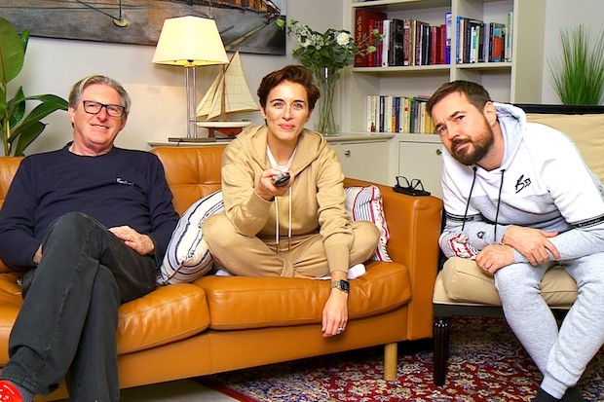
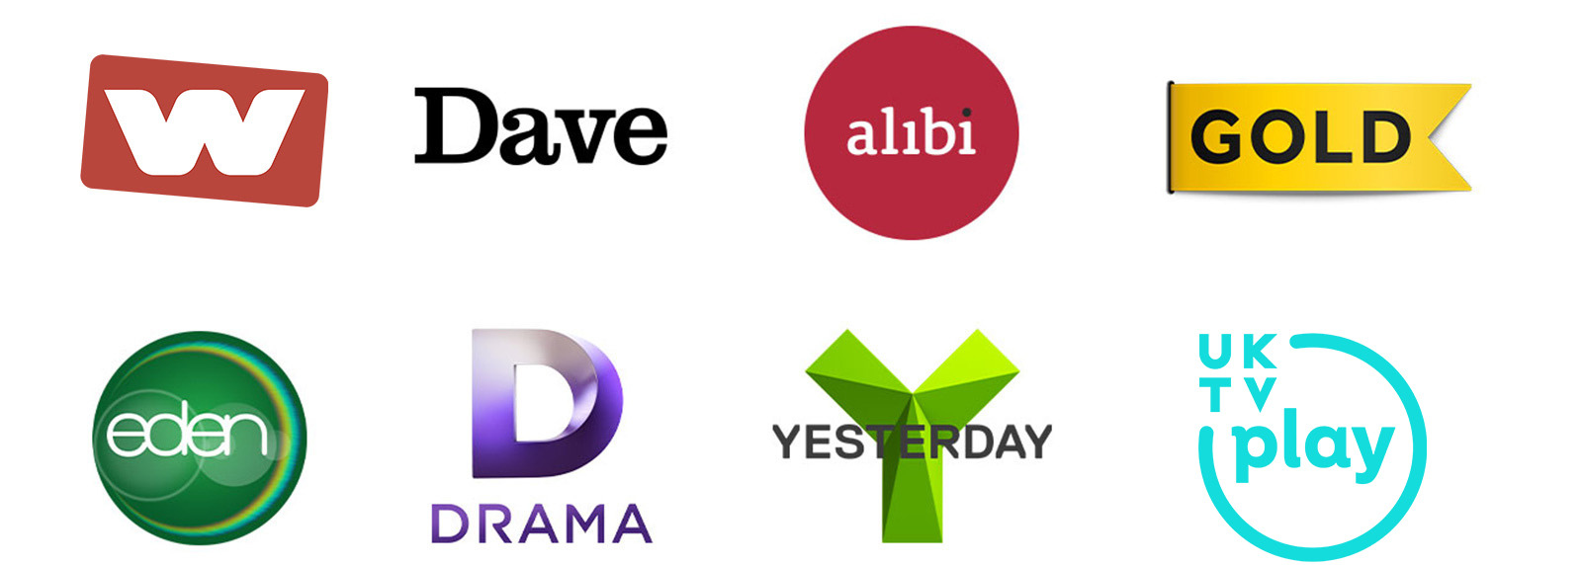
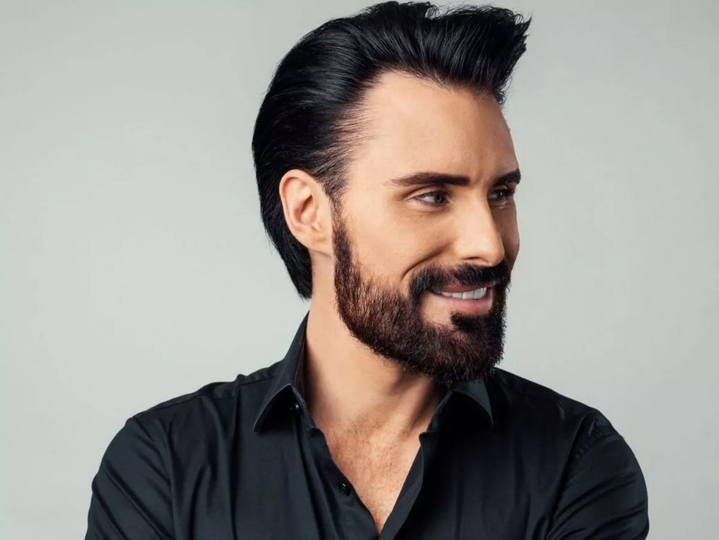
Programming Highlights – Q4 2024
ITV
I’m a Celebrity Get Me Out of Here
Big Brother
Joan
The 1% Club
Password
Playing Nice
International Football
Channel 4
The Great British Bake Off
Celebrity Gogglebox
After The Party
Married at First Sight: UK
Jungle Dads
Junior Taskmaster
Generation Z
Everyone Else Burns S2
Sky
Bob Marley: One Love
Based on a True Story S2
The Day of the Jackal
Never Mind the Buzzcocks S4
Portrait Artist of the Year 2024
Lee
The Ark S2
The Overlap S2
Stalker
UKTV
Channel 5
Apocalypse Slough: A Murder They Hope Mystery
Follow the Leader with Jamali Maddix
Find It, Fix It, Flog It
The Diplomat
Dating Naked
The Hardacres
All Creatures Great and Small S5

