Slide 1
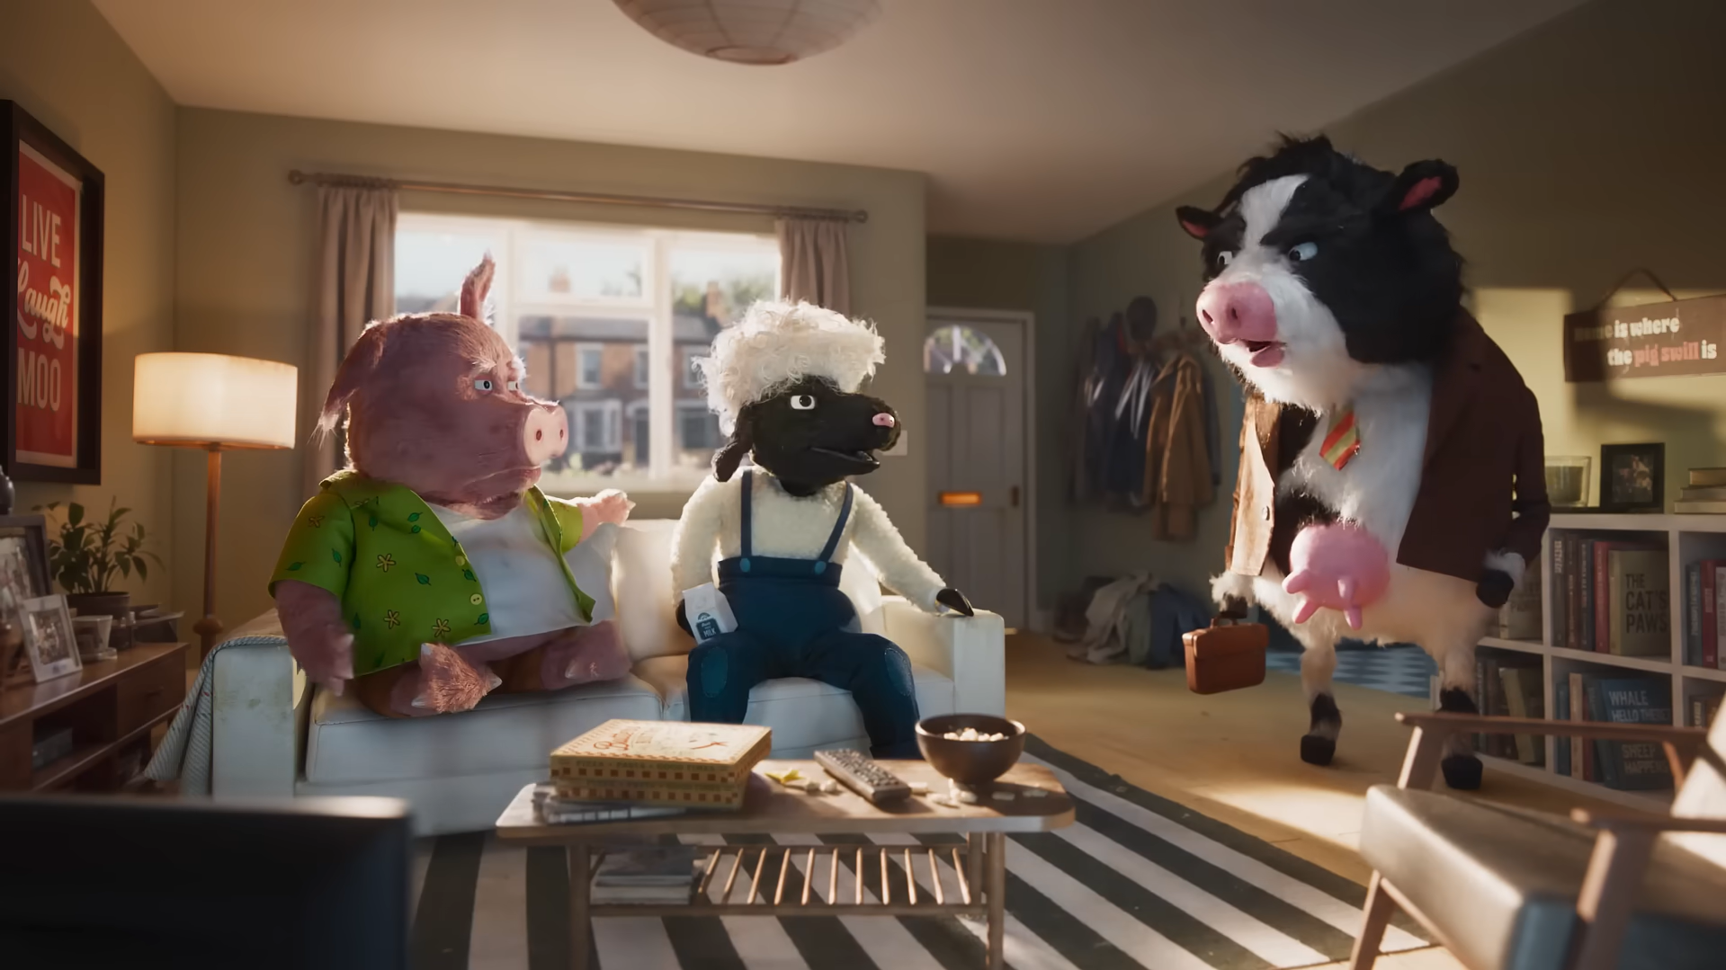

Monthly TV viewing report
September 2026
Confused.com – Just Use Confused

Slide 2
September linear TV facts & figures
Total TV weekly reach %
Total TV viewed per day
Commercial TV viewed per day
Impacts
Individuals
68.1 | 40.2bn | 1h 47m | 1h 12m
71.7 | 39.4bn | 2h 2m | 1h 22m
70.9 | 15.5bn | 1h 35m | 59m
47.0 | 2.1bn | 23m | 17m
70.4 | 17.7bn | 1h 57m | 1h 20m
72.8 | 21.7bn | 2h 6m | 1h 24m
67.2 | 2.1bn | 50m | 34m
Adults
ABC1 adults
16-34
Men
Women
Housepersons with children
Sources: Barb September 2026, industry standard TV viewing in-home on a TV set. Reach 3min+. 30” equivalent impacts.
Notes:
September linear TV figures for weekly reach, impacts, total TV viewing hours and commercial TV viewing hours

Slide 3

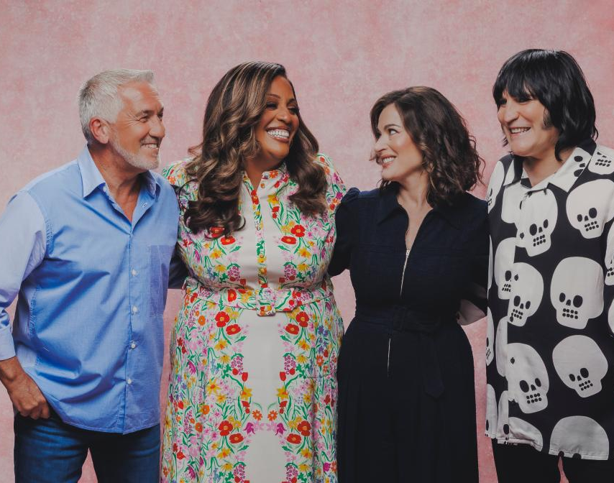


Some notable TV moments in September
On 28 September, ITV1 aired The Blame to an average audience of 5.95m.
On 22 September, Channel 4 aired The Great British Bake Off to an average audience of 5.99m.
On 17 September, 5 aired All Creatures Great and Small to an average audience of 2.94m.
On 6 September, Sky Sports aired Italian F1 GP to a TV set audience of 1.19m and a device audience of 42k.
Source: Barb, September 2026, individuals. Average audience figures, TV set and devices viewing 1-7 days (includes pre-broadcast figures, if applicable).

Slide 4
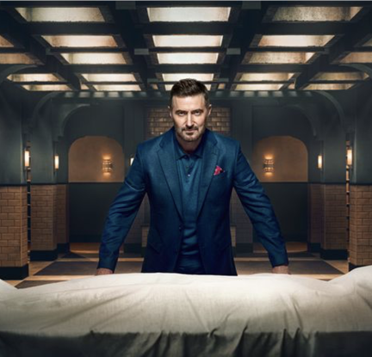
Top 5 ITV1 programmes
The Blame (28 September)
5.95 million viewers
Trigger Point (14 September)
5.03 million viewers
Winter (30 September)
3.98 million viewers
Coronation Street (2 September)
3.88 million viewers
Emmerdale (2 September)
3.59 million viewers
Winter – ITV1
Source: Barb, September 2026, individuals. Average audience figures, TV set and devices viewing 1-7 days (includes pre-broadcast figures, if applicable)
Notes:
Top 5 programmes - ITV

Slide 5

Top 5 Channel 4 programmes
The Great British Bake Off (22 September)
5.99 million viewers
24 Hours in Police Custody (6 September)
2.62 million viewers
Gogglebox (4 September)
2.47 million viewers
The Great Celebrity Pottery Throw Down (13 September)
1.90 million viewers
Taskmaster (10 September)
1.84 million viewers
The Great Celebrity Pottery Throw Down – Channel 4
Source: Barb, September 2026, individuals. Average audience figures, TV set and devices viewing 1-7 days (includes pre-broadcast figures, if applicable)
Notes:
Top 5 programmes – Channel 4

Slide 6
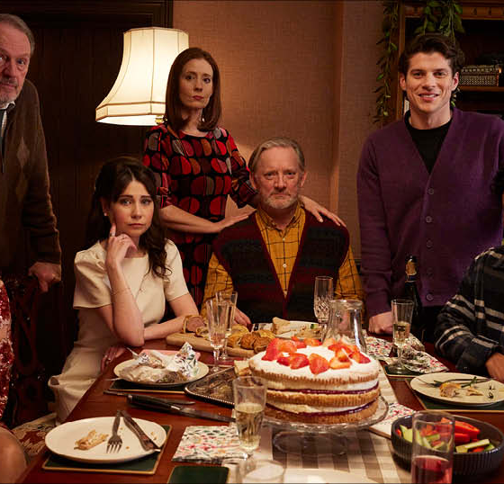
Top 5 Channel 5 programmes
All Creatures Great and Small (17 September)
2.94 million viewers
Forever Home (14 September)
1.59 million viewers
Michael Palin in the Philippines (28 September)
1.27 million viewers
Cause of Death (30 September)
1.21 million viewers
Police Interceptors (21 September)
1.09 million viewers
Forever Home – Channel 5
Source: Barb, September 2026, individuals. Average audience figures, TV set and devices viewing 1-7 days (includes pre-broadcast figures, if applicable)
Notes:
Top 5 programmes – Channel 5

Slide 7

Top 5 commercial non-PSB* programmes (non-sport)
Big Brother, ITV2 (27 September)
1.27 million viewers
The Chelsea Detective, U&Drama (16 September)
1.20 million viewers
Harry Potter and the Half-Blood Prince, ITV2 (27 September)
0.68 million viewers
Bookish, U&Alibi (2 September)
0.68 million viewers
Harry Potter and the Chamber of Secrets, ITV2 (13 September)
0.58 million viewers
The Chelsea Detective, U&Drama
Source: Barb, September 2026, individuals. Average audience figures, TV set and devices viewing 1-7 days (includes pre-broadcast figures, if applicable)
Notes:
Top 5 programmes – commercial non-public service broadcasting channels

Slide 8

Top 5 Netflix programmes
The Gentleman (3 September)
3.18 million viewers
Monster: The Lizzie Borden Story (17 September)
2.04 million viewers
Unabomber (25 September)
1.30 million viewers
Wonka's the Golden Ticket (23 September)
1.15 million viewers
The Real Unforgotten (9 September)
1.11 million viewers
The Gentlemen – Netflix
Source: Barb, September 2026, individuals. Average audience achieved during the first seven days of their availability. Only includes TV set viewing.
Notes:
Top 5 programmes – Netflix

Slide 9

Top 5 Amazon Prime Video programmes
Reacher (16 September)
2.71 million viewers
Neagley (16 September)
1.53 million viewers
The Grand Tour (4 July)
1.46 million viewers
In The Grey (9 September)
0.90 million viewers
The Love Hypothesis (23 September)
0.78 million viewers
Reacher – Prime Video
Source: Barb, September 2026, individuals. Average audience achieved during the first seven days of their availability. Only includes TV set viewing.
Notes:
Top 5 programmes – Amazon Prime Video

Slide 10
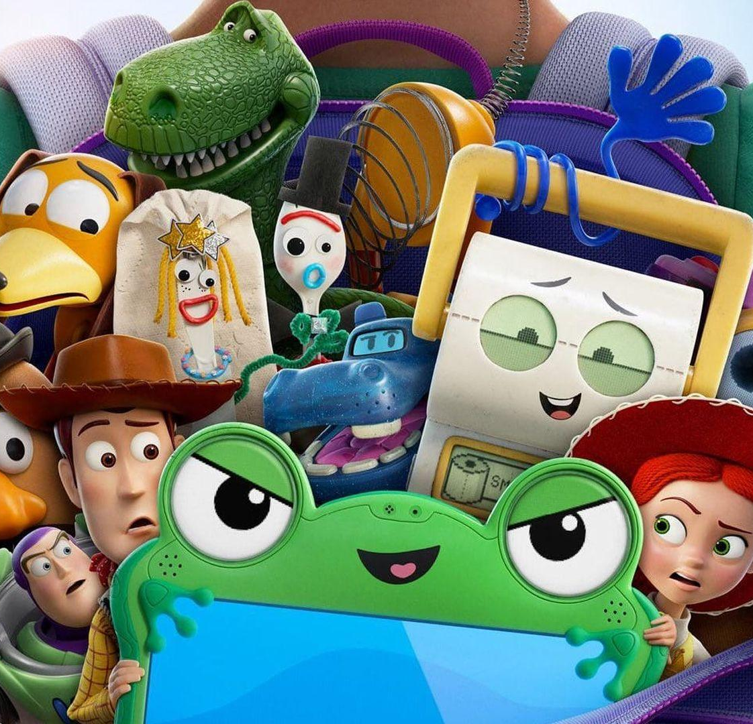
Top 5 Disney+ programmes
Toy Story 5 (23 September)
2.60 million viewers
Star Wars The Mandalorian and Grogu (2 September)
0.96 million viewers
The Real Rooneys (24 September)
0.44 million viewers
American Horror Story (25 September)
0.28 million viewers
The Secret Lives of Mormon Wives (10 September)
0.28 million viewers
Toy Story 5 – Disney+
Source: Barb, September 2026, individuals. Average audience achieved during the first seven days of their availability. Only includes TV set viewing.
Notes:
Top 5 programmes – Disney+

Slide 11
Top commercial programmes with largest proportion of device viewing
Total audience
1.09m
4.50m
2.62m
3.38m
3.22m
Source: Barb, September 2026, individuals. Average audience figures, TV set and devices viewing up to 7 days post-broadcast. Based on programmes with 1 million+ total TV viewers
Notes:
Top commercial programmes with largest proportion of device viewing

Slide 12
Top commercial programmes with largest proportion of pre-broadcast boxset BVOD viewing
Total audience
4.93m
1.00m
5.95m
1.45m
2.27m
Source: Barb, September 2026, individuals. Average audience figures, TV set and devices viewing up to 7 days post-broadcast. Based on programmes with 1 million+ total TV viewers
Notes:
Top commercial programmes with largest proportion of pre-broadcast boxset BVOD viewing

Slide 13
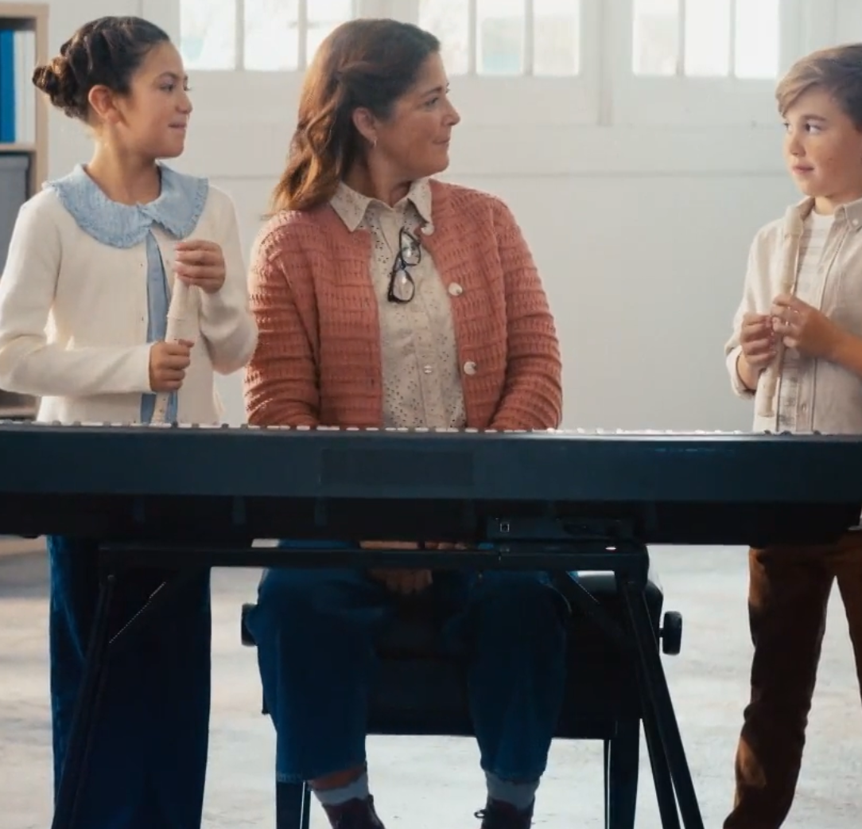
Key new to linear TV advertisers in September
Audika
Audika launched its first major TV advertising campaign titled "For Your Ears Only
One Day Tests
Same day blood test provider, One Day Tests, launched its first-ever TV campaign
The Cornish Company
The Cornish Company debuted its inaugural TV ad on ITV
Audika – For Your Ears Only
Notes:
New to TV advertisers in September.

