Slide 1
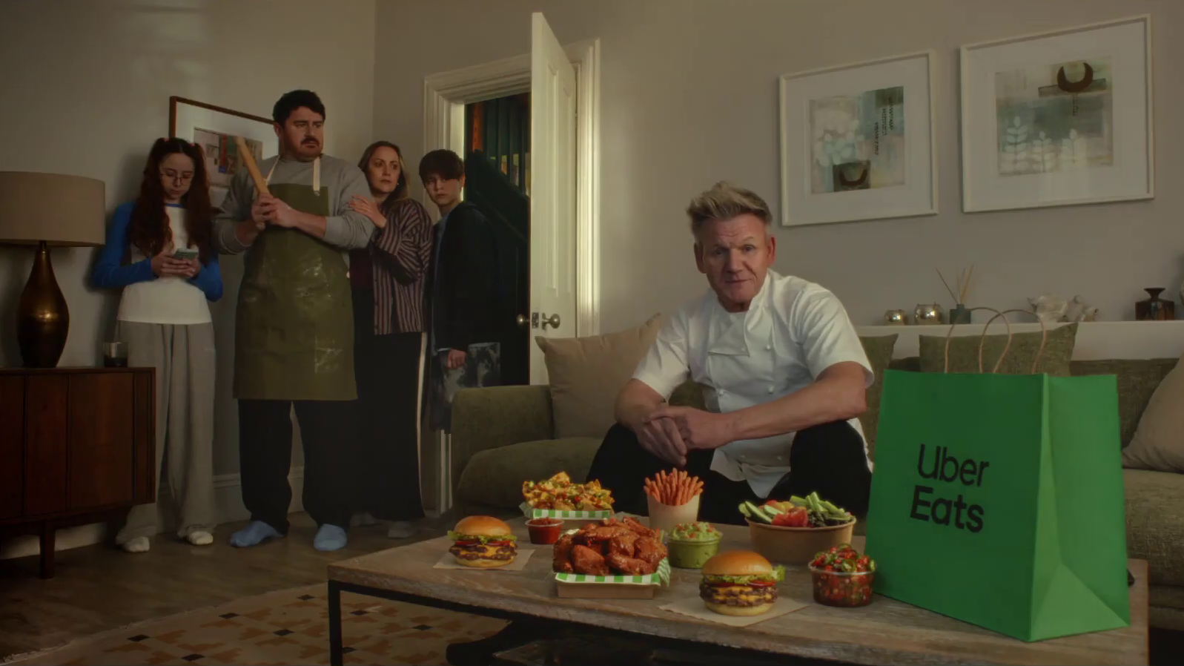

Monthly TV viewing report
June 2026
Uber Eats – Who Could Cook at a Time Like This

Slide 2
June linear TV facts & figures
Total TV weekly reach %
Total TV viewed per day
Commercial TV viewed per day
Impacts
Individuals
71.4 | 41.0bn | 1h 56m | 1h 15m
74.6 | 40.1bn | 2h 12m | 1h 26m
73.7 | 16.1bn | 1h 45m | 1h 3m
53.0 | 2.4bn | 31m | 21m
74.0 | 18.2bn | 2h 11m | 1h 25m
75.2 | 22.0bn | 2h 13m | 1h 27m
71.0 | 2.2bn | 58m | 38m
Adults
ABC1 adults
16-34
Men
Women
Housepersons with children
Sources: Barb June 2026, industry standard TV viewing in-home on a TV set. Reach 3min+. 30” equivalent impacts.
Notes:
June linear TV figures for weekly reach, impacts, total TV viewing hours and commercial TV viewing hours

Slide 3
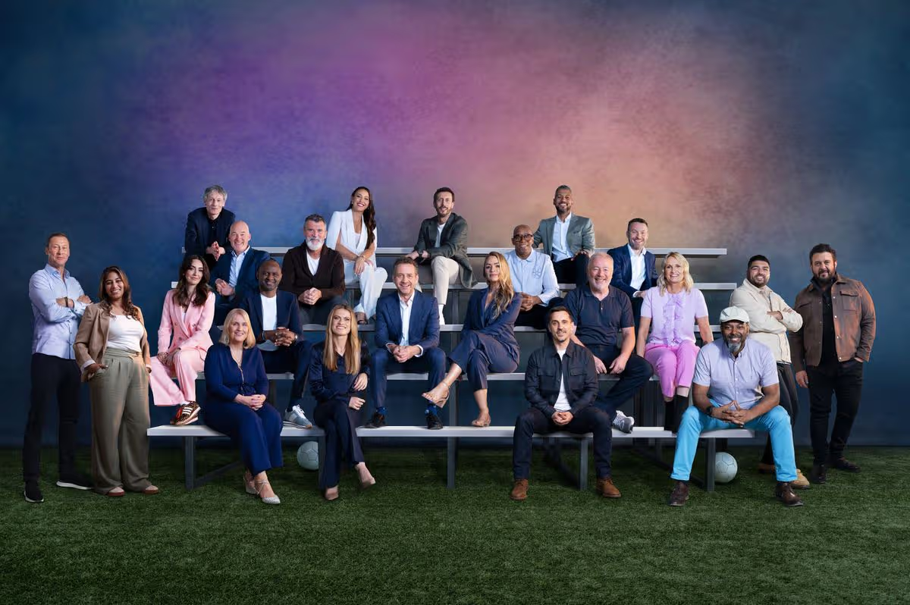


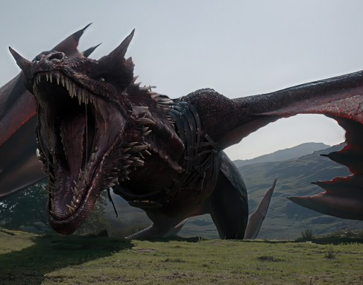
Some notable TV moments in June
On 17 June, ITV1 hosed England’s first game with World Cup: ENG v CRO to an average audience of 11.18m.
On 9 June, Channel 4 aired miniseries Tip Toe to a pre-broadcast audience of 305k, live audience of 407k, and time-shifted audience of 1.4m.
On 2 June, Channel 5 aired The Fortune to an average audience of 1.79m.
On 21 June, Sky Atlantic aired House of the Dragon to an audience of 0.95m.
Source: Barb, June 2026, individuals. Average audience figures, TV set and devices viewing 1-7 days (includes pre-broadcast figures, if applicable).

Slide 4
Top 5 ITV1 programmes
World Cup 2026: ENG v CRO (17 June)
11.18 million viewers
World Cup 2026: PAN v ENG (27 June)
8.83 million viewers
World Cup 2026: MEX v RSA (11 June)
6.18 million viewers
World Cup 2026: BRA v JPN (29 June)
5.24 million viewers
World Cup 2026: NED v JPN (14 June)
4.52 million viewers
FIFA World Cup 2026 – ITV1
Source: Barb, June 2026, individuals. Average audience figures, TV set and devices viewing 1-7 days (includes pre-broadcast figures, if applicable)
Notes:
Top 5 programmes - ITV

Slide 5
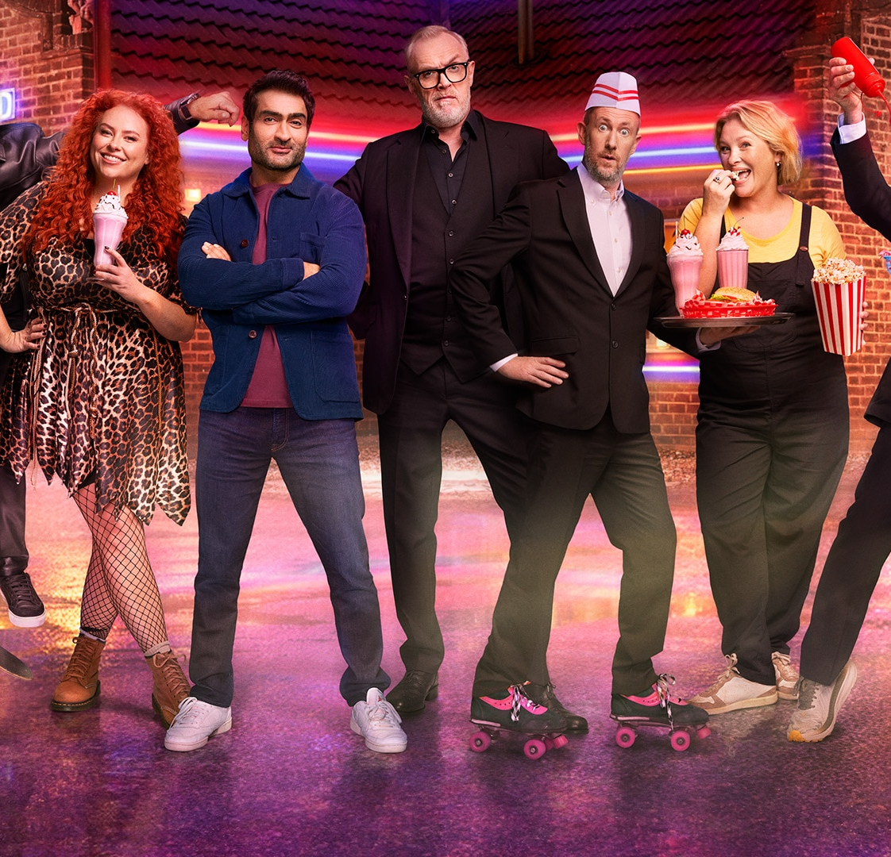
Top 5 Channel 4 programmes
Celebrity Gogglebox (5 June)
2.21 million viewers
Tip Toe (7 June)
2.13 million viewers
Taskmaster (11 June)
1.64 million viewers
Location, Location, Location (3 June)
1.37 million viewers
Formula 1 (7 June)
1.33 million viewers
Taskmaster – Channel 4
Source: Barb, June 2026, individuals. Average audience figures, TV set and devices viewing 1-7 days (includes pre-broadcast figures, if applicable)
Notes:
Top 5 programmes – Channel 4

Slide 6
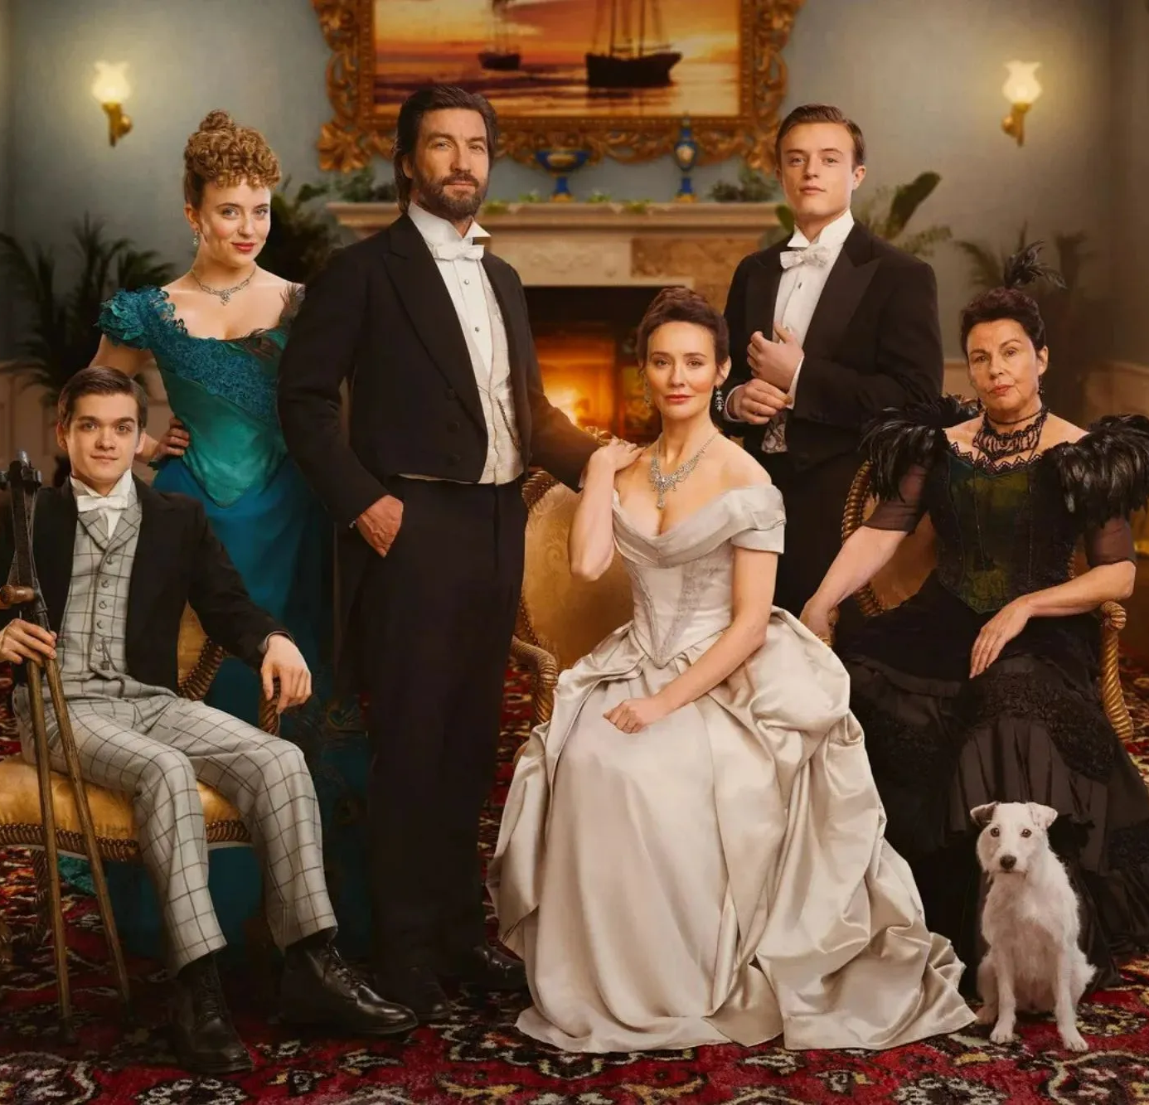
Top 5 Channel 5 programmes
The Fortune (2 June)
1.79 million viewers
Forensics: Crash Scene Investigators (1 June)
1.77 million viewers
The Hardacres (11 June)
1.43 million viewers
Little Disasters (14 June)
1.17 million viewers
Police Interceptors (1 June)
1.06 million viewers
The Hardacres – Channel 5
Source: Barb, June 2026, individuals. Average audience figures, TV set and devices viewing 1-7 days (includes pre-broadcast figures, if applicable)
Notes:
Top 5 programmes – Channel 5

Slide 7
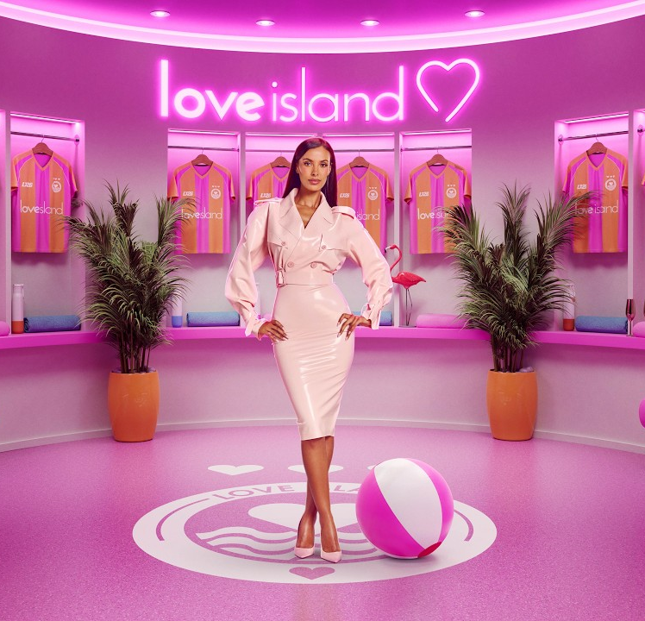
Top 5 commercial non-PSB* programmes (non-sport)
Love Island, ITV2 (7 June)
1.96 million viewers
House of the Dragon, Sky Atlantic (21 June)
0.95 million viewers
The Brokenwood Mysteries, U&Drama (1 June)
0.67 million viewers
The Rookie, Sky Witness (8 June)
0.66 million viewers
Home and Away, 5STAR (19 June)
0.56 million viewers
Love Island, ITV2
Source: Barb, June 2026, individuals. Average audience figures, TV set and devices viewing 1-7 days (includes pre-broadcast figures, if applicable)
Notes:
Top 5 programmes – commercial non-public service broadcasting channels

Slide 8
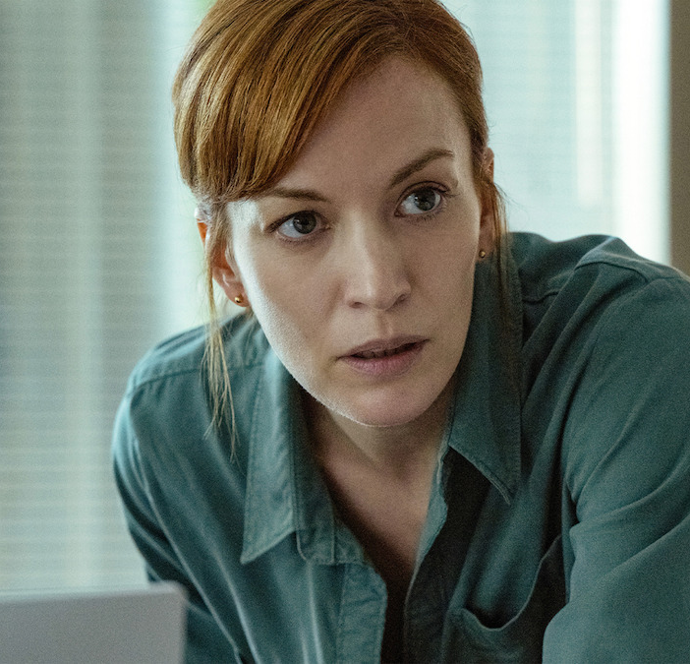
Top 5 Netflix programmes
I Will Find You (18 June)
2.96 million viewers
Maternal Instinct (12 June)
2.45 million viewers
The Witness (4 June)
1.91 million viewers
Office Romance (5 June)
1.55 million viewers
The Murder of Rachel Nickell (4 June)
1.32 million viewers
I Will Find You – Netflix
Source: Barb, June 2026, individuals. Average audience achieved during the first seven days of their availability. Only includes TV set viewing.
Notes:
Top 5 programmes – Netflix

Slide 9
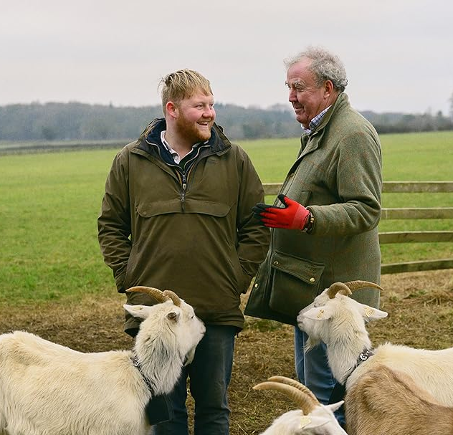
Top 5 Amazon Prime Video programmes
Clarkson’s Farm (3 June)
5.05 million viewers
The Sheep Detectives (24 June)
1.44 million viewers
Every Year After (10 June)
0.31 million viewers
Furiosa: A Mad Max Saga (5 June)
0.28 million viewers
Your Fault: London (17 June)
0.26 million viewers
Clarkson’s Farm – Prime Video
Source: Barb, June 2026, individuals. Average audience achieved during the first seven days of their availability. Only includes TV set viewing. *Only viewing in June.
Notes:
Top 5 programmes – Amazon Prime Video

Slide 10

Top 5 Disney+ programmes
Hoppers (3 June)
1.84 million viewers
Rivals (5 June)
1.06 million viewers
Avatar: Fire and Ash (24 June)
0.54 million viewers
Alice and Steve (8 June)
0.44 million viewers
The Bear (26 June)
0.26 million viewers
Rivals – Disney+
Source: Barb, June 2026, individuals. Average audience achieved during the first seven days of their availability. Only includes TV set viewing.
Notes:
Top 5 programmes – Disney+

Slide 11
Top commercial programmes with largest proportion of device viewing
Total audience
1.67m
1.03m
1.23m
1.23m
3.80m
Source: Barb, June 2026, individuals. Average audience figures, TV set and devices viewing up to 7 days post-broadcast. Based on programmes with 1 million+ total TV viewers
Notes:
Top commercial programmes with largest proportion of device viewing

Slide 12
Top commercial programmes with largest proportion of pre-broadcast boxset BVOD viewing
Total audience
1.37m
1.19m
2.07m
1.08m
1.20m
Source: Barb, June 2026, individuals. Average audience figures, TV set and devices viewing up to 7 days post-broadcast. Based on programmes with 1 million+ total TV viewers
Notes:
Top commercial programmes with largest proportion of pre-broadcast boxset BVOD viewing

Slide 13
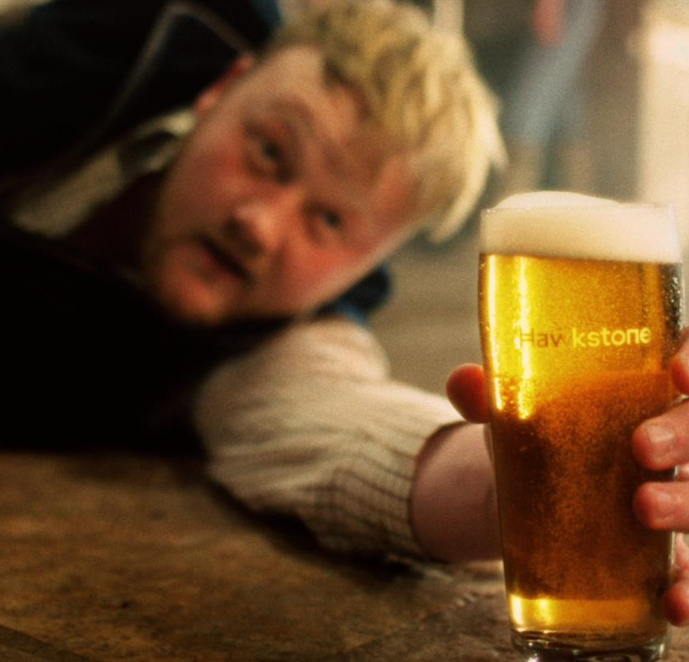
Key new to linear TV advertisers in June
Hawkstone
Hawkstone made its TV debut in the final ad break before England’s first match of the 2026 FIFA World Cup.
Moss
British menswear brand Moss launched its first ever TV commercial, under the title ‘Bring Back Stories’ for SS26.
Surewise
Mobility scooter insurer, Surewise launched its first ever TV advert, aiming to raise awareness to the 60% of mobility scooter users who are uninsured.
Hawkstone – A Year’s Graft in Every Pint
Notes:
New to TV advertisers in June.

